Slide 1
ECE 445 Spring 2016 Group 22
Smart Drone Delivery Improvement
By Sachin Weerasooriya, Rahul Joshi, and
Raymond Hoagland

Slide 2
Introduction
Drone technology constantly advancing
Wide variety of possible uses
Notes:
Sachin

Slide 3
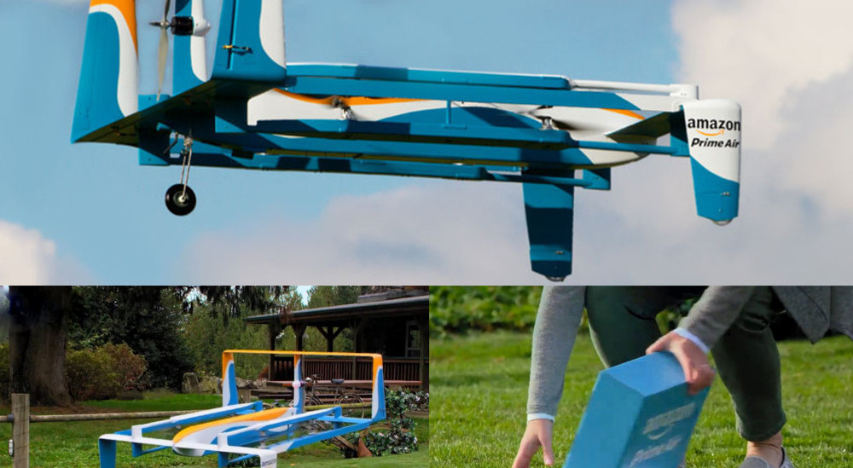
Amazon’s Delivery Method
Notes:
Sachin

Slide 4
Problems With Model
Current delivery methods have option for signature confirmation
Drone delivery problems:
No package confirmation
Theft
Inadvertent damage
Delivery to wrong address
Notes:
Sachin

Slide 5
Solution
Unique landing pad per user
Phone App for package confirmation
Threat detection system while drone on ground
Notes:
Sachin

Slide 6
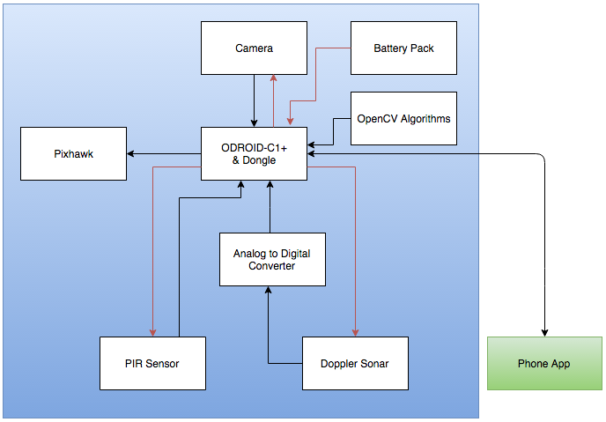
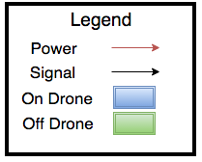
Block Diagram
Notes:
Sachin

Slide 7
R+V For Computer Algorithms
Total .25fps processing speed
Color decryption with 80% accuracy
Drone lands at center(+-2.5ft from middle)
User confirmation sent/received within 1 minute
App works on Android Lollipop
Notes:
Joshi

Slide 8
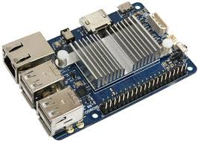
Computer Vision Design Choices
Camera: Logitech C920
Commonly used in other drone projects
Experimentally better
Single Board Computer: ODROID-C1+
5V2A Supply
1.5 GHz Quad Core CPUs
1 GB DDR3 SDRAM
40 GPIO Pins and 2 ADCs
Notes:
Joshi

Slide 9
Landing Pad Encoding
SHA-1 encoding
Base 4 color scheme
Additional color for padding
Nested contour borders
Notes:
Joshi

Slide 10
Original Idea: Base 16
SHA-1 returns hex bytes
16 Base colors
Colors indistinguishable in HSV
Highly susceptible to confusion
Notes:
Joshi

Slide 11
Why Not Base 2?
Corner Identifier to find center
Overlap due to limited options
Smaller blocks (scaling)
Notes:
Joshi

Slide 12
Why Not QR?
More complicated to scale
Height of Decoding
Notes:
Joshi

Slide 13
Image Capture
Gaussian Blur
Exposure (60%)
Brightness (20%)
512x512 px
Notes:
Joshi

Slide 14
Landing Pad Locator
Average Purple Pixels
Dead Zone 200x200px
HSV detection used
Notes:
Joshi

Slide 15
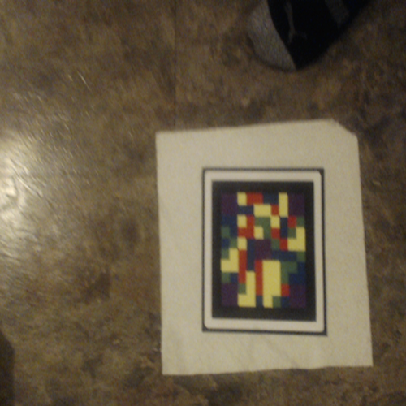
Image Reconstruction
Nested Contour Area
Rotation to ${90}^{°}$angle
Purple Outline
Original Image
Reconstructed Image
Notes:
Raymond

Slide 16
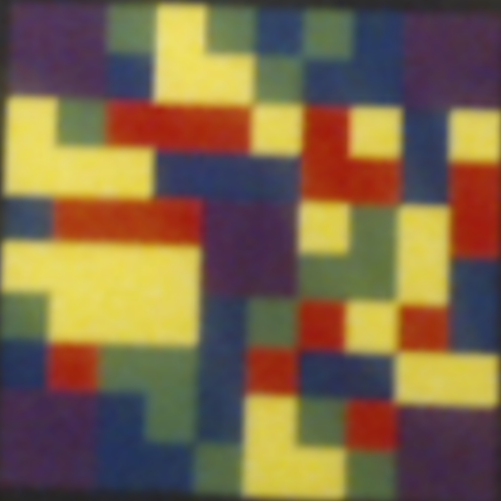
Image Normalization
Reference Color
CLAHE (Lab-Space)
RGB Normalization
$R^{′}=\frac{R}{R+G+B}$
$G^{′}=\frac{G}{R+G+B}$
$B^{′}=\frac{B}{R+G+B}$
Original Image
RGB + CLAHE
Notes:
Raymond

Slide 17
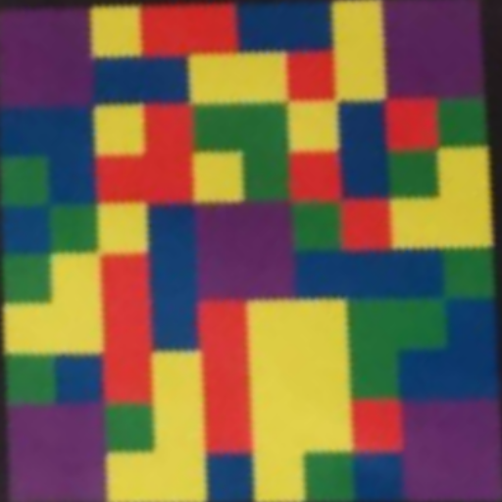
Image Decoding
HSV Filtering
Pixel Location Match
Ties Favors Expected
Original Image
Recovered Green Sections
Notes:
Raymond

Slide 18
Image Decoding
Direct Similarity
Misses left black
Considers all possible ${90}^{°}$ rotations
Susceptible to Rotation Inaccuracy
Original Image
Final Reconstructed Image
Notes:
Raymond

Slide 19
Drone Choice
Drone: 3DR IRIS+ Multicopter
Pixhawk Controller
Payload 400 grams
Notes:
Sachin

Slide 20
MAVProxy
Python wrapper (MAVLink protocol) for ODroid
Take off and fly in cross-shaped pattern
Land drone
Landing pad not found
Landing pad successfully decoded (> .60 match)
Take off if threat detected (arm every 4 seconds)
Notes:
Raymond

Slide 21
User Application and Server
Android app to request confirmation
GCM Protocol Implementation
Server on odroid
Notes:
Joshi

Slide 22
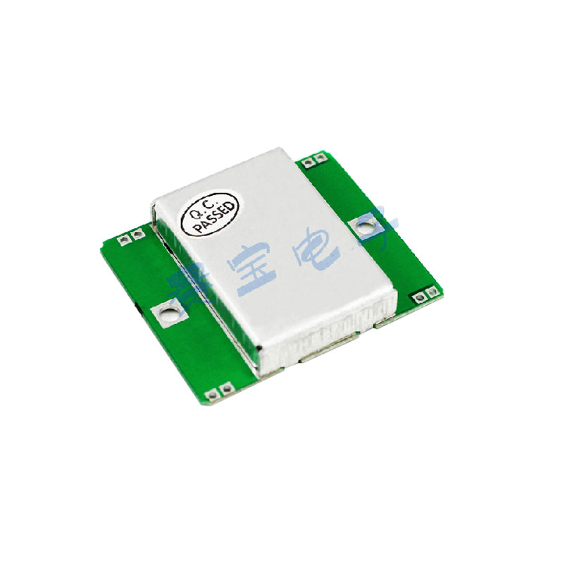
Sensor Choices
Must avoid threats within 15 feet
PIR & Microwave Motion Sensor
Small
Low weight
Easy to mount
Low current draw
Different means of motion detection
PIR Sensor
Doppler Sensor
Notes:
Sachin

Slide 23
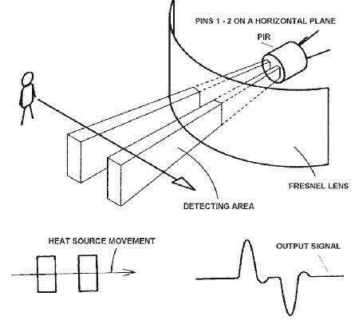
PIR Sensors
PIR – Passive Infrared Sensor
Two IR sensitive strips
Device detects IR differential
Digital Output
https://learn.adafruit.com/pir-passive-infrared-proximity-motion-sensor/how-pirs-work

Slide 24
Microwave Motion (Doppler) Sensor
Transceiver emits 10.525 GHz signal
Analyzes reflected signal
Reflected signal of moving object will have Doppler Shift
http://www.limpkin.fr/public/HB100/HB100_Microwave_Sensor_Application_Note.pdf

Slide 25
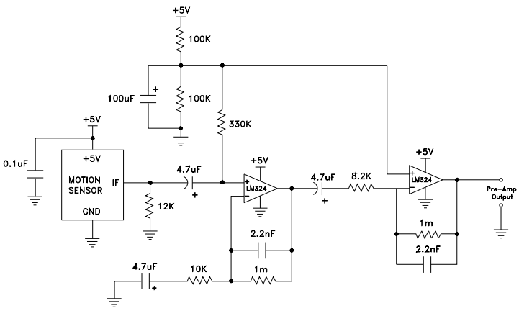
App Sheet Schematic
http://www.limpkin.fr/public/HB100/HB100_Microwave_Sensor_Application_Note.pdf

Slide 26
Circuit Design Modifications
Design RC filters

Slide 27
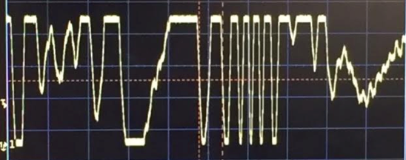
Amplified Doppler Output

Slide 28
Interpreting Results
Doppler data fed into ADC
10 bit resolution, 8KS/S data rate
All PIR sensors read into C1+ via GPIO pins
Multi-thread program monitors each side of drone
Both sensors high in same second is a threat

Slide 29
System Integration
5 core sub-processes
I/O Pipes
Non-blocking read (threaded enqueue)
2 additional threads
Initiate after landing
Land again after confirmation
Notes:
Raymond

Slide 30
Delays + Complications
Drone Delivery
DF-13 Connector
SITL support
MAVProxy Documentation
Handling glare
Notes:
Joshi

Slide 31
Further Work
Base 2 Encoding + Auto-correlation
Additional Redundancies (Hamming)
Get the drone flying!
Better glare removal
Verify landing pad exists
Safety Measures
Notes:
Joshi

