Slide 1
Automated Thermal Cell-Tester
ECE 445 Final Presentation
Team 7
12/7/2021

Slide 2
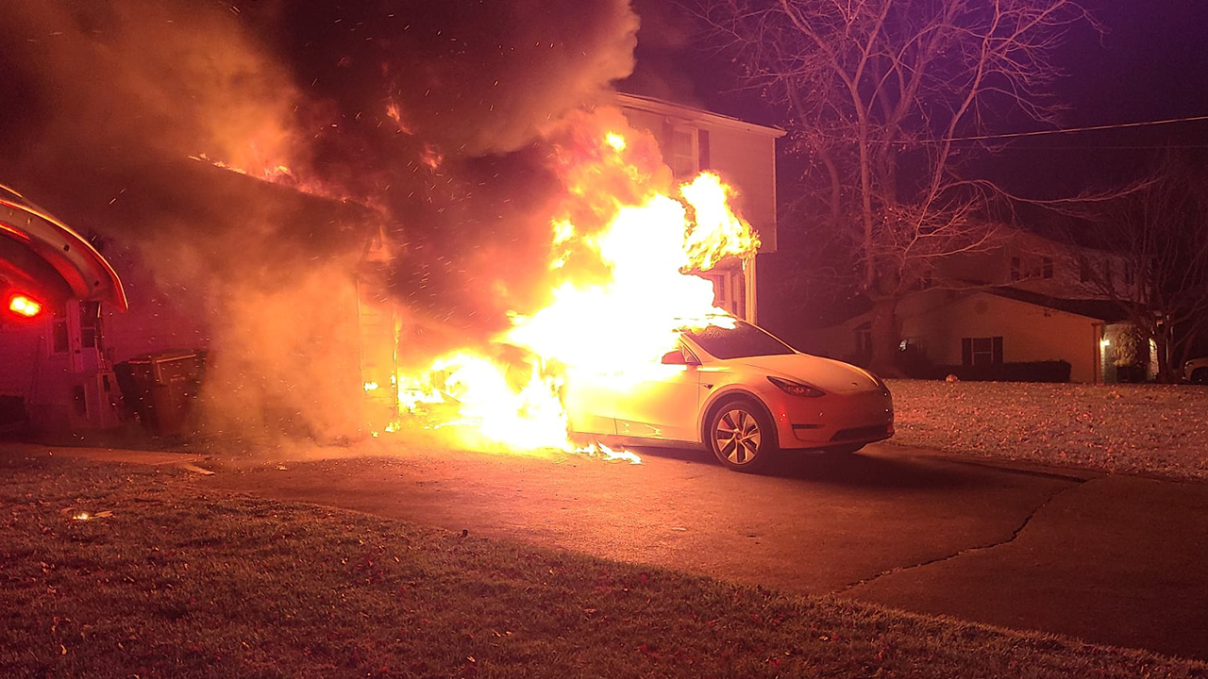
Motivation and Problem
Lithium-ion related chemical fires
High-profile cases
Tesla
Samsung
Causes vary
Thermal runaway
Manufacturing defects
Figure 1: M. Lencki, “Tesla in Pennsylvania catches fire, flames spread to home,” Fox Business, 26-Nov-2021. [Online]. Available: https://www.foxbusiness.com/lifestyle/tesla-catches-fire-flames-spread-home-pennsylvania. [Accessed: 02-Dec-2021].
ECE 445: Senior Design Laboratory
GRAINGER ENGINEERING
Notes:
Lithium-ion batteries are being increasingly employed in industries
The biggest drawback with this technology is that lithium-ion batteries have a tendency to start extremely dangerous and destructive chemical fires. Generally, the cause of this can be traced to either a manufacturing defect or thermal runaway.

Slide 3
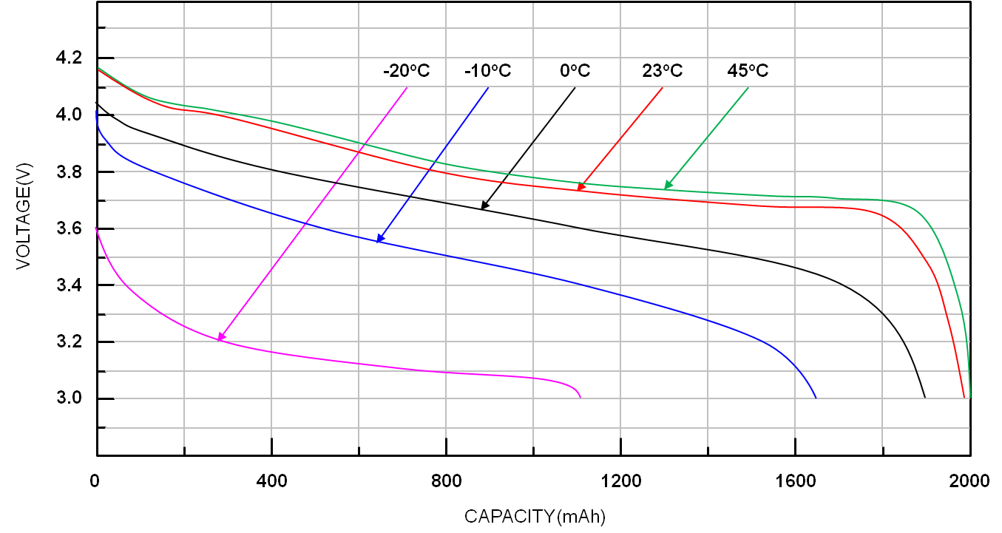
Theory
Cell Characteristics
Capacity
State of charge to open-circuit voltage (SoC-OCV) relation
Equivalent circuit model with two time constants
Thermal Application
Deviances from normal operating conditions
More Theory
Hysteresis
Figure 2: R. T. Corporation, “Li-ion battery and gauge introduction,” Li-ion Battery and Gauge Introduction | Richtek Technology, 2015. [Online]. Available: https://www.richtek.com/Design%20Support/Technical%20Document/AN024. [Accessed: 02-Dec-2021].
ECE 445: Senior Design Laboratory
GRAINGER ENGINEERING
Notes:
Before moving on to our objectives, let's briefly pick up the theories needed for this project.

Slide 4
Objective
Test for various characteristics
Capacity
Charge/discharge (SoC-OCV) curve
RC polarization constants
Thermal stressing
Explore cell behavior at different temperatures
Characterize cells easily
Must be automated and relatively hassle-free.
Figure 2: R. T. Corporation, “Li-ion battery and gauge introduction,” Li-ion Battery and Gauge Introduction | Richtek Technology, 2015. [Online]. Available: https://www.richtek.com/Design%20Support/Technical%20Document/AN024. [Accessed: 02-Dec-2021].
ECE 445: Senior Design Laboratory
GRAINGER ENGINEERING
Notes:
We will look at how these characteristics change when the battery is heated.

Slide 5
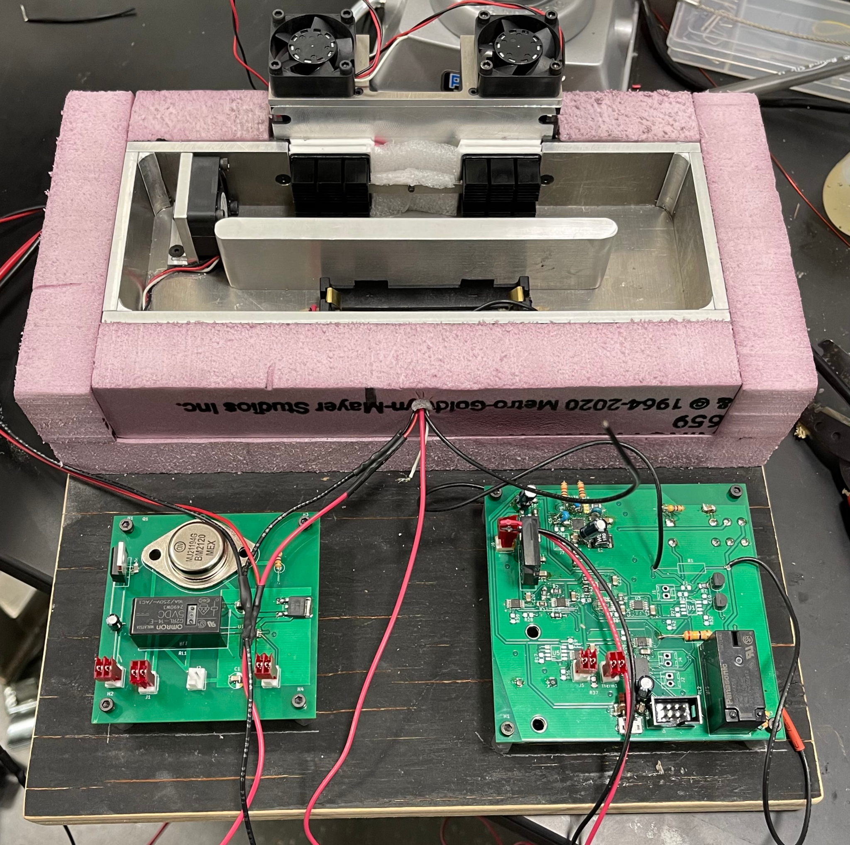
Our Solution
The Automated Thermal Tester
Tests cells under various current and thermal loads
Captures voltage and current data
Analyzes data for cell characterization
ECE 445: Senior Design Laboratory
GRAINGER ENGINEERING

Slide 6
High Level Requirements
The device will perform the three necessary tests to accurately characterize a lithium-ion cell's capacity, charge/discharge curve, and RC polarization characteristics which provide a great deal of insight into battery performance.
The user interface will receive results from tests of specific cells and use those results to display the current battery characteristics as well as the cell's performance over time.
The device will control a thermal unit that will to maintain a constant temperature from 15°C-35°C to within ±5°C throughout any given test allowing for characterization of the cell over a range of thermal conditions.
ECE 445: Senior Design Laboratory
GRAINGER ENGINEERING

Slide 7
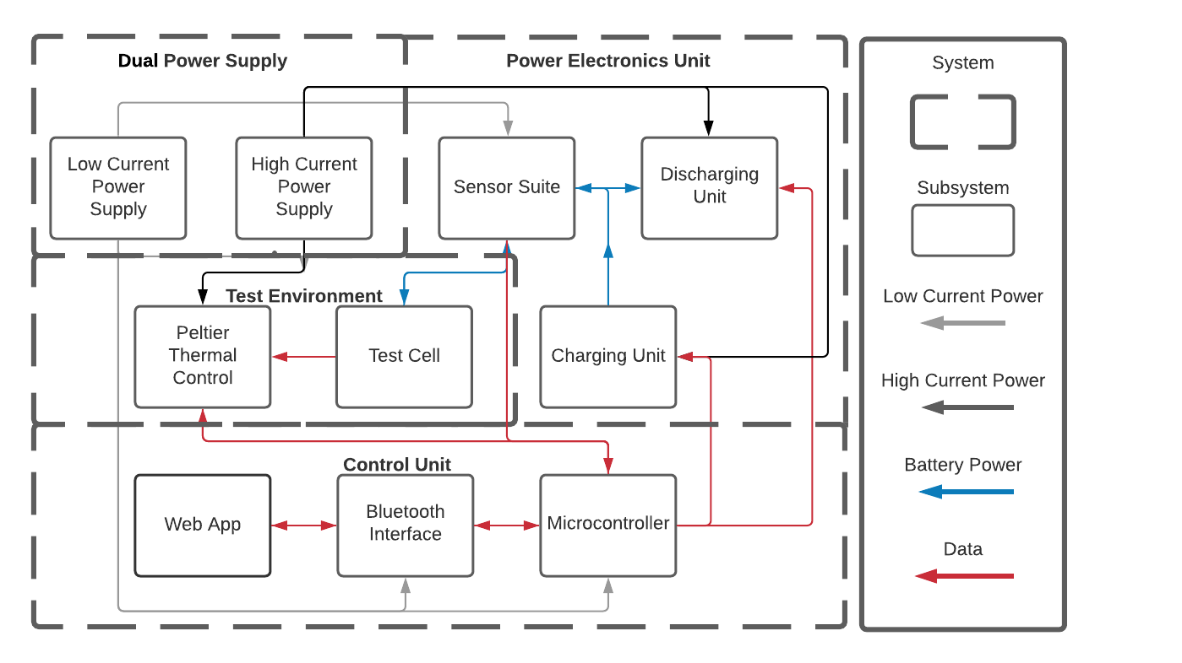
Block Diagram
ECE 445: Senior Design Laboratory
GRAINGER ENGINEERING

Slide 8
Power Electronics - Discharging Circuit
Requirements | Verification
1. Isolate the battery and avoid any inrushes of current to the board or power supply. 2. Successfully control current out of the battery to within ±50 mA. | 1. Perform exhaustive startup conditions and measure current on oscilloscope over time. 2. Demand constant current at 0A to 5A in 1A increments from the battery and use an oscilloscope to measure current at each step, compare results with expected value.
ECE 445: Senior Design Laboratory
GRAINGER ENGINEERING

Slide 9
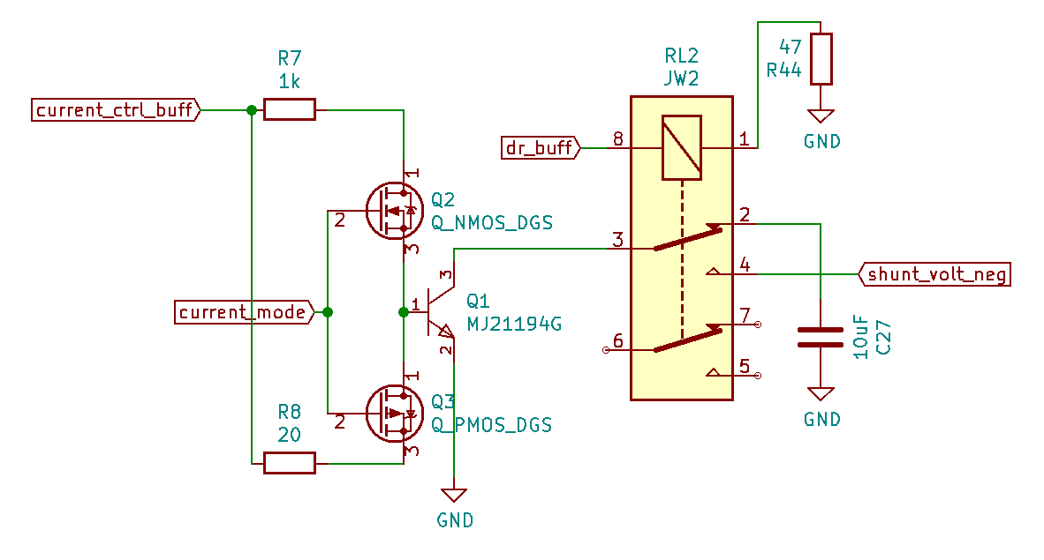
Power Electronics - Discharging Circuit
Voltage Controlled Current Source
MOSFET toggled resistances to operate at a wide variety of currents
Relay for battery isolation and safety
ECE 445: Senior Design Laboratory
GRAINGER ENGINEERING

Slide 10
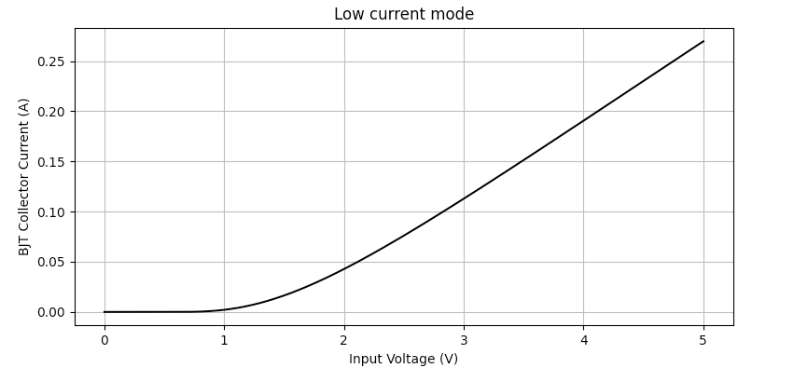
Power Electronics - Discharging Circuit
ECE 445: Senior Design Laboratory
GRAINGER ENGINEERING

Slide 11
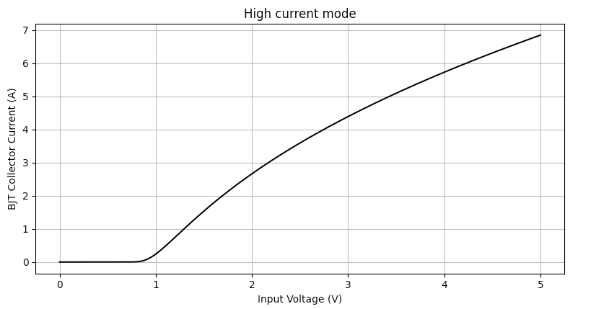
Power Electronics - Discharging Circuit
ECE 445: Senior Design Laboratory
GRAINGER ENGINEERING

Slide 12
Power Electronics - Charging Circuit
Requirements | Verification
1. Isolate the battery and avoid any inrushes of current to the board or power supply. 2. Successfully control current flowing into the battery to within ±50 mA. | 1. Perform exhaustive startup conditions and measure current on oscilloscope over time. 2. Supply current to the battery at 0A to 5A in 1A increments and use an oscilloscope to measure current at each step, compare results with expected value.
ECE 445: Senior Design Laboratory
GRAINGER ENGINEERING

Slide 13
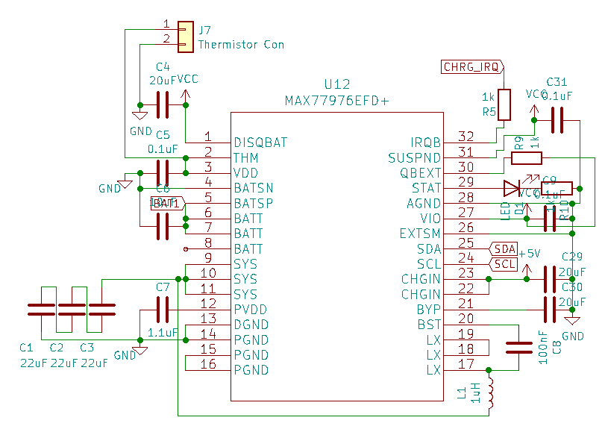
Power Electronics - Charging Circuit
Prepackaged IC
Single cell charger
Charging up to 5.5 A
On-board thermistor
safety shutdown
Safety Concerns
Lack of experience operating this IC
Possible improper application
ECE 445: Senior Design Laboratory
GRAINGER ENGINEERING

Slide 14
Power Electronics - Sensor Suite
Requirements | Verification
1. Isolate the battery and avoid any inrushes of current to the chip, board, or power supply. 2. Measure voltage and current on the battery to within ±50 mV and ±50 mA respectively of the true measurement. | 1. Perform exhaustive startup conditions and measure current on oscilloscope over time. 2. Confirm that measurements read out from the main controller align to within 50 mV and 50 mA with those of a voltmeter and ampmeter over the course of an entire capacity test.
ECE 445: Senior Design Laboratory
GRAINGER ENGINEERING

Slide 15
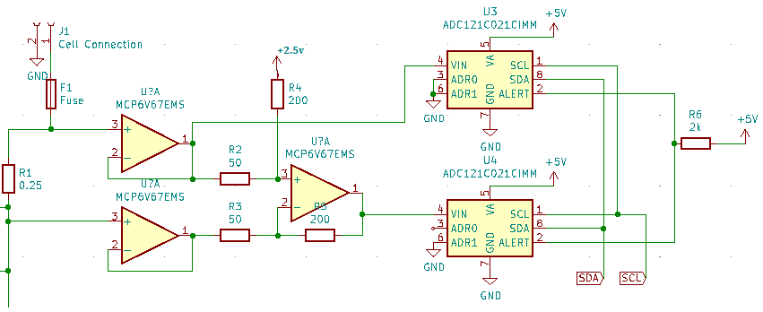
Power Electronics - Sensor Suite
Voltage sensor
Buffered battery positive terminal
ADC referenced to ground
Current sensor
Buffered shunt resistor terminals
Differential Amplifier
readout on ADC
ECE 445: Senior Design Laboratory
GRAINGER ENGINEERING

Slide 16
Test Environment
Requirements | Verification
1. Set the internal temperature of the thermal chamber by causing a change in the polarity or power consumed by the Peltier devices. 2. Maintain a given temperature (±5ºC) over long stretches of time (e.g. ∼ 10 hours) by controlling the output of fans and Peltier devices to ensure optimal efficiency and minimize needless power consumption. 3. Identify a valid range of testing temperatures in given environment (e.g. outdoors vs. in a refrigerator). | 1.A Generate voltage difference to Peltier devices. 1.B Use a thermal sensor for ensuring there is a difference. 2.A Using a thermal sensor, ensure that the temperature of the two sides of the Peltier device do not tend towards the average temperature. 2.B Ensure that fans and heatsinks perform the necessary functions well enough by examining Peltier device behavior through a thermal sensor over time. 3. Use a thermal sensor to analyze the exact temperature ranges available to the system.
ECE 445: Senior Design Laboratory
GRAINGER ENGINEERING

Slide 17
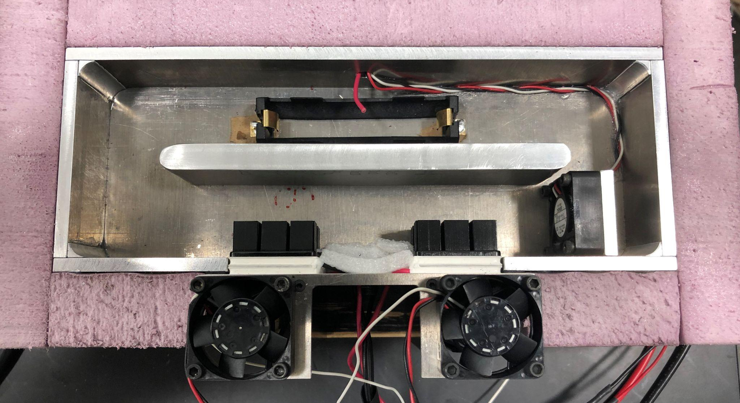
Test Environment
Peltier Devices
Constant Current Source
Linear Temperature Characteristics
I²R losses
Heatsink Sizing
Interior: 2.50℃/W @ 200 LFM
Exterior: 0.90℃/W @ 250 LFM
Total ~11.1 W dissipation @ 10℃ ΔT
Air Flow Loop
Fan: ~300 LFM
Defined Interior Loop
Figure 3: Cui Devices, “Peltier Module,” CP36H-2 datasheet, Oct. 2019
ECE 445: Senior Design Laboratory
GRAINGER ENGINEERING

Slide 18
Control Unit - User Interface
Requirements | Verification
1. Successfully relay information about the given test being performed or the start/end of a test to the users computer over bluetooth. 2. User interface should store data from tests on the users computer and later load the same file format for analysis. 3. User interface should convey information about a cell’s history, as well as its current behavior. 4. User interface will have an option for viewing the current state of the cell and information on the test provided that it is currently performing one. | 1. Perform at least one of each type of test while having Bluetooth keep alive message time signatures be < 8ms apart. 2.A Save test results to computer. 2.B Read test results back to ensure they were saved in the proper format. 3. The user-end graphs and data are aesthetic, easy to understand, and encapsulate the data well. 4. The testing page of the User interface updates at least every 500ms with all the data dumped to it since the last update, including current cell information.
ECE 445: Senior Design Laboratory
GRAINGER ENGINEERING

Slide 19
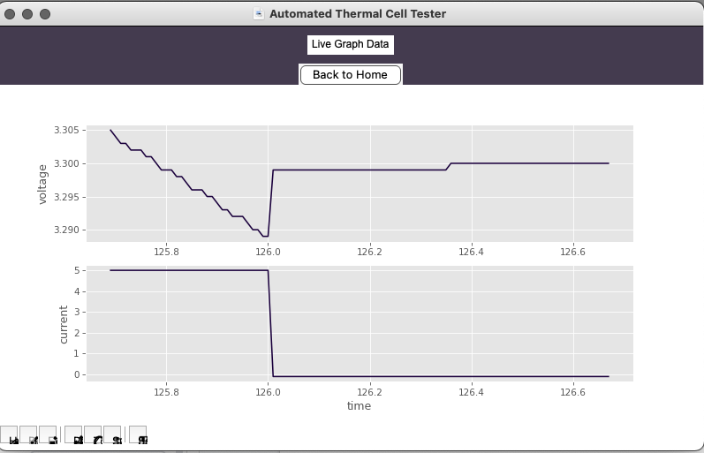
Control Unit - User Interface
Serial interface and Live Data
Four different message types
DATA – used in live data feed
ERROR – contains snapshot of the state of the cell
START – triggers test start on controller
STOP – triggers test to stop on controller
ECE 445: Senior Design Laboratory
GRAINGER ENGINEERING
Notes:
Test options
Live data

Slide 20
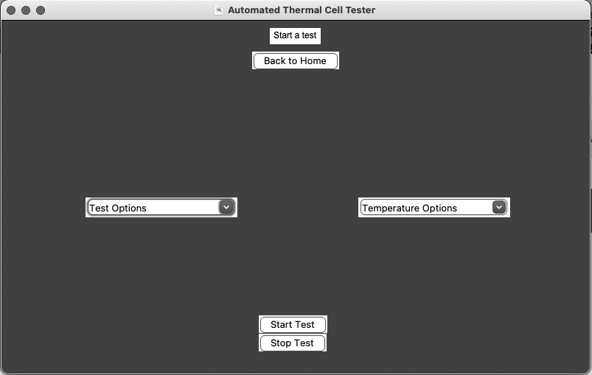
Control Unit - User Interface
Test Management
Determine the type of test to run
Temperature (Hot, Room Temperature, Cold)
Routine (Capacity, SoC-OCV, HPPC)
Sends start and stop commands
ECE 445: Senior Design Laboratory
GRAINGER ENGINEERING
Notes:
The main controller will handle the specific structure of the testing routines, the USB Serial communications with the Python Gui Application, the control over the thermal module, and reading Voltage, Current, and Temperature. The Python Gui Application will handle the data from the main controller and determine the characteristics of the cell.
TEST ANALYSIS

Slide 21
Control Unit - User Interface
Test Analysis and Theory
Coulomb counting – Capacity test
Data storage and retrieval – SoC-OCV test
Differential equation solver – HPPC test
ECE 445: Senior Design Laboratory
GRAINGER ENGINEERING
Notes:
For all three of our tests, we employ fairly well-known techniques for determining the battery characteristics. In the capacity test, we want to measure Amp-hours of a cell. Because amperes are coulombs per second, then an amp hour is 3600 seconds at one amp which is 3600 Coulombs. Therefore, if we keep track of current over time we should be able to essentially add up all the coulombs of charge that the battery outputs over the course of the capacity test. As for the soc-ocv test, we simply need to track the data throughout the test and be able to display it to the user. Finally, the HPPC test uses a discrete time step differential equation solver which used the curve fit function from the scipy library.

Slide 22
Control Unit - Firmware
Requirements | Verification
1. Successfully relay information about the cell under any condition every 100 ms 2. In case of emergency, safely exit a test and relay an error message containing a snapshot of the error state of the cell. 3. User loop must take < 25 ms to check for a serial message, update relevant measurements, and maintain current and thermal feedback. | 1.A Toggle an LED after 100 rounds through the timer ISR. 1.B Start and stop a timer on each toggle - should read ~ 10 s. 2. Provide various error state inputs and ensure the relays shut off (audio feedback), and user interface displays error message (visual feedback). 3.A Toggle an LED after 400 rounds through the user loop 3.B Start and stop a timer on each toggle - should read < 10 s.
ECE 445: Senior Design Laboratory
GRAINGER ENGINEERING

Slide 23
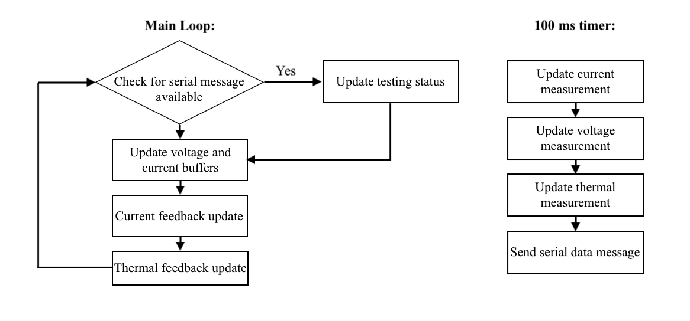
Control Unit - Firmware
ECE 445: Senior Design Laboratory
GRAINGER ENGINEERING

Slide 24
Control Unit - Interfaces
Serial interface – GUI
DATA_MESG (TX’d) contains cell and environment data
ERROR_MESG (TX’d) triggers error screen on GUI
START_MESG (RX’d) starts a test
STOP_MESG (RX’d) stops any ongoing test
SPI
Control over DAC peripherals
I²C
Control over ADCs and charging IC peripherals
ECE 445: Senior Design Laboratory
GRAINGER ENGINEERING

Slide 25
Dual Power Supply
High Current Power Supply
Supplies Power Electronics
7.5A Output
Subject to some variability at high loads
Low Current Power Supply
Supplies Digital Electronics
1A Output
Extremely stable
ECE 445: Senior Design Laboratory
GRAINGER ENGINEERING

Slide 26
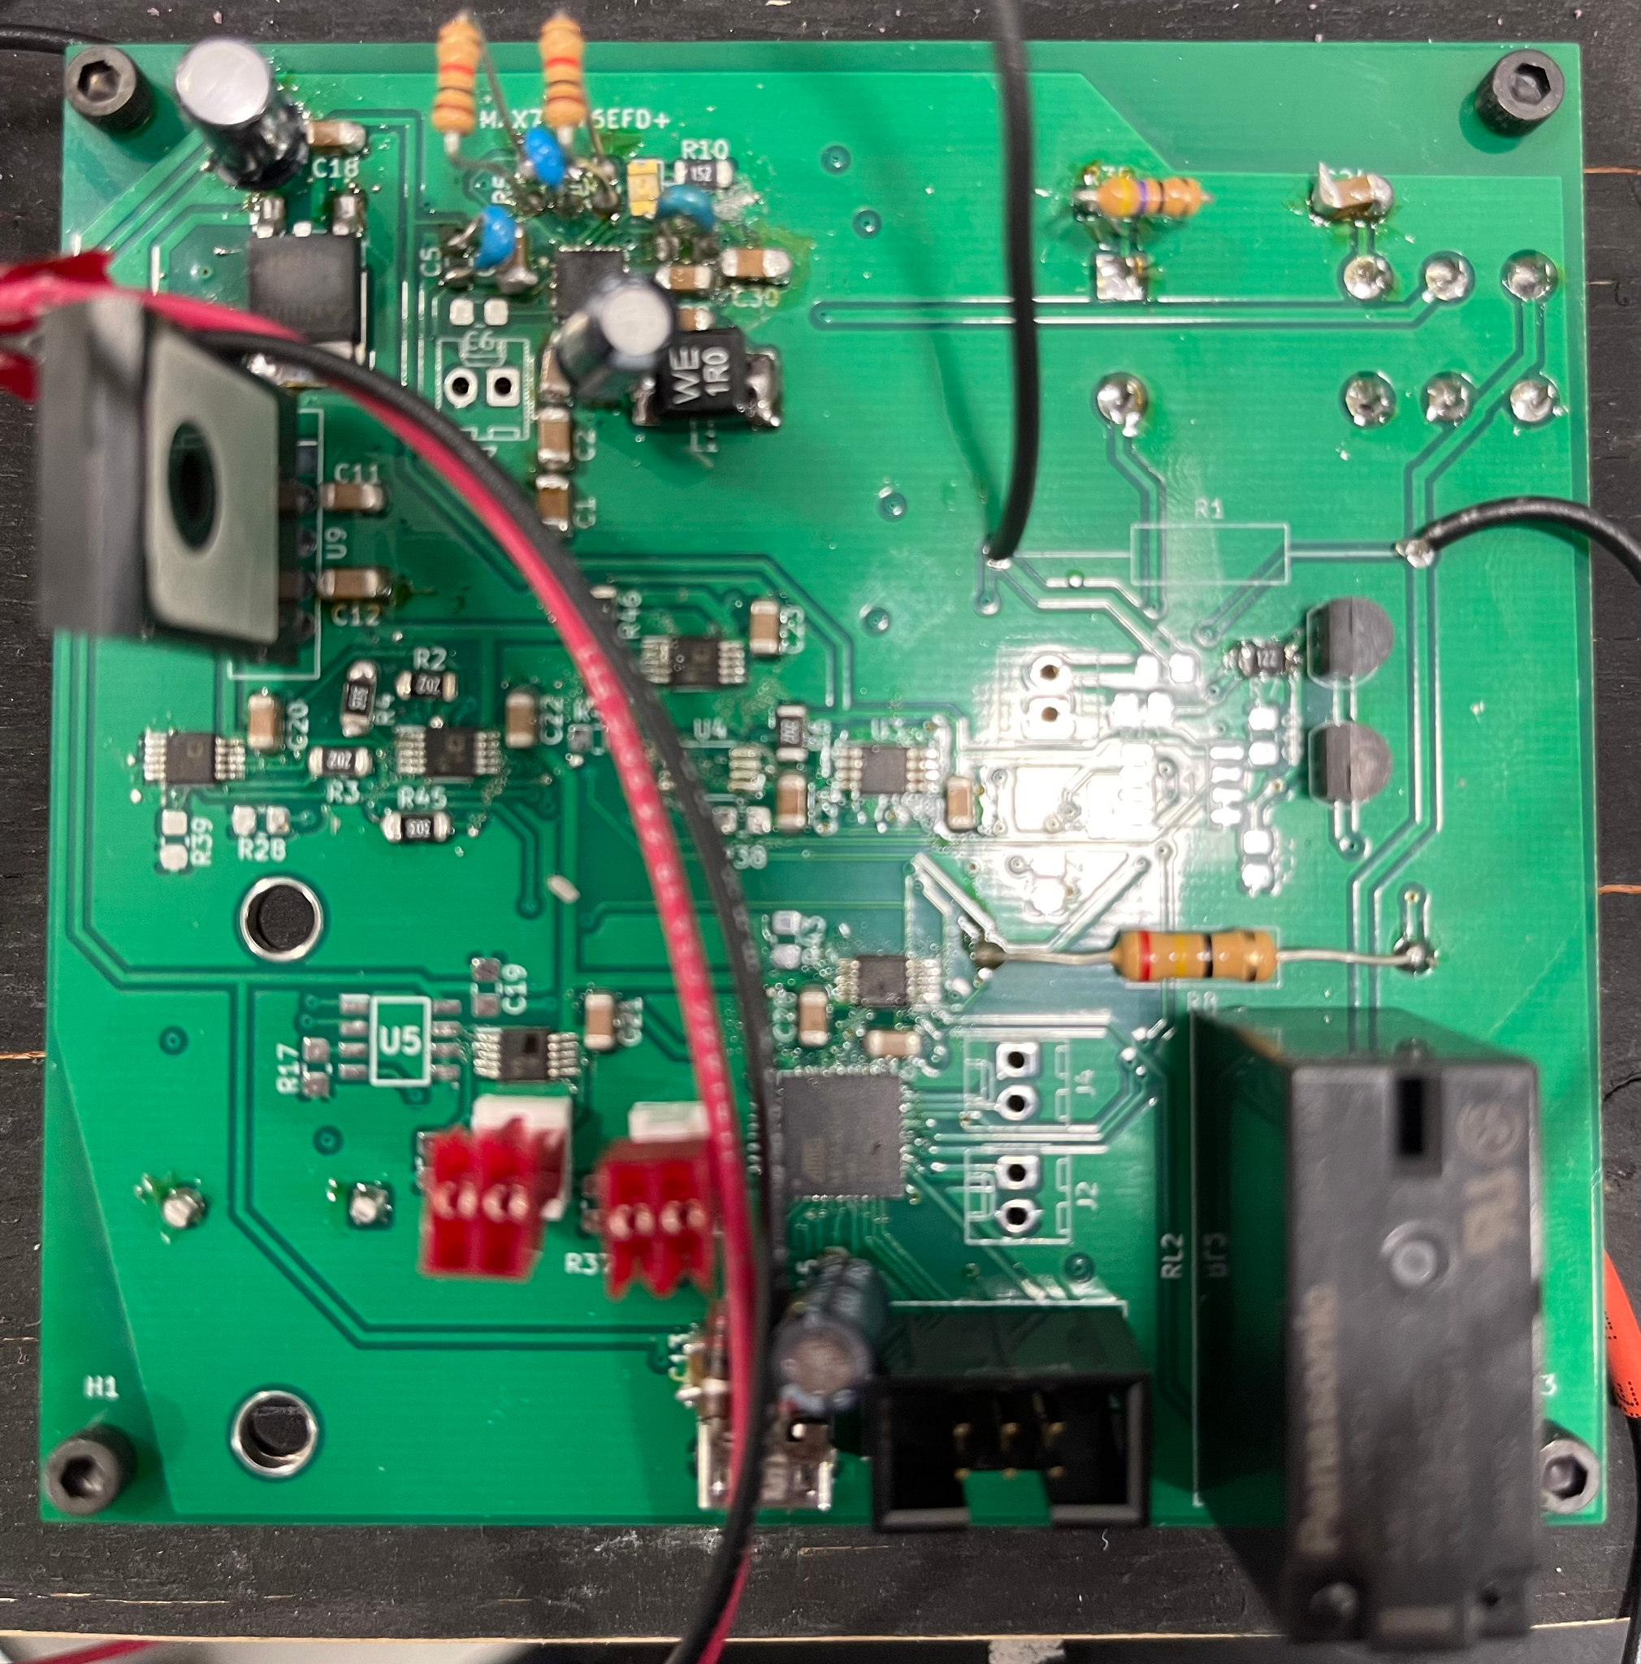
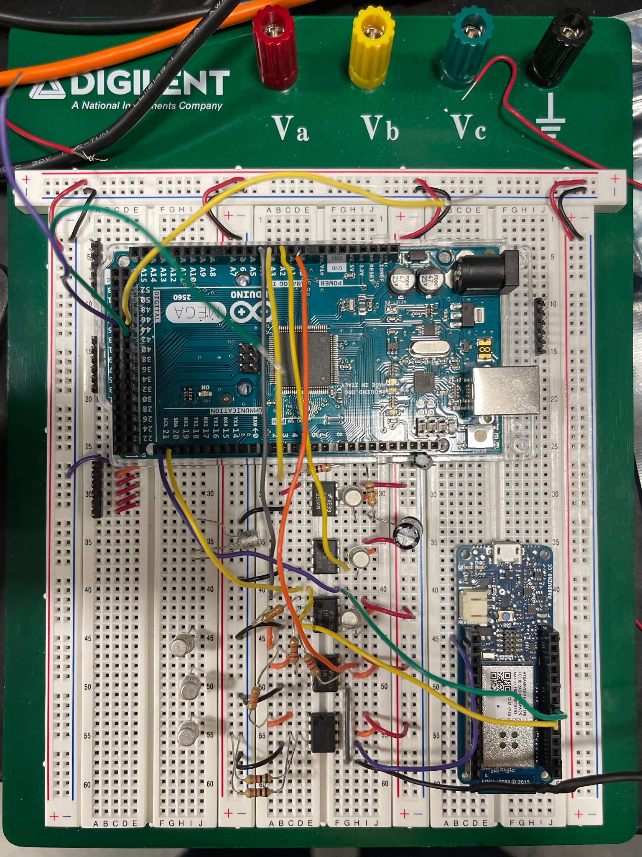
Build Process
ECE 445: Senior Design Laboratory
GRAINGER ENGINEERING

Slide 27
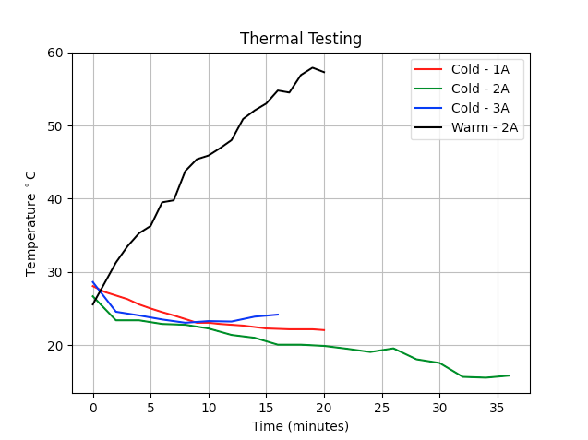
Thermal Tests
ECE 445: Senior Design Laboratory
GRAINGER ENGINEERING

Slide 28
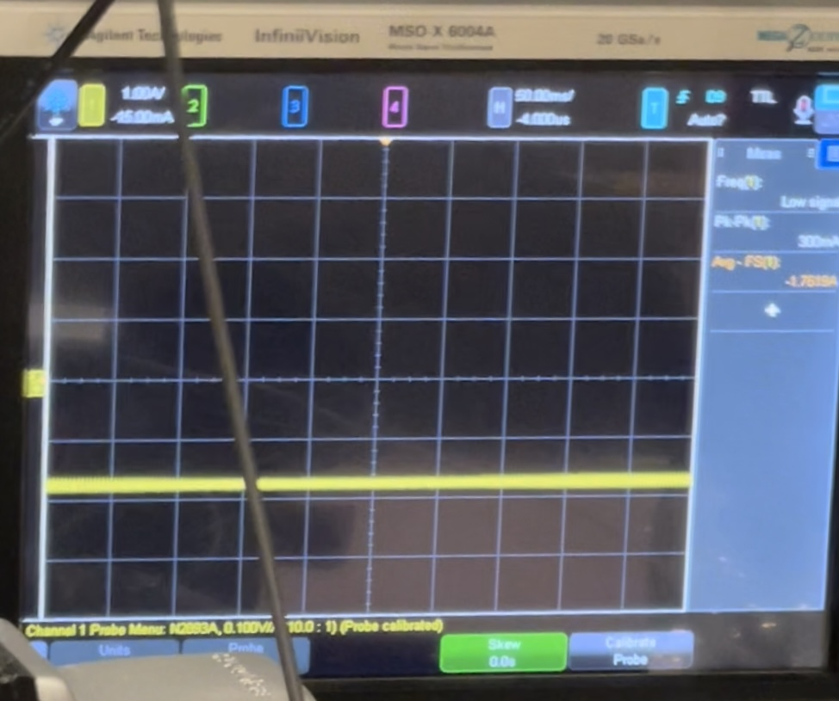
Current Drain
Tested on AAA battery
Control current drain
Up to 1.8 A – unsustainable
300 mA variation
Mechanical potentiometer
Exact drain determined by hand
ECE 445: Senior Design Laboratory
GRAINGER ENGINEERING

Slide 29
Ethics and Safety
This project is motivated by safety
High currents and power dissipation
Dual power supply
Two boards
Lithium-ion cells
Necessary precautions were taken during handling
No lithium-ion cells were tested because an isolation fault was detected
Tested on AAA batteries
ECE 445: Senior Design Laboratory
GRAINGER ENGINEERING
Notes:
JOON
Should be long.
Trying to test Lithium-ion batteries.

Slide 30
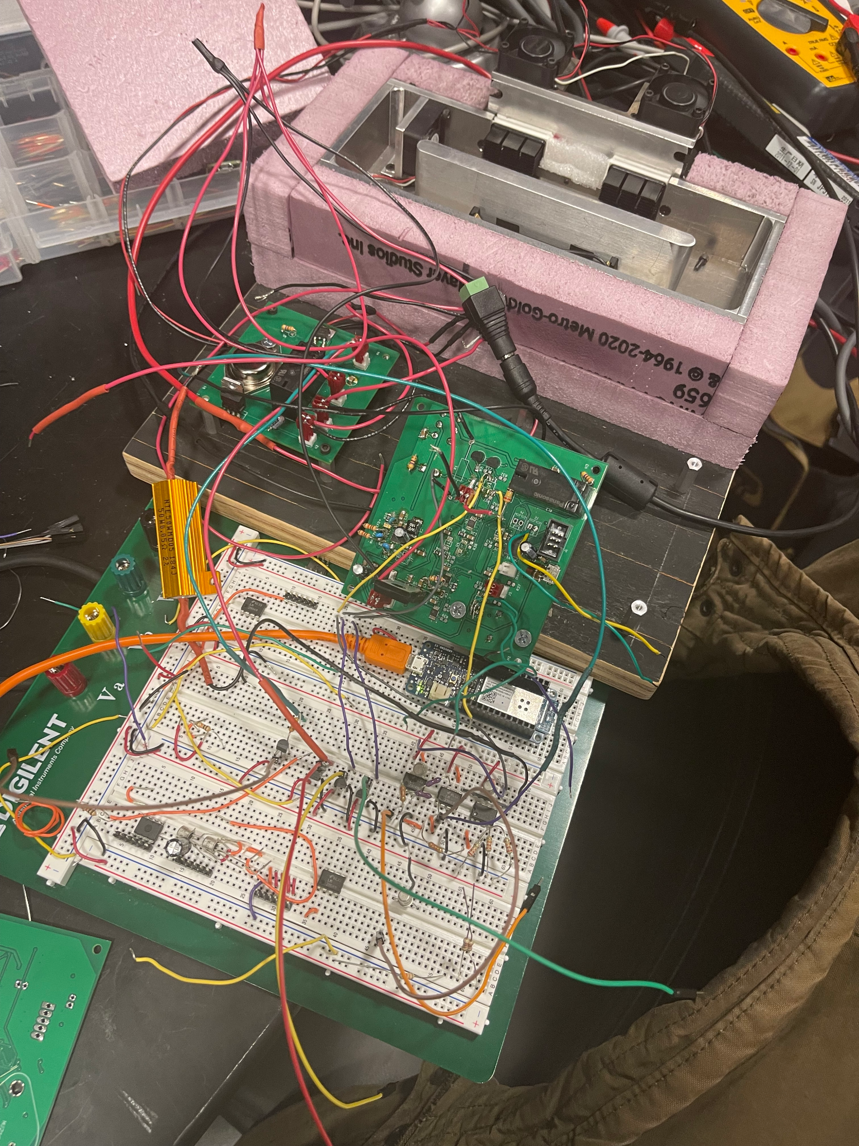
Triage
User interface communication
Bluetooth security issues
Serial implemented as solution
Charging circuit
Not the appropriate application
Op-amps
Incorrectly wired SHD* pin
Control
No connection from RST* to HB*
ECE 445: Senior Design Laboratory
GRAINGER ENGINEERING
Notes:
JOON
Worst to not too worst

Slide 31
Next Steps
Address the charging circuit
Ensure proper application environment
Fix the PCB
Op-amps – SHD* pin
Controller – HB* pin to RST* pin
Test and finish code
Unable to implement and test very much code
ECE 445: Senior Design Laboratory
GRAINGER ENGINEERING
Notes:
JOON

Slide 32
References
[1] M. Lencki, “Tesla in Pennsylvania catches fire, flames spread to home,” Fox Business, 26-Nov-2021. [Online]. Available: https://www.foxbusiness.com/lifestyle/tesla-catches-fire-flames-spread-home-pennsylvania. [Accessed: 02-Dec-2021].
[2] R. T. Corporation, “Li-ion battery and gauge introduction,” Li-ion Battery and Gauge Introduction | Richtek Technology, 2015. [Online]. Available: https://www.richtek.com/Design%20Support/Technical%20Document/AN024. [Accessed: 02-Dec-2021].
[3] Cui Devices, “Peltier Module,” CP36H-2 datasheet, Oct. 2019
ECE 445: Senior Design Laboratory
GRAINGER ENGINEERING
Notes:
JOON

Slide 33
Questions
ECE 445: Senior Design Laboratory
GRAINGER ENGINEERING
Notes:
JOON

