Slide 1
ECE445 – Senior Design | Group 32
Chengliang Li, Siping Meng, Honglu He

Slide 2
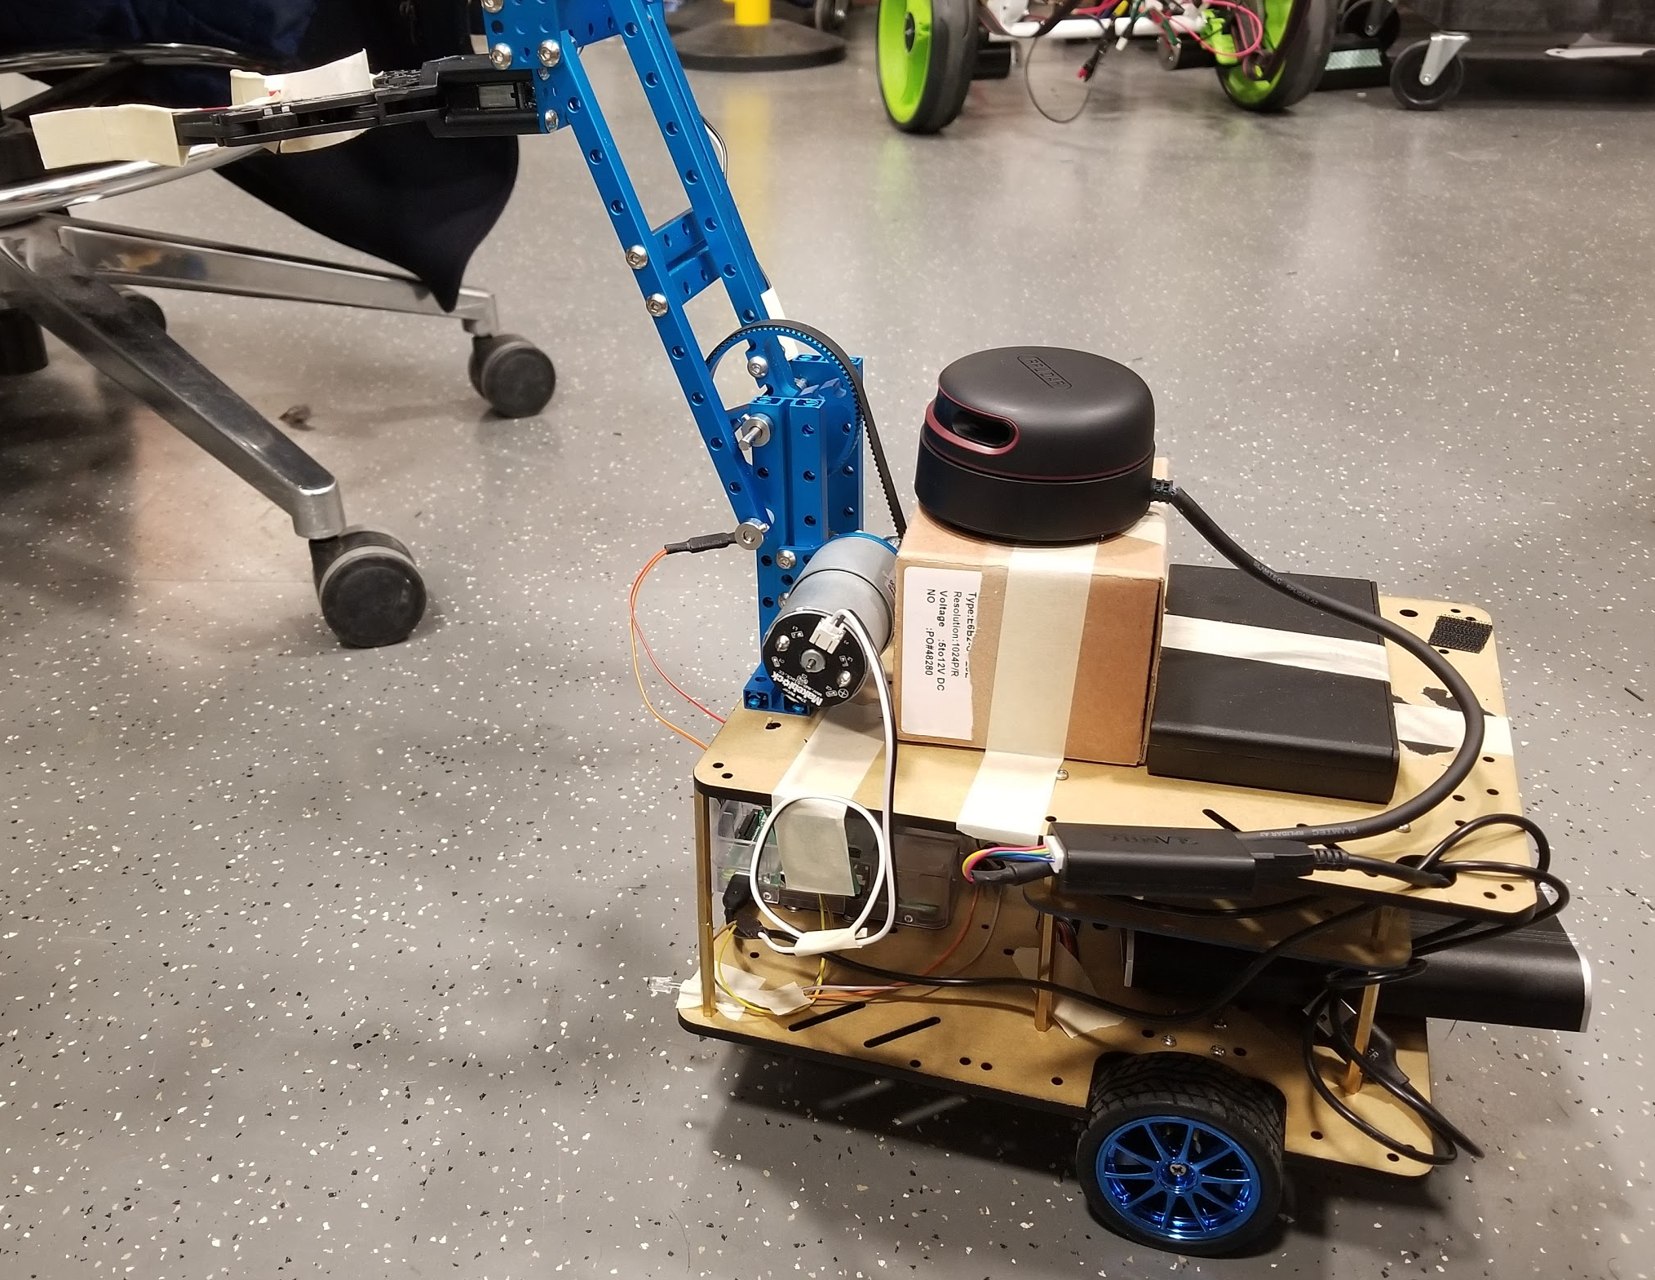
Introduction
For a long time, the idea of robots doing chores around the house has long captured people’s imaginations.

Slide 3
Design
We created a small automated robot which could grab and shift objects after receiving the command given by the user.

Slide 4
Parts
Chassis, PCB and Motor
LiDAR and Path planning
ROS, SLAM and Control

Slide 5
Chassis, PCB and Motor
Chengliang Li
Chenliang Li

Slide 6
Chassis
We used an three wheels acrylic waffle board robot car chassis.
Chenliang Li

Slide 7
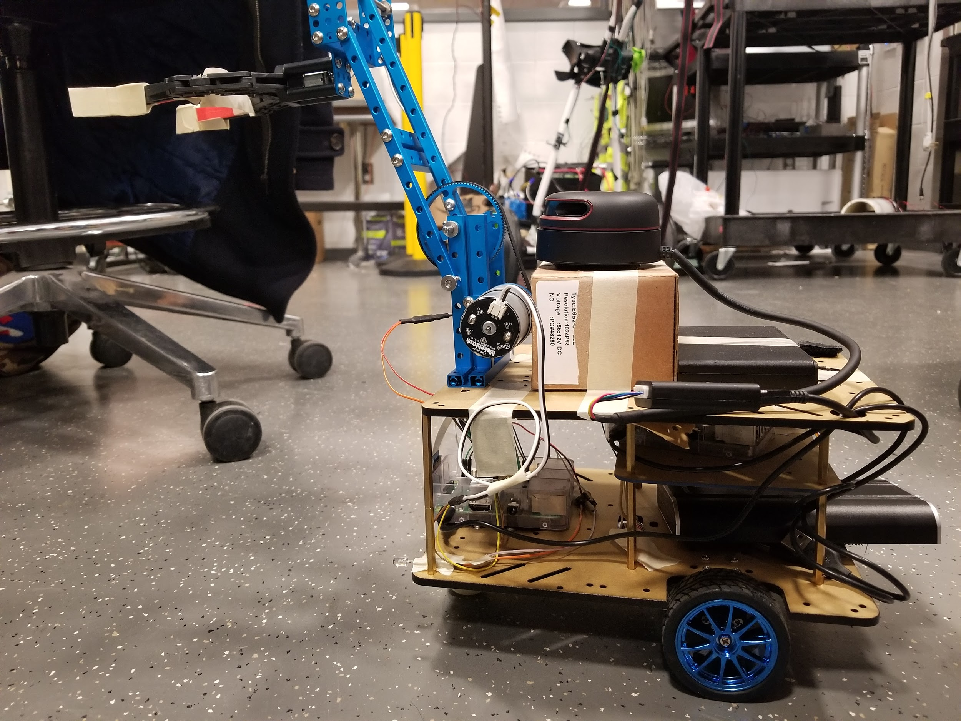
Chassis (real photo)
Chenliang Li

Slide 8
Motor
The DC brushed motor we used to drive our robot is CHR-GM25-370, DC 12V, 330 RPM.
Drive the robot at 4.5cm/s with 6.7kg weight
Chenliang Li

Slide 9
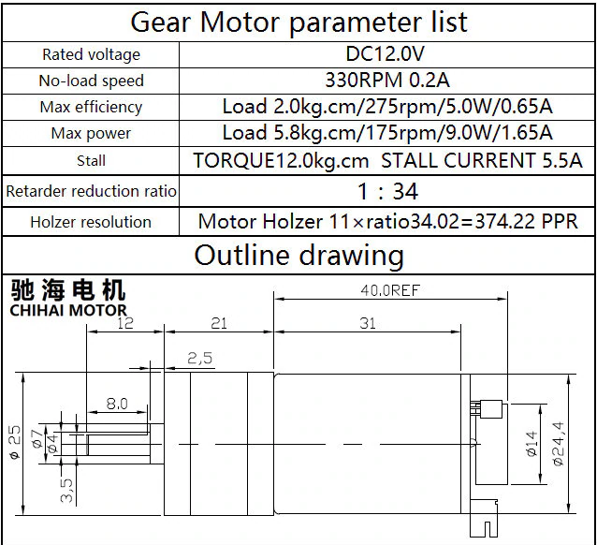
Motor (parameters and real photo)
Chenliang Li

Slide 10
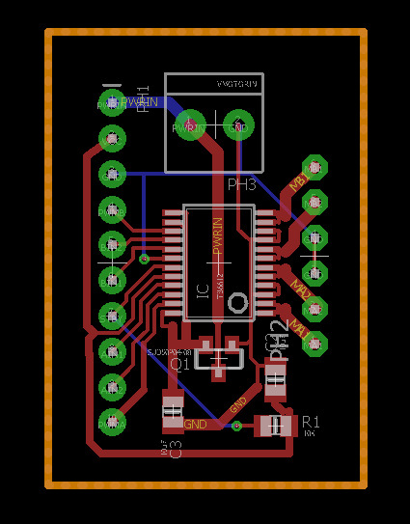
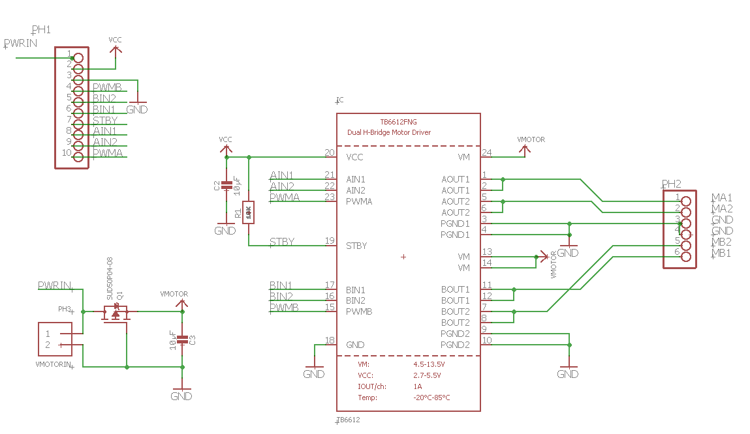
PCB
We designed a PCB for our motor controlling system, centered on TB6612 motor controlling chip.
Chenliang Li

Slide 11
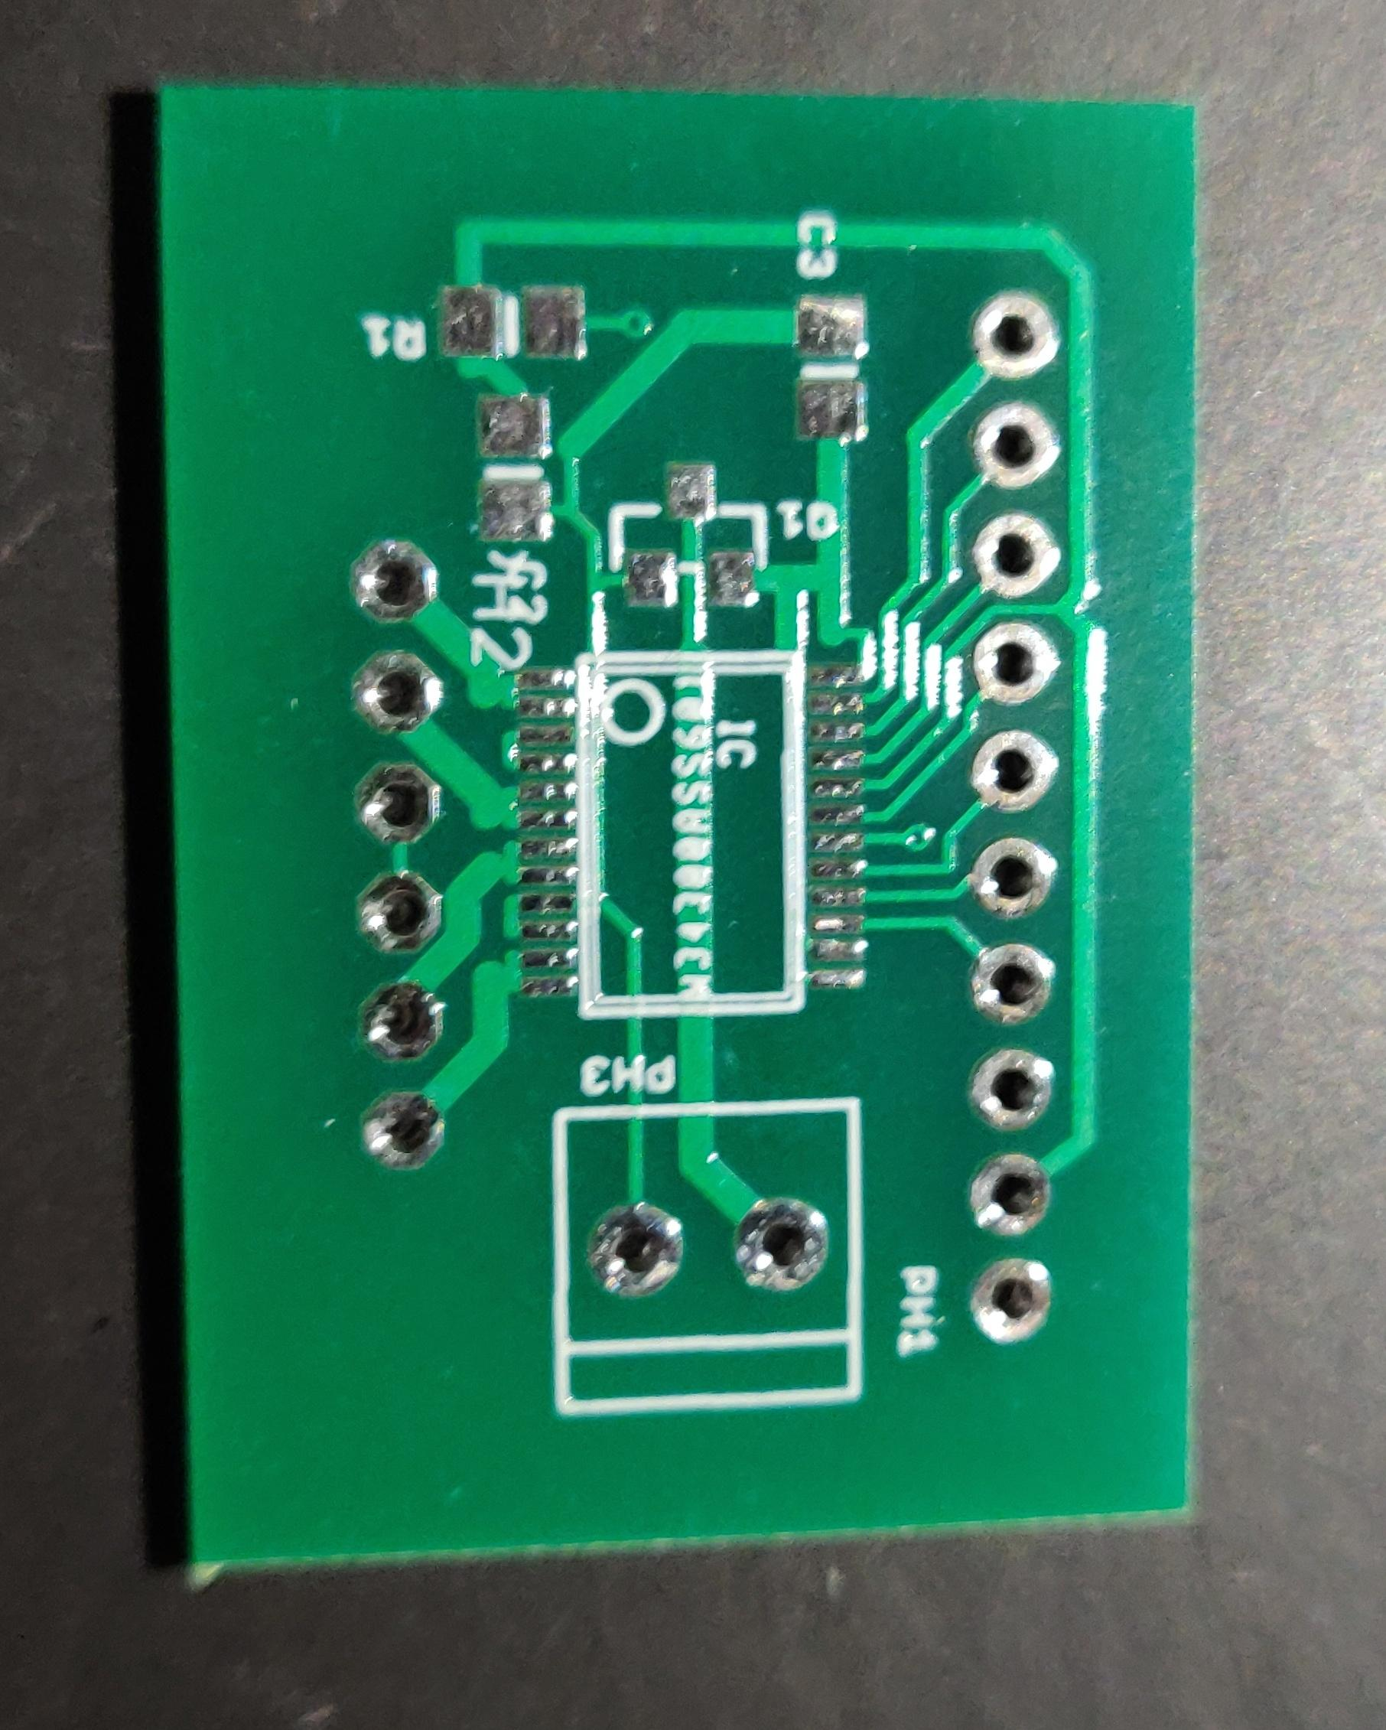
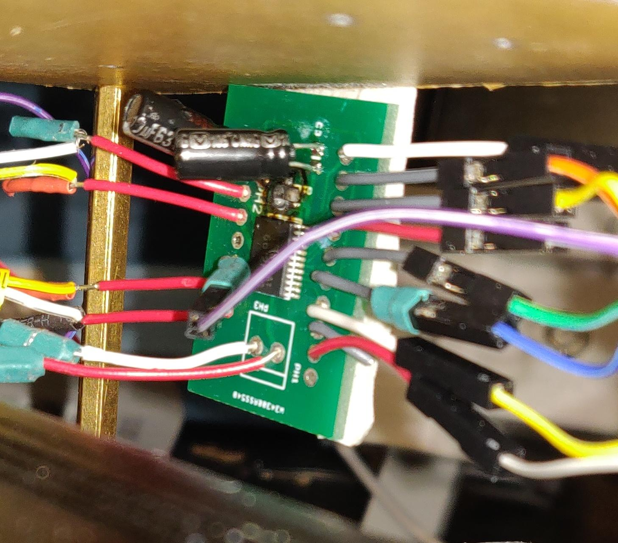
PCB (photo of empty and soldered board)
Chenliang Li

Slide 12
Functional Tests
Motor test:
Voltage input w/ different weights ↓
rotation rate test
PCB test:
Mock PWM signal, logic and power voltage
↓
Output voltage variation test
Chenliang Li

Slide 13
Challenges and Failures
Revise for better PCB design
Find PCB bugs
The component layout for balancing
Exposed wires and components
Chenliang Li

Slide 14
Other Tests
Test with GPIO on Raspberry Pi
Test otation speed test for LiDAR
Chenliang Li

Slide 15
LiDAR and Path planning
Siping Meng

Slide 16
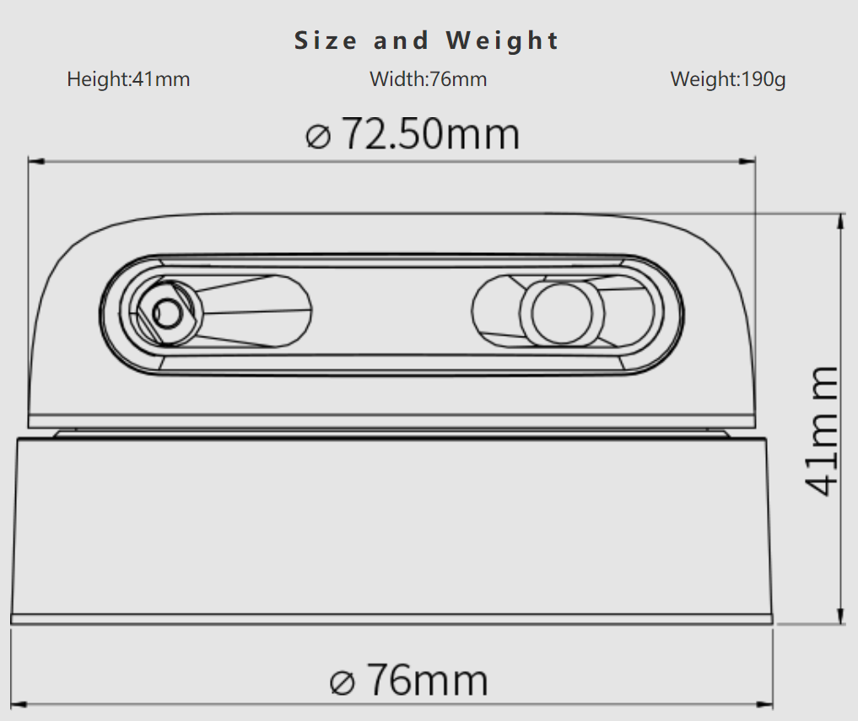
LiDAR
Low Cost 360 Degree Laser Range Scanner
12 meter radius
Siping Meng

Slide 17
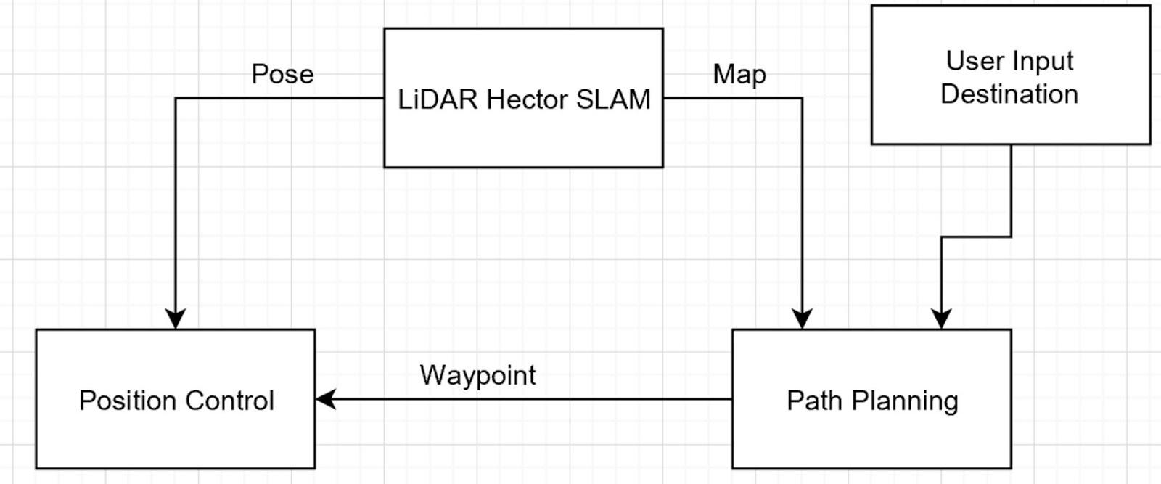
LiDAR and Path planning
Siping Meng

Slide 18
Requirements and Verifications
LiDAR
2D Mapping
Obstacle avoidance
Path Planning
Siping Meng

Slide 19
LiDAR and MAP
Input is Hector SLAM MAP
[0,0,0,-1,100,100,0...,0]
0 - Empty Space
-1 - Not Sure
100 - Obstacle
Siping Meng

Slide 20
LiDAR and Path planning
Hard to visualize in 1D
visualization tool for debug
robot size
Siping Meng

Slide 21
LiDAR and Path planning
Hard to visualize and plan in 1D
Siping Meng

Slide 22
Siping Meng

Slide 23
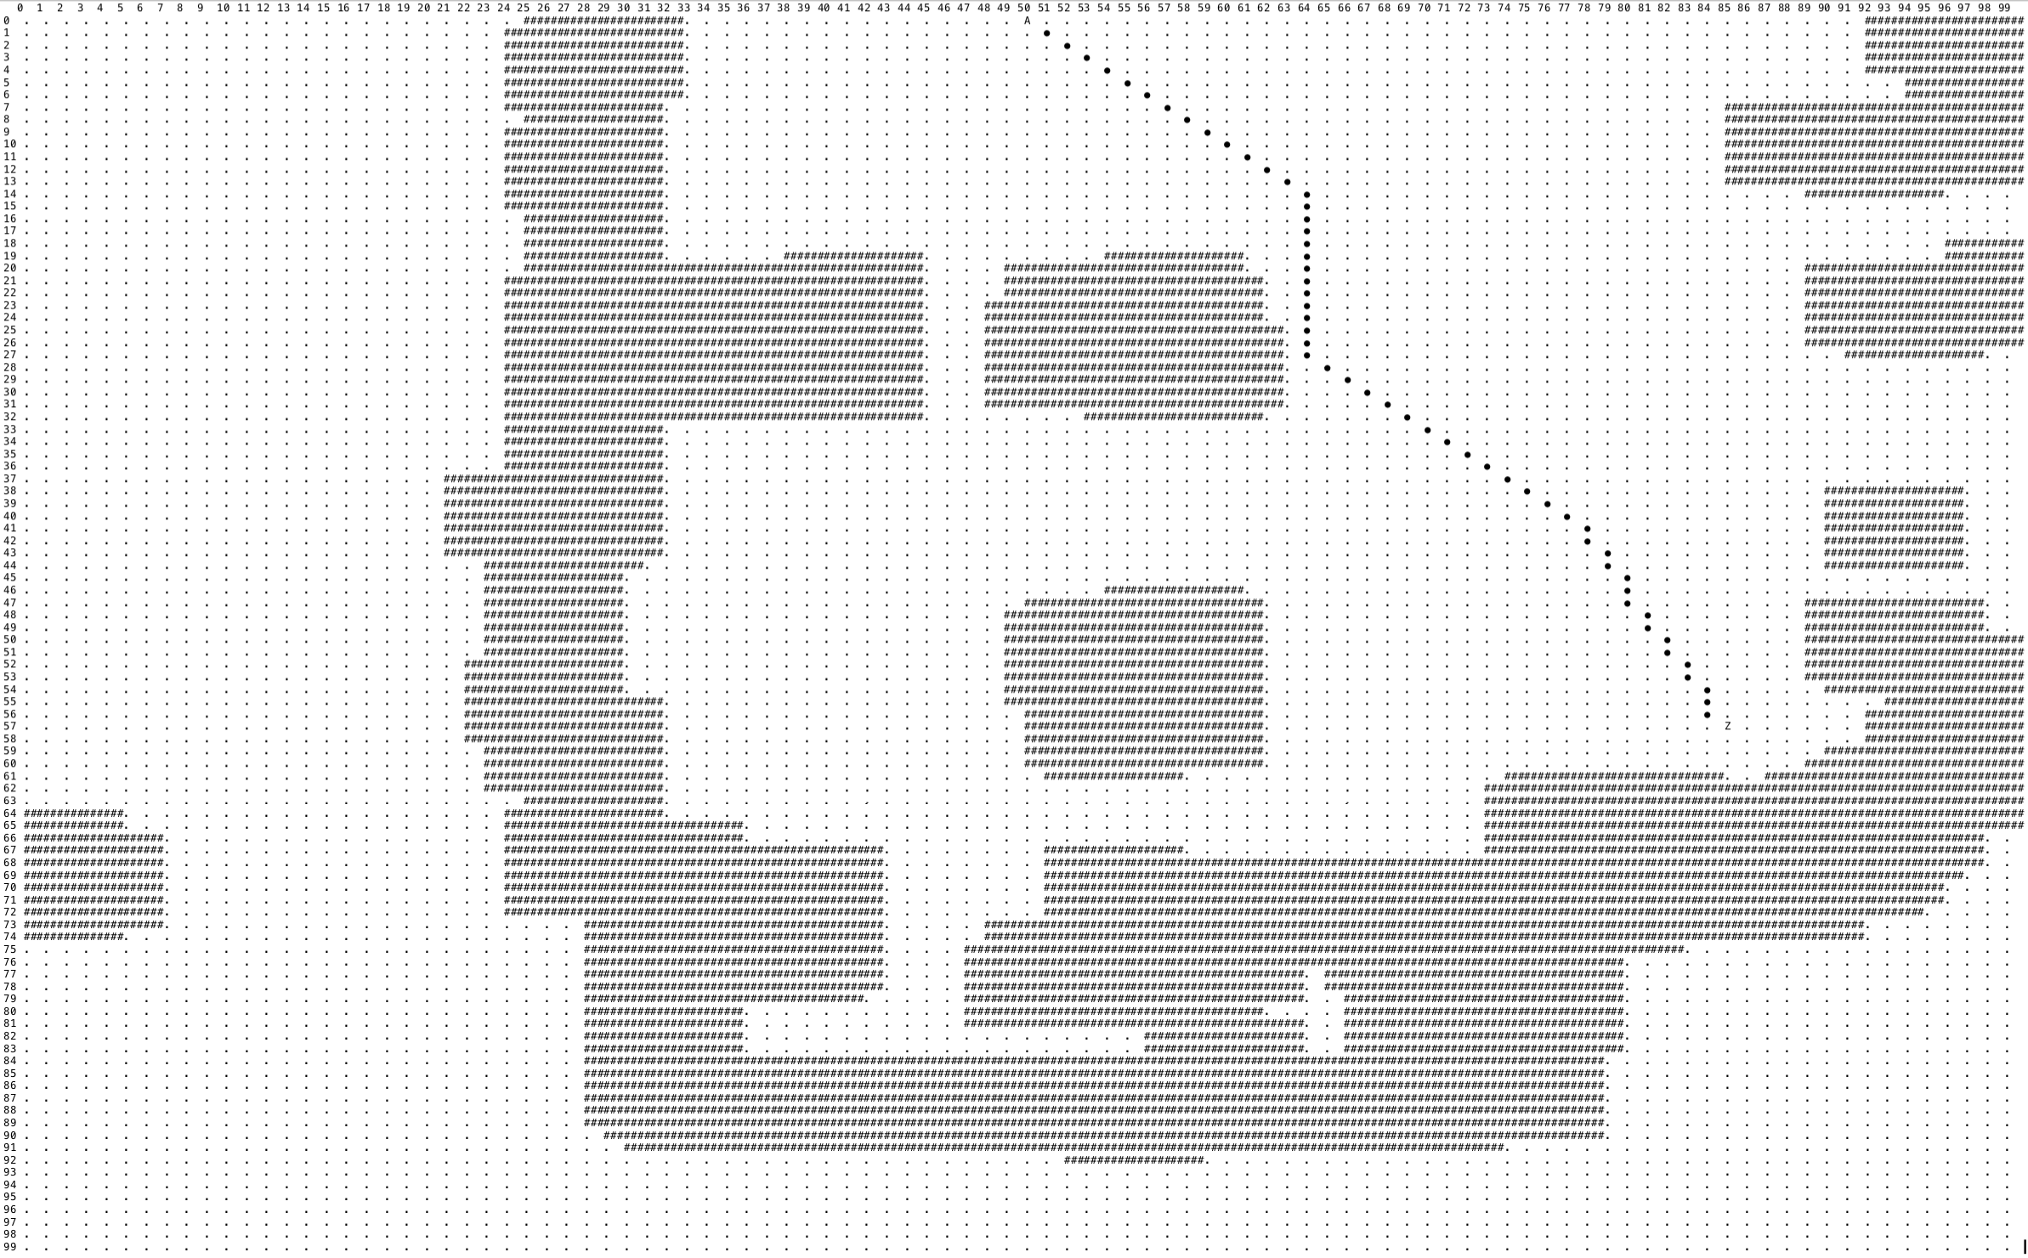
Siping Meng

Slide 24
Siping Meng

Slide 25
Functional Tests
Test on computer
Try out on robot
Debug on computer
Try out on robot
Siping Meng

Slide 26
Challenges and Failures
Replan
Moving object(s)
Siping Meng

Slide 27
ROS, SLAM and Control
Honglu He

Slide 28
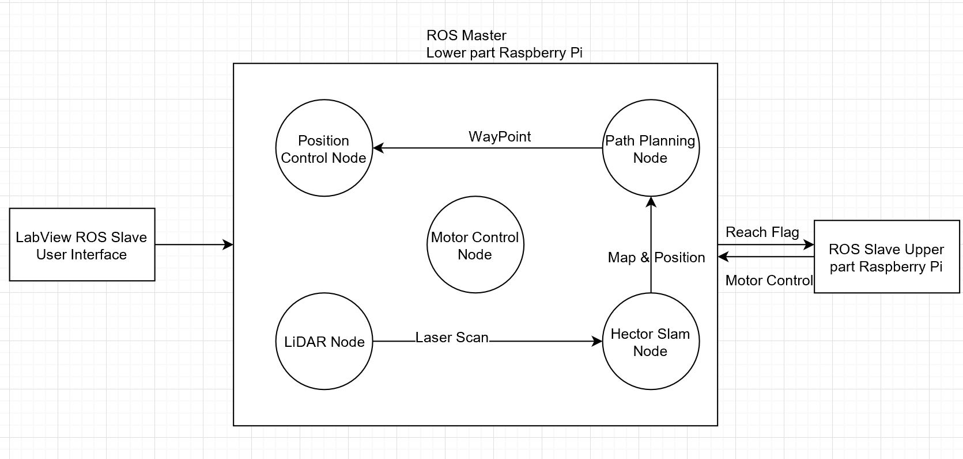
ROS
Review of original design
Honglu He

Slide 29
Hector SLAM
Input:
LiDAR sensor_msgs: LaserScan.msg
Output:
Pose: Geometry_msgs: Pose.msg
Map: Navigation_msgs: OccupancyGrid.msg
Honglu He

Slide 30
Honglu He

Slide 31
Honglu He

Slide 32
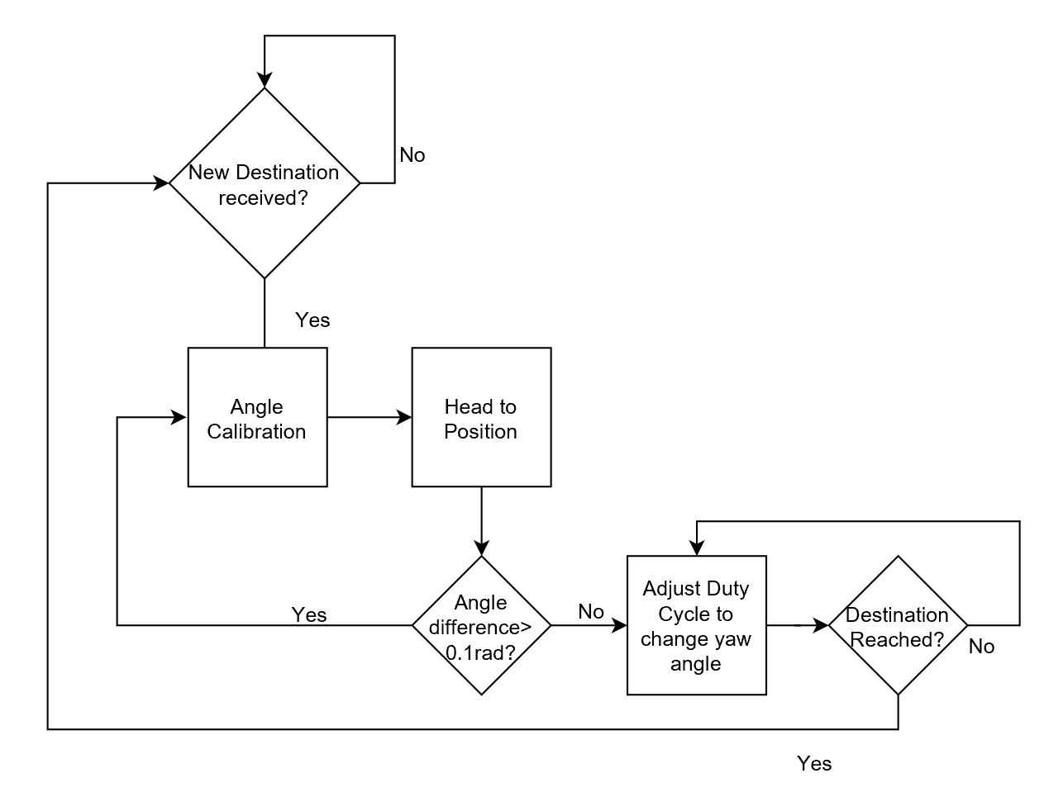
Position Control
Honglu He

Slide 33
Motor Control
Simply receive command from upper part to adjust robot’s angle and position.
Honglu He

Slide 34
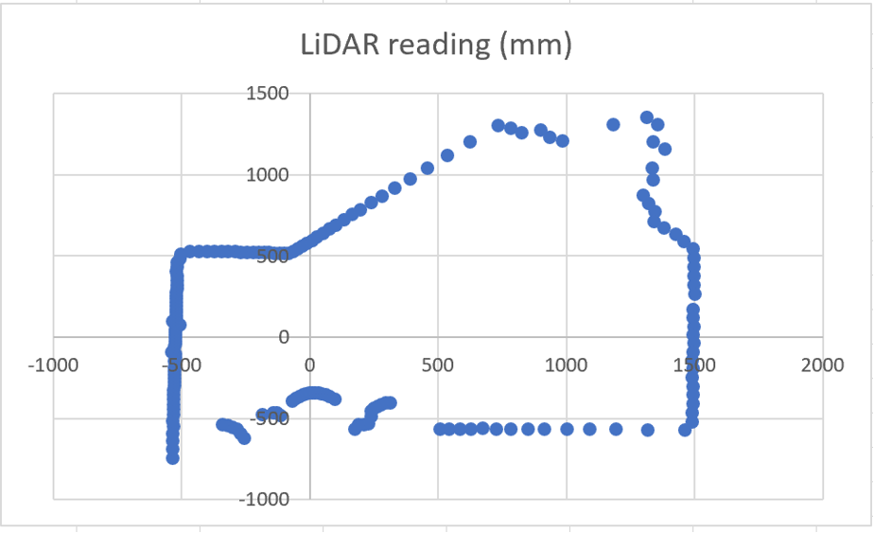
LiDAR PointCloud Tests
Honglu He

Slide 35
LiDAR Mapping Test
Honglu He

Slide 36
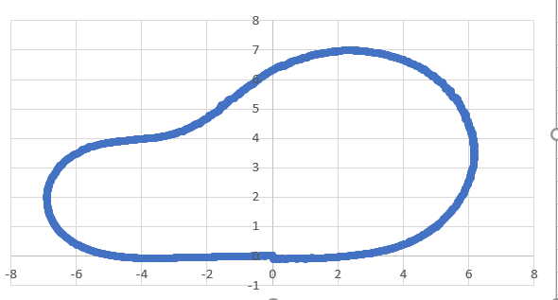
Localization Test
Honglu He

Slide 37
ROS Wireless Motor Control Test
LabView on Window laptop takes in “←”, ”↑”, and ”→”
Raspberry Pi subscribes to the message and can make straight, left and right actions.
Honglu He

Slide 38
ROS communication between 2 Pis
Upper part Pi publish motor control command
Lower part Pi successfully receives command and makes the action
Honglu He

Slide 39
Challenges and Failures
The SLAM will fail if there’s moving object close to LiDAR at first 5 seconds after the SLAM starts.
The SLAM output angle will be corrupt if the the robot turns too fast (50% duty cycle on each side)
Map conversion takes time, so the robot will keep converting maps for path planning, and the path planning will use prepapared map
Honglu He

Slide 40
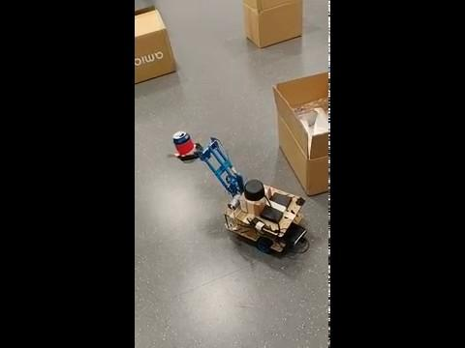
Result

Slide 41
Further Work

Slide 42
Overall Design
Concise wiring
Better control for motors
More precision in localization
Emergency stop

Slide 43
Acknowledgement
Amr Martini Suggestions and support for . the whole semester.
Prof. Chen Advice on design review.

