Slide 1
Maximum Power Point Tracker for a Wind Turbine
By: Alec Biesterfeld, Tyler Rasmussen, Ben Scrementi
TA: Evan Widloski
Team #11

Slide 2
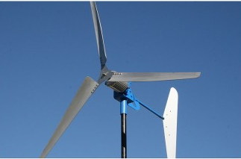
Introduction
Maximum power tracking system for the WindTura 750 turbine
Suitable for home-scale wind power systems
2

Slide 3
Objectives
Track maximum power at various wind speeds using a digital controller to adjust the load presented to a turbine
Dissipate up to 750W to a resistive load
Low-cost and accessible solution (<$200)

Slide 4
What is Maximum Power Point Tracking (MPPT)?
Adjust load presented to the system via power converters
At smaller loads, turbine spins slower
At higher loads, turbine spins faster
Optimal speed controlled by the duty cycle of the converter
4

Slide 5
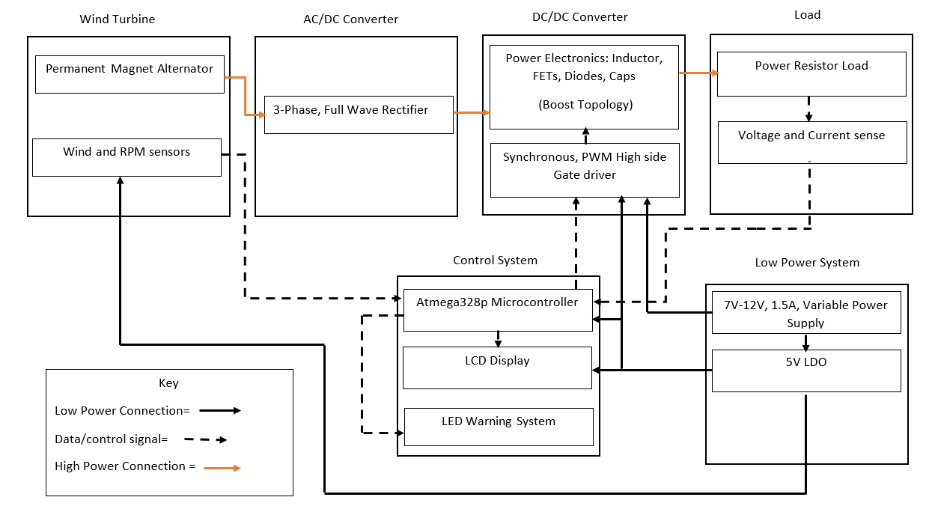
System Overview

Slide 6
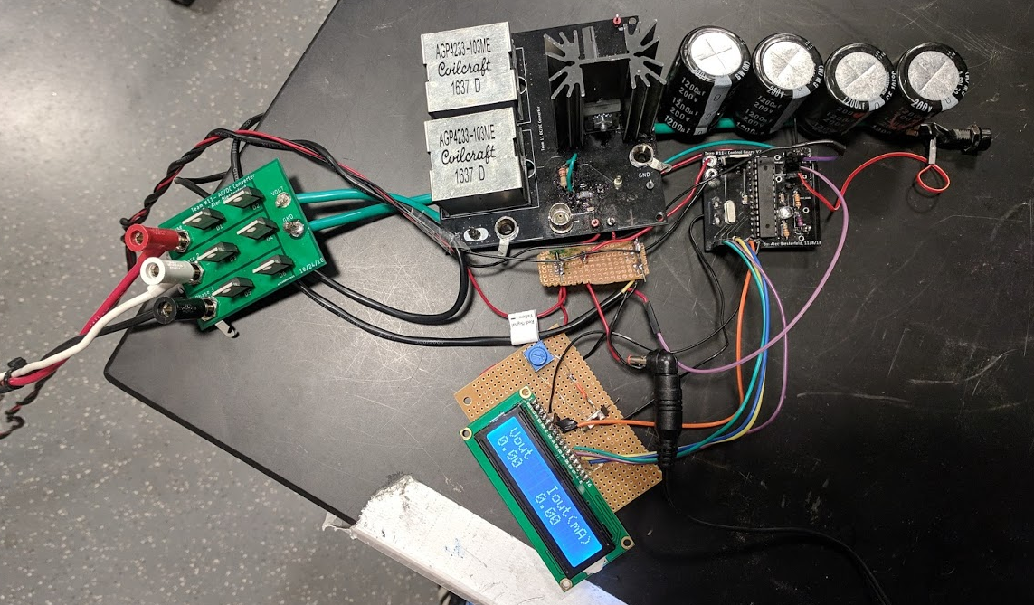
To Sensors on Turbine
To Load
To Turbine
6
To Wall Outlet

Slide 7
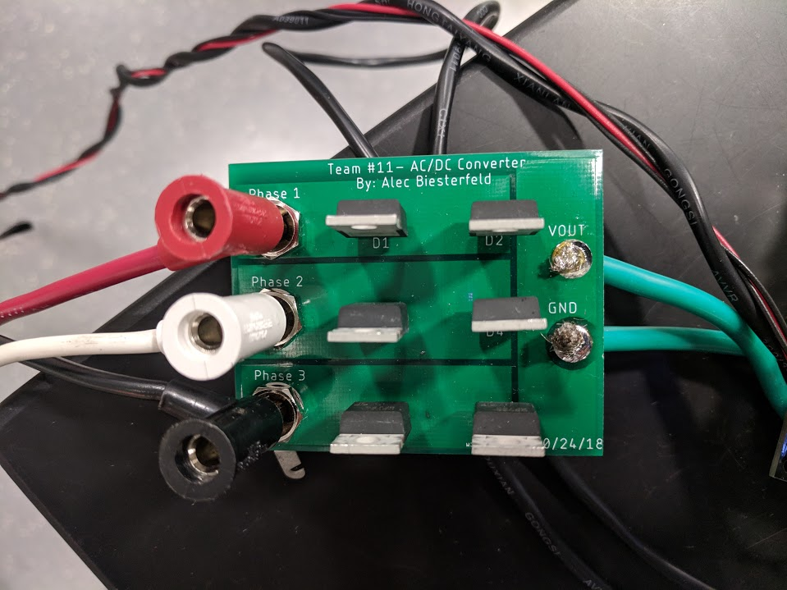
AC/DC Converter Subsystem
3 Phase, Full-Wave Rectifier
Function:
Receive input from a three-phase PMA
Supply a DC voltage to the DC/DC subsystem

Slide 8
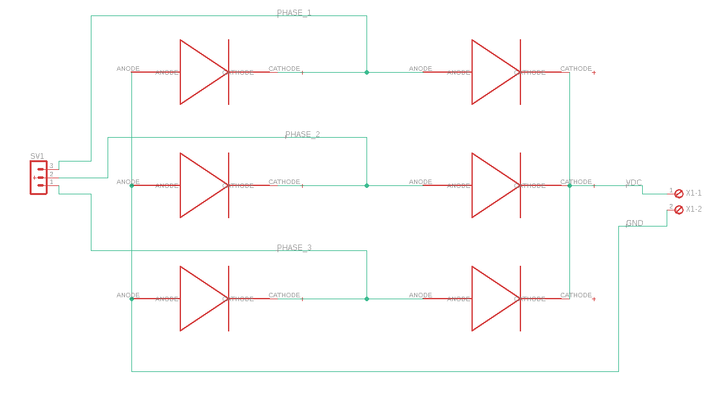
AC/DC Schematic

Slide 9
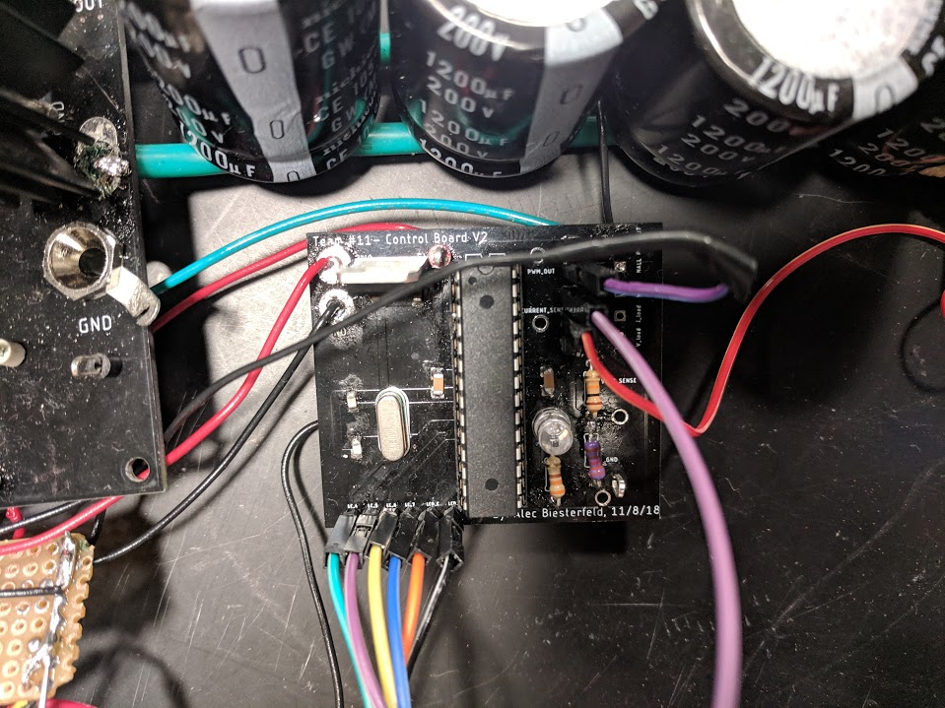
Controller Subsystem
Functions:
Process sensor input
Calculate system parameters
Algorithmically determine the optimal duty cycle
Output system parameters to the display
Components:
Sensor units
Microcontroller
System Display

Slide 10
Control System Board Schematic

Slide 11
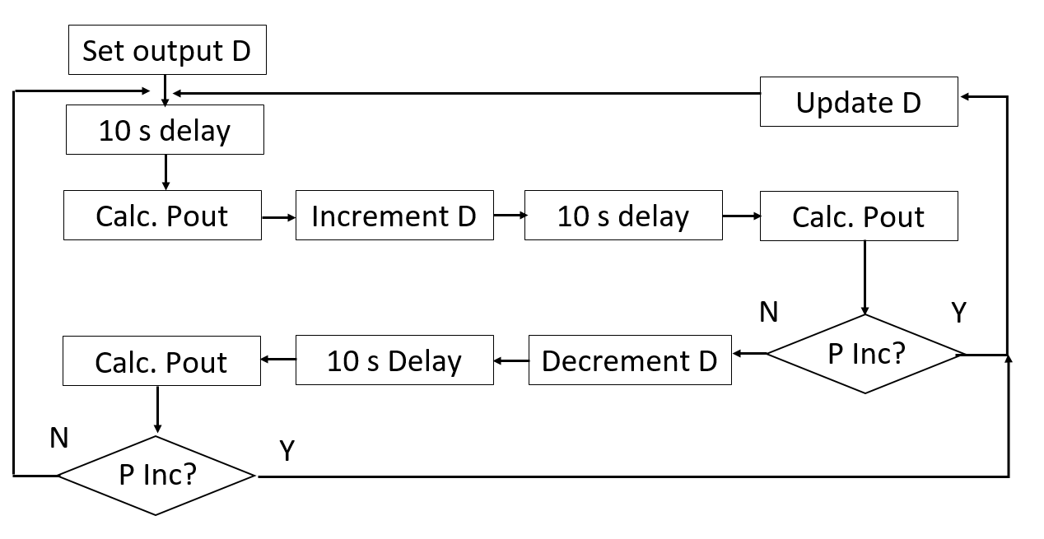
Software Control Algorithm

Slide 12
System Display
Display Screens:

Slide 13
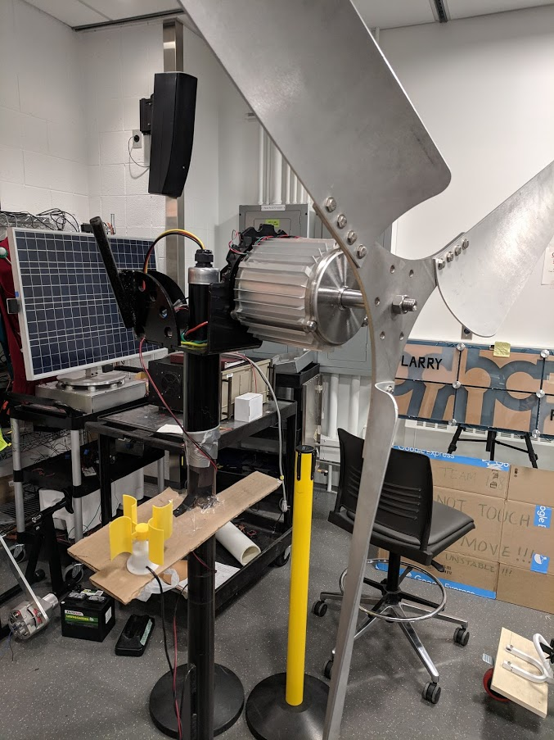
Anemometer (Wind Sensor)
Anemometer
Provide analog output voltage to ATMEGA328p ADC
Use provided LUT to convert voltage to wind speed (m/s)

Slide 14
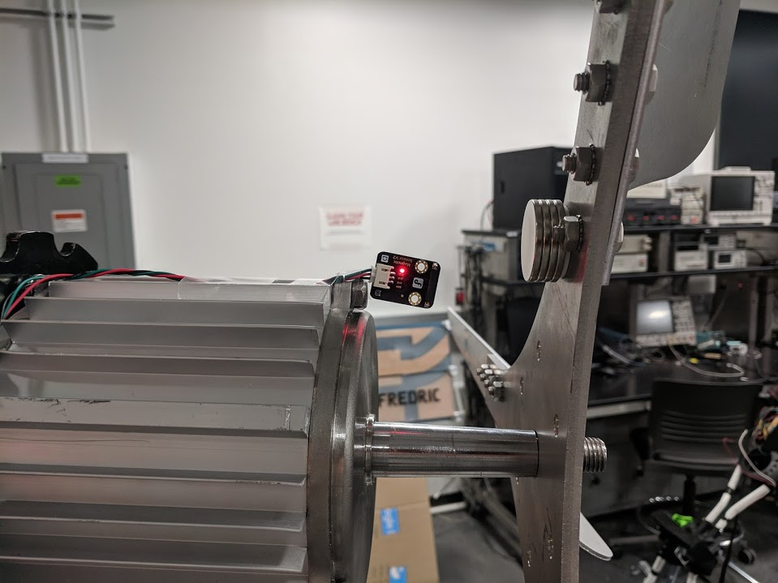
Hall Effect (RPM) Sensor
Hall Effect Sensor
Digital output high upon pass of a magnet
Used to calculate rotational speed
HIGH
LOW
T1
T2

Slide 15
Control System Sensor Units
Voltage Sensor
10 kΩ and 3.3 kΩ for voltage divider
Convert output voltage to 5 V logic
Current Sensor
Four 15 Ω, 0.5W resistors for final demonstration
ACS758 used for higher currents

Slide 16
Microcontroller
Pin Number | Pin Name | Design Function
4 | PD2 | LCD Display
5 | PD3 | LCD Display
6 | PD4 | LCD Display
11 | PD5 | LCD Display
12 | PD6 | LCD Display
13 | PD7 | RPM Sensor
14 | PB0 | LCD Display
15 | PB1 | DC/DC PWM Signal
16 | PB2 | LED warning light
23 | ADC0 | Voltage Sensor
24 | ADC1 | Current Sensor
28 | ADC5 | Wind Sensor
Atmega328p, 28 DIP package
Programmed using an Arduino bootloader and Arduino IDE
16

Slide 17
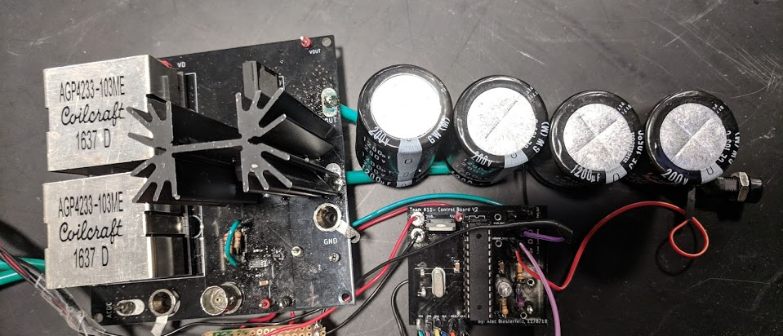
DC/DC Converter
Purpose
Adjust the load presented to the turbine by changing its duty ratio
Components
Gate driver IC
Boost Converter

Slide 18
DC/DC Converter Requirements
Should be able to operate at up to 800W
Should have an output voltage ripple of ±3% of the output voltage at 100W, ±10% at 800W
Should be at least 80% efficient at up to 800W, 90% efficient at up to 100W

Slide 19
Topology Selection
Originally used a SEPIC converter in order to be able to adjust the voltage out of the turbine up or down
Lower efficiency
Didn’t work well at low switching frequencies
Thermal issues
Switched to a boost converter
Higher efficiency
Still able to adjust the turbine’s speed up or down

Slide 20
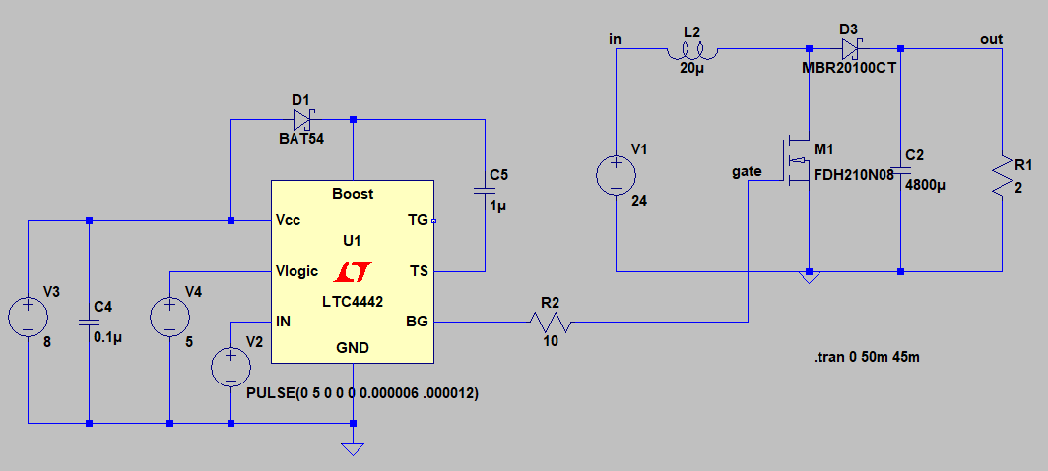
LTSPICE Boost Simulation
20

Slide 21
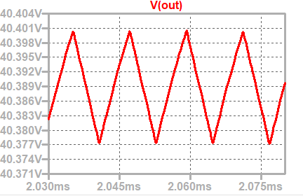
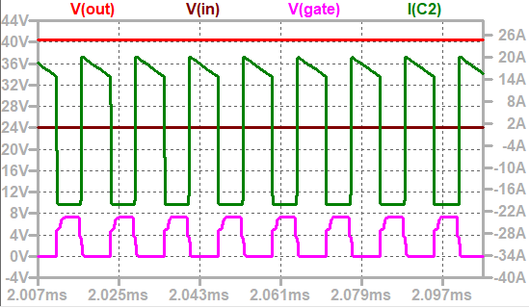
LTSPICE Boost Simulation
= 24mV = .2% of minimum output voltage
21

Slide 22
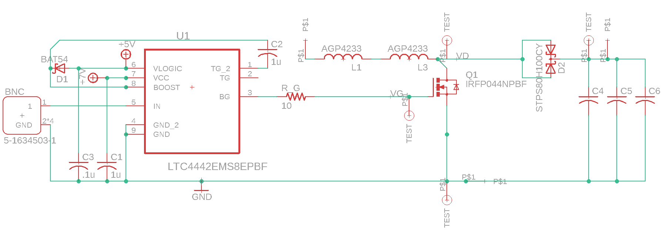
DC/DC Converter Schematic

Slide 23
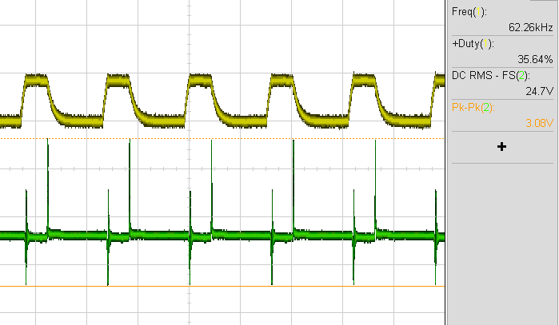
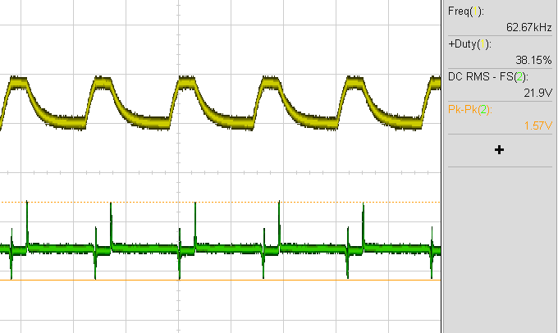
Gate Resistor Selection
V_{GATE}
V_{GATE}
V_{OUT}
V_{OUT}
R_{G}=110 Ω
2V Voltage Spike
η = 88.7% at 75W
R_{G}=220 Ω
1V Voltage Spike
η = 86.6% at 70W

Slide 24
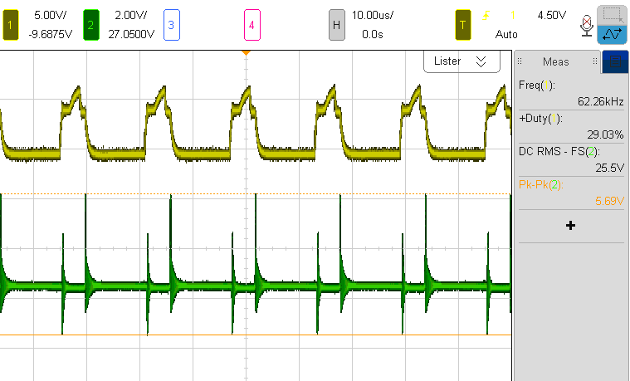
R_{LOAD} | 7Ω
Duty Ratio | 29%
V_{IN} | 19.63V
P_{IN} | 98.1W
V_{OUT} | 25.1V
P_{OUT} | 90.1W
Efficiency | 91.8%
Required Efficiency | 90%
V_{OUT} Spikes | 3.5V
Required Ripple | < 0.75V
Boost Converter Results
24

Slide 25
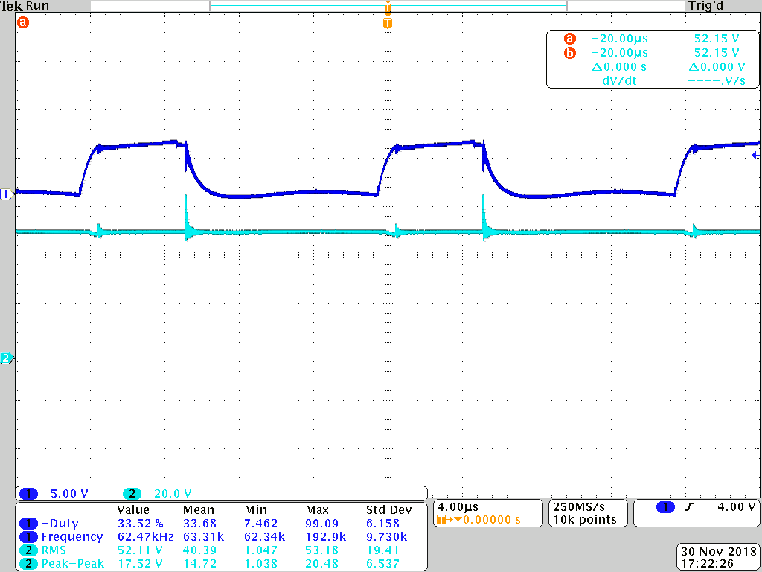
R_{LOAD} | 8.33Ω
Duty Ratio | 33.5%
V_{IN} | 38.2V
P_{IN} | 337.6W
V_{OUT} | 50.94V
P_{OUT} | 309.4W
Efficiency | 91.63%
Required Efficiency | 85%
V_{OUT} Spikes | 14V
Required Ripple | < 2.5V
Boost Converter Results
25

Slide 26
Dynamometer Testing
https://photos.app.goo.gl/L5j9qSB3Cxwuy1kz5
26
Notes:
https://photos.app.goo.gl/L5j9qSB3Cxwuy1kz5

Slide 27
Dynamometer Testing
Duty Ratio | 20% | 25% | 35%
RPM | 434 | 380 | 268
P_{IN} | 216.0W | 181.8W | 122.4W
V_{OUT} | 50.8 | 47.2 | 37.5
P_{OUT} | 187.7W | 156.9W | 101.4W
Efficiency | 86.9% | 86.3% | 82.84%
Required Efficiency | 80% | 80% | 80%
For a 14 Ω load and 5.5 Nm of torque from the dynamometer, data was collected at different duty ratios
Testing limited by dynamometer’s current limit

Slide 28
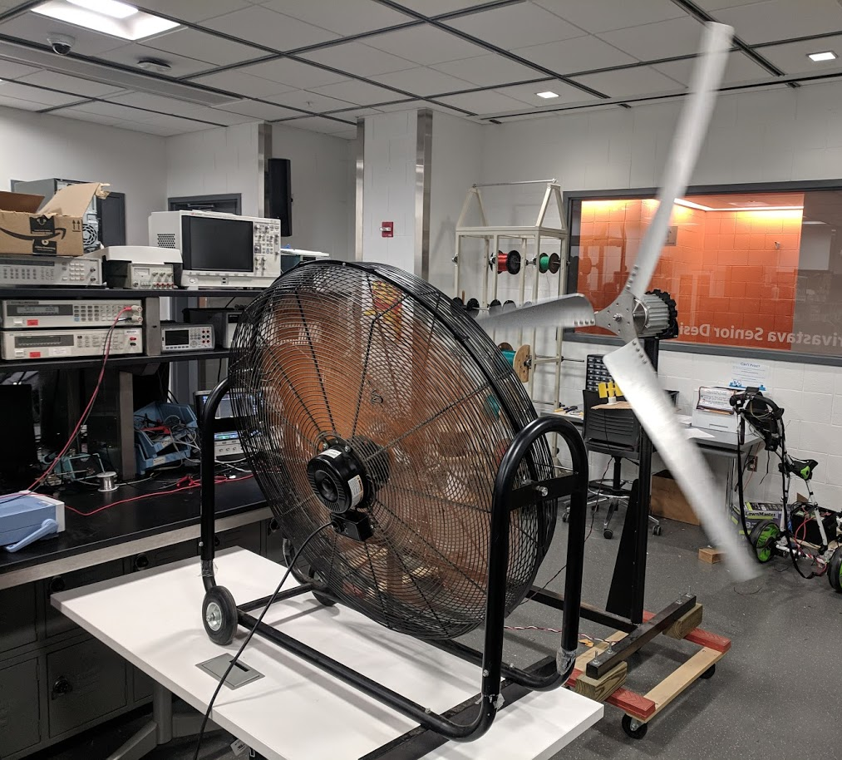
Fan Testing
Used an industrial fan to simulate wind
Connected to 100 Ω load and power meter
Max output ~ 350mW
28

Slide 29
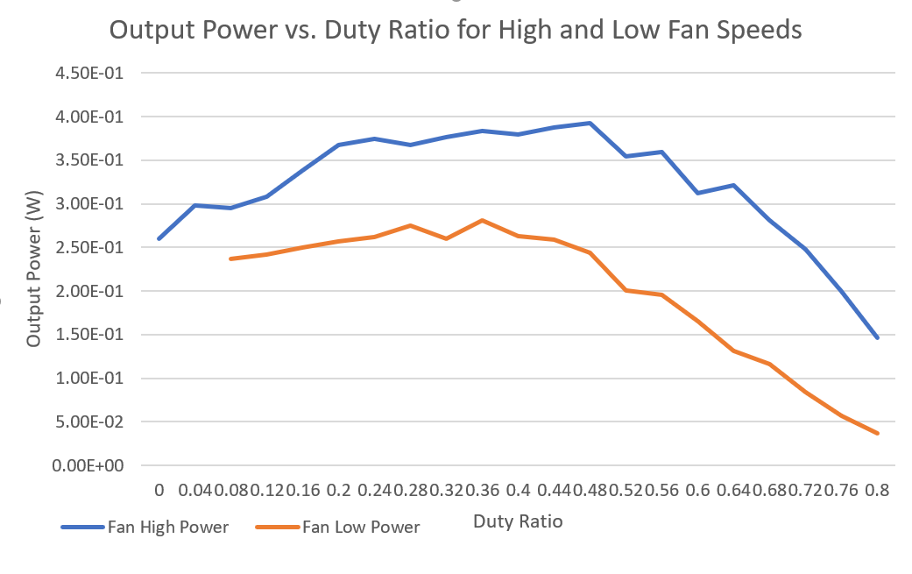
Fan Testing Results
Peak at 48%
Peak at 36%

Slide 30
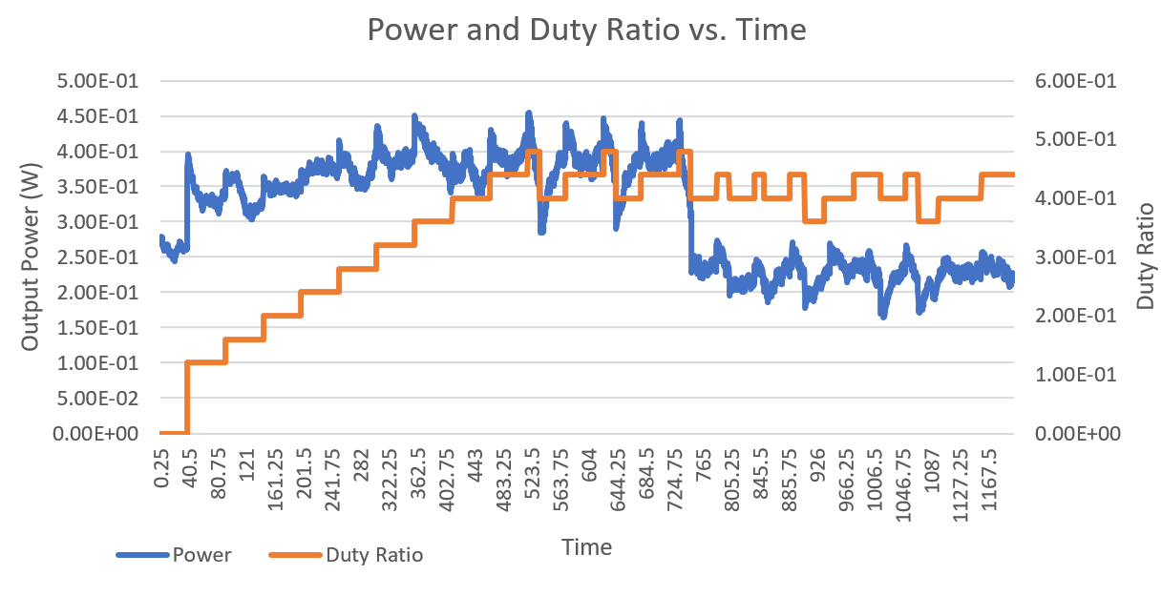
Fan Testing Results
Stabilizes between 36-44%
Stabilizes between 40-48%
High Fan Speed
Low Fan Speed

Slide 31
Fan Testing Results
Converged around 43.5%
Peak at 48%
Peak at 36%
Converged around 42%

Slide 32
Boost Converter Simulation

Slide 33
Block Diagram of System

Slide 34
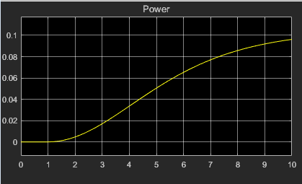
Step Response without Boost Converter
Step input had an amplitude of 1 and a 1 second step size
The step input was meant to represent mechanical input from turbine

Slide 35
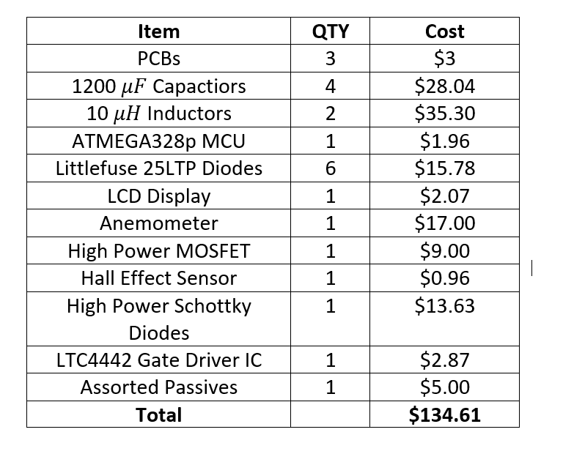
Project Costs
Goal: Less than $200
35

Slide 36
Conclusions
Effective maximum power point tracking demonstrated in a laboratory setting
Power electronics proven to be able to operate above 300 W
Successful interface with the WindTura 750 turbine system

Slide 37
Future Work
Improved testing conditions (wind tunnel, outside in relatively high winds)
Tune the response time of the power tracking system
Integration of a battery in order to create a complete off-grid power solution

Slide 38
Acknowledgements
Evan Widloski
Prof. Haran
Kevin Colravy
Prof. Raginsky
Prof. Banerjee
38

Slide 39
Questions?
Thanks for listening!

