Slide 1
Power Board For IlliniSat-3
Group #35: Robert Maksimowicz, Dongze Lu
ECE 445 Fall 2018

Slide 2
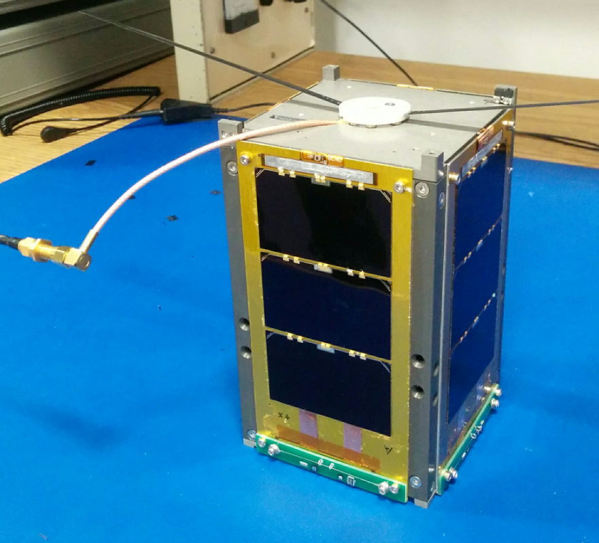
CubeSat Brief History
A class of nanosatellites that use standard size and form factor
Grew over the years into academia
Low-cost platform for science investigators
Only about 50% of launches are successful

Slide 3
Objective
More reliable board than its predecessor
Introduce a Controller Area Network (CAN) bus as a form of communication between satellite subsystems
High-performance microcontroller
Notes:
High performance microcontroller - talk about why this particular model

Slide 4
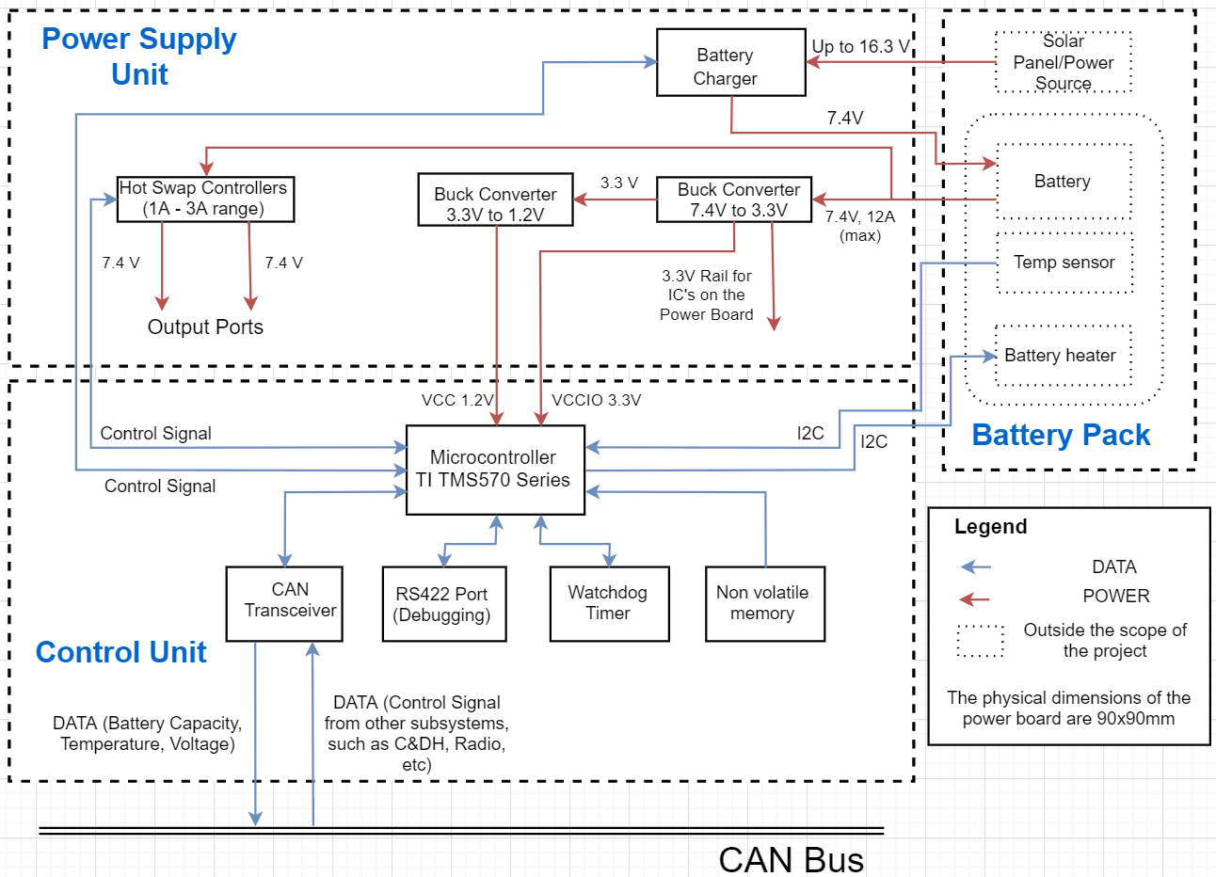
Block Diagram
Notes:
Overview of the original design

Slide 5
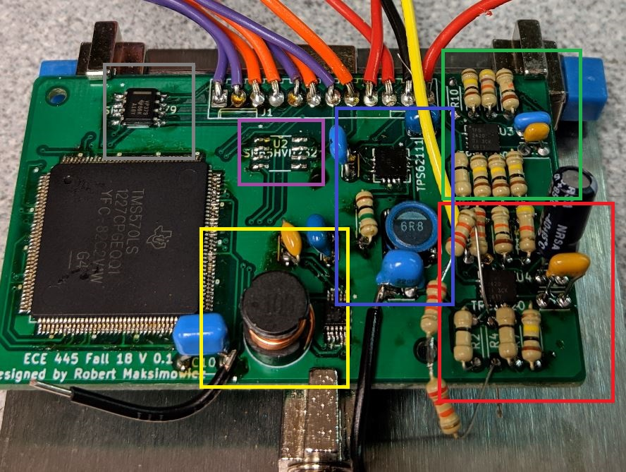
Notes:
We need a better picture. Take one later with CAN bus soldered on the board. Also, add there stuff is in the picture (hot swap, converters, etc)

Slide 6
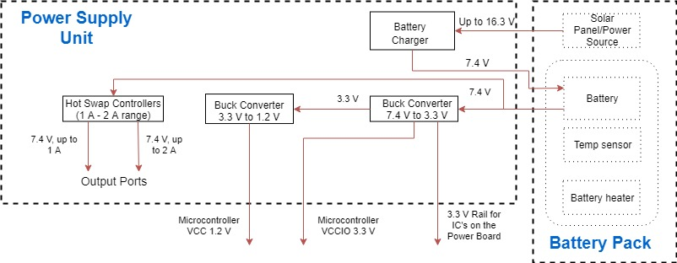
Power Subsystem

Slide 7
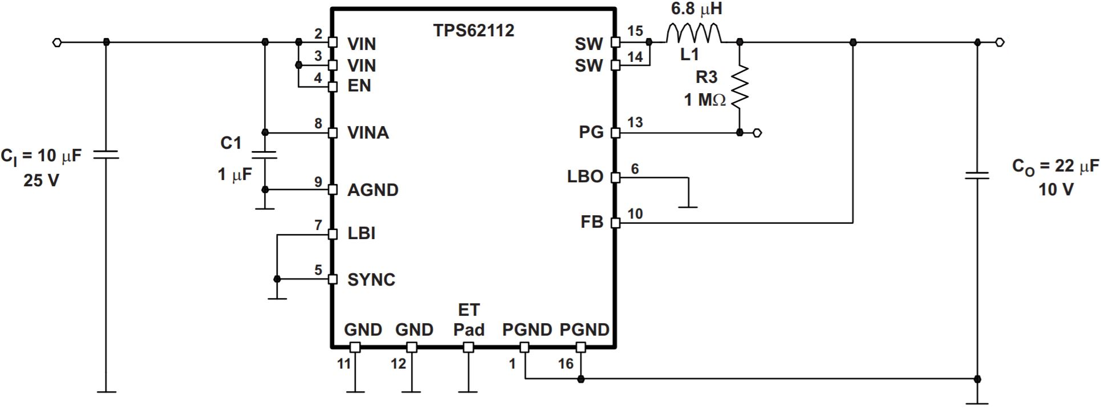
Buck Converters
Requirements:
Both buck converters must achieve at least >80% efficiency
For 7.4 V to 3.3 V converter, the output voltage should fall between 3.3 V ± 0.3 V
For 3.3 V to 1.2 V converter, the output voltage should fall between 1.2 V ± 0.06 V

Slide 8
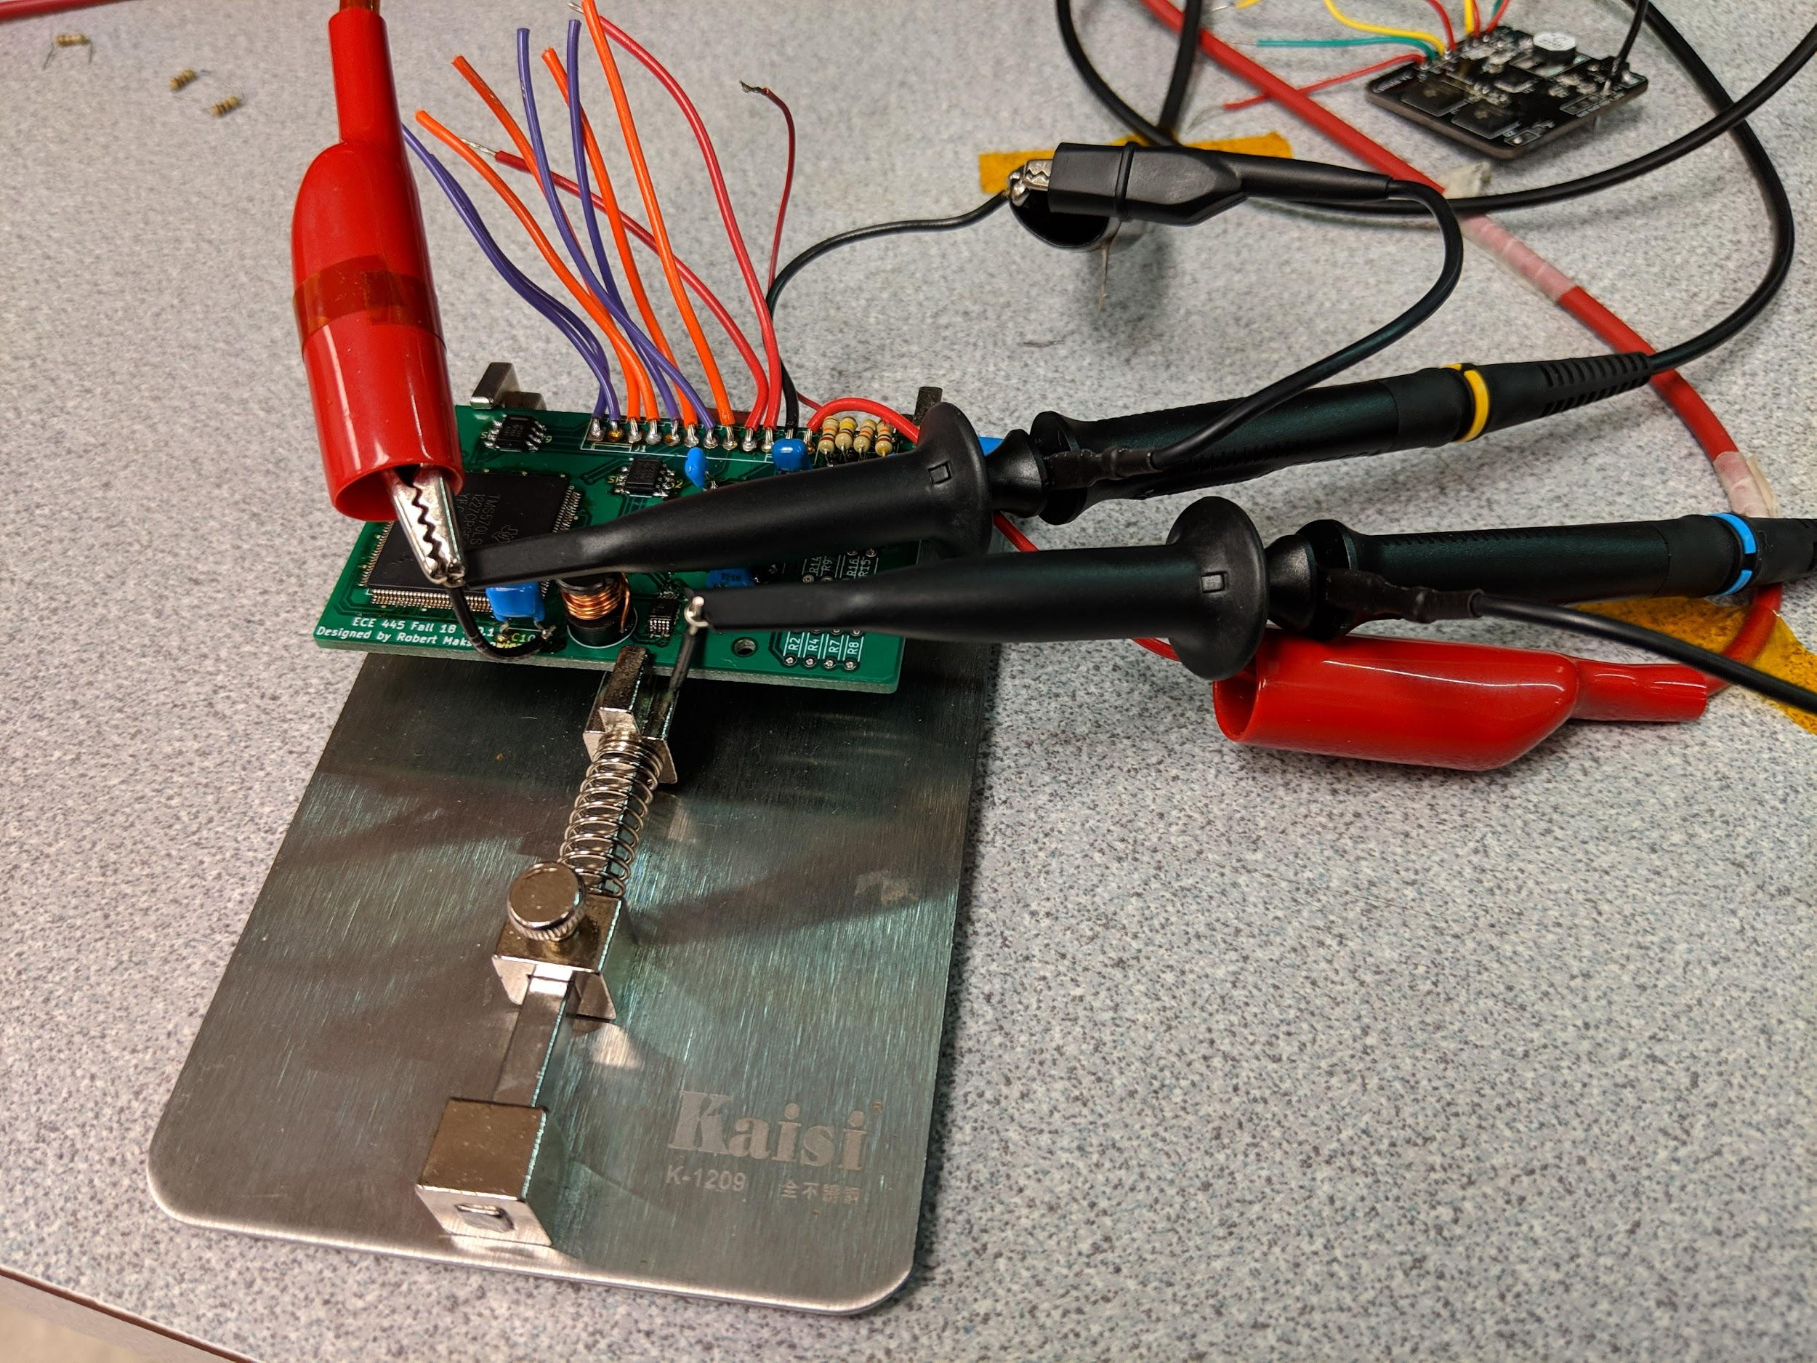
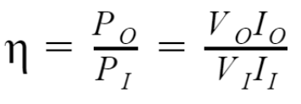
Buck Converter Efficiency
Efficiency of a converter is defined as:

Slide 9
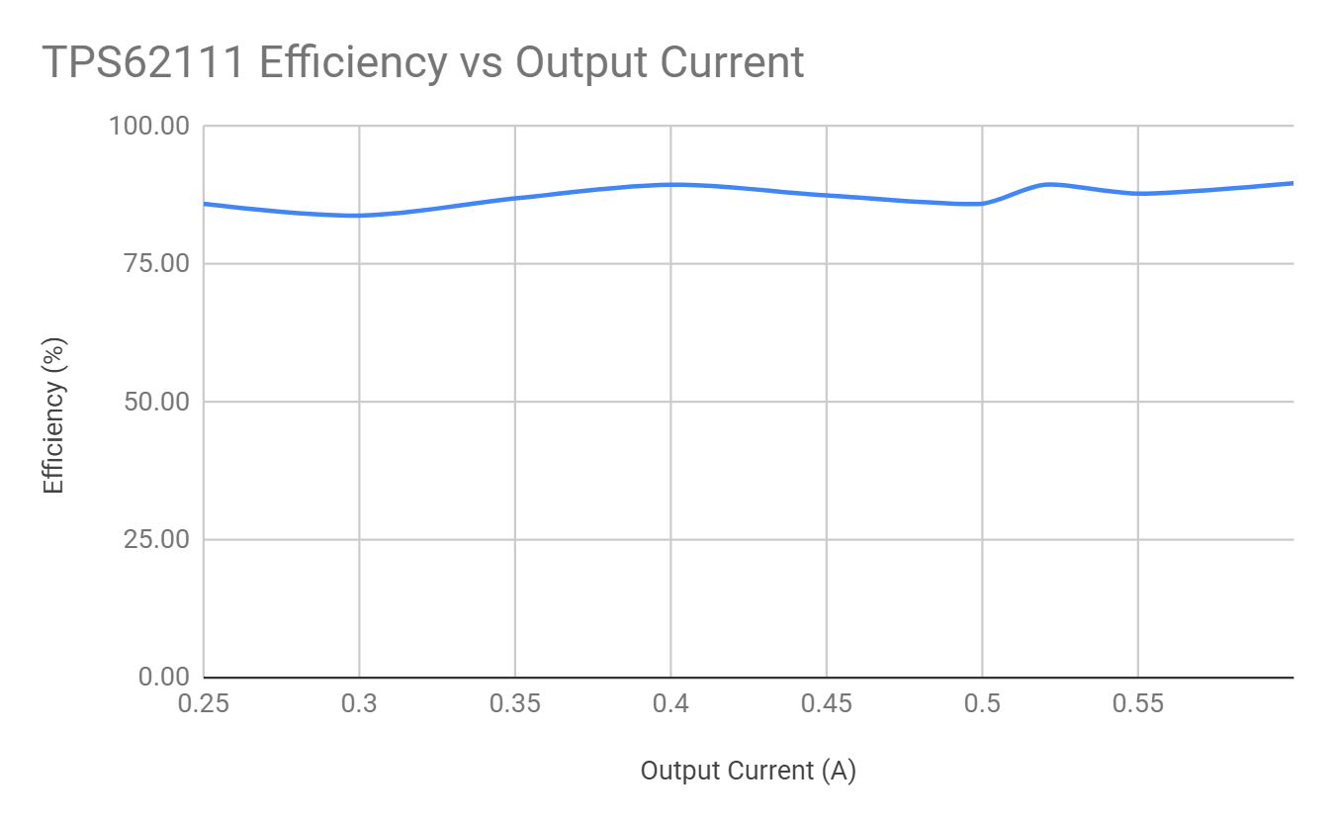
TPS 62111 (7.4 V to 3.3 V)

Slide 10
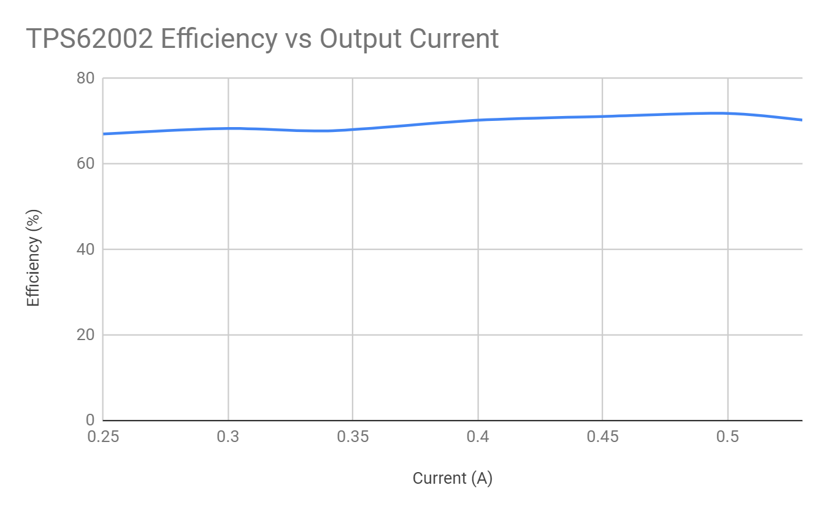
TPS 62002 (3.3 V to 1.2 V)

Slide 11
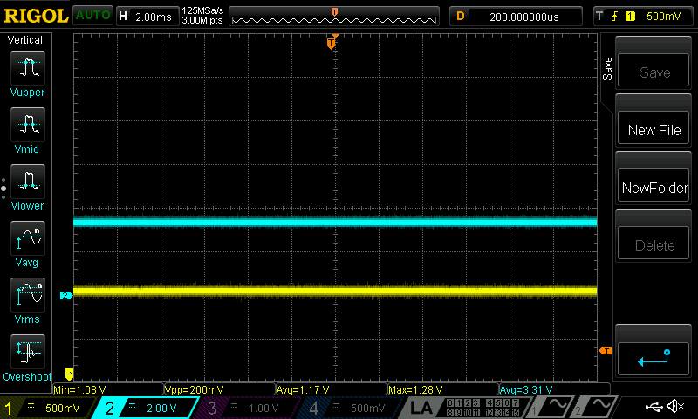
Notes:
This is a test picture for the 1.2 V converter under the load (0.4 A, which is max usage of the microcontroller based on the manual).

Slide 12
Hot Swap Controllers
Used in systems where module will have to be removed or added while the system remains up and running
Servers, network switches, etc.
TPS2420 provides highly integrated load protection
Programmable current limit threshold sets the maximum current allowed into the load
Notes:
The TPS2420 device protects loads, minimizes inrush current, and safely shuts down in the event of a fault.

Slide 13
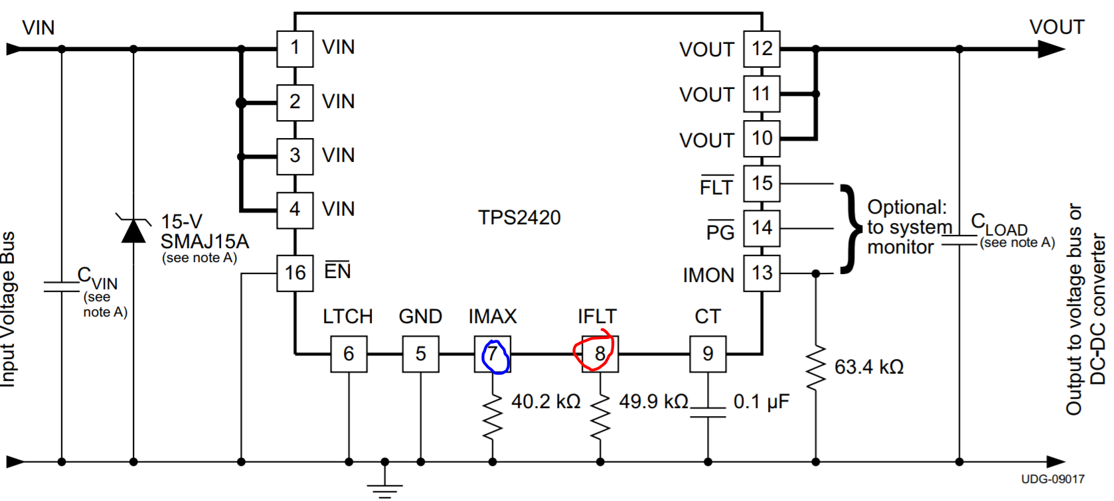
http://www.ti.com/lit/ds/symlink/tps2420.pdf

Slide 14
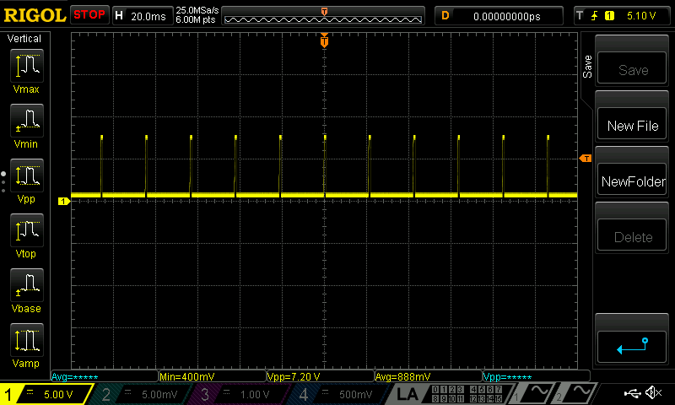
Notes:
How swap trying to turn on, load is over 1 A
Either this or the video of 1A bench test with explanation why the output is not the way it is

Slide 15
Video Presentation
https://www.youtube.com/watch?v=s7VJ30dT8L0

Slide 16
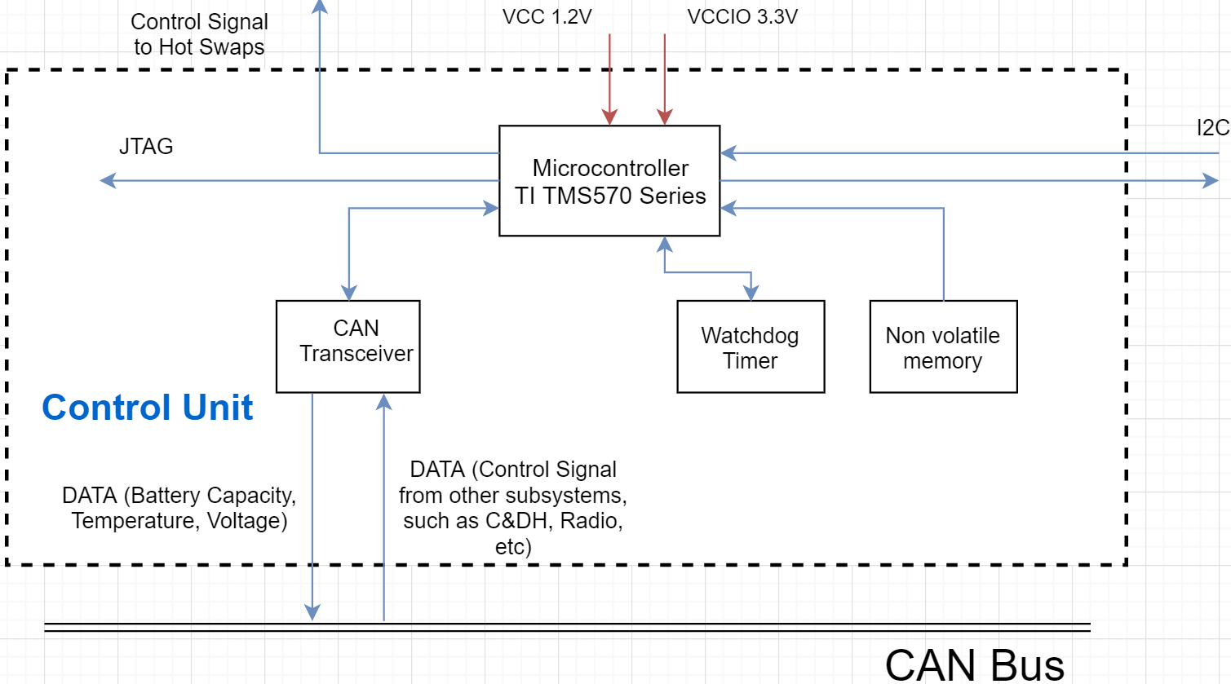
Control Unit

Slide 17
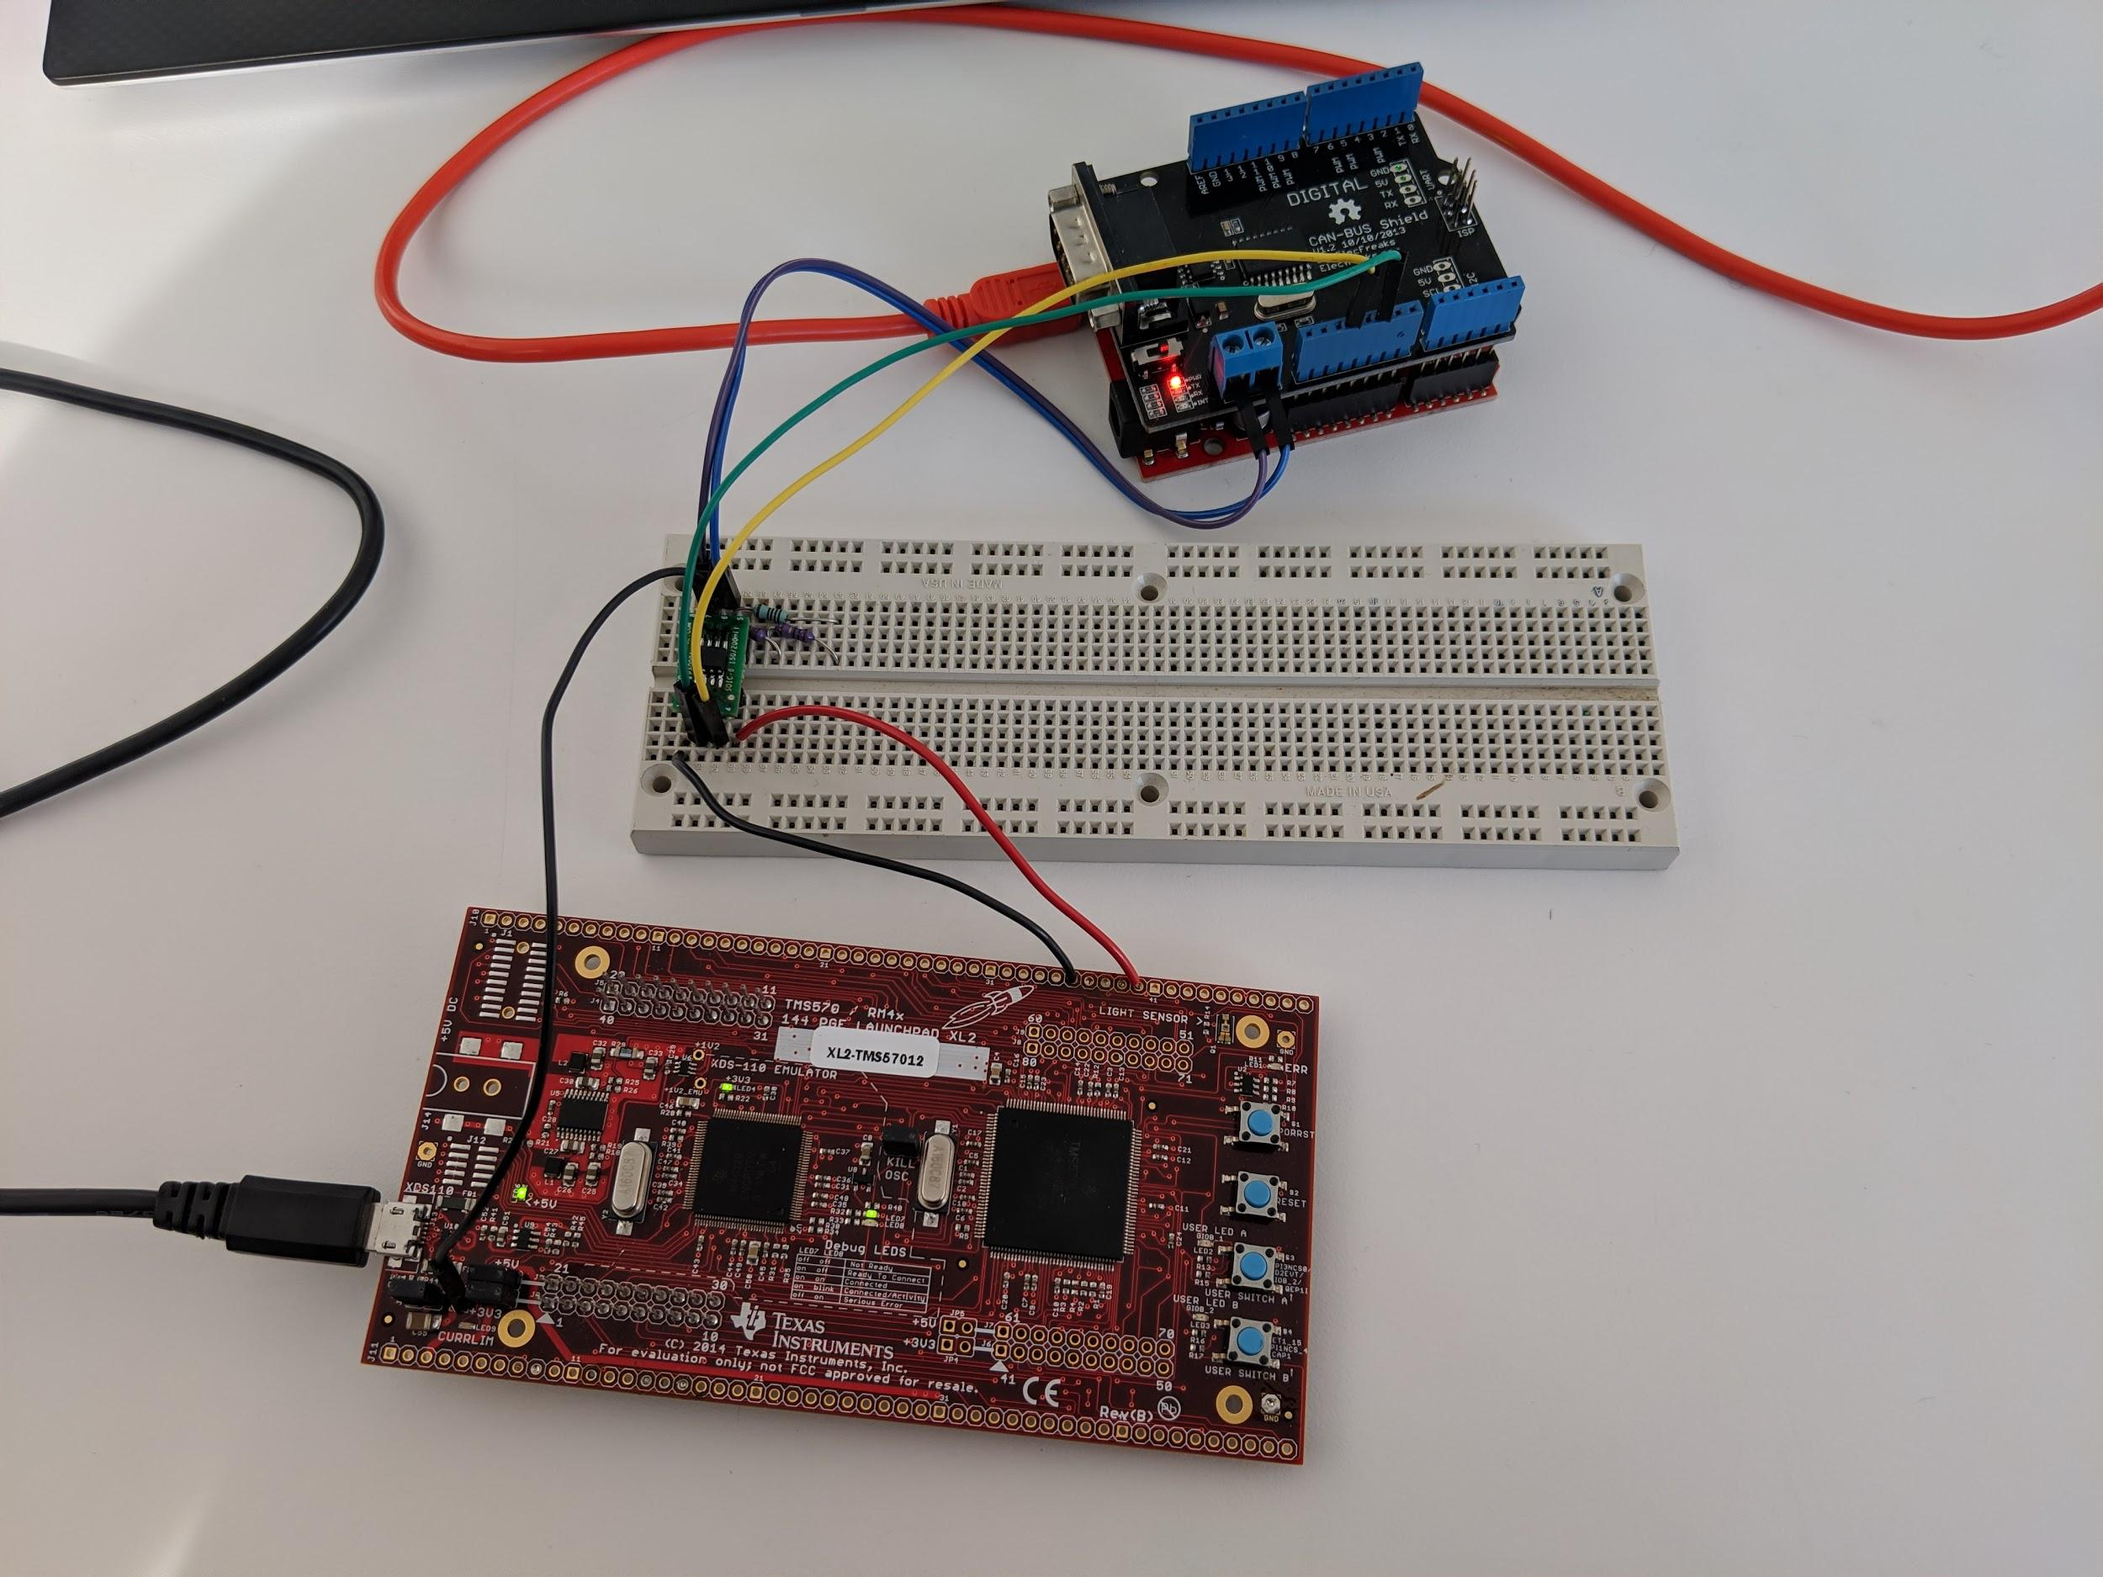
CAN Transceiver
Requirement:
Must be able to encode and decode data packets on CAN bus
Notes:
say where is the microcontroller where is the can transceiver and where is the can bus

Slide 18
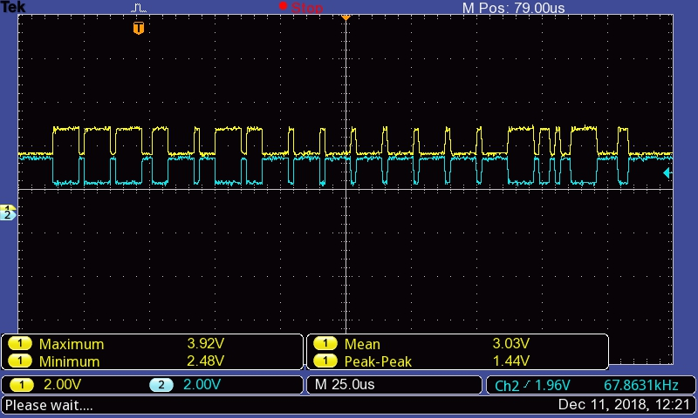
CAN Transceiver
Header
DATA
Checksum
and ACK

Slide 19
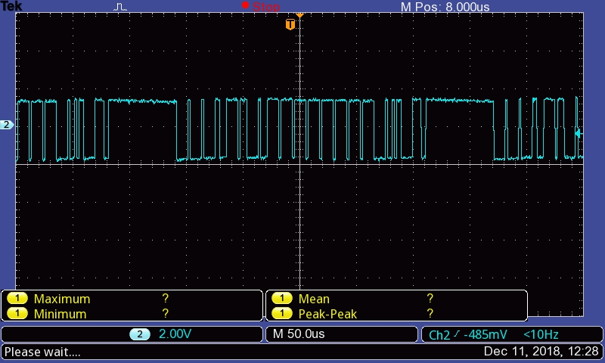
CAN Transceiver
Header
DATA
Checksum
and ACK

Slide 20
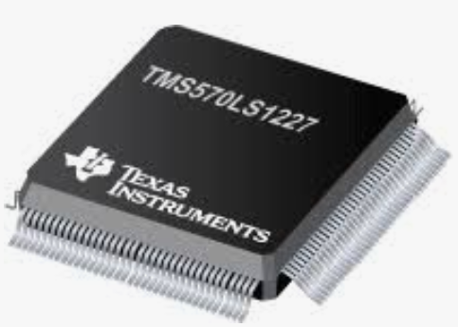
Microcontroller
Requirements:
Must be able to send and receive data packets on Controller Area Network (CAN) bus
Must be able to communicate using Inter-Integrated Circuit (I2C) communication
Must be able to control hot swap controllers using signals from General Purpose Input/Output (GPIO pins)

Slide 21
Microcontroller
The microcontroller failed to transmitting data blocks using I2C and CAN communication. The communication are established but the data was never transmitted/received
GPIO successfully control the hot swap controllers
Notes:
Engineering explanation why the I2C and CAN failed. The lower level data packets are handled by Serial Peripheral interface(SPI) on the microcontroller side which could not recognize the data block. One possibility is that the clock is not synchronized. Another possibility is that the data length in our I2C or CAN communication exceeds the SPI’s data length

Slide 22
External Non-Volatile Memory
Requirement
Must be able to load program into microcontroller during startup
Notes:
Why FRAM? low power consumption, is not affected by magnetic-fields and is radiation resistant

Slide 23
External Non-Volatile Memory
Using microcontroller internal memory
The difficulty of implementation versus necessity

Slide 24
Watchdog Timer
Requirements
Reset the microcontroller when timer expires
Sends a reset signal to nRST pin on the microcontroller after the timer expires
Notes:
Why we need watchdog? When satellite operating in outer space, no human interference.

Slide 25
Watchdog Timer
Successfully reset the program when the timer expires
Reset signal send to the nRST pin
Verified by setting expiration time
Notes:
Development board nrst led lights up to indicate microcontroller performed reboot

Slide 26
RS422-Port
RS422-port uses SCI serial communication. The SCI communication is not sufficient for debugging
JTAG is required to establish debugging functionality between a PC and microcontroller
Notes:
SCI can transmits data between PC. It could not read microcontroller register or address’s values and transmitting it to PC

Slide 27
Conclusion and Future Work
One of the buck converters efficiency and power output range is sufficient, the other is not
Hot swap controller power PCB trace test

Slide 28
Conclusion and Future Work
The communication protocols in control
Fixing the communication protocols
Integrating the external non-volatile memory

Slide 29
Questions

