Slide 1
ECE Senior Design
Group 67 AWIS (Aliased Water Illusion Screen)
Chaoyu Zhou, Yixiong Li, Shan Zhao
May,3 2017
Notes:
ECE Main Slide

Slide 2
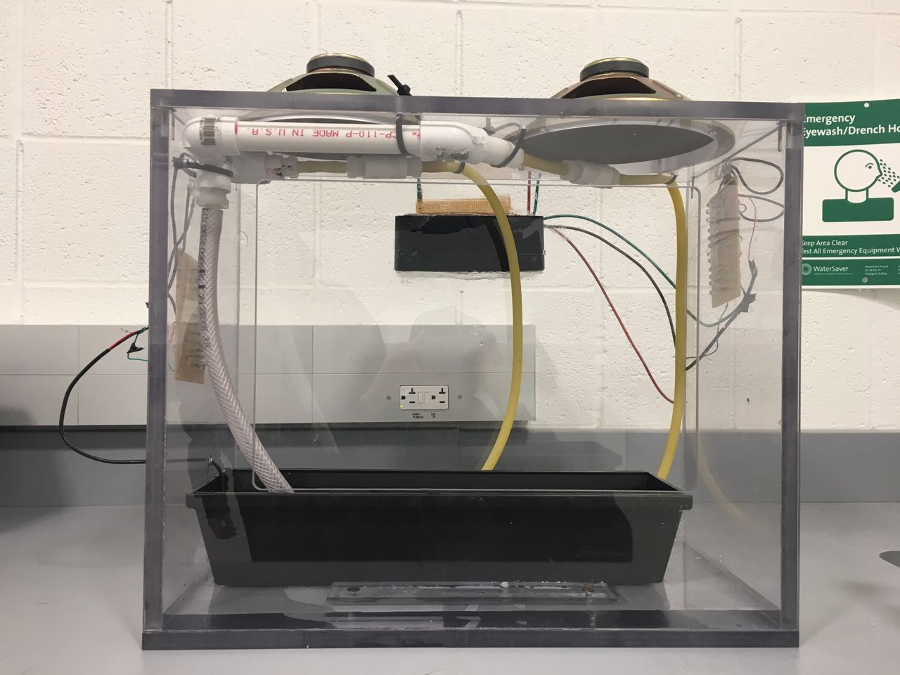
Introduction
Based on the stroboscopic effect
Manipulate frequencies of speaker and strobing light
Illusions: water droplets going up, floating , going down
Speaker
Control Unit
Strobing Light
Water Pump
Figure1: Overall Design
1

Slide 3
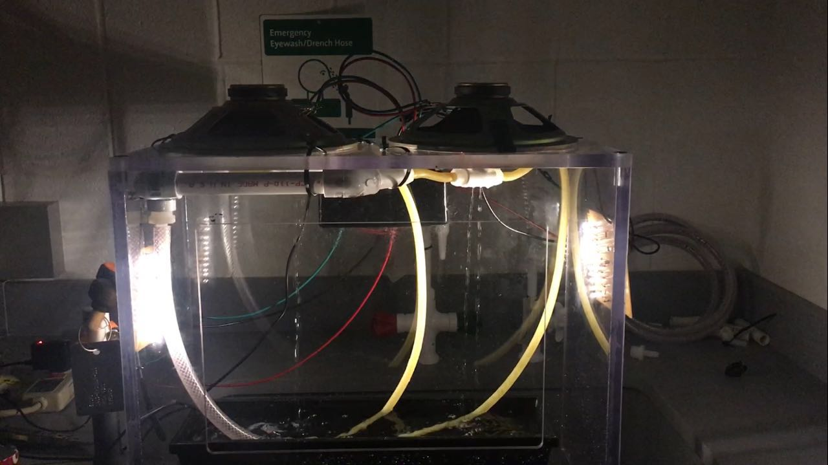
Final Effect
Speaker Vibration
Floating Water Droplets
Figure 2: Design Effect
2

Slide 4
Features
A framework to support water pipes, seal off water vapor from electronic components
Vibration: a group of speakers located at top of the box
Light: one set of strobing light on one side of the box
Water recycle: water pump
3

Slide 5
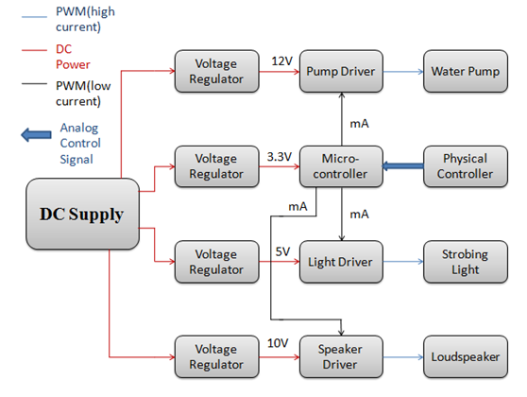
System Diagram
Figure 3. block diagram
4

Slide 6
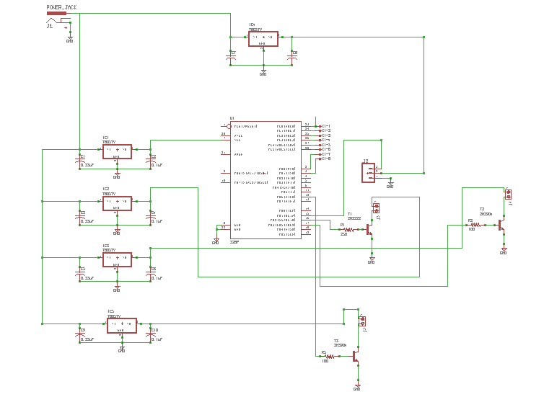
Processing Schematic
5
Figure 4. overall schematic

Slide 7
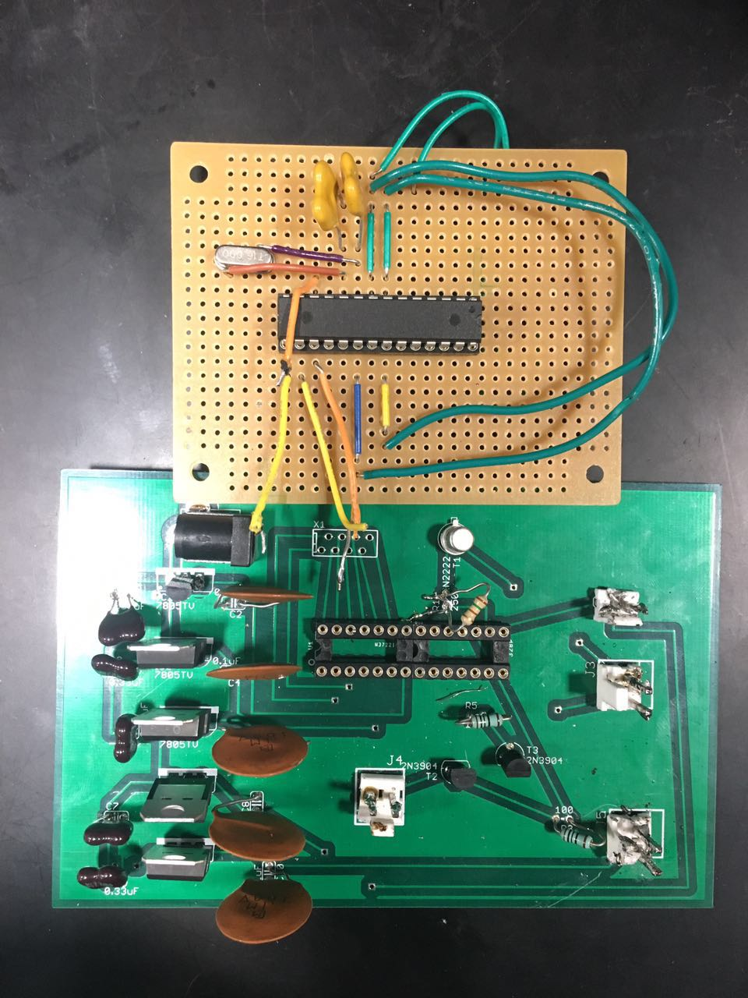
PCB Design
Power Jack
Voltage Regulator
MCU
Speaker Driver
Water Pump
Figure 4. pcb
Strobing Light
6

Slide 8
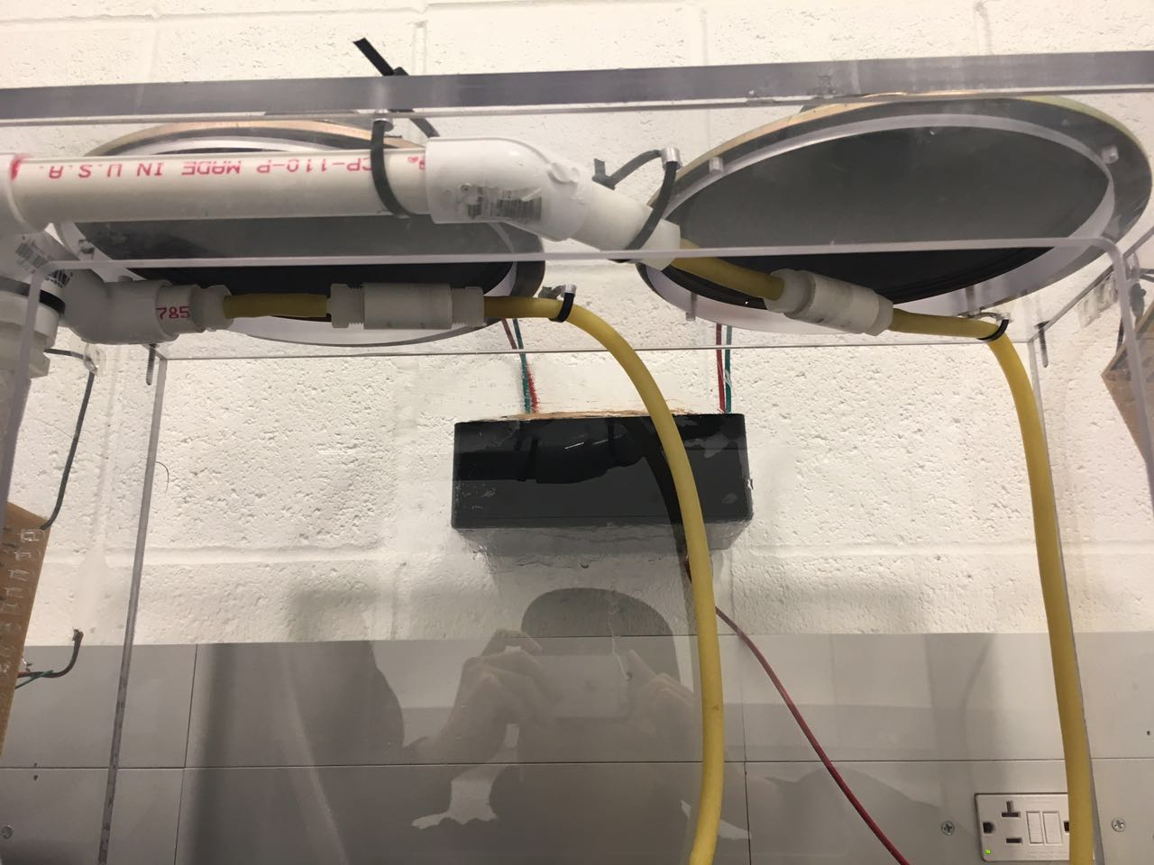
Water Unit
Figure 5. water unit
7

Slide 9
Hardware Overview:
Speakers/Speaker Drivers
Pump
Strobing lights/Lights drivers
MCU (Atmega328)
8

Slide 10
Strobing Light
Two sets of strobing light
Employ driver to amplify PWM(Pulse Width Modulation) input from MCU(micro-controller)
Maximum current : 0.24A
Require 5V from power supply
9

Slide 11
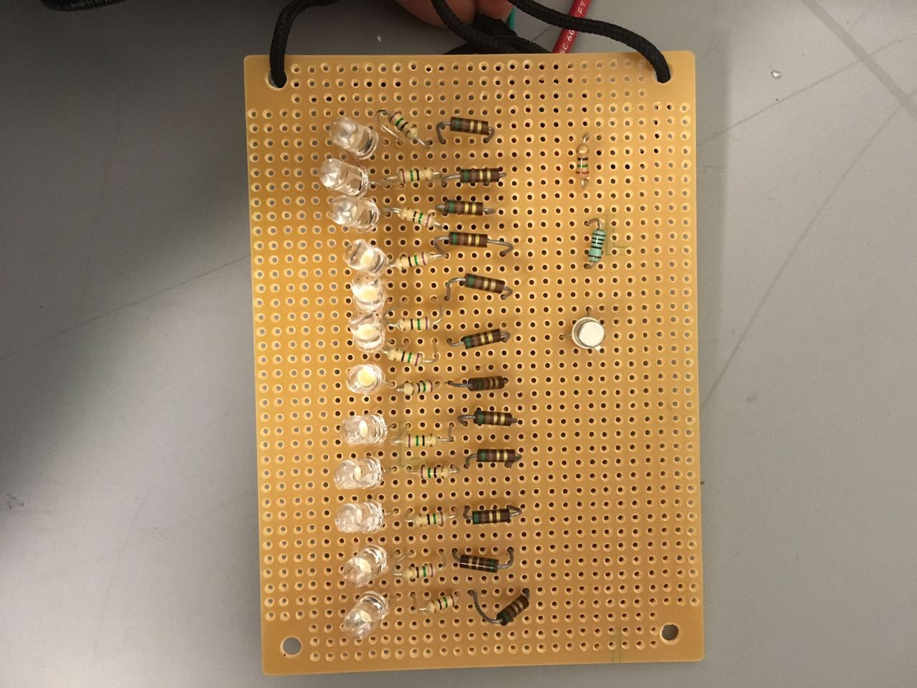
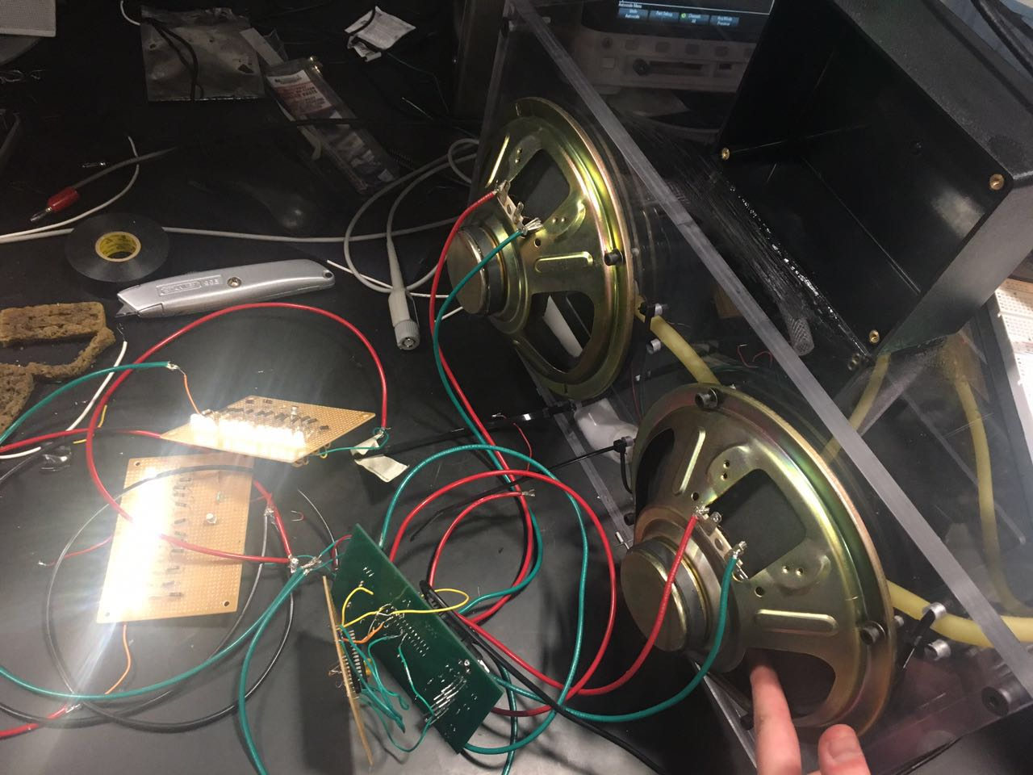
Strobing Light
Figure 6 .Strobing Light Effect
10

Slide 12
Strobing Light (schematic)
Figure 7. schematic of strobing light
11

Slide 13
LTSPICE
Figure 8. waveform of amplified current in strobing light circuit
12

Slide 14
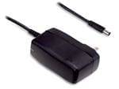
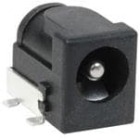
Power Supply:
120 to12 Volts power adapter
Power jack
Regulators ( 5V, 10V, 12V)
Figure 9. Power Adapter
Figure 10. Power Jack
13

Slide 15
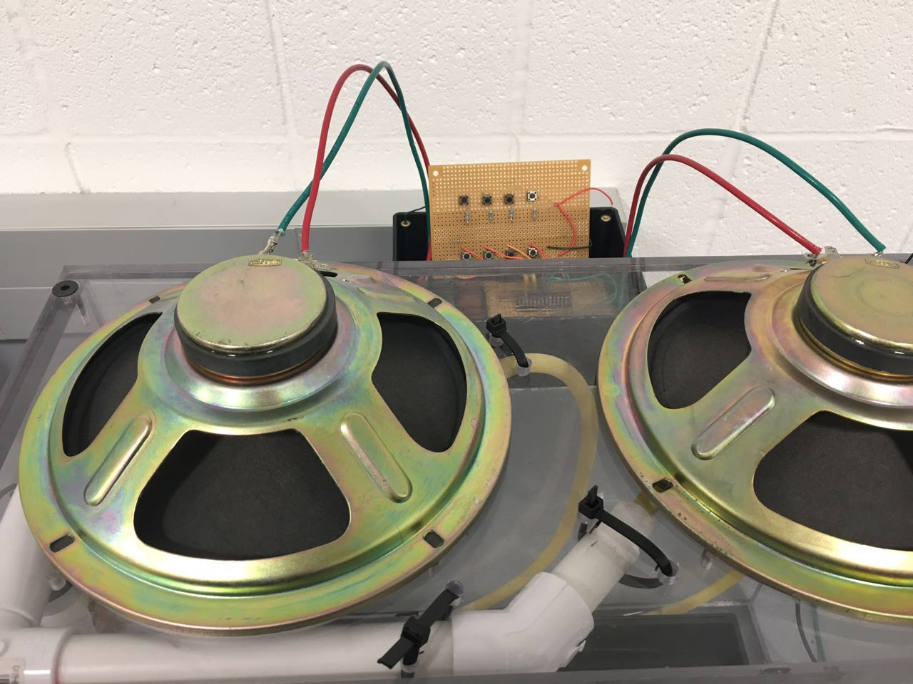
Speaker
Figure 11. Speaker
14

Slide 16
Speakers
Full Range Paper Cone
Amplify PWM input from MCU
Maximum current : 0.3A
Require 10V from power supply
15

Slide 17
LTSPICE
Figure 12. waveform of amplified current running through speaker
16

Slide 18
Microcontroller
Use Atmega328 to output PWM to strobing light, speaker and water pump drivers
Provide PWM with proper frequencies and proper duty cycle square wave
Connected with physical controller to provide User Interaction.
17

Slide 19
Software Overview
Consists of an input segment and an output segment
Both segments are ran every cycle.
At the end of each cycle, the code asks the MCU to stay idle for 100 microseconds
18

Slide 20
Future Hardware Development
Current Limitations:
1.Unable to create droplets with the corresponding frequency
2.The water tank is too small.
3.If possible, eliminate noise
19

Slide 21
Future Hardware Development
1.Droplets Generating
Re-use the frame, cabinet, water pump.
Replace the suspension system with a softer tubing.
Attach the end of the tubing and press it against the speaker
Replace the current speaker with one with larger vertical displacement available .
20

Slide 22
Future Hardware Development
2. Tank improvement
Remove the current water tank.
Seal between the edge of the PVC cabinet walls
Implement a hole to get water out
Use the bottom of the cabinet as the new water reservoir
21

Slide 23
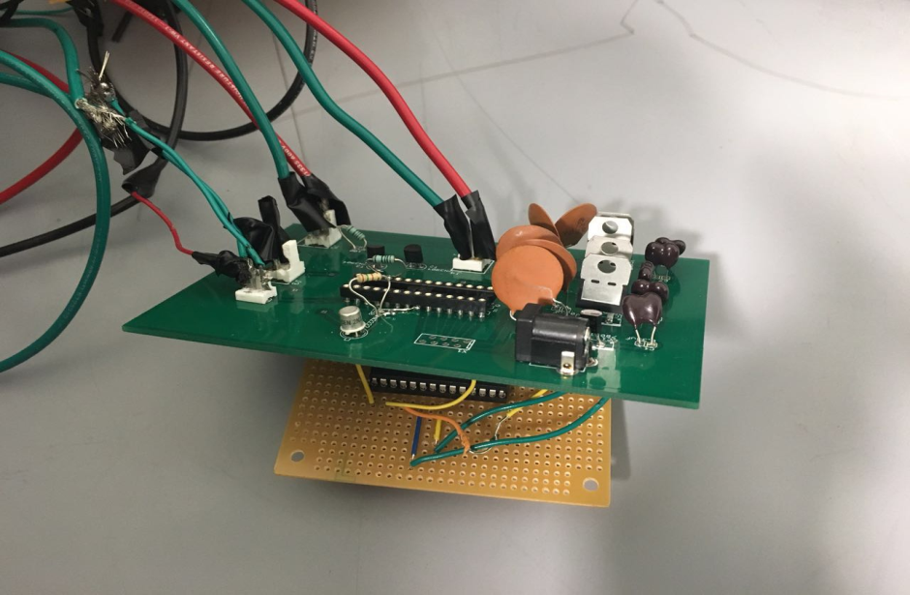
Future Software Development
Current Limitations:
Limited by the physical connection between the controller and the device
Only certain frequencies and duty cycles can be chosen
Need a more intuitive way to debug
Figure 13. messy connection
22

Slide 24
Credits
Professor Karl Reinhard
Prof. Michael Oelze
Luke Wendt
Jackson Lenz
Kexin Hui
Machine Shop
Electronic Shop
23

Slide 25
Thank You

