Slide 1
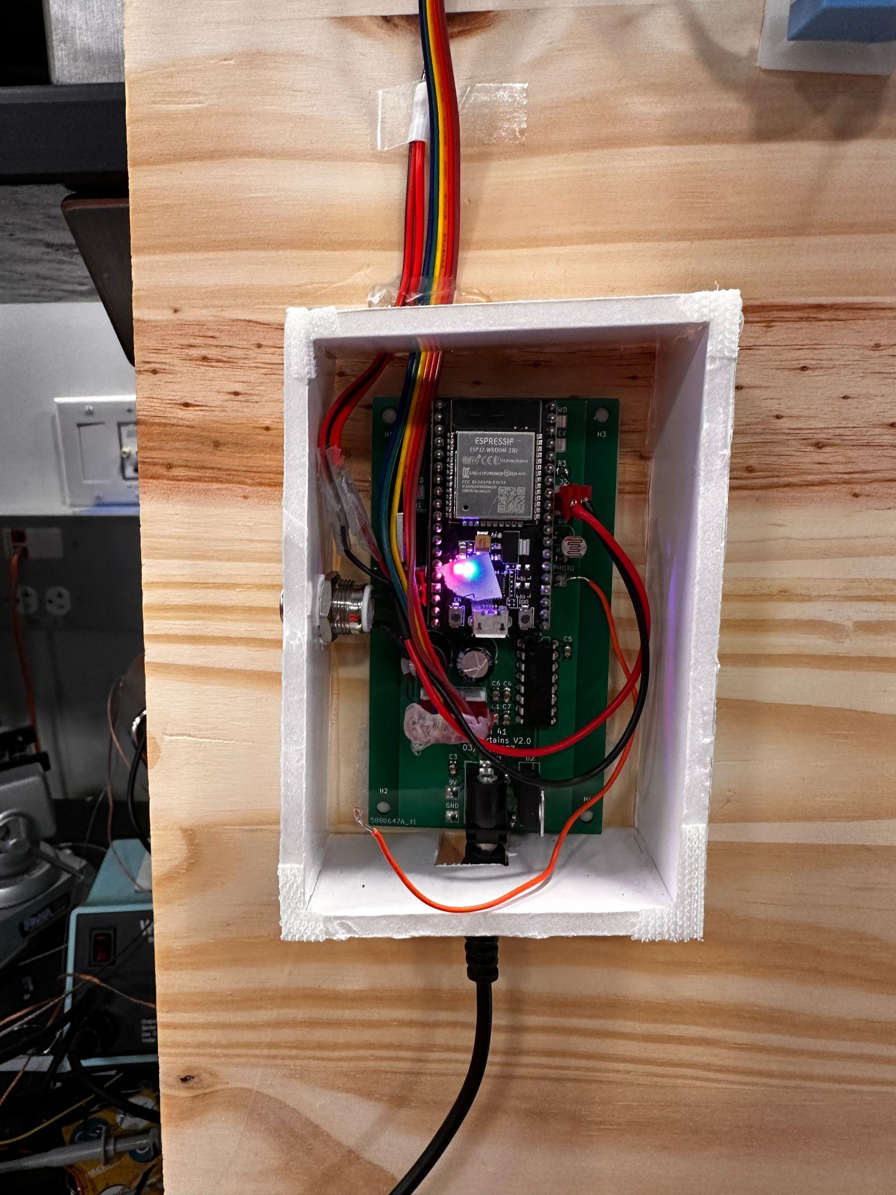
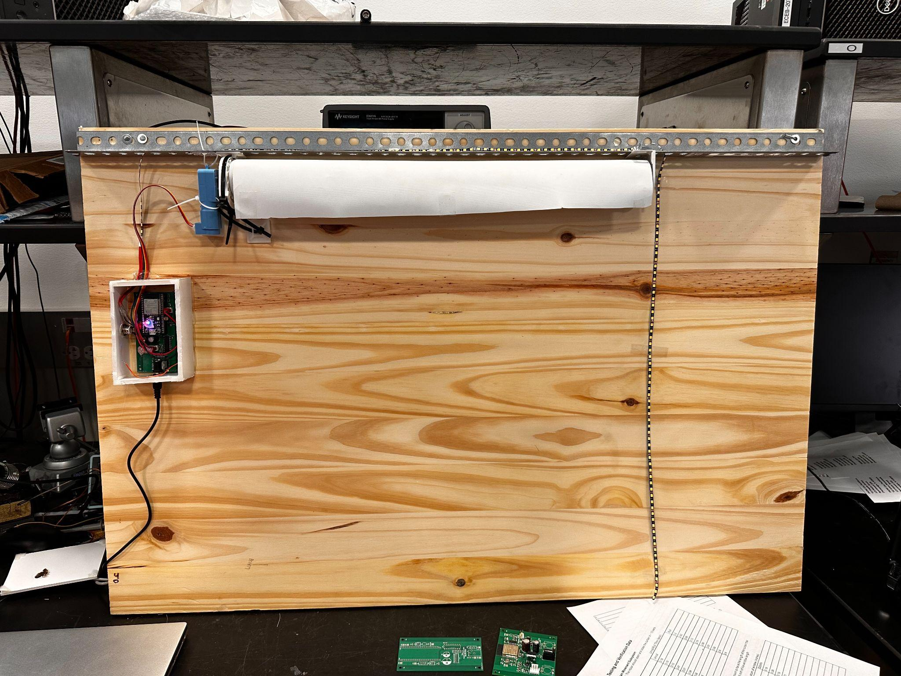
Team 41: Smart Curtains
Jack Davenport, Vinay Konda, Max Mauschbaugh
Notes:
All

Slide 2
Objective:
Able to open and close curtains in less than 10 seconds using the manual button on the device.
The curtain system works based on the user’s settings set from their smartphone.
Our LED strip reacts and illuminates a room above 650 lumens when the photoresistor level is lower than our decided threshold value.
Notes:
Jack

Slide 3
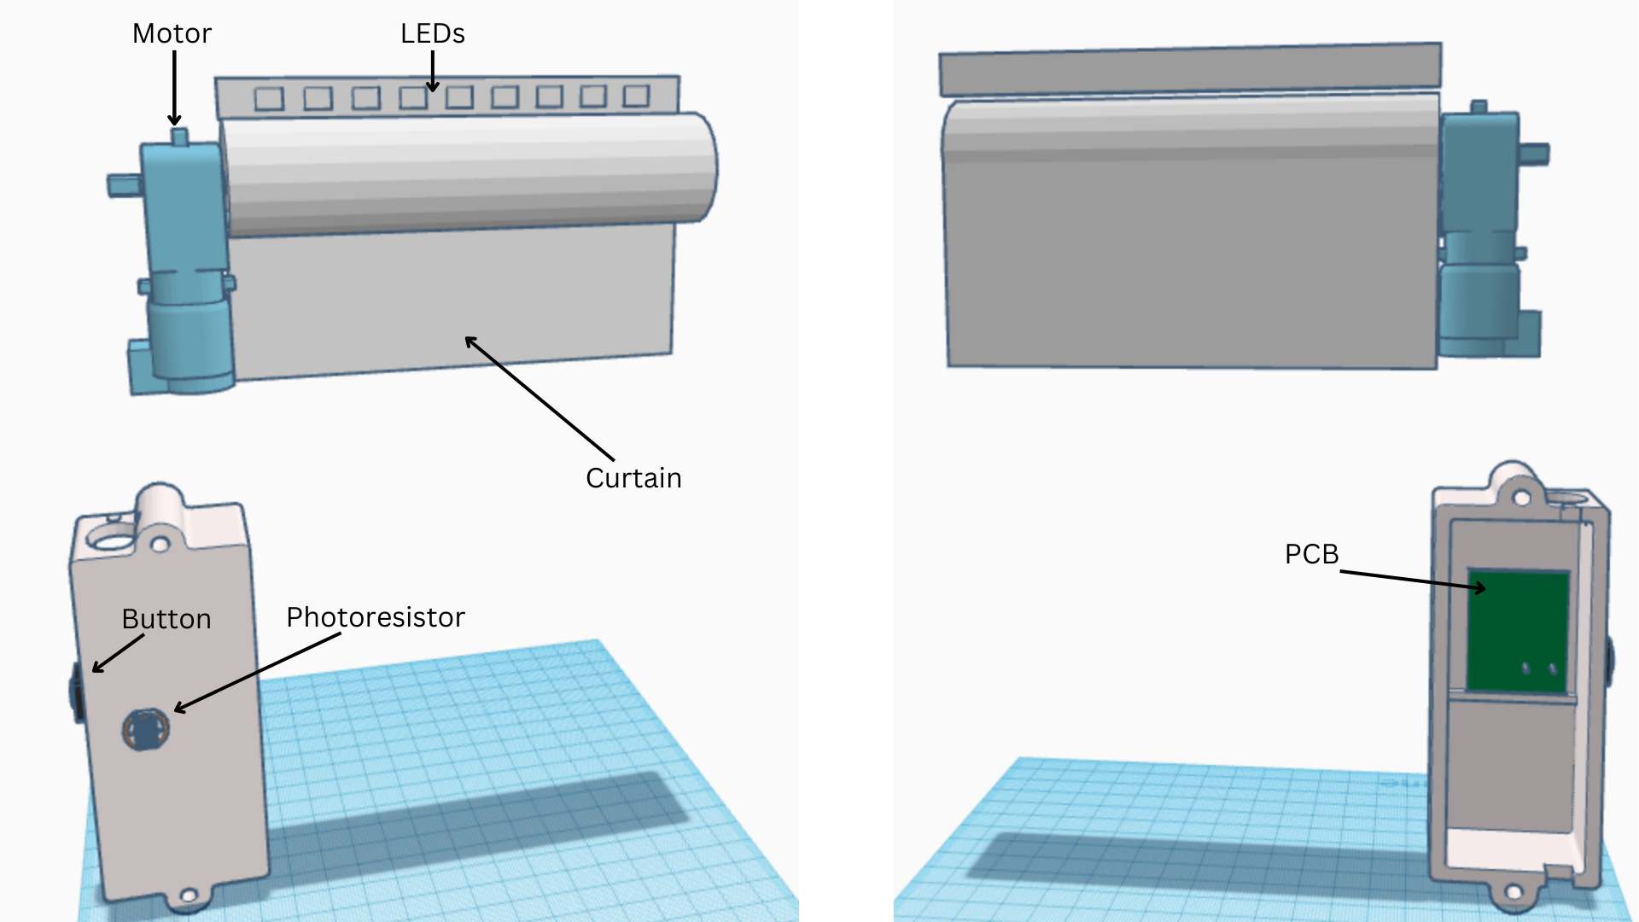
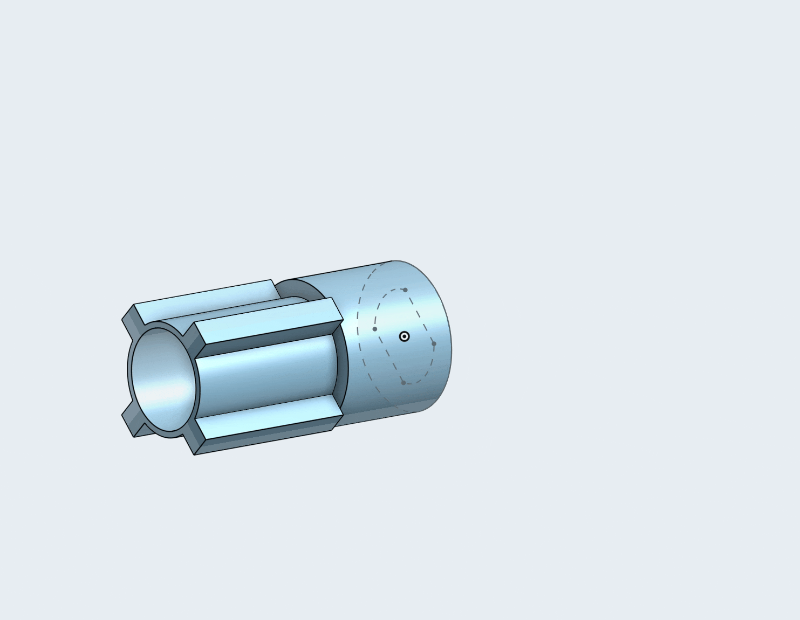
3D Model
Notes:
Vinay

Slide 4
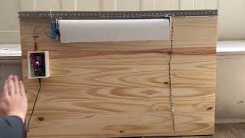
Notes:
Max

Slide 5
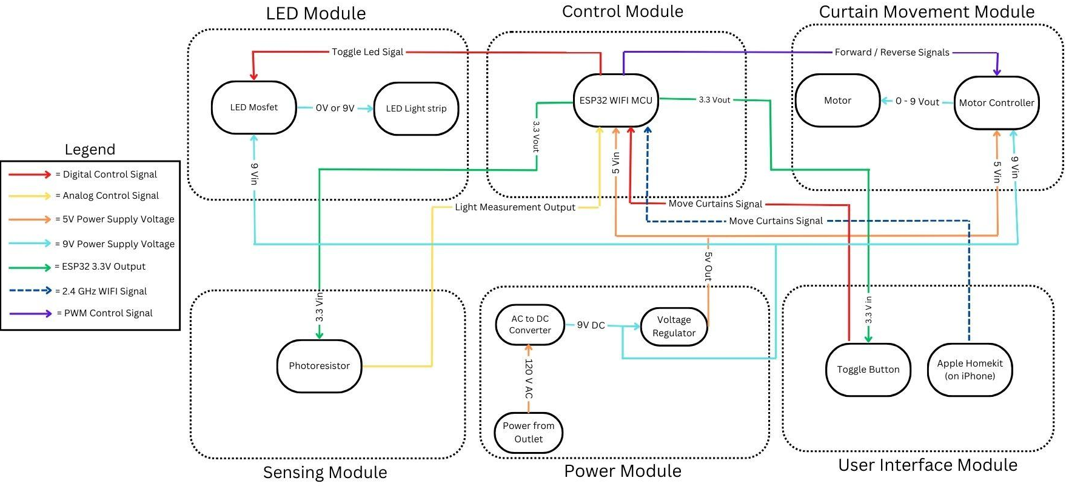
Block Diagram
Notes:
Vinay

Slide 6
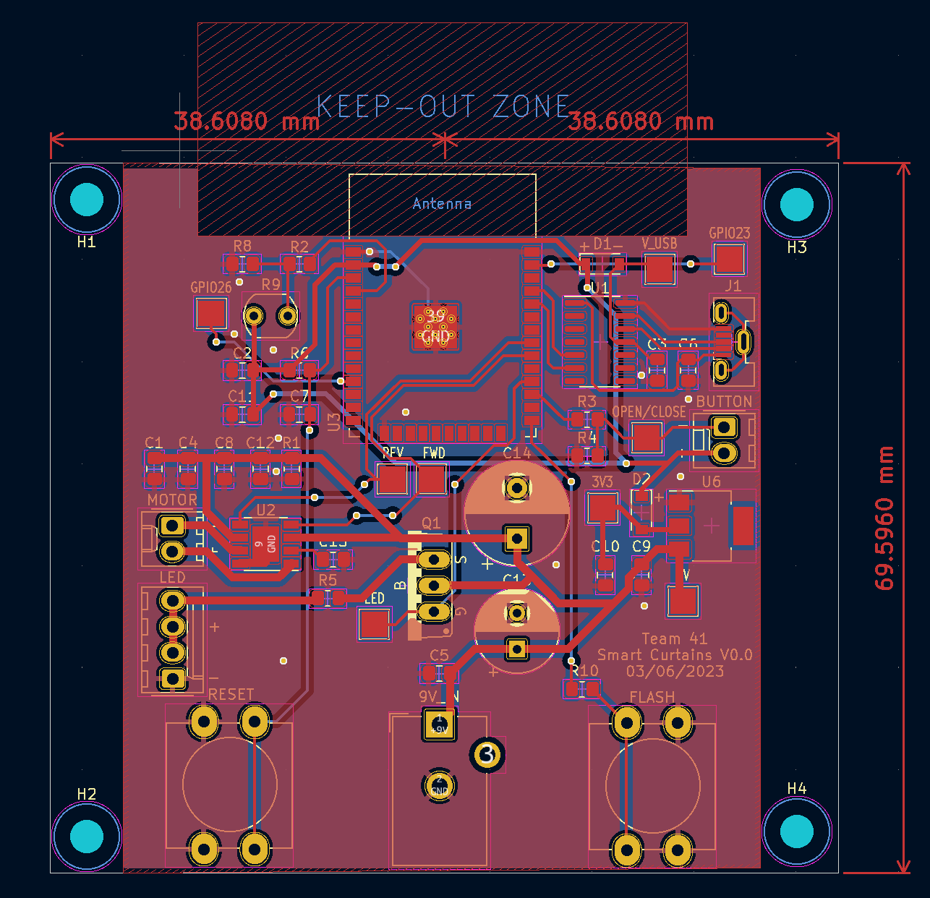
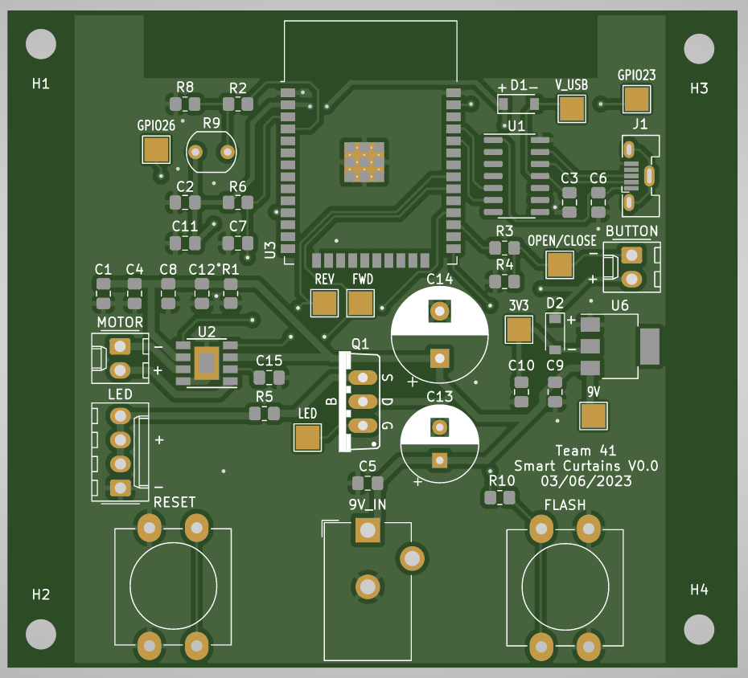
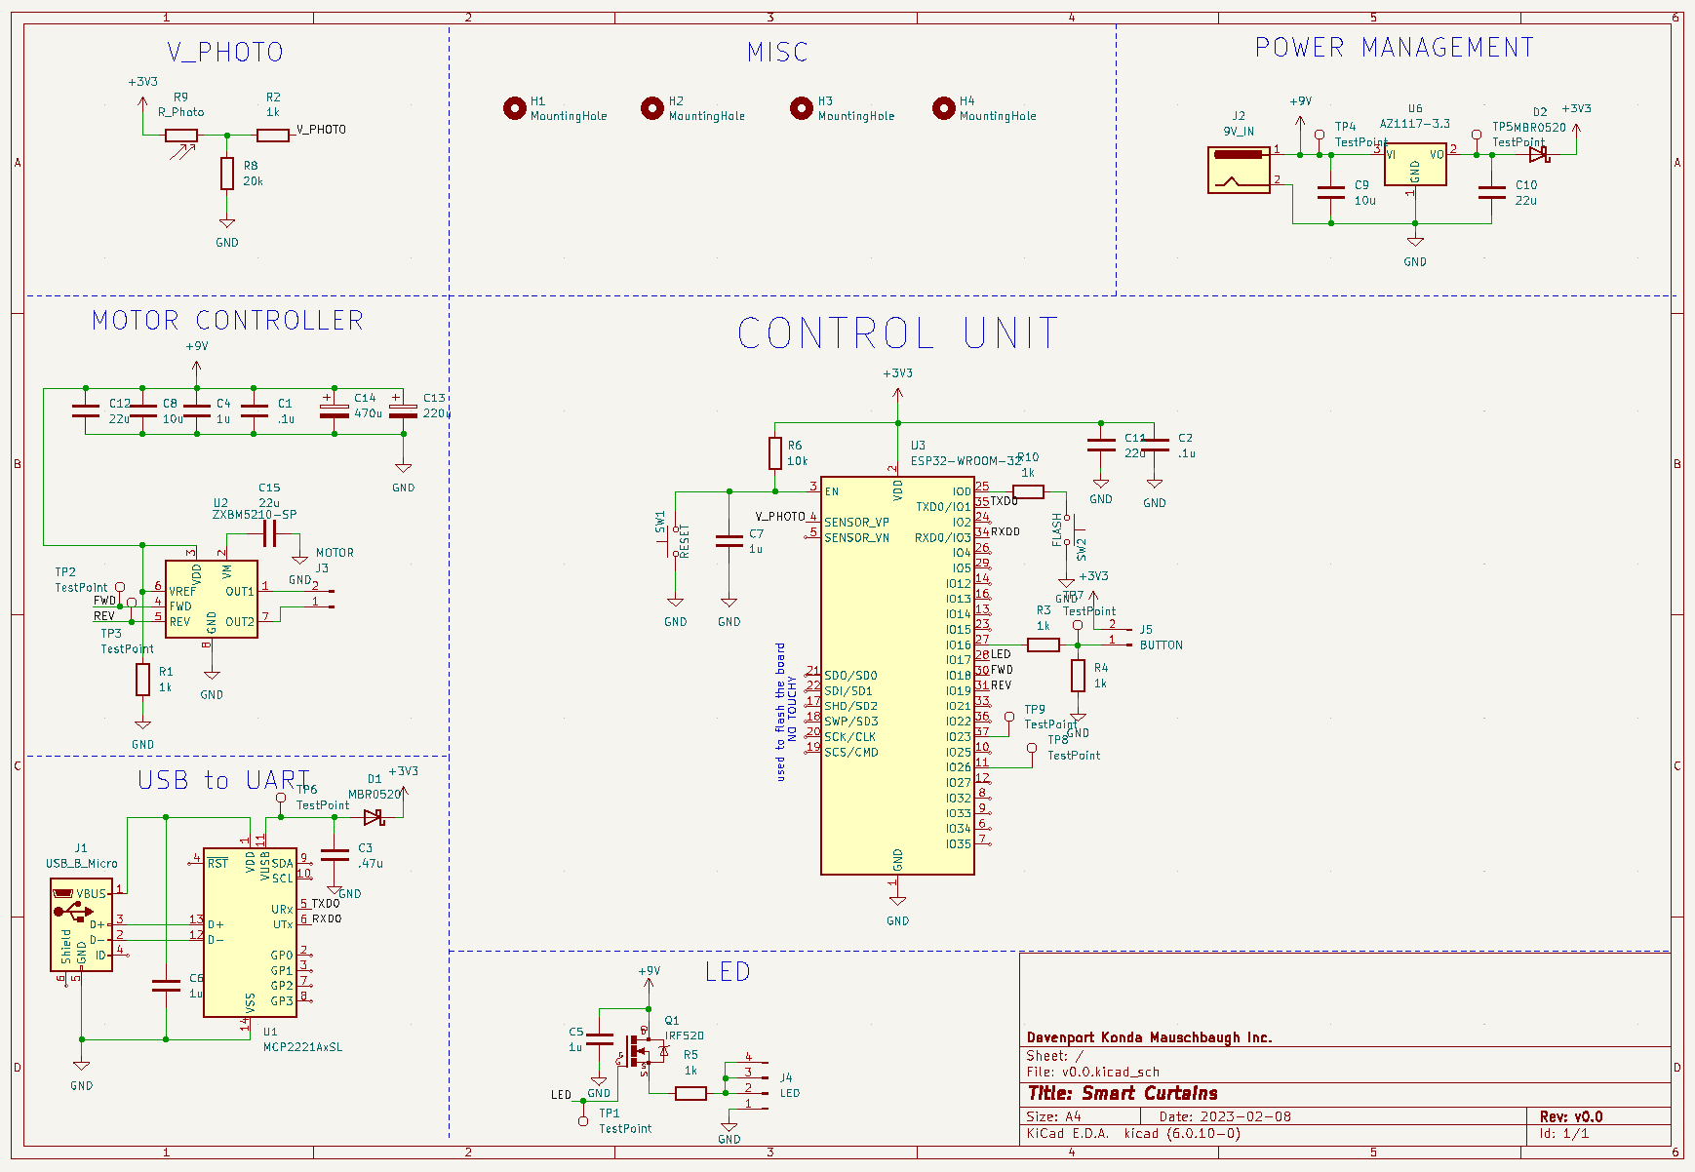
Initial Hardware Design
Notes:
Jack

Slide 7
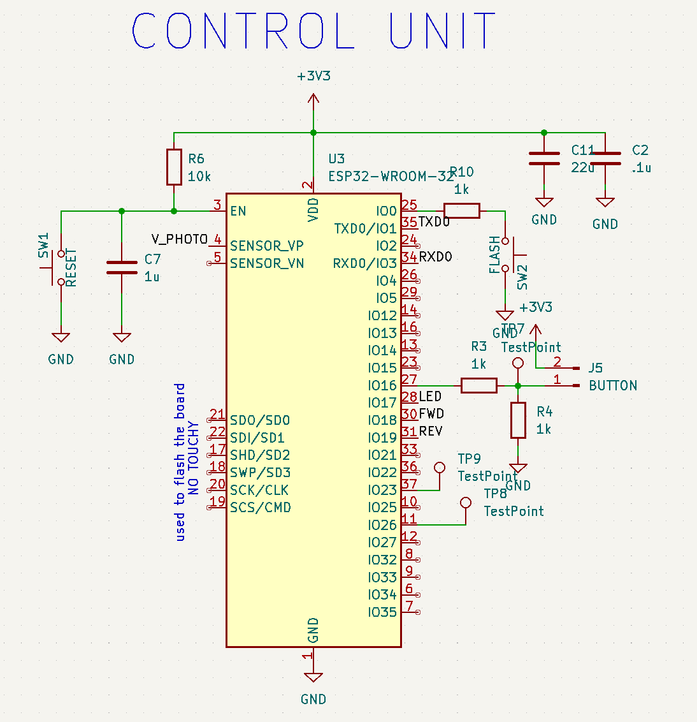
Control Unit
Problems
Soldering
Burnt ESP32s
Solutions
Development Board
Notes:
Max

Slide 8
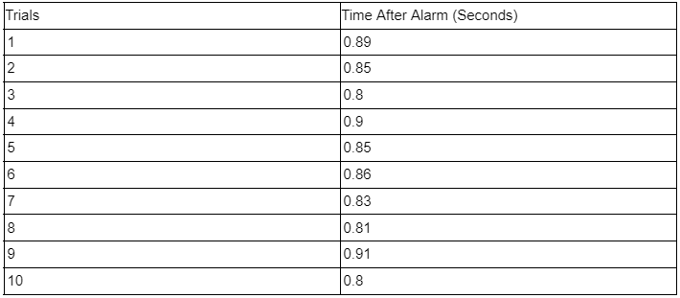
Control Unit R&V Part 1
Requirements
ESP32 reacts to alarm within 1 second to raise curtain
Results
Notes:
Max

Slide 9
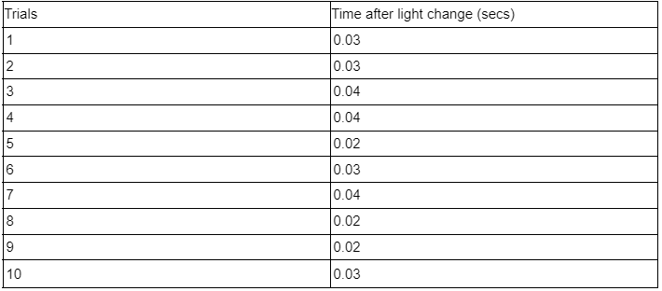
Control Unit R&V Part 2
Requirements
The PCB should accurately receive data from the light sensors and dim/brighten the LED strip accordingly within 1 sec.
Results
Notes:
Max

Slide 10
Control Unit R&V Part 3
Requirements
The PCB should handle manual button presses appropriately based on the state of the curtain
Results
Notes:
Max

Slide 11
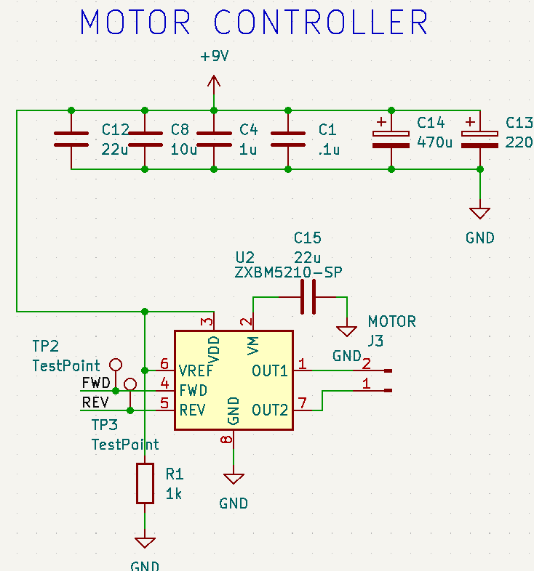
Motor Controller
Problems
V_{DD} vs. V_{M}
Choosing a controller
Solutions
L7293D
Notes:
Jack

Slide 12
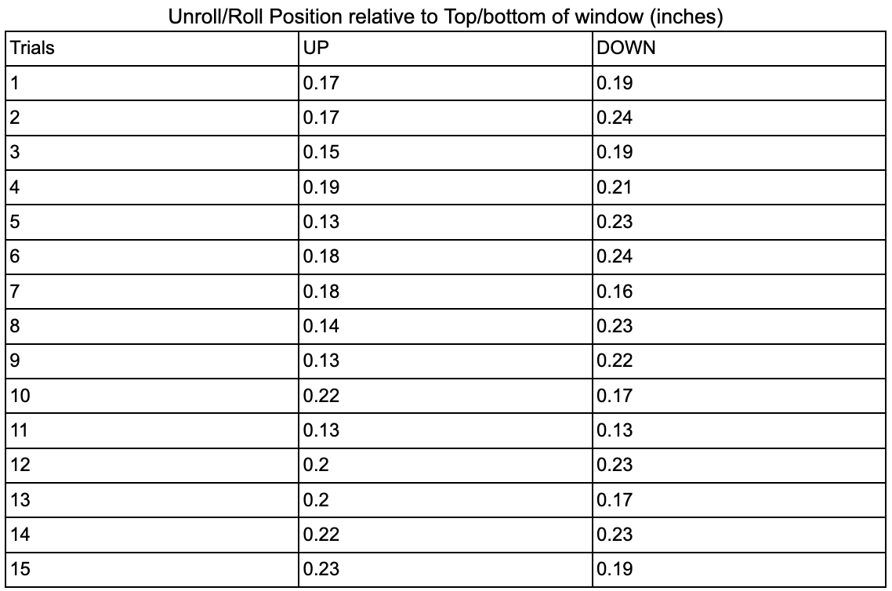
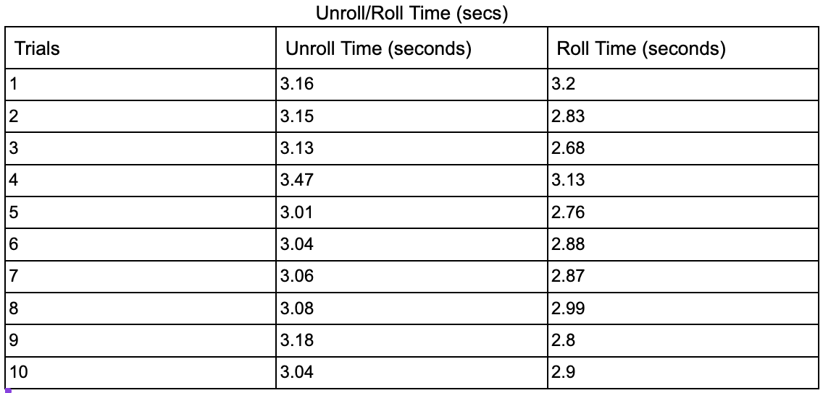
Motor Controller R&V
Requirements
Roll/unroll within 10 seconds
Accurately roll/unroll within 0.5 inch
Results
Notes:
Jack

Slide 13
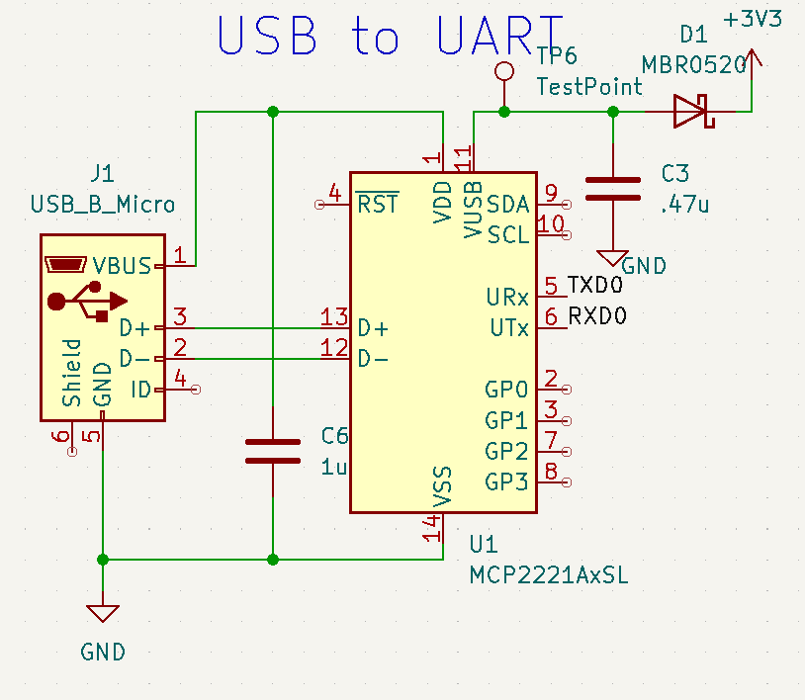
Programmer
Problems
USB backwards on PCB
Soldering issues
Solutions
Development board
Notes:
Vinay

Slide 14
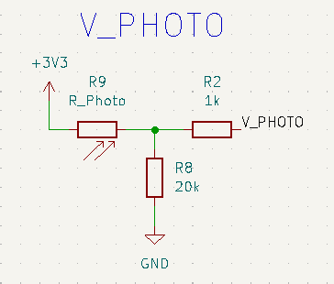
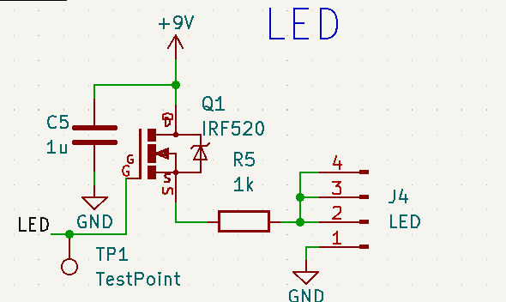
Light Sensing/LEDs
Problems
VDR resistor values
Common Drain vs. Common Source
Solutions
Breadboard
Notes:
Max

Slide 15
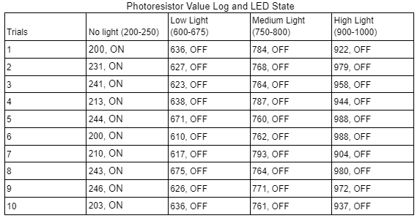
Light Sensing/LEDs R&V
Requirements
Read light intensity (0 to 1023)
Activate LEDs depending on threshold
600 lumens
Results
9 V / 12 V * 2400 lm = 1800 lm
Notes:
Max

Slide 16
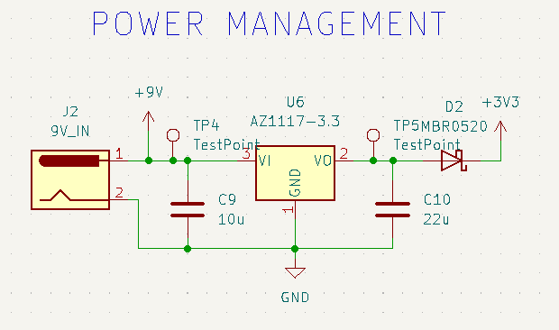
Power Management
Problems
Wrong KiCad footprint
Heat
Solutions
L7805CV
Notes:
Jack

Slide 17
Power Management R&V
Requirements
600 mA absolute maximum
Stable 5 V
Results
Notes:
Jack

Slide 18
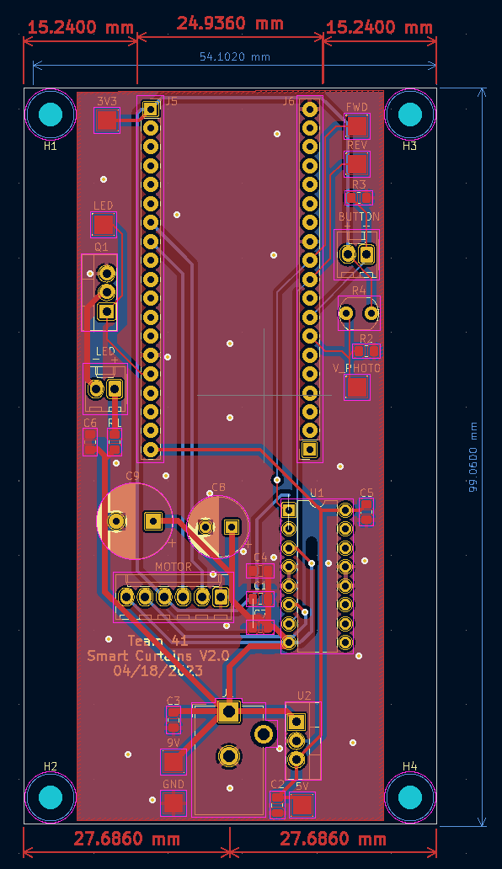
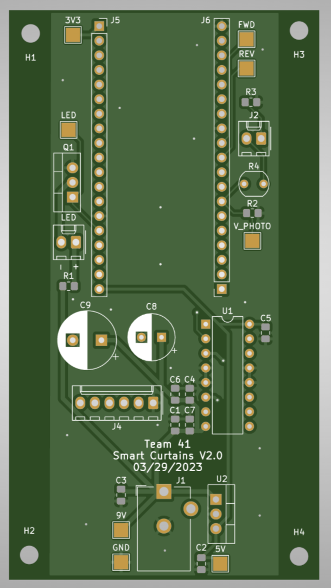
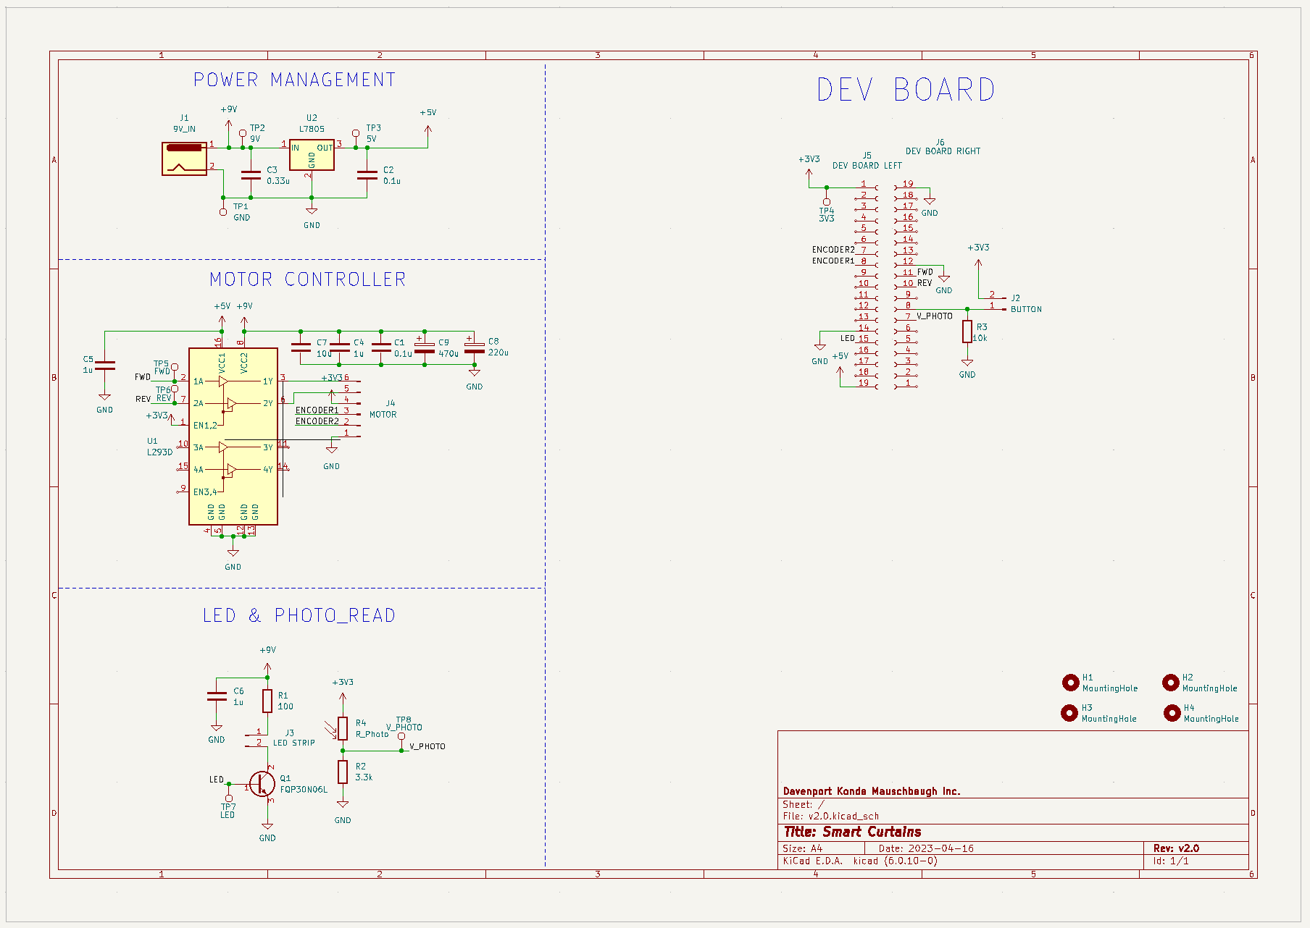
Final Hardware Design
Notes:
Jack (brief)

Slide 19
Software Design
-ESP32 with Arduino IDE
-Apple HomeKit (ESPHap)
-PWM
-Analog to Digital Converter
Notes:
Max

Slide 20
What we learned
Breadboard first
Order extras
Caution with ESP32
Notes:
Vinay

Slide 21
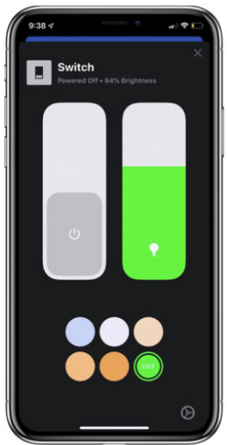
Next Steps
V3.0
9V to 12V
Stronger motor
ESP protection
User specified LED threshold
Variable LED brightness
Notes:
Jack

Slide 22
Conclusion
Thank you for listening, any questions?
Notes:
Vinay

