Slide 1
Quantum Entanglement Educational Device
Andrew Situ, Benjamin Kassel, and Ian Skirkey
Team 24

Slide 2
Introduction
What is our project?
Currently no commercially available device to help illustrate quantum entanglement
Sponsored project by Professor Kwiat from the physics department
A physical representation of quantum entanglement for educational purposes
ECE 445: Team 24
GRAINGER ENGINEERING

Slide 3
Introduction
What is Quantum Entanglement?
ECE 445: Team 24
GRAINGER ENGINEERING
Notes:
According to standard quantum theory, particles have no definite states, only relative probabilities of being one thing or another at least until they are measured

Slide 4
Introduction
What is Quantum Entanglement?
ECE 445: Team 24
GRAINGER ENGINEERING
Notes:
When two particles interact, they can become “entangled,” shedding their individual probabilities and becoming components of a more complicated probability function that describes both particles together.
The more complicated probability is not affected by the distance between the two entangled particles

Slide 5
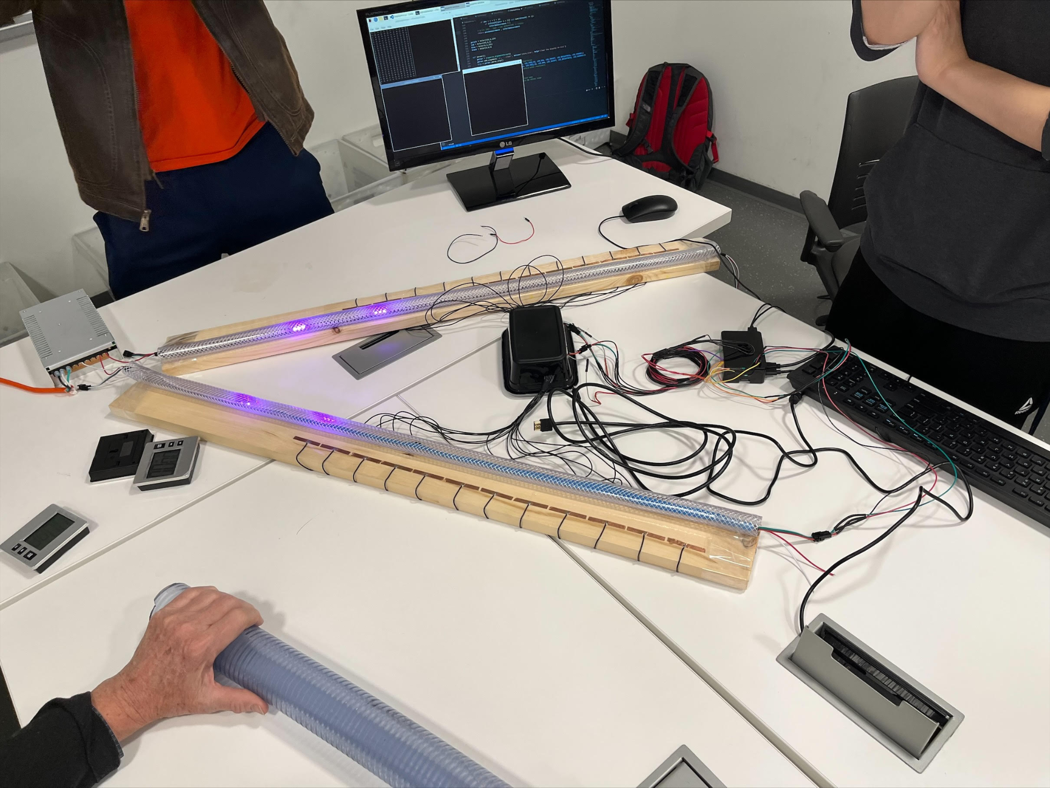
Problem Statement and Proposed Solution
First Prototype of the Quantum Entanglement Demo Device
ECE 445: Team 24
GRAINGER ENGINEERING

Slide 6
Color Measurement Video Demonstration
Demoing the method of acquiring a color measurement on the prototype
ECE 445: Team 24
GRAINGER ENGINEERING

Slide 7
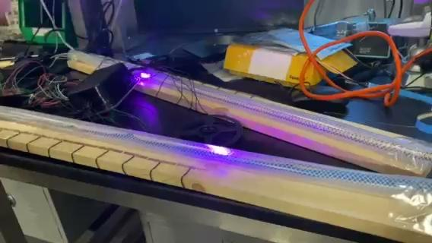
Position Measurement Video Demonstration
Demoing the method of acquiring a position measurement on the prototype
ECE 445: Team 24
GRAINGER ENGINEERING

Slide 8
Original Design
Original Block Diagram
ECE 445: Team 24
GRAINGER ENGINEERING

Slide 9
Design Changes
What changed from our original design?
Went from a microcontroller and Raspi control system to just a Raspi
Removed the cryptography element from the project
Removed the speed adjustment knob
Did not end up needing the voltage regulator
ECE 445: Team 24
GRAINGER ENGINEERING

Slide 10
Requirements & Verification: High Level Requirements
Requirement | Verification
Can be easily assembled and disassembled
Ability to display a user’s measurement onto a monitor
Ability to customize the repetition rate, pulse separation, and hold time
ECE 445: Team 24
GRAINGER ENGINEERING

Slide 11
Requirements & Verification: Input System
Requirement | Verification
The copper touch pads, along with the capacitive sense breakout boards should be able to deliver touch flag data to the microcontroller with at least 97.5% accuracy.
The keyboard should have a latency of < 200ms between the keyboard stroke and the microcontroller. It should be able to send a signal 99% of the time when a key is pressed.
With the knob turned to 100%, the velocity of the lights should move at the full speed of 5 m/s ± 0.1 . When the knob is turned to 0%, the velocity of the lights should move at the minimum speed of 0.1 m/s ± 0.1. With any other setting between 0 and 100% be within 0.1 and 5 /s.
ECE 445: Team 24
GRAINGER ENGINEERING

Slide 12
Requirements & Verification: Control Board System
Requirement | Verification
The resolution of the LED display must be able to display a letter with such a clarity that each letter and number can be easily distinguished from one another from 10 feet away.
The resolution of the LED display must be able to display a letter with such a clarity that each letter and number can be easily distinguished from one another from 10 feet away.
ECE 445: Team 24
GRAINGER ENGINEERING

Slide 13
Requirements & Verification: Output System
Requirement | Verification
A refresh rate of at least 30Hz
The USB interface must be able to deliver keystroke data that matches the input from the user to the microcontroller, dropping less than 5% of the data from the keyboard, or one in every twenty keystrokes.
The microcontroller must be able to output two UART signals to the LEDs
The microcontroller must be able to receive the inputs from two USB keyboards
ECE 445: Team 24
GRAINGER ENGINEERING

Slide 14
Successes
Analysis of the Project’s Successes
Capacitive touch capability
LED Animation
Results display
ECE 445: Team 24
GRAINGER ENGINEERING

Slide 15
Challenges
Analysis of the Project’s Challenges
Keyboard interface
Raspberry Pi and microcontroller intercommunication
Amount of soldering
Capacitive touch limitations
ECE 445: Team 24
GRAINGER ENGINEERING

Slide 16
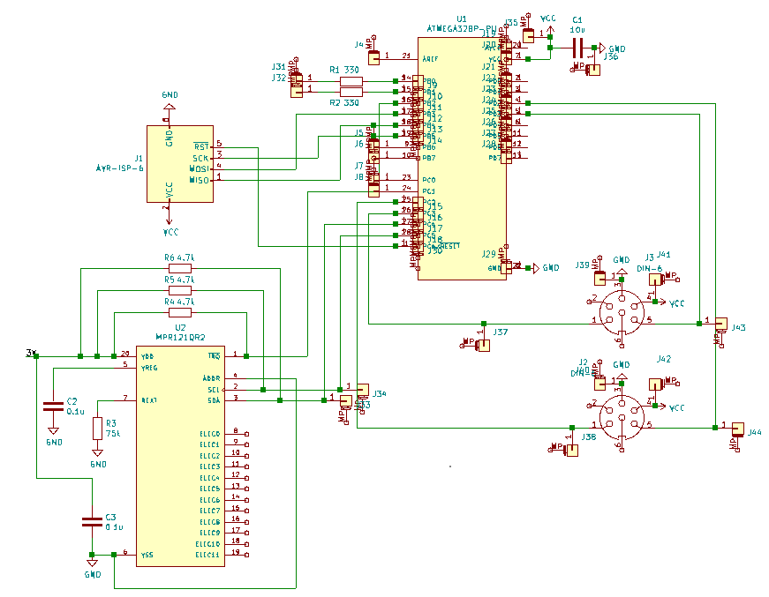
Conclusion
What did we learn?
Project management
Soldering
Microcontroller utilization
PCB design
Basics of quantum entanglement
ECE 445: Team 24
GRAINGER ENGINEERING

Slide 17
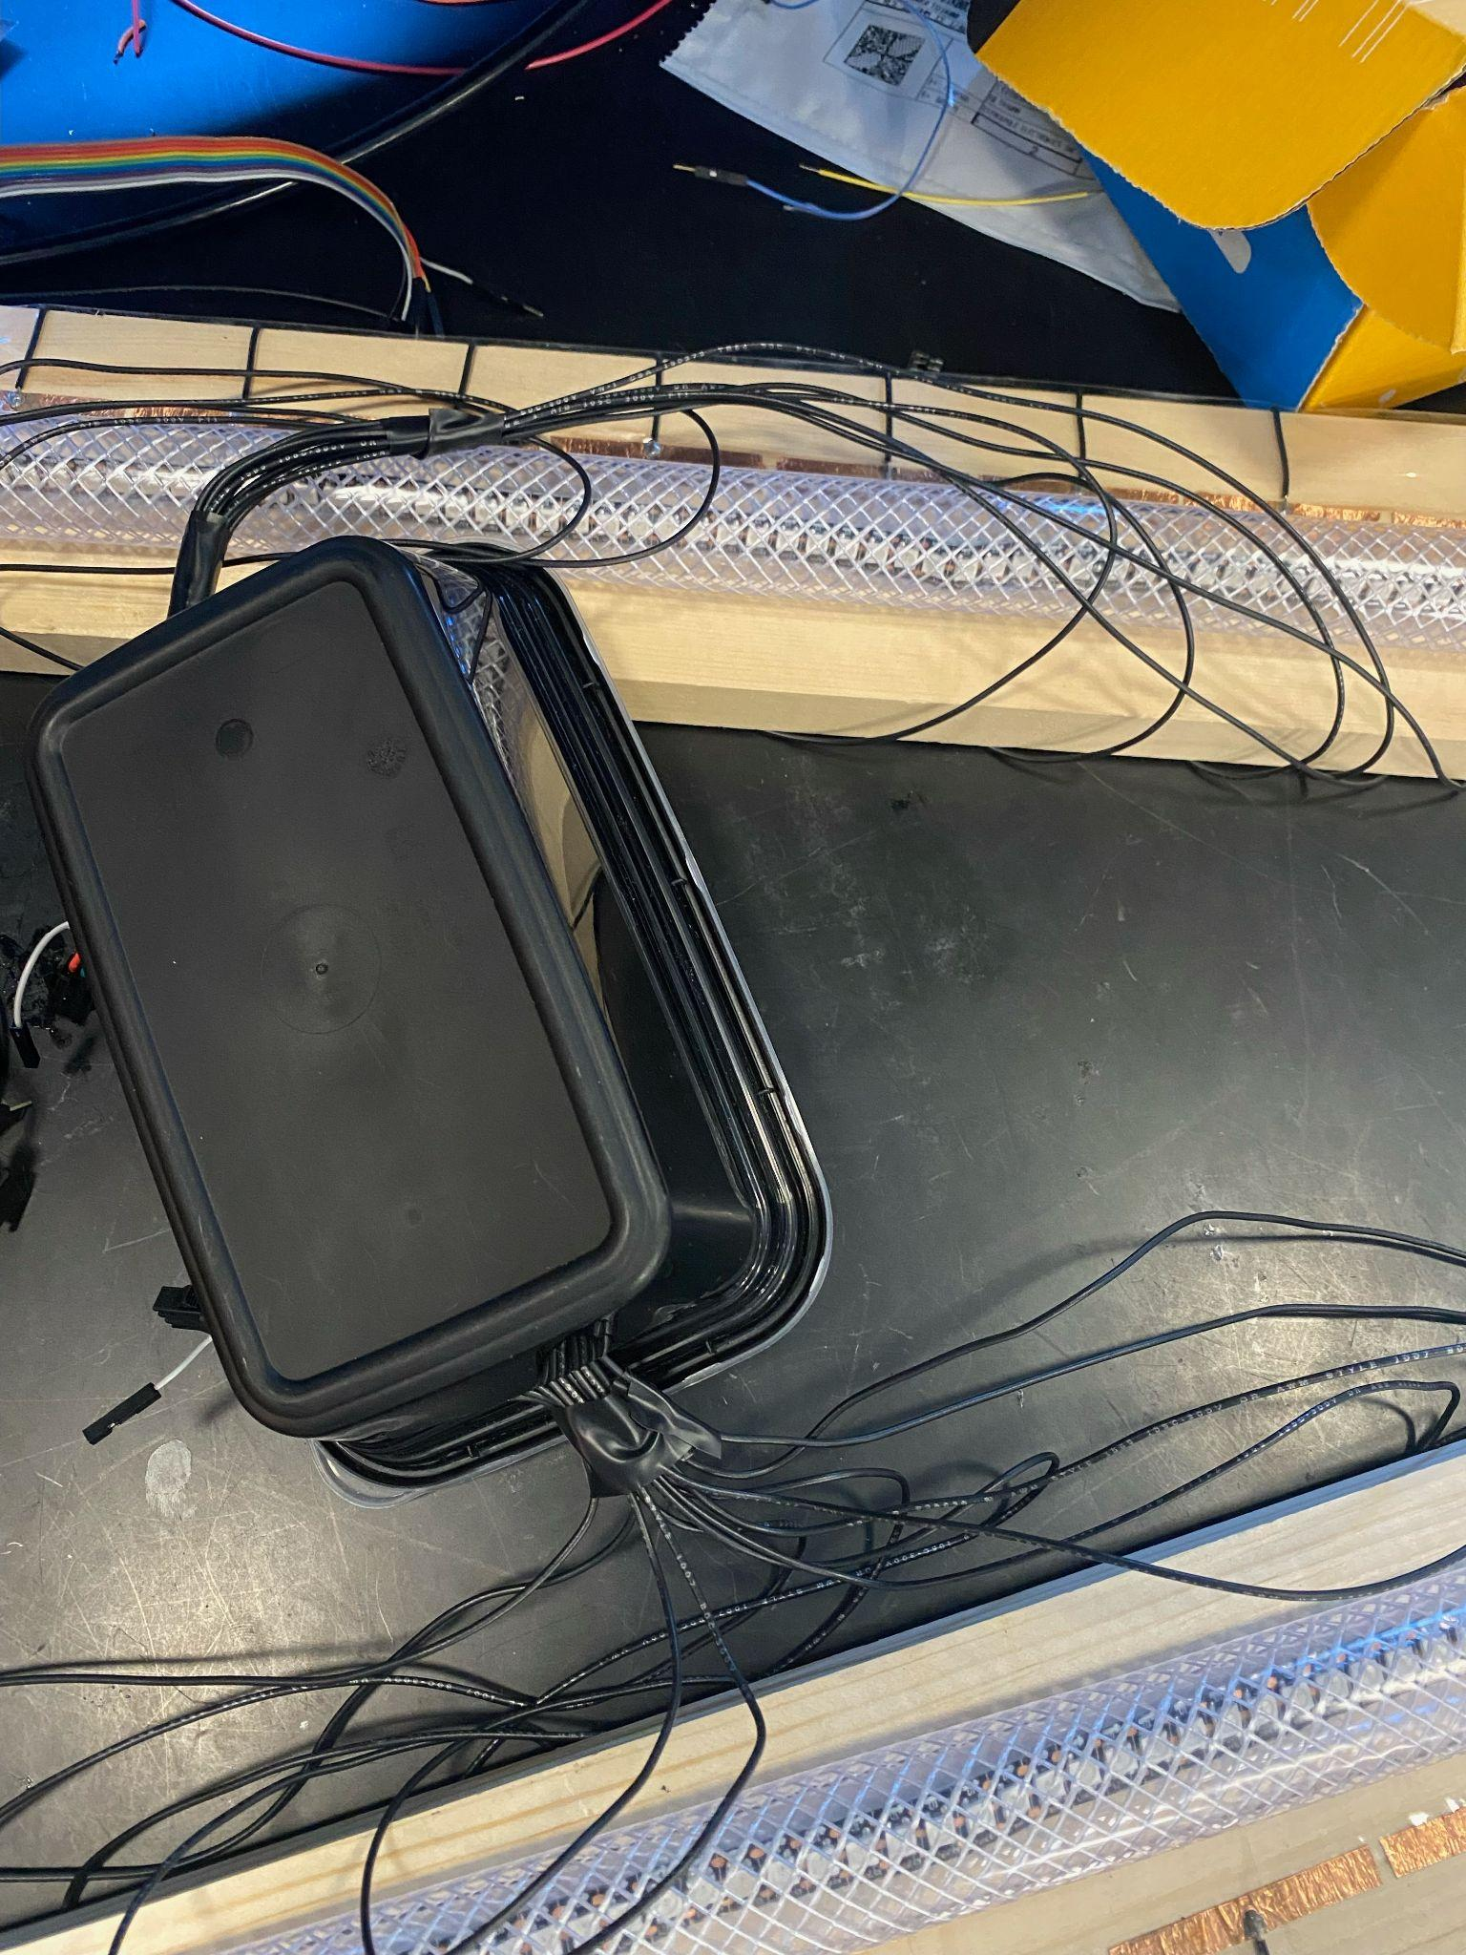
Conclusion
What we would we do differently?
Order parts earlier
Find better sources for microcontroller design
Order more spares
More methodical physical design
ECE 445: Team 24
GRAINGER ENGINEERING

Slide 18
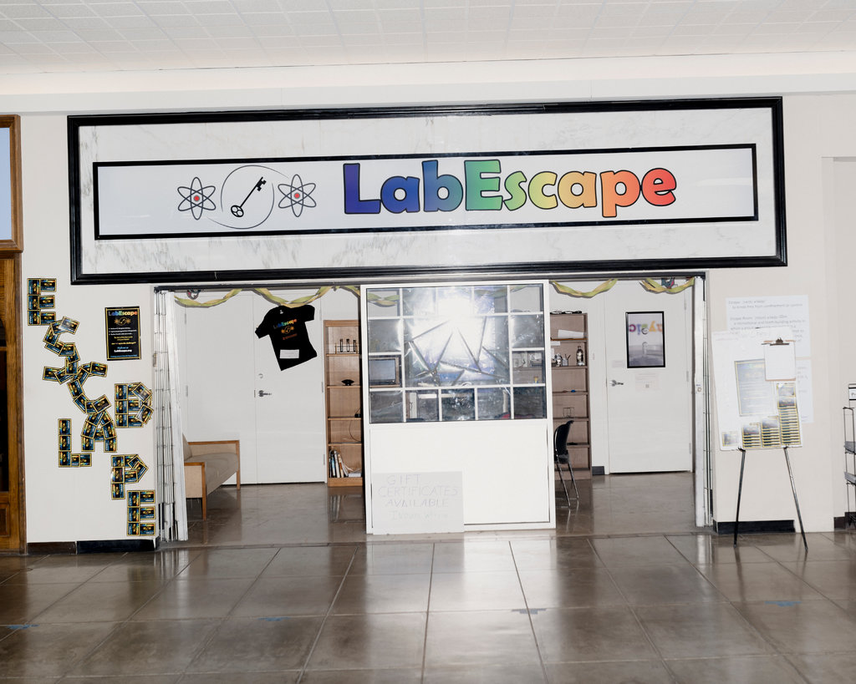
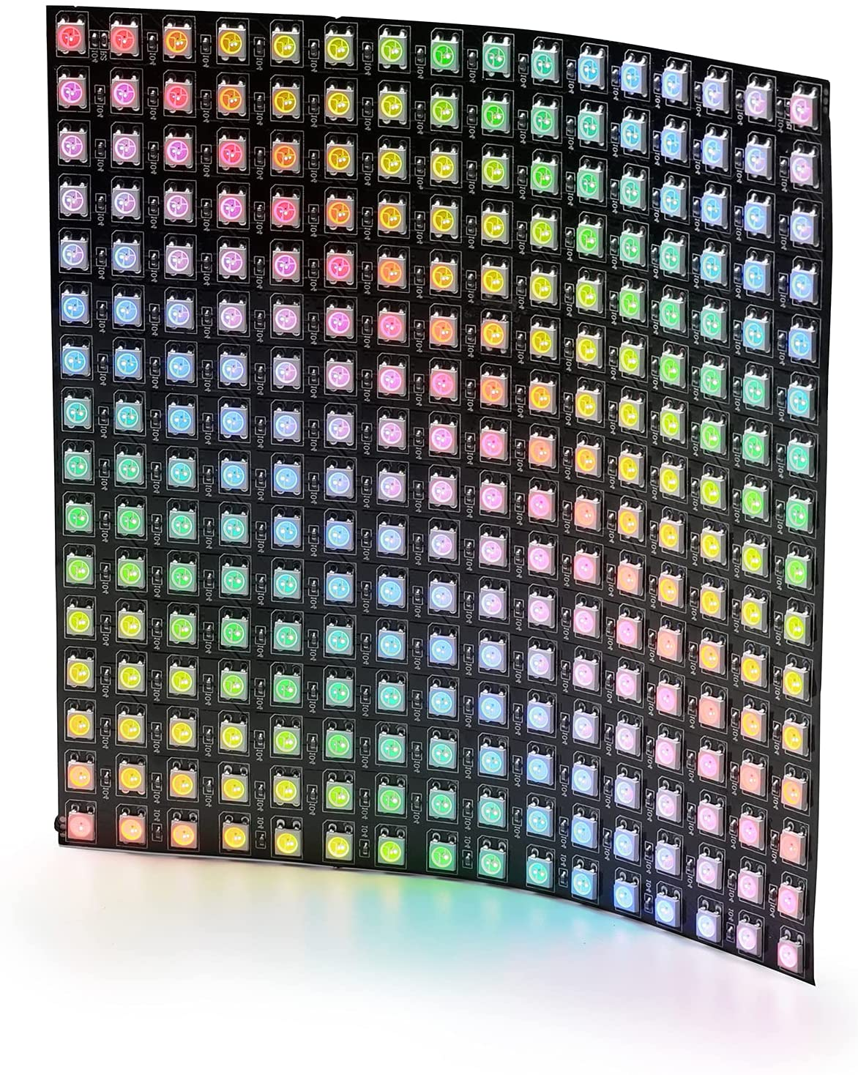
Future Work
What is next for this project?
Quantum memory
Quantum cryptography demonstration
Telecom wavelength simulation
Adding a physical switch for repetition rate
Lab Escape
ECE 445: Team 24
GRAINGER ENGINEERING

Slide 19
Questions and comments?
ECE 445: Team 24
GRAINGER ENGINEERING

