Slide 1
Textbook Detection System With Radio-Frequency Identification
Group 7
TA: Jose Sanchez Vicarte
Members: Xiaohao Wang & Xiaosheng Wu & Zhao Weng

Slide 2
Outline
Introduction
Overview
Modular design
Software
Conclusion and future work

Slide 3
Introduction
Use radio-frequency identification (RFID) to keep track of textbooks in a student’s backpack
Android application to show a checklist of missing textbooks

Slide 4
Outline
Introduction
Overview
System overview
Block diagram
Physical design
Modular design
Software
Conclusion and future work

Slide 5
System Overview
Hardware:
Lithium Ion battery
Protection circuit
Temperature Sensor
Bluetooth module
RFID antenna and reader
Microcontroller
LED and buttons
Software:
Bluetooth connection with microcontroller
Android application

Slide 6
Block Diagram
Power module
Battery
Switch
Protection Circuit
Power
Analog Signal
Digital Signal
Temperature
Sensor
Voltage Regulator
RFID module
Control module
Bluetooth module
Antenna Circuit
v
Bluetooth Module
Micro-controller
RFID Reader
Two Buttons
Three LEDs

Slide 7
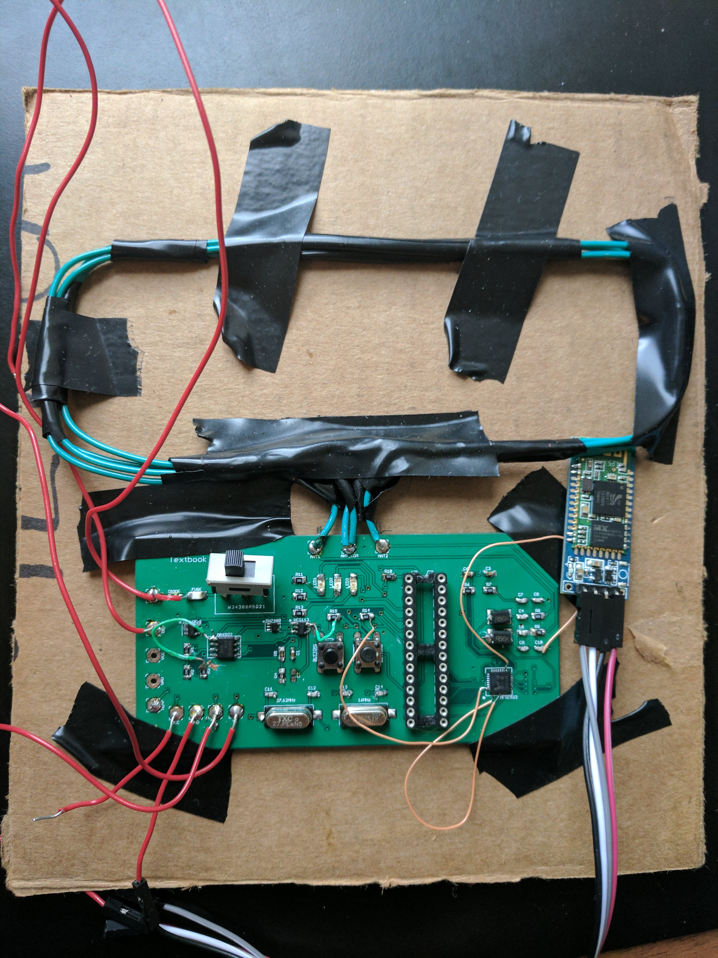
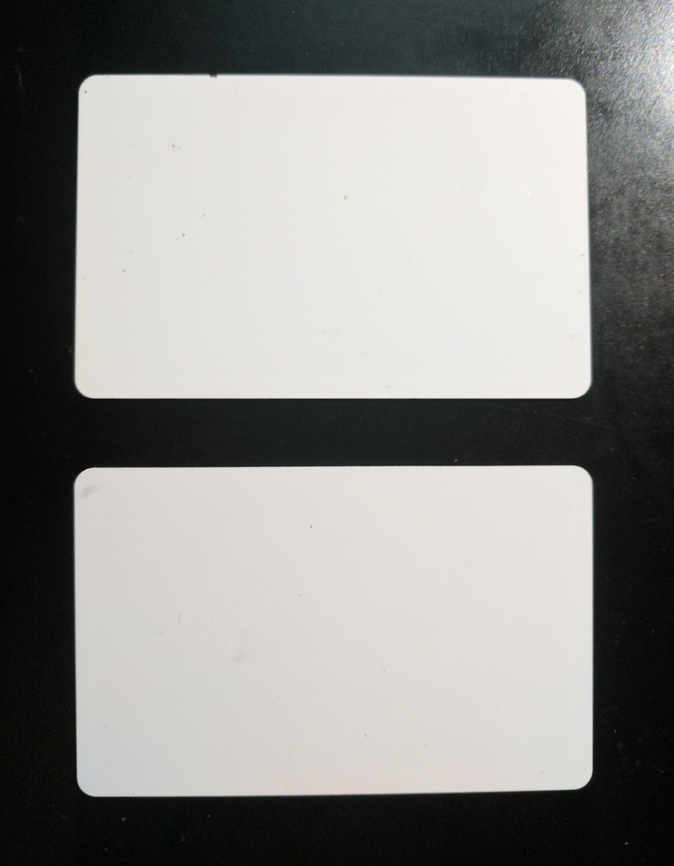
Physical Design
RFID tag
RFID antenna
Bluetooth module
Power module
RFID module
RFID tag
Control module

Slide 8
Outline
Introduction
Overview
Modular design
Power module
Control module
RFID module
Bluetooth module
Software
Conclusion and future work

Slide 9
Outline
Introduction
Overview
Modular design
Power module
Control module
RFID module
Bluetooth module
Software
Conclusion and future work

Slide 10
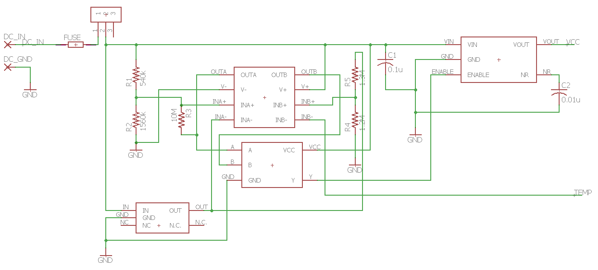
Power Module
Protection circuit
1A fuse
Undervoltage lockout (UVLO)
Temperature protection
Regulator
Output 3.3V when Enable is HIGH
Output 0V when Enable is LOW
Off-board temperature sensor
Enable
Temperature input

Slide 11
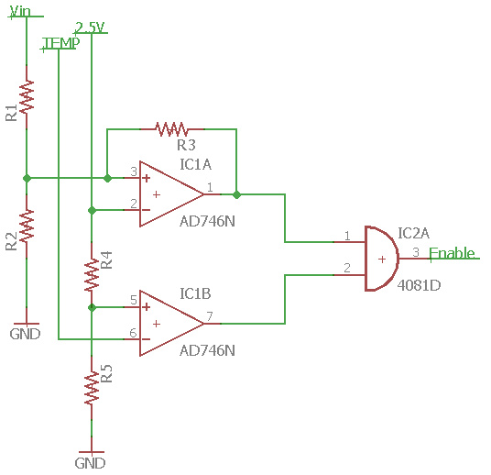
Protection circuit
Enable output is 0V when DC_IN is less than 3.3V
Enable signal stays at 0V until DC_IN rises above 3.5V
Enable output is 0V when temperature is higher than 70°C (~1.23V)

Slide 12
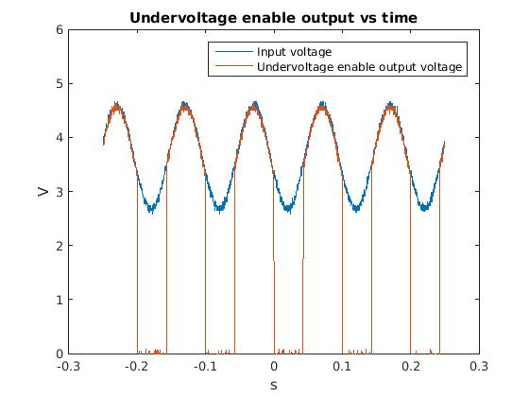
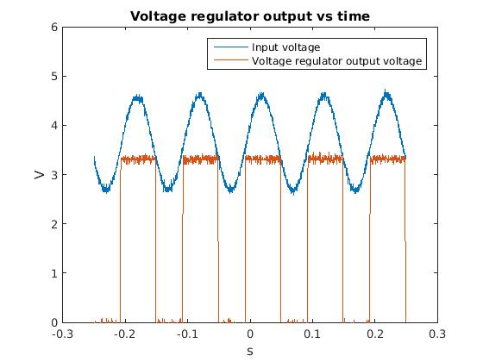
Power Module Breadboard Verification
3.5V
3.5V
3.3V
3.3V
Tested on breadboard with oscilloscope and function generator
Input sine wave with 2V $V_{p−p}$, 3.7V offset
Enable output drops to 0V when input is below 3.3V
Enable output stays at 0V until input rises above 3.5V
Voltage regulator output constant 3.3V when enable signal is HIGH

Slide 13
Power Module PCB Verification
Results different because we can’t find same resistor values
Enable signal is 0V when input drops below ~3.38V
Enable signal stays at 0V until input rises above ~3.54V
Enable signal is 0V when TEMP input is above ~1.23V (~70.5°C)
Voltage regulator output start to fluctuate around threshold
Cause microcontroller to restart randomly

Slide 14
Outline
Introduction
Overview
Modular design
Power module
Control module
RFID module
Bluetooth module
Software
Conclusion and future work

Slide 15
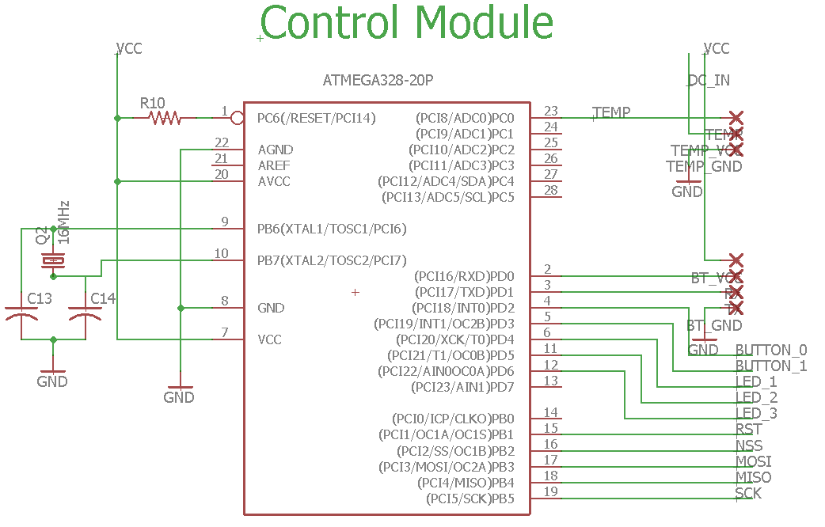
Control Module
ATmega328 microcontroller
LEDs represent system status
Receive data from the RFID module
Send data to the Bluetooth module
Turn on/off the antenna circuit with two buttons
Microcontroller circuit

Slide 16
Power module
Battery
Switch
Protection Circuit
Power
Analog Signal
Digital Signal
Temperature
Sensor
Voltage Regulator
RFID module
Control module
Bluetooth module
SPI
UART
Antenna Circuit
v
Bluetooth Module
Micro-controller
RFID Reader
Two Buttons
Three LEDs

Slide 17
Outline
Introduction
Overview
Modular design
Power module
Control module
RFID module
Bluetooth module
Software
Conclusion and future work

Slide 18
RFID Module
Receive tag IDs when tag is placed near antenna
Send tag data to the microcontroller
Detection area: 15cm × 5cm
Detection range: 3cm to 5cm

Slide 19
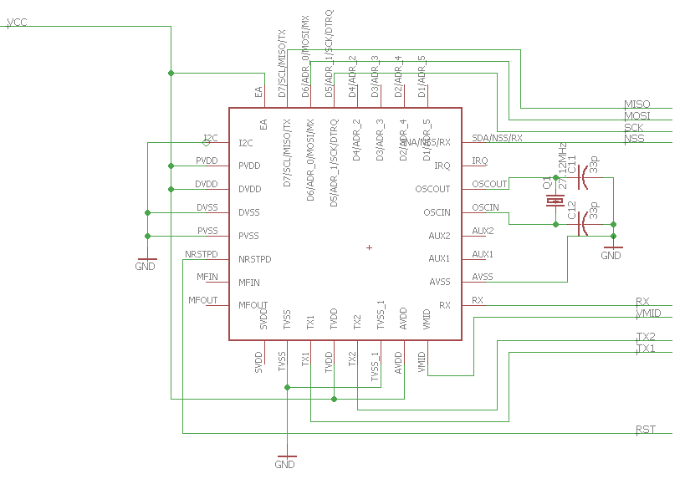
RFID Reader
MFRC522 RFID reader
Operate at 13.56MHz (HF)
Receive tag IDs from the antenna circuit
Transmit tag IDs to the control module
Antenna circuit has no power when turned off

Slide 20
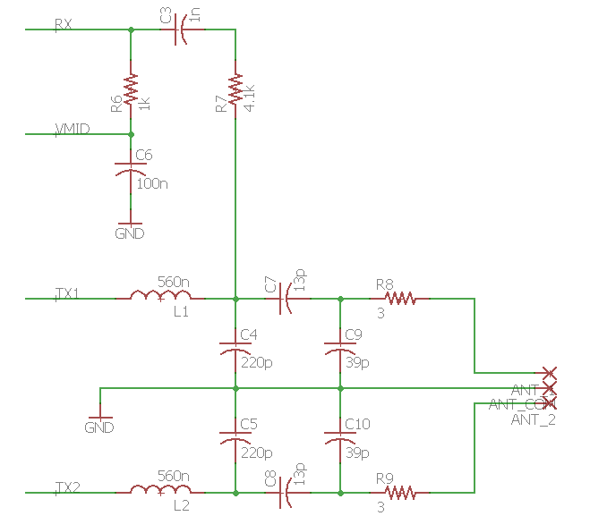
RFID Antenna Circuit
Follow NXP application note AN1445 for antenna design
Use given values for EMC filter and receiver circuit
Antenna size: 15cm × 5cm
Measure antenna parameters with network analyzer
Tune matching circuit so input impedance is 50 Ω
Receiver circuit
Matching circuit
Antenna
EMC filter

Slide 21
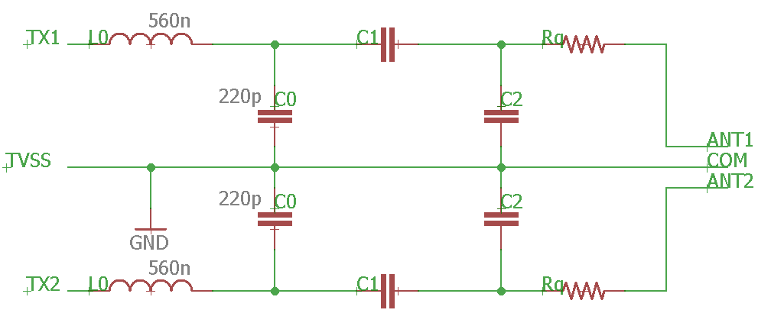
RFID Antenna Transmitter Circuit Calculations
Measured antenna parameters:
Inductance: 3.88μH
Resistance: 5.5Ω
Capacitance: ~1pF
$R_{Q}=0.5(\frac{ω∙L_{a}}{35}−R_{a})≈3\text{Ω}$ (1)
$R_{pa}=\frac{{(ω∙L_{a})}^{2}}{R_{a}+2R_{Q}}≈9502\text{Ω}$ (2)
$R_{tr}=\frac{R_{match}}{{(1−ω^{2}L_{0}C_{0})}^{2}+{(ω\frac{R_{match}}{2}C_{0})}^{2}}≈217\text{Ω}$ (3)
$C_{1}≈\frac{1}{ω(\sqrt{\frac{R_{tr}∙R_{pa}}{4}}+\frac{X_{tr}}{2})}≈17pF$ (5)
$X_{tr}=2ω\frac{L_{0}\left(1−ω^{2}L_{0}C_{0}\right)−\frac{{R_{match}}^{2}}{4}C_{0}}{{(1−ω^{2}L_{0}C_{0})}^{2}+{(ω\frac{R_{match}}{2}C_{0})}^{2}}≈−58\text{Ω}$ (4)
$C_{2}≈\frac{1}{ω^{2}\frac{L_{a}}{2}}−\frac{1}{ω\sqrt{\frac{R_{tr}∙R_{pa}}{4}}}≈55pF$ (6)

Slide 22
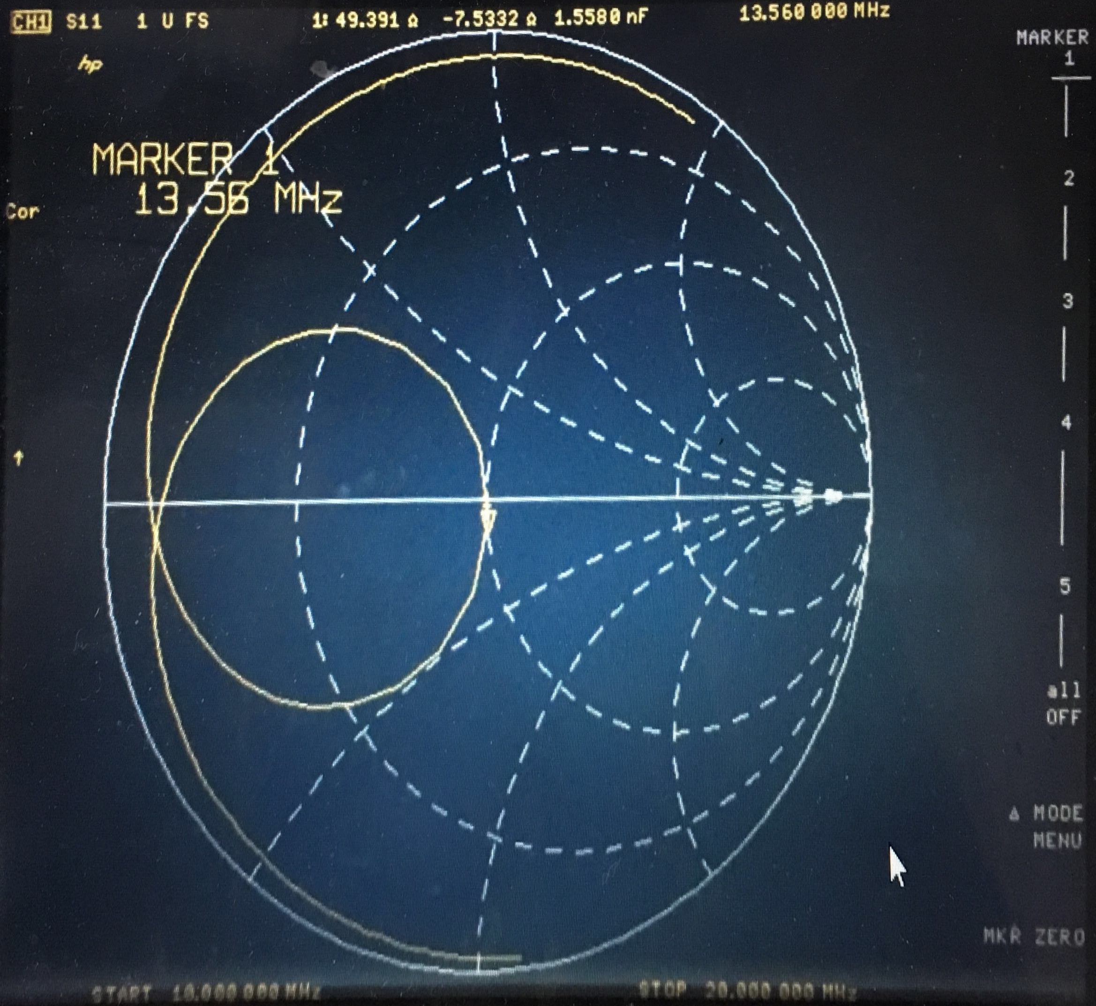
RFID Antenna Circuit Tuning
Adjust $C_{1}$ and $C_{2}$ for tuning
Final values:
$C_{1}=13pF$
$C_{2}=39pF$
$R_{Q}=3Ω$
Results:
Impedance about 50Ω

Slide 23
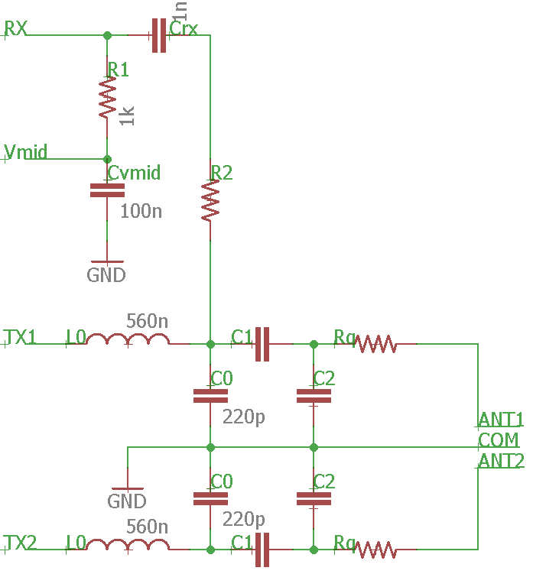
RFID Antenna Receiver Circuit
Use low capacitance probe and oscilloscope to measure peak-to-peak voltage across $C_{0}$
Calculate resistor $R_{2}$
Receiver circuit

Slide 24
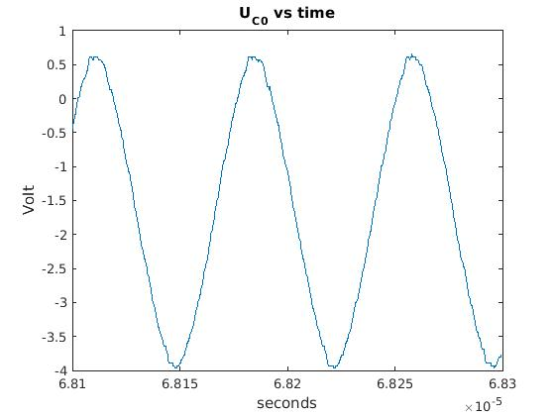
RFID Antenna Receiver Circuit
Use low capacitance probe and oscilloscope to measure peak-to-peak voltage across $C_{0}$
$U_{C0}≈4.6V$
Frequency about 13.6MHz
$R_{2}=R_{1}∙\left(\frac{U_{C0}}{U_{RX}}−1\right)$
$=1k∙\left(\frac{4.6}{1}−1\right)=3.6k$Ω (7)
Use 4kΩ resistor
3.5cm to 4.5cm range for version 1
5cm to 7cm range for version 2

Slide 25
Outline
Introduction
Overview
Modular design
Power module
Control module
RFID module
Bluetooth module
Software
Conclusion and future work

Slide 26
Bluetooth Module
JY-MCU HC-06
Transmit data with 9600 baud 80% of time
Connect to Android application

Slide 27
Outline
Introduction
Overview
Modular design
Software
Microcontroller software
Android application
Conclusion and future work

Slide 28
Microcontroller software
Initialize SPI connection
Initialize UART connection
Set up LEDs and buttons
Modify RFID chip registers
Transfer the tag ID to the Bluetooth module
“40 81 90 7E”

Slide 29
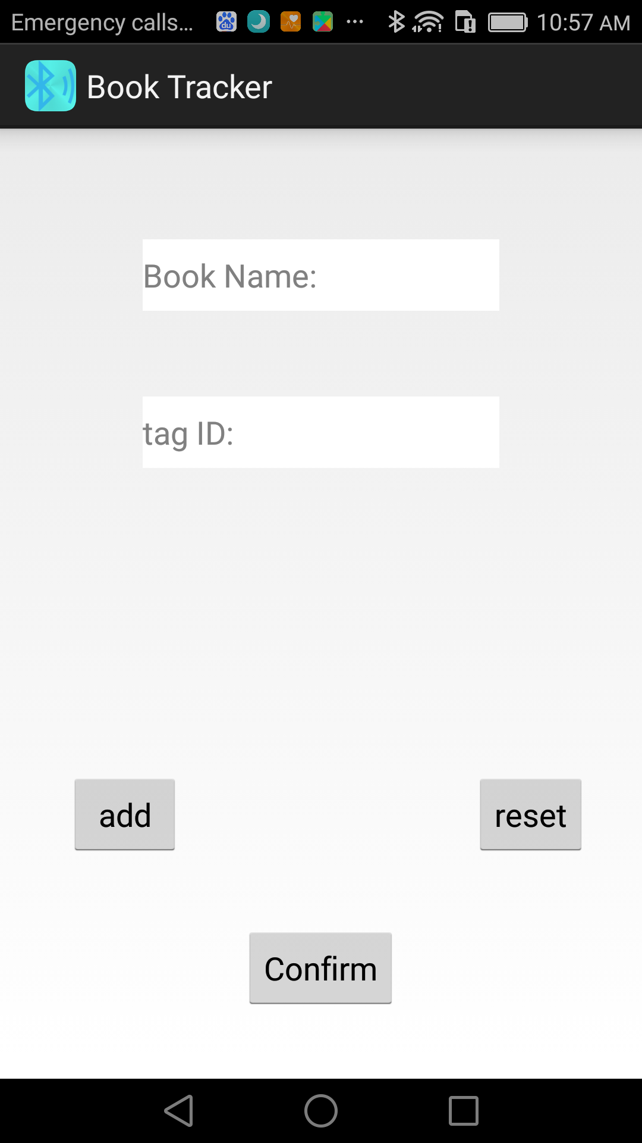
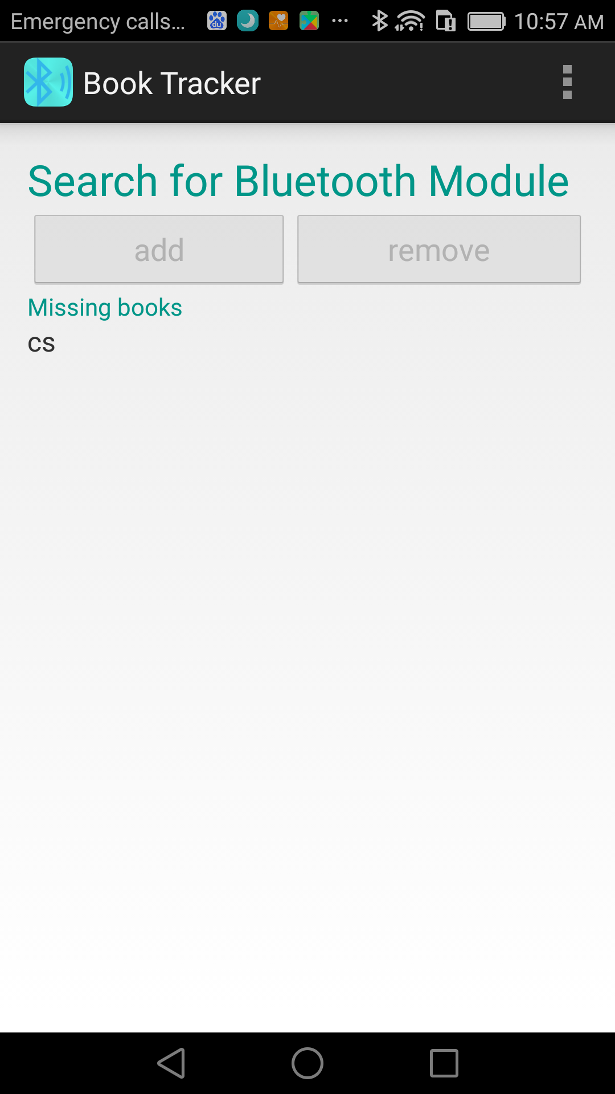
Android Application
Add tag ID and book name pairs for initialization
Connect to the Bluetooth module
Automatically update a check list of missing books

Slide 30
Outline
Introduction
Overview
Modular design
Software
Conclusion and future work

Slide 31
Conclusion
Improved detection area and distance with customized RFID module
Microcontroller able to send RFID data to Bluetooth
Android application as user interface
Microcontroller restart randomly near threshold
Android application not fully automated

Slide 32
Future Work
Use force sensor to automatically turn on/off RFID antenna
Automatically initialize tag IDs in the Android application
Recommend books based on Calendar
Use separate regulator for different modules

Slide 33
Questions?

Slide 34
Thank you!

Slide 35
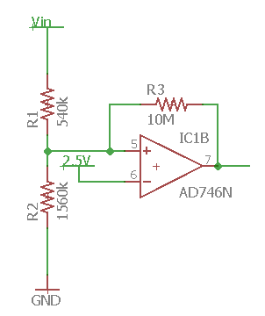
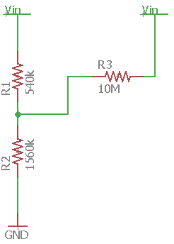
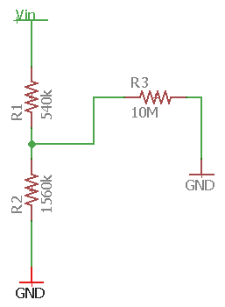
UVLO
UVLO circuit
Dropping equivalent
Rising equivalent
Want to create 200mV hysteresis to prevent circuit from switching on and off rapidly
When dropping, $R_{3}$ parallel with $R_{1}$, decreasing Vin needed to reach 2.5V
When rising, $R_{3}$ parallel with $R_{2}$, increasing Vin needed to reach 2.5V

Slide 36
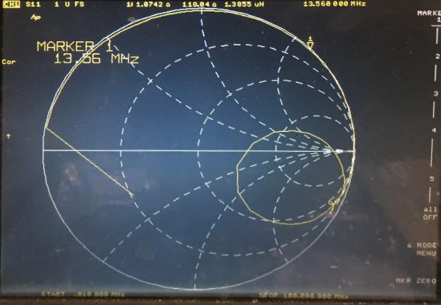
RFID Antenna
Antenna size: 5cm × 15cm
Require two antennas coils
Recommended antenna inductance: 0.3μH to 3μH
Three-turn antenna inductance is too high
Choose two-turn antenna
Smith chart of a single coil two-turn antenna

Slide 37
