Slide 1
Bat Migration Monitor
Electrical & Computer Engineering
Team 35
Romin Patel, Hoguer Benitez, Lilian Rafferty
2024/04/30

Slide 2
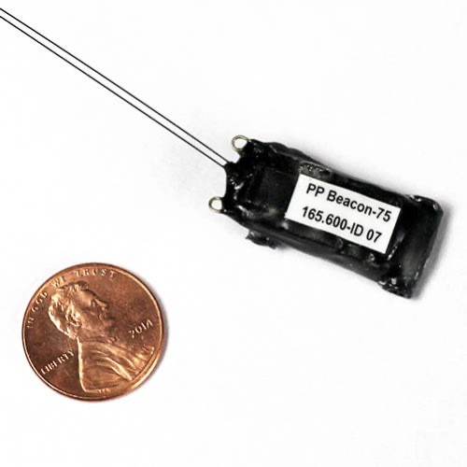
Introduction
Problem
Current Solutions
Bats are beneficial to the environment as they provide pest control, pollination, and seed dispersal.
The population of bats have steadily declined throughout the years due to various reasons such as White Nose Syndrome, habit destruction, caught into wind turbines.
Due to the unawareness of their migratory path, minimum support has been provided to protect them
Current market consist of two different devices that can be implemented on bats
VHF Tags
Beneficial only when bats are stationary
Labor intensive and expensive
GNSS Tags
Untraceable
Expensive
ELECTRICAL & COMPUTER ENGINEERING
GRAINGER ENGINEERING
Notes:
Mention Josie’s Pitch

Slide 3
Objectives
ELECTRICAL & COMPUTER ENGINEERING
GRAINGER ENGINEERING

Slide 4
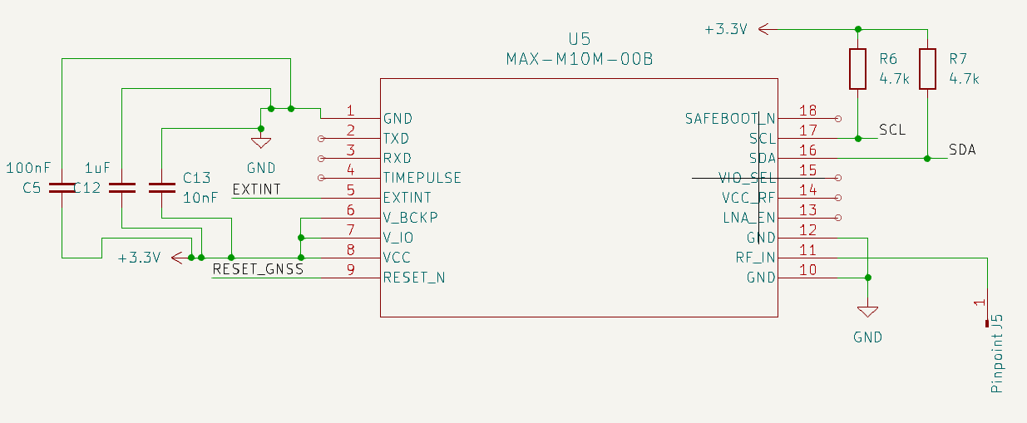
High Level Requirement 1
The device requires a GNSS module that will monitor the daily paths of a bat, which will provide insights of the movement patterns’ bats take throughout the day.
Our device will collect data every 5-10 minute intervals during a span of 6 hours for 3 consecutive days
ELECTRICAL & COMPUTER ENGINEERING
GRAINGER ENGINEERING

Slide 5
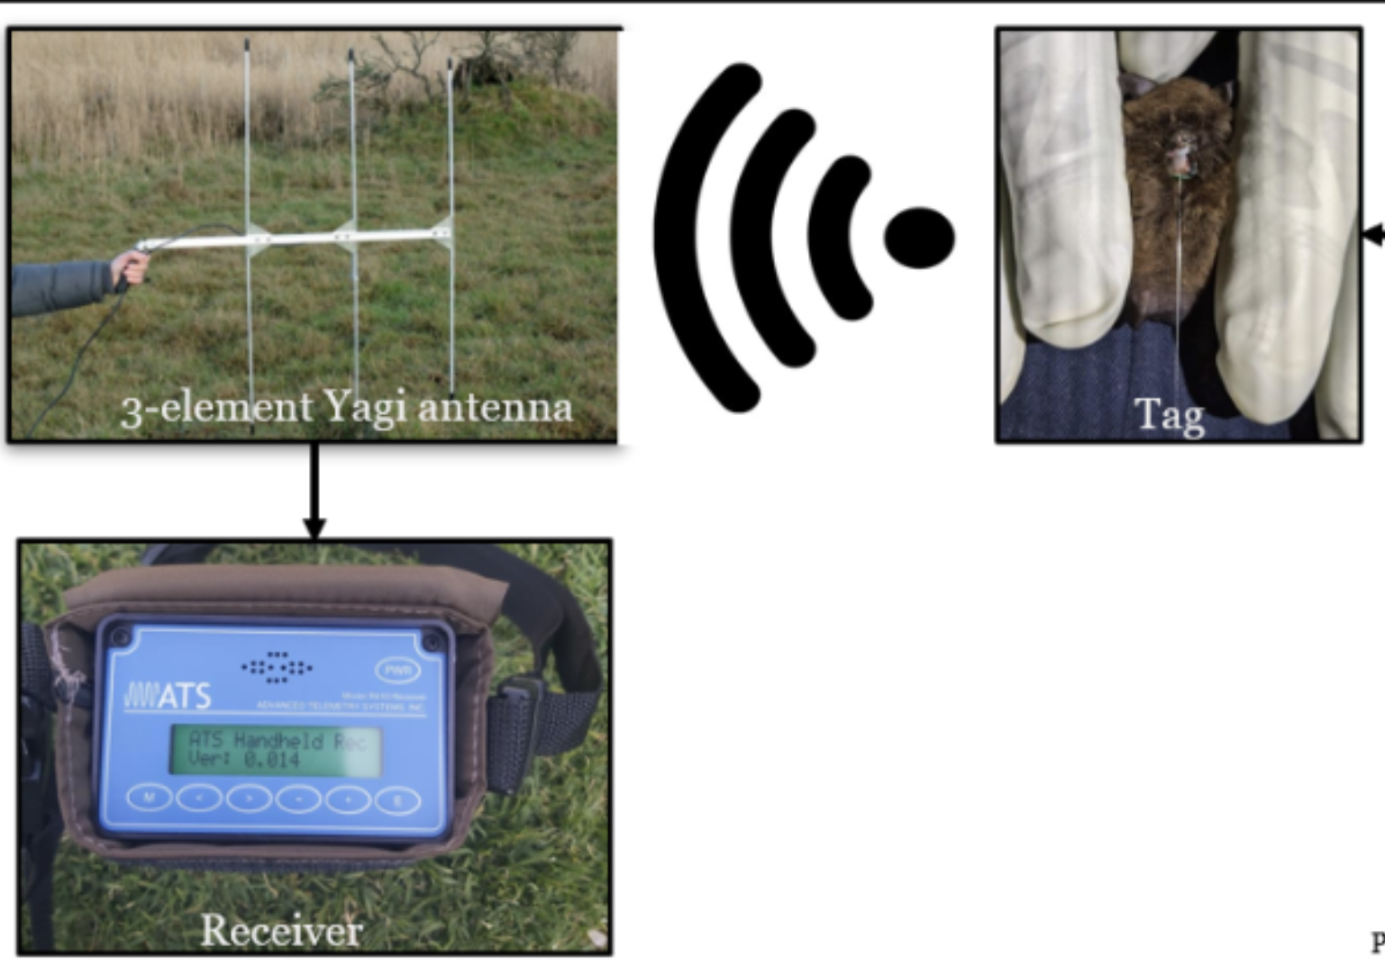
High Level Requirement 2
To retrieve the device, a tracking system is integrated in order to pinpoint the exact location of the device so that the collected data is retrieved from the bat that is traced.
For our tracking system, a VHF transmitter and receiver is utilized such that the device can be detected within a 1km range.
ELECTRICAL & COMPUTER ENGINEERING
GRAINGER ENGINEERING

Slide 6
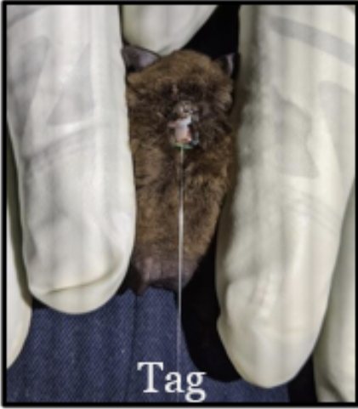
High Level Requirement 3
In order to not interfere with the bats’ normal functionality, the weight and dimensions of the device need to be highly considered in the design aspect
~1.6g & < 21x13x5 mm
ELECTRICAL & COMPUTER ENGINEERING
GRAINGER ENGINEERING

Slide 7
Design Overview
ELECTRICAL & COMPUTER ENGINEERING
GRAINGER ENGINEERING

Slide 8
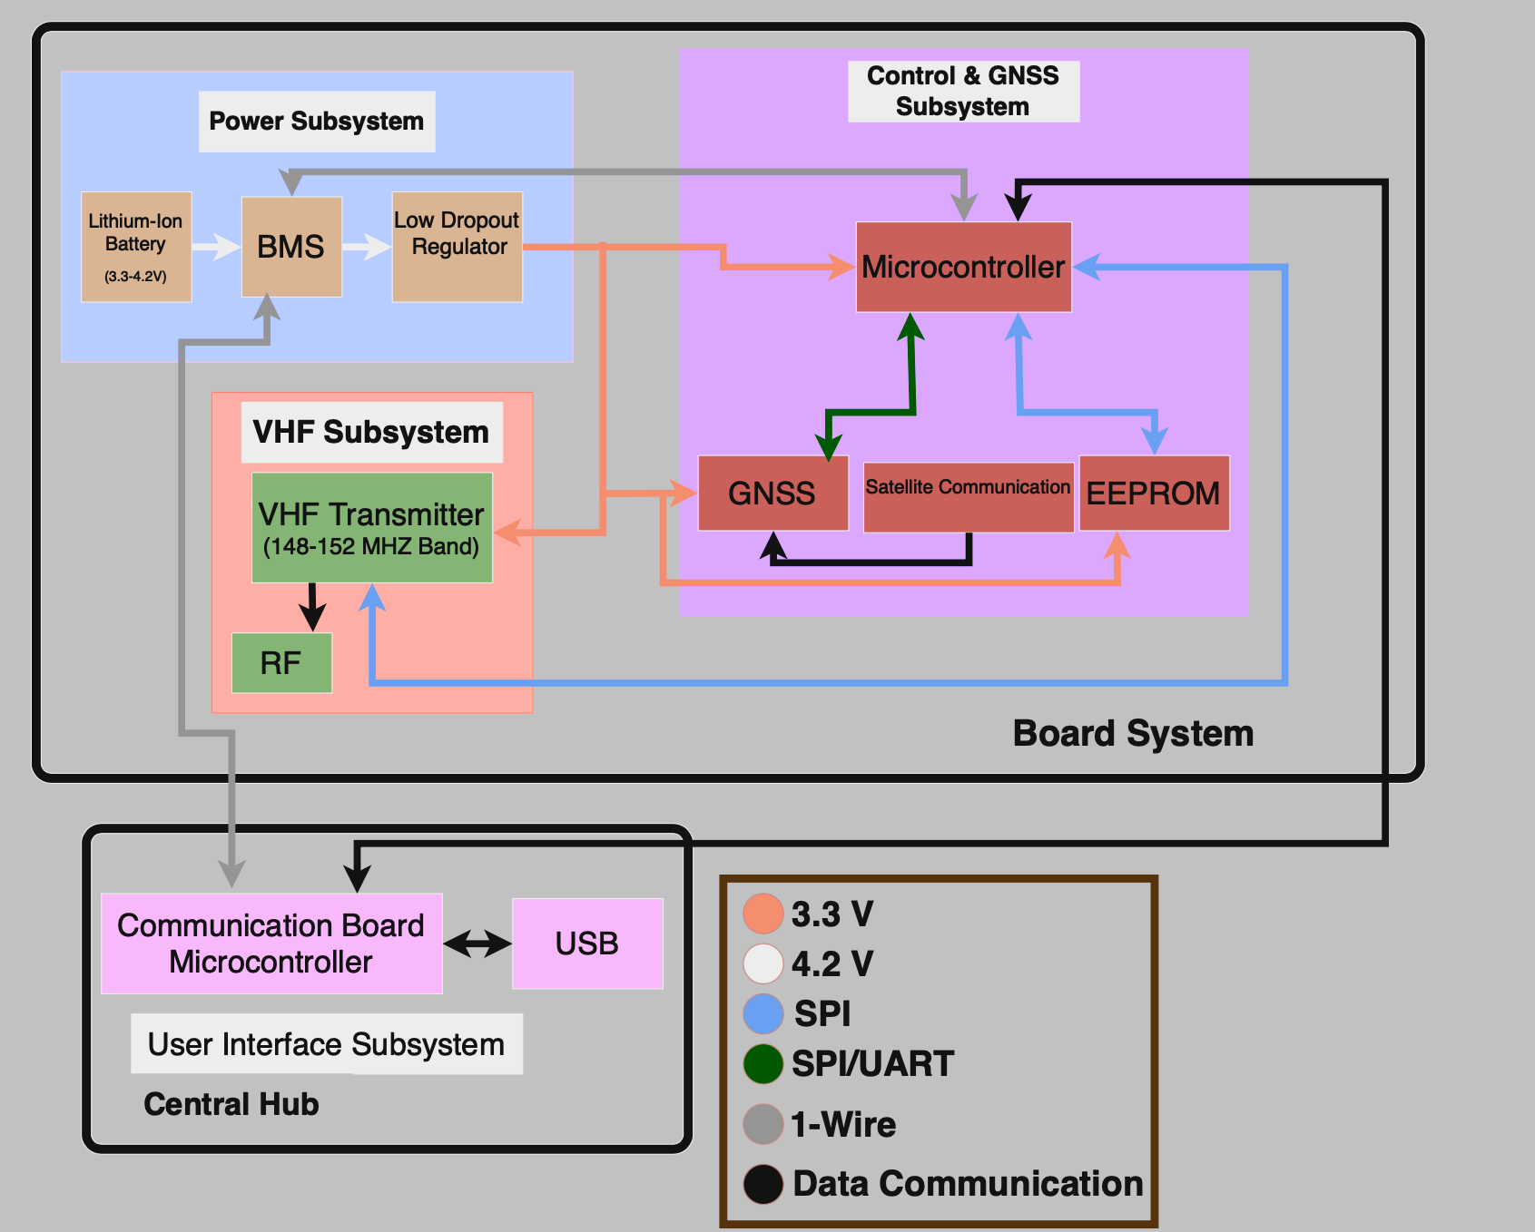
Block Diagram
ELECTRICAL & COMPUTER ENGINEERING
GRAINGER ENGINEERING

Slide 9
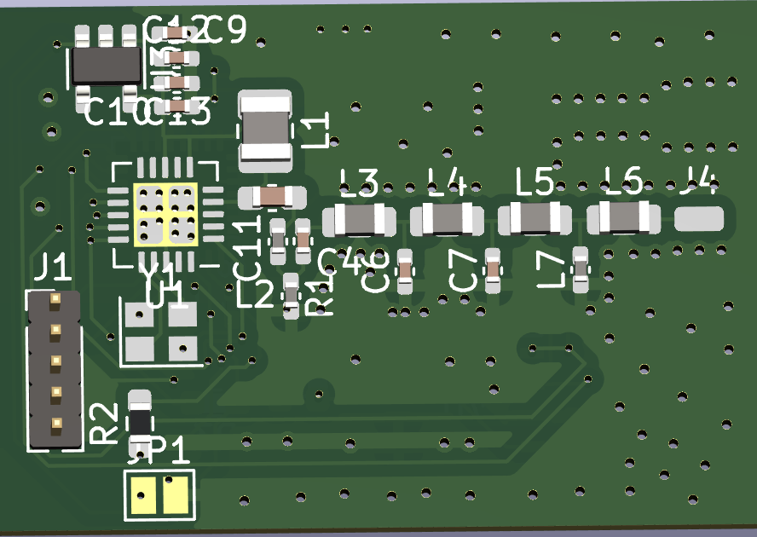
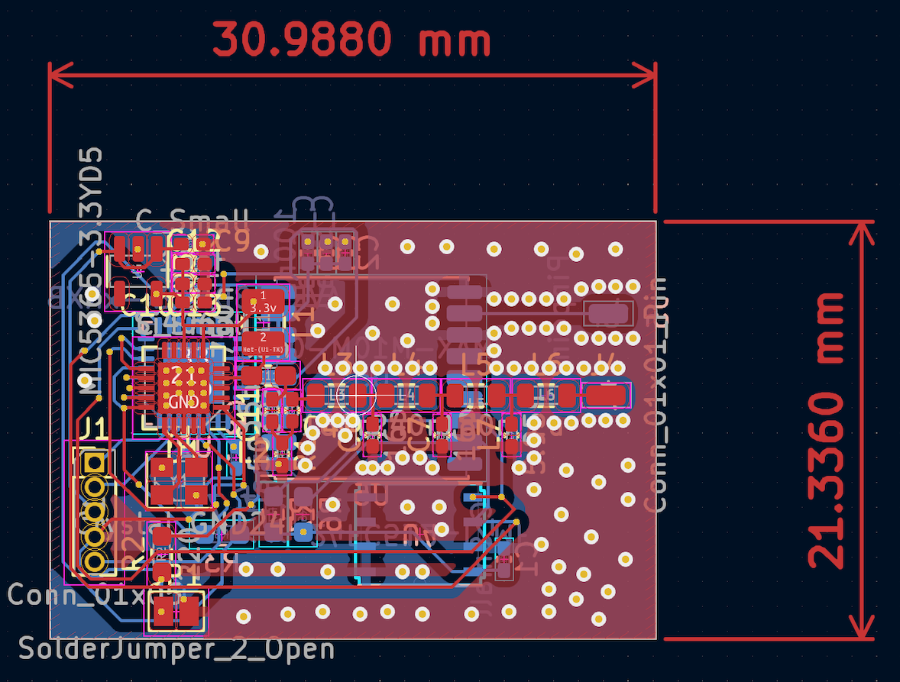
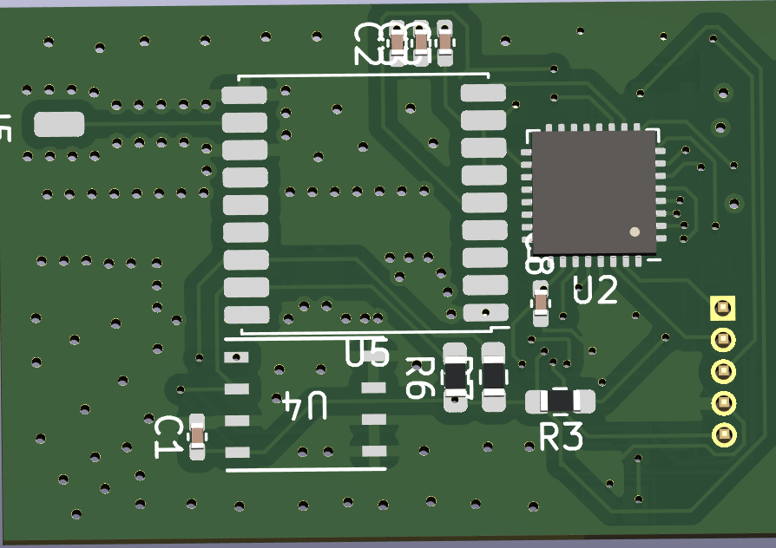
PCB Design
VHF & GNSS PCB
ELECTRICAL & COMPUTER ENGINEERING
GRAINGER ENGINEERING
Notes:
“We implemented everything onto a small PCB, except for the battery implementation, we decided to keep that separate to make the PCB design simpler”

Slide 10
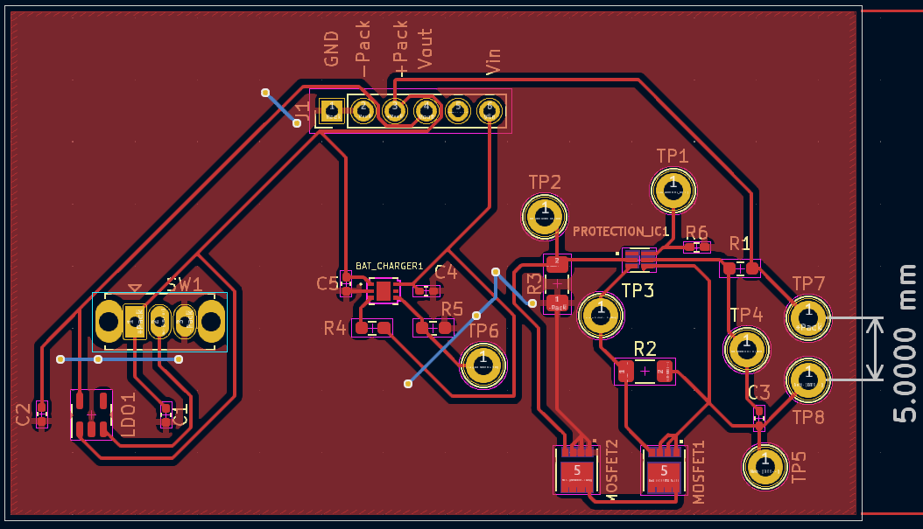
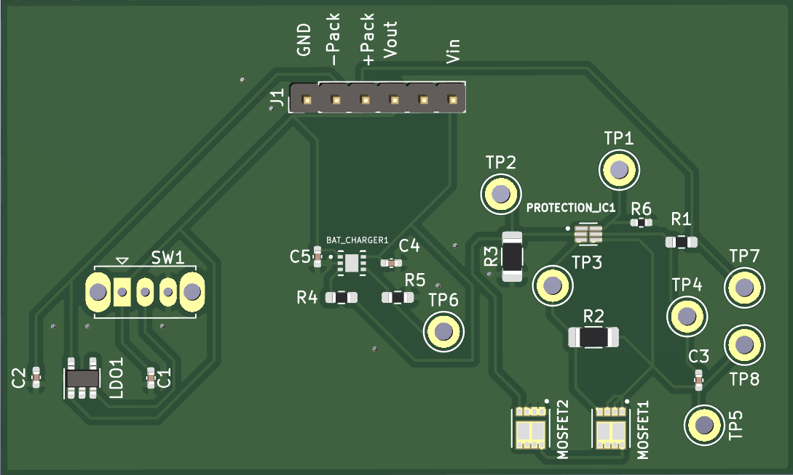
PCB Design
Power PCB
ELECTRICAL & COMPUTER ENGINEERING
GRAINGER ENGINEERING

Slide 11
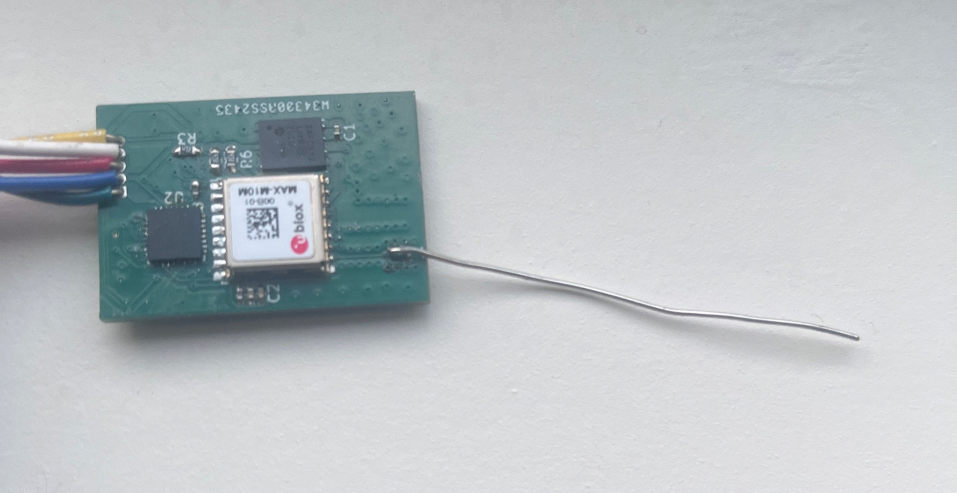
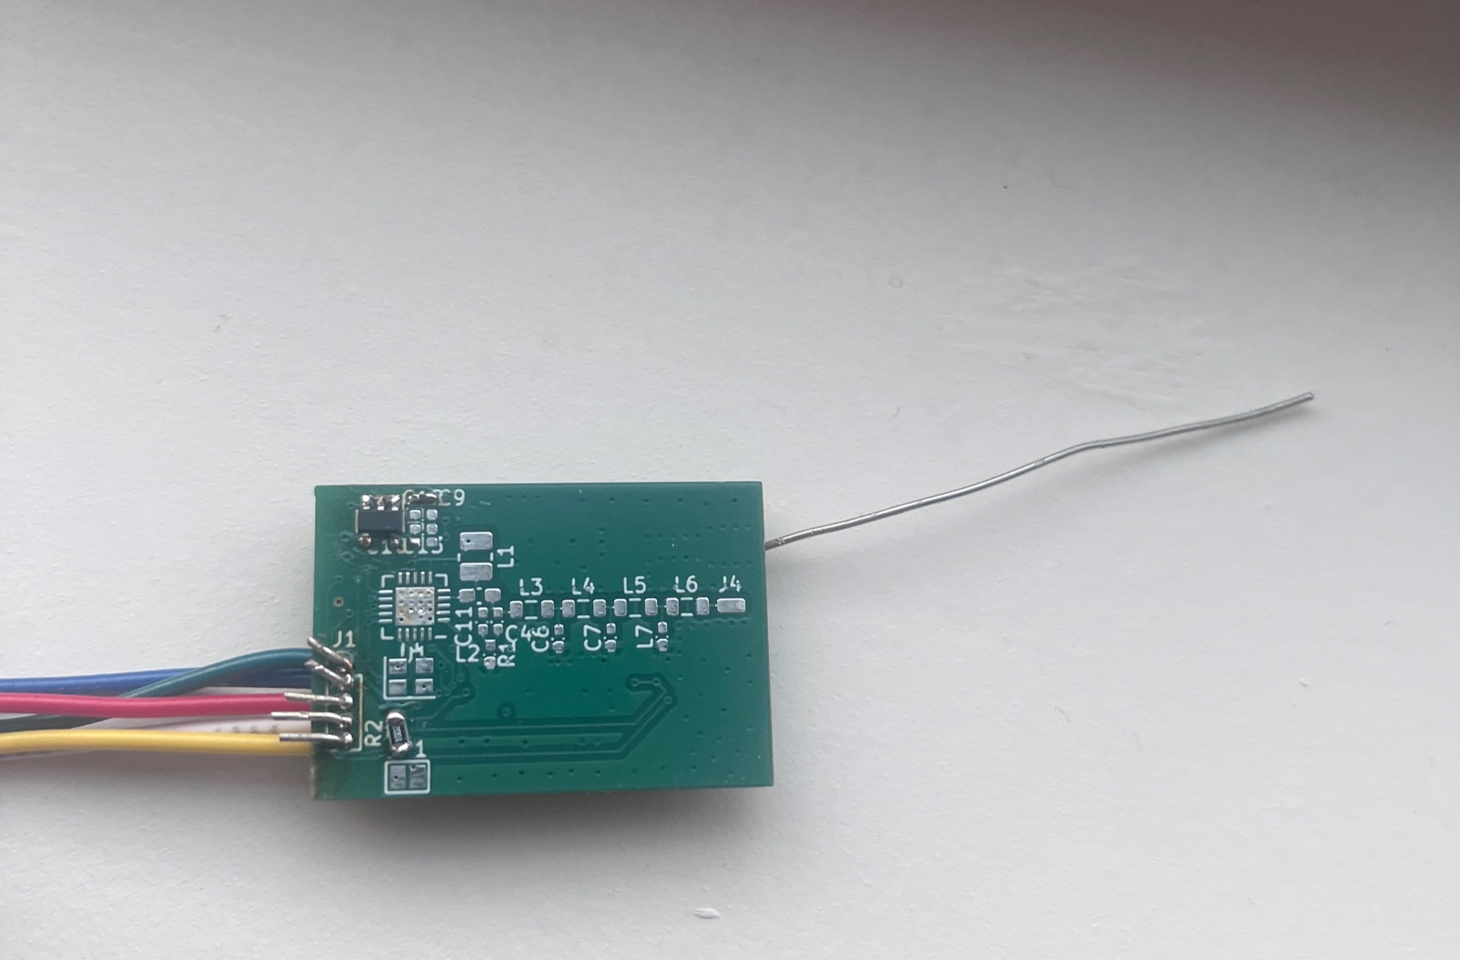
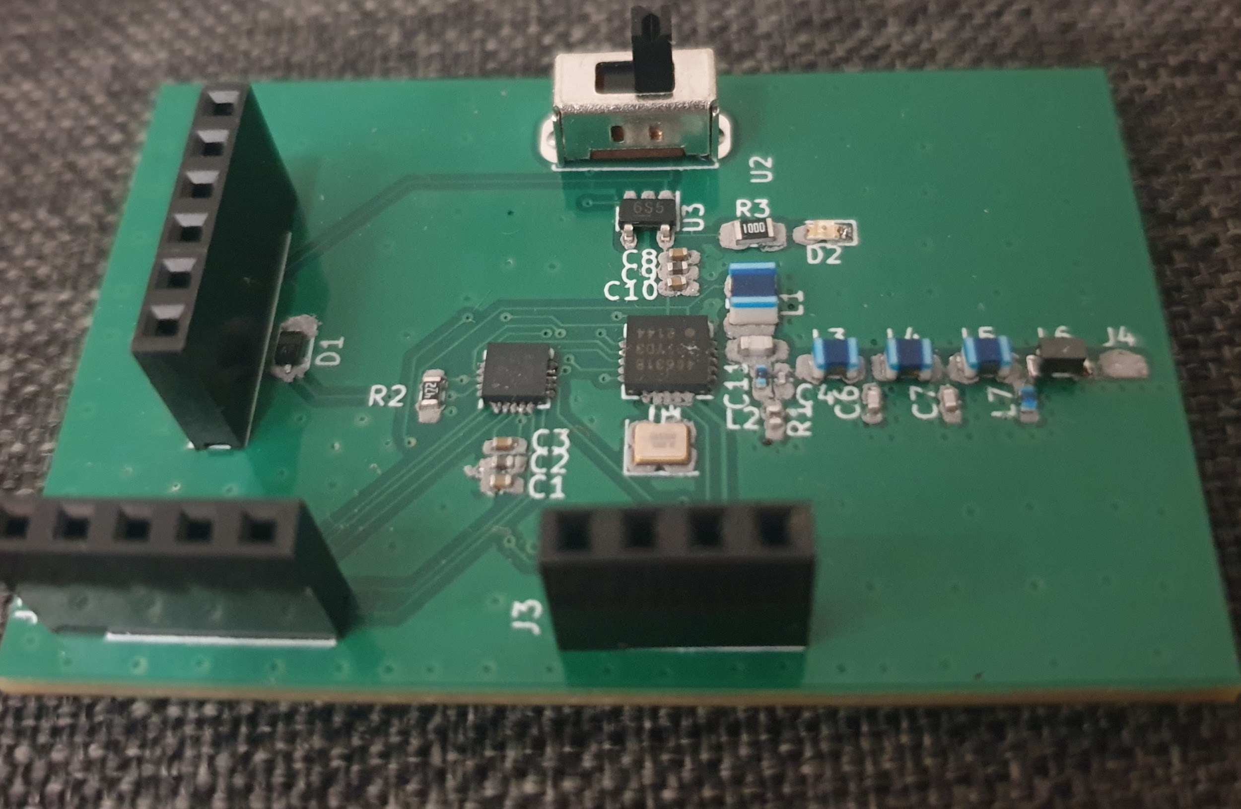
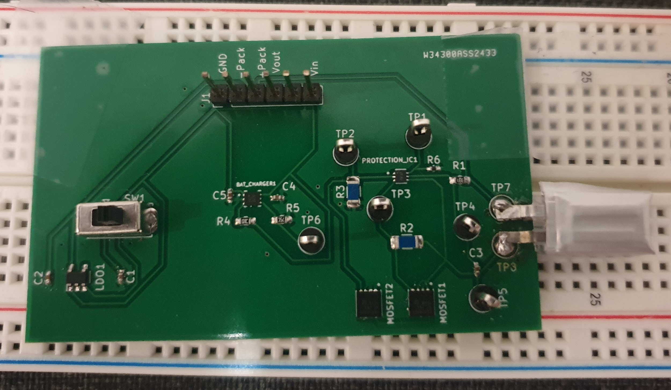
Design
2 Sided PCB Consisting of VHF Subsystem & Control and GNSS Subsystem
ELECTRICAL & COMPUTER ENGINEERING
GRAINGER ENGINEERING

Slide 12
VHF Subsystem
ELECTRICAL & COMPUTER ENGINEERING
GRAINGER ENGINEERING

Slide 13
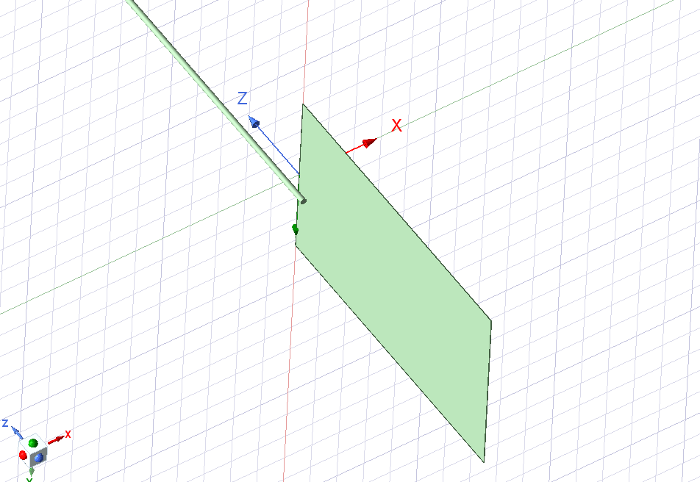
VHF Subsystem
Requirements:
148-152 MHz spectrum for current receiver
1 km range
12 ms On/Off pulse
Testing:
Fast Fourier Transform Measurements for operation frequency
The NRES lab we are creating this device for currently uses a 148-152 MHz receiver and the expected impedance for the transmitting circuit is 50 Ohms.
Model of Antenna
(PCB plane is 21 x 13 mm and wire is r=0.2 mm, L=4.76 cm)
ELECTRICAL & COMPUTER ENGINEERING
GRAINGER ENGINEERING

Slide 14
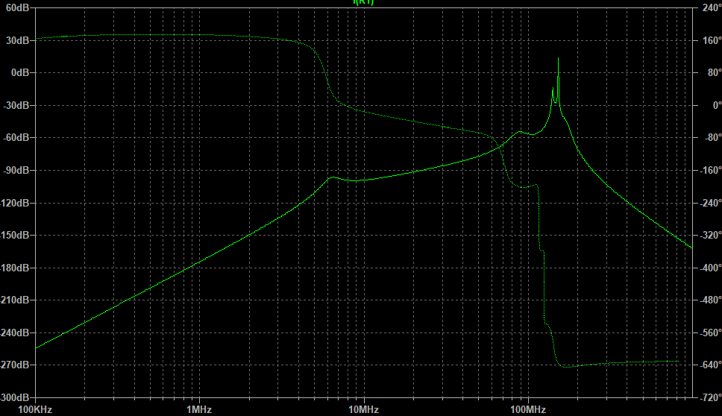
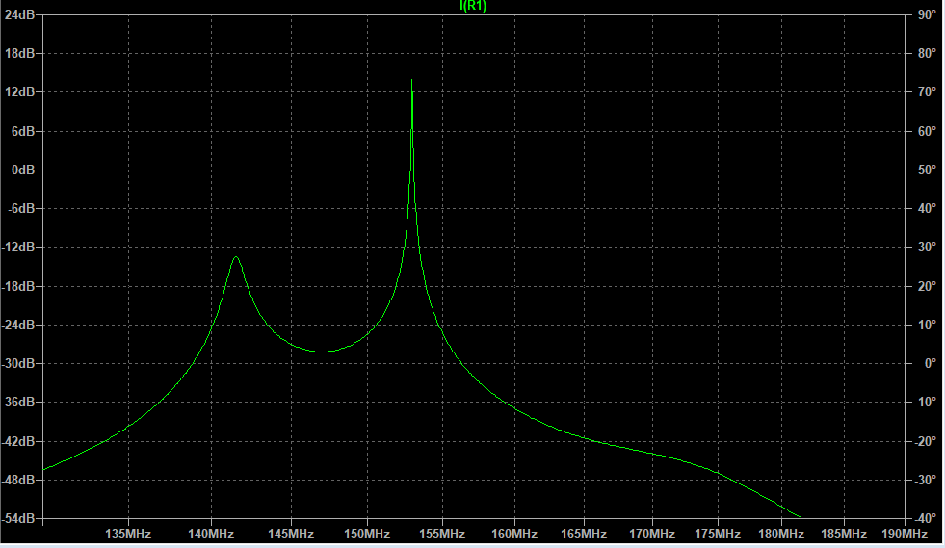
VHF Subsystem
ELECTRICAL & COMPUTER ENGINEERING
GRAINGER ENGINEERING
Notes:
Left: Overall
Right: Zoomed in for 148-152MHz
The guide recommends using a TEE lowpass filter with the 3dB ripple at the operating frequency(148-152MHz). Values were calculated and the following simulations were given. The simulated system met specs.

Slide 15
Control & GNSS Subsystem
ELECTRICAL & COMPUTER ENGINEERING
GRAINGER ENGINEERING

Slide 16
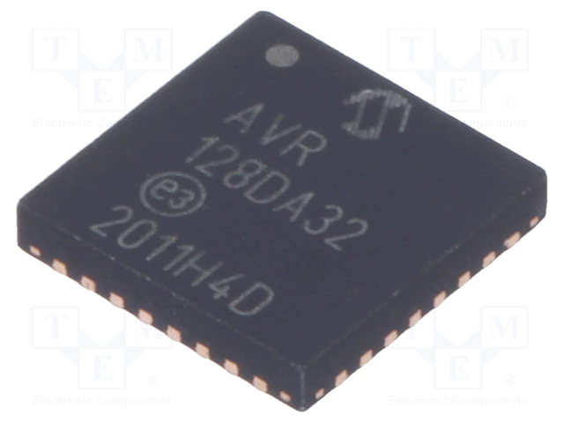
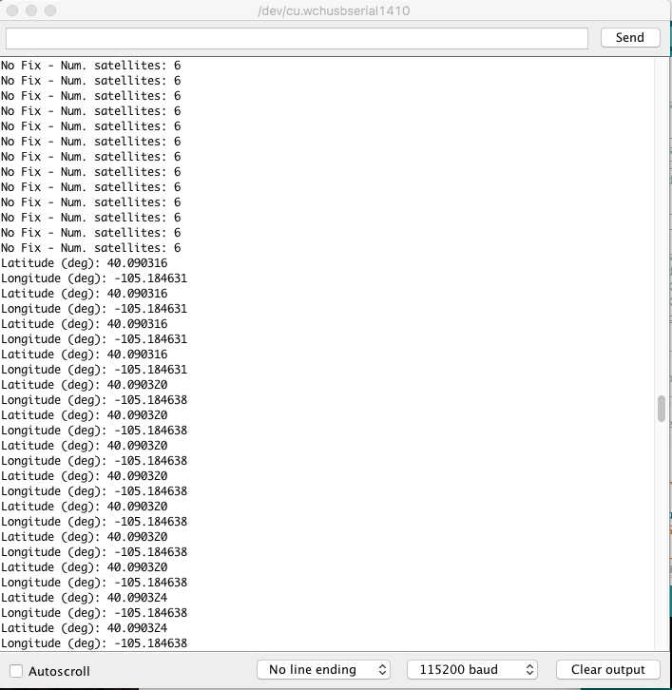
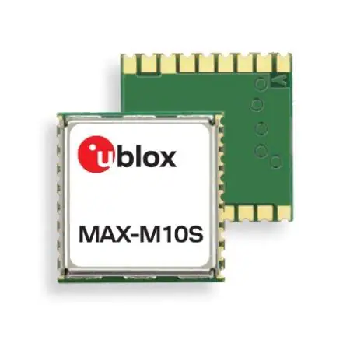
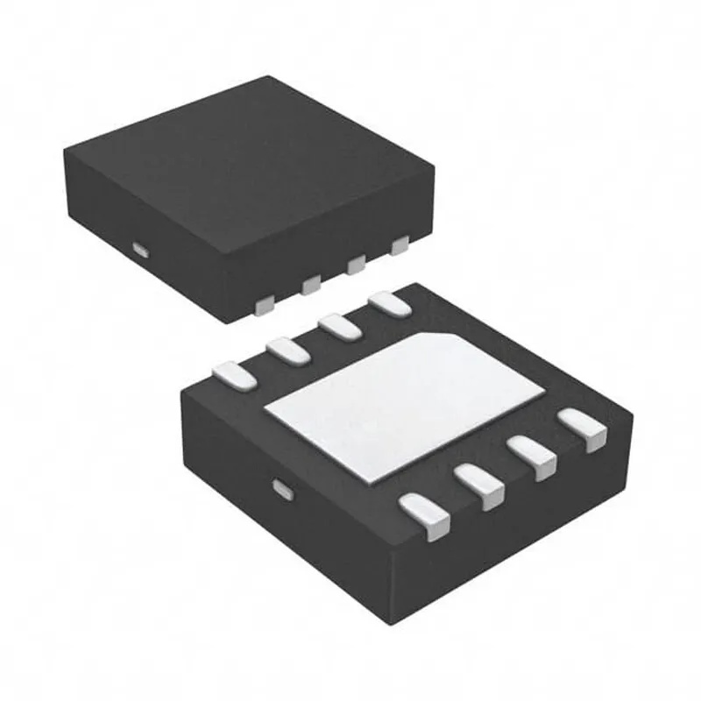
Control & GNSS Subsystem
AVR128DA32 MCU
24FC512 I2C Serial EEPROM
Output from Serial Monitor via MCU
ELECTRICAL & COMPUTER ENGINEERING
GRAINGER ENGINEERING

Slide 17
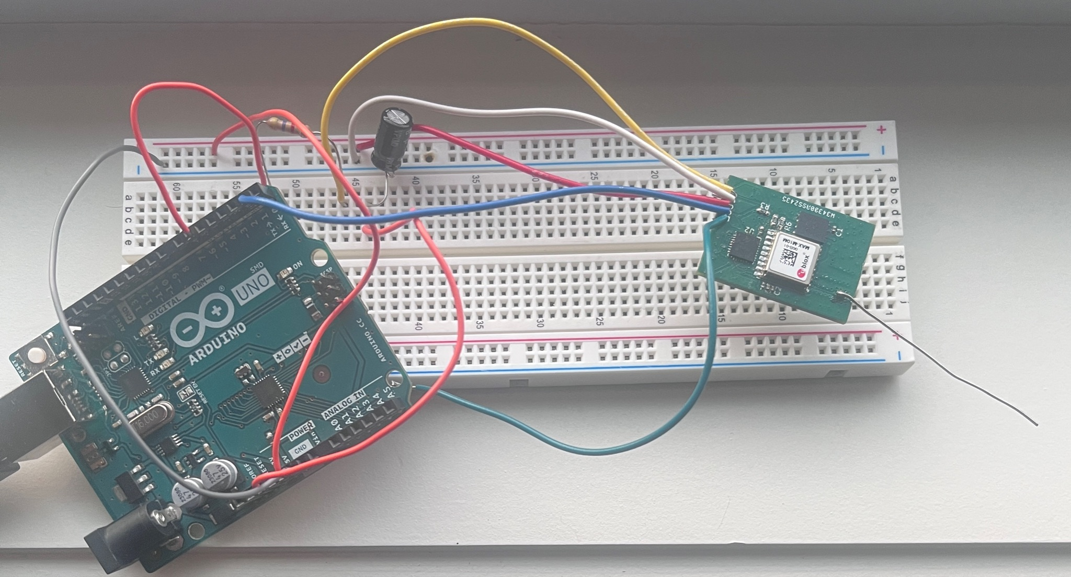
Control & GNSS Subsystem
Collecting Precise Positioning Via GNSS Module
GNSS ublox MAX M10M chip with high accuracy of the range of 1.5m. Requires a voltage supply of 1.8 V - 5 V with a lower power consumption of less than 10 mW
GNSS chip has I2C Communication Protocol compatibility.
I2C will be utilized with microcontroller
GNSS receiver module can receive minimum signal strength of ~130 dbm from satellites
ELECTRICAL & COMPUTER ENGINEERING
GRAINGER ENGINEERING

Slide 18
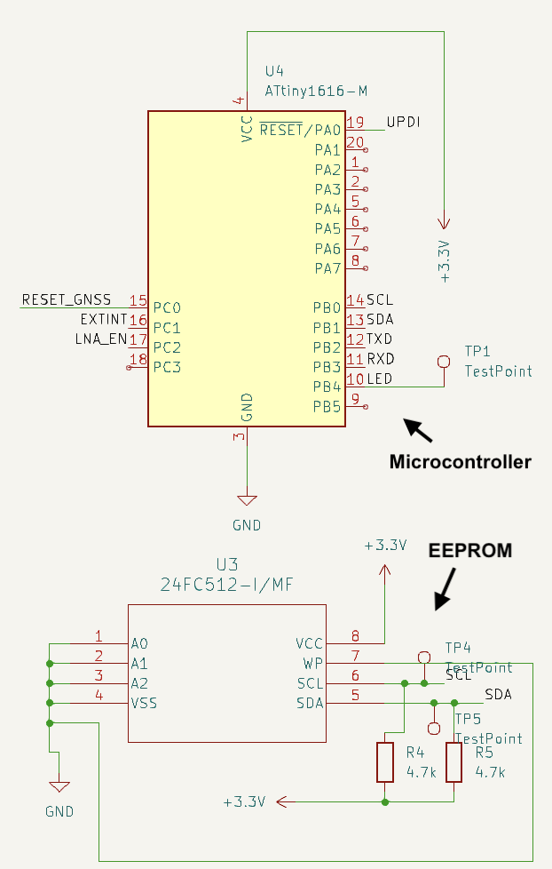
Control & GNSS Subsystem
Storing Data to the EEPROM
The data collected from the GNSS module is stored in a external EPROM (Erasable Programmable Read Only Memory)
Typical microcontrollers cannot withhold the amount of memory we require for our project
EEPROM 24FC512 Microchip can store 512kb of memory
~6000 8 MB sized high resolution photos
I2C will be utilized to communicate with the microcontroller
ELECTRICAL & COMPUTER ENGINEERING
GRAINGER ENGINEERING

Slide 19
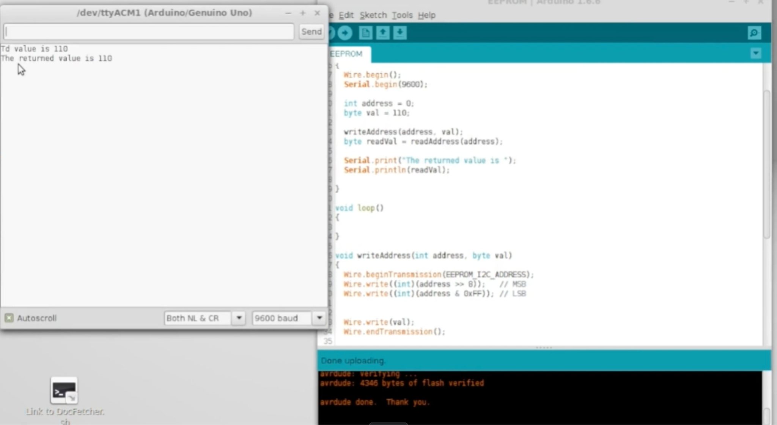
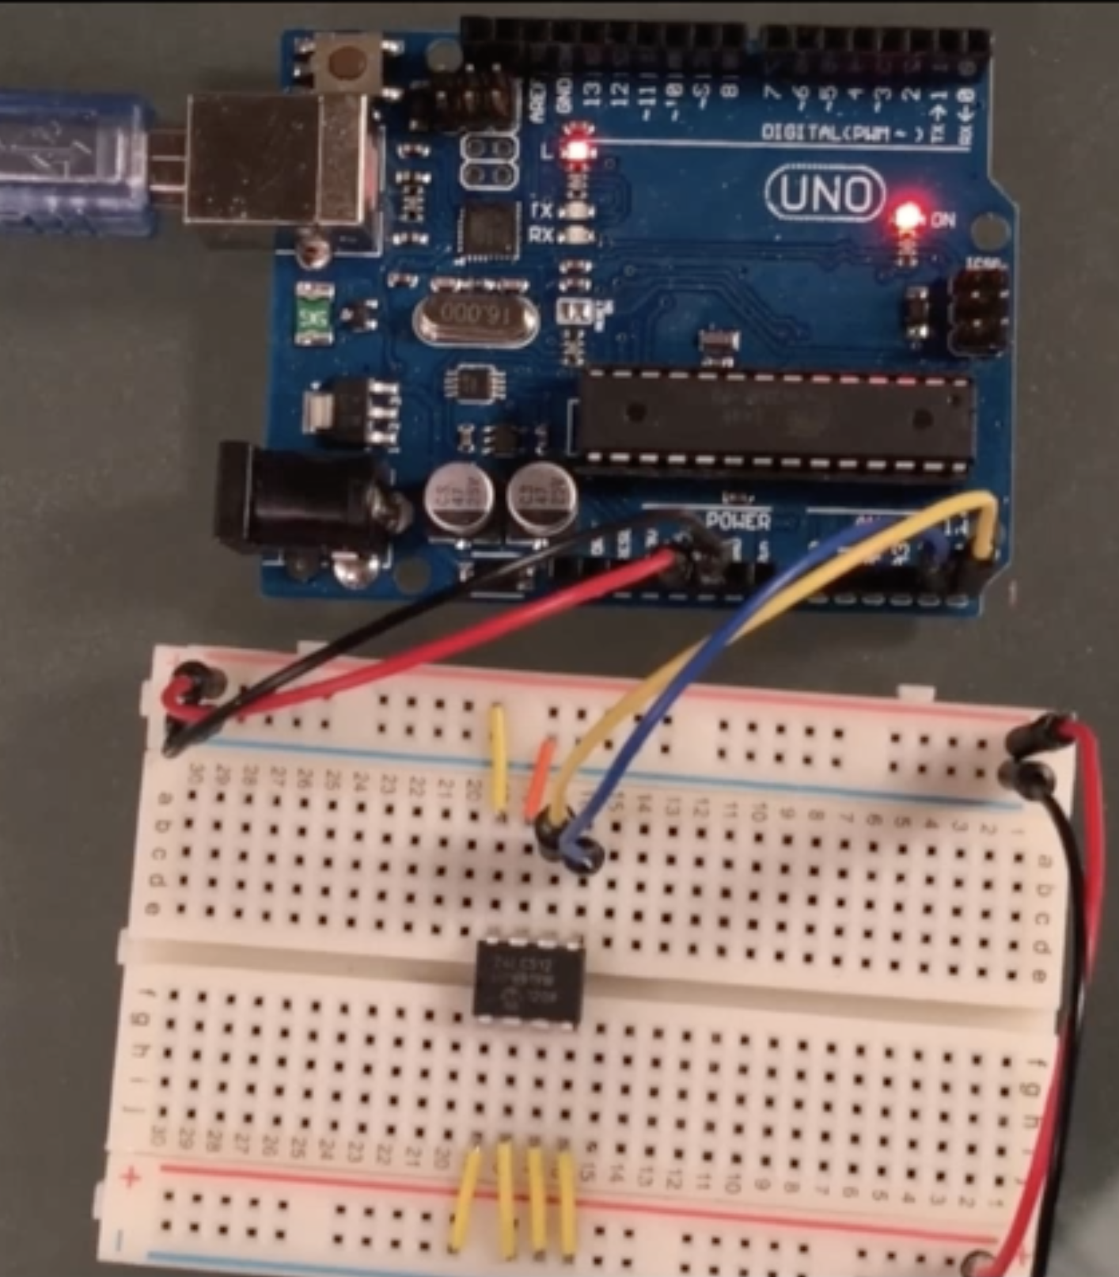
Control & GNSS Subsystem Success and Challenges
Success
Confirmed that the write and read operations for our EEPROM are functioning properly
Conducted proper tests to ensure the stability of I2C communication for consistent data exchange between the devices with Arduino Uno
Designed a PCB that fits within our dimension constraints

Slide 20
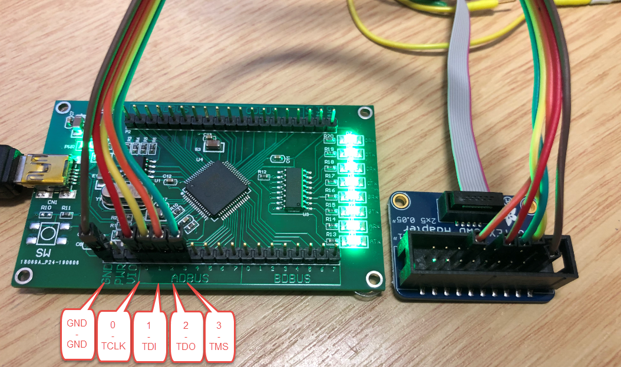
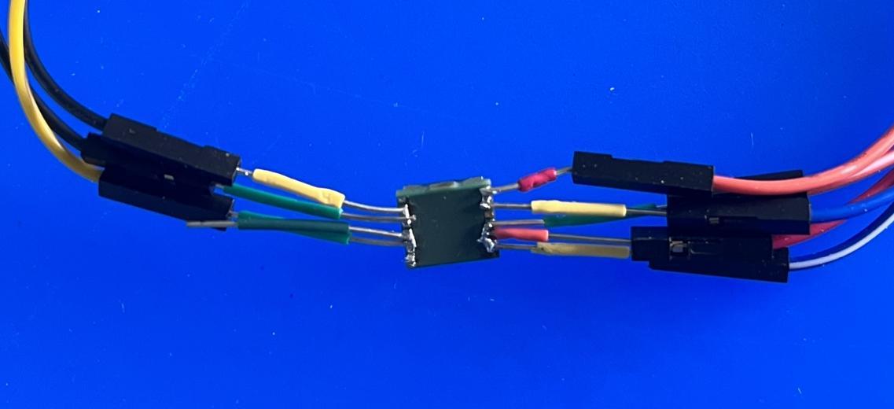
Control & GNSS Subsystem Success and Challenges
Challenges
Difficulty understanding flash memory resulted to a huge delay in the testing phase
ATTINY 1616 MCU has 16k bytes of flash memory
AVR128DA32 MCU has 128k bytes of flash memory
Dealing with microchips with beginner level soldering skills
Debugging process becomes more time consuming
During testing phase, PCBs with pin connectors for each individual pin of the chips would have called for enhanced efficiency of debugging
Minimum resources for programming certain chips in subsystem
Due to the small market of the GNSS MAX M10M, minimum resources and troubleshoot available
The AVR128DA32 MCU uses UPDI programming and debugging interface
JTAG & ISP commonly used
Vs.

Slide 21
Power Subsystem
ELECTRICAL & COMPUTER ENGINEERING
GRAINGER ENGINEERING

Slide 22
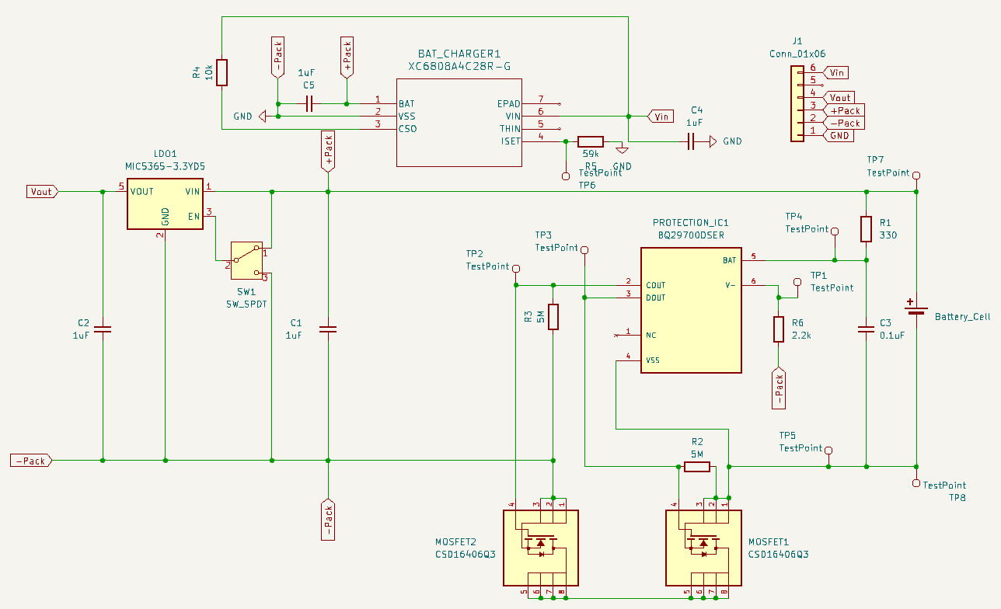
Components
Battery
Weight
Capacity
BMS
Safety
Charger
Current
Voltage
LDO
Voltage
Current
BMS
LDO
Battery
ELECTRICAL & COMPUTER ENGINEERING
GRAINGER ENGINEERING

Slide 23
PCB Design
ELECTRICAL & COMPUTER ENGINEERING
GRAINGER ENGINEERING

Slide 24
Requirements and Verifications
Requirement 1 of 3:
Requirements | Verification | Testing
Provide 3.3V +/- 0.1V from a 3.7V source | Connect the subsystem output to an oscilloscope to ensure that the output voltage stays within 0.1V of 3.3V | Vbattery = 3.7V Vout = 3.26 V
ELECTRICAL & COMPUTER ENGINEERING
GRAINGER ENGINEERING

Slide 25
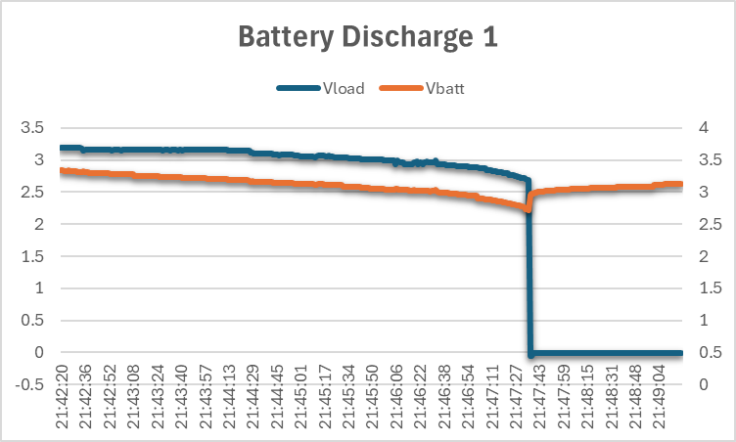
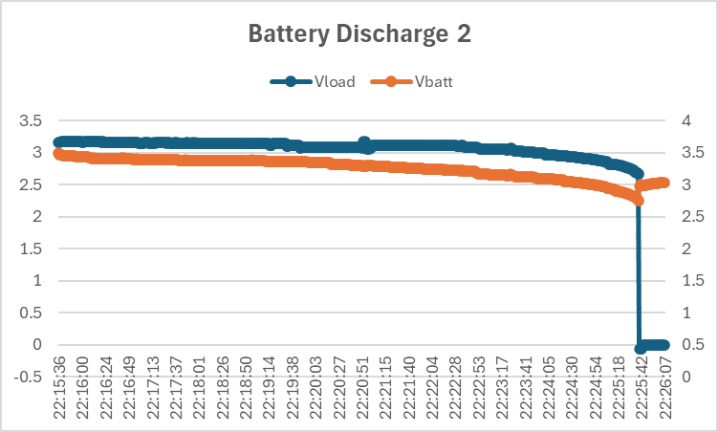
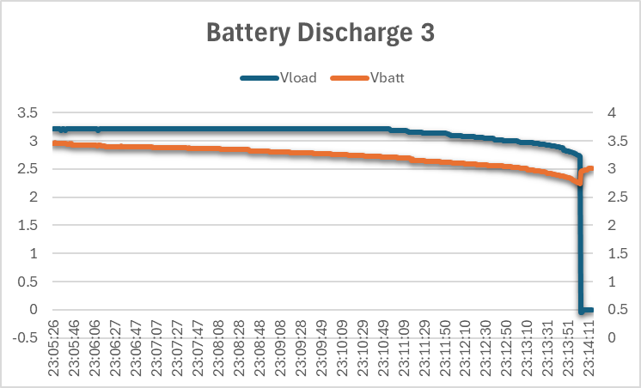
Requirements and Verifications
Requirement 2 of 3:
Requirements | Verification | Testing
- Operating current for standby and max operating current requirements, that is, 110uA and 24mA+/- 1 mA - Discharge Cutoff Voltage | Connect the LDO output to a variable load and measure the current and voltage using an oscilloscope to ensure the minimum current and the max current requirement is met while staying within 0.1V of 3.3V | Blue: Vload Orange: Vbatt I = 25 mA V = 3.3 V R = V / I = 147 Ohms
ELECTRICAL & COMPUTER ENGINEERING
GRAINGER ENGINEERING

Slide 26
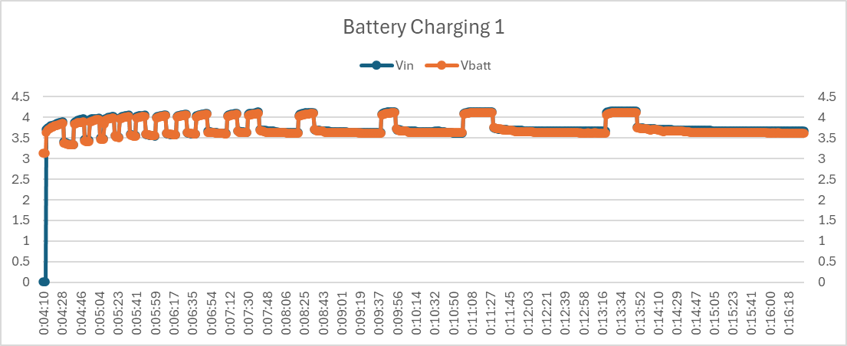
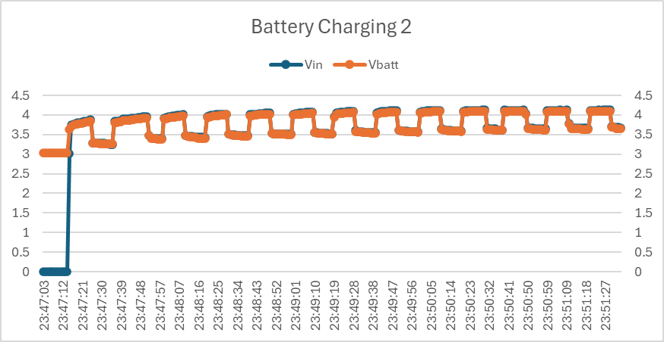
Requirements and Verifications
Requirement 3 of 3:
Requirements | Verification | Testing
The battery charging circuit must be able recharge the battery at its specific current and voltage rates | The battery has a standard charge of 0.2C and a rapid charge of 0.5C. The battery should charge until current declines to <= 0.02C. We can verify this by setting up the circuit separately before the final assembly. The charging circuit and the battery will be connected via banana wires and pins on different PCBs, this is to be able to use a current probe in such a small circuit. Once the circuit is tested, the final product will have the components in one PCB. | Blue: Vpack & Vin Orange: Vbattery
ELECTRICAL & COMPUTER ENGINEERING
GRAINGER ENGINEERING

Slide 27
Conclusion
ELECTRICAL & COMPUTER ENGINEERING
GRAINGER ENGINEERING

Slide 28
Conclusion
What did we Learn?
Enhanced Computer Aided Design Skills
Problem Solving
Technical Writing and Communication Skills
Soldering/Soldering Oven
Expanding our Knowledge on Programming Microcontrollers
Research methods for components
Contacting companies for parts
ELECTRICAL & COMPUTER ENGINEERING
GRAINGER ENGINEERING

Slide 29
Conclusion
What would we do differently?
Alter our debugging strategy in order to have more efficient testing
During part ordering, purchase more backup parts in case of emergencies
EEPROM were backordered
Prior to confirming parts, ensure resources and troubleshooting is available if necessary
Test points, Test points, Test points
ELECTRICAL & COMPUTER ENGINEERING
GRAINGER ENGINEERING

Slide 30
Future Work
Fully integrate all subsystem within the initial dimension constraints of <21x13x5 mm
Find solution to allow functionality between the GNSS and microcontroller.
Construct it to be more user-friendly for other departments to utilize in their research
Build a custom PCB using a lighter material
ELECTRICAL & COMPUTER ENGINEERING
GRAINGER ENGINEERING

Slide 31
Thank You! Any Questions?
Special thanks to, Josie Hoppenworth
Team 35
Romin Patel, Hoguer Benitez, Lilian Rafferty

