Slide 1
Guitar Harmonizer Synthesizer
ECE 445 Final Presentation
Group 28
Danielle Lange
Madhav Khirwar
Ishan Jain

Slide 2
Overview
Going to discuss the problem and intended solution of product
ECE 445
GRAINGER ENGINEERING

Slide 3
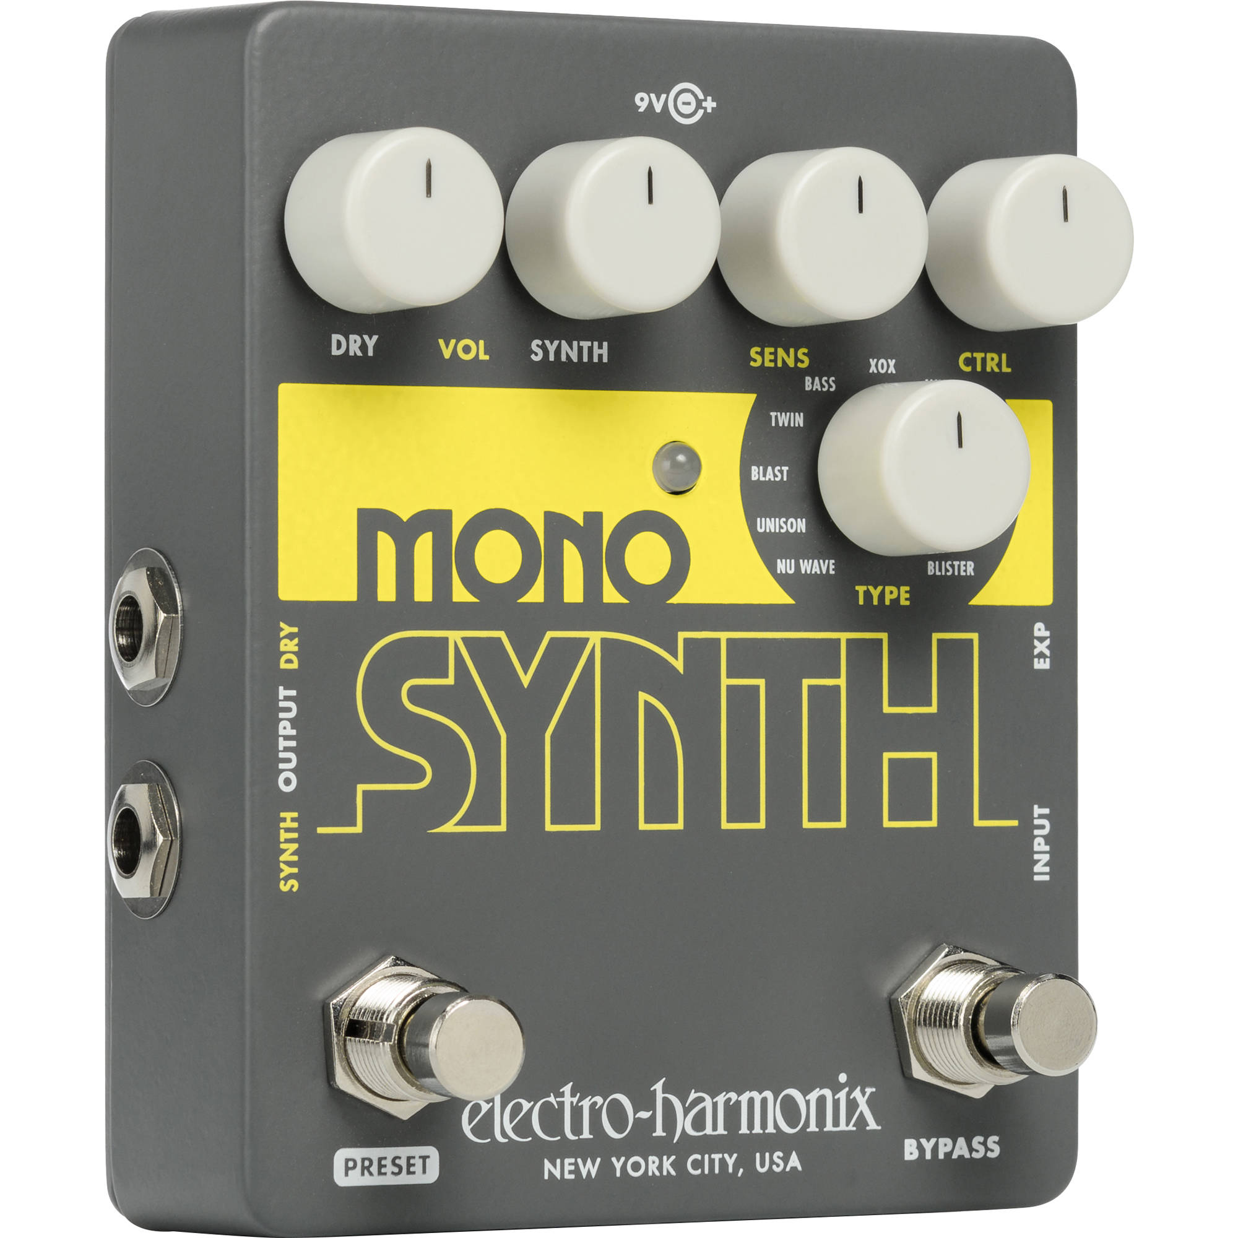
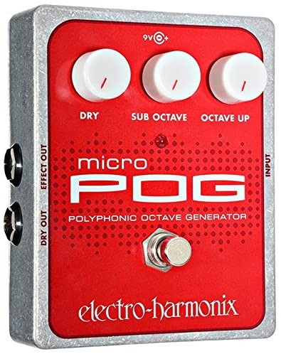
Background and Problem
Helpful Background Knowledge
Guitar pedal- alters the sound of a guitar
Synthesizer- creates musical sounds by generating waveforms (electronic music)
Octave- different pitches between octaves, each octave above/below is double/half current octaves frequency
The Problem
Doubling/harmonizing original guitar note with an altered and synthesized note
Requires re-recording
Often done note for note
Directly proportional to complexity of guitar part
ECE 445
GRAINGER ENGINEERING
Notes:
Guitarist are unable to harmonize their guitar notes and synthesize without having to re-record and manually overlay synthesized parts over the audio recording

Slide 4
Solution
Guitar Synthesizer Pedal
Harmonizes with original guitar note
Can be used in a variety of musical contexts - to double or provide backing harmonies for a melody
All happens in real time
ECE 445
GRAINGER ENGINEERING

Slide 5
Design
Includes summary of original design and changes to the design
ECE 445
GRAINGER ENGINEERING

Slide 6
Original Design
Block Diagram
ECE 445
GRAINGER ENGINEERING

Slide 7
Changes to Design
Midi
Due to late shipment of Midi cable were not able to verify
Combinational Logic
Changed to be in software
DAC board
Decreased price and reduced PCB footprint
Input Buffer
Changed to adapt to using Teensy’s Analog input instead of audio board
Physical design
Changes the rotary potentiometers to switches
Better for ease of use
More flexibility in selecting harmonies
Status
Optimized
Work in progress
ECE 445
GRAINGER ENGINEERING

Slide 8
Subsystem Design & Functionality
Go through each functional subsystem of design explaining its purpose, functional requirements, and verifications
ECE 445
GRAINGER ENGINEERING

Slide 9
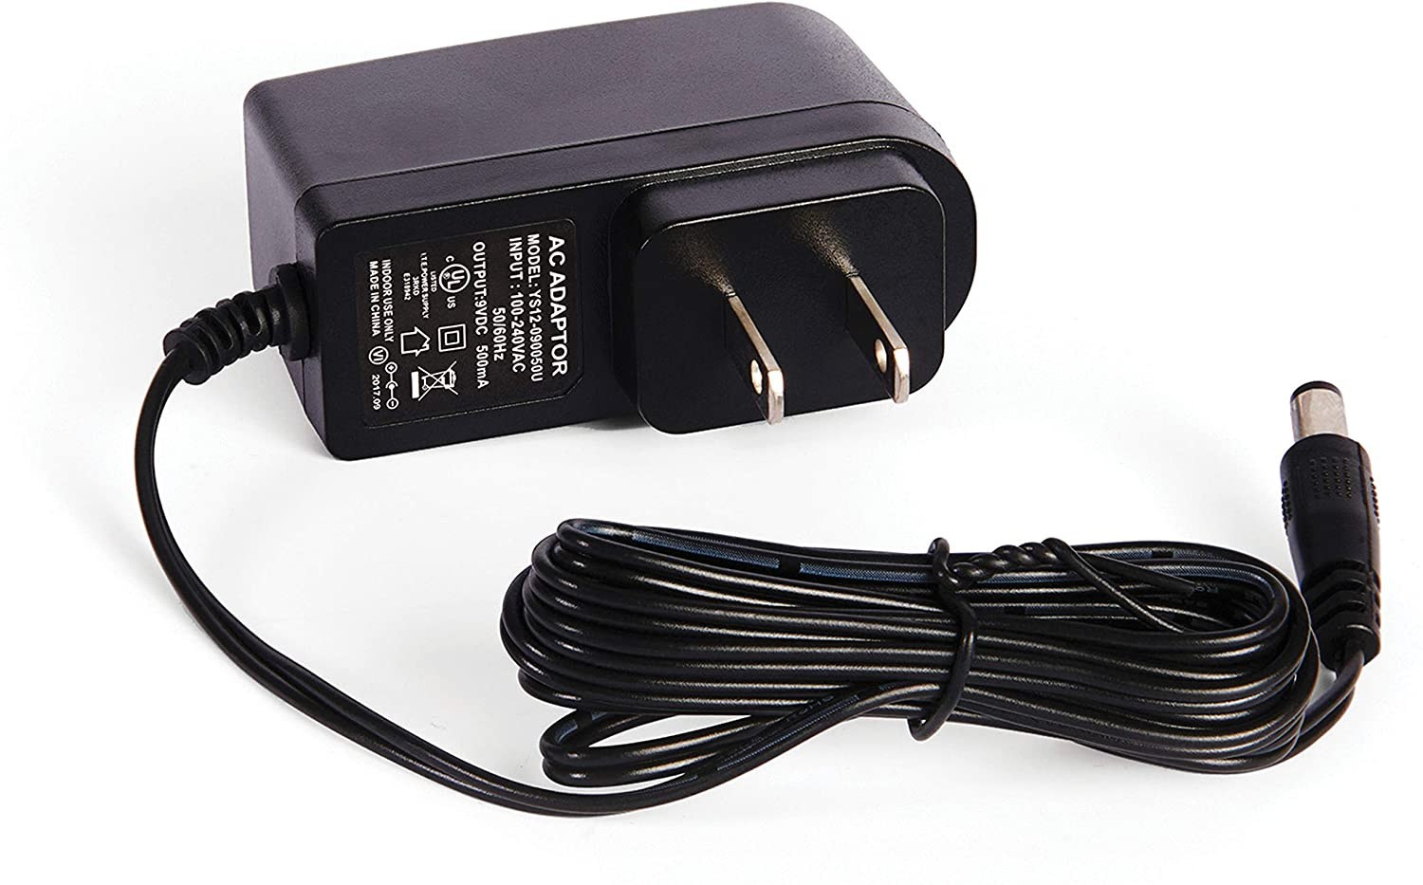
Power Subsystem
Purpose
Supply DC voltage to hardware subsystems
Functional Requirements
Supply Teensy with 5v
Can never exceed 6v
No overheating past 40°C
Work with standard 9v power supply
ECE 445
GRAINGER ENGINEERING

Slide 10
Input Buffer
Purpose
Bring signal within voltage range of audio input to the Teensy (0v-1.2v)
Original Functional Requirement
Divide guitar signal peak to peak voltage by 3
New Functional Requirement
Signal DC offset 0.6v
Input constants signal
Multimeter reading: 0.598v
ECE 445
GRAINGER ENGINEERING
Notes:
Explain why impedance is important
0.

Slide 11
ADC Subsystem
Analog Input for 16 bit ADC at 44.1 kHz
Purpose
To receive data from the input buffer and digitize it.
Functional Requirements
Accurately read frequencies between 82Hz and 1320 Hz.
For this, we tested the ADC 50-1500Hz
Signal distortion at ADC should be 5% max, so as to not be read as a semitone higher/lower.
ECE 445
GRAINGER ENGINEERING
Notes:
For ADC, we use the 16-bit CD quality analog input onboard the Teensy 3.2, a popular digital signal processing chipset. We buffer and gainstage the guitar input signal before it is supplied to the Teensy in order to increase the impedance as well as attenuate the headroom to 3.3V peak-to-peak, with the maximum signal amplitude itself being 2.4V peak-to-peak.
For DAC, we built a circuit around a PT8211 DAC chip which adds 16-bit CD quality DAC capabilities, and buffer the output of the DAC as well as ensuring that the headroom is back to the original 9V of the guitar input signal.

Slide 12
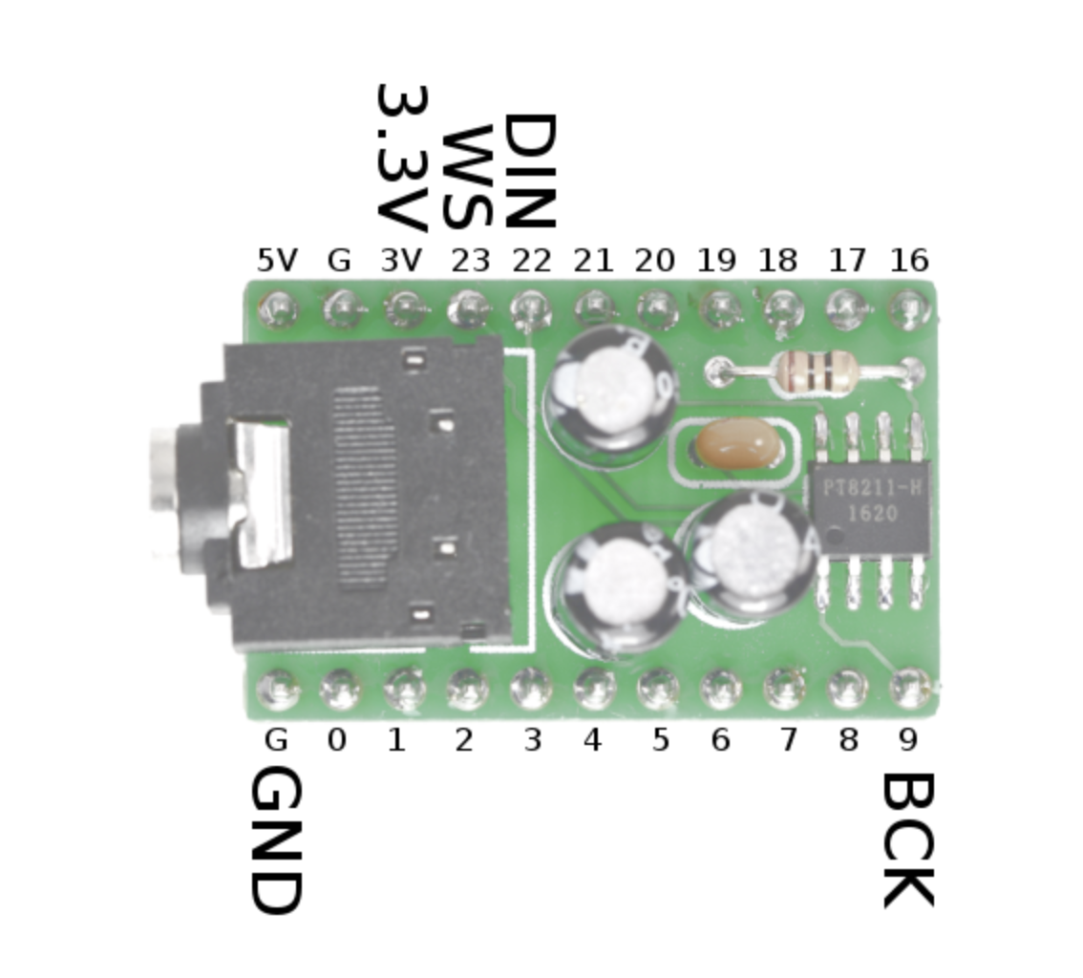
DAC Subsystem
Purpose
To convert digitized output to analog and send it to output buffer
Functional Requirements
Accurately output frequencies between 82 Hz and 3000 Hz
For this, we tested the DAC between 50-3000Hz
Signal distortion at DAC should be 1% max so as to be in tune
Analog Output for 16 bit DAC at 44.1 kHz
ECE 445
GRAINGER ENGINEERING
Notes:
For ADC, we use the 16-bit CD quality analog input onboard the Teensy 3.2, a popular digital signal processing chipset. We buffer and gainstage the guitar input signal before it is supplied to the Teensy in order to increase the impedance as well as attenuate the headroom to 3.3V peak-to-peak, with the maximum signal amplitude itself being 2.4V peak-to-peak.
For DAC, we built a circuit around a PT8211 DAC chip which adds 16-bit CD quality DAC capabilities, and buffer the output of the DAC as well as ensuring that the headroom is back to the original 9V of the guitar input signal.

Slide 13
Digital Signal Processing
Purpose
To recognize what note the guitarist has played
To calculate the harmonies
To generate waveforms
Functional Requirements
Resolve to the correct note within 5 ms (tie break to higher note)
Should be able to calculate: unison, major/minor 3rd, perfect 5th, major/minor 7th, octave.
Allow choice of waveforms between Square/Sine/Sawtooth.
ECE 445
GRAINGER ENGINEERING

Slide 14
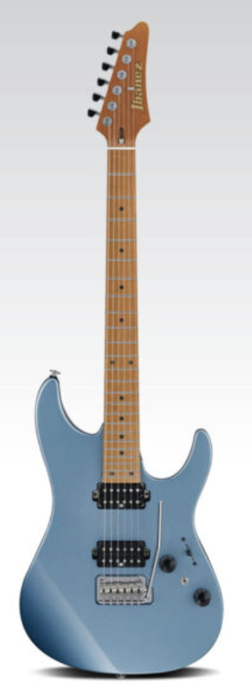
Digital Signal Processing
Step 1: Recognise the frequency:
YIN Algorithm for real-time fundamental frequency estimation
Output frequency with the largest amplitude
Implementation works for frequencies up to 4000 Hz
Step 2: Recognise the note:
Guitar has 49 distinct notes on a 24 fret guitar
Stored in a sorted array
Use binary search to find closest ‘correct’ note according to 12 TET
O(log n), where n is 49 ≈ 6 operations per note
ECE 445
GRAINGER ENGINEERING
Notes:
Intonation differences, string tension, fretting tension

Slide 15
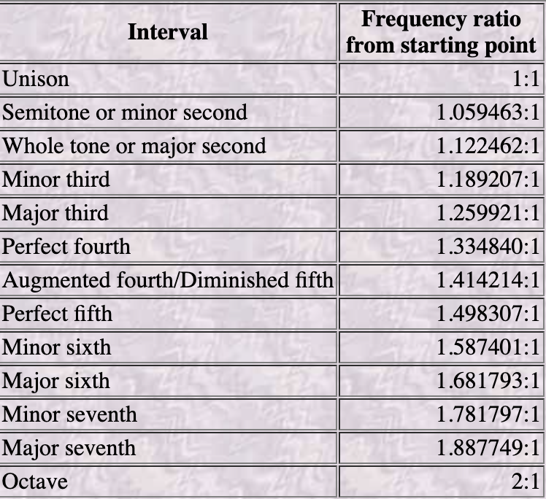
Digital Signal Processing
Step 3: Calculate Harmonies:
Intervals in 12 TET can be expressed as real numbers
Product of interval multiplier with note = note at interval
E.g. A at 440 Hz * 1.49831 = 659.2564 which is E
Step 4: Generate Waveforms:
If required, change frequencies of all switched on waveforms
If required, change shape of output waveform
If MIDI cable/port are attached, MIDI signals for notes are automatically sent to connected synth/DAW.
ECE 445
GRAINGER ENGINEERING
Notes:
Intonation differences, string tension, fretting tension

Slide 16
Combinational Subsystem
Purpose
Combine original guitar signal with synthesized signal
Functional Requirements
Original signal and synthesized signal are level-balanced
Now because gain in defined is software
ECE 445
GRAINGER ENGINEERING

Slide 17
Output Subsystem
Purpose
Reverse the 3v division from the input buffer
Functional Requirements
Multiply the peak to peak voltage by 3
ECE 445
GRAINGER ENGINEERING
Notes:
Increases clarity

Slide 18
Results
Demonstrate the results of the project along with challenges and successes
ECE 445
GRAINGER ENGINEERING

Slide 19
Demo Video
ECE 445
GRAINGER ENGINEERING

Slide 20
High Level Verifications
Latency
Want each note to have latency of <10ms
Roughly a 5ms delay end to end
Convenience
Makes overall music production and performance significantly more convenient for the guitarist.
ECE 445
GRAINGER ENGINEERING

Slide 21
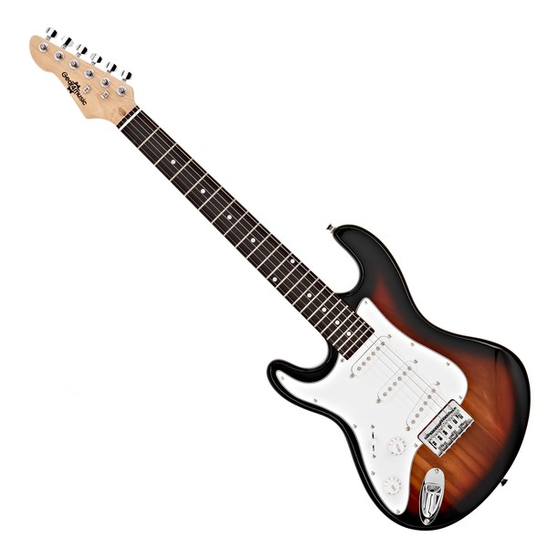
Challenges & Successes
Demo Failure
Teensy overheated and broke
Possible reasons for failure
A short between wires while trying to enclose design
The 5v power accidentally connecting to 3.3v pin
Successes
Overall achieved great sound output
Achieved a final working project
Developed a product useful for musicians both in a studio and live context
ECE 445
GRAINGER ENGINEERING

Slide 22
Conclusion & Future Work
What did you learn?
How to make a PCB design properly
How to make hardware and software design decisions.
How to adapt our design to changing and updated goals.
Future work includes:
adding functionality to select a scale
generate harmonies that are diatonic
Redesigned differences:
Maybe should have stuck with Audio Shield
Higher cost, but more reliable results for ADC
ECE 445
GRAINGER ENGINEERING

