Slide 1
Charging & Depositing Charged Metal Particles
Group 10 - Logan Marlow with David Rubrecht
ECE 445 Senior Design of Spring 2017

Slide 2
Introduction
Current techniques for 3D printing metal items are material inefficient and cannot be scaled to large print volumes. By contrast, a plastic 3D printer does not have those same concerns, primarily due to its central component: the extruder head.
Our ultimate goal, place an electrical charge onto metal powder particles, use that charge to levitate small groups of particles using dynamic electric fields. With these particles now thermally isolated, heat to liquid and drop.

Slide 3
Directives
Accumulate charge onto metal powder
Drop small groups of charged particles accurately
Simple interface to drop particles

Slide 4
System Overview
Electrical
Power Supply
Charging Driver
Motor Driver (and Stepper Motor)
Control Unit (Microcontroller and User Interface)
Mechanical
Charging Drum
Powder Chamber
Software
Embedded C for driver control and user input

Slide 5
System Overview
Electrical
Mechanical
User Interface
Motor and Driver
Charging Drum
Microcontroller
Charging Driver
Powder Chamber
Power Supply

Slide 6
Electrical Overview
Power Supply
Takes 120Vac wall power, converts into 24V and 5V DC.
Charging Driver
Controls the voltage and current delivered to the charging drum and powder chamber
Motor Driver
Constant current, controls the bipolar stepper motor’s coils to step and hold the motor.
Control Unit
Takes user input from buttons, outputs state using LEDs and controls drivers.

Slide 7
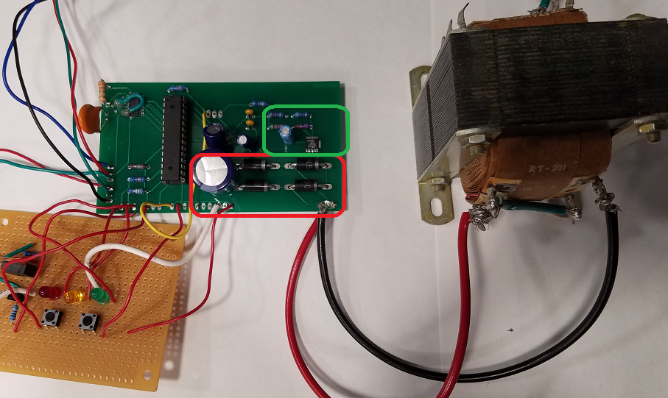
Power Supply
Stancor RT-301 transformer steps 120Vac wall power to 24Vac
Bridge rectification and filtering to 24Vdc
Linear regulation to chop 24Vdc down to 5Vdc

Slide 8
Power Supply Schematic
5VDC
GND
24VDC

Slide 9
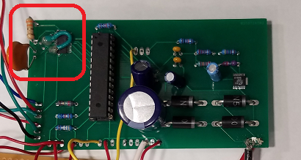
Motor Driver and Stepper Motor
TI DRV8824 chip outputs the current in the correct waveform for the stepper motor
Voltage divider to set the constant current level for the TI
NEMA 17 geared bipolar stepper motor

Slide 10
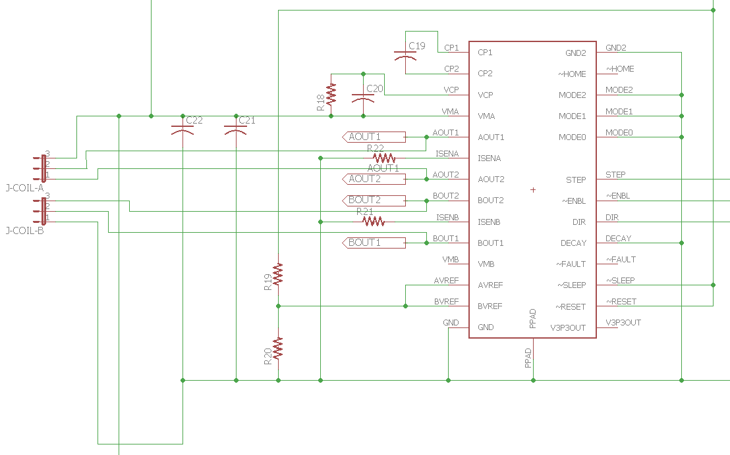
Motor Driver Schematic
5VDC
24VDC
To Motor Coils
GND

Slide 11
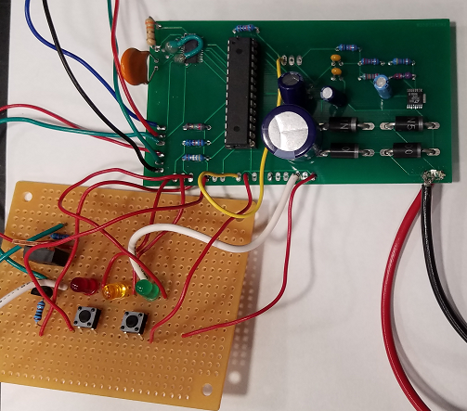
Micro Controller
ATMega328P-PU
Finite State Machine with three states:
Idle,
Ready,
Dispensing
Two button user interface:
On
Dispense
Controls motor and charging unit
LEDs for visual feedback and debugging

Slide 12
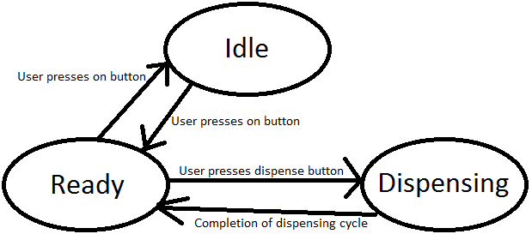
Finite State Machine

Slide 13
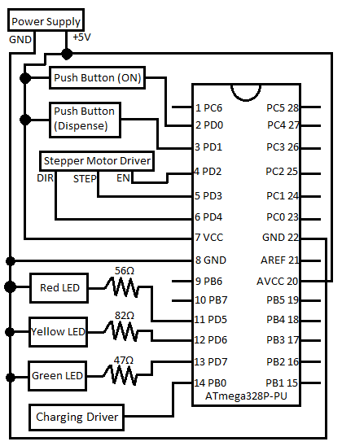
Control Schematic

Slide 14
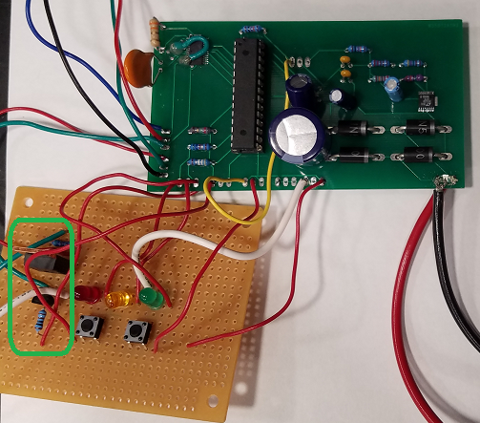
Charging Driver
Controls 24V source to the charging
drum
Allows drum to discharge when not
in use
Controlled by 5V signal

Slide 15
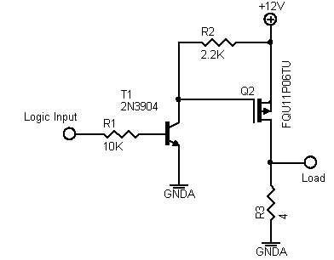
Charging Driver Schematic

Slide 16
Mechanical Overview
Charging Drum
Acts as the capacitive anode in charging
Contains the notch used for dispensing
Powder Chamber
Holds reservoir of titanium powder
Acts as the capacitive cathode in charging

Slide 17
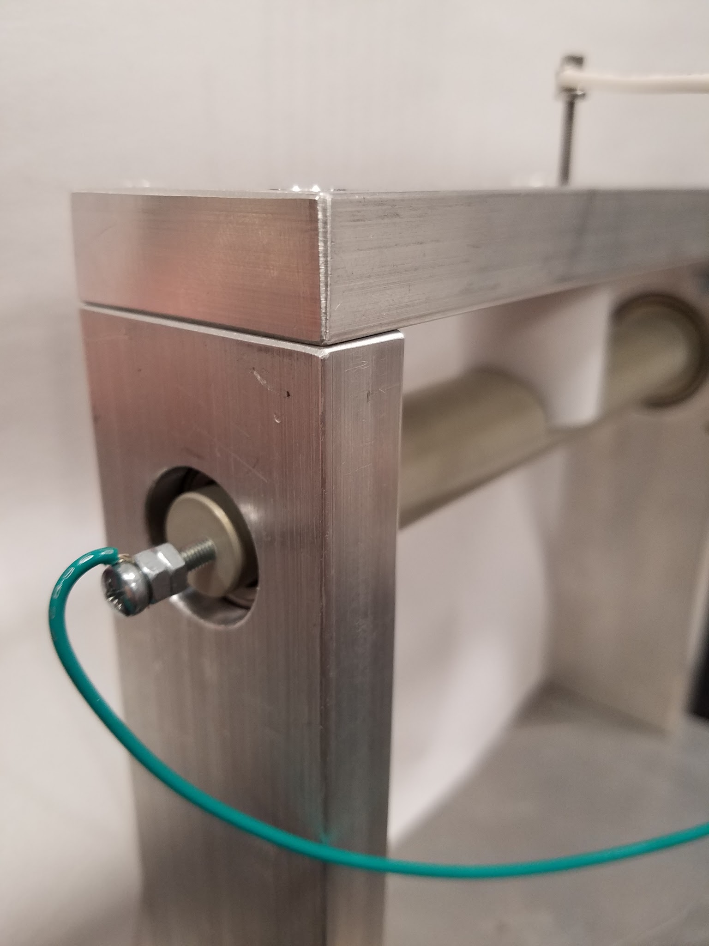
Charging Drum
Uses small notch to collect and remove powder from the powder chamber
Anodization layer allows electrical insulation of the aluminum core to the titanium powder
Rotates with a stepper motor coupled to its central axis

Slide 18
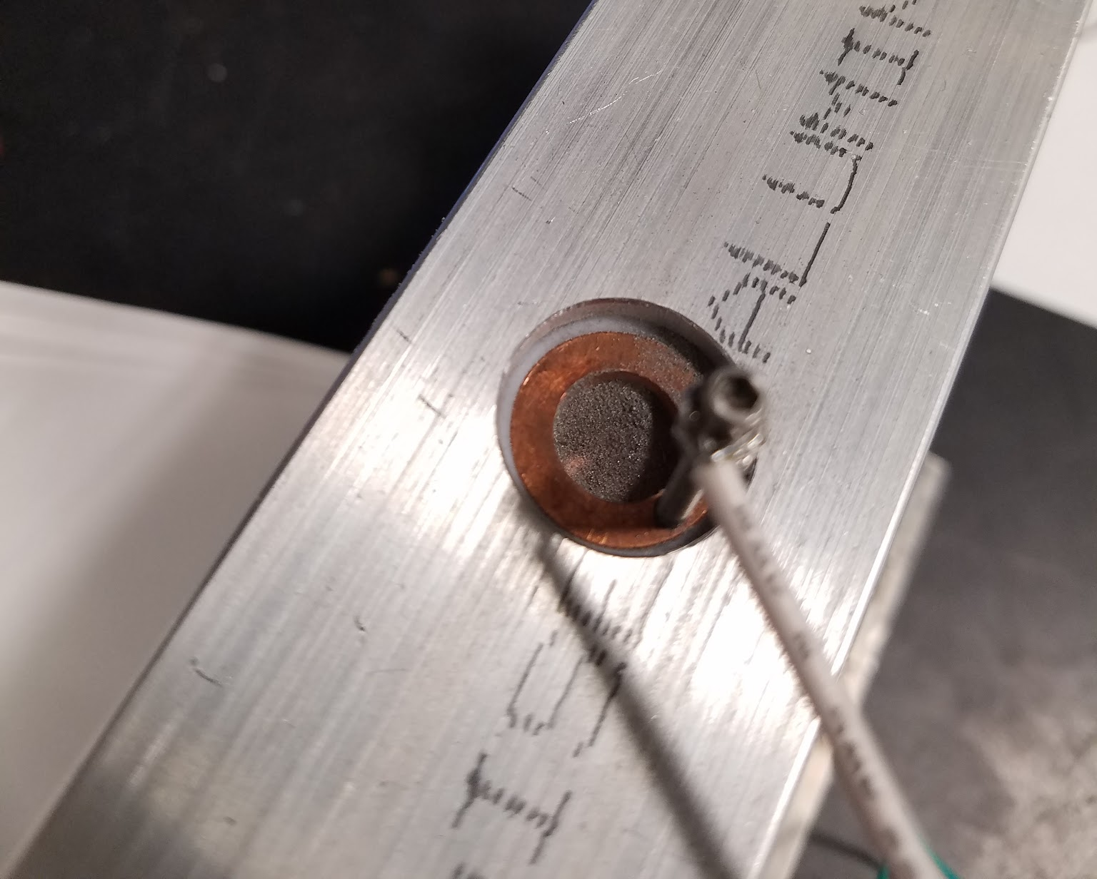
Powder Chamber
Teflon exterior coating electrically insulates chamber from the rest of the chassis
Copper interior allows maximum surface area of contact for held titanium powder, connects titanium powder to ground
Hole in bottom of chamber aligns with notch

Slide 19
Further Electrical Development
Higher voltage charging driver for increased charge per unit mass on titanium powder
Device-PC communication for interfacing as a part of a 3D printer
Addition of infrared sensors to track position of particle clump after dispensing
Array of dynamically powered plates for levitation via electrical attraction

Slide 20
Further Mechanical Development
Brushless DC motor for higher startup torque and speed compared to stepper motors
Thicker anodization layer to allow for a deeper dispensing notch
Top mounted chassis so powder dispensed can be dropped like an extruder head
Larger auxiliary powder chamber that replenishes main powder chamber during usage

Slide 21
SWOT Analysis of Charged Particle Dispensary
Strengths:
Precise charging of particles
Consistent dispense size
Weaknesses:
Insufficient motor strength
Slow dispense rate
Threats:
Oxidation of exposed powder
Metal wire 3D printers
Opportunities:
Large 3D printers
Supports multiple metal
Serial communication

Slide 22
Special Thanks To...
Sam Sagan
Prof. Scott Carney

Slide 23
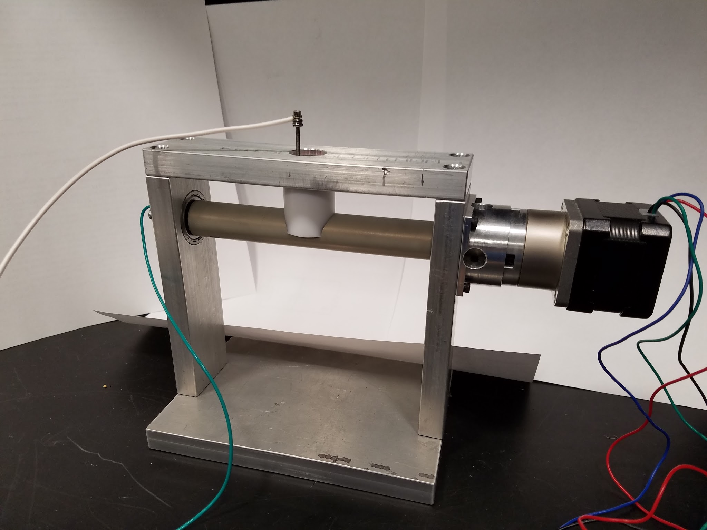
That’s All Folks!

