Slide 1
Solar Powered Rechargeable Battery Pack with Controllable Voltage Output
ECE 445 Senior Design, Spring 2018
Zihao Zhang & Zhuohang Cheng (Team 55)

Slide 2
Introduction
This system have the ability to output different voltage levels to accord with different demand.
This system provides user oriented battery with portability, flexibility, and endurable capacity for the increasing use of battery today.

Slide 3
Design Goals
Self-recharged from both the mounted solar panel and wall plug.
Output a range of DC power (5 V – 48 V ) at 1 A.
Output 120V AC power at 1 A.
Display the voltage, current, and power on the LCD screen while charging or discharging.

Slide 4
System Overview
Hardware
Lead-Acid Battery, AC Battery Charger
DC/DC Converter, DC/AC Inverter, Transformer
Microcontroller, Measurement System, User Interface, Display System
Software
C2000 microcontroller for PWM generation and control
Arduino for measurement and display system control

Slide 5
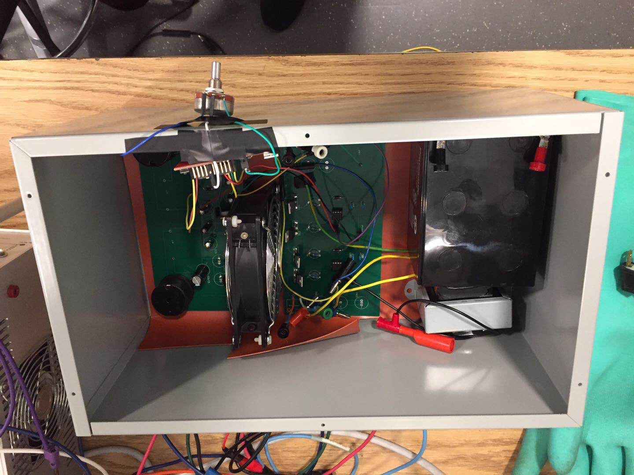
System Overview

Slide 6
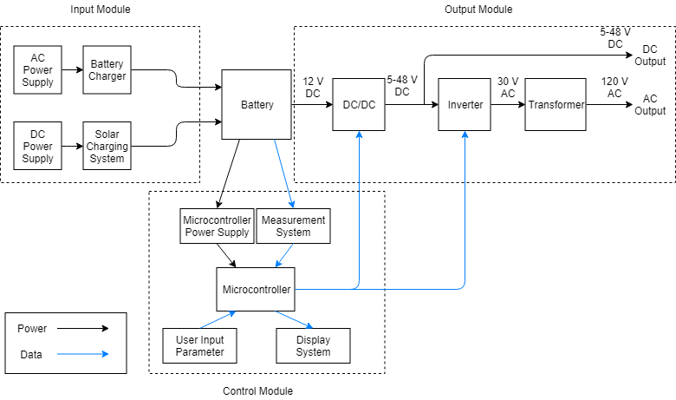
System Overview

Slide 7
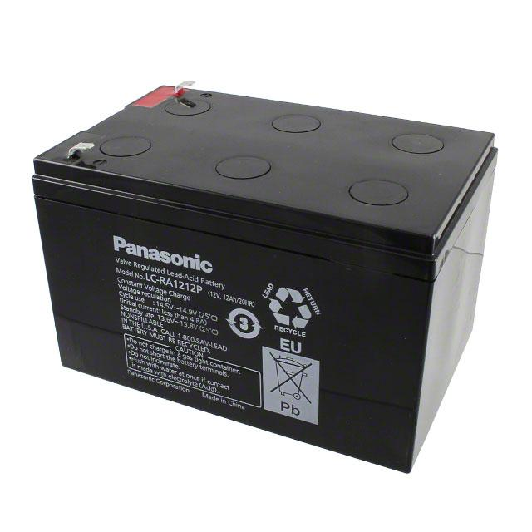
Battery
12 V 12 Ah Lead-Acid Battery
Battery voltage varies 12 – 13.8 V

Slide 8
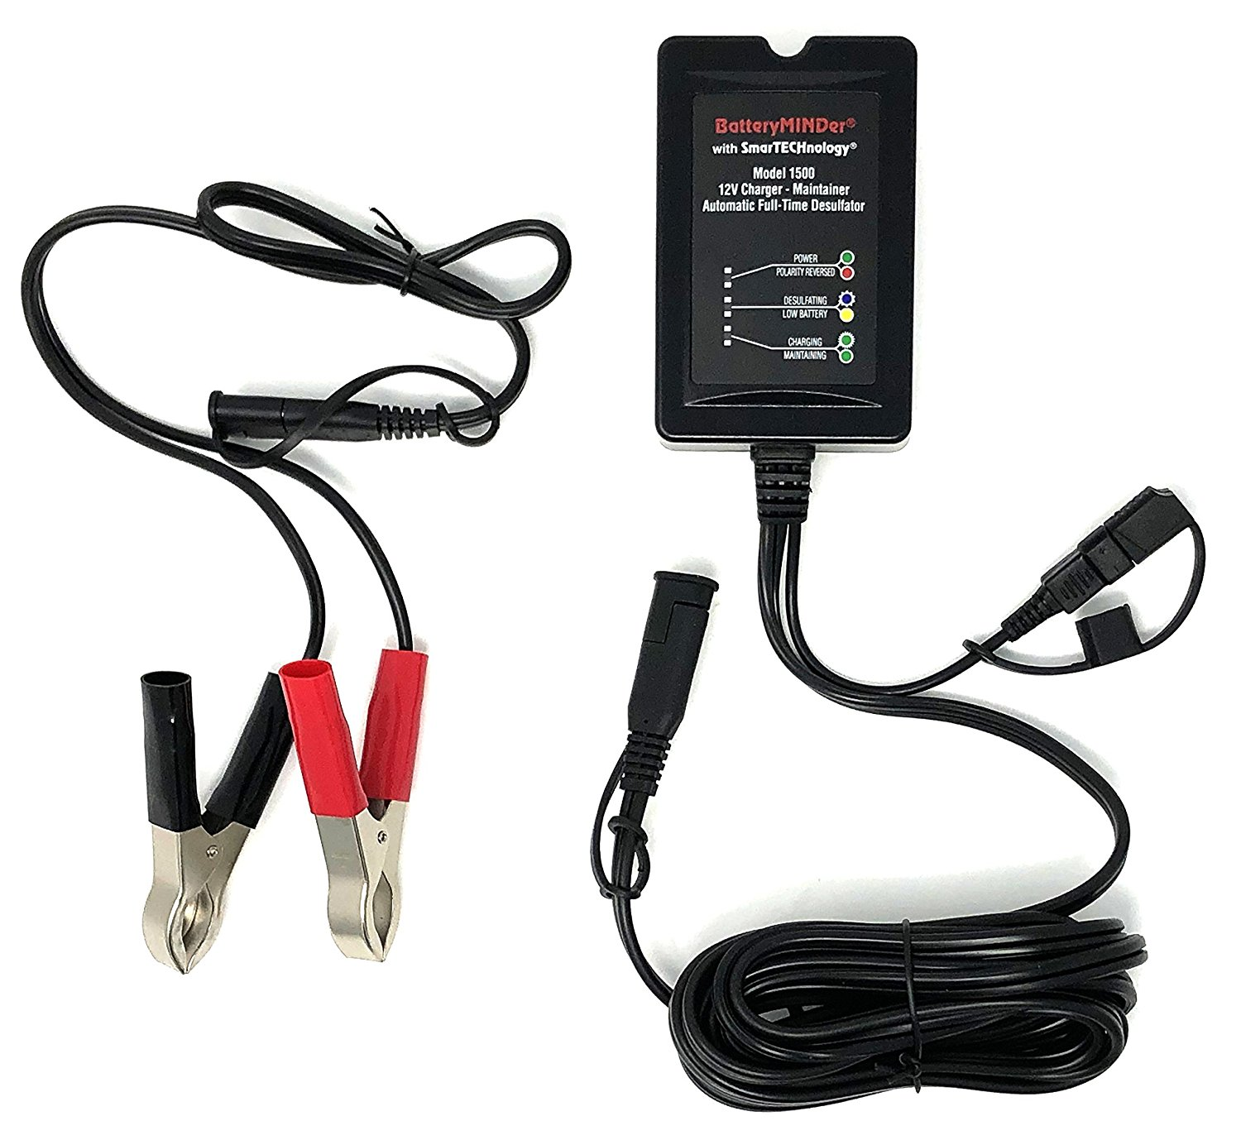
Battery Charger
Lead-acid battery requires an extremely precise charging process.
For safety reason, we used a commercial AC battery charger.
Built-in reverse polarity protection, short circuit protection and over-temperature protection.

Slide 9
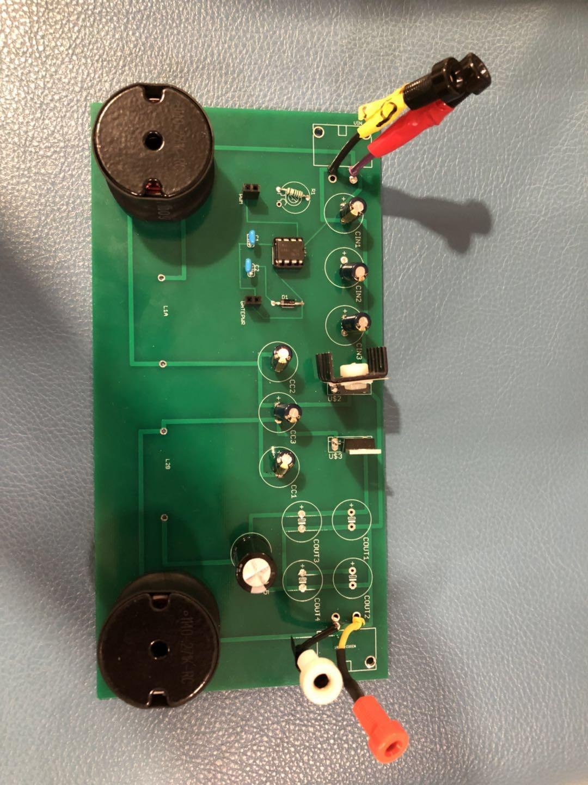
DC/DC Converter: SEPIC Converter
Input Voltage: 12 V
Output Voltage: 5 - 48 V
Maximum Output Current: 1 A
Efficiency: > 70 %
Switching Frequency: 100 kHz

Slide 10
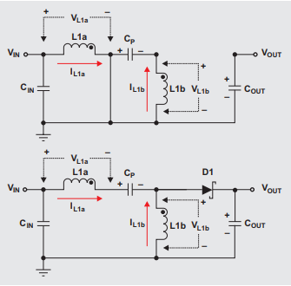
DC/DC Converter: SEPIC Topology

Slide 11
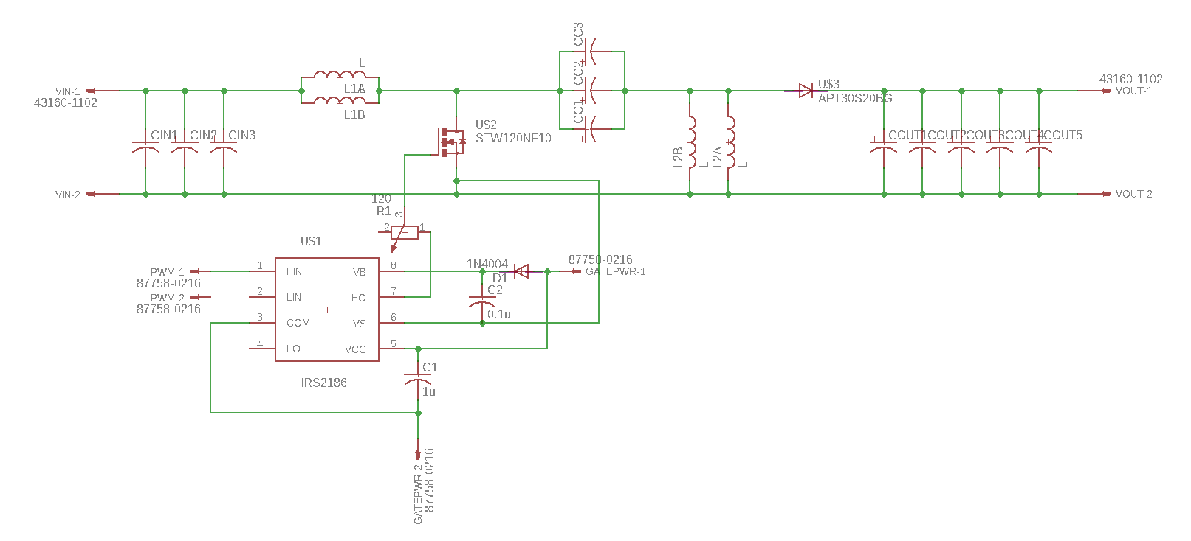
DC/DC Converter: Schematic

Slide 12
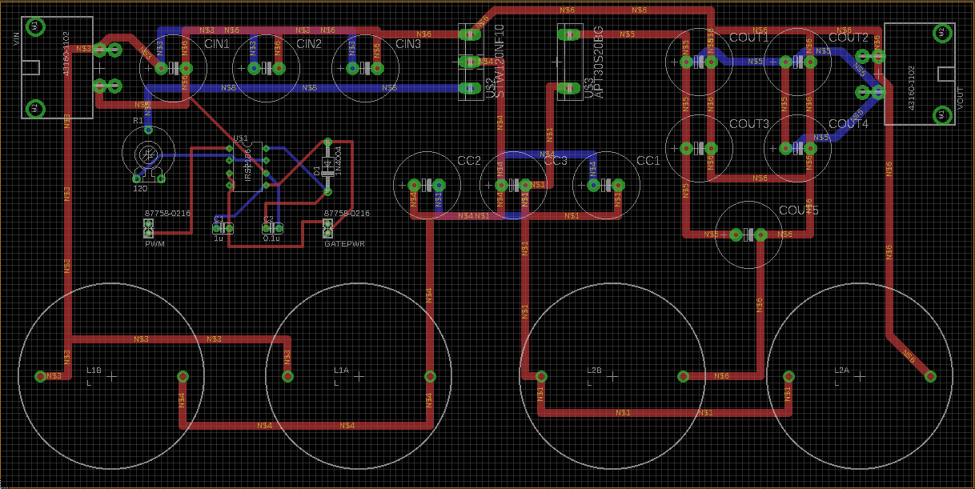
DC/DC Converter: PCB Design

Slide 13
DC/DC Converter: Test Results
Duty Ratio | V_{in} | I_{in} | P_{in} | V_{out} | I_{out} | P_{out} | Efficiency
31% | 12 | 0.576 | 6.928 | 5.102 | 1.003 | 5.122 | 73.9%
46% | 12 | 1.117 | 13.466 | 10.370 | 1.030 | 10.684 | 79.3%
55% | 12 | 1.609 | 19.328 | 15.230 | 1.015 | 15.471 | 80.0%
62% | 12 | 2.268 | 27.237 | 20.676 | 1.040 | 21.525 | 79.0%
67% | 12 | 3.000 | 36.072 | 26.170 | 1.062 | 27.815 | 77.1%
70% | 12 | 3.521 | 42.322 | 30.637 | 1.040 | 31.902 | 75.3%
73% | 12 | 4.390 | 52.690 | 36.198 | 1.059 | 38.098 | 72.3%
75% | 12 | 4.994 | 59.622 | 40.290 | 1.037 | 41.780 | 70.0%

Slide 14
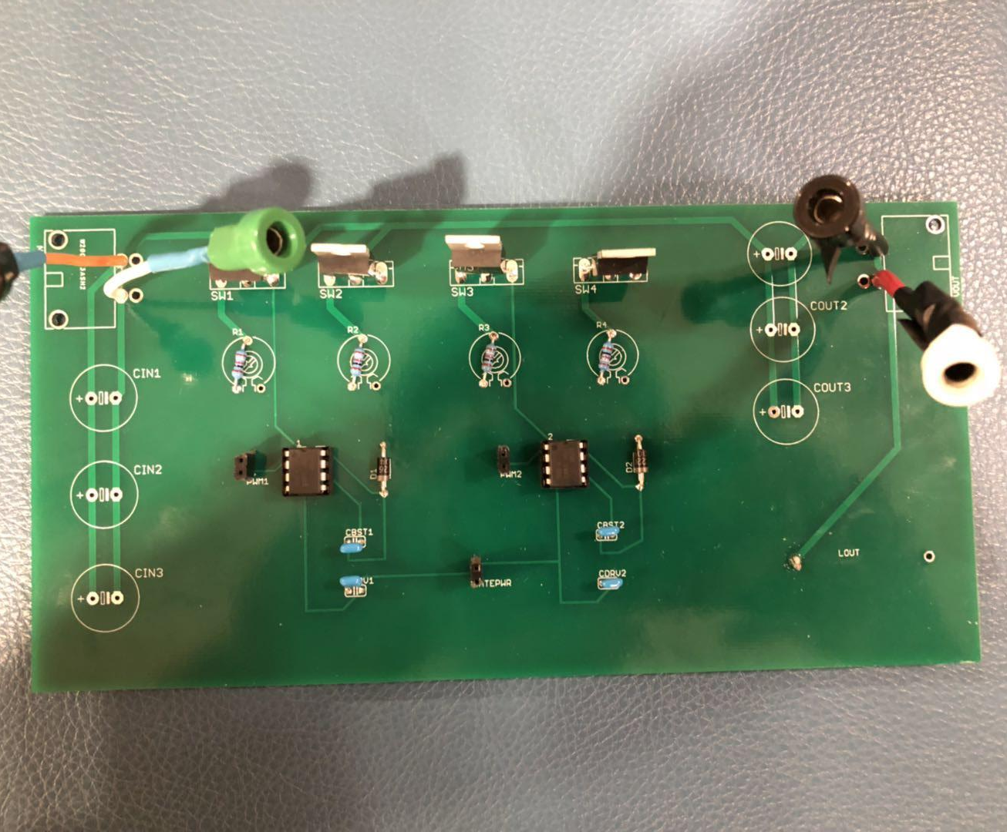
DC/AC Inverter: Full-Bridge Inverter
Input Voltage: 42 V DC
Output Voltage: 30 V_{RMS} AC
Maximum Output Current: 4 A
Frequency: 60 Hz
Eliminate 3rd Harmonic

Slide 15
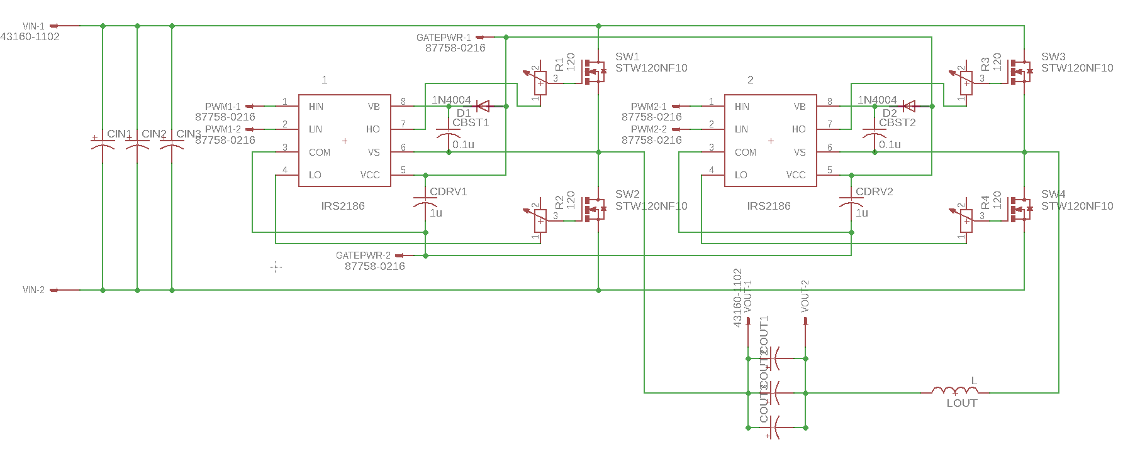
DC/AC Inverter: Schematic

Slide 16
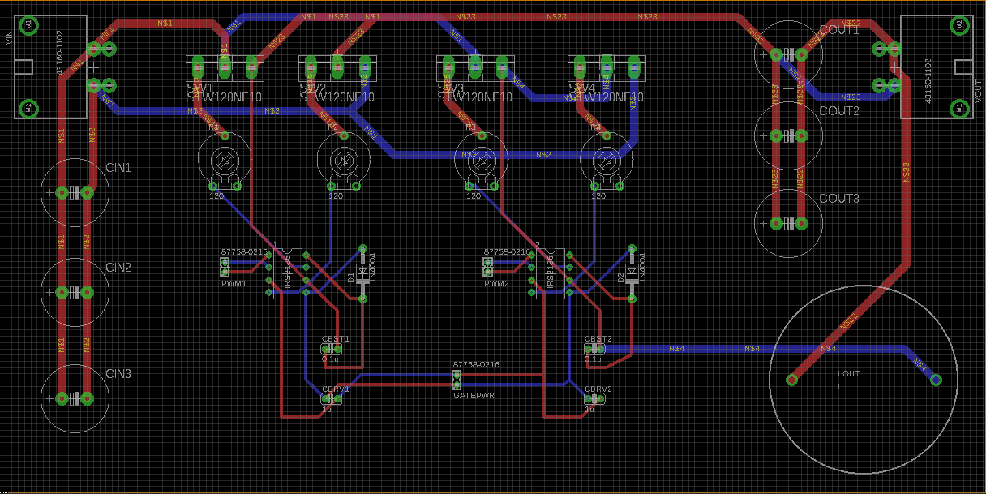
DC/AC Inverter: PCB Design
A design flaw (more on this later)

Slide 17
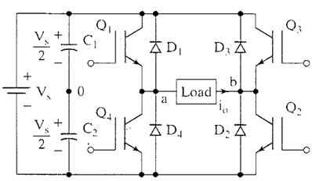
DC/AC Inverter: 3rd Harmonic Elimination
Switch D1 and D2 have 30 degrees phase shift to remove 3rd harmonic.

Slide 18
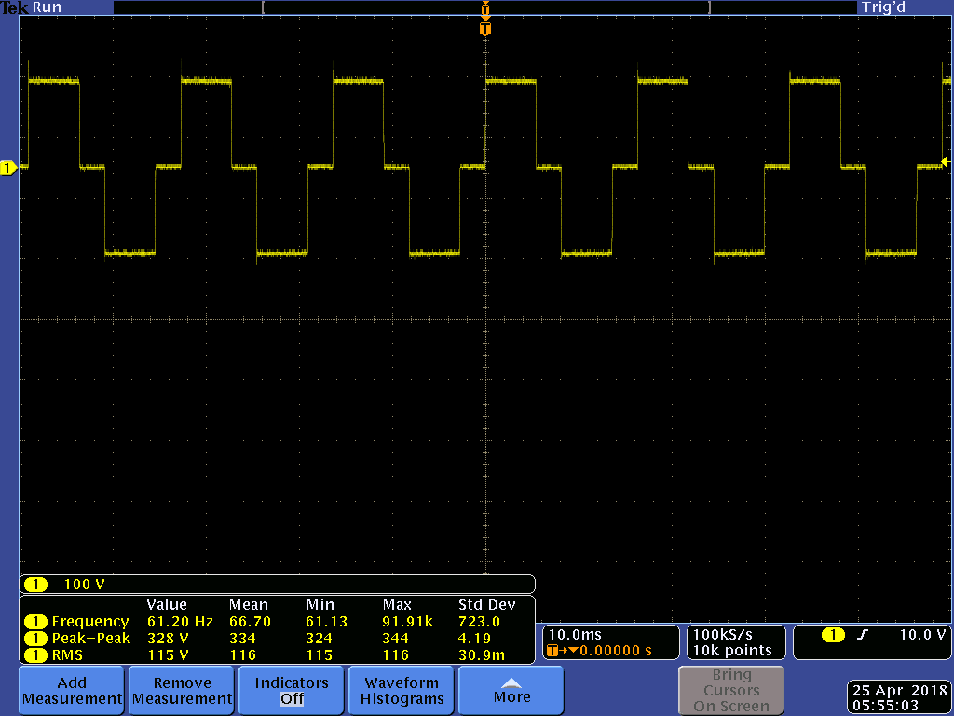
DC/AC Inverter: Test Results

Slide 19
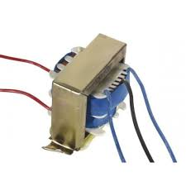
Transformer
Primary Voltage: 115 V
Secondary Voltage: 30 V
Maximum Output Current: 10 A
Inverter + Transformer
Converter + Inverter + Transformer

Slide 20
Software
C2000 Microcontroller
Generate PWM waveform for the gate drivers from both the converter circuit and inverter circuit
Arduino
Perform measurement of the output voltage and current and displace them onto LCD

Slide 21
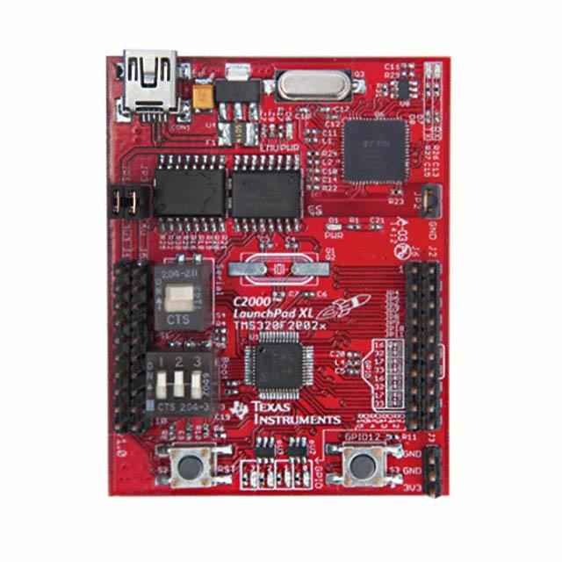
Microcontroller: C2000
Generate 100 kHz PWM wave with variable duty cycle that can be controlled by rotary potentiometer
Generate four 60 Hz PWM waves for the four gate drivers of inverter circuit, each waves would have specific phase shifts

Slide 22
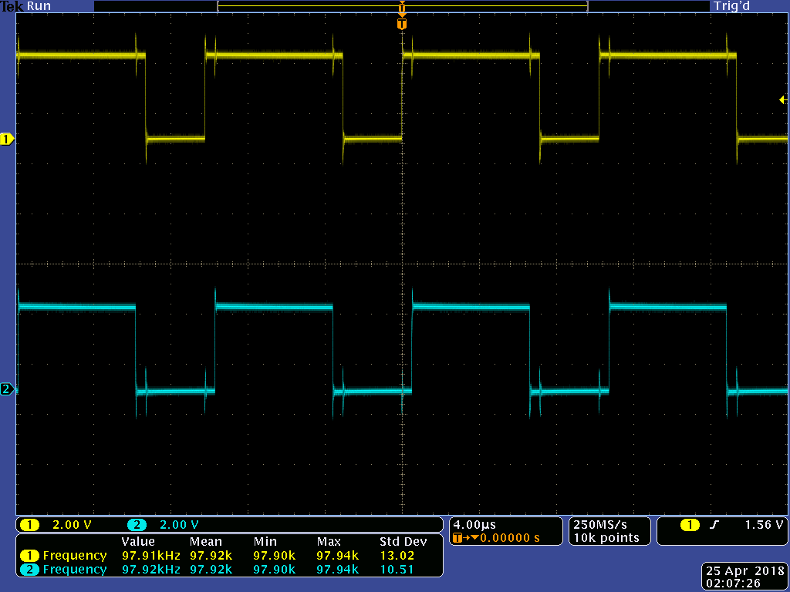
Microcontroller: PWM for Converter
Frequency: 97.92 kHz
Variable Duty Ratio

Slide 23
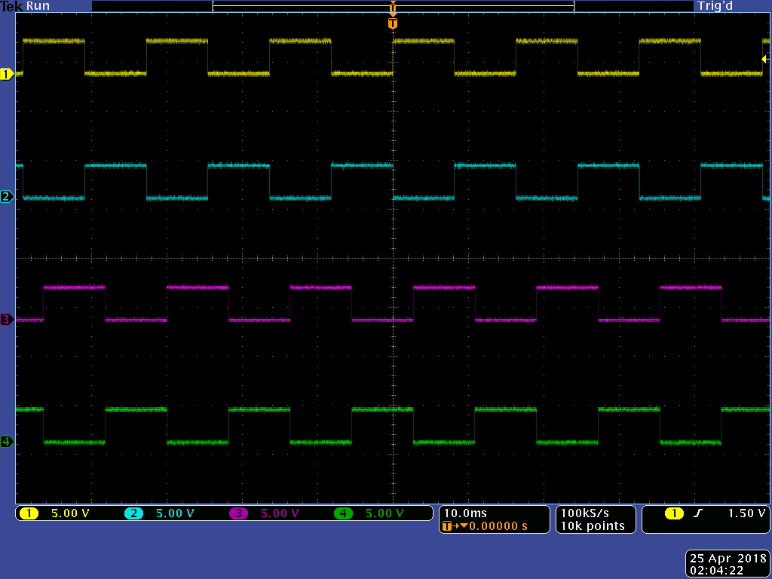
Microcontroller: PWM for Inverter
Yellow and blue are 180° phase shift.
Purple and green are 180° phase shift.
Yellow and purple are 30° phase shift.
Frequency: 60 Hz

Slide 24
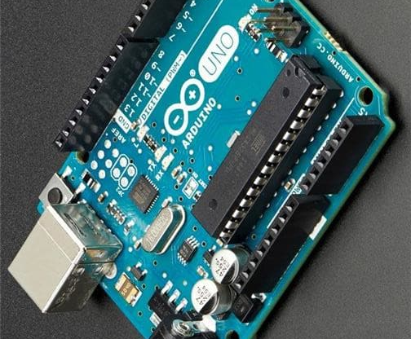
Arduino
Arduino and current sensors are used to measure the DC output voltages and currents of the system and output the data to the LCD screen

Slide 25
Measurement System
Voltage Measurement
Arduino itself is sensitive to analog voltage ranges from 0 to 5 V.
Voltage divider scales down the output voltage to 0 - 5 V.
Current Measurement
ACS711 Hall-Effect Linear Current Sensor
Applied current flowing through this sensor is converted into a proportional voltage sensed by Arduino.

Slide 26
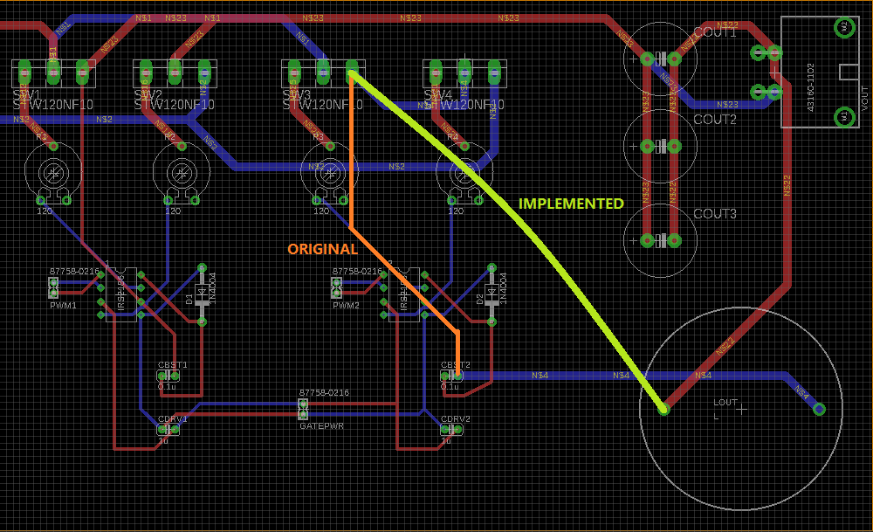
Challenges: PCB Design Flaw
The small logical trace specified is the main trace for power delivery
This burns out a few gate drivers connected with the trace and one of the PCB
Solution: Another wire to deliver power is soldered on the back of our PCB

Slide 27
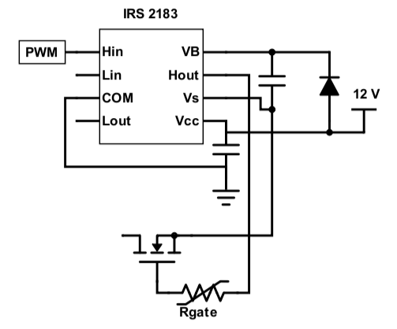
Challenges: Efficiency Improvement
Original MOSFET: STW120NF10 (N-channel 100 V, 110 A, 9.0 mΩ R_{DS(on)}) only works with low side gate driver.
New MOSFET: IRFB4115GPbF (N-channel 150 V, 104 A, 9.3 mΩ R_{DS(on)}) works with both high and low side gate driver.
10% Efficiency improvement

Slide 28
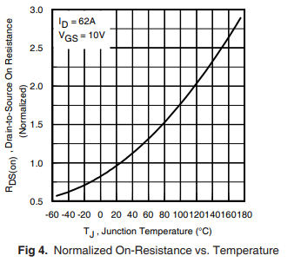
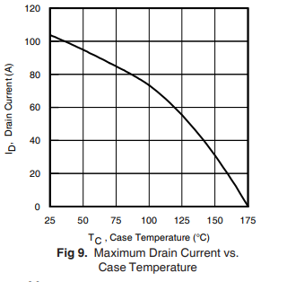
Challenges: Efficiency Improvement
The drain-to-source resistance increases as the temperature increases.
The drain current decreases as the temperature increases.
Significantly reduces the MOSFET’s efficiency.
Output voltage cannot be stabilized due to the efficiency change.

Slide 29
Challenges: Measurement System
The measurement system worked perfectly on the breadboard test
However, it failed when it was soldered on the perfboard for no reason
Solution: Not enough time for replacement

Slide 30
Final Assess: Requirement Achievement
Requirement: Converter | Achievement | Requirement: Inverter | Achievement
DC Input Voltage 12V - 12.8V | achieved | Inverter Output Voltage 30Vrms | achieved
DC Output Voltage 5V - 40V | achieved | Inverter Output Current 1A | achieved
Output Ripple < 5% | achieved | Transformer Output Voltage 120Vrms | achieved
Maximum 1A | achieved | Third Harmonic Elimination | achieved
>= 70% Efficiency | achieved | Transformer Output Current 1A | failed

Slide 31
Final Assess: Requirement Achievement
Requirement: Measurement | Achievement | Requirement: Microcontroller | Achievement
Measure DC Voltage 5V - 40V | achieved | Generate 4 PWM for Inverter | achieved
Measure Current 1A | achieved | Generate PWM with Controllable Duty Cycle for Converter | achieved
Display Measurement on LCD | achieved
Able to Control Output Voltage | achieved

Slide 32
Future Hardware Development
PCBs could be designed more compact
MCU could be integrated into the PCBs to reduce the system size for portability
Solar panels with charging system could be integrated for variable charging method
Battery pack with larger capacity could be selected for better endurance

Slide 33
Thank you!
Questions?

