Slide 1
Sub-Gigahertz Arduino Shield
A
By: Alex Beck and Christopher Baldwin
Group 16
Fall 2020

Slide 2
Problem: There is a gap in the market for cheap, long range, and low power wireless communications.
Solution: Create an Arduino Shield that establishes wireless communications using signals with a frequency less than one gigahertz.

Slide 3
High Level Requirements
The arduino shield must be able to convert a 7-17 DC input voltage into 5 volts for the Arduino.
The arduino must be able to send and receive wireless signals from the remote and execute a pre-programed action upon receiving a signal from the remote.
The remote control must be able to send and receive wireless signals with frequencies lower than 1 gigahertz to the arduino shield.

Slide 4
Outline
Block Requirements
Overview
Part Breakdown
Assembly
Requirements and Verification Results
PCB
Design
Assembly
Improvements
Software
Instruction Set
Thread Breakdown
Screenshots
Future Plans
Conclusion

Slide 5
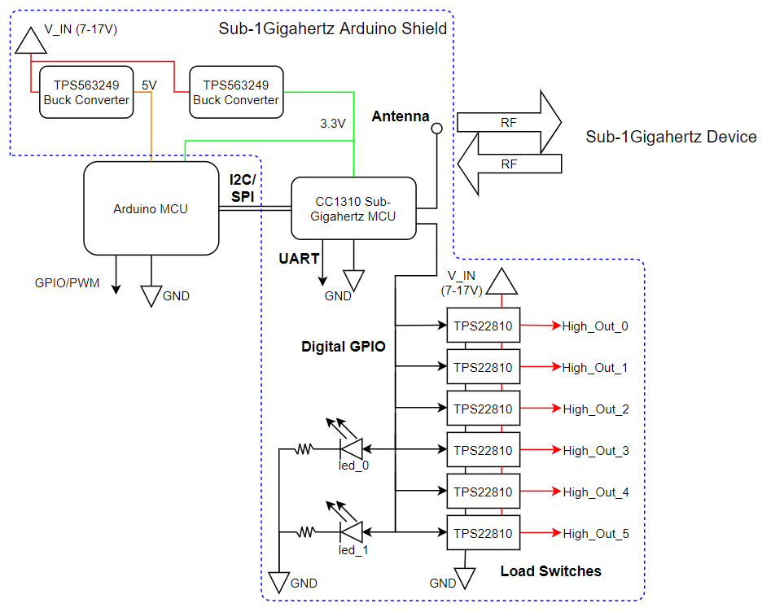
Block Diagram
Arduino
5V Buck Converter
3.3V Buck Converter
Sub-Gigahertz MCU
RF Antenna
Load Switches

Slide 6
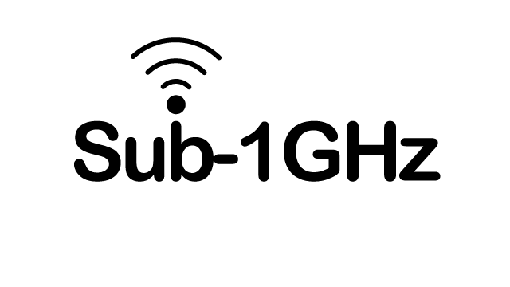
Design Choices
Sub-1Gigahertz vs Wifi, BLE, or Zigbee
Security, Power, and Range
MCU vs Transceiver
Buffering, 5V Tolerance, ADC, AES Encryption, and RF Translation
Buck vs Linear Regulator
Efficiency and Input Range
Load Switch vs Relay or Discrete Transistor
Space, Current Limiting, Quick Output Discharge, and Lower Parasitic Power
https://www.ti.com/wireless-connectivity/sub-1-ghz/overview.html

Slide 7
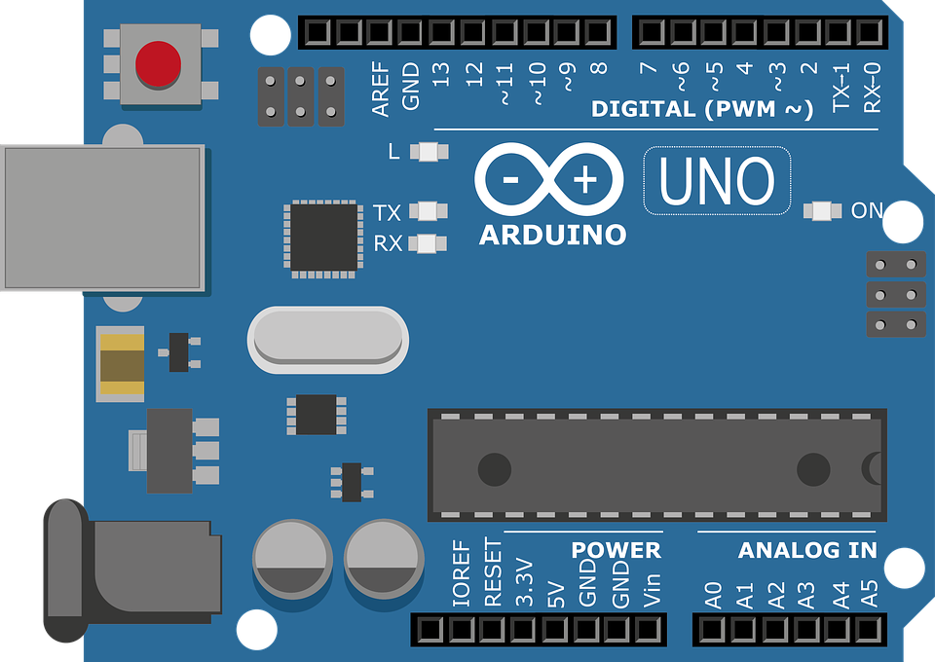
Arduino
Why:
Inexpensive and Open-Source
Library Support
Simple and free IDE
Features:
7-12 V Recommended Input
5 V Digital Output
5 V Digital / Analog Input
SPI/I2C Native Support
https://pixabay.com/illustrations/arduino-arduino-uno-technology-2168193/

Slide 8
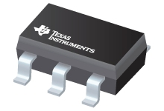
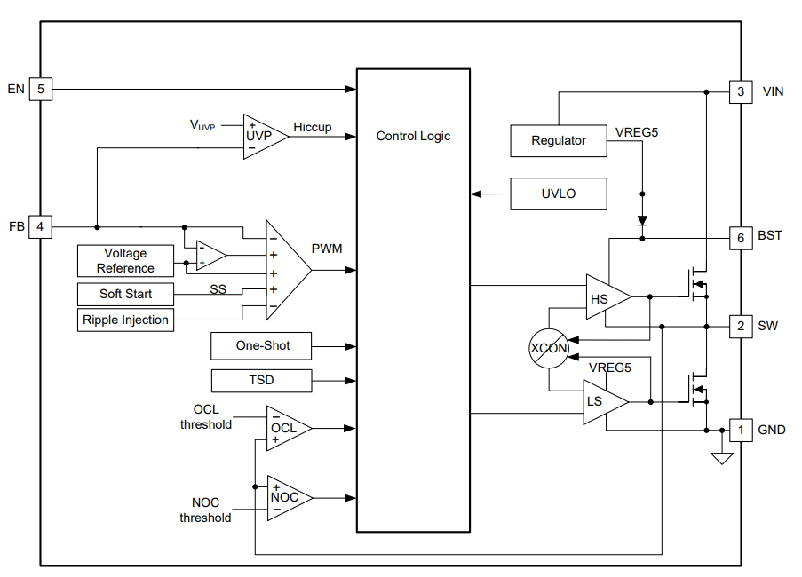
Buck Converter (TPS563249)
Reduces 7-17V input range to 3.3V and 5V rails
Features:
Vin (Min) (V) 4.5
Vin (Max) (V) 17
Vout (Min) (V) 0.6
Vout (Max) (V) 7
Iout (Max) (A) 3
Iq (Typ) (uA) 260
https://www.ti.com/lit/ds/symlink/tps563249.pdf?ts=1607113179584&ref_url=https%253A%252F%252Fwww.ti.com%252Fproduct%252FTPS563249

Slide 9
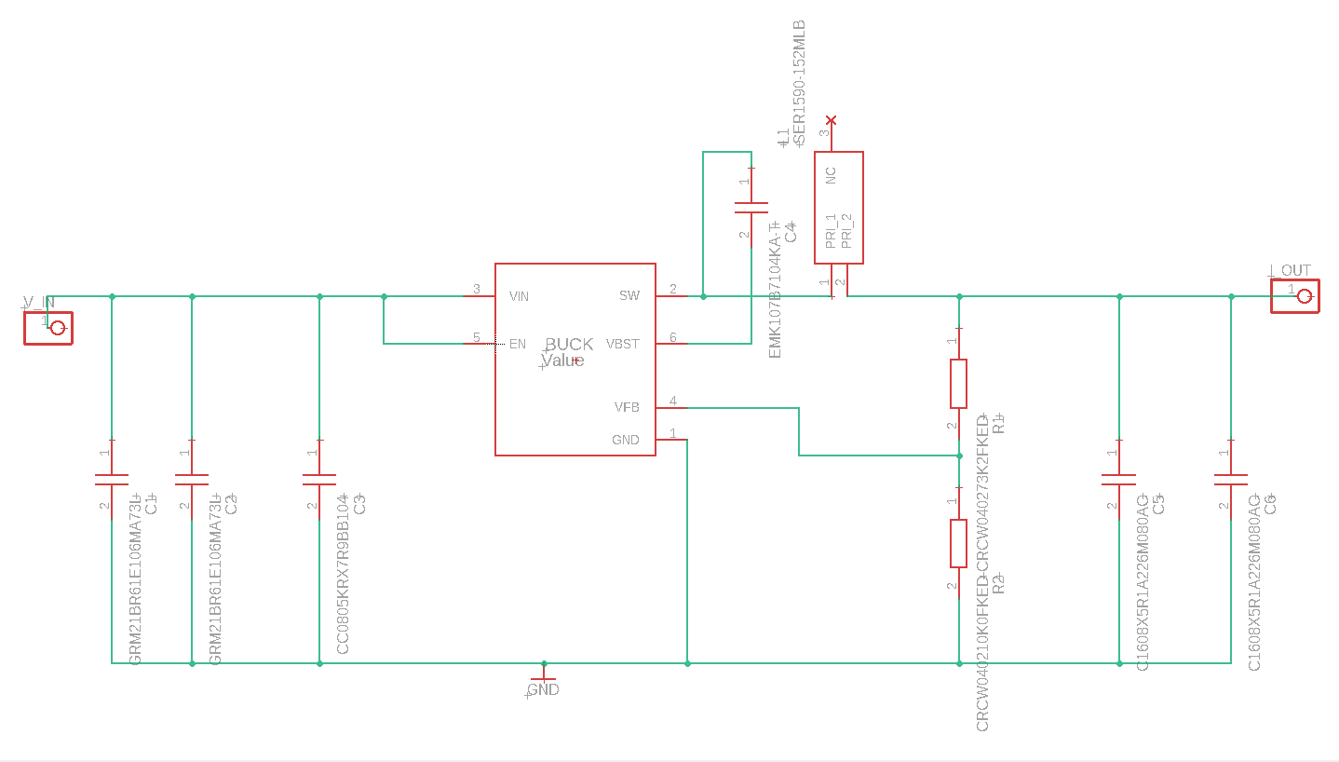
5 Volt Buck Converter Schematic
Allows for more efficient conversion of power from 7-17V to 5V for the Arduino with high current capability
Feedforward Capacitor
Inductor
Voltage Output
Voltage Input
Output Capacitors
Input Capacitors
TPS563249
Feedback Resistors

Slide 10
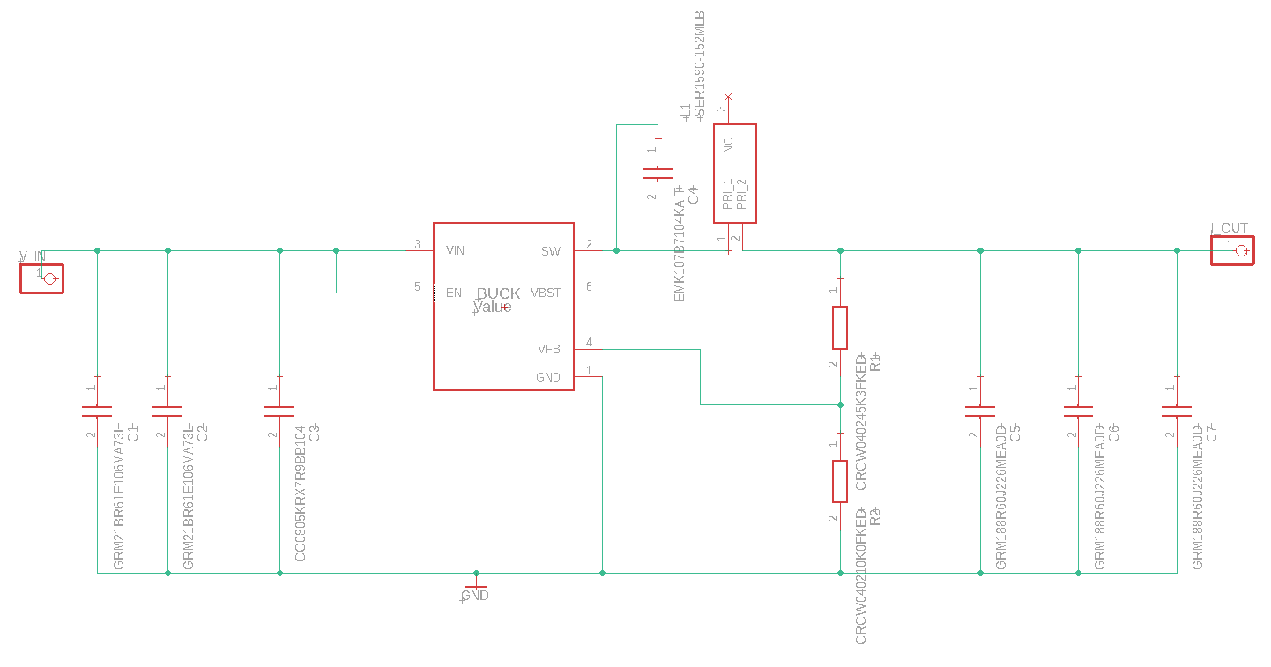
3.3 Volt Buck Converter Schematic
Allows for more efficient conversion of power from 7-17V to 3.3V for the Shield with high current capability
Feedforward Capacitor
Voltage Output
Inductor
Voltage Input
Output Capacitors
Input Capacitors
TPS563249
Feedback Resistors

Slide 11
Buck Converters
Requirements:
Provides voltage within ±5% of the goal from a 7-17 input voltage.
Must remain below maximum operating temperature of all devices (-40 °C , 125 °C).
Efficiency must be 80% or higher.
Verification:
Measure the output voltage with a multimeter.
(Next Slide)
Check the temperature of all devices with an IR thermometer.
Below 60 °C
Measure the input and output current and voltage to calculate efficiency.
88.15% (90% predicted)

Slide 12
5 Volt Buck Converter Output:
3.3 Volt Buck Converter Output:
*No Load
*No Load

Slide 13
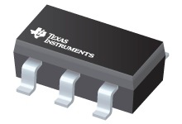
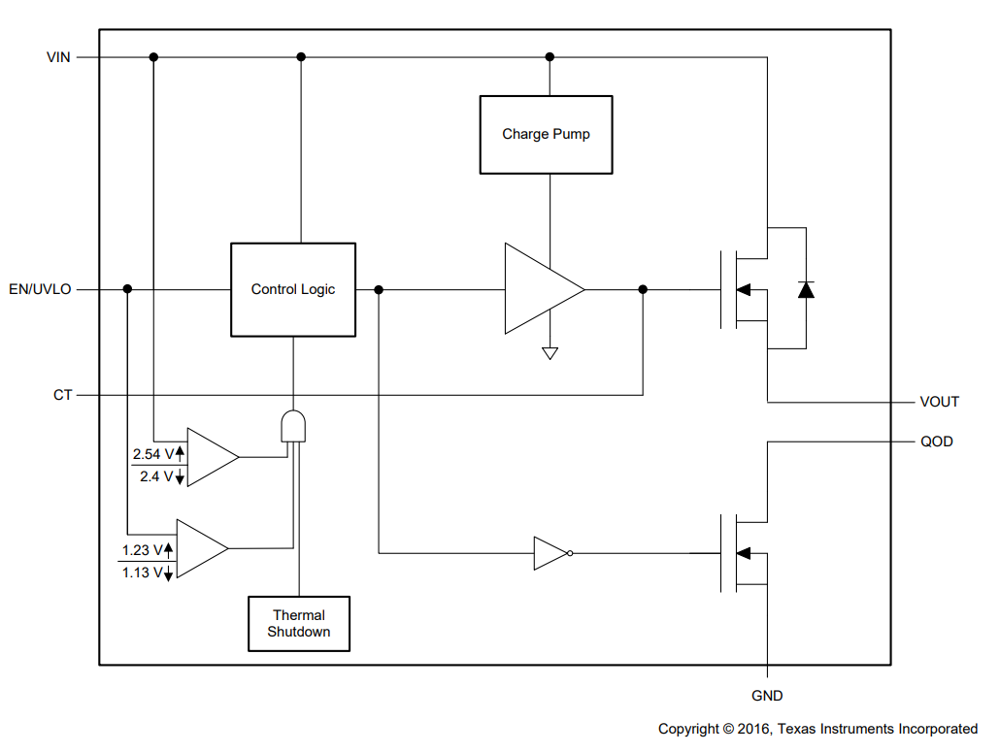
Load Switches (TPS22810)
Allows MCU to output at the same voltage as the input voltage
Features:
Vin (Max) (V) 18
Imax (A) 3
Ron (Typ) (mOhm) 79
Shutdown current (ISD) (Typ) (uA) 0.5
https://www.ti.com/lit/ds/symlink/tps22810.pdf?ts=1607101911679&ref_url=https%253A%252F%252Fwww.ti.com%252Fproduct%252FTPS22810

Slide 14
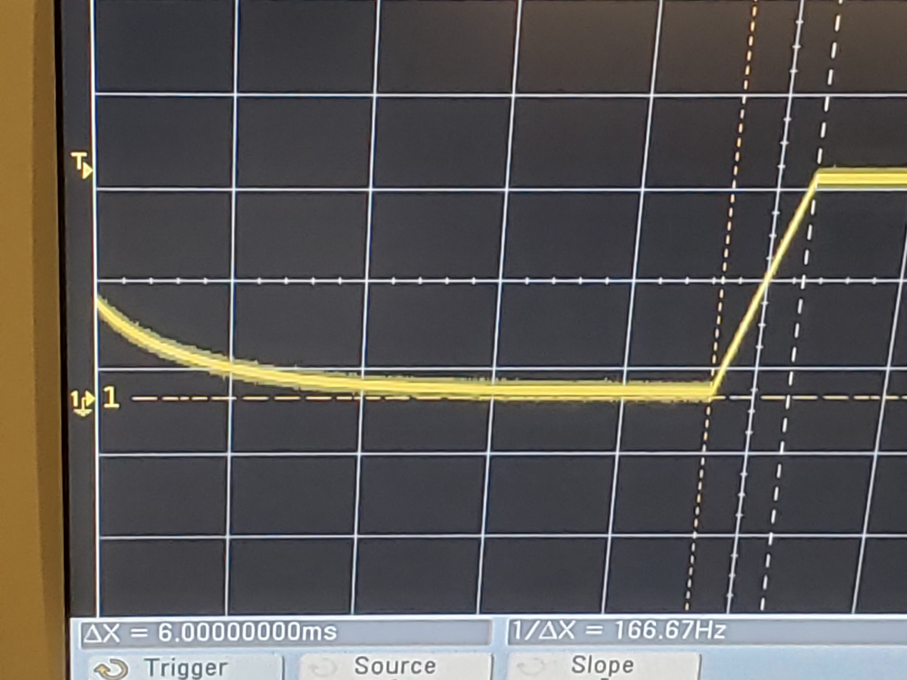
Load Switches
3.3 V Input
12 V Output
6 ms Rise Time
25 ms Fall Time (no quick output discharge)

Slide 15
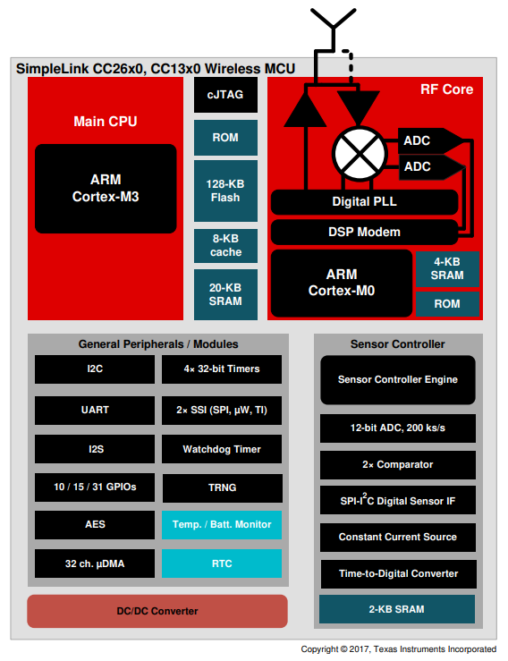
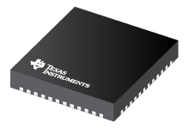
MCU (CC1310)
Handles RF Communication and Triggers Load Switches
Features:
TX power (Max) (dBm) 15
Arm® Cortex®-M3 CPU
1 SPI, 1 I2C, 1 UART, 12-bit ADC 8-channel, 2 comparators, 4 timers, 8-bit DAC
Sensitivity (best) (dBm) -124
15 GPIO Pins
https://www.ti.com/lit/ug/swcu117i/swcu117i.pdf?ts=1607097234694&ref_url=https%253A%252F%252Fwww.ti.com%252Fproduct%252FCC2640

Slide 16
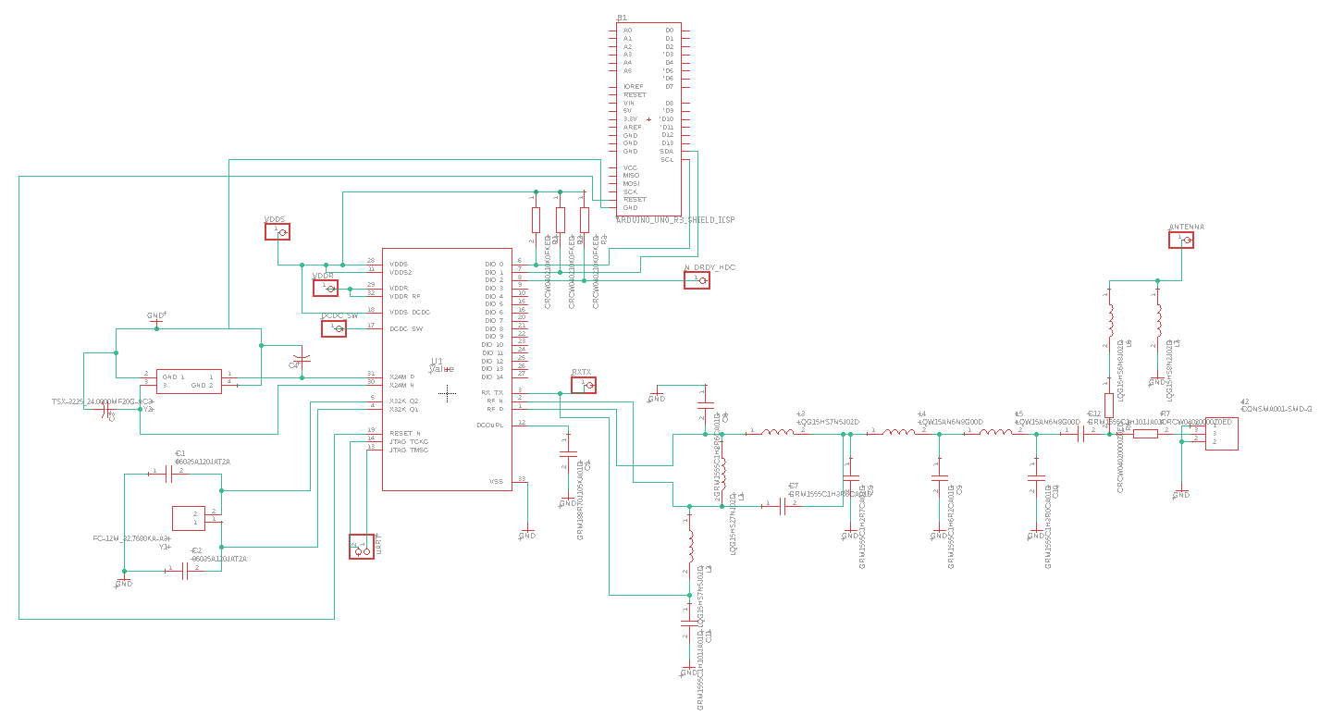
MCU
Shield Schematic Pins
SPI
24 MHz Oscillator
Filter & Antenna
32 KHz Oscillator

Slide 17
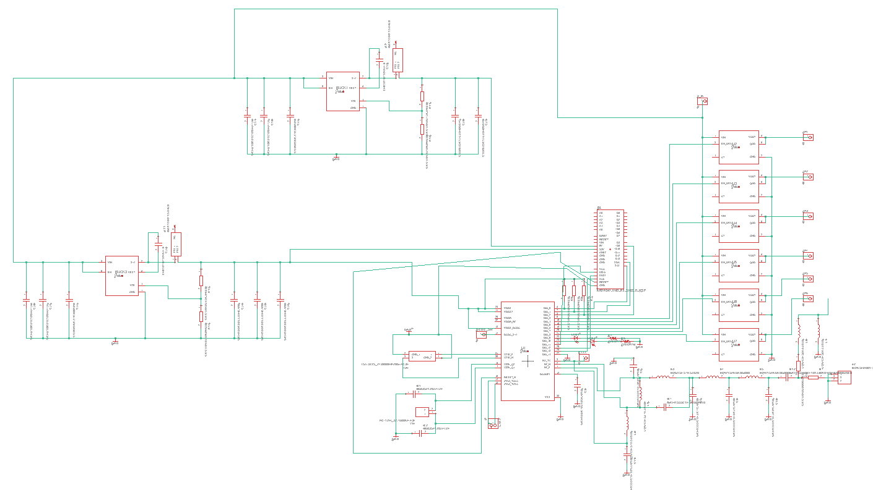
Putting Them All Together
Load Switches
Buck Converter
Arduino
Buck Converter
MCU

Slide 18
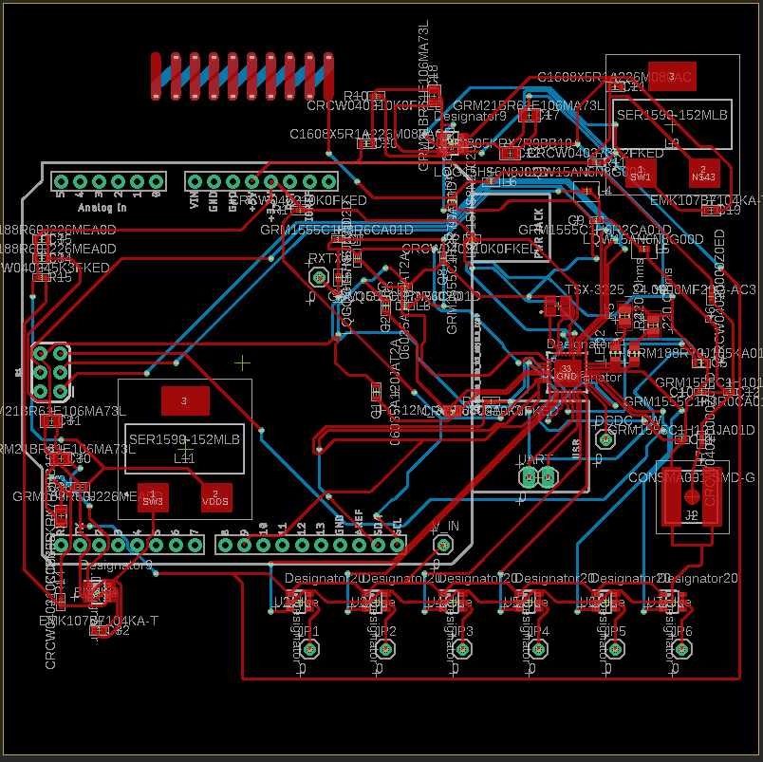
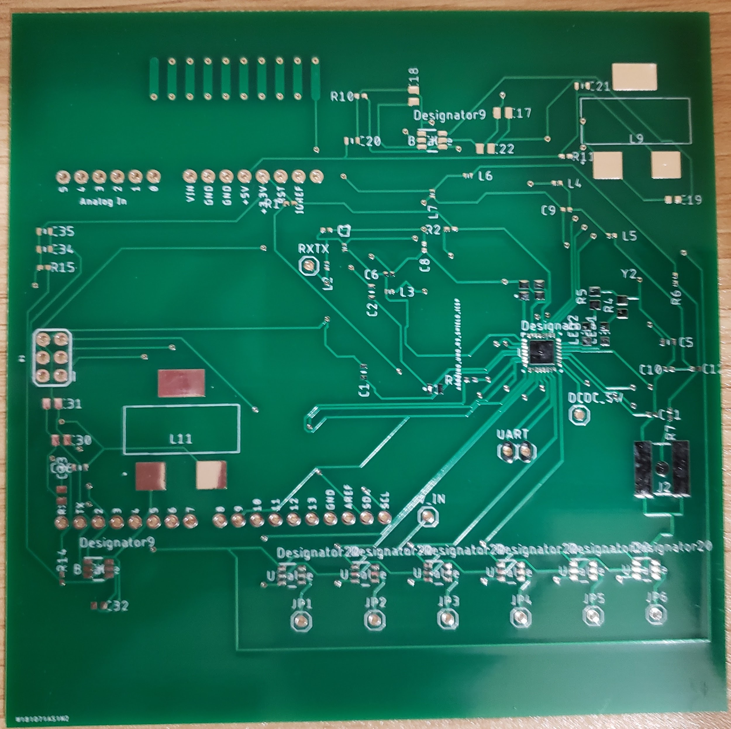
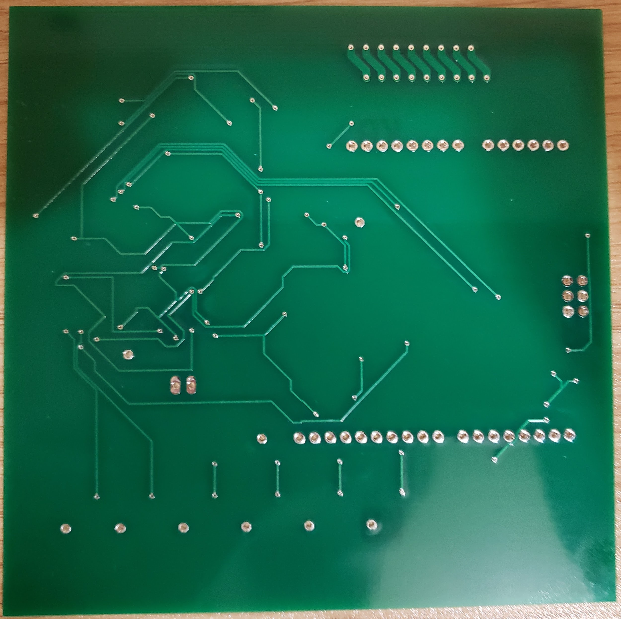
Final PCB Design

Slide 19
Block Diagram
Arduino
5V Buck Converter
3.3V Buck Converter
Sub-Gigahertz MCU
RF Antenna
Load Switches

Slide 20
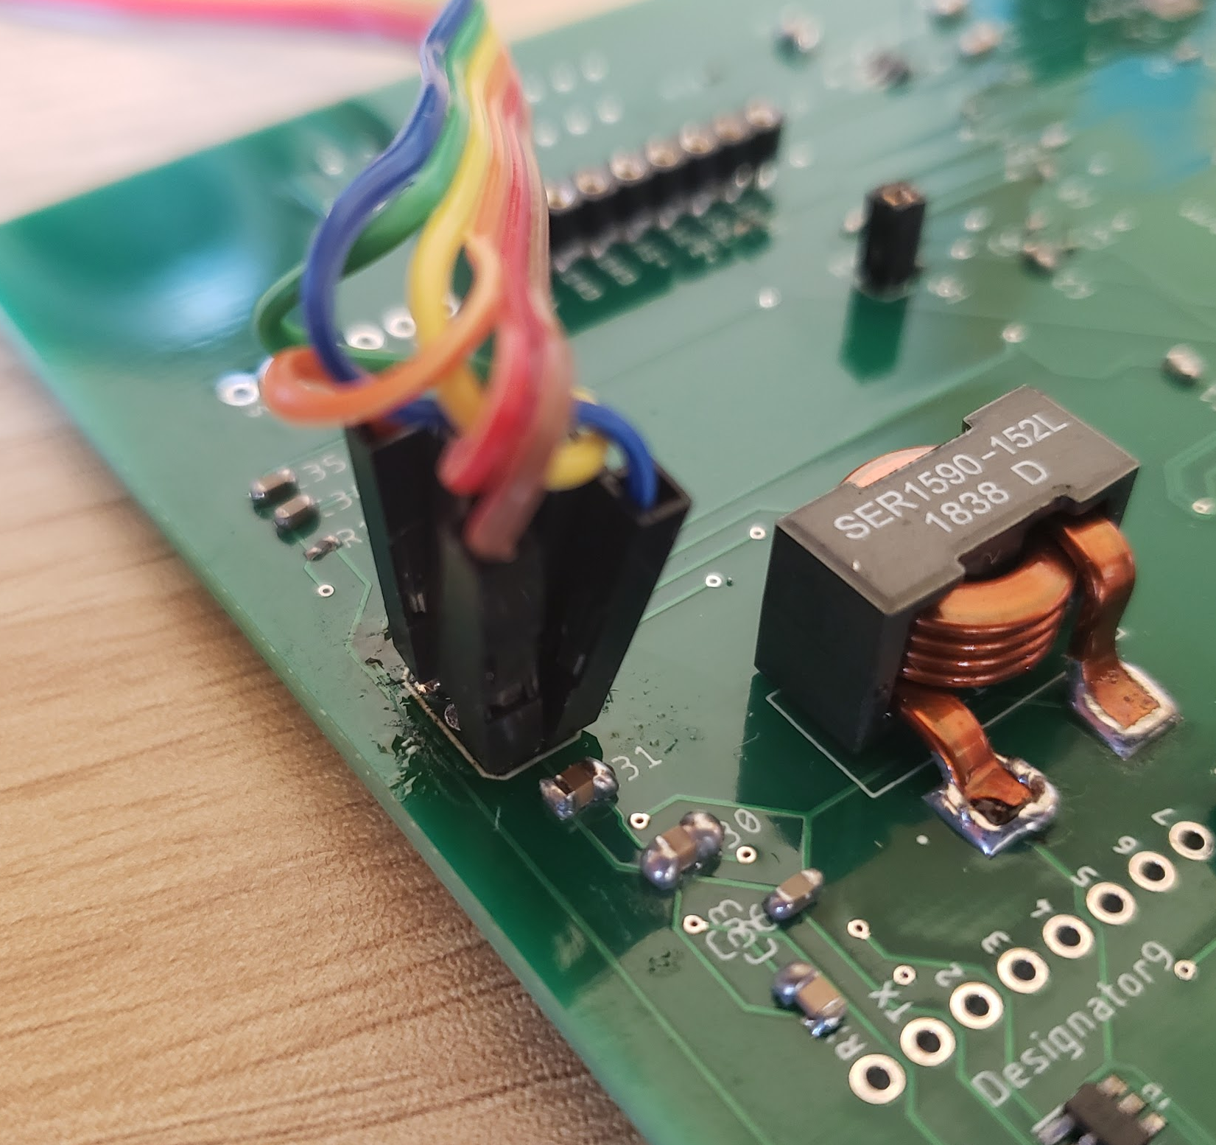
Issues During Implementation
Pin headers for the Arduino were too small for ICSP (SPI)
Used wires as a substitute.

Slide 21
Future Implementation Improvements
Capacitor 21 was extremely close to the inductor.
This made soldering the capacitor very difficult.

Slide 22
Soldering on the MCU
Needed to use the heat gun.
Initially tried 300 degrees Celsius.
Ended up using 450 degrees Celsius.

Slide 23
PCB Post Soldering

Slide 24
Sub-Gigahertz Shield Instruction Breakdown
ACK
Shield sends token 0xA5 to ensure shield is initialized and ready
GET_STATUS
Shield send bitwise status
GET_GPIO
Returns the status of the GPIO on the next transaction
SET_GPIO
Sets the GPIO of the given index to the given value
GET_RF
Sets up the next transaction to read RF
GET_RF_BUF
Reads the RF buffer when following a GET_RF call
SEND_RF
Sets the length of the SEND_RF_BUF call
SEND_RF_BUF
Sends the buffer to be sent over RF

Slide 25
Arduino Software Breakdown
Polls shield for status
Executes on status change
Supports two digital interrupts for local inputs
Notes:
The software works by polling the shield for status changes. Upon a change it may read the RF, execute a response and return to checking the status. Currently the software supports two digital interrupts to signal local inputs.

Slide 26
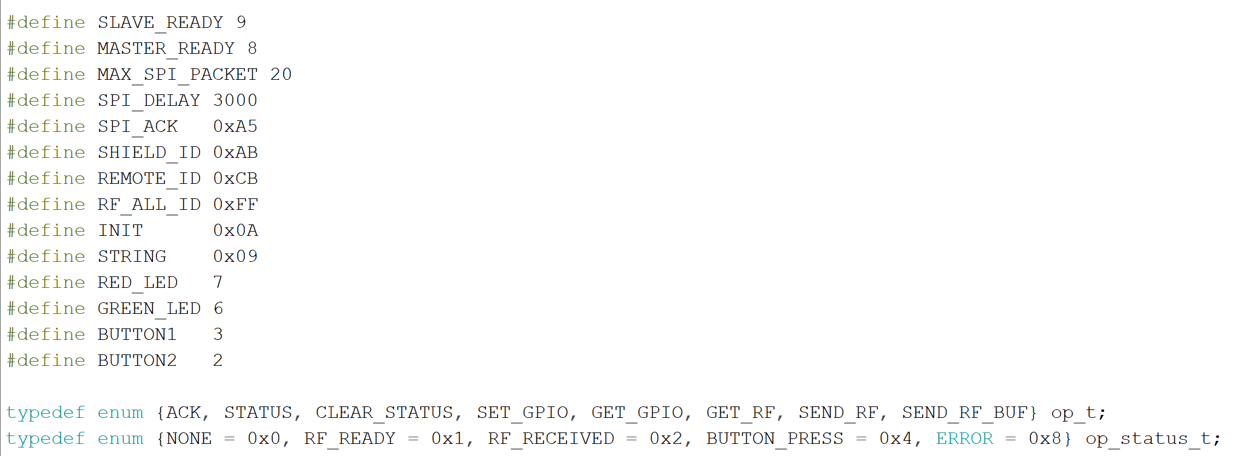
Definitions and Opcodes/Status

Slide 27
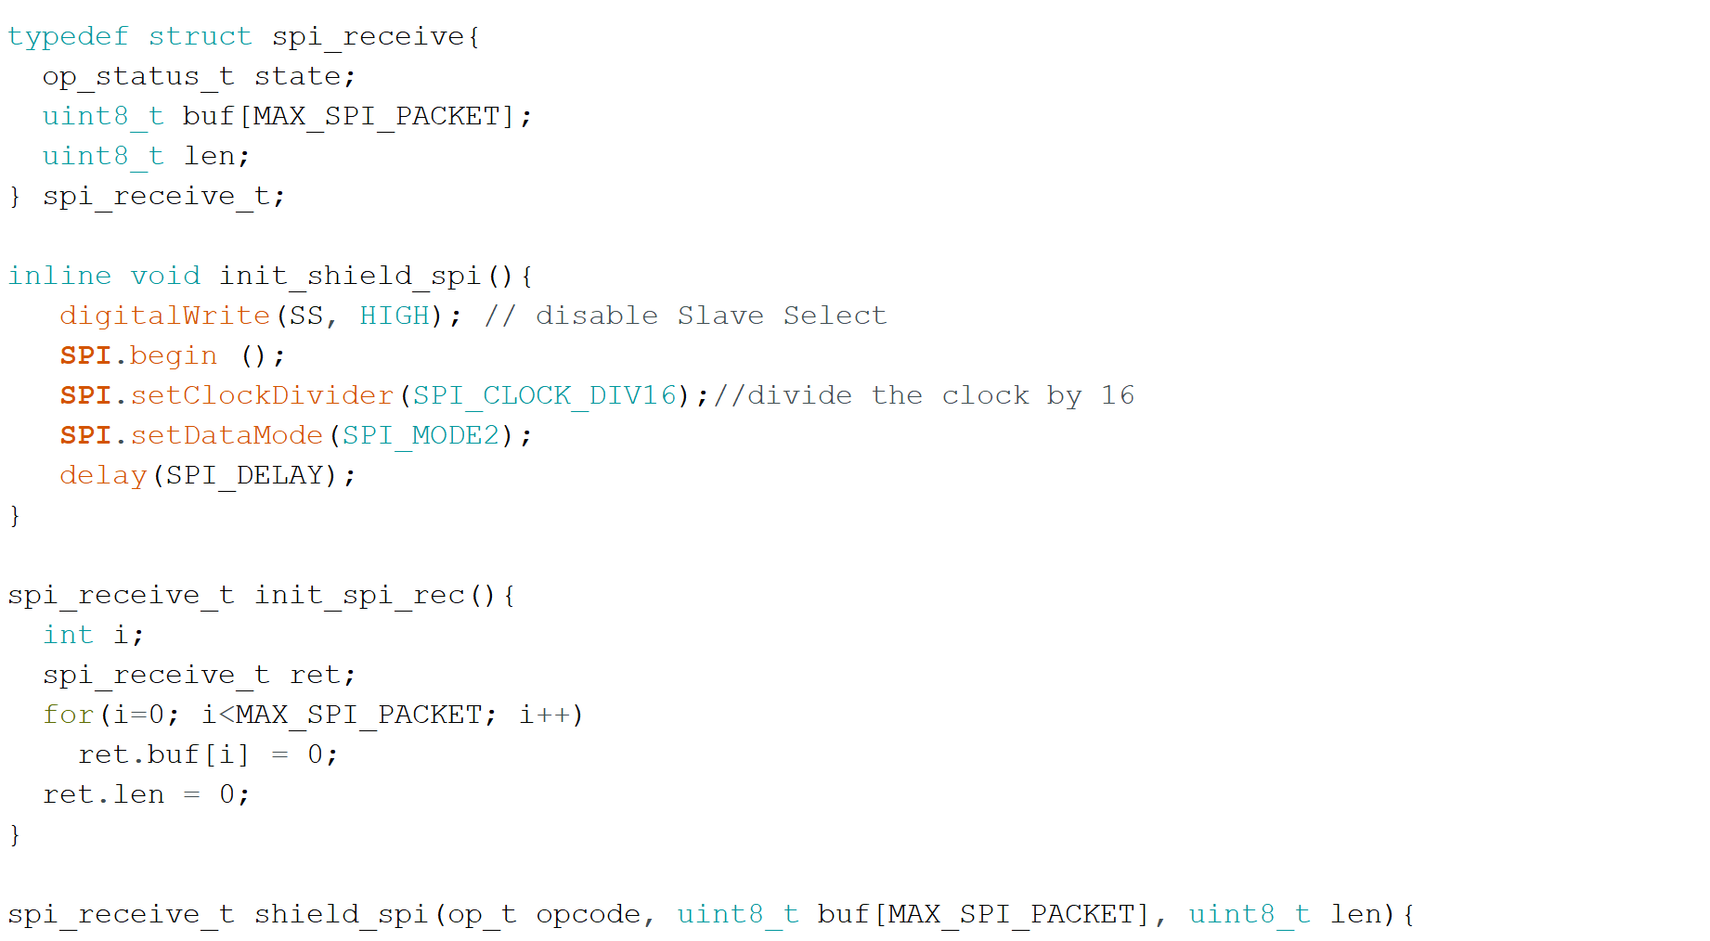
SPI Struct, and shield_spi function parameters

Slide 28
Sub-Gigahertz POSIX Threads
slaveThread:
Decodes the previous SPI transaction, sets the Tx buffer (if need be), sets the SPI slave buffer for the next SPI transaction, and waits until the next SPI transaction (interrupt + semaphore).
txThread:
Once the Tx buffer has been set, the thread cancels the Rx command, runs the Tx command, and signals the rxThread to continue (semaphore)
rxThread:
Runs the Rx command, gets the Rx buffer from the queue (callback) and updates the status.

Slide 29
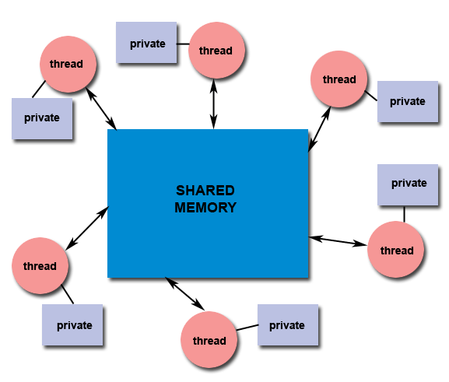
What is a POSIX Thread?
“A thread is the smallest sequence of programmed instructions that can be managed independently by an operating system scheduler.”
POSIX threads are an IEEE standard (IEEE 1003.1c) which define an API for thread creation and synchronization
Allow for “simultaneous” execution of code
Lightweight compared to processes
https://stackoverflow.com/questions/15127279/whats-a-pthread
https://computing.llnl.gov/tutorials/pthreads/

Slide 30
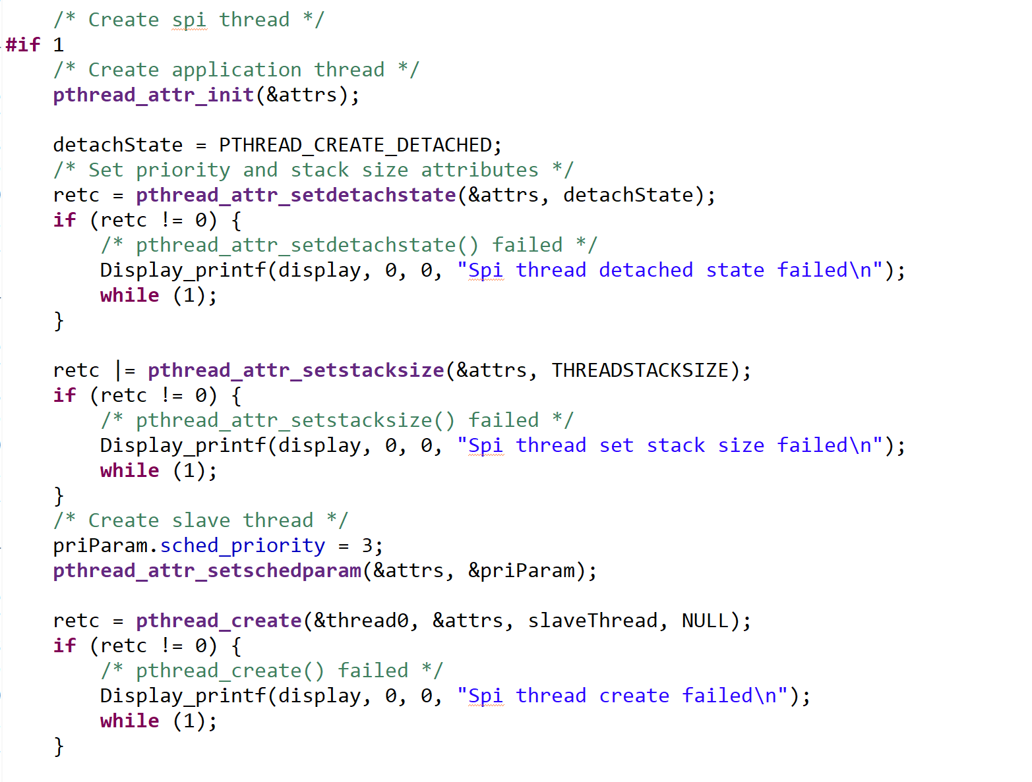
TI RTOS Pthread Creation
Initialize attributes
Detach from current thread
Set stack size
Issues with using too much stack space
Set Priority
Create the thread

Slide 31
Sub Gigahertz Arduino Shield
Requirements:
CC1310 controller will be powered from the 3.3 V output of Arduino.
The Shield sends and receives instructions with the Arduino over SPI/I2C.
The shield will trigger GPIO signals from commands received over SPI/I2C bus protocols.
Verification:
Measure 3.3 V output of the Arduino with a multimeter.
3.301 V (1.8 V to 3.8 V)
Ensure the CC1310 triggers a response when it receives a command from the Arduino
Measure the GPIO output signal with a multimeter to ensure a correct response.
3.023 V

Slide 32
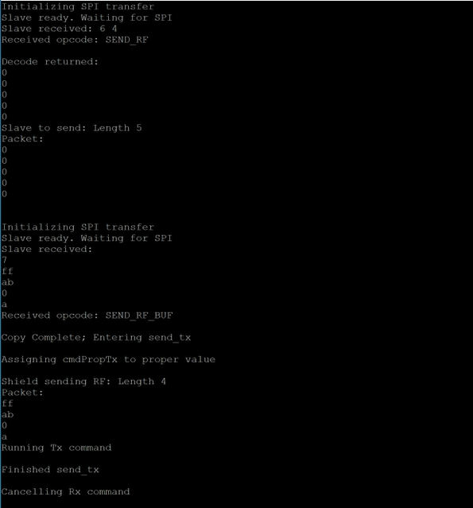
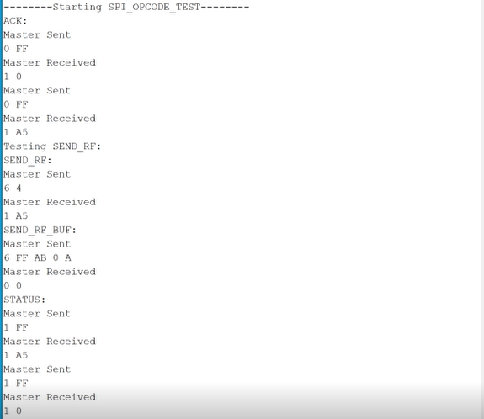
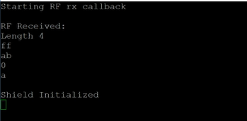
Arduino Init
Arduino Sends Shield the Length for the RF Packet
Arduino Waits Until Shield Sends ACK Token
Arduino Sends Out RF Broadcast to All Devices
Shield Receives RF Packet from Arduino
Shield Sends RF Packet
Remote Receives RF Packet

Slide 33
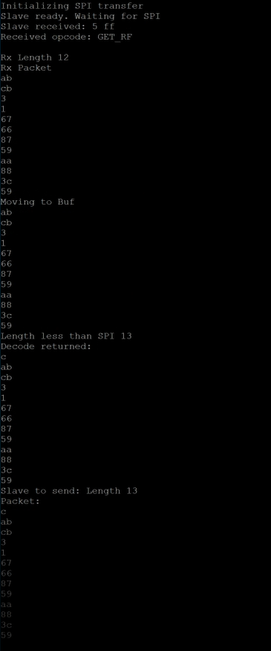
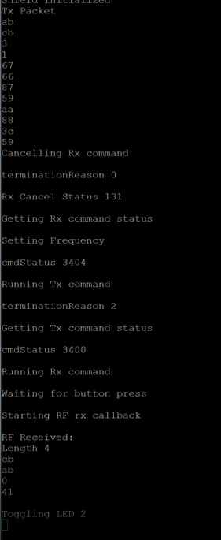
Remote Sending Packet to Arduino
Shield Sends Status 2 (RF_Received)
Packet Received by Shield
Packet Starts at the Remote
Packet Sent to Arduino over SPI
Arduino Decodes and Executes (Sends Response)
Remote Receives Response

Slide 34
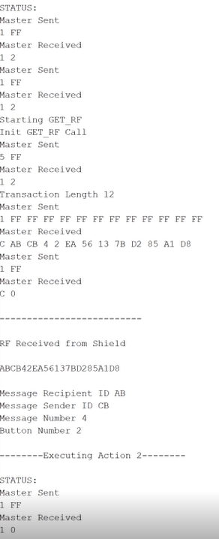
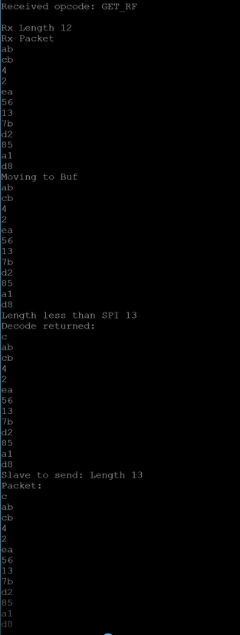
Remote Sending Packet to Arduino
Shield Sends Status 2 (RF_Received)
Packet Received by Shield
Packet Starts at the Remote
Packet Sent to Arduino over SPI
Arduino Executes Action

Slide 35
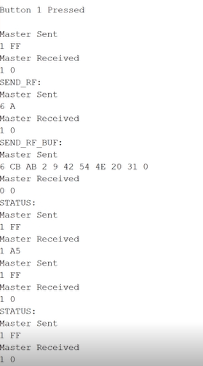
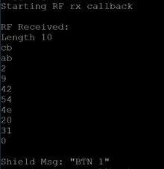
Shield Sending to Remote
Button Interrupt
Shield Receives RF Packet
Packet Sent to Arduino over SPI
Shield Gets Length of RF Packet
Remote Receives RF Packet
Shield Sends RF Packet over Sub-1Gigahertz

Slide 36
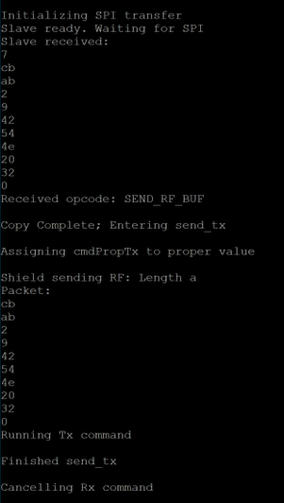
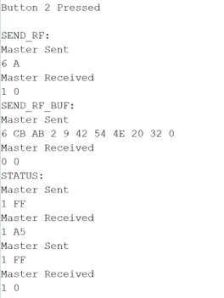
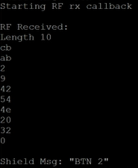
Shield Sending to Remote
Button Interrupt
Shield Receives RF Packet
Remote Receives RF Packet
Packet Sent to Arduino over SPI
Shield Sends RF Packet over Sub-1Gigahertz

Slide 37
Future Plans
Second Generation PCB to allow for stacking
Interrupt based Arduino Signaling on status change
Reduce power
Support AES encryption for RF messages
Prevents replay attacks
Support TI’s SimpleLink Architecture
Allows for better integration with existing sub-gigahertz products and device connectivity
Implement a demo with SoftTimer library with Arduino
Allows for pseudo muti-threading to detach polling from main program.

Slide 38
Conclusion
Working first concept
Some implementation hiccups
Great project to put open-source
Commercially viable
Fun and easy future features

