Slide 1
Self-Standing Monopod
Xin Chen| Jianan Gao| Diyu Yang
ECE 445 | Spring 2017 | Group 20
May 2, 2016
Notes:
<number>

Slide 2
Agenda
Introduction
Design
Challenges
Future Work
Acknowledgement
Notes:
Channing
<number>

Slide 3
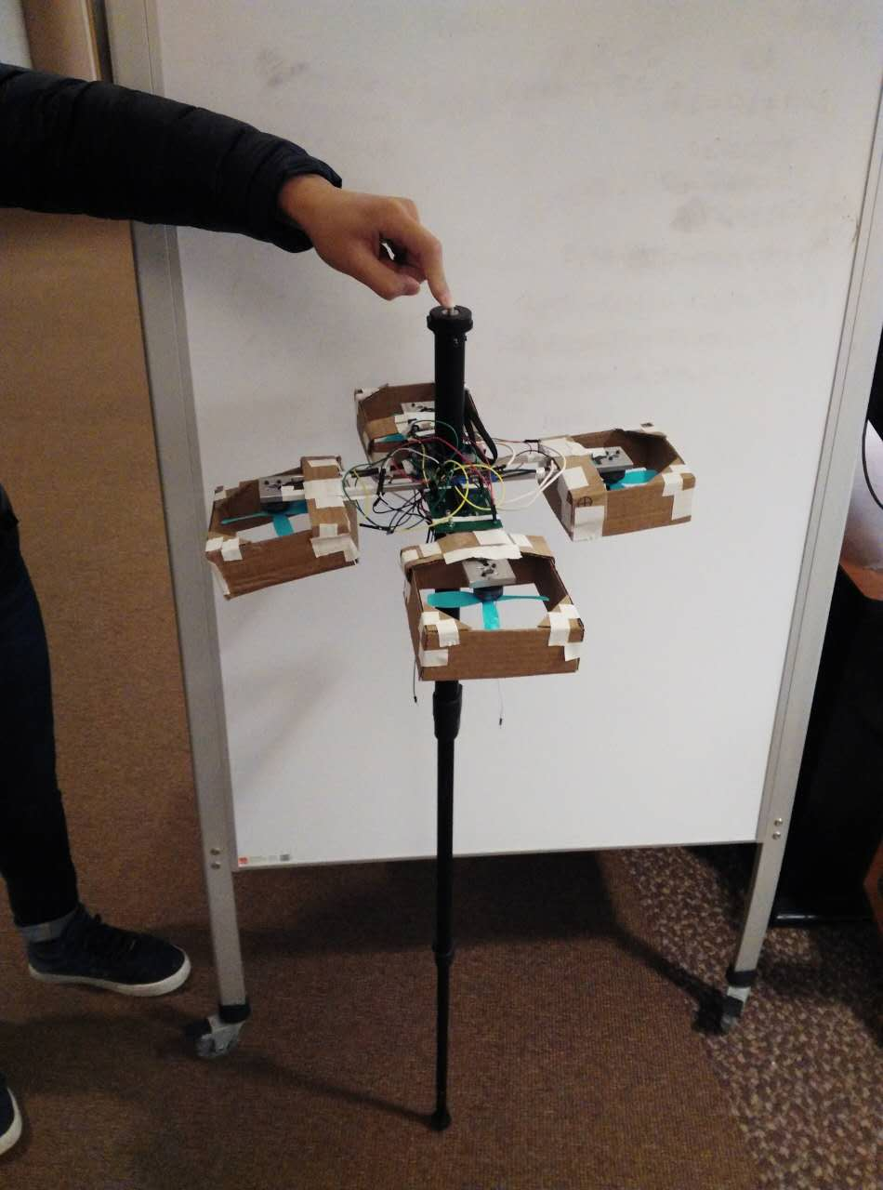
Introduction
Limitation of tripod
Inconvenient to setup
One shooting angle
Extremely heavy
Thrust from four propellers
Stabilize itself
Notes:
Channing
<number>

Slide 4
Design
IMU
Power
Signal
Power
MCU
Motor 1
Motor 2
Motor 3
Motor 3
Propeller 1
Propeller 2
Propeller 3
Propeller 4
Block Diagram

Slide 5
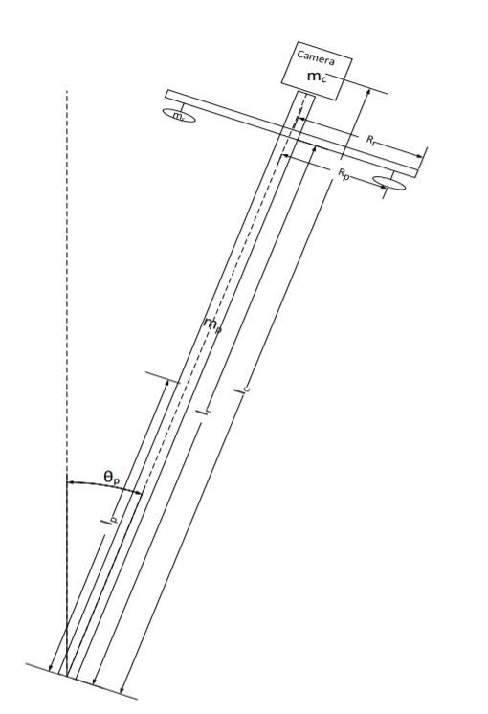
Physical Design
Four arms
15cm to make sure safety & convenience
Propellers
Look down to have better aerodynamics
Better than reaction wheels
Source: https://i.ytimg.com/vi/sIZ2hrmJCmY/maxresdefault.jp
Notes:
<number>

Slide 6
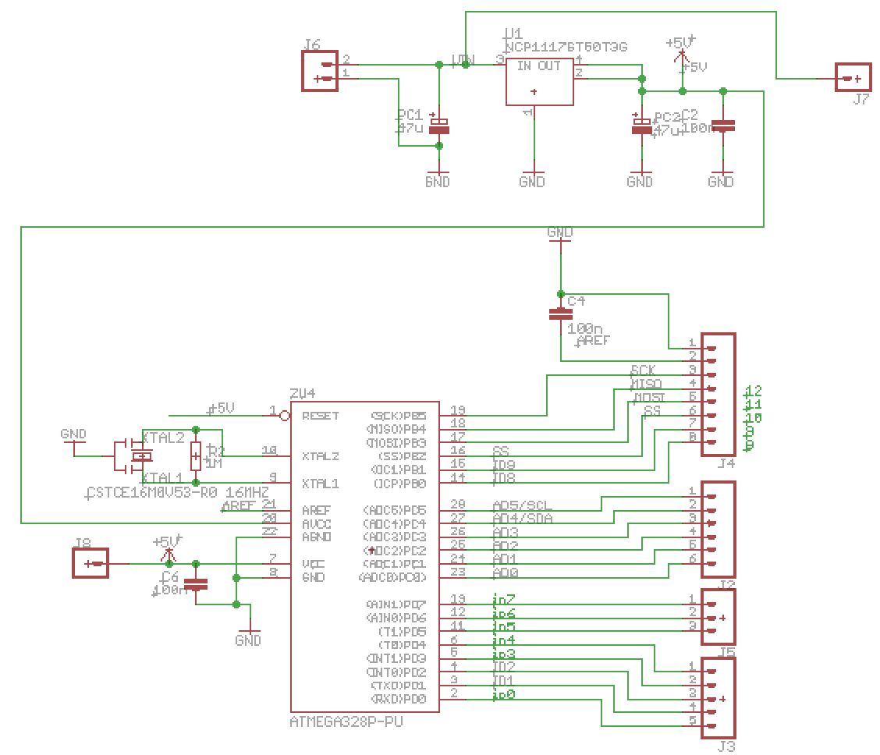
Microcontroller Circuit
5V voltage regulator
Atmega328p
4 PWM pins
2 analog input pins
Notes:
Nick
<number>

Slide 7
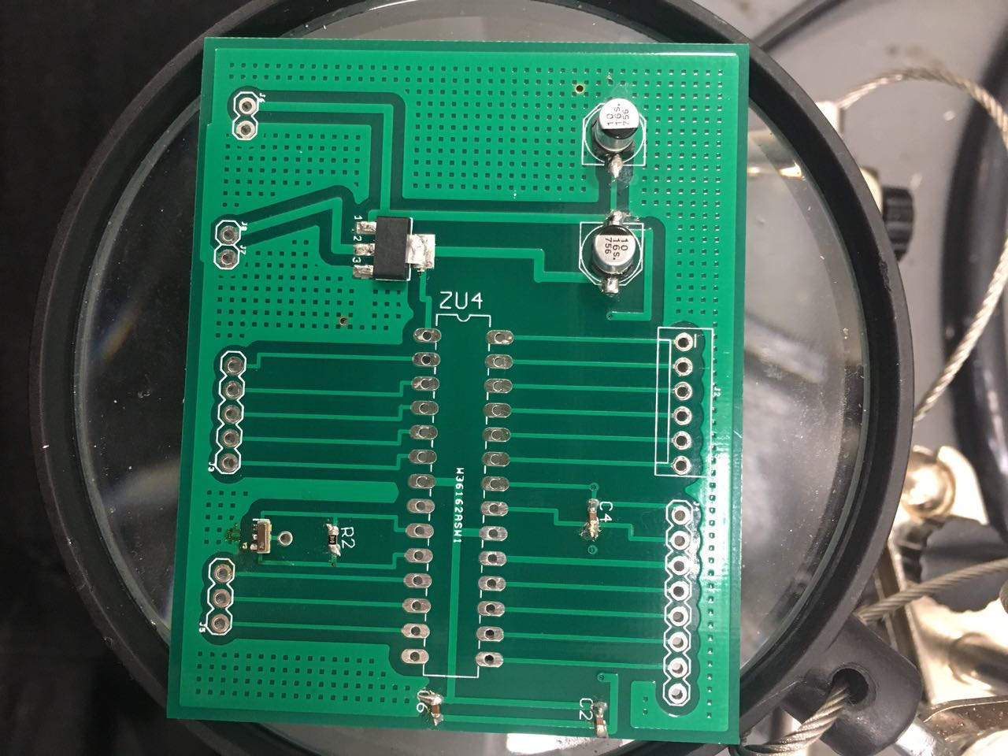
Microcontroller Circuit
5V regulator
Digital Output
Microcontroller
Analog Input
Digital output
Notes:
Nick
<number>

Slide 8
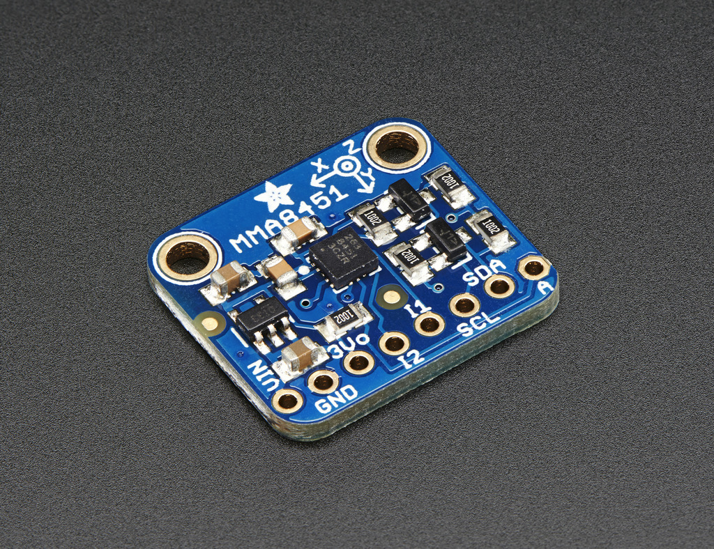
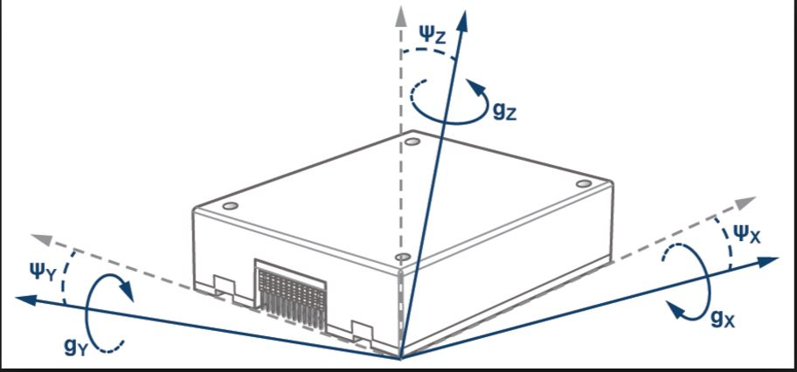
IMU Model
3-axis accelerometer
Sample Rate 800 Hz > 24 Hz
Accuracy
Notes:
Nick
<number>

Slide 9
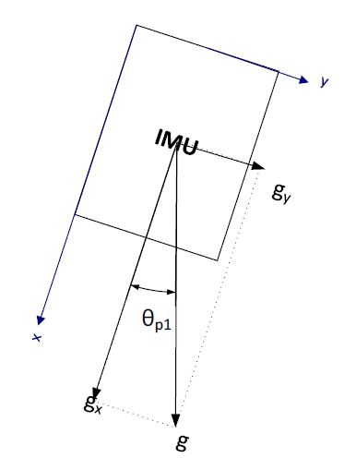
Calculating Angles
??1 = arcsin(??, G)
G = 9.81m/s²
Should Check for Nan condition

Slide 10
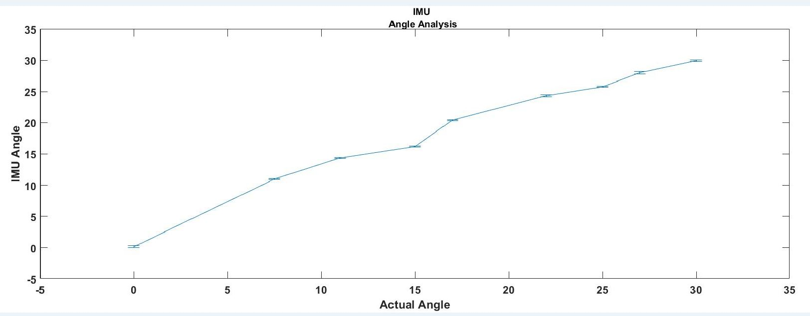
Checking accuracy And Stability of Output

Slide 11
Median Filter
Θ
Read five consecutive filtered angle values
Sort values
Take Second smallest value
Θ_filtered

Slide 12
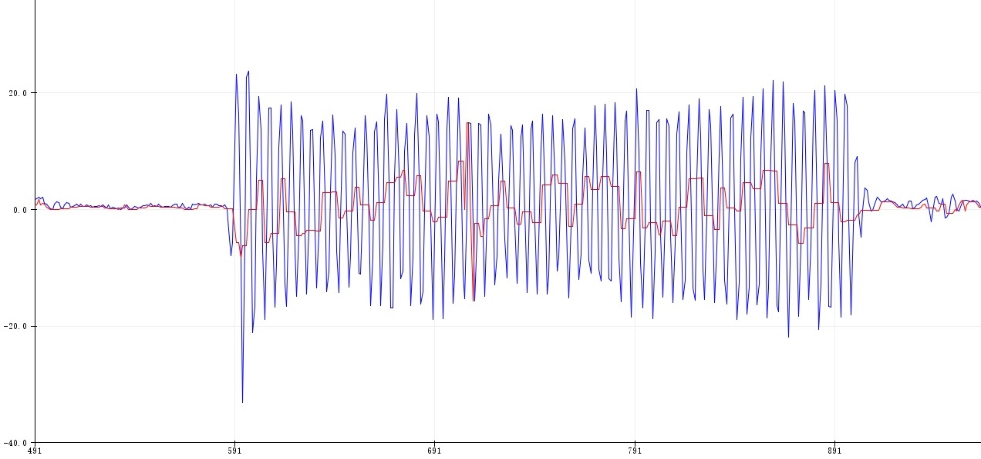
Median Filter Results

Slide 13
Angular velocity approximation
Θ_filtered(t), Θ_filtered(t+Δt)
Ω(t) = {Θ_filtered(t)+Θ_filtered(t+Δt)} / Δt
Ω_avg(t)={Ω(t-2Δt)+ Ω(t-Δt)+ Ω(t)}/(3Δt)
Ω(t)= Ω_avg(t)

Slide 14
From IMU to Control system
Read Raw Data From IMU (gx, gy, gz)
Read raw data
Calculate angles
Filtering and boundary checking
Output updated angles to Control Systems
Use arcsine function to calculate raw angles
False
Θ == nan?
Update Θ values
True
Median Filter
First Order Approximation
Θ1, Θ2, Ω1, Ω2
Control Systems

Slide 15
Control system
PD control: Output = Kp*(Θd-Θ(t))+Kd*(Ωd-Ω(t));
Θd=0; Ωd=0
PWM = Output + Compensation;
Boundary checking for PWM signal

Slide 16
Functionality Demonstration
Notes:
Nick
<number>

Slide 17
Challenge Encountered
Power supply
System delay
Thrust of propellers

Slide 18
Future work
Implement additional functionality i.e sitting, holding camera.
Make height changeable.

Slide 19
Acknowledgement
Professor Hutchinson – Provide feedback on our geometric design & overall criticism
TA Luke Wendt- Guidance throughout
Mark Smart- Machine shop
Lab specialist Daniel Block – Inspire us & Help debug our motor driver
Notes:
Nick
<number>

Slide 20
Questions?

Slide 21
THANK YOU!

