Slide 1
PC Buttonpad
Adit Umakanth, Stephanie Jaster, Yicong Dong
Team No. 12

Slide 2
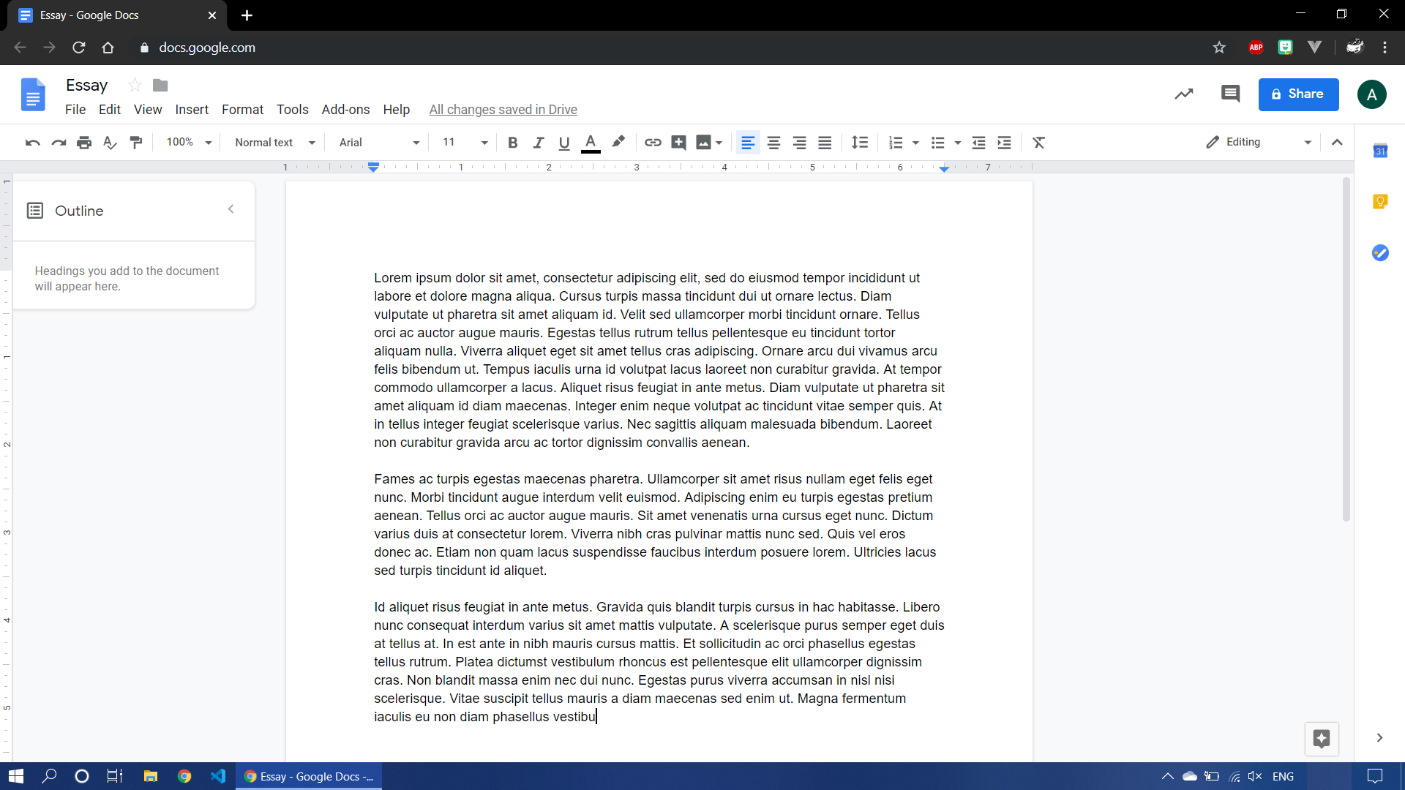
Notes:
Example: working on an essay. Decide to start listening to some music

Slide 3
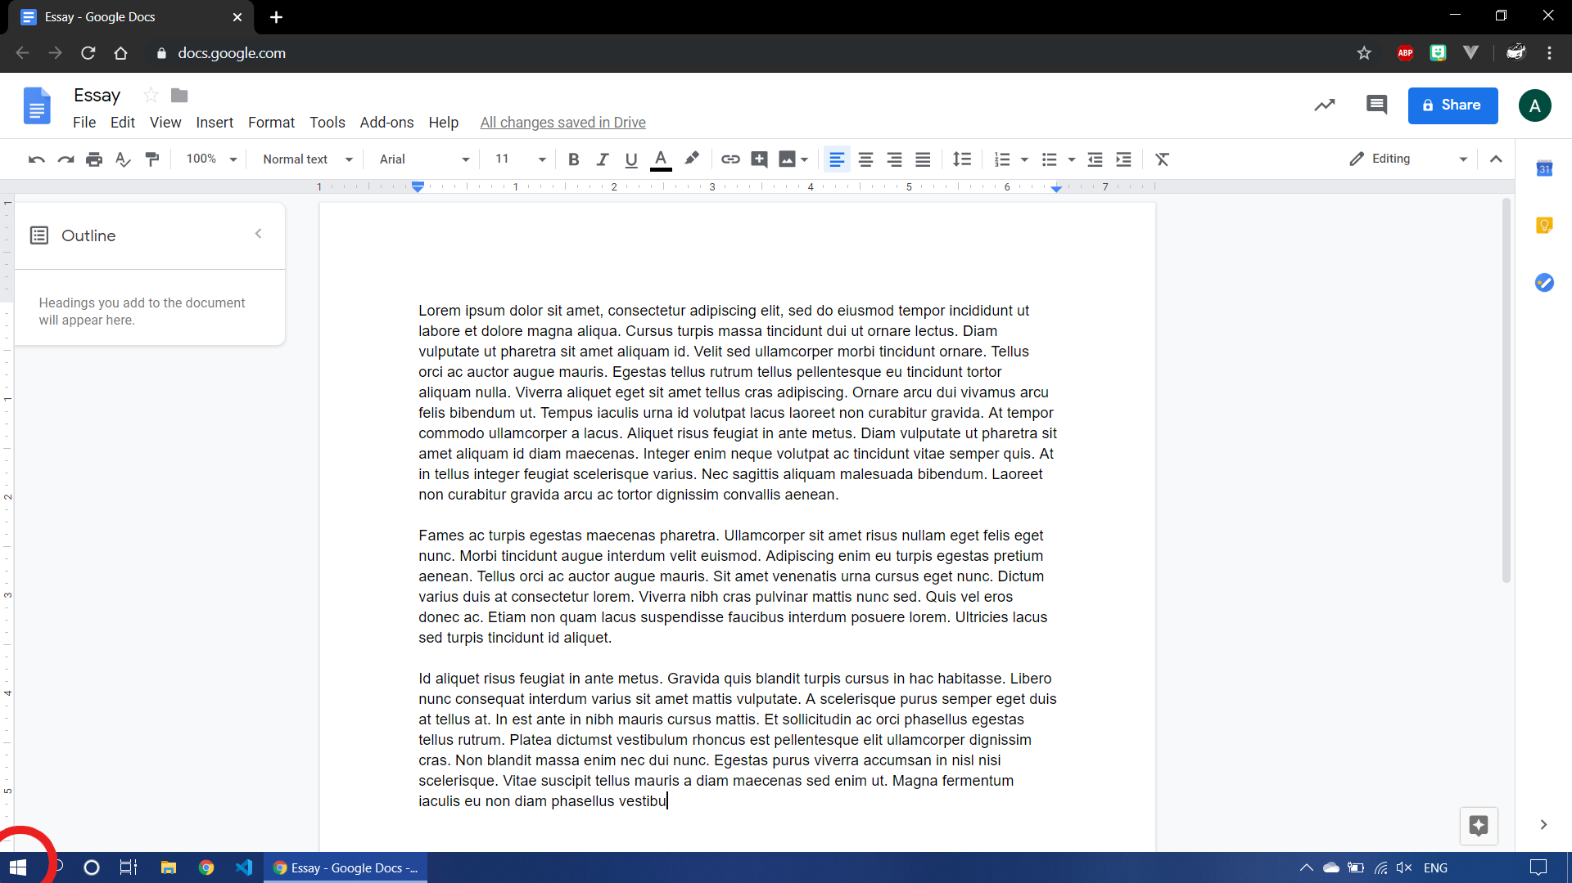
Notes:
First need to click on the start button

Slide 4
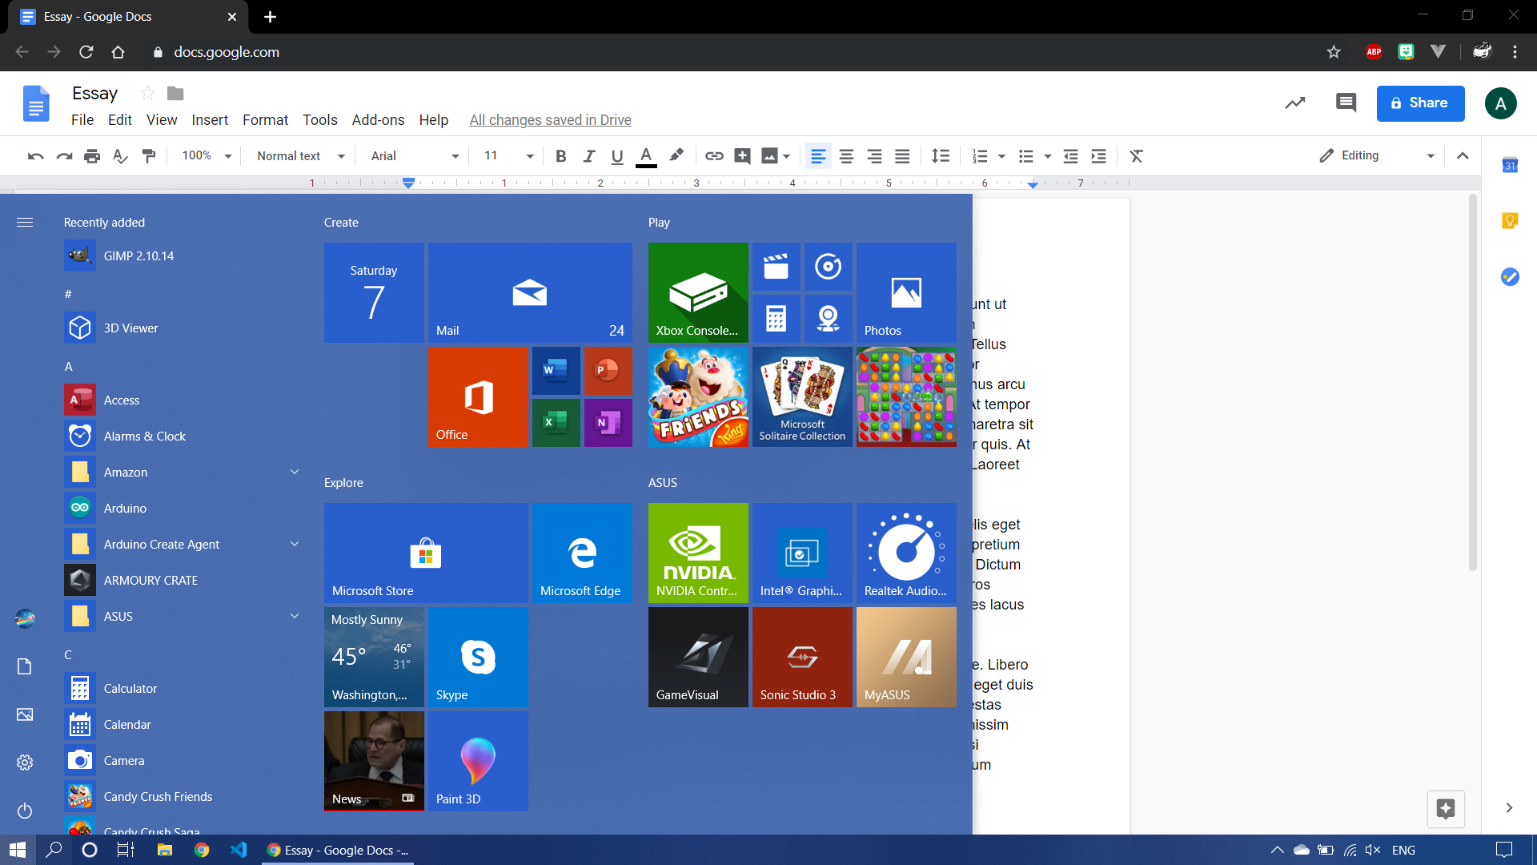
Notes:
Start menu opens. Now scroll down to Spotify.

Slide 5
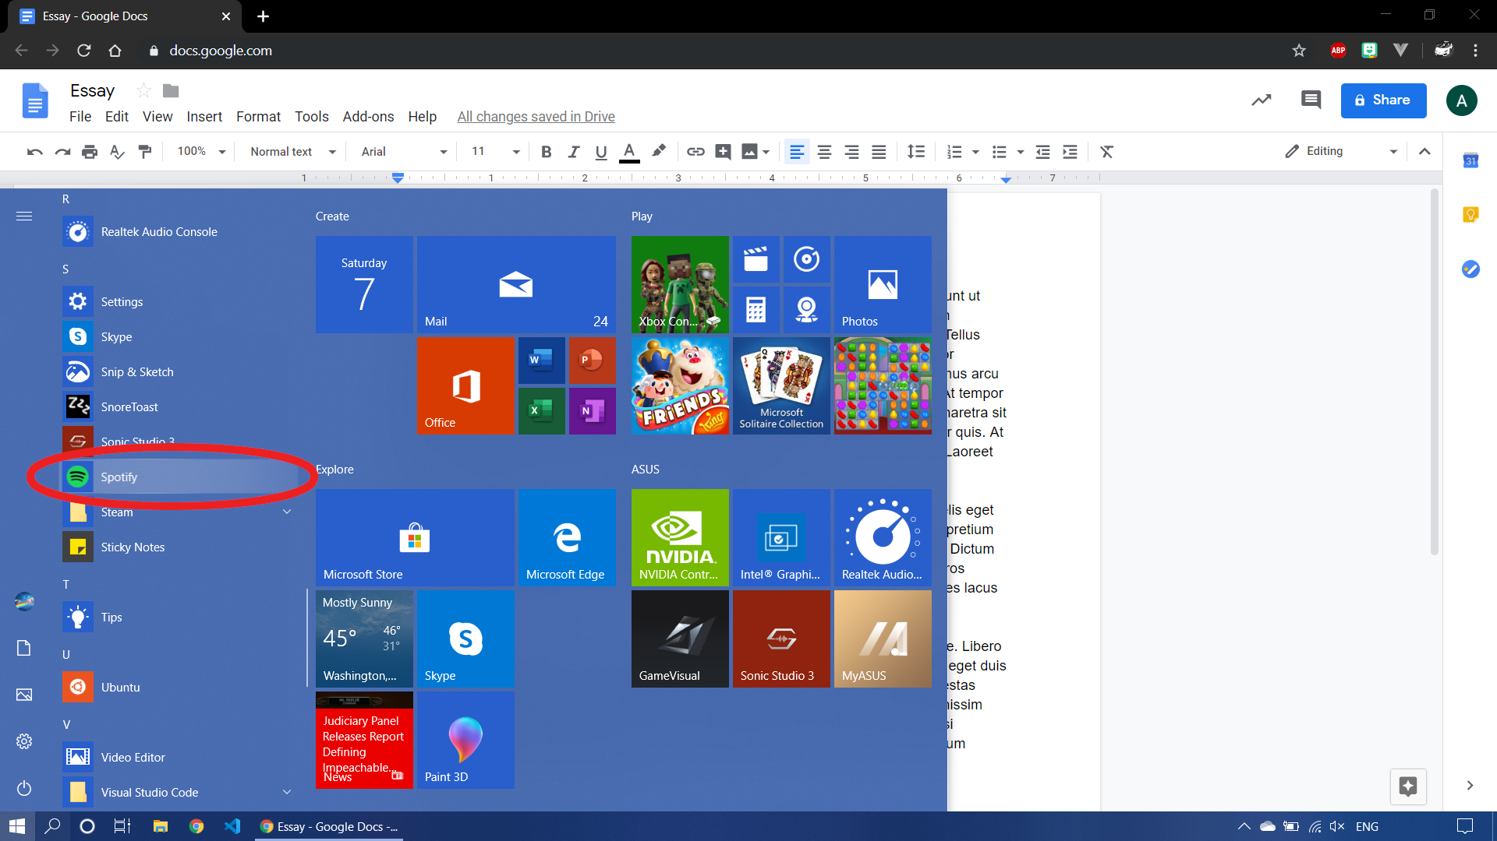
Notes:
Click on Spotify and wait for it to open

Slide 6
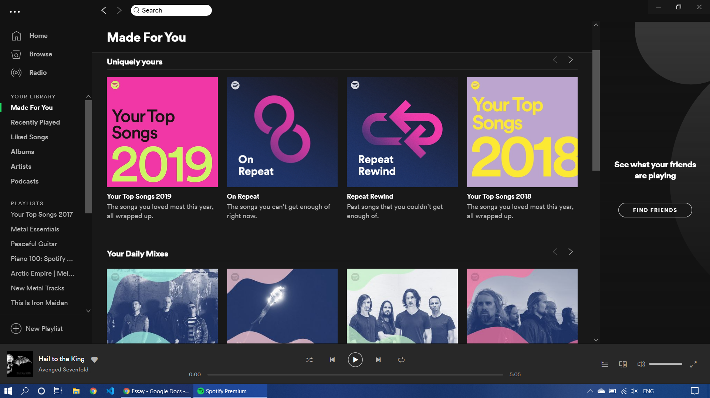
Notes:
Click the search button

Slide 7
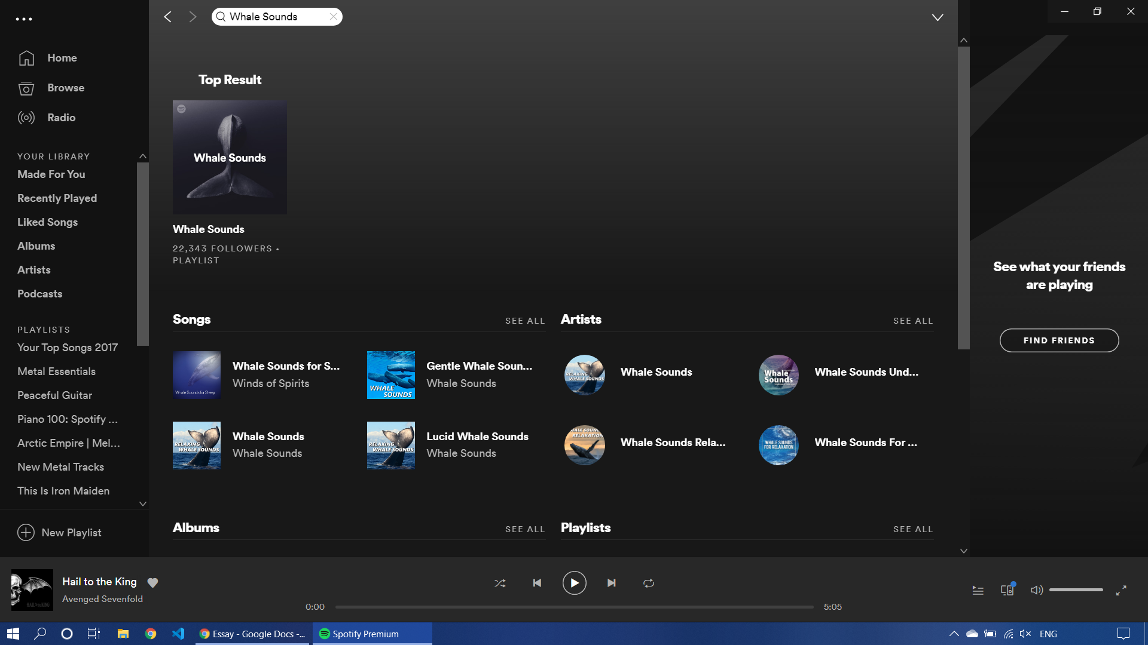

Slide 8
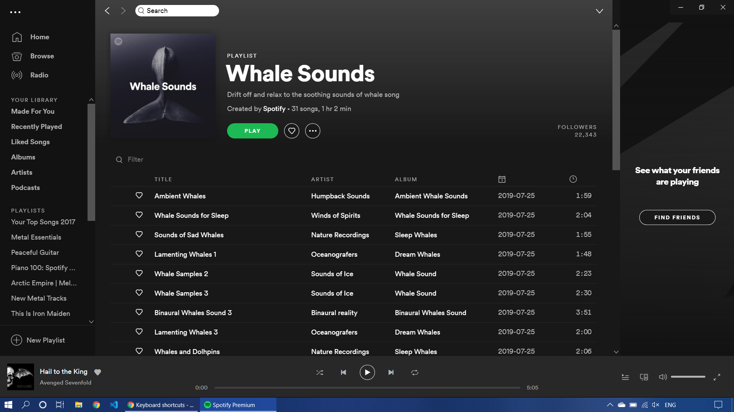

Slide 9
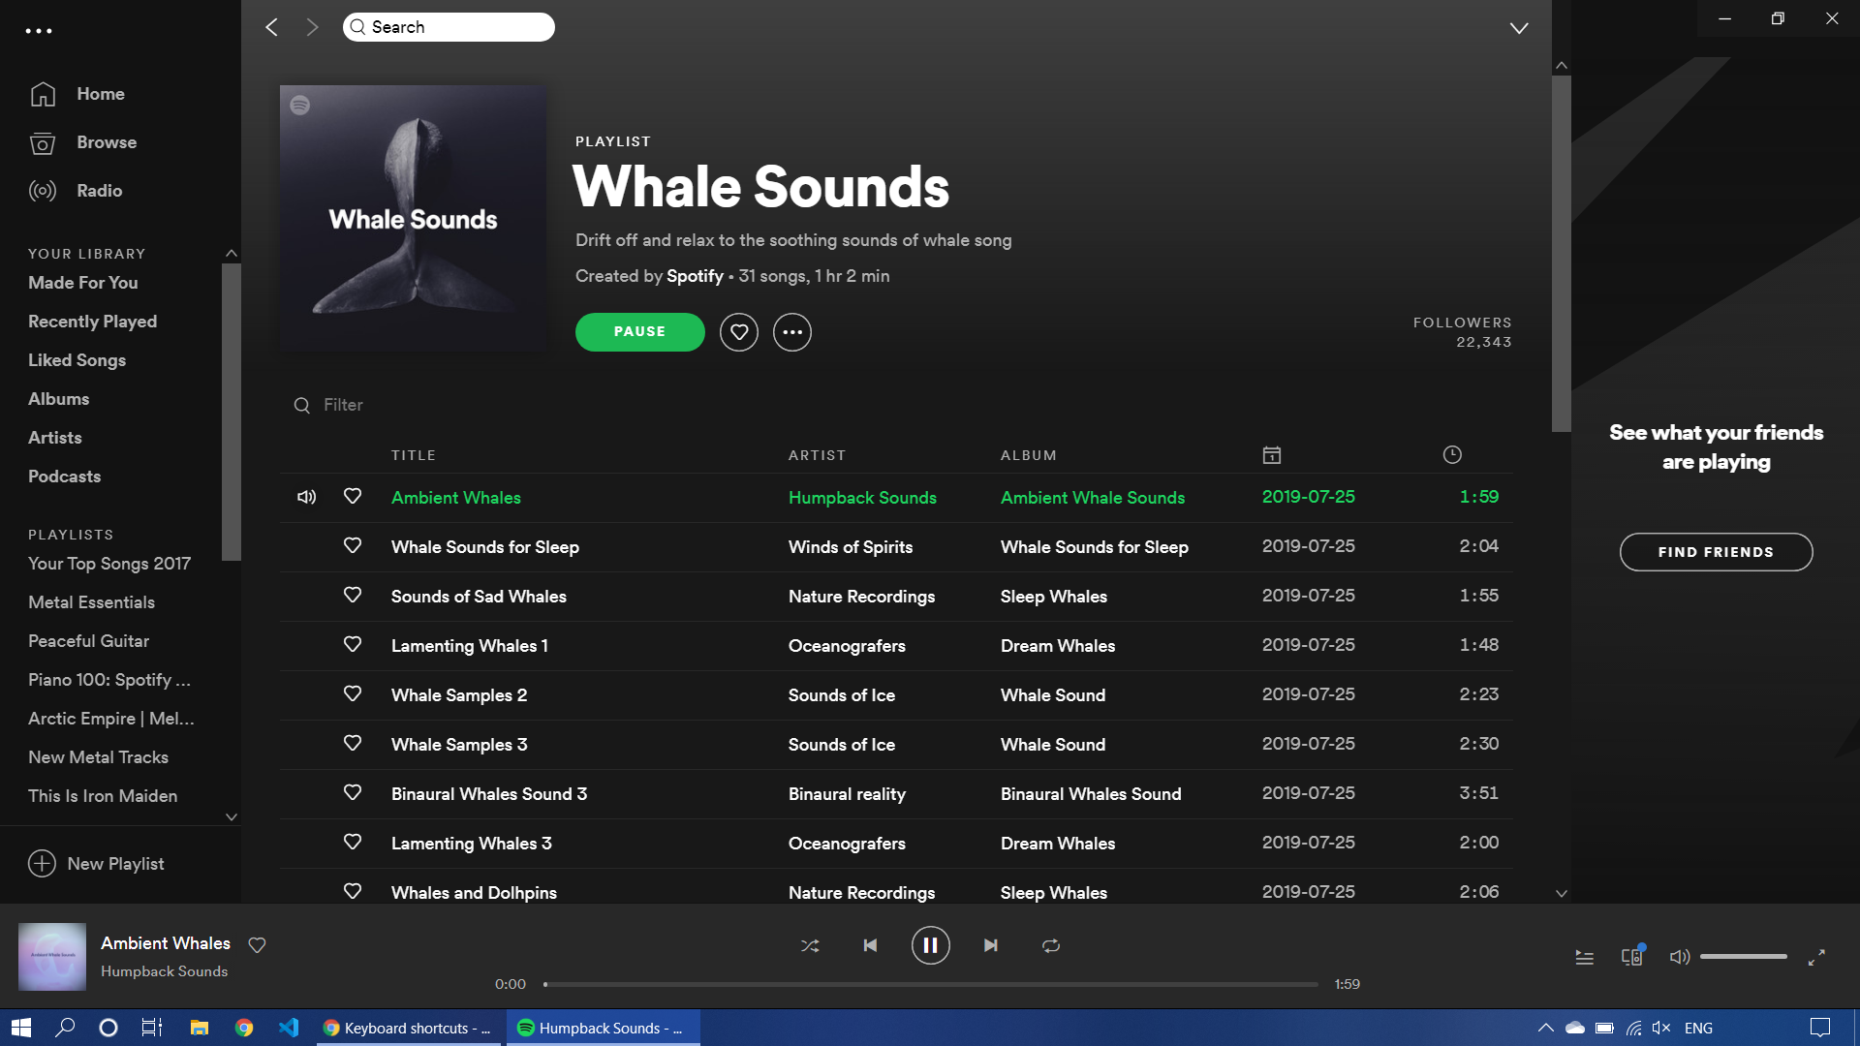

Slide 10
Problem
Keyboards and mice are old technology
Lots of repetitive actions
There should be an easier way

Slide 11
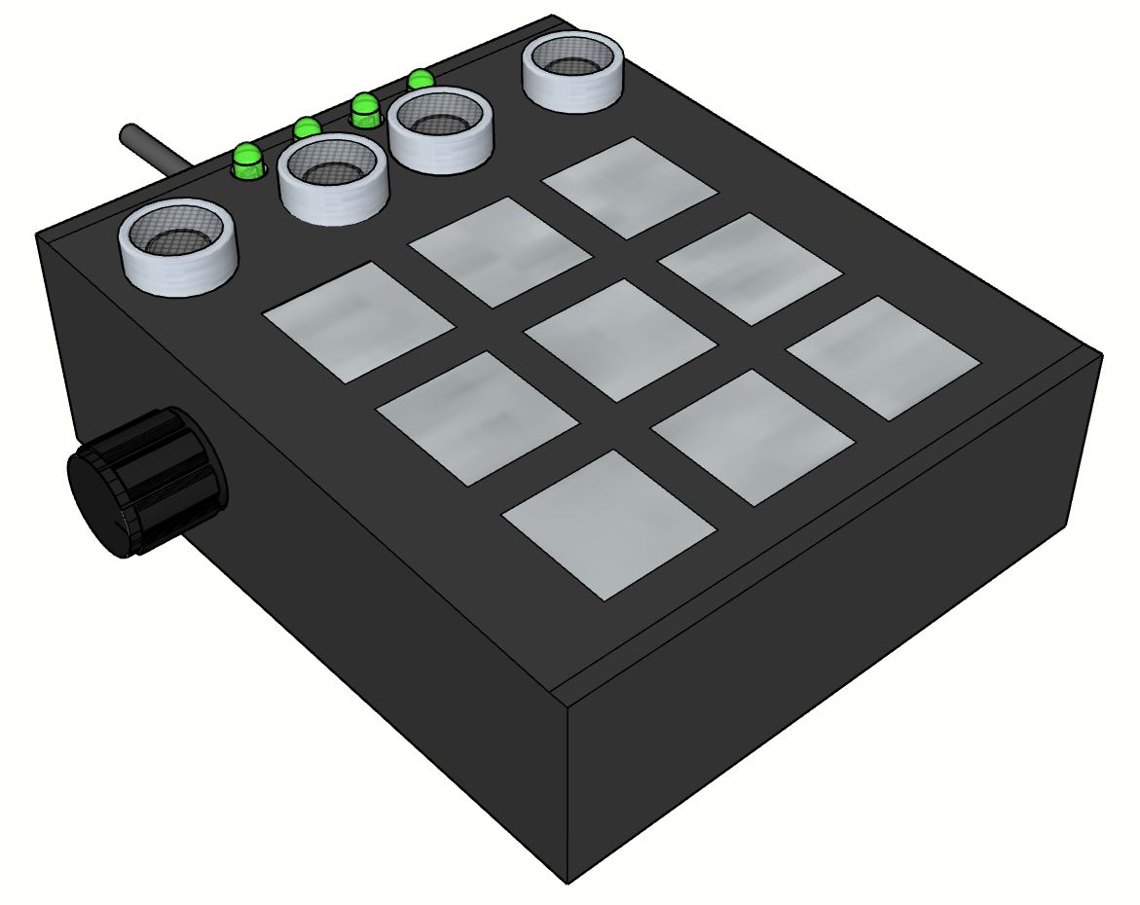
Solution
The PC Buttonpad
Actions can be customized
Can store hundreds of actions

Slide 12
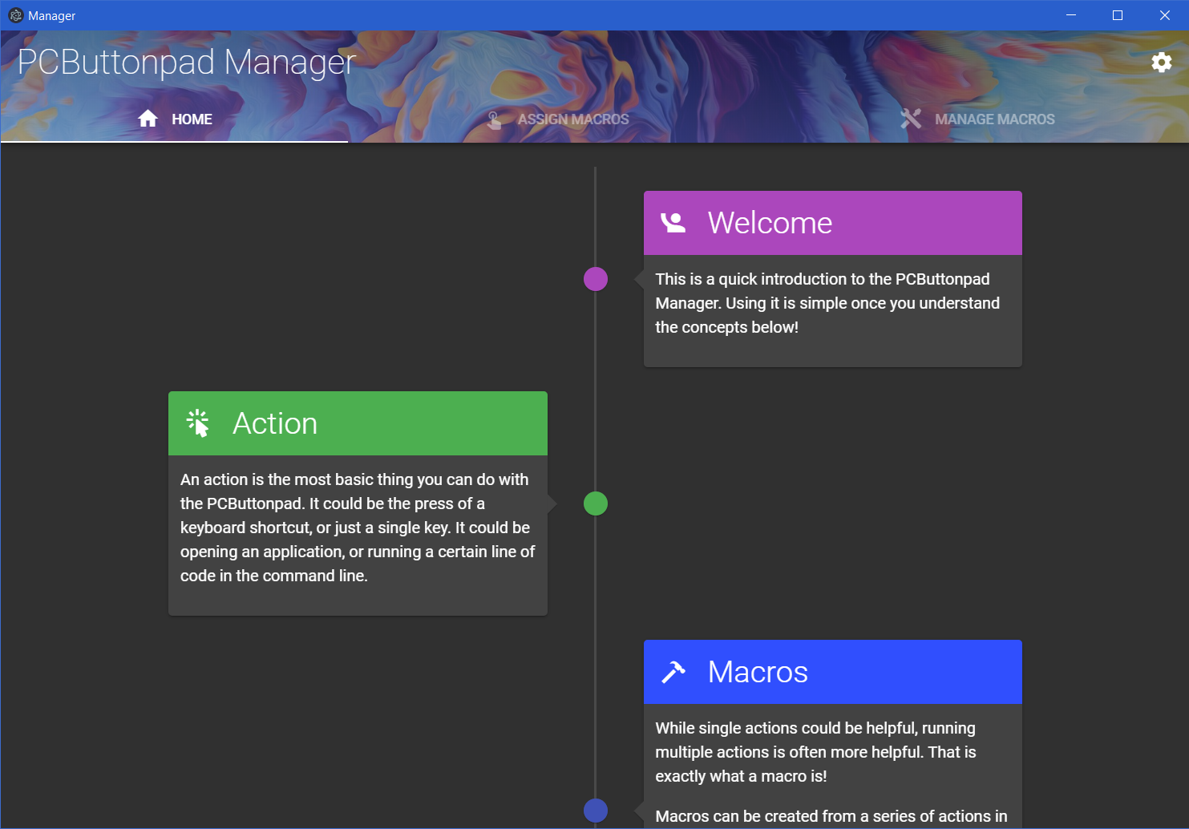

Slide 13
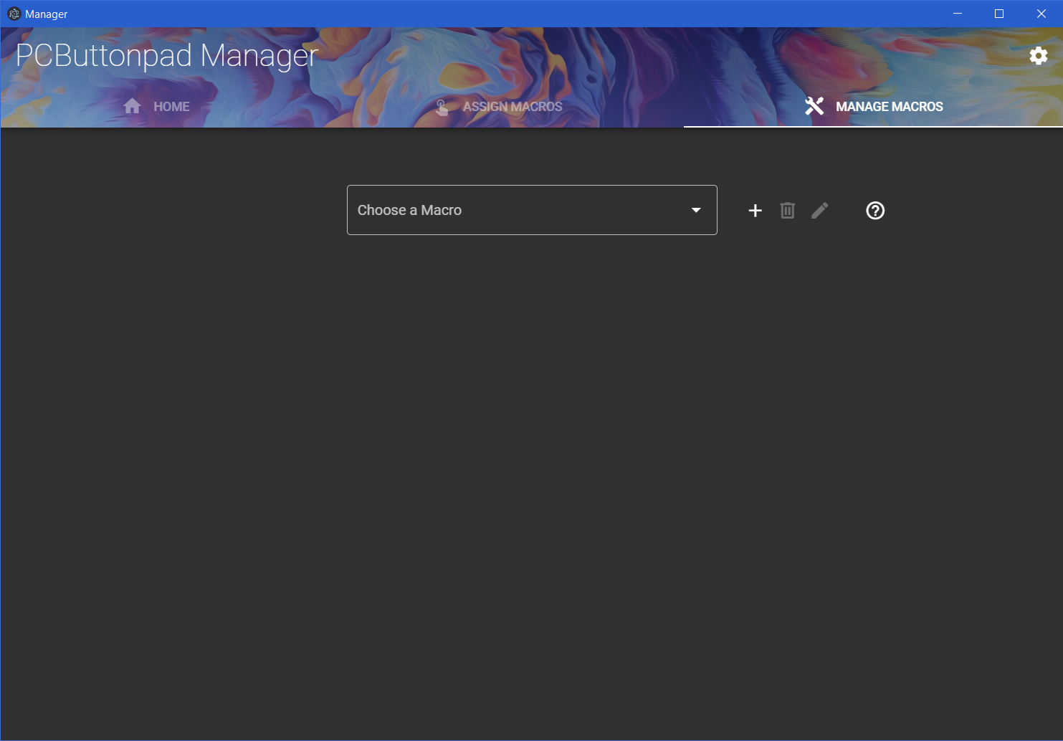

Slide 14
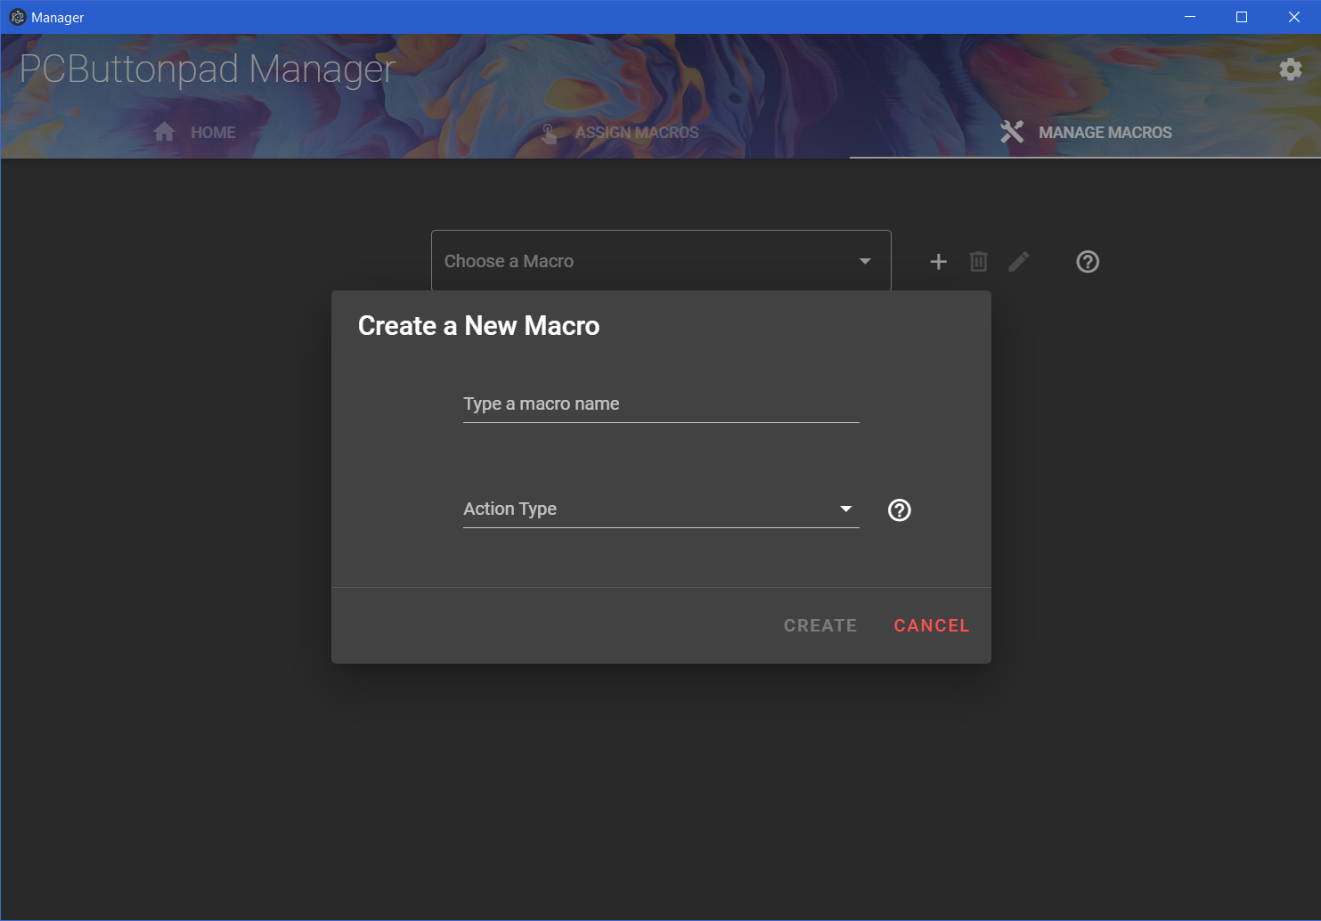

Slide 15
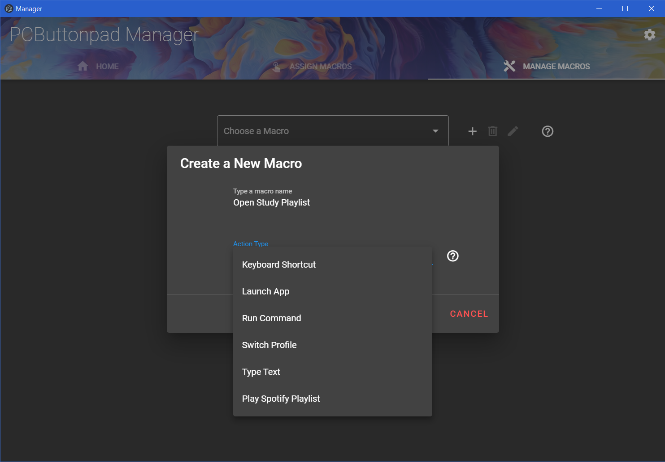

Slide 16
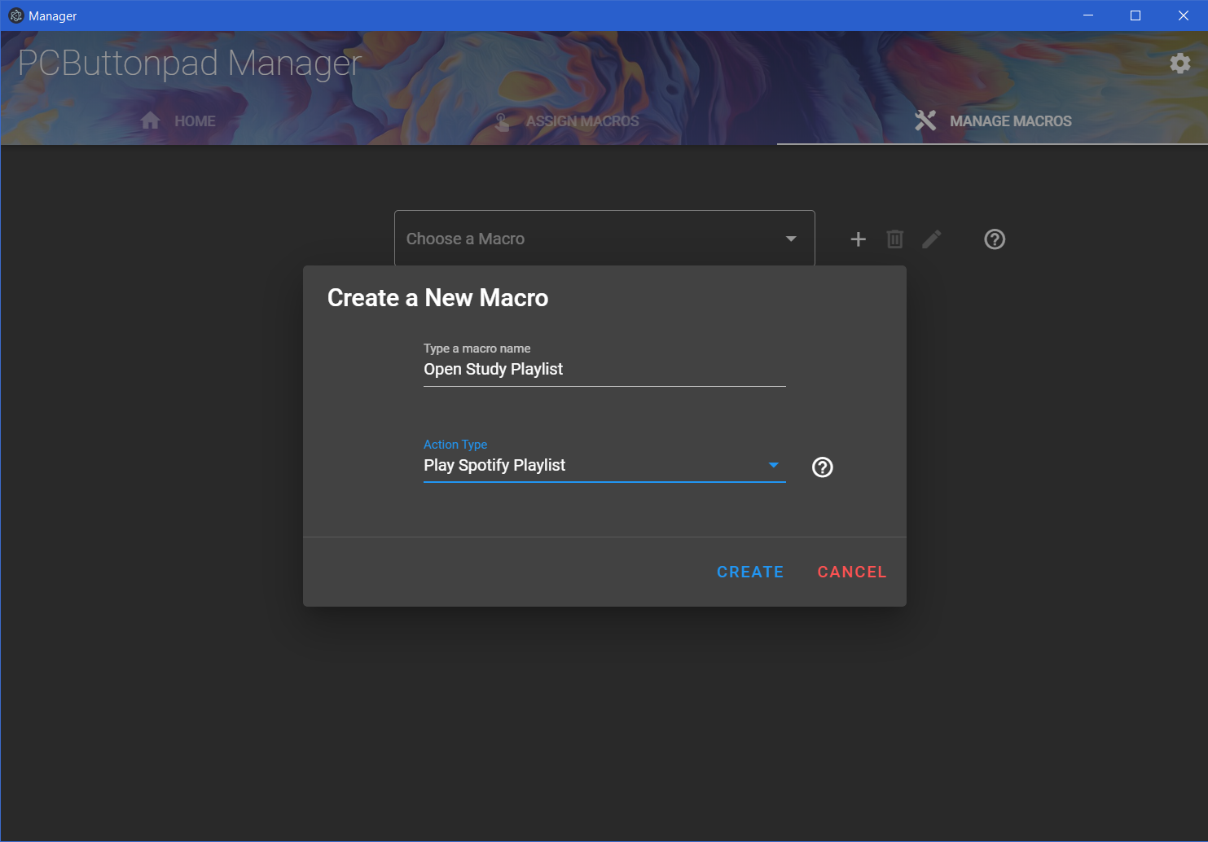

Slide 17
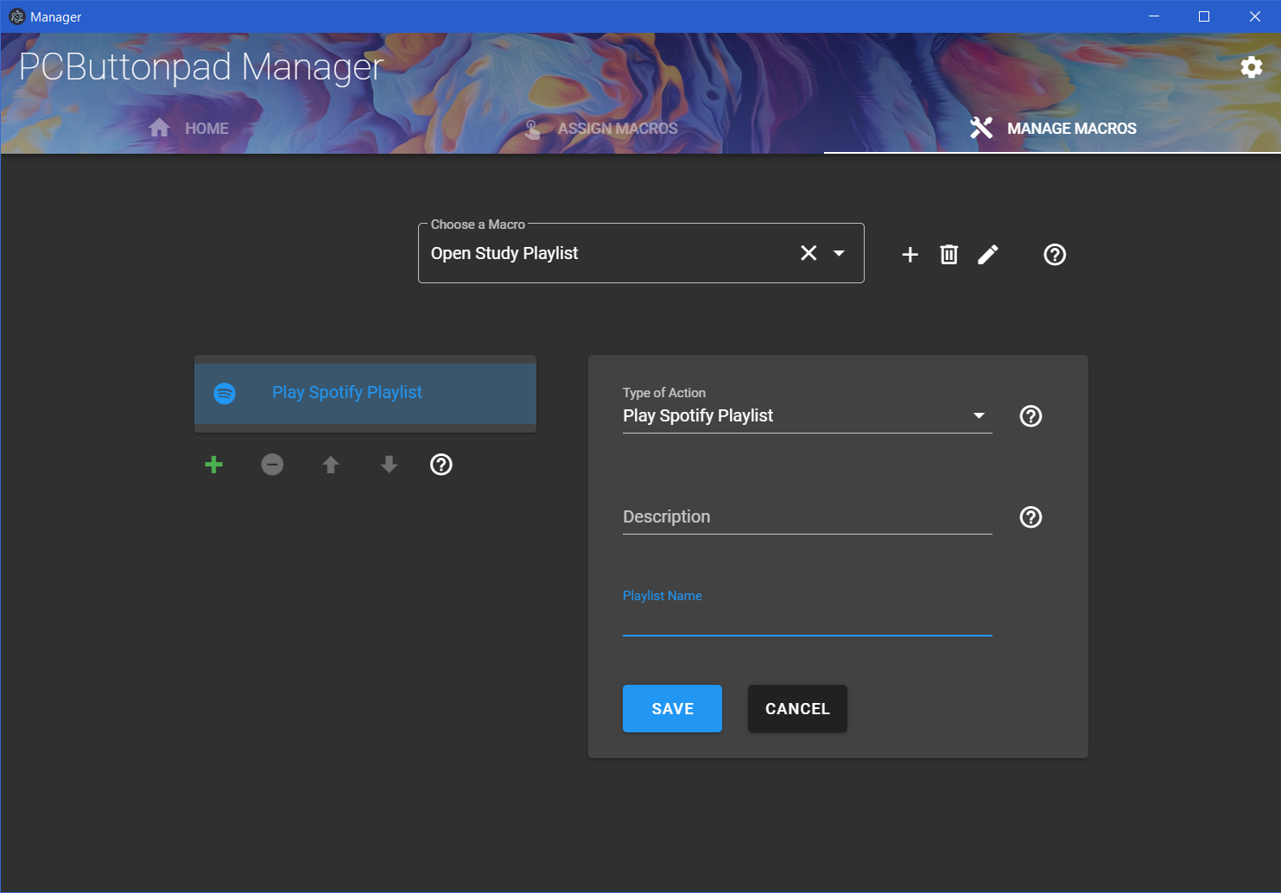

Slide 18
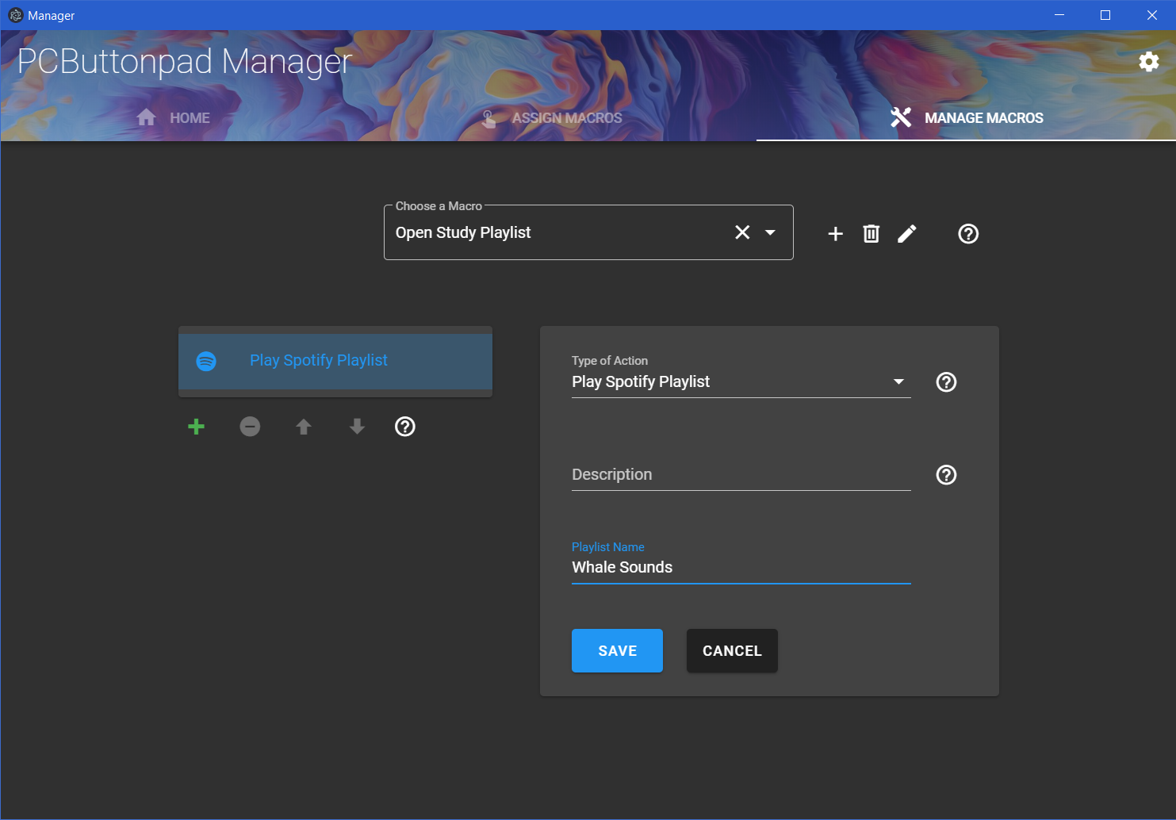

Slide 19
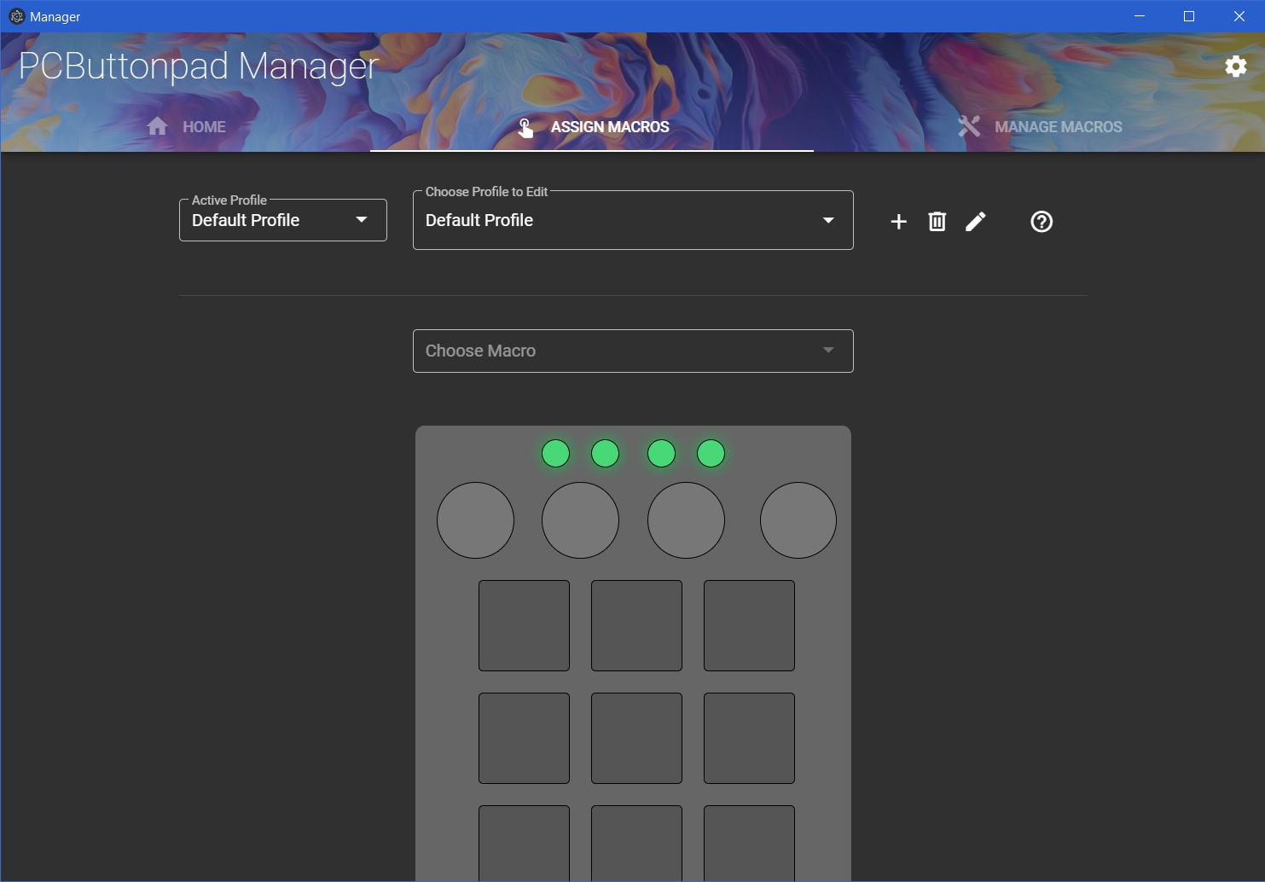

Slide 20
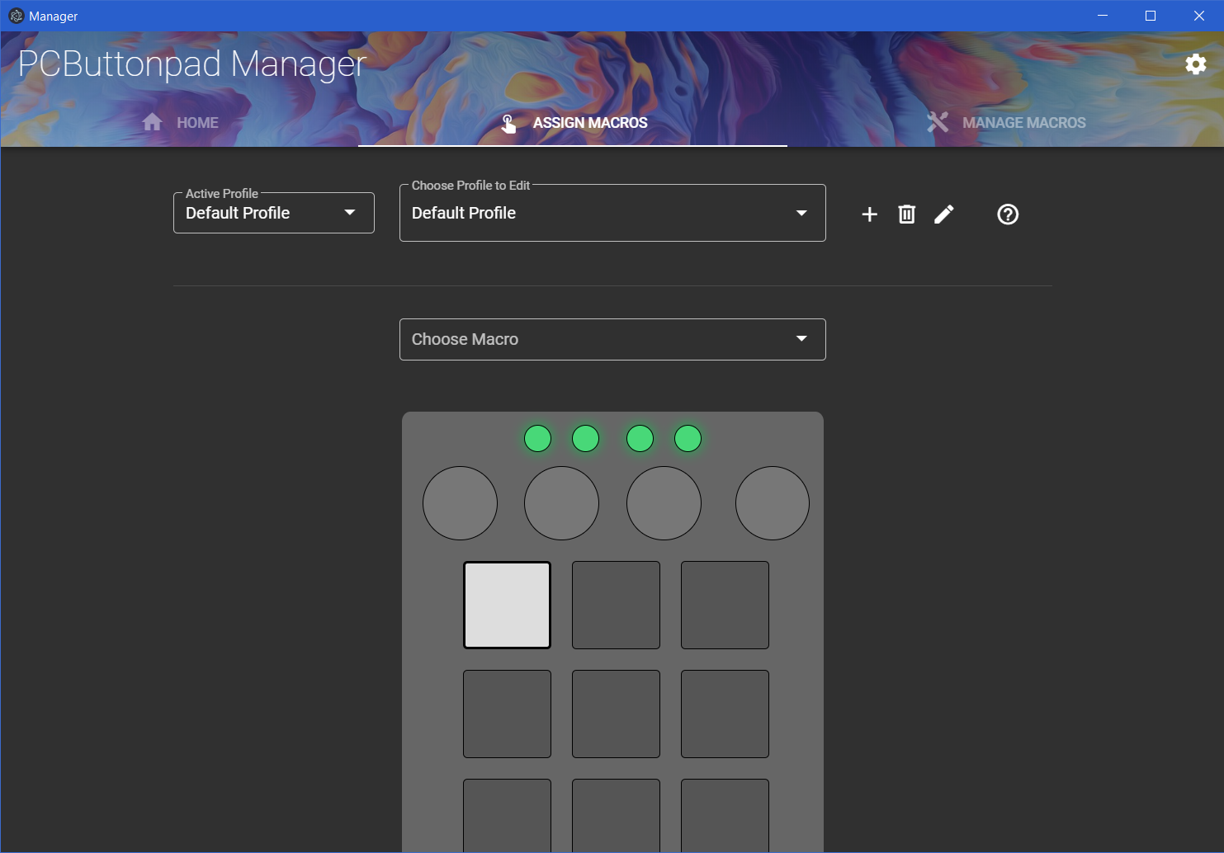

Slide 21
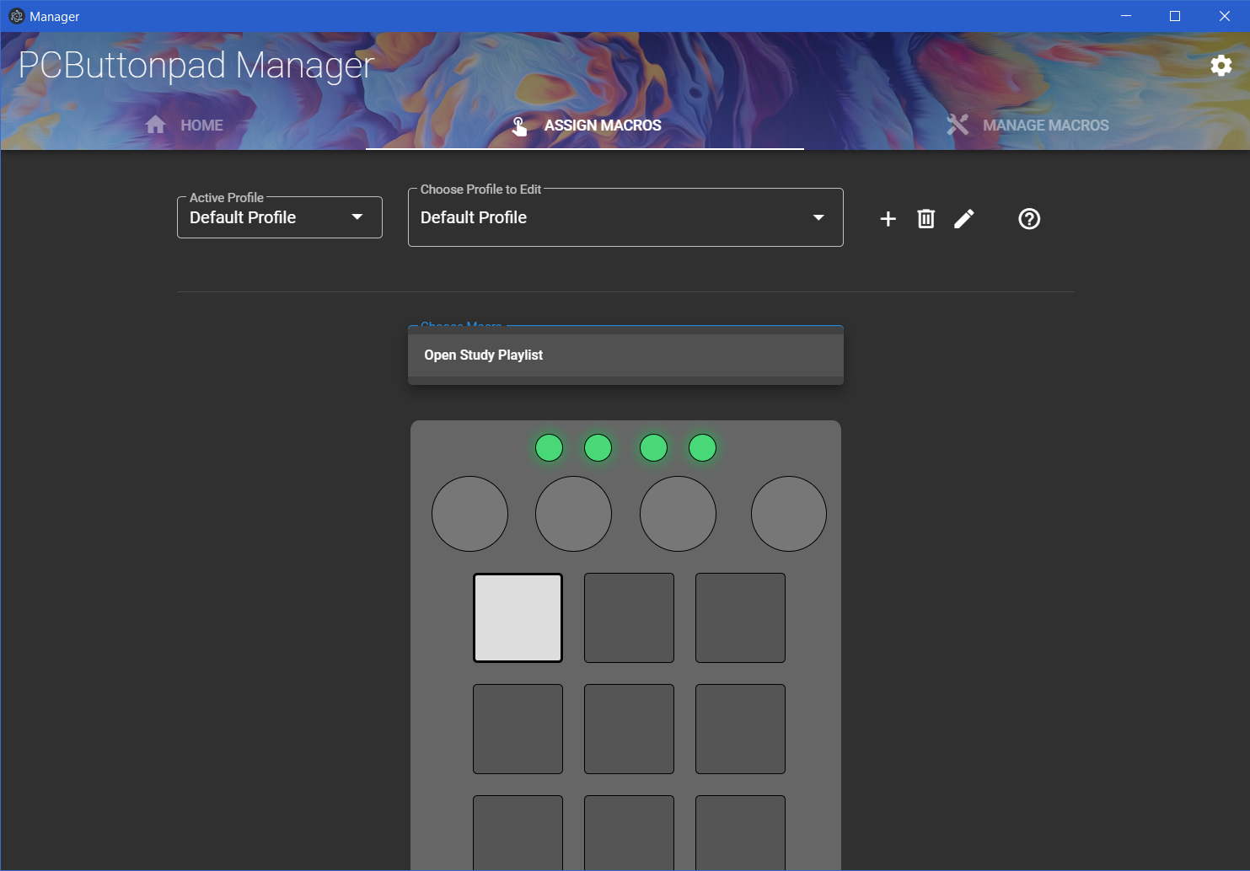

Slide 23
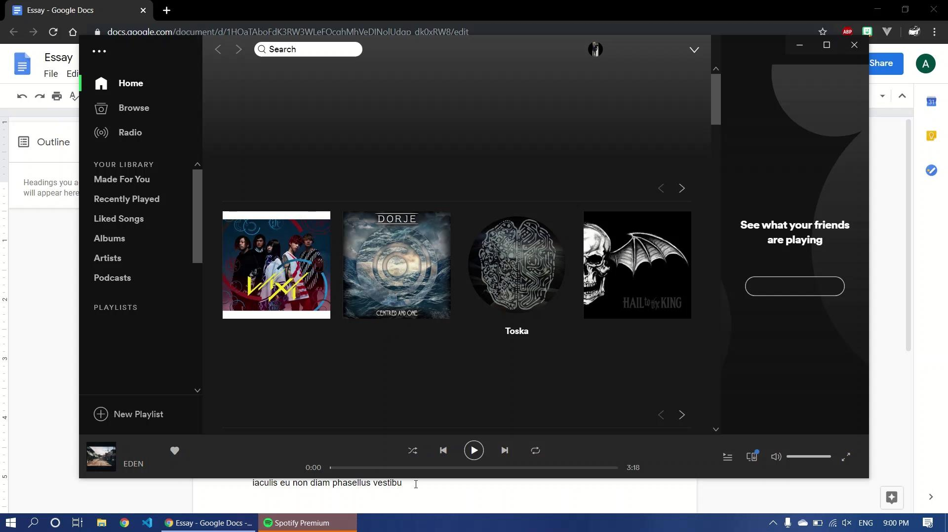
Notes:
Video showing how easy it is to open a playlist

Slide 24
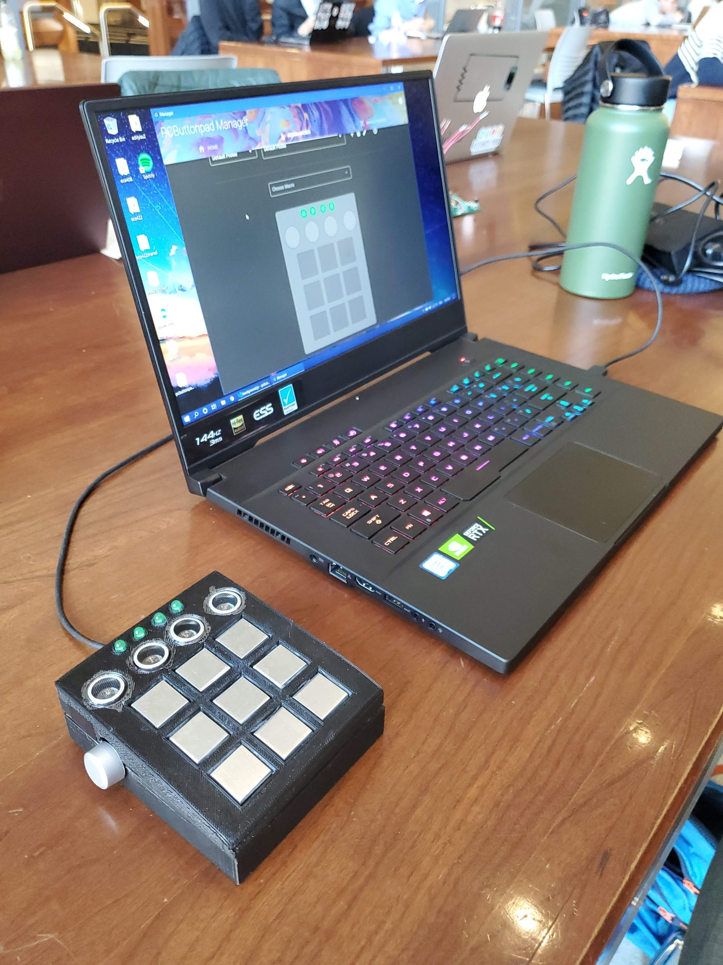
S
O
L
U
T
I
O
N
Notes:
Talk about high level requirements

Slide 25
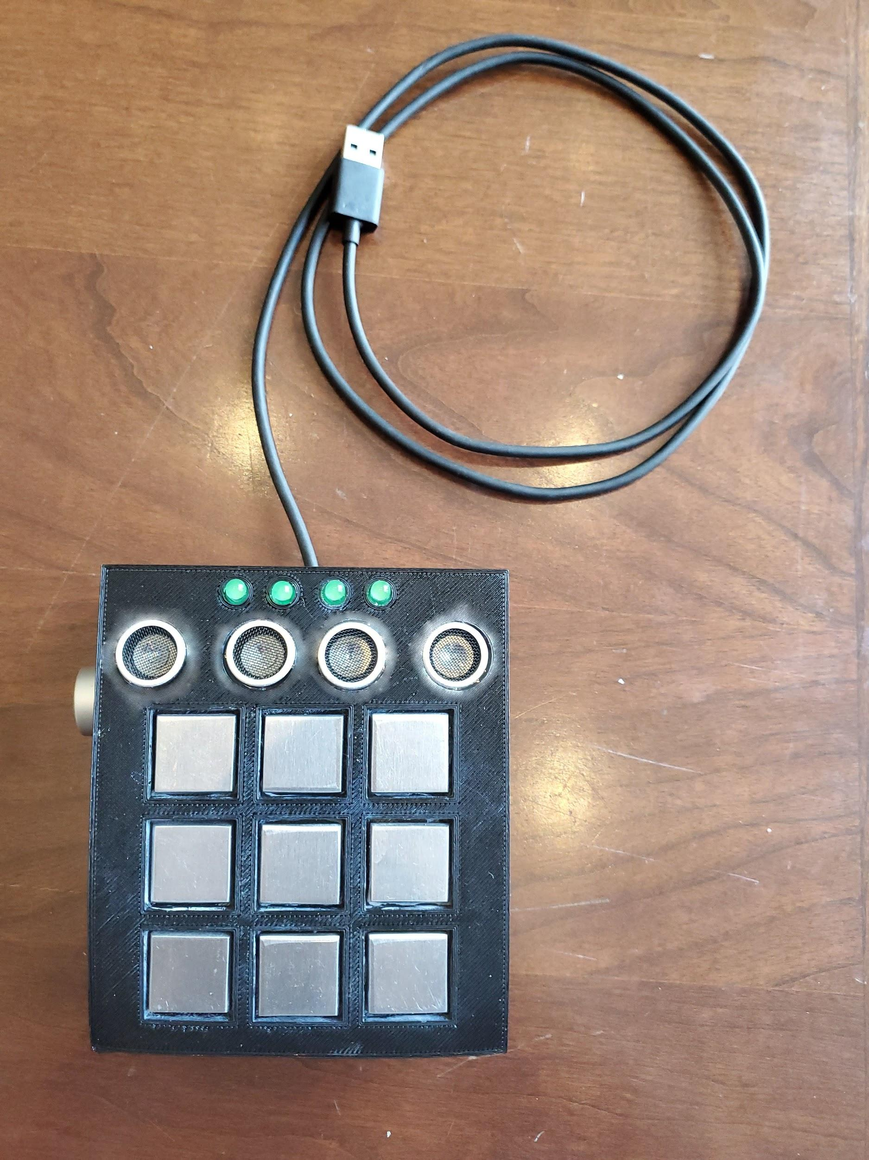
S
O
L
U
T
I
O
N
LED Array
Ultrasonic
Sensors
Rotary Encoder
Capacitive Touch
Sensors
Notes:
Talk about physical design, 3D printing (Stephanie)

Slide 26
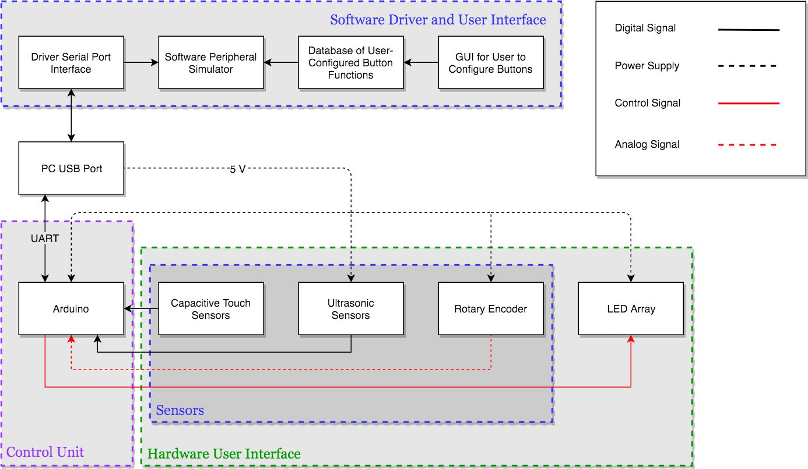
D
B I
L A
O G
C R
K A
M
Notes:
Stephanie

Slide 27
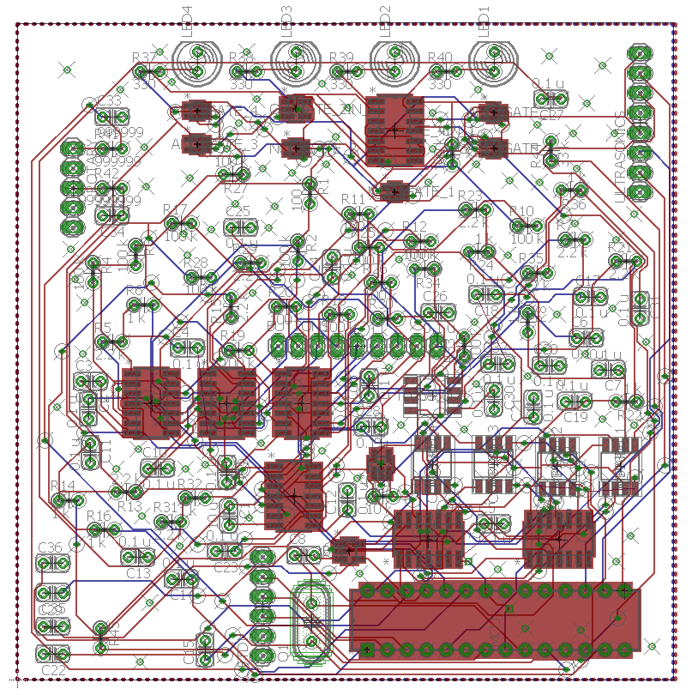
P
C
B
Notes:
Stephanie
LED array: gates smoked -> Arduino
Buttons that we touched
Timer chips for capacitive touch sensing
Comparators and encoders (logic) that turned analog signals to digital signals
Microcontroller

Slide 28
Software GUI
Notes:
Adit

Slide 29
Software GUI
Easy to use
Powerful
Cross-platform (Windows, macOS, Linux)

Slide 30
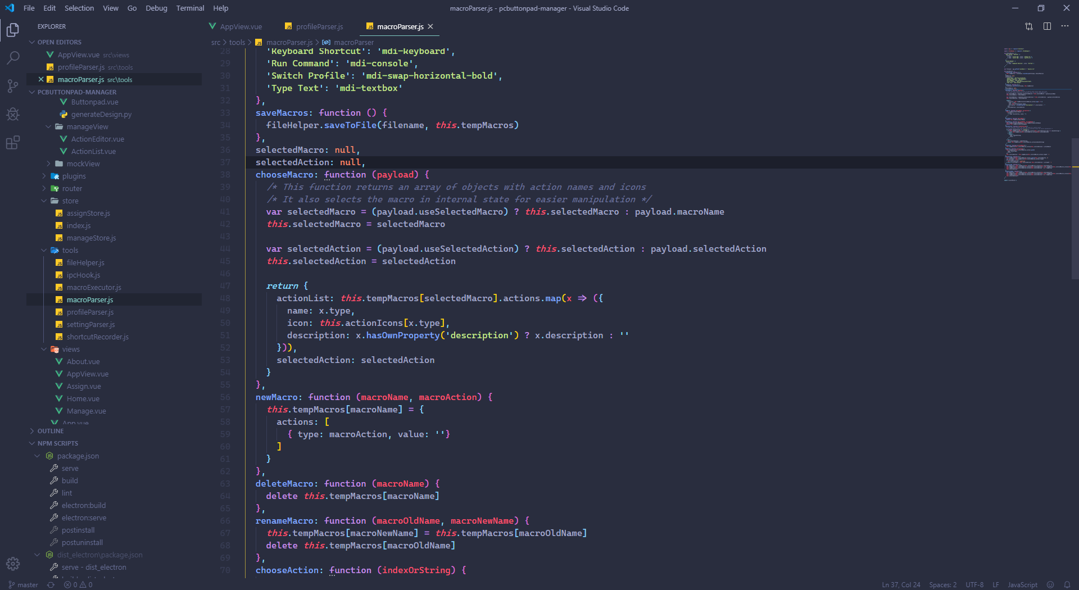
Development
Written in multiple programming languages
Thousands of lines of code

Slide 31
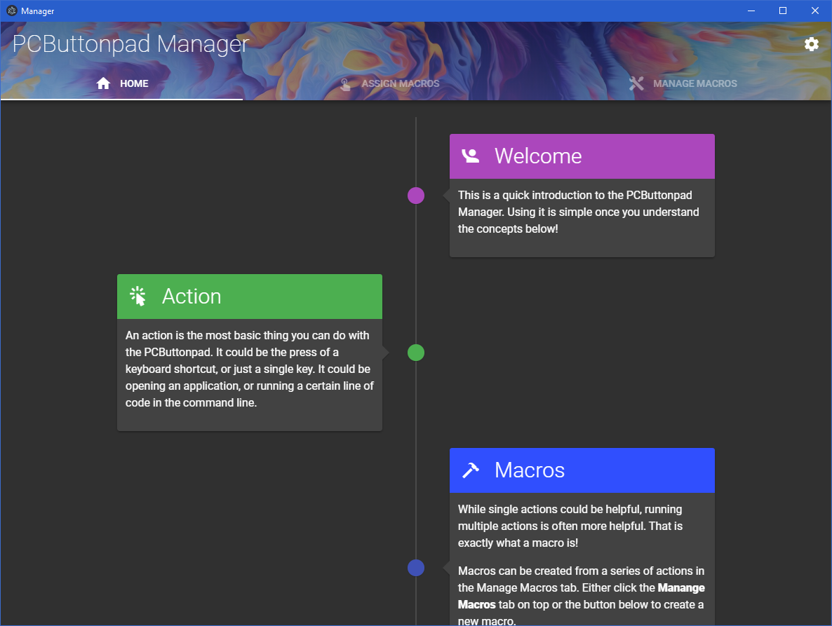
Overview

Slide 32
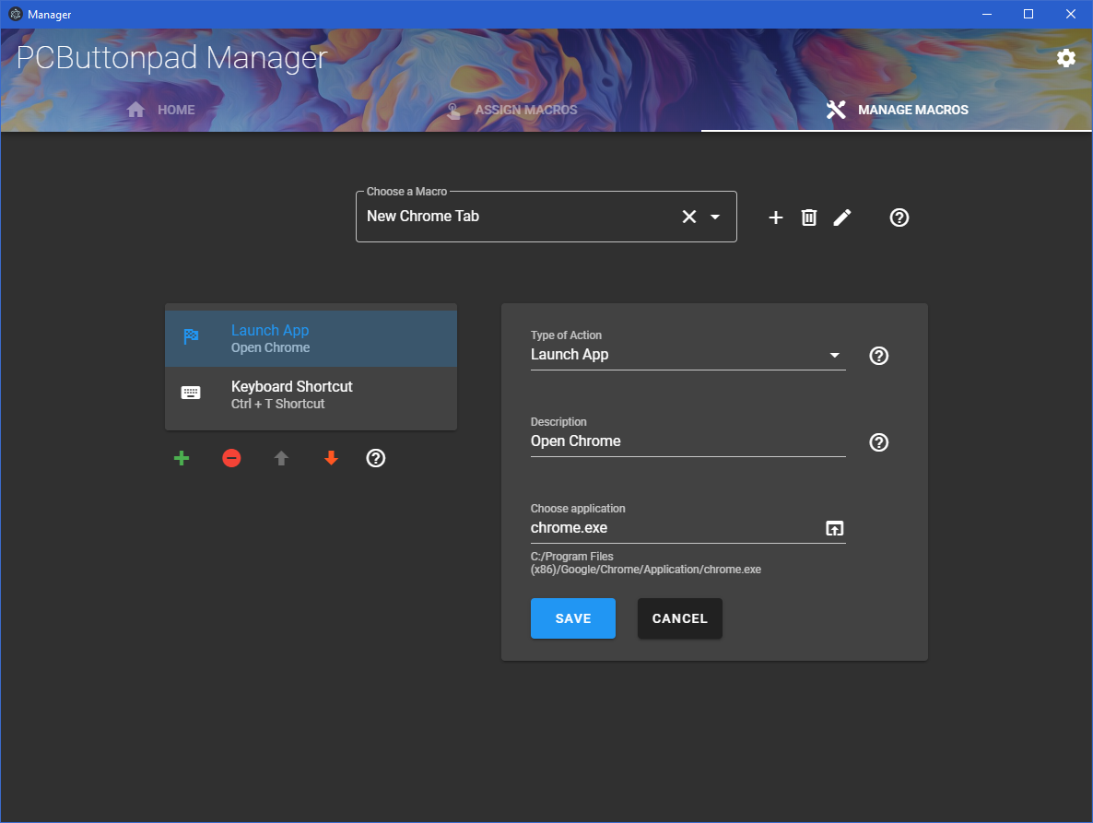

Slide 33
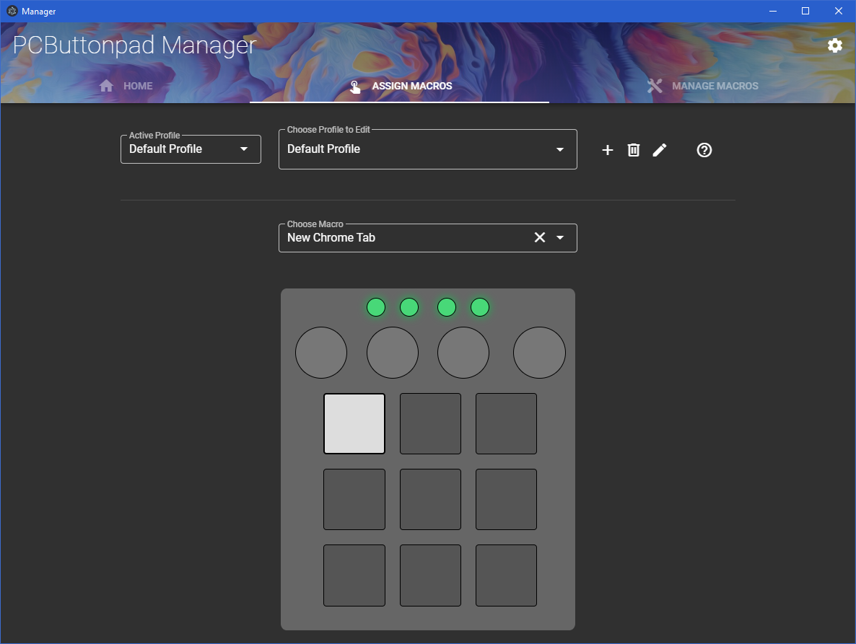

Slide 34
Capacitive Touch Sensors
Notes:
Yicong

Slide 35
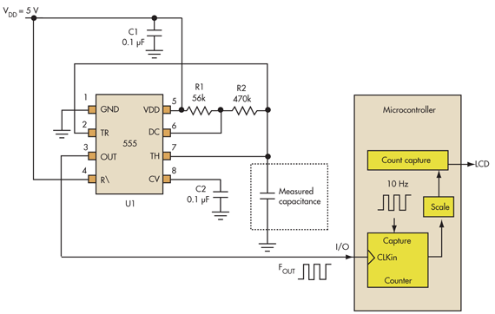
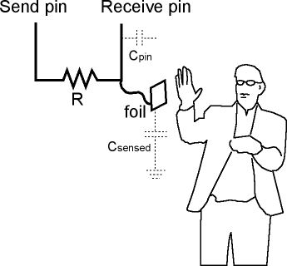
Capacitive Touch Sensors
Digital
Analog

Slide 36
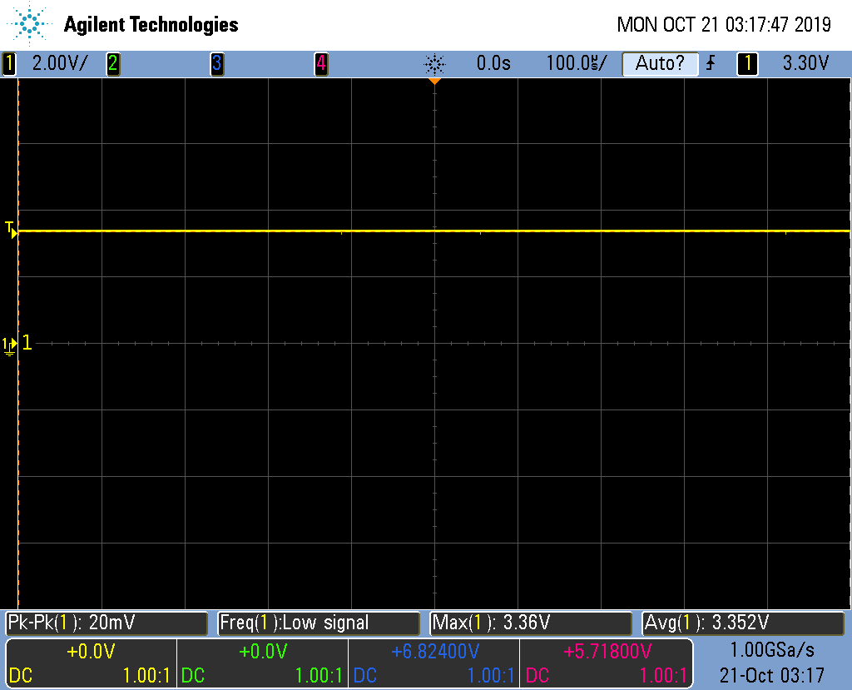
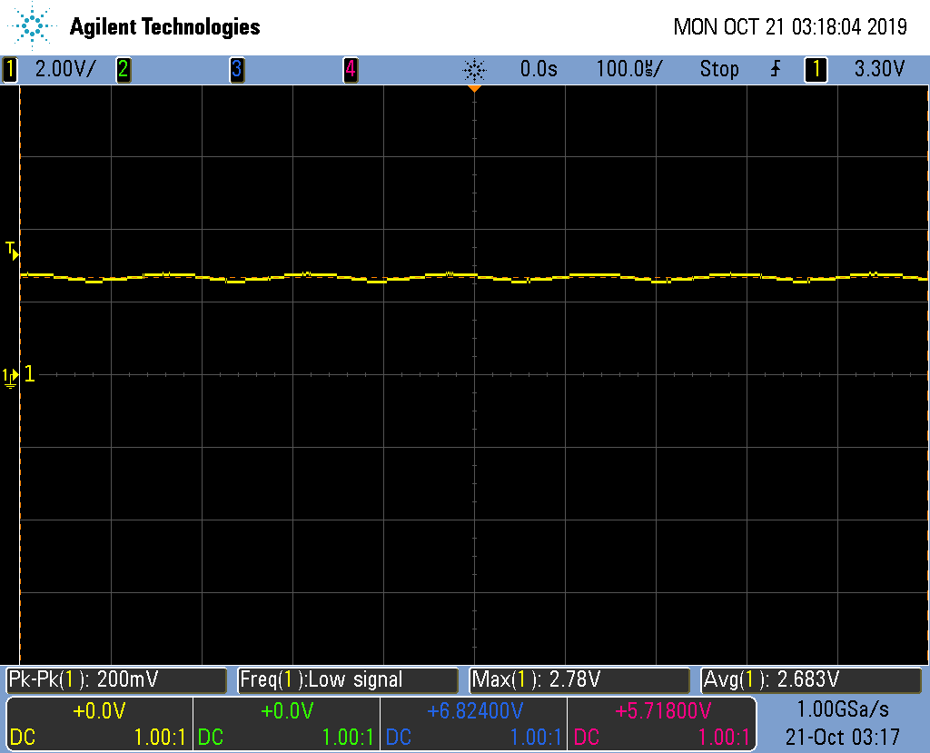
Capacitive Touch Sensors
Requirements
Must detect touching situations only, i.e. would not trigger unless the finger is ≤ 0.5 mm away from the button.
Verifications
Pretest this using Arduino, coins, foils, etc. on a breadboard, and place finger as close to the metal as possible without touching. Observe how the reading changes as we do so. If not desirable, change resistor value.

Slide 37
Rotary Encoder
Notes:
Yicong

Slide 38
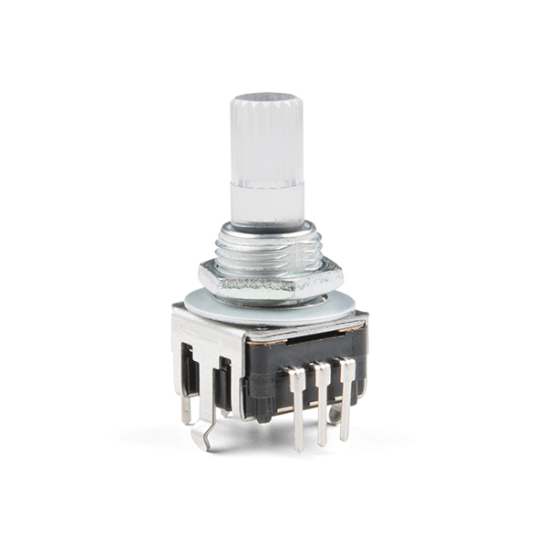
Rotary Encoder
Possible functions
Volume
Brightness
Pages
Requirements | Verifications
Must register each turn as either +1 or -1 in the signal print out. | Print on screen using Arduino
Mechanism
Two metal contact points
Pulse delay → direction

Slide 39
Ultrasonic Sensors
Notes:
Stephanie

Slide 40
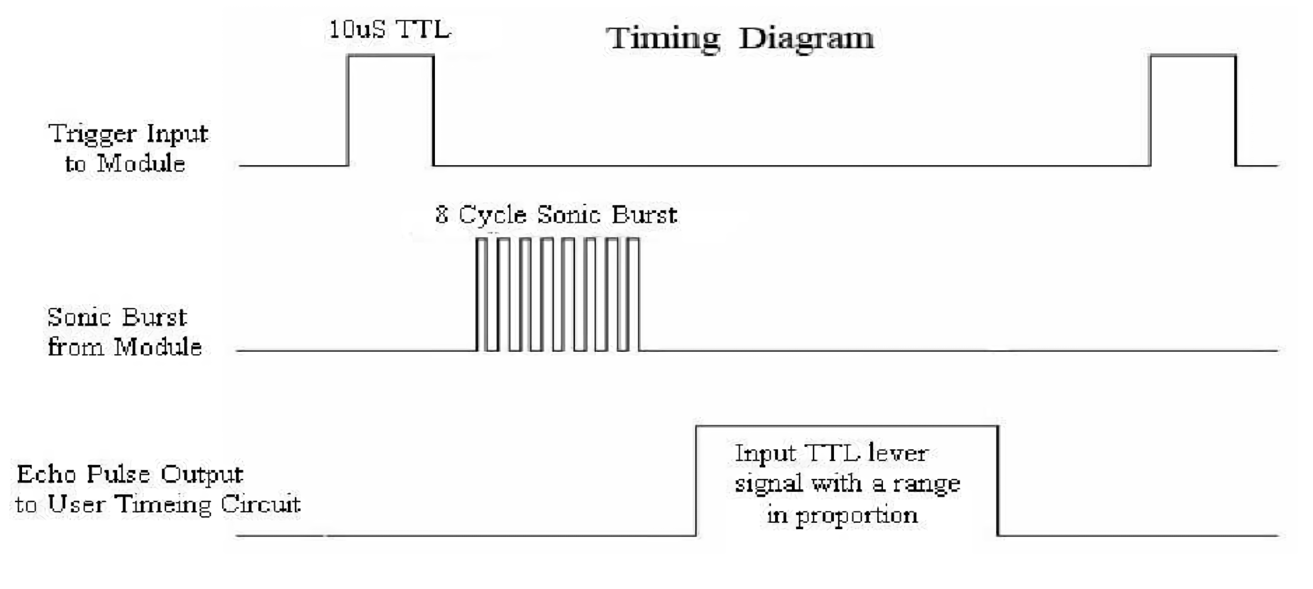
Ultrasonic Sensors
Touchless gesture controls
Profile swiping
D = (speed of sound in air × time)/2

Slide 41
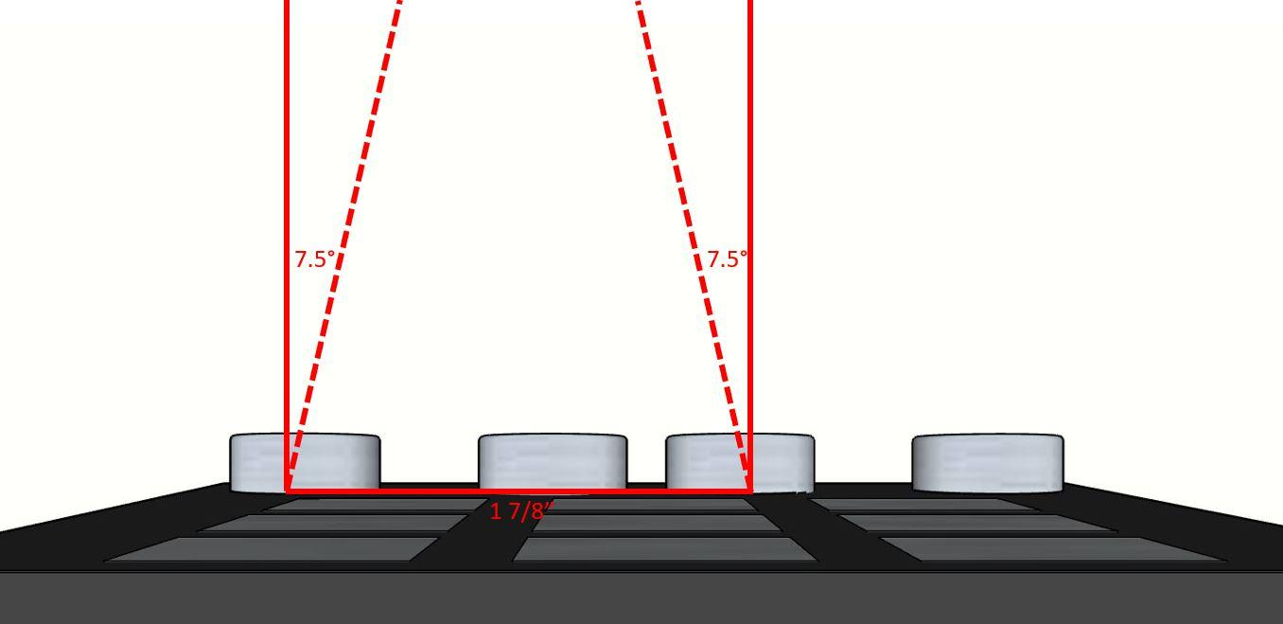
Ultrasonic Sensors
Requirements | Verification
Distance range for motion detection must be between 2 cm and 1 m. Angle of measurement is within 15°. Two adjacent ultrasonic sensors must individually collect data. Measurement cycle period should exceed 60 ms. | Test accuracy of data around lower distance threshold at 2 cm and ensure that accuracy is maintained up to 1 m. Test hand placement above sensor at several angles, including 15°, and compare the data. Take and record data from a single ultrasonic sensor. Test two ultrasonic sensors, side by side, to see if their signals interfere or cause any discrepancy in the data compared to the data of a single ultrasonic sensor. We will set the cycling period to ~70 ms in the microcontroller before sending the following 10 µs TTL pulse.

Slide 42
Accomplishments
Cross-platform software GUI
Capacitive sensing mechanism
Data communication through Arduino
Notes:
Stephanie

Slide 43
Failures
Ultrasonic sensors unresponsive with large data
LED logic unable to work on PCB
Software could not change system settings (volume, brightness, etc.)
Notes:
Yicong

Slide 44
Future Work
Software can be improved upon
Enhance rotary encoder functionality
Use a standalone MCU instead of an Arduino
Strengthen ultrasonic sensors’ communications
Notes:
Adit

Slide 45
Acknowledgements
Mengze Sha
Professor Wei He
David Null
Jan Progen
Gregg Bennett and the ECE Machine Shop
Notes:
Adit

