Slide 1
ECE 445 | Fast, Low-Cost Swarm Robots
By Michael Bartmess, Peter Cork, and Paul Ernst

Slide 2
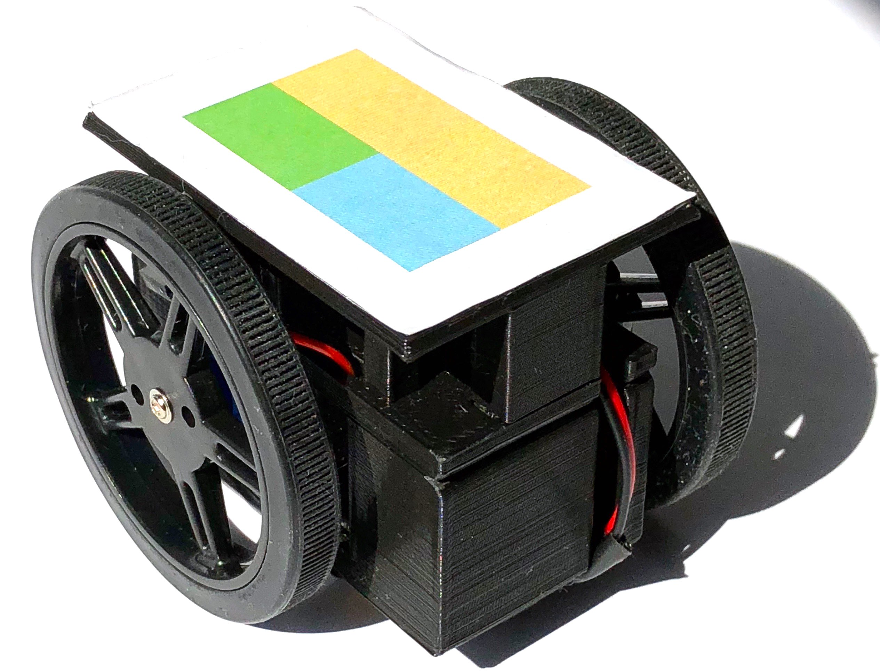
Swarm Robots | Overview
Project was to design and build a fleet of robots
Each robot can:
Can move quickly and independently
Have their current position calculated
Will converge on a destination position
Purpose:
Visualizing transitions and shapes
Platform to test route planning algorithms
Evaluate using machine vision in real time for control purposes
Final Robot Design

Slide 3
Swarm Robots | Demonstration

Slide 4
Swarm Robots | Control Loop
Capture Image of Field
Compute Position and Orientation
Compute Motor Commands and Send
Move Robots

Slide 5
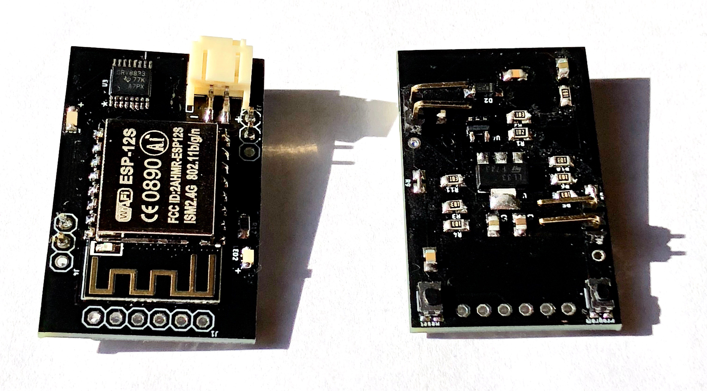
Swarm Robots | Hardware
Two main systems:
Vision System
Robot System
Robot Main Logic Board, Top and Bottom View

Slide 6
Project | Hardware: Vision System Block Diagram
Laptop
120V AC
WiFi Connection
Control System
Vision Software
USB
USB
802.11n
5V
120V AC
Router
Webcam
To Robots

Slide 7
Swarm Robots | Hardware: Vision System Requirements + Verification
Webcam:
Router:
Requirement: | Verification:
Be 1080p to provide high enough resolution | Pass, 1920x1080 image
Able to stream at least 10fps | Pass, capable of 30fps
Requirement: | Verification:
Transmit and receive a 2.4 GHz signal | Pass
Transmit 8 packets of 16kB in under 100ms | Pass, though our packets were significantly smaller
Connect to 8 devices at one time | Pass
Laptop:
Requirement: | Verification:
Fast enough to analyze a frame in under 100ms | Pass, can analyze at 15fps

Slide 8
Swarm Robots | Hardware: Robot System Block Diagram
To Router
Programming Pins
ESP8266 SoC
Motor Block
UART
5V Power
WiFi Connection
Antenna
Flash
GPIO
PWM
Left Motor
Processor
3.3V
Motor Controller IC
Power Block
5V
Right Motor
3.3v LDO Regulator
Battery Charger
4.2V
4.2V
4.2V
Li-Ion 4.2v Battery

Slide 9
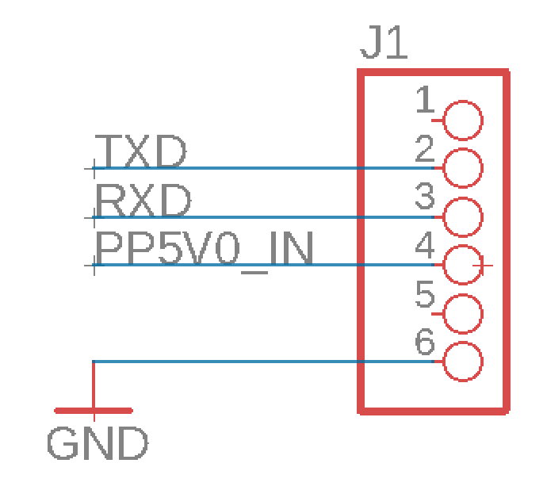
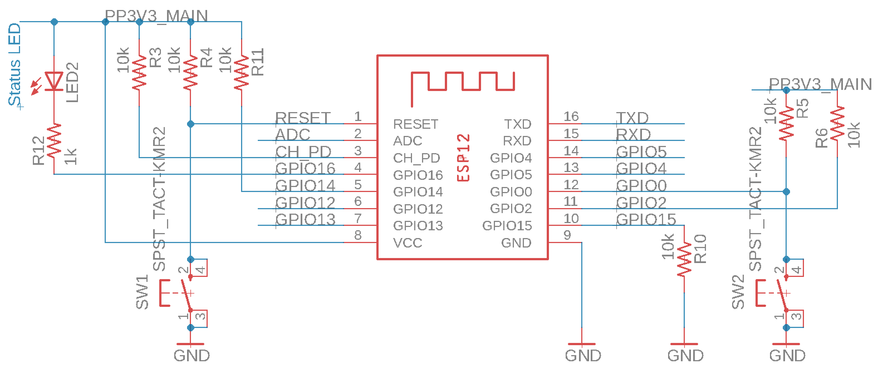
Swarm Robots | Hardware: SoC Block
Used ESP12-S SMT Module
Switches for Reset and Program
General purpose Red LED
GPIO 4, 5, 12, and 13 for Motor Controller

Slide 10
Swarm Robots | Hardware: SoC Block Requirements and Verification
Requirement: | Verification:
Be fast enough to respond to compute and respond to loop corrections in under 100ms. | Pass, but not relevant in final implementation
Be able to connect to a 2.4GHz signal. | Pass
Can transmit 2 PWM signals simultaneously. | Pass, capable of driving the two motors independently
Runs reliably between 2.95v and 3.4v | Pass, No measurable change in packet loss at 15ft
Consumes less than 200mA while transmitting | Pass, transmission draws 90mA when sending and receiving packets at 100Hz

Slide 11
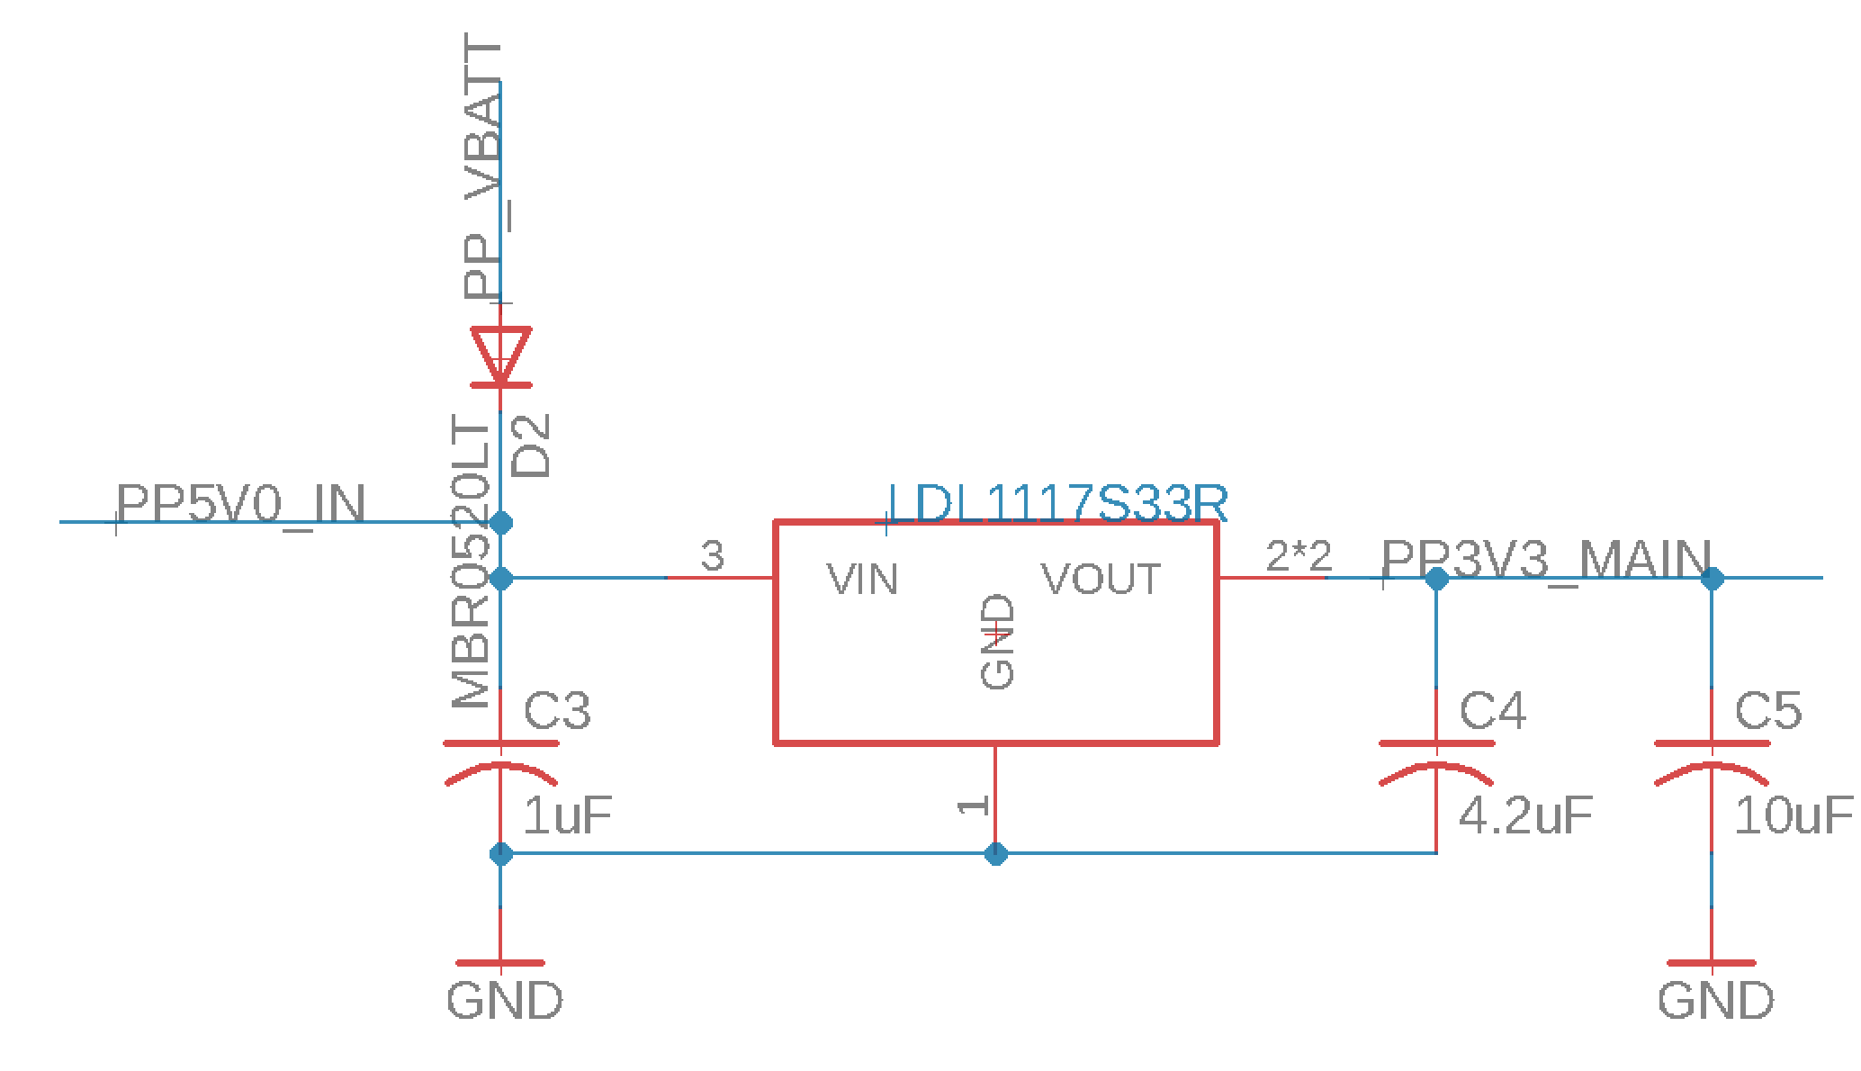
Swarm Robots | Hardware: Power Block
5v provided when plugged in
Charges battery at 100mA (ish)
LED for charging feedback
LDO produces 3.3v output

Slide 12
Swarm Robots | Hardware: Power Block Requirements and Verification
Requirement: | Verification:
Charging Circuit: Able to charge the battery in less than 1 hour. | Mixed, correct circuit charges in 4 hours, swapping resistor 1 and 2 causes charging in 40 minutes
Voltage Regulator: Able to maintain a voltage output between 2.95V and 3.4V over an input range of 3.5V to 4.2V | Pass, voltage ranges between 3.27V and 3.29V
Voltage Regulator: Able to provide 500mA of steady state current | Pass, No degradation while drawing 500mA
Battery: Able to provide 500 mA for 30 mins | Pass, stayed in operation for over 30 minutes
Battery: Output voltage stays between 3.5 and 4.2V | Pass, min voltage seen was 3.7V, max was 4.18V

Slide 13
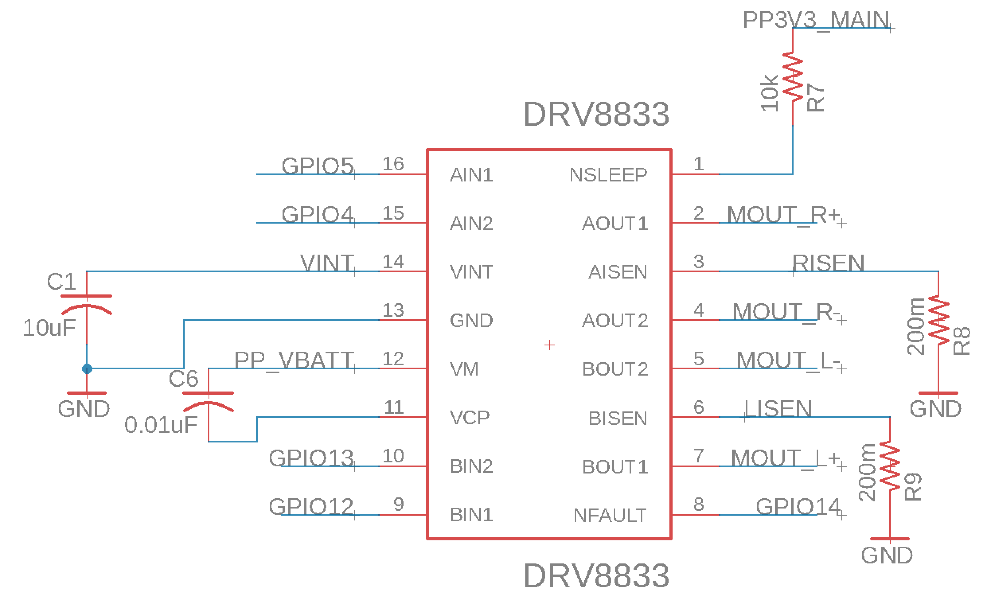
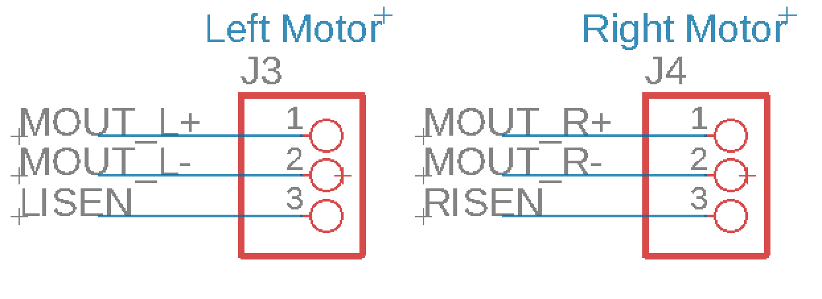
Swarm Robots | Hardware: Motor Block
Uses DRV8833 as controller
Current limits to 1A draw per motor (Eq. 1)
Digital PWM signals amplified
Bidirectional control for each motor

Slide 14
Swarm Robots | Hardware: Motor Block Requirements and Verification
Requirement: | Verification:
DC Motor: Draw less than 150mA with no load at 4V | Fail, Draws 190 mA, but since the power profile of the SoC was 100mA under what we expected this was a non-issue
Motor Controller: Operate from 3.7 to 4.2V | Pass, some mild speed changes
Motor Controller: Be able to run a DC motor bidirectionally | Pass

Slide 15
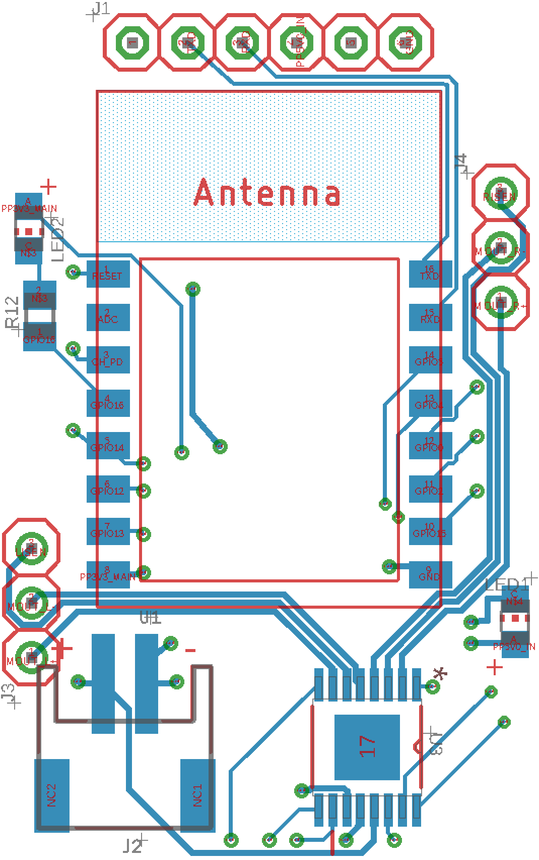
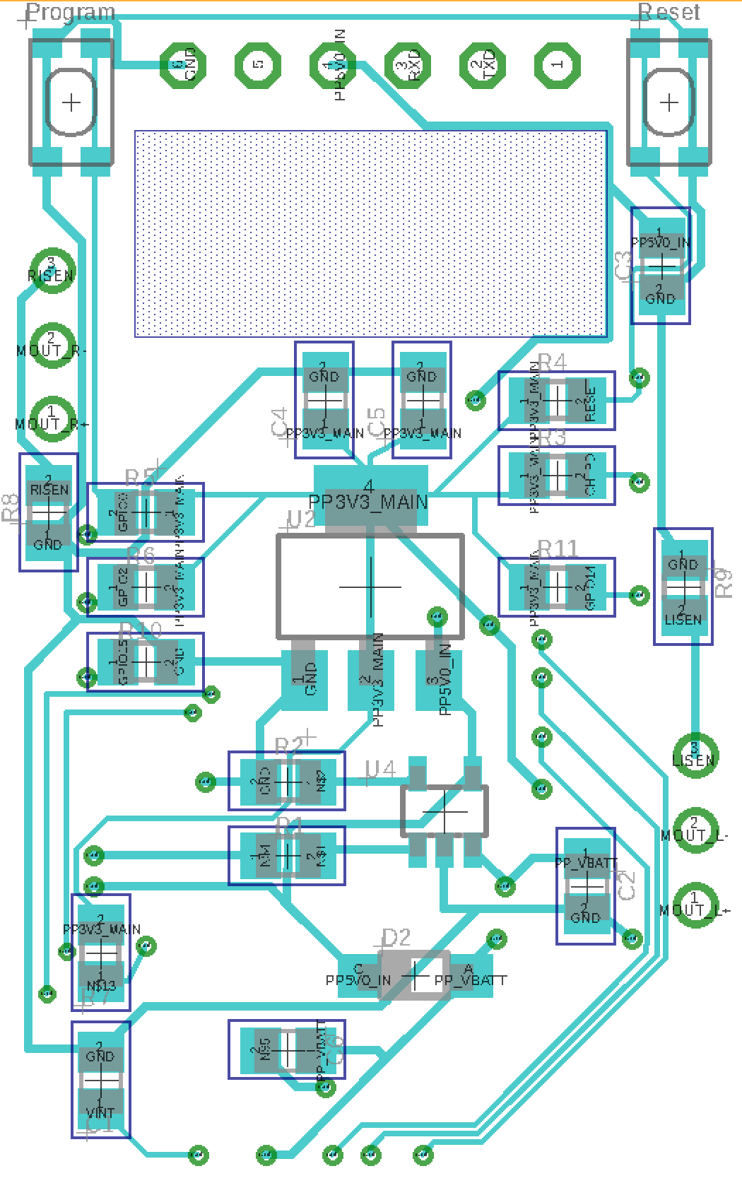
Swarm Robots | Hardware: Layout
2 layer
6 mil signal traces
10 mil power traces
All SMT components
0805 footprint for passives
Antenna keep-out area
Top Layer:
SoC
Motor Controller
Charge and Status LEDs
Battery Connector
Bottom Layer:
Push Buttons
Most Passives
Voltage Regulator and Charger IC
Top Layer
Bottom Layer

Slide 16
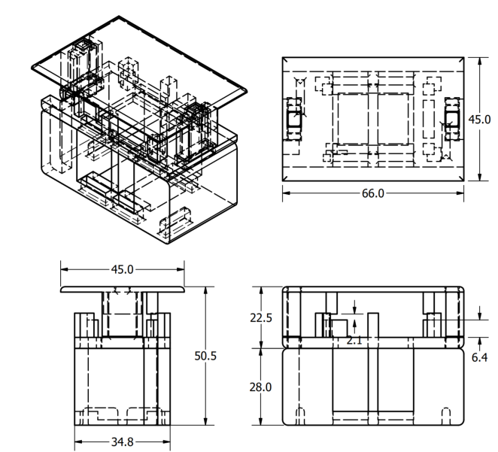
Swarm Robots | Hardware: Physical Design
3D printed chassis
3 discrete parts per chassis
Footprint of 29.7cm²
Battery located on bottom
Motors connect to right angle male 0.1" headers
Top used for vision target

Slide 17
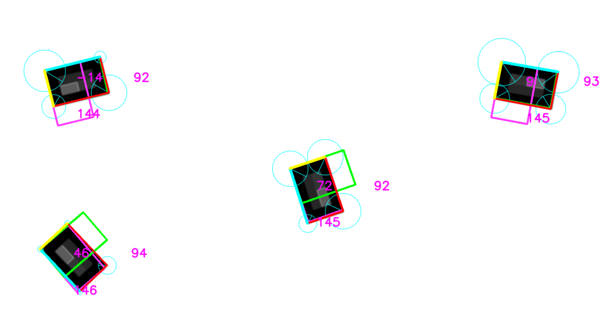
Swarm Robots | Software
Camera configuration
Computer Vision:
Feature Recognition
Position Extraction
Formation design
Control loop
Network connection
Robot Firmware

Slide 18
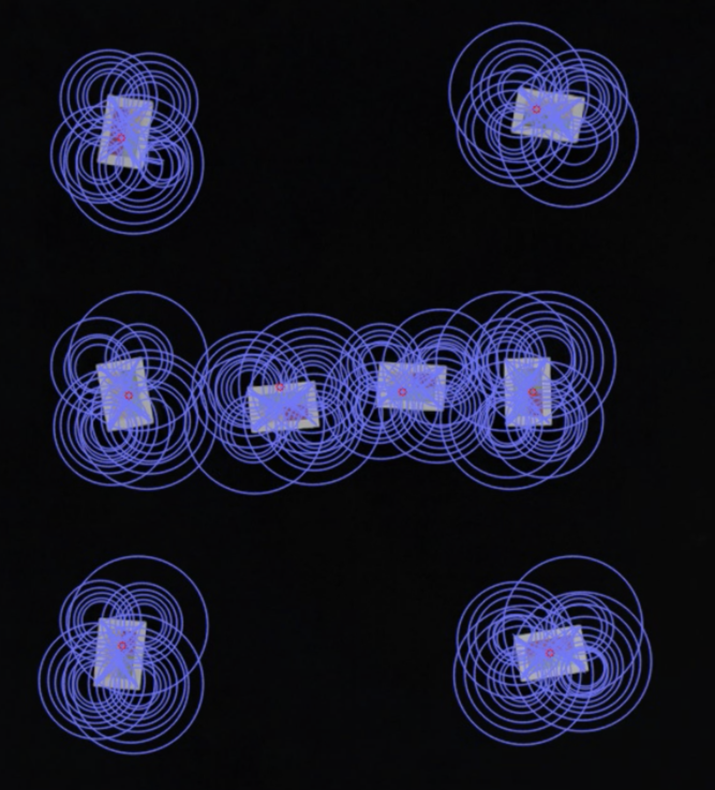
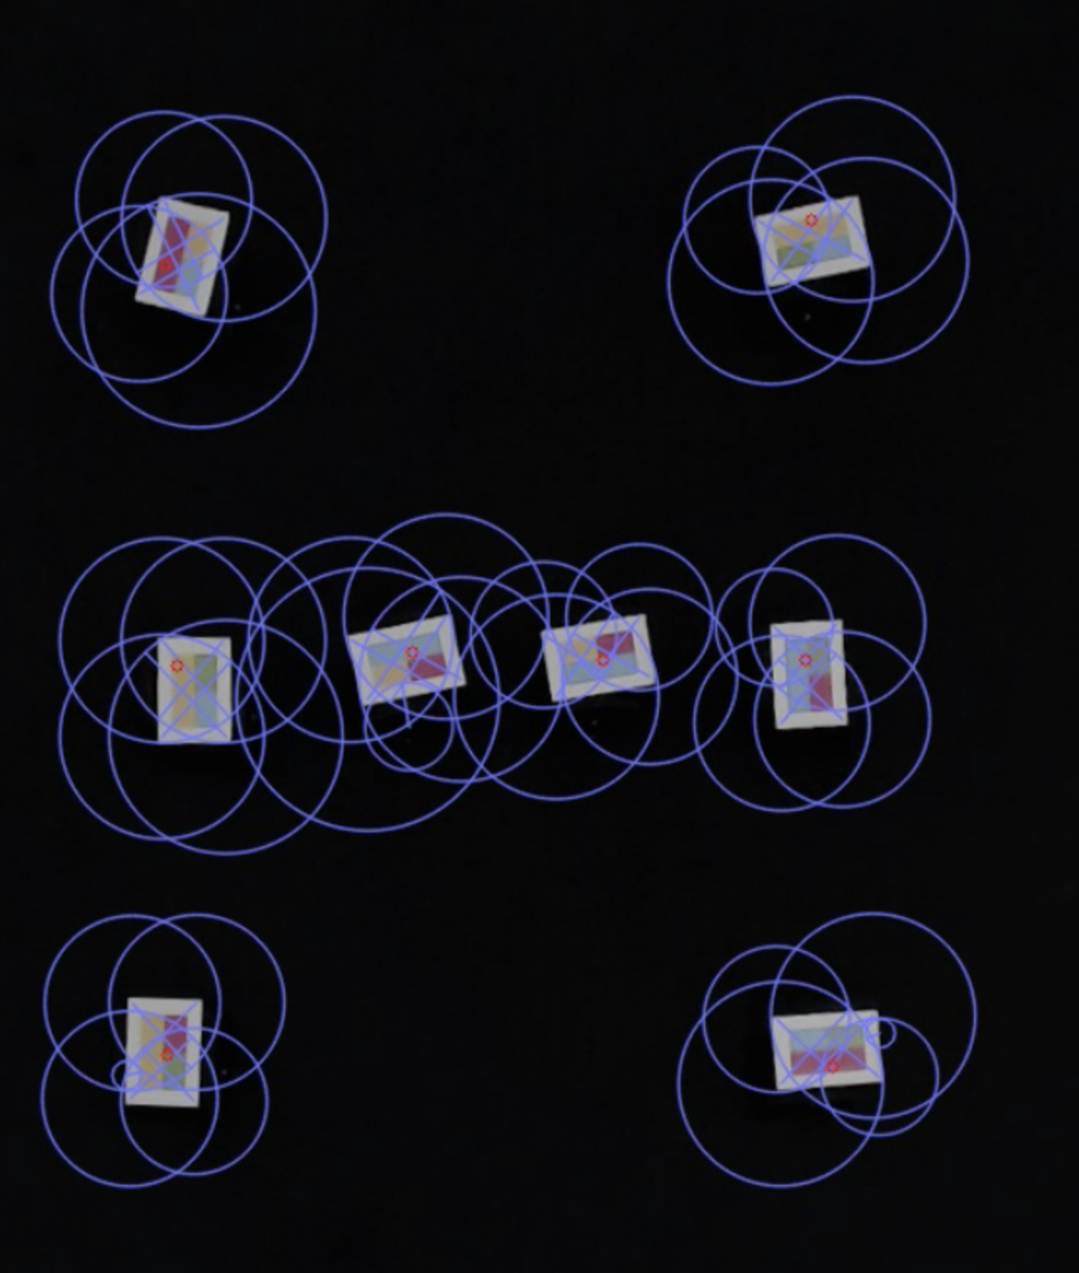
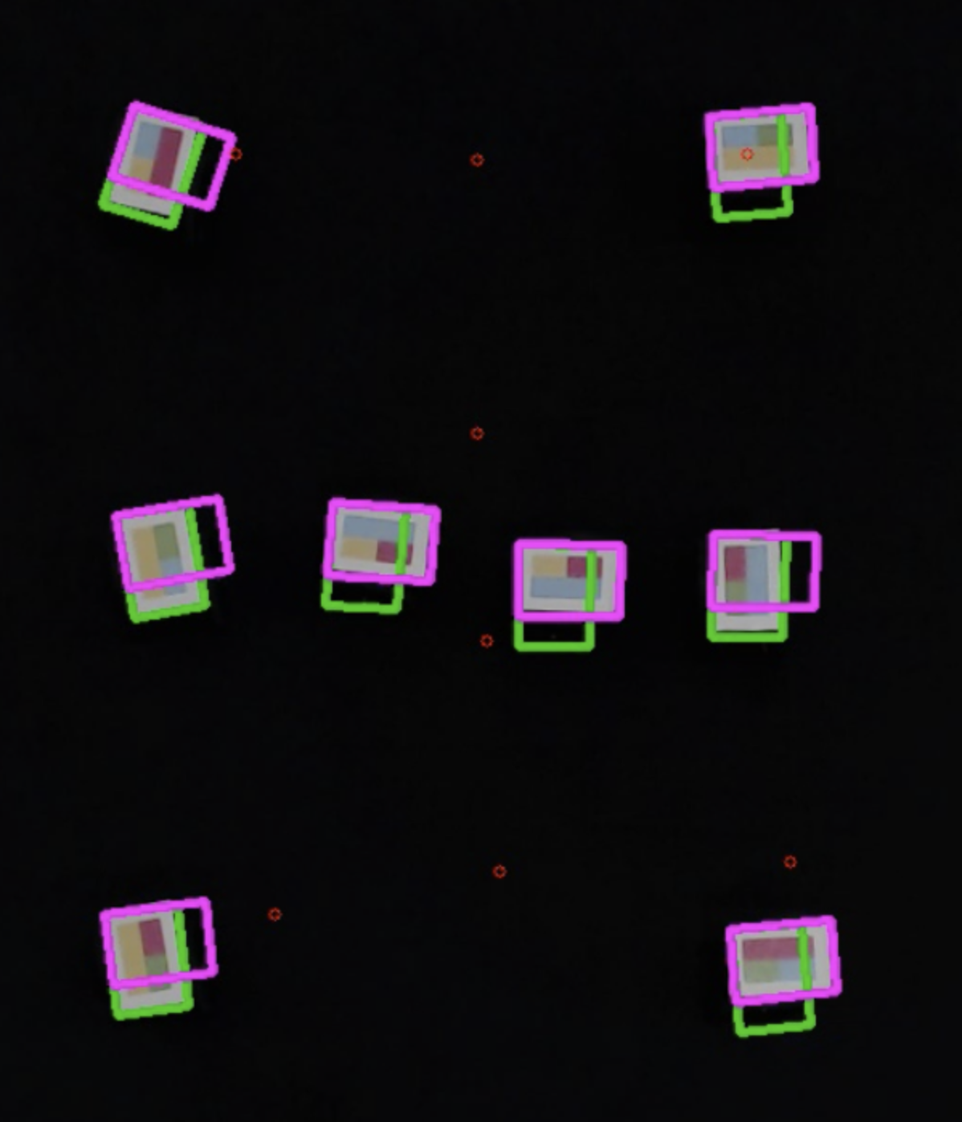
Swarm Robots | Software: Feature Recognition
Using Open CV library in Python
Uses ORB algorithm to find features:
Fast, free algorithm for corner detection
Has difficulty near edge of image
Has difficult when many corners near each other
Software steps:
Convert image to black and white
Process with ORB
Group similar/duplicate corners
Match corners to form rectangles
Pass to position extraction block
Feature Recognition Stages

Slide 19
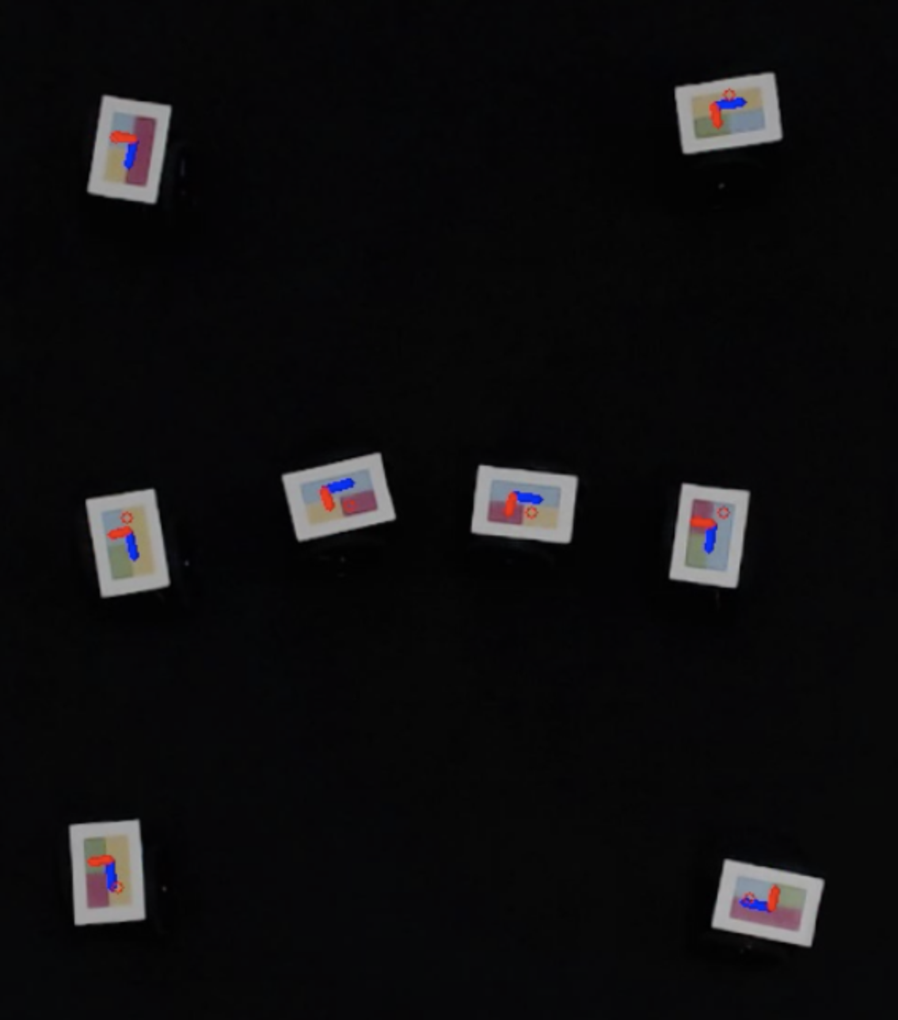
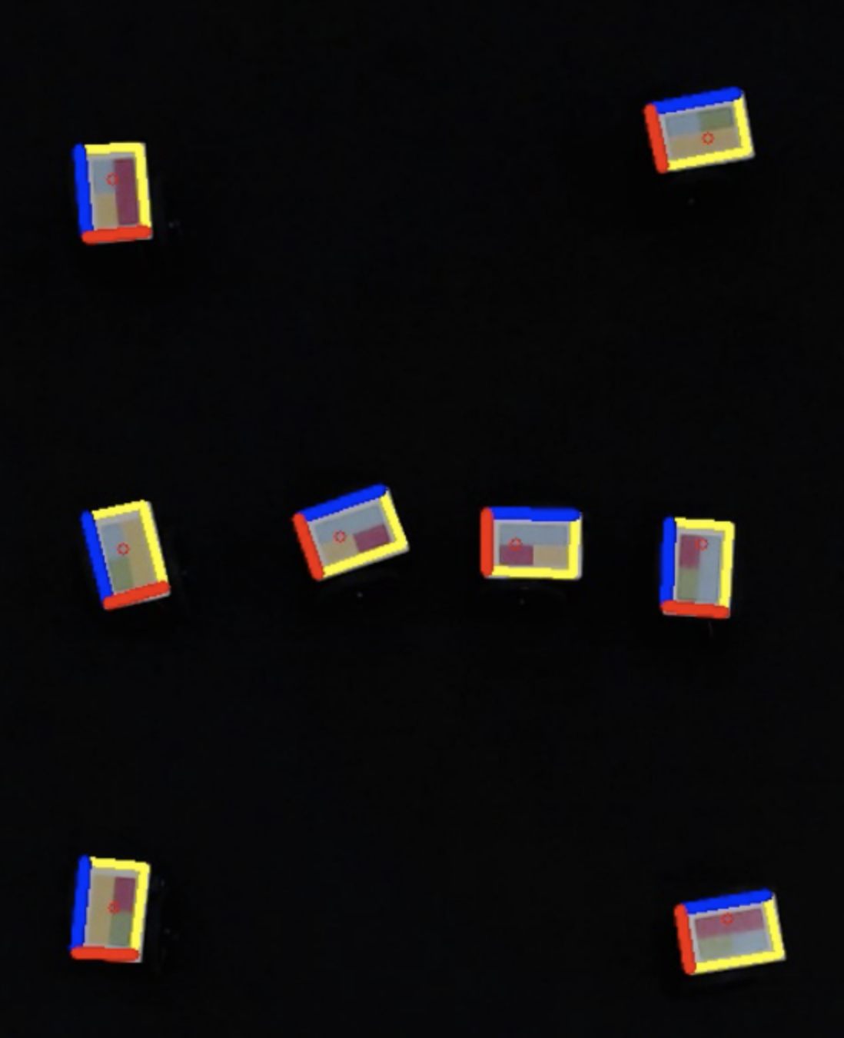
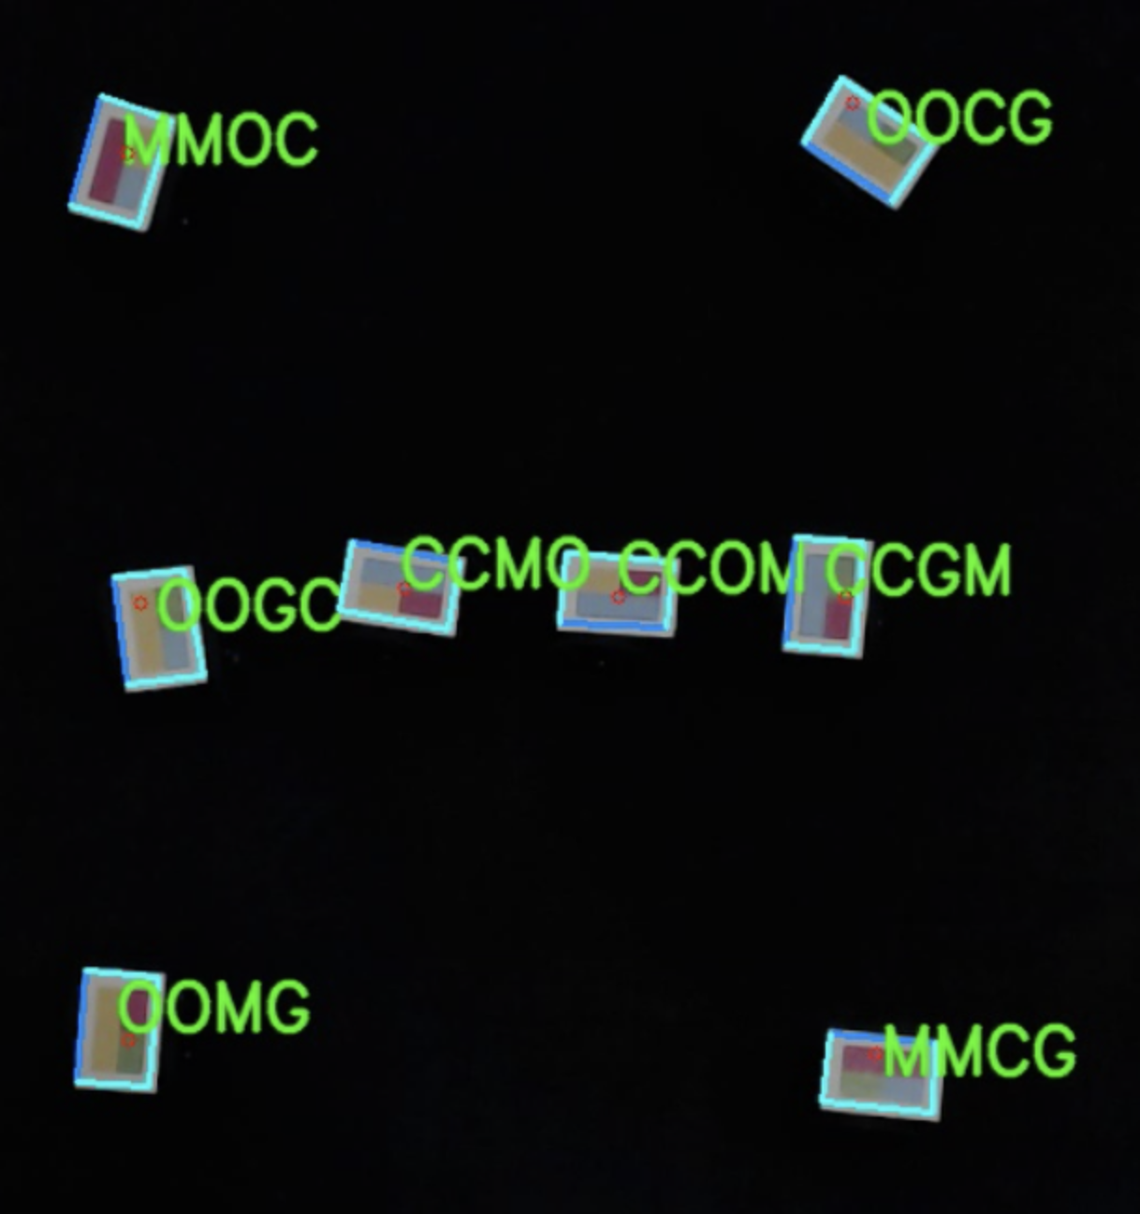
Swarm Robots | Software: Position Extraction
Extracts the position, orientation, and ID
Software Steps:
Using rectangles found from last step
Sample colors of quadrants to form ID
Uses YIQ color space for greater separation
Use long color bar to calculate orientation
Use center of rectangle for position
Position Extraction Stages

Slide 20
Swarm Robots | Software: Formation Design
Allows for "matched" endpoints
Each robot has a specific destination
"Unmatched" endpoints possible, though not implemented
Series of matched endpoints allow for more complicated transitions
Similar to a marching band
Software Steps:
Load in the saved endpoint file
Set endpoints for robots
Wait for robots to move to endpoint
Adjust to final orientation
Wait 0.5 seconds to verify convergence

Slide 21
Swarm Robots | Software: Control Loop
Uses position data and endpoint
Required to account for motor non-idealities
Computes motor power for each robot
Software Steps:
Compute distance between robot and endpoint
Calculate angle to travel to endpoint
Send pure rotation commands until pointing towards endpoint
Move forward
On approach, use cool-down and time-to-run
Time to run sets timeout on command
Cooldown prevents accepting a new command
"Second Degree" PWM

Slide 22
Swarm Robots | Software: Network Connection
Uses UDP packets over 802.11n
Maintains a dedicated connection to each robot
Robots send packets back
Status of robot
Debug information
Computer sends robot packets every 66ms
Power for the motors
Run time
"Cooldown" time
Packet to Robot from Computer
"C" | "T" | "R" | "L"
Version | Cooldown | Rotational Command
Straight command |  | Time to run
Flags |  | Robot ID 0 | Robot ID 1
Robot ID 2 | 0xFF | Reserved
Packet to Computer from Robot
"S" | "T" | "A" | "T"
Version | Cooldown | Reserved
Total Sent Packets |  | Time to run
Total Received Packets |  | Robot ID 0 | Robot ID 1
Robot ID 2 | 0xFF | Reserved

Slide 23
Swarm Robots | Software: Robot Firmware
Connects to router
10ms control loop
Reads packet
Sets motor speed via PWM
If packet contains a cool down, block incoming packets
Over-the-air updates
Automatic updates if robots running old version
Allowed for removing dedicated USB-to-UART chip
Programmed in C

Slide 24
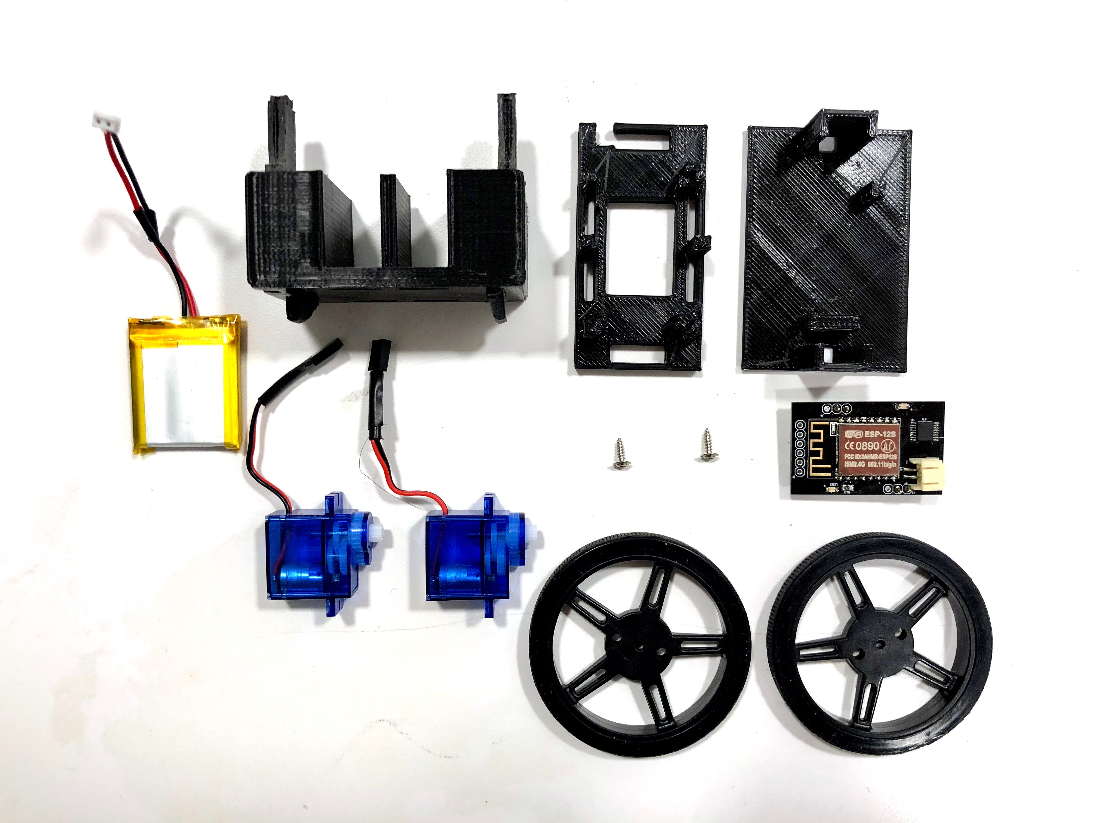
Swarm Robots | Assembly
Soldering PCBs
31 components per board
496 components soldered in total
Assembling Robot
Shortening and resoldering the motor and battery wires
Press-fit motors into housing
Wheels are screwed onto motors
Top slides on

Slide 25
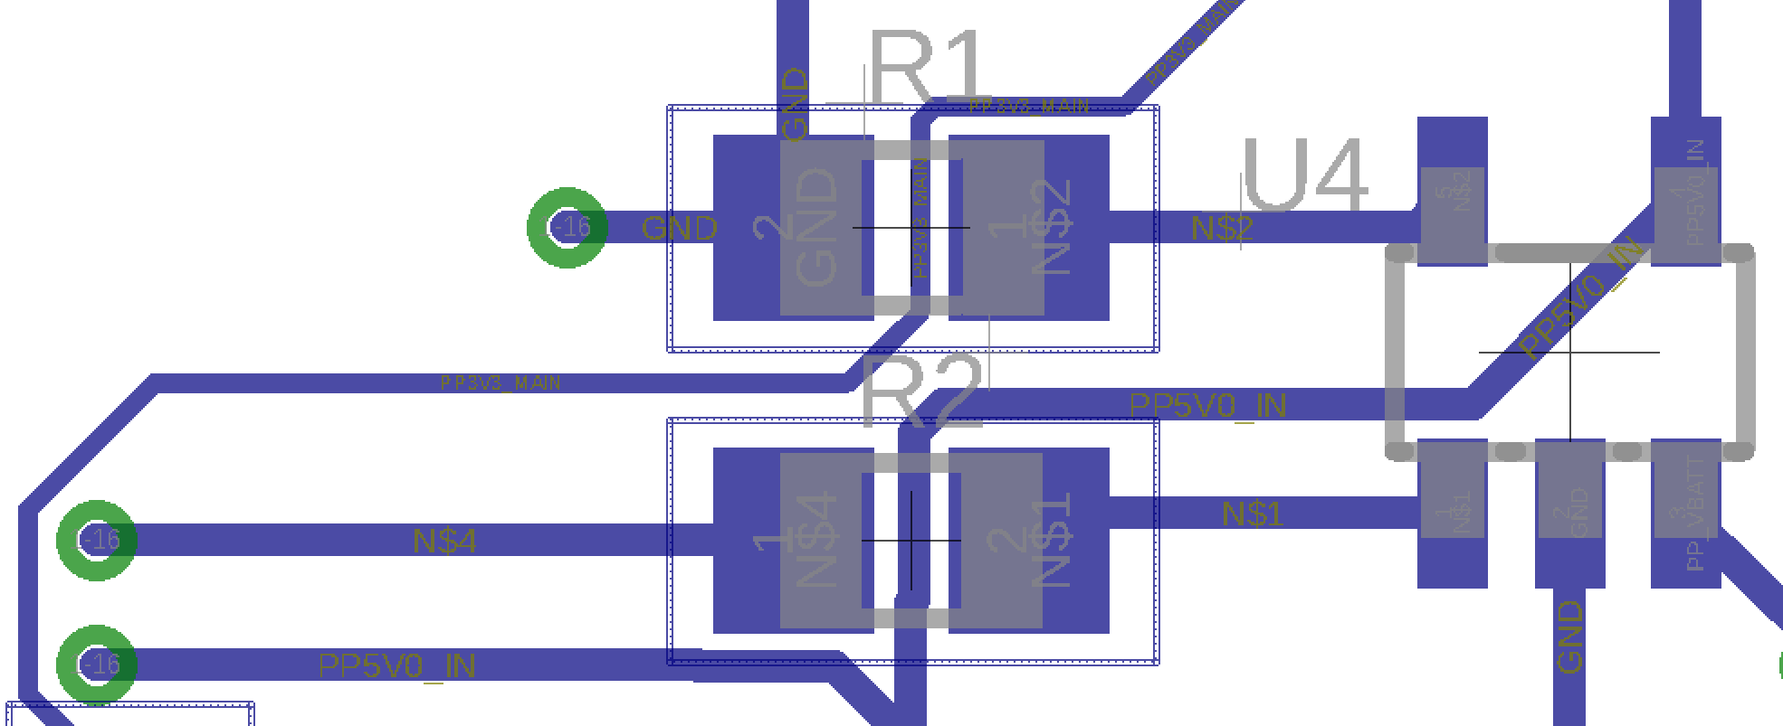
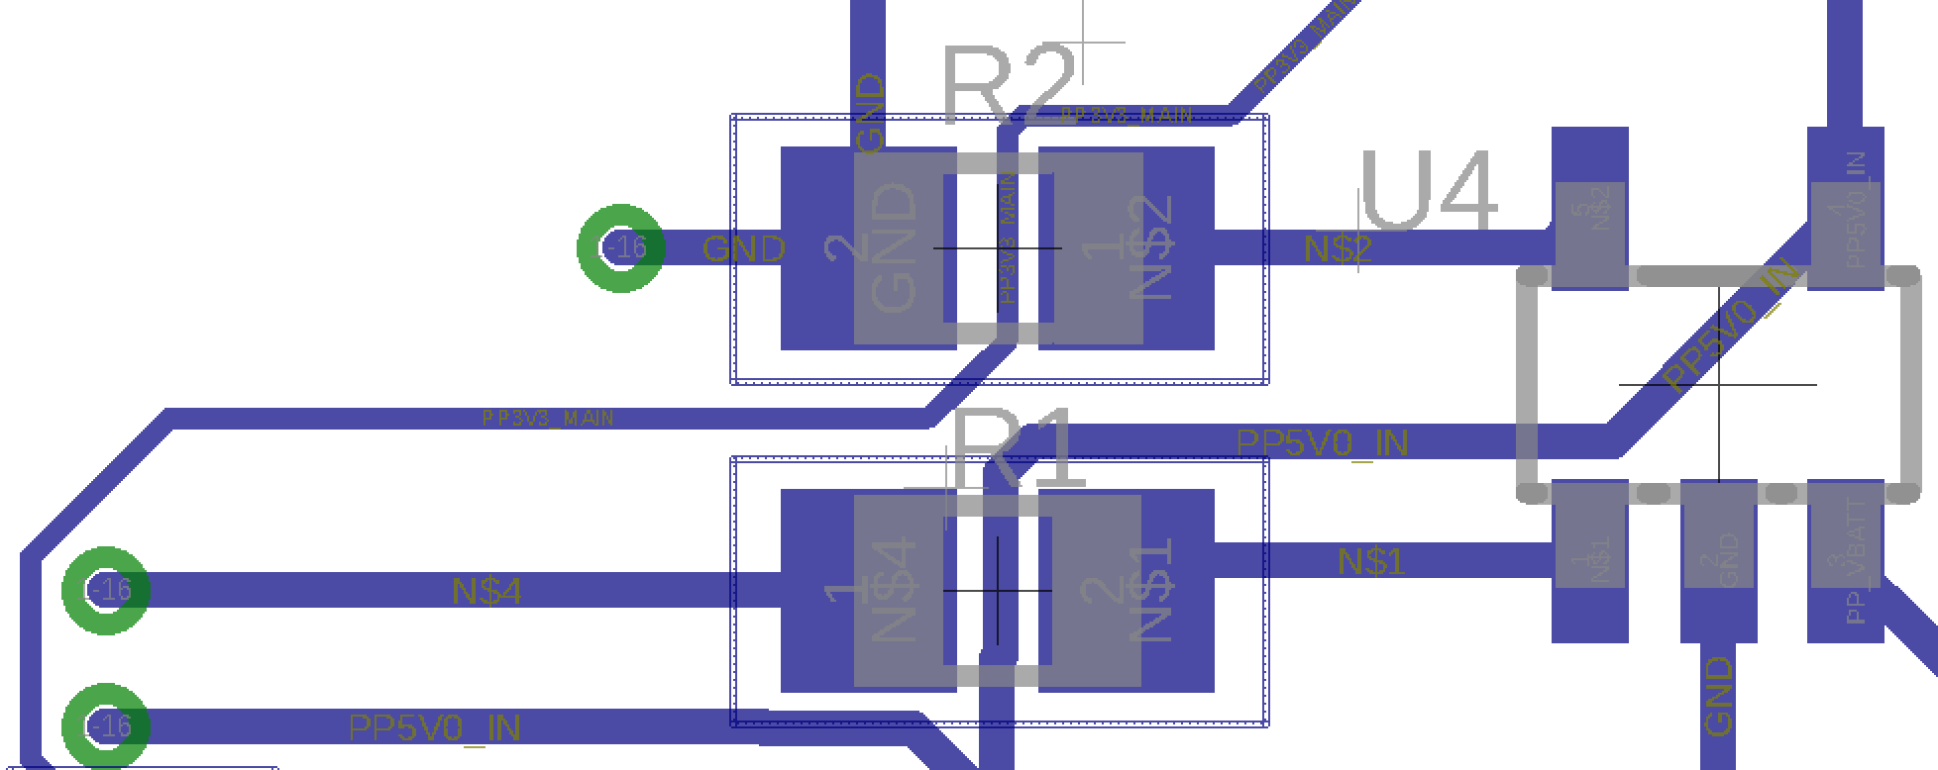
Swarm Robots | Failure Analysis
3 Primary Failure Modes:
Ohmic short across push buttons
Poor solder joints on motor controller IC
Charger IC not working
82% of robots failed at some point
56% of robots were restored to working condition
Mitigations:
Different push buttons, and more liberal use of flux remover
Better soldering technique
Proper layout review to catch silkscreen mismatch

Slide 26
Swarm Robots | Looking Forward
Hardware:
Reduce footprint
Add failure mitigations
Add off switch
Use real connector for charging/programming
Use better motors
Setup for faster charging
Add battery voltage view
Software:
Improve vision detection run time
Collision detection
Automatic ID of robots
Unmatched endpoint setup
Velocity control

Slide 27
Questions?

