Slide 1
Music-Visualization and Motion-Controlled LED Cube
ECE 445 Spring 2018 Team 34
Hieu Huynh
Islam Kadri
Zihan Yan
TA: Zhen Qin

Slide 2
Team Members:
1. Hieu Huynh – Electrical Engineering
Software Engineering – General
2. Islam Kadri – Computer Engineering
Software Engineering – General
3. Zihan Yan –Electrical Engineering
Digital Circuits and Hardware Design

Slide 3
Problem Statement
Music visualization devices are usually expensive to build, fix, and buy and are generally limited to pre-programmed displays or only use a sound’s frequency input to affect the visualization. For example, Kinetic Rain, a bronze droplet and steel wire based kinetic art piece, in Singapore’s Changi Airport, cycled over 16 pre-programmed shapes and cost several million dollars to build. Additionally, these devices don’t allow for user interaction which can take away from the entertainment value of the device.

Slide 4
Proposed Solution
Building a device that allows music visualization and user interactivity by using an 8x8x8 RGB LED grid would take advantage of LED technology’s efficient and aesthetically pleasing properties, as well as be economically efficient. Using the amplitude and direction of arrival, in addition to the frequency, the device will be able to display better looking visuals. Furthermore, by implementing a 3D Snake game, the user will have a medium to interact with the device and increase its entertainment value. This will be done using sensors to track the user’s hand movements.

Slide 5
High Level Requirements
1. Device correctly extracts the information from the sound in an accurate manner.
2. The LED cube can reflect the frequency, amplitude, and direction of arrival of the sound.
3. Device can correctly pick up the user’s hand motion and properly control the Snake based on that information.

Slide 6
Block Diagram

Slide 7
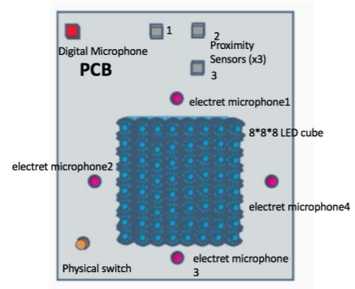
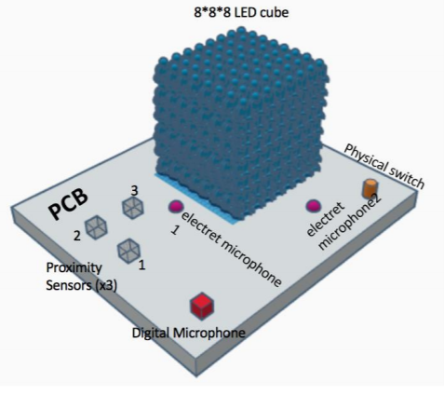
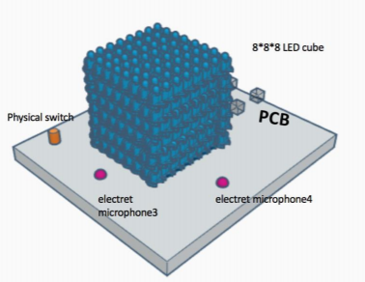
Physical Design
Bird Eye View
Side Views

Slide 8
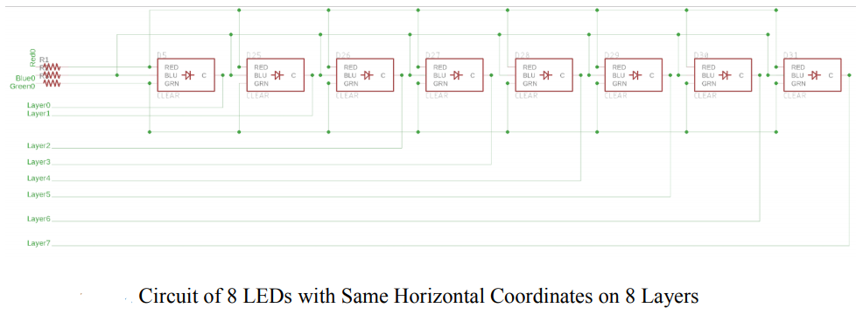
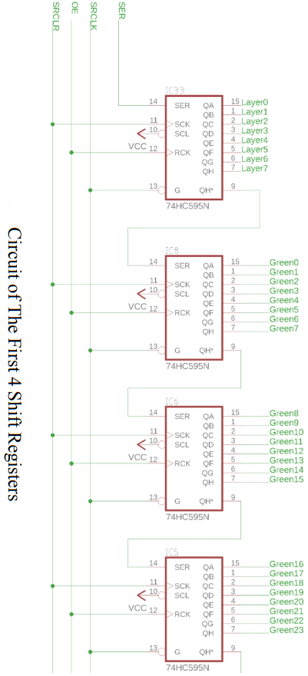
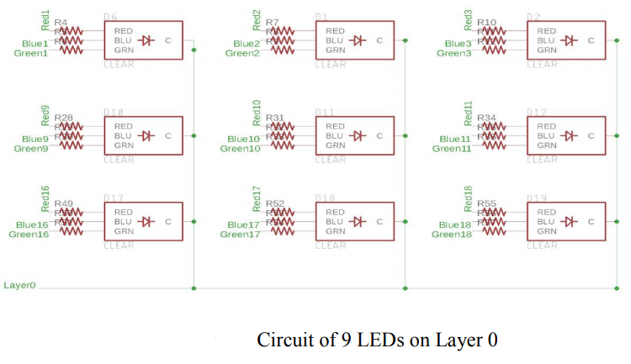
Schematic: LED Module
Shift Registers
LEDs

Slide 9
Requirements: Microphone Module
1. Components:
4 Electret Microphones
1 Digital MEMS Microphone
2. Requirements
Microphones must have frequency response from 50Hz to 20kHz
Microphones must have high SNR and high sensitivity
Electret Microphones’ output must be amplified to be in range 0-5V
Output of Digital Microphone must have I2S format

Slide 10
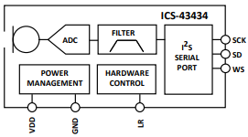
Schematic, Requirements: Microphone Module
Electret Microphones and Amplifier Circuit
Digital MEMS Microphone
Electret Microphone:
Frequency Response: 20Hz-20kHz
SNR: 60dBA
Sensitivity: -44dB
Digital MEMS Microphone
Frequency Response: 50Hz-20kHz
SNR: 64dBA
Sensitivity: -26dB +/-1dB
Output Format: I2S
Amplifier Circuit:
Gain: 20x

Slide 11
Proof of Concept: Microphone Module
Electret Microphone and Amplifier Circuit

Slide 12
Requirements, Schematic: Proximity Sensor Module
Components
3 Ultrasonic Sensors (HC-SR04)
2. Requirements
Ensure that sensors can detect the position of hand when hand is moving and motionless in range of 3cm to 1m.

Slide 13
Schematic: Power Module
Total Power Consumption: 16W.
Uses DC 5V 8A 40W AC To DC Power Adapter
http://www.gadgetronicx.com/guide-build-3-3v-power-supply-circuit/

Slide 14
Requirements: Control Unit
Requirements:
1. Correctly controls the color of LEDs and updates LED cube with rate of 100Hz
2. Correctly computes the frequency spectrum of sound with frequency resolution of at most 160Hz
3. Correctly extracts the amplitude of input sound
4. Correctly estimates the direction of arrival of sound
5. Estimate movement of user’s hand in 6 directions
6. Use user’s hand movement to drive Snake game

Slide 15
Requirements: Control Unit
Requirement 1: Correctly controls the colors of LEDs and updates LEDs cube with rate 100Hz
1. To control LEDs’ colors: Use Bit Angle Modulation (BAM) Method
Use 4-bit BAM → 16x16x16 = 4096 colors
2. To update LEDs cube with rate 100Hz:
Arduino shifts out 200 bits to update each layer of LEDs every 1.25ms
→ Update 1 layer with rate 1000/1.25 = 800Hz
⬄ Update LEDs cube with rate 800/8 = 100Hz

Slide 16
Requirements: Control Unit
Requirement 2: computes the frequency spectrum of sound with frequency resolution of at most 160Hz
To compute frequency Spectrum: Use 256-point FFT.
256-point FFT provides Fs/256 = 40000/256 = 156.25Hz frequency resolution
Have 40k samples/sec
→ Need to compute 256-point FFT 157 times/sec
→ Compute 256-point FFT every 6ms

Slide 17
Requirements: Control Unit
Requirement 3: Correctly extract the amplitude of input sound
Compute the exponential moving average using following formula:
$$New_Amplitude= \left(1−α\right) ×Old_Amplitude+α × Sample_Amplitude$$
with α = 0.125
Why?
Influence of past sample decreases exponentially fast → Fast update
Maintain stability when there is sudden spikes in amplitude

Slide 18
Requirements: Control Unit
Requirement 4: Correctly estimates the direction of arrival of sound
To estimate the direction of arrival of the sound:
Compute 4 exponential moving averages of signals received from 4 electret microphones using the following formula:
$$New_Amplitude= \left(1−α\right) ×Old_Amplitude+α × Sample_Amplitude$$
with α = 0.125
For every second, find which microphone has the highest average amplitude by comparing 4 average values
Determine the direction of arrival

Slide 19
Requirements: Control Unit
Requirement 5: Estimates movement of user’s hand in 6 directions

Slide 20
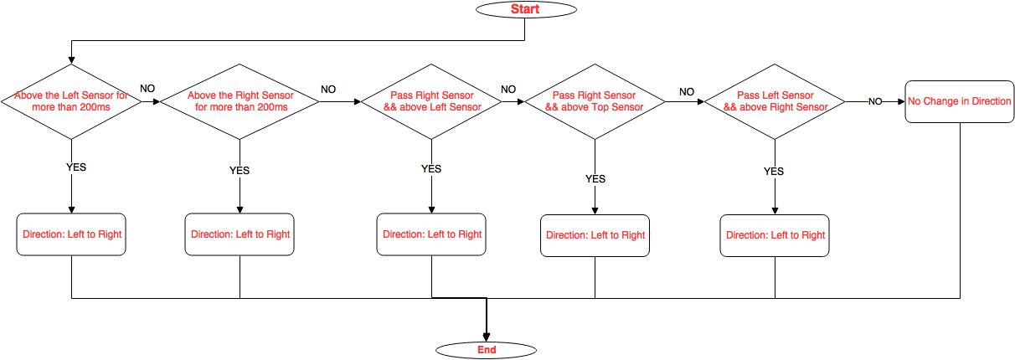
Flowchart: Ultrasonic Proximity Sensor

Slide 21
Proof of Concept: Proximity Sensor Module

Slide 22
Requirements: Control Unit
Requirement 6: Use user’s hand movement to drive Snake game

Slide 23
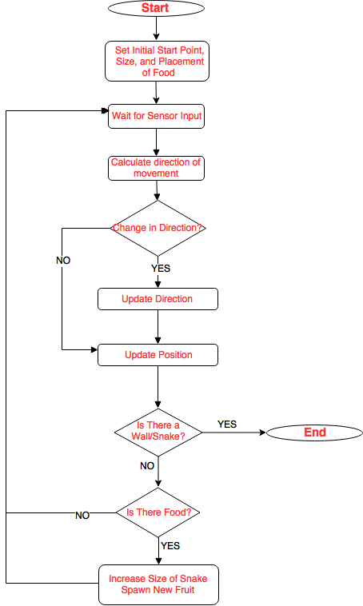
Flowchart: Snake Game

