Slide 1
App controlled solar powered street lamp
Project Group #2
Kevin Dahm, Justin Lindstrom, Brendan Weibel

Slide 2
Introduction

Slide 3
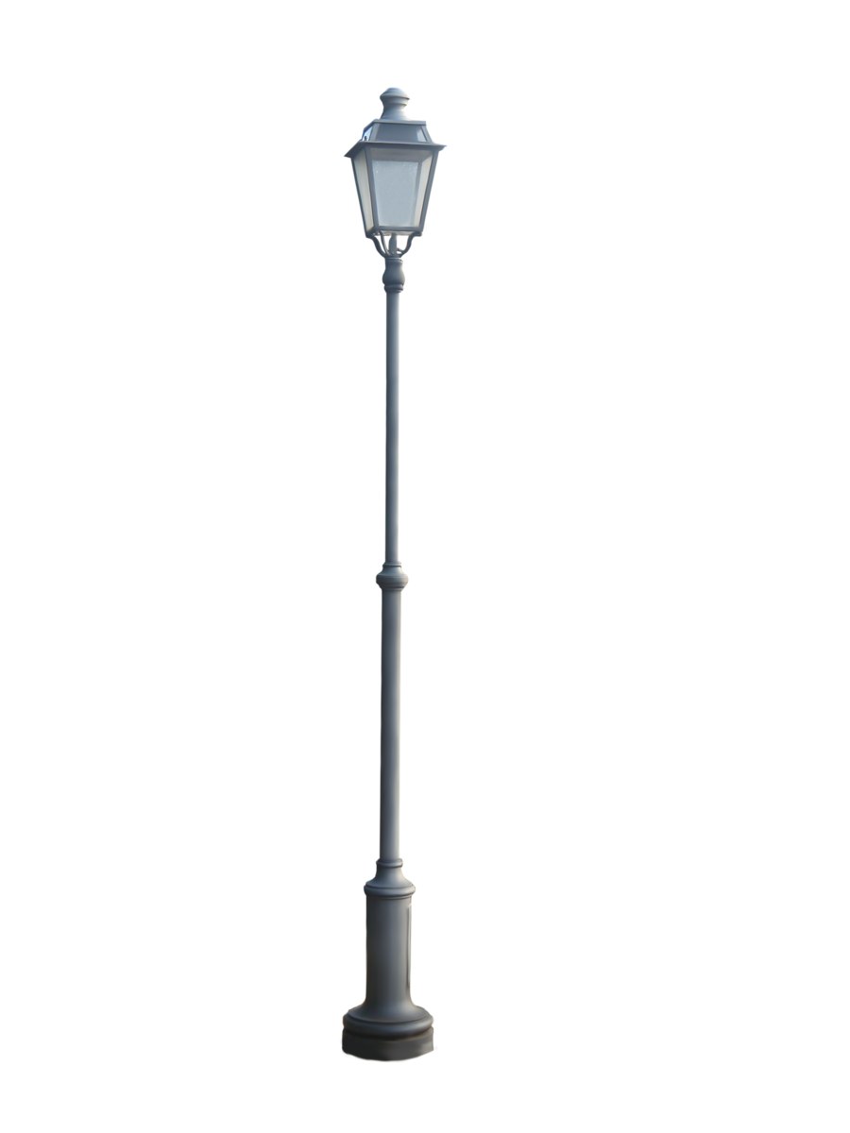
Project Introduction
Rural areas often do not have infrastructure to use traditional power sources
Lighting driveways and streets are important for safety of homeowners
Solar power creates portability and longevity of a street lamp
Controlling a light from the comfort of your home is important for a user’s experience

Slide 4
Objective

Slide 5
Objectives
The street lamp will create a brightness of at least 3000 lumens over a wide area
Due to long night conditions, lamp must be able to function for a minimum of 8 hours
Battery charge must be remotely checked
LED must be able to be controlled remotely
Dimming
Turning on/off

Slide 6
Design Overview

Slide 7
Design – block diagram

Slide 8
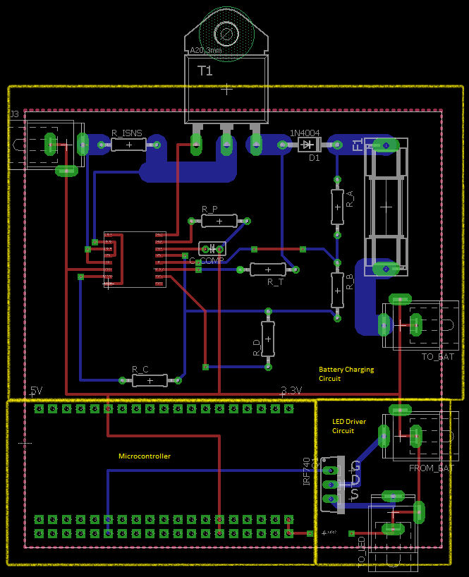
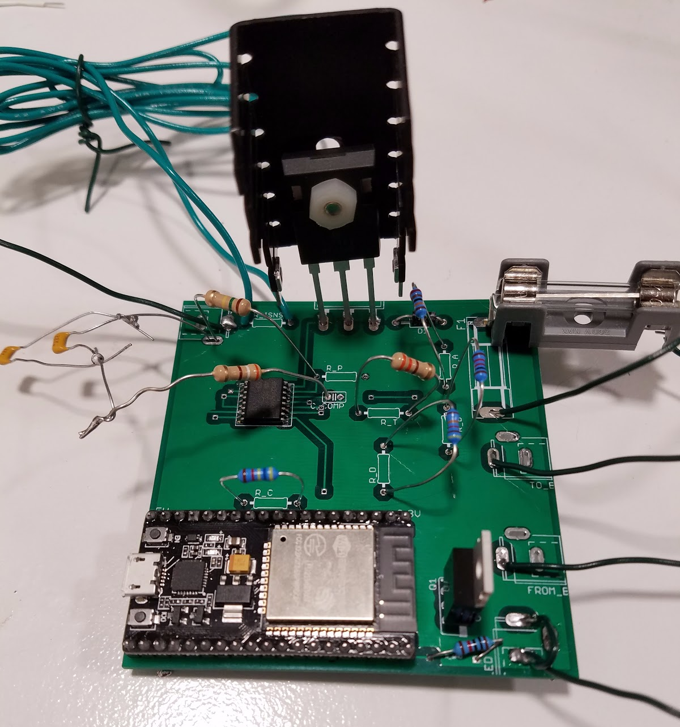
Design – pcb

Slide 9
Requirements

Slide 10
Requirements – power
Requirement | Verification
Regulates a voltage input of 12V to 23V to a safe charging voltage of 13.14V to 14.5V Input 17.5 +/- 10%; Output 14.3V +/- 10% | Generate 3V input. Monitor output voltage and save data. Slowly step up input to 23V while measuring. Maintain 23V for an hour to see temperature changes. Verify it stayed in desired range. Connect Battery charger to fully discharged SLA battery. Measure voltage and current at battery terminals. Ensure all charging stages are met.

Slide 11
Requirements – control
Requirement | Verification
Must be able to view the battery charge and turn off/on the light from a mobile application | Once user opens the app, user can see a value of percent charge of the lamp as well as a visual representation of that percentage. The user also sees a large switch on the screen which has on and off buttons in order to turn the lamp on and off.
Must be able to communicate with a cell phone over Wi-Fi from a range of 250 feet | Configure ESP32 to connect to Wi-Fi Place lamp 250 feet away Connect to Wi-Fi on Phone Communicate with lamp by changing brightness on the phone
Must be able to change the brightness of the lamp | Turn on the lamp at low brightness Slowly increase brightness on the application Probe output on oscilloscope to see change in PWM

Slide 12
Requirements – lighting
Requirement | Verification
Must sufficiently illuminate dark area while using 33W | Use Voltmeter to find the current and voltage drop through the device while it’s on. Ensure it is drawing 33W of power over 12V. Turn off other lights and ensure it provides adequate lighting to the surrounding area
Must be able to visibly change brightness of the lamp | Vary output voltage into lamp from power source View change in brightness

Slide 13
Power module

Slide 14
Solar panel
Renogy 100 Watt 12 Volt Monocrystalline Solar chosen
Power requirements determined LED would be on 100% for 4 hours, and 50% for 4 hours each day (220 Wh per day)
Urbana, IL average sunlight would result in this panel receiving 365.5 Wh per day

Slide 15
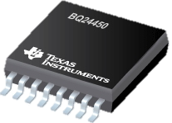
Battery Charger – Summary
Will regulate the power coming in from the solar panel to provide the necessary voltage that our battery will accept
BQ24450 integrated charge controller for lead-acid batteries
Voltage and Current regulation using this chip
Temperature-compensated reference necessary
2 Charging Modes
Boost Mode
Float Mode

Slide 16
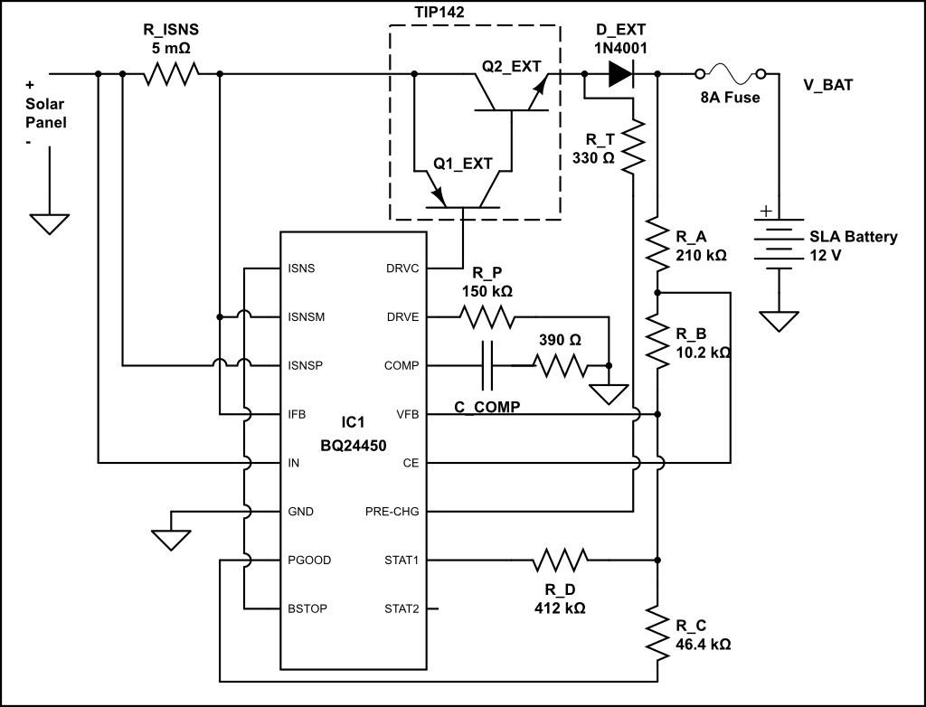
Battery charger – Circuit

Slide 17
Battery charger – Calculations
$R_{c}=2.30 V ÷50 μA=46 kΩ$
$V_{Float}=V_{Ref} × \left(R_{A}+R_{B}+R_{C}\right)÷R_{C}→R_{A}+R_{B}=2×R_{C}=92.8 kΩ$
$V_{Boost}=V_{Ref} × \left(R_{A}+R_{B}+{\left(\frac{1}{R_{C}}+\frac{1}{R_{D}}\right)}^{−1}\right)÷{\left(\frac{1}{R_{C}}+\frac{1}{R_{D}}\right)}^{−1}→R_{D}=412 kΩ$
$V_{Th}=V_{Ref} × \left(R_{A}+R_{B}+{\left(\frac{1}{R_{C}}+\frac{1}{R_{D}}\right)}^{−1}\right)÷\left({R_{B}+\left(\frac{1}{R_{C}}+\frac{1}{R_{D}}\right)}^{−1}\right)→R_{B}=10.2 kΩ$
$R_{a}=92.8 kΩ−R_{b}=210 kΩ$
$I_{Pre}=(V_{In}−V_{Pre}−V_{Dext}−V_{Bat})÷R_{T}$
$I_{Max}−C_{HG}=V_{ILM} ÷R_{ISNS}→R_{ISNS}=250 mV÷5 A=50 mΩ$

Slide 18
Battery
12 V
SunXtender PVX-340T
 | Absorption Voltage at 25° C | Float Voltage at 25° C
Volts Per Cell | 2.37 – 2.40 V | 2.20 – 2.23 V
For 12V System | 14.2 – 14.4 V | 13.2 – 13.4 V

Slide 19
Battery charger – Results
Boost to Float Transition Point

Slide 20
Control Module

Slide 21
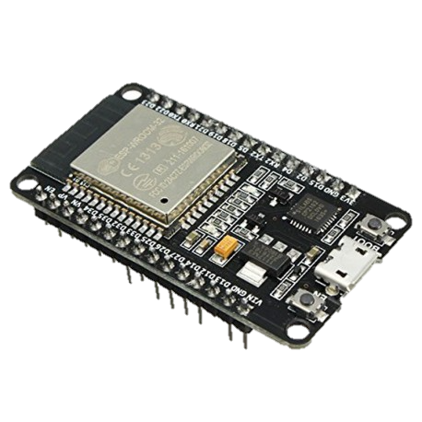
microcontroller
ESP32 can work as a standalone Wi-Fi and Bluetooth device
ESP32 achieves ultra-low power consumption through its own proprietary software
EspressIf has built an Arduino Development Platform

Slide 22
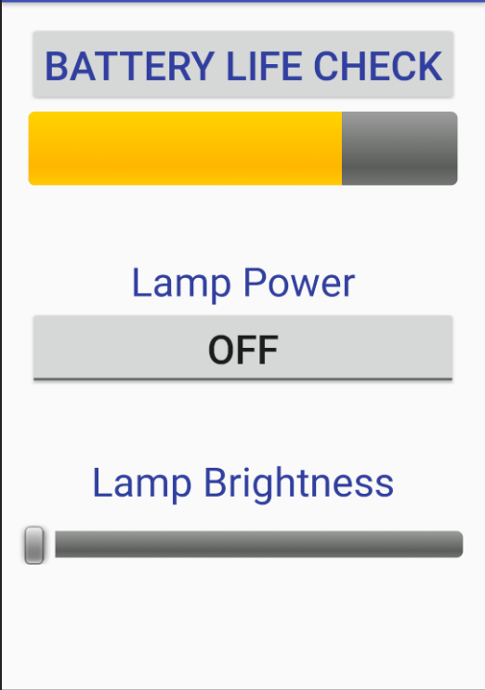
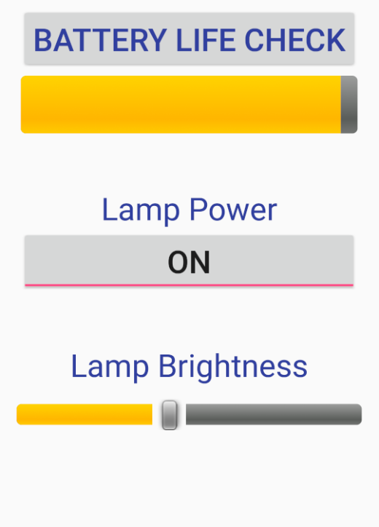
Android application - UI
Single Screen Design
Three Functionalities
Battery Life Check
Explicit On/Off
Brightness Scaling

Slide 23
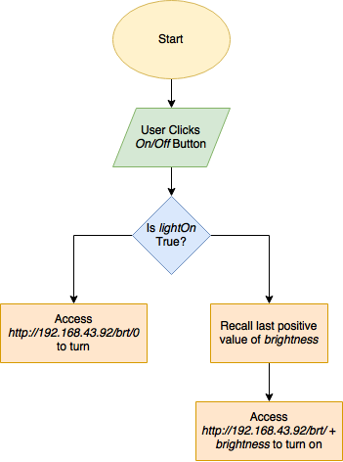
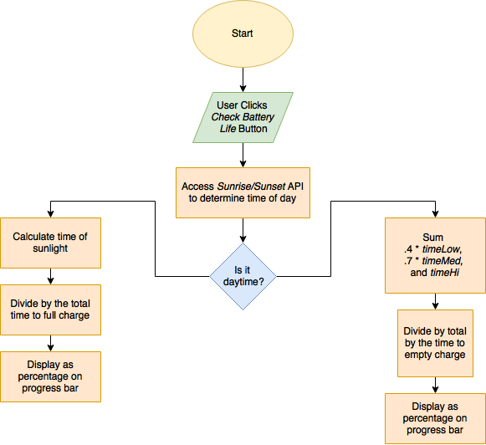
Android application - Logic
Yes
No
Yes
No
off

Slide 24
Wi-Fi connection
Uses ESP32 to create a local web server on device within the user’s home Wi-Fi network
Utilizes WiFi.h class and uses a hard-coded ssid and password
Continuously checks if server is available to continue running server
Sends simple response for accesses

Slide 25
Lighting module

Slide 26
Led Design Decisions
Use 12 volt, 3000 lumen bulb
To allow control, need use of microcontroller
Microcontroller voltage too small, need “relay”
Provide dimming functionality through PWM
Use MOSFET as relay to allow for fast switching of PWM

Slide 27
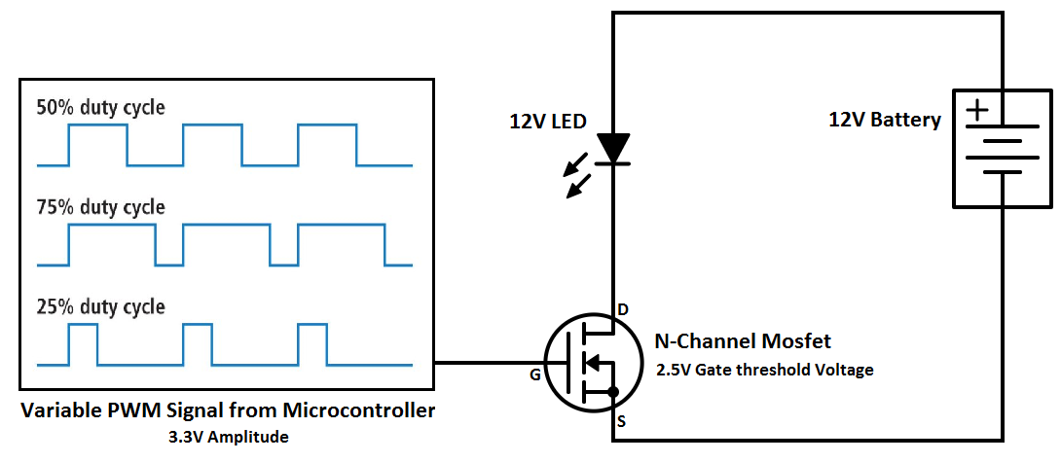
Dimming Design

Slide 28
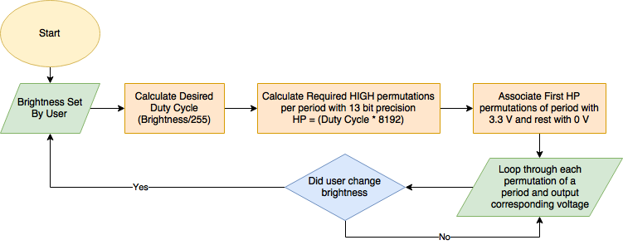
Dimming Implementation

Slide 29
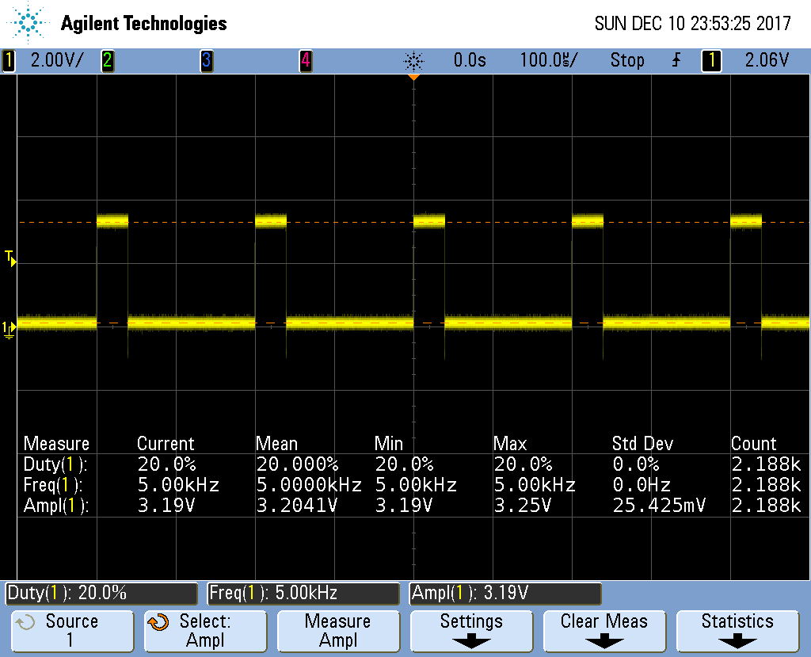
PWM Output – 20% Brightness

Slide 30
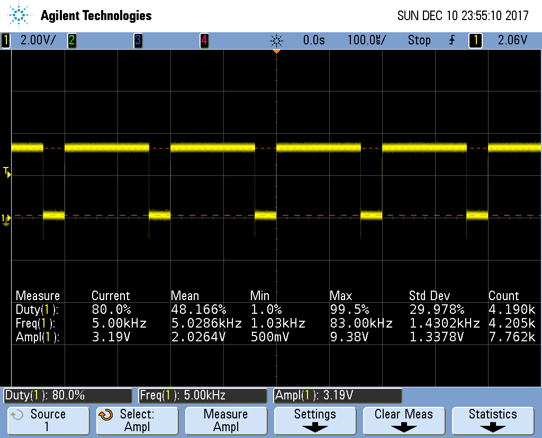
PWM Output – 80% Brightness

Slide 31
Dimming Verification

Slide 32
Successes and Challenges

Slide 33
Successful Final Design

Slide 34
successes
All of our requirements were met by our demo
Control Module
Strong connection between phone and lamp system
Lighting Module
Full dimming capabilities
Extremely bright light
Power Module
Clearly saw regulating voltage and current into the battery
Differences between float and boost modes

Slide 35
challenges
We were unable to test our system with the correct solar panel
We used a power supply to simulate output voltage from solar panel
Unable to determine where system would operate on the IV-curve
Battery state of charge has a high probability of error because we used a mathematical model to find the value
An additional PCB iteration would have created a design that would be easier to work with as we have “hacked” our way to a functioning circuit by using additional components

Slide 36
Further work

Slide 37
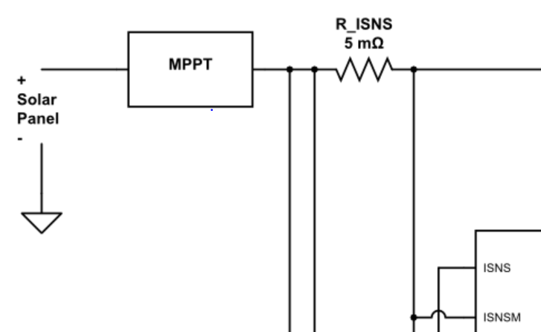
Maximum Power Point Tracking
Adding MPPT with impedance matching will allow device to be fully functional with solar panel and maximize efficiency.

Slide 38
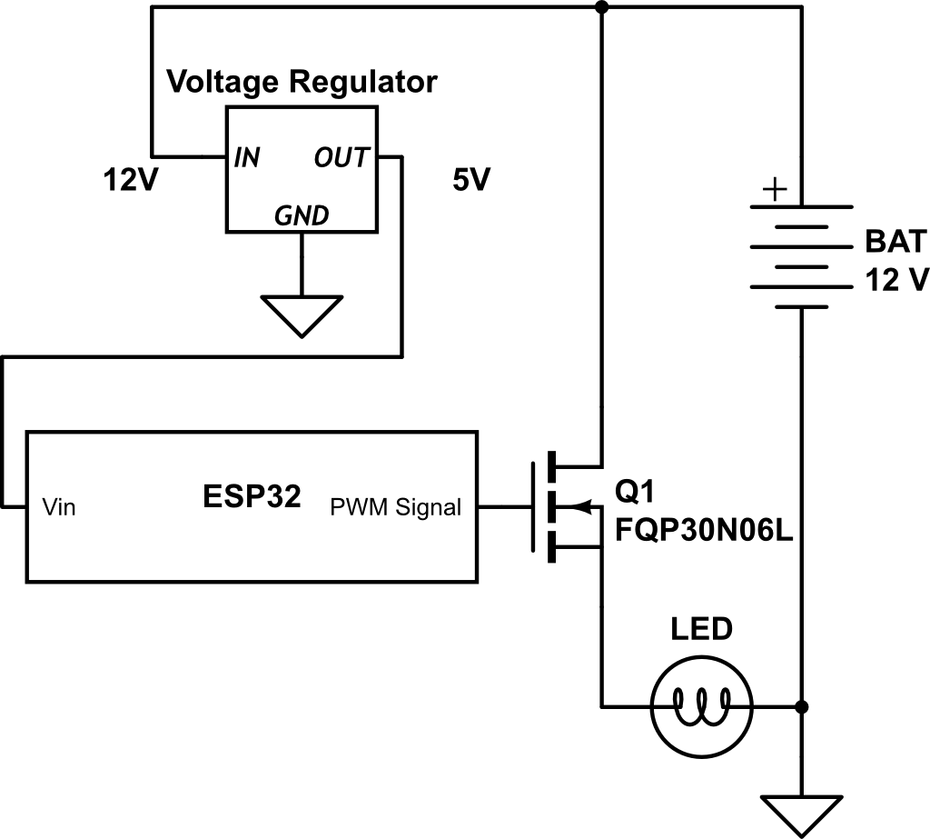
Voltage Regulator
Add a 12v to 5v voltage regulator from the battery to the microcontroller.
Prevent the need for secondary power source

Slide 39
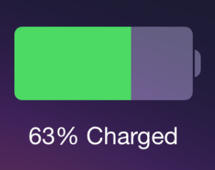
State of Charge
State of charge measurements with less margin of error.
Finding the most accurate method for calculating the state of charge would improve user satisfaction and overall quality of device.

Slide 40
Conclusion

Slide 41
Safety And Ethics
Due to the potential hazards of charging and discharging a Lead-acid battery, the IEEE’s Code of Ethics codes #1 and #9 were adhered to in the strictest way possible.
Furthermore, Dealing with a light that is approximately 3000 lumens needed to be considered so that consumers of this product would not damage their eyes.

Slide 42
Final Thoughts
Successfully charged 12v AGM battery in laboratory setting.
Effectively controlled LED with mobile application using wireless communication.
Maintained small size to aid in the portability of commercialized product.

Slide 43
Questions?

