Slide 1
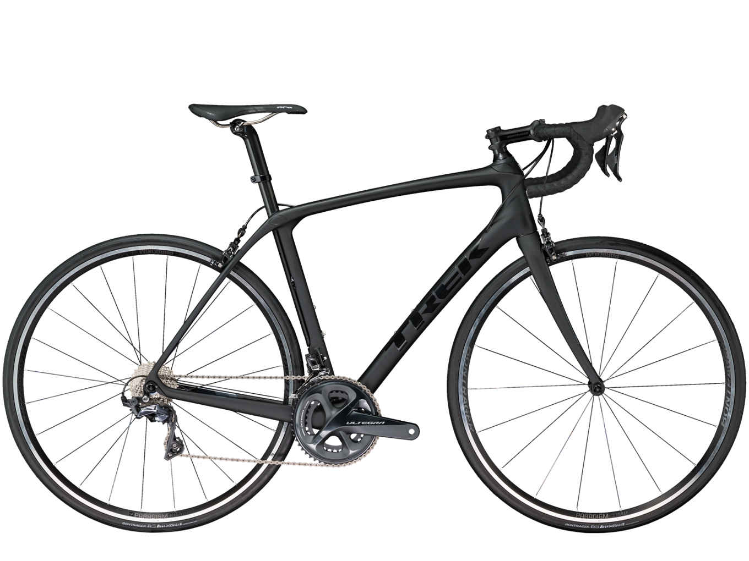
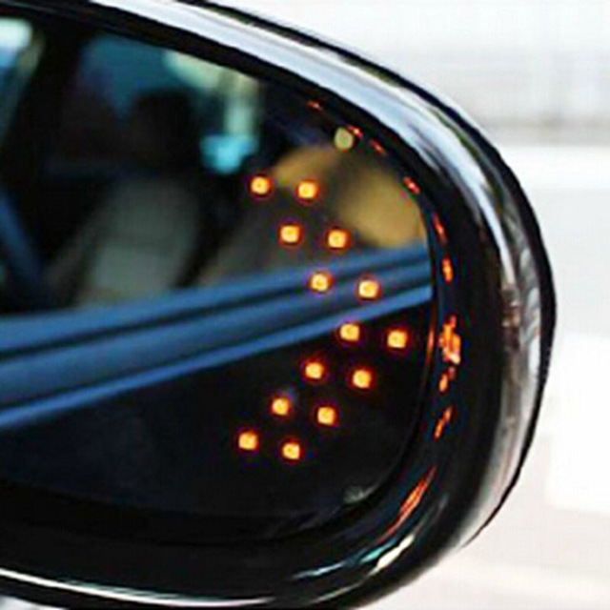
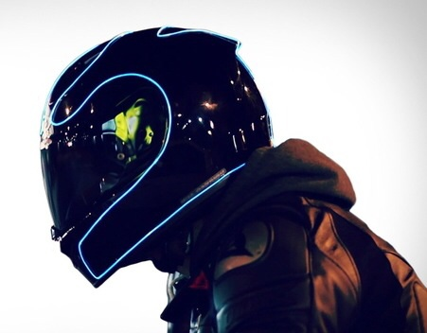
Wireless Signaling System
ECE 445 Fall 2018
Kevin Tian, Larry Liu, Suriya Kodeswaran
ktian2, lliu65, kodeswa2
Team 38

Slide 2
Thank You!
To:
TA Xinrui Zhu,
Professor Can Bayram,
all of the ECE 445 Course Staff!
Notes:
Larry
Really appreciate all the guidance and feedback we’ve received throughout the semester as it’s been a great experience in this class.

Slide 3
Introduction
Our goal for this past semester has been to design a simple, affordable system for improving the safety of cyclists and for all of those that share the road.
We accomplish this through a wirelessly connected system of 2 modules:
“brain of the bike”: pressure sensors, microcontroller circuits attached to the front of the bicycle.
External Interface: ultrasonic sensor and LED circuits mounted/integrated into the cyclist helmet.
Notes:
larry

Slide 4
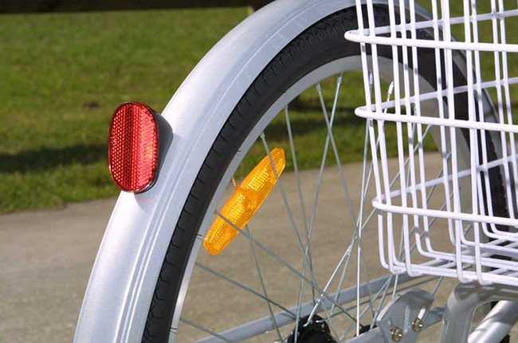
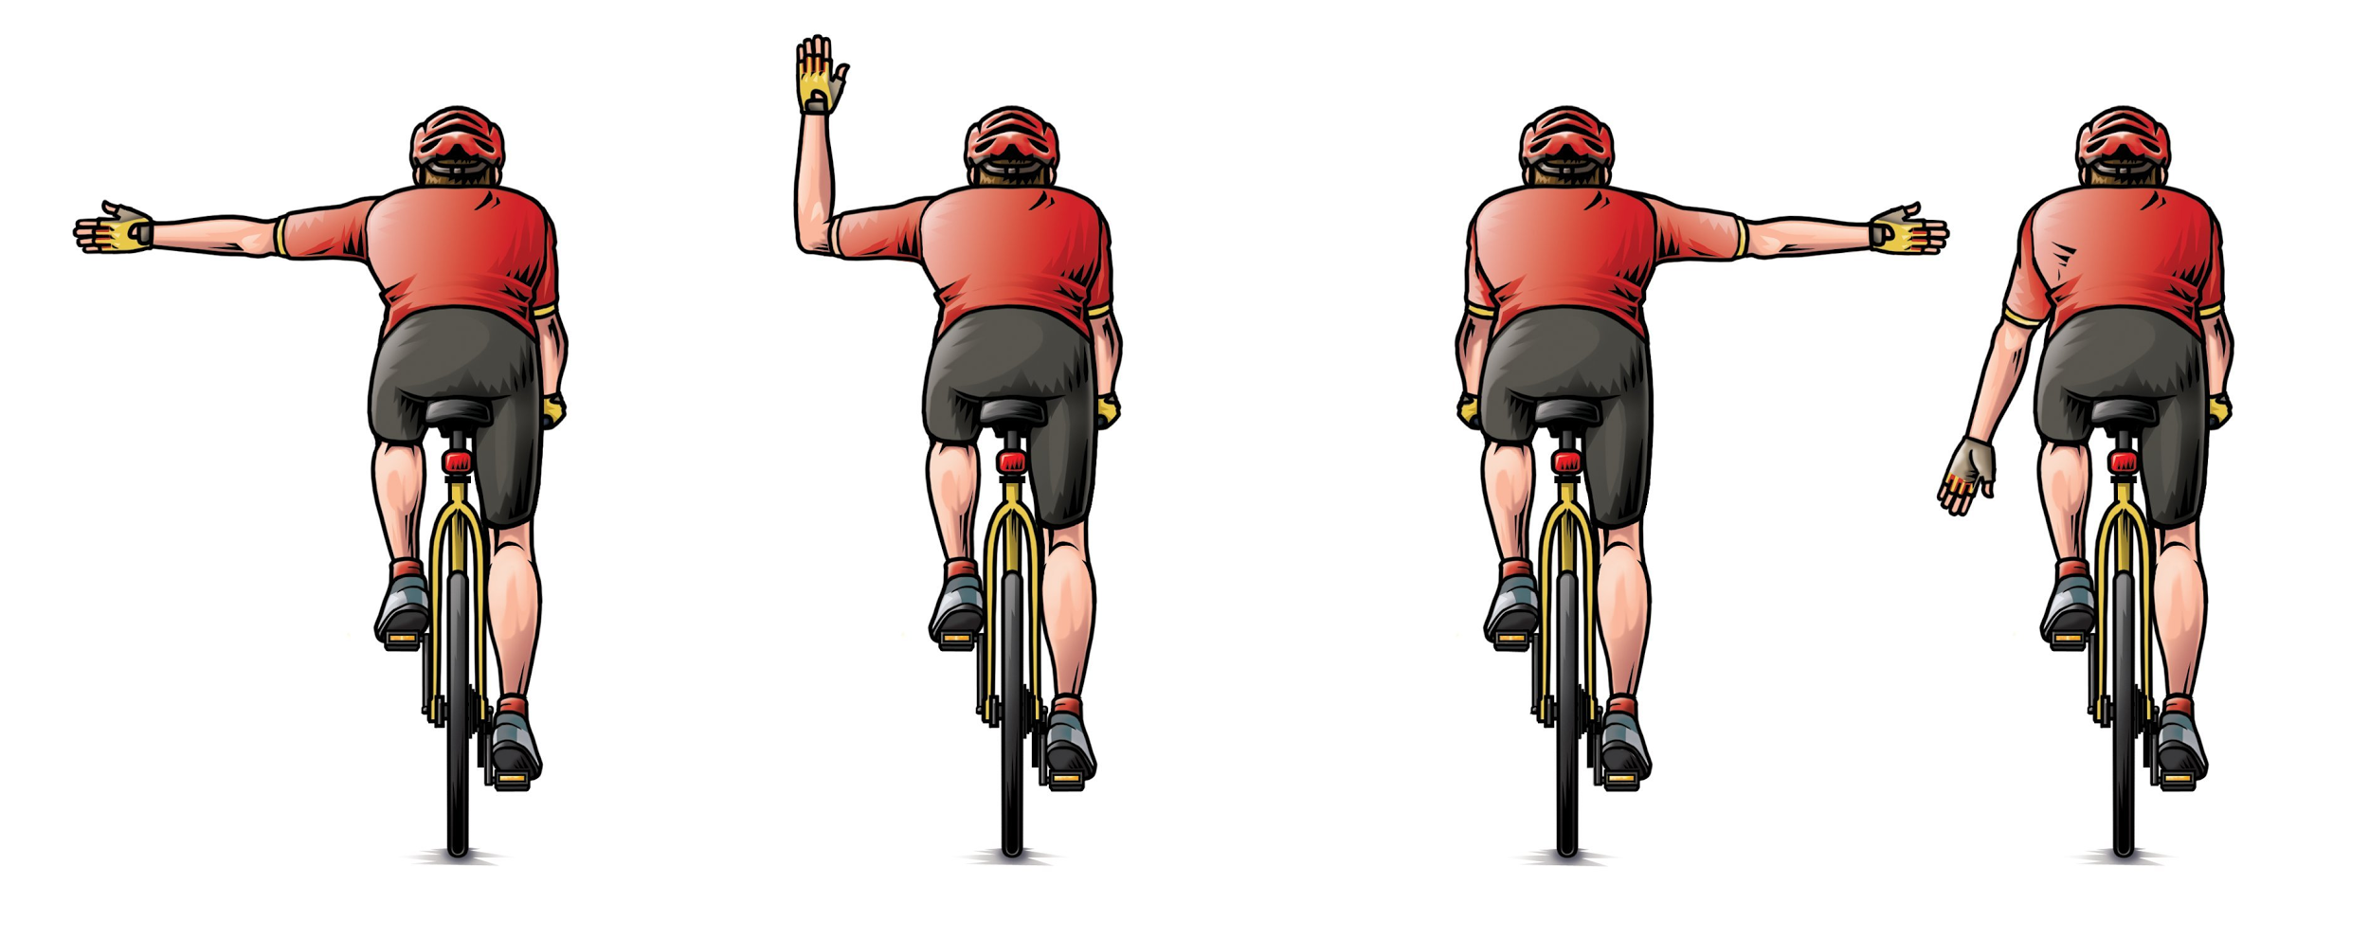
Objective
Some problems we aim to solve in numerous road accidents that occur across the U.S. occur as a result of:
1) Vehicle drivers having low visibility of other cyclists (especially at night) - Reflector lights and blinkers are not enough 2) Miscommunication from unclear bicycle signaling - Common methods for signaling turns involves hand signaling 3) Lack of awareness by cyclist of incoming moving vehicles and
other cyclists
Notes:
larry

Slide 5
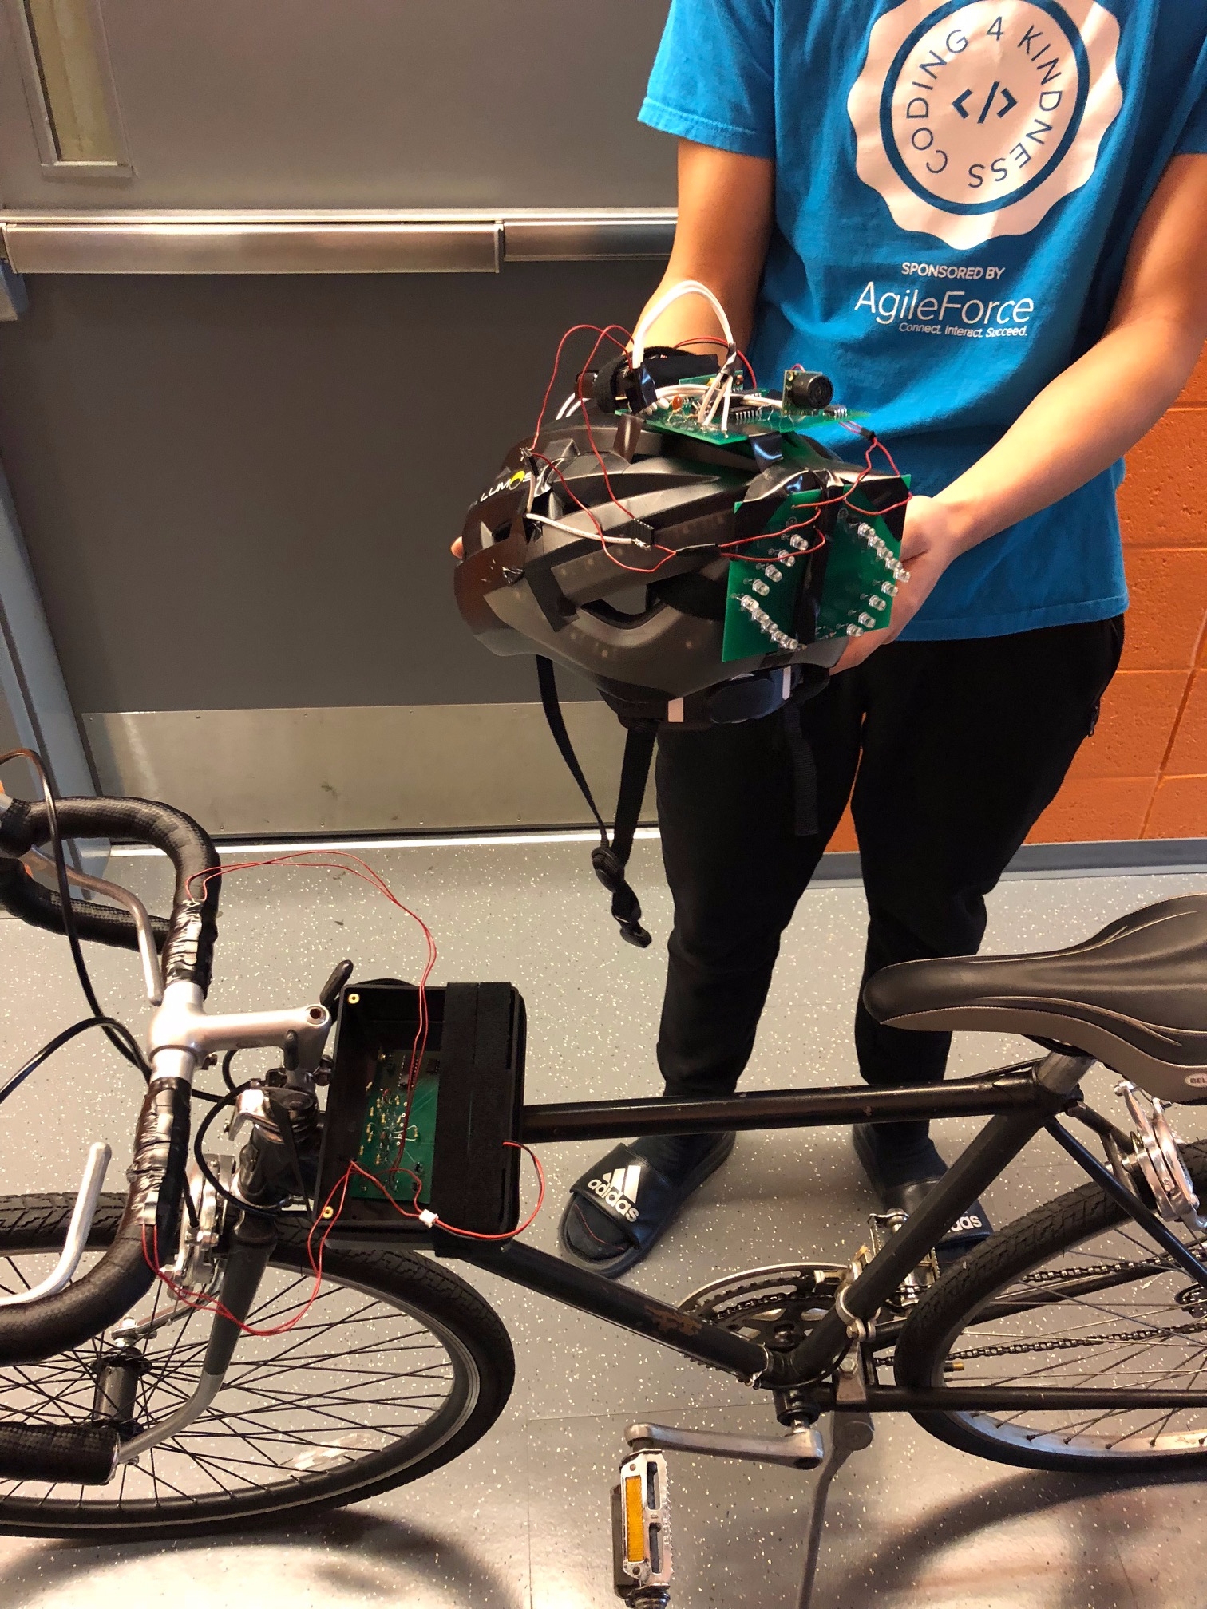
Photo Credit: Professor Can Bayram
Basic Functionalities:
When a pressure sensor is pressed, the corresponding helmet’s turn LEDs will start blinking to signal the desired turn.
Ultrasonic sensor flashes rear LEDs on detection of an incoming object
Demo Links:
Wireless transmission of signals from pressure sensors of front circuit to corresponding sets of LEDs
Ultrasonic sensor detecting approaching objects behind it
Notes:
larry

Slide 6
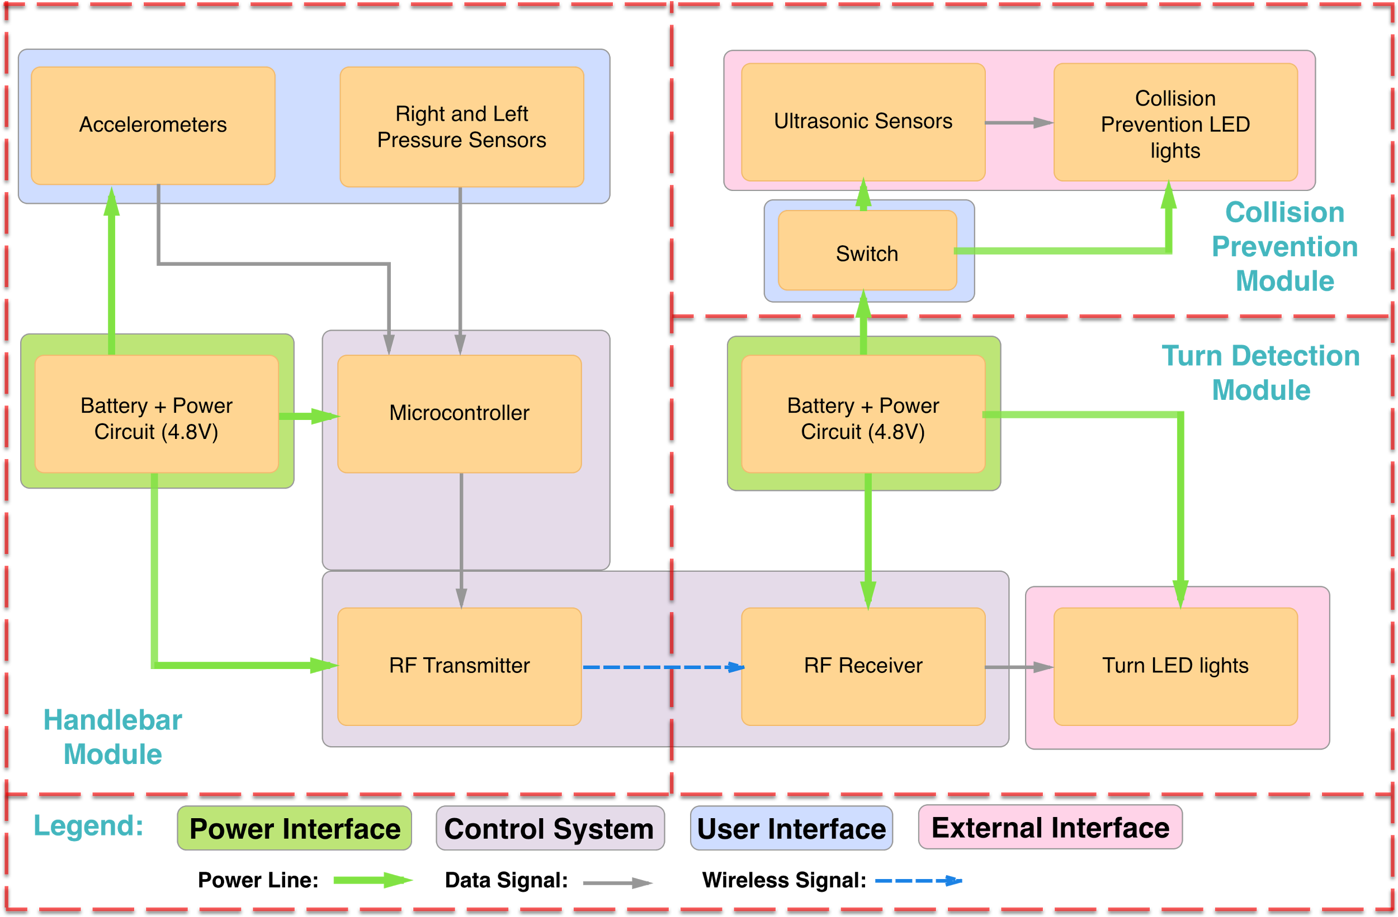
Design: Block Diagram
Notes:
larry

Slide 7
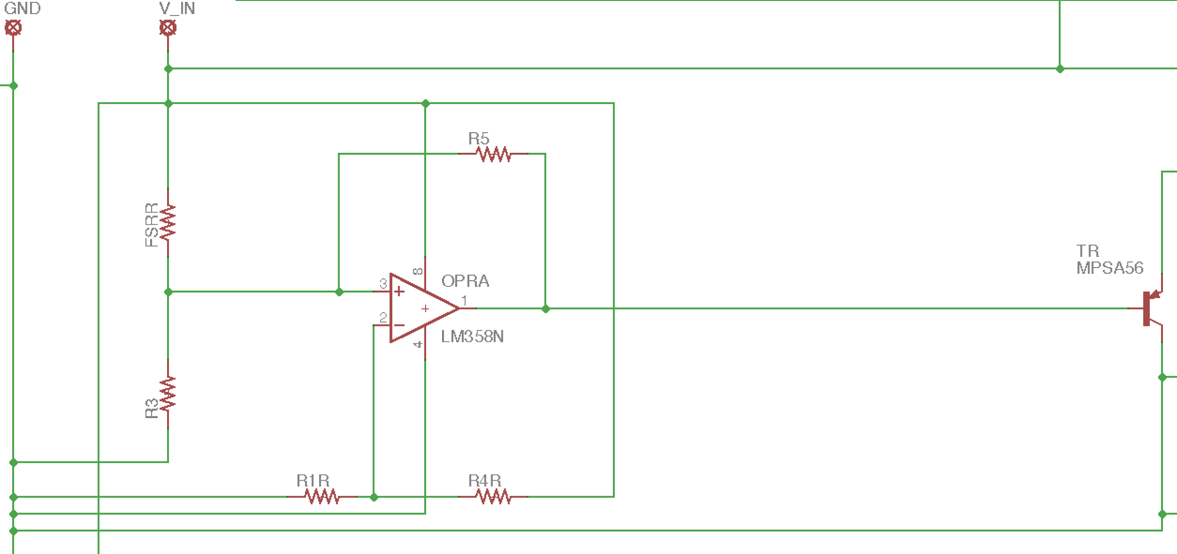
Design: FSR Threshold Switch
Design:
Op Amp regulates pressure sensor input → output result.
Measured voltage drop across resistors when sensors are pressed.
Used VDR to compute necessary threshold for Op Amp to output high.
Transistor switches signal low.
Notes:
Suriya
Use and op amp as a comparator
When + node is greater than the - node, output is high

Slide 8
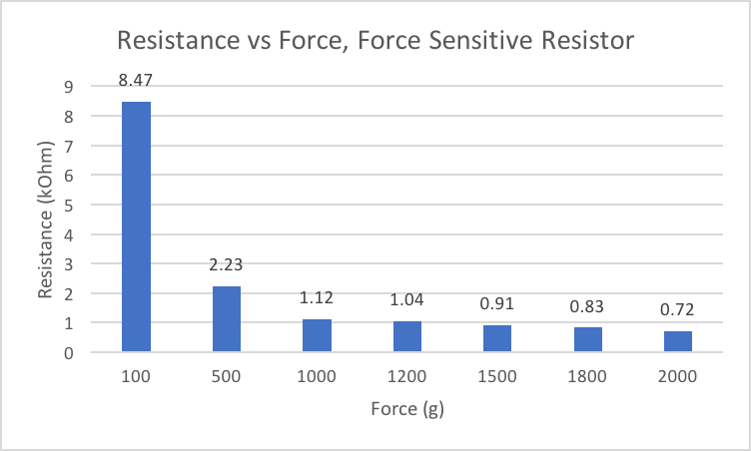
Design: Data Plots: Pressure Sensors
Notes:
suriya

Slide 9
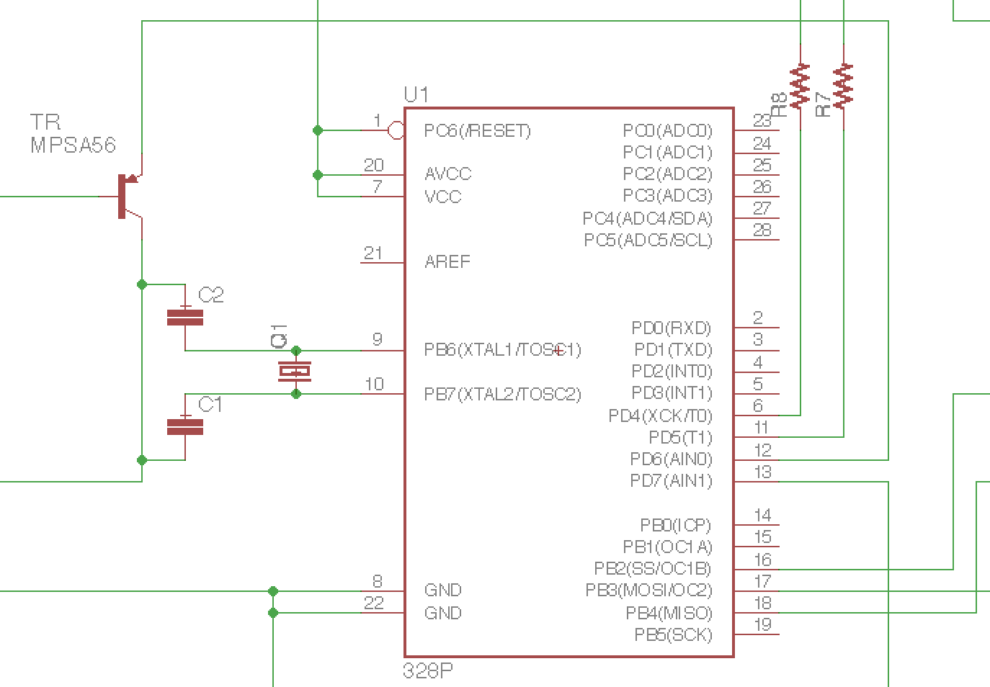
Design: ATmega328p
Design:
32 KB Flash Memory, 32 pins
Active high inputs utilized digital pins 6 and 3.
MCU logical outputs were delivered out on digital pins 5 and 4.
Operated at 4.8 V
Operates using external clock at a frequency of 16 MHz.
Programmed via AVRDUDE
Notes:
Larry
Mention sensitivity of digital input pins
avrdude-utility to download/upload/manipulate the ROM and EEPROM contents of AVR microcontrollers using the in-system programming technique (ISP)
Mention how shitty avrdude was to use: config, overkill amount of code, provided templates were unclear, much more difficult than simply programming via Arduino ISP
EEPROM: electrically erasable programmable read-only memory and is a type of non-volatile memory used in computers and other electronic devices to store relatively small amounts of data but allowing individual bytes to be erased and reprogrammed.

Slide 10
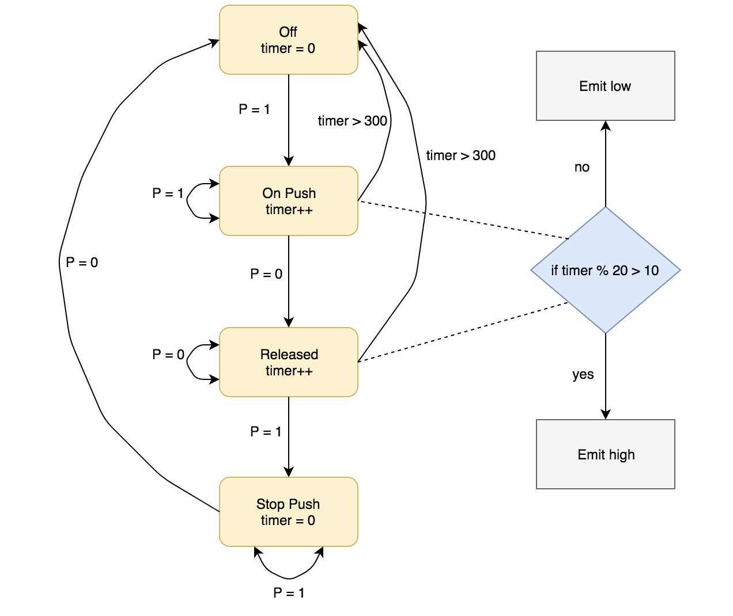
State Diagram
Software logic for one sensor
Simulates blinking and timed turn-off
P = 0 → pressure sensor not pushed
P = 1 → pressure sensor pushed
Notes:
suriya

Slide 11
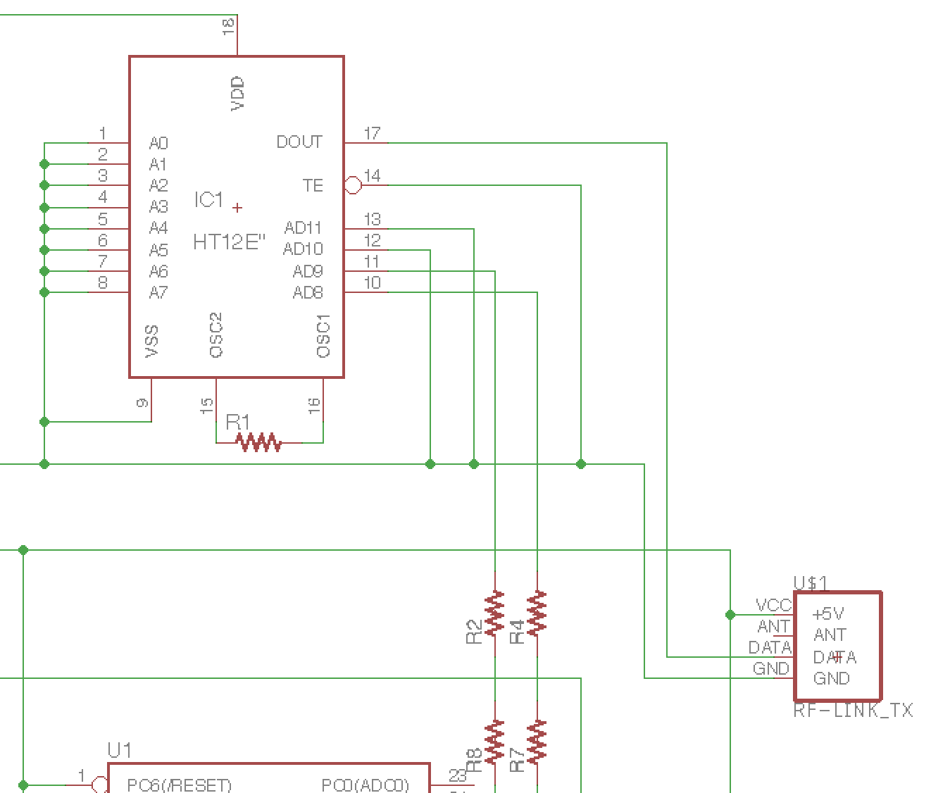
Design: RF Transmitter
Design:
Utilized a 4-bit encoder to translate individual bit information received from digital pin outputs of MCU.
Encoder relayed information to the data in pin of our transmitter.
RF Link Transmitter wirelessly transmitted data to the receiver at 434 MHz.
Notes:
larry

Slide 12
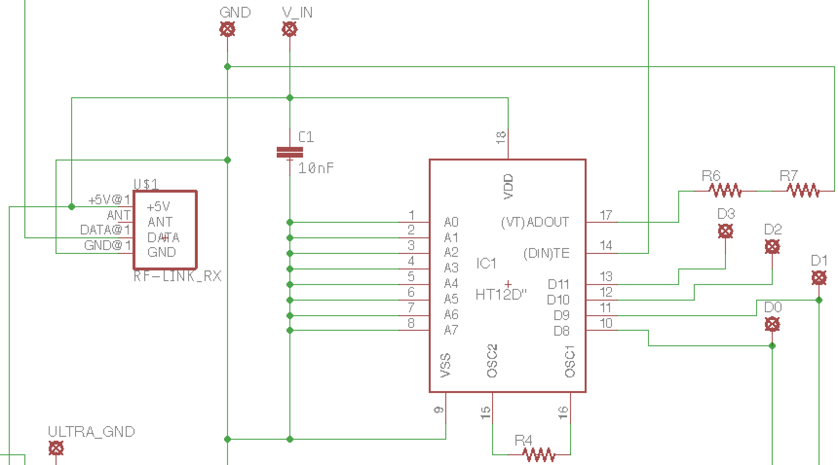
Design: RF Receiver
Design:
Wirelessly transferred data arriving at RF Link receiver is routed to a decoder.
Decoded output bits are combined with Ultrasonic Sensor output to determine the state of the helmet LEDs.
Notes:
larry

Slide 13
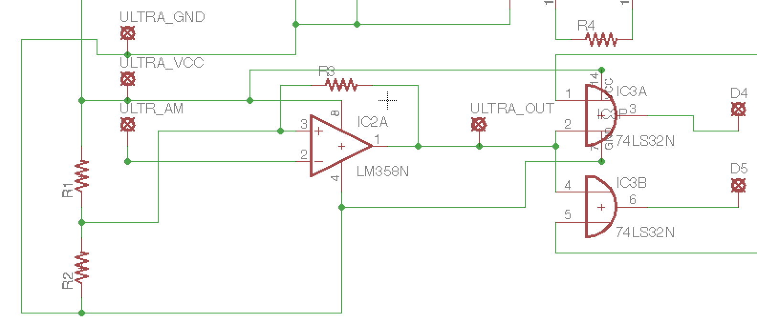
Design: Ultrasonic Range Finder
Design:
Analog voltage routed to threshold switch circuit
Has a minimum detection distance of 6 inches (15.2 cm). Max: 254 inches or 21 ft.
Large detection cone
Calculated the distance from: (V_{cc}/512) / in. to determine voltage thresholds.
Notes:
Suriya
Uses op-amp comparator similar to fsr
Able to set threshold based off of data tested
Voltage decreases linearly as it detects something closer and closer
OR’d with the light control word to override if something is within range

Slide 14
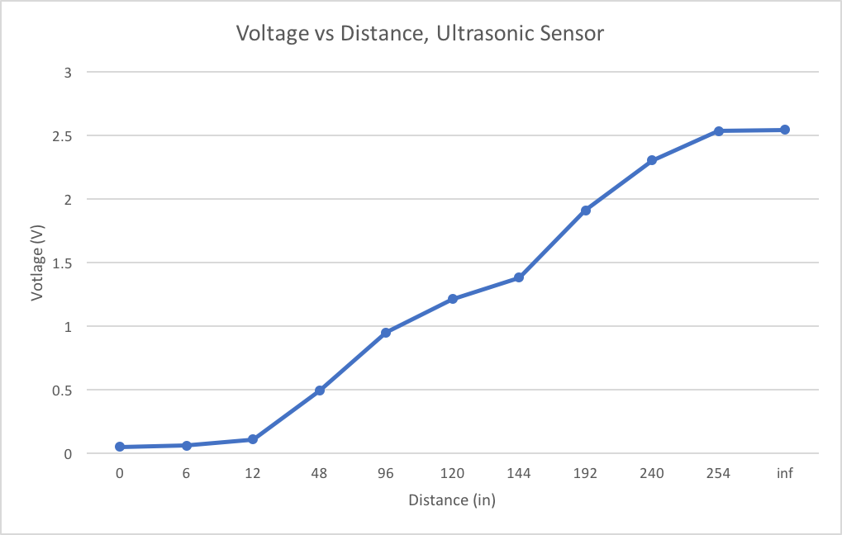
Design: Data Plots: Ultrasonic Sensor
Notes:
suriya

Slide 15
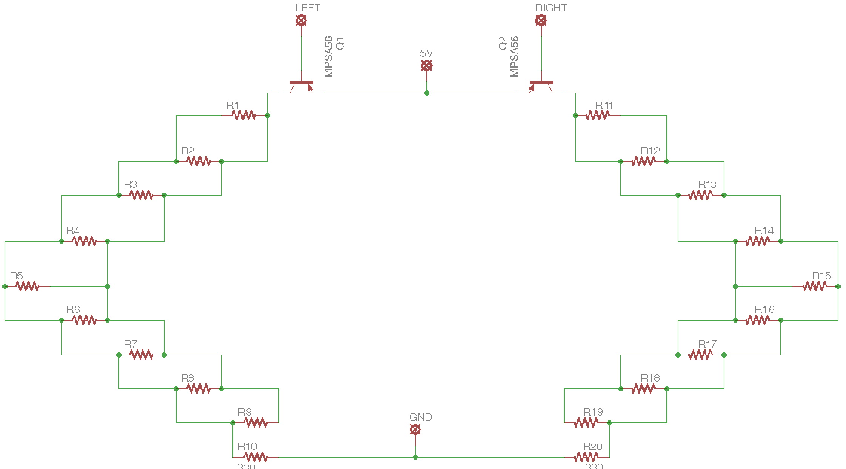
Design: LEDs
Design:
Simple circuit utilizing transistor to help supply power.
Logical output of OR gates send signals to transistor for turning on or off corresponding LEDs
Notes:
kevin

Slide 16
Design: Power Consumption
Front Component:
Battery Pack: 4.8V - Three 1.6V AA batteries (11.25 Wh)
MCU (0.96 mW), RF Transmitter (38.4 mW)
11.25 Wh / (0.96 mW + 38.4 mW) = 285.8 hours
Rear Component:
Battery Pack: 4.8V - Three 1.6V AA batteries (11.25 Wh)
18 LED’s (18*80 mW), Ultrasonic Sensor (9.6 mW), RF Receiver (38.4 mW)
11.25 Wh / (18*80 mW + 9.6mW + 38.4 mW) = 192.1 hours
Notes:
kevin

Slide 17
R&V
Requirements | Verifications
Variable Force Threshold Switch - 4 lb force detected by pressure sensors | ✓ Op-Amp outputs HIGH or LOW depending on the pressure detected
Accelerometer - Accelerometer correlates ± 4g as a turn (only intended for switching off LEDs after turn is completed) - replaced w/ a 2nd pressure s. press | 🅇 Accelerometer clock speed was incompatible with our MCU frequency
Ultrasonic Sensor - Detects objects under 120 in. away | ✓ LEDs turn on in object is detected in range
Microcontroller - Read data from input sensors and translate it to be transmitted across RF Transmitter | ✓ Input pins and output pins had correct values as seen on an oscilloscope
RF Transmitter/Receiver - Control words are consistently sent and caught between the pair | ✓ Receiver is verified to have the same data as the output pins on the MCU, indicating successful transmission
Power Supply - Deliver sufficient voltage to power all components and enough wattage to keep it powered for a significant amount of time | ✓ Consistently provides 4.8V of V_{CC} to both front and rear modules
LEDs - Should respond to inputs from pressure sensors and ultrasonic sensor | ✓ Pushing a pressure sensor causes its respective lights to turn on. Ultrasonic sensor detection causes both sets of lights to turn on
Notes:
Suriya + kevin

Slide 18
Strengths & Weaknesses
Strengths:
Modularization
Utilized sensors with low power consumption
Minimized circuits as a foundation for building additional features
Weaknesses:
Range of transmitter signal can be unreliable at times
Should buy a better quality sensor to prevent tuning of [transmitter → receiver] reception
Were unable to integrate accelerometer for disabling lights
Challenge: operated a different clock frequency than our ATmega328p
LEDs were not as visible during day - provide greater voltage source
Notes:
kevin

Slide 19
Challenges
MCU Programming
Switched from TI CC2640F128RGZR to ATMega328p - time challenge
Required addition of separate transmitter and encoder to circuit
Clock failures
Accelerometer
Source code has different power source and clock frequency
Requires bootloader and significant more software testing
Power Source
RF Link Receiver inoperable above 5.1 V, yet brighter LEDs need higher voltage
PCB
⅗ of PCBs delivered from PCBWAY were broken
Notes:
Suriya
Accelerometer: Decided to mimic functionality by adding a turn-off to the pressure sensor and blinking lights from MCU
Mention: We took the tradeoff of having dimmer LEDs and keep the module working, better implementation would be to use a voltage regulator on the power delivery to RF Receiver

Slide 20
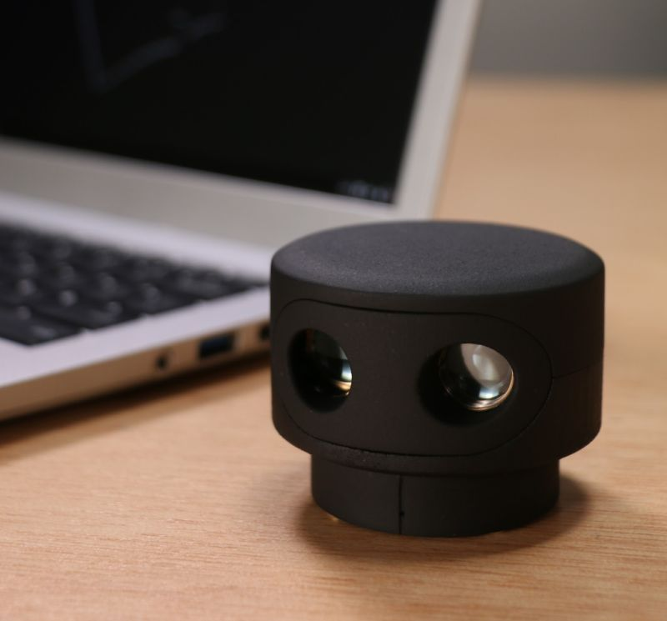
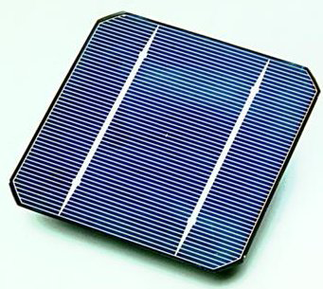
Future Work
Charge helmet LEDs via micro-USB or solar cells
Integrate 2nd MCU into helmet circuit to perform more advanced signal processing
Upgrade to low-cost LIDAR to detect surrounding objects more accurately
Streamlined LEDs, utilize strip for better clarity and compactness
Generate subtle helmet vibrations when detecting vehicle approaching at rapid speed
Yellow hazard lights
Develop a smart-app that connects to helmet via Bluetooth
Opens another broad class of connected features
Integrate “Hey Siri” + “Ok Google” features
Measure bike time/routes, take phone calls, music, etc.
Cloud updates to helmet software: Server → Mobile phone → Helmet circuit
Notes:
larry

Slide 21
References
Presentation Images
Reflector lights
Road
Hand signaling
Siri
OK Google
Phone
iTunes
Calendar
Solar cells
LIDAR
helmet
Car LED
Road bicycle
Citations
“IEEE IEEE Code of Ethics.” IEEE - IEEE Code of Ethics www.ieee.org/about/corporate/governance/p7-8.html. Accessed 20 Sept. 2017.
Force Sensing Resistor Integration Guide and Evaluation Parts Catalog. Interlink Electronics. https://www.sparkfun.com/datasheets/Sensors/Pressure/fsrguide.pdf. Accessed on 10/1/2017.
RF Receiver. Wireless Hi Sensitivity Receiver Module (RF ASK). https://cdn.sparkfun.com/datasheets/Wireless/General/RWS-371-6_433.92MHz_ASK_RF_Receiver_Module_Data_Sheet.pdf. Accessed on 09/20/2017.
LV-MaxSonar -EZ Series Datasheet. High Performance Sonar Range Finder. https://www.maxbotix.com/documents/LV-MaxSonar-EZ_Datasheet.pdf. Accessed on 09/25/2017.

Slide 22
Thank You!

Slide 23
Questions?

