Slide 1
Electric Bike with Regenerative Braking
Team 38
Chloe, Jace, Lucas

Slide 2
Introduction

Slide 3
Agenda
Objective
Motivations for project
Design
Modifications, requirements
Testing and Results
Reflection
Ethics

Slide 4
Objective
Electric bikes- excellent method of green transportation
Useful for navigating cities and urban environments
Problems
Limited by range
Brake wear and maintenance
Solution
Regenerative braking

Slide 5
Video

Slide 6
Design

Slide 7
High Level Requirements
Regen braking utilized to some extent
Flipping switch initiates regenerative braking
10 mph top speed
Emergency shutoff

Slide 8
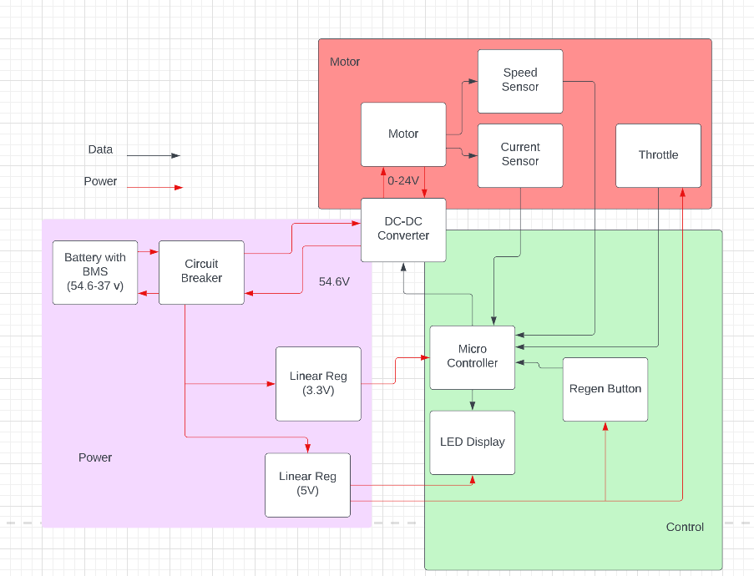
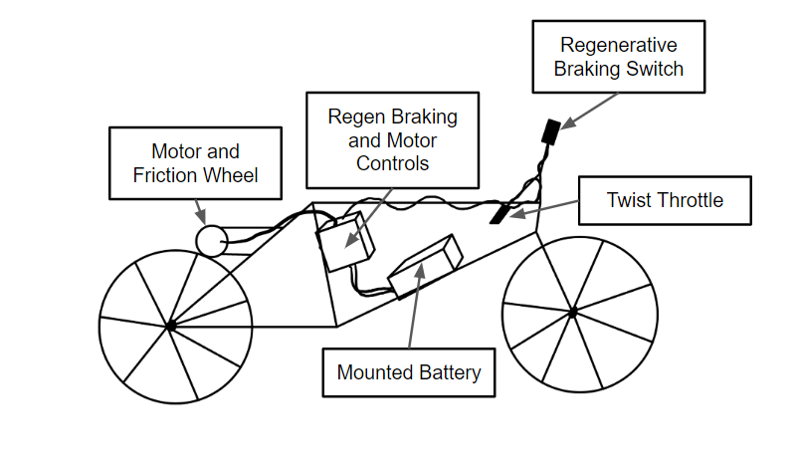
Original Design

Slide 9
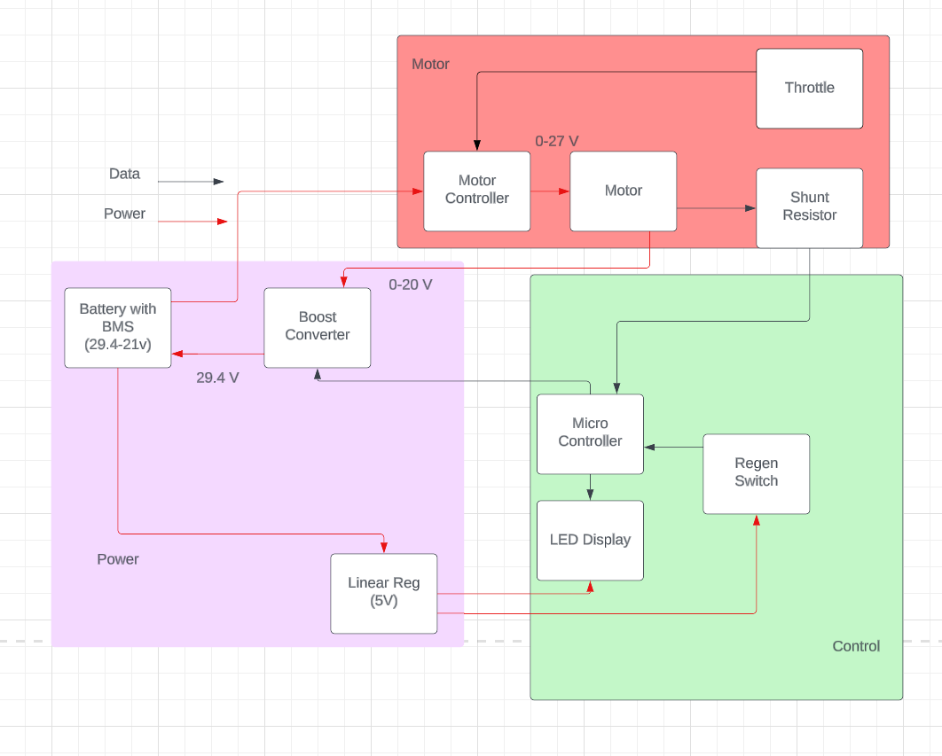
Changes to Design
Battery
24V
Motor Controller
Handles motor activation when not regenerative braking
Boost
Replaces buck/boost
Motor
Brushed DC
Power diverter
Power diverter used to ensure that only one circuit is active at a time

Slide 10
Block Diagram Comparison
Original Block Diagram
Final Block Diagram

Slide 11
Subsystem Requirements
Power
29.4V-21V to 24V ± 2.5V for motor controller
29.4V ± 1.0V to recharge battery
5V ± 1.0V to regen switch
Motor
Current measurements within ± 5% accuracy
Responds proportionally to throttle input

Slide 12
Subsystem Requirements
Control
Microcontroller responds to switch signal within 1s
Supplies 5V digital enable
Displays current measurement on LCD

Slide 13
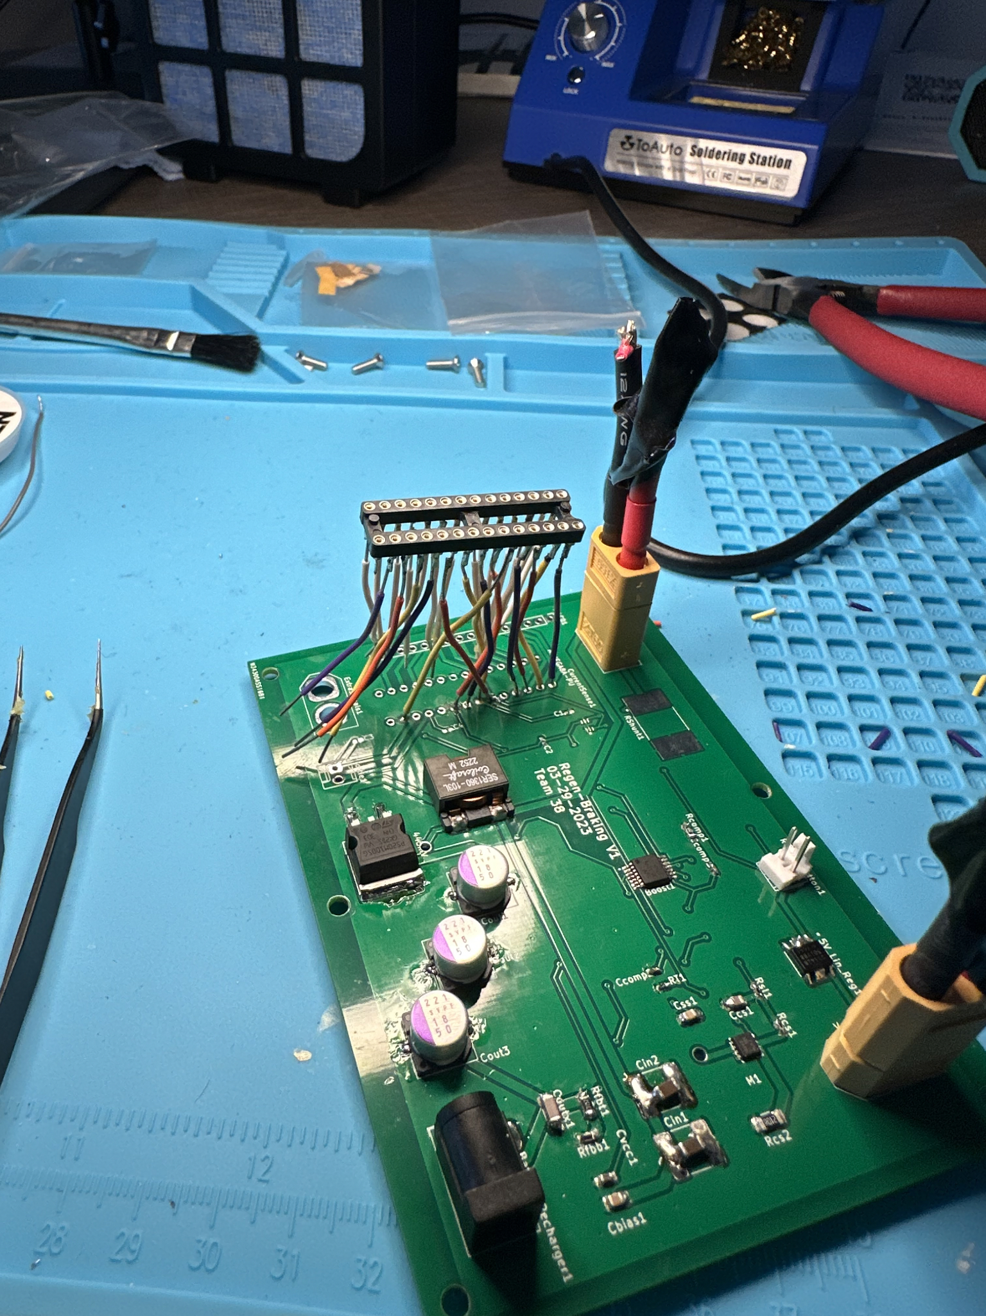
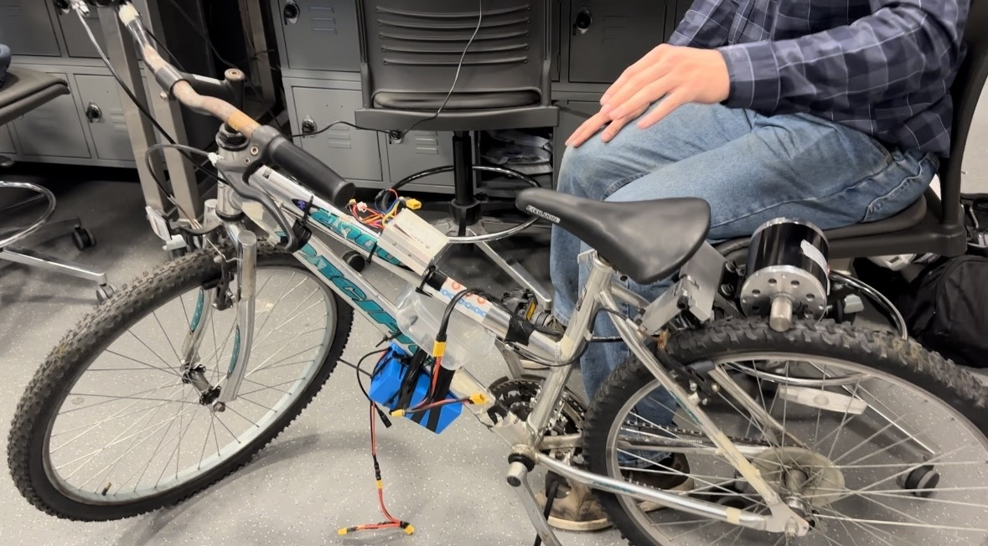
Project Build

Slide 14
Testing and Results

Slide 15
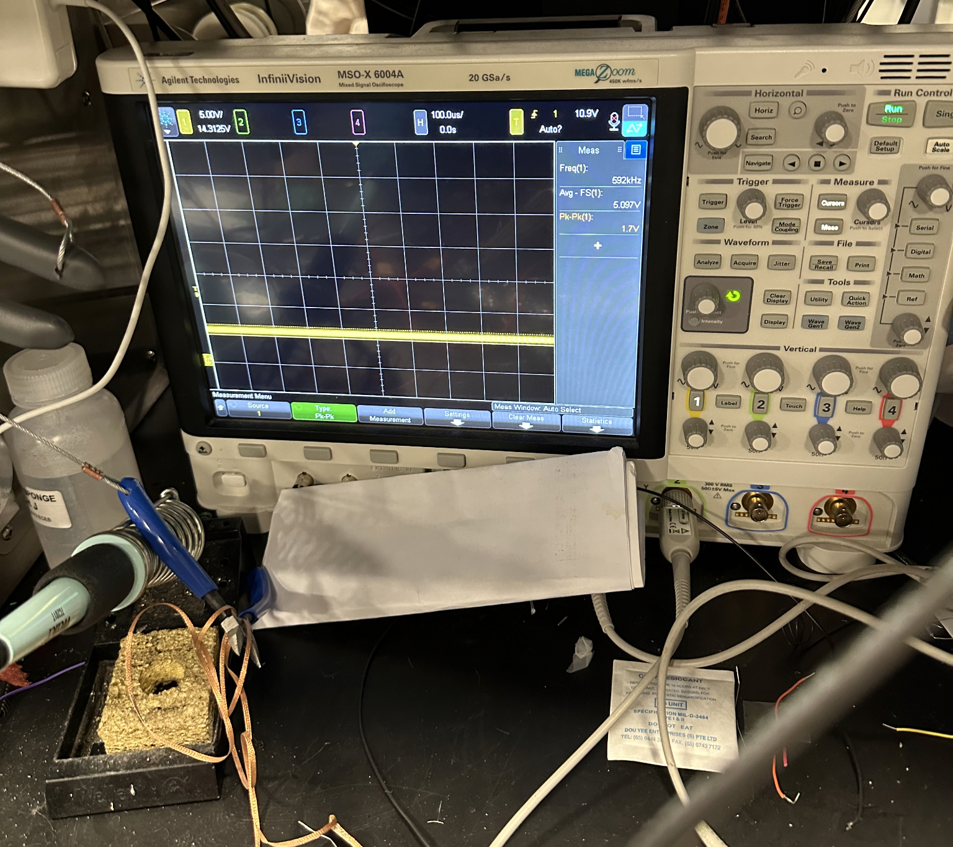
Linear Regulator
Input (V) | Average (V) | Peak-to-Peak (V)
5 | 5.076 | 1.7
10 | 5.108 | 1.7
15 | 5.097 | 1.7
20 | 5.097 | 1.7
25 | 5.087 | 1.7

Slide 16
Battery Charger
Tested battery charger to get good baseline for how well our boost circuit needed to perform.
Average Output: 29.25 V
Peak-to-Peak : 2.5 V

Slide 17
Boost Output V1
Input (V) | Average (V) | Peak-to-Peak (V)
5 | 29.74 | 1.0
6 | 29.74 | 1.0
7 | 29.77 | 1.0
8 | 29.78 | 1.1
9 | 29.78 | 1.2
10 | 29.78 | 1.1
12.5 | 29.79 | 1.2
15 | 29.80 | 1.4
17.5 | 29.80 | 1.5
20 | 29.80 | 1.6

Slide 18
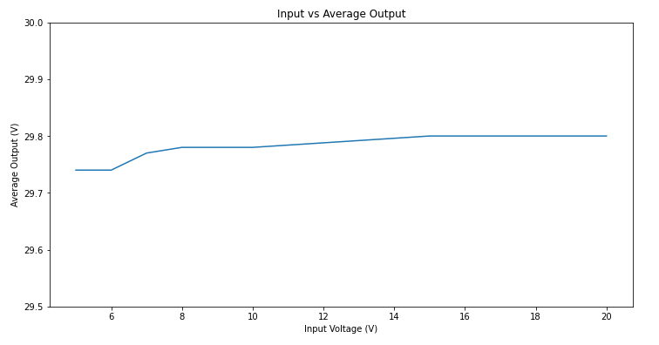
Boost Output V1

Slide 19
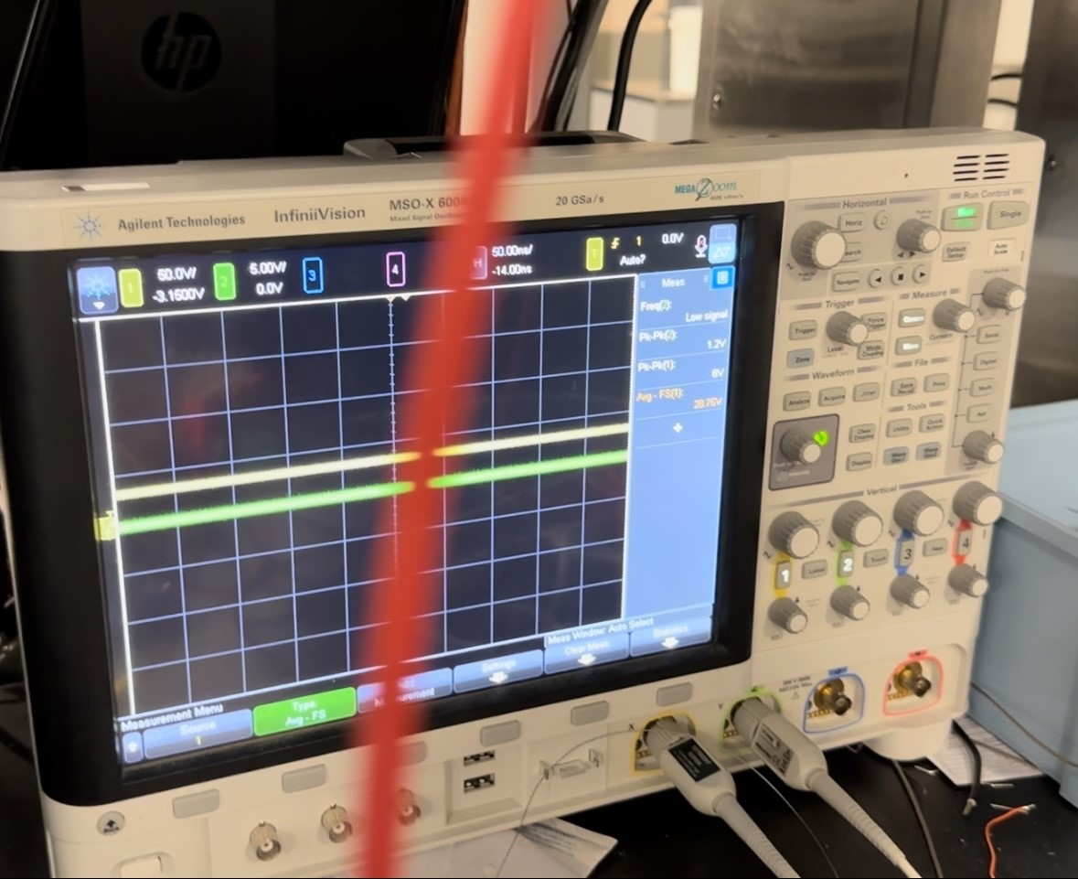
Boost Output V2
Input (V) | Average (V) | Peak-to-Peak (V)
5 | 9.1186 | 0.60
7 | 22.795 | 0.60
10 | 23.201 | 1.14
13 | 26.192 | 0.87
15 | 29.600 | 0.87
17 | 29.604 | 0.87
20 | 29.604 | 0.94
22 | 29.600 | 1.00
24 | 29.604 | 1.07

Slide 20
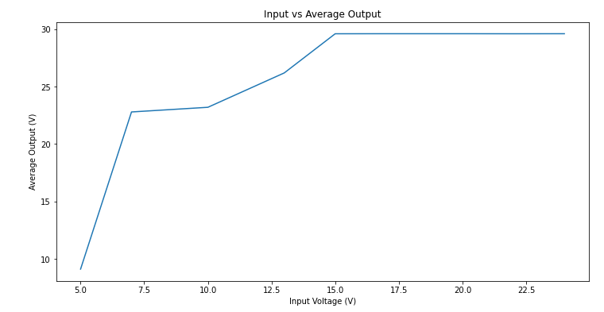
Boost Output V2

Slide 21
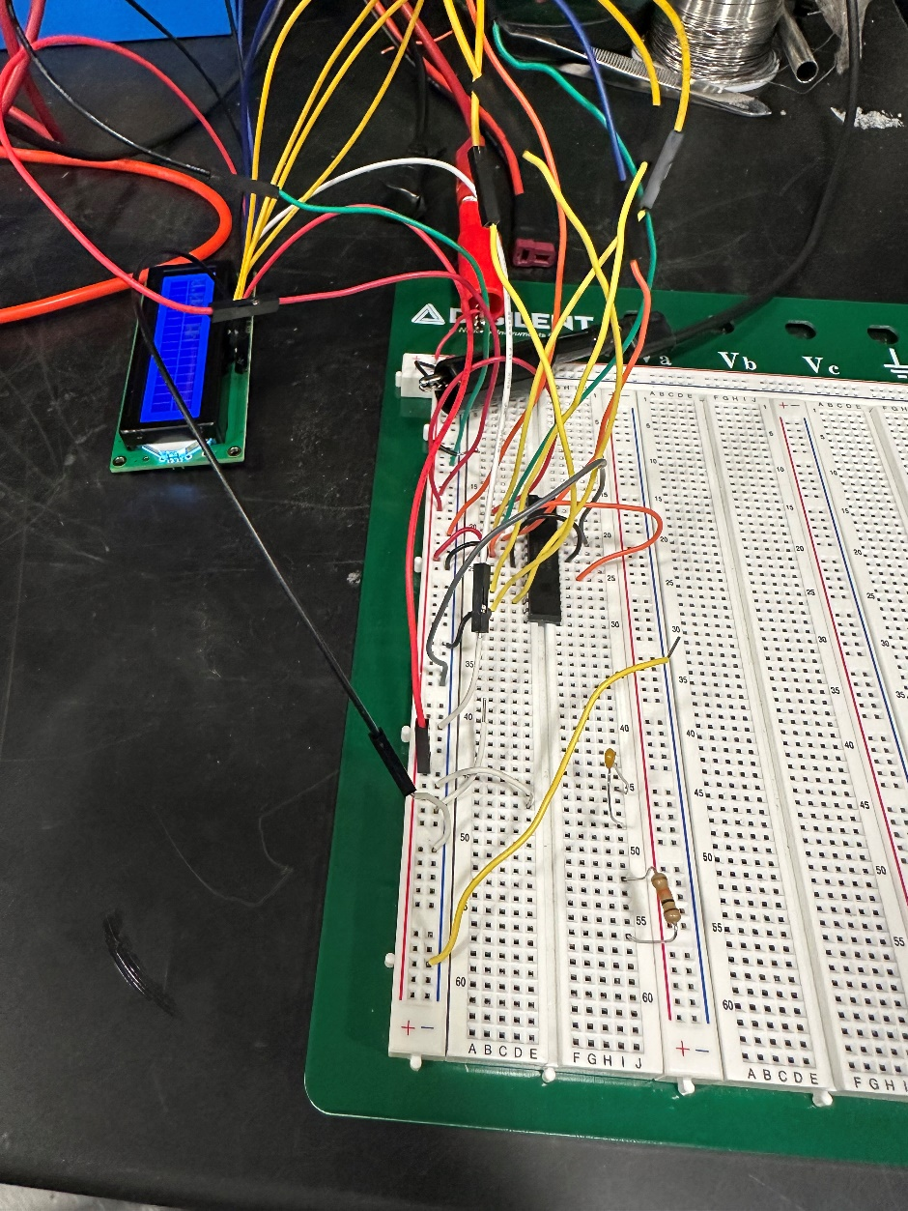
Microcontroller
Enable
seen in boost output
output increases when switch pressed
supply voltage when switch off
Commonly Used Testing Setup for Microcontroller

Slide 22
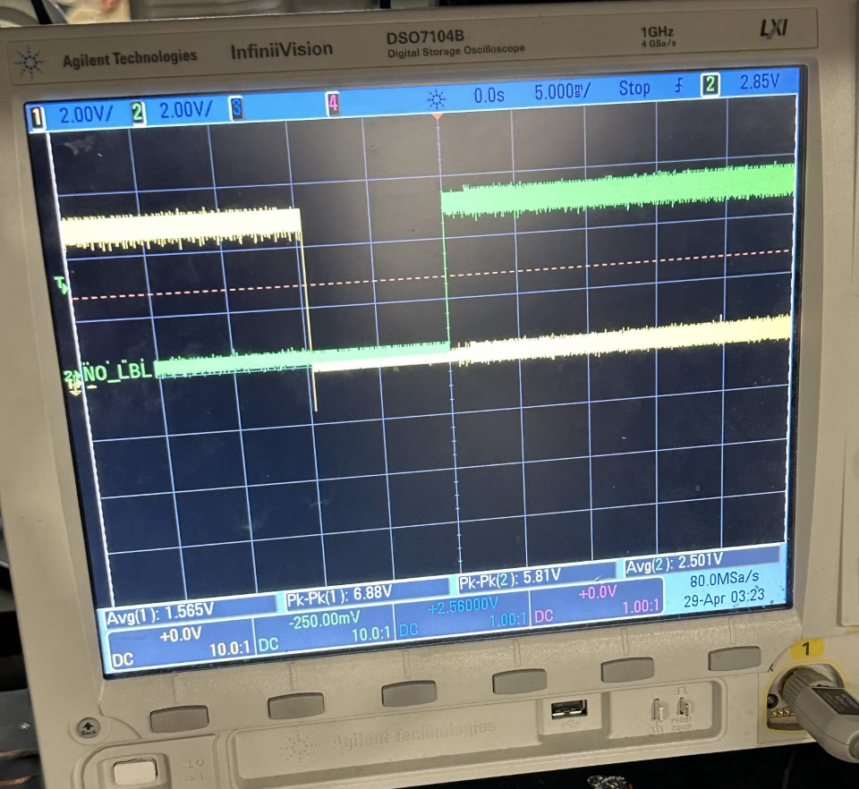
Microcontroller
Switching
gate signals for protection circuit
one for forward
one for regen
10ms delay between low and high switches

Slide 23
Microcontroller
LCD
constant and varying waveforms
calculated amp hours vs observed
ex: 0.1V square wave, 0.05V offset, 0.2Hz
 | 10 seconds | 1 minute
Observed (Ah) | 0.68 | 4.10
Calculated (Ah) | 0.69 | 4.17
Error (%) | 1.45 | 1.68

Slide 24
Project Reflections

Slide 25
Successes
Project works as an electric bike
Regeneration was accomplished
Boost Output
Boost output is steady and consistent from 14-24v
Boosting only occurs when the switch is on

Slide 26
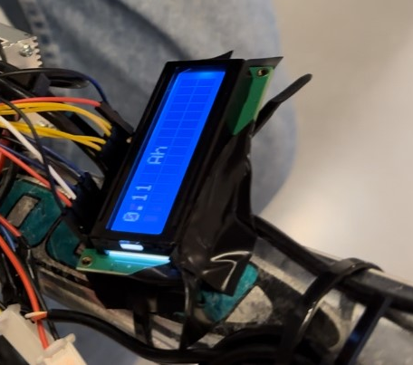
Successes
Microcontroller Function
The microcontroller was properly powered by a linear regulator
Performed all desired functions
Displayed power regenerated in amp hours (Ah)
shunt and current sense

Slide 27
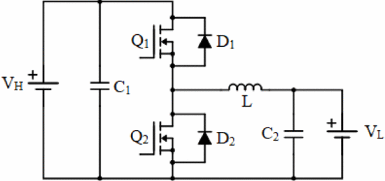
Challenges
Power project experience
No significant group member experience
Buck/boost design
Changed in final design
Limited products available
Little experience with switching converters
Power diverter design
Power MOSFETs proved difficult
Non-isolated half-bridge bidirectional DC/DC converter (A. Sharma et al.)

Slide 28
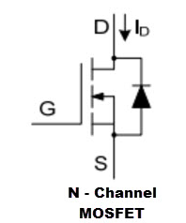
Failures and Explanations
Full Integration
Proper power diverter needed for complete integration
MOSFET driven protection board leaked current during testing
Diode caused undesired effects
Relays
more suitable option for this type of circuit

Slide 29
Failures and Explanations
Boost Output Behavior
Swapped capacitors on second PCB
Lower output voltages for inputs 5-13V
Input (V) | Average (V) | Peak-to-Peak (V)
5 | 9.1186 | 0.60
7 | 22.795 | 0.60
10 | 23.201 | 1.14
13 | 26.192 | 0.87
Boost Circuit V2 Behavior caused by Swapped Capacitors

Slide 30
Conclusions
Protection Circuit
Original design failed
Would use combination relays and MOSFETs
Necessary for realization of full project
Check layouts before PCB submission
Microcontroller layout in KiCad was incorrect
PCB needed rework as a result

Slide 31
Conclusions
Detailed testing procedures
Documentation
Take notes and pictures regularly
Design with failure in mind

Slide 32
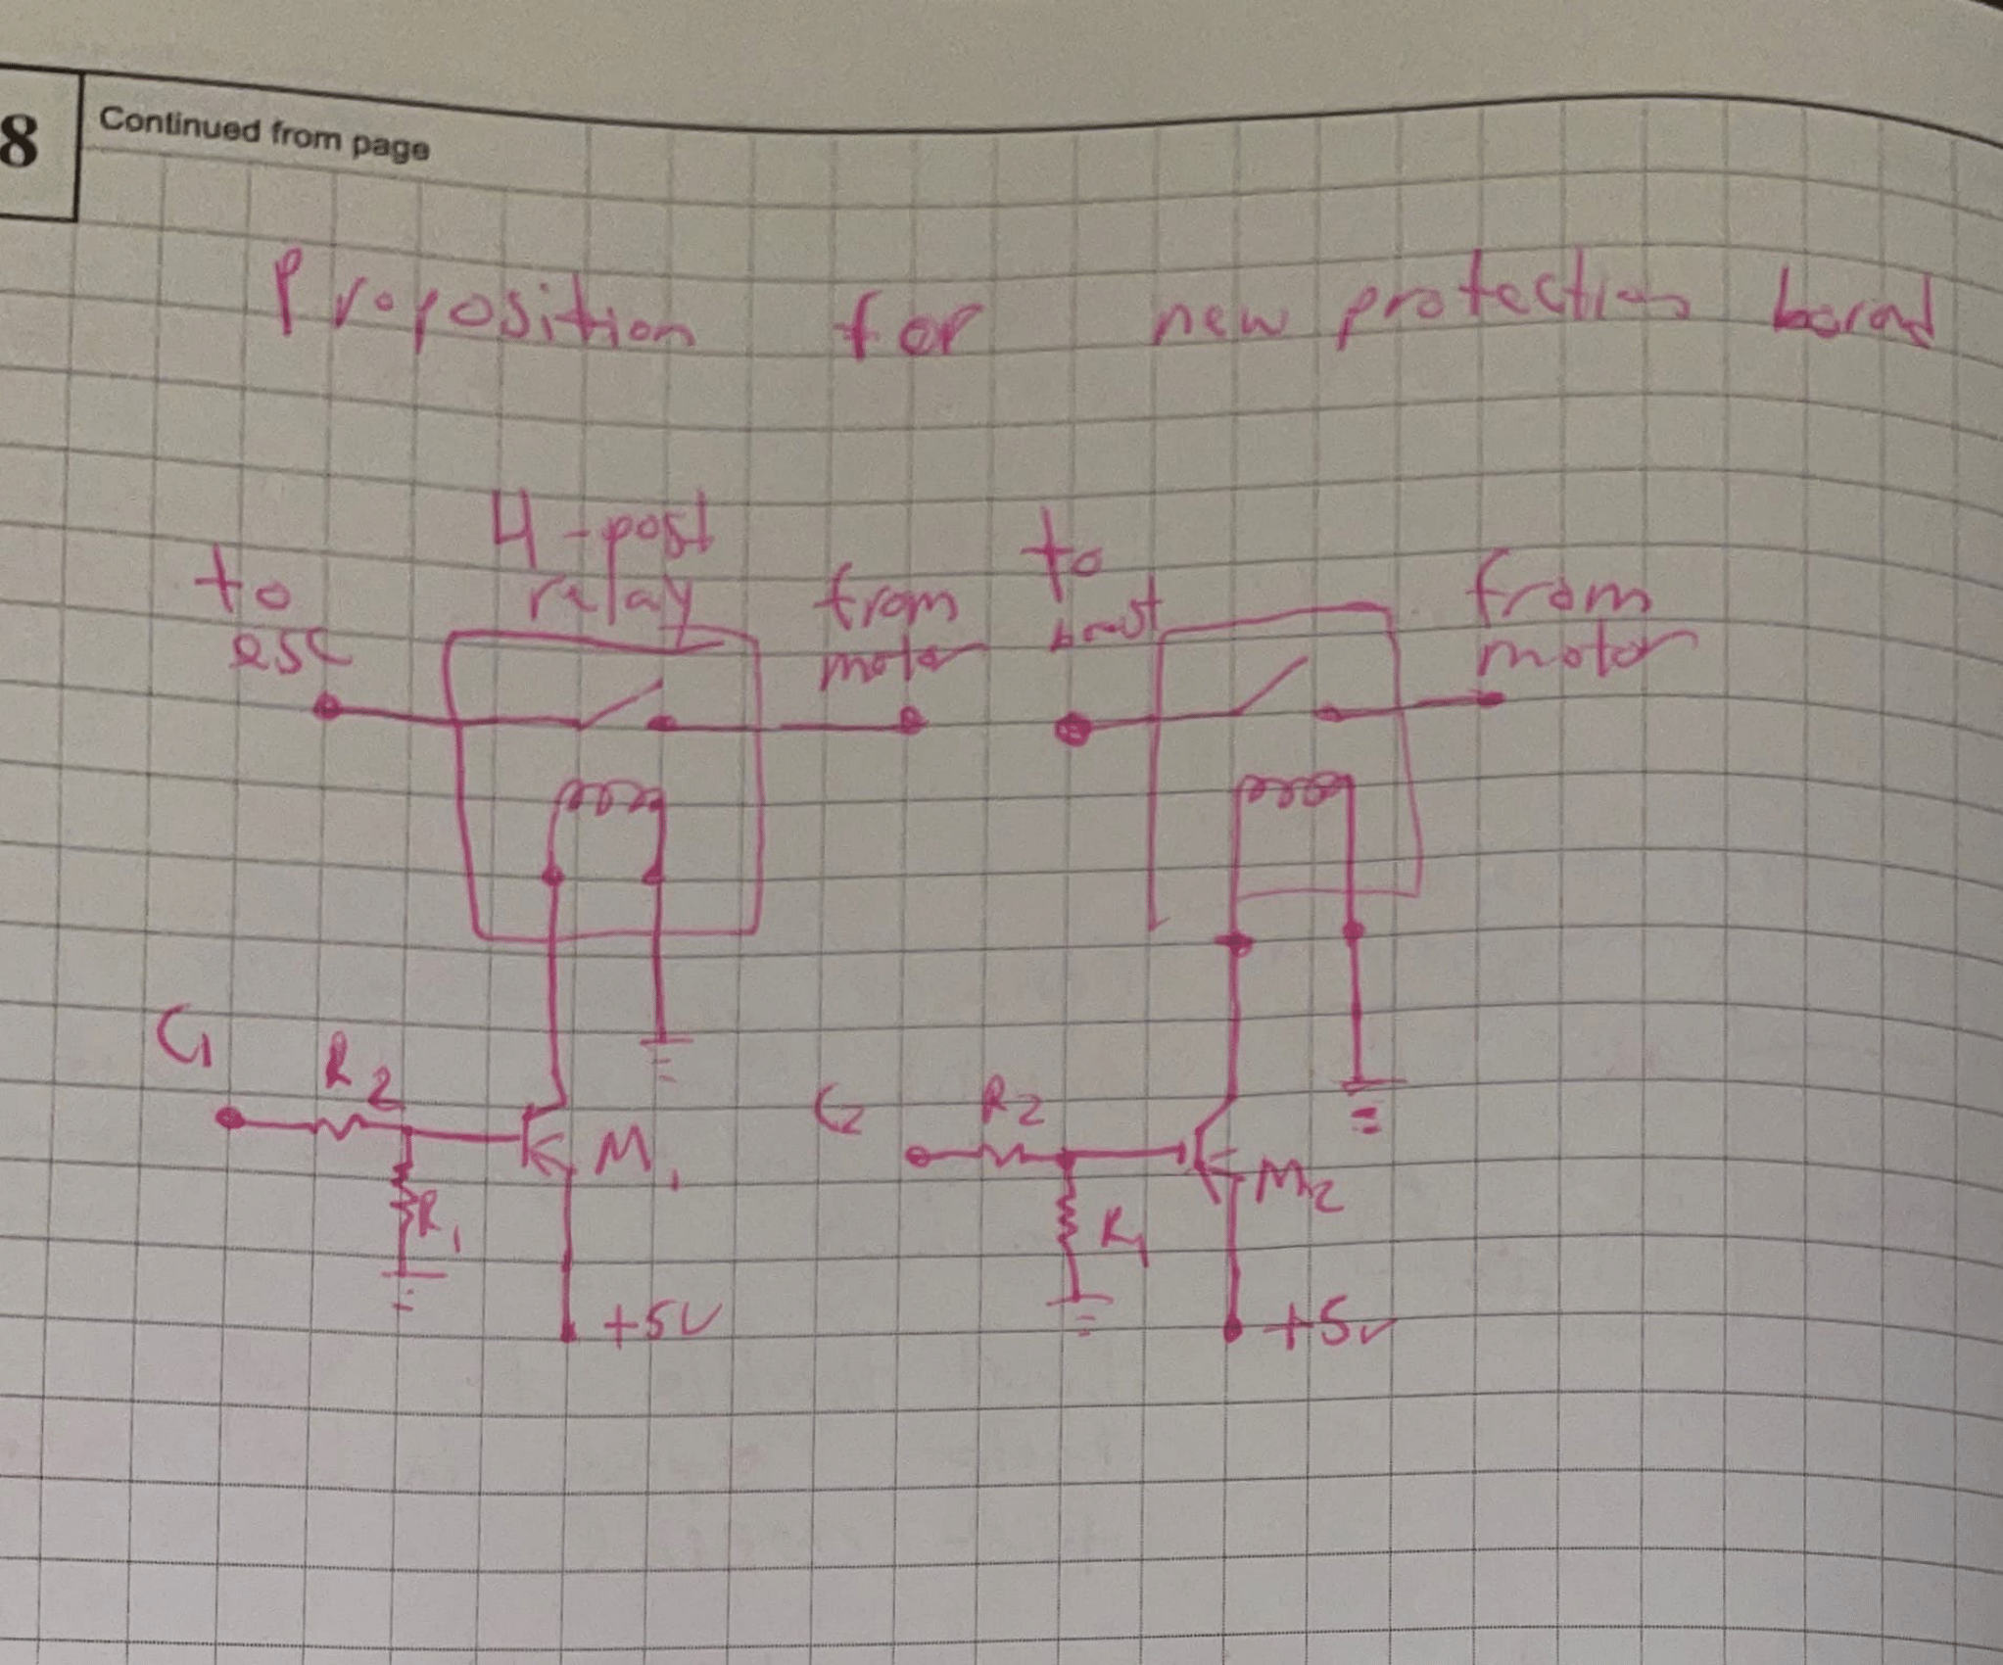
Recommendations
Protection Circuit
Finished project much more usable
Separate forward mode from regenerative mode
Result- working regenerative braking system with motor capability
PCB Rework
Microcontroller pin layout
Test points

Slide 33
Recommendations
Battery Charge
info on LCD
Aesthetic Rework
PCB enclosure
Battery mount
Higher quality bike
Better user experience while riding

Slide 34
Ethical Considerations
Lithium ion battery protections
Overcurrent, overvoltage, short circuit
Must not be damaged during assembly
High voltage training
Stopping power
Top speed limitations
User error

Slide 35
References
[1] “Over 450 electric bikes compared! What does an ebike cost?,” eBikesHQ.com, 25-Oct-2022. [Online]. Available: https://ebikeshq.com/cost-of-an-ebike/. [Accessed: 08-Feb-2023].
[2] M. Toll, “The truth: How far can an electric bicycle really go on a single charge?,” Electrek, 19-Mar-2022. [Online]. Available: https://electrek.co/2020/06/12/how-far-can-an-electric-bicycle-really-go-on-a-charge/. [Accessed: 08-Feb-2023].
[3] “Do bike brake pads get old?,” Cycling Vitality, 07-Aug-2022. [Online]. Available: https://cyclingvitality.com/do-bike-brake-pads-get-old. [Accessed: 08-Feb-2023].
[4] “IEEE code of Ethics,” IEEE. [Online]. Available: https://www.ieee.org/about/corporate/governance/p7-8.html. [Accessed: 08-Feb-2023].
[5] “Preventing fire and/or explosion injury from small and wearable lithium battery powered devices,” 20-Jun-2019. [Online]. Available: https://www.osha.gov/sites/default/files/publications/shib011819.pdf. [Accessed: 09-Feb-2023].
[6] “Illinois State Electric Bike Laws,” EVELO, 30-Aug-2022. [Online]. Available: https://evelo.com/blogs/ebike-laws/illinois#:~:text=Class%201%3A%20eBikes%20equip ped%20with,the%20speed%20of%2020%20mph. [Accessed: 21-Feb-2023].
[7] “Universidad politécnica salesiana sede cuenca - ups,” Jun-2021. [Online]. Available: https://dspace.ups.edu.ec/bitstream/123456789/20506/1/UPS-CT009183.pdf. [Accessed: 22-Feb-2023].
[8] D. Torres and P. Heath, “Regenerative braking of BLDC Motors - Microchip Technology.” [Online]. Available: https://ww1.microchip.com/downloads/en/devicedoc /regenerative%20braking%20of%20bldc%20motors.pdf. [Accessed: 22-Feb-2023].

Slide 36
References
[9] A. Sharma, R. Mishra, A. K. Yadav, and A. Phukan, “Bidirectional DC-DC converter for incorporating regenerative braking in e-bikes,” 2018 International Conference on Electrical, Electronics, Communication, Computer, and Optimization Techniques (ICEECCOT), 2018.
[10] “ISL81801 Datasheet,” Renesas Electronics Corporation. [Online]. Available: https://www.renesas.com/us/en/document/dst/isl81801-datasheet. [Accessed: 24-Feb-2023].
[11] “Atmega8a Data sheet summary - microchip technology.” [Online]. Available: https://ww1.microchip.com/downloads/en/DeviceDoc/Microchip%208bit%20mcu %20AVR%20ATmega8A%20data%20sheet%20summary%2040001991A.pdf. [Accessed: 24-Mar-2023].

