Slide 1
Portable Pill Dispenser
ECE 445 FALL 2019 – GROUP 15
JUSTIN COUVIGNOU
PHILLIP ZHOU
SAYAN SUR
Notes:
General Feedback: Make it more like a business presentation, i.e., basic facts, concise bullet points, and high-level design features (features > specs). Smaller bullets can be used for high-level engineering FAQ’s, numbers, and R&V results.
!!ASSIGNMENTS IS RANDOM ORDER!!

Slide 2
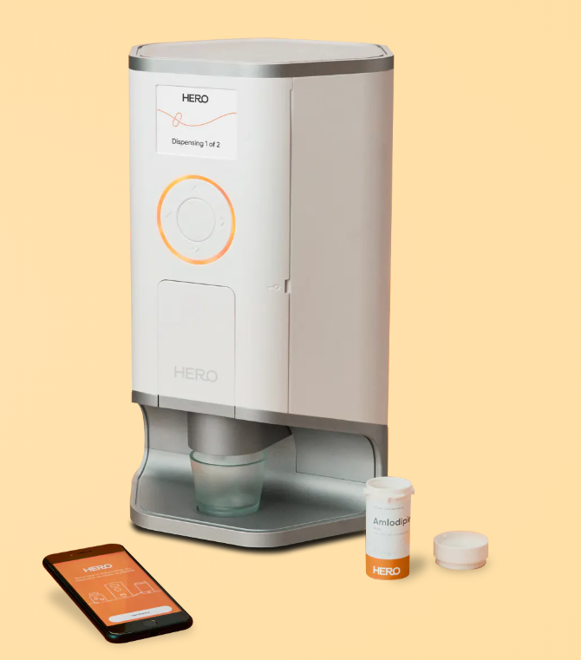
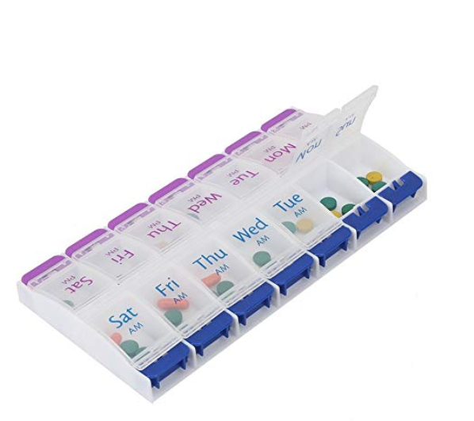
Problem
Current “smart management” devices are big, stationary devices.
Require a user to be at home to receive medication. This greatly restricts the user if their prescription contains many daily pills.
Fully manage dispensing of correct medication to the user.
Other solutions include container-like devices
Containers require a user to preload the pills manually on a daily or weekly basis.
User or caretaker must keep track of their dosages.
Devices are portable.
Notes:
https://herohealth.com/our-product?utm_source=google%20merchant&utm_medium=banner&utm_campaign=google%20merchant%2C%20google%20search&gclid=EAIaIQobChMI0s622tv75QIVUfDACh0hkQMYEAYYASABEgLB6PD_BwE
Add Motivation to problem.
Bullet point the problem statements

Slide 3
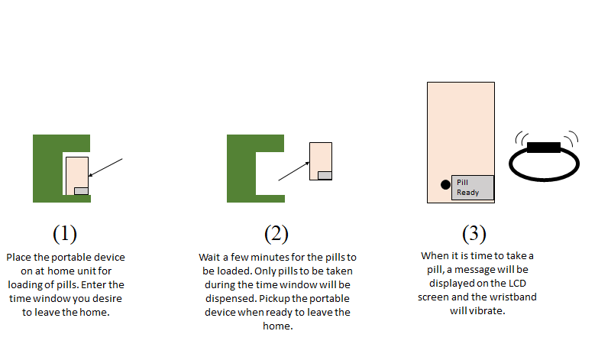
Solution
A portable device capable of autonomously storing and dispensing medication when needed.
Device may be loaded from an at home unit, with no help from a human.
Provides user with basic dosage information (e.g., take with/without food, MAOI conflicts, etc.).
Custom programmable messages displayed on LCD screen.
Notes:
JC
Mention Cost, use cases, applications, and how it solves the problems
-Give one minute pitch info here - see piazza post for the basic template

Slide 4
High Level Requirements
Autonomous, wireless, and hands-free loading.
House at least 3 different pill types and dispense them at correct times.
Display relevant dosage information to the user.
Notes:
Bullet point, shorten.
Mention similarities to AHU, expand on portability.

Slide 5
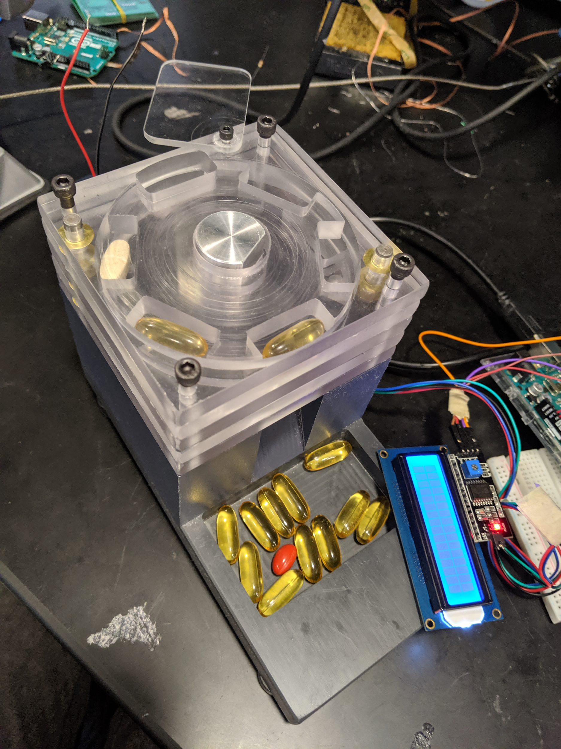
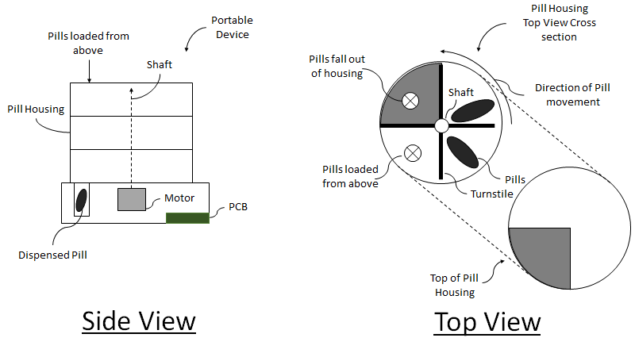
Mechanical Design
<ADD PIC>
Notes:
Add pic of new design. 12/4 - Justin

Slide 6
Video Demo - Loading

Slide 7
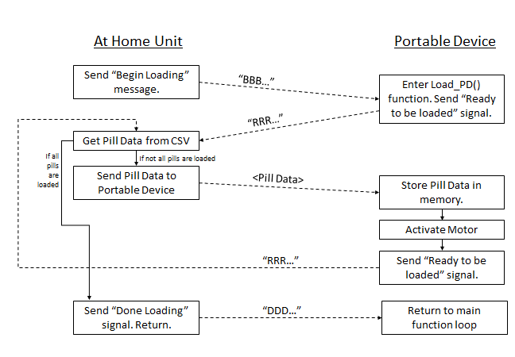
Loading Process
At home unit only communicates begin loading message when: (i) RFID Tag is detected, and (ii) user presses “Begin loading” button
Prescription data is parsed from a CSV, using Processing3.
Loading requires continuous back and forth communication between both devices.

Slide 8
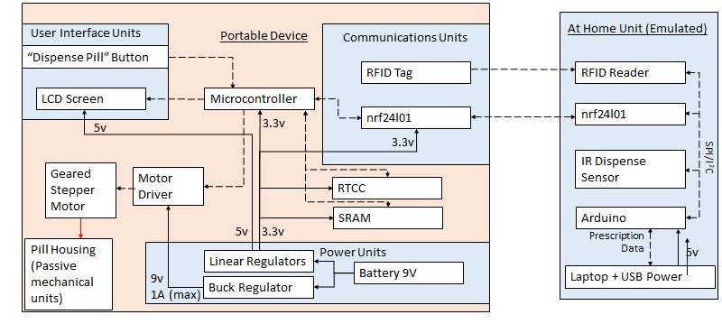
Block Diagram
Mechanical
Output
Data
Power
Notes:
Briefly mention UI and Power, bulk should be on Motor & Comms

Slide 9
At Home Unit (Emulated)
To facilitate loading of the portable device, basic functionalities of an At Home Unit (AHU) where implemented.
Read ID from a passive RFID tag from the portable device (Safety and security).
Communicate with the portable device when loading using near field communications (NFC).
Autonomously sense when a pill is loaded into the portable device using an IR distance sensor.
Some functionalities of the AHU were ignored due to the scope of the project
Mechanical means of dispensing
Ordering of pills. Assumed dispensed pills are in FIFO order.
Notes:
Want to describe these first as its a good transition from briefly discussing the AHU then PD.

Slide 10
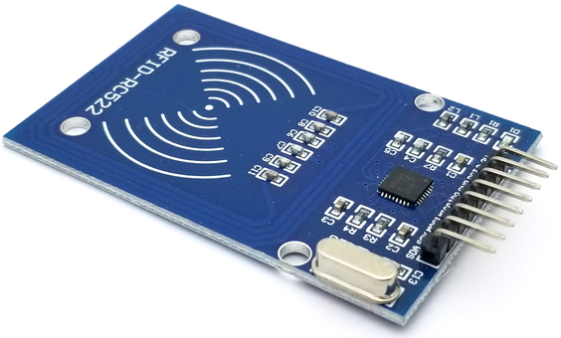
Communications Subsystem - Hardware
Radio Frequency Identification for product authentication
Passive tag, active reader to minimize power consumption
Ensures pills are loaded into correct device
Ensures pills are only dispensed when portable device is near the at home unit
Short range RF module for data transfer
Creates multi-device network
Small form factor for portability
Completely wireless system between at home unit and portable devices
Near field communication limits interference, secures user data
Notes:
Want to describe these first as its a good transition from briefly discussing the AHU then PD. [SS]
product safety, multiple pd for 1 ahu - PZ

Slide 11
Communications Subsystem - Radio
Notes:
PZ

Slide 12
Communications Subsystem - Encoding and Decoding
CSV data input, times truncated into 10hr, 1hr, 10min, 1min
Real Time Clock IC outputs numbers as characters for each time bin
Minute accuracy is implemented, but can expand to second accuracy
Common prescription information, time are encoded
Encoding is attached to custom message, and sent
At receiver, data bits are separated and decoded
Notes:
ASCII 7 bit
PZ
Kristina Notes: Move up to communications

Slide 13
Memory Subsystem - SRAM
ATMega328p can only store 8 pills as local variables.
Requires use of external memory to hold pill data.
Instability issues if dynamic memory exceeds 80% (~1.6kB).
23k256 Memory
Stores data for up to 1023 pills.
Each pill stored in a Page, or 32 byte section of memory.
Uses Serial/Parallel Interface (SPI).
Addr | Data
00 | Pill 1 [Time, Dose Info, Msg.]
32 | Pill 2 [Time, Dose Info, Msg.]
64 | Pill 3 [Time, Dose Info, Msg.]
96 | Pill 4 [Time, Dose Info, Msg.]
128 | Pill 5 [Time, Dose Info, Msg.]
...
32*N | “Pills empty”
Next Pill

Slide 14
Sensing and Timing Subsystems
IR Distance Sensors
compare calibration value to current value to see if something, i.e. a pill, has fallen out of the device/been loaded
removed from final design on the dispenser side due to false-positive results
Hall effect sensor [DRV5053]
used to calibrate the rotor position
rotating magnet moves underneath stationary sensor for bearing
RTC (real-time clock)
RTC system sends time string to microchip to compare time strings with those stored on-chip
time is [HH:MM] format
time dispense data is read from CSV files

Slide 15
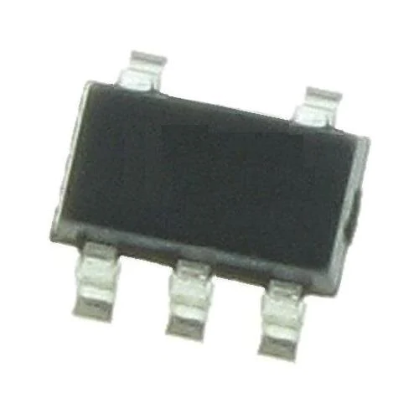
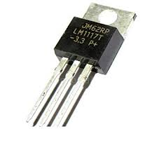
Power Subsystem
9-volt battery powering this system, connected to two linear regulators
3.3V linear voltage regulator fed to microcontroller, RTCC system, SRAM, and nrf24l01 subsystems
model LM1117 (Texas Instruments)
5V linear regulator used to power the motor driver
model AP2210K (Texas Instruments)
always draws power, even if not running motor
change in motor required removal of previous buck regulator in design
Notes:
SS

Slide 16
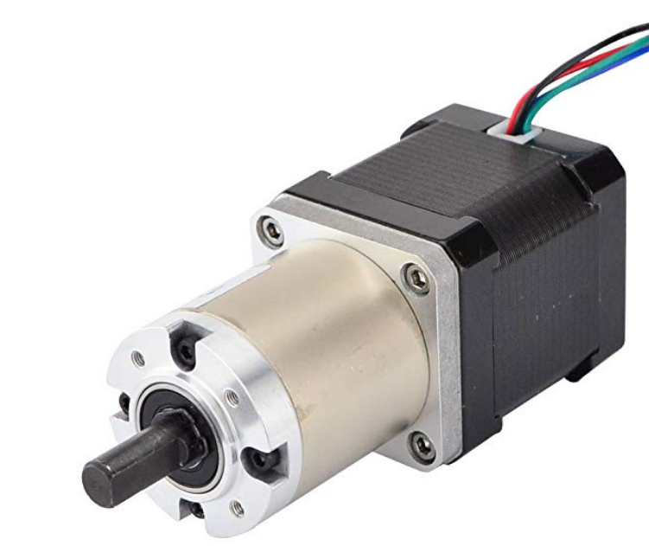
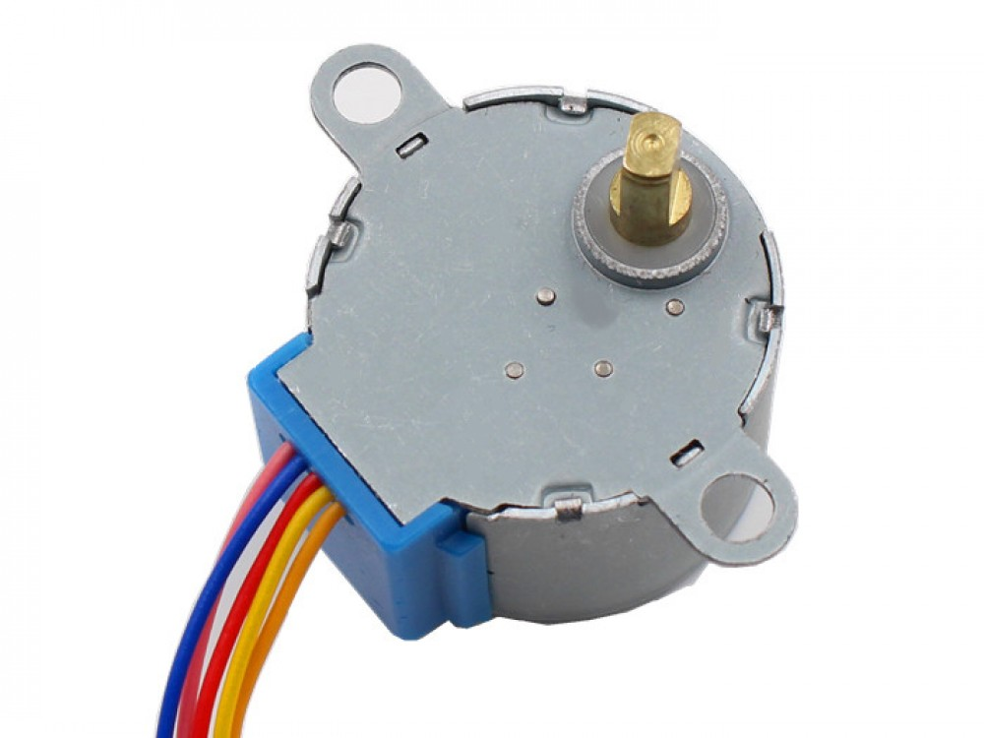
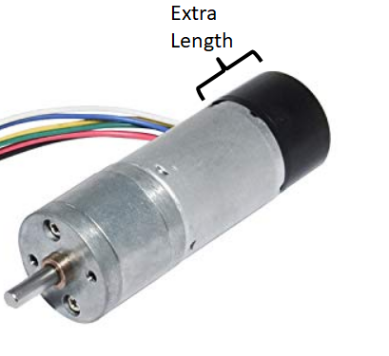
Motor Subsystem
Platform supports all motor types.
Bipolar Stepper Motor (top)
Unipolar Stepper Motor (middle)
Brush DC Encoded Motor (bottom)
Stepper motors chosen for high precision and small size.
In conjunction with calibration stage, steppers may be actuated with high pose precision.
Geared steppers required for sufficient holding torque.
Large 9V motor (3Nm) can support:
about 100 turnstiles.
about 5 geared layers in new design.

Slide 17
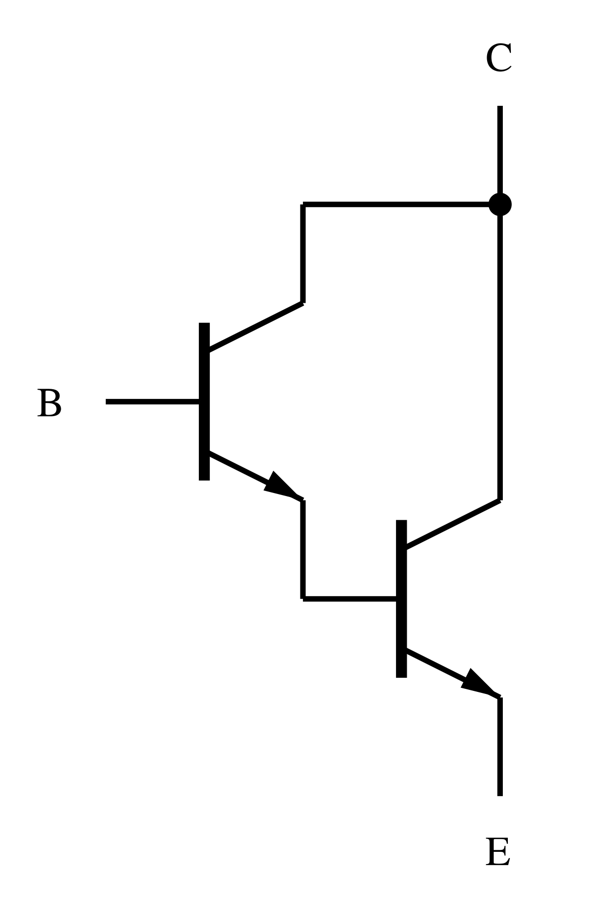
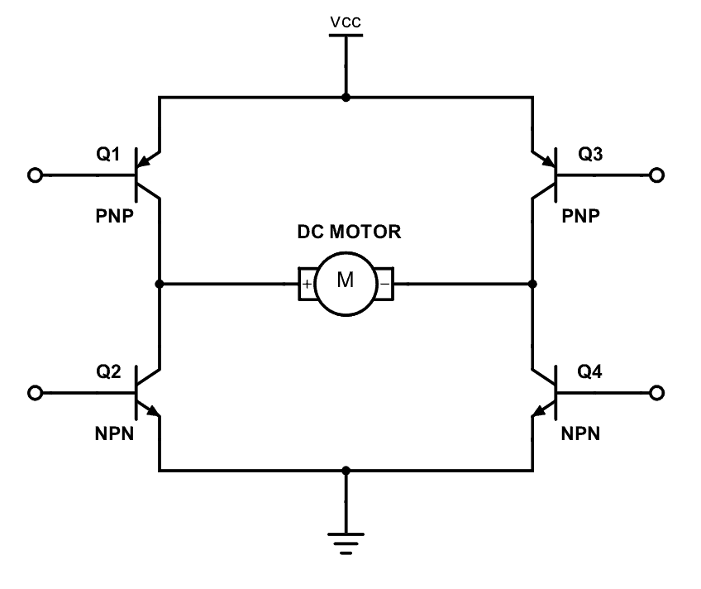
Motor Subsystem - Driver Choices
Bipolar motors must be driven using H-Bridge (L293D)
Changes direction of current flow through coils to change a magnetic field to step the motor.
Unipolar stepper and DC motors may be driven using either H-Bridge or Darlington Array (ULN2003).
Darlington Array draws and amplifies current from a supply (battery).
Darlington Array only turns DC motor in one direction.
Darlington Array H-Bridge
(one of 4 stages)

Slide 18
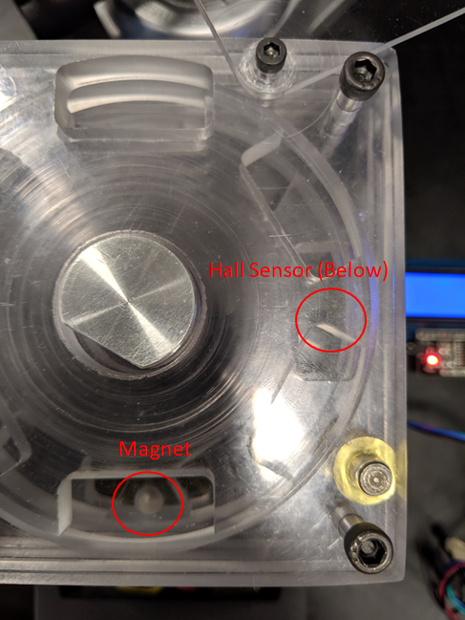
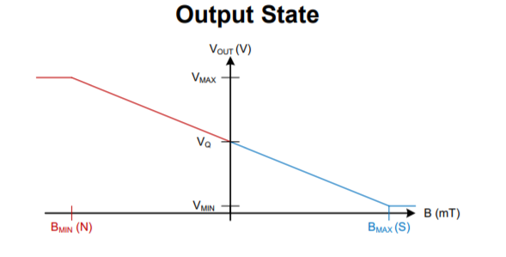
Motor Subsystem - Calibration
Hall effect sensor and magnet calibration
Hall effect sensor measures a strength of a magnetic field and produces a voltage based on the magnetic field.
Small magnet disposed in a lower rotating gear of the portable device.
Sensor produces a voltage substantially different than V_{Q} (greater or lower depends on orientation).
When the motor is one step from a full rotation, calibration rotation is initiated.

Slide 19
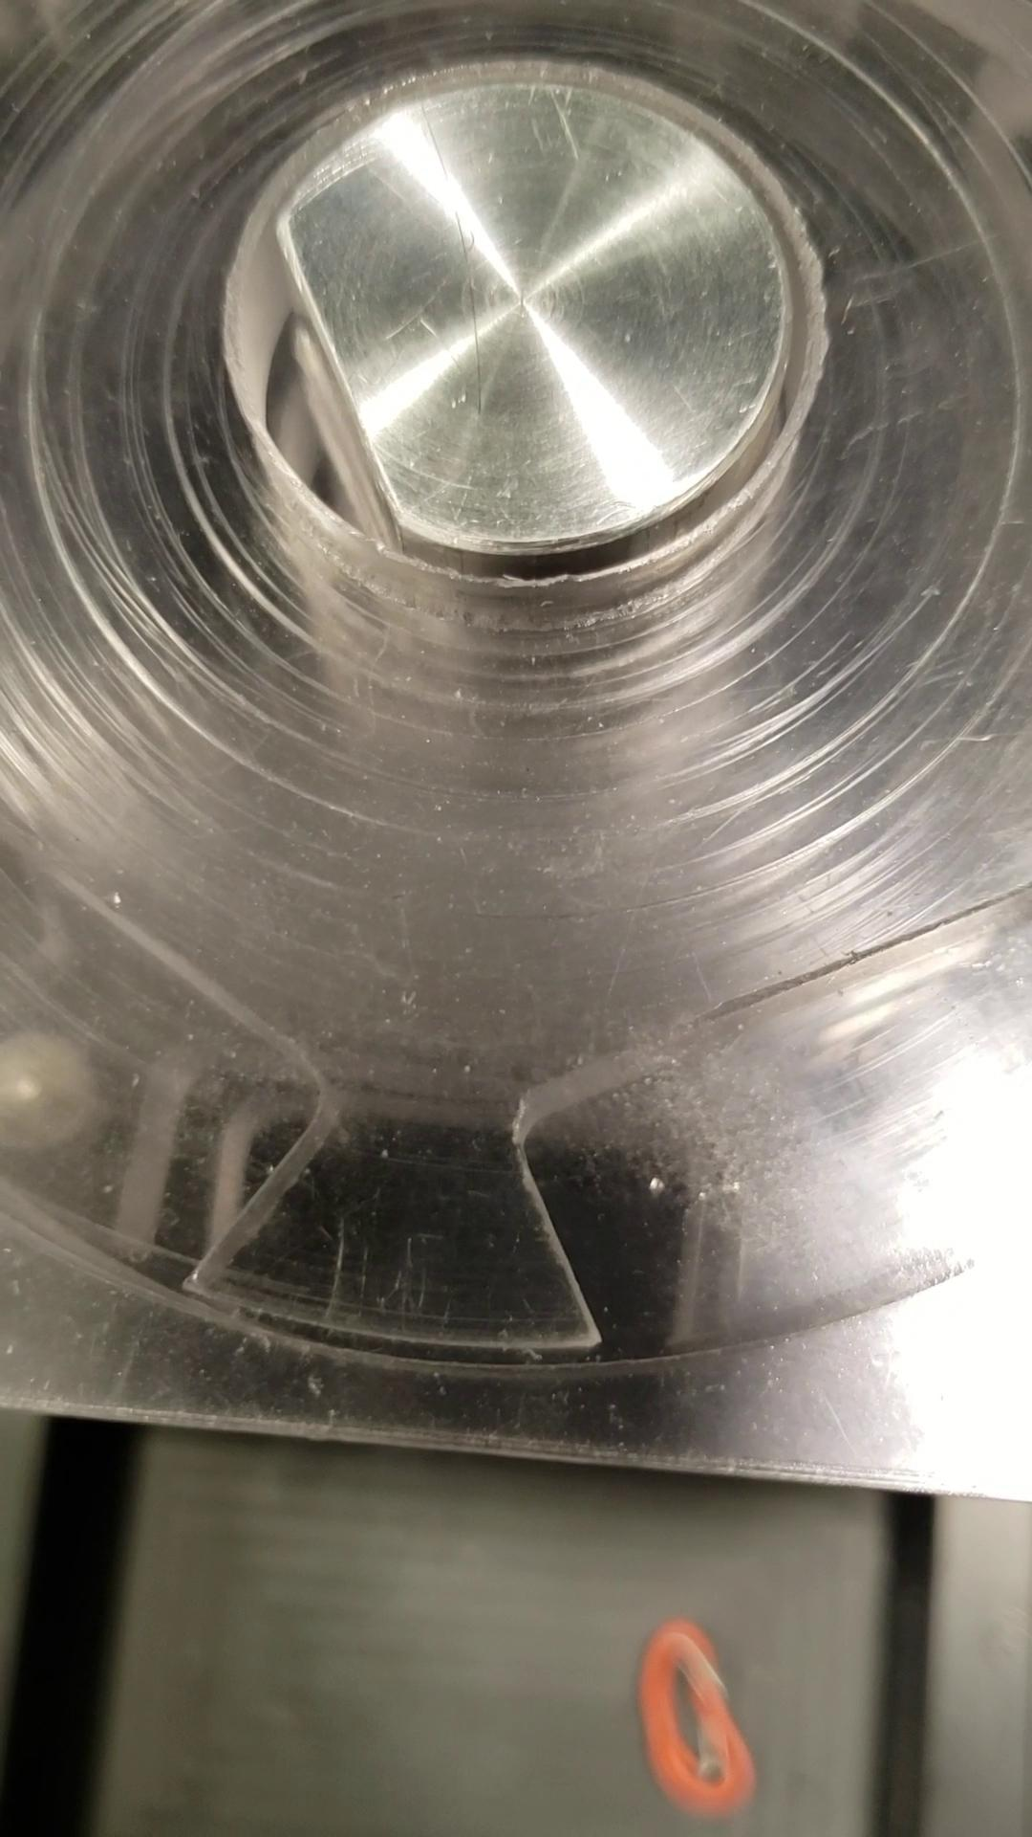
Motor Subsystem - Calibration Video

Slide 20
User Interface Subsystem
Minimize User Interface for ease of use
Single button control
16x2 LCD screen to display messages
Preset messages and custom text messages set from At-Home Unit
Preset messages for food, water, alcohol, MAOI restrictions
Custom text currently limited to 29 characters, can extend with more memory
Notes:
PZ
Kristina Notes: Discuss ease of use and minimal input required from user.

Slide 21
Current Mechanical Design Problem
Odd number of pill slots per layer causes misalignment and occasional jamming.
May require forcefully turning the motor or disassembly of device to correct.
Misalignment causes smaller pills to fall through the hole outlined on the right.
Could be corrected using an even number of slots per layer.
Current design not suitable for small (e.g., ~1cm) pills.
Fine-grained, long pills may get broken inside device
Notes:
[SS]

Slide 22
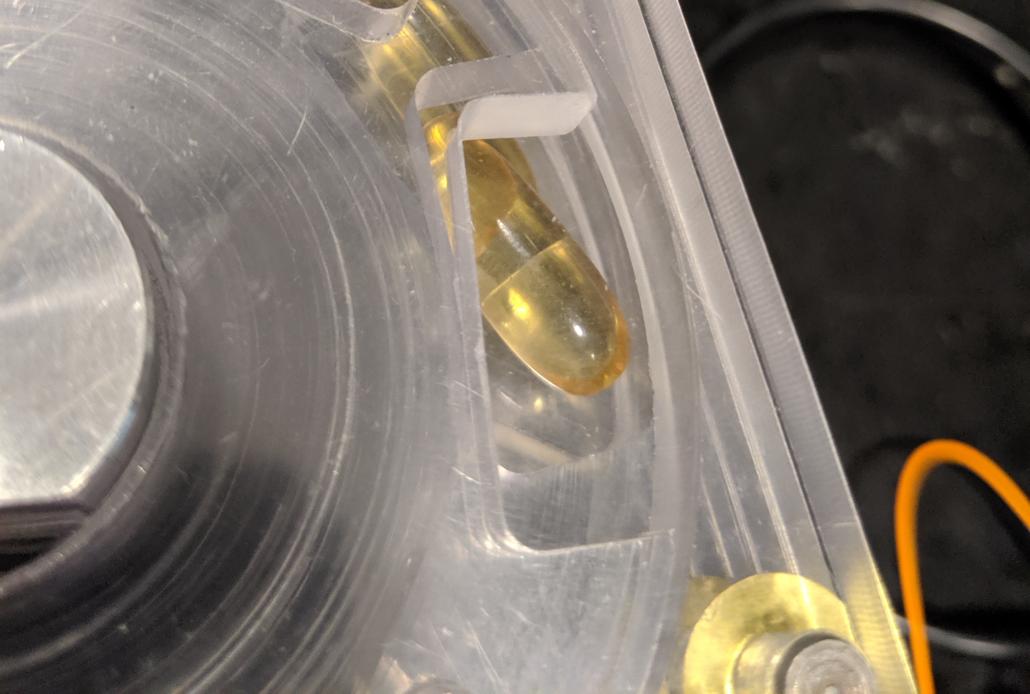
Current Mechanical Design Problem
Jammed Pill

Slide 23
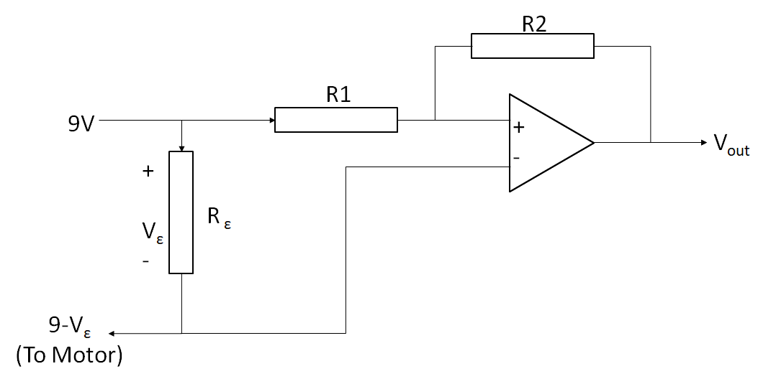
Current Sensing of Jammed Motor
When motor jams, current to the motor spikes over 500mA.
Can use a low-resistance resistor in series with the motor supply.
Tested using Arduino. Successfully triggers when jammed.
Could not implement on PCB due to time constraints.
Potential solution to the problem in later hardware revisions.
Gain = R2/R1 = 5
R1 = 50kohm
R2 = 240kohm
R _{ε}= 1 ohm

Slide 24
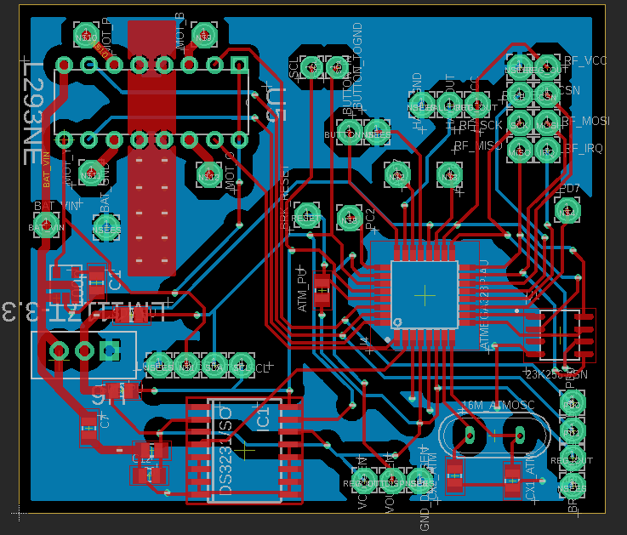
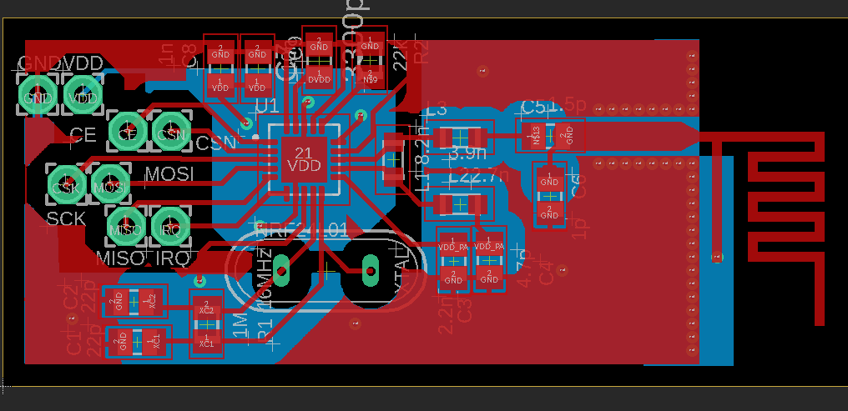
PCB Layout and Sizing
Primary size factor for portability at 2.34x2.03in (5.95x5.16cm)
Minimize noise on traces
Heat sinks for any relevant IC on board
Build RF communications module directly onto PCB
Reduce cost by building directly onto PCB
PCB trace antenna to remove bulky external antenna
Meandering Inverted F Antenna Design
Notes:
PZ
Kristina Notes: Put with Block Diagram.

Slide 25
System Integration Challenges
Incomplete bootloading will result in unknown fuse bits, rendering ATMega unprogrammable
SRAM unable to properly communicate with ATMega on PCB
Hall sensor too fragile for current physical design
Power issues when actuating motor for the rest of the circuit
pills breaking inside device is possible if jammed
Notes:
Issues slides (NEW)

Slide 26
High Level Requirements - Review
Autonomous, wireless, and hands-free loading.
Requirement Met
House at least 3 different pill types and dispense them at correct times.
Requirement Somewhat Met
Display relevant dosage information to the user.
Requirement Met
Notes:
All three of us should talk on this slide.
Kristina Notes: Bullet Points w/ checkmars/X & potential solutions

Slide 27
Future Work
Improve the mechanical design.
Occasional jams which are unreachable without disassembly or forcing of the motor to rotate.
Size and weight of the device could be greatly reduced. This would reduce the size of our motor, reduce power consumption, etc.
Design a more advanced interleaving-gear system that works on pills of all sizes
Enable modularity of pill housings. Electronics platform enables modular pill housings.
Improve battery efficiency
Currently, motor driver is held ON always. Next hardware revision can control this using a single ATMega.
add inductive charging
add door over dispense opening so motor can be used in a non-FIFO manner
Enable Manual Loading
Manual loading process is much simpler than loading with another AHU device and makes use of implemented submodules.
Notes:
Justin
KN: Cut down.

Slide 28
Citations
[1] theseniorlist.com. (2017). ‘Automated Medication Dispensers: Pill Dispensers for Seniors’. [online]. Available at: https://www.theseniorlist.com/medication/dispensers/ [Accessed 29 Aug. 2019].
[2]Last Minute Engineers. (2019). ‘UHow nRF24L01+ Wireless Module Works & Interface with Arduino’. [online]. Available at: https://lastminuteengineers.com/nrf24l01-arduino-wireless-communication/ [Accessed 02 Oct. 2019].
[3] Nordic Semiconductors. ‘nRF24L01+ Single Chip 2.4GHz Transceiver Product Specification v1.0’. [online]. Available at: https://www.nordicsemi.com/-/media/DocLib/Other/Product_Spec/nRF24L01PPSv10.pdf [Accessed 9 Sep. 2019].
[4] T. Pattnayak. (2014). “Antenna Design and RF Layout Guidelines”. [online]. Available at: https://www.cypress.com/file/136236/download [accessed 21 Oct. 2019].
[5] M. Smart. ‘Design requirements for our Milled PCBs’. Champaign, IL. University of Illinois at Urbana Champaign. [online]. Available at: http://eshop.ece.illinois.edu/pcbdesign/designreq/designreq.php [Accessed 23 Sep. 2019].
[6] DroneBot Workshop. (2019). ‘Stepper Motor with Hall Effect Limit and Homing Switches’. [online]. Available at: https://dronebotworkshop.com/stepper-motor-hall-effect/ [Accessed 28 Sep. 2019].
[7] DroneBot Workshop. (2019). ‘Using LCD Displays with Arduino’. [online]. Available at: https://dronebotworkshop.com/lcd-displays-arduino/ [Accessed 28 Sep. 2019].

