Slide 1
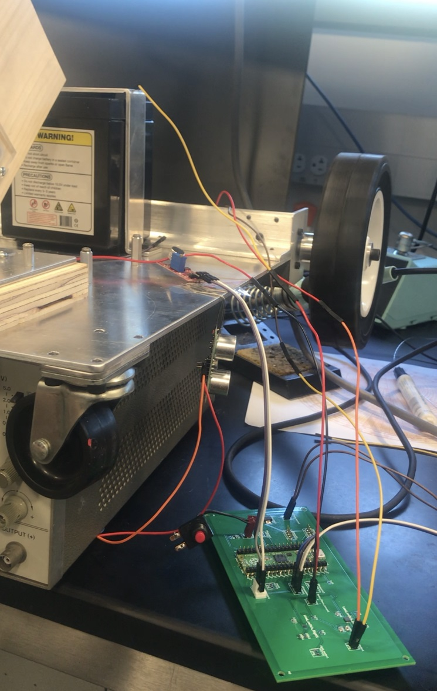
Automated Metal Detection Robotics
Jack Li¹, Sumukh Kenkere Vasudeva Murthy¹
¹University of Illinois at Urbana-Champaign
05/03 2022
Department of Electrical and Computer Engineering
Team 57

Slide 2
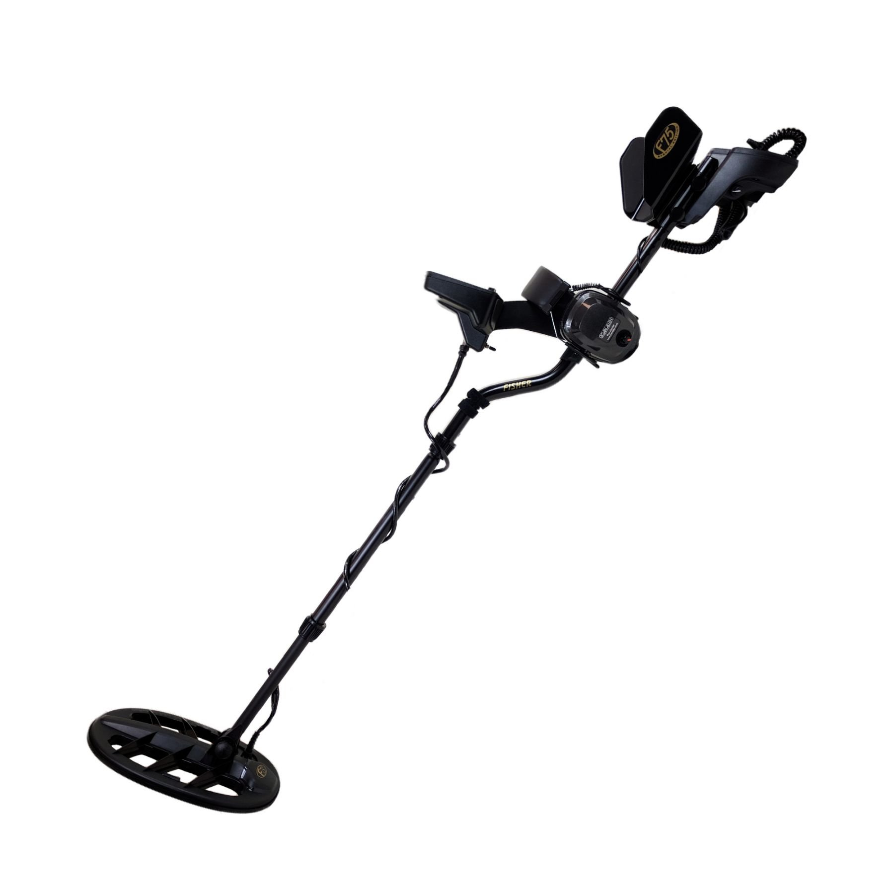
Problem & Motivation
Time commitment
Potential Hazards
There are cases when people cannot metal-detect manually
Department of Electrical and Computer Engineering
Team 57

Slide 3
Then, how about?
Department of Electrical and Computer Engineering
Team 57

Slide 4
Goals
High efficiency
Safety insurance
Accuracy
Time commitment
Potential Hazards
There are cases when people cannot metal-detect manually
Department of Electrical and Computer Engineering
Team 57

Slide 5
Design overview—block diagram in a nutshell
Mechanical system
Control system
Sensor system
Department of Electrical and Computer Engineering
Team 57

Slide 6
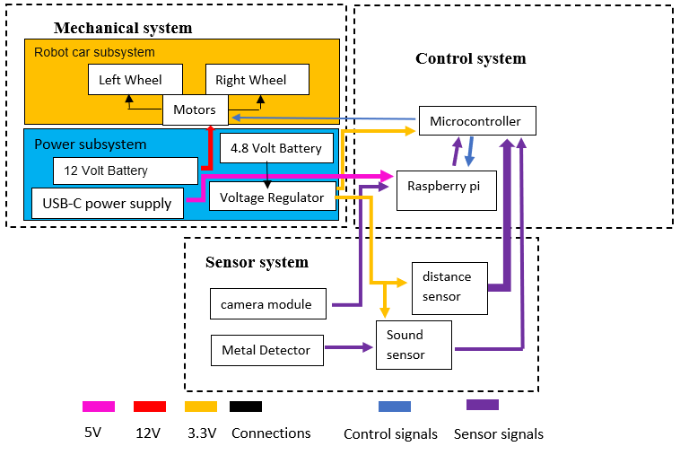
Design overview—block diagram
Department of Electrical and Computer Engineering
Team 57

Slide 7
Design overview—Modulization
Hardware modules
Software modules
Peripheral module: includes all the components attached to PCB module (power sources, sensors, Raspberry Pi)
Robot module: robot entity, the end output module
Printed Circuit Board (PCB) module: provide circuit that connects the other two modules
Microcontroller control module: program used to control all the signals in the system (manipulate input, generate output)
Raspberry Pi machine vision module: program used to pattern recognize detected object
Department of Electrical and Computer Engineering
Team 57

Slide 8
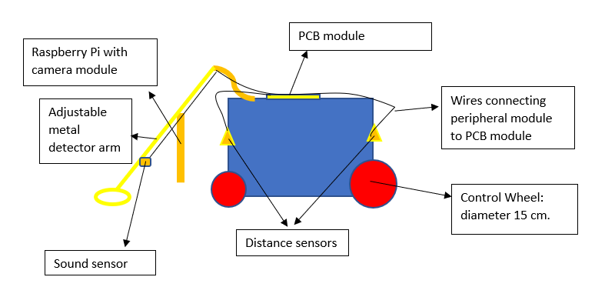
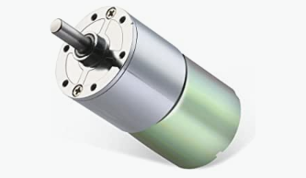
Design Details—robot module
Department of Electrical and Computer Engineering
Team 57

Slide 9
Design Details—Peripheral module
Powers: 4.8-volt PCB power source
12-volt motor power source
Sensors: Ultrasonic sound sensor (2.4-5.5 volt)
Sound sensor (3.3-5 volt)
Department of Electrical and Computer Engineering
Team 57

Slide 10
Requirements & Verification—Peripheral module part 1
Part | requirement | Verification Procedure | Results
batteries | ${Voltage}_{measured}$= ${Voltage}_{ideal}±x$, for $0≤x≤0.5$ volt | Connect batteries to a breadboard or PCB and use multimeter to measure the voltage reading | PCB battery shows 4.79 volt in stable reading. Motor battery source shows 12.9 volt
Sound sensor | $$1.8 volt≤V_{digital output}≤3.3 volt$$ | Connect sound sensor to PCB, slightly rotate the potentiometer on the sensor clockwise to increase sensitivity, measure the voltage of the digital output pin with a multimeter. | The multimeter reads about 2.7 volt, which is enough to trigger an active high once it is connected to microcontroller
Department of Electrical and Computer Engineering
Team 57

Slide 11
Requirements & Verification—Peripheral module part 2
Part | requirement | Verification Procedure | Results
Ultrasonic sensor | Distance sensitivity is at least 20 cm | Connect the sensor directly to PCB or other development board. Run program to measure distance. Either display the distance measured or use external connected device to indicate a “stop” operation when the distance measured is below 20 cm | We have used the second method to qualitatively show that the distance sensitivity is at least 20 cm by stopping the car’s motion with hand covering the distance sensor with distance smaller than 20 cm. This is done with PCB and sensor connected.
Department of Electrical and Computer Engineering
Team 57

Slide 12
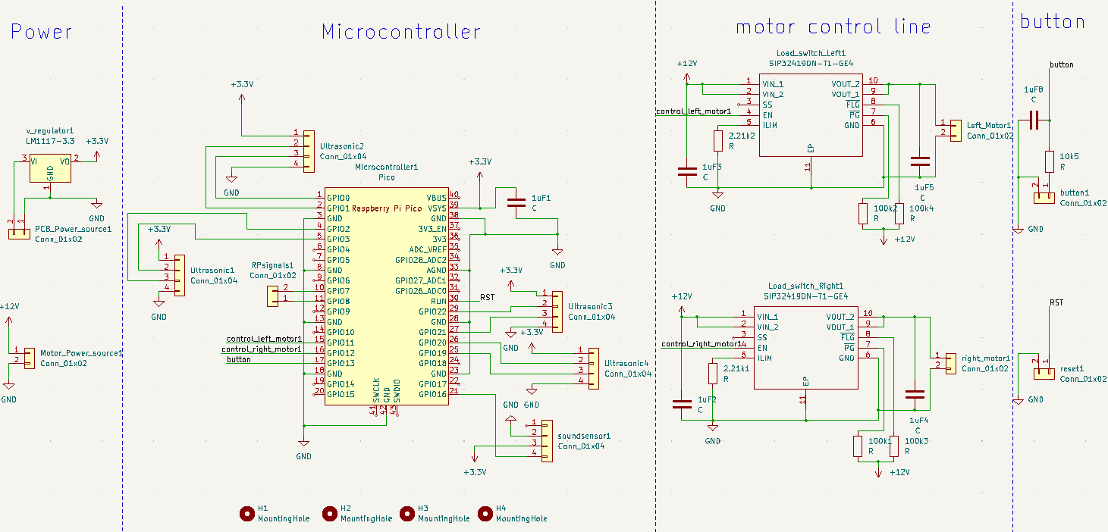
Design Details—PCB module (circuit schematic)
Department of Electrical and Computer Engineering
Team 57

Slide 13
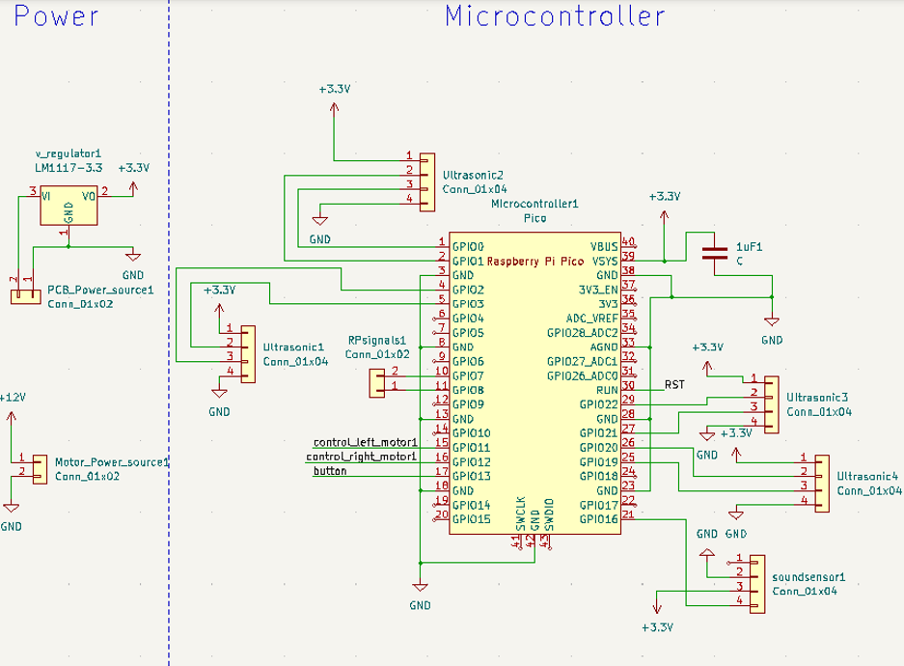
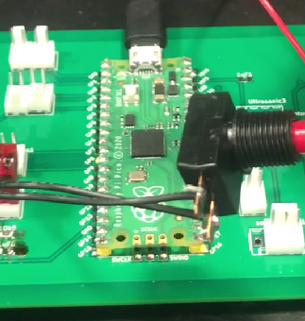
Design Details—PCB module 1
Department of Electrical and Computer Engineering
Team 57

Slide 14
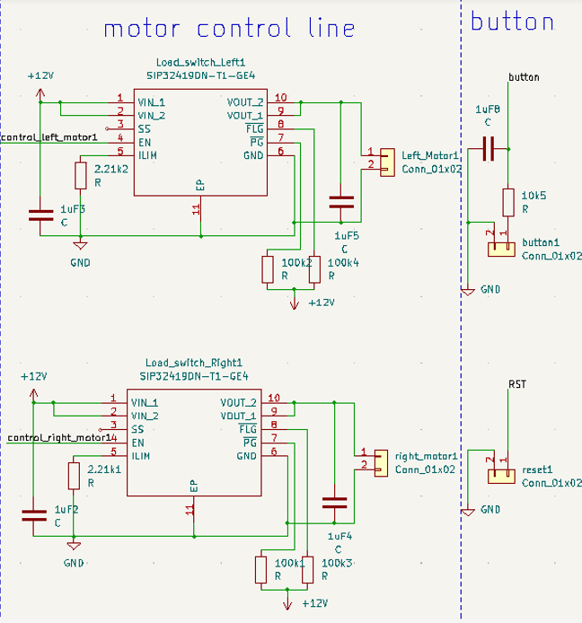
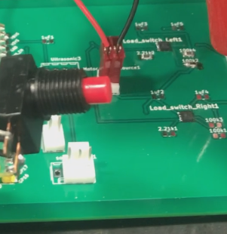
Design Details—PCB module 2
Department of Electrical and Computer Engineering
Team 57

Slide 15
R&V—PCB module
Part | requirement | Verification Procedure | Results
voltage regulator | $V_{output}$= $3.3 volt±x$, for $0≤x≤0.1$ volt | Solder the voltage regulator into PCB firstly and apply PCB power source for voltage measurement | $$V_{output}=3.27\sim 3.29 volt$$
power switch | $V_{output}≥0.9V_{in}$ once switch is on, and $V_{output}≤1 volt$ when it is off | Solder the component onto PCB firstly. Apply motor power source Use an external 3.3-volt power source with ground common-grounded into the PCB and positive lead touching the enable pin on the power switch. Measure the switch output voltage with multimeter. | When positive lead touches the enable pin on the power switch $$V_{ouput }=12.8 volt\sim 12.9 volt$$ When enable pin is grounded, $$V_{ouput }≈0.6 volt$$
Department of Electrical and Computer Engineering
Team 57

Slide 16
Design Details—microcontroller control module
Input signals: distance, sound detected, image recognition
Output signals: motor on/off
Department of Electrical and Computer Engineering
Team 57

Slide 17
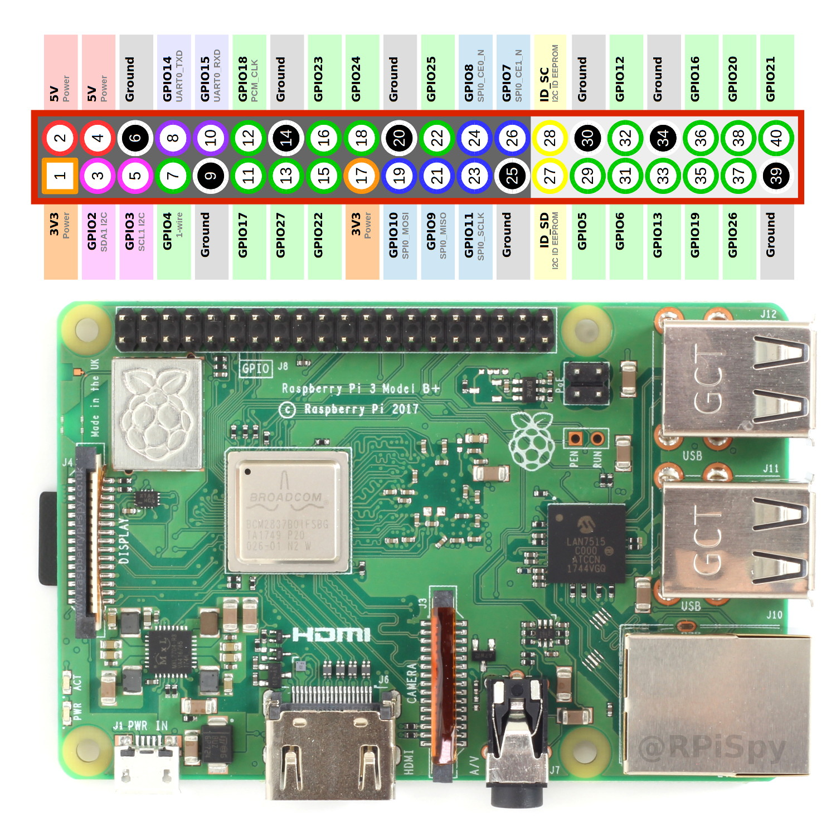
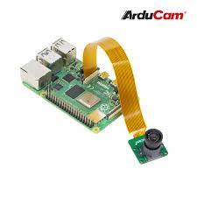
Design Details—Raspberry Pi machine vision module
Built using a combination of Raspberry Pi 4 and the camera module called Arducam.
—5-megapixel color resolution
—1 Gb Ram Raspberry pi 4
—extra SD card
Code is built on the algorithm called ‘You Only Look Once’ (YOLO).
Department of Electrical and Computer Engineering
Team 57

Slide 18
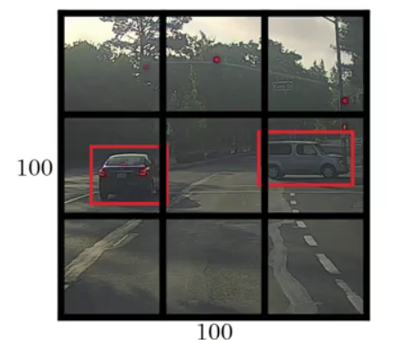
Design Details—Raspberry Pi machine vision module
The algorithm works by taking an image as an input and dividing it into grids like the example shown on the right. Then, it detects objects within each grid in the case that most of the object is present by comparing it to a dataset of images.
Each grid is individually evaluated to ensure that no object in the field of view (the image taken) is missed.
After the object is identified, we verify if it is the matched object and send a high/low signal from Raspberry Pi.
Department of Electrical and Computer Engineering
Team 57

Slide 19
Performance video
Department of Electrical and Computer Engineering
Team 57

Slide 20
Conclusions
In this project, we were able to get all the subsystems/modules working independently. These indicate promising development that can be done to make this project more specialized and higher-functioned.
In the end, we faced problems related to shortage of parts and lack of optimization of parameters. Robot car’s motion can also have more functions for a more complicated PCB design we initially have.
Future work includes developing pattern recognition to global scale (used for route optimization), extending more motion choices of the car, or adding a separate arm with an extra motor to control the detector.
Department of Electrical and Computer Engineering
Team 57

