Slide 1
Automatic Tea Brewing Thermos
(Team 60)
Joseph Niemerg, Vincent Murphy, Danny Yi
ECE 445 Spring 2018
TA: Nick Ratajczyk

Slide 2
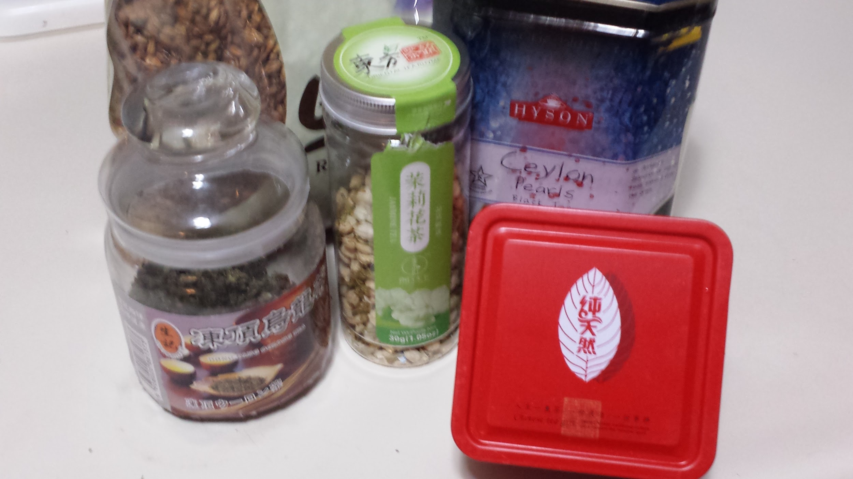
Introduction
Provide a portable solution for people wanting to brew specific teas
Provide perfectly brewed tea without the hassle
More robust tea brewing options with an easy interface

Slide 3
Objectives
Multiple forms of input (buttons or phone app)
Wide range of drinking/steeping temps
Maintain drinking temperature up to 20 min

Slide 4
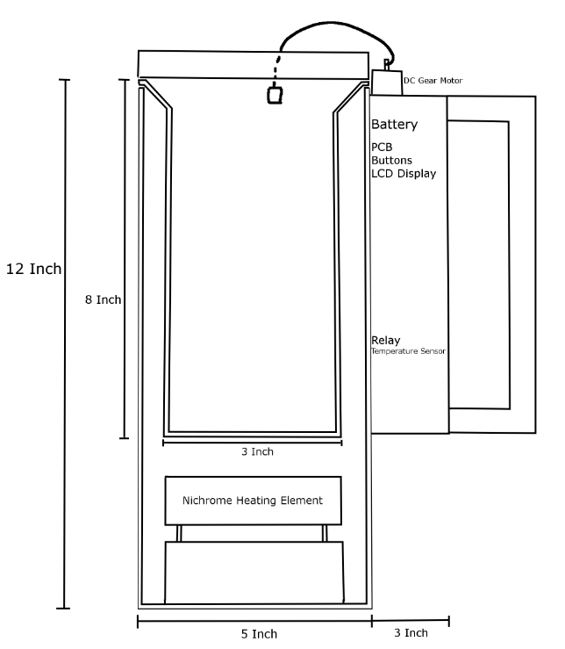
Physical Design

Slide 5
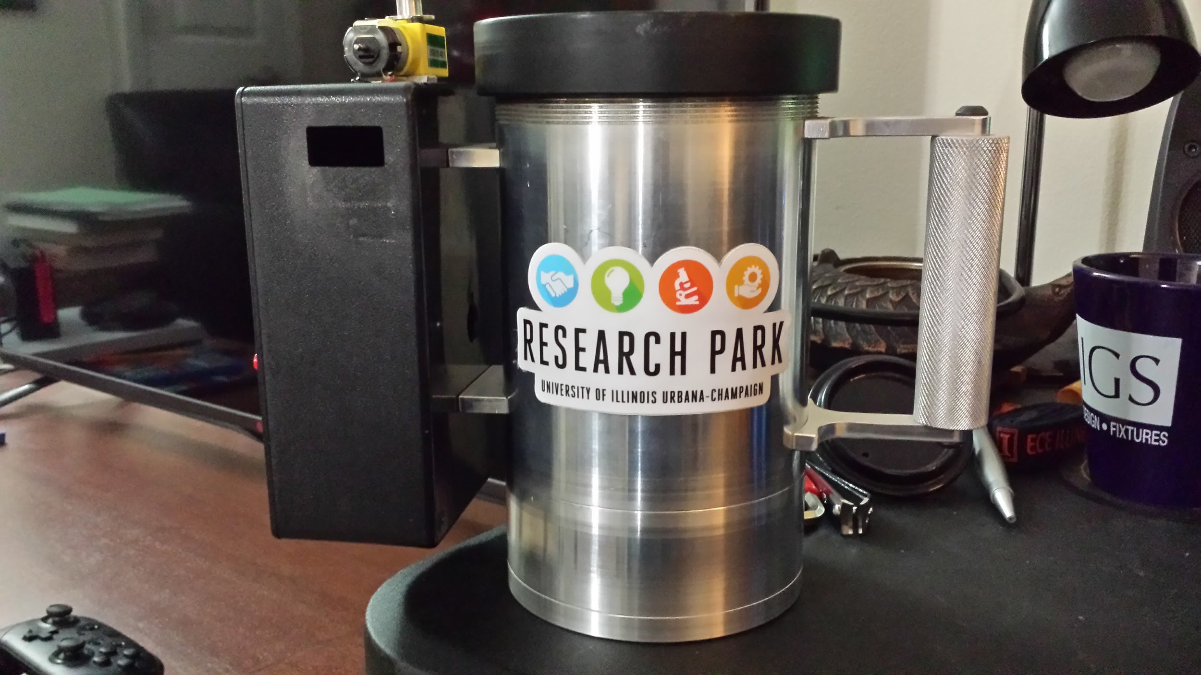
Physical Design

Slide 6
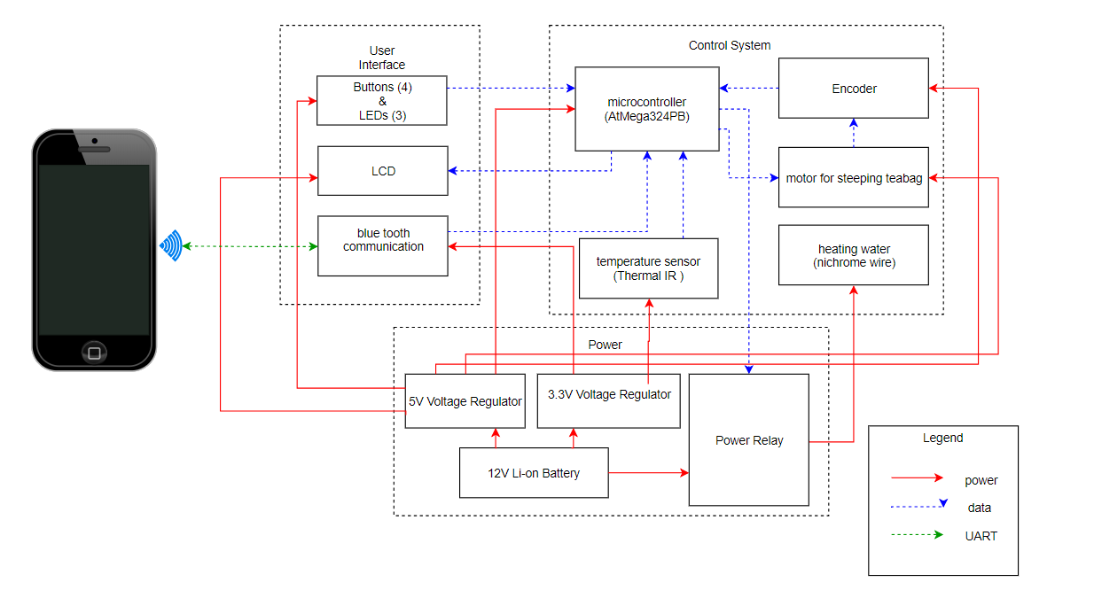
Block Diagram

Slide 7
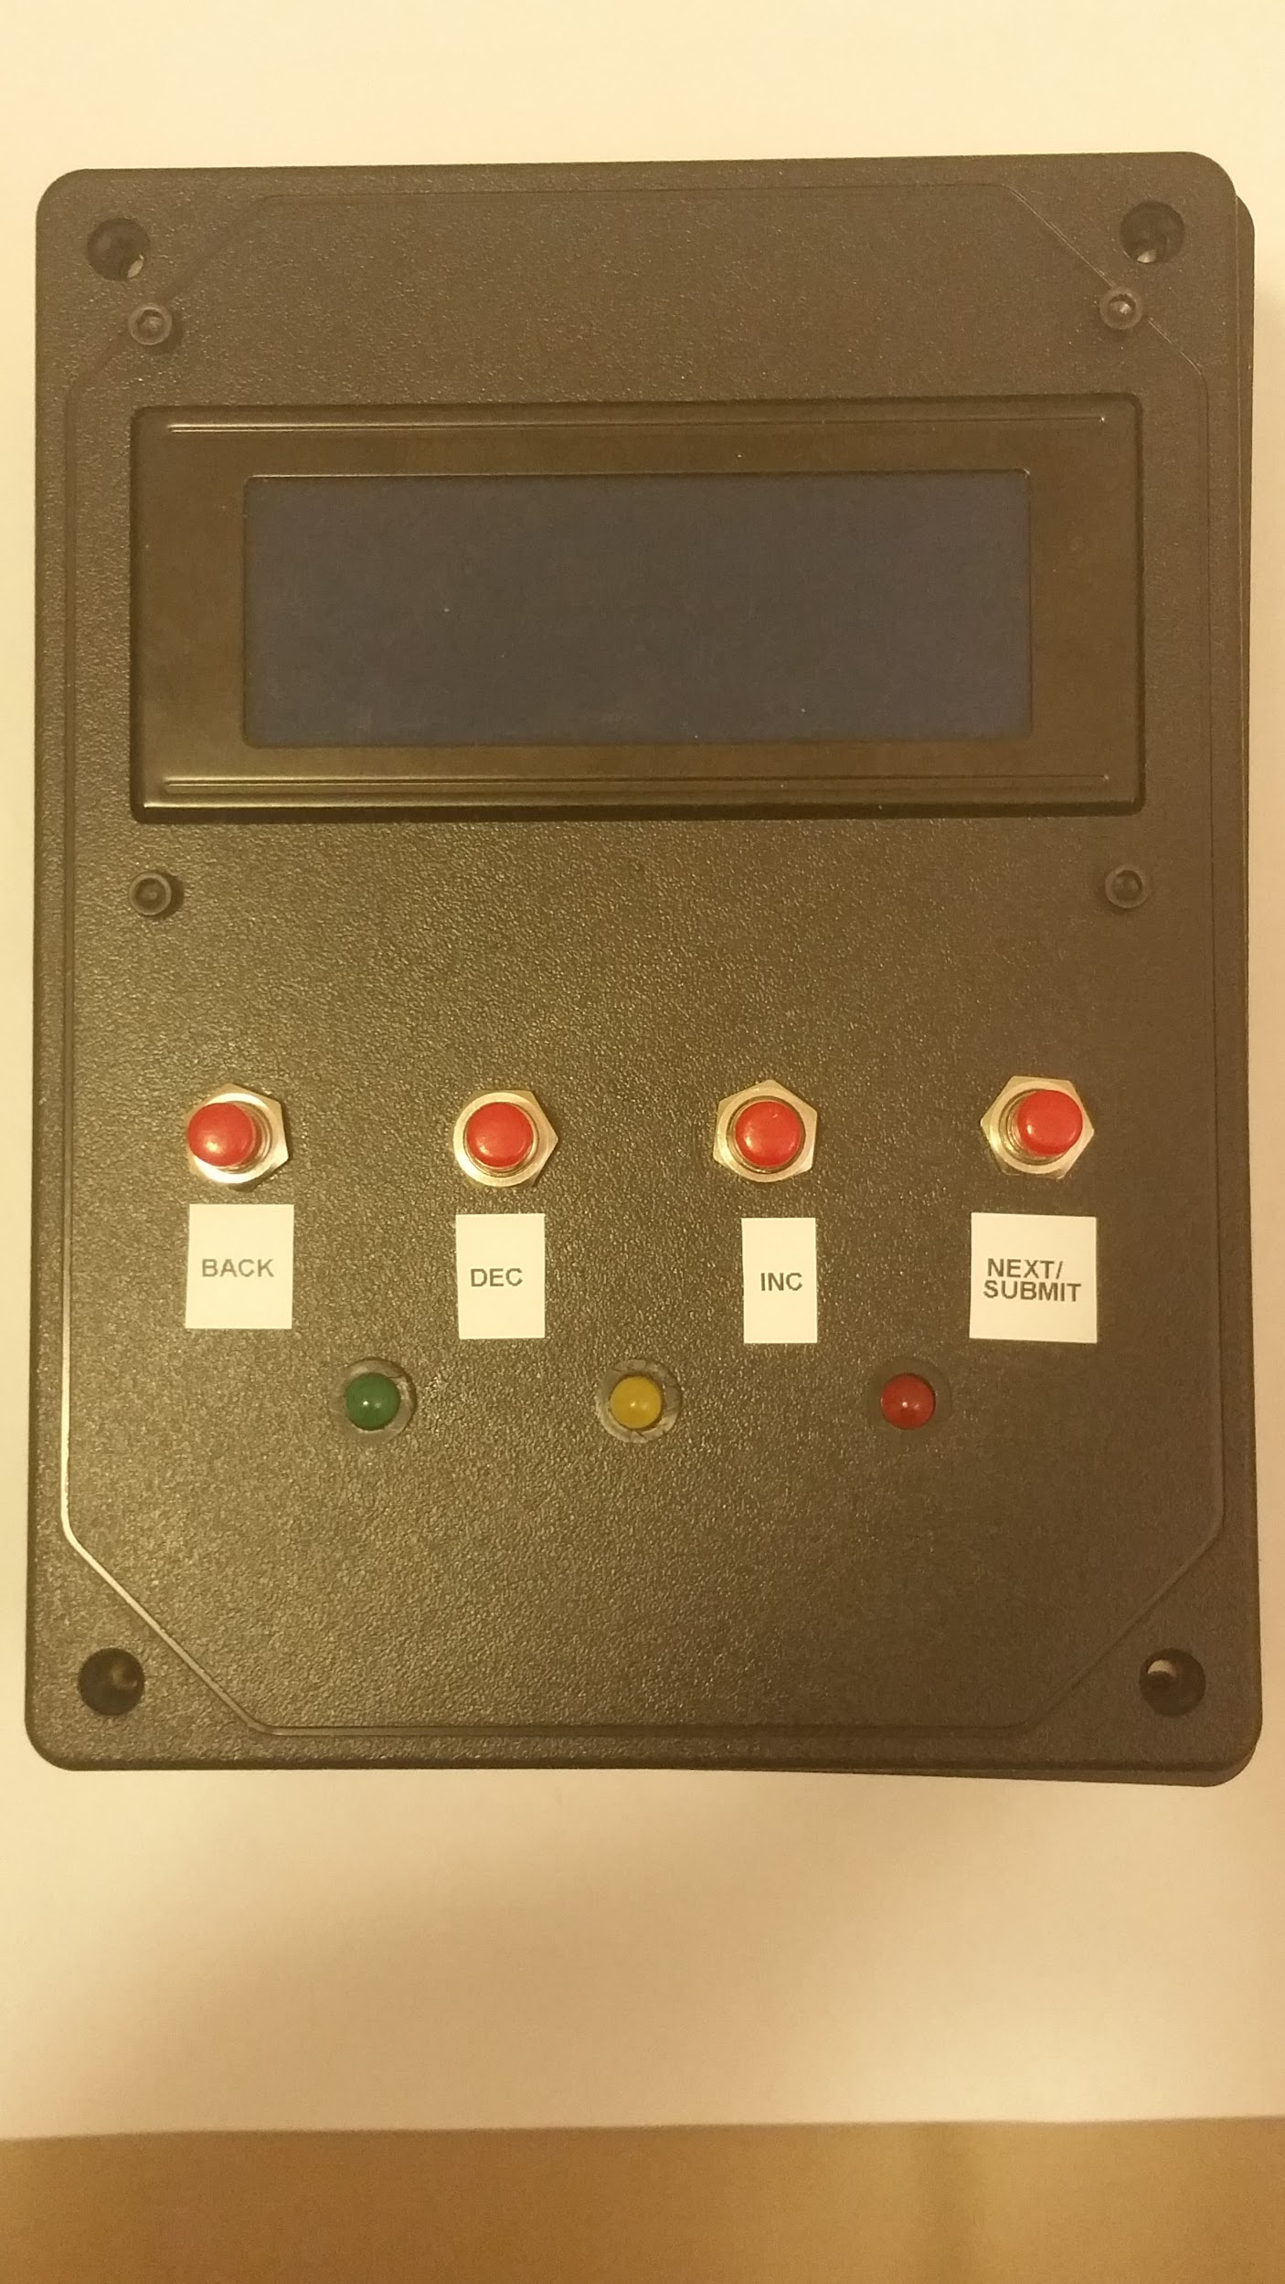
User Interface
LCD Screen and Buttons
Bluetooth

Slide 8
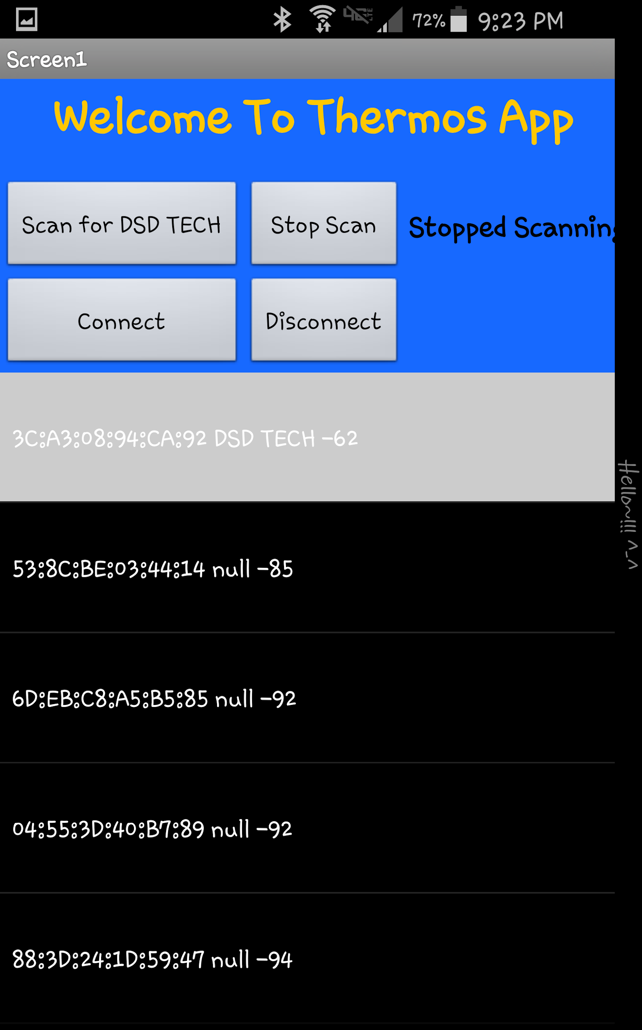
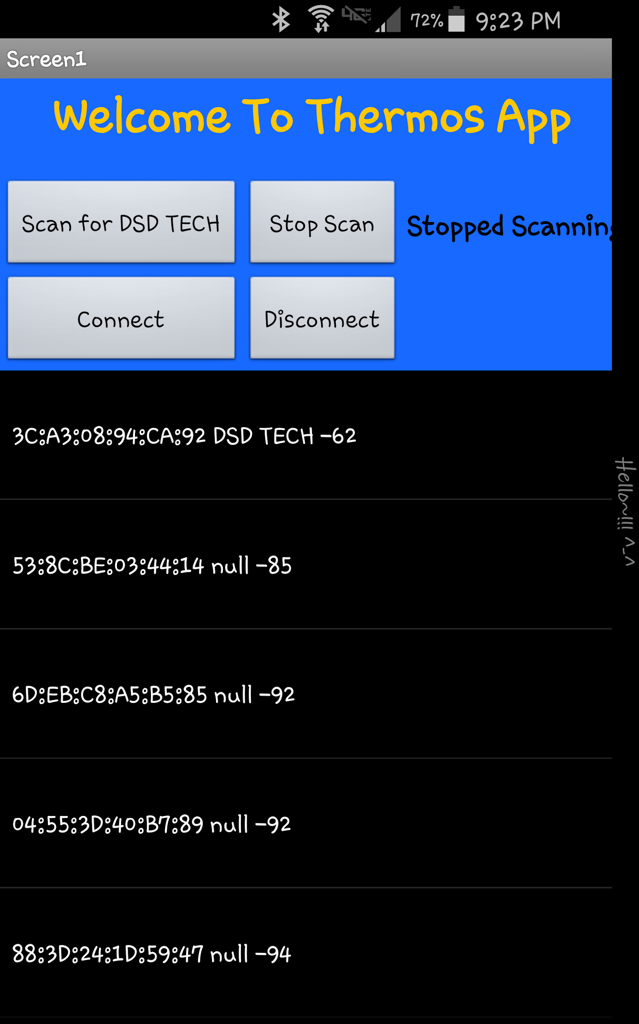
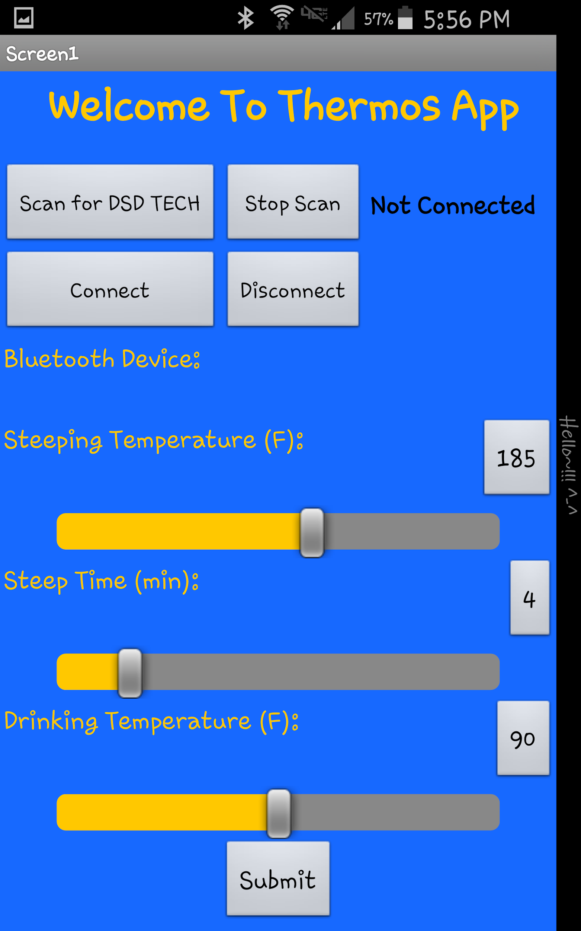
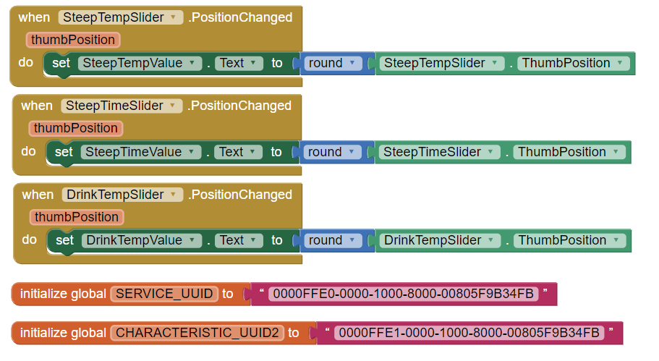
Phone App
Sample Code

Slide 9
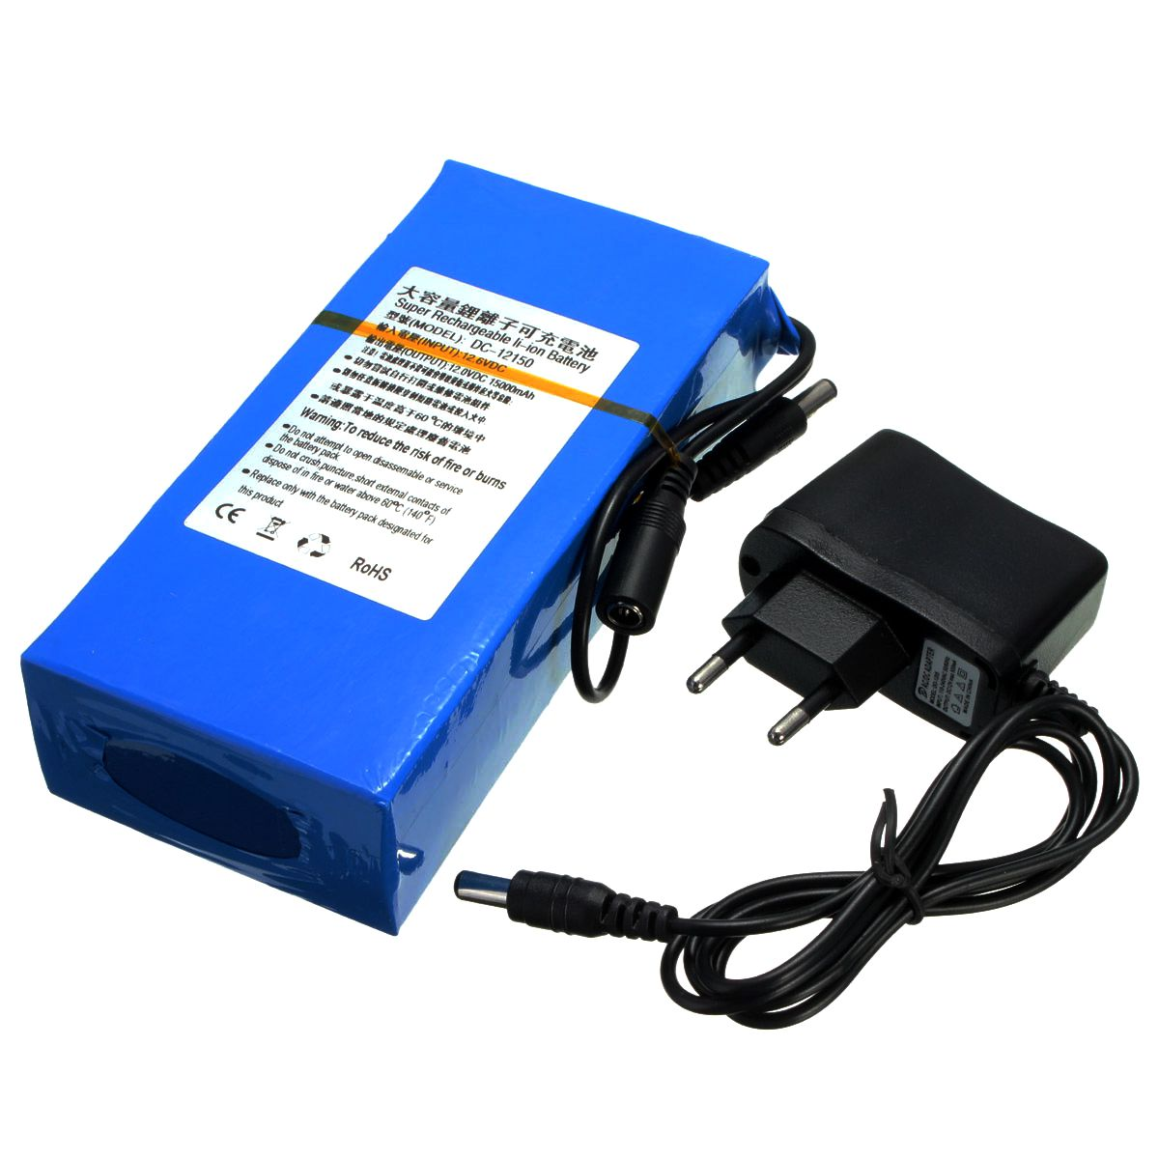
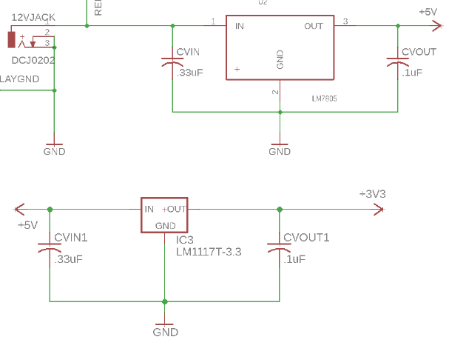
Power
Lithium - Ion Battery
12 V DC
9800 mAh
2A max out
5 V Voltage Divider
3.3 V Voltage Divider

Slide 10
Control
Motor Control:
Ensure motor moves correct distance to lower tea bag
H-Bridge chip controls motor direction
Heating Element Control:
Keeps drink at desired temperature
Don’t overdraw current from battery
Run on a timer determine by user input

Slide 11
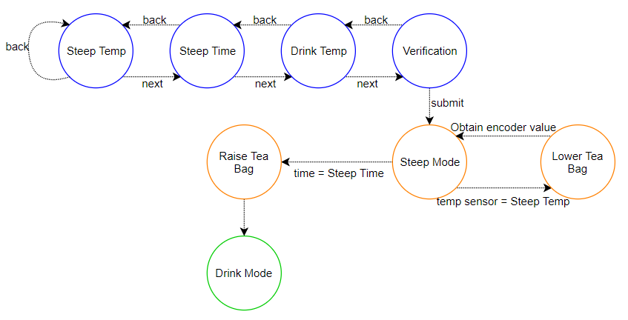
State Diagram

Slide 12
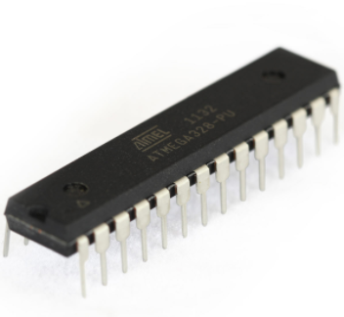
Control
Microcontroller ATmega328P
16 MHz with crystal oscillator
Arduino Bootloader
13 I/O Digital & 6 Analog

Slide 13
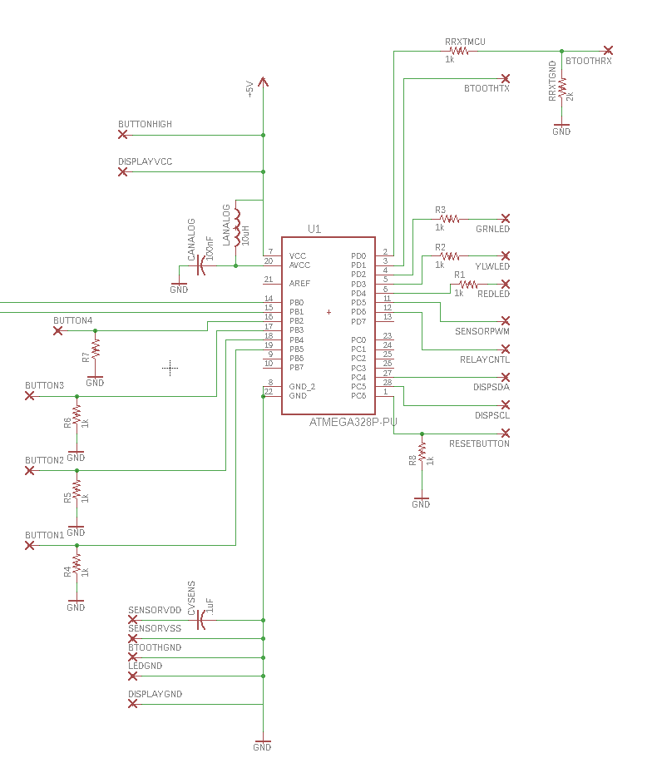
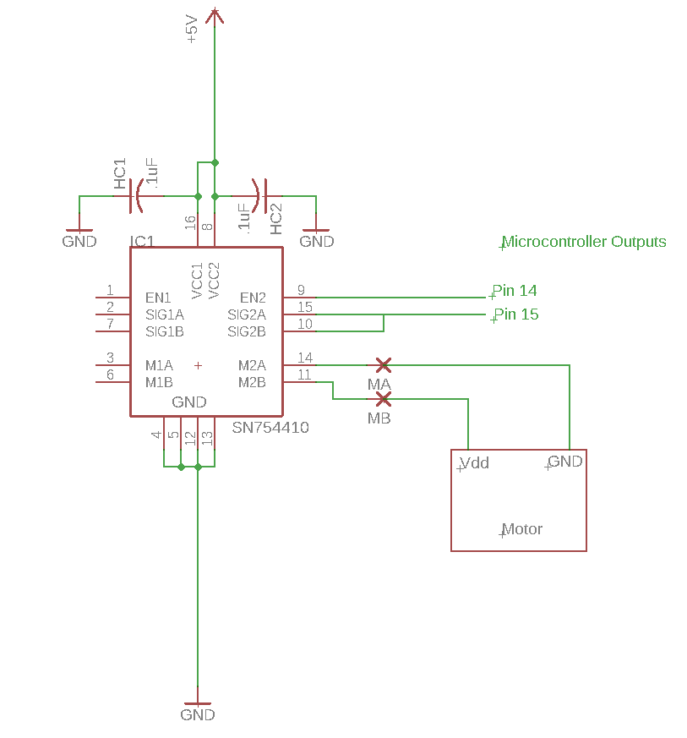
Control Schematics

Slide 14
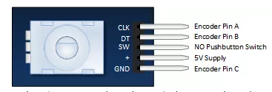
Rotary Encoder
Keyes - 040
Clk & DT signals sufficient for our purposes
Tested via S/W (Arduino)
Feedback for motor

Slide 15
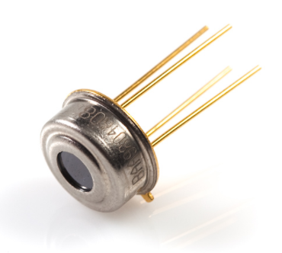
IR Sensor
MLX90614
Programmable (PWM mode / SMBus)
Accuracy of 0.5 ° C
Range of -70 to +380°C
Premade Arduino Library

Slide 16
Heating Element:
Controlled by IR sensor reading
Output is either ON/OFF (Relay Completes Circuit)
Length: 15 inch
Size: 30 Gauge
Resistance: 8.437 Ohms
Input Voltage: 12 V
Power Output: 17 Watts

Slide 17
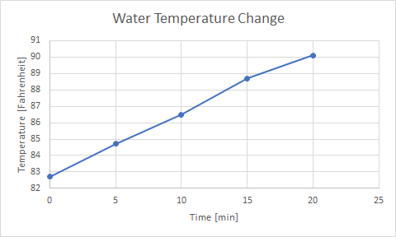
Heating Element (Test)

Slide 18
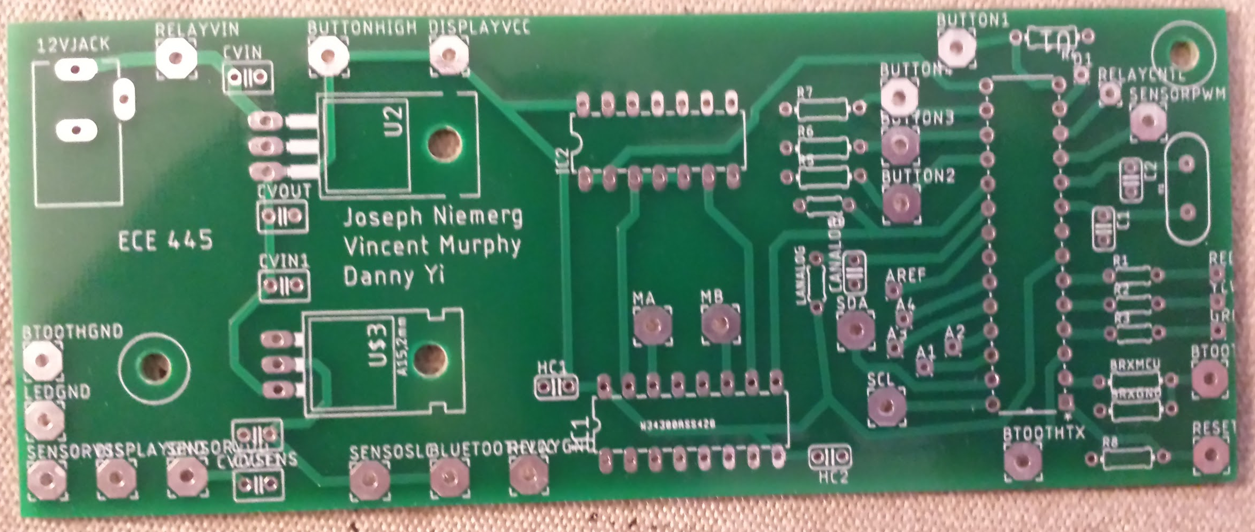
PCB (front)

Slide 19
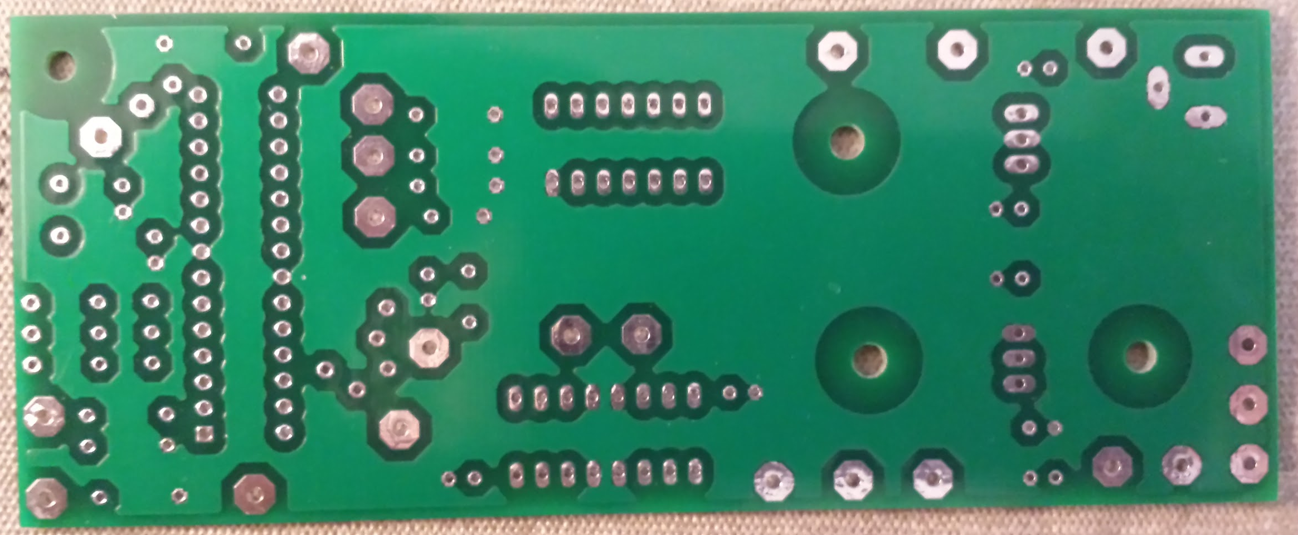
PCB (back)

Slide 20
Troubleshooting
Circuit changes after PCB design stage
SMBus used for IR sensor rather than PWM
Far apart connections for off-board devices
Uneven distribution of components on board
Encoder’s maximum rotational speed

Slide 21
Conclusion:
Future Work:
Decrease size
Better power matched battery
More robust phone app interface
Improved PCB design
Software improvements
Add loose tea drop in system
On board Programming

