Slide 1
Bicycle Street Notification System
Anant Jani | Savannah Russell | Stephanie Wong
ECE 445 Presentation | Fall 2017 | Team 8

Slide 2
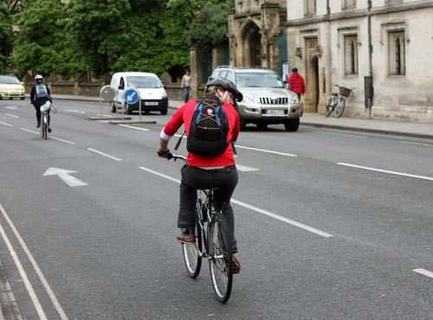
Introduction
66 million cyclists in America with 800+ bicycle traffic fatalities
Bike riders at risk, no universally used warning signs or safety measures as cars

Slide 3
Objectives
Create a bicycle light system in order to enhance visibility on the road
Allow the cyclist to focus on what’s happening around them
Turn signals will have automatic shut off

Slide 4
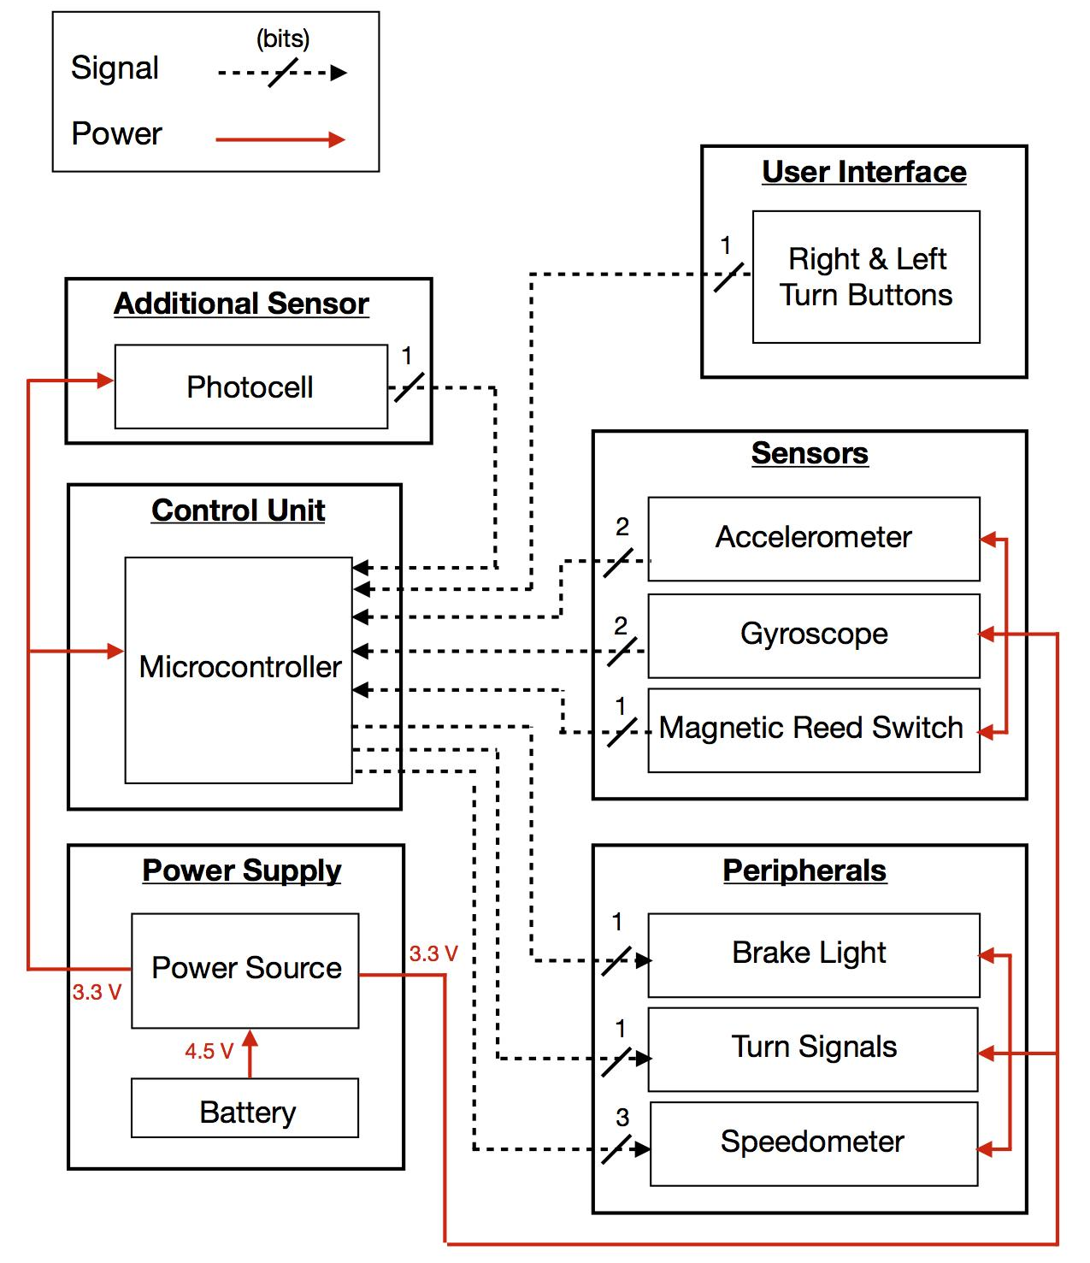
Block Diagram

Slide 5
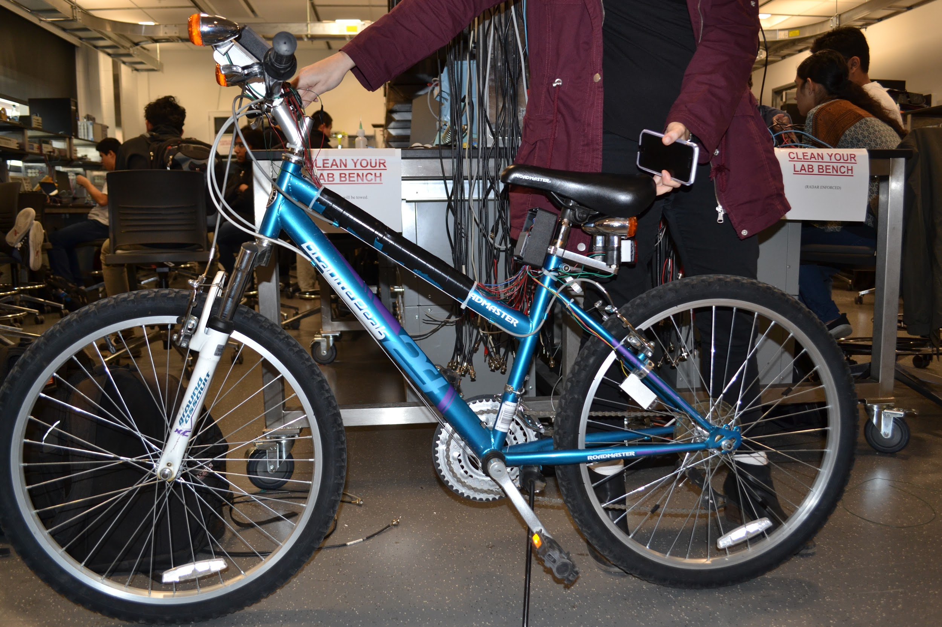
Final Product

Slide 6
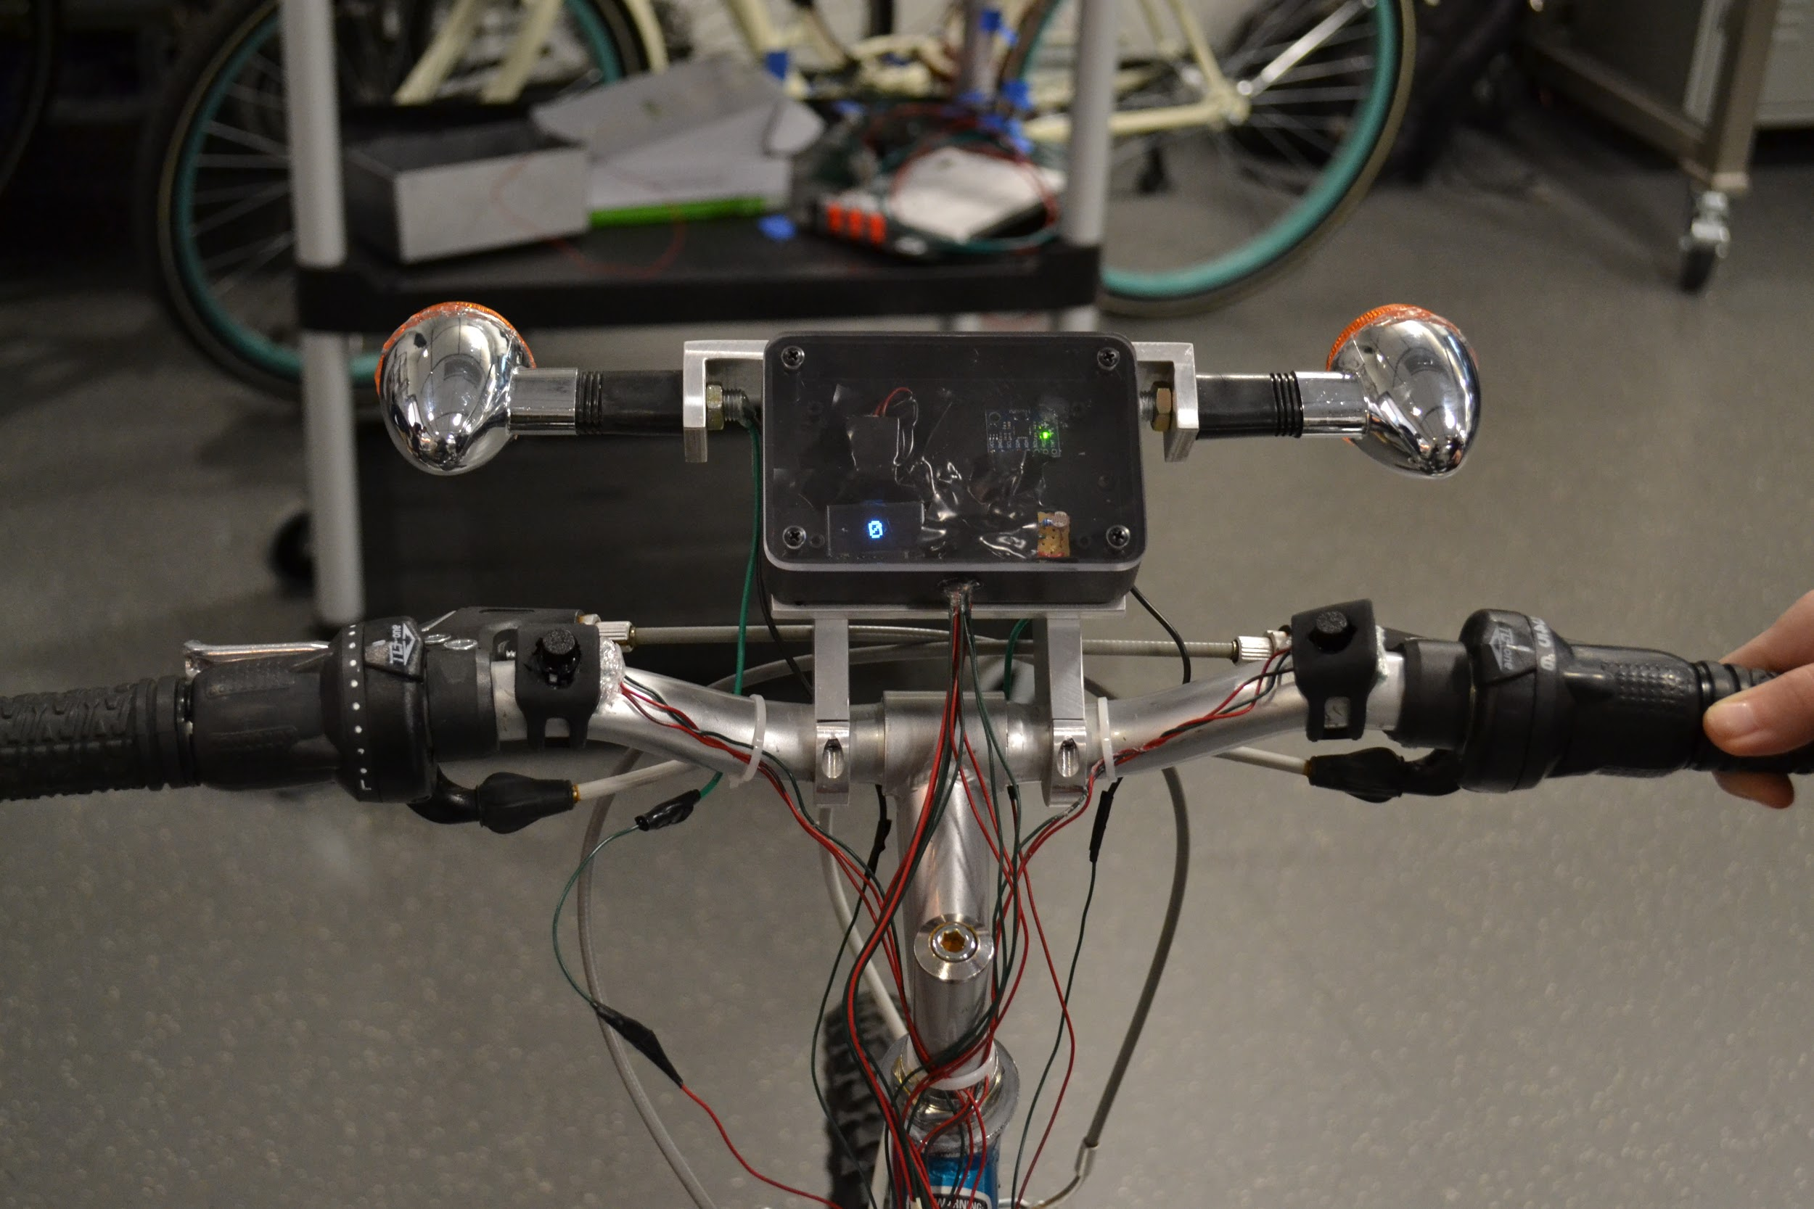
Final Product

Slide 7
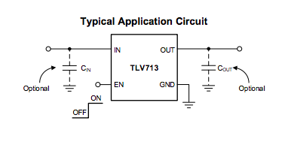
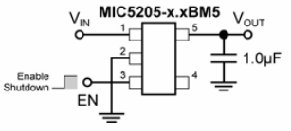
Power Supply
Purpose:
Modify 4.5V input voltage to system’s needed 3.3V
Use 3 AA Batteries
Estimated 428 hours of battery life
Original
Final
Notes:
-accidentally shorted the LVR
-original regulator showed 3.3 V, but drop in voltage when single load was applied
-happened couple days before demo, no time to order new one, no spares left
-researched different workarounds
-simplest solution as a last resort was to desolder LVR from arduino
-found arduino LVR had same package size SOT-23 5 and similar specs
-able to use this LVR with our existing PCB trace
-precaution, resoldered entire microcontroller

Slide 8
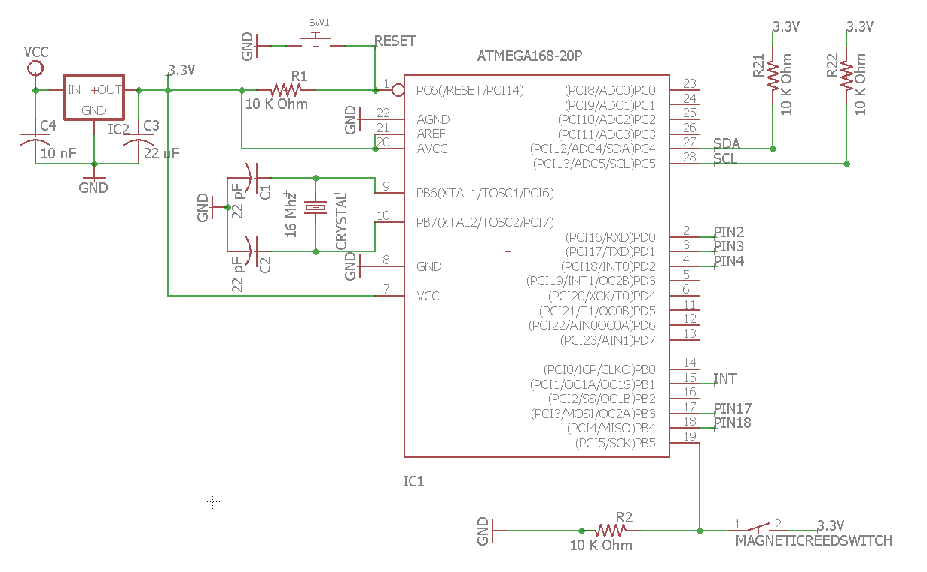
Control Unit
Purpose: Enables communication between sensors and user interfaces with the peripheral modules
Power Calculation:
P = 3.3 V * 7.94 mA = 26.202 mW
Notes:
-ATMega328P, widely used and easily integratable with our system
-for amount of sensors and outputs we have
-16 MHz crystal to stabilize the system
-DON’T FORGET TRANSITION TO NEXT SPEAKER (steph gonna talk more about sensors and peripherals, etc.)

Slide 9
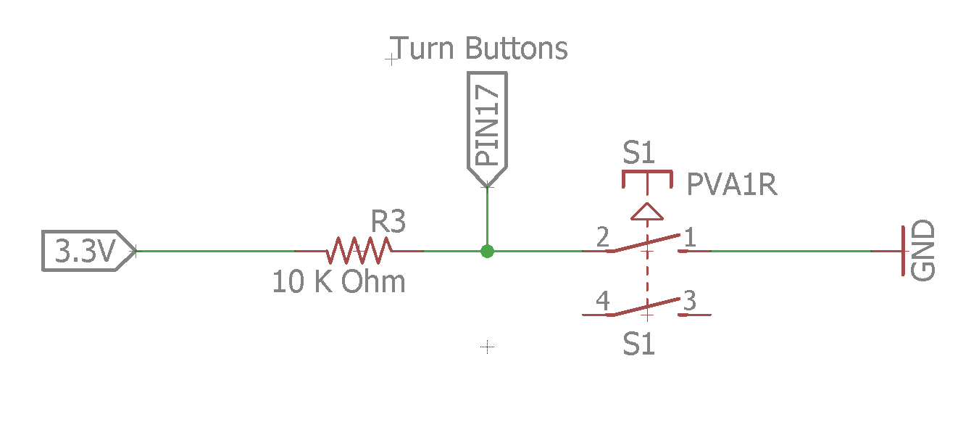
Turn Buttons
Purpose:
Controls LED turn signals
Manually turn on/off
Active LOW
Notes:
-turn buttons part of the user interface
-user can turn on signals and choose to turn off manually (i.e. switching lanes, decide not to turn)
-active low, so no floating voltages are read
-simple push button, not a switch, etc. allows microcontroller to read as low only when button pressed, rather than low until switch turned high

Slide 10
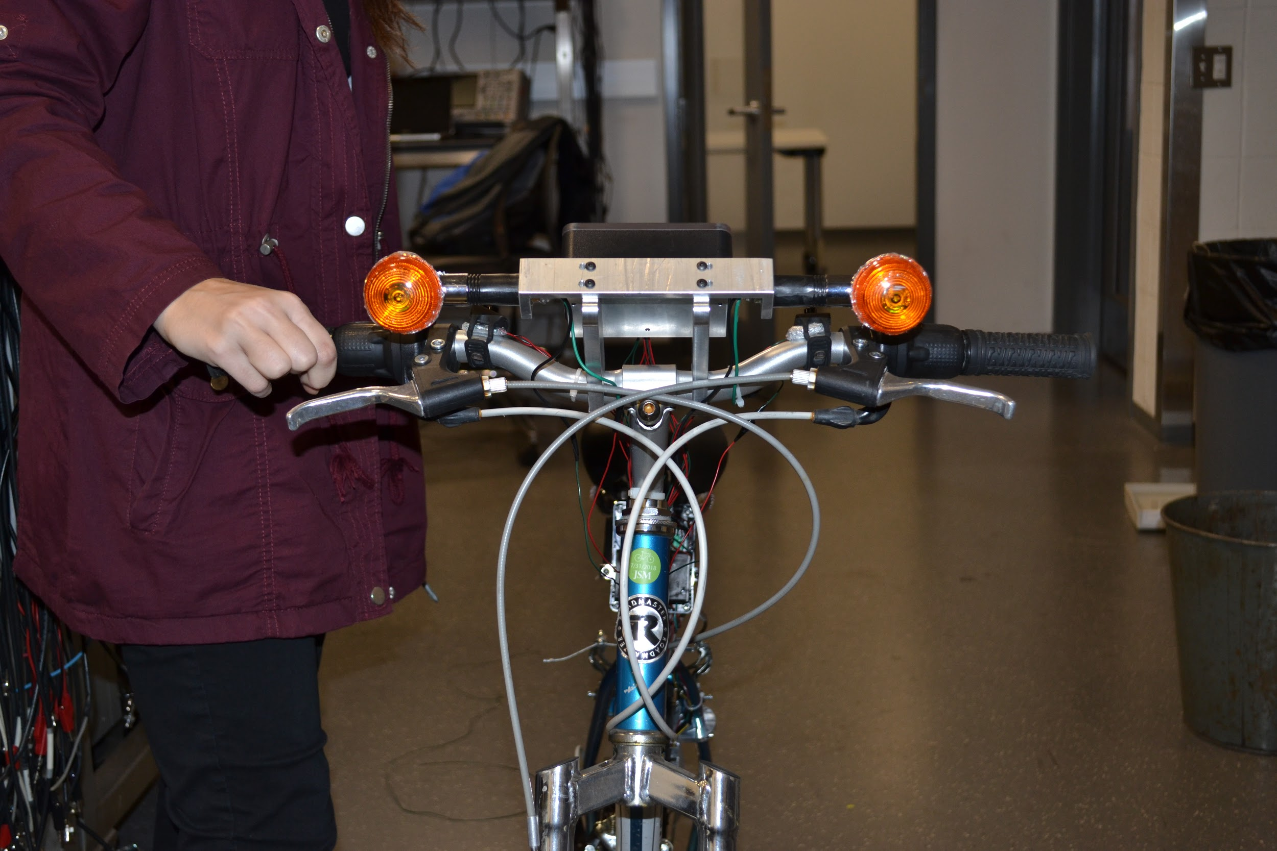
LED Turn Signals
Consists of:
Four turn signals: 2 facing forwards, 2 facing backwards
Each light used two 5mm, white LEDs
Encased within IP54 regulated casings
Power Calculation:
P = 3.3 V * 20 mA = 66 mW
For 8 LEDs: 8 * 66 mW = 528 mW
Notes:
-IP54 Standards = safe for outdoor environment, protected against rain and dust - still function
-as previously mentioned, can turn on manually or automatically
-automatic is determined by the gyroscope, which can be seen integrated in the next slide

Slide 11
LED Turn Signals
Notes:
-video showing the integration of the gyroscope with turn signals

Slide 12
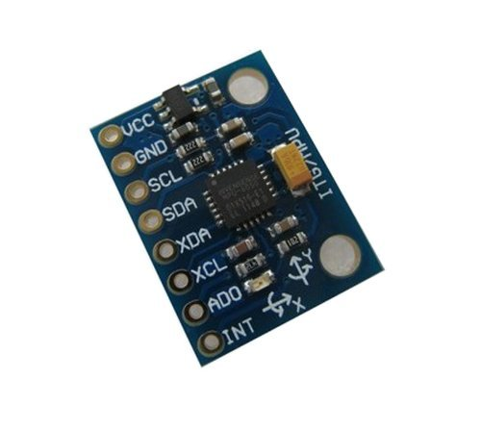
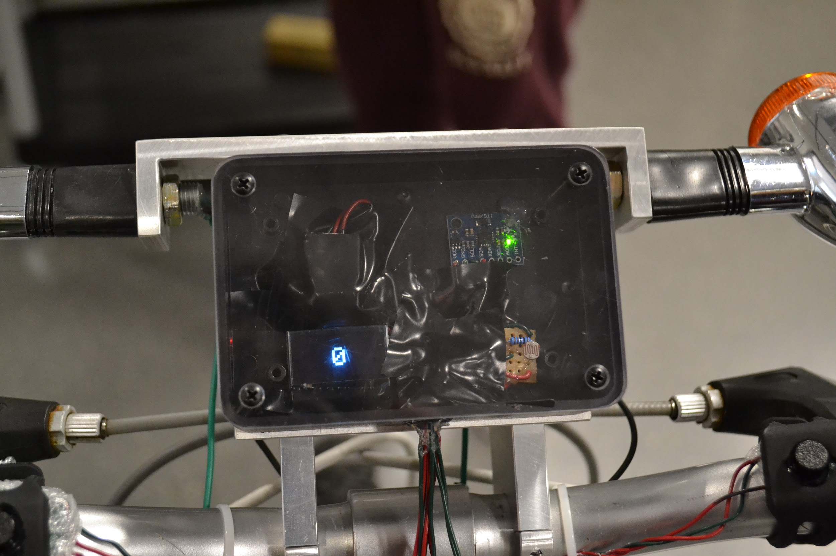
Gyroscope
Purpose:
To control the automatic shut off of LED turn signals
Yaw provides most accurate turn data
Compare to pitch & roll
Power Calculations:
Operating gyroscope: P =3.3 V * 3.6 mA = 11.88 mW
Standby gyroscope: P =3.3 V * 5µA = .0165 mW
Notes:
-Originally designed the schematic, but ended up being too difficult to solder
-Made design consideration to buy the breakout board
-Focus on improving design rather than soldering trivial PCB
-utilized the yaw data, most change for a turn in display casing

Slide 13
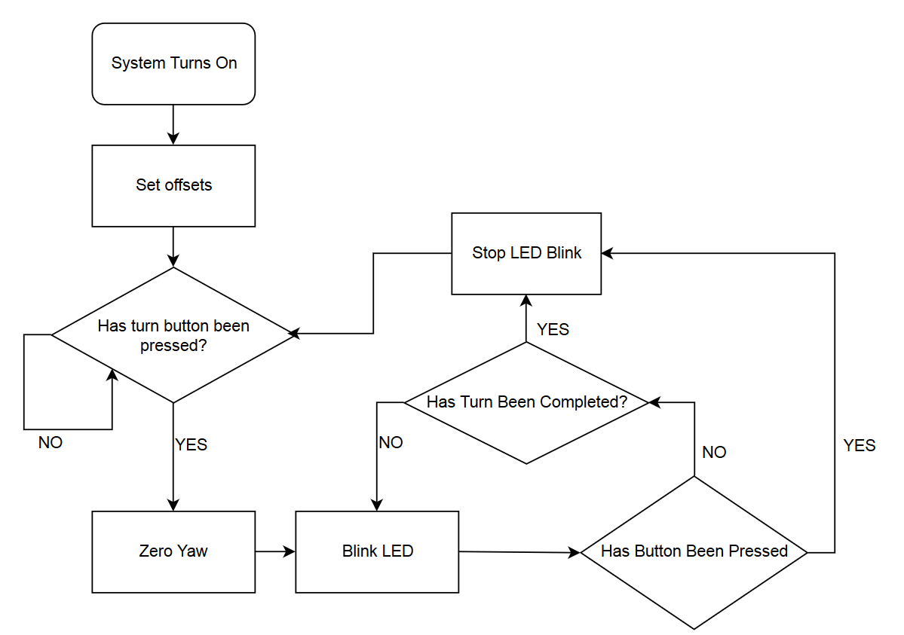
Gyroscope - Operational Logic
Notes:
-how the gyroscope operates in our system
-only care about yaw values after button pressed and before a turn has been completed

Slide 14
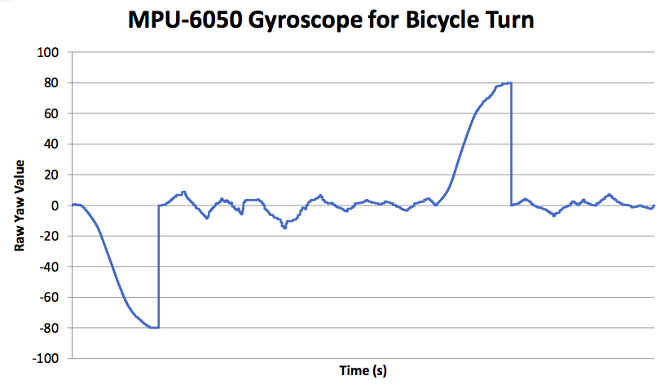
Gyroscope - Data Analysis
Notes:
-right turn, left turn
-user presses button, yaw is zeroed
-once the yaw reaches +/- 80, yaw is zeroed for good measure
-as previously mentioned, do not care about yaw values unless a button pressed and before turn complete

Slide 15
Gyroscope - Integration with Lights
Notes:
-gyroscope integration with lights
-not the actual threshold for project, just for a proof of concept
-threshold values can be adjusted

Slide 16
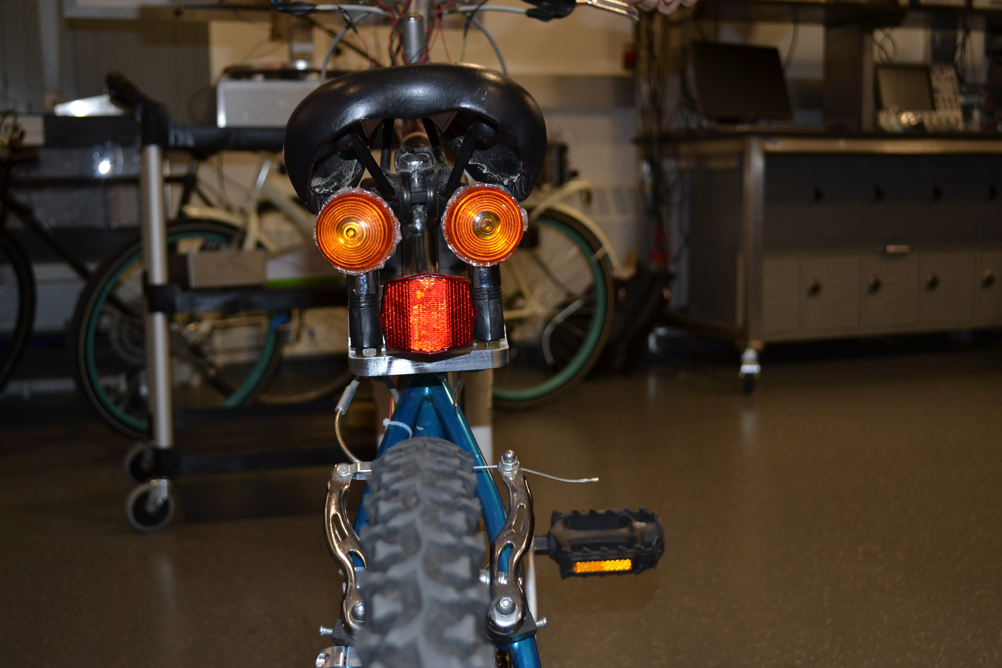
Brake Light
Consists of:
Brake light used two 5mm, white LEDs under red diffuser
Encased within IP54 regulated casing
Power Calculation:
P = 3.3 V * 20 mA = 66 mW
Notes:
-brake light turns on when there is deceleration of ¼ mph or greater
-communicates with microcontroller and receives signal from accelerometer
-2 LEDs under a red diffuser
-casings are waterproof to IP54 standards

Slide 17
Safety Demonstration
Back lights demonstrate testing the IP54 Standard casing
Notes:
-prove that lights are able to withstand rain in outdoor environments

Slide 18
Accelerometer
Purpose:
To control the automatic LED brake
X-axis provides most accurate
deceleration data
Power Calculations:
Operating accelerometer: P =3.3 V * 500µA = 1.65 mW
Notes:
-determines if there is deceleration or not
-experimented with x,y, and z axes
-the orientation of sensor in casing showed x-axis had most accurate results
-however, we use y and z as additional boundaries for better accuracy

Slide 19
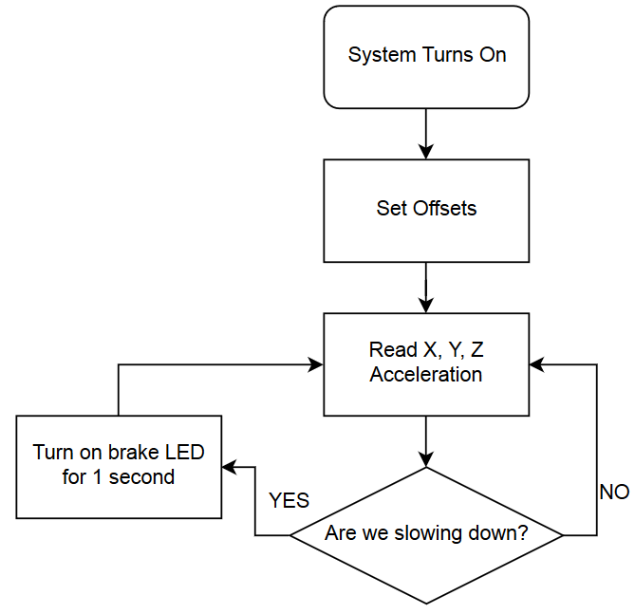
Accelerometer - Operational Logic
Notes:
-if only used x values, would be very sensitive, especially when going over bumps
-to ensure better accuracy, we use y and z values for additional boundary checks before turning on brake light
-set x to -3 as threshold, provided accurate brake light

Slide 20
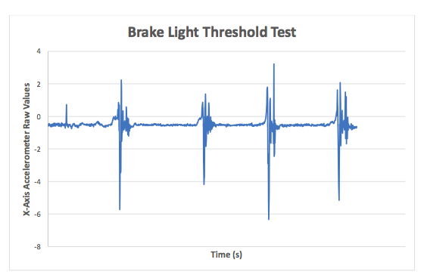
Accelerometer - Testing
Notes:
-see that threshold of -3 in x-direction works well for brake light
-showing data for various types of braking
-DON’T FORGET TRANSITION TO NEXT SPEAKER (anant - Magnetic reed switch)

Slide 21
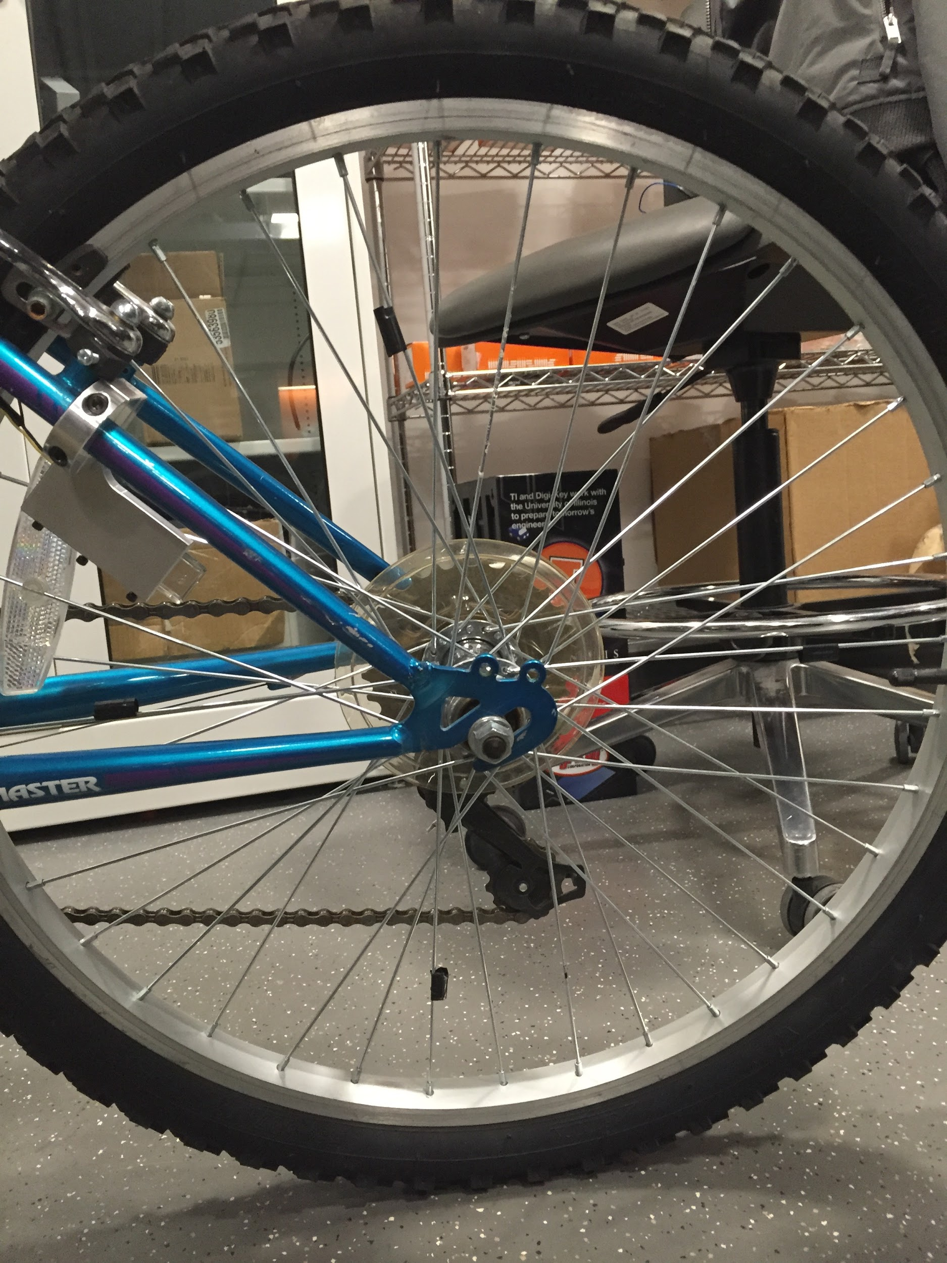
Magnetic Reed Switch
Purpose:
Determines speed of cyclist
Four sets of magnets spaced 90° apart
Calculate speed using angular velocity
⍵ = 𝚫𝛳/𝚫t
V = ⍵ * R

Slide 22
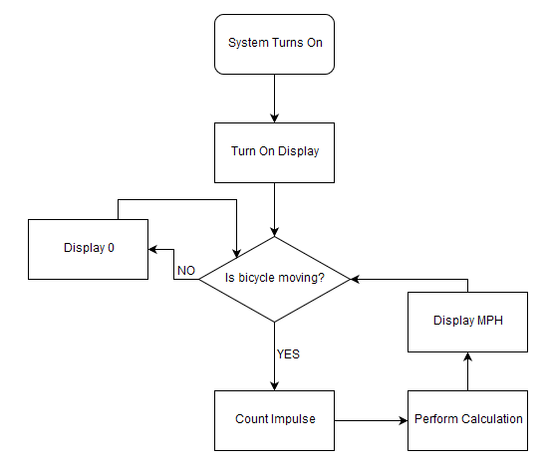
Magnetic Reed Switch - Operational Logic

Slide 23
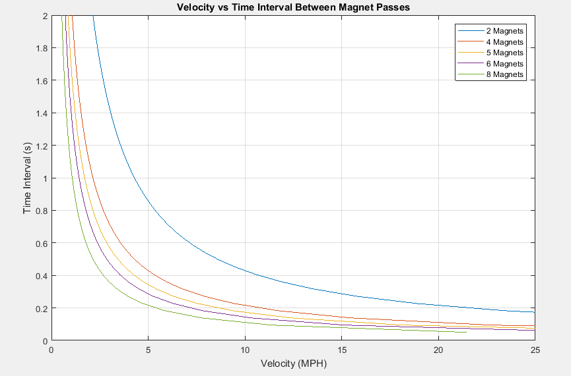
Magnetic Reed Switch - Tolerance

Slide 24
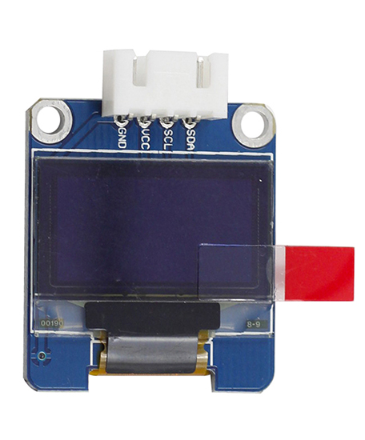
Speedometer
Purpose:
Displays cyclist speed with 1 mph accuracy
OLED Digital Display
Screen: 22mm x 14mm
Encased within IP54 housing

Slide 25
Speedometer - Results
GPS app used to verify the accuracy of the speedometer
Confirms speedometer within 1 mph of bike’s actual speed

Slide 26
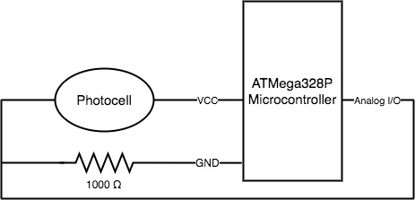
Photocell
Purpose:
Conserve battery life during daylight hours
Save up to 428 mW
Addition to original project requirements
Detects environmental light
Notes:
Photocell consumes 100mW.
8 LEDs consume 528 mW total.
Saves you 428 mW when used in daylight.
Photocell works by detecting environmental light, changes in resistance.

Slide 27
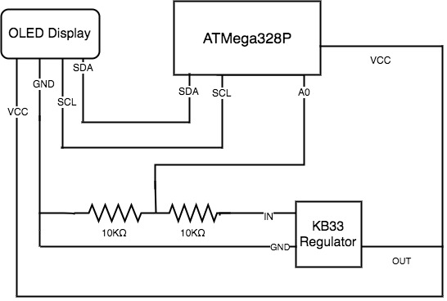
Battery Gauge
Purpose:
Battery indicator using display
75-100%, 50-75%, <50% battery remains
Additional feature
Wasn’t able to fully integrate to project
Consumes too much power
Notes:
-Voltage divider

Slide 28
Conclusions
All system parts work while integrated together
LED turn signals shut off automatically or manually
Light casings are IP54 safe
Speedometer display is visible and accurate

Slide 29
Recommendations for Further Work
Redesign battery gauge
Modifications to photocell
GPS addition to front casing
Wireless system for easy installation
Improve aesthetics
Notes:
-redesign battery gauge to have optimal functioning and consume minimal power
-modify photocell to work under any condition outside (i.e. streetlights)
-GPS addition to front display, shows user how far and where he has cycled
-wireless system for easy user installation (also improves aesthetics)

Slide 30
Thank You
Any questions?

