Slide 1
STRE&M: LED Absorption Spectrometer
Electrical & Computer Engineering
Group #52
Gage Gulley, Adrian Jimenez, Yichi Zhang

Slide 2
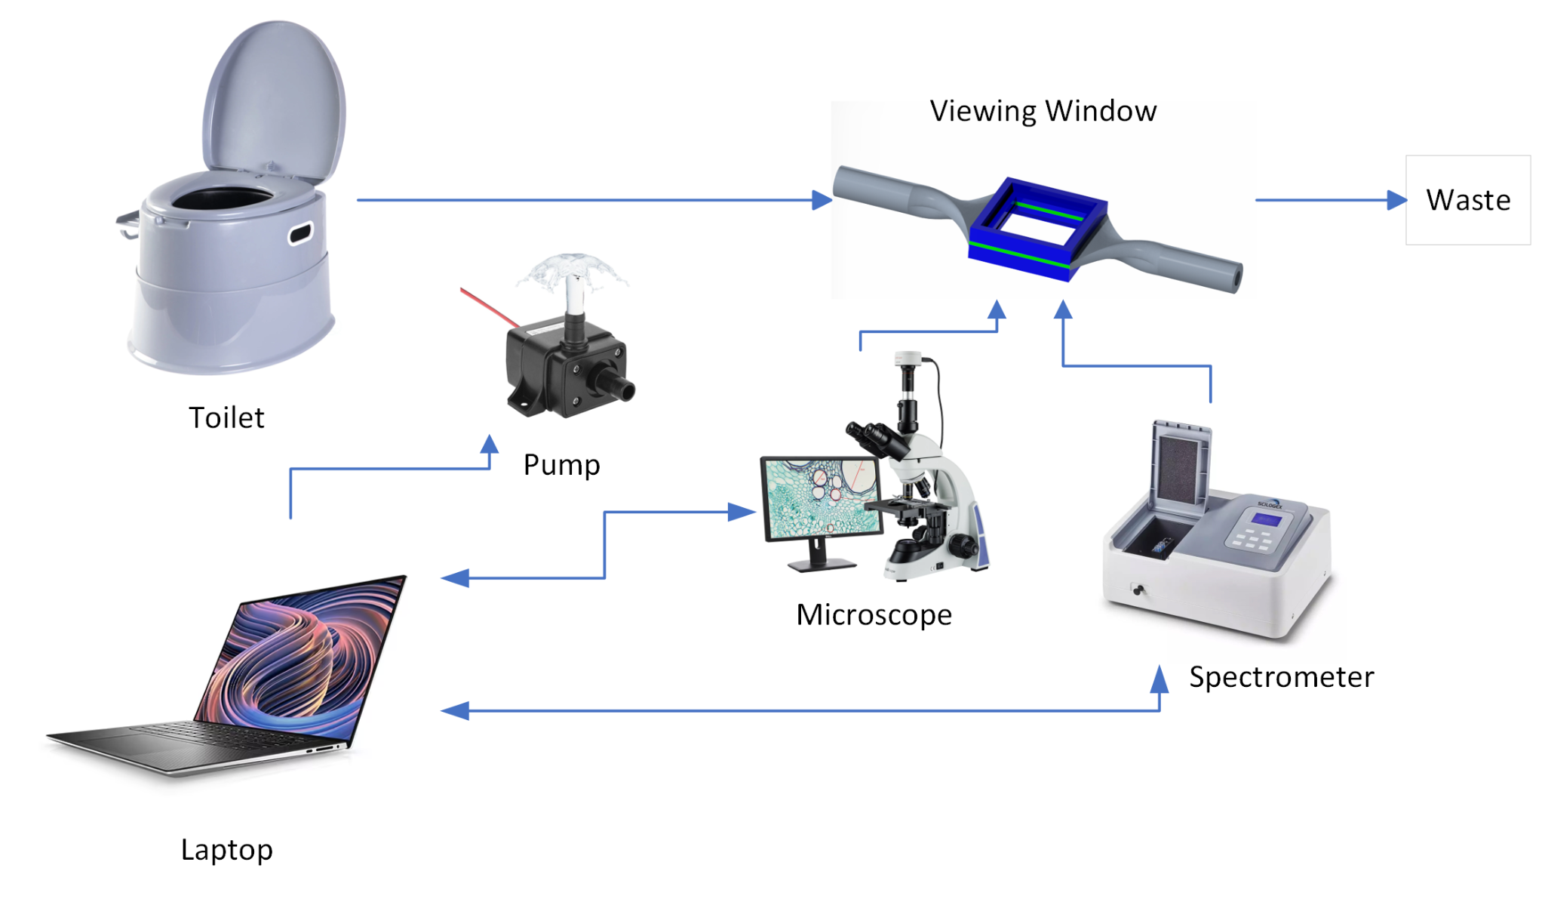
Project Overview
The STRE&M Device
Integrate the urine collection and urinalysis(Magnification and Absorbance Spectrum) into one system
Automate the sample collection and analysis processes
Why Absorption Spectrometry
Protein Examination
Protein | Spectrum 1 (nm) | Spectrum 2 (nm)
Hemoglobin | 454&528 | 577&542(Oxy-Hb)
Bilirubin | 454 | 400-490
Tryptophan | 280
ELECTRICAL & COMPUTER ENGINEERING
GRAINGER ENGINEERING

Slide 3
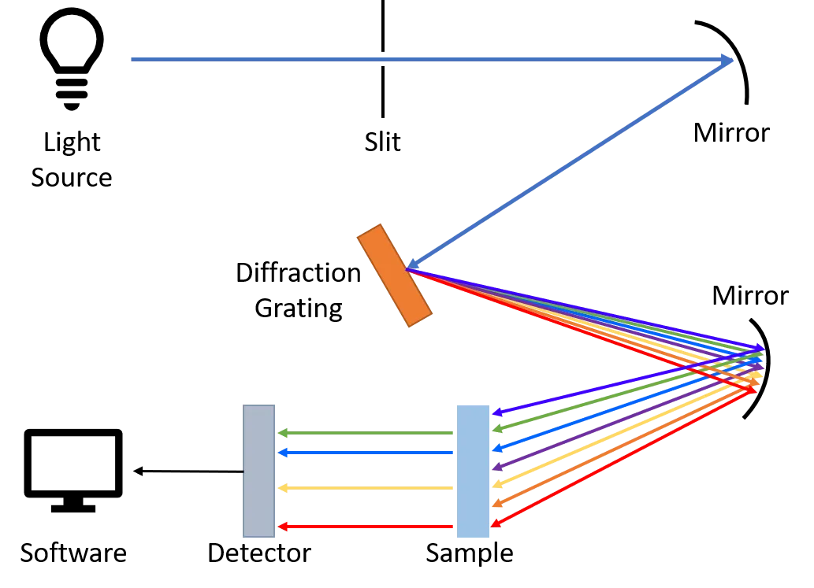
Project Overview(Spectrometer)
Usual Spectrometer
Pros:
Very accurate (accuracy > 96%)
Cons:
Fragile device, cannot be integrated into the overall system
Very expensive (medical purpose > $5000)
High power consumption
ELECTRICAL & COMPUTER ENGINEERING
GRAINGER ENGINEERING
Notes:
Working principle

Slide 4
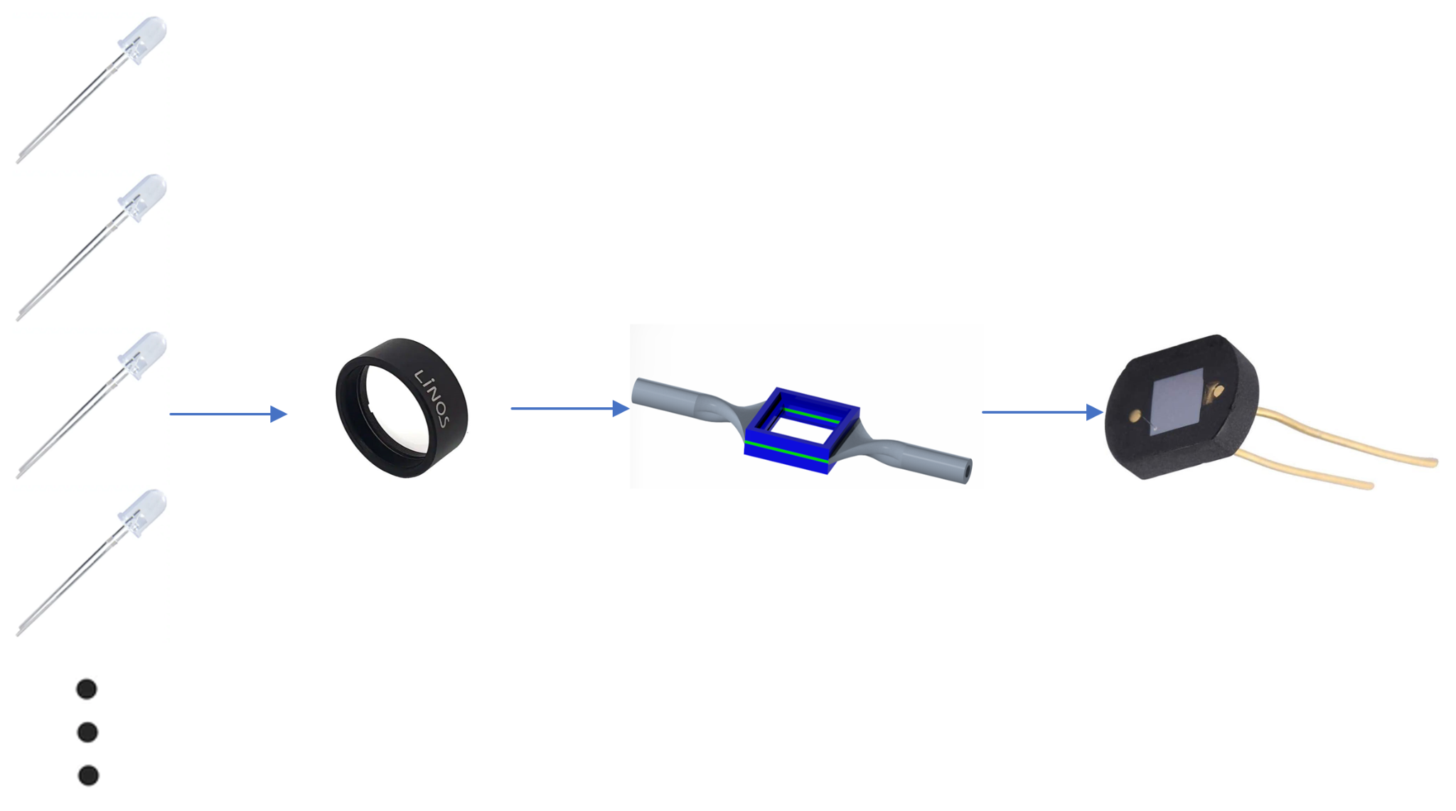
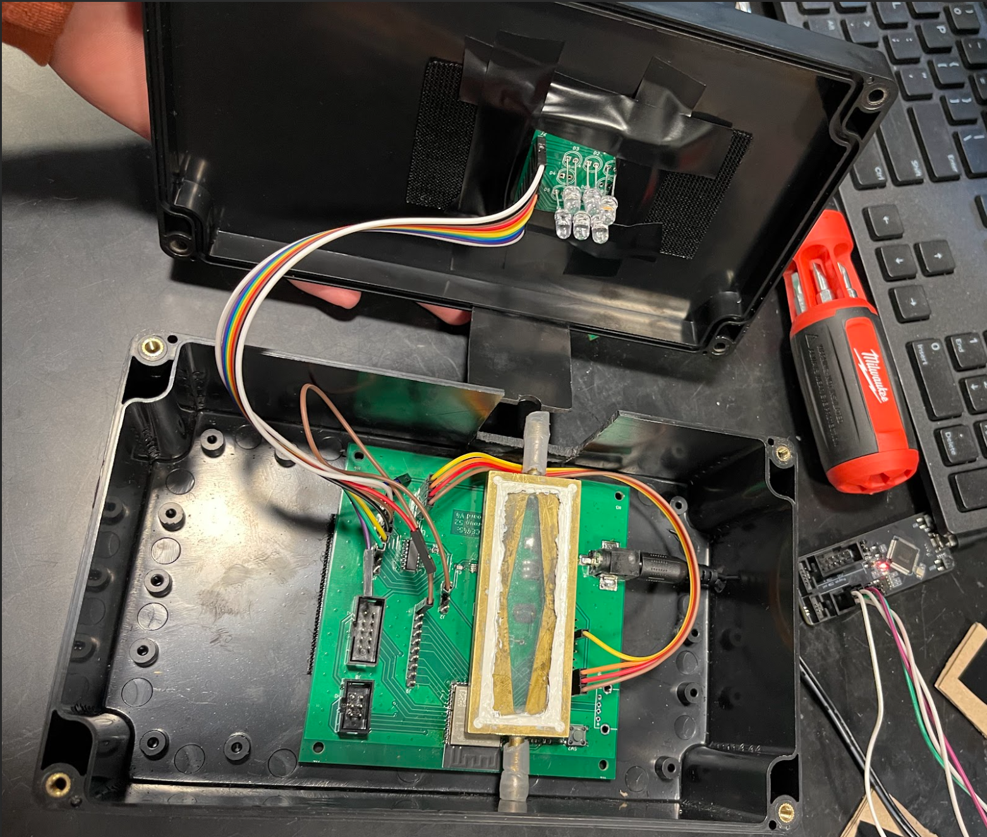
Project Overview(Spectrometer)
LED Spectrometer
Pros:
Cheap to build (< $100)
Low power consumption
Sturdy device that can be integrated in to the overall system
Cons:
Cannot display full detailed spectrum with current design, due to the resolution limit
ELECTRICAL & COMPUTER ENGINEERING
GRAINGER ENGINEERING
Notes:
working principle

Slide 5
Design Specification
ELECTRICAL & COMPUTER ENGINEERING
GRAINGER ENGINEERING

Slide 6
Design Specification
High Level Requirements
The spectrum analysis and data transfer must be completed in less than 30 seconds
Our system must be able to produce an absorbance spectrum for a sample with known absorbance in our desired range (440-660nm) and generates no response for a sample with known absorbance in the range excluding (440-660).
The device must be capable of performing absorbance spectroscopy with a resolution rate of ~36 nm for the light source emitting lights ranging from 440 nm to 660 nm.
ELECTRICAL & COMPUTER ENGINEERING
GRAINGER ENGINEERING

Slide 7
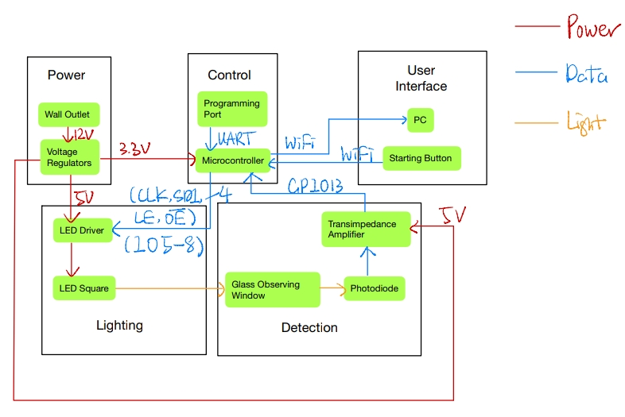
Design Specification
Block Diagram
Power Subsystem
Produce stable 3.3V & 5V
Control Subsystem
Calculate and upload the absorbance spectrum
Interface with other subsystems based on the control signals from the User Interface
Lighting Subsystem
Drive an LED array with 6 different LEDs
Detection Subsystem
Detect the light passing through the sample
User Interface
Display the absorbance spectrum
Launch sample analysis and calibration
ELECTRICAL & COMPUTER ENGINEERING
GRAINGER ENGINEERING

Slide 8
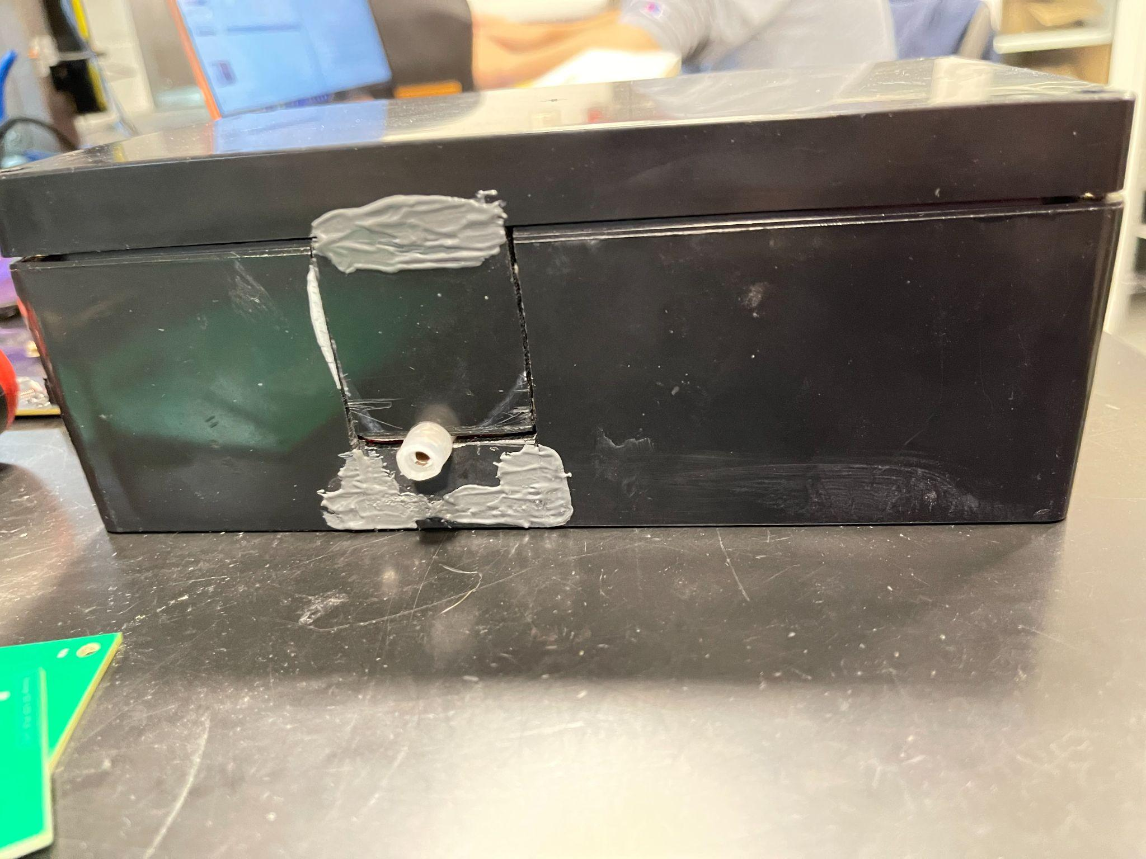
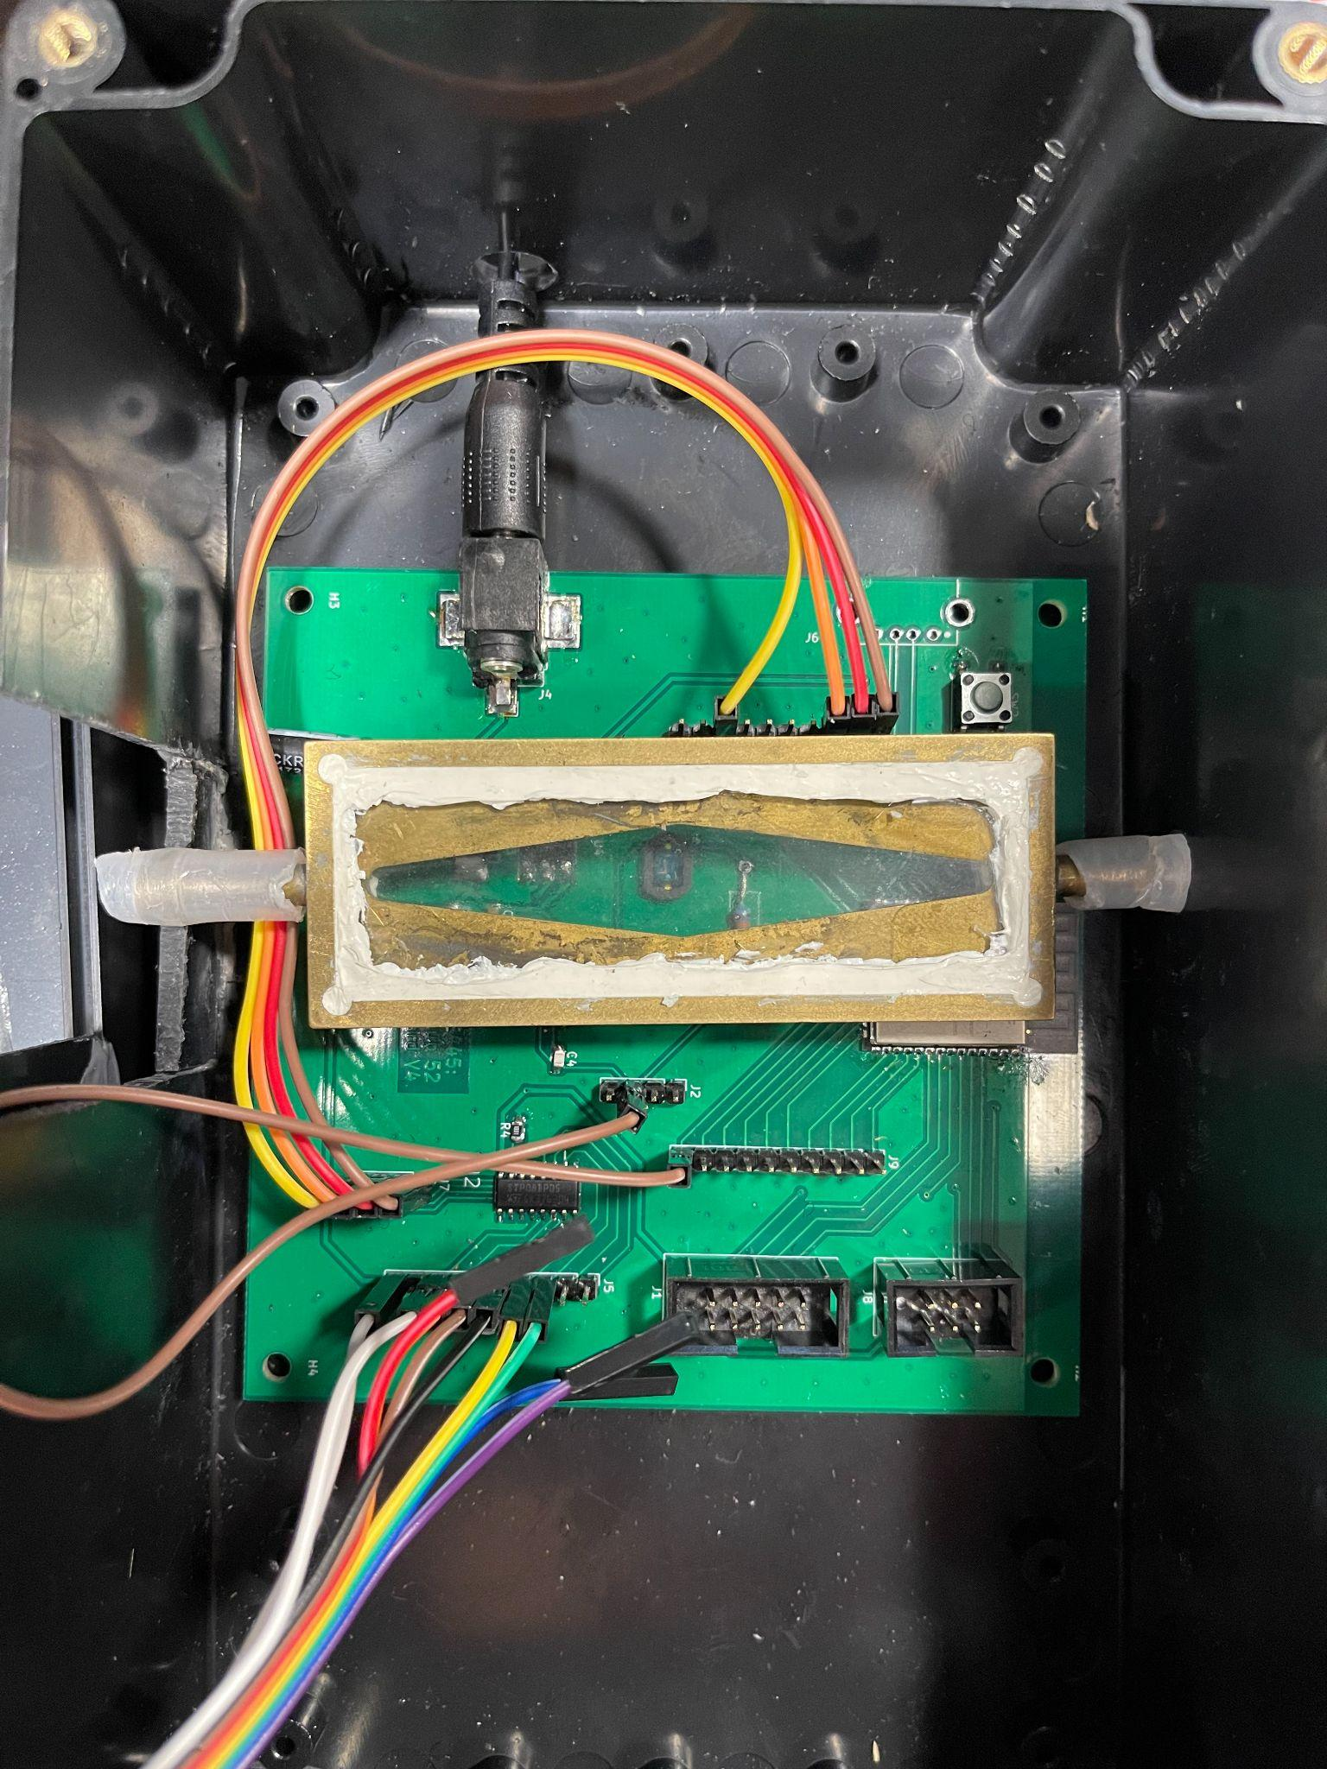
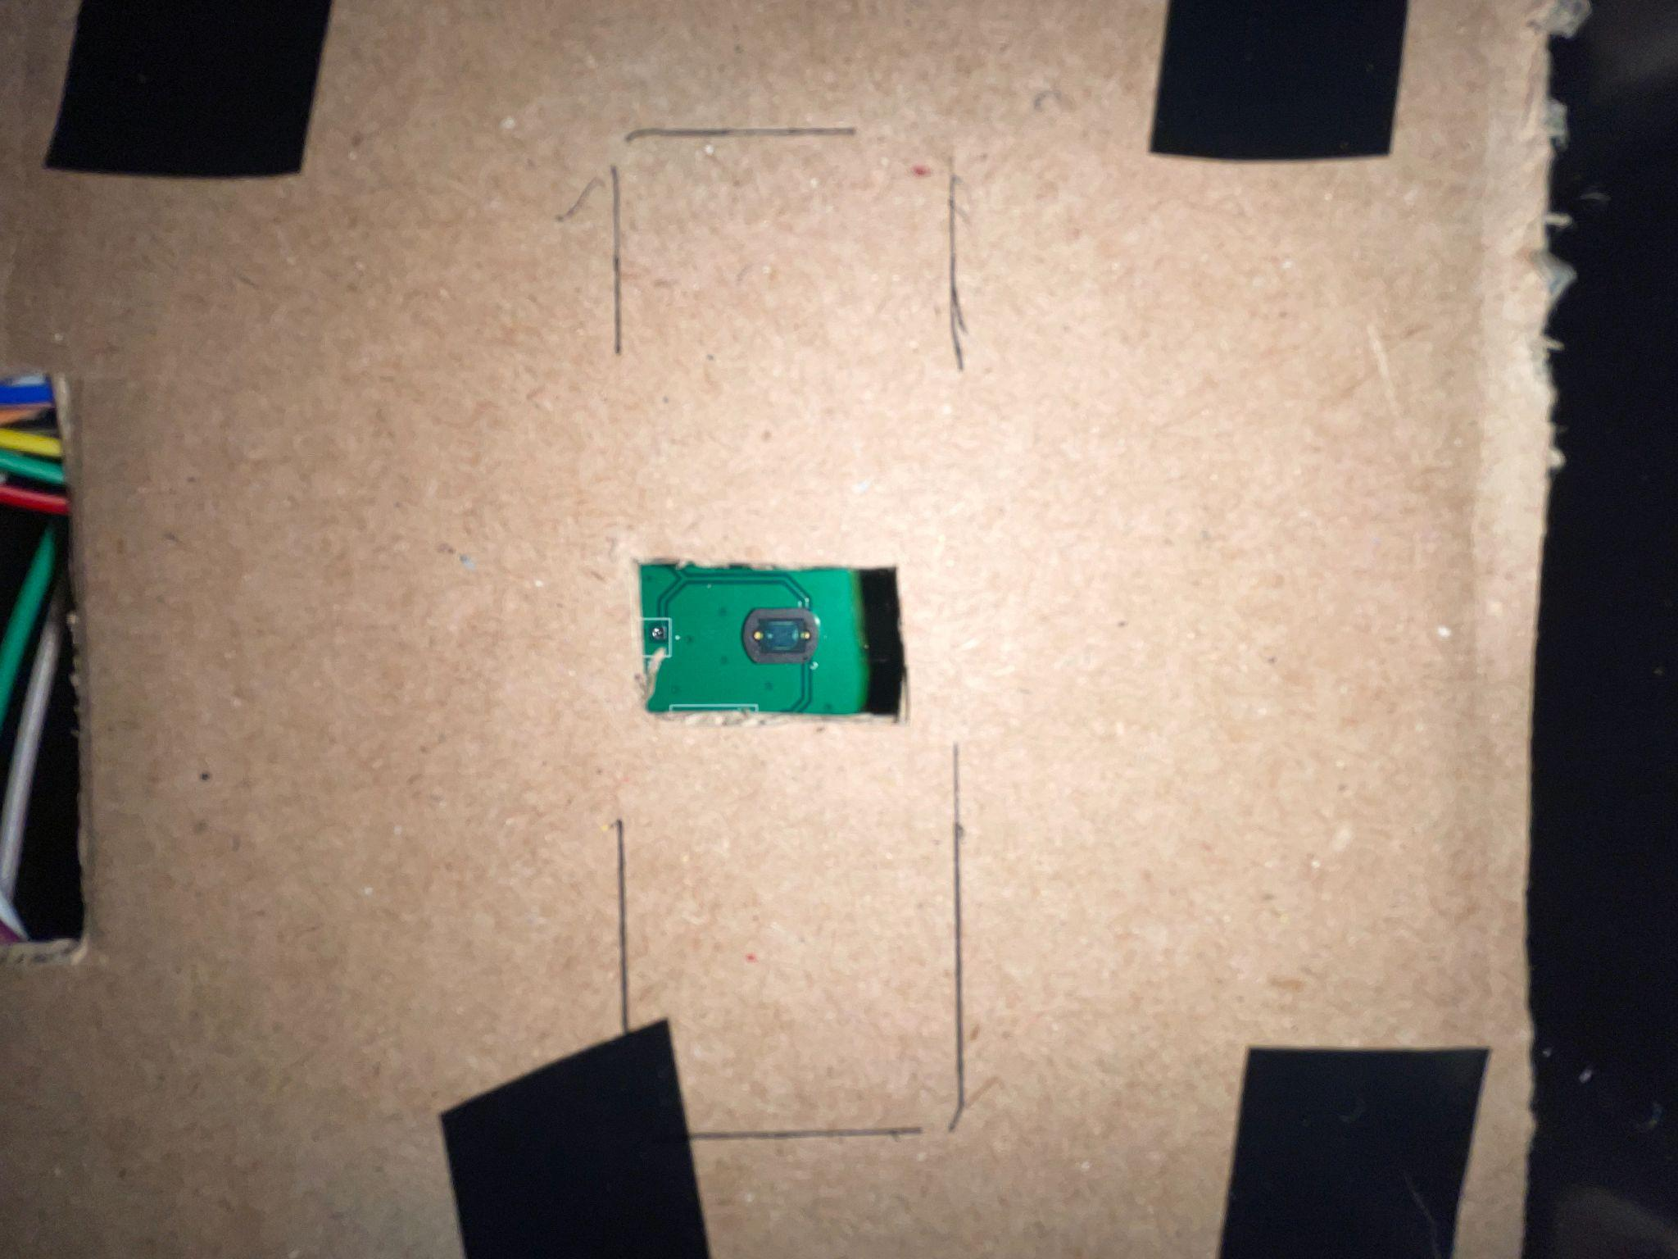
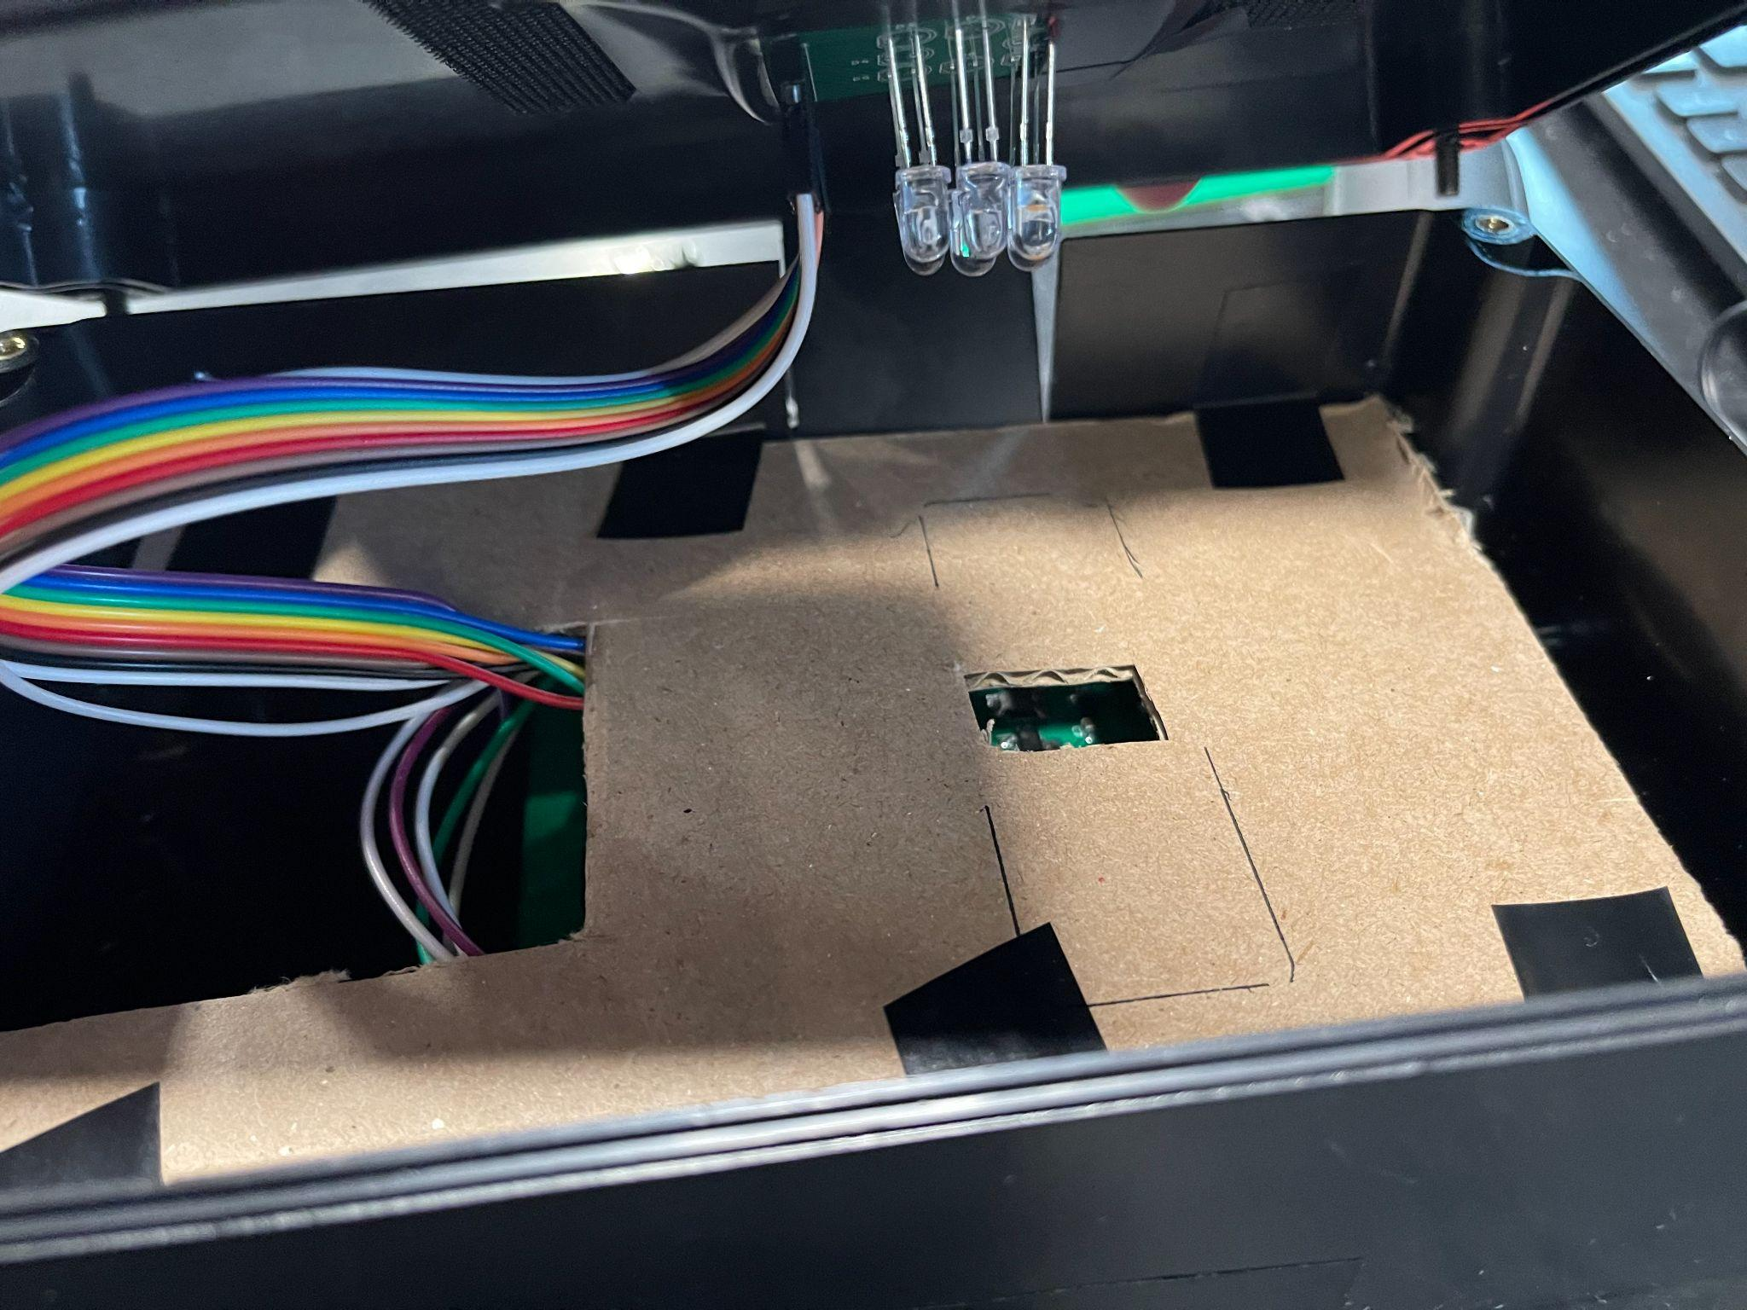
Design Specification
Enclosure Design
Can be Integrated into current STRE&M prototype
Can record and upload spectrum analysis wirelessly
Very adaptable design can meet any wavelength requirement by swapping LED and resistor values
Can work for up to 8 LEDs
ELECTRICAL & COMPUTER ENGINEERING
GRAINGER ENGINEERING

Slide 9
How to use the spectrometer and testing results
ELECTRICAL & COMPUTER ENGINEERING
GRAINGER ENGINEERING

Slide 10
Project Video
ELECTRICAL & COMPUTER ENGINEERING
GRAINGER ENGINEERING

Slide 11
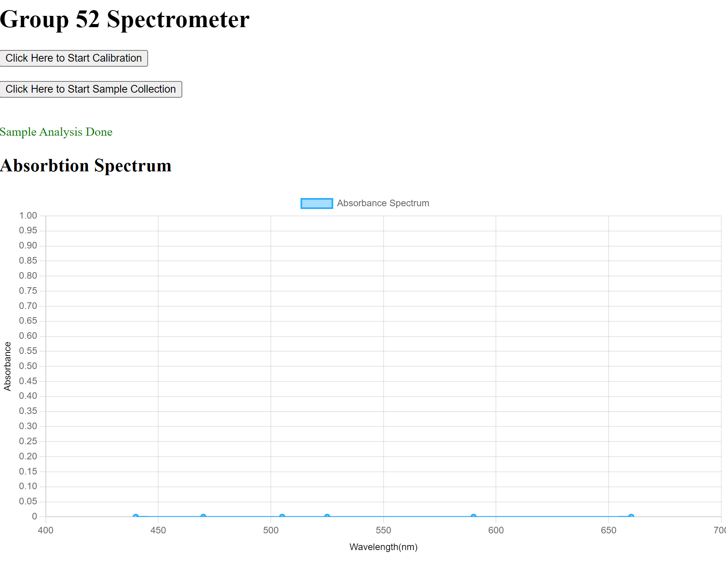
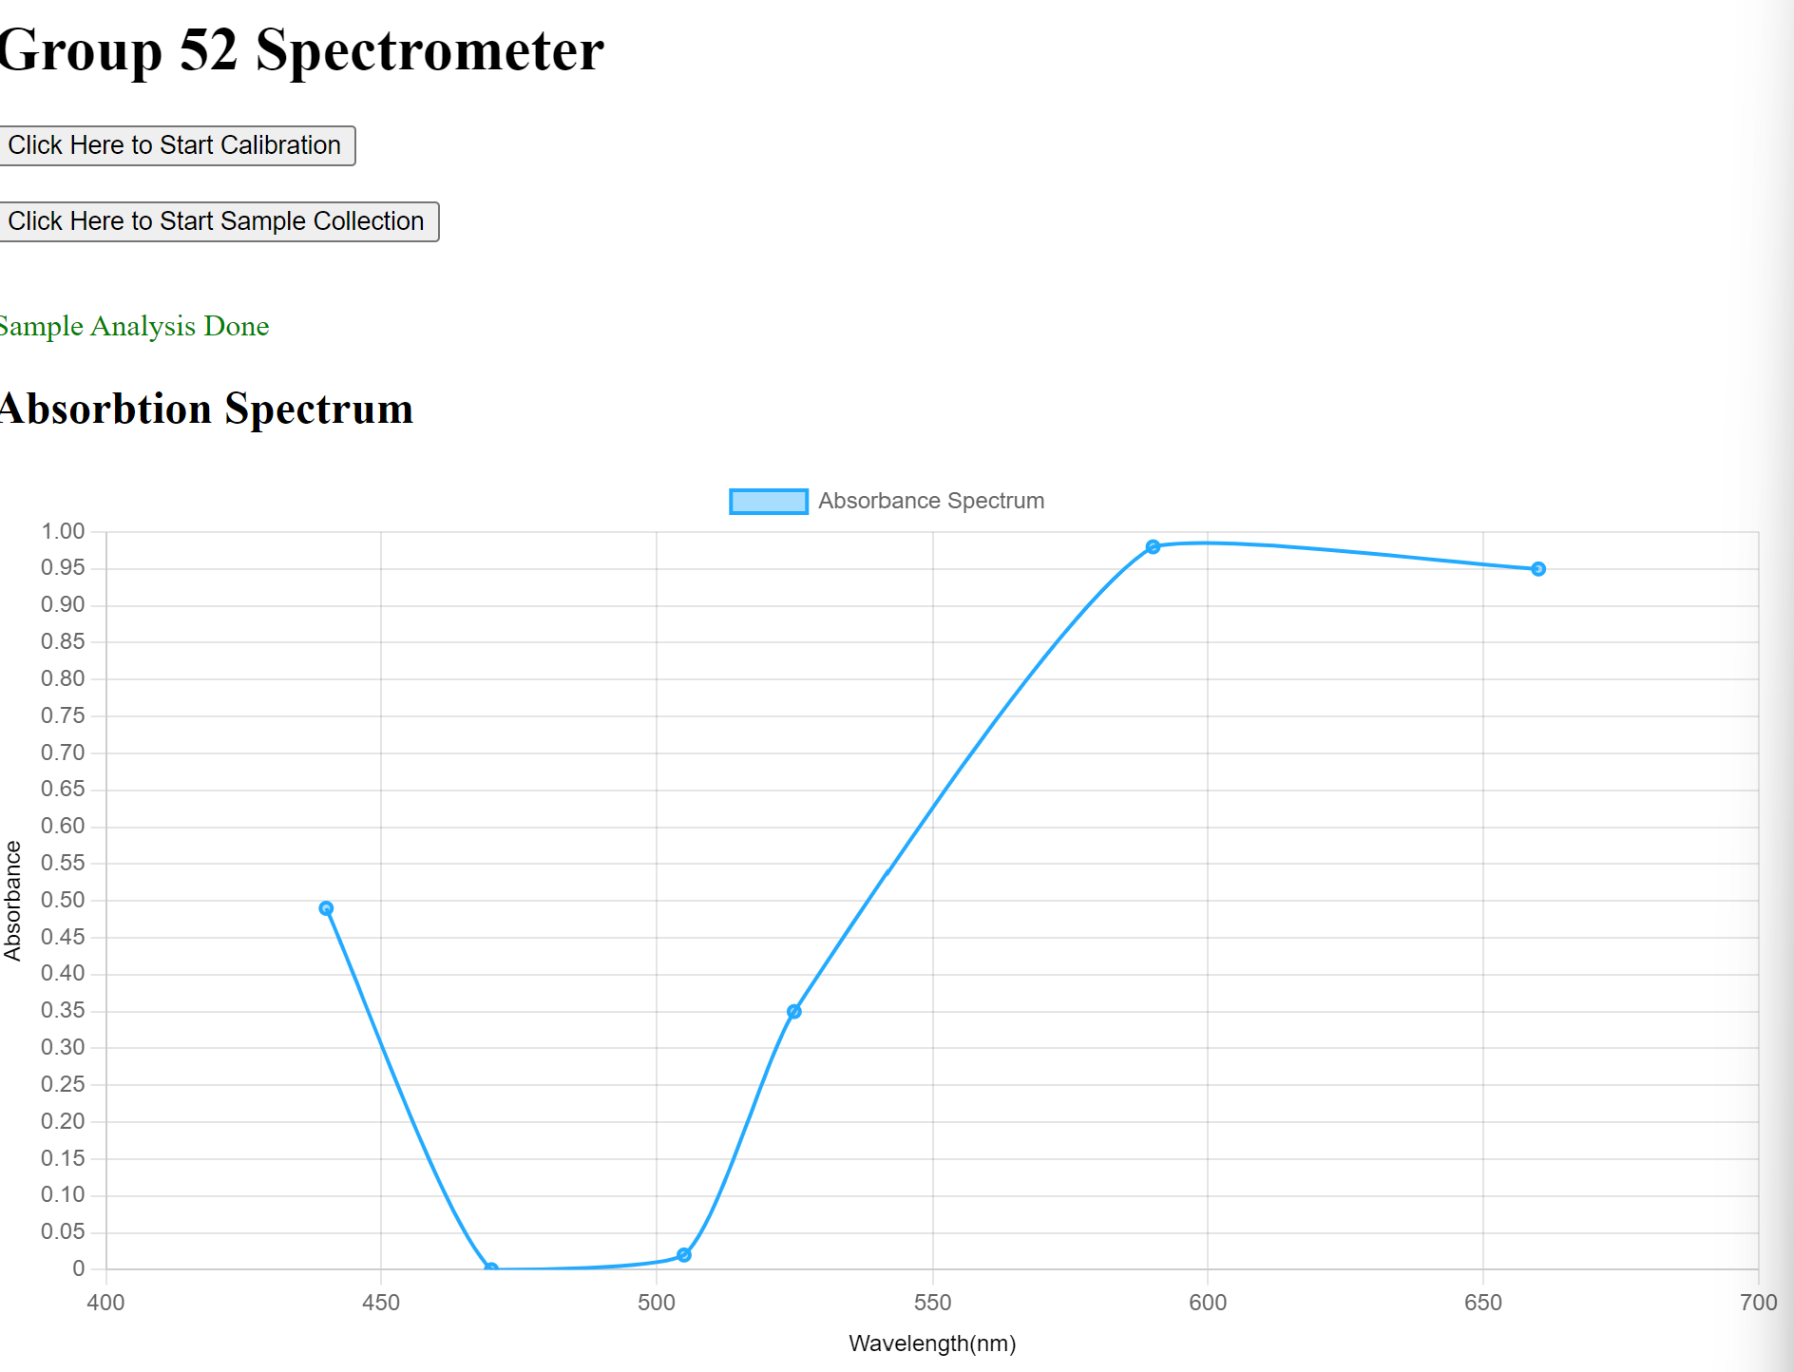
Interface webpage
Calibration (Plain Water)
Generated Spectrum (Sample)
ELECTRICAL & COMPUTER ENGINEERING
GRAINGER ENGINEERING

Slide 12
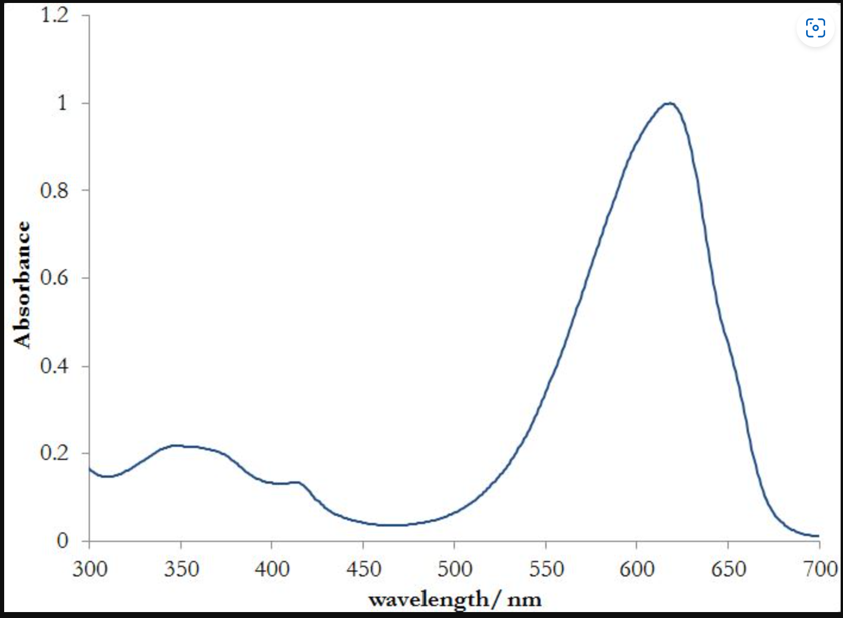
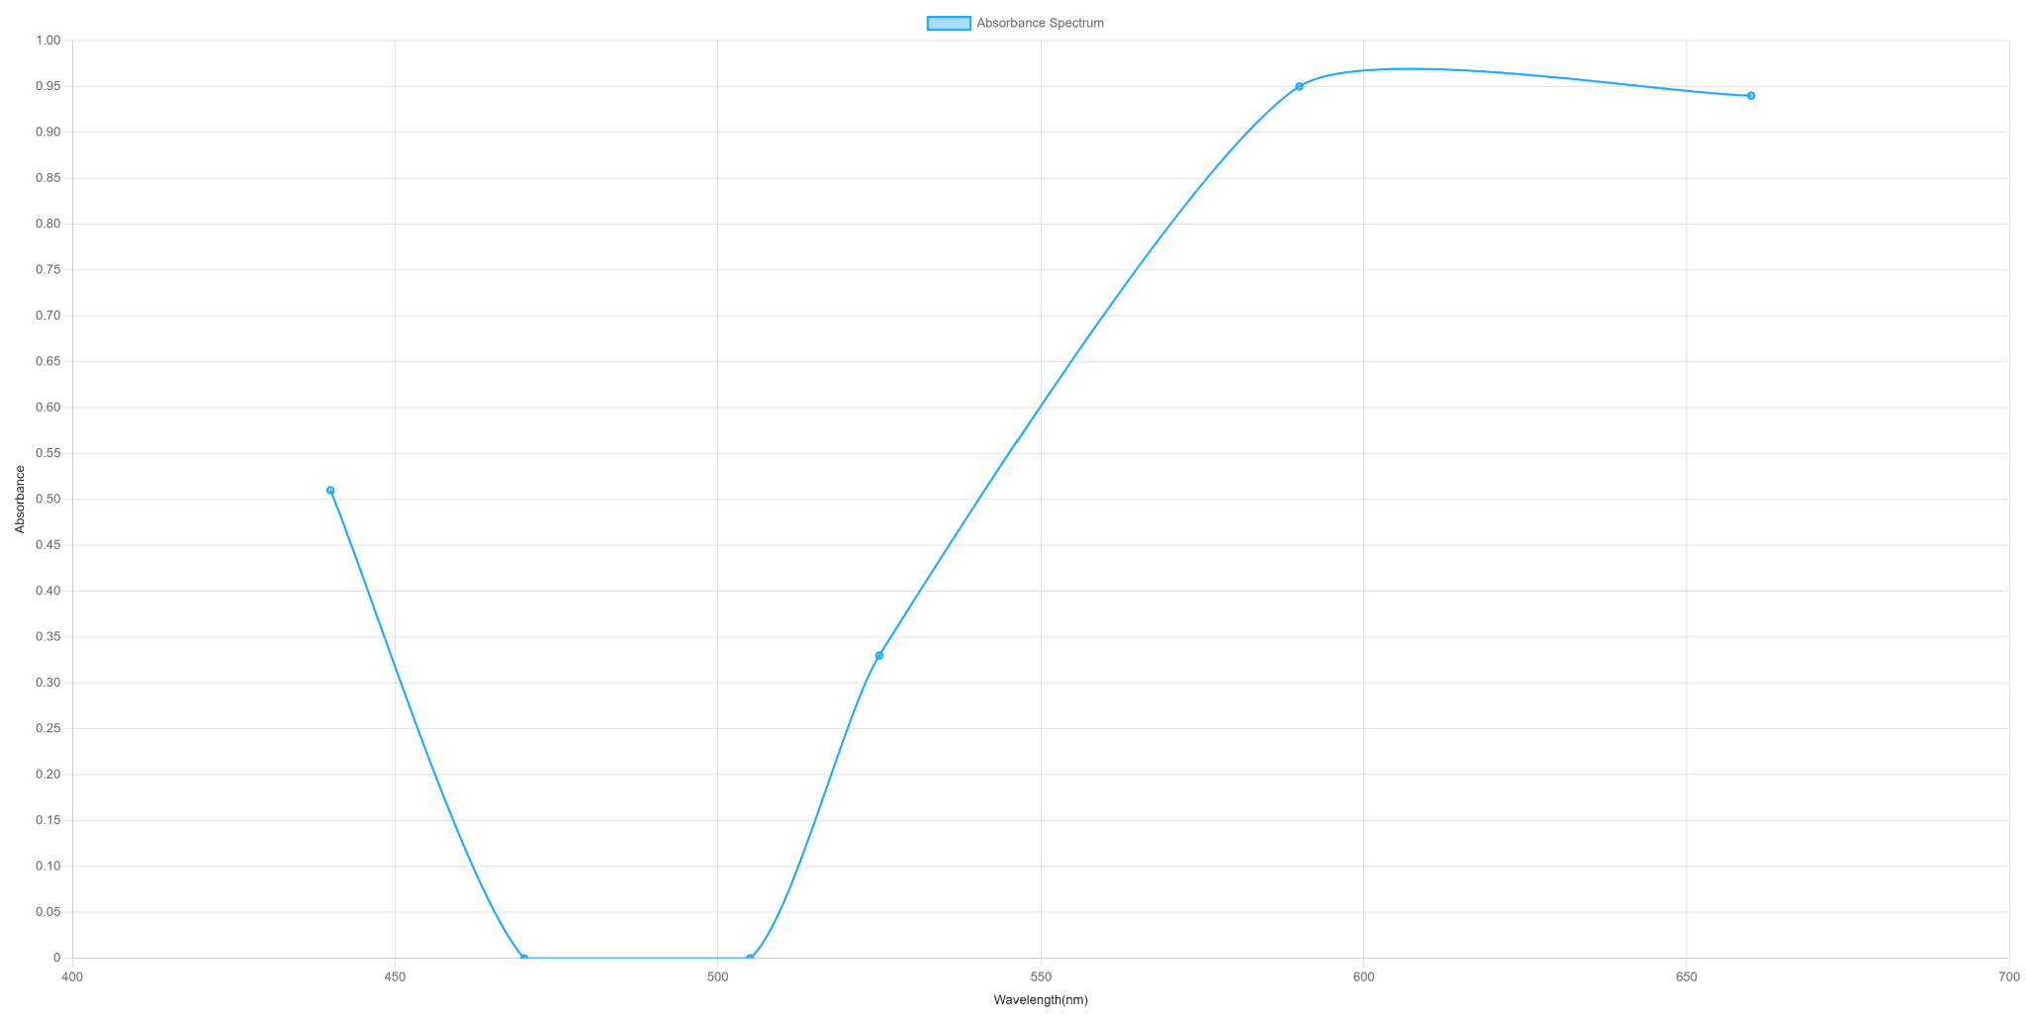
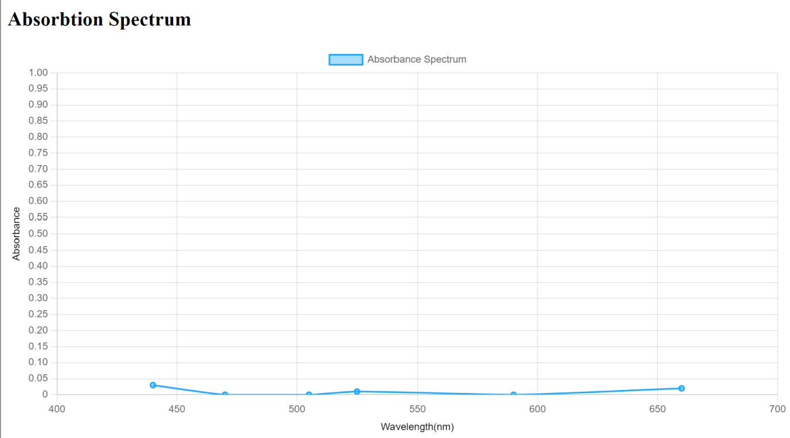
System Results
Our System Results
Our generated spectrum is comparable to known absorption spectrum
In this case, the known spectrum peaks at 600nm
Our absorption spectrum peaks at 590nm
We are able to analyze multiple samples without the need for recalibration
Analyzing the control as a sample after multiple samples yields a spectrum with less than 5% absorption
Known spectrum for blue-dye
Generated spectrum
ELECTRICAL & COMPUTER ENGINEERING
GRAINGER ENGINEERING

Slide 13
Design, Challenges, and Results
ELECTRICAL & COMPUTER ENGINEERING
GRAINGER ENGINEERING

Slide 14
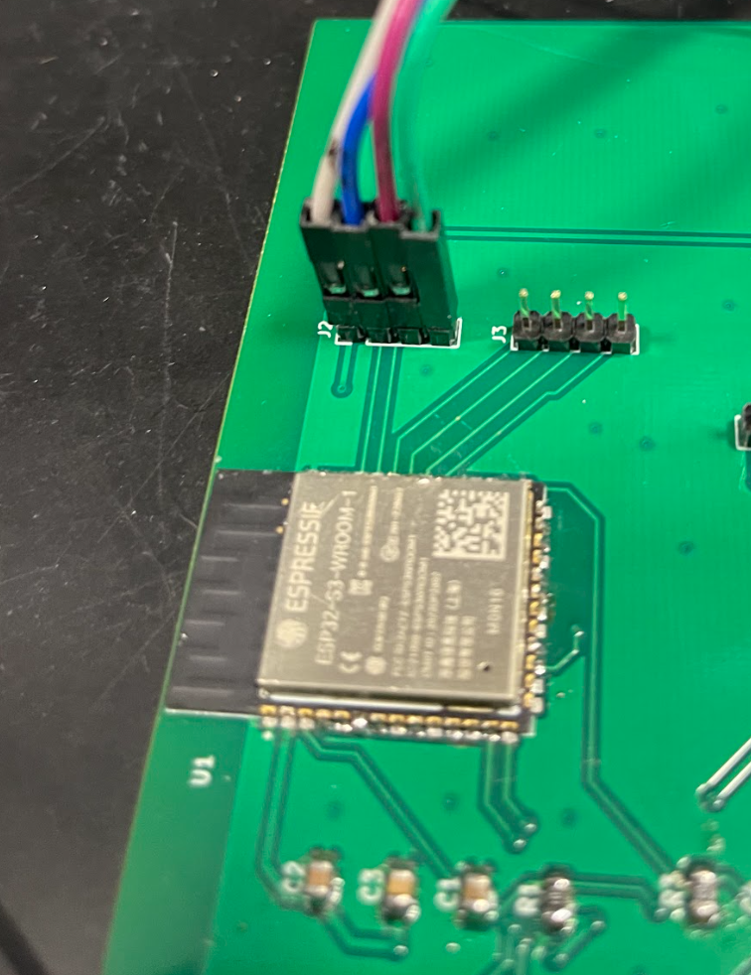
Design & Challenges: Control Unit
Initial Design
Components in our initial system:
ESP32-S3-WROOM
JTAG & UART 4-pin headers
Boot & Enable push-buttons
Challenges
Could not program the ESP32
Reset button was not grounding correctly when the push button was pressed
Measured around 1.6-1.7V when pushed
Soldering the microcontroller with the oven was difficult
Acted like heat sink
ELECTRICAL & COMPUTER ENGINEERING
GRAINGER ENGINEERING

Slide 15
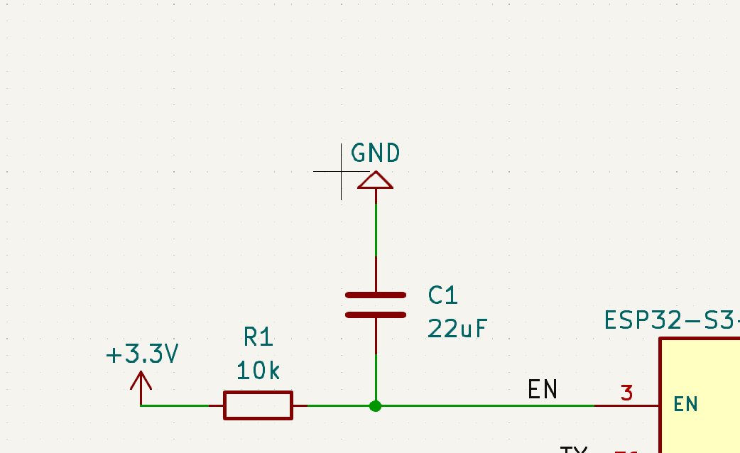
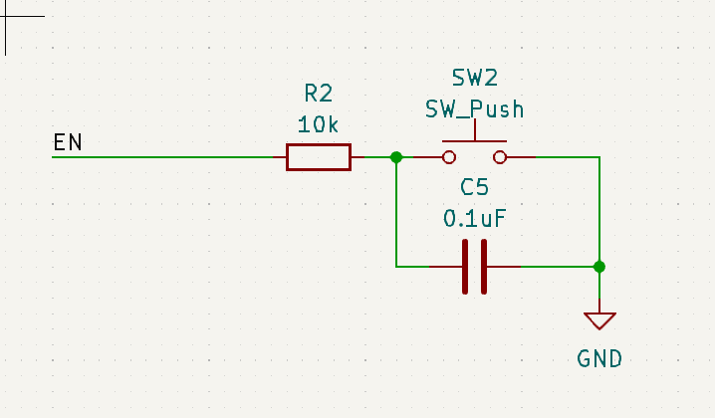
Design & Challenges: Control Unit
Why did it not work?
Programming
Our first microcontroller was damaged from going through the oven multiple times
Our programmer (ESP-PROG) can control the EN and BOOT pins
4 pin header could not accommodate the connection of the RST and BOOT pins.
Push Button
Pushing the RST button on PCB did not ground the pin
Caused by 10k R2 resistor
Soldering the ESP32
Hand-soldered the microcontroller rather than using the oven
ELECTRICAL & COMPUTER ENGINEERING
GRAINGER ENGINEERING

Slide 16
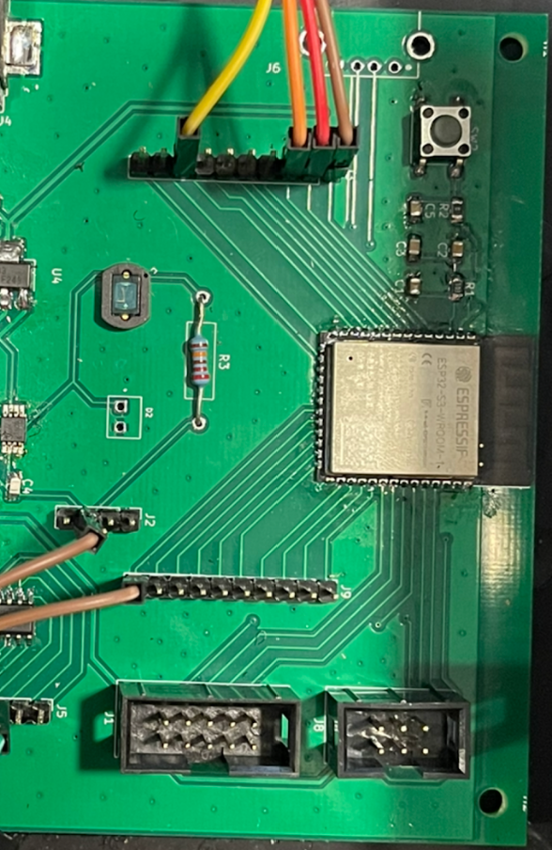
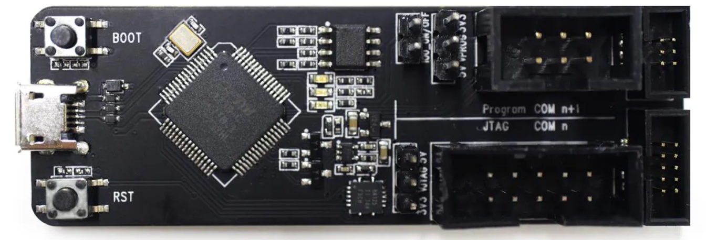
Design & Challenges: Control Unit
Revised Design
Changes in our revised design:
JTAG & UART 4-pin headers became 6-pin connectors
The ESP-PROG uses a connector that we wanted to match on our PCB for quick connection
Only have EN push-button
Allows us to reset from the PCB
Direct connection from UART port to EN and BOOT pins on MCU
Switched the 10㏀ R2 resistor to a 0Ω resistor
ELECTRICAL & COMPUTER ENGINEERING
GRAINGER ENGINEERING

Slide 17
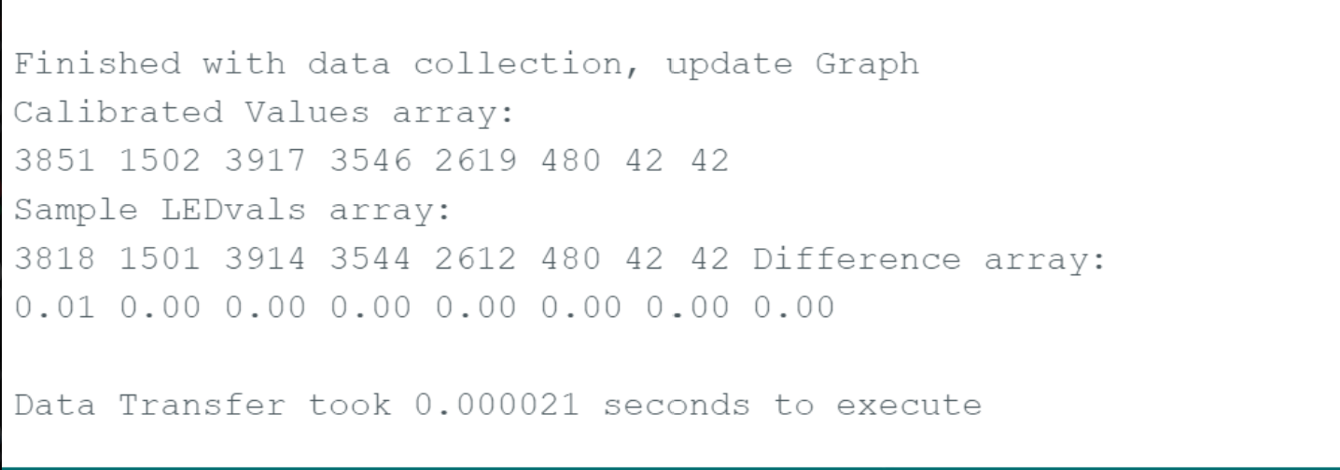
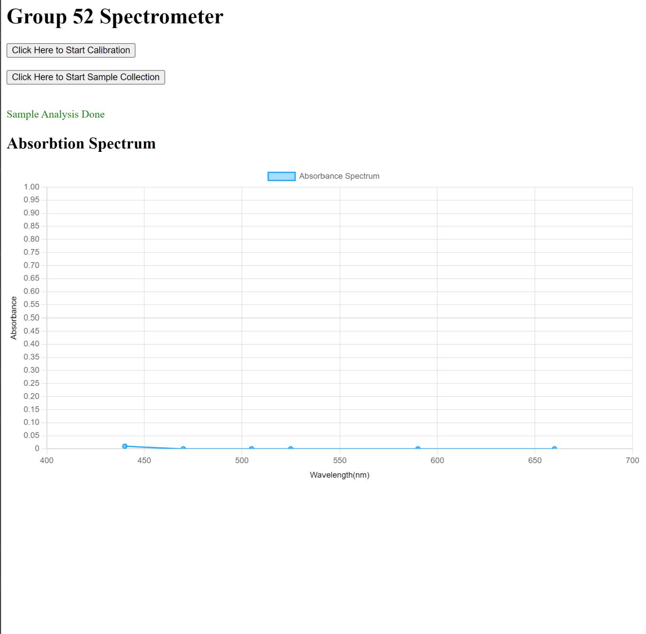
Subsystem Results: Control Unit
Requirements & Verification
The data must be transferred to the computer within 2 seconds of sending data
Timed how long it takes to calculate the absorbance and update the webpage
Only takes 0.000021 seconds
The data must be displayed in a graph that resembles the output of a standard spectrometer
Webpage displayed graph with fixed X and Y axis
Interactive data points
ELECTRICAL & COMPUTER ENGINEERING
GRAINGER ENGINEERING

Slide 18
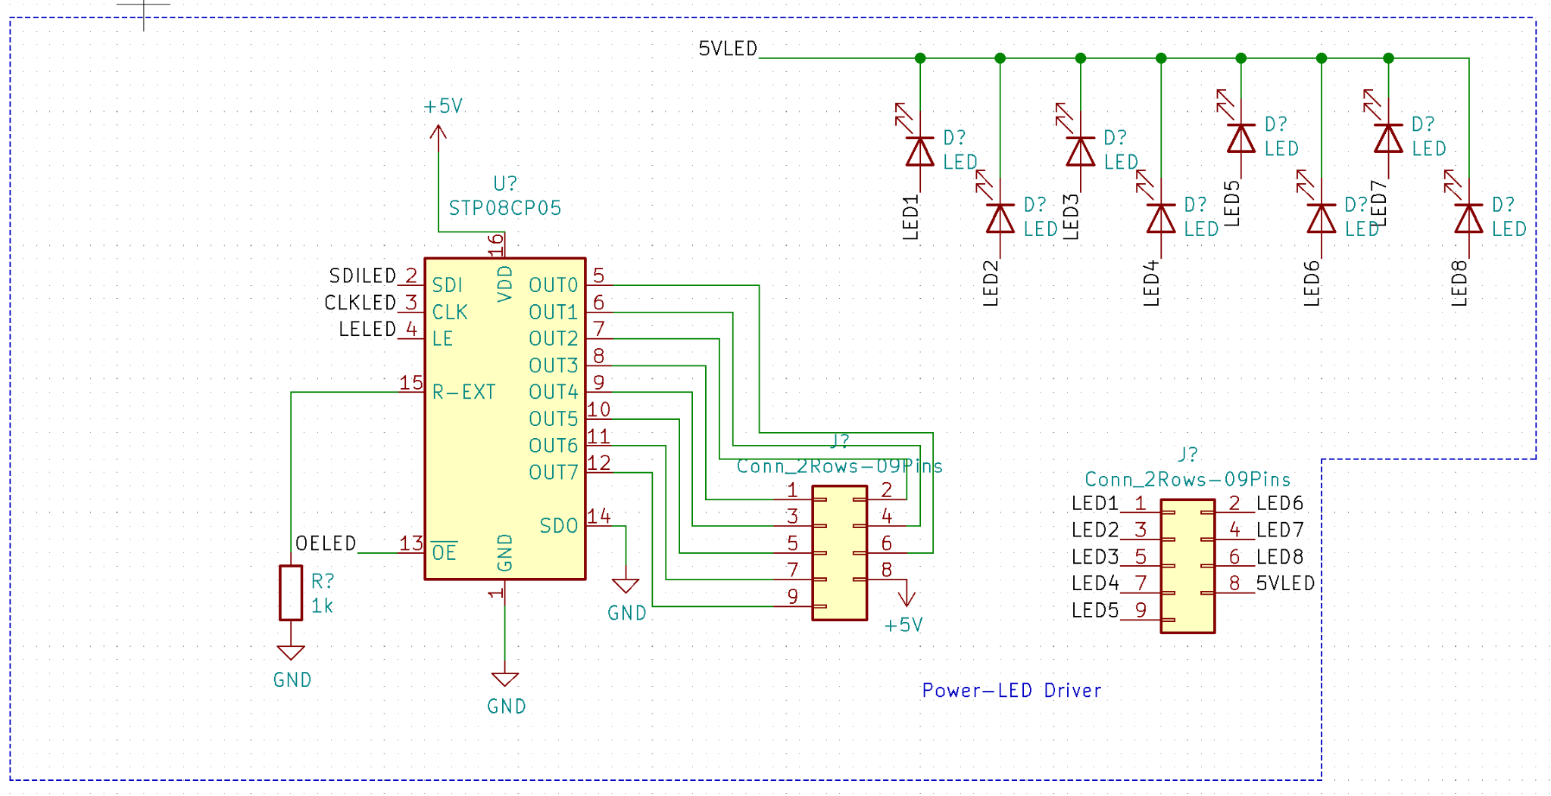
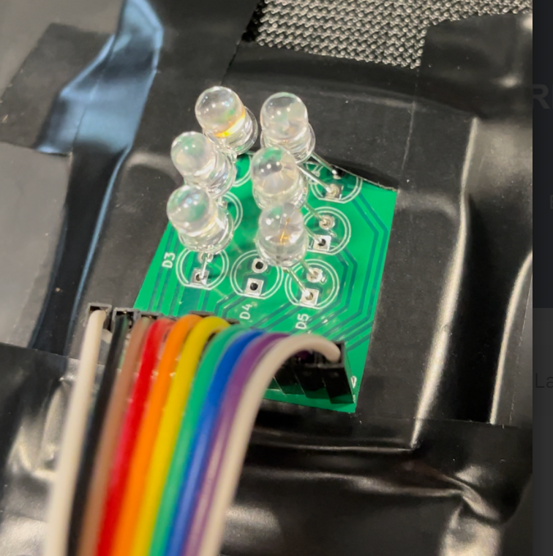
Design: Lighting
Lighting Subsystem
Components
LED Array
Separate PCB
6 LEDs arranged in circular pattern
LED Driver
Linear shift register
Supports 8 outputs
Adjustable current output (up to 100mA)
ELECTRICAL & COMPUTER ENGINEERING
GRAINGER ENGINEERING

Slide 19
Challenges: Lighting
Challenges
Changed LED wavelength values from 380-480nm to 440-660 nm
Initial UV LEDs were low power
UV light requires ppe for those around
Buying LEDs from the same manufacturer with equally spread out wavelengths is not possible unless custom ordered
Forced wavelengths to be spread out, dropped resolution to be about 36nm
ELECTRICAL & COMPUTER ENGINEERING
GRAINGER ENGINEERING

Slide 20
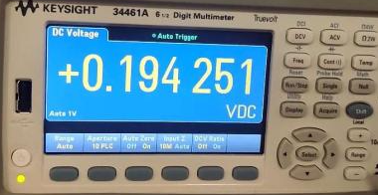
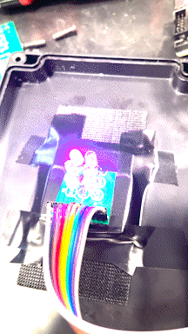
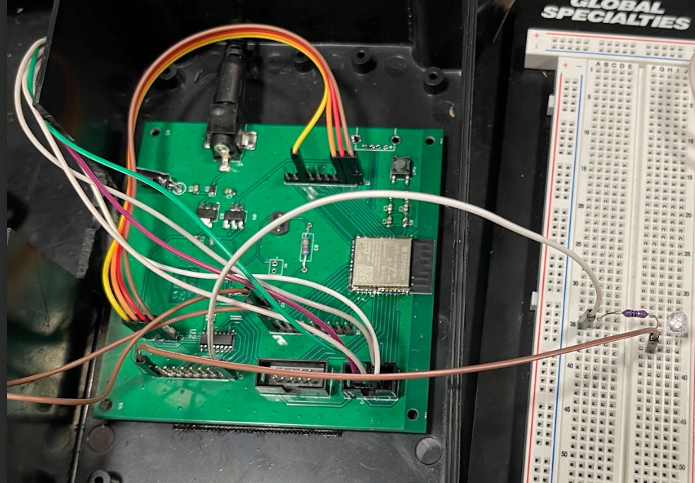
Subsystem Results: Lighting
Verification
All LEDs function and light up sequentially
No LEDs are lit when in standby
Sweeps in order of increasing wavelength
Verified our LED driver is supplying 20mA
Simple circuit with 10 ohm resistor
Measured voltage across resistor
ELECTRICAL & COMPUTER ENGINEERING
GRAINGER ENGINEERING

Slide 21
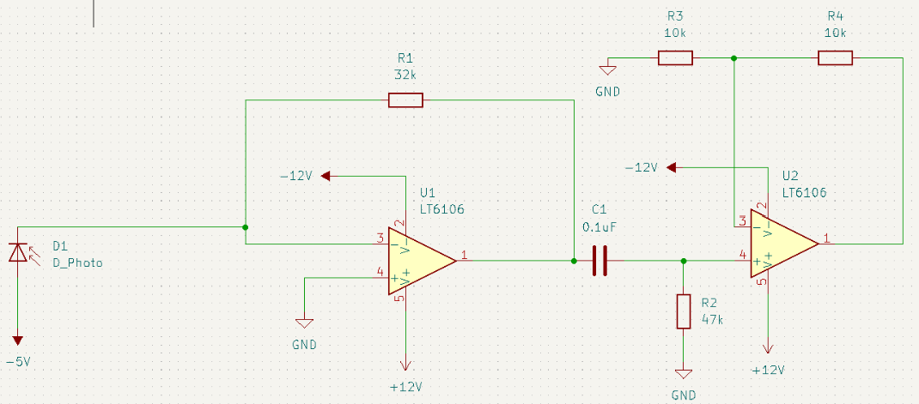
Design & Challenges: Detection
Initial Design
Components in our initial system:
Op-Amp
Photodiode
Charge pump to achieve +/- 5V Bias Voltages
Why did it not work?
Charge pump had extremely small footprint (difficult to place even with microscope)
Difficult to set gain
Initial Design
ELECTRICAL & COMPUTER ENGINEERING
GRAINGER ENGINEERING

Slide 22
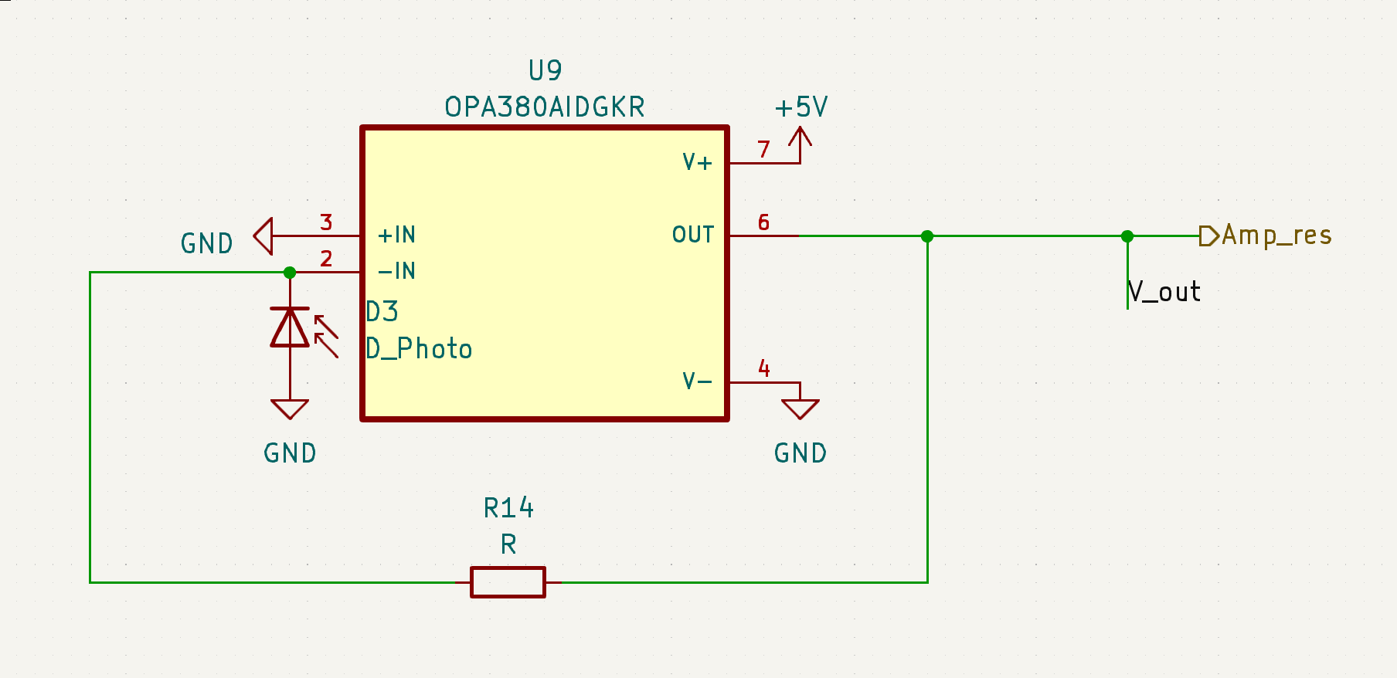
Design & Challenges: Detection
Revised Design
Revised subsystem components:
Transimpedance Amplifier
Photodiode
Biasing Resistor
Redesign
ELECTRICAL & COMPUTER ENGINEERING
GRAINGER ENGINEERING

Slide 23
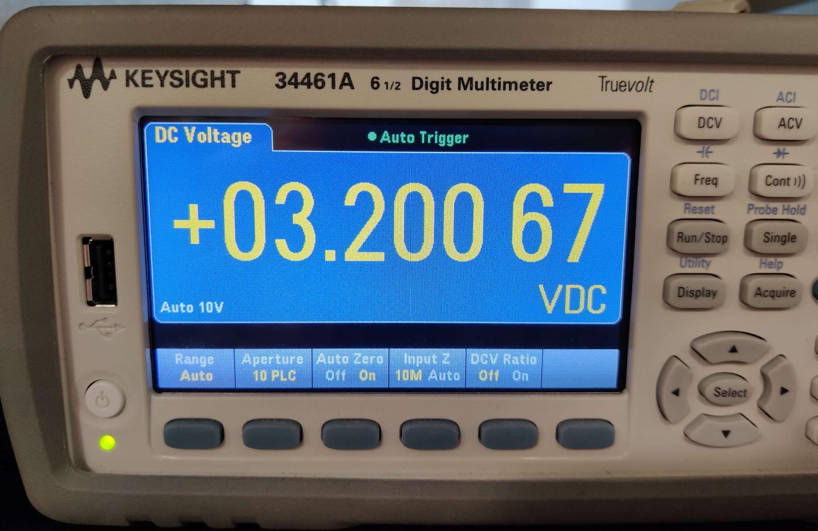
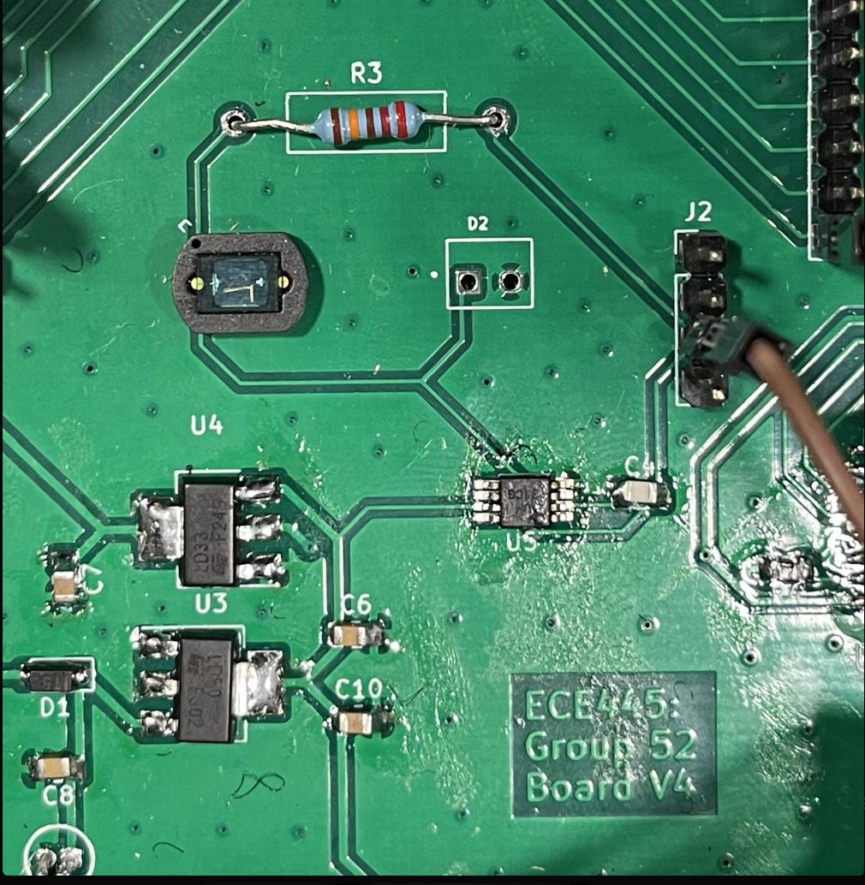
Subsystem Results: Detection
Results & Verification
We did not violate the 3.3V pin maximum of the ESP32 internal ADC
Confirmed the photodiode detection system could sweep from about a 0.27V minimum to about 3.2V maximum
Photodiode is central to the PCB layout, allowing for the viewing window to align with the photodiode
Gain is adjustable by changing only one through-hole resistor
Set gain according to the dark environment of our enclosure
ELECTRICAL & COMPUTER ENGINEERING
GRAINGER ENGINEERING

Slide 24
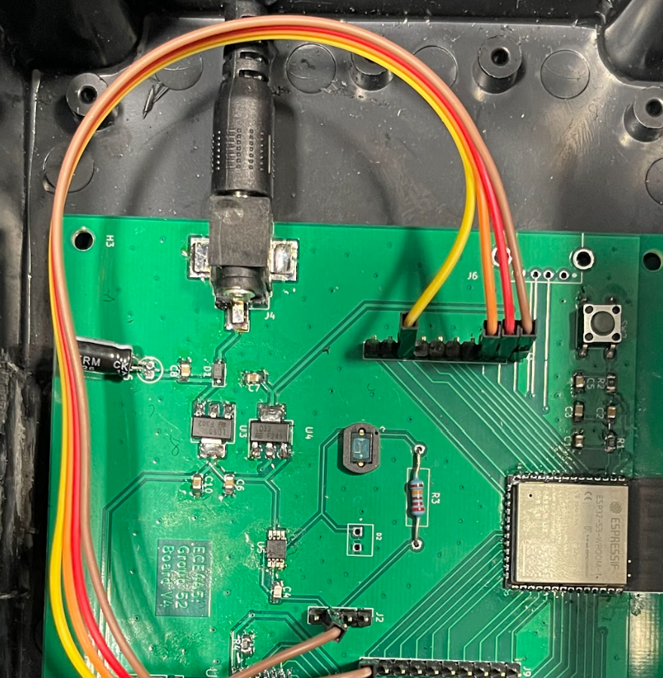
Design & Challenges: Power
Design
3.3V linear regulator
5V linear regulator
Barrel jack for 12V wall power supply connection
Challenges
None
ELECTRICAL & COMPUTER ENGINEERING
GRAINGER ENGINEERING

Slide 25
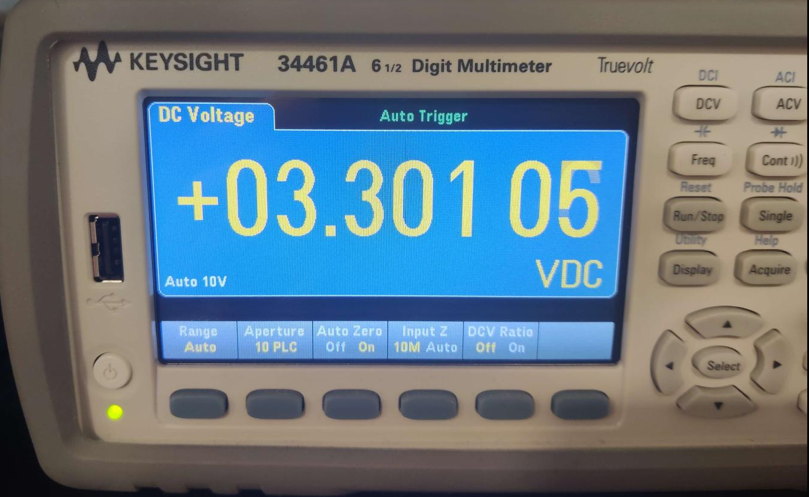
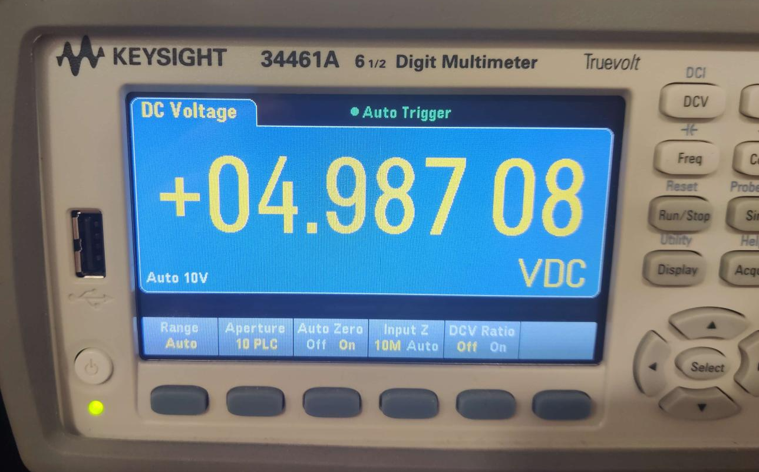
Requirements and Verification: Power
Requirements & Verification
The output voltage of the 3.3V voltage regulators should be (3.3±0.2)V
Measured the output of the 3.3V regulator during the process of a sample collection
The output voltage of the 5V voltage regulators should be (5±0.2)V
Measured the output of the 5V regulator during the process of a sample collection
ELECTRICAL & COMPUTER ENGINEERING
GRAINGER ENGINEERING

Slide 26
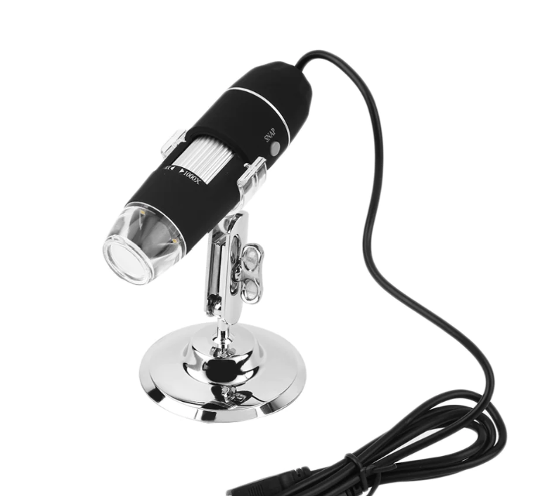
✅
✅
Moving Forward
Spectrometer system is complete and ready to be integrated
Hand off to the STRE&M project managers
Integration into overall system
Digital Microscope
Footprint & connections were included in PCB design
Future teams or individuals working on the project can implement a digital microscope using the same PCB
✅
✅
✅
ELECTRICAL & COMPUTER ENGINEERING
GRAINGER ENGINEERING

Slide 27
Any additional questions?
Please feel free to ask or email us!
Contact Information
Adrian Jimenez: adrianj2@illinois.edu
Yichi Zhang: yichi7@illinois.edu
Gage Gulley: ggulley2@illinois.edu
ELECTRICAL & COMPUTER ENGINEERING
GRAINGER ENGINEERING

