Slide 1
RFID Lock
Team 40
By Nich Rogers, David Sullivan, Arely Irra

Slide 2
Agenda:
1. Introduction
2. Functionality
3. Successes & Failures
4. Conclusions & Further Work
2/24
ELECTRICAL & COMPUTER ENGINEERING
GRAINGER ENGINEERING

Slide 3
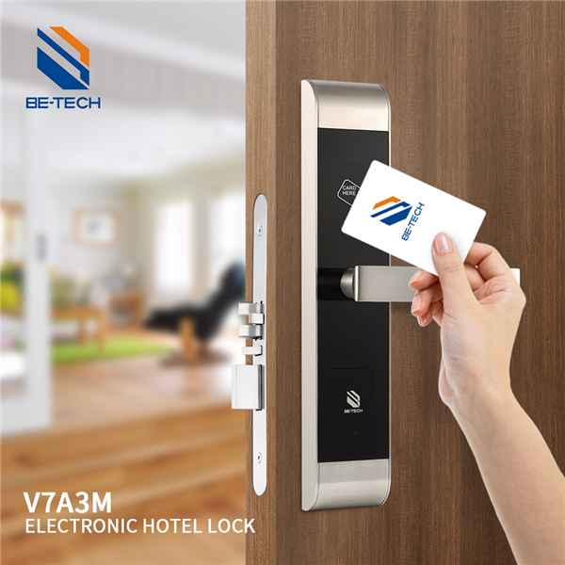
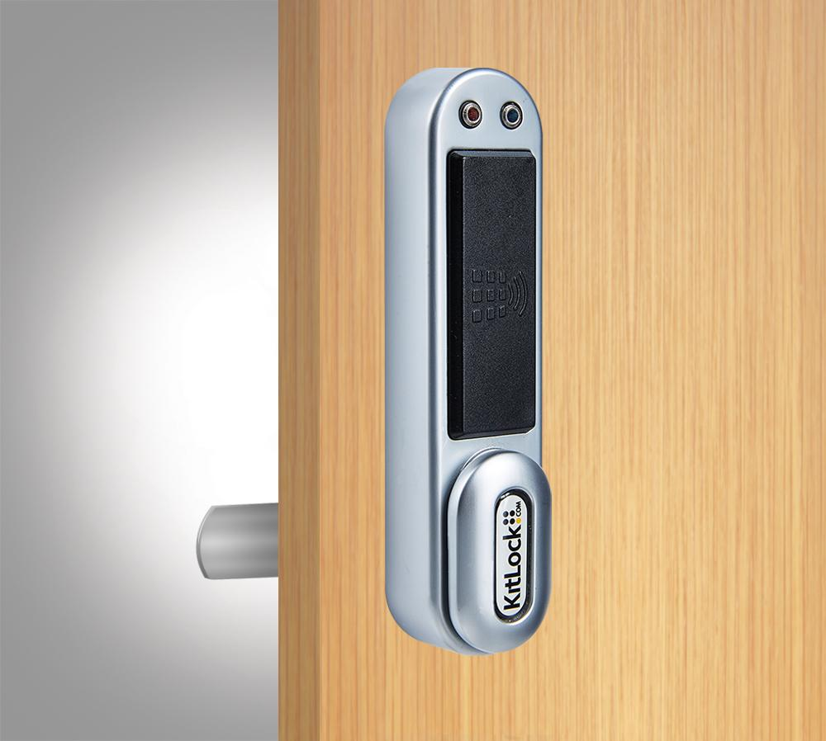
Objective: What are we solving?
Why are RFID locks useful?
Examples of uses
college apartments, visually impaired, health conditions
Rent friendly version
Do NOT exist
Replace entire handle, deadbolt
Security deposit
3/24
ELECTRICAL & COMPUTER ENGINEERING
GRAINGER ENGINEERING
Notes:
Renter friendly solutions do not exist or is not being made by possible competitors and physical design aspect would allow ours to be a unique entry into the market

Slide 4
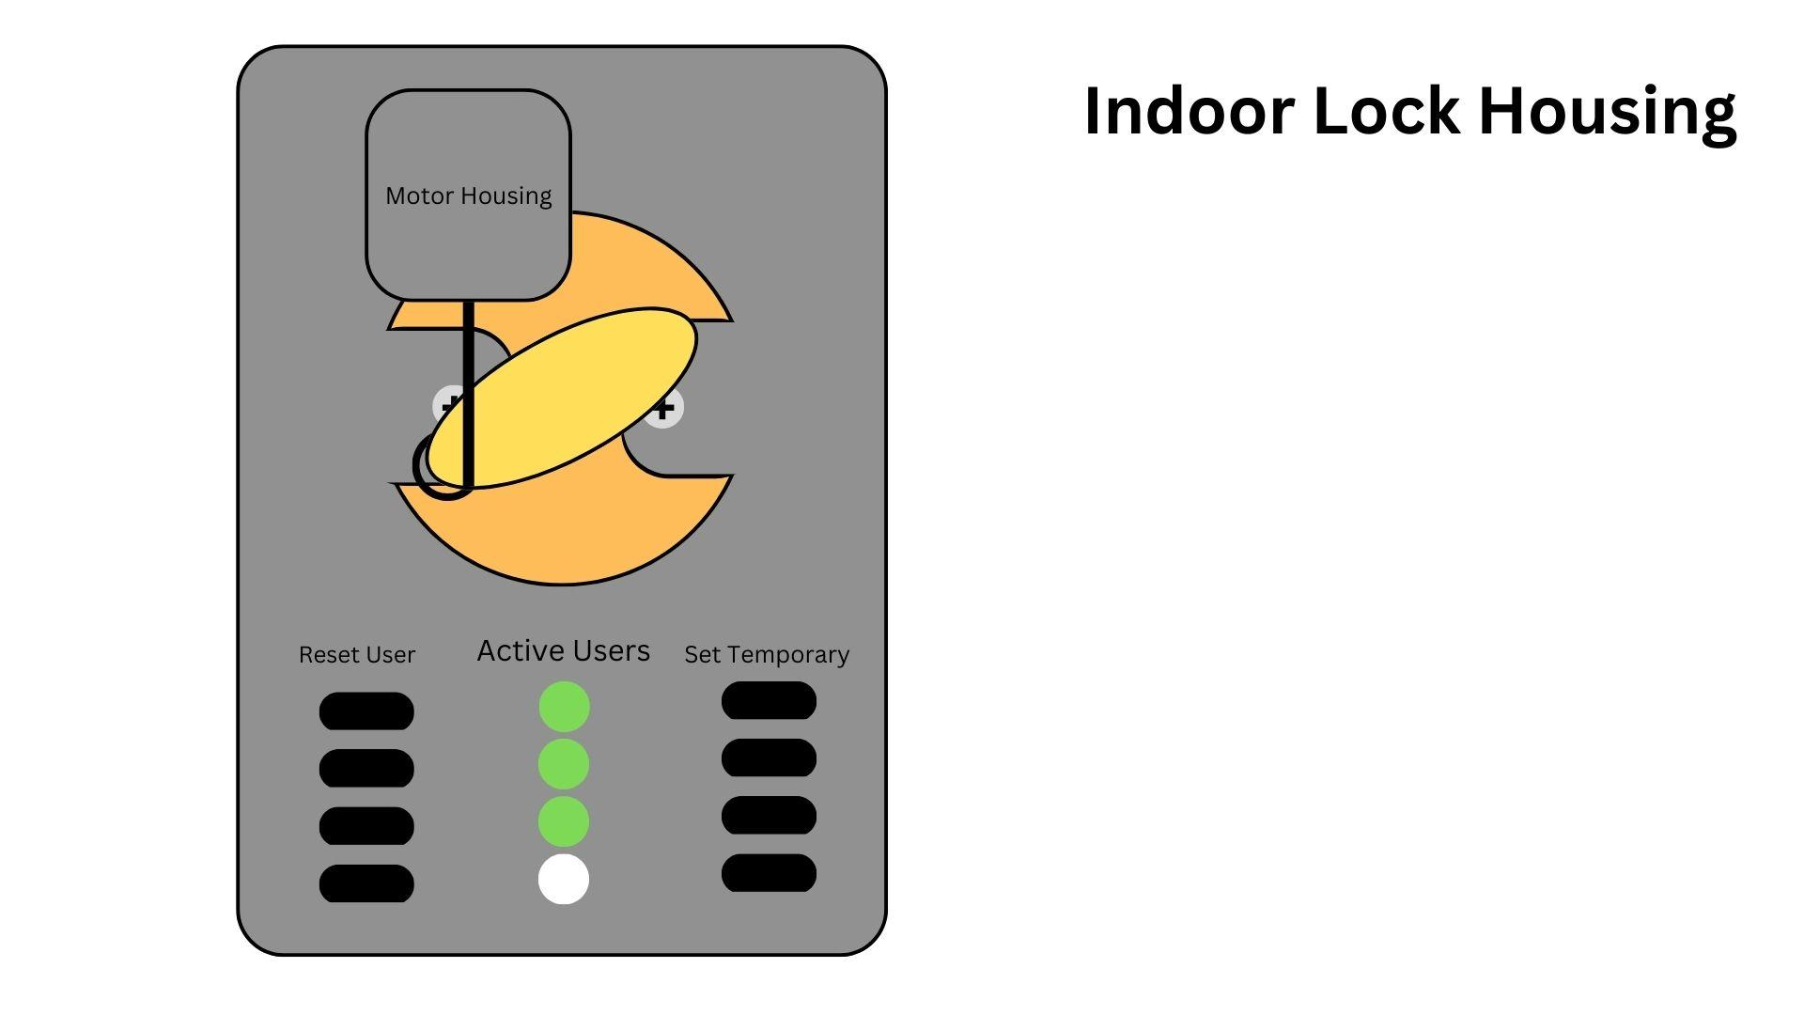
Initial Design
Physical Design
Competitive
Current Infrastructure
Allow normal use
4/24
ELECTRICAL & COMPUTER ENGINEERING
GRAINGER ENGINEERING
Notes:
Initial designs of the product focused on the physical as that is what would set our product apart from competitors. Our product would exist with current infrastructure on apartment doors to allow continued access of current keys for roommates, landlords etc to have access but allow for new RFID access as well.

Slide 5
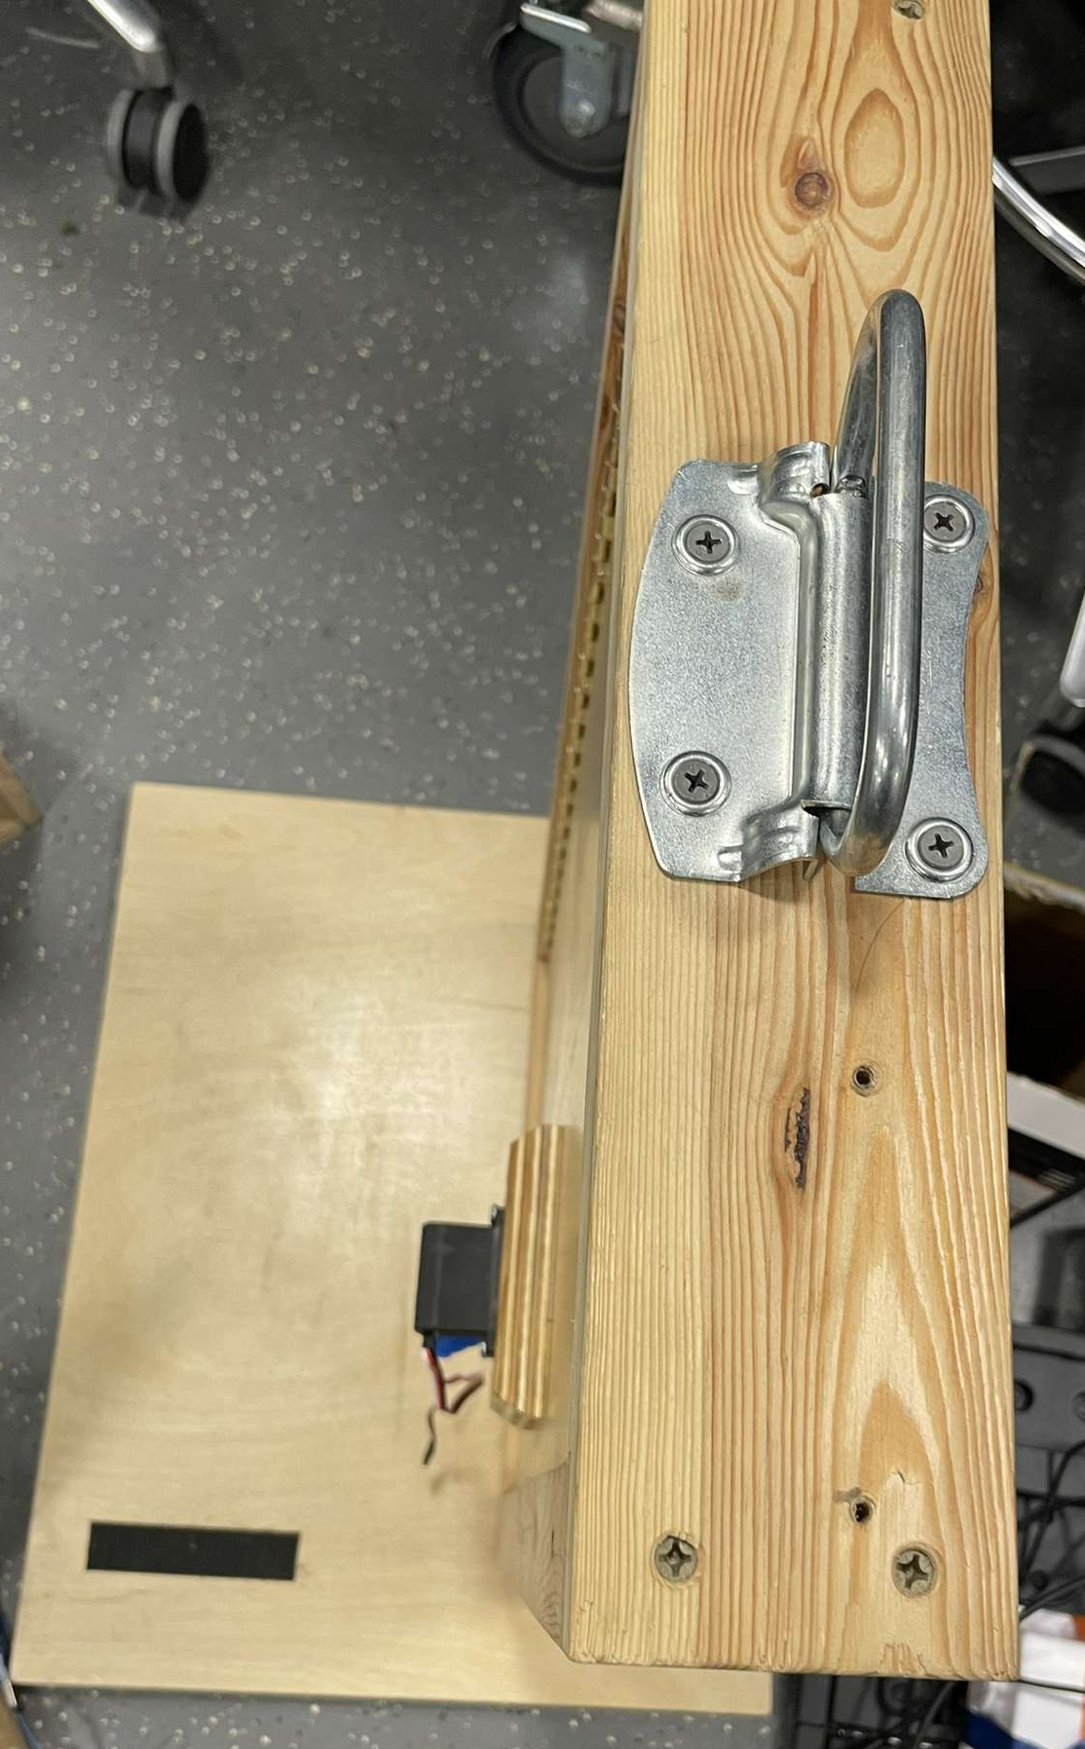
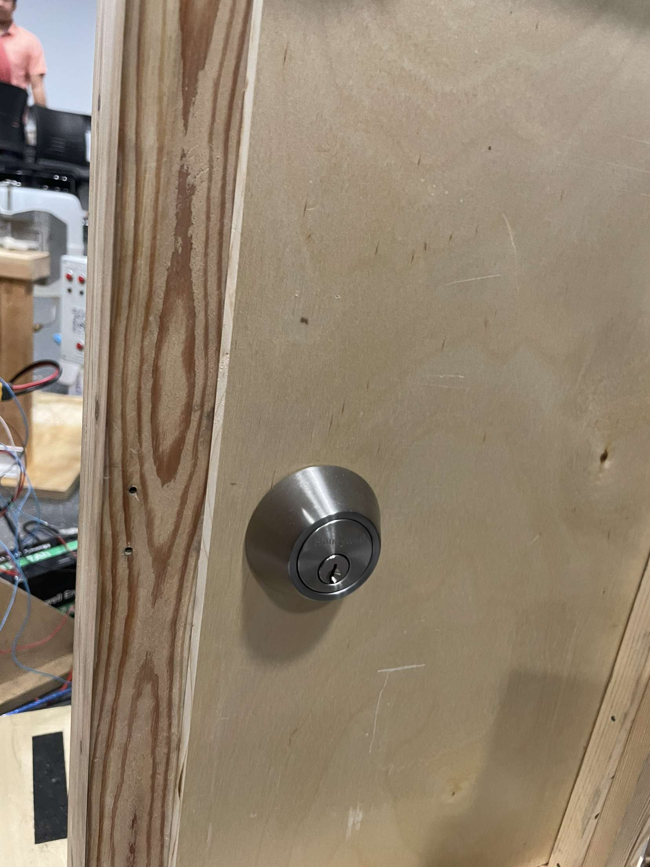
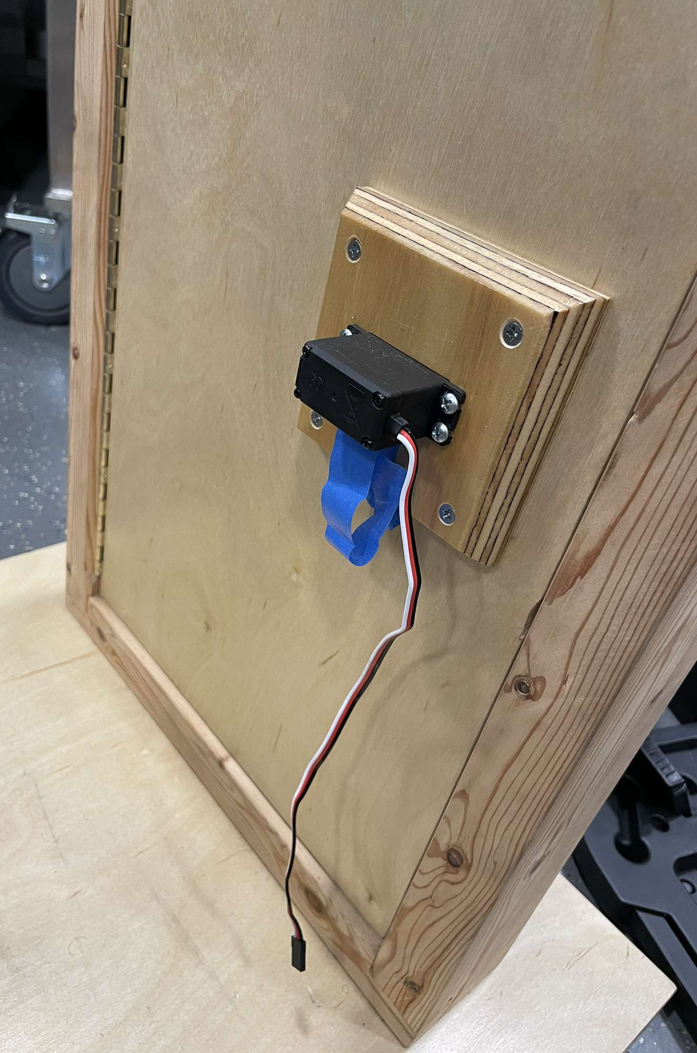
Design Changes
Prototype
Machine Shop
Design discussion
Torque
Base plate vs. final
Needs more refinement
Top View
Front View
Back View
5/24
ELECTRICAL & COMPUTER ENGINEERING
GRAINGER ENGINEERING
Notes:
The idea itself was workshopped with the machine shop on how to mount a servo motor to effectively rotate the lock. It was recommended that we use a high-torque servo motor mounted to the lock via a custom metal base plate. It ended up almost replacing the inside portion of the deadbolt entirely and needs more refinement to be the rent friendly product we had in mind but at this point the physical aspect was not the main focus anymore.

Slide 6
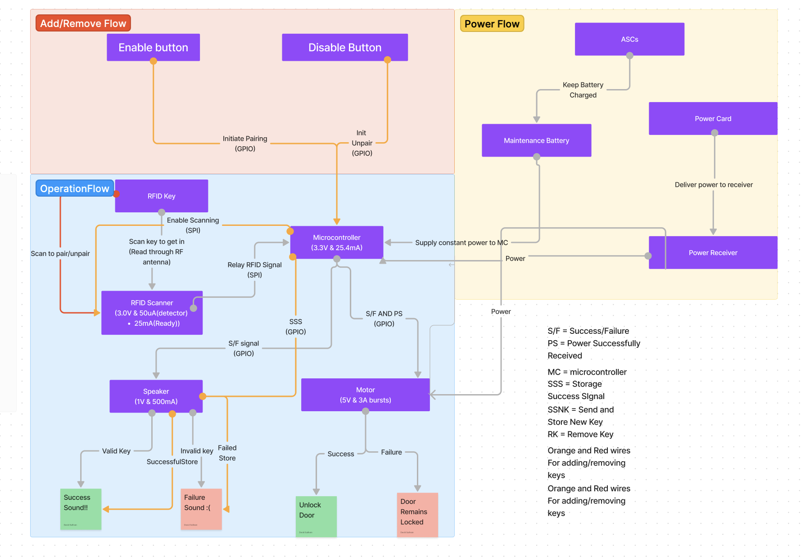
Block Diagram
High Level Overview of block diagram
IMAGE / GRAPHIC
6/24
ELECTRICAL & COMPUTER ENGINEERING
GRAINGER ENGINEERING
Notes:
Here is a quick overview of the high level subsystems of our design. We had three main subsystems: the power subsystem, the door management subsystem and the user interface subsystem. The power subsystem consists of the wireless power transmitter and receiver that form the heart of the project. The door management subsystem is the controlling component of the project, consisting of the the NFC scanner, microcontroller and servo motor that all interact to unlock/lock the door. Lastly, for user interfacing, we have a button to add a key to the system’s memory.

Slide 7
Functionality
Test results and data
7/24
ELECTRICAL & COMPUTER ENGINEERING
GRAINGER ENGINEERING

Slide 8
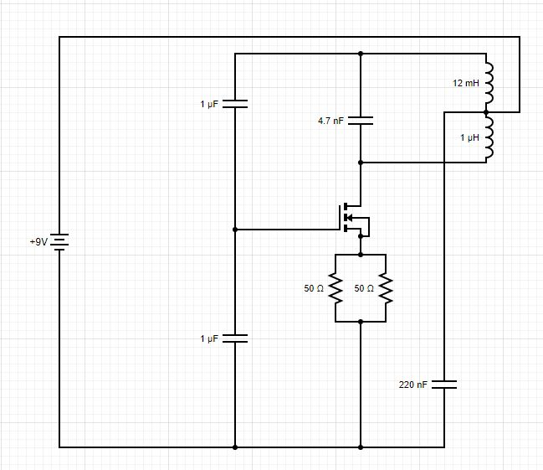
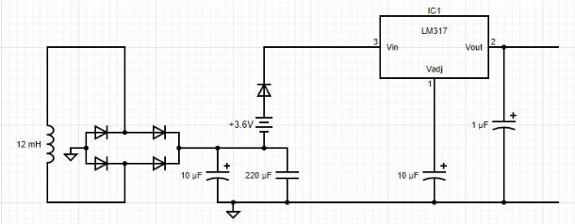
Brief Overview
Power Circuits
Induction Power
LC Oscillator
Two separate circuits
Source and Sink
8/24
ELECTRICAL & COMPUTER ENGINEERING
GRAINGER ENGINEERING
Notes:
Our design was meant to use induction charging. Induction charging uses an alternating current in one inductor to induce an emf in another inductor. Air is the medium this energy is transferred over most commonly and in our circuit.
Since this requires two separate circuits for one circuit will act as the power source and the other as the power sink. The power sink has an output of 5V where there computation and functional components will be connected (microcontroller, motor, RFID reader etc…)

Slide 9
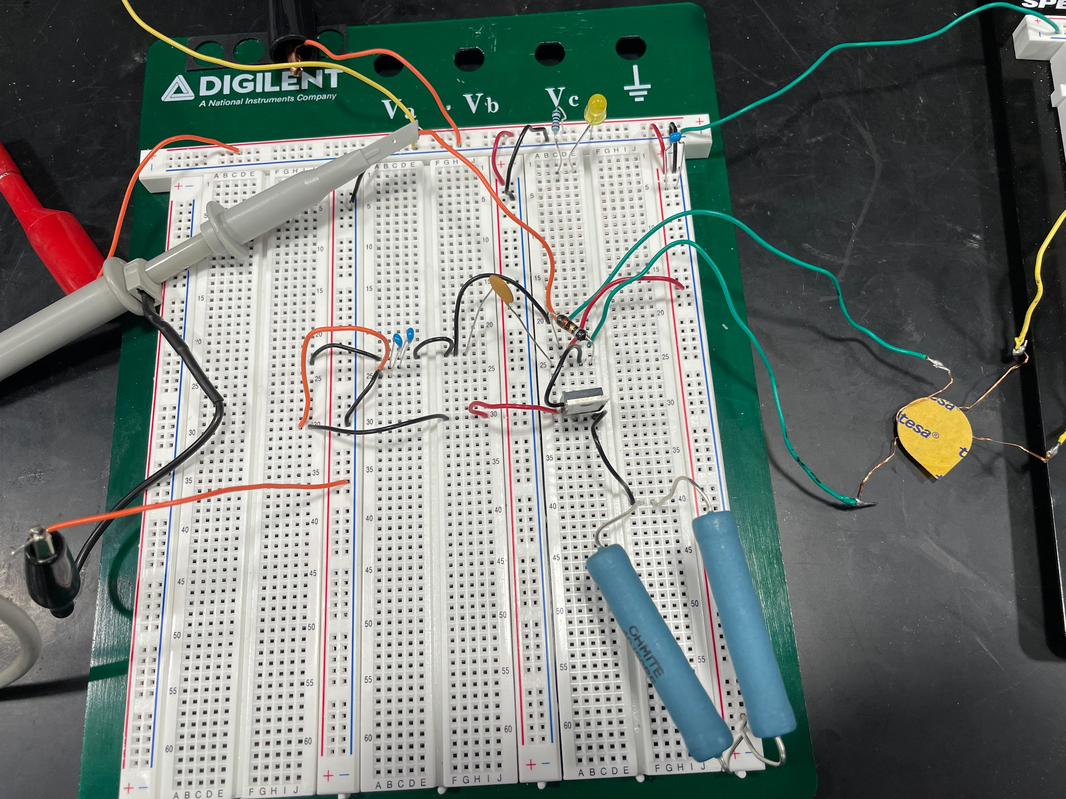
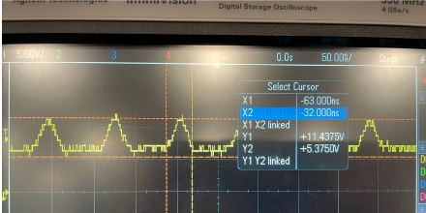
Power Supply
Operating power source
Induction power supply
Mosfet
~50 ns
9/24
ELECTRICAL & COMPUTER ENGINEERING
GRAINGER ENGINEERING
Notes:
Using induction to supply power means we need an alternating current source.
Using a mosfet as a switch we are able to get an AC current through the induction charging coil. This current oscillation reflected by the oscillating voltage swapped at a rate of ~50 nanoseconds with the inductor changing from a voltage of ~11.5 V to ~5.5 V with reference to ground.

Slide 10
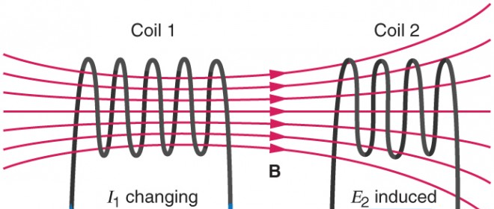
Power Supply
Powersink
EMF
1.7 Volts, at .1 Amps
Needed 5V at .4745A
Compensation
1,500 uses
10/24
ELECTRICAL & COMPUTER ENGINEERING
GRAINGER ENGINEERING
Notes:
The alternating current induces an emf in the opposite coil when placed in vicinity
Output
This AC emf induced was converted to a DC voltage. This voltage only managed to hit 1.7V at .1 A. Not close enough to the required 5V, .4745 A.
Adding a 3.6 V battery to boost the voltage allowed the linear voltage regulator to charge to the necessary voltage within a range of ~3.5-30 seconds.
When removing testing outliers this goes down to ~3.5-8 seconds.

Slide 11
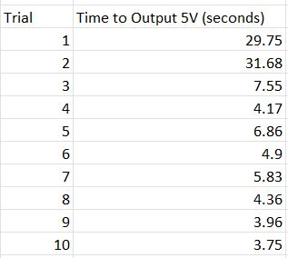
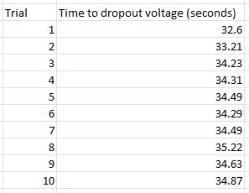
Circuit Charging Data
Charging Trials
Discharging Trials
11/24
ELECTRICAL & COMPUTER ENGINEERING
GRAINGER ENGINEERING

Slide 12
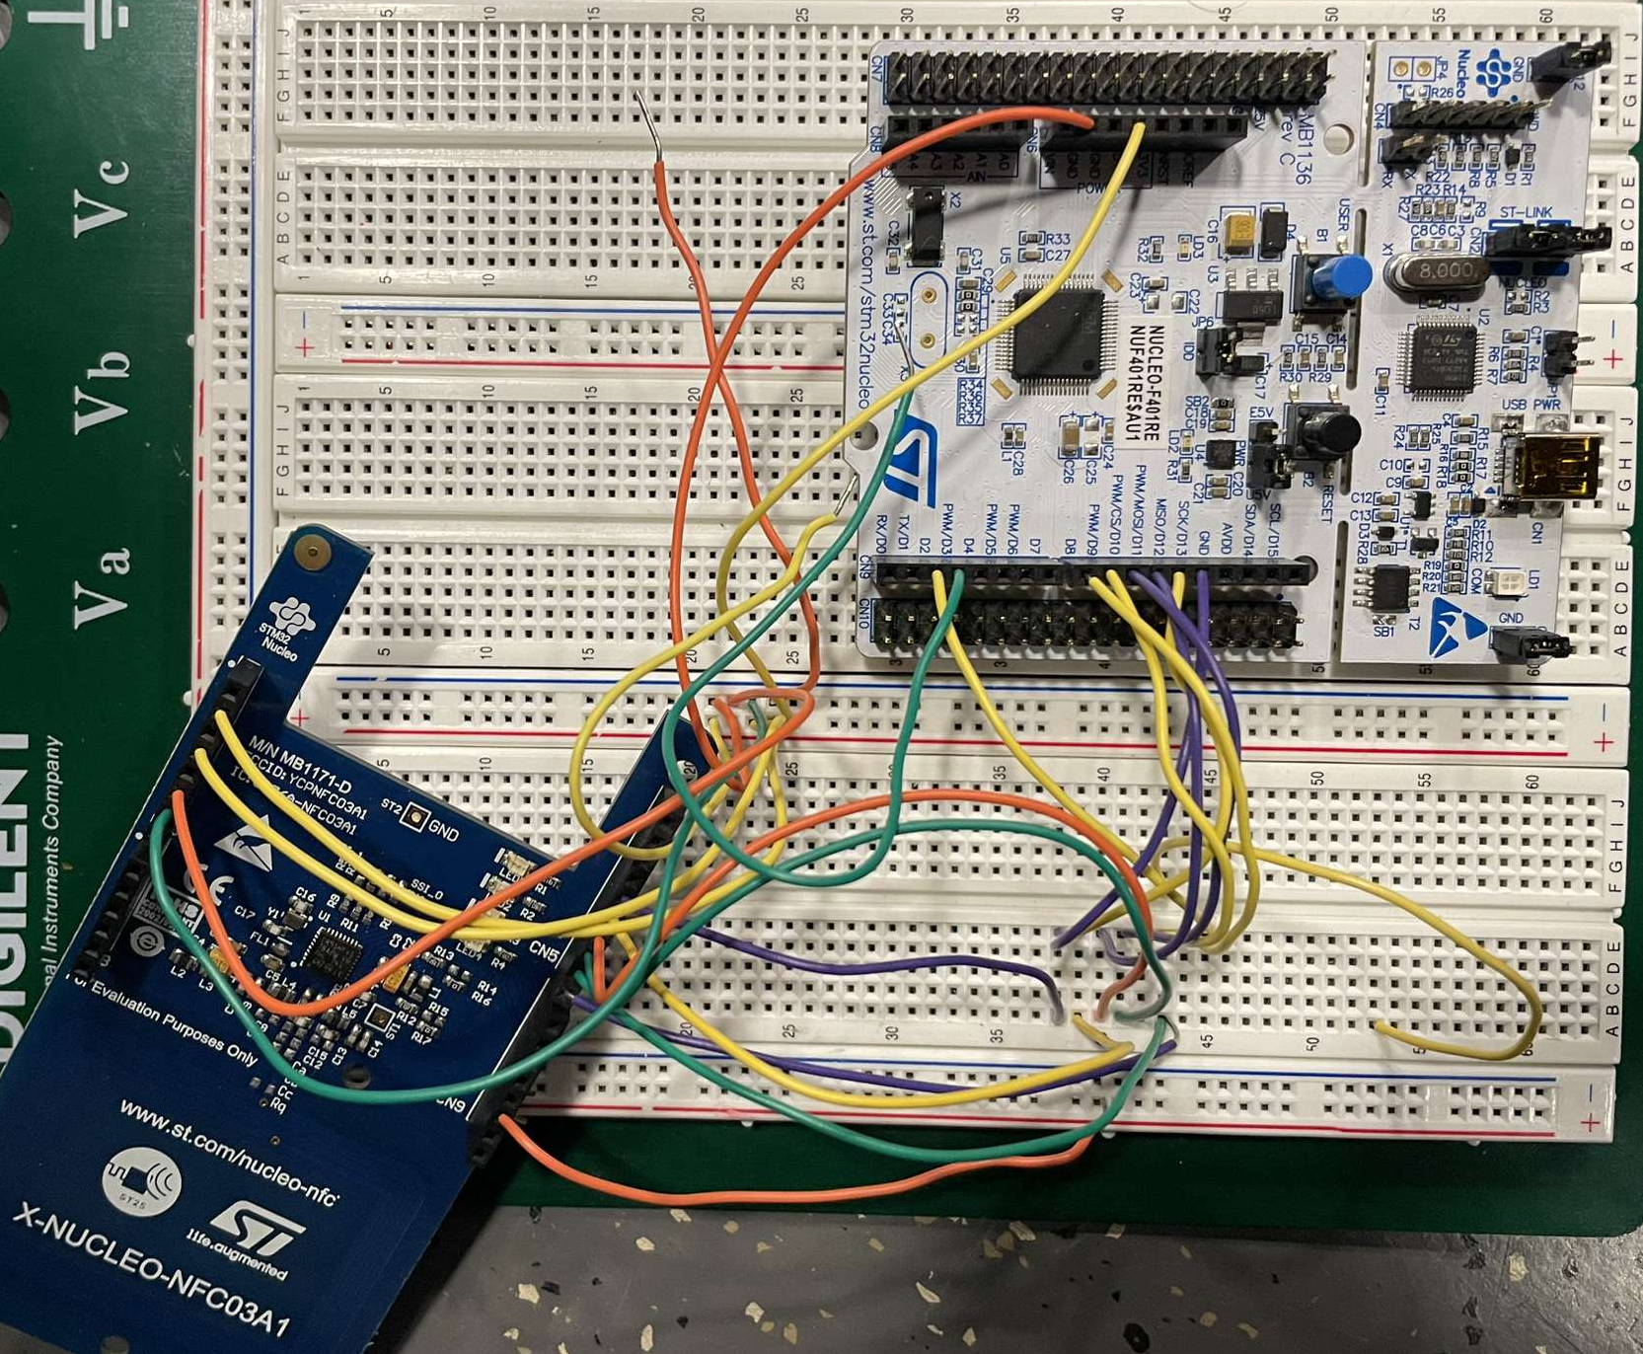
RFID/NFC Implementation
12/24
ELECTRICAL & COMPUTER ENGINEERING
GRAINGER ENGINEERING
Notes:
Unfortunately, we were unable to get our system soldered onto the PCB and so ended up breadboarding the system to get the desired functionality. The circuit itself is relatively simple, with the microcontroller connected to the NFC scanner, servo motor and button. Most of the magic here occurs in the microcontroller where the key is read and stored. The button on the

Slide 13
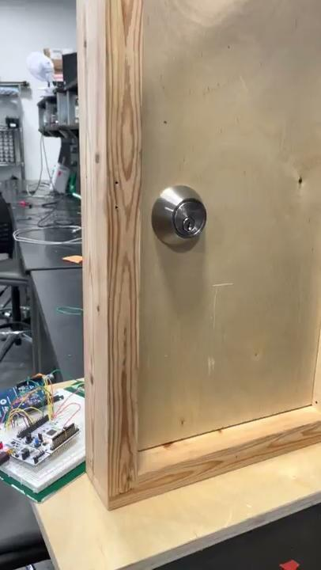
RFID/NFC Implementation
https://youtu.be/UBmJpX4orZQ
13/24
ELECTRICAL & COMPUTER ENGINEERING
GRAINGER ENGINEERING
Notes:
Here is a quick demonstration of the NFC system working in full. Try to not to read the numbers on my credit card too closely :)

Slide 14
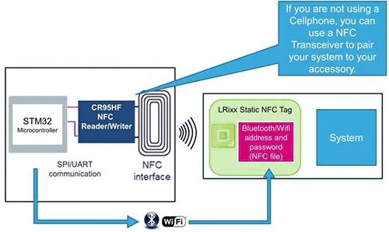
RFID Considerations/Concerns
Necessary Considerations
Pros:
NFC is ubiquitous
Well documented
Expandable to Smartphone Applications
Cons:
NFC is relatively short range
RF communication protocols are confusing for first time developers
IMAGE / GRAPHIC
14/24
ELECTRICAL & COMPUTER ENGINEERING
GRAINGER ENGINEERING

Slide 15
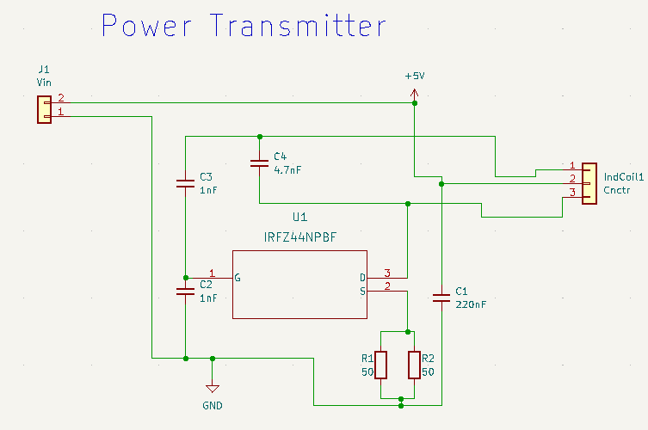
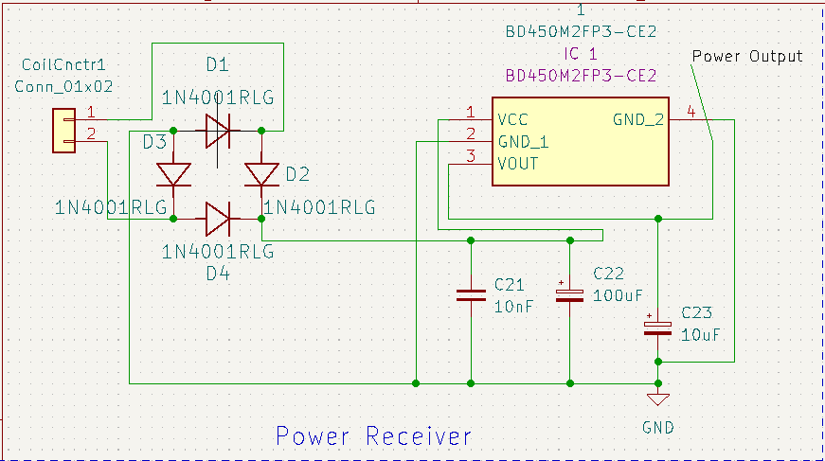
PCB Designs
Power Circuits
15/24
ELECTRICAL & COMPUTER ENGINEERING
GRAINGER ENGINEERING

Slide 16
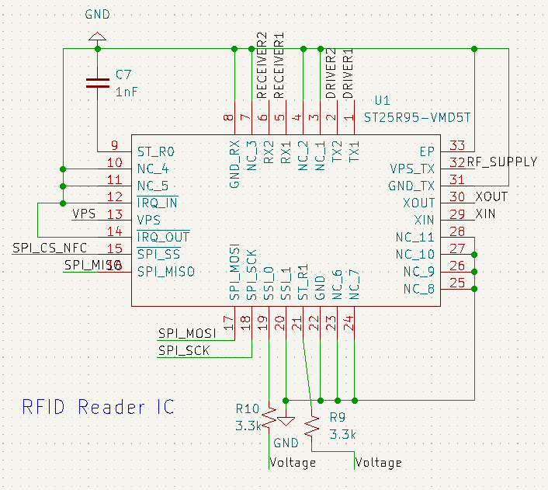
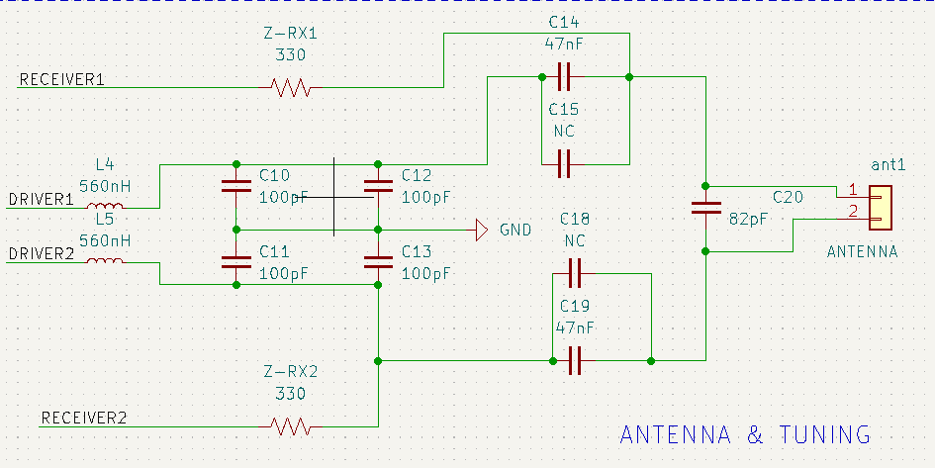
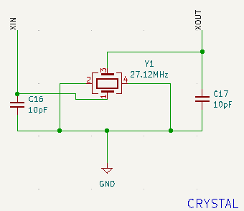
PCB Designs
Door Unit PCB P1
16/24
ELECTRICAL & COMPUTER ENGINEERING
GRAINGER ENGINEERING

Slide 17
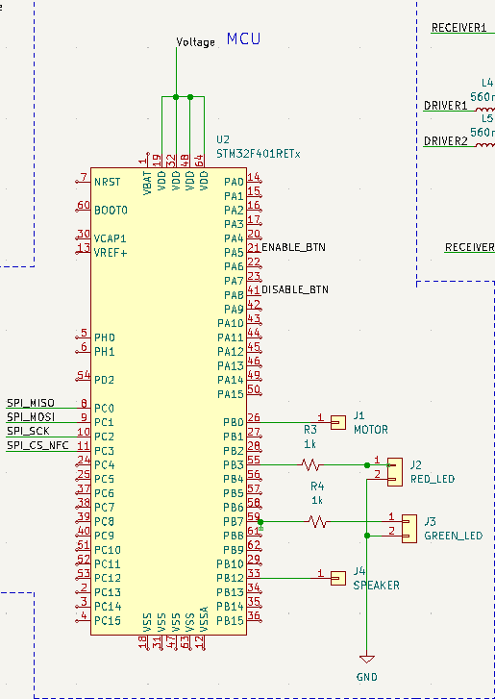
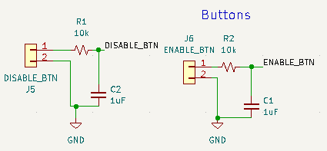
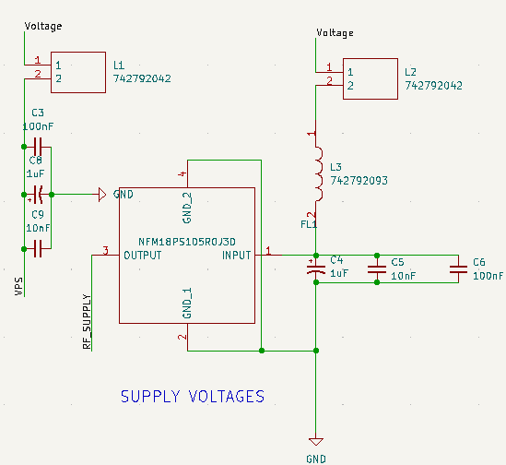
PCB Designs
Door Unit PCB P2
17/24
ELECTRICAL & COMPUTER ENGINEERING
GRAINGER ENGINEERING

Slide 18
Successes & Failures
18/24
ELECTRICAL & COMPUTER ENGINEERING
GRAINGER ENGINEERING

Slide 19
Power circuit
LC Oscillator
Troubleshooting
Mosfet, and current ratings
Induced emf
Too low
1.7 V boosted with battery
Solutions
Coil turns, area, B field/current
Higher rated parts
Capacitors
Voltage
output times
discharge times
19/24
ELECTRICAL & COMPUTER ENGINEERING
GRAINGER ENGINEERING
Notes:
LC Oscillator
The power source circuit is an LC Oscillator which took more troubleshooting than anticipated. Taking into account current draw we were able to source higher current rated resistors from ECE store and got this working.
Induced emf
While the coupled induction coils produced an emf in the sink, it was not strong enough to hit 5V output at .4745A.
Induced emf is based on:
Coil turns
Change in flux over time
larger area, higher turn count, or increased B field
Increased current flow through power source
New mosfet and resistors with even higher current ratings.
Capacitors
Voltage output times
Voltage discharge times

Slide 20
Lock Management Subsystem
RFID Reader
Differentiating between different NFC protocols
NFC has multiple sub protocols, each with different key lengths
Need more data on power requirements
Successfully able to read and decode NFC cards
Microcontroller
Flash Memory
Too many reads and writes
Successfully wrote keys to memory
Keys overwriting each other, could unlock with unadded keys
Like RFID Reader, need accurate power measurement
Servo Motor
Voltage Requirements
Initial measurements incorrect, to run successfully, servo required 5V/3A
20/24
ELECTRICAL & COMPUTER ENGINEERING
GRAINGER ENGINEERING
Notes:
LC Oscillator
The power source circuit is an LC Oscillator which took more troubleshooting than anticipated. Taking into account current draw we were able to source higher current rated resistors from ECE store and got this working.
Induced emf
While the coupled induction coils produced an emf in the sink, it was not strong enough to hit 5V output at .4745A.
Induced emf is based on:
Coil turns
Change in flux over time
larger area, higher turn count, or increased B field
Increased current flow through power source
New mosfet and resistors with even higher current ratings.
Capacitors
Voltage output times
Voltage discharge times

Slide 21
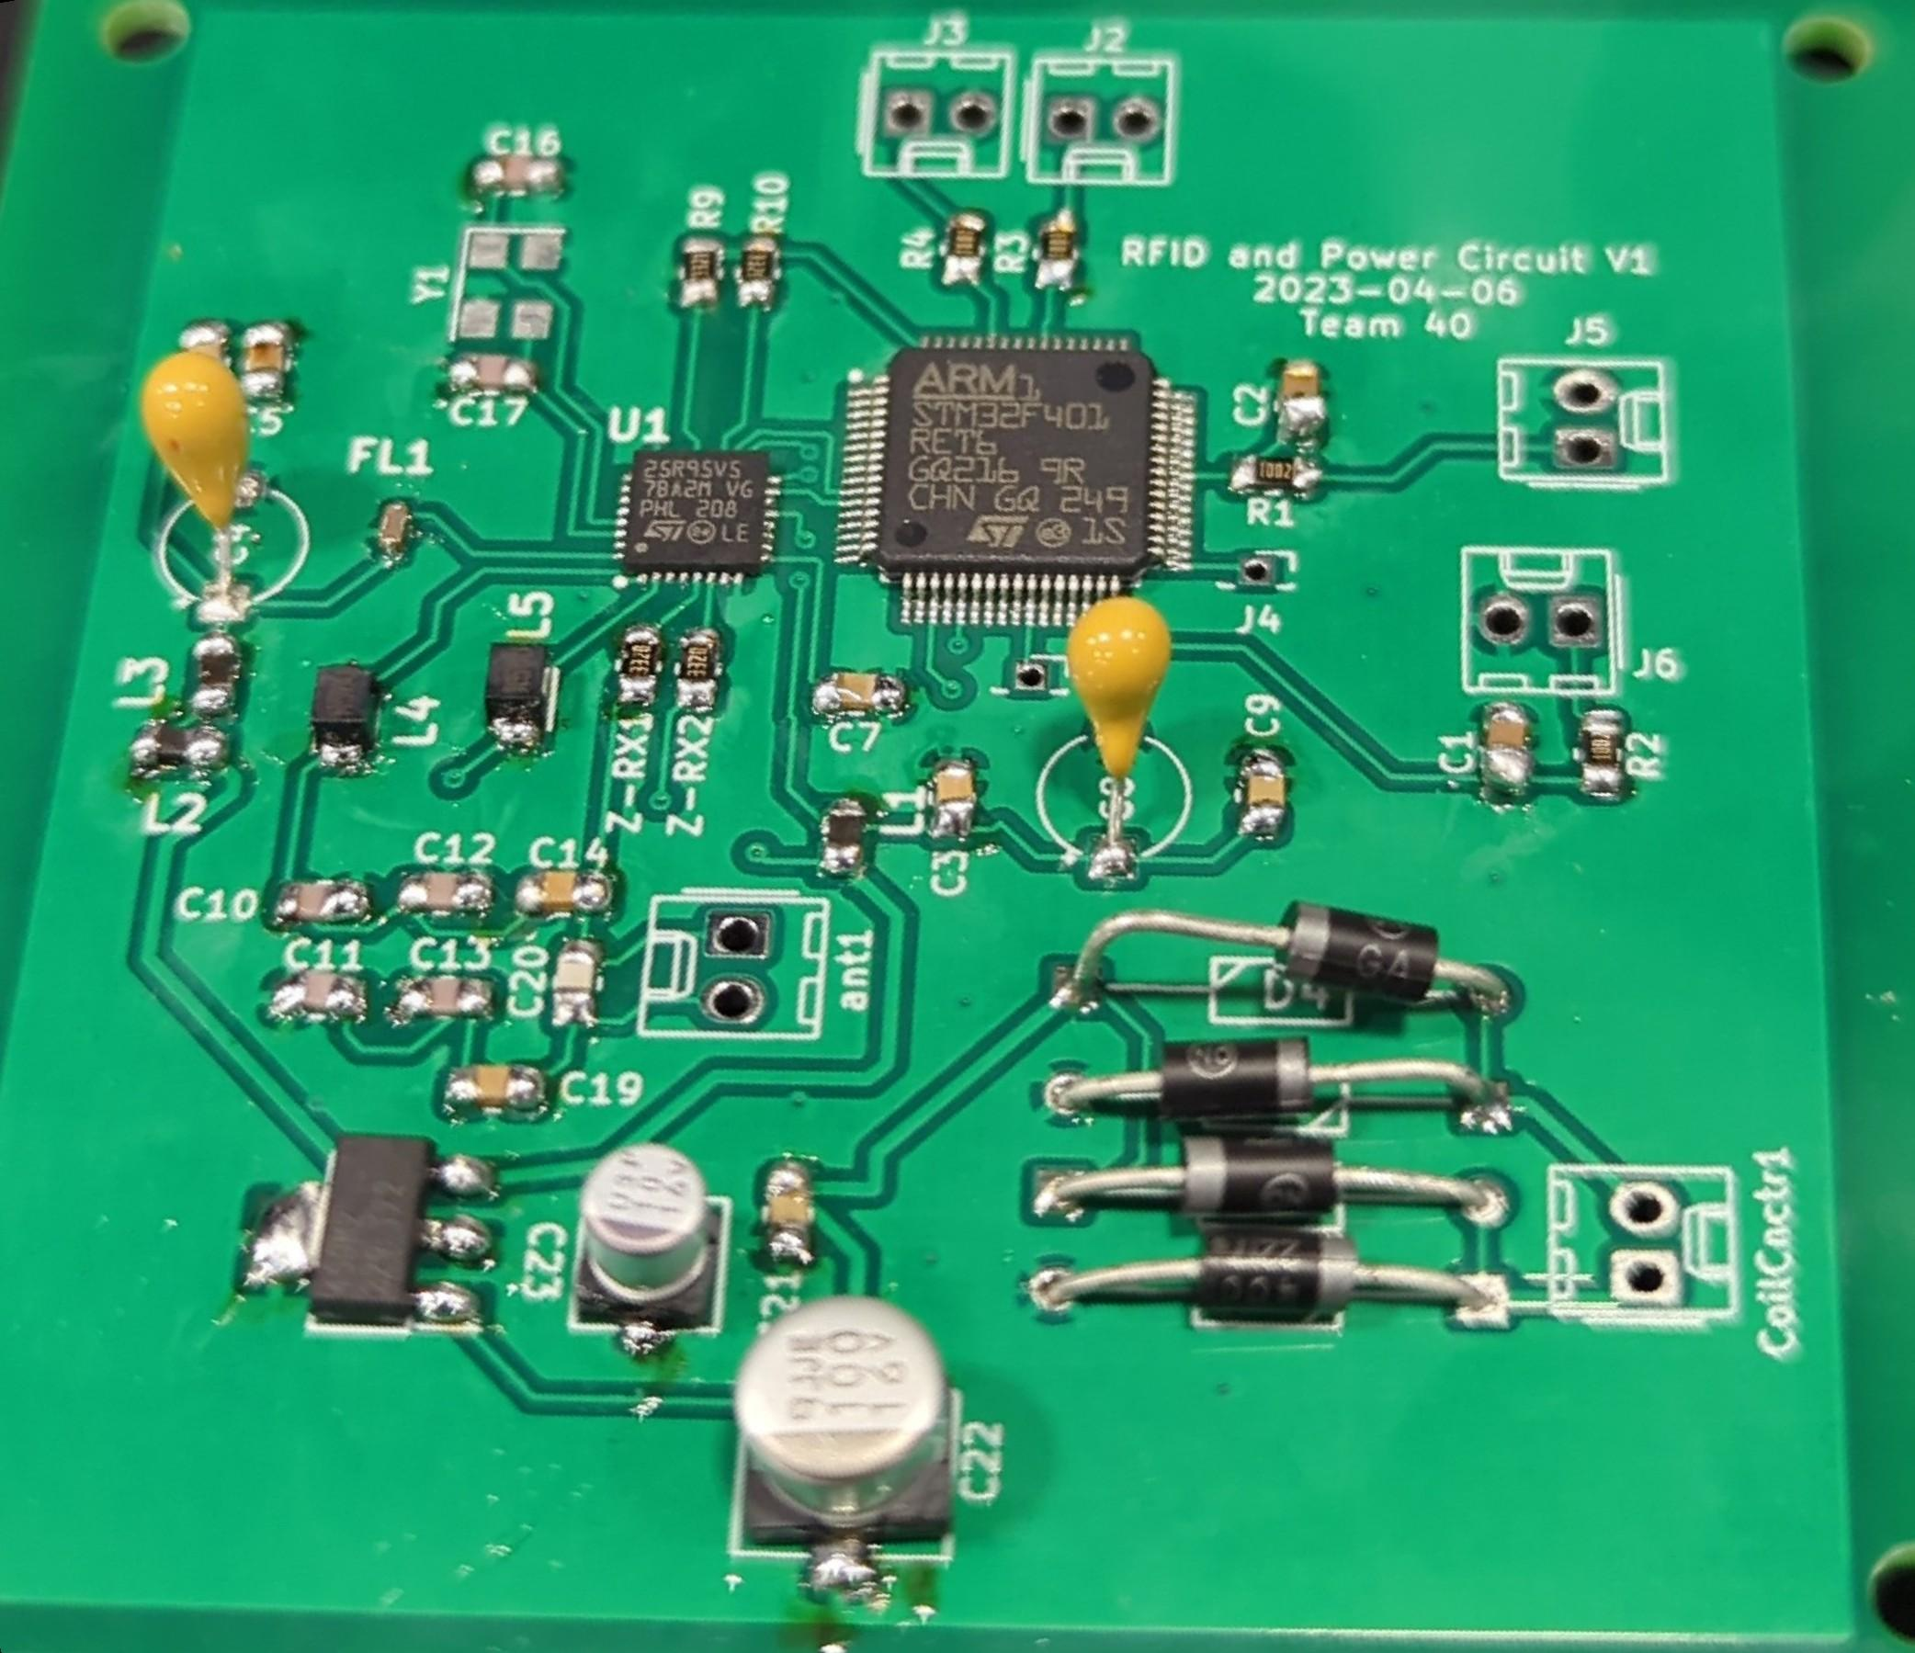
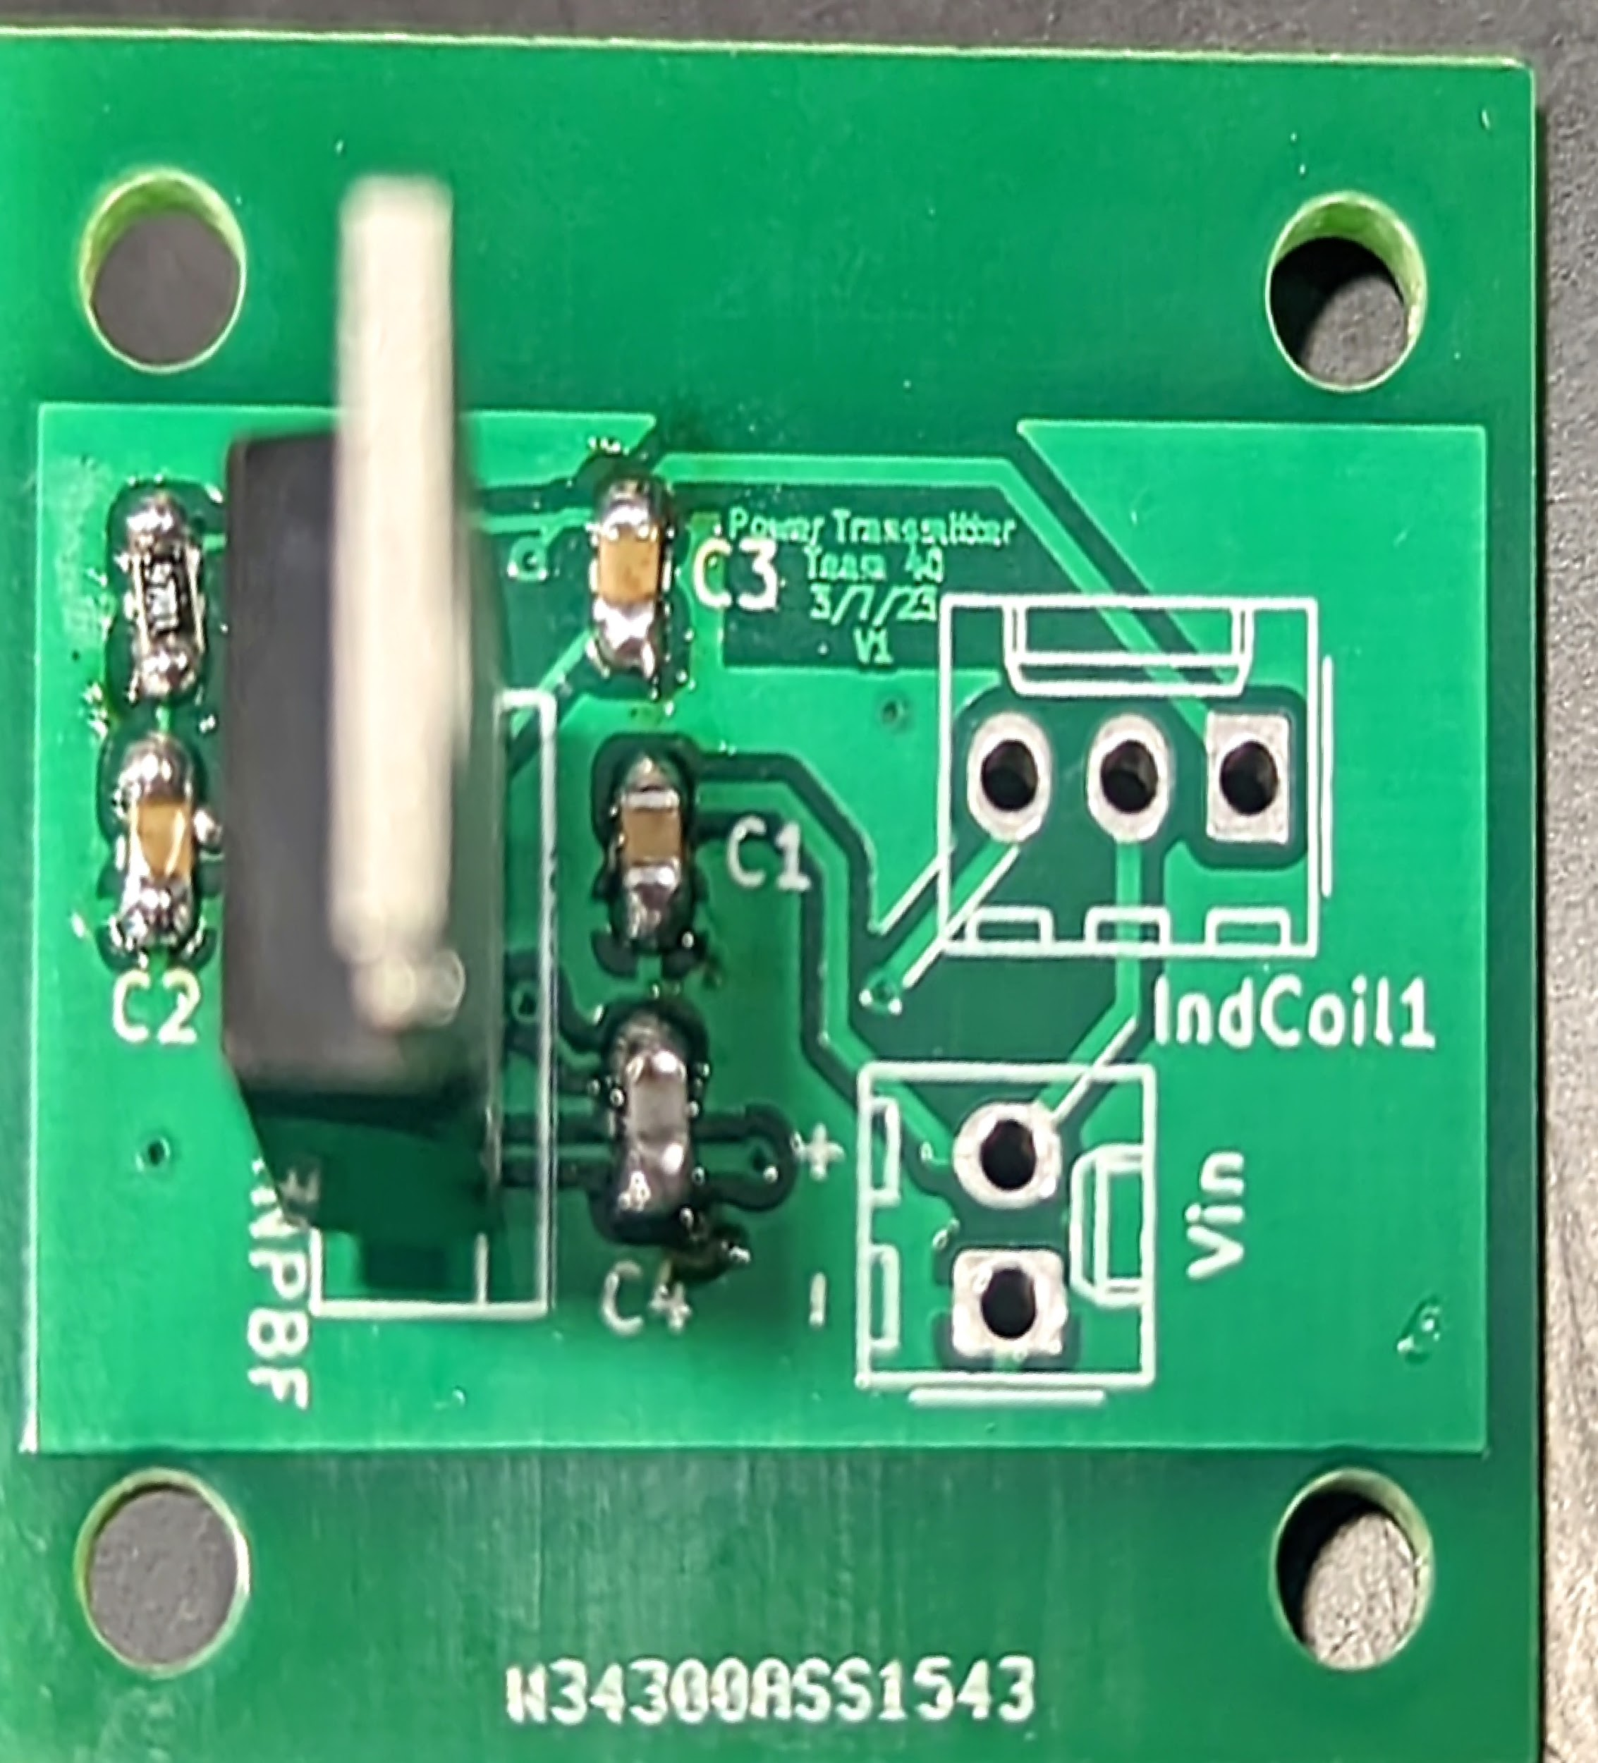
PCB
Power Transceiver, Receiver and MCU
PCB with power receiver and microcontroller:
last minute changes
cost us PCB delivery time
Late parts delivery
Burning through parts
Instead of waiting for the PCB
Breadboard testing/debugging
dev board simulation
Unit PCB
User PCB
21/24
ELECTRICAL & COMPUTER ENGINEERING
GRAINGER ENGINEERING

Slide 22
Conclusion and Further Work
22/24
ELECTRICAL & COMPUTER ENGINEERING
GRAINGER ENGINEERING

Slide 23
Takeaways
Further Adjustments
Microcontroller currently boots from cold each time the power brick comes into contact
Overuse of flash memory
Could be resolved with small battery
Onboard Flash vs SPI Flash
Current System utilizes onboard flash
Frequent reads and writes degrade flash which could eventually corrupt the program
Move to entirely ram based program or use off-board flash
23/24
ELECTRICAL & COMPUTER ENGINEERING
GRAINGER ENGINEERING

Slide 24
Further Work
Power, PCB, and Casing
Further research and testing for power
New PCB designs
Waterproof casing
Testing for user friendliness
Stretch Goal
Develop an application that stores key cards
Use systems like Samsung Reverse wireless charging for powering (Qi standard compliance)
24/24
ELECTRICAL & COMPUTER ENGINEERING
GRAINGER ENGINEERING
Notes:
Future work includes further research and testing to reach a level of power that’s strong enough to power the motor through wireless charge, as well as printing new PCB designs to reflect these changes.
Additional work includes creating a waterproof renter friendly casing that would mount around the deadbolt, and testing for user friendliness using the speakers and LED’s to indicate when an RFID has been scanned.
A stretch goal that would be beneficial for productization would be to develop an application that can store key cards. Another additional feature would be to utilize a system such as Samsung’s reverse wireless charging to power the system without needing the power brick.

