Slide 1
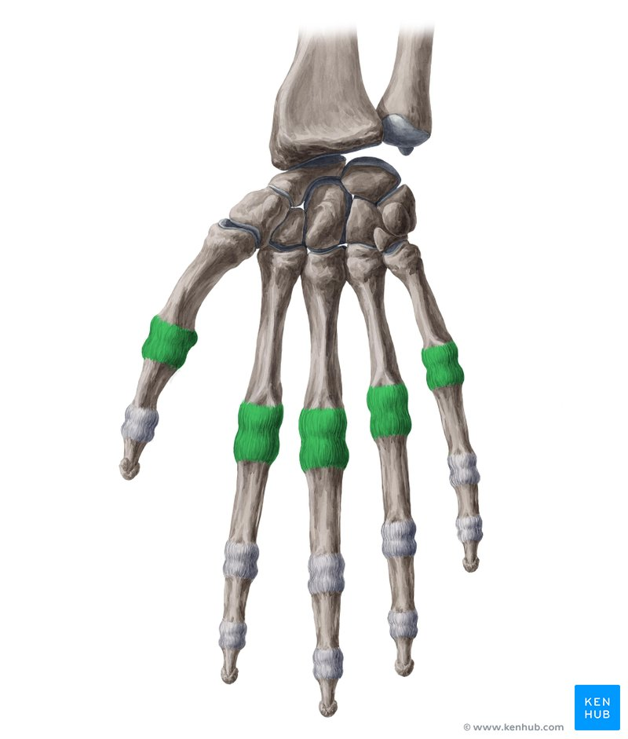
VR Force Feedback Gloves for Lateral Finger Movement
Team 23
Yoonseo Choi, Aaron Gros, Sean Kim
TA: Jason Paximidas
Fall 2022
Notes:
Sean
greeting, introduce our team, ourselves, and our project
Metacarpophalangeal(MCP) Abduction and Adduction Force Feedback Gloves for VR

Slide 2
Introduction
Motivation
The Problems
Video Demo
Notes:
Sean
You'd be curious about why we wanted to make another version of VR force feedback gloves even though we already have a few different options out there.
During our introduction, we'll present what was our motivation to start our project, what are some problems of VR force feedback gloves for sale currently, and a short demo video of our device just to briefly show you what it does.

Slide 3
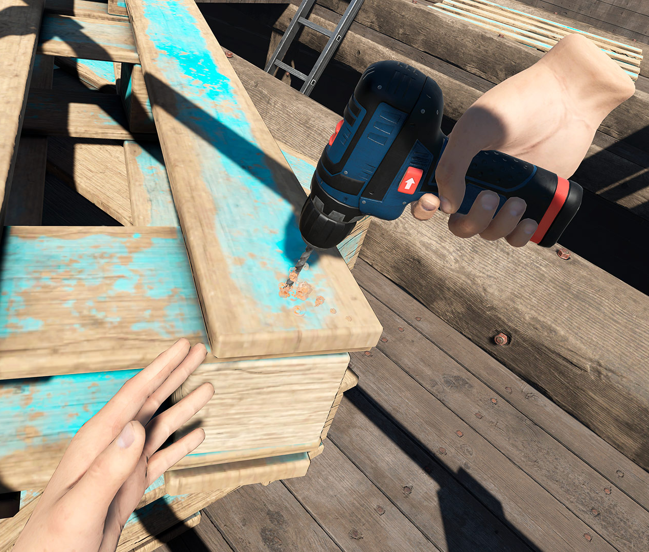
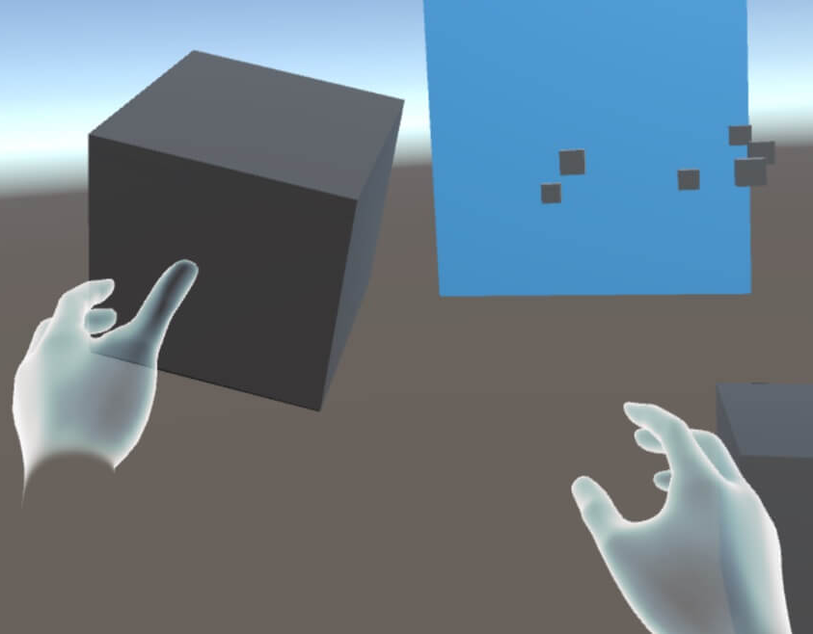
Motivation
Notes:
Sean
So, here is our motivation of building our new version of VR force feedback gloves.
The market for VR devices is growing rapidly. Some VR devices provide you only visual effects and some other devices provide you even more experience like force feedback or thermal feedback, etc., however none of those products provide force feedback for the finger's lateral movement based on our research.
We focused on the force feedback because we thought it could be used in many different fields to either receive feedback from the VR platform or vice versa.
There are already some products that give you force feedback for the finger's flexion and extension , but not for side-to-side movement.
If we have such VR force feedback gloves that support force feedback for both flexion-extension and lateral movement of fingers, it would become a more intuitive device to use in real world.

Slide 4
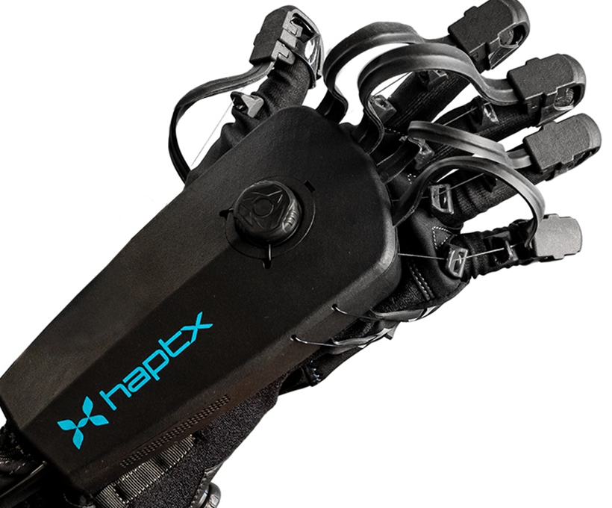
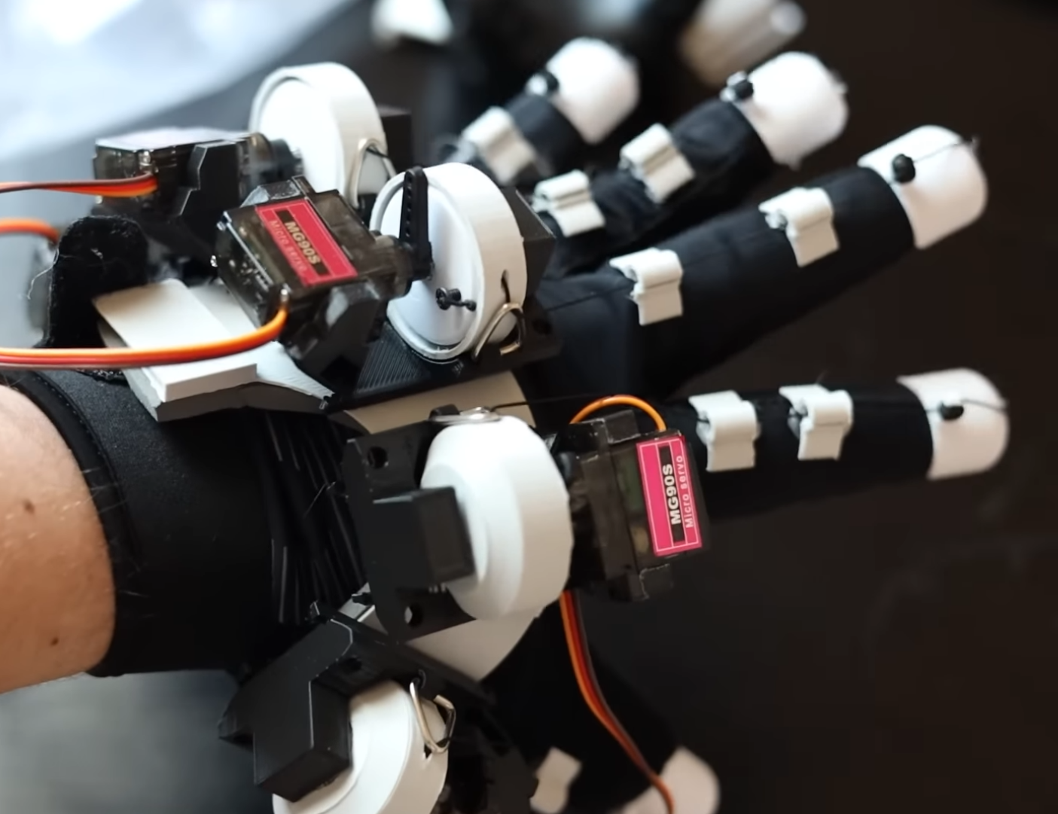
The Problems
Commercial:
Cheap Tracking Force Feedback
Open Source:
Cheap Tracking Force Feedback
Haptx (commercial)
Lucid Gloves (open)
Notes:
Sean
We have commercial and open source options when it comes to purchase a pair of VR force feedback gloves.
However there are some good things and bad things about each option.
Commercial ones, they are quality, ready to be used, but they are expensive because they are mostly targeted towards industry and research. Some commercial products do track side-to-side movements of the fingers, but none of them gives you side-to-side force feedback based on our research.
Open source options are cheap, anyone can have access to them, but they are too bulky and takes you a good amount of time to build them. Also, none of them supports side-to-side movement tracking nor side-to-side force feedback.

Slide 5
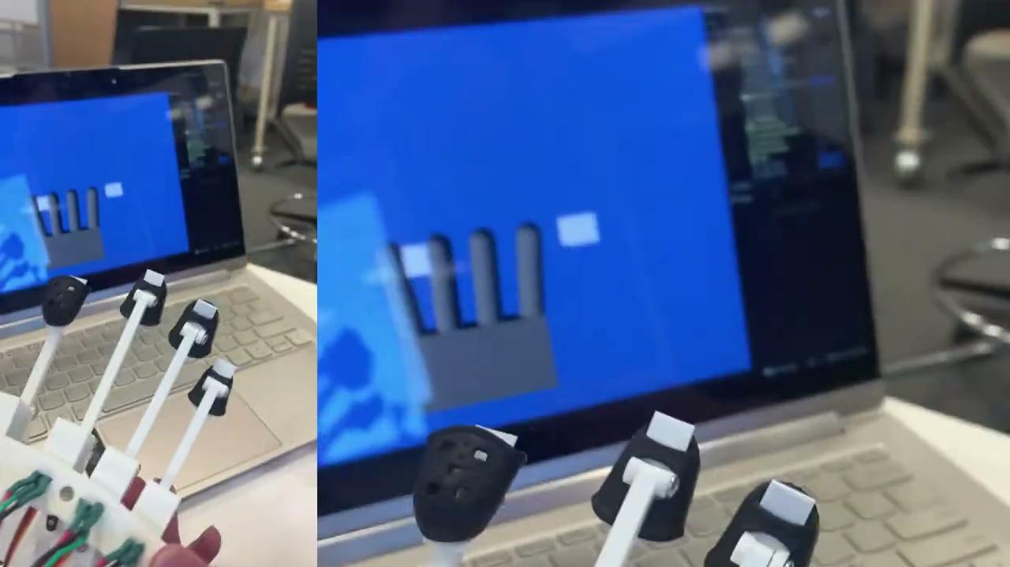
Video Demo
Notes:
Sean
Before we get started with our design overview, I’ll show you guys a short video demo. It will briefly show you how our lateral force feedback works.
The white rectangles are our VR obstacles and when the VR fingers hit the obstacles, our force feedback glove should restrict the finger movement to the side where the obstacle is.
As you can see the finger moves freely in the direction without an obstacle, but when we try to move the finger towards the obstacle, it won’t go further.

Slide 6
Design Overview
High-Level Requirements
Block Diagram
Mechanical
PCB
Firmware
Software
Requirements & Validation
Notes:
Yoonseo
Slide 6: Now that we’ve introduced our completed project and explained vaguely its purpose and functionality,
we’ll dive deeper into its development process and
present the different modules integrated within the achieved product.
So I’ll first state some HL requirements,
then I’ll show the block diagram to give you a visual of how the modular glove design looks like.
Then, my partners and I will each give a brief overview of the different subsystems (Mechanical, PCB, FW, SW) we individually contributed towards on this project.
Finally, I’ll conclude with some of the requirements each system sought to achieve and the validation tests conducted to verify them.

Slide 7
High-Level Requirements
Track Finger: +/- 2.5 degrees
Restrict Finger : +/- 2.5 degrees
Restriction Torque: 0.186 - 0.392 Nm
Notes:
Yoonseo
Slide 7: So here are our high level requirements for the glove we set at the beginning of the semester.
We tailored our design so that the finished product would be able to successfully
Restrict and Track user’s finger position with a maximum error of 2.5 degrees
Retain the finger’s restriction torque within a harmless range shown here.
We’ll later show test results that verify our product upheld these requirements

Slide 8
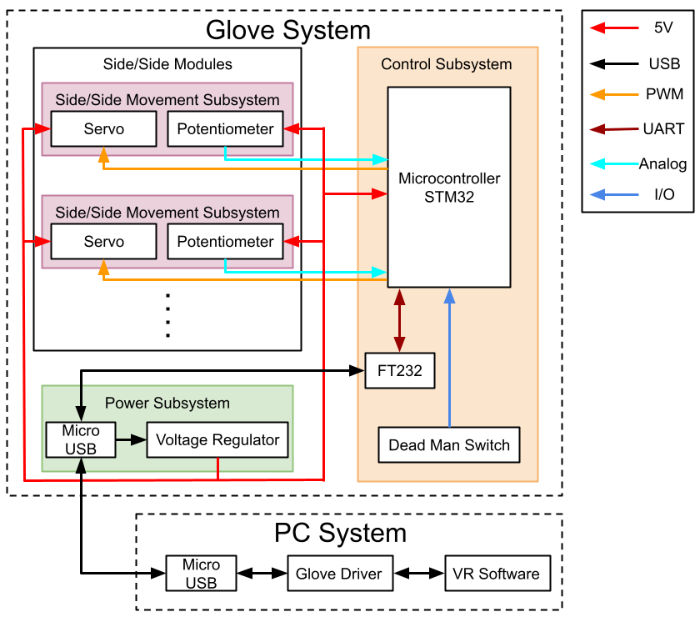
Block Diagram
Control Subsystem Microcontroller
Power Subsystem Voltage regulator
Mechanical Subsystem Actuator Potentiometer
PC Subsystem VR Software
Notes:
Yoonseo
Slide 8: Before we delve deeper into the different types of modules,
here’s the block diagram that’ll help you visualize the integration of the 4 main subsystems of our product:
Controls
Power
Mechanical
PC

Slide 9
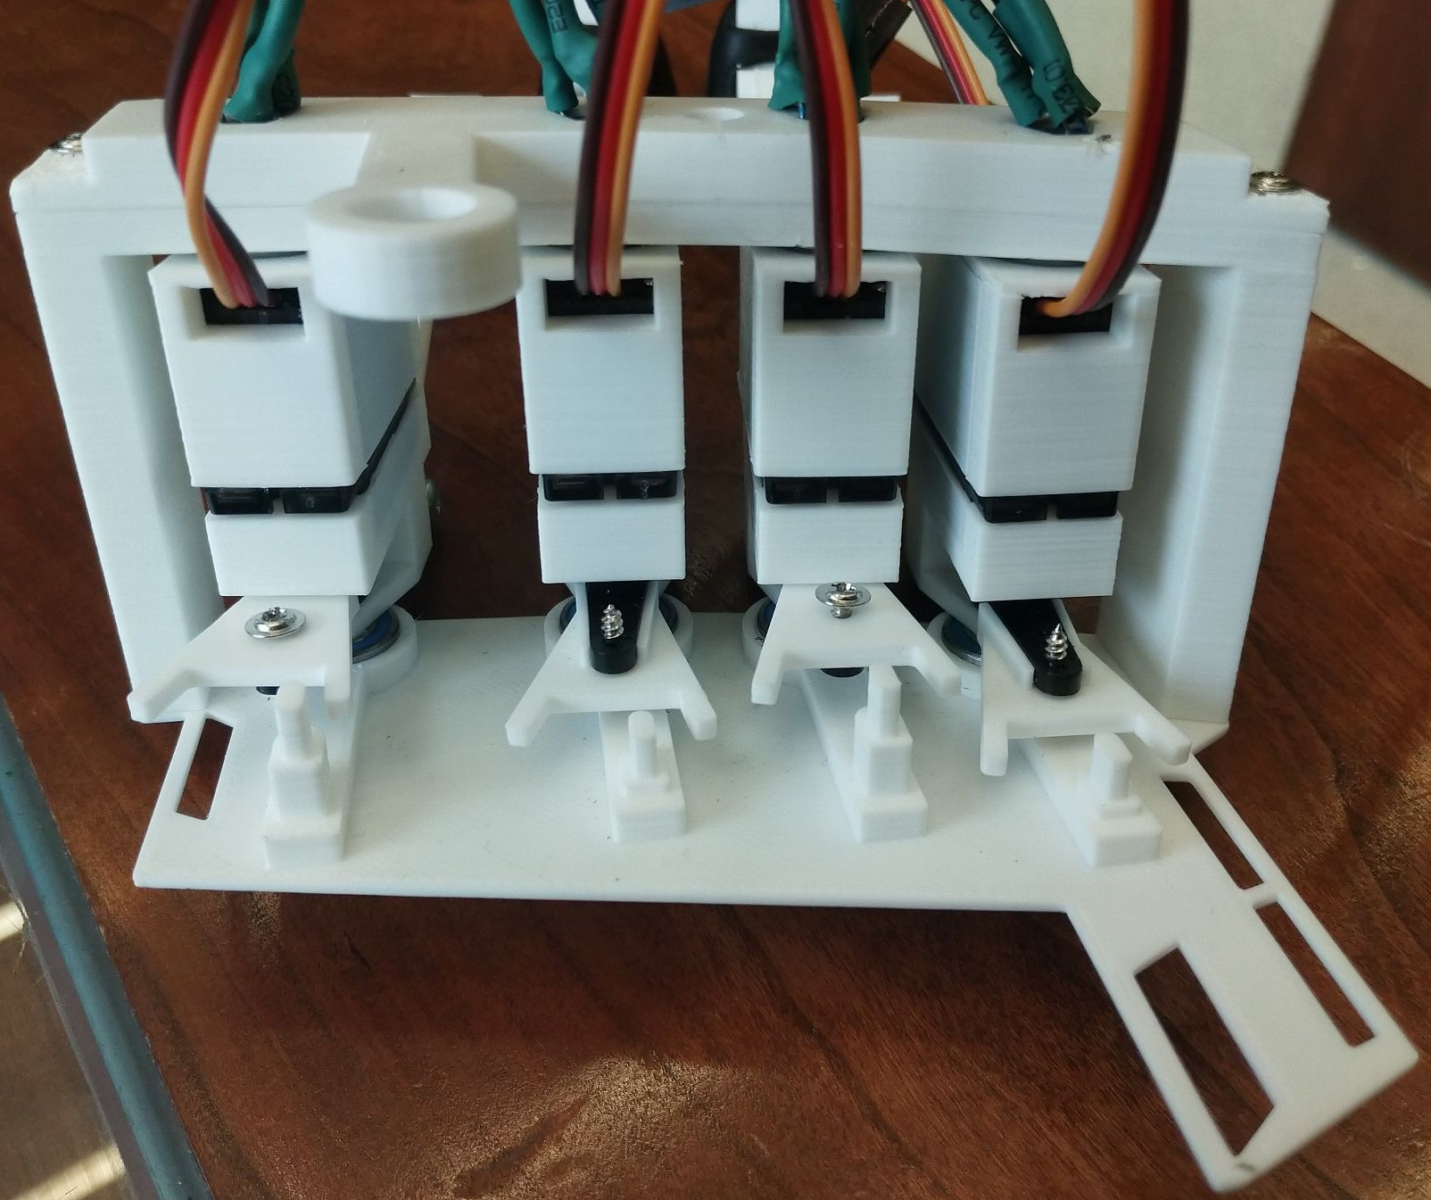
Mechanical Design
Notes:
Aaron

Slide 10
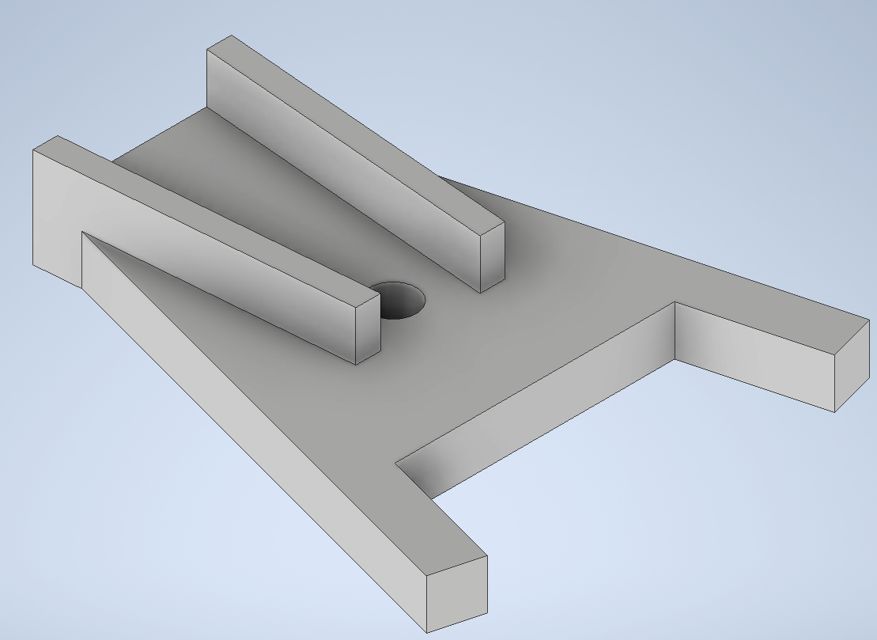
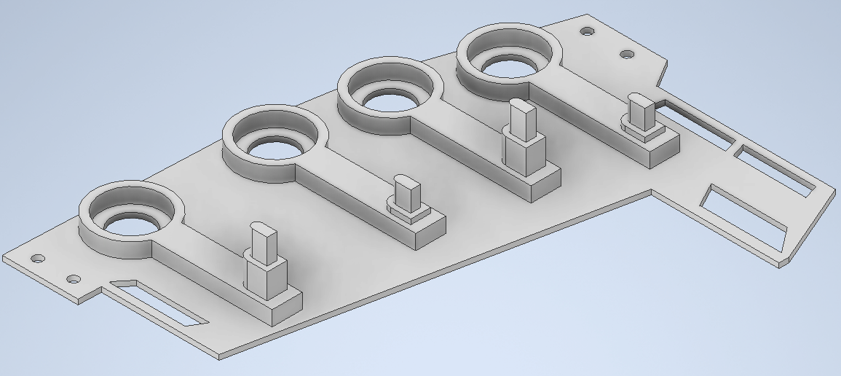
Mechanical Design
Why?
Servo
Stopping pin
Notes:
Aaron

Slide 11
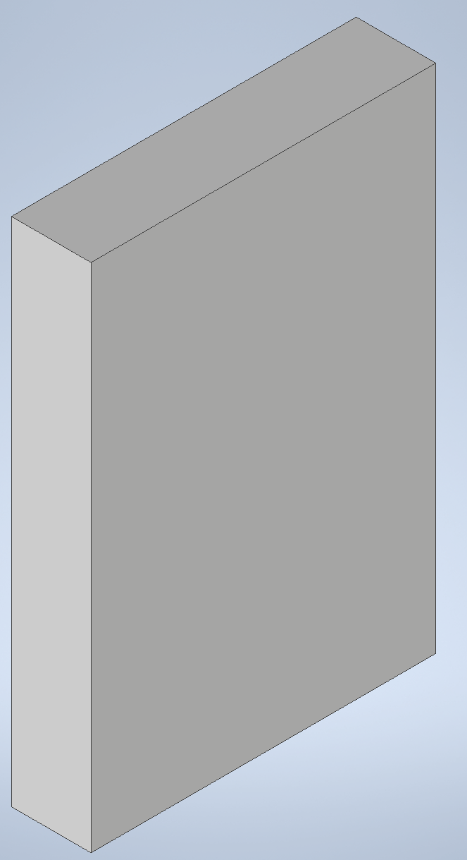
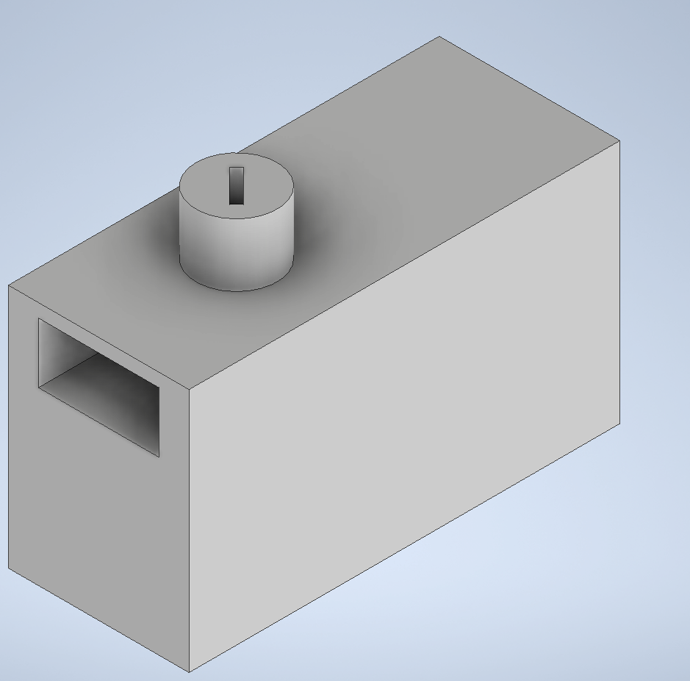
Mechanical Design
Separate
Angled
Notes:
Aaron

Slide 12
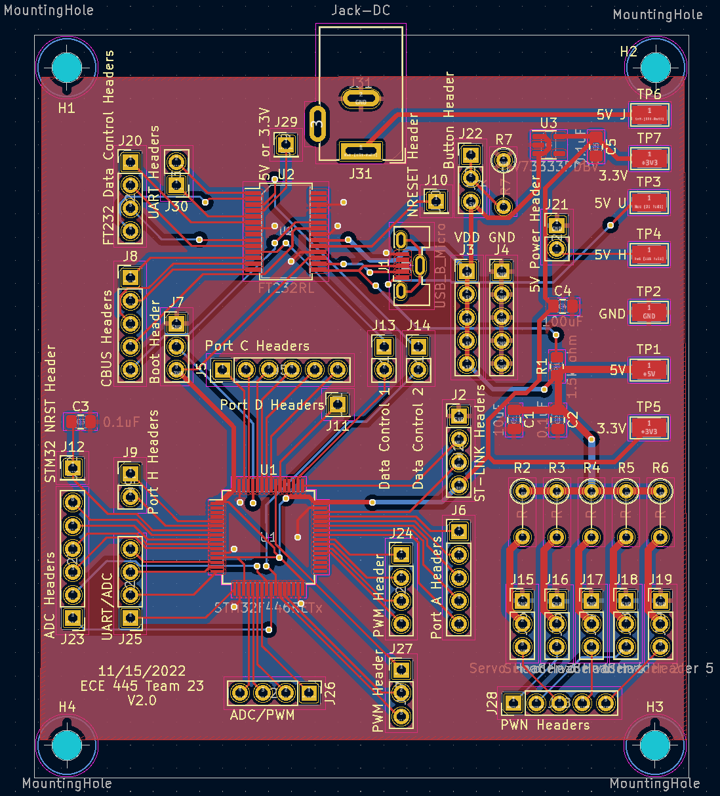
PCB Design
Microcontroller (STM32)
USB to UART IC (FT232)
Micro USB
5V power input
Linear voltage regulator (5V to 3.3V)
Test pads
Pin Headers (side-to-side module)
Notes:
Sean
This is our 2nd version of the PCB. As you can see it’s a bit large for what it does, but it can become more compact if we keep working on the project in the future.
Our PCB is composed of many different parts.
This is our Microcontroller, stm32, which is one of the most commonly used microcontrollers for such projects.
This is FT232, it enable us to convert USB to UART,
With this Micro USB port, we transfer data between the PC and the control subsystem,
Here is a 5V power input. This was our main source of power for the board, we just used a 5V barrel jack wall adapter.
We also added a linear voltage regulator to drop the voltage from 5V to 3.3V for the microcontroller,
And some test pads, these were very helpful when we were finding problems when our device didn’t work properly.
There are very many pin headers but I want to show you this area over here. These pin headers & pin holes combination is for our servos and we put the pinholes to let us add resistors in case we need it to drop the current goes into the servos.

Slide 13
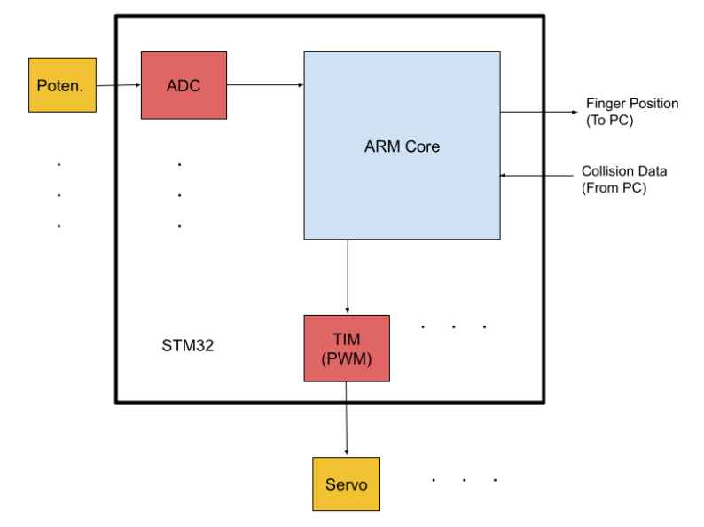
Controls Subsystem
STM32 MCU
Sends finger position
Receives collision info
Notes:
Yoonseo
Slide 13: So, the next important subsystem in our product is the Controls Subsystem. If the mechanical aspect was the “brawn”, the controls subsystem can be seen as the “brain” of the VR glove.
The configuration of the subsystem can be explained by the simple block diagram shown here, but in terms of functionality, powered by an STM32 MCU, this module exists to primarily perform 2 tasks:
Send physical finger positions to the graphics platform to accurately represent them as virtual fingers
Receive virtual finger collision info from the graphics platform to accurately translate the same haptic feedback to the physical finger.
In the diagram, Potentiometers can be interpreted as the physical finger position and the servo as the finger haptic feedback mechanism

Slide 14
Data Processing Algorithm
Output (To PC)
Input (From PC)
Notes:
Yoonseo
Slide 14: The two tasks mentioned earlier are illustrated in this slide by algorithm flowcharts.

Slide 15
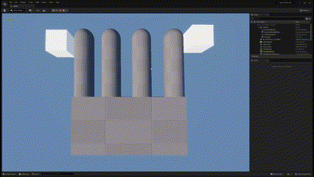
PC (Graphics) Subsystem
Notes:
Aaron

Slide 16
Requirements
Control | Power | Mechanical
Must be able to send 4Kb of position data to the computer per second and receive 4Kb of data from the computer per second over UART. Must sample each potentiometer at least 30 times per second Must sample the dead man’s switch at least 2 times per second Must be able to adjust the PWM signal at least 5 times per second | Must be able to output 5V +/- 1V from a 5V source | The mechanical design in conjunction with the actuator must have a step size of at most 3 degrees While in conjunction with the mechanical design,they must produce a stall torque in between 1.9 to 4 Kg/cm The mechanical design in combination with the potentiometer must measure the finger’s angle within +/- 2.5 degrees
Notes:
Yoonseo
Slide 16: Now that the subsystems have been explained, we’ll refer back to the objectives this project aimed to achieve and present the different requirements for the glove and the corresponding verifications.
I won’t go into detail now about what each requirement achieves, but our team members can explain further if anyone has questions at the end.
So here’s our project requirements.

Slide 17
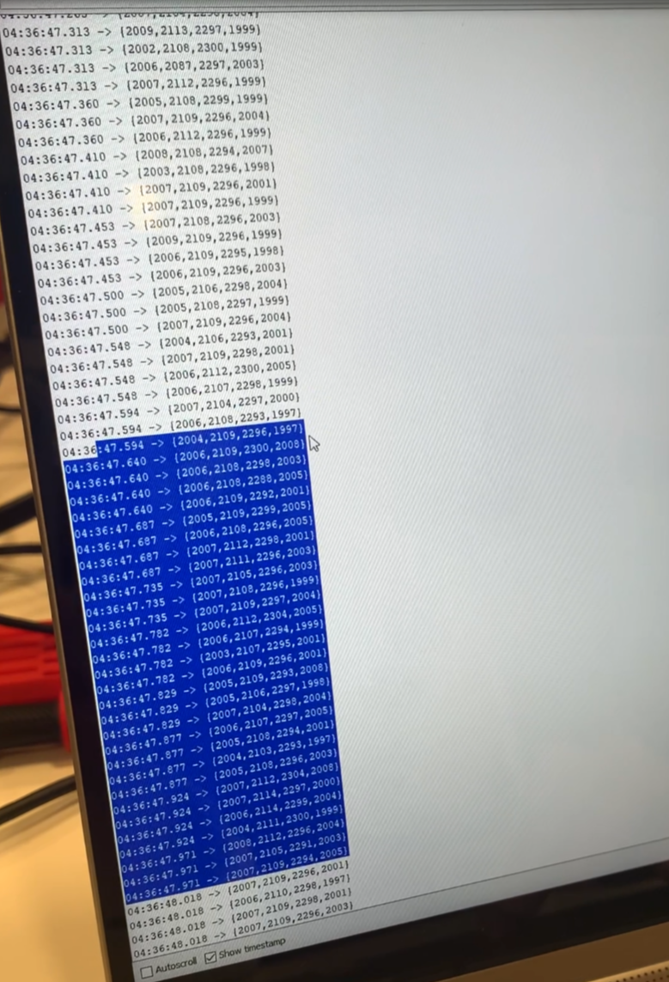
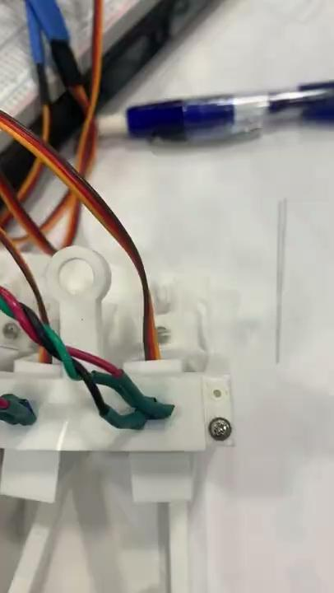
Verifications
Serial Write Speed ~10k b/s
PWM Set Speed ~19 /s
Radius (Distance) x Force = Torque
10.79 N x 0.0254 m = 0.274 Nm = 2.794 Kg-cm
Notes:
Yoonseo
Slide 17: And here are our corresponding verifications. We’ll play the videos at the end if you had any question about these tests.

Slide 18
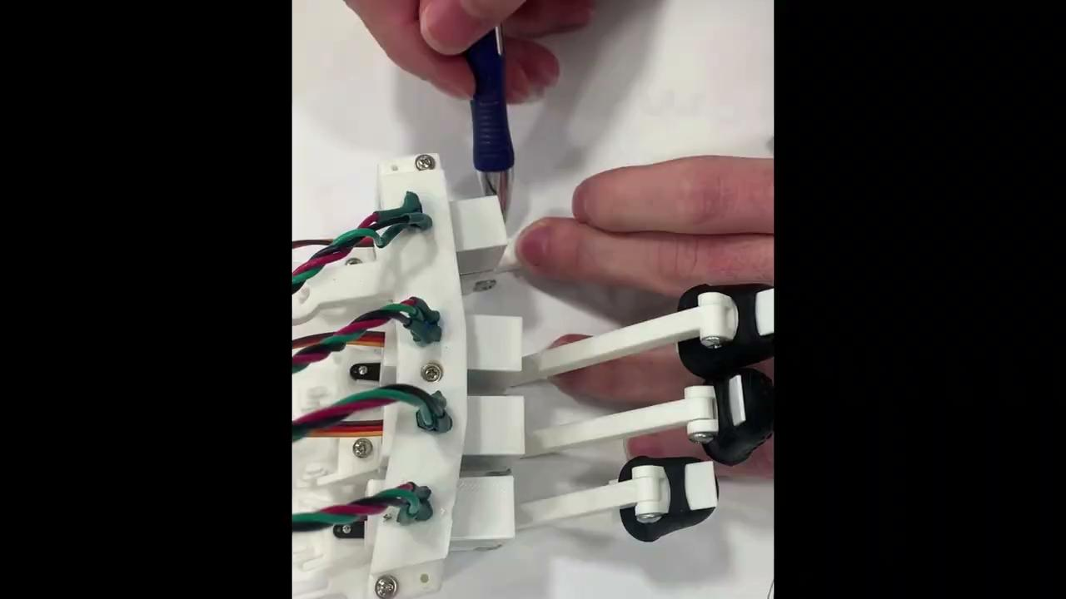
Verifications
Collision Accuracy Within 2°
Angle Accuracy Within 2°
Step Accuracy ~2°
Notes:
Yoonseo

Slide 19
Conclusions
Successes and Challenges
Further recommendations
Notes:
Aaron

Slide 20
Successes and Challenges
Virtual Simulation Mechanical Design
HL Requirements Firmware
Subsystem Requirements
PCB
Serial Read Bandwidth
Notes:
Aaron

Slide 21
Further Recommendations
Adjustability
Potentiometer Noise
Calibration Program
+ Flexion/Extension
Dev Board
Notes:
Aaron

Slide 22
Firmware - Technical Details
Finger movement tracked by ADC (0-4095, 12 bits)
Mapped to 0-360 range and sent to graphics platform
Virtual Finger Collision data scheme
‘0’(00): none, ‘1’(01): right, ‘2’(10): left, ‘3’(11): both
Force Feedback sensation from servos via PWM
Servo can only take small range of values
Maps 0.5ms to 2.5ms → -90 to 90 degrees

