Slide 1
Variable Voltage Battery Pack
ECE 445 Final Presentation: Spring 2017
Group 26: Jeffrey Zhu, Mason Randle, Javier Santiago Lara

Slide 2
Our Problem To Solve
Most larger portable power sources are static
Don’t provide active information to the user
People increasingly rely on and consume more electric power

Slide 3
Objectives
Make a power pack capable of variable AC and DC output
Allow the user to select the output voltage with a control knob
Include voltage and current monitoring
Display information to the user

Slide 4
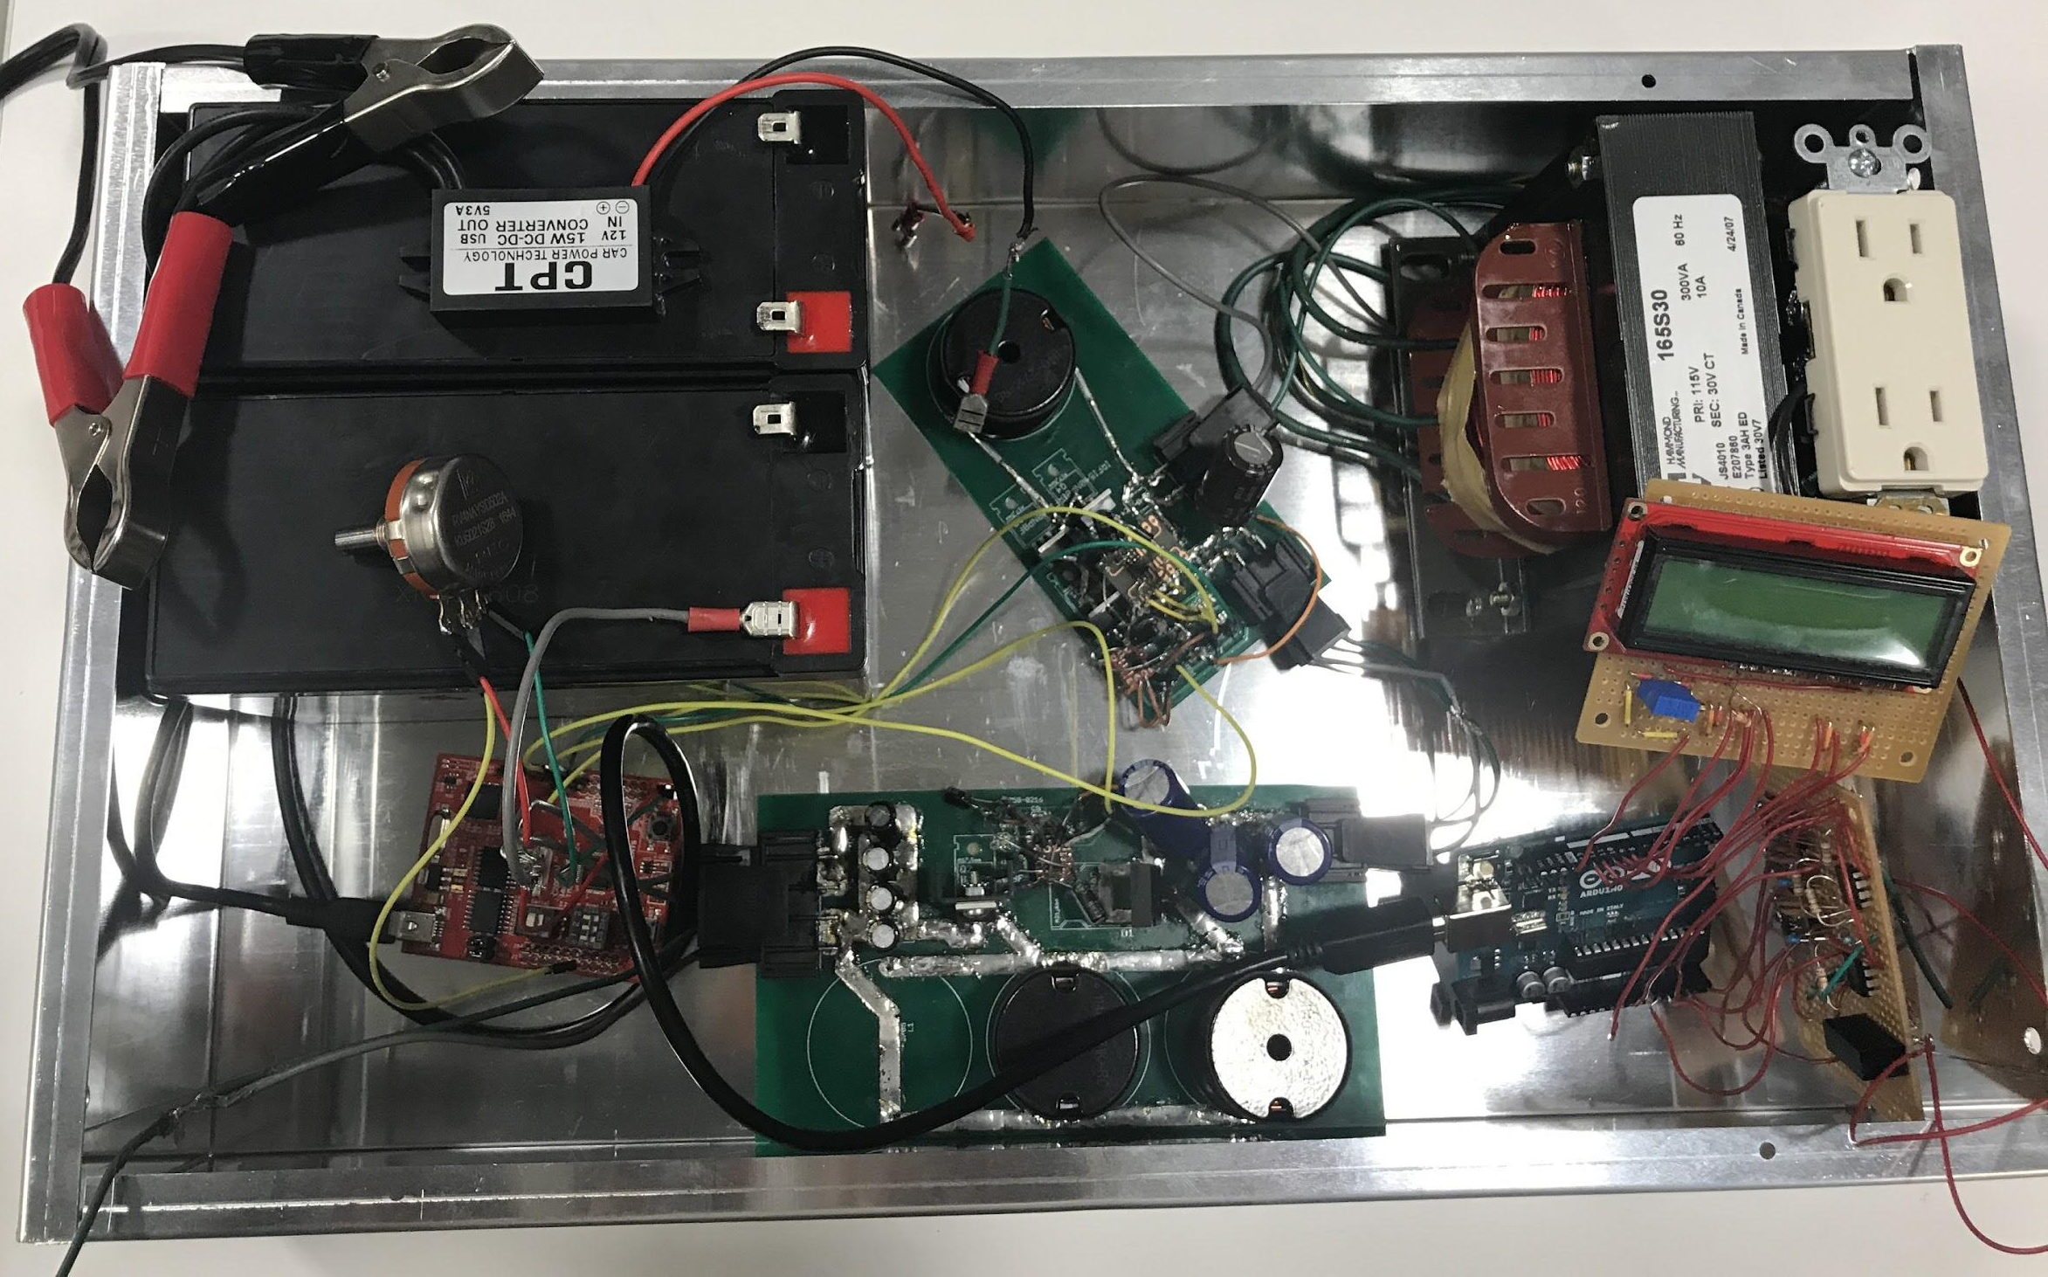
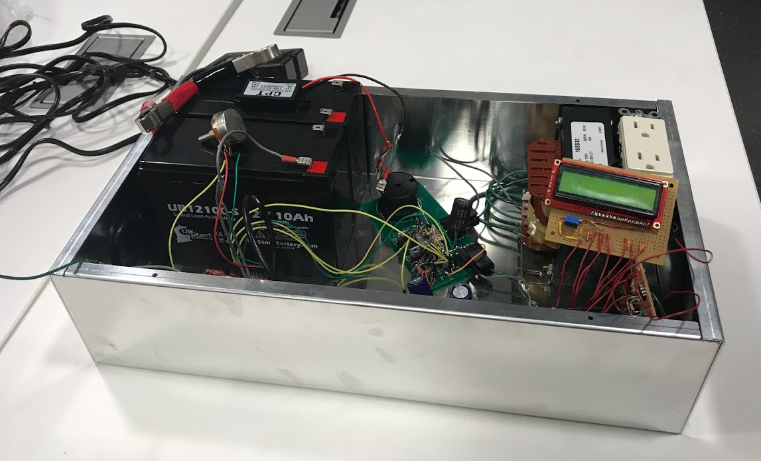
Finished Product

Slide 5
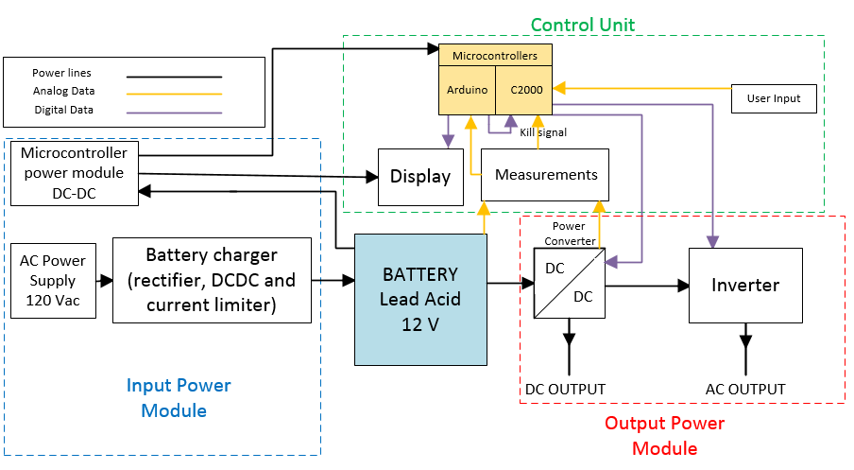
High Level Block Diagram

Slide 6
Power Stages
For High AC:
120 W
12 V
10 A
For High AC:
120 W
40 V
3 A
For High AC:
120 W
30 V rms
4 A rms
For High AC:
120 W
120 V rms
1 A rms
DC/DC
Inverter
Transformer
1:4
For Low DC:
40 W
12 V
3.33 A
DC Output:
40 W
40 V
1 A

Slide 7
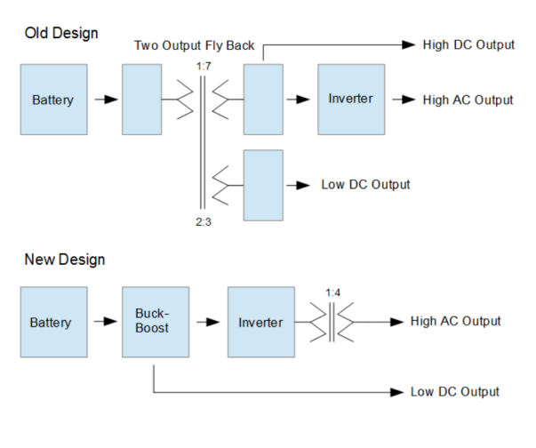
Review of Original Design
Flyback DC/DC converter with 2 secondary windings
Low voltage winding for DC output
High voltage winding to inverter input
Changes made
Flyback replaced by buck-boost
Added output transformer to inverter
Reasons for changes
Difficult to find suitable flyback transformer
Multiple DC/DC outputs redundant
Reduction in component voltage stress

Slide 8
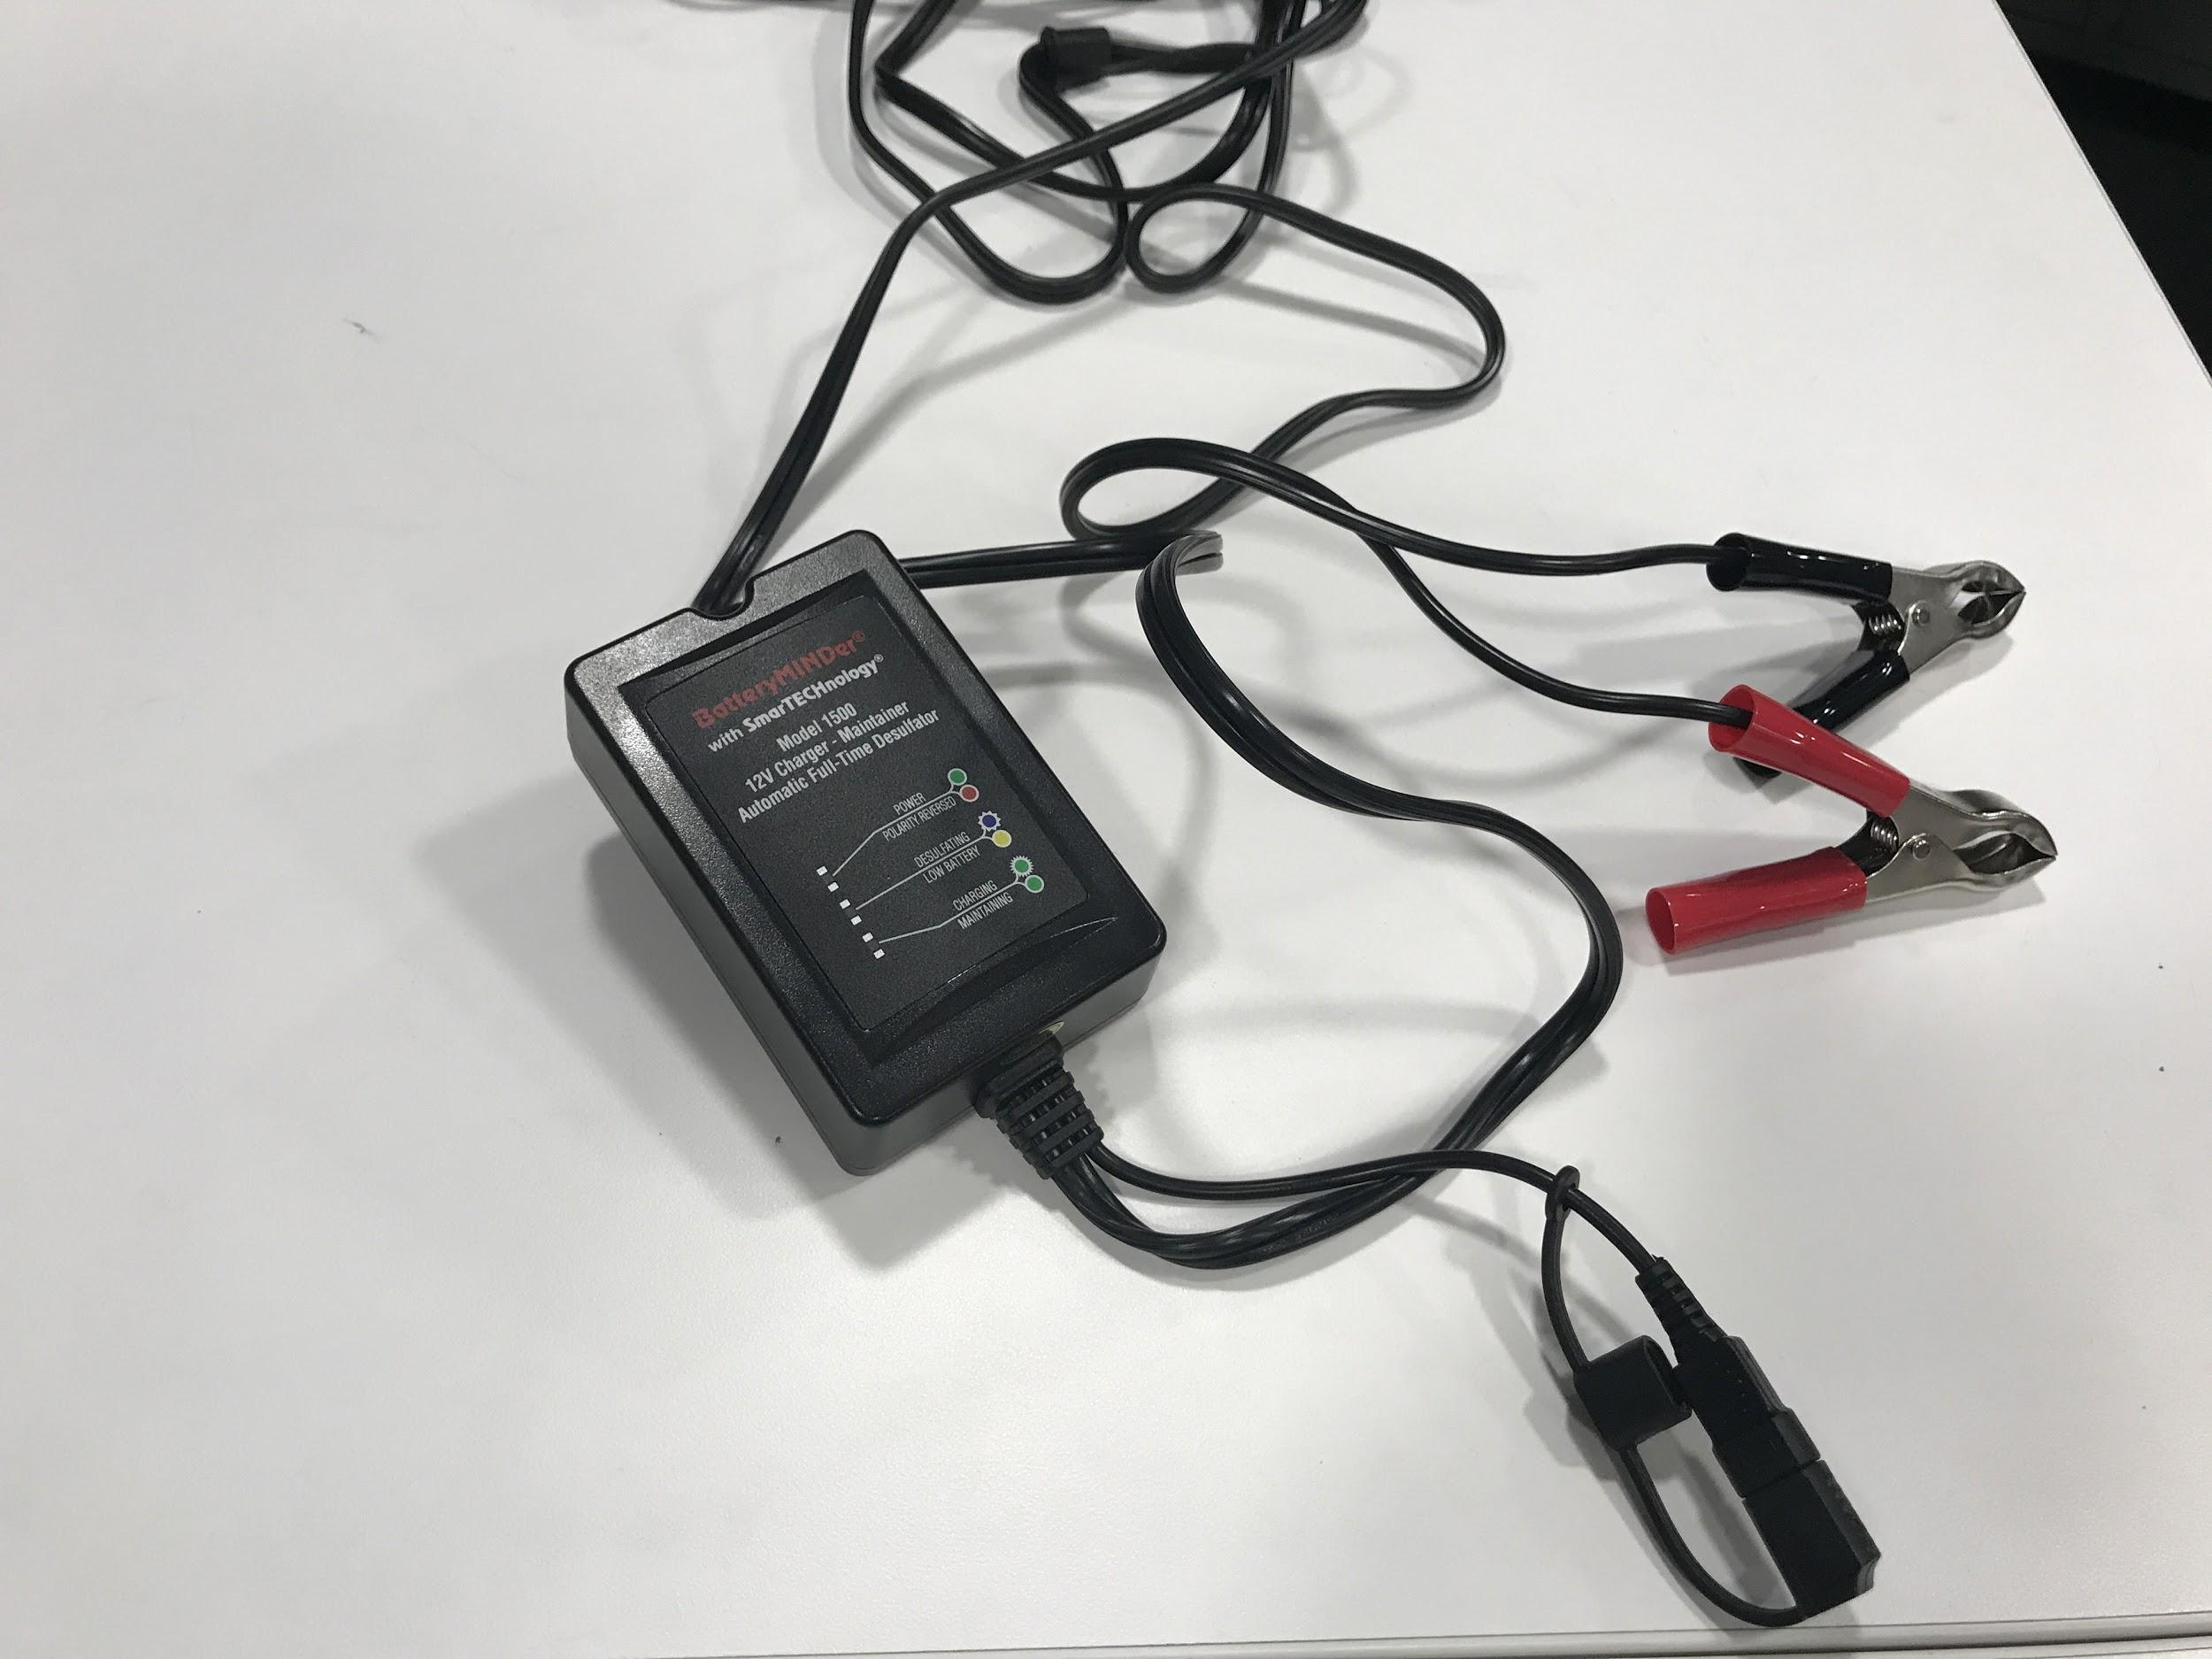
Input Power Module: Battery Charger
Purchased Component
Safety
Protection
3 Stage Charging
Increases Lifespan of Batteries
PHOTO

Slide 9
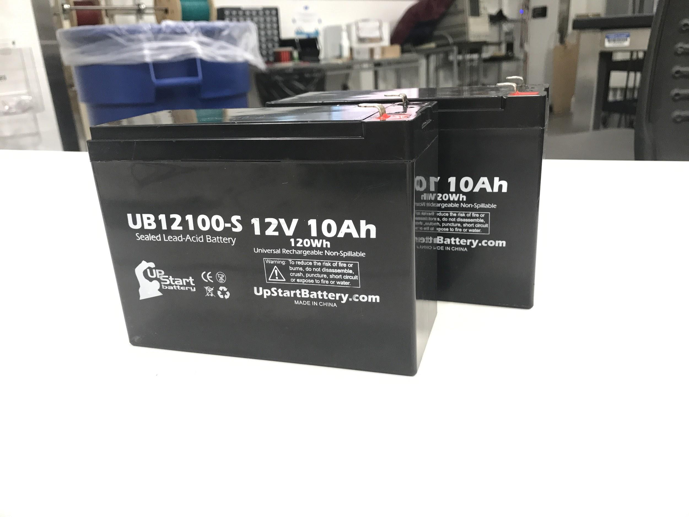
Input Power Module: Batteries
Purchased Components
2x 12V 10Ah Lead Acid Batteries
Voltage varies 11.7 - 12.5 V
PHOTO

Slide 10
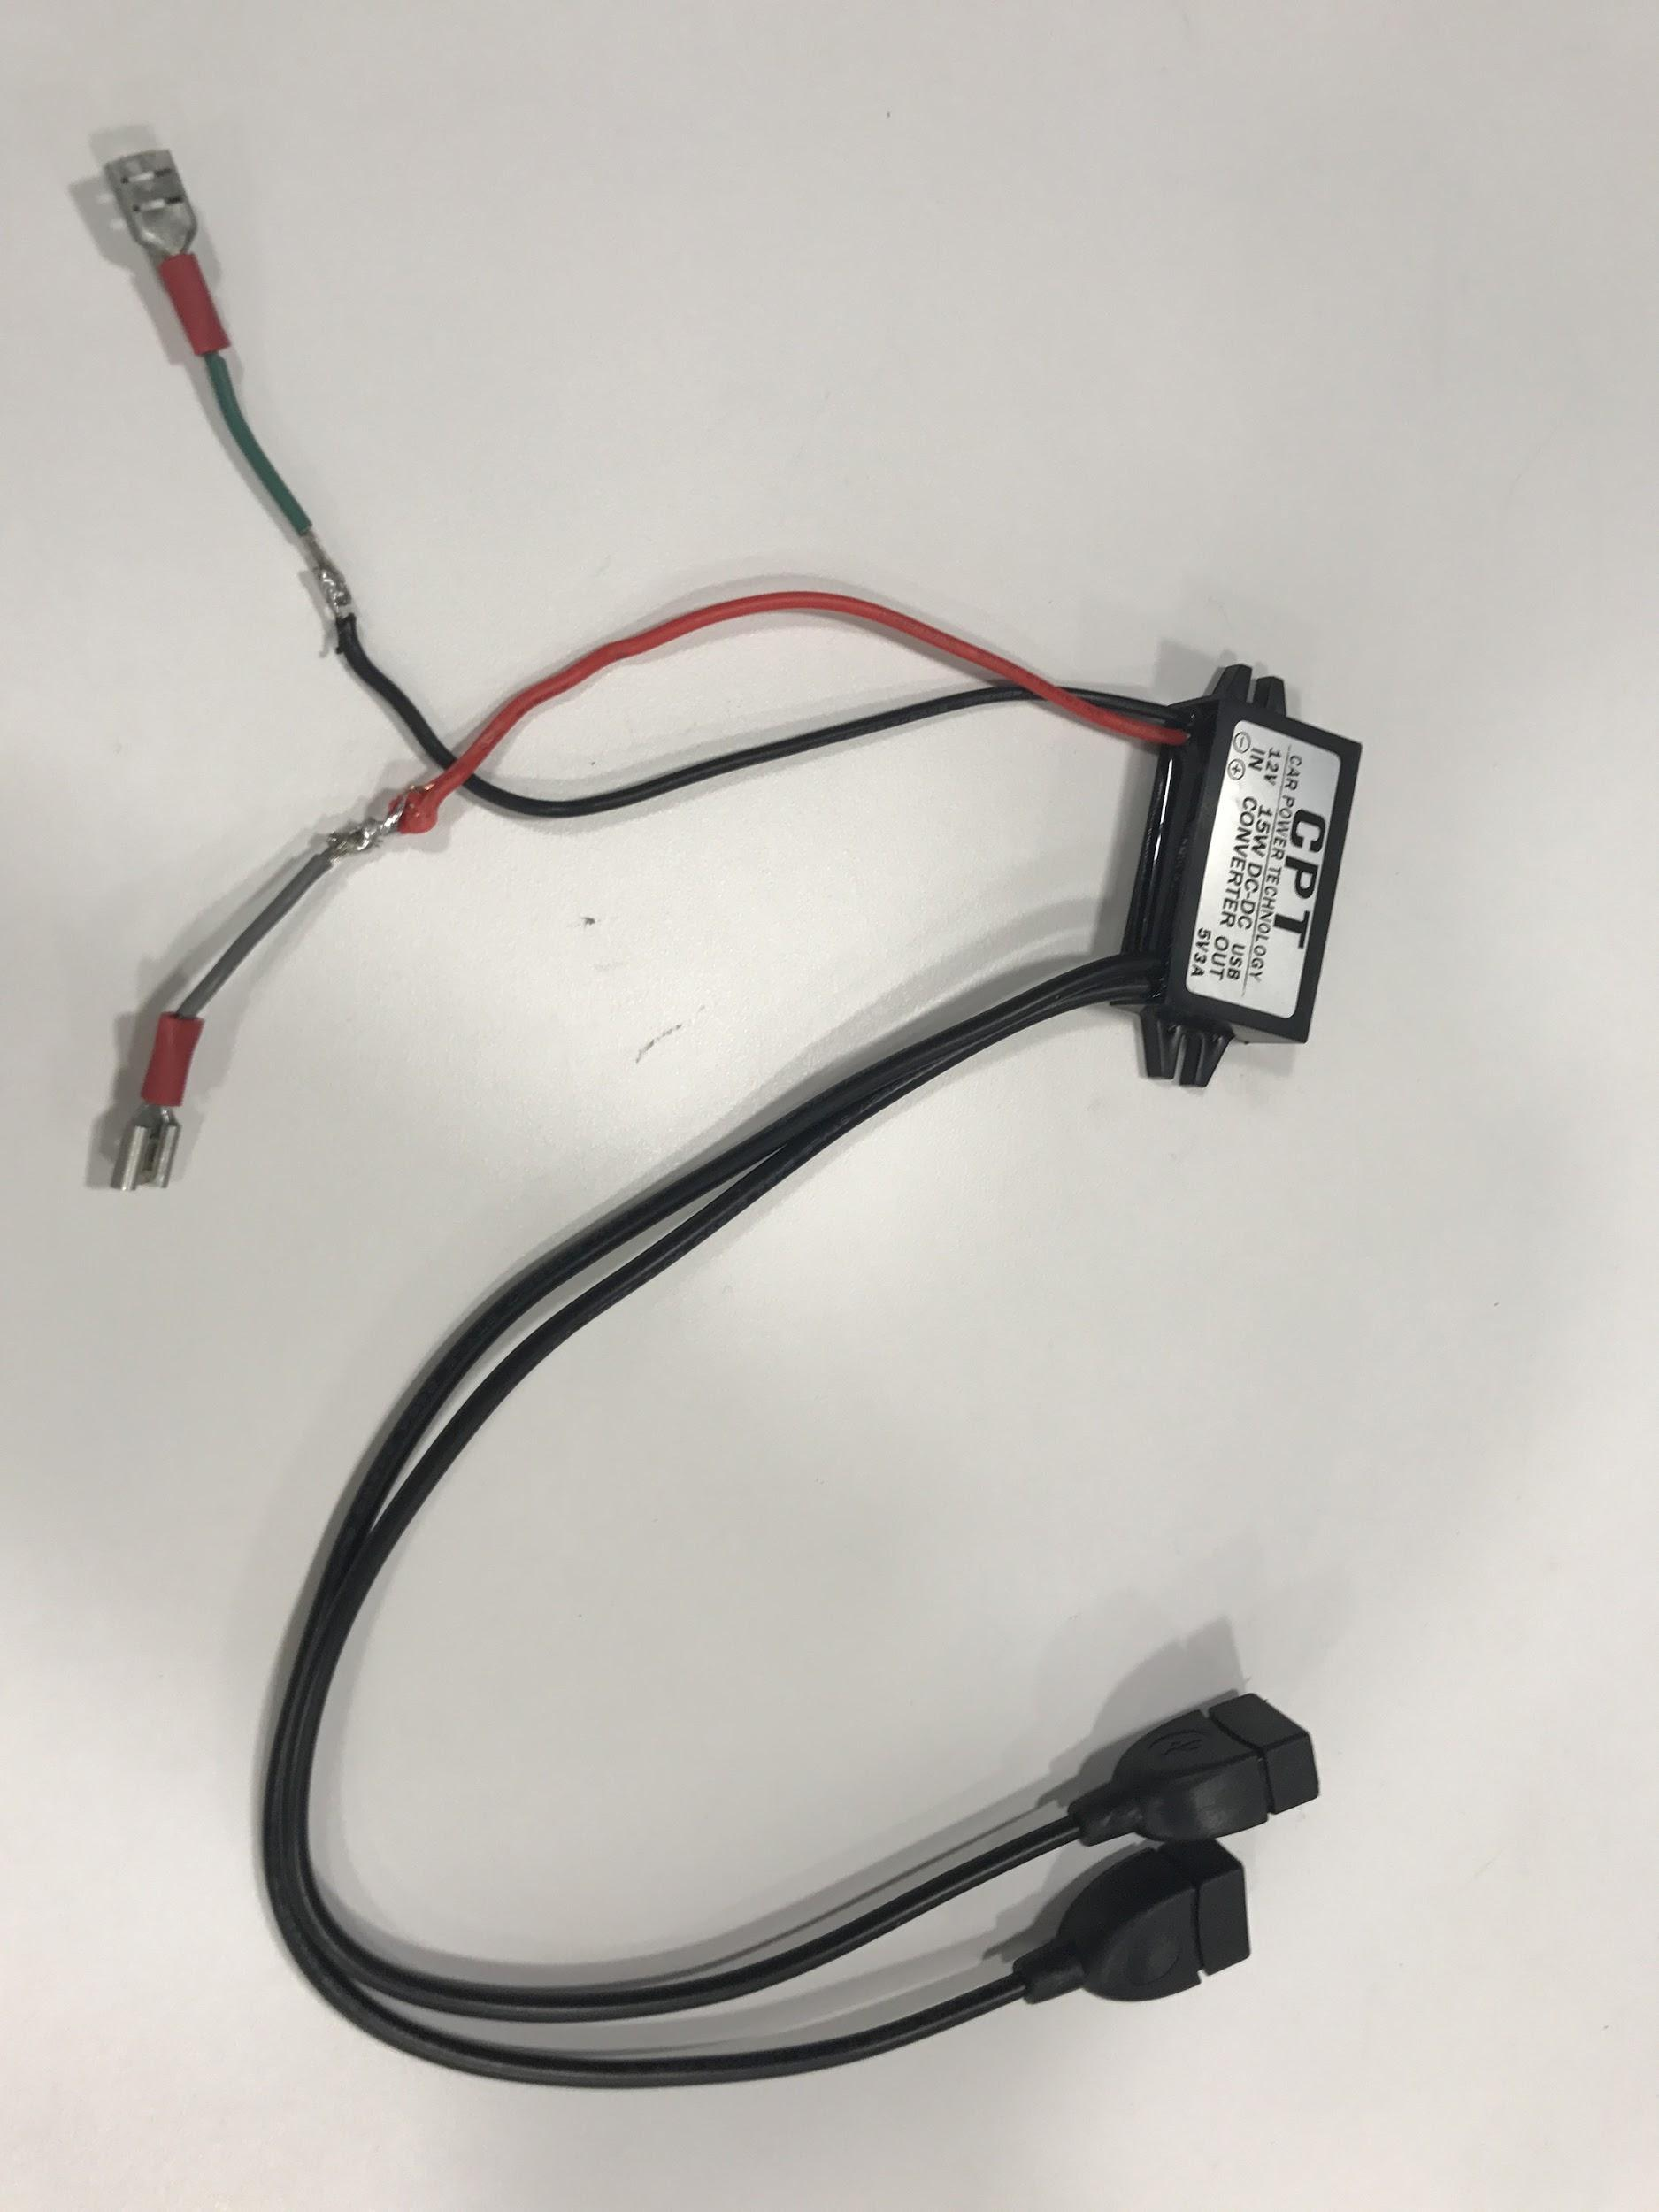
Input Power Module: Microcontroller Power Converter
Purchased Component
12 to 5 V DC/DC Power Converter
Did not require feedback
Voltage variation within proper range
PHOTO

Slide 11
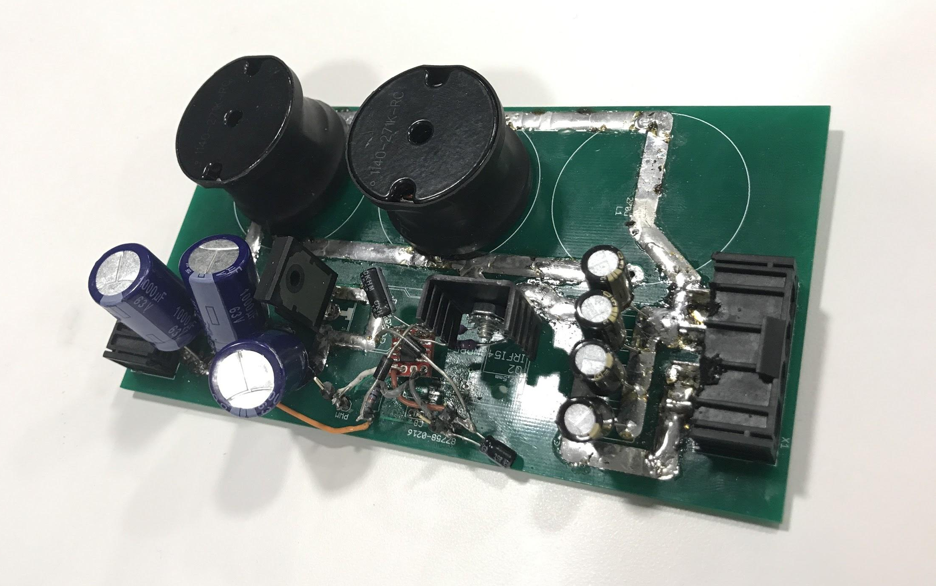
Output Power Module: Buck-Boost Converter
Designed Component
DC/DC Converter
Input: 12V
Output: 5-40V
DC Output of 1 A
Switching frequency: 98kHz
PHOTO

Slide 12
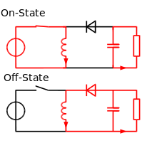
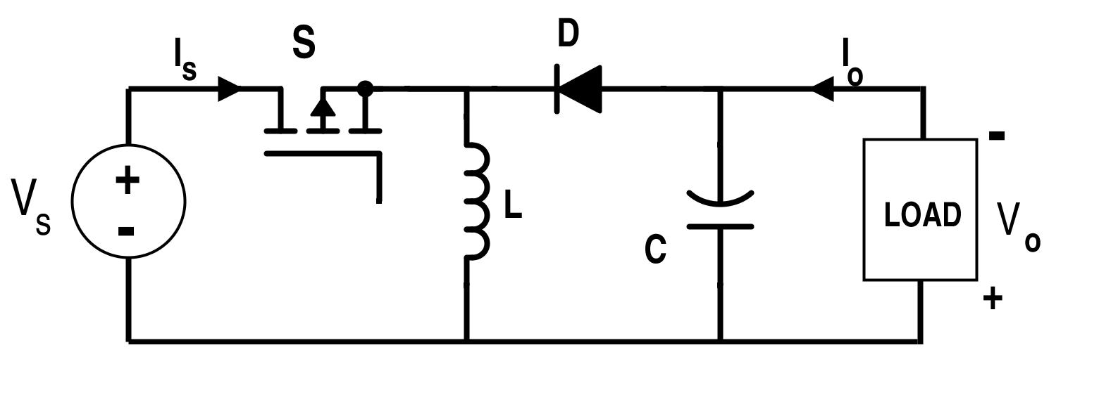
Buck-Boost: Topography and Operation
Minimum duty cycle: Vo,min = 5, Vin = 12 -> 5/12= D/(1-D) -> Dmin = .29
Maximum duty cycle: Vo,max = 45, Vin = 12 -> 45/12 = D/(1-D) -> Dmax = .79
Images courtesy of learnabout-electronics.org

Slide 13
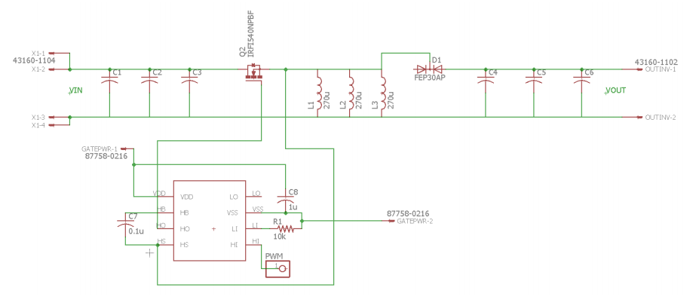
Buck-Boost: Circuit Schematic

Slide 14
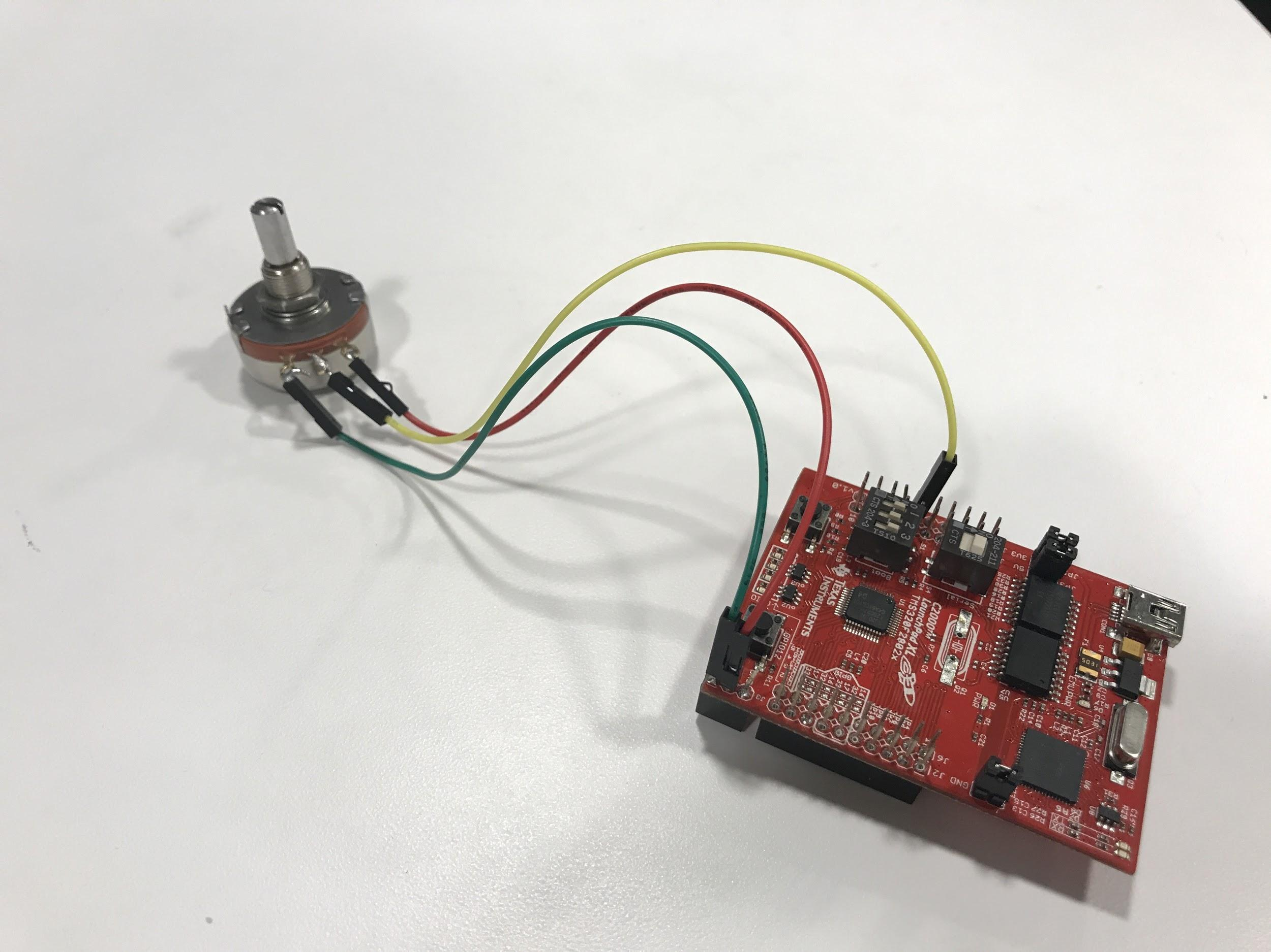
Buck-Boost: Control Scheme
C2000 interprets control knob setting through an ADC pin
C2000 generates 98kHz PWM with duty cycle proportional to ADC input
For safety: duty cycle capped at 82%

Slide 15
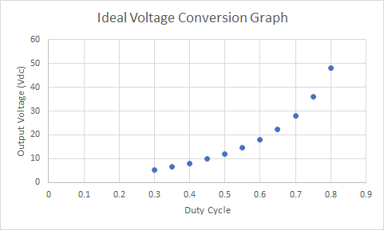
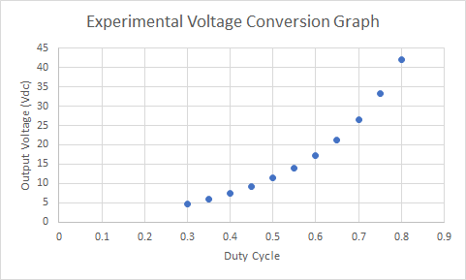
Buck-Boost: Voltage Conversion
Ideal Voltage Conversion Graph (Vin = 12V)
Measured Voltage Conversion (50 Ω Load)

Slide 16
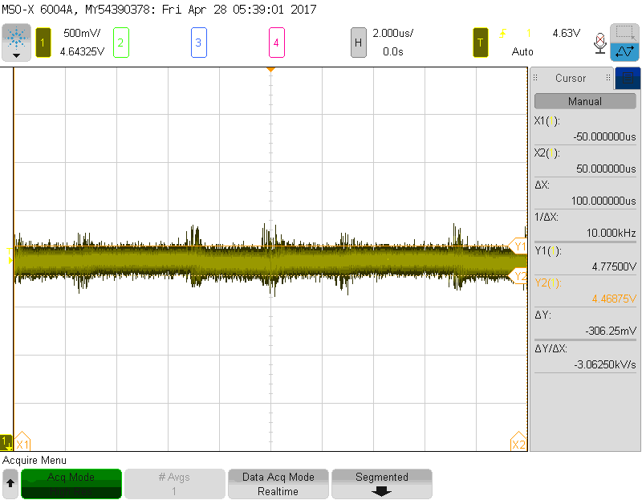
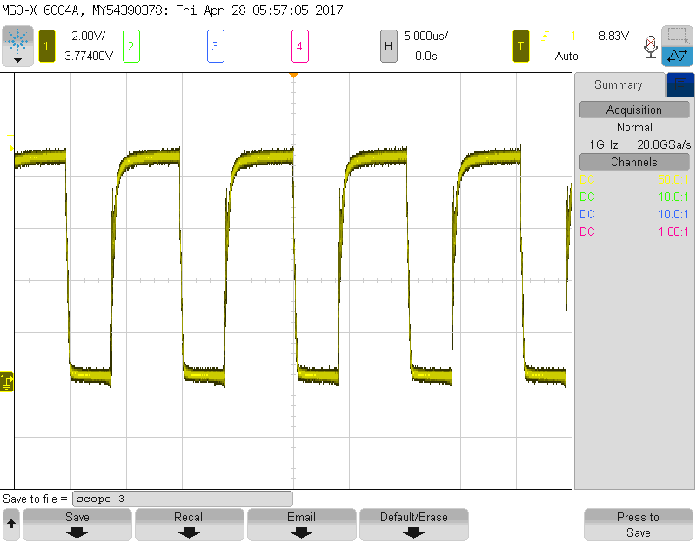
Buck-Boost: More Results
Voltage ripple was successfully kept under 5% with large inductors and output capacitance
Gate Driver Waveform was usually clean (more on this later)

Slide 17
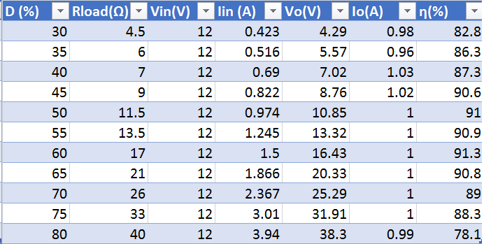
Buck-Boost: Efficiency Results
Test Conditions:
12V input
1 A output
Results:
80-90% efficiency

Slide 18
Buck-Boost: Performance

Slide 19
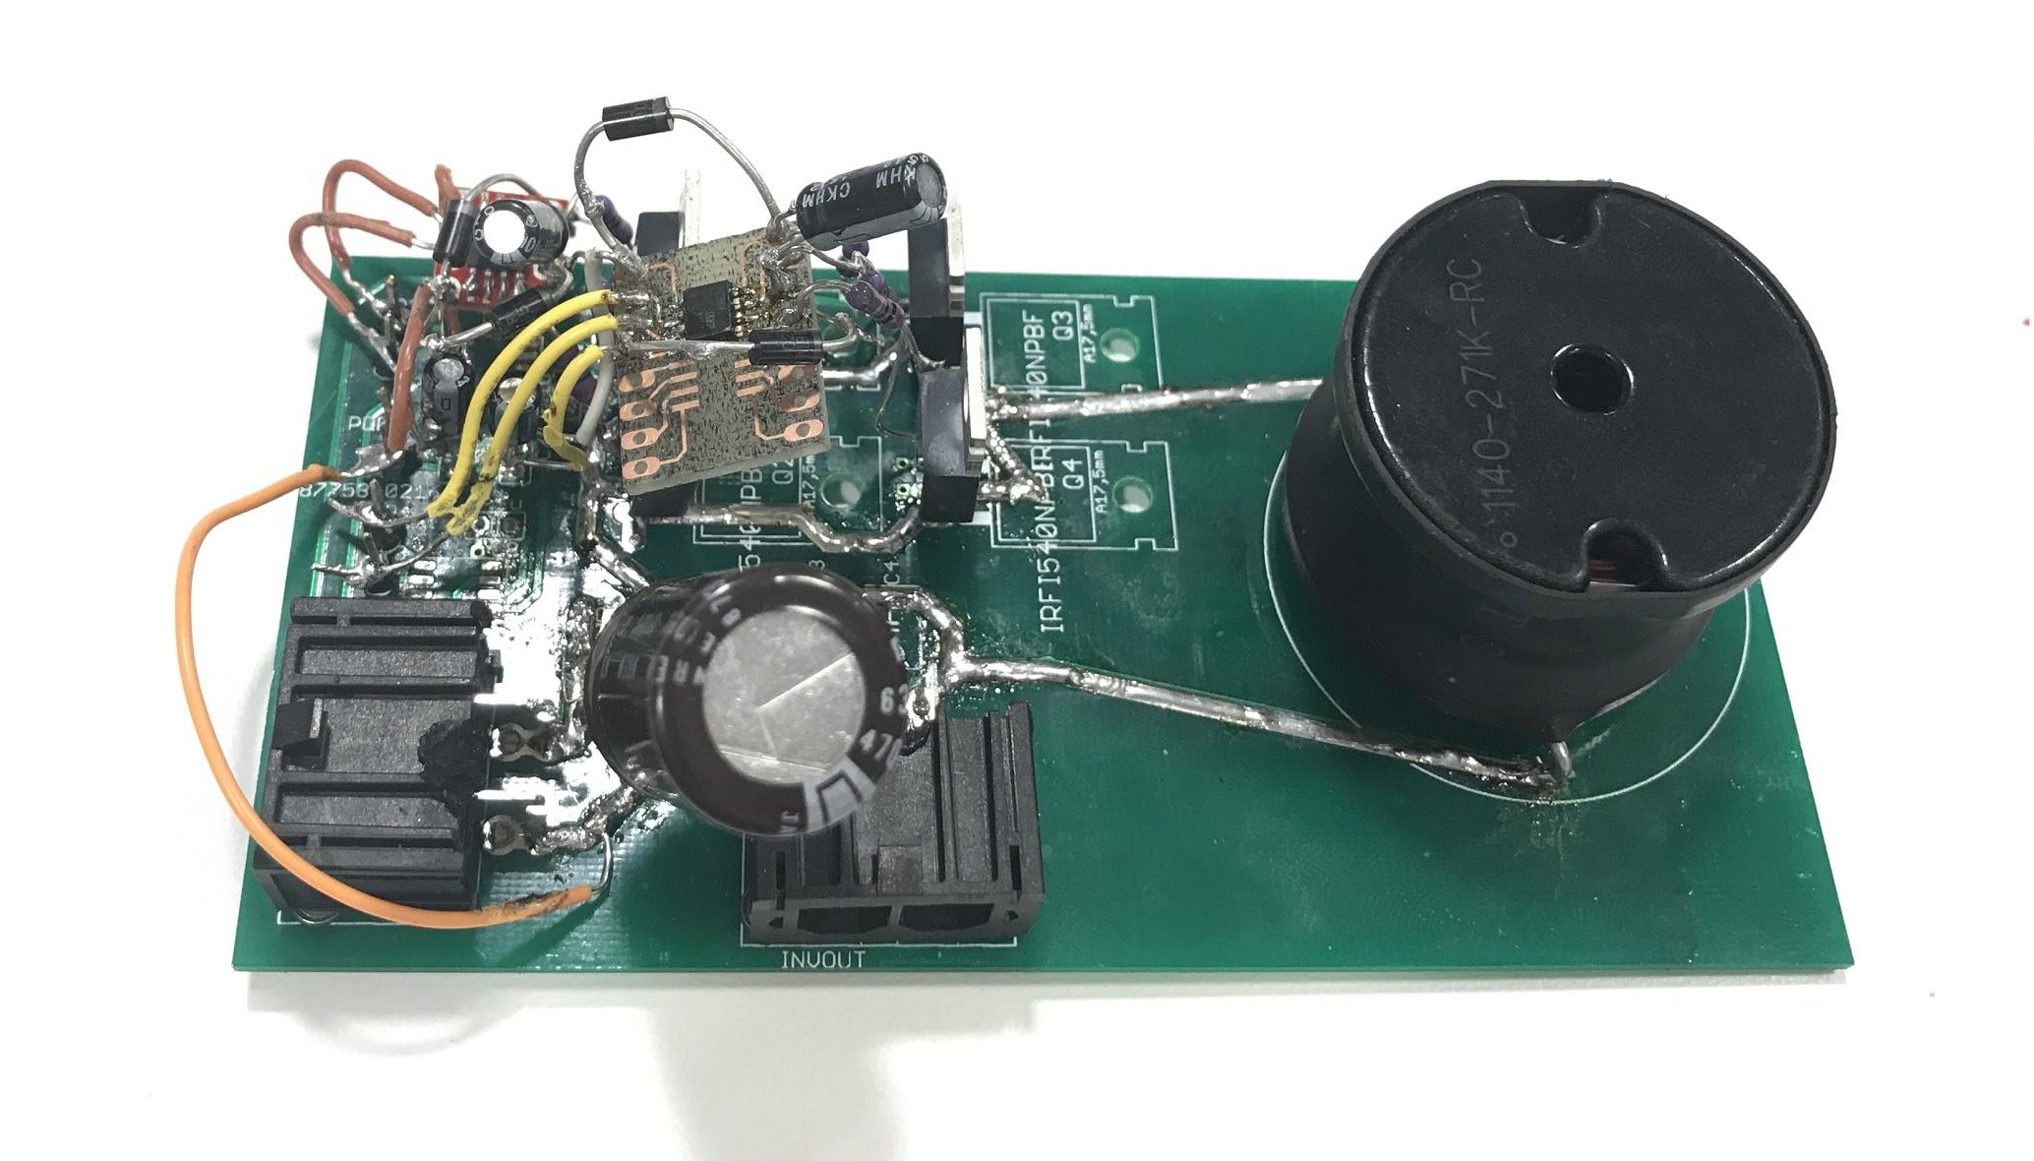
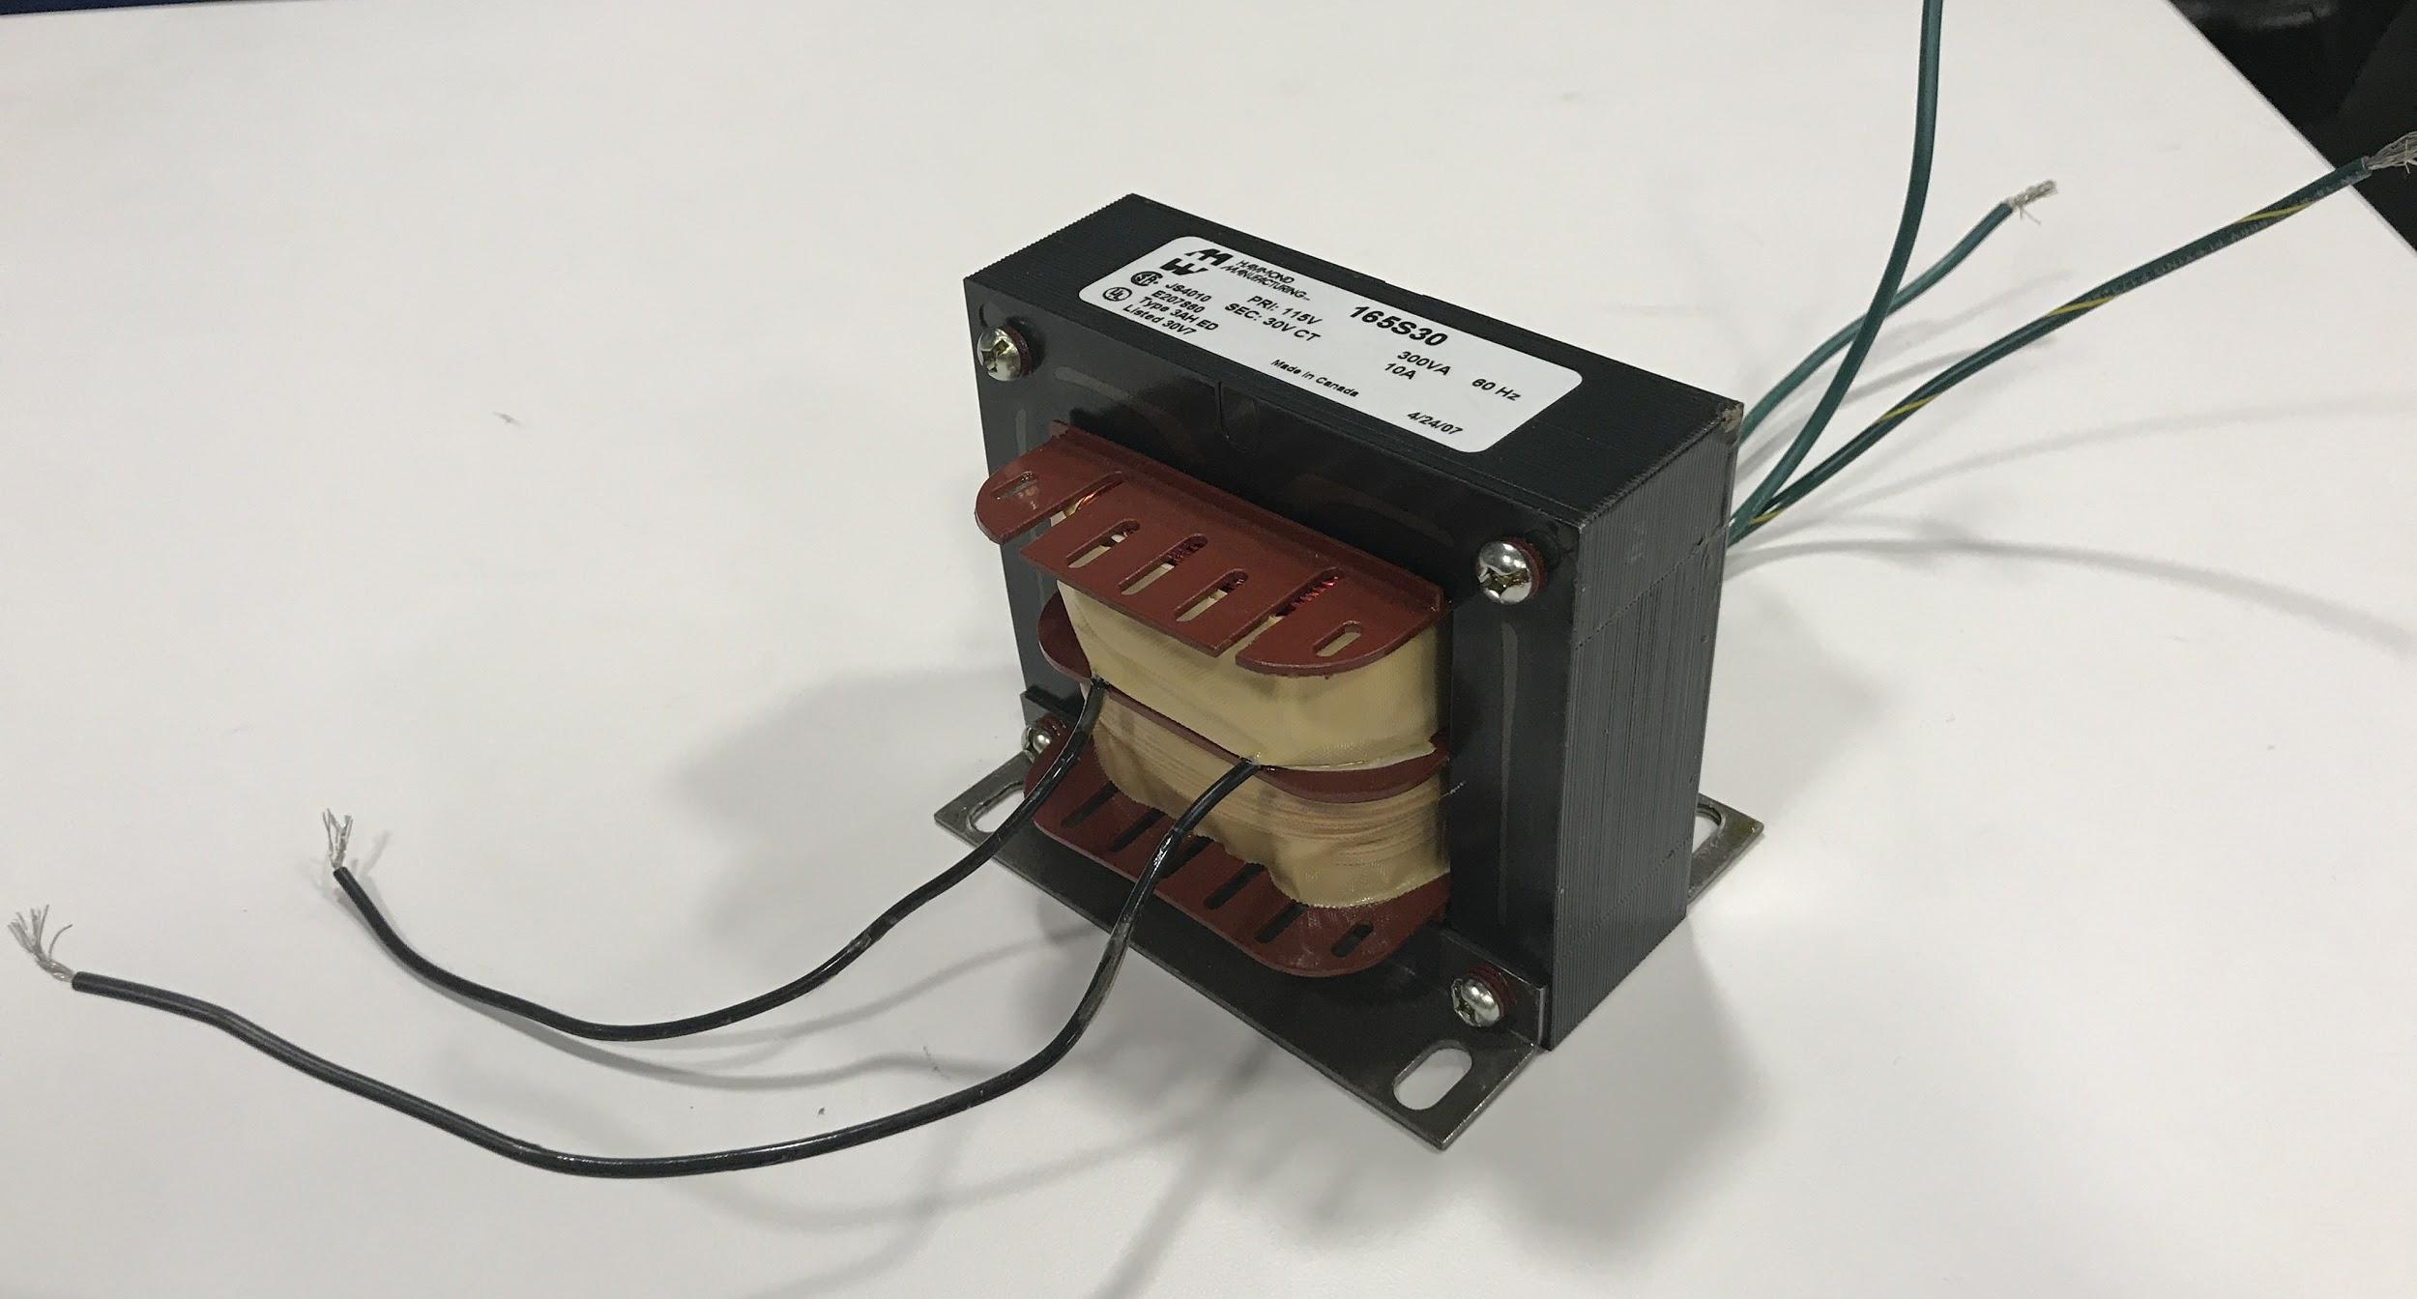
Output Power Module: Inverter & Transformer
Full Bridge Inverter
Input: 5-40V from buck-boost
Output: 4-30V AC RMS
Frequency: 60Hz
Purchased Component: Transformer
4:1 Turns Ratio
Steps up AC Voltage on Output

Slide 20
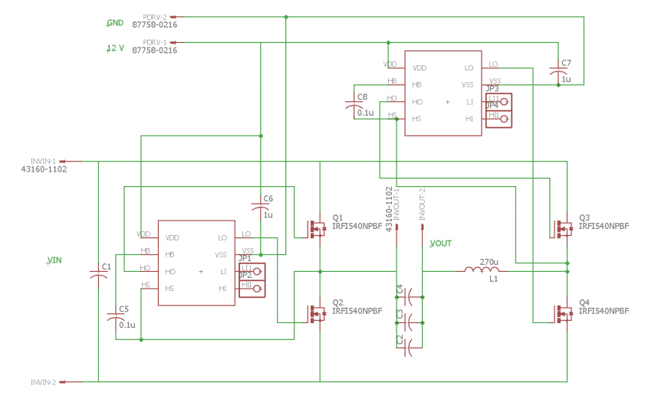
Inverter: Circuit Schematic

Slide 21
Inverter: Harmonic Elimination
Switching timing technique which can remove specific harmonic components
Used to remove the third (largest) harmonic by setting delta to 30 degrees
Reduces THD considerably
Image courtesy of researchgate.net

Slide 22
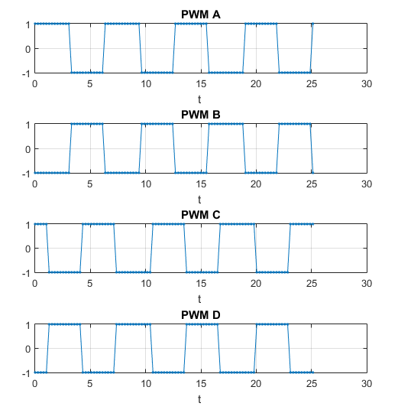
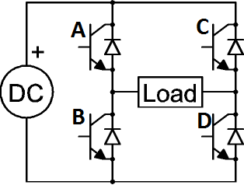
Inverter: Circuit Topography
Image Courtesy of Electronics-Tutorial.net

Slide 23
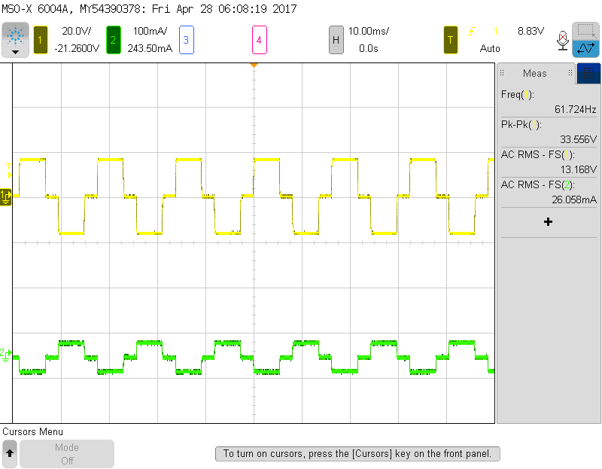
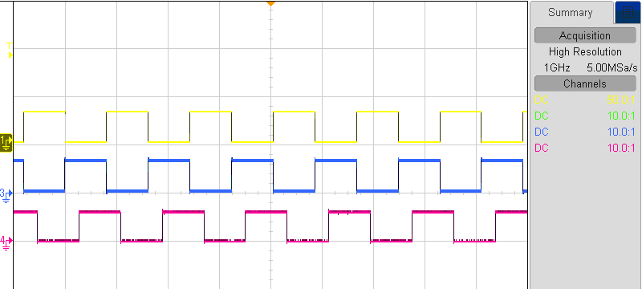
Inverter: Control Scheme
Reduce the output THD through 3rd harmonic elimination
~2us of programmed deadtime between high and low switches, for safety
Yellow and blue, 180 degrees shifted
Yellow and red, 120 degrees shifted
Voltage in yellow, current in green

Slide 24
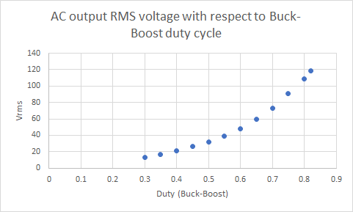
AC Voltage Output: Experimental Results
Output AC voltage dependent on output DC voltage
Tested output range of 13 to 120 Vrms

Slide 25
AC Output: User Input Verification

Slide 26
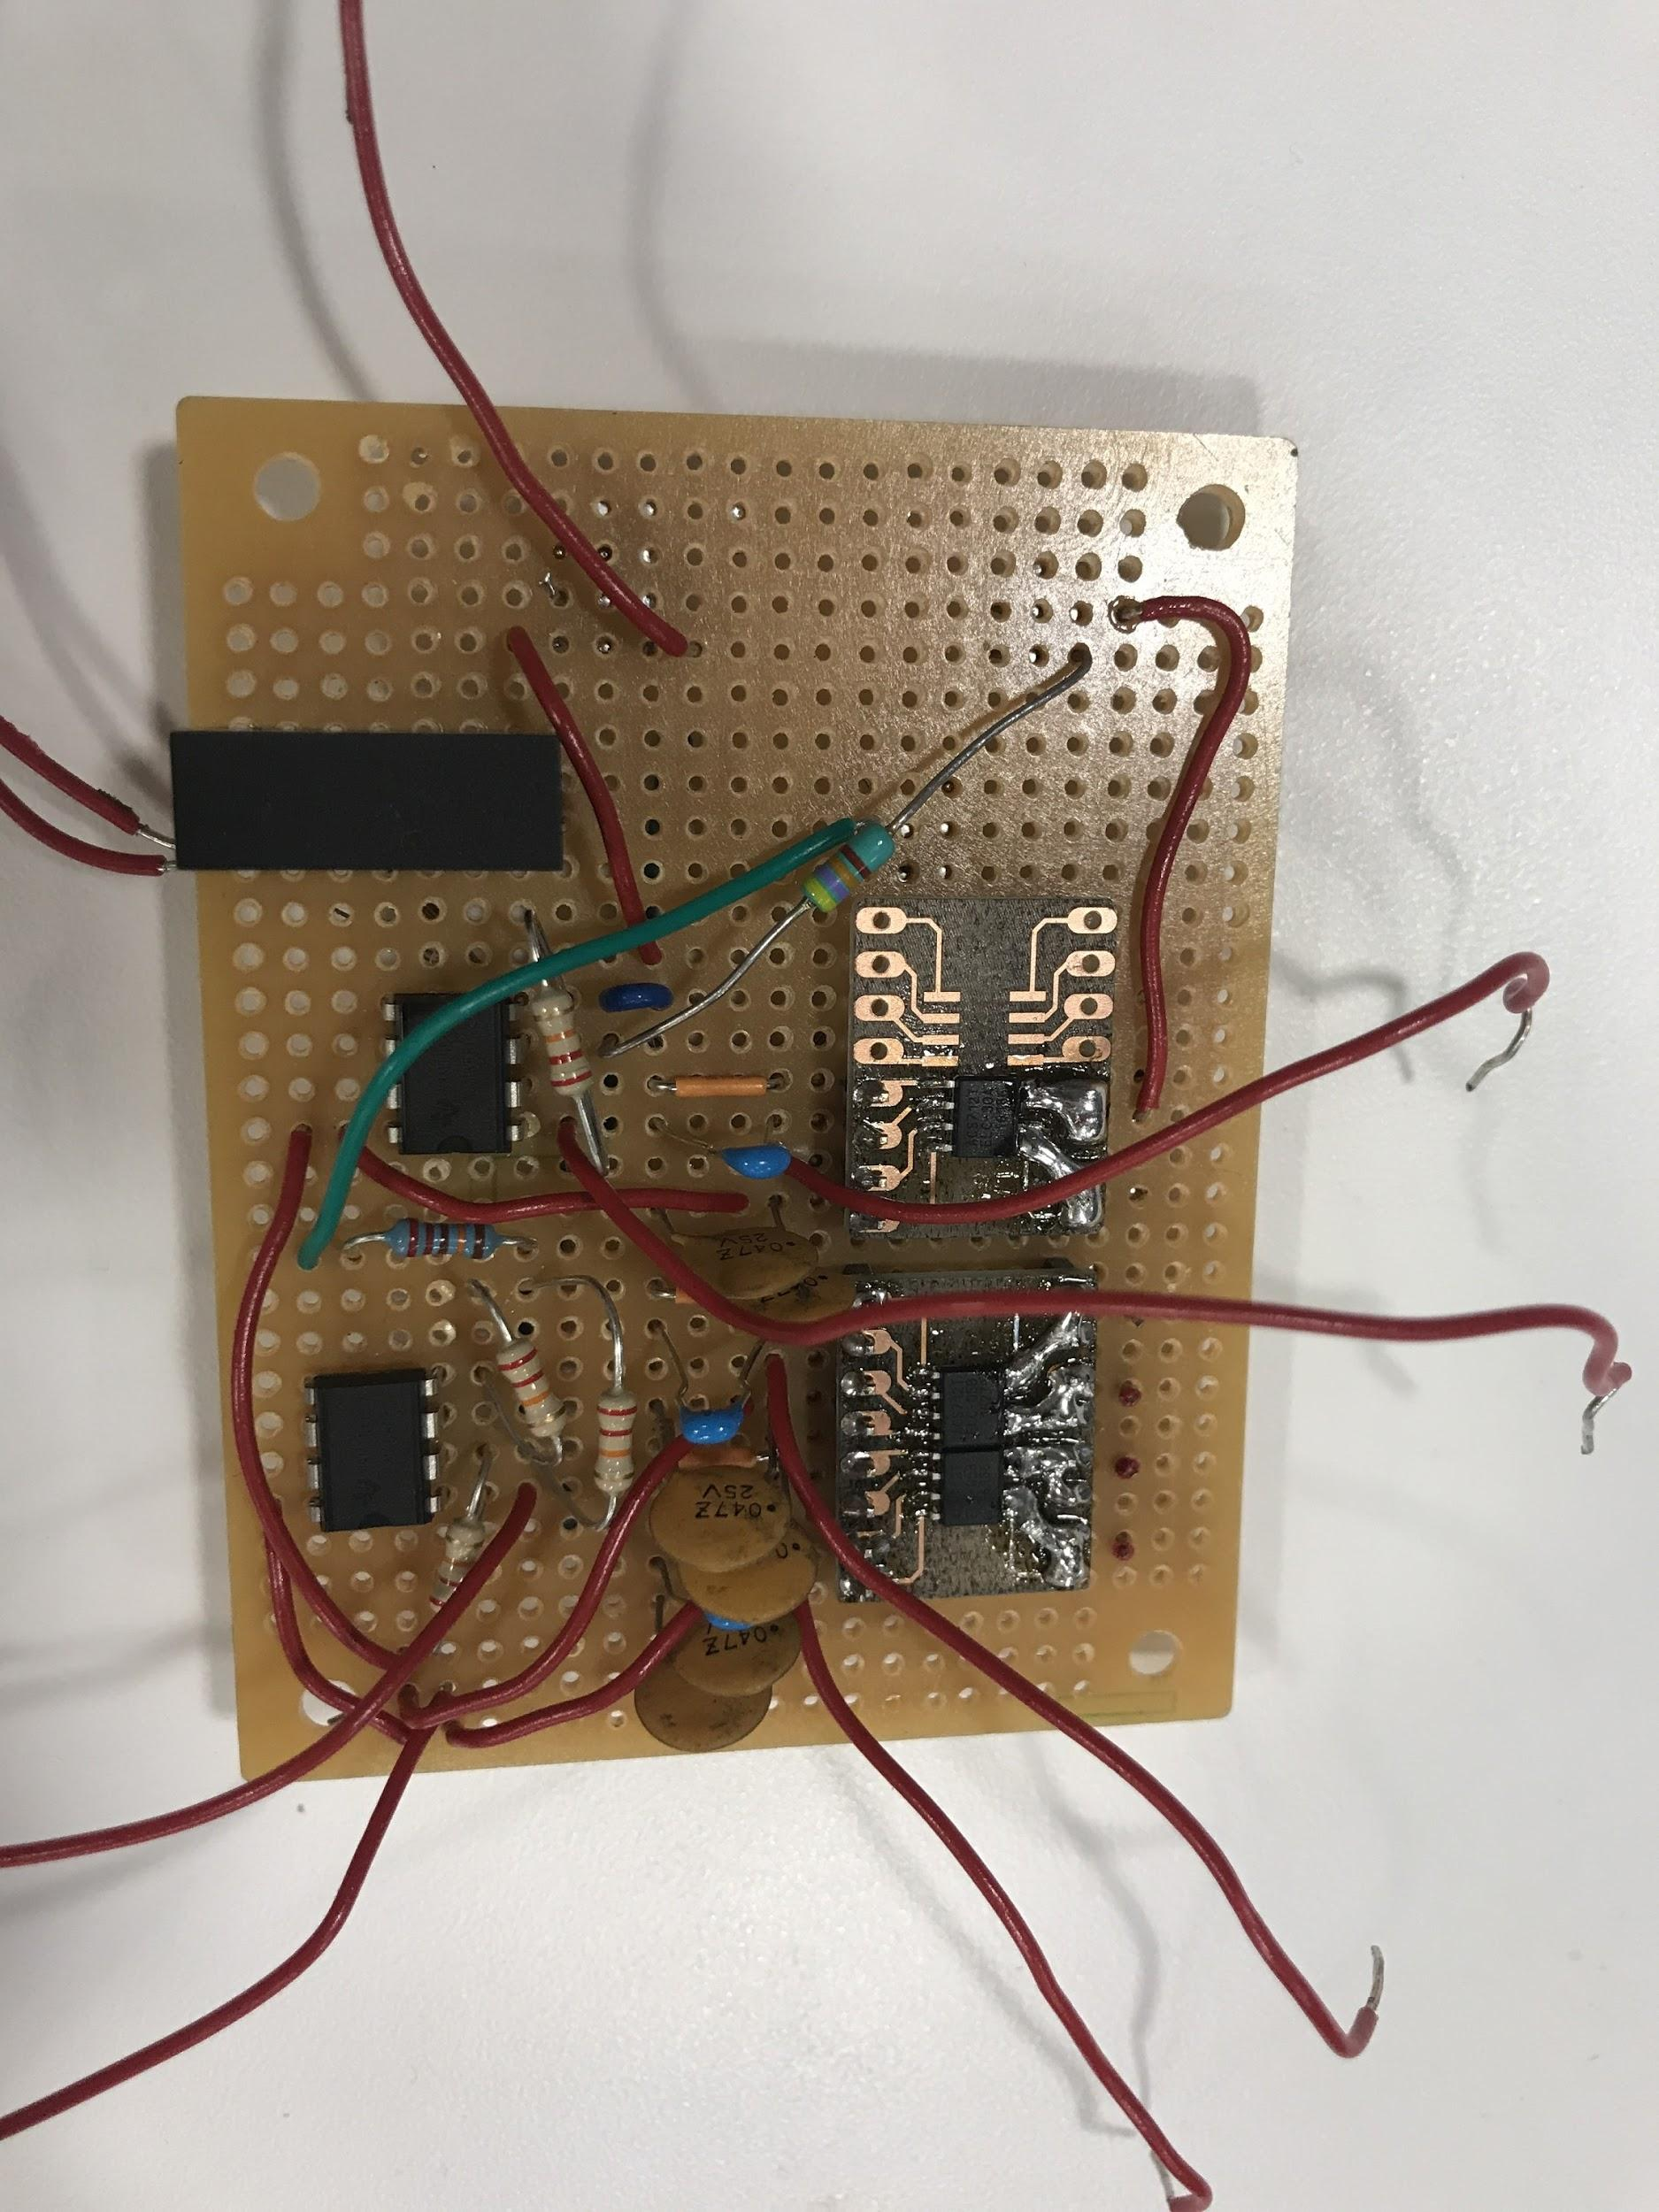
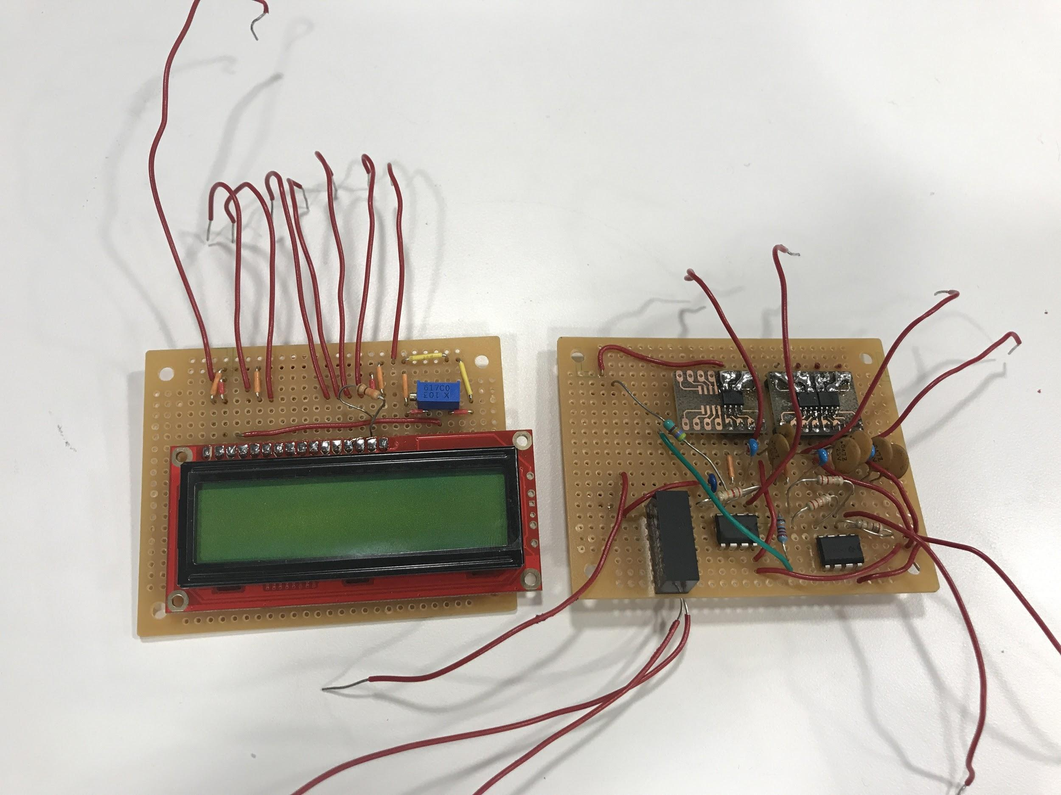
Control Module: Measurement Circuit
2 Voltage Measurement
Battery voltage
Buck-boost output
3 Current Measurements
Battery current
DC output current
AC output current
LCD display

Slide 27
Measurement Circuit Hardware
Voltage Measuring
Resistive divider down to 0-5V
Op-amp buffer for battery voltage
Inverting op-amp for buck-boost voltage
Current Measuring
ACS hall effect sensor, used for both AC and DC currents
Arduino
Voltages and currents interpreted by Arduino program
LCD
Displays voltage and current values to user

Slide 28
Measurement Circuit Software
Voltage sensing Algorithm
Measure ADC input
Scale ADC value according to resistive divider
DC sensing Algorithm
Measure ADC voltage output of ACS chip
Multiply by scale factor for current
Add offset
AC sensing Algorithm
Measure Vpp from ACS
Calculate Vrms
Convert to Irms using scale factor and offset

Slide 29
Final Results: Meeting Power Requirements
Buck-Boost | Met? | Inverter | Met? | AC Output | Met?
5-40 V | Yes | Remove 3rd Harmonic | Yes | 120 V RMS | Yes
1 A | Yes | 30 V RMS | Yes | 1 A RMS | No
75% Eff | Yes
5% Ripple | Yes

Slide 30
Final Results: Meeting Other Requirements
The input power module successfully met all its requirements to charge, supply battery power, and power microcontrollers
The C2000 successfully controlled both converters
Arduino measurement circuit code created and was able to control display
Measurement circuit functionality and LCD screen were not implemented in the final project successfully

Slide 31
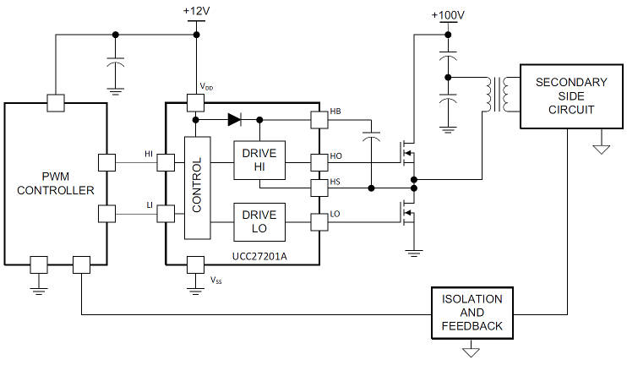
Design Challenges: Bootstrap Gate driver
Image courtesy of Electronics Weekly
Why bootstrap gate driving is necessary
Inverter and buck-boost have high side gates (source not directly grounded)
C2000 cannot source sufficient power to drive a power MOSFET
ICs exist to fulfill this need
Add external bootstrap and bypass capacitors
Can be used to drive low and high side gates simultaneously

Slide 32
Design Challenges: Bootstrap Gate Driver
Problems with original IC choice: UCC27211D
Low tolerance to transient negative source voltage spikes
PCB did not include protection measures
Destroyed 10 ICs in course of testing
Improper grounding for buck-boost gate driver
New gate driver selected: IRS21867S
Resilient to negative transient voltage spikes
Incorporated clamping diode and limiting resistors
New gate driver necessitated deviation from original PCB traces
Demonstrated survivability and functionality

Slide 33
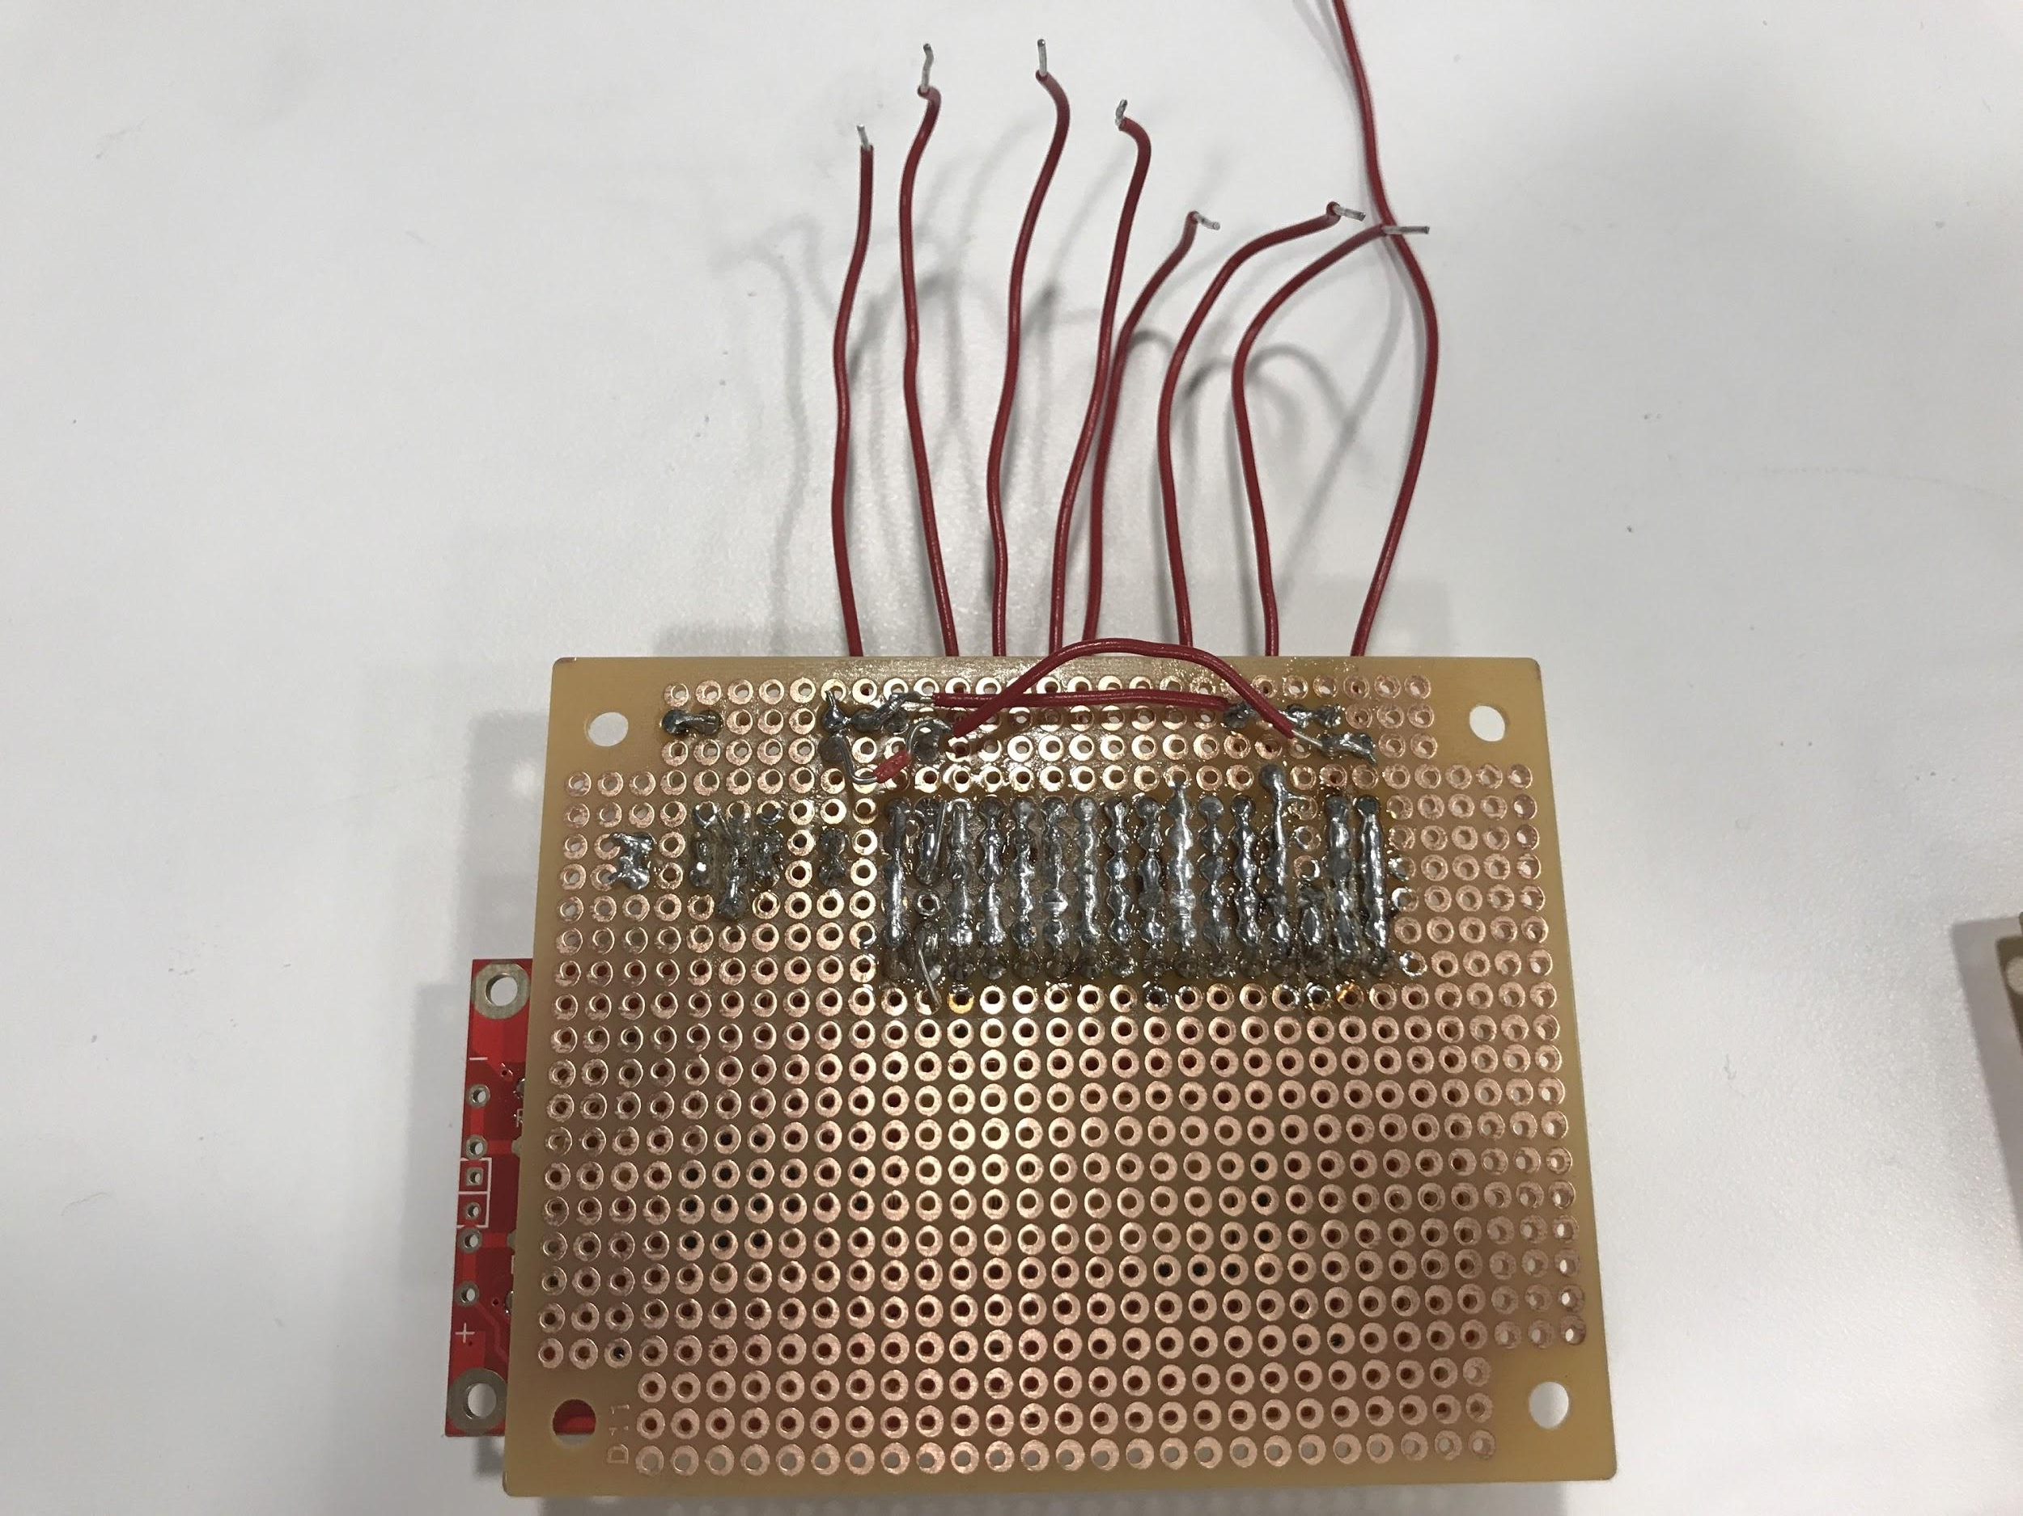
Design Challenges: Measurement Circuit
LCD display
Successfully tested LCD drive
LCD failed during final tests. No replacement available

Slide 34
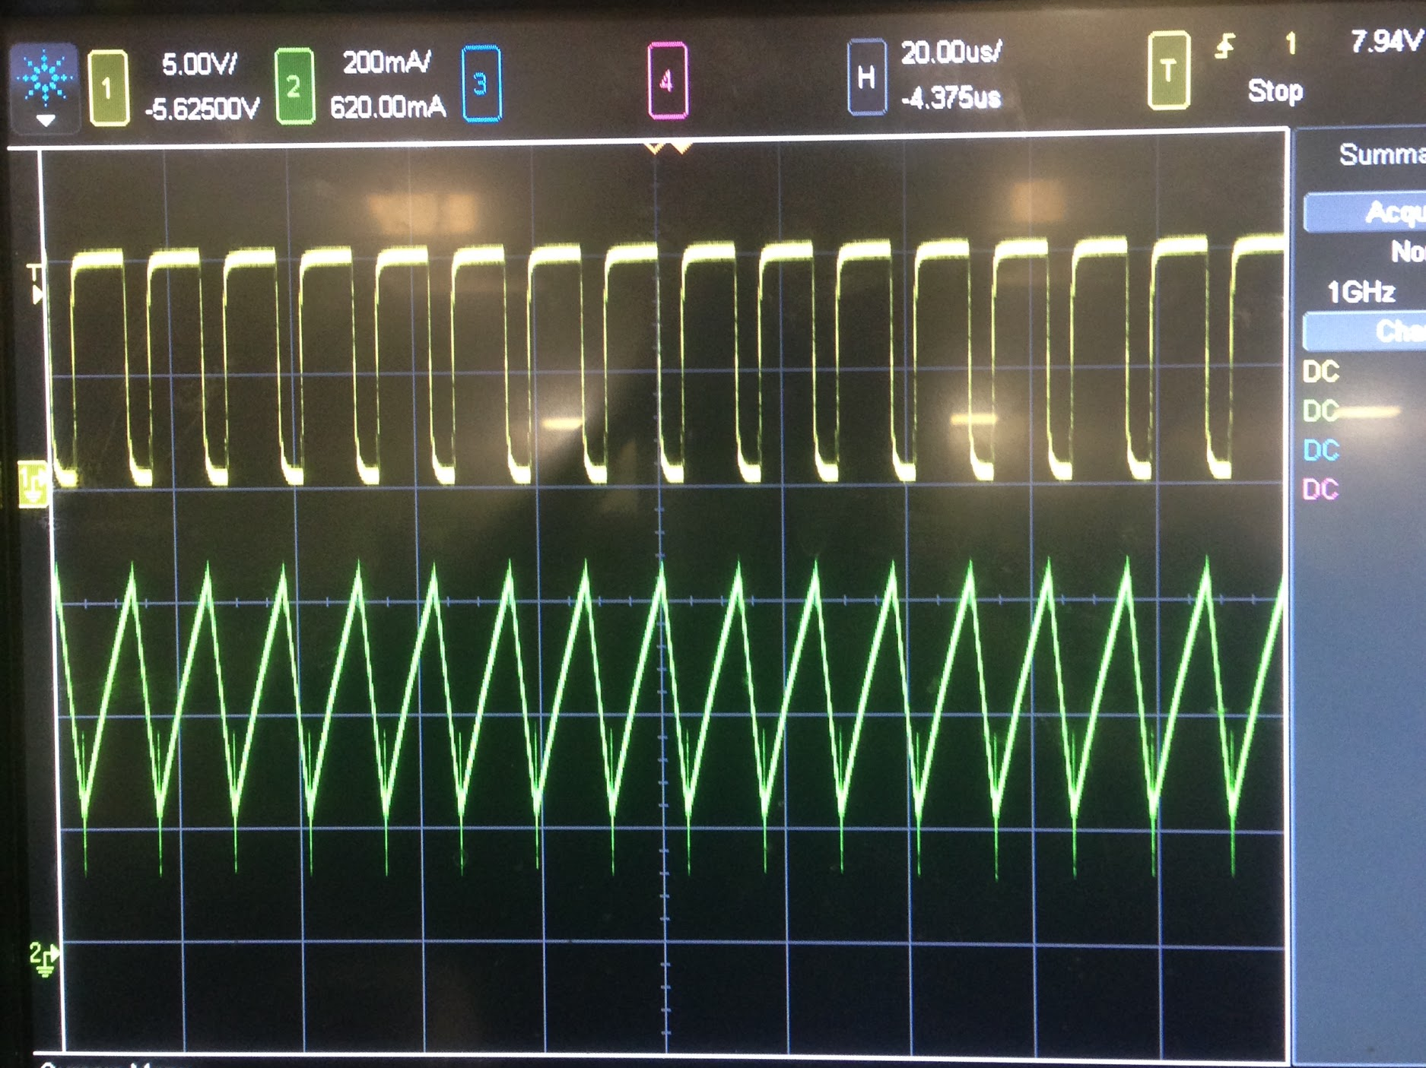
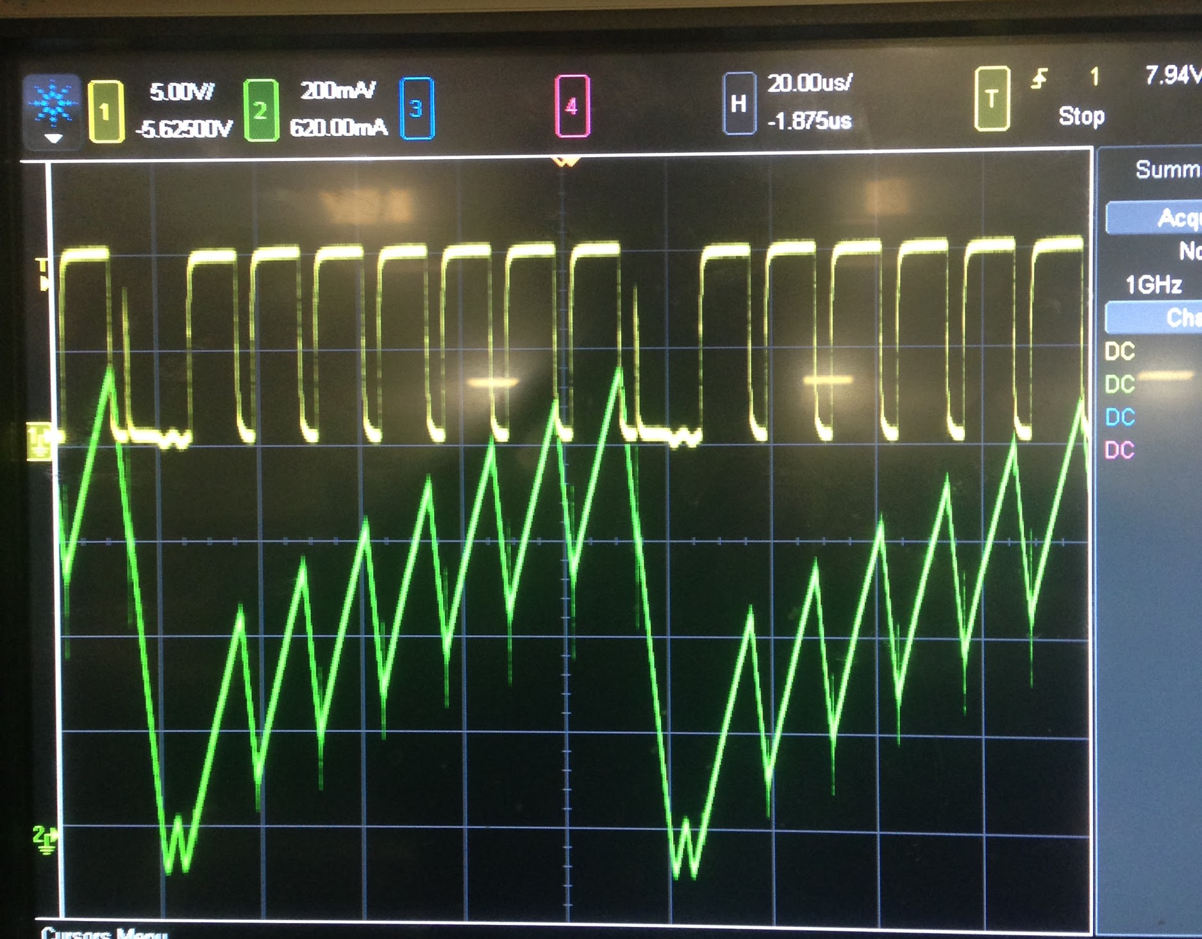
Design Challenges: High Power Testing
At high duty cycle and high amps signal noises became larger
Gate driver output waveform began to “skip” which caused audible ringing and voltage drop
Issue was partially resolved with clamping diodes and lower gate driver power voltage

Slide 35
Future Work
Purchase new LCD screen and incorporate measurement circuit into final design
Fix Buck-Boost voltage drop problem to increase output power of project

Slide 36
Thank You!
Questions?

