Slide 1
BCAN’T:
Beacon Controlled
Autonomous Network
(for Trains)
Team 5: Susan Chen, Prithvi Garimalla, Jordi Pakey-Rodriguez
TA: Jacob Bryan
Notes:
Pri
INTRODUCE NAMES

Slide 2
Introduction
BCAN’T is a beacon based system for model train layouts that enables fully autonomous “Set and Go” operation.
Notes:
Pri

Slide 3
Objective
Operate on analog (DC) and bipolar digital command control (DCC) track power
Detect obstacles on the track
Read customizable speed limit beacons
Notes:
Pri

Slide 4
Hardware
Notes:
Jordi

Slide 5
Beacon
Small modules powered by rails
Continuously transmit unique ID via modulated infrared (IR) light
Simple and low cost design
Notes:
Jordi

Slide 6
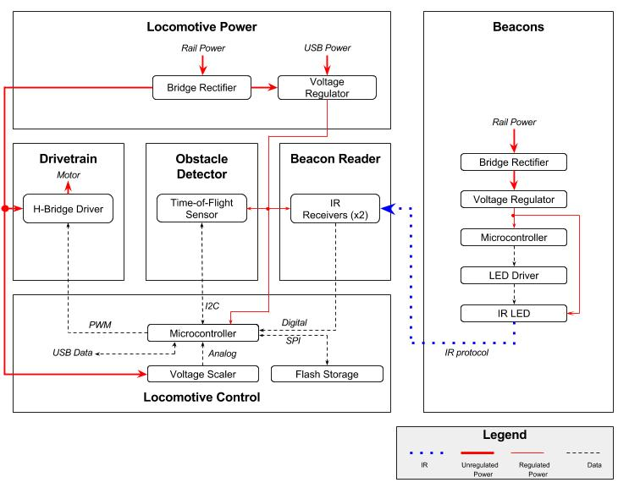
Notes:
Jordi

Slide 7
Beacon
Notes:
Jordi
LED is controlled by PWM signal from MCU with the aid of a MOSFET

Slide 8
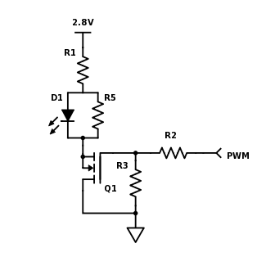
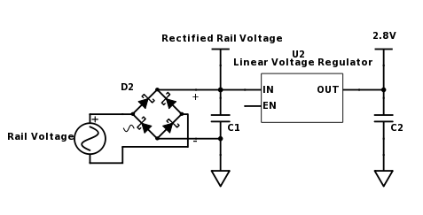
Beacon Circuits
Beacon Power Circuit
IR LED Circuit
Notes:
Jordi

Slide 9
Beacon Protocol
Custom protocol based on Philips RC5/RC6
38kHz modulation
Manchester encoding
960μs bit period
16 bit data length
Notes:
Jordi
38kHz modulation - widely available
Manchester encoding - G.E. Thomas convention
960us bit period - 23.04ms total length
16 bit data length - IDs 0x0000 - 0xFFFF

Slide 10
Beacon Verification
Beacon ID: 0xCA53
Notes:
Jordi
0xCA53

Slide 11
Locomotive
USB mass storage device class (USB MSC) programming mode
Store mappings in flash storage
Rail voltage sensing via analog to digital converter (ADC)
Control
Notes:
Pri

Slide 12
Notes:
Pri

Slide 13
Locomotive Control Design
Combines information from the laser time-of-flight sensor, track voltage sensor, and beacon reader
Uses this data to perform actions such as setting the desired motor speed or toggling lights or peripherals

Slide 14
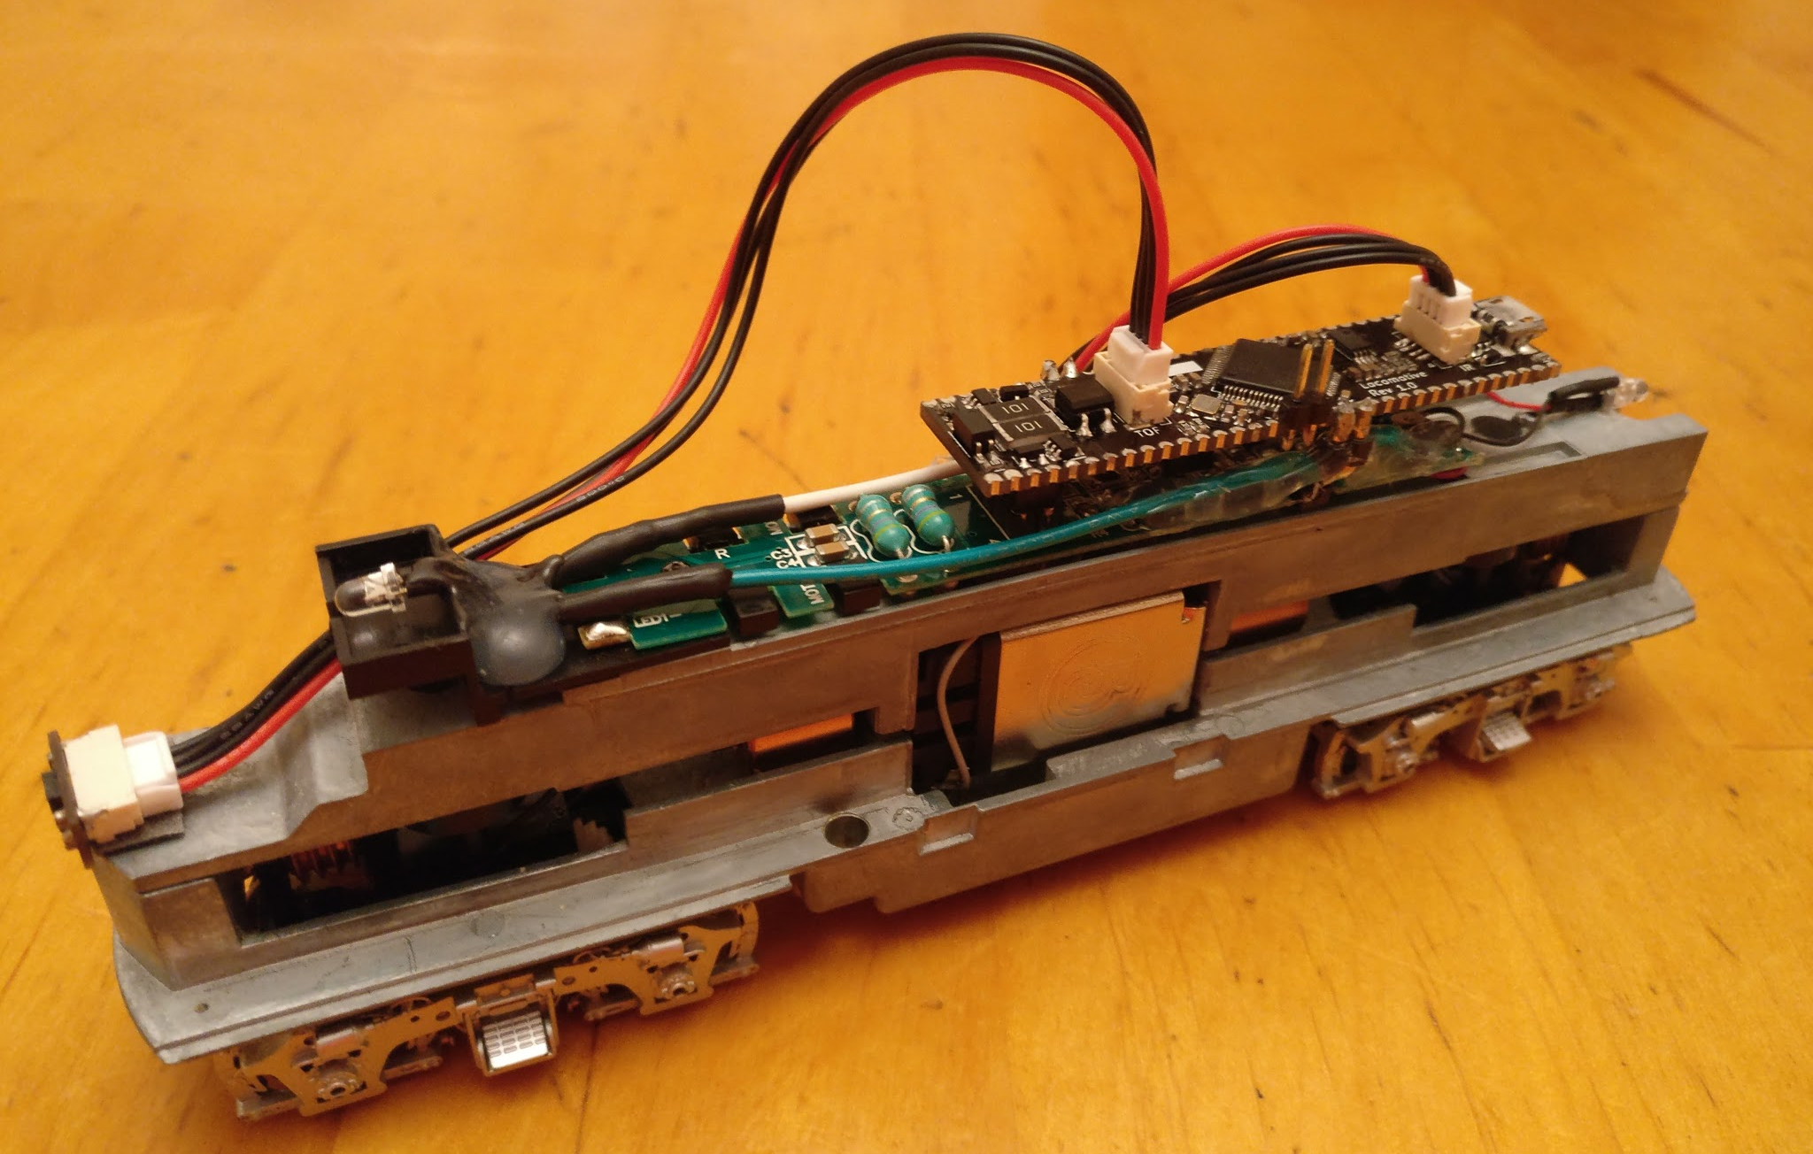
Notes:
Pri

Slide 15
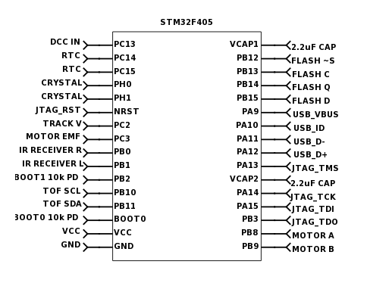
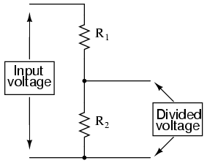
Locomotive Control Circuit
Microcontroller
Voltage Scaler Circuit
Notes:
Pri

Slide 16
Locomotive Control Verification
Unable to test and verify the USB or flash storage due to time constraints and locomotive hardware control issues
Rail voltage sensing was tested and verified to be working
Notes:
Pri

Slide 17
Locomotive
Accepts 3.5V to 16V and -3.5V to -16V from rail & 5V from USB
Full bridge rectifier
Low-dropout (LDO) linear voltage regulator
Power
Notes:
Susan

Slide 18
Notes:
Jordi

Slide 19
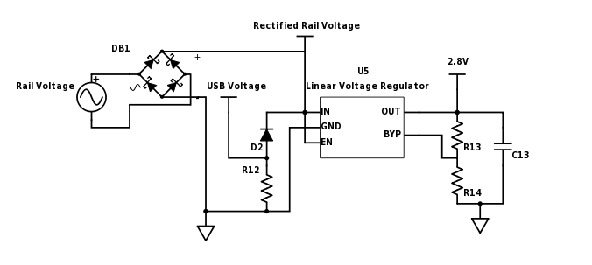
Locomotive Power Circuit
Notes:
Susan

Slide 20
Locomotive Power Verification
Notes:
Susan

Slide 21
Locomotive
Power MOSFET H-bridge motor driver circuit
NPN transistor gate drivers
10kHz PWM used to avoid resonance and noise
Drivetrain
Notes:
Susan

Slide 22
Notes:
Jordi

Slide 23
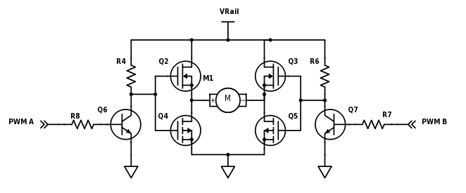
Drivetrain Circuit
Notes:
Susan

Slide 24
Drivetrain Verification
Tested and verified motor input on breadboard due to last-minute PCB issues
Tested with locomotive motor off tracks
Notes:
Susan

Slide 25
Locomotive
Read beacon IDs as train travels over them
Mounted underneath train
Two IR receivers to differentiate direction of travel
Beacon Reader
Notes:
Susan

Slide 26
Notes:
Jordi

Slide 27
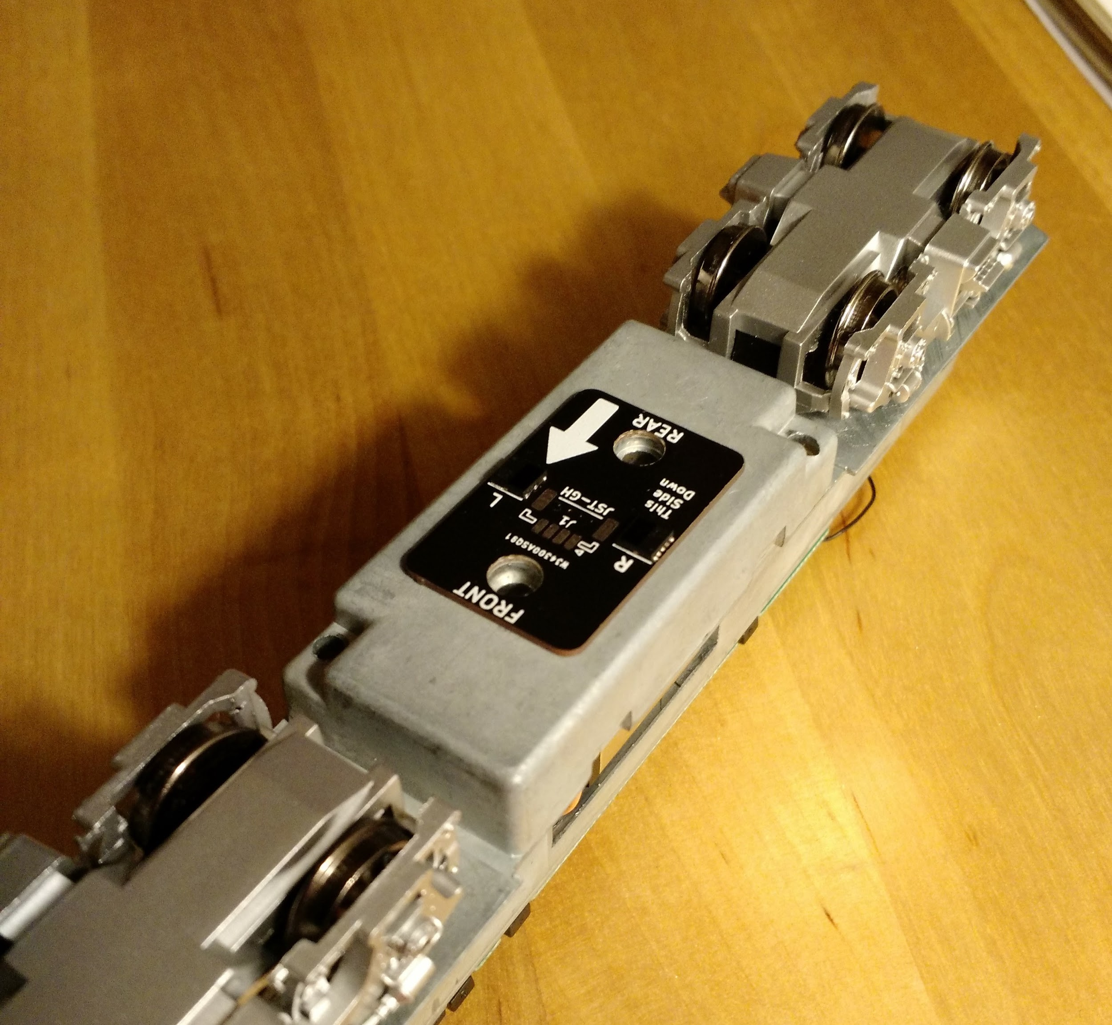
Beacon Reader
Notes:
Susan

Slide 28
Beacon Reader Verification
Notes:
Susan

Slide 29
Locomotive
Detect obstacles in front of train and come to a stop
Laser time-of-flight (TOF) sensor
Sense distance from 5-200mm to within 1mm accuracy
Obstacle Detector
Notes:
Susan

Slide 30
Notes:
Jordi

Slide 31
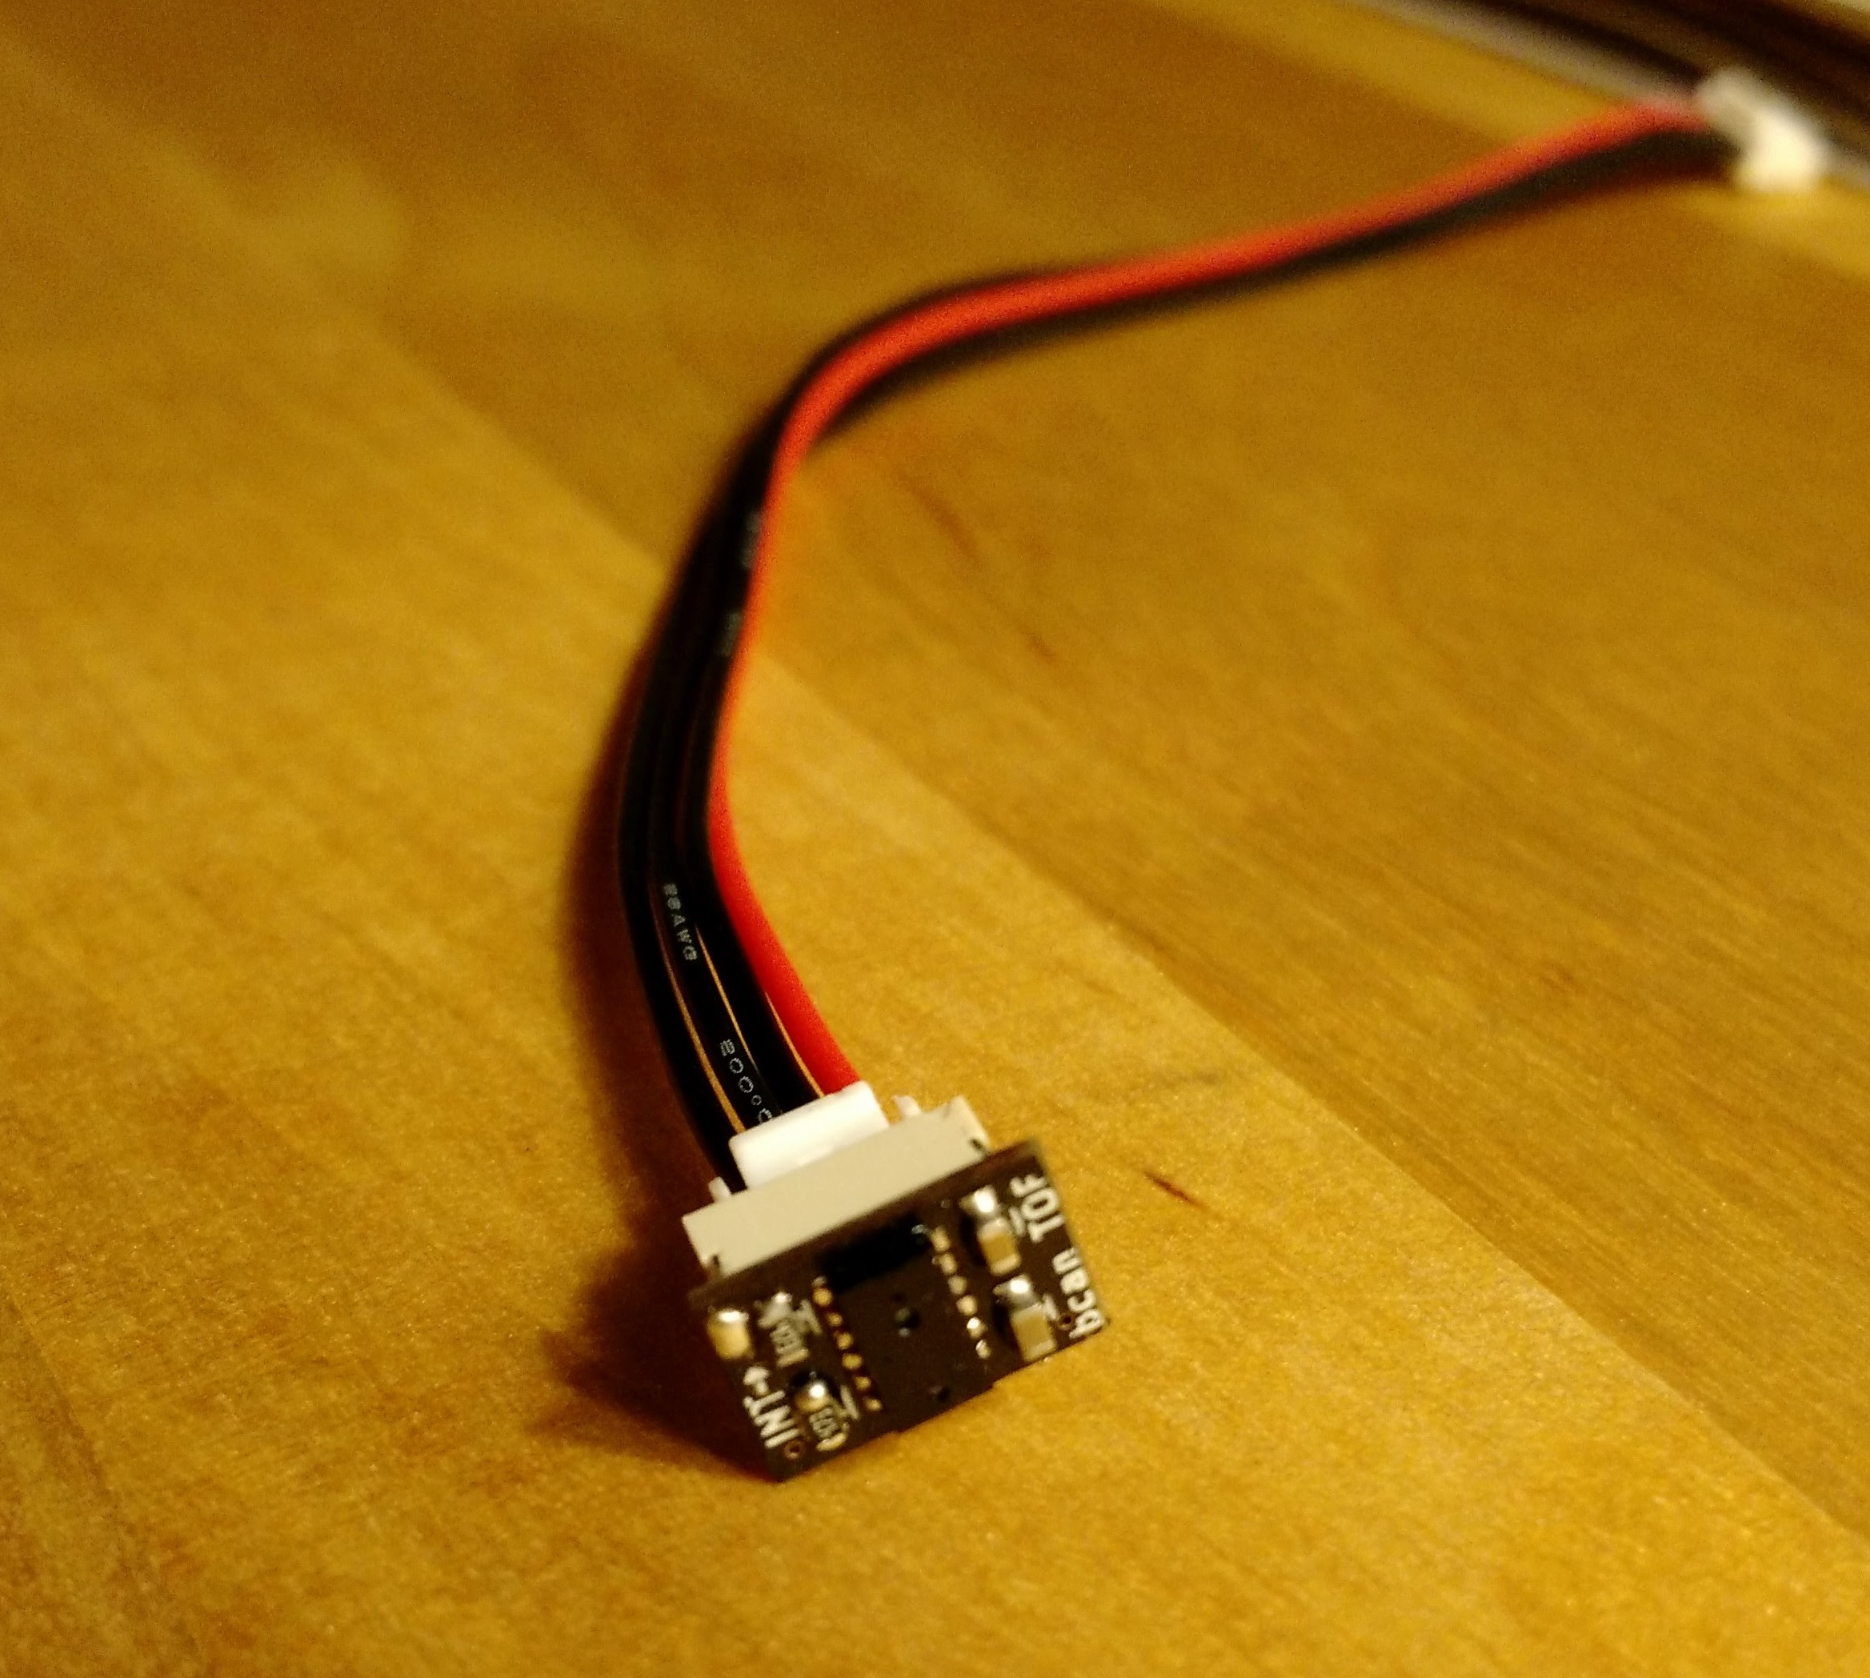
Obstacle Detector
Notes:
Susan

Slide 32
Obstacle Detector Verification
Tested and verified working at a distance of 50mm
Did not detect tracks
Unable to test with moving train due to locomotive control hardware issues
Notes:
Susan

Slide 33
Firmware
Notes:
Jordi

Slide 34
Locomotive
LibOpenCM3 (LOCM3) for STM32F4 ARM processor
EVent Queue (evq) library
Complex driver implementation and interrupt handlers
Firmware
Notes:
Jordi

Slide 35
Locomotive Firmware
Clock
LED
Beacon
Motor PWM and ADC
Time-of-Flight
USB MSC
Flash storage
Notes:
Jordi
LibOpenCM3 (mid-level API for STM32 hardware access)
Focus on Clock, beacon, motor

Slide 36
Locomotive Firmware Interrupts
Systick
Fires every millisecond
Timer (TIM3)
Fires on pin-change from the IR receivers
Used for beacon reading
Maintains a complex data buffer to reconstruct the ID
Analog to Digital Converter (ADC)
Fires on ADC channel conversion
Used for motor control
Notes:
Jordi

Slide 37
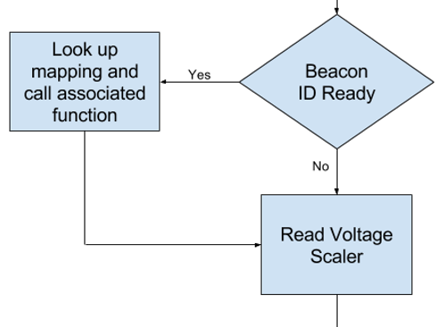
Locomotive Firmware Event Queue (evq)
Modules consist of “check” and “action”
A “check” is constantly polled
When it returns true, “action” is executed
This allows for pseudo-multithreading on a single threaded MCU.
Built as a separate project from BCAN’T
Notes:
Pri

Slide 38
Software
Notes:
Pri

Slide 39
Desktop
Simple user interface to create and edit beacon mappings
Runs online in any browser
User copies the saved file to the board via USB
Configurator
Notes:
Pri

Slide 40
Desktop Configurator
http://jordi.codes/bcan
Notes:
Pri

Slide 41
Lessons Learned
Notes:
Jordi

Slide 42
Hindsight is 20/20
Last minute hardware failures hindered testing
Next time, move testing up in our schedule
Should have dropped obstacle detector
Notes:
Jordi
While we were able to build and test most of the components individually, but some eleventh-hour hardware failures kept us from running everything on an actual model train.
Given the chance to redo the project, we would test our final board earlier than we actually did to hopefully encounter these issues sooner and fix them in time to successfully integrate all parts of the project.

Slide 43
Moving Forward
Beacon reading, the most innovative part of the project, works great!
Our system is economical, and there’s a legitimate path to expose it to the greater model train community.
Notes:
Pri
Start this slide out with “But we didn’t fail!”
The most innovative part of the project, the beacon reading system, was fully tested and was demonstrated to work. Given more time to iron out the kinks, this could provide real value to model train enthusiasts.
Since we also designed our system to be economical, there is a realistic way we could bring it to market.

Slide 44
Credits
Jacob Bryan - for his invaluable help and advice, and for supporting us at every turn
Jamie Norton - for the initial concept and brainstorming
Professor Oelze - for his feedback during our design review and demo
Professor Pilawa - for his advice on the locomotive voltage regulation circuitry
Notes:
Susan

Slide 45
Thank you!
Questions?
Notes:
Susan

