Slide 1
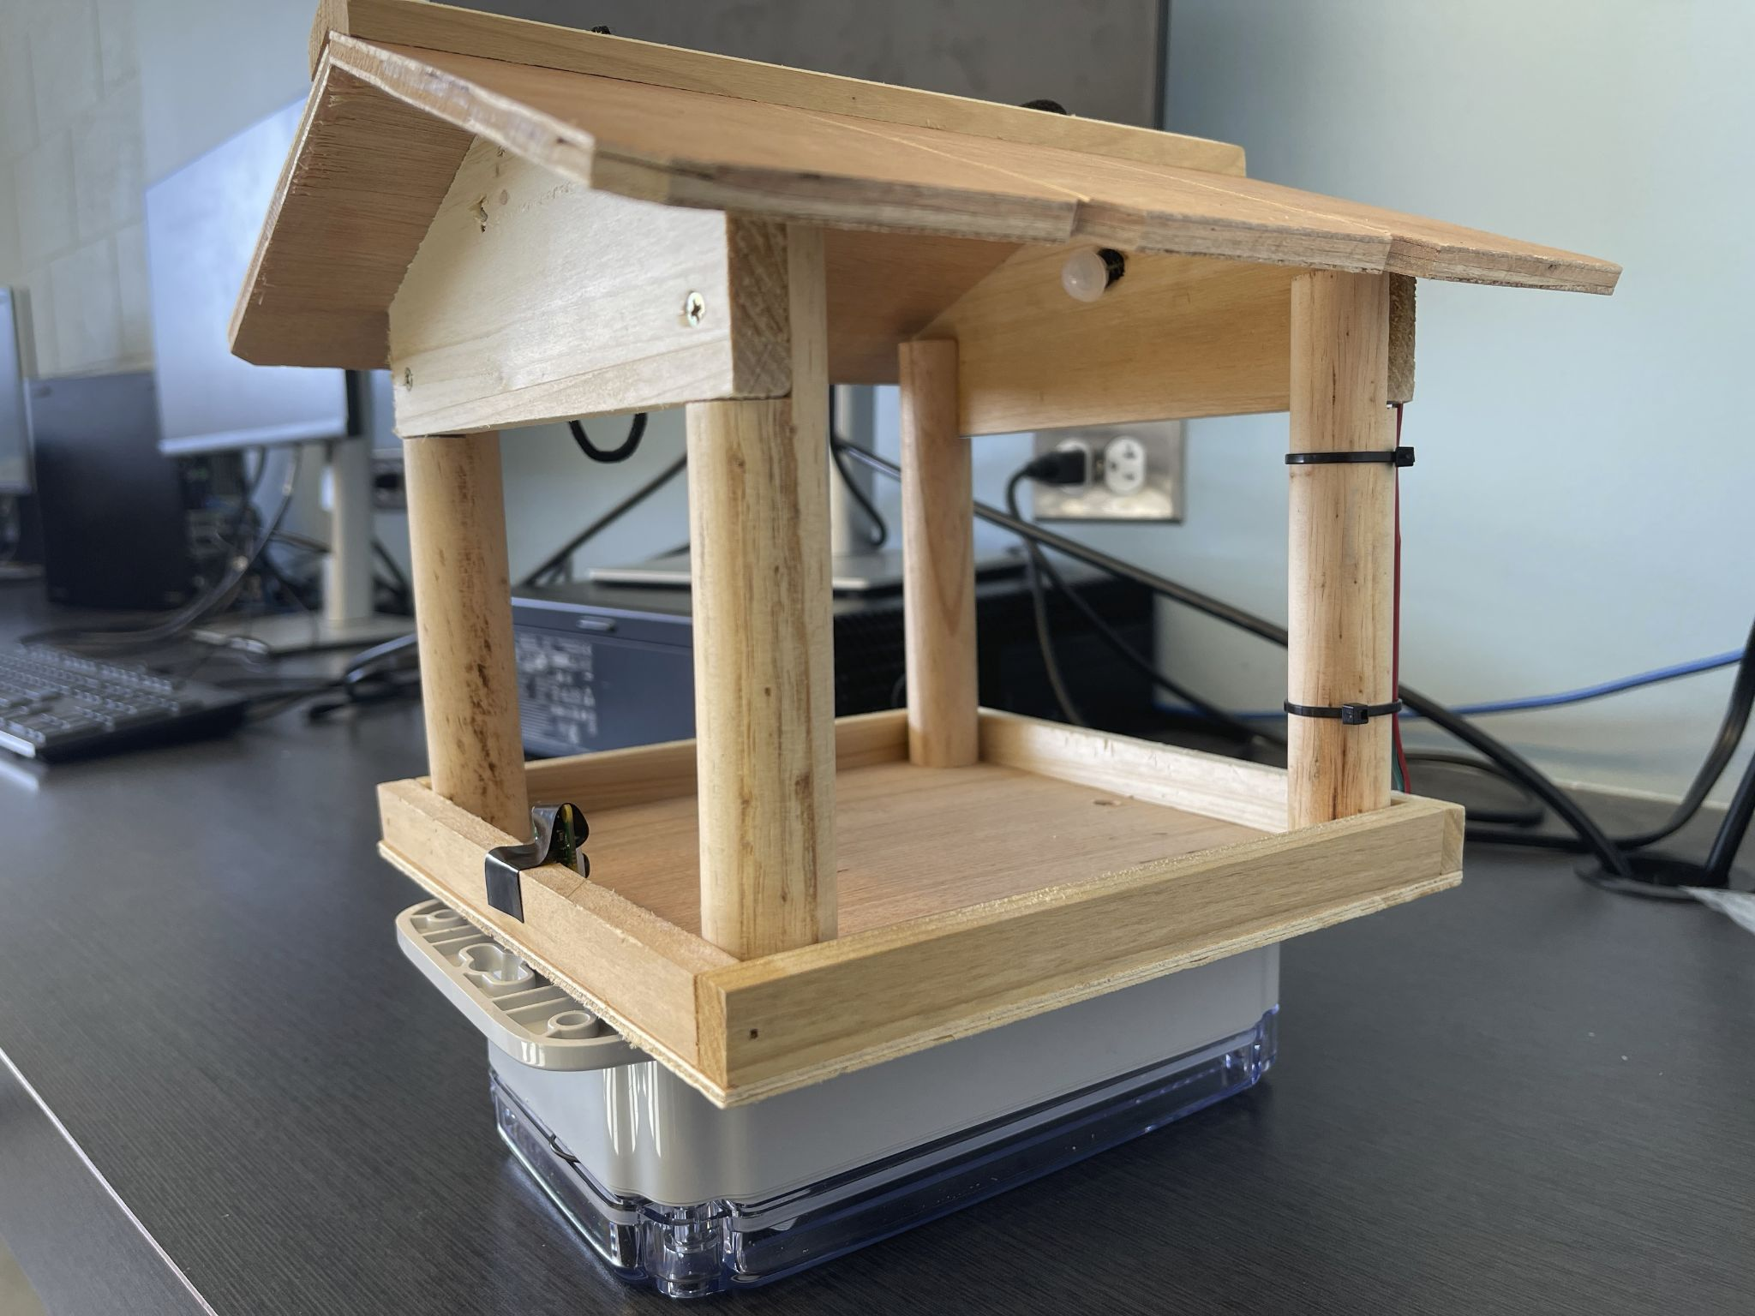
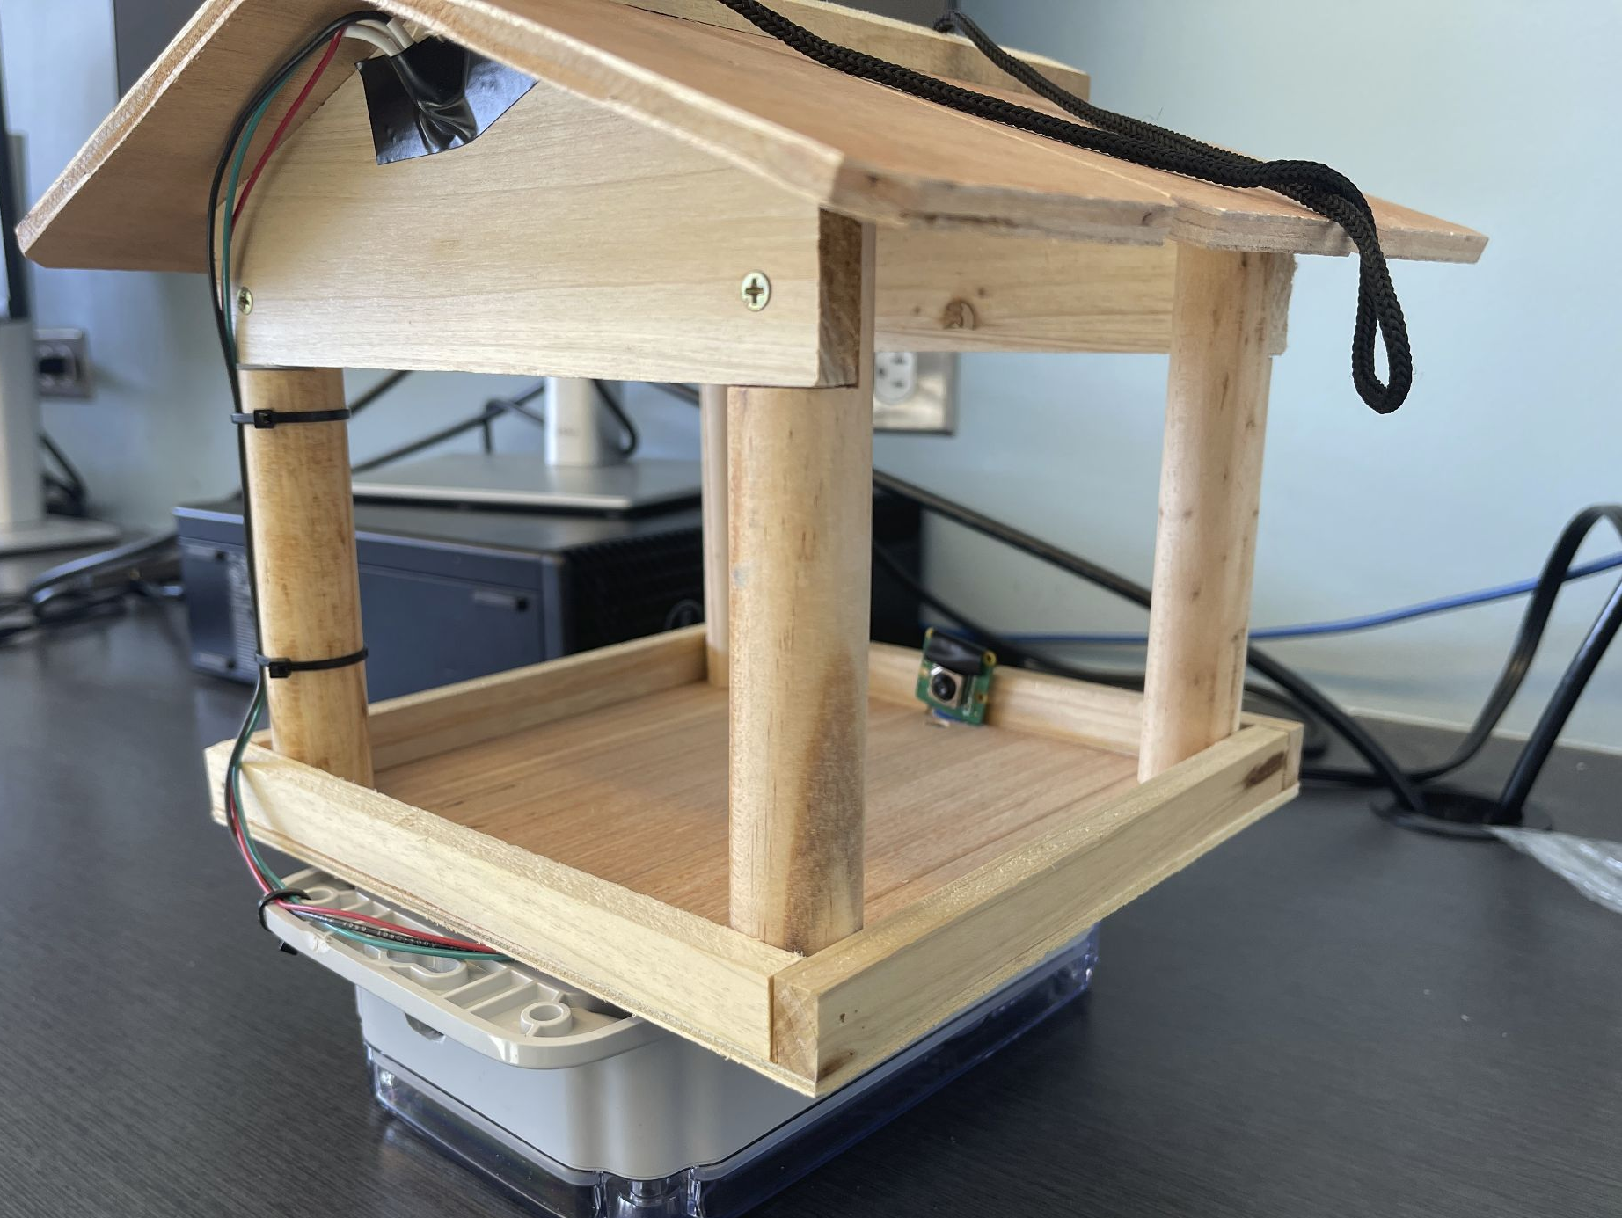
Automated Video Capture Bird Feeder with Data Collection
Team #10
Kevin Li (kli56)
John Golden (jgolden4)
Colten Brunner (cbrunner)
TA: Nikhil Arora
Professor: Viktor Gruev
Spring 2024

Slide 2
Project Summary: The Smart Bird Feeder
Objective
Live Stream Bird Activity: Watch birds feeding in real-time directly on your mobile device.
Automatic Bird Identification: Machine learning software identifies the bird species visiting your feeder.
Notes:
Objective: To create a bird feeder that captures video of birds while they are feeding and live streams the video to a mobile device. Additionally, the system will identify the species of bird using machine learning software. The hardware for the product will all be contained on the physical bird feeder, and capable of extended outdoor use.

Slide 3
High Level Requirements
Fast Activation: Camera activates within 10 seconds of bird landing (90% accuracy).
Live Video Feed: 720p+ resolution with less than 15 second delay.
Auto turn off: Camera turns off within 30 seconds of bird departure. Stays on during timeout for renewed motion (minimizes wind/leaf false positives).

Slide 4
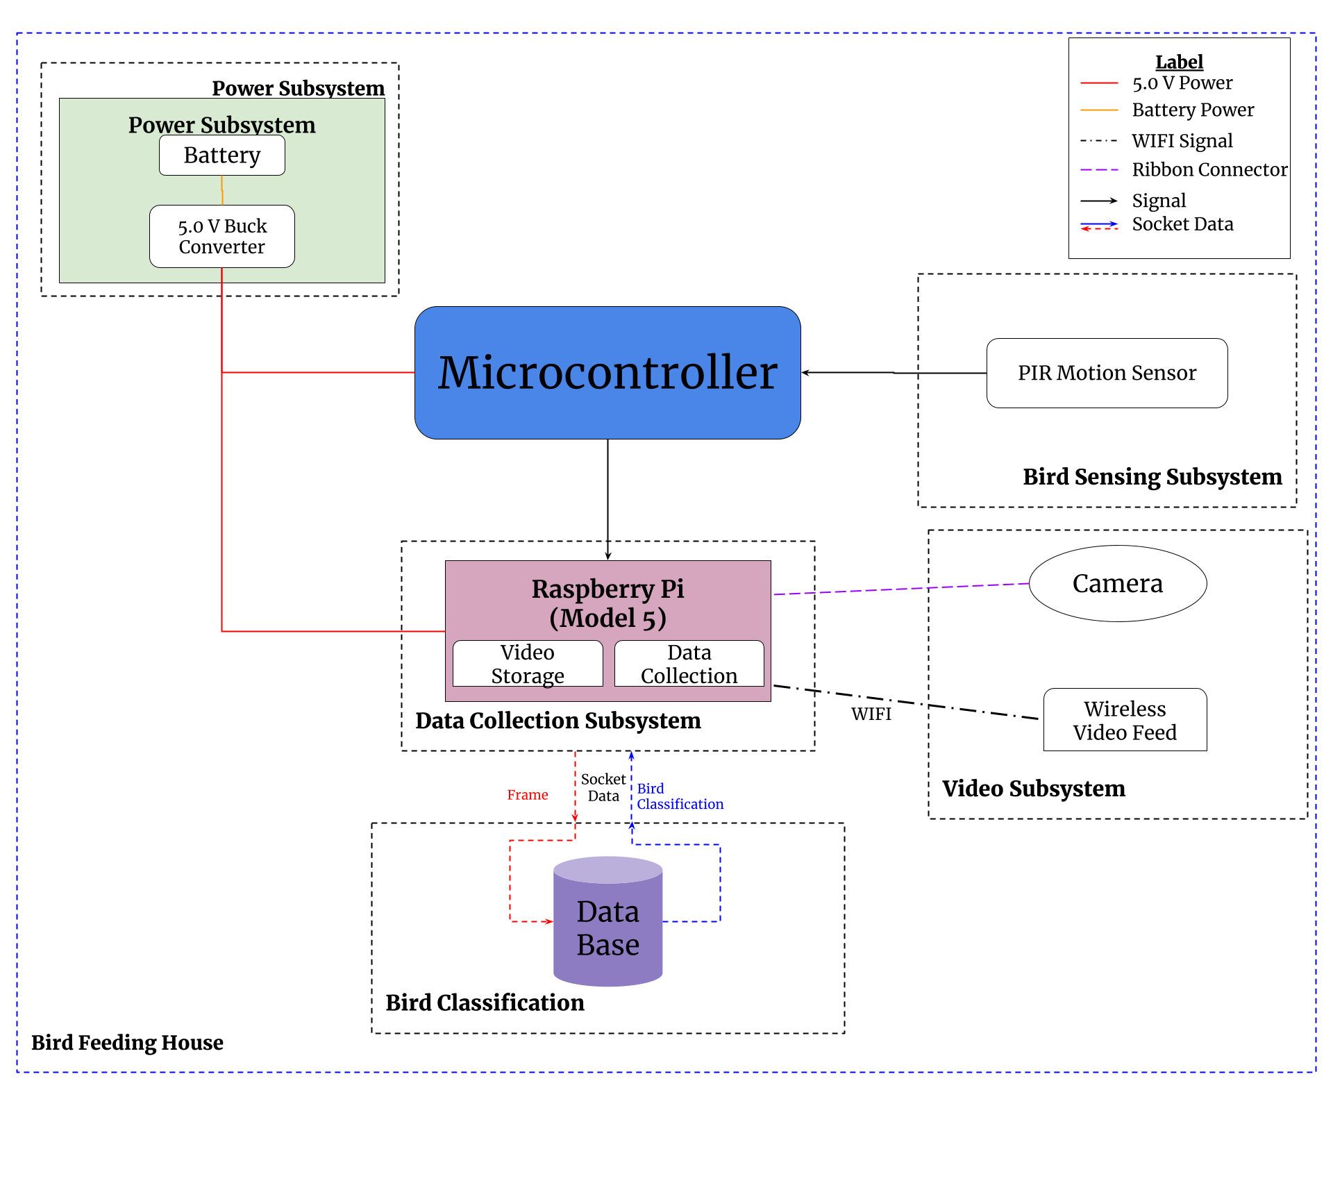
Final Block Diagram

Slide 5
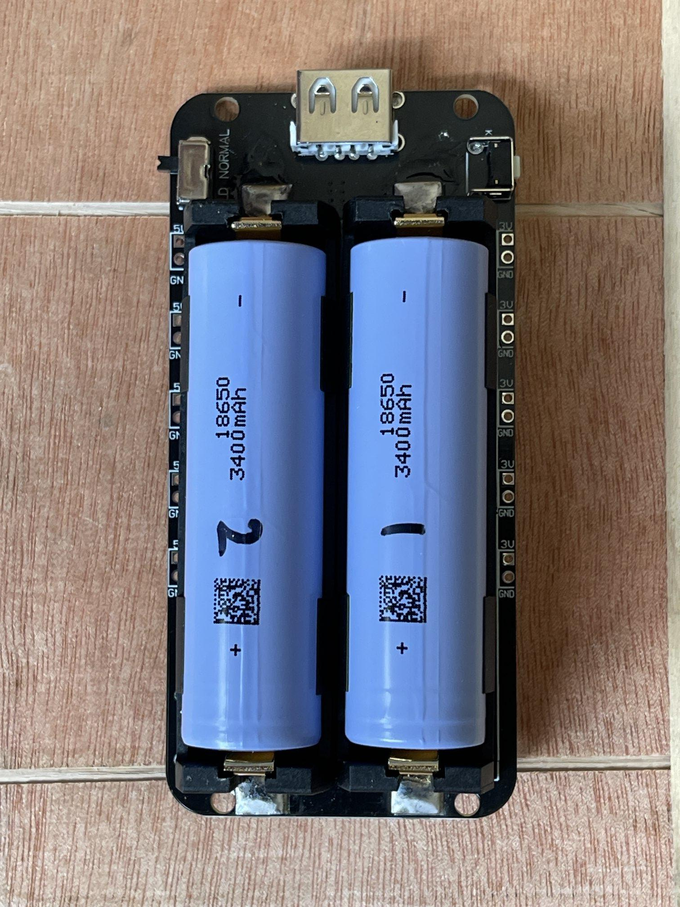
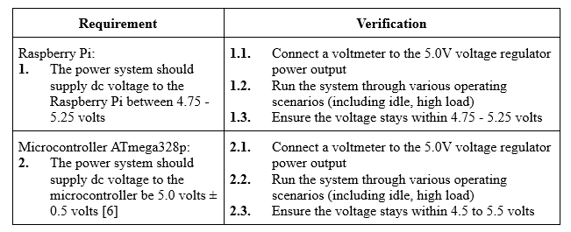
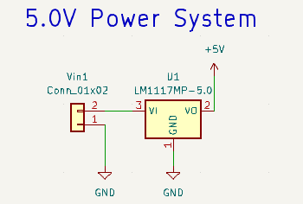
Power Subsystem
Battery Pack

Slide 6
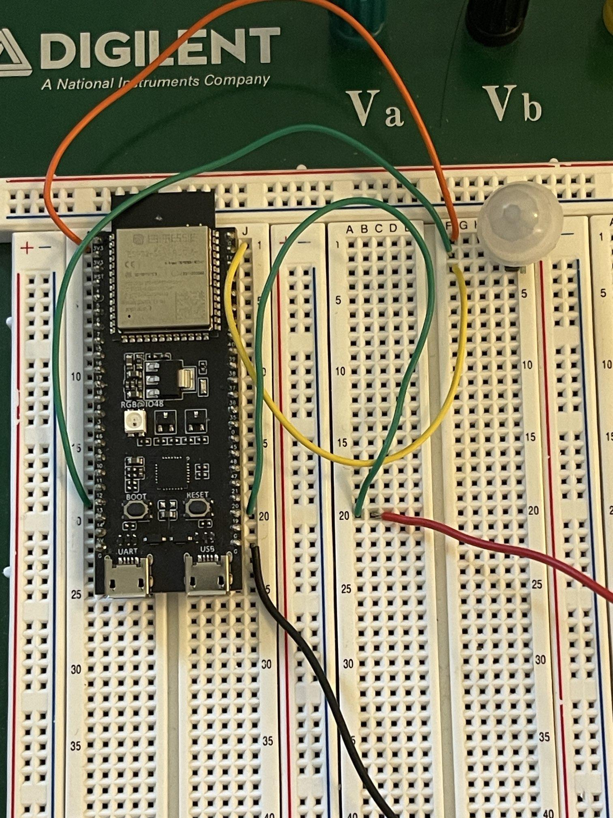
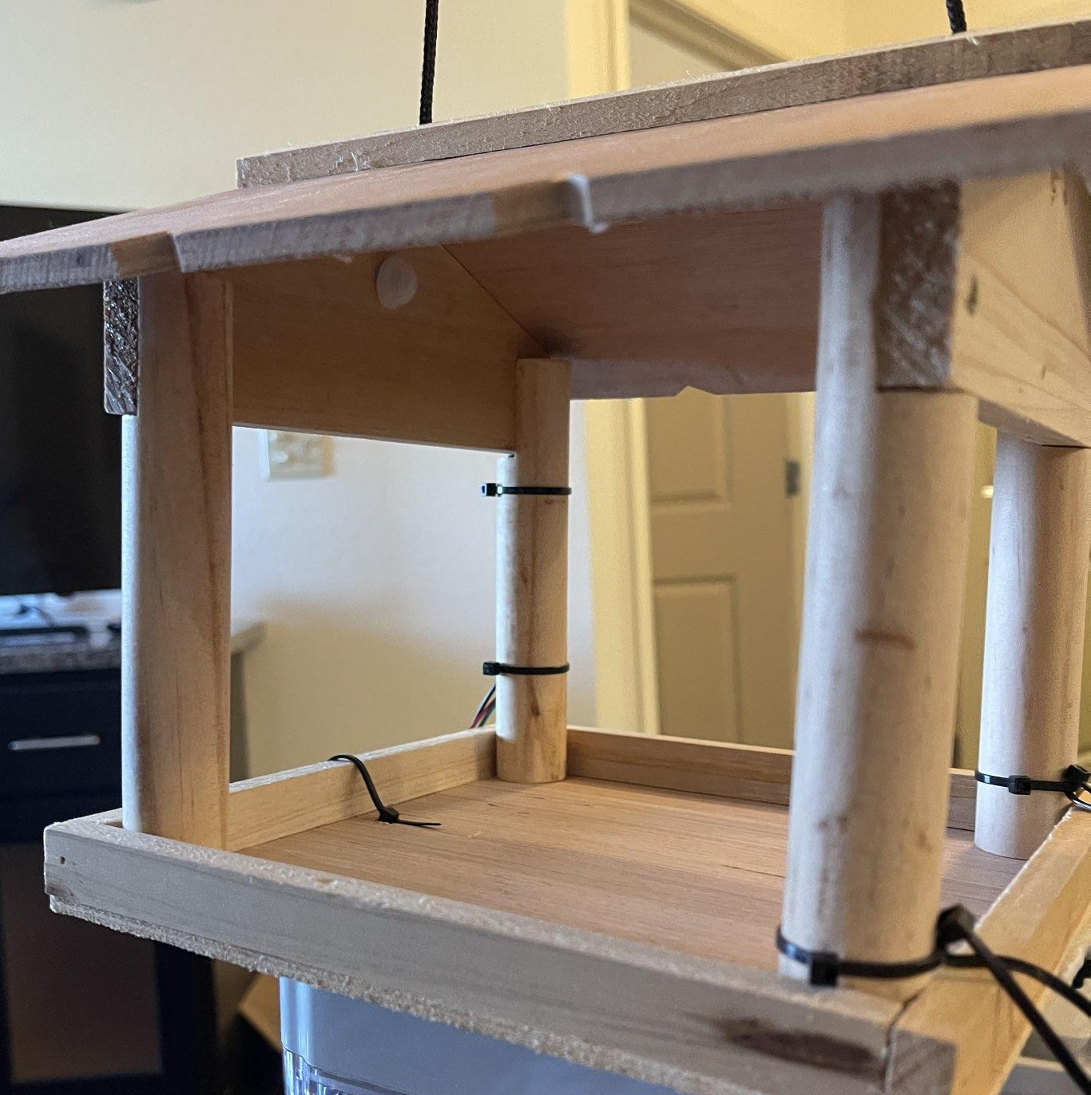
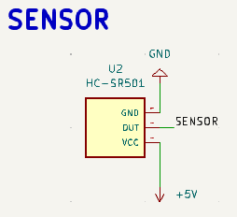
Sensing Subsystem
Sensor Wiring
Sensor Position in Bird Feeder
Sensor Testing on Breadboard

Slide 7
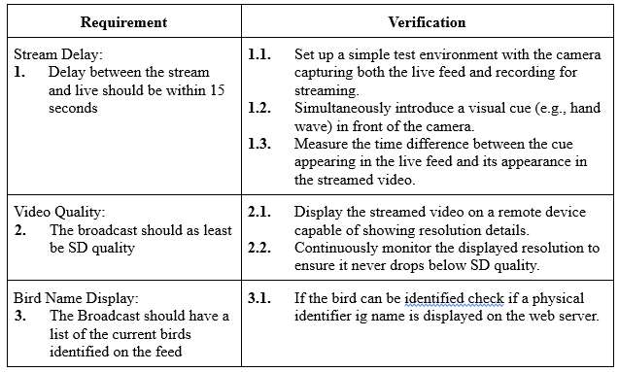
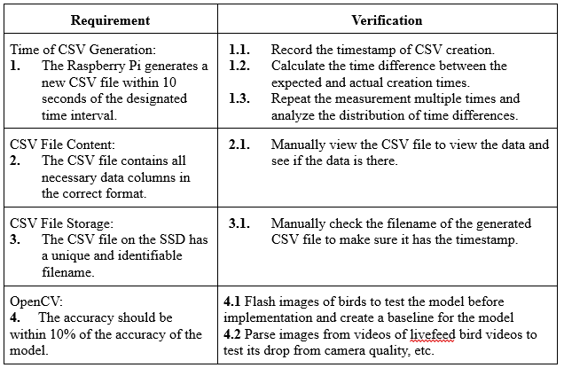
Video Feed & Data Collection Subsystem

Slide 8
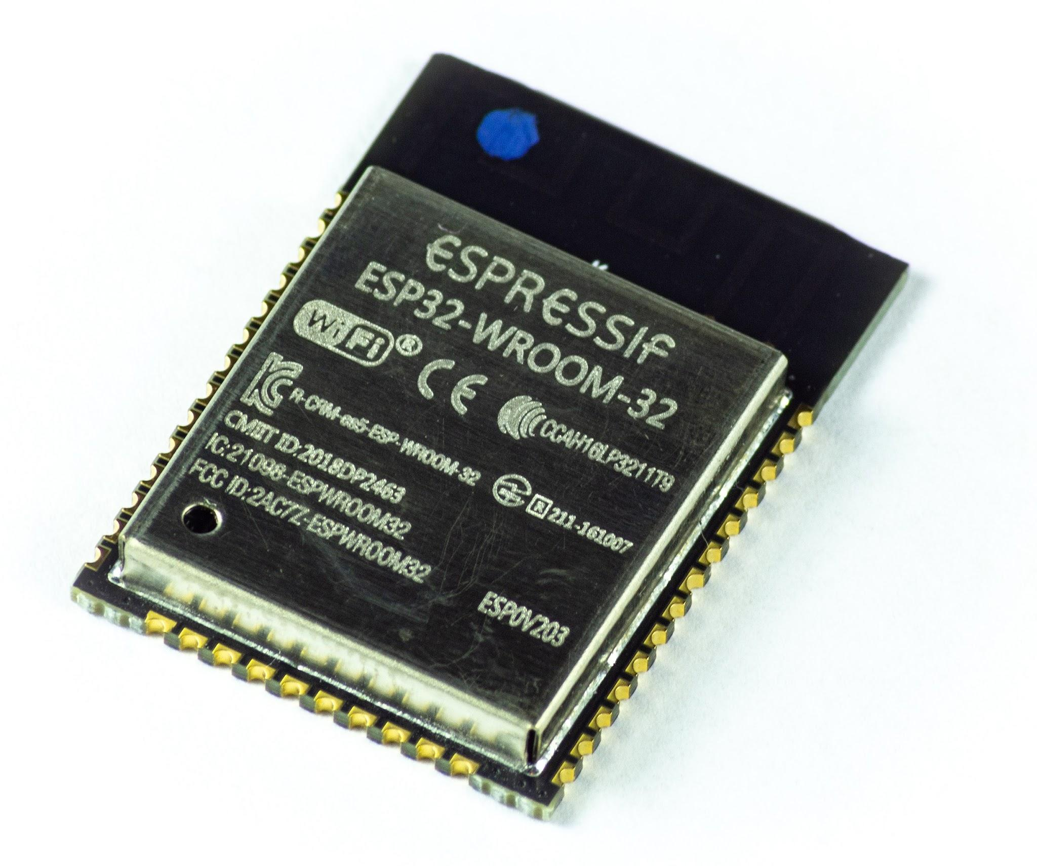
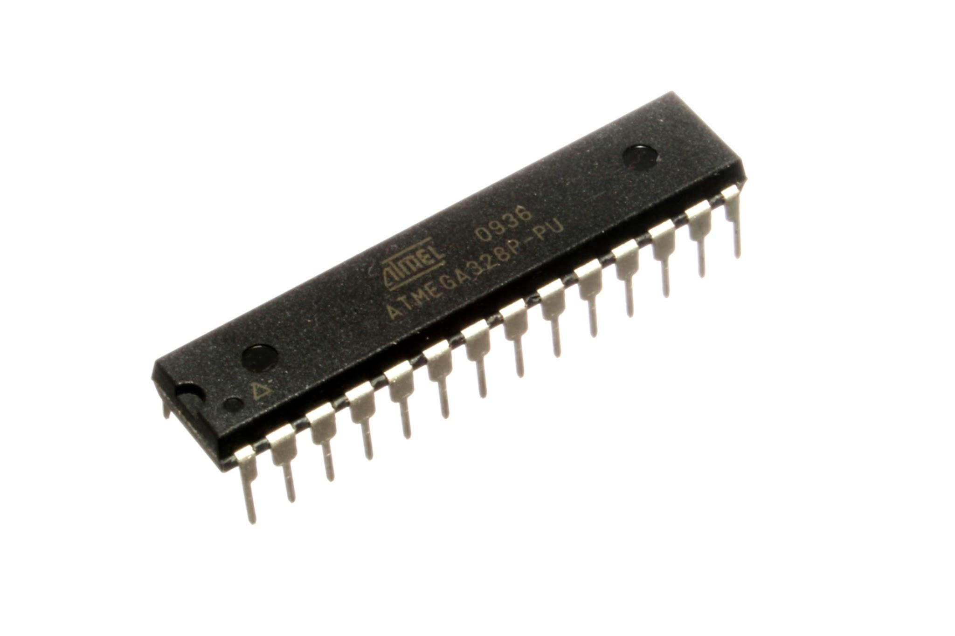
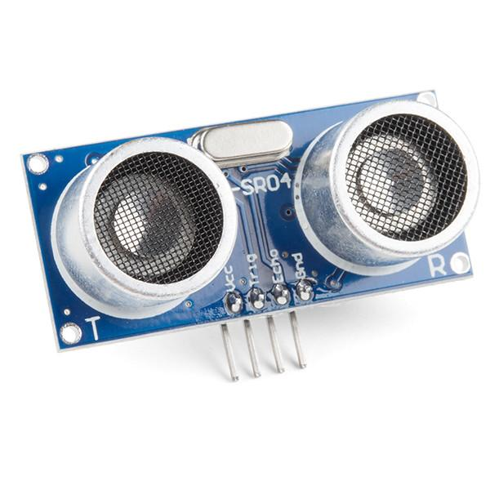
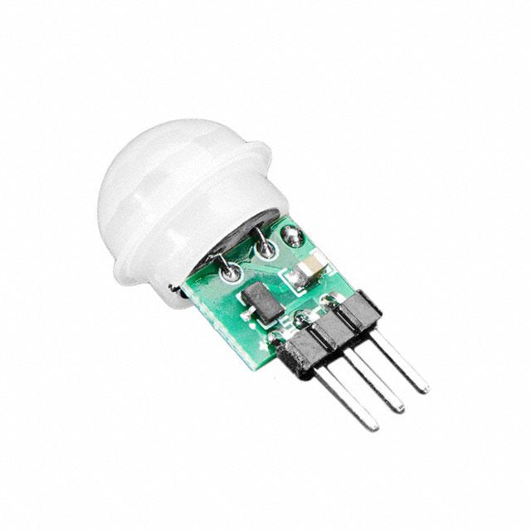
Design Changes
Microcontroller Selection
ESP32 to ATMega328P
Motion Sensor
Ultrasonic to PIR
Power Supply
Wall power to battery pack
Image classification, server communication
Bird classification model for 450 bird species
Socket communication between raspberry pi and server running model

Slide 9
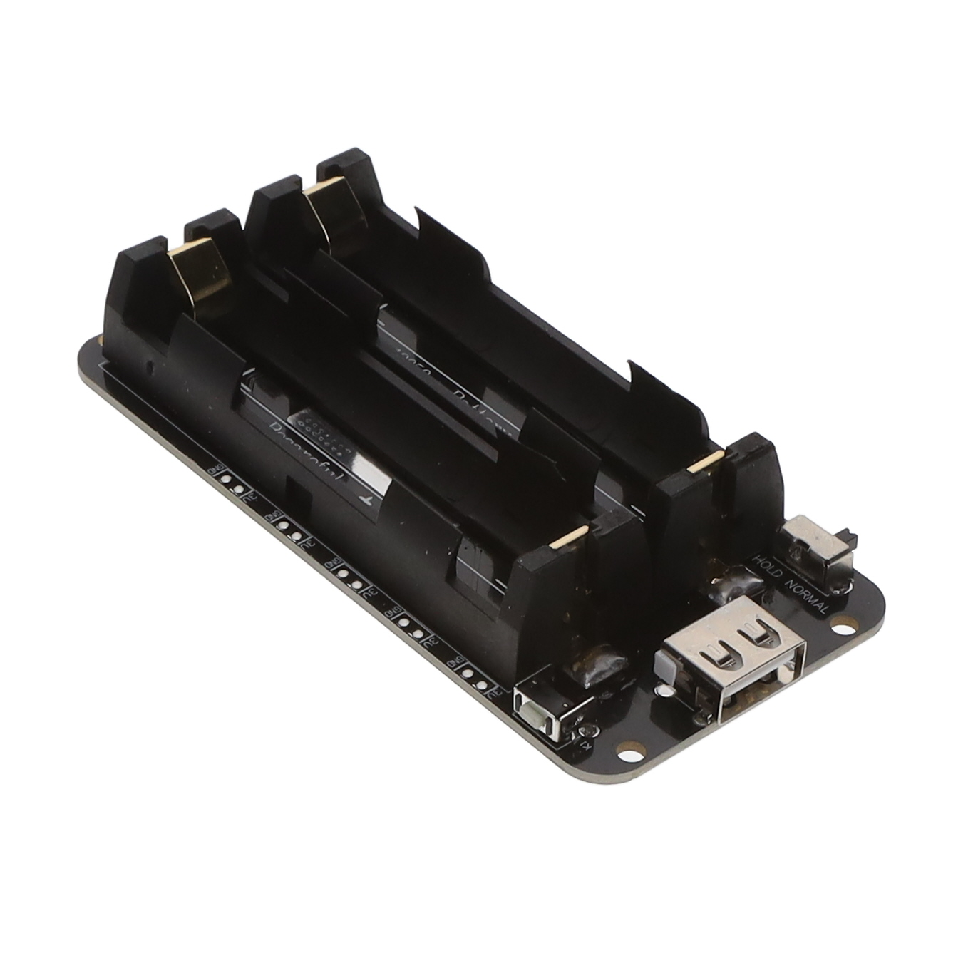
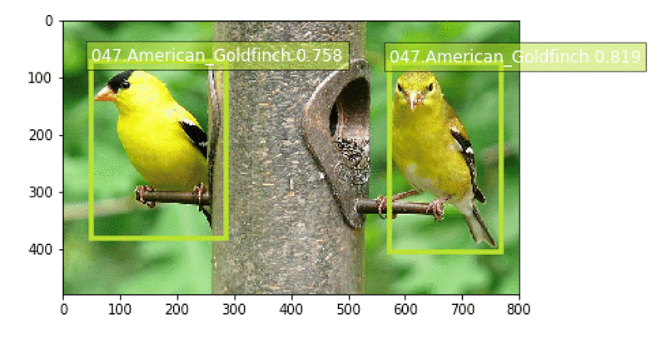
Challenges
PCB lead times
Software integration
Power issues
Programming and GPIO
Detection implementation timeframe
Notes:
Include challenges faced and how we solved them

Slide 10
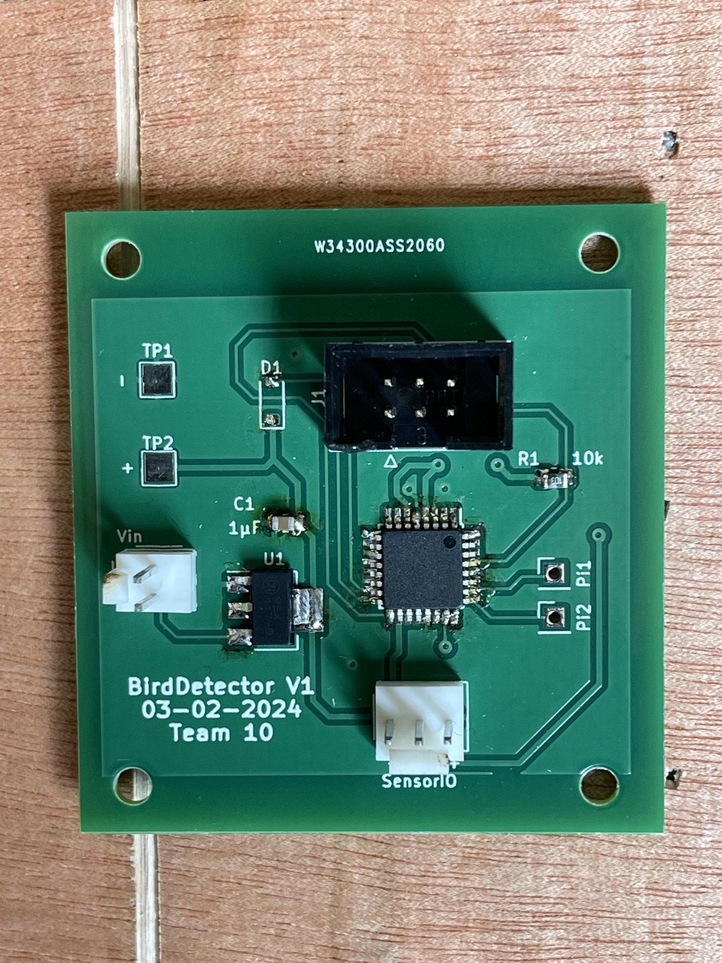
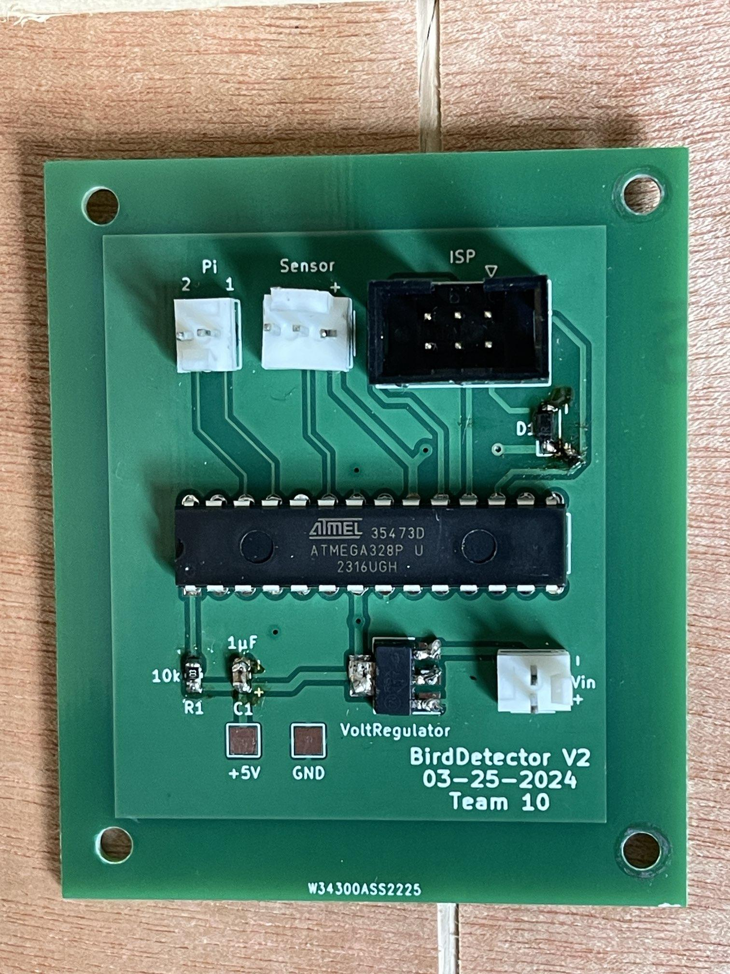
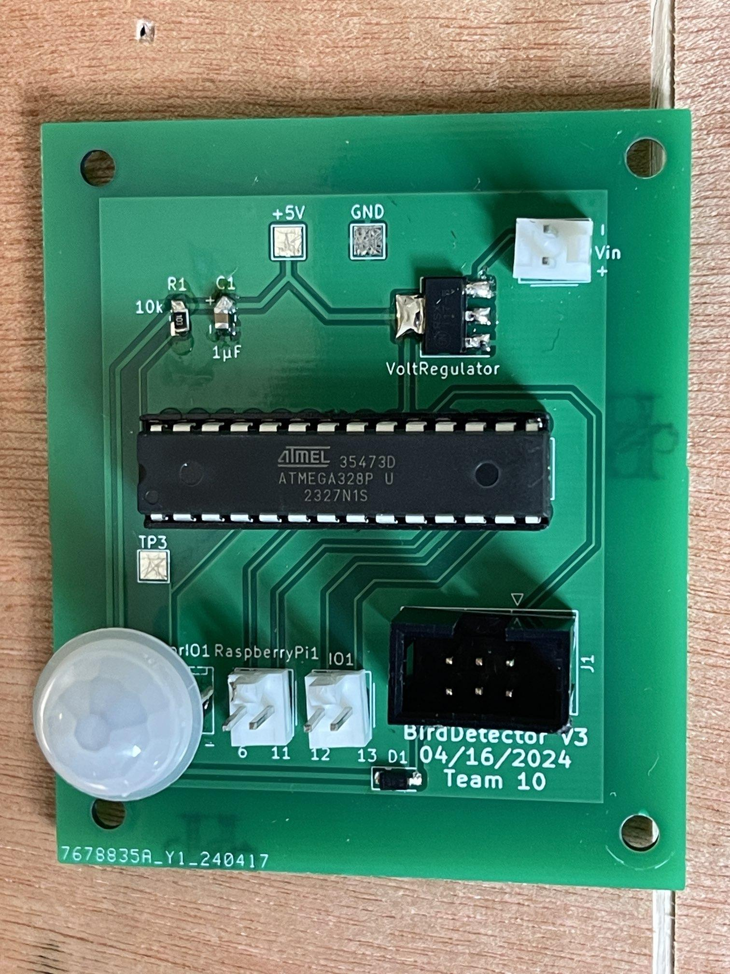
PCB Iterations
Version 1
Version 2
Version 3
ESP32
Poke Through
GPIO Pins Change
Notes:
Initial Design: Used the atmega that was the small chip which made it hard for us to solder and when we eventually solder it we got errors like floating pins
2nd Version: Implemented a poke through method for the ATmega to make it easier for us to solder.
This also made the profile of the pcb smaller with a simpler layout
3rd Version: We needed to make this version because of the GPIO pins we initially selected. We had digital pins that were RX and TX which is not what we wanted.

Slide 11
Results and Outcomes
All high level requirements were satisfied
Requirements and verifications met
Main failure was the microcontroller
Difficulty programming
Model was able to accurately identify several pictures of bird
No real field testing was conducted
Notes:
Include examples of the working model, CSV, webpage output, picture of the bird feeder

Slide 12
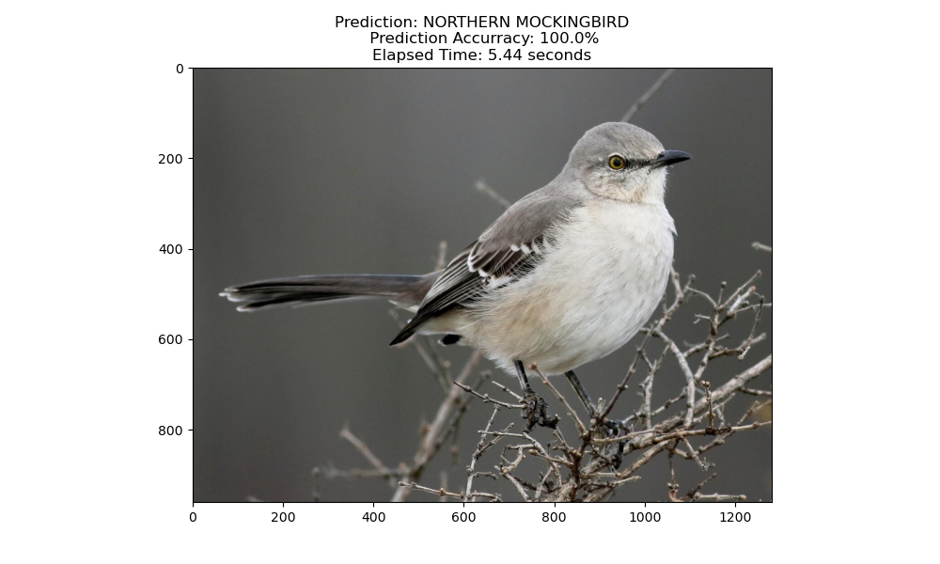

Slide 13
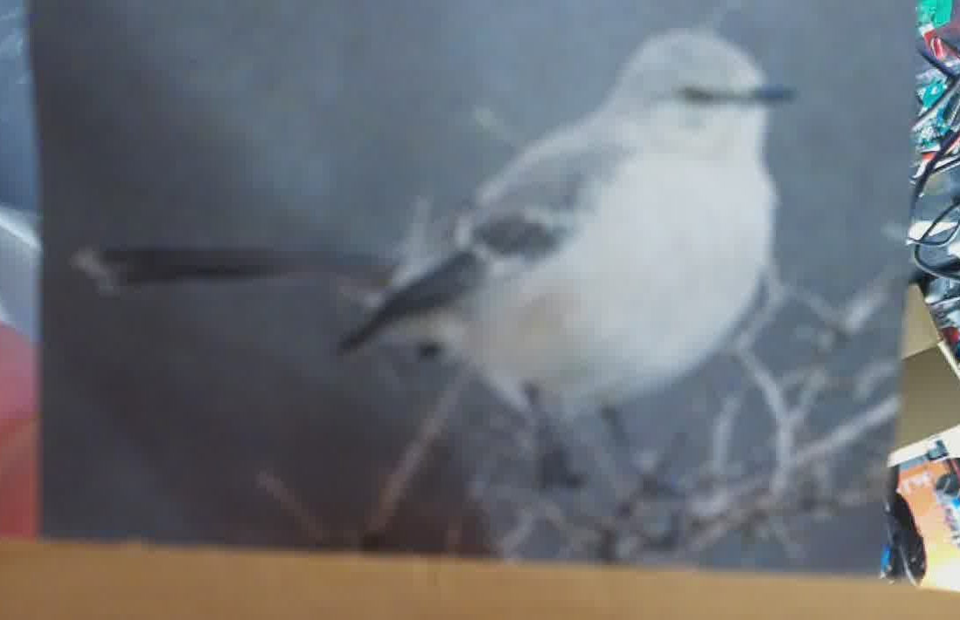

Slide 14
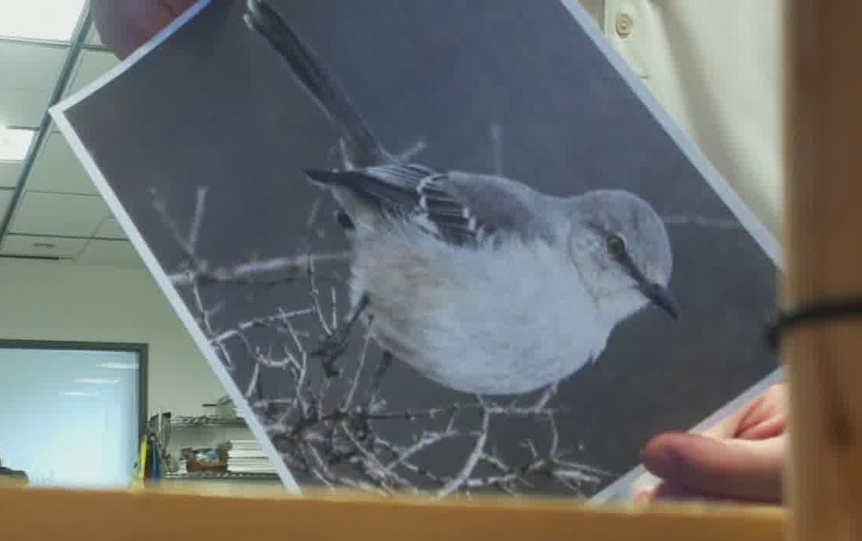

Slide 15
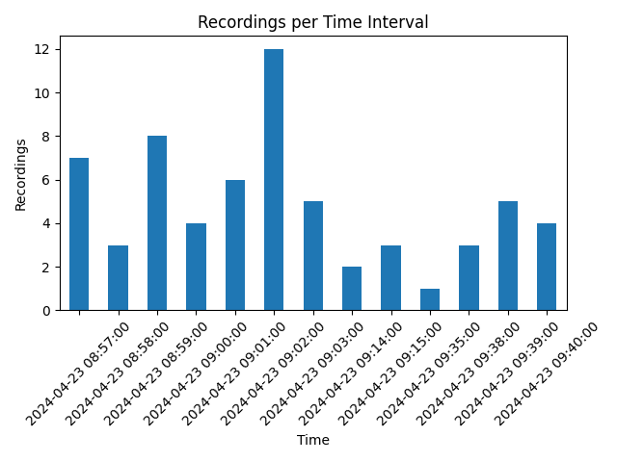
Notes:
Add Bar Graph

Slide 16
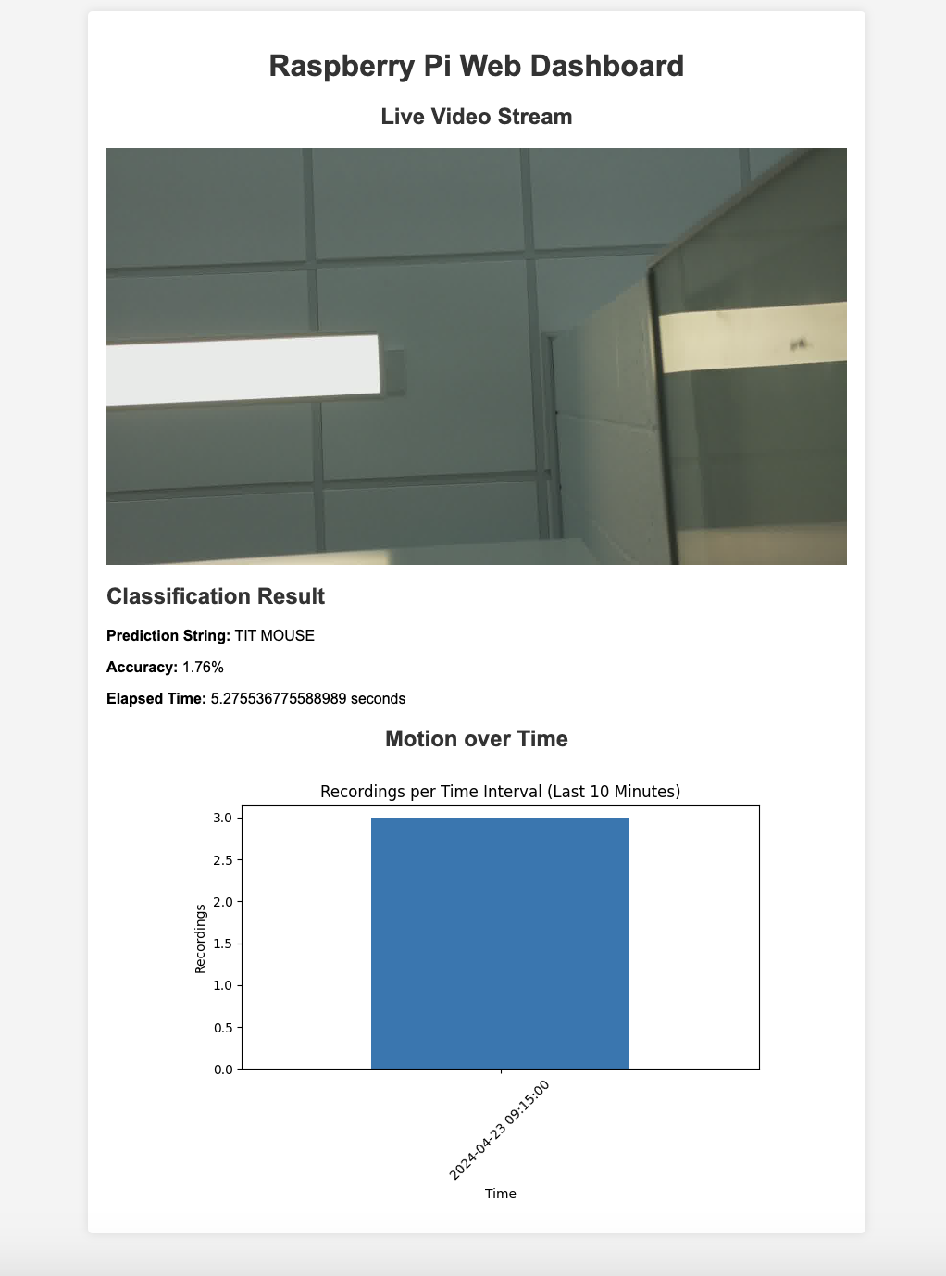
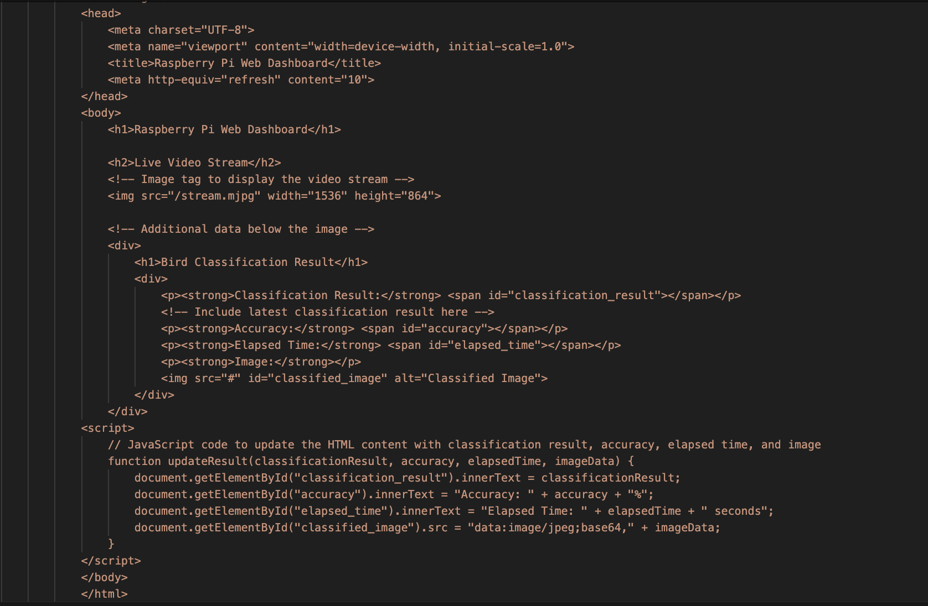
Web Page GUI
Notes:
Add Gui

Slide 17
Video
Notes:
Add Gui

Slide 18
Next Steps
Fix final PCB issues
Include cellular notification system
Improve recognition algorithm
Optimize what frames are to be classified
Dedicated video processing unit, remove pi
Notes:
Recognition algo is on 450 birds that are common among that area. While there is a focus on birds in this hemisphere the improvements could be such that a frame upside down or what not can still recognize the bird. Including more bird images also can be an improvement. The frames to be classified should be the best quality ones out of a burst of images that away we save time classifying the best quality frame of the bird.

Slide 19
THANK YOU!

