Slide 1
Universal PoE Stepper Motor Driver for Argonne National Lab
ECE 445
Group 28
Armando Rodea, Putra Firmansyah, Bryan Monk
Notes:
Rindra

Slide 2
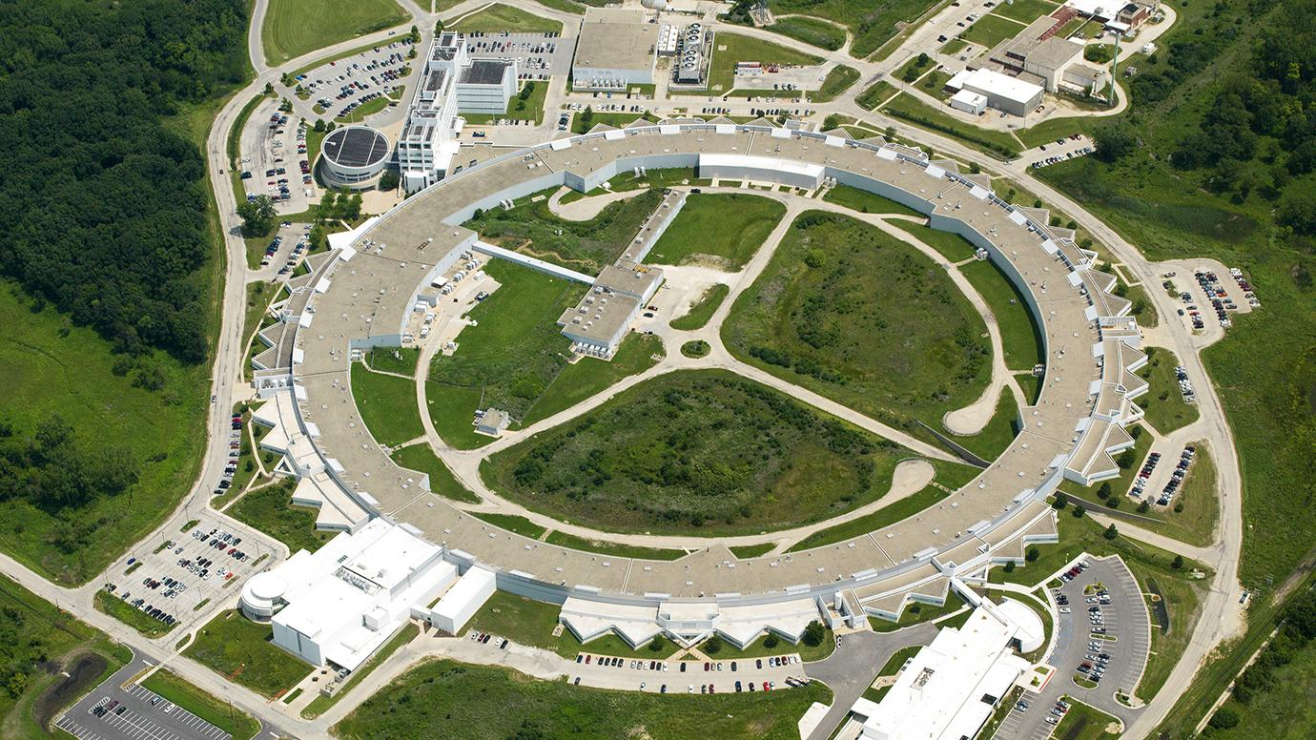
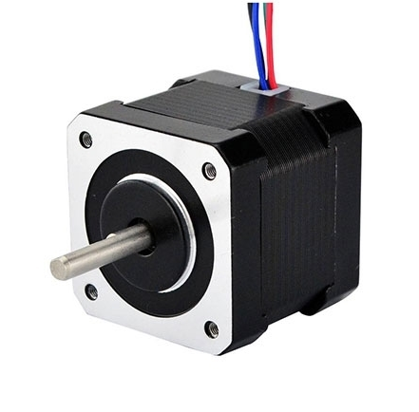
Introduction
Project Overview
Argonne National Lab: Advanced Photon Source (APS)
Use countless steppers for positioning/alignment
Need for new and compact stepper drivers
Our project: stepper driver using power over ethernet (PoE)
Stepper Motor
APS Synchrotron Beamline
ELECTRICAL & COMPUTER ENGINEERING
GRAINGER ENGINEERING
Notes:
Bryan

Slide 3
Objective
Problem
Current stepper drivers are bulky and expensive
Running out of available slots for drivers
Smaller solutions require power + serial communication
Solution
Power over ethernet (PoE)
Merge communication and power into one cable
Send ethernet commands to control high accuracy microstepping drivers
Universal (different current requirements)
Network switches already installed
PoE+ (25.5W of power)
PoE++ (51W of power)
ELECTRICAL & COMPUTER ENGINEERING
GRAINGER ENGINEERING
Notes:
Armando

Slide 4
Design
ELECTRICAL & COMPUTER ENGINEERING
GRAINGER ENGINEERING

Slide 5
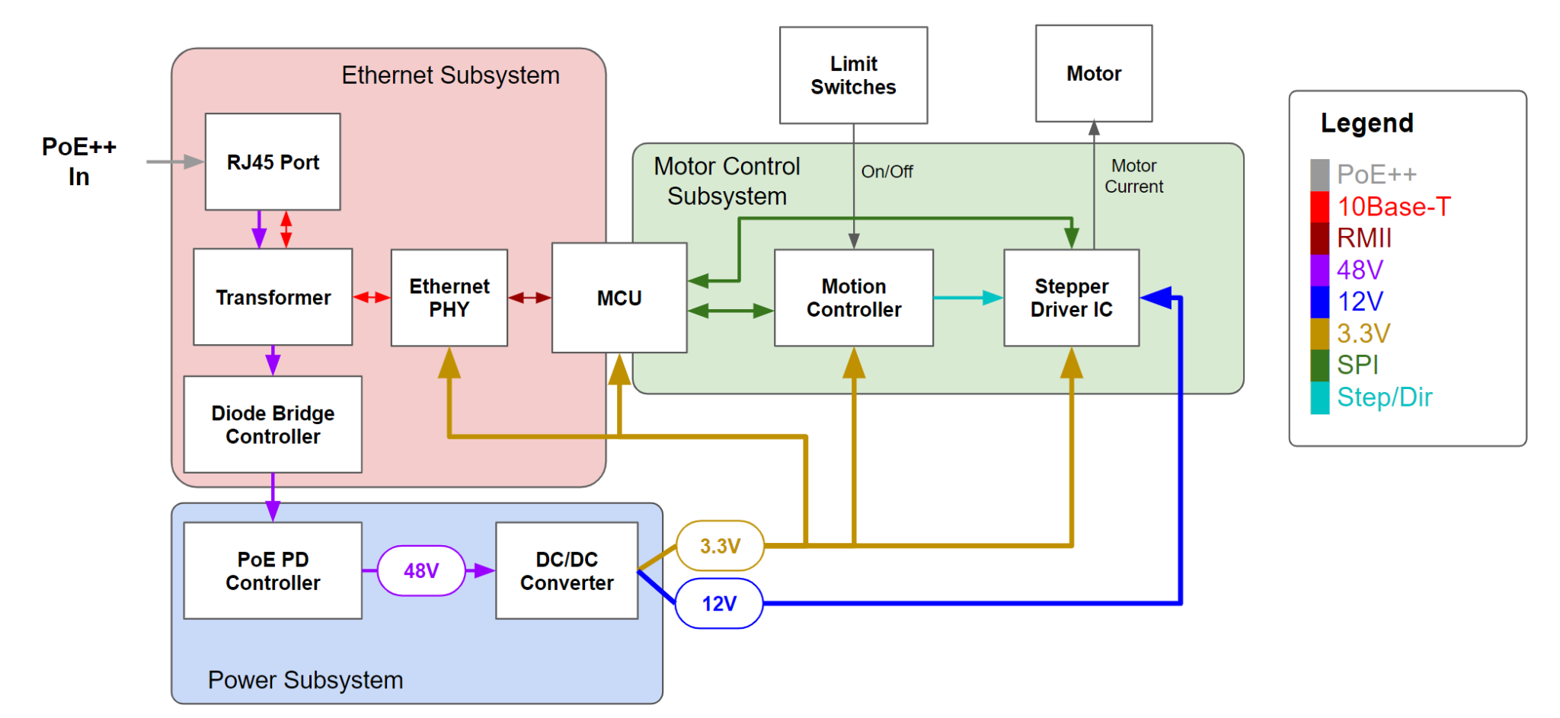
Block Diagram
ELECTRICAL & COMPUTER ENGINEERING
GRAINGER ENGINEERING
Notes:
Rindra

Slide 6
Ethernet Subsystem
Design Overview
Diode bridge controller (LT4321)
PD controller (LT4293)
Ethernet PHY (DP83848)
Legend
█ PoE++
█ 10Base-T
█ RMII
█ 48V
Ethernet Subsystem
PoE++ In
RJ45 Port
Transformer
Ethernet PHY
MCU
Diode Bridge
Controller
PoE PD Controller
48V
Power Subsystem
ELECTRICAL & COMPUTER ENGINEERING
GRAINGER ENGINEERING
Notes:
Bryan

Slide 7
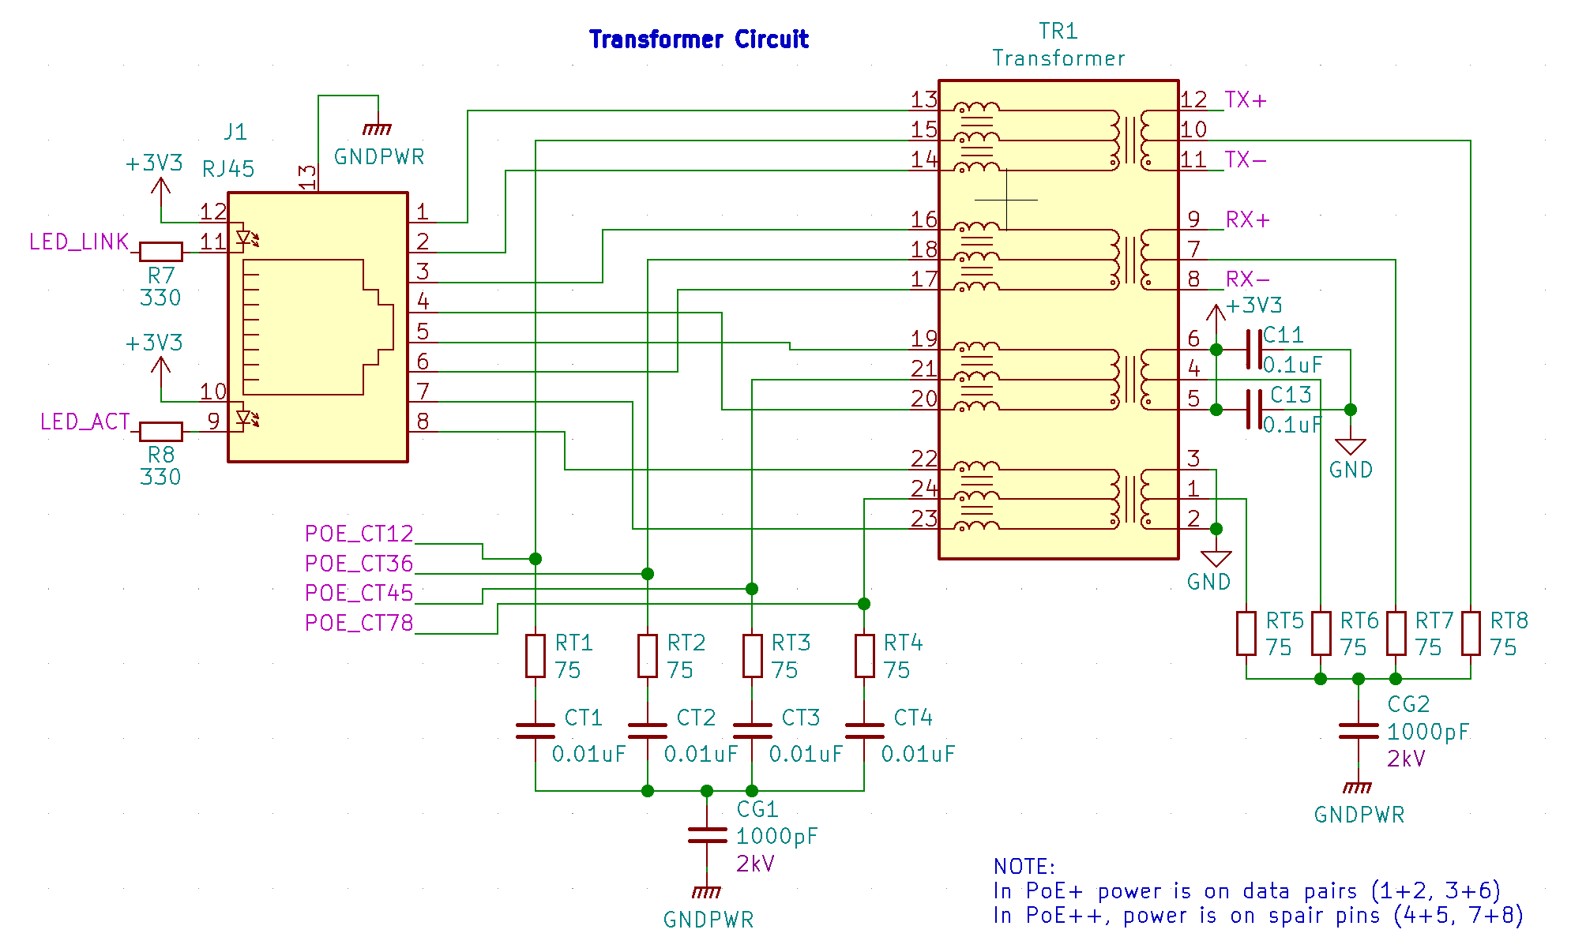
Ethernet Subsystem
Schematic
ELECTRICAL & COMPUTER ENGINEERING
GRAINGER ENGINEERING
Notes:
Bryan

Slide 8
Ethernet Subsystem
Schematic
ELECTRICAL & COMPUTER ENGINEERING
GRAINGER ENGINEERING
Notes:
Bryan

Slide 9
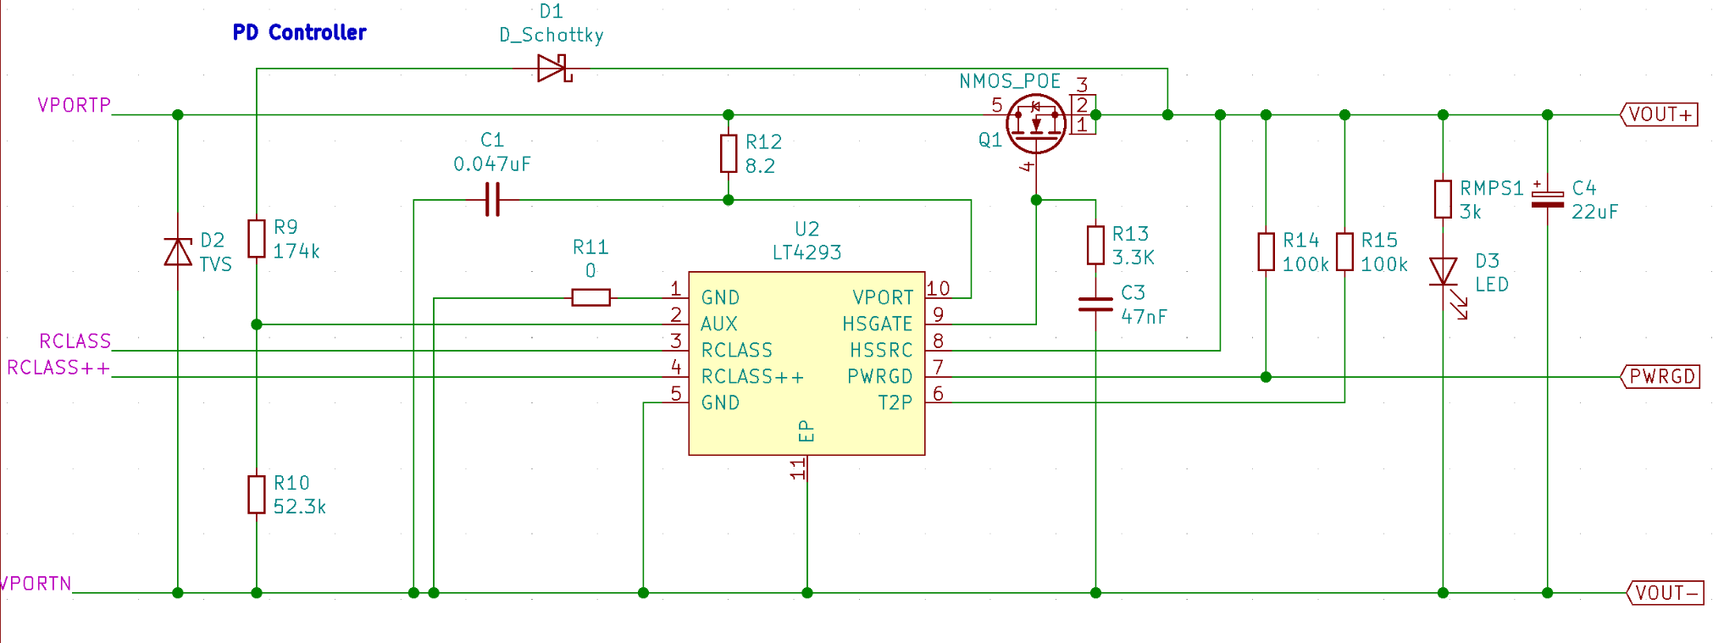
Ethernet Subsystem
Schematic
ELECTRICAL & COMPUTER ENGINEERING
GRAINGER ENGINEERING
Notes:
Bryan

Slide 10
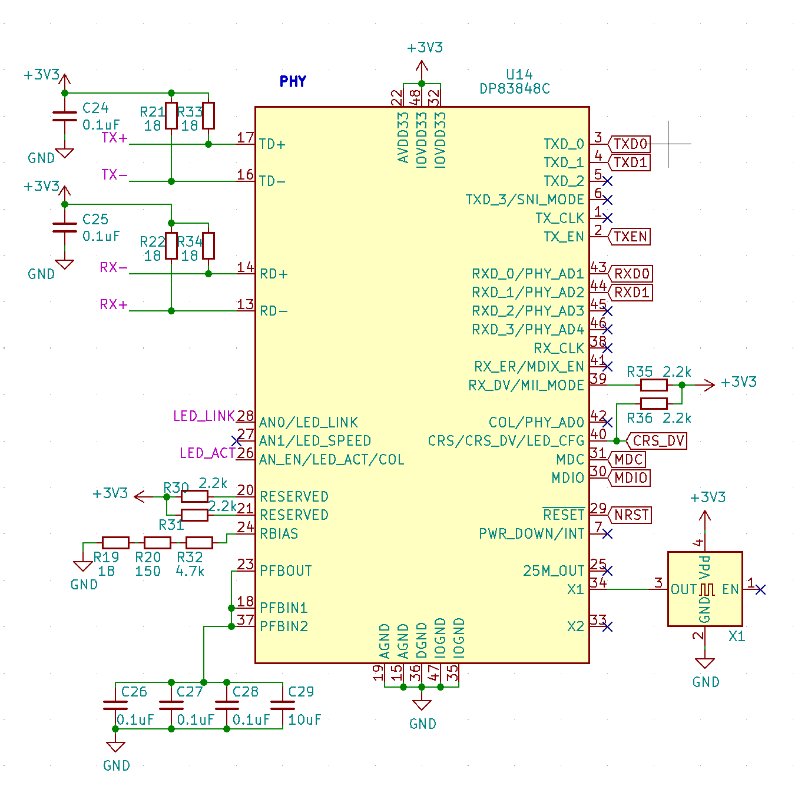
Ethernet Subsystem
Schematic
ELECTRICAL & COMPUTER ENGINEERING
GRAINGER ENGINEERING
Notes:
Bryan

Slide 11
Ethernet Subsystem
Requirements and Verification
Ethernet subsystem receives TCP packet from the RJ45 port and into the MCU
Was unable to get the ethernet software working
All packets lost when tried to ping
Must output 48 V DC
Measured 51V with a multimeter (not a problem)
Worked for both PoE+ (25.5W) and PoE++ (51W) standards
ELECTRICAL & COMPUTER ENGINEERING
GRAINGER ENGINEERING
Notes:
Bryan

Slide 12
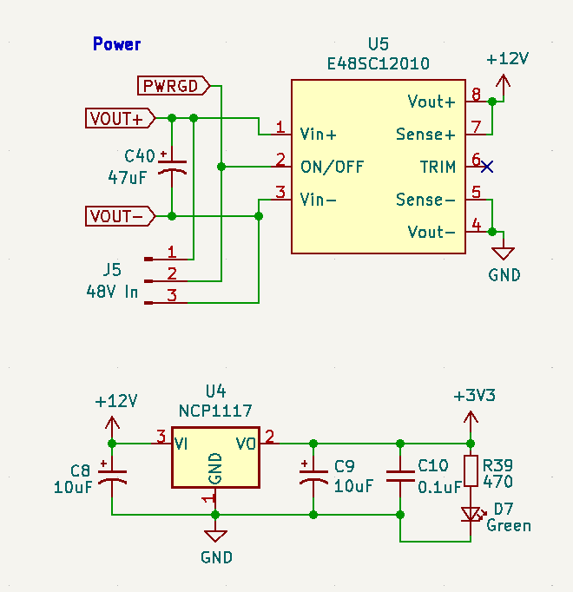
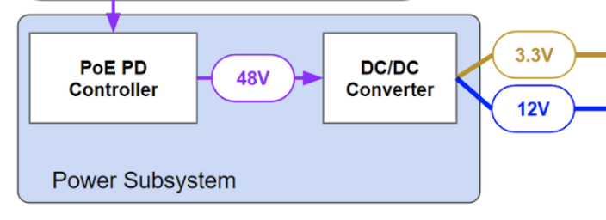
Power Subsystem
ELECTRICAL & COMPUTER ENGINEERING
GRAINGER ENGINEERING
Notes:
Rindra

Slide 13
Power Subsystem
Requirements and Verification
Must step down 48 VDC to 11.5 - 12.5V with 5.5 - 6.5 A
Input 48 VDC using a power supply and verified that it consistently outputs readings within the required range
Must step down 48 VDC to 3.0 - 3.6 V
Input 48 VDC using a power supply and verified that it consistently outputs readings within 3.0 - 3.6 V
ELECTRICAL & COMPUTER ENGINEERING
GRAINGER ENGINEERING
Notes:
Rindra

Slide 14
Motor Control Subsystem
Design Overview
Motion Controller (Trinamic TMC429)
Stepper Driver IC (Trinamic TMC2660)
Motor current output
Limit switch input
Limit Switches
Motor
Legend
Motor Control Subsystem
Motor Current
█ 48V
█ 12V
█ 3.3V
█ SPI
█ Step/Dir
On/Off
MCU
Motion Controller
Stepper Driver IC
3.3V
12V
ELECTRICAL & COMPUTER ENGINEERING
GRAINGER ENGINEERING
Notes:
Armando

Slide 15
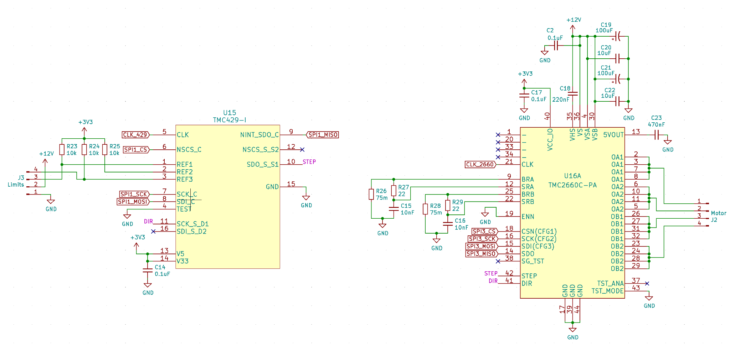
Motor Control Subsystem
Schematic
ELECTRICAL & COMPUTER ENGINEERING
GRAINGER ENGINEERING
Notes:
Armando

Slide 16
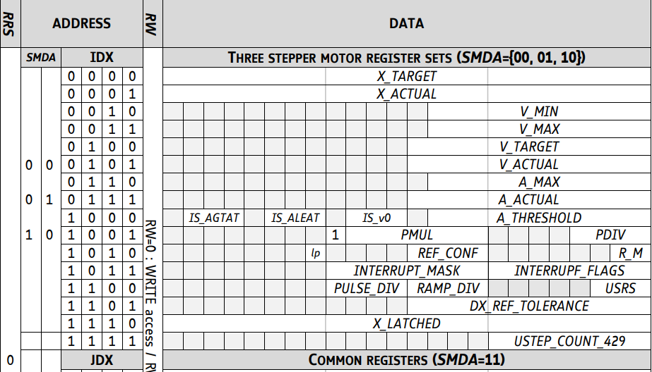
Motor Control Subsystem
ELECTRICAL & COMPUTER ENGINEERING
GRAINGER ENGINEERING
Notes:
Armando

Slide 17
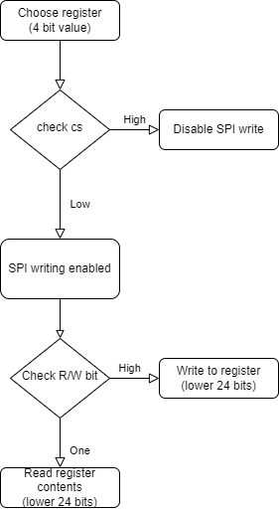
Motor Control Subsystem
HAL_SPI_TransmitReceive(&hspi1, DATA_SENT, DATA_RECIEVED, NUM_BYTES_READ,TIMEOUT);
Example functions:
setPosition
getPosition
setVelocity
getVelocity
setCurrentScale
ELECTRICAL & COMPUTER ENGINEERING
GRAINGER ENGINEERING
Notes:
Armando

Slide 18
Motor Control Subsystem
Requirements and Verification
Converts SPI commands from MCU to step/dir pulses which are accurate enough for microstepping 256 microsteps per full step
Verified that when the motor moved 1 full rotation (360°), it has moved 56800 microsteps (256 microsteps * 360°).
Must be able to provide up to 3A per motor phase without going above 125° C
Was able to move 3 different motors with all functions and temperature did not exceed 43° C
ELECTRICAL & COMPUTER ENGINEERING
GRAINGER ENGINEERING
Notes:
Rindra

Slide 19
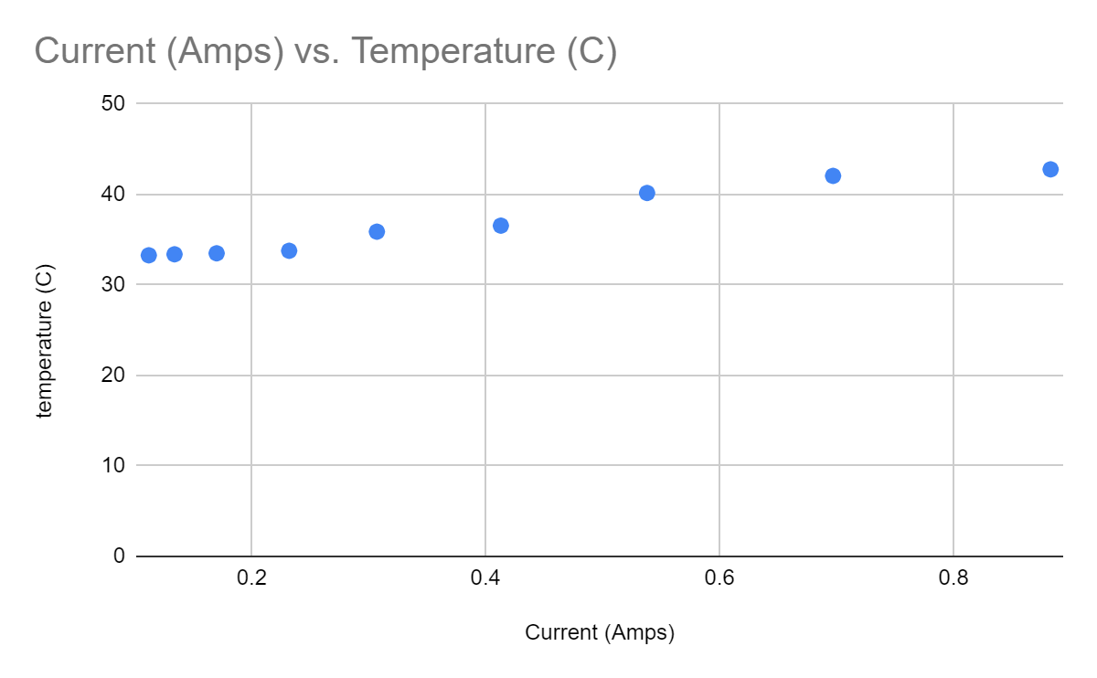
Motor Control Subsystem
Requirements and Verification
ELECTRICAL & COMPUTER ENGINEERING
GRAINGER ENGINEERING
Notes:
Rindra

Slide 20
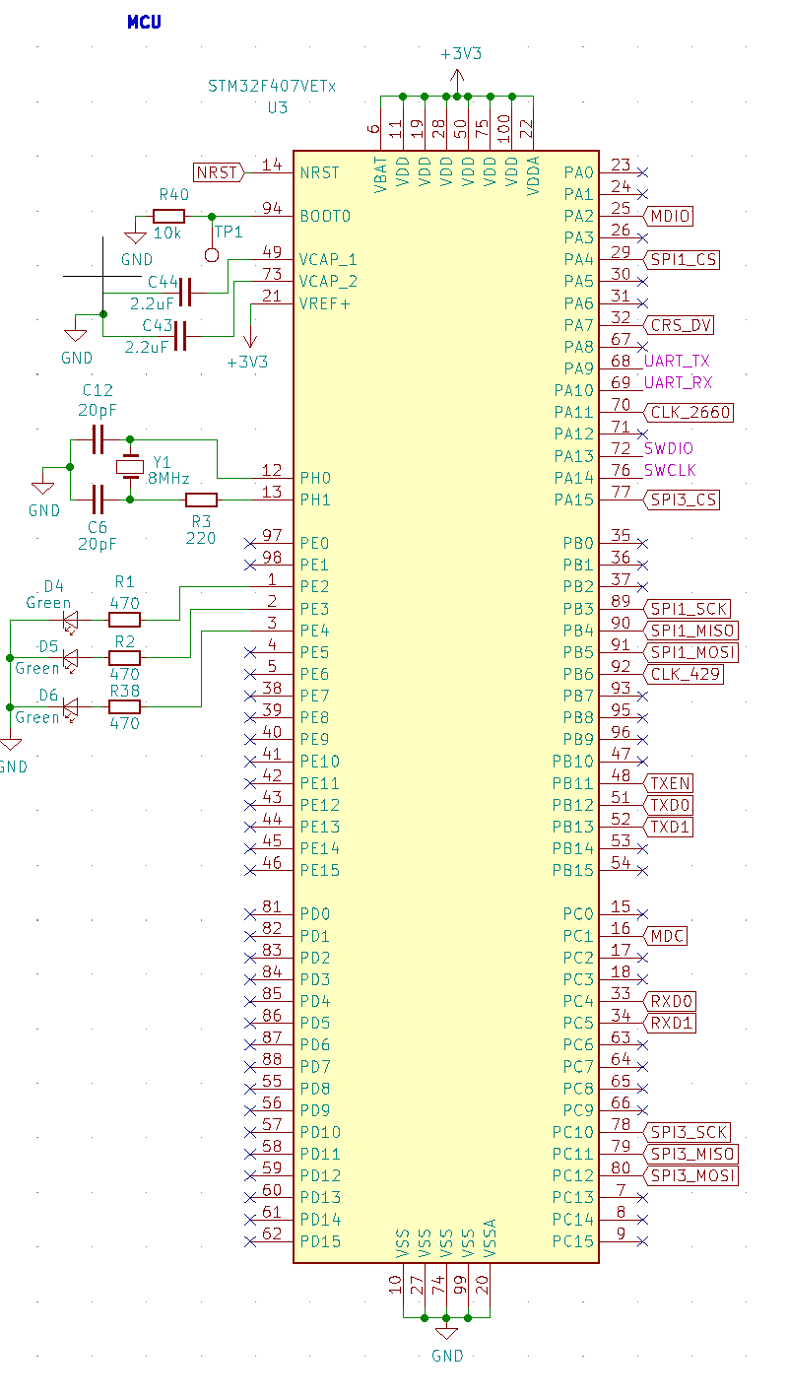
MCU
Design
STM32F407
Integrated Ethernet MAC
Ethernet RMII input
SPI Outputs for TMC429 and TMC2660
UART for debugging
Status LEDs
ELECTRICAL & COMPUTER ENGINEERING
GRAINGER ENGINEERING
Notes:
Rindra

Slide 21
Project Build
ELECTRICAL & COMPUTER ENGINEERING
GRAINGER ENGINEERING

Slide 22
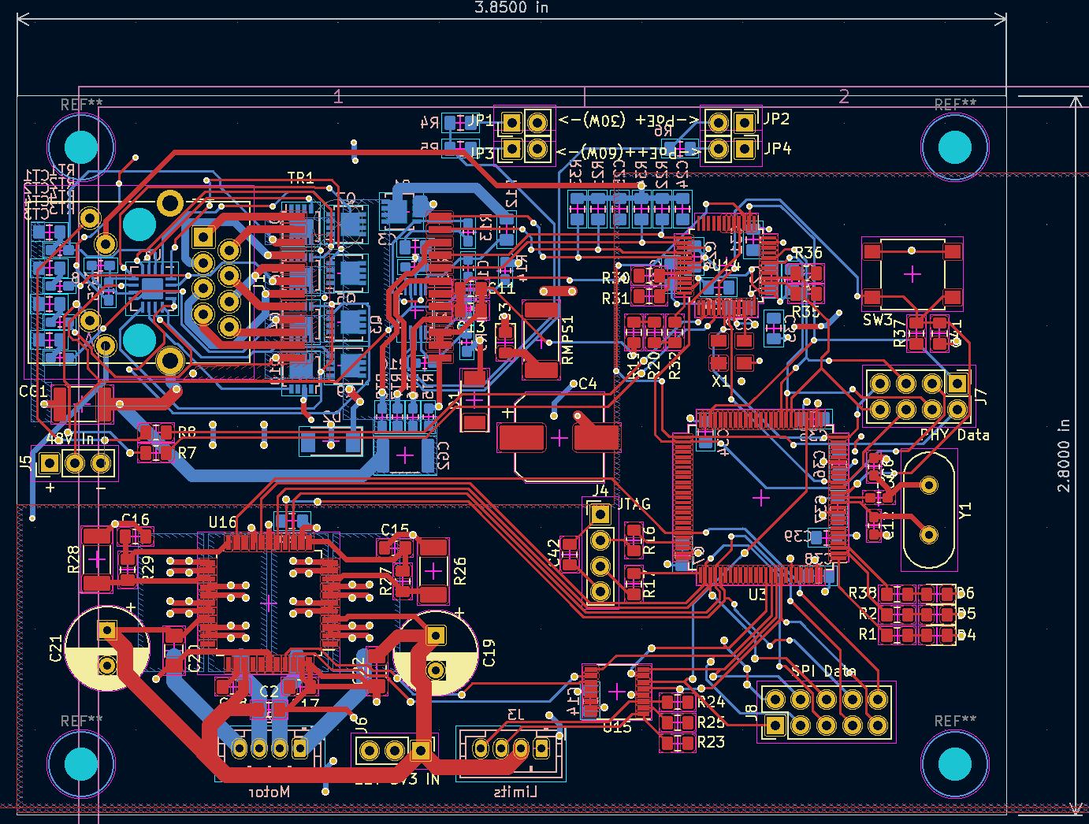
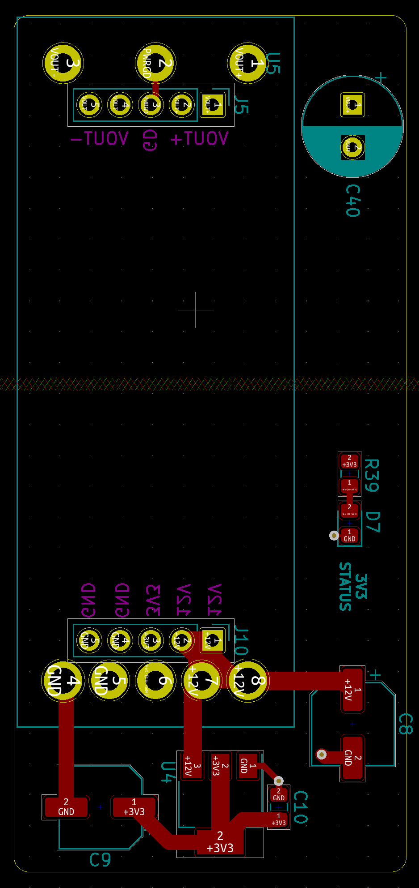
Project Build
ELECTRICAL & COMPUTER ENGINEERING
GRAINGER ENGINEERING
Notes:
Armando

Slide 23
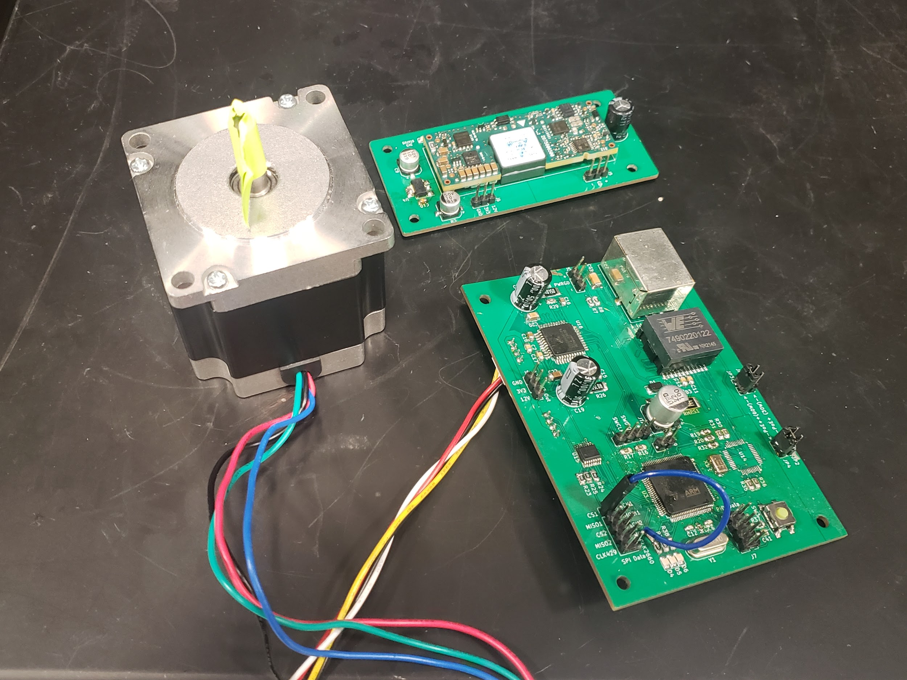
Project Build
Results
PoE circuitry able to output 48 VDC and supports 60W and 30W PoE standards
Power board able to step down 48V to 3.3V and 12V
MCU able to communicate with motor control subsystem properly
Able to:
Move motor to a target position
Read current motor position
Move motor at a given velocity
Able to set amount of current to power up motor
Currently, ethernet communication not working but is temporarily substituted with UART communication
ELECTRICAL & COMPUTER ENGINEERING
GRAINGER ENGINEERING
Notes:
Rindra

Slide 24
Project Build
Video
ELECTRICAL & COMPUTER ENGINEERING
GRAINGER ENGINEERING

Slide 25
Project Build
Problems
Damaged STM32F407 MCU and 2 DP83848 PHY chips
PoE Negotiation failed due to transformer in RJ45 component
Shorted MOSFET which caused PoE++ to fail
Stop switches repeatedly gets disabled
MCU clock output to Trinamic chips very noisy - used internal clock for TMC2660
Ethernet software did not work
ELECTRICAL & COMPUTER ENGINEERING
GRAINGER ENGINEERING
Notes:
Armando

Slide 26
Conclusion
ELECTRICAL & COMPUTER ENGINEERING
GRAINGER ENGINEERING

Slide 27
Conclusion
Future Work
Ethernet subsystem
Test with STM32 + ethernet dev board
TVS diodes on PHY data inputs
Software implementation of ethernet
Integration into Argonne control software (SPEC)
Power board stacked on main PCB
16 MHz oscillator for Trinamic ICs
4 layer board
ELECTRICAL & COMPUTER ENGINEERING
GRAINGER ENGINEERING
Notes:
Bryan

Slide 28
THANKS!
ELECTRICAL & COMPUTER ENGINEERING
GRAINGER ENGINEERING

