Slide 1
Water Quality Monitoring System
Group 41
Nelson Lao, Junik Kim, Samuel Hung

Slide 2
Introduction
Water contamination affects millions of people per year.
Significant for those living in rural areas (ex. Flint).

Slide 3
Objective
Design a system that automatically collects water data
Reduce the number of people required to monitor water
Proof of concept

Slide 4
Design Requirements
System collects data at user-set time intervals.
Sensor readings must reflect actual water temperature to within a certain degree of accuracy
Sends an alert via text message

Slide 5
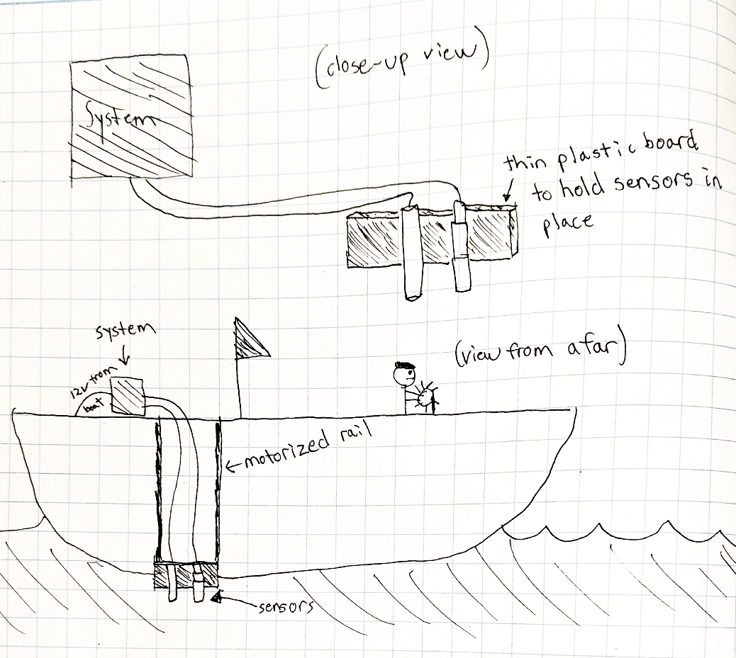
Physical Design & Function
Typical usage: to be placed on and powered by a boat’s 12V battery.
Sensors separated from rest of system.
Does not require constant attention from user.
One time setup

Slide 6
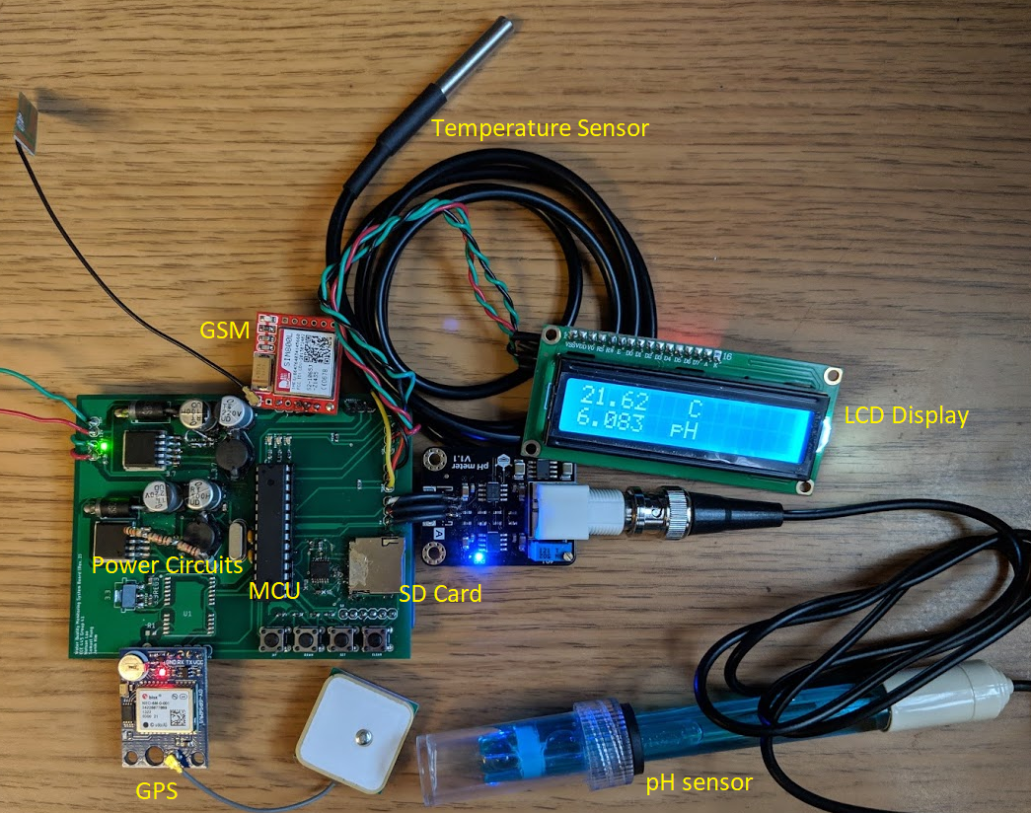
Final Product

Slide 7
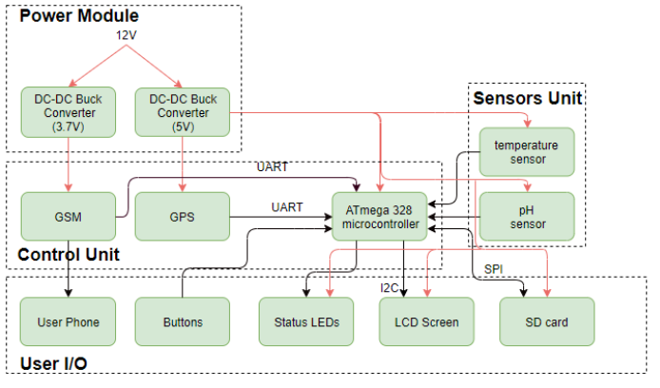
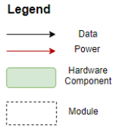
Block Diagram

Slide 8
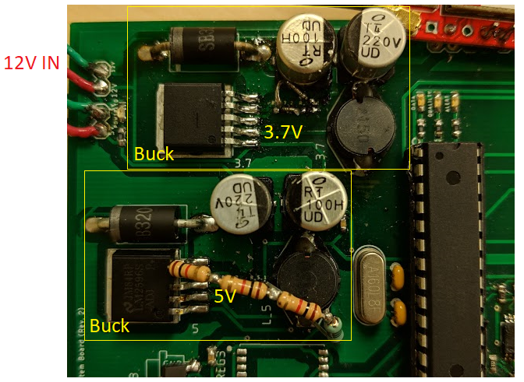
Power
12V-5V DC-DC Buck Converter
12V-3.7V DC-DC Buck Converter

Slide 9
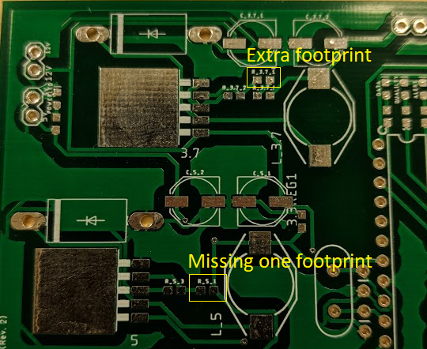
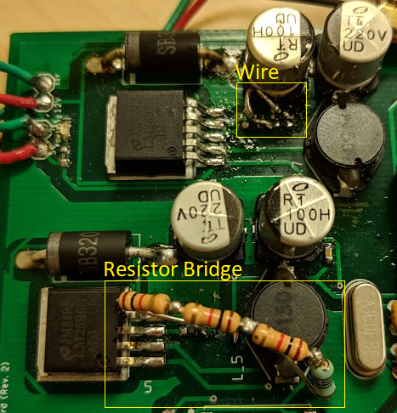
Power (PCB fix)
Used resistor bridge to form 3.1k required programming resistor value, soldered onto pads.
Used wire to jump/connect two pads.

Slide 10
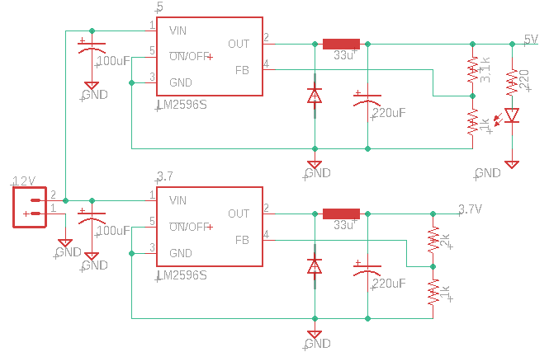
Power Circuits Schematic

Slide 11
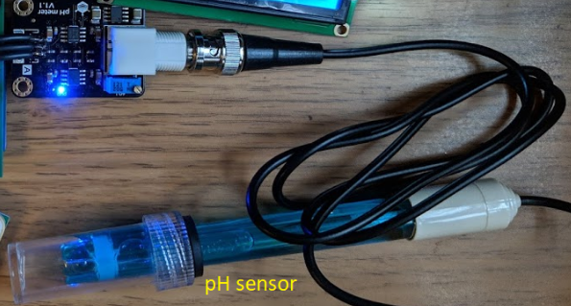
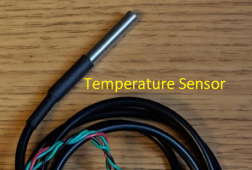
Sensors
DFRobot Analog pH meter
Waterproof digital temperature sensor (DS18B20)

Slide 12
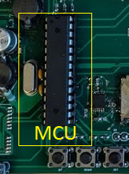
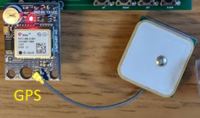
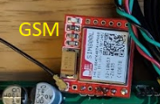
Control Unit
Microcontroller (ATmega328p)
Global Positioning System (GPS)
Global System for Mobile communications (GSM)

Slide 13
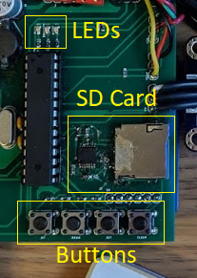
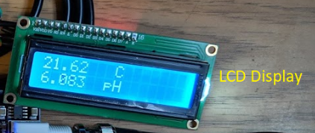
User I/O
Push buttons
LEDs
LCD screen
User Phone
SD card

Slide 14
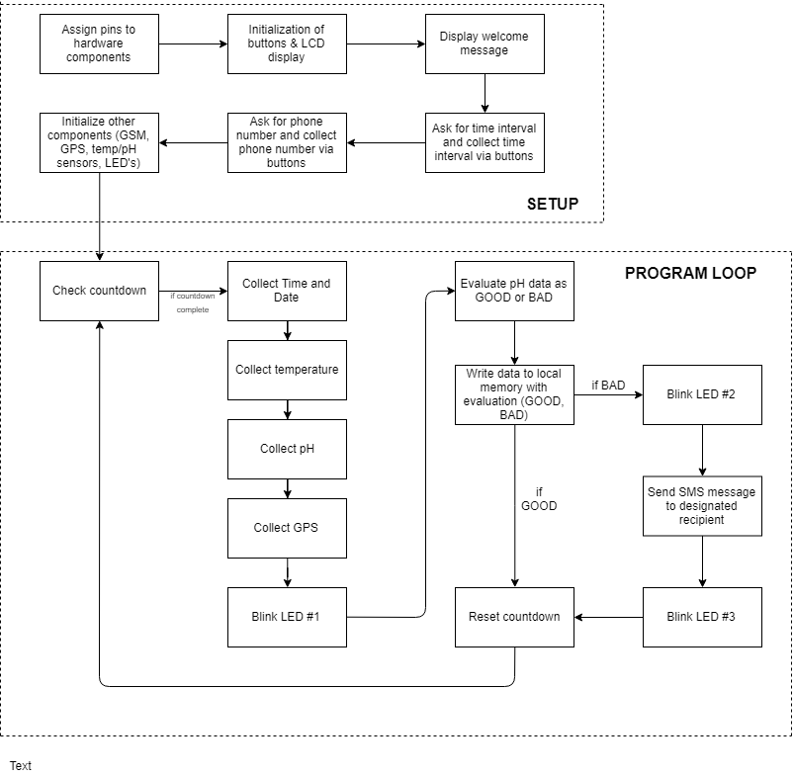
Software
Program ATmega328 microcontroller via Arduino IDE
Supports C/C++

Slide 15
Design Verifications
pH Sensor: measured pH is within 0.5 pH levels from actual pH
Temperature Sensor: Temperature from sensor is within 0.1 Celsius from actual water temperature
GPS: Grab initial coordinates. Walk ten meters. Check new coordinates for any difference.
GSM: Send a text message (SMS) to a specified number
SD card: Write arbitrary data to a file on the SD card.

Slide 16
Functional Test Results
GPS: Success: Coordinates change with every step (sensitive, making it functional enough for our system).
GSM: Fail. Could not connect to the 2G network.
pH Sensor: Success
Temperature Sensor: Success
SD card: Success

Slide 17
Challenges
Could not get GSM to connect to 2G network in area.
Low on program memory.
Tight PCB fabrication deadlines and delays.
Soldering difficulties.

Slide 18
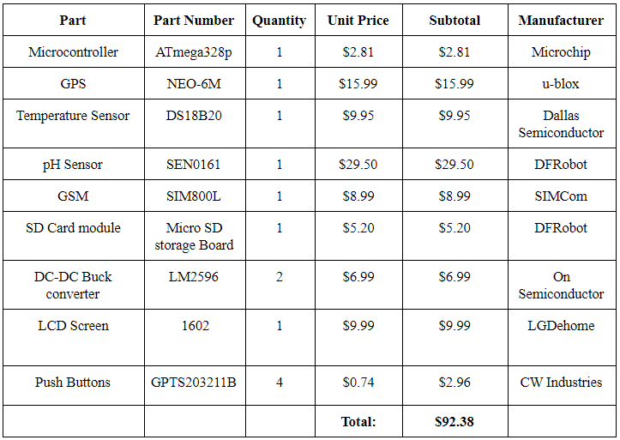
Costs

Slide 19
Future Work
Integrate more sensors for more accurate water quality measurements.
Integrate GPS module and GSM module on PCB.
Research into remotely controlling a boat.

Slide 20
Credits
Professor Jing Jiang
David Null (TA)

