Slide 1
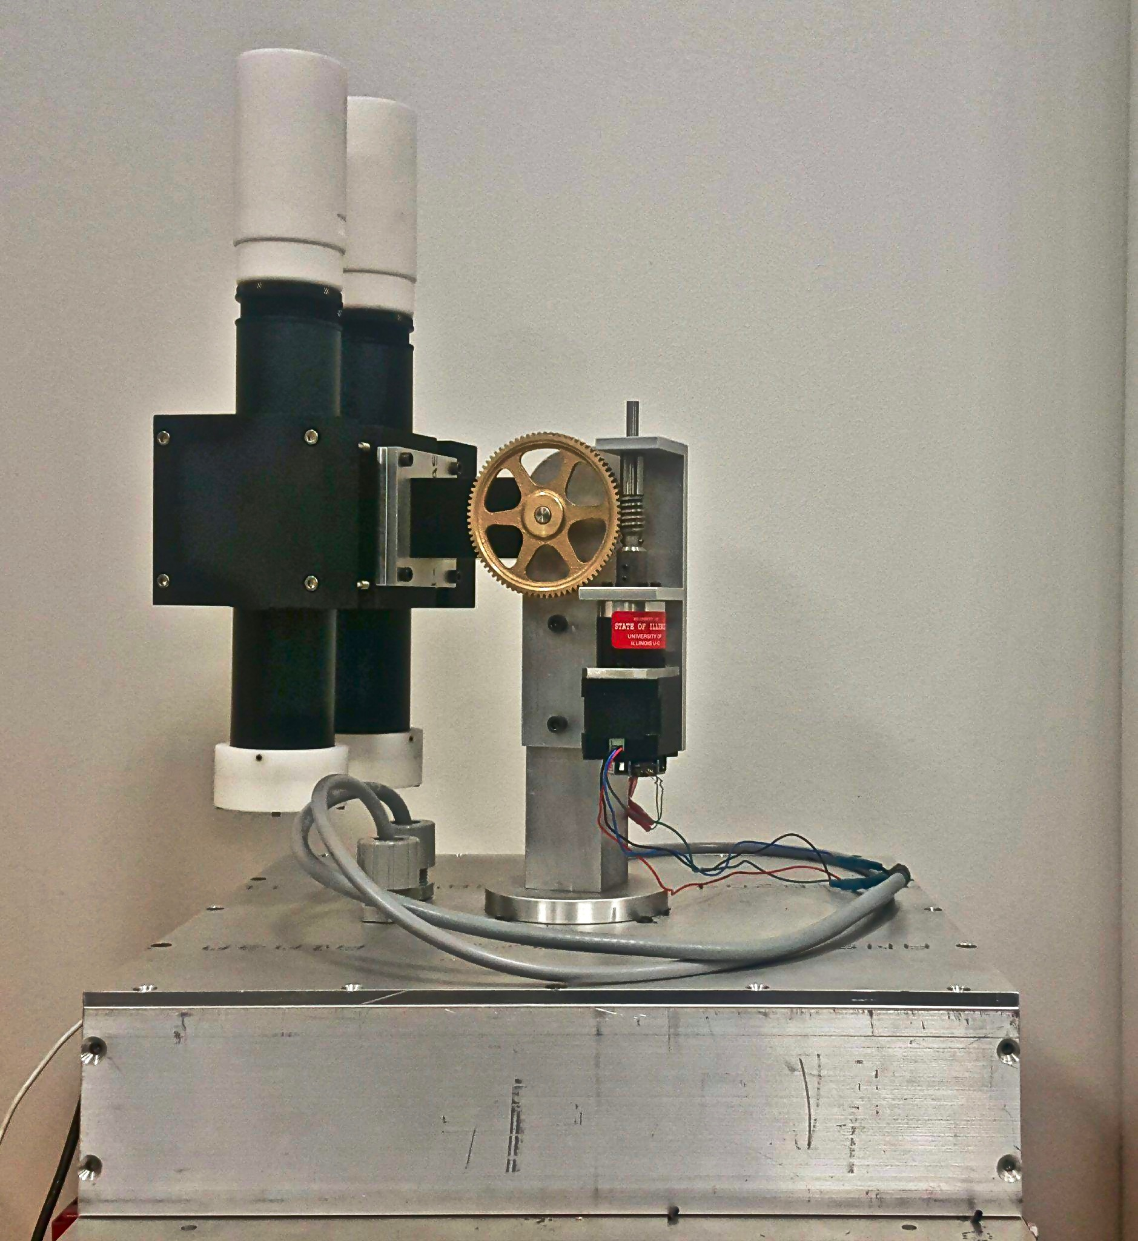
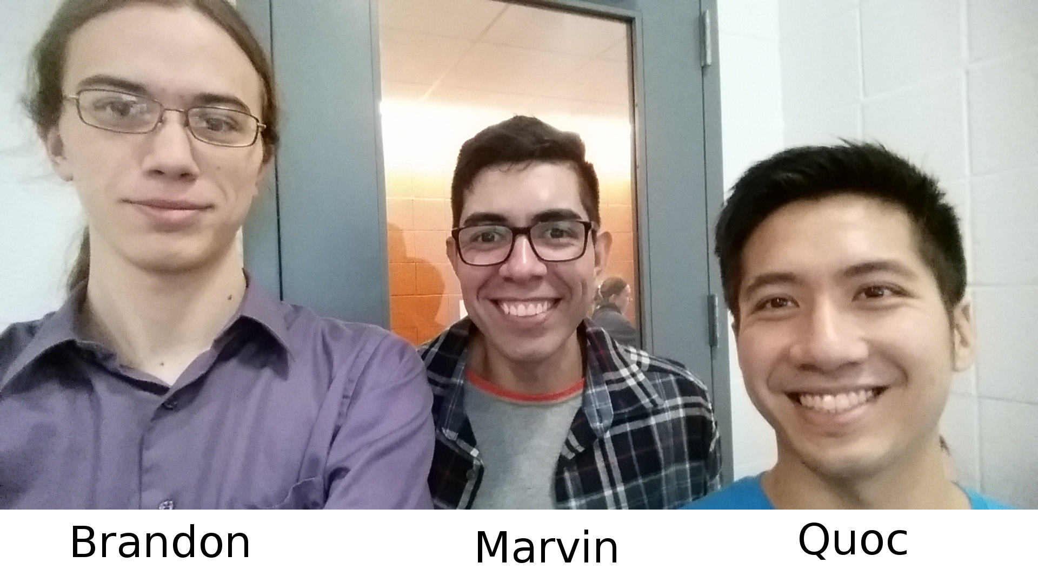
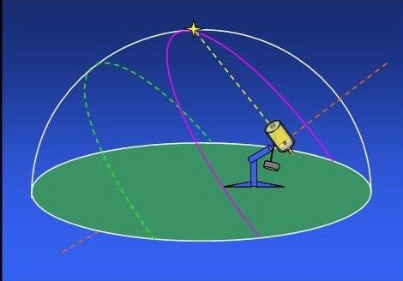
Autonomous Motorized Mount for the PATHS Sensor
Group 23
Notes:
Presenter: Quoc
Time ~

Slide 2
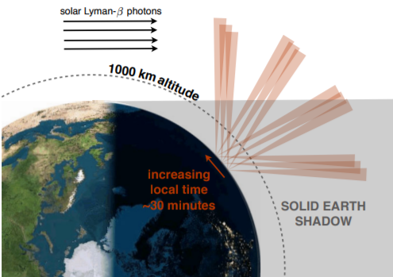
Introduction
Autonomous mount for Professor Waldrop
Remote Sensing Research
Tracking the middle of Earth’s umbra
Fig. PATHS Sensor viewing geometry
Notes:
Presenter: Quoc
Time ~ 30s

Slide 3
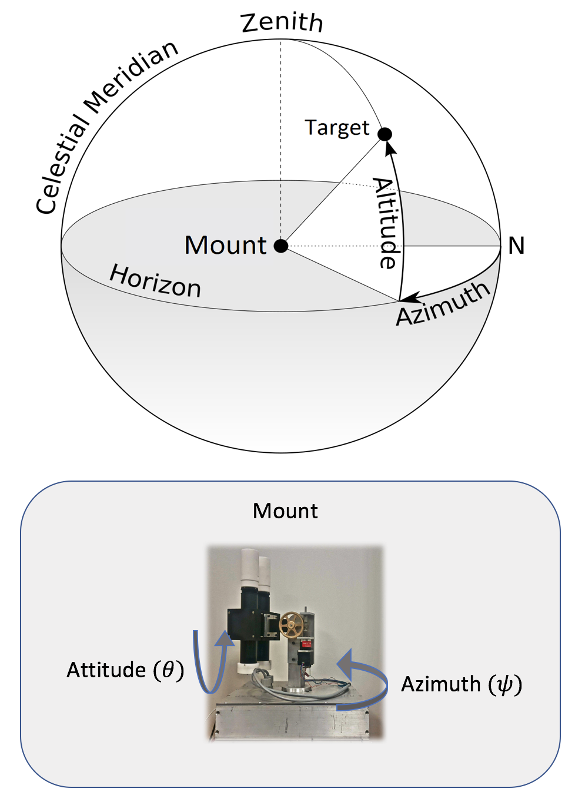
Functionality
Notes:
Presenter: Alex
Time ~ 1-2 mins

Slide 4
Objectives & Goals
1. Design a strong and robust mount to hold and move sensor along two degrees of freedom
2. Performs smooth tracking
3. Tracking to within 0.5 degrees of precision
4. Design control that
- Initializes coordinates from external tracking system
- Takes in heading and attitude angles from external tracking system
- Implements close loop feedback control
Notes:
Presenter: Alex
Time ~ 1.5min

Slide 5
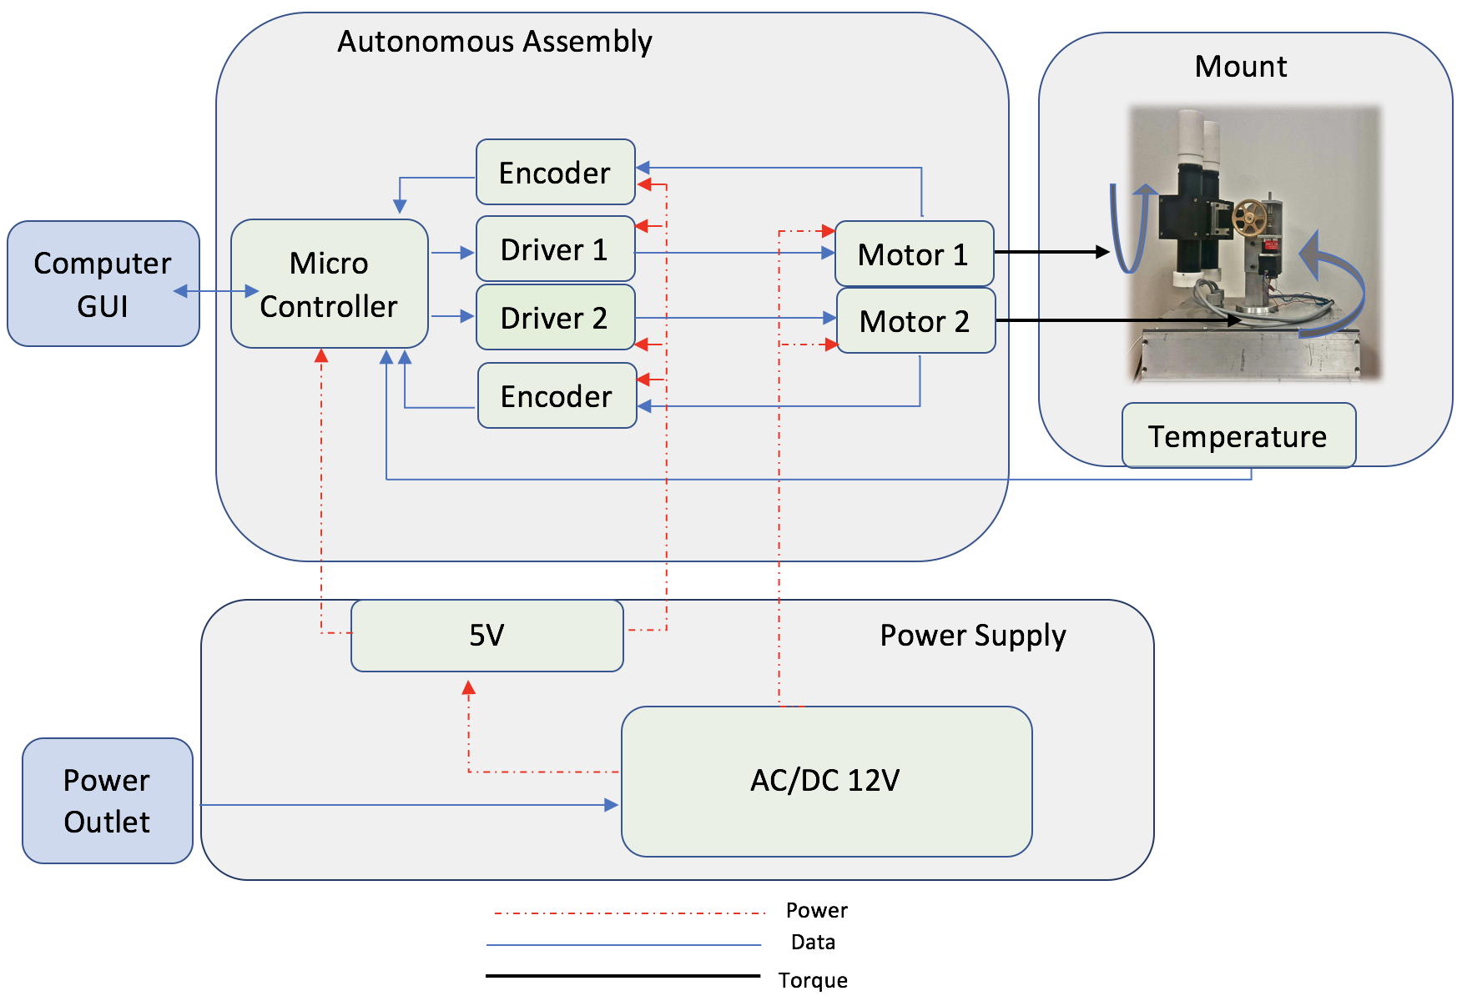
High
Level
Modular
Design
Notes:
Presenter: Brandon
Time ~ 1-2 mins

Slide 6
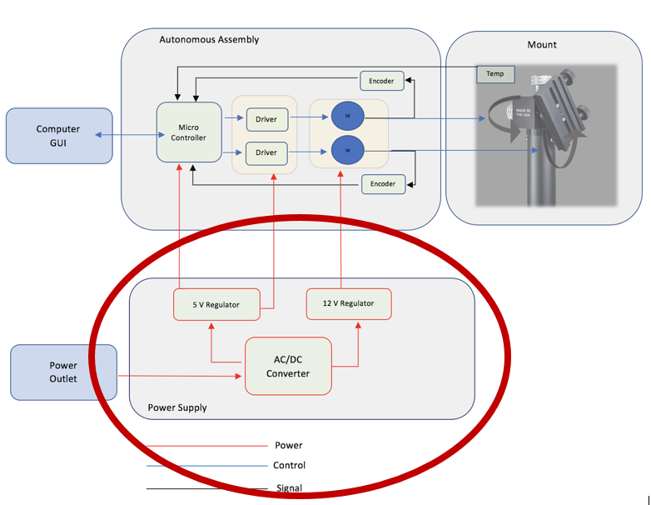
Modifications to Initial Design
Opted for an off-the-shelf power supply
Our own power module would be too bulky for the custom mount
Notes:
Presenter: Brandon
Time ~ 1 min

Slide 7
Design Component Requirements
Power needs to supply a maximum of 6A at 12V
Stepper motor minimum holding torque = 3 Nm
Driver needs to deliver the peak current draw of 3 A
Microcontroller needed USB support, analog input, and interrupt pins
Minimum required encoder’s resolution 2048 PPR
Notes:
Presenter: Quoc

Slide 8
Power Supply Specifications
The power needs to be reliable, efficient, and safe!
12V ± 0.1V
Max currents of 6amps
Both Motor draw ~ 1.7 amps on continuous operation, and 2.3 on rest.
Runs for 3 hours without overheating
Notes:
Presenter: Alex
Time ~ 1-2 mins

Slide 9
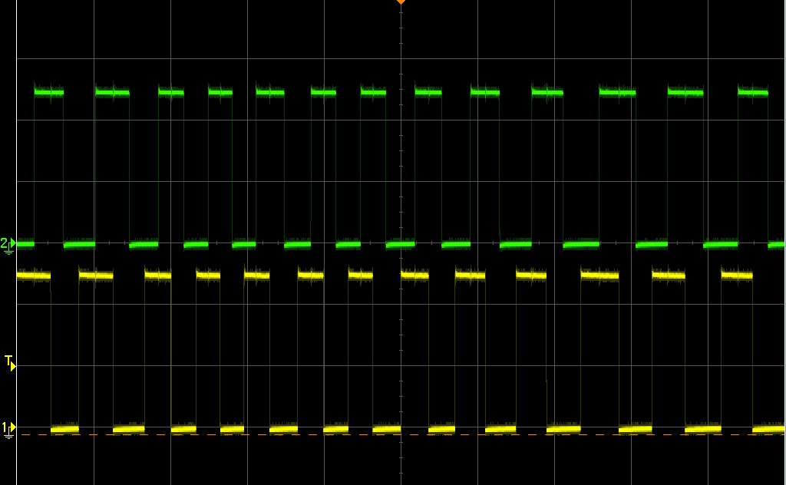
Requirements and Verification
Microcontroller:
Pins were properly sending and receiving signal
Drivers:
Successfully drove steppers in both directions
Encoders:
Was able to read back the position reliably
Fig. A, B signals from the encoder capturing movement.
Notes:
Presenter: Quoc

Slide 10
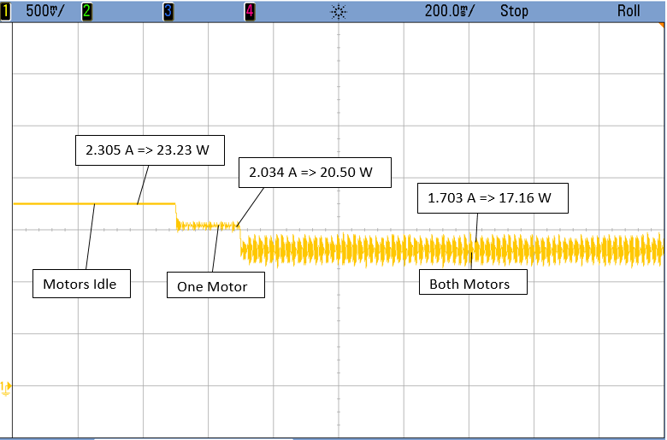
Power Consumption Testing
Notes:
Presenter: Brandon

Slide 11
Project Build
1. Design a strong and robust mount to hold and move sensor along two degrees of freedom
Worked with ECE Machine Shop for a custom built mount
Sturdy build with no slippage
Attitude with 0-90 degrees range
Heading with 0-360 degrees range
Bundled cables for tidiness
Designed to hold 4 kg
Motor produces enough torque (30 kg-cm) to move 4kg
Notes:
Presenter: Alex
Time ~ 1-2 mins

Slide 12
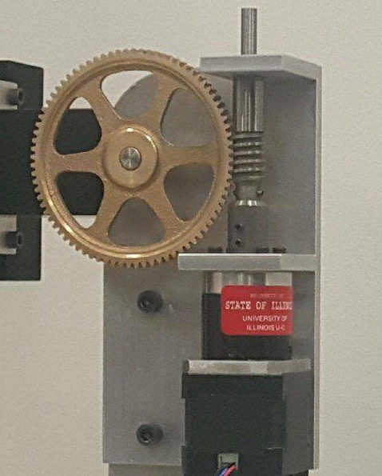
Project Build
2. Performs smooth tracking
Motor Step: 1.8 degrees
Motor Gear Ratio: 27:1
Motor Output Step 0.0667 degrees
Mount Gear Ratio: 80:1
Mount Output Step: 0.00083 degrees
Very Smooth Tracking!
Notes:
Presenter: Alex
Time ~ 1-2 mins

Slide 13
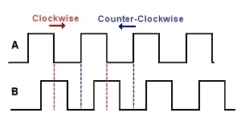
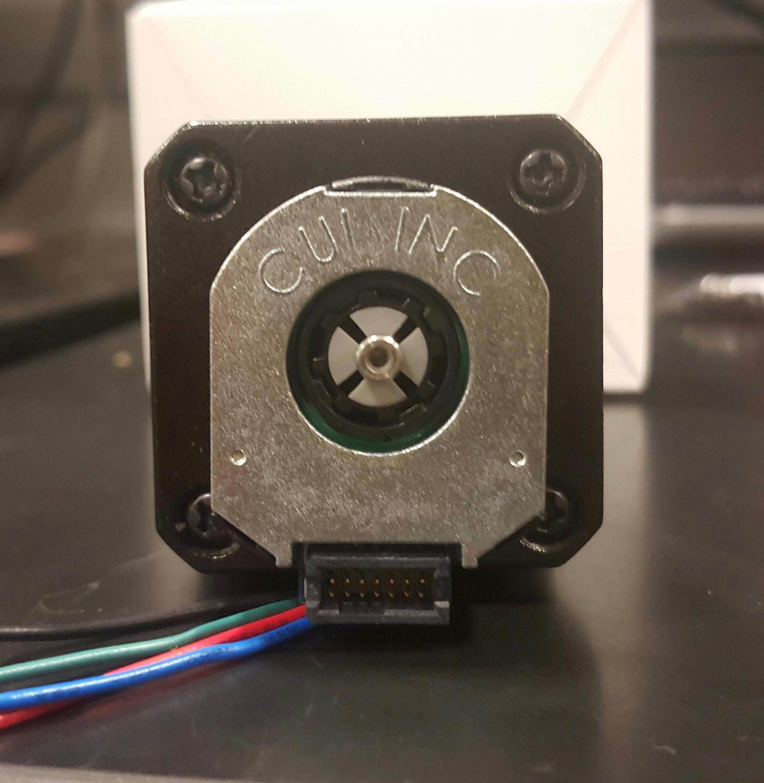
Project Build
3. Tracking to within 0.5 degrees of precision.
Resolution: R = 2048
Period: T = 360/R ~ 0.17578 deg
How many highs on A each CW step (1.8 deg)?
Step_Angle/Period = 1.8/0.17578 = 10 highs
There are 10 highs per 0.0667 deg of motor!
There are 10 highs per 0.00083 deg of mount!
Very high precision!
Notes:
Presenter: Alex
Time ~ 1-2 mins

Slide 14
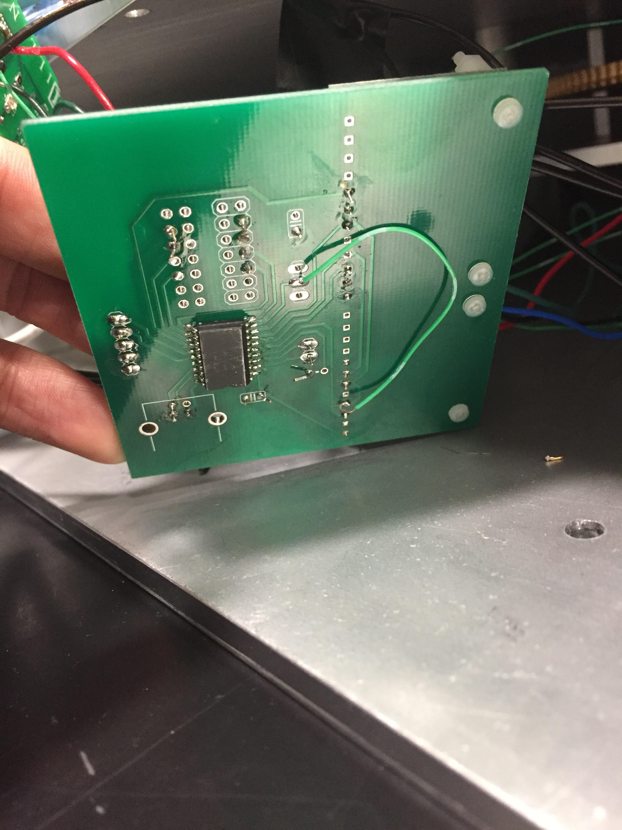
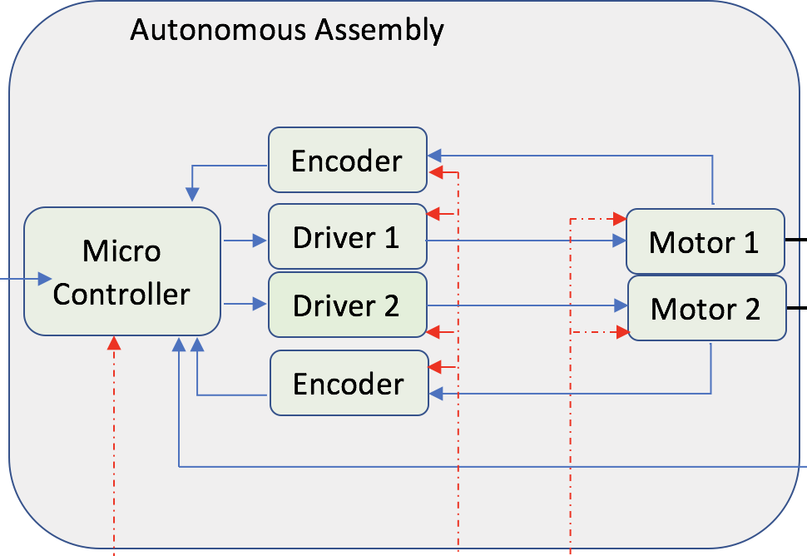
Autonomous Assembly
Notes:
Presenter: Quoc

Slide 15
Software Design Aspects
Microcontroller
Receives initialization coordinates from external tracking system
Takes in heading and attitude angles from external system
Correctly and reliably reads encoders
Notes:
Presenter: Brandon

Slide 16
Software Design Aspects (Cont.)
Single byte representing type
Goto, State, Time Update, etc.
7 little-endian 32-bit integers
Notes:
Presenter: Brandon

Slide 17
Demo
Notes:
Presenter: Quoc
Time ~ 1-2 mins

Slide 18
Successes and Challenges
Successes:
Every component was compatible from the get-go
We can reliably point at the same location repeatedly
Challenges:
Our mount went past its range limits causing the gear rod to bend
Machine Shop patched up the rod and gear
The 5V regulators on the driver had no overcurrent protection
Used a separate 5V regulator
The encoder pins were TINY
Encoders are high resolution, so they transition at a high frequency
Notes:
Presenter: Quoc

Slide 19
Conclusion and Future Work
Mount has all basic functionality and feedback
Temperature sensor integration
Tidy up our current prototype towards a final product
Use more secure connectors
Isolate the PCB within the case
Add limit switches to prevent damage
Addition movement modes
Remaining sources of error
Notes:
Presenter: Brandon

Slide 20
Acknowledgements
Thank you!
Professor Waldrop - For the proposal and for funding the project
Our TA, Yamuna Phal - For her guidance, support, and everything
ECE Machine Shop Supervisor, Scott McDonald - For an amazing mount
All of the ECE 445 professors for their support and work
Notes:
Presenter: Brandon, Alex, Quoc
Time ~ < 1min

Slide 21
Questions?
Notes:
Presenter: All
Time: 4 min

