Slide 1
RF Range detection and alert system team 26
Rebecca Cole, aaron sowers, sameeth gosike
TA: Channing philbrick
Notes:
Aaron

Slide 2
Introduction and Objective
Goal: Detect and Alert the user of the RC Car’s range and relative location
Implementation:
Bluetooth Communication
GPS Modules
RSSI (Received Signal Strength Indication) Chip
OLED (Organic Light Emitting Diodes) Display
Notes:
Becky

Slide 3
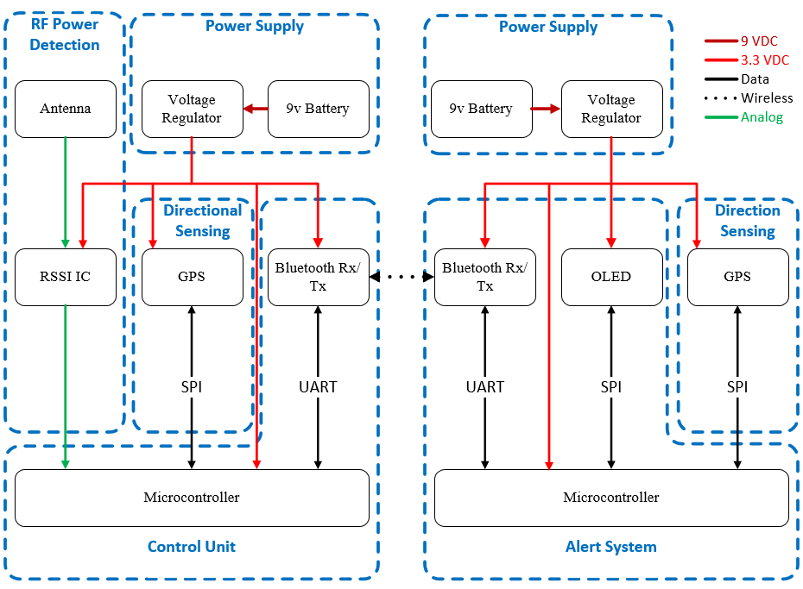
Design: Block Diagram
Main Features:
Power Supply
RF Power Detection
Directional Sensing
Control Unit
Alert System
Notes:
Aaron
- Needs new block diagram

Slide 4
Top Level R&V
Notes:
Aaron
Becky – Change so it says Y/N instead of colors; Change Achieved to Integrated

Slide 5
Power Supply
Regulates 9.2V Battery down to 3.3V Supply
Goal: $V_{out}$ = 3.3V +/- 5%
Notes:
Becky

Slide 6
Power Supply: Verification
Verification:
Utilized Power Supply to Sweep from 5-10V to verify the 3.3V output

Slide 7
RF Power Detection
RF detection circuit for 27 MHz signal
RSSI Chip - Scales input power logarithmically
Utilizes Bandpass Filter
Notes:
Aaron
Order of bullet points
Mention Bandpass Filter application

Slide 8
RF Power Verification
Simulation results for 27 MHz bandpass filter
Notes:
Aaron
- Mention 3 dB

Slide 9
Control Unit
Took inputs from RF Power Detection, GPS and Bluetooth Modules to communicate range and GPS coordinates to Alert System
Verification:
Implemented RF Power Detection and passed values over the Bluetooth to display on Alert System
Notes:
Becky

Slide 10
Microcontroller
Designed for ATmega328P
Prototyping utilized Arduino Uno and RedBoard
Capable of handling the desired peripherals
SPI
I2C
Analog Inputs

Slide 11
Bluetooth Module
Utilized SparkFun Bluetooth Mate Gold
RN-41 Class 1 Bluetooth Chip
Bluetooth Module Features:
Range greater than that of the car
Able to communicate with 2 digital pins or SPI communication
Notes:
Becky
- Bullet point order

Slide 12
Control Unit: Code
Notes:
Becky

Slide 13
Alert System
Display relative location and direction fed from the GPS and RSSI units
Utilizes Adafruit OLED Display and Arduino microcontroller
Verification:
Modified print rate on OLED display through code delays to implement a reasonable refresh rate
Notes:
Becky

Slide 14
Alert system: Code
Notes:
Becky

Slide 15
Directional Sensing
Responsible for providing relative location between user and car
Implemented with Adafruits Ultimate GPS module built around MTK3339 chip
Verification
Updates data at rate of 10 Hz
Provided NMEA sentences with both longitudinal and latitudinal coordinates
Accurate within only about 50m of true location

Slide 16
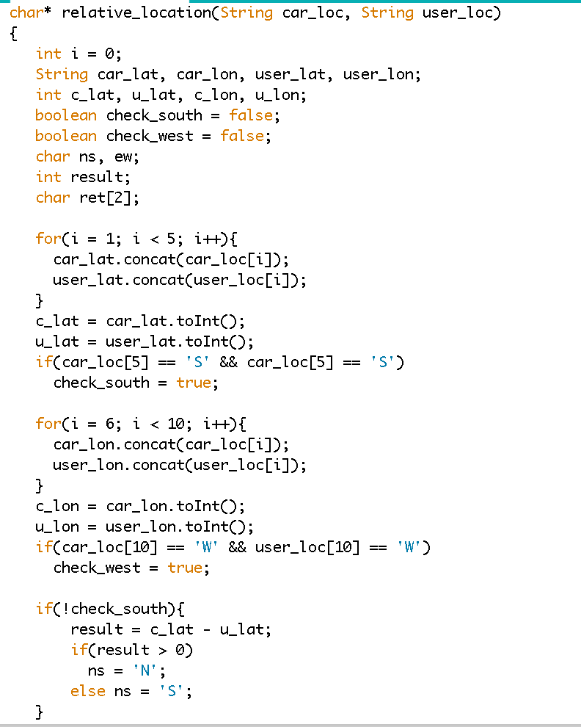
Directional Sensing: code

Slide 17
Full Board Circuit Schematic
Notes:
Aaron:
Highlight its flexibility within the chip – for the OLED display/RSSI is only on one side of the chip but can be implemented on both
- Trim it down / Move so it is better organized

Slide 18
Challenges: Power Supply and Control Unit
Power Supply:
Verification for the Battery was not well established
Implementing a proper load difficult
Correct Resistors were difficult to find
Control Unit:
Bluetooth and GPS both needed SPI communication
Bluetooth passed only characters between serial terminal
Notes:
Becky

Slide 19
Challenges: Alert System And RF Detection
Alert System:
OLED Library size
Display Refresh Rate
RF Detection System:
Antenna length
Weak Transmitter Power
Notes:
Becky and Aaron

Slide 20
Challenges: Directional sensing
GPS Module
Location data GPS provided was accurate only up to about a hundredth of a minute
Difficult to capture true location points of user and car
This made calculating relative location between the user and car inaccurate since car being used had a reliable range of about 15 feet

Slide 21
Challenges: Integration
Low memory issues from the size of the libraries caused hesitation during integration
Some PCB board layout issues due implementation changes
Notes:
Aaron

Slide 22
Conclusion
Achievements:
RSSI successfully integrated with the Bluetooth and OLED Display
GPS Module integration difficulty
Further Plans:
Integrate GPS Module
Integrate onto new PCB and RC Car
Notes:
Becky

Slide 23
Questions?

