Slide 1
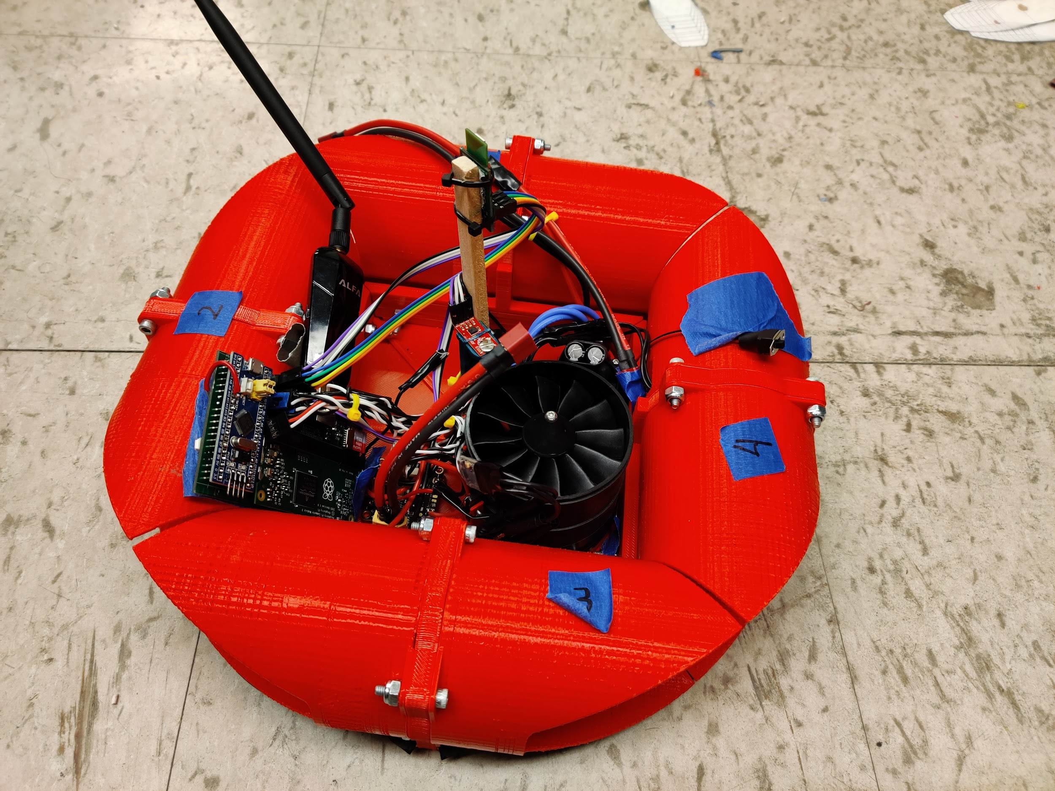
Computation, Localization, and Power Systems for Distributed Robotics
ECE 445 Final Presentation
Team #26
Lyle Regenwetter, Tanitpong Lawphongpanich TA: Jonathan Hoff

Slide 2
Problem Statement
All in one drone controllers are becoming increasingly common
None are geared toward ground-based mobile robotics
System with specialized features intended for ground based robots:
Higher precision multi-sensor localization versus conventional drone
Sensor fusion & control optimized for planar motion & localization
Designed to run both high level python code together with low level real time C code
Support wifi and networking systems
Incorporate ease-of-use features such as battery hot-swapping

Slide 3
Objectives & Requirements
Selected hovercraft as robot of choice
Some design decisions were inherently platform-specific
Made efforts to make components compatible with other modes or robots
Four high level objectives for the system:
500 W peak power to up to 5 motors and actuators & accommodate battery hot-swapping
Sensor fusion algorithm state running at 100Hz with ±10 cm, ±10 degrees accuracy
<500 g without batteries & <1500 g with batteries, <3000 cm^3 space
Motion commands to physical outputs and localization data to user in <30 ms & <20 ms

Slide 4
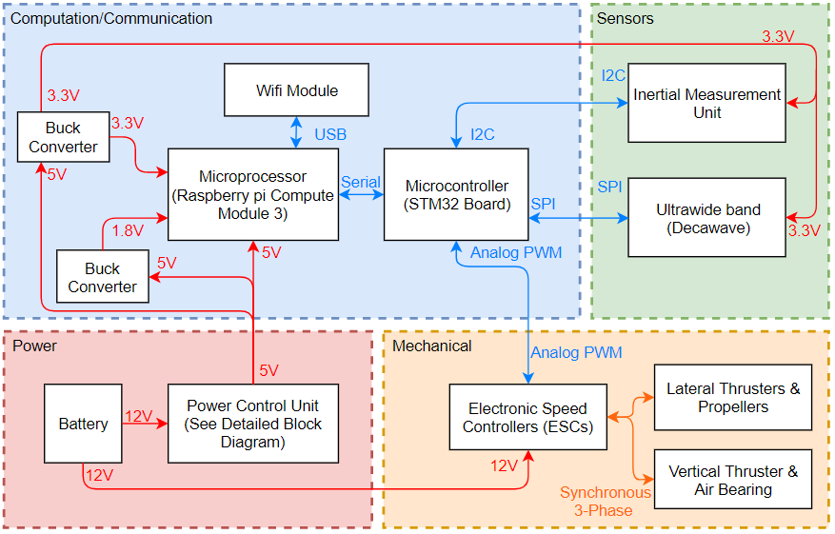
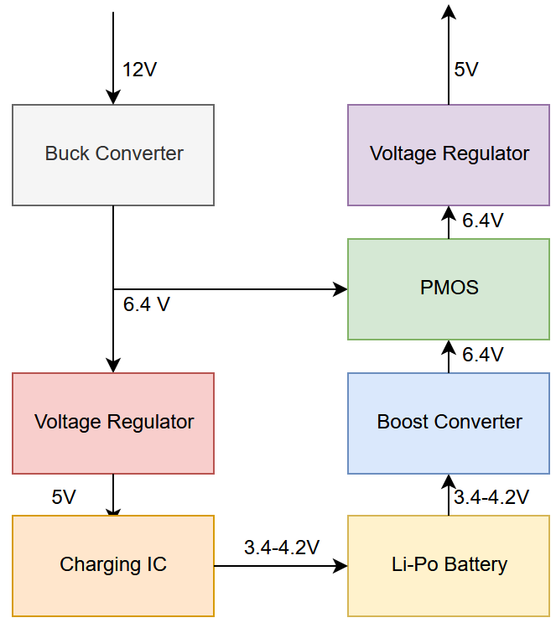
Hardware: Block Diagrams
Overall System Diagram
Power Block Detail

Slide 5
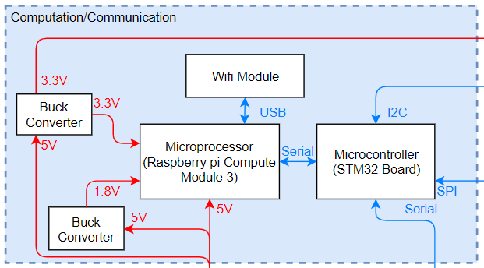
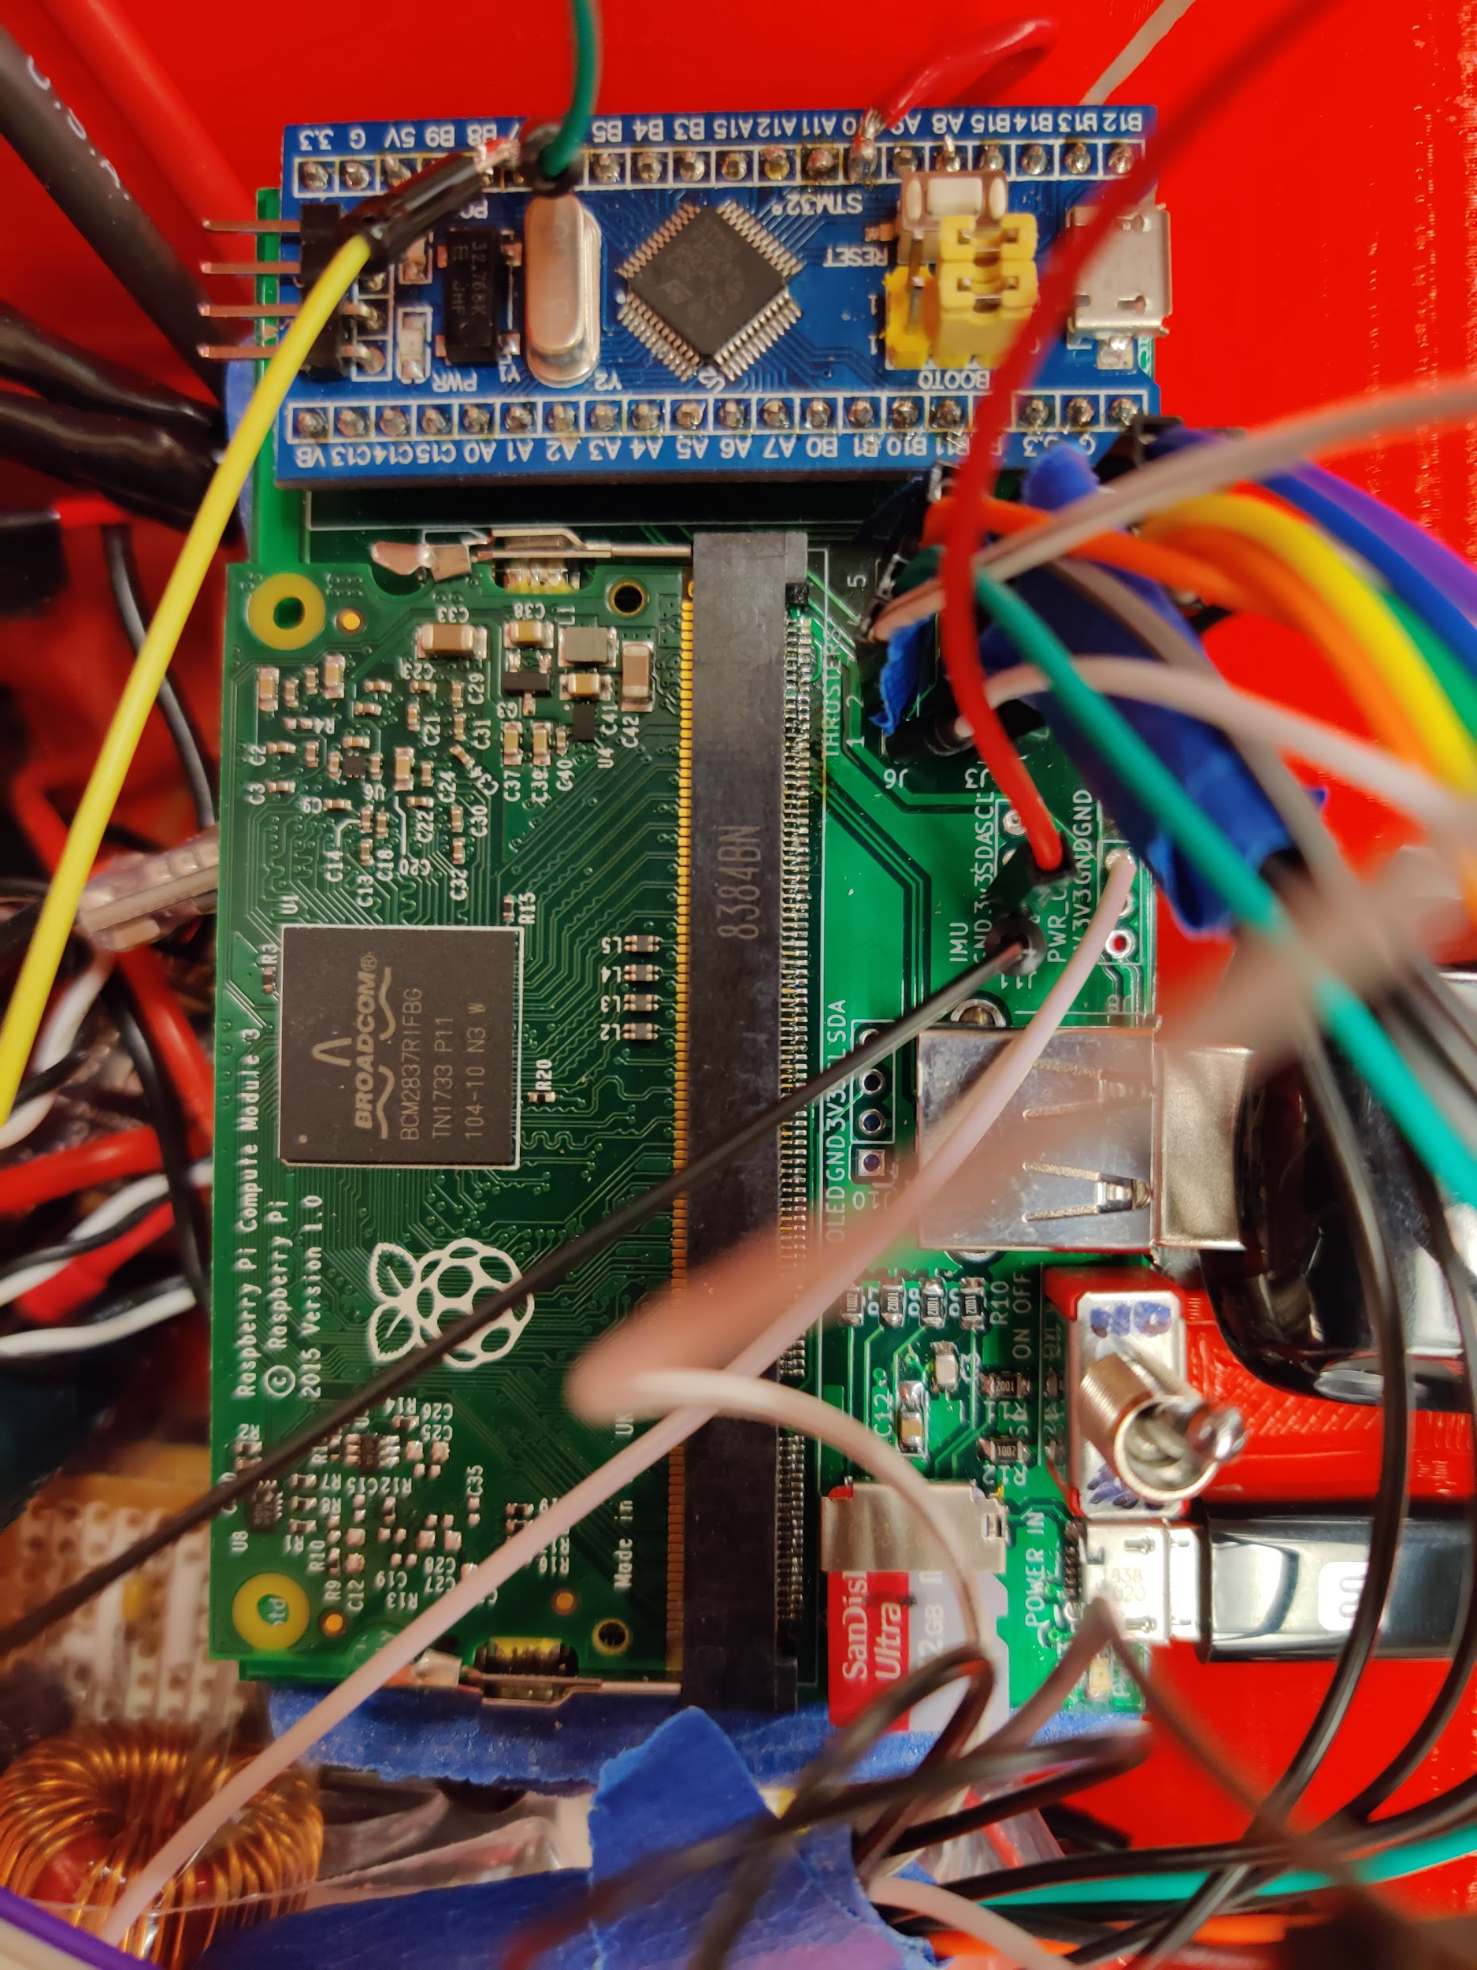
Computation & Communication Board
Two buck converters supply 1.8V and 3.3V
Houses SD Card, RPi CM3, STM32 Blue Pill
Usb plugs, headers for sensors & ESCs
Key Requirements:
Data transmission to and from server
Supplies necessary voltages to RPi CM3
Incorporates all components
Verification:
Latency testing
Testing full system function through manual control

Slide 6
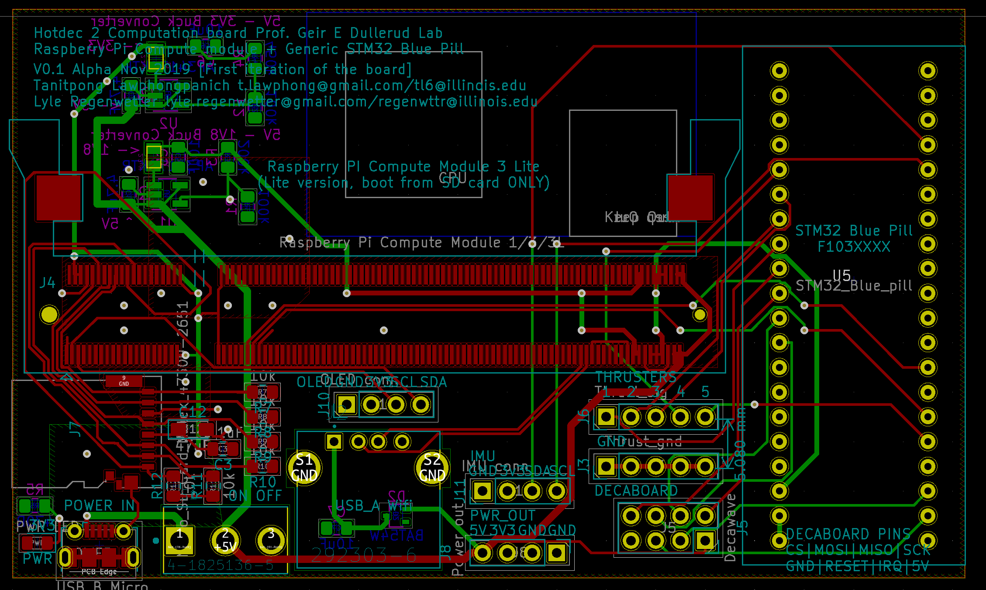

Slide 7
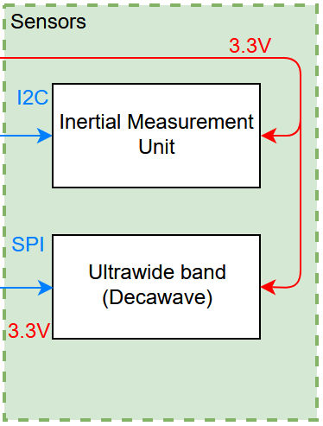
Sensors
Decawave Ultrawide-band sensor on craft + Decawave receivers in room
9 DoF Inertial Measurement Unit on Craft
Key Requirements:
IMU samples at 100 Hz and decawave at 10Hz
Fused sensor accuracy of ±10cm/ ±10 deg
Verification:
Read data values at specified frequencies and verify that no two are identical

Slide 8
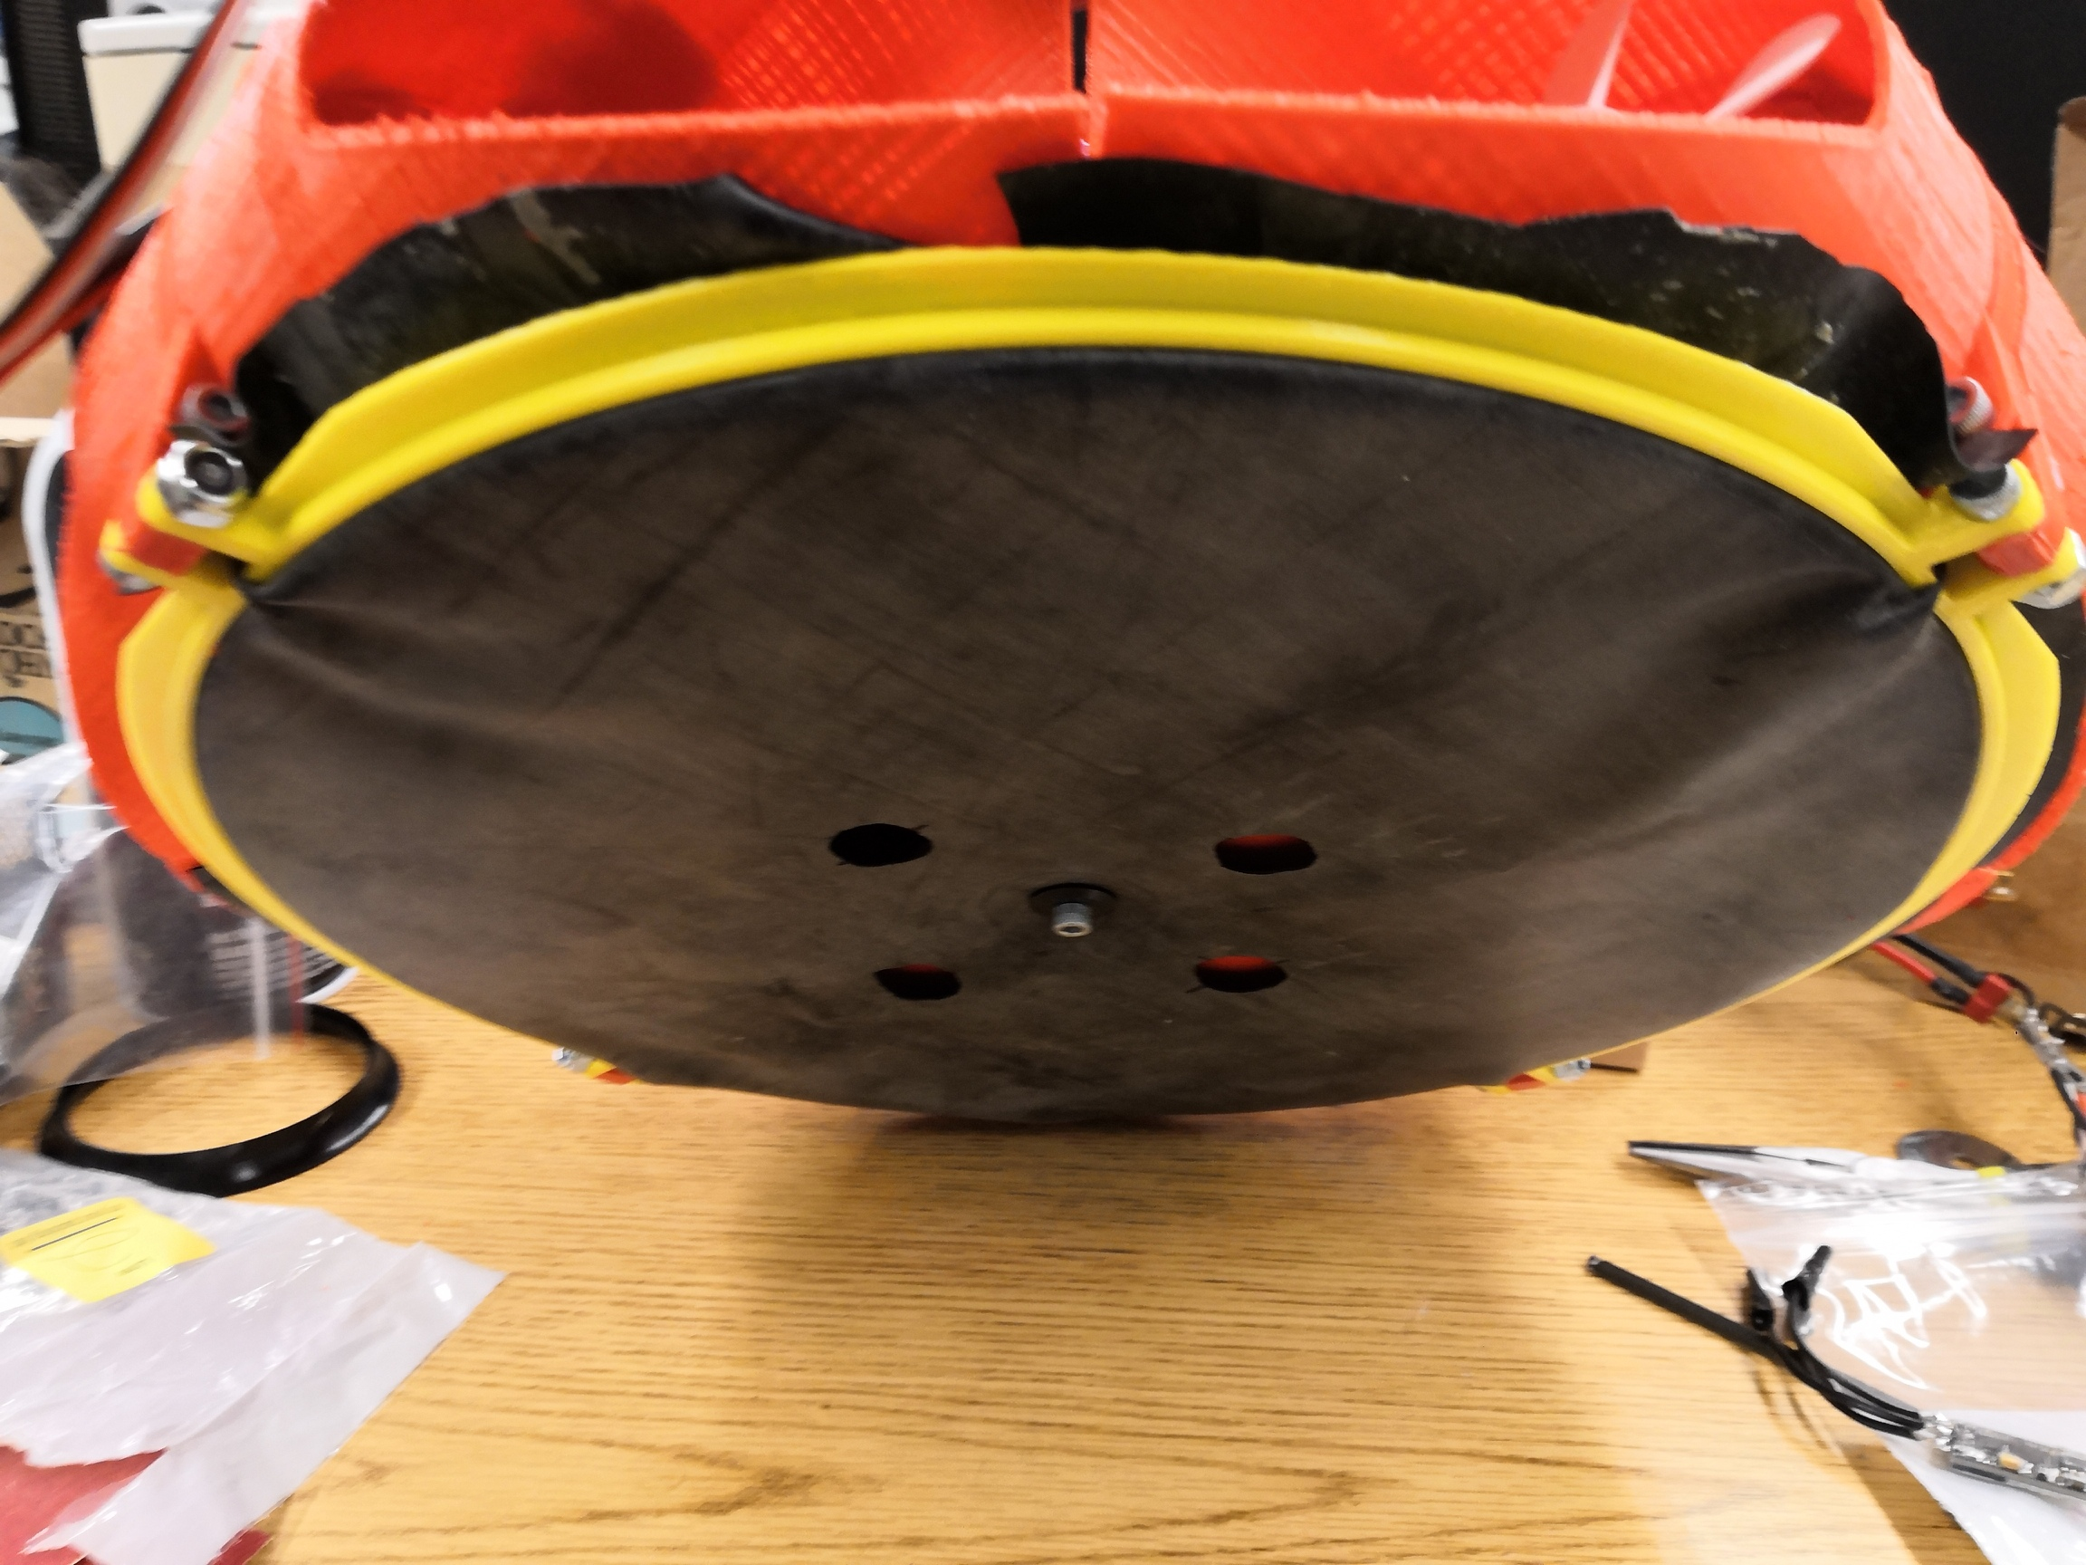
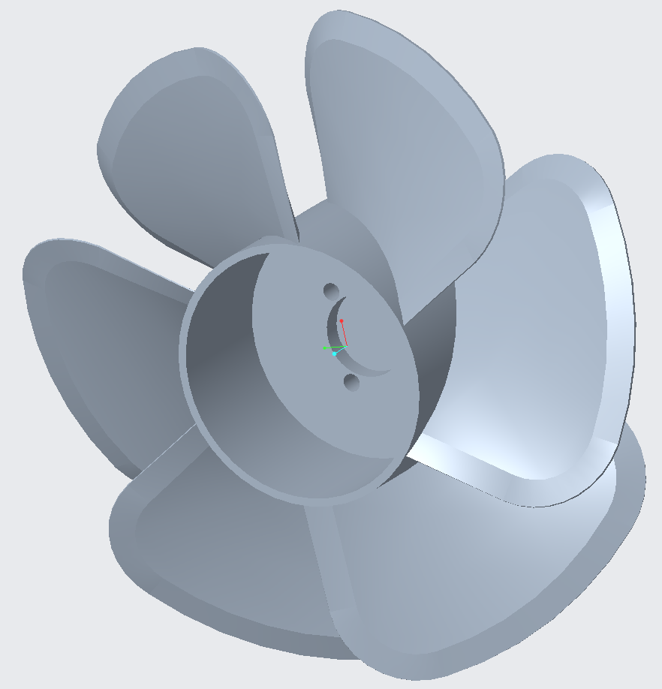
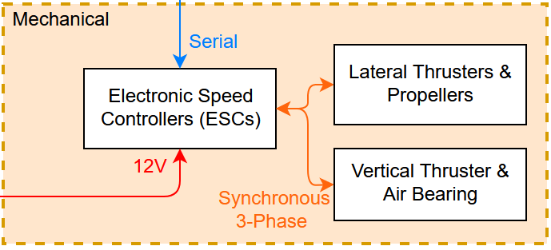
Mechanical
Air bearing system for levitation
Custom designed bidirectionally optimized propellers
ESCs power all thrusters
Key Requirements:
Mechanical components convert control input to physical actuation
Verification:
Verify mechanical components move as commanded when driving

Slide 9
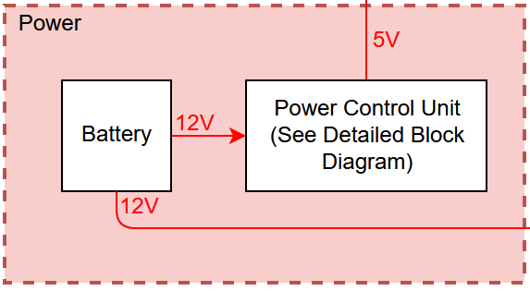
Power
Power system keeps electronics online while main batteries are swapped
Contains 1 buck converter, 1 boost converter
Charging IC charges Li-Po when main power is connected and backup is not fully charged
Key Requirements:
Backup battery powers keeps electronics system running when main battery is disconnected
Main batteries power electronics & actuators
Verification:
Drive craft from main battery
Unplug main battery and verify that electronics stays on

Slide 10
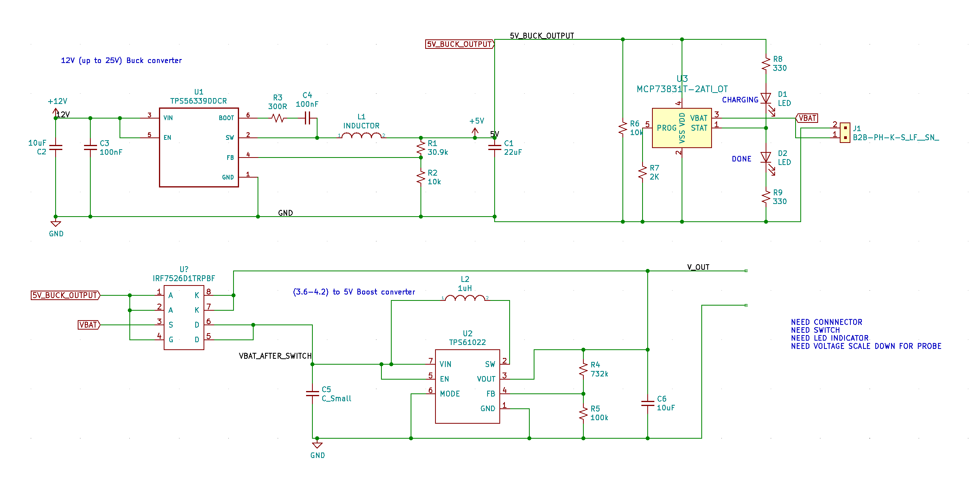

Slide 11
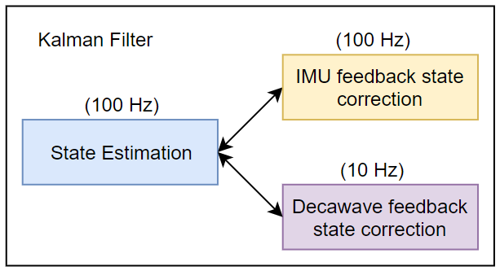
Software
Kalman Sensor Fusion Algorithm
Communication to and from server from craft
Key Requirements:
State updates at 100Hz, ±10 cm, ±10 deg. accuracy
<30 ms latency & <20 ms latency to and from server
Verification:
Compare real physical state to predicted state
Ping server and measure response time

Slide 12
Testing
System achieved all the goals we set out to achieve
Some reliability issues at demo; weren’t able to demo Kalman filter
Developed simulation framework to test performance of craft under interesting conditions (No IMU, extreme noise, propeller failure, etc.)

Slide 13
Key Challenges
Soldering 200 pin SODIMM connector
STM32s from different manufacturers behave differently
Debugging buck converter issues
Ultrawide-band firmware interfering with ESC PWM timer on STM32

Slide 14
Main Component Summary
Summary of Custom-Designed Hardware Components:
1 mainboard PCB
3 Decawave PCBs
3 buck converters
1 boost converter
1 battery charger circuit
1 power switching circuit
4 SLS-fabricated propellers
1 FDM-fabricated chassis
1 Spray-moulded air bearing
2 FDM-fabricated Decawave towers
Summary of Custom-Designed Software Components:
Kalman sensor fusion filter
PID control algorithm
Sensor and control simulation for testing
Pygame server
Python client
Arduino firmware

Slide 15
Notes:
Add more image of sensors and complete system, decaboard

Slide 16
Further Work
Plan to continue next semester, since this is an ongoing research project!
Put power system on PCB
Include optic sensors (like on bottom of computer mouse)
Add Vision systems (Camera + NVIDIA Jetson)
Manufacture multiple and test swarm coordination
Add automatic charging dock
Apply system to other crafts (hybrid drone/hovercraft, kiwi/holonomic drive)
Assist in the testing of lunar robots (low gravity/friction simulation)
Plenty of ways to apply our work this semester!
Notes:
Add more image of sensors and complete system, decaboard

Slide 17
Acknowledgements
We would like to thank Professor Geir Dullerud for his direction, his support, and granting us access to his facilities throughout the project.
We would also like to thank Jon Hoff for his feedback and supervision.
Notes:
Add more image of sensors and complete system, decaboard

Slide 18
Questions?
Thanks for attending!
Any questions?
Notes:
Add more image of sensors and complete system, decaboard

