Slide 1
Bike Generator with Fitness Monitoring
By: David Zhang, Daniel Davidar, and Micheal Westfall
Team 21

Slide 2
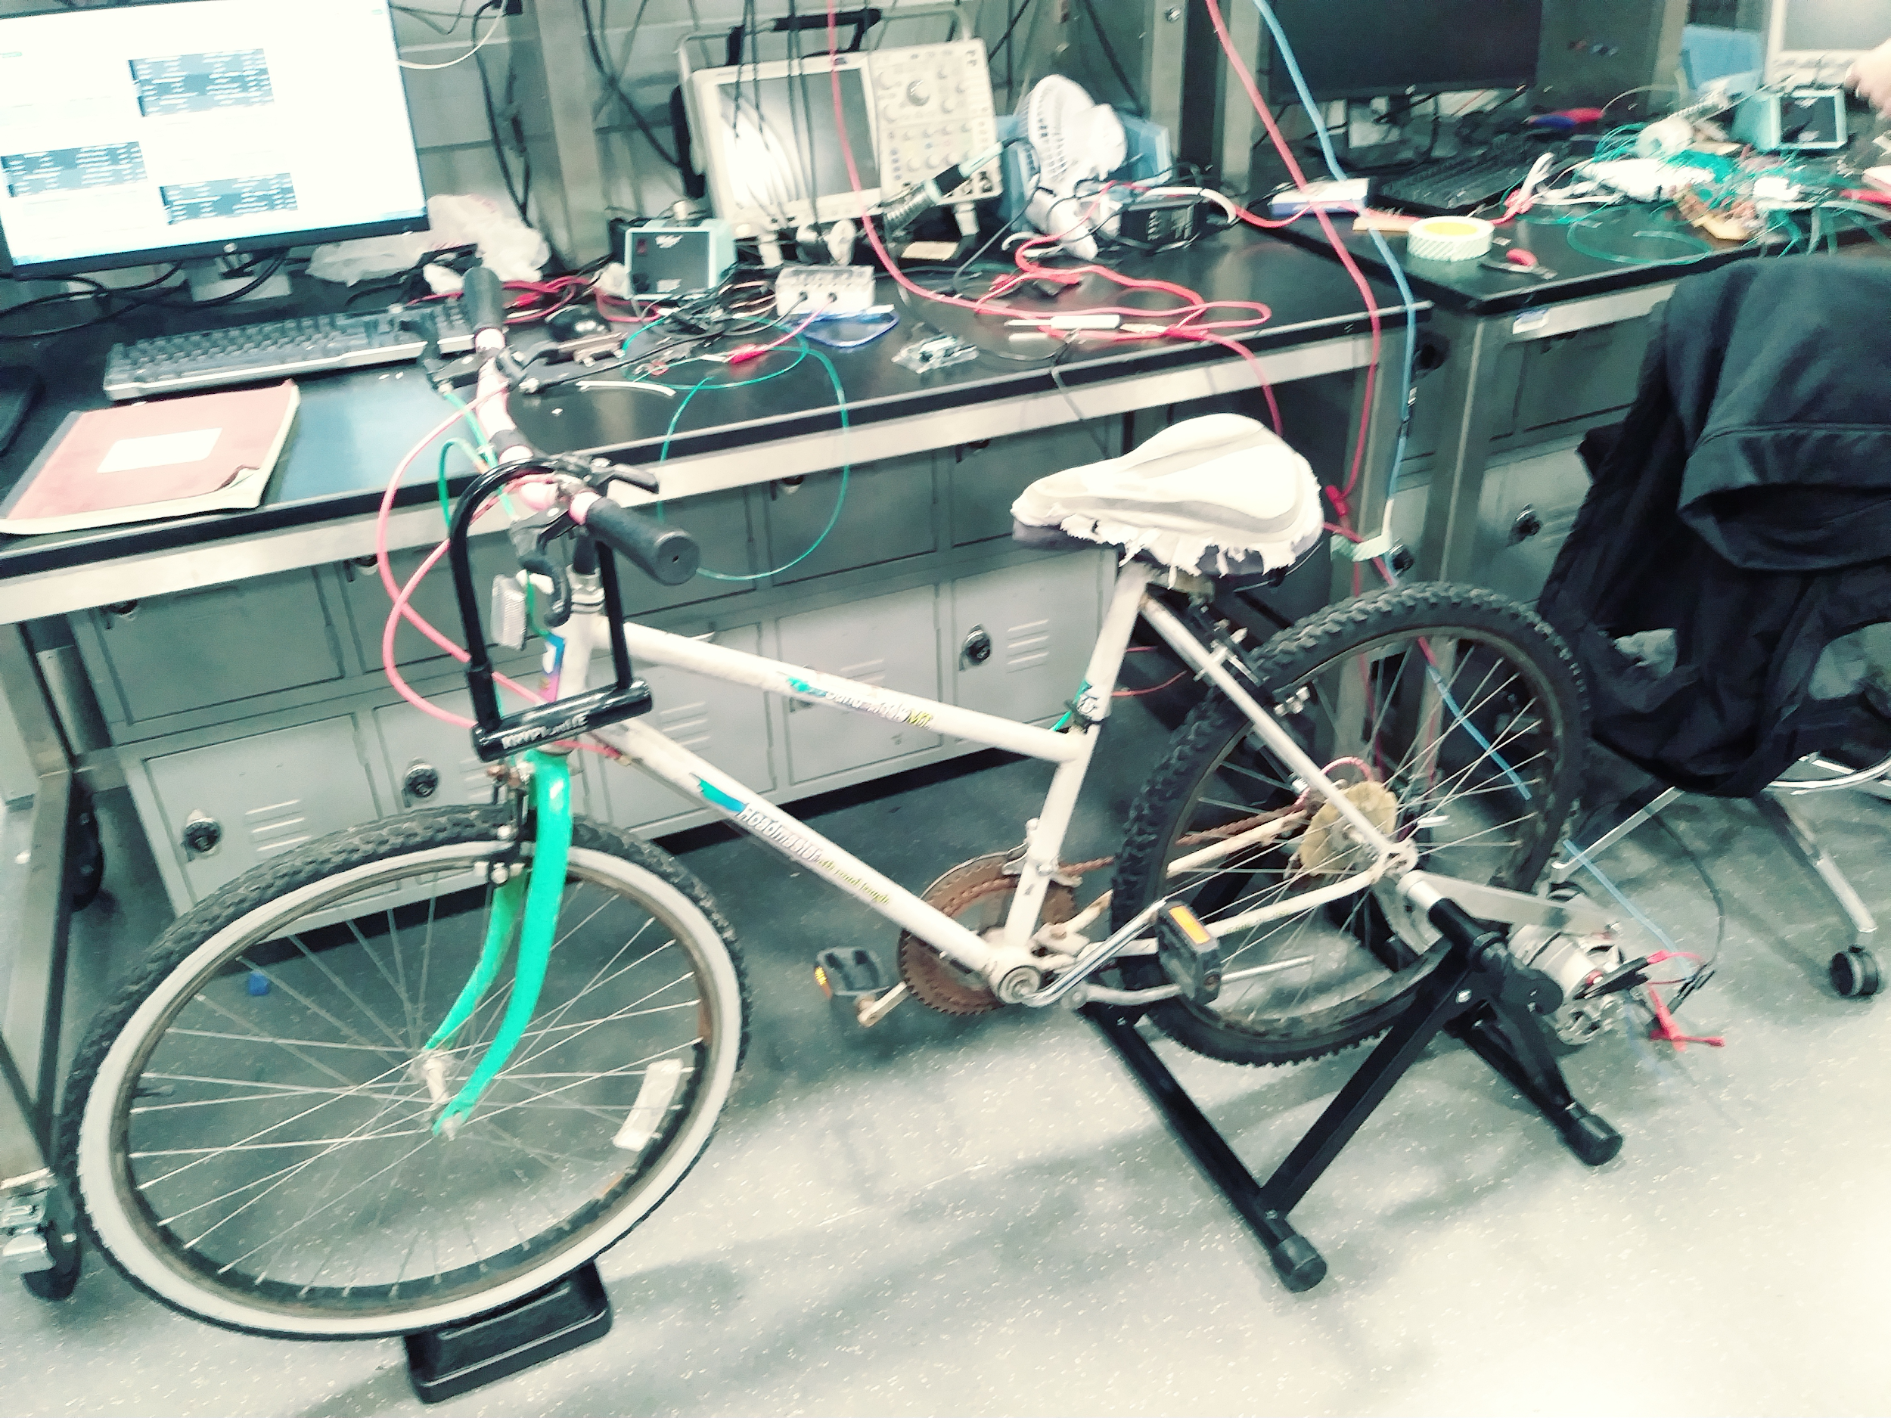
Project Overview
Our project is to feasibly generate electrical power from a bike and to track important statistics relating to the user’s exercise and energy generated from the bike

Slide 3
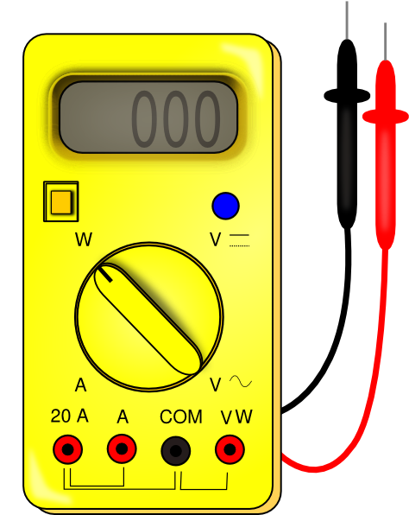
High-Level Requirements
Generate 25 watts net power
Easy to set-up and take apart
Track the following statistics to within 10%:
Total distance
Speed
Energy generated

Slide 4
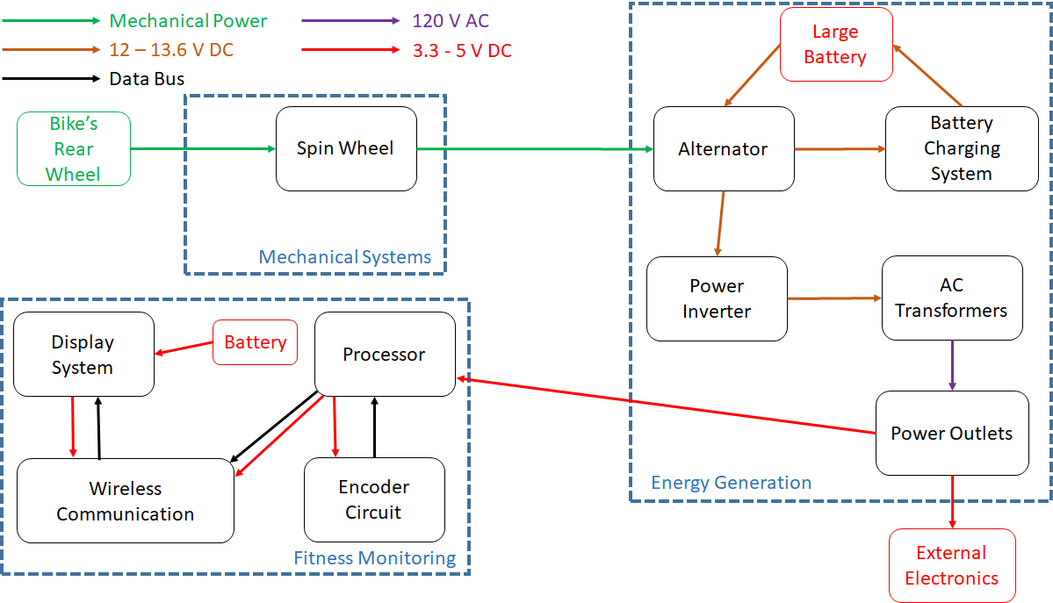

Slide 5
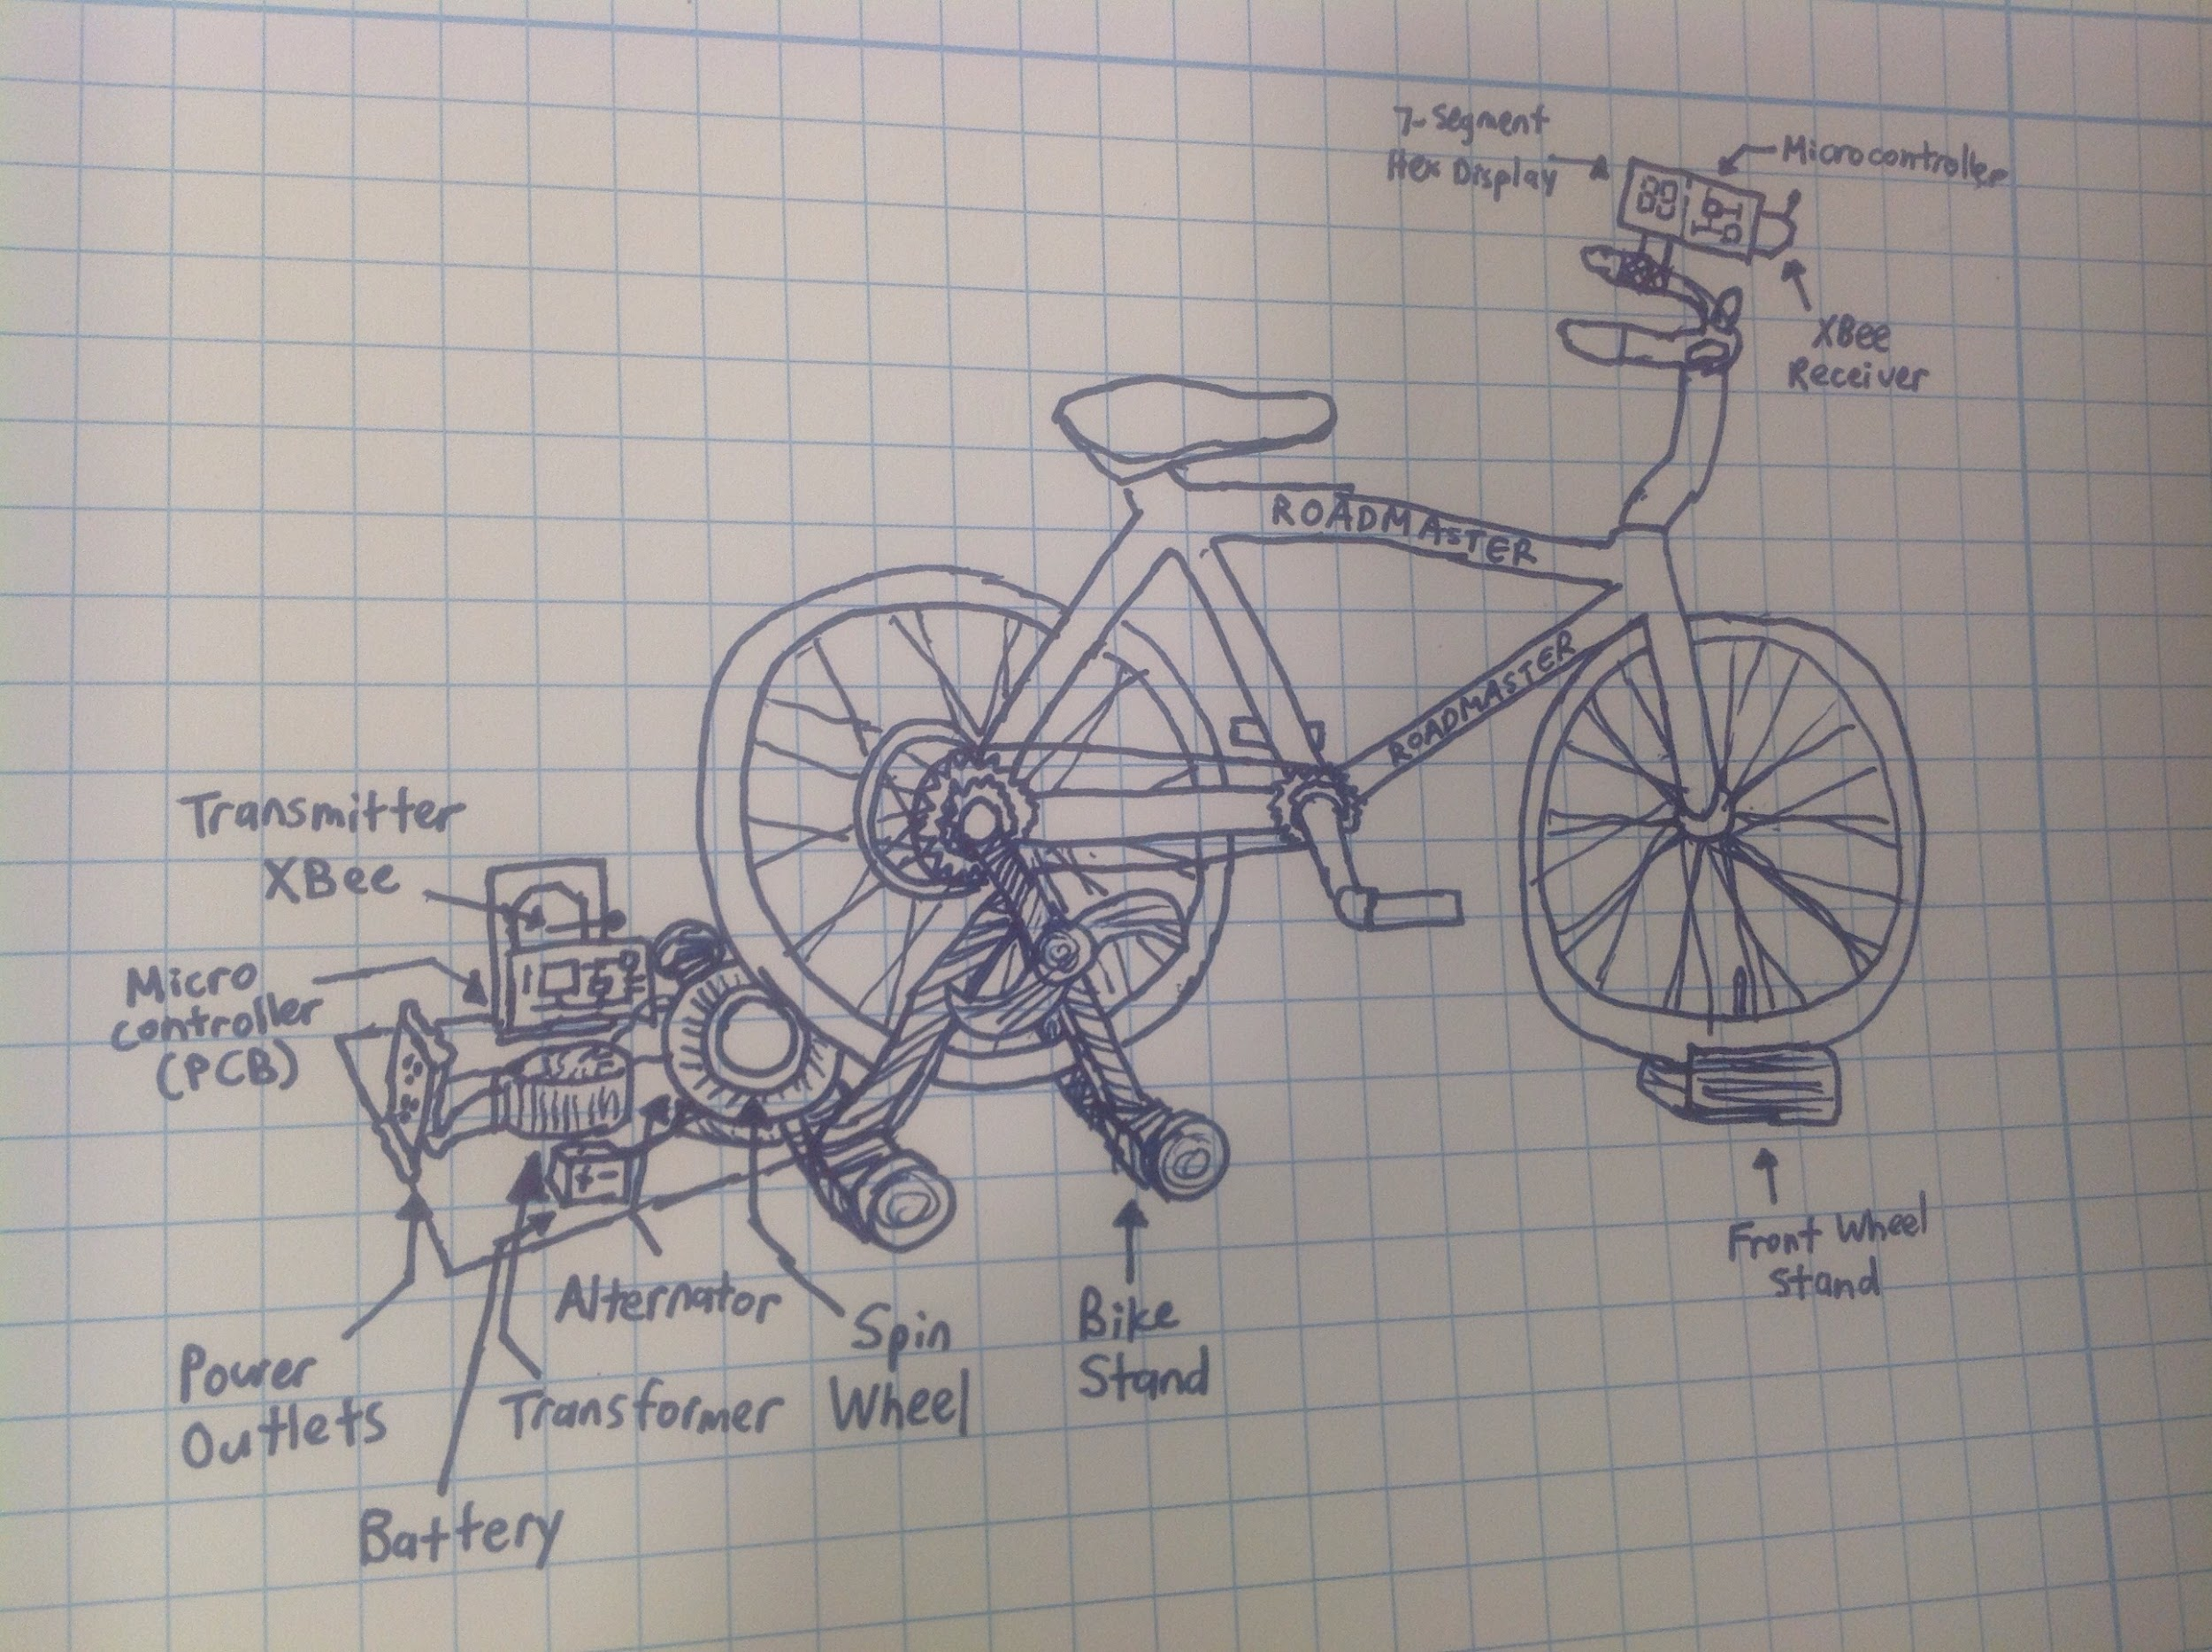
Physical Design Sketch

Slide 6
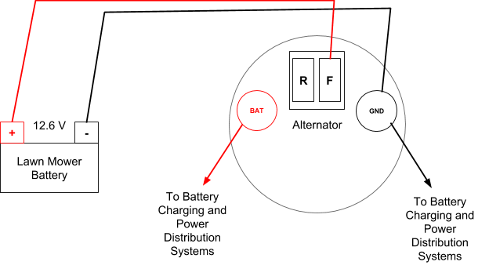
The Alternator
From High-Level Requirements, this must generate at least 25 Watts for the rest of the project to be feasible
Our source for turning mechanical power to electrical power

Slide 7
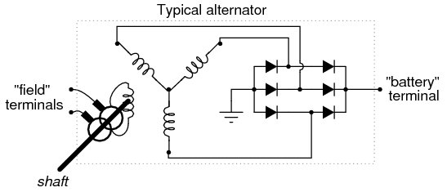
The Alternator
The internal circuit of the alternator
*Thank You, Joe Zatarski

Slide 8
The Alternator
It has requirements of its own:
RPM Threshold (1420 RPM)
Field Current
Input Voltage (> 12V)
Proper Load (the smaller the resistance the better)

Slide 9
The Alternator Results
It can produce over 100 W!
RPM | Resistance | Current | Voltage | Power | Torque Req.
750 | 3 | 2.167 | 6.5 | 14.1 | 0.62
1000 | 3 | 3 | 8.9 | 26.7 | 0.765
1200 | 3 | 3.633 | 10.9 | 39.6 | 0.875
1400 | 3 | 4.25 | 12.75 | 54.2 | 0.965
1600 | 3 | 4.92 | 14.75 | 72.6 | 1.09
1400 | 1 | 10 | 10 | 100 | 1.525

Slide 10
Torque, Speed, Comfortable
P=τ*2π*v
50 watts =τ*2π*91.65RPM/1.364*1min/60 sec
Torque is 7.11 Nm at 1362 RPM alternator spinning
44.4 N at 14.2 mph

Slide 11
Voltage Regulator
Originally going to buy one
Wanted a buck regulator for maximum efficiency
Meant to regulate the voltage coming out of the alternator
Steps down the voltage using PWM and a mosfet

Slide 12
Problems with Voltage Regulator
Decided to build one since cheaper
Regulator is meant to regulate current going into alternator
When the voltage is above 14.5 V, cut current
When below 13.5 V, apply current
More complicated and needed more circuity like a power control device

Slide 13
Power Inverter
Converts DC to AC
Thought that alternator was pure AC
Full-wave rectifier with filter to make pure DC
Going to make it out of RC-timer with two mosfets

Slide 14
Problems with Power Inverter
Alternator output was half-wave rectified
Needed a different filter to get pure DC
RC-timer needs stable supply to get constant charge time
Even with stable supply, output was wrong
RC-timer work but mosfets were current limit

Slide 15
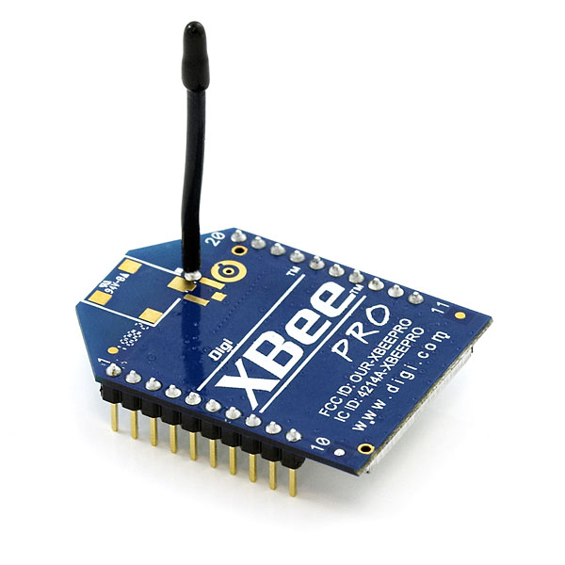
Wireless Communication
XBee Pro will transmit data serially using UART with each other
Unfortunately, we could not get one XBee to communicate to the other

Slide 16
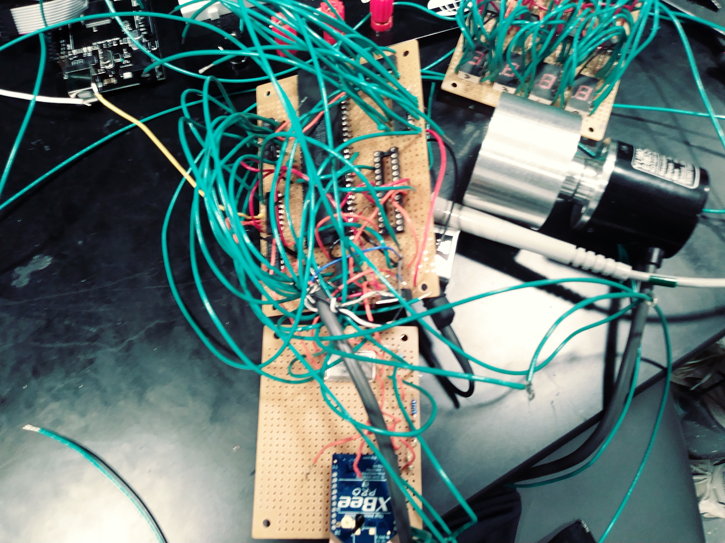
Fitness Monitoring Board

Slide 17
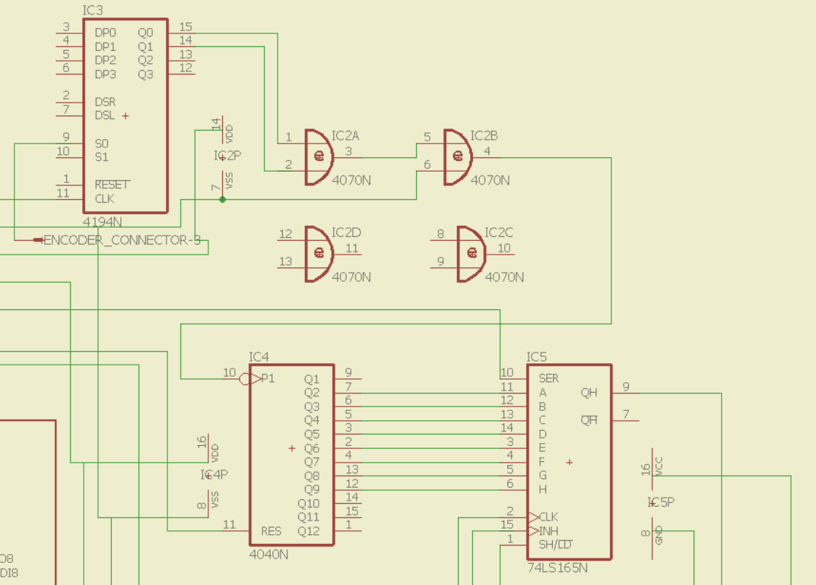
Encoder Interface

Slide 18
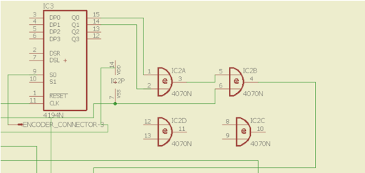
Encoder Edge Detector

Slide 19
Display System

Slide 20
Reflection
We were able to prove that our system can generate enough power from pedaling and that our system is efficient
We were able to get our display system to work, but because of the XBees failing unexpectedly, the display would not show the data that would be tracked by the encoder and the microcontroller.

Slide 21
Future Work
If we would redo the project, we would like to use an LCD to avoid the complexity that would come with wiring the fitness monitoring.
The following aspects of our project still needs work:
Bike Recharging System
Connection from Alternator to Power Outlet

Slide 22
Thank you for coming to our presentation!
Any questions?

Slide 23
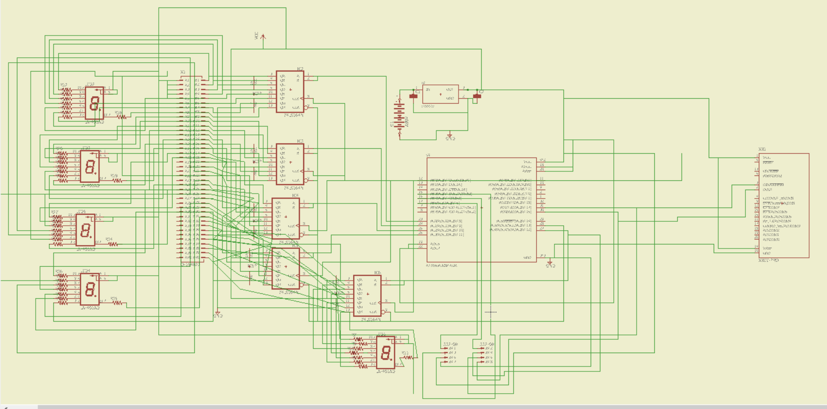
Appendix A - Display Schematic

Slide 24
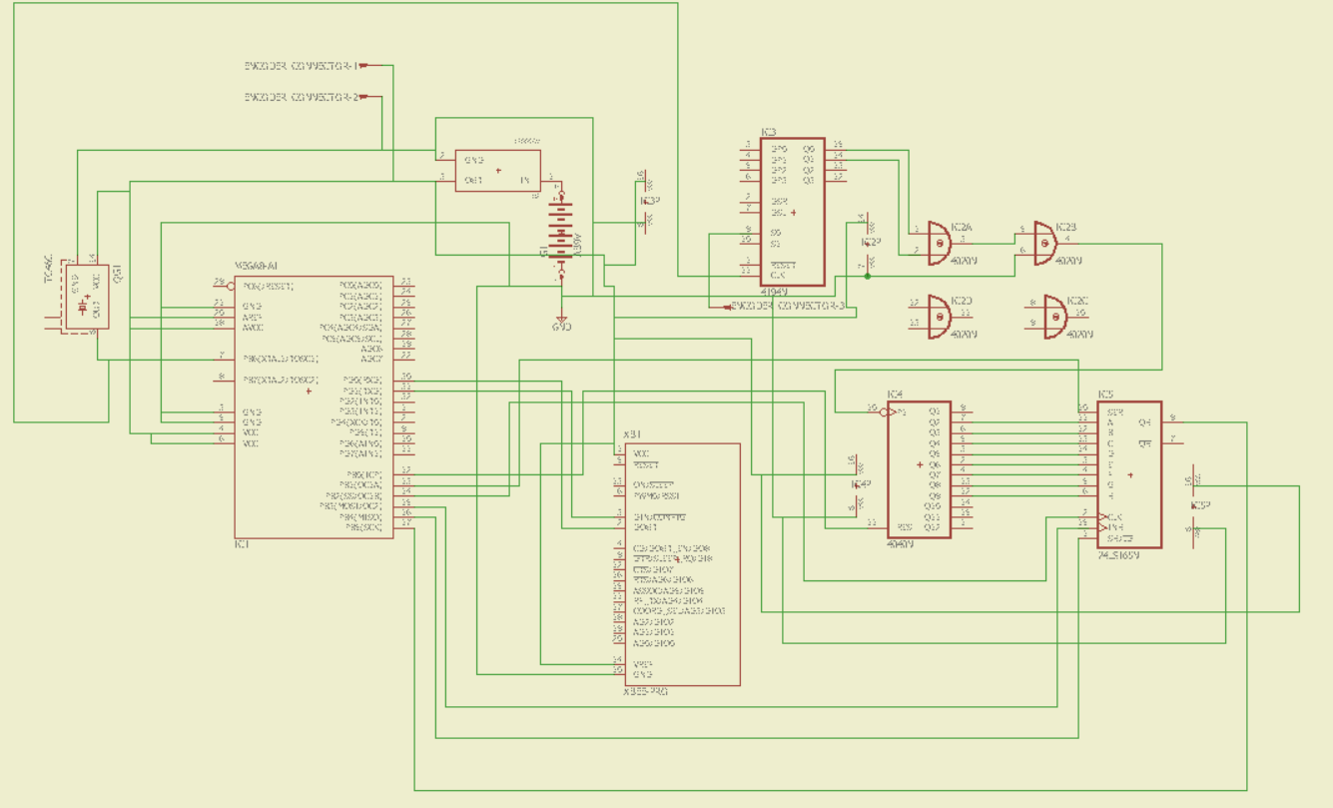
Appendix B - Fitness Monitoring Schematic

