Slide 1
MLC: Modular Light Control
Group 44: Ibrahim Odeh, Rohan Tikmany & Konrad Woo
ECE 445 Senior Design, April 29, 2019

Slide 2
Introduction
Method of light automation using Passive Infrared (PIR) and audio cues
Handles zonal lighting in a modular, affordable way
Notes:
Example of some ECEB rooms where you wave hands etc

Slide 3
Objectives
Aimed to eliminate issue of lights turning off when people still in the room
Make as modular as possible to eliminate blind spots
Allow grouping of sensors to switches using Wi-Fi connection

Slide 4
System Overview
Master Switch Central hub for management
Slave Switch Communicates with master to control lights
Sensor Module PIR and Mic to communicate with switch
Notes:
Lay out main parts of the system,
Master switch, Slave Switch and Sensor. One line for each at max

Slide 5
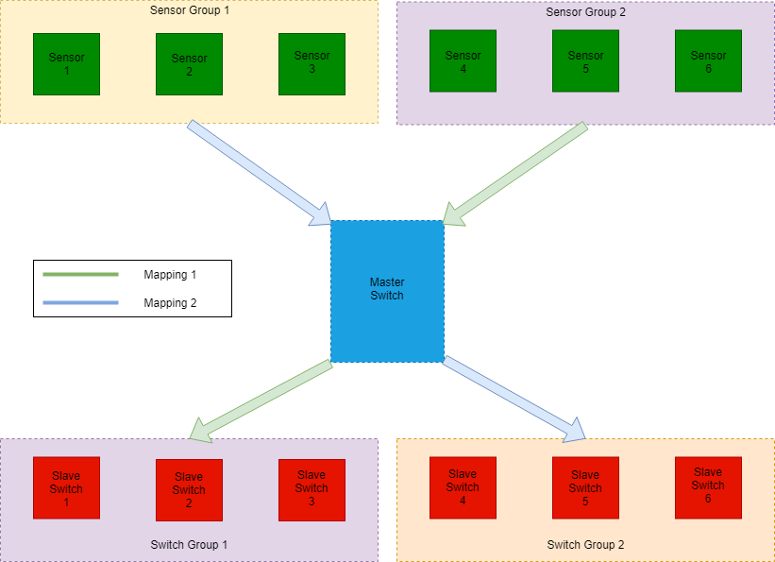
System Overview
Notes:
Add block diagram

Slide 6
Sensor Subsystem

Slide 7
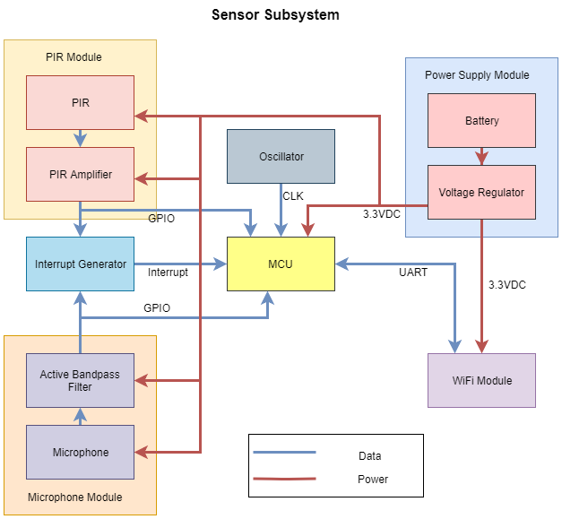
Notes:
Add block diagram

Slide 8
Sensor Subsystem
PIR and audio excitation
Sensor outputs filtered and amplified
Filtered + amplified outputs sent to interrupt generator
A thresholded interrupt is sent to ATMega328P
Notes:
Lay out main parts of the system,
namely sensors and microphone and just give a line into for each with an image each

Slide 9
Sensor Subsystem: PIR
PIR output filtered, amplified, and compared with Vdd
Notes:
Go into a specific part of the system ex. PIR and describe a few lines of it
Add 1-2 slides for each part. I (Rohan) will add the control and wifi part to the system

Slide 10
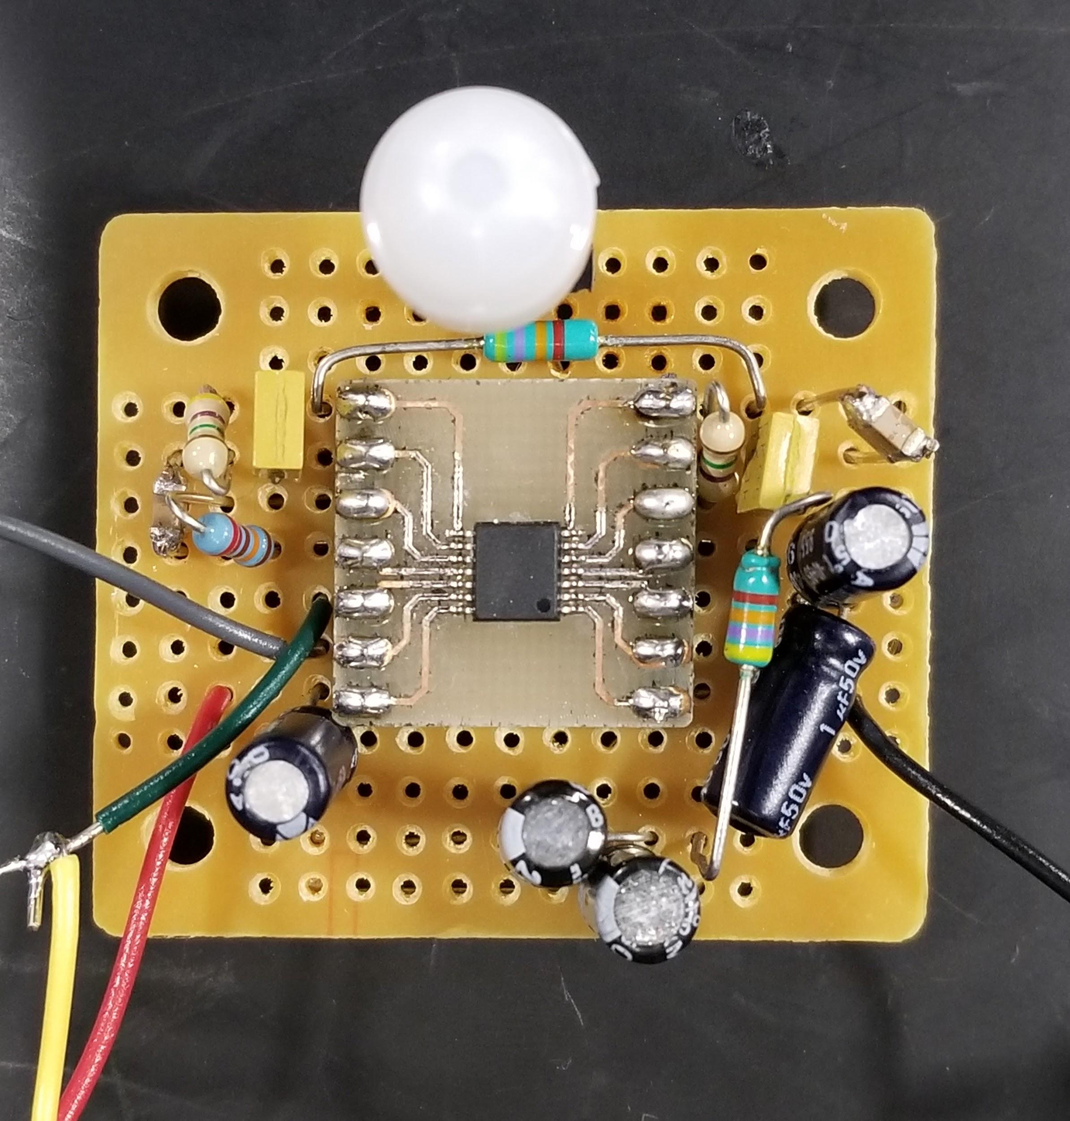
Sensor Subsystem: PIR Filter
Notes:
Add flowchart for software

Slide 11
Sensor Subsystem: Mic
ICS-40180 mic detects up to 20kHz [1]
Output RMS of 0.398V needs to be amplified to 3.3V pk-pk
Needs to be bandpassed to human vocal range
Failed amplification with LM741 op-amp and varied gains!
Notes:
Tried different gains ranging from 3 to

Slide 12
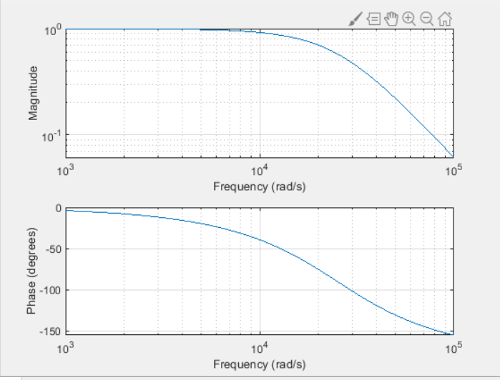
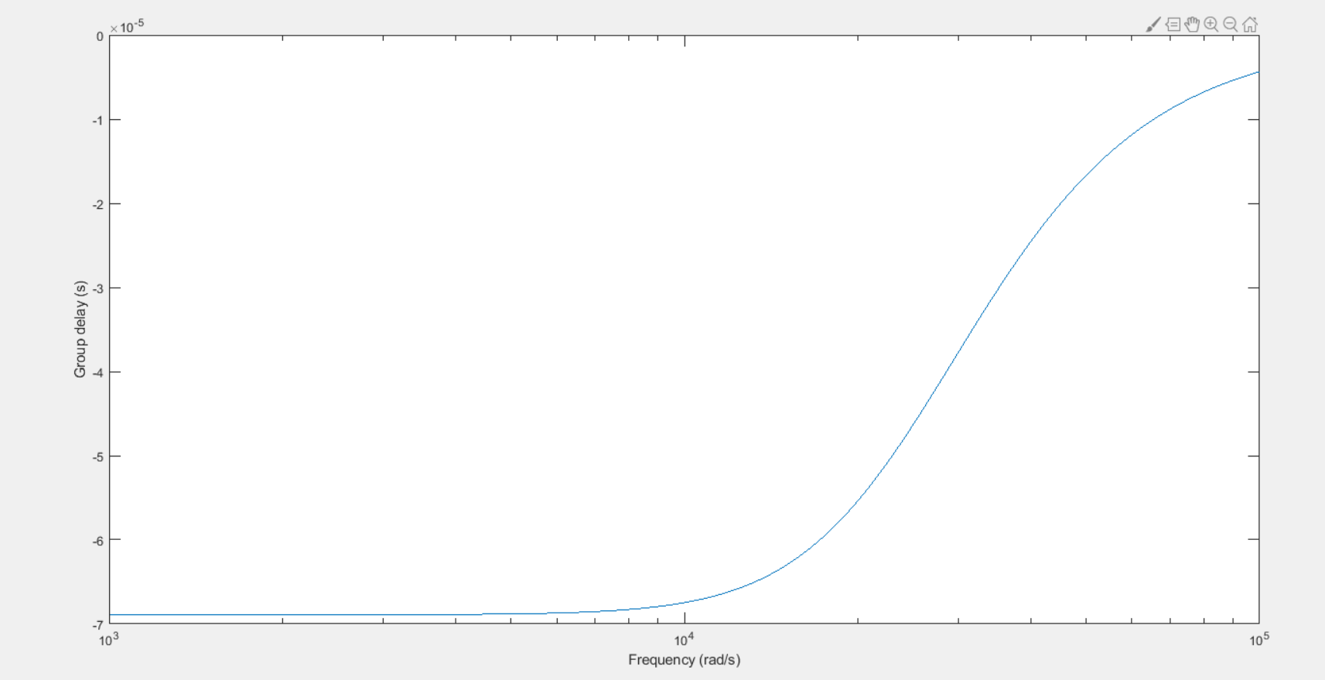
Bessel Filter
Filter response
Filter group delay

Slide 13
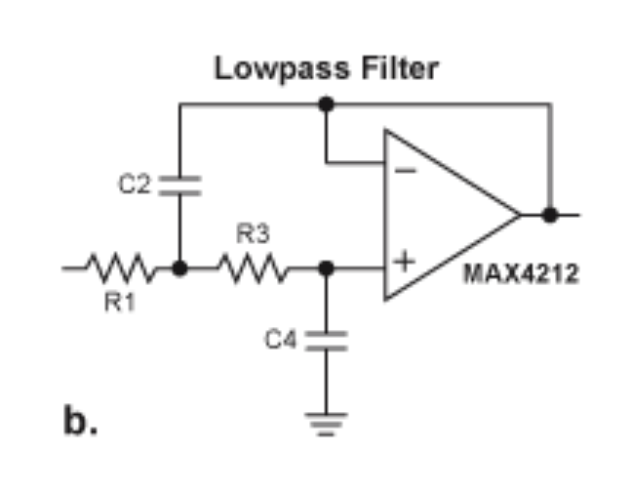
Bessel Filter
Filter Transfer Function [2]
Filter Topology [2]

Slide 14
Sensor Subsystem: Control Software
ATMega328P
Receive interrupts from both sensor modules
Send commands to ESP8266 to communicate with master switch module
ESP8266
Communicate with other parts of the system
Receive commands from the ATMega328
Notes:
See actual chat

Slide 15
Switch Subsystem

Slide 16
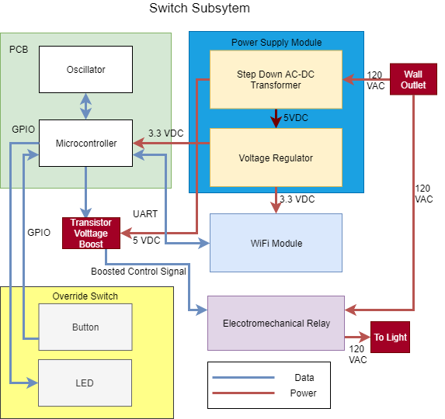
Notes:
Switch Subsystem BD

Slide 17
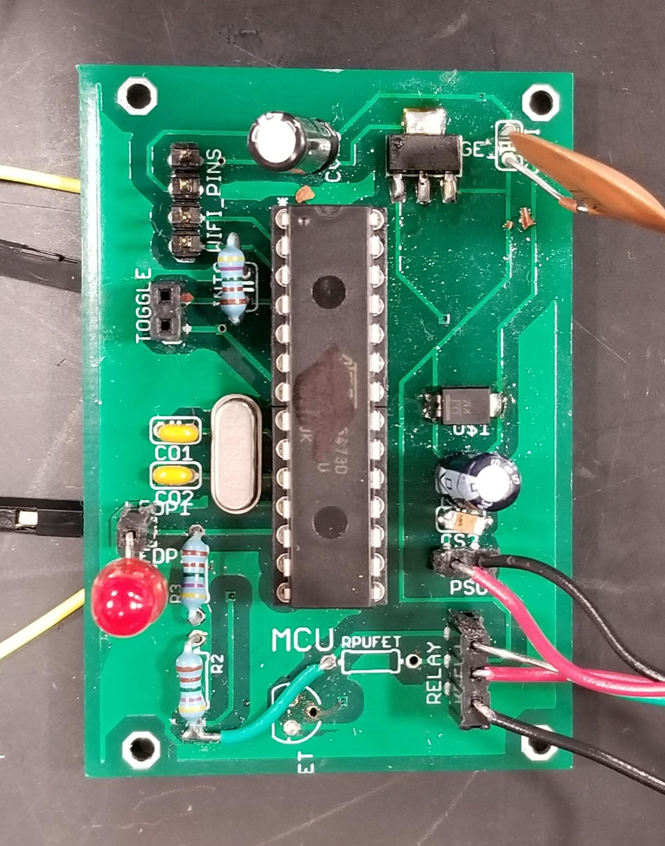
Switch Subsystem
Replace existing wall-mounts
All switch layouts identical!
Difference is in the software
Master is main “hub”
Notes:
Add overview of the split between master and slave and explain basic difference in between the two

Slide 18
Switch Subsystem
Power:
ATMega and ESP require 3.3VDC
Step-down Transformer (PSK-S5B): 5.02 ± .5% VDC
Voltage Regulator (LD1117S33): 3.3 ± .2% VDC
Notes:
SDT 84-264VDC
LD1113CTR

Slide 19
Switch Subsystem
ATMega outputs 3.3V to voltage-boosting transistor
5V boosted control signal to electromechanical relay (EMR)
Lights connected to normally open (NO)
In practice, voltage booster not needed!
Notes:
Choose one part of the hardware and elaborate on it, ideally add pictures

Slide 20
Switch Subsystem: Control Software for Slave
ATMega328P
Receive interrupts from the ESP8266 and override button
Send control signal to Relay to control lights
ESP8266
Receive messages from master switch
Monitor current state of lights
Raise interrupts on ATMega
Notes:
See actual chat

Slide 21
Switch Subsystem: Control Software for Master
ATMega328P
Receive interrupts from both sensor modules
Send commands to ESP8266 to communicate with master switch module
ESP8266
Send commands to other parts of the system
Monitor current state of lights
Raise interrupts on ATMega
Interact with UI to change system mapping and policies
Notes:
See actual chat

Slide 22
User Interaction
Communication through simple HTTP requests
Each subsystem has a unique ID to address it with
Interaction can be done through App (future development), a mobile phone or a personal computer/laptop

Slide 23
Ethics and Safety
Power
120VAC mains power handled with commercial step-down transformer to reduce risk
DC voltage regulator to act as secondary failsafe
Allows ATMega to run with lower power consumption
Microphone security
Microphone output used as pulse for interrupt
No audible speech transmitted, just a boolean
Notes:
Talk about Software security and about safety of the switches

Slide 24
Future Hardware Development
Functional audio + filter components
Audio scrambling aspect for potential voice detection
More power reduction
Additional sensing mechanisms
Proper enclosures and mounts for tidy wiring
Notes:
Stuff like hardware enclosures, more robust sensors maybe, testing on battery life etc

Slide 25
Future Software Development
Add robust UI for easy control
Change from HTTP to HTTPS for better security
Allow for more customization such as timeouts
Streamline and optimize software to increase efficiency
Notes:
Added UI, benefit of individual self control, Mobile APP, Change to better security protocols

Slide 26
Credits
Amr Martini
Professor Arne Fliflet
All the Professors for ECE445
All the TA’s for ECE445
ECE Supply Center and Services Shop

Slide 27
References
[1] Invensense, “ICS-40180 Datasheet”, 2015, [Online]. Available: https://www.invensense.com/wp-content/uploads/2015/02/DS-000021-v1.22.pdf
[2] Maxim Integrated, “Analog Filter Design Demystified”, 2003, [Online]. Available: https://www.maximintegrated.com/en/app-notes/index.mvp/id/1795

Slide 28
THANK YOU

