Slide 1
Smartphone Hemocytometer
Rui Pu
Shixin Wu (Simon)
Fengmao Zheng (Steven)
Professor Brian T. Cunningham

Slide 2
1 Background & Intro
2 Objectives
3 Design
4 Conclusion
Agenda

Slide 3
1 Background & Intro
2 Objectives
3 Design
4 Conclusion
Agenda

Slide 4
Background & Intro
Diagnosis
Leukopenia: Low White Blood Cell Count
Liver diseases
Autoimmune disorders
Leukocytosis: High White Blood Cell Count
Asthma
Tissue Damage
Periodically Recheck
Adjust Treatment Plan
Notes:
White blood cell counting and differentiating is extremely valuable as it provides doctors with key information for diagnosing many different diseases.
white blood cell count is not only a critical measurement in diagnosis phase, it’s also quite important as the treatment progresses, in most times doctors constantly need the white blood cell count from the patient in order to monitor the side effect of the chemotherapy thus to adjust the treatment plan accordingly . This makes immediate feedback necessary….

Slide 5
Background & Intro
Hemocytometer with Lab Microscope:
Time-consuming,
Bulky
Expensive
Automated Hematology analyzer:
Complex
Expensive
Smartphone Hemocytometer:
Portable
Easy
Cost-Effective
Notes:
For over 100 years, doctors have been using hemocytometer which is a glassy slide with grid that’s used to determine the white blood cell ratio, and holding the hemocytometer under a lab microscope to manually differentiate and count the white blood cells. This traditional method has to be operated in a lab, and it’s bulky, expensive and time-consuming. There are also few products out in the market that allows doctors to perform white blood cell counts in an automated fashion, but all of them cost thousands of bulks and very complex to use. In this project, we built a smartp….

Slide 6
1 Background & Intro
2 Objectives
3 Design
4 Conclusion
Agenda

Slide 7
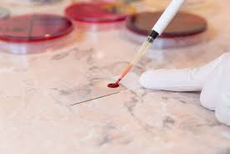
Objectives
Smartphone with Microscope Lens Clip-on capturing images of blood cells
Automatic platform linearly moving the blood sample slide
Mobile App controlling the slider motion and photo documentation
Notes:
In our project, we propose to design and build a portable smartphone hemocytometer that enables testing and documentation at the point of care. Using the smartphone's camera with a microscope clip on, the project creates an automatic platform for taking panoramic microscopic images of the blood sample. The project also provides a foundation for future development so that eventually doctors can run a machine learning identification algorithm on the smartphone hemocytometer to differentiate the five different types of white blood cells and complete said important item from blood test that would have taken hours.
Blood smear sample--
Our system captures images of the blood cells slide using smartphone with microscope len clip-on. Since the field of view of a single frame is enough for white blood cell count, the automatic platform linearly moves the blood sample slide in order to capture more regions of the blood sample slide. Our system also includes a mobile application that could control the slider movement and document the images that are captured by the phone camera.

Slide 8
1 Background & Intro
2 Objectives
3 Design
4 Conclusion
Agenda

Slide 9
1 Mechanical Subsystem
2 Optical Subsystem
3 Electrical Subsystem
4 Software Subsystem
Design

Slide 10
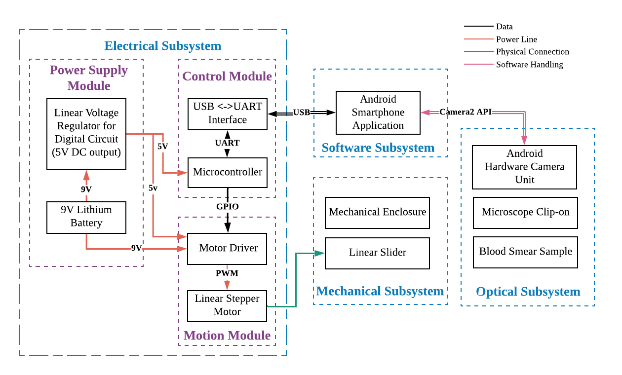
Notes:
On the electrical subsystem side, the smartphone hemocytometer consists of a power supply module that provides power for all devices in the circuit, a motion module of high precision linear motor to drive the blood smear on a linear slider, a microcontroller as the control module, and a communication module that serves as a bridge between the smartphone and the microcontroller. On the software side, an Android application will be devised to communicate with the microcontroller and to take photos.

Slide 11
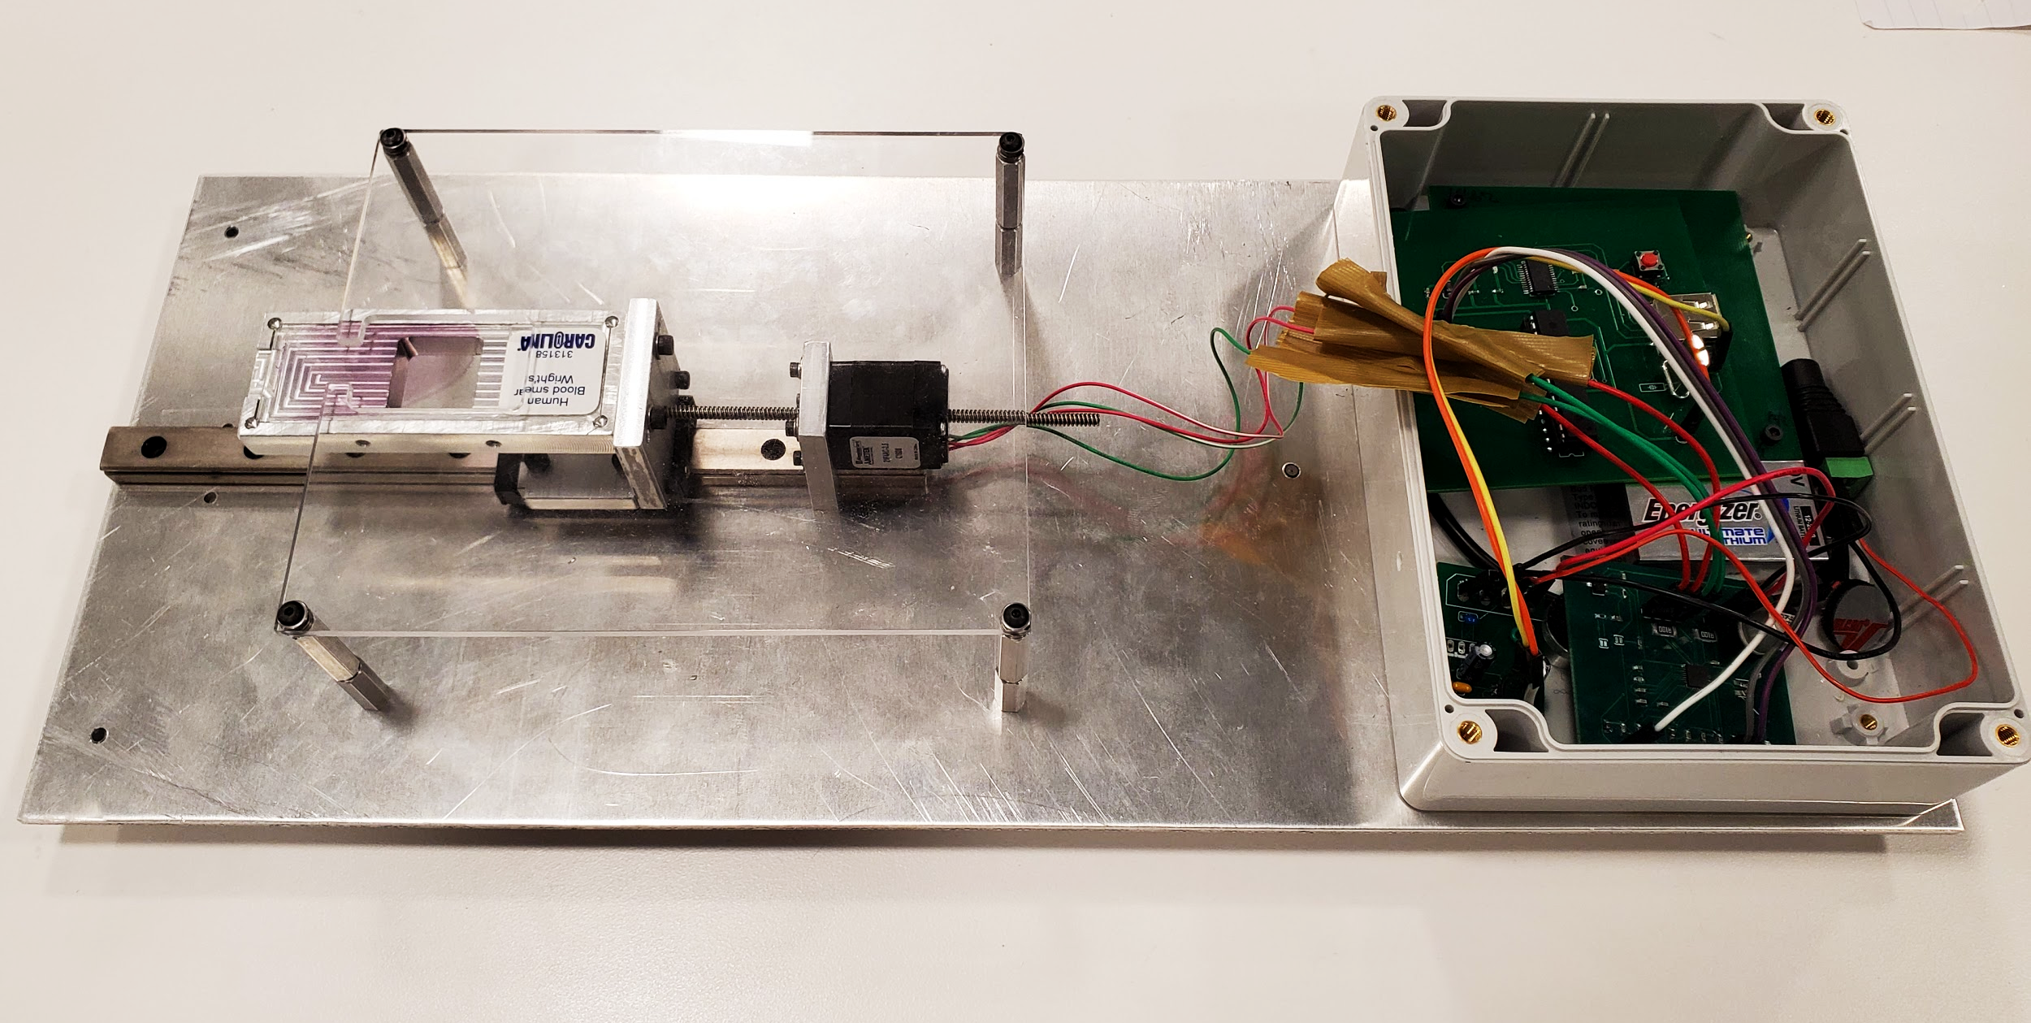
Mechanical Subsystem
Portability
Light-weight design
Stability
Ball Bearing Slider
Pocket for Blood Slide
Configurability
Standoff Spacer Screw
Notes:
Linear Slider
The external screw from the linear stepper actuator will push the slider to move the blood smear sample laterally.
Mechanical Enclosure
The mechanical enclosure is a 3D printed box. We
mount the linear slider and linear actuator on the bottom to avoid vibration and
shaking of the system. The smartphone is positioned on top of the enclosure
and there we leave a hole for the camera and flash light.
Lighting

Slide 12
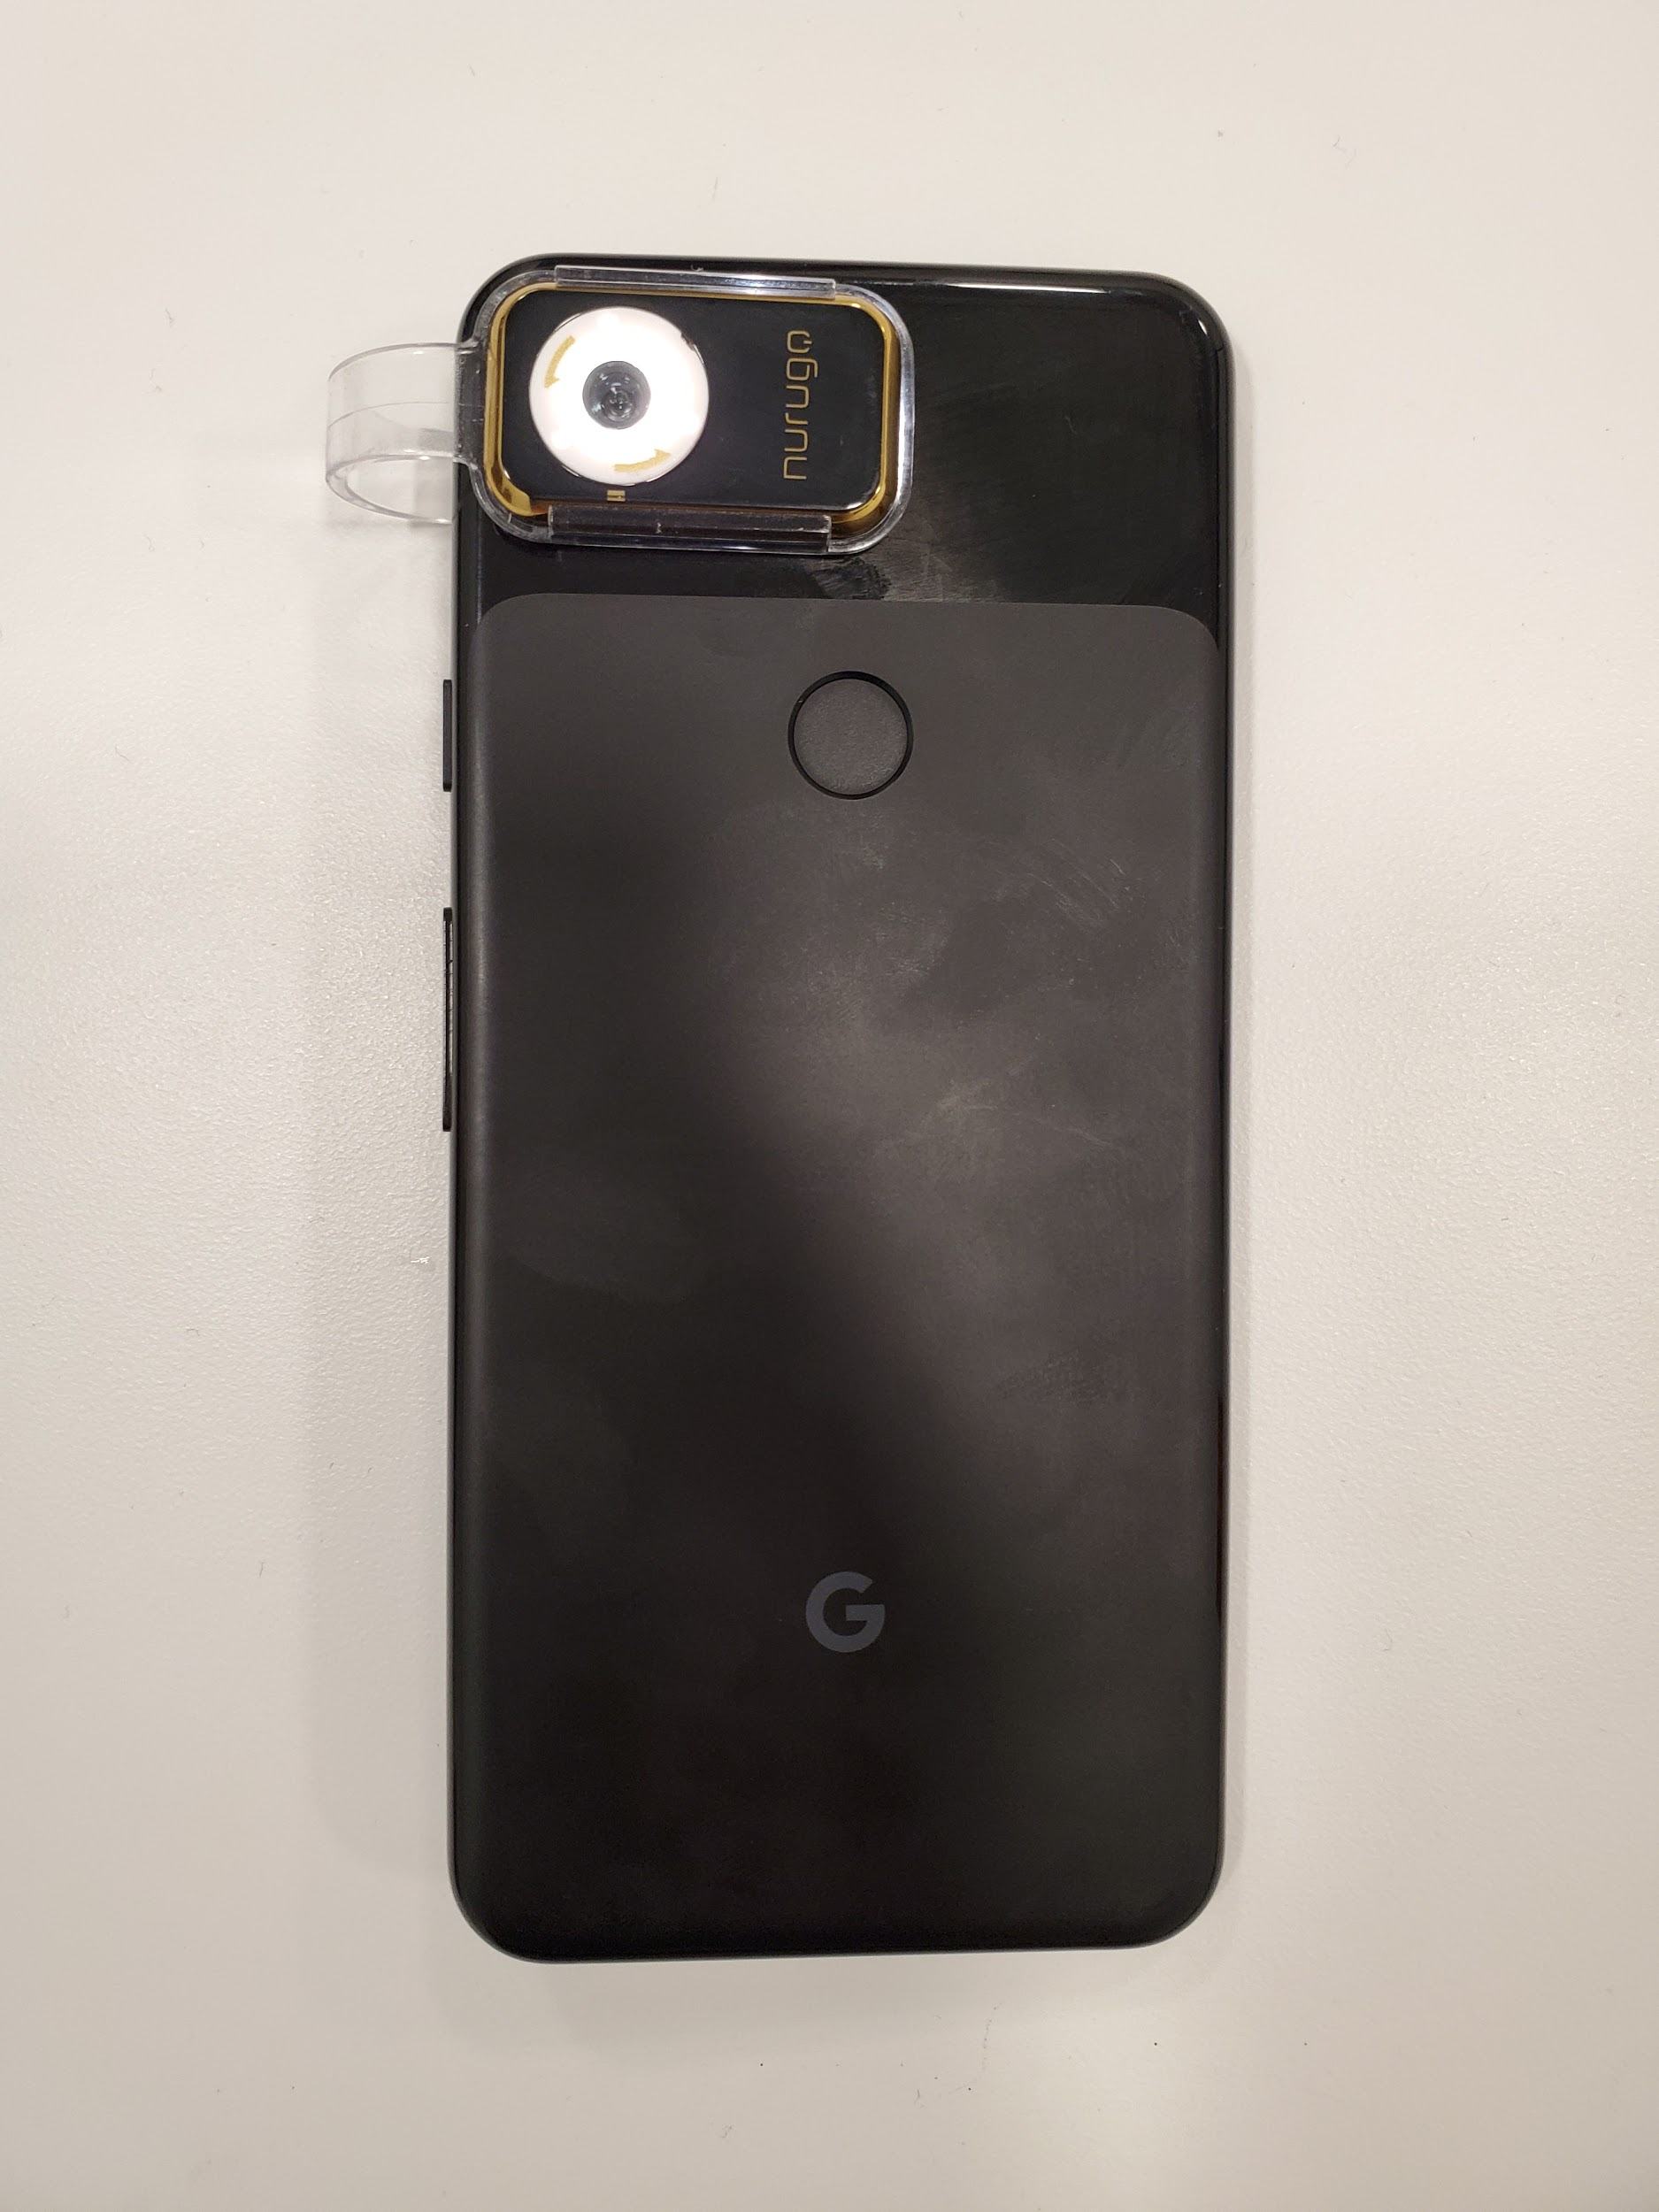
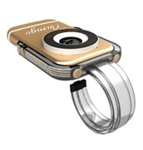
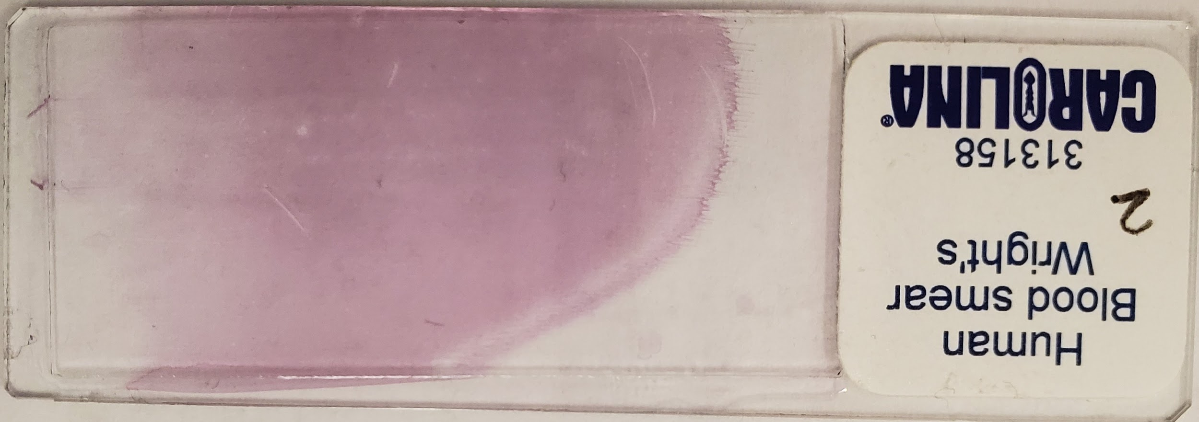
Optical Subsystem
Nurugo Smartphone Microscope Clip-on
40x-400x magnification
Illumination with camera flashlight
Compatible with all smartphones
Hardware Camera Unit
12.2MP rear facing camera
Blood Smear Sample
From Carolina Biological Supply
Wright’s Stain
Notes:
For the lens on Amazon, we could use it to adapt to more designs on iPhone, Android Phone and PCs because it’s USB connection(However, the motio)

Slide 14
1 Motion Module
2 Power Supply Module
3 Control Module
Electrical Subsystem

Slide 15
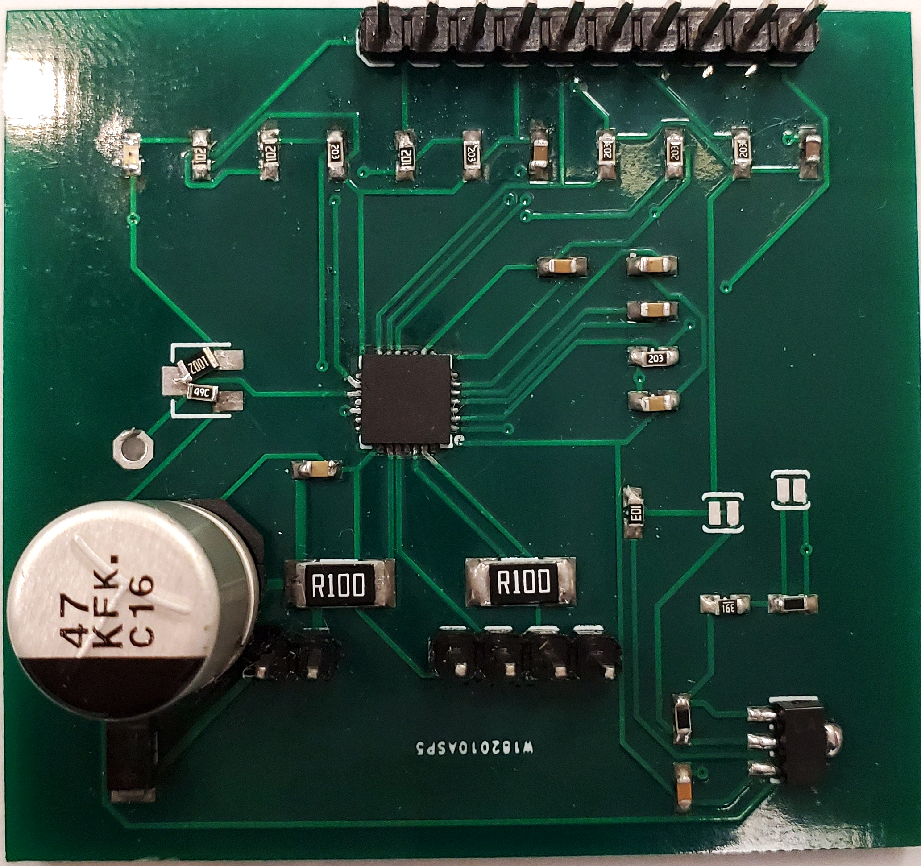
Motion Module
Linear actuator with 9.906um per step
Accuracy
A4988 stepper motor driver
Full step mode
Energy efficient
Motor Output Pins
4 pin bipolar output
Notes:
There is a linear actuator and a motor driver PCB in out motion module. We used a high precision linear actuator with 1.8° per phase which translates to 9.906 micron in linear motion
Delay
Accuracy
The core unit to the motor driver board is the A4988 motor driver chip which takes control signal from the microcontroller and outputs the step signal to drive the stepper motor. We are using full step mode as our motor gave us enough accuracy. This chip also directly connects the load power from the 9V battery to the motor for maximum energy efficiency.

Slide 16
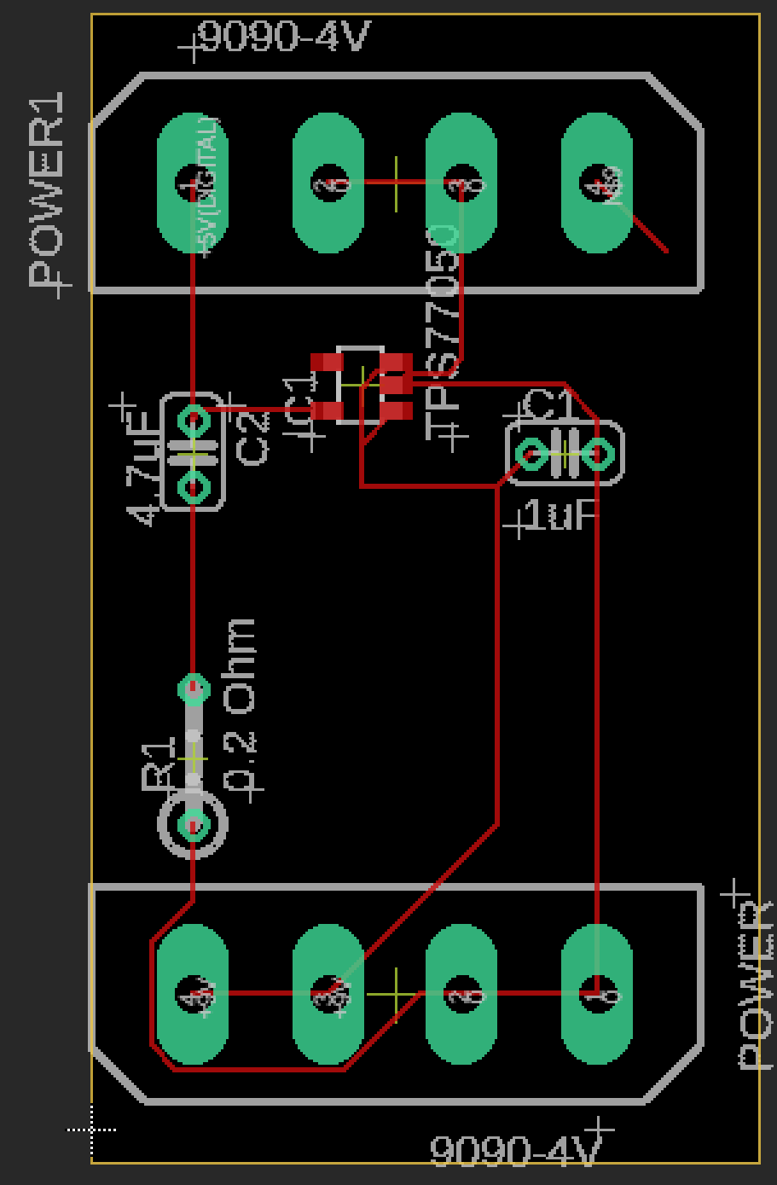
Power Supply Module
One linear regulator for Digital circuit
9V to 5V
Minimize power loss
Load power regulation
Load power directly connects to the motor
Notes:
The power supply module has been modified to only 1 regulator for digital power. This regulator regulates 9V to 5V.

Slide 17
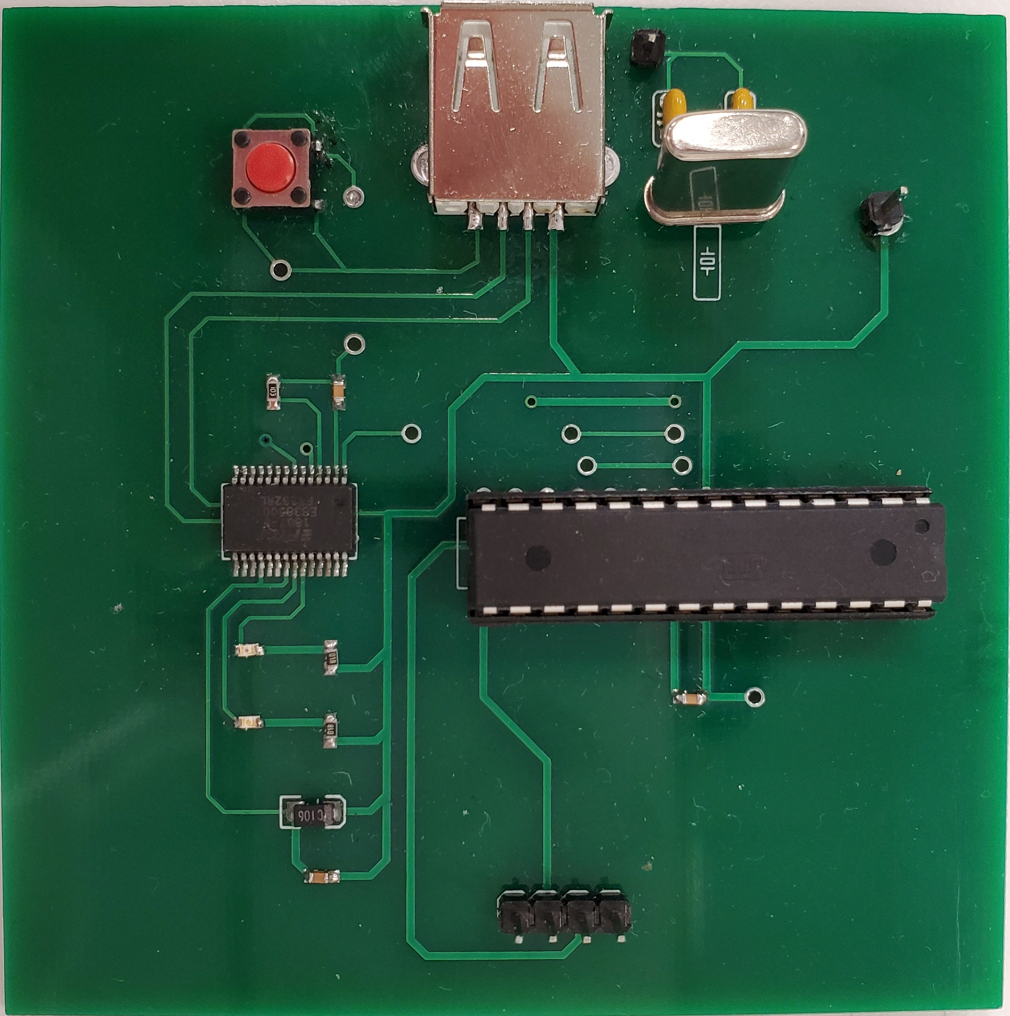
Control Module
Circuit
Microcontroller: ATmega328P
USB-A Connector
USB-UART IC: FT232R
Control Signals Output
Notes:
This is our control module where the micro-controller software embeds. First the USB connector will receive the request for taking image, then the message will be converted to UART by the USB-UART IC and send to microcontroller for the software to take action. The microcontroller then sends the en, dir and step signal via the GPIO output.

Slide 18
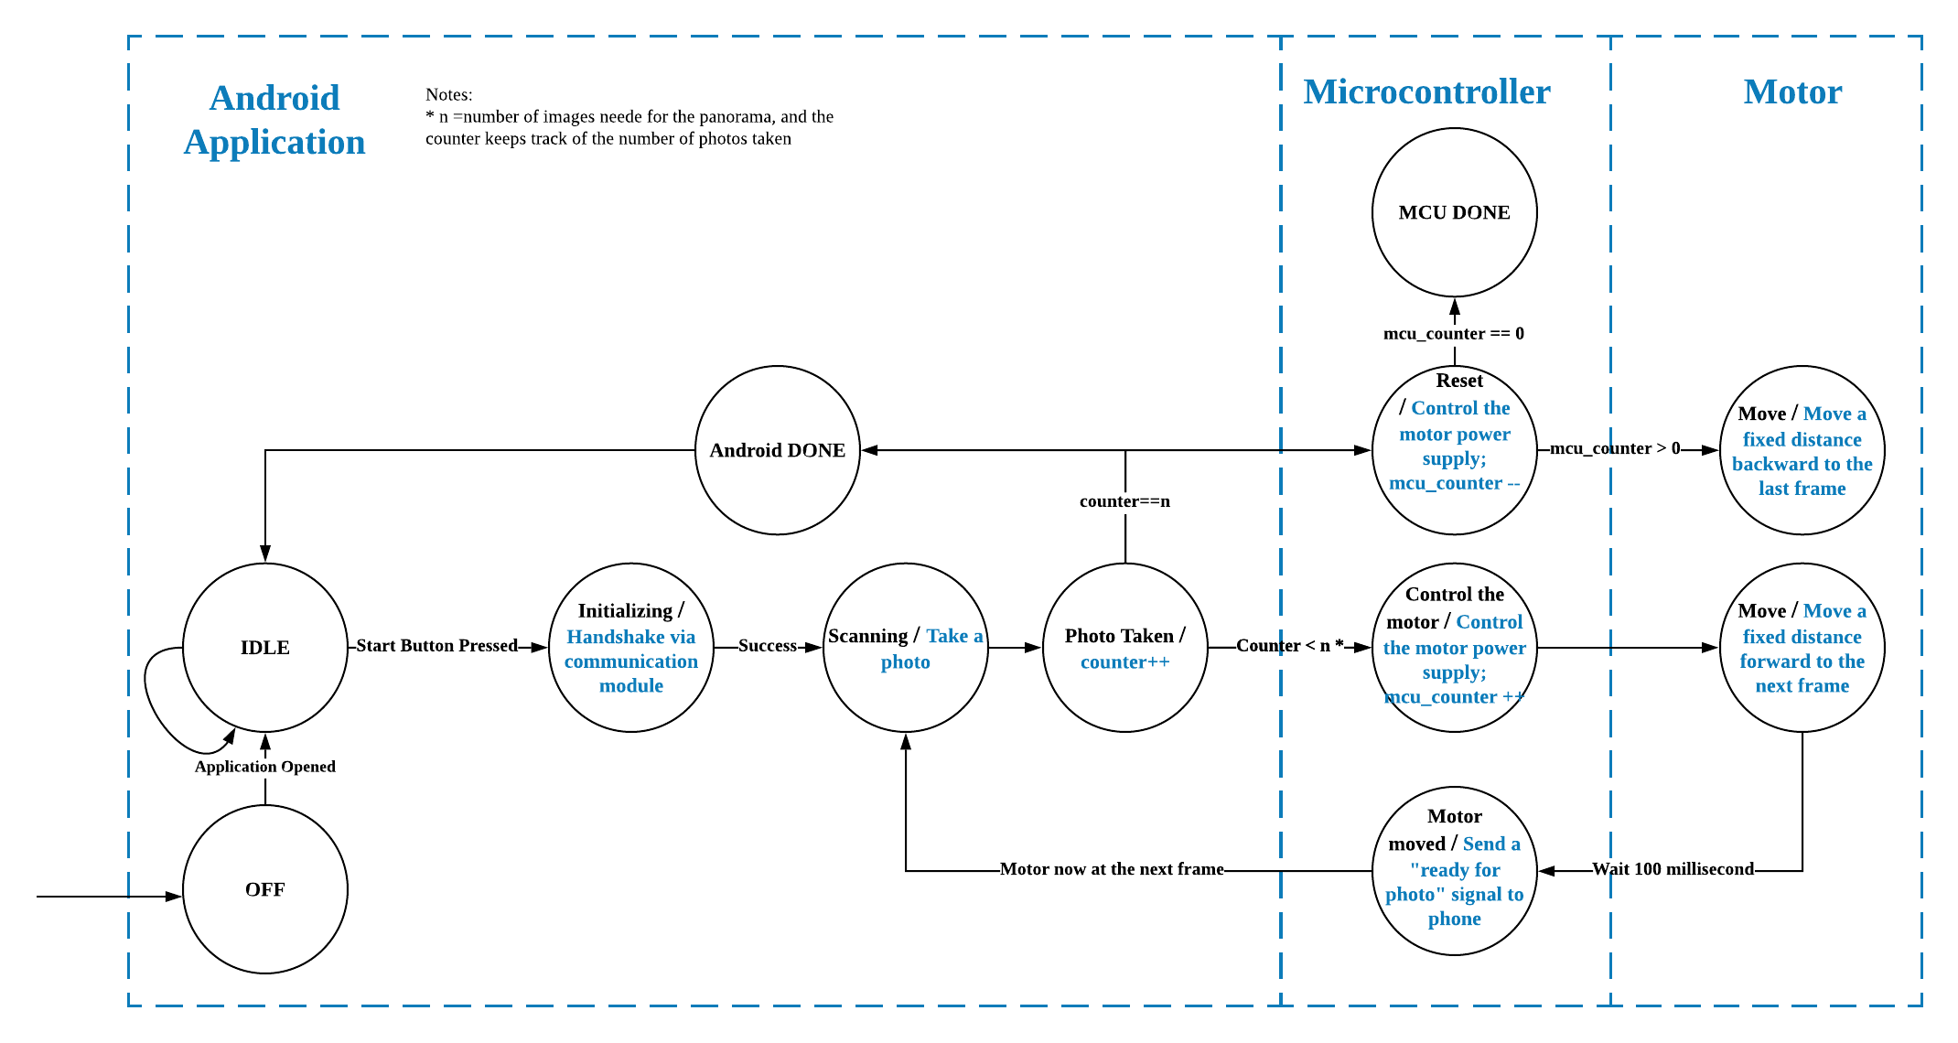
Software Subsystem
Notes:
Camera Unit
Zoom scrollbar
Flash light
Autofocus
Communication Unit
USB connection

Slide 19
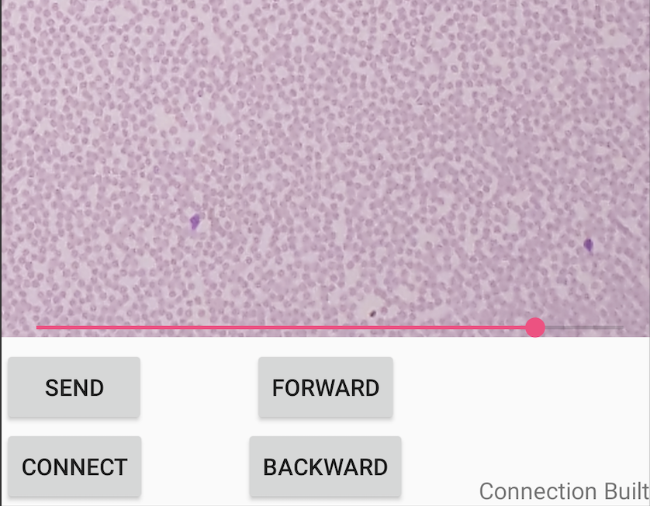
Android Application
Scrollbar: Slide to zoom in and out
Connect: Initialize serial connection with MCU
Send: Begin the Scanning Process
Forward: Move the motor forward 10 steps
Backward: Move the motor backward 10 steps
Status: Serial connection status

Slide 20
Image Stitching
Sharpening Kernel
cv2.xfeatures2d.SIFT
cv2.findHomography
cv2.warpPerspective

Slide 21
Microcontroller Software
Operating Modes, Full Step
Operating Modes | Functions
FrameForward | Moving forward for one image frame (45 steps)
FrameBackward | Moving Backward for ten image frame (45*n steps)
MoveForward | Moving forward for 10 steps
MoveBackward | Moving backward for 10 steps

Slide 22
Function Verification
Software Subsystem
Image Field of View
Minimal FOV for correct white blood cell counting estimation: 5mm²
One Image Size (200x magnification): 0.8mm*1.1mm
Panoramic Image size (10 frames stitching): 4.85mm*1.1mm = 5.335mm²
Frame Overlap
Minimal overlap for image stitching: 30%
Overlap between two frames: (1- 0.45/0.8)*100% = 43.75%
Android App
Debugger via WiFi
Notes:
In order to make the motion module to be moving correctly, we tried to simulate step sequence with function generator and ended up having the motor rocking back and forth.
Echo
Drive a rule with our slider and manually calculated the steps
As per demoed, the system is working properly with all of them functioning

Slide 23
Function Verification
Optical Subsystem
Visual Quality Assessment: 100% Human Identification
Magnification: Nurugo App + Pixel counts
Electrical Subsystem
Control Module: USB-UART communication - Echo Test
Motion Module: Motor step size
Notes:
In order to make the motion module to be moving correctly, we tried to simulate step sequence with function generator and ended up having the motor rocking back and forth.
Echo
Drive a rule with our slider and manually calculated the steps
As per demoed, the system is working properly with all of them functioning

Slide 24
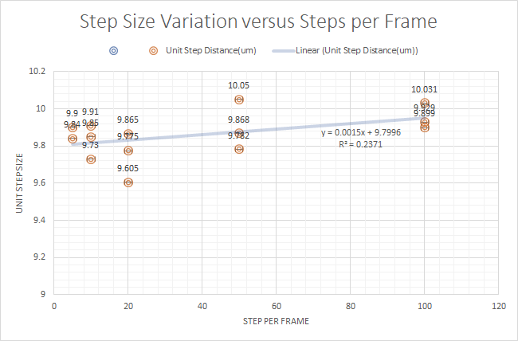
Result and Analysis
Notes:
For our experiment measuring the step size, we computed this plot of numbers of continuous step versus unit step size. so we take(10,20,50,100 steps at a time), versus the unit step distance. I put a ruler on the slider and used the smartphone microscope to trace how far it drove. Then I divided the displacement by the amount of steps per frame.
Expected 9.906 from datasheet
Uniform,
As we can tell the unit step distance is close to the expected unit step distance.

Slide 25
1 Background & Intro
2 Objectives
3 Design
4 Conclusion
Agenda

Slide 26
Conclusion
Functions
Electrical System for motion
Mobile App for photography
Features
Modularity
User Oriented
Availability
Notes:
Functions
Controlling the motion module
Camera App running
Features
Modularity(al functional modules that could be easily replaced, e.g. new motor, new lens, new phones, new blood? I mean other types of microscopy)
User Oriented (all automatic platform, user just need to insert the blood smear and tap buttons)
Availability (any Android cell phone is adaptable)

Slide 27
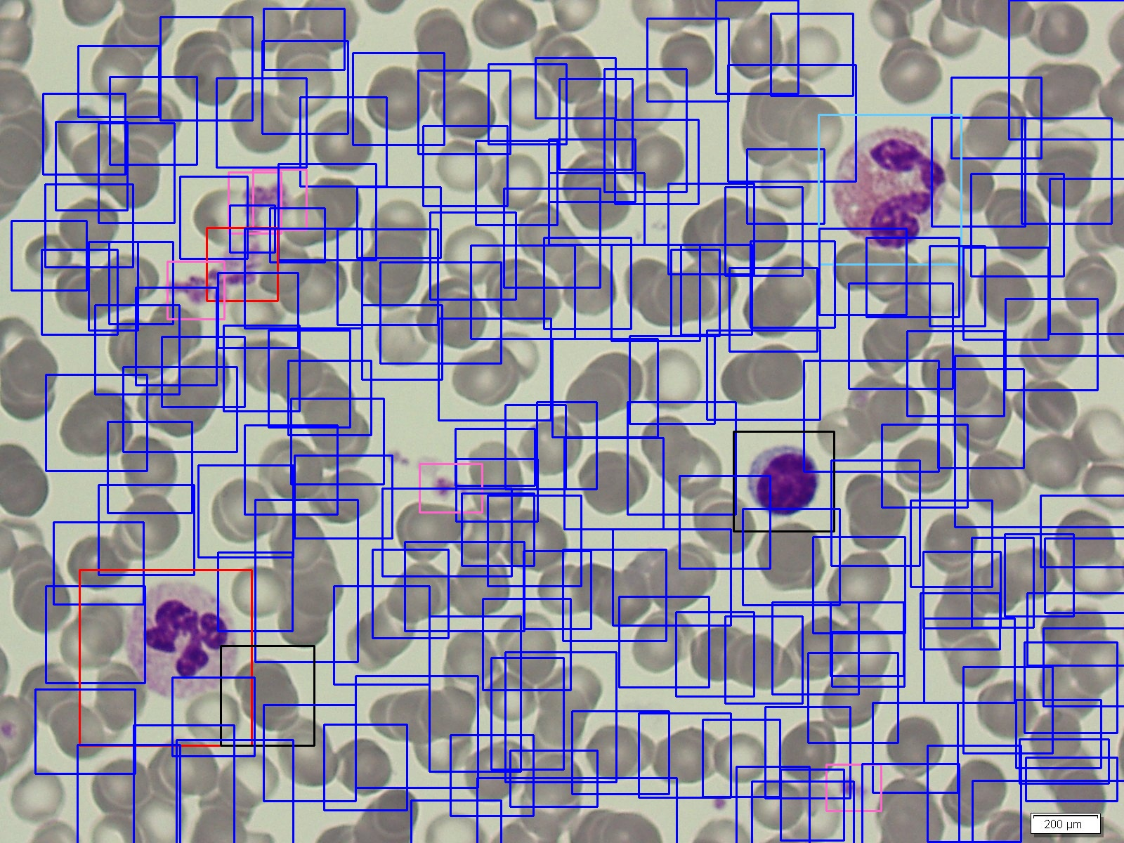
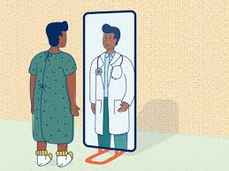
Future Development
AI for blood analysis
Object detection and classification
Cloud Functionality and user database
Patient Profile and Tracking
Patients self-checkup
Automatic blood smear preparation
Notes:
AI for blood analysis
Object detection and classification
Cloud Functionality and user database
Patient Profile and Tracking
Patients self-checkup
Automatic blood smear preparation
Scalable cost
Use microstepping or better imaging technique to use cheaper motors
Use self designed lens
Portability
Integrate PCB to one board
mechanical system material

Slide 28
Acknowledgements
Professor Brian T. Cunningham
Professor Jing Jiang
Amr Martini
ECE Machine Shop
DeepCyte Project Team
Shuyue Zhang, Ege Onal, John Godziszewski, Tiffany Yathaputanon, Aminah Bilal

Slide 29
Thank You

