Slide 1
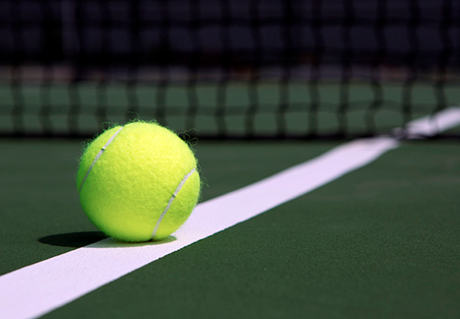
Portable Sport Boundary Sensors
Group #62: Neil Bhide, Andreya Dart, Modhura Kar
ECE 445
May 1, 2017

Slide 2
Introduction
A cheaper and portable system to call balls close to boundary lines on a tennis court
Can be used for recreational and high school events.
To take away the tension created by opponents miscalling shots during matches
Notes:
Modhura

Slide 3
High-Level Requirements
System must be able to run for 3 hours when the battery is fully charged
Sensors must way less than 2 lbs
Sensors must be able to accurately detect 90% of the shots correctly
Notes:
Andreya

Slide 4
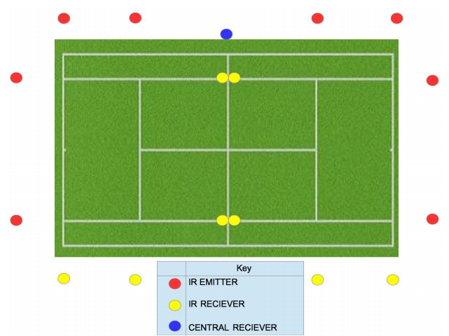
Design Overview
Three block diagrams: emitter, receiver, central receiver
Three modules: power, detection, display
Notes:
Neil

Slide 5
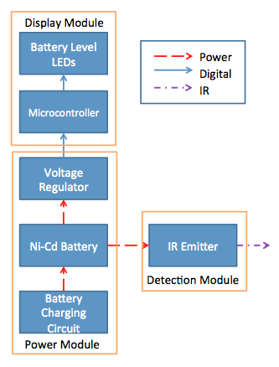
Design: Emitter Block
Notes:
Modhura

Slide 6
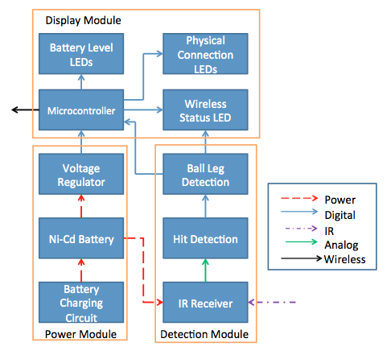
Design: Receiver Block
Notes:
Andreya

Slide 7
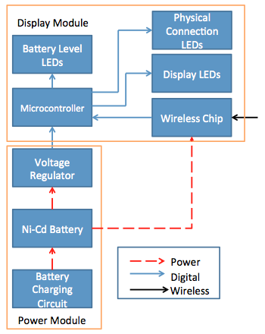
Design: Central Receiver Block
Notes:
Neil

Slide 8
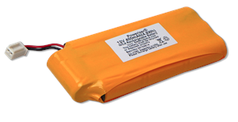
Power Module
Battery Charging Circuit
12 to +/-5 DC/DC Converter Circuit
12 to 3.3 DC/DC Converter Circuit
Notes:
Modhura

Slide 9
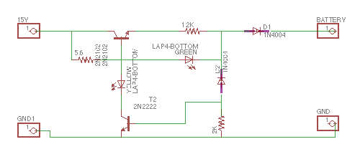
Battery Charging Circuit
Charges 12 V Ni-Cd battery to full capacity
Notes:
Modhura

Slide 10
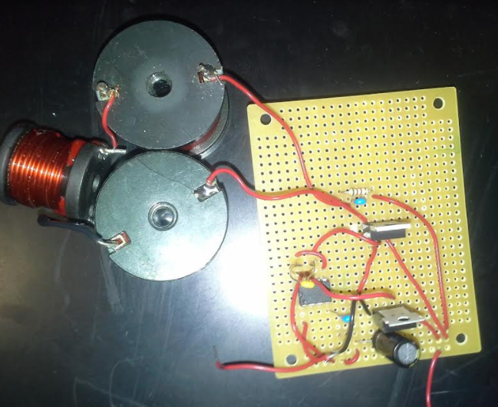
DC/DC Converters
12 V to +/- 5 V
Steps down battery voltage to microcontroller, and op-amps
Accepted an input of 10 V to 12 V and has a steady output of +/- 4.78 V
12 V to 3.3 V
Steps down battery voltage to power wireless chip
Accepted an input of 10 V to 12 V and had a steady output of 3.3 V
Notes:
Modhura

Slide 11
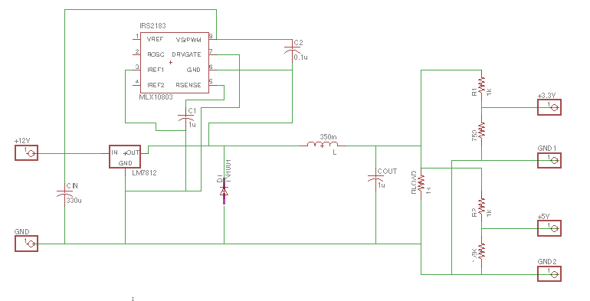
PWM

Slide 12
Detection Module
IR Emitter
IR Receiver
Hit Detection Circuit
Ball/Leg Detection Circuit
Notes:
Andreya

Slide 13
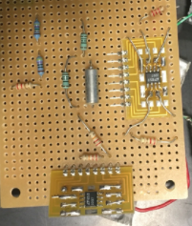
Ball Leg Detection
Component will determine if a ball or leg/foot has broken the IR beam
A “ball hit” as a beam break <=12 ms +/- 2.5% and a “leg hit” as a beam break >17 ms +/- 2.5%.
Resets (output voltage returns to zero after 12 ms +/- 5%
Notes:
Andreya

Slide 14
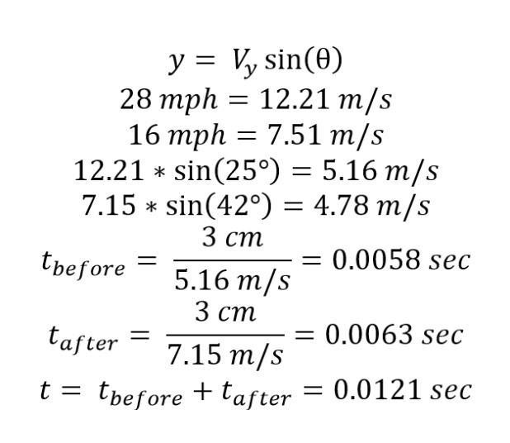
Calculations
Pallis, Jani Macri. The Tennis Server. “Follow the Bouncing Ball - Ball/Court Interaction - Part III”, 2016. [Online]. Available: http://www.tennisserver.com/set/set_02_11.html. [Accessed 19-Feb-2017].
Notes:
Modhura

Slide 15
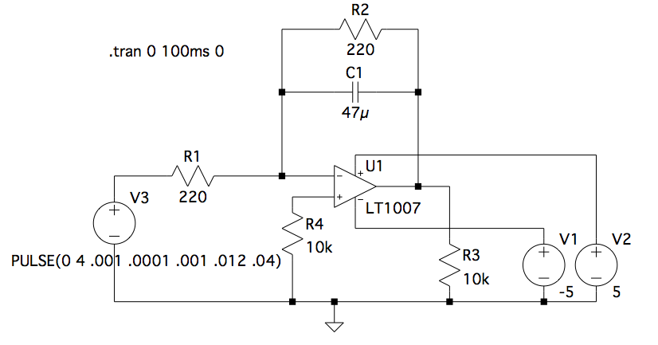
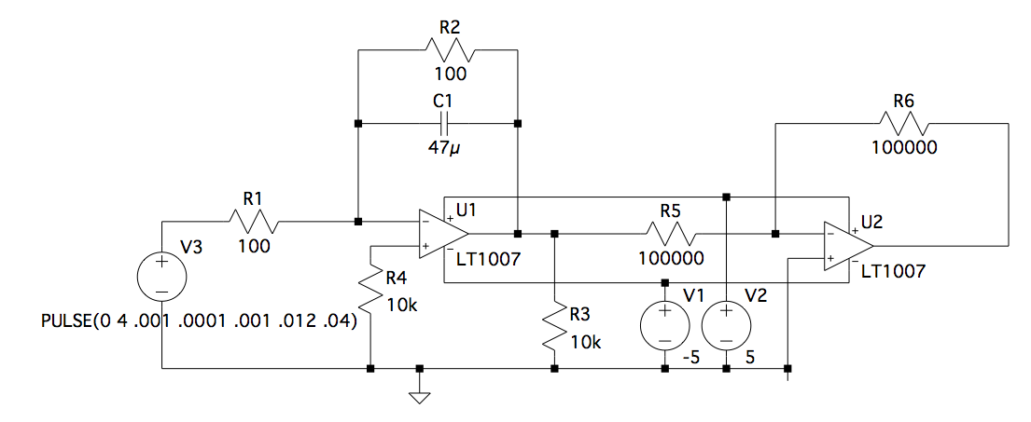
Designed Circuit
Actual Circuit
Notes:
Andreya

Slide 16
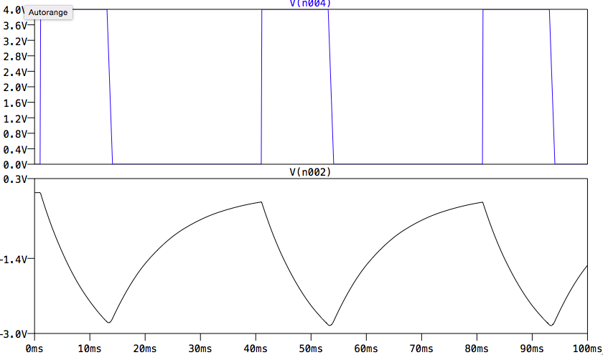
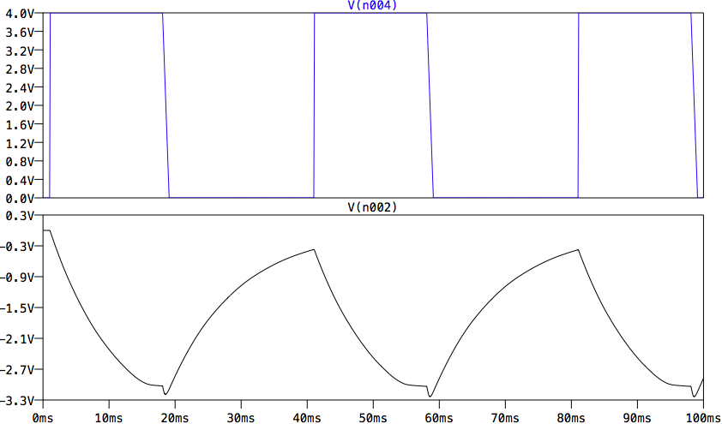
Input Voltage
Ball ‘Hit’ Simulation
Output Voltage
Input Voltage
Leg ‘Hit’ Simulation
Output Voltage
Time
Notes:
andreya

Slide 17
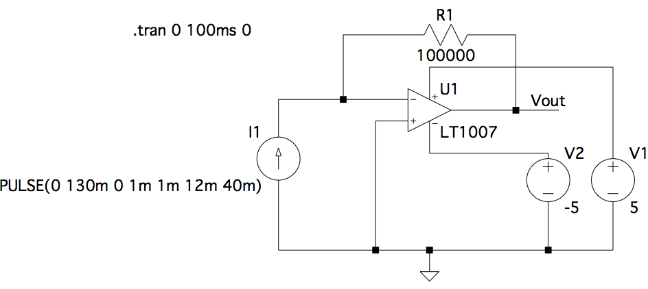
Hit Detection Circuit
Determine if the beam has been broken and pass data to ball/leg detection
Able to detect a boundary hit given different current magnitudes flowing from receiver.
0 mA to 75 mA +/- 5 mA is a boundary hit
75 mA to 130 mA +/- 5 mA is a cleared hit
Notes:
andreya

Slide 18
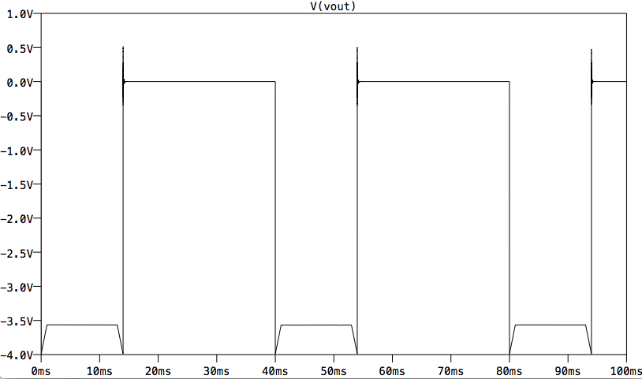
Output Voltage
Time
Notes:
andreya

Slide 19
Hit Detection Circuit
Depended on the sensor output, which was not ideal
Implemented in demo using the microcontroller
Notes:
andreya

Slide 20
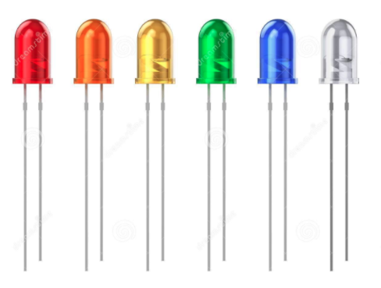
Display Module
Battery Level Indication
Wireless Indication
Detection Indication
Microcontroller
Wireless Chip
Notes:
neil

Slide 21
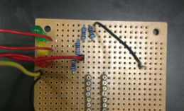
Battery Level Indication
LED Color | Operating Voltage
Green | 12 V to 11.52 V
Yellow | 11.51 V to 11.08 V
Red | 11.07 V to 10.66 V
Notes:
neil

Slide 22
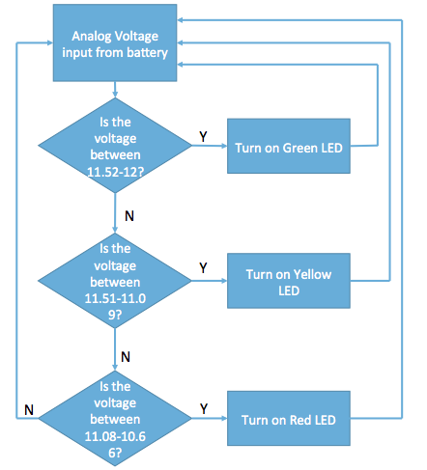
Notes:
neil

Slide 23
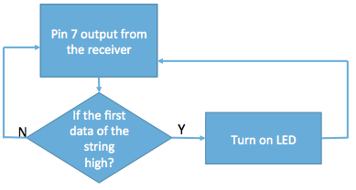
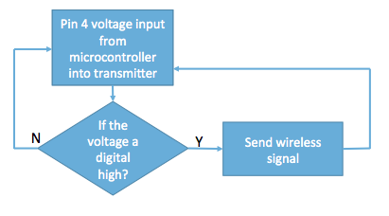
Wireless Indication
LEDs light up corresponding to correct wireless connection
Notes:
neil

Slide 24
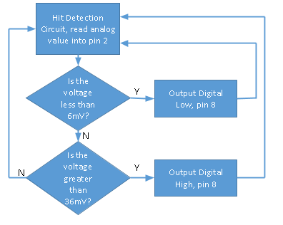
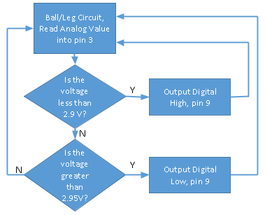
Detection Indication
Display LED light up within 5 s of a detected boundary hit.
Display LEDs must remain on for 5 s +/- 1 s
Display LEDs must emit 5 lumens ± 5% so it can be seen at a distance of 50 ft
Notes:
neil

Slide 25
Project Failed
Didn’t account for fluctuations from different components
Ball/leg detection circuit stopped working last minute
Wireless chip picked up too much outside interference
Voltage regulator in converters burned up last minute
Notes:
andreya

Slide 26
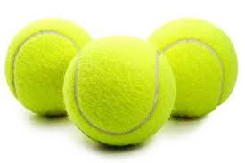
Future Work
Make system compatible for other sports
Use button or switch for necessary modifications that come with each sport
Find a better way to line up sensors on court
Notes:
modhura

Slide 27
Questions and Comments

