Slide 1
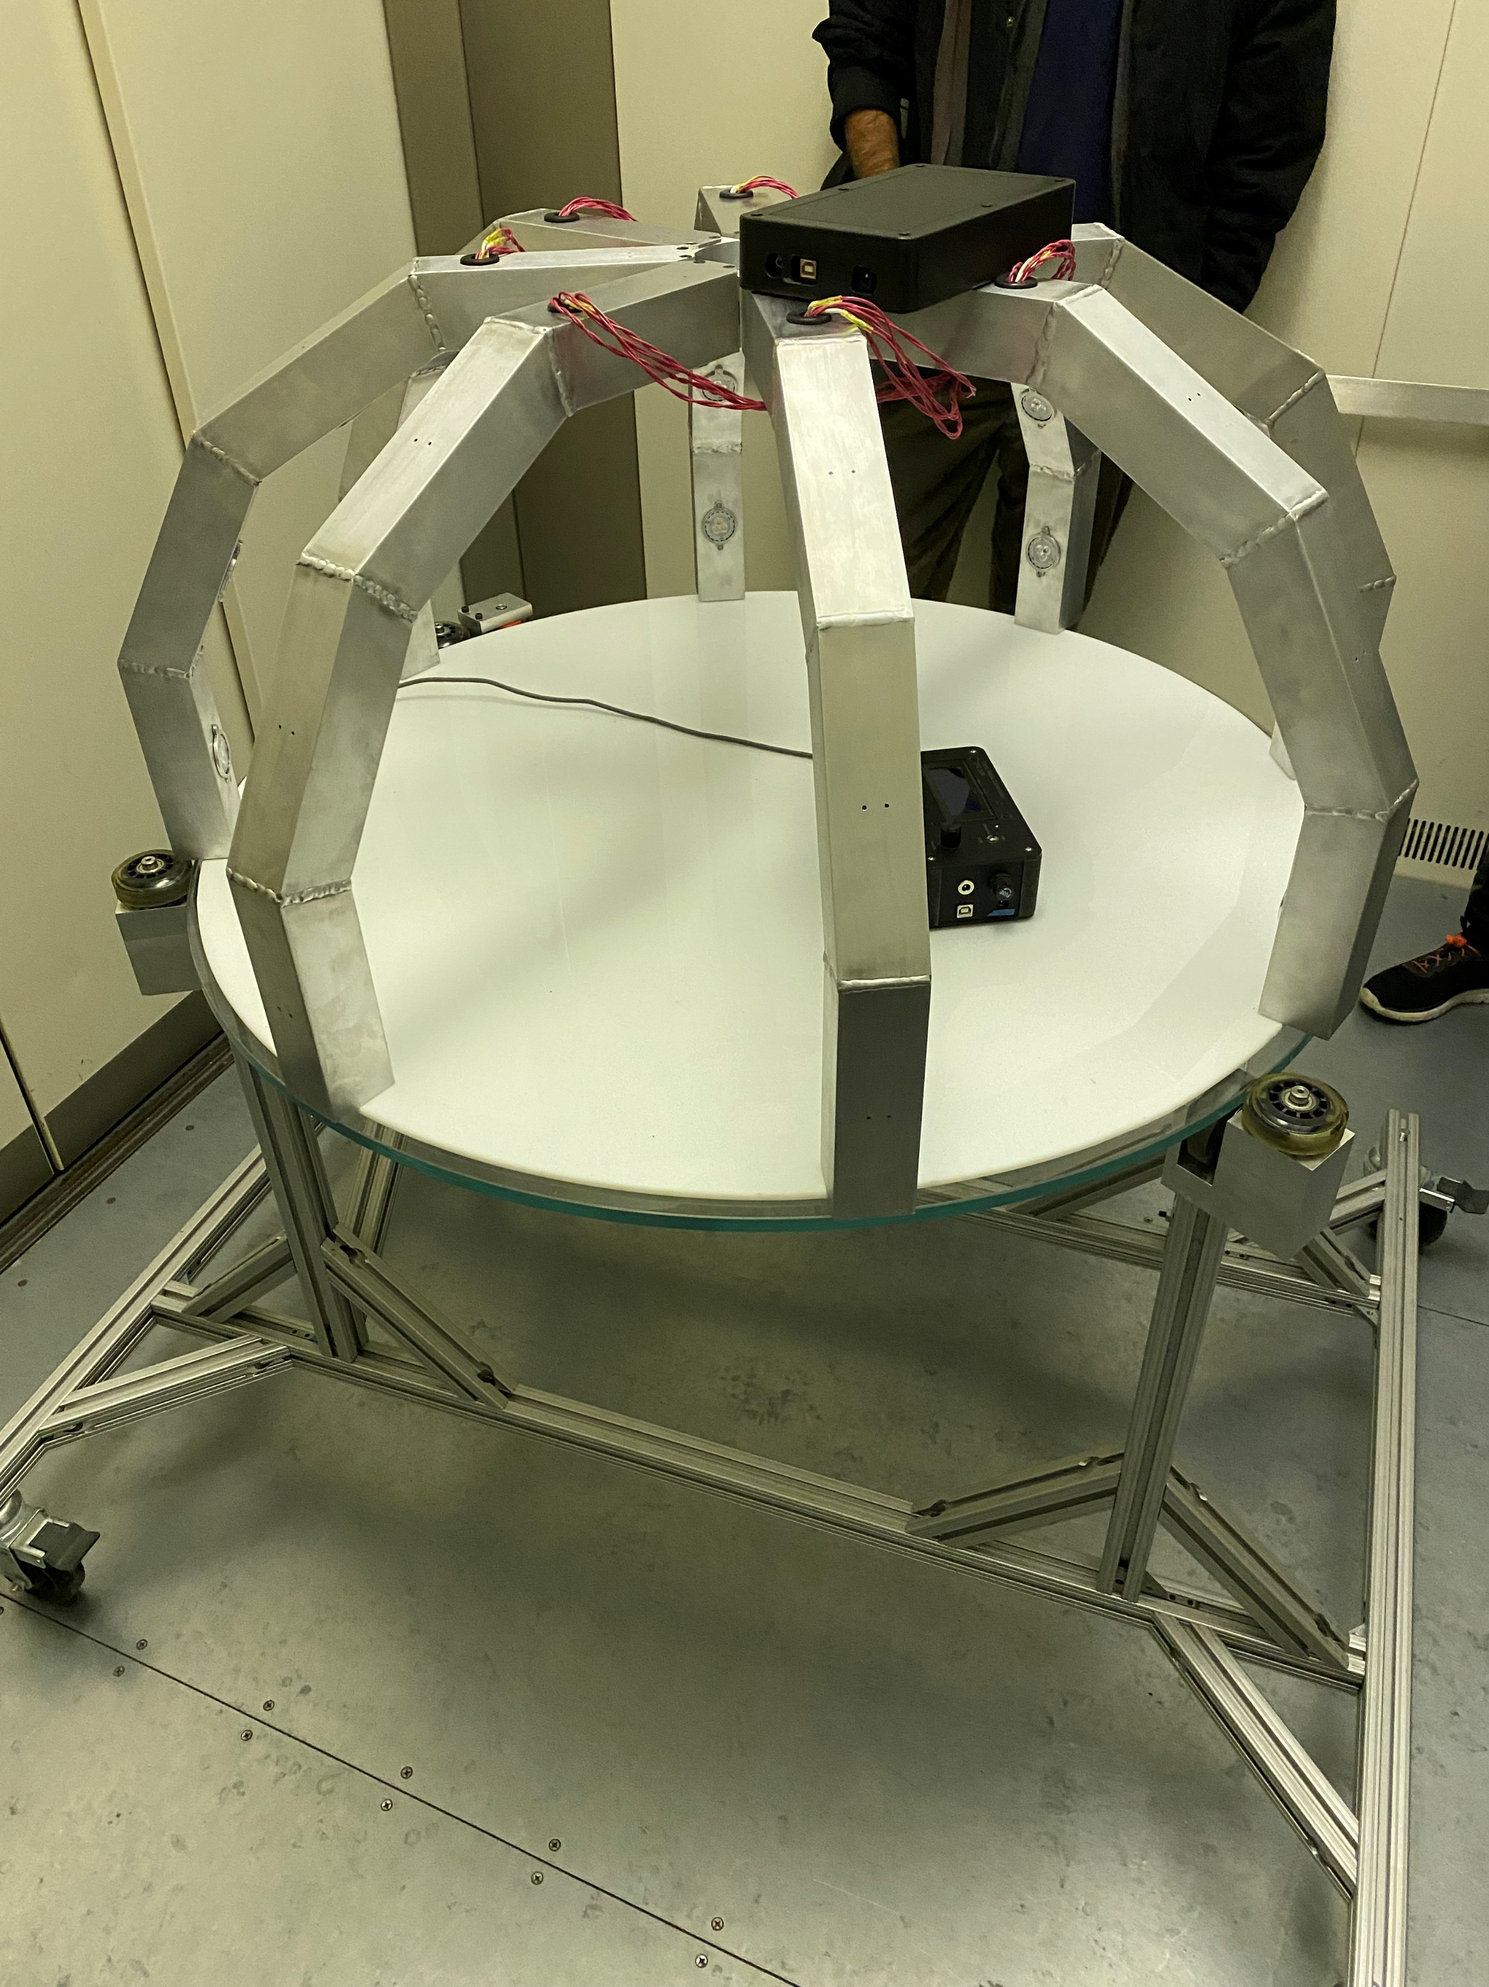
RTI Dome 2.0
Alexander Calmas
Hadrian Doromal
John Ducham
Team 11

Slide 2
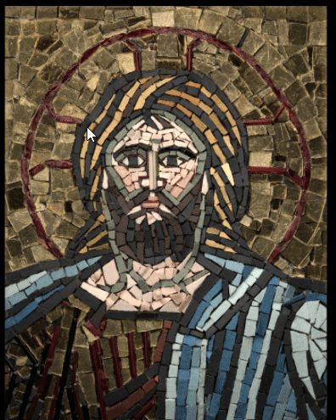
Reflectance Transformation Imaging
- Neil Armstrong

Slide 3
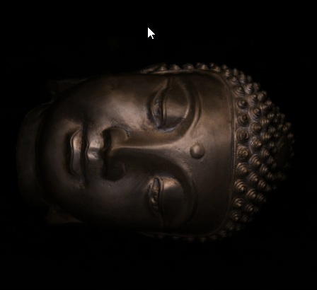
Reflectance Transformation Imaging
- Neil Armstrong

Slide 4
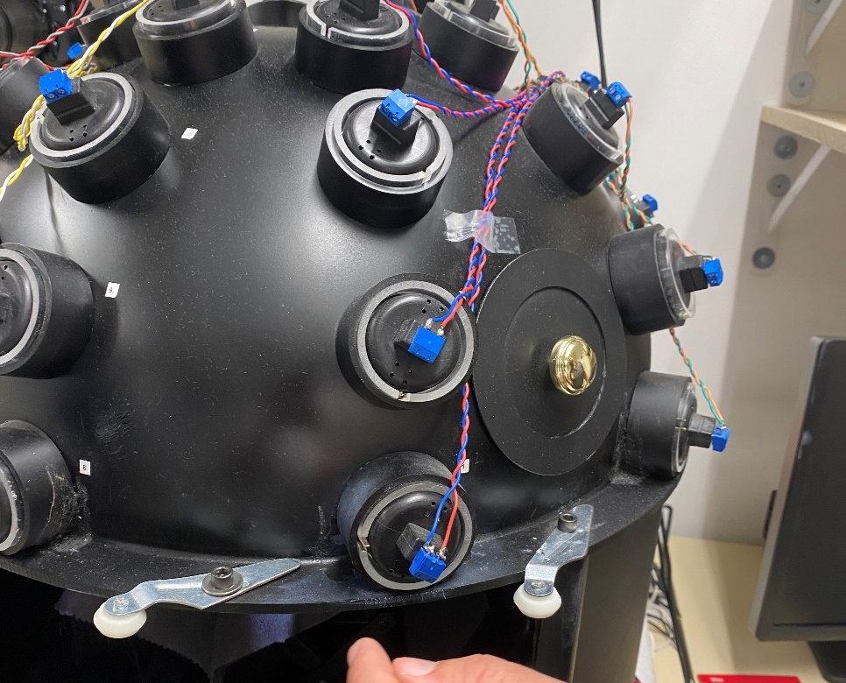
Problems with the dome
Fragile- connections fail frequently and LEDs are loose in the frame
Slow- automation software no longer works, and thirty-two images (minimum!) must be taken manually for each artifact
Heavy- a solid metal dome does not lend itself to easy transportation

Slide 5
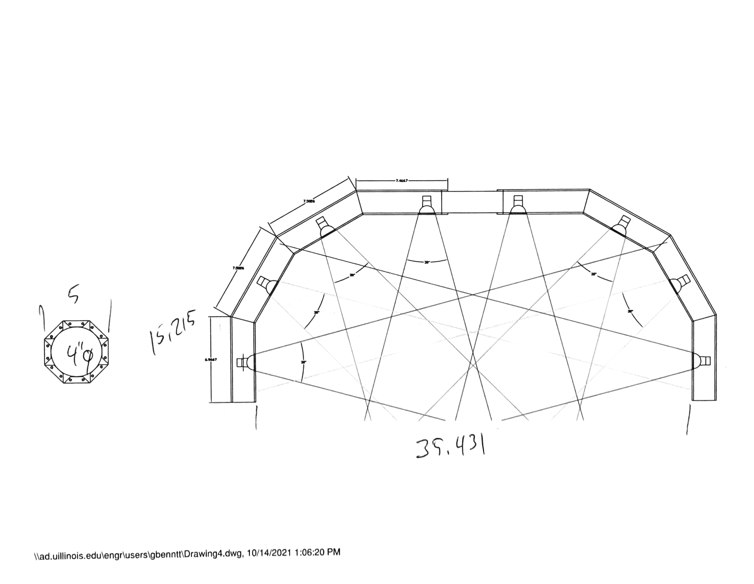
Our solution
Sturdy- mounted connections for each light within the frame
Fast- updated software interface that will perform the repetitive steps of RTI at the push of a button
Light- a hollow aluminum frame that saves weight while maintaining the stability required by the photography process

Slide 6
Lighting Module
Control Module
LED Bulbs
12V Power
5V Linear Regulator
LED Drivers
Microcontroller
Optocoupler Latch
12V
5V
Data
Workstation
Camera

Slide 7
PCB Design

Slide 8
LED Drivers
Powering and controlling 32 LED studio lights.

Slide 9
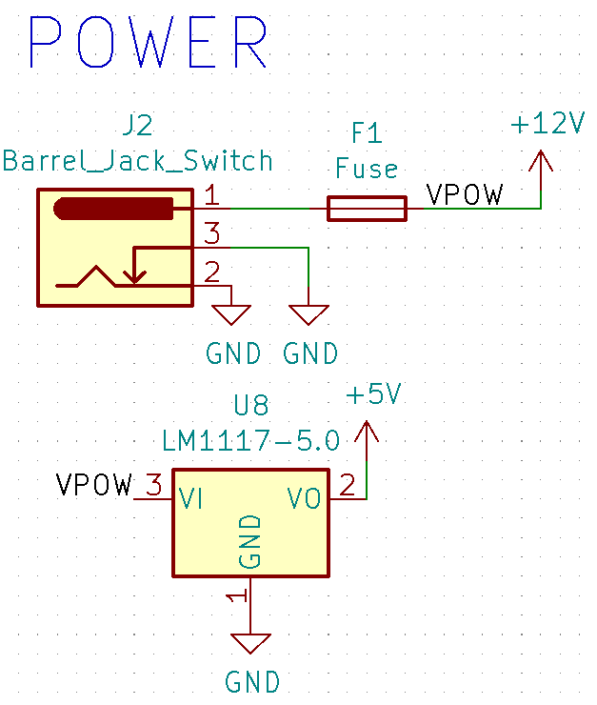
Power
We want to power our lights and the microcontroller from a wall outlet.
Current drawn by the LEDs is high enough to damage other components.

Slide 10
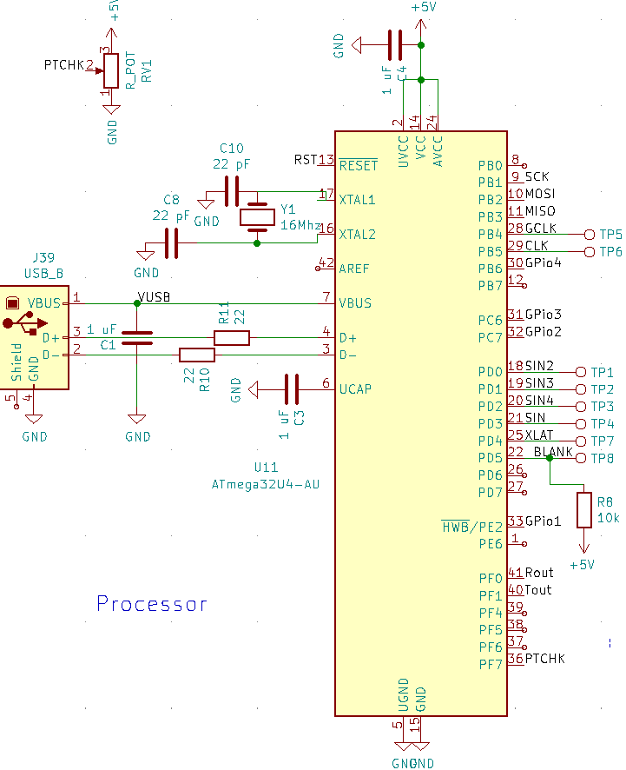
ATMega32U4
Control LED drivers
Signal external camera
Receive commands from control software

Slide 11
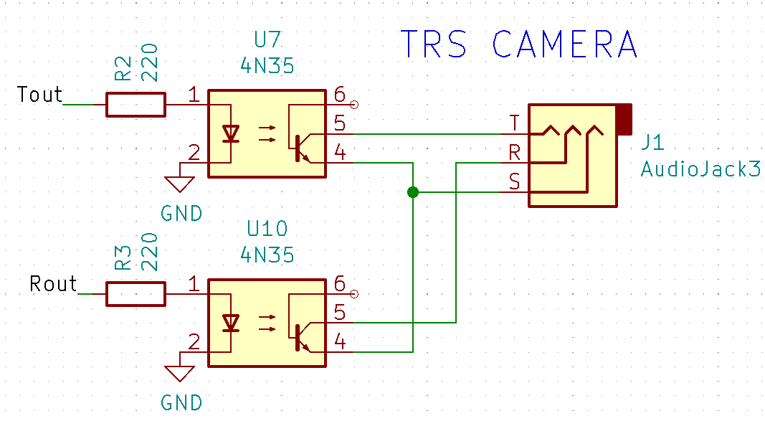
Camera Signal
An optocoupler latch triggers the camera shutter when closed.
Physically separates the camera from the electric circuit.

Slide 12
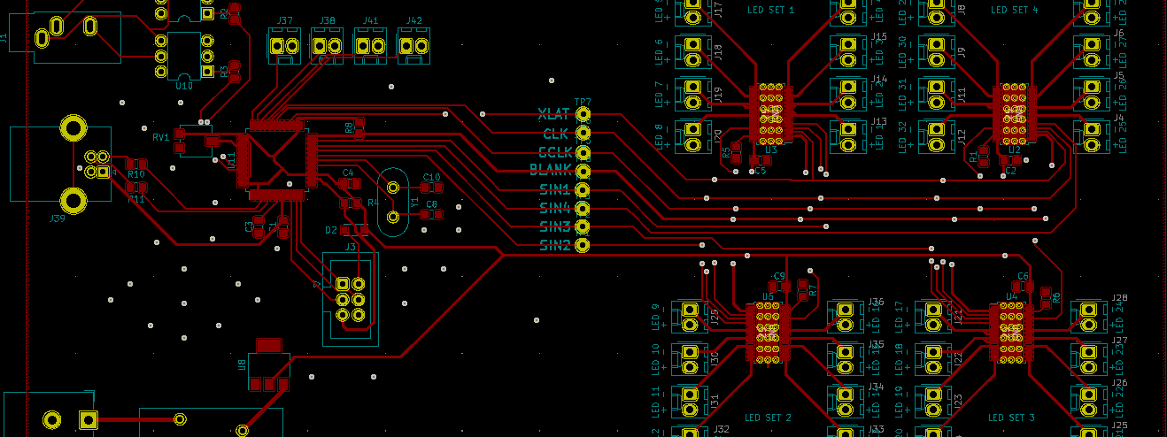
Summary

Slide 13
Control Software

Slide 14
Control Software
Requirements:
Platform agnostic
Easy to use
Support for automatic and manual photography

Slide 15
Control Software
Requirements:
Platform agnostic
Easy to use
Support for automatic and manual photography

Slide 16
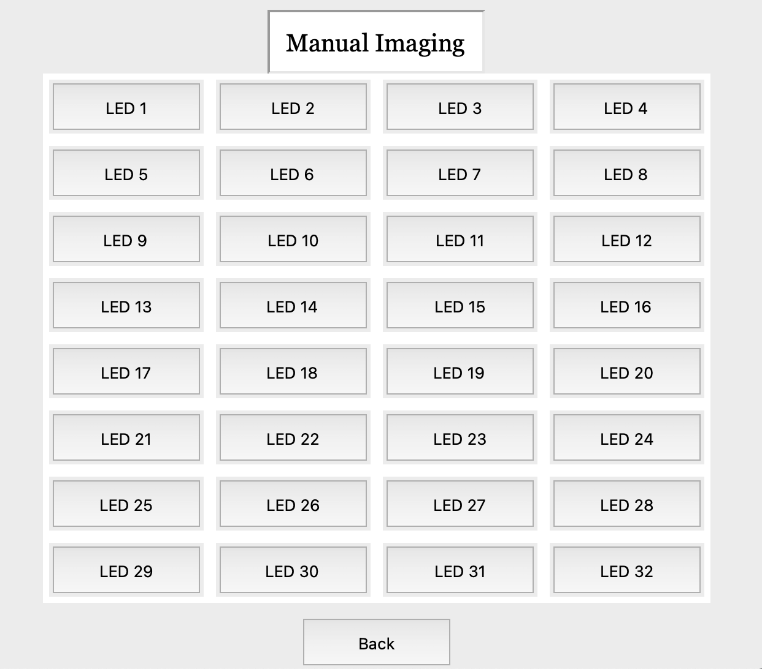
Control Software
Requirements:
Platform agnostic
Easy to use
Support for automatic and manual photography

Slide 17
Identifying the dome
Previous implementation required a COM port to be manually selected every time the software was run.
We look for our device ID and find it automatically.

Slide 18
Supporting Windows and Mac
Python allows us to support multiple operating systems relatively easily.
Using a high-level language makes future software maintenance easier for our sponsor.

Slide 19
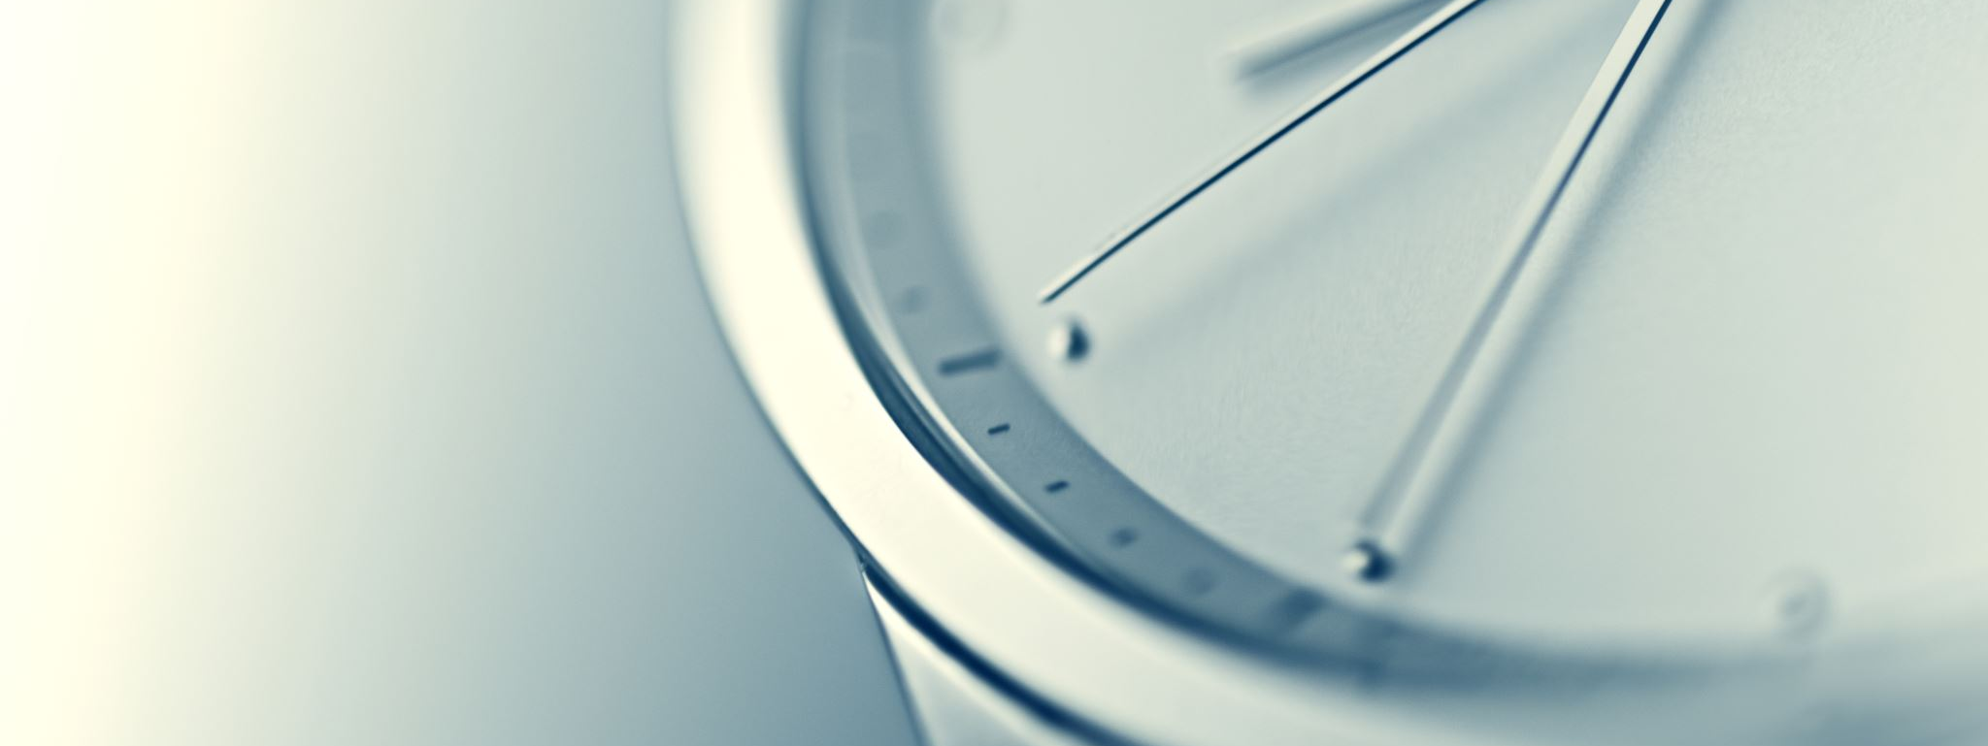
Timing Constraints

Slide 20
Goal 1: Faster than manual
Without any automation, imaging an artifact manually takes around 15 to 20 minutes.
Each face of an artifact is photographed separately.

Slide 21
Goal 2: Beat the dome
Before its control software failed, the old RTI dome took two minutes to complete an imaging cycle.

Slide 22
Constraint 1: Camera Speed
The Canon EOS Mark III camera has several drive modes. When configured to shoot continuously at high speed, photos can be taken up to six times per second.

Slide 23
Constraint 2: LED Triggers
Time needed to communicate with LED drivers is negligible compared to camera drive speeds.
We send 192 bits of lighting data to a LED driver when we want to toggle a light on or off.

Slide 24
Constraint 2: LED Triggers
We can shift in a bit of data in 2 microseconds (constrained by a minimum 1 microsecond delay in software).
Turning a light off and another one on requires 384 bits to be sent at a rate of 2 microseconds per bit.
Total time to toggle a light: 768µs

Slide 25
Summary
We can update subject lighting in less than a millisecond.
Even at conservative rates of 1-2 images per second, we can smash the previous two-minute cycle time!
Theoretical max at 6 images per second: 32 photos taken in just over 5 seconds.

Slide 26
RTI Dome 2.0
Alexander Calmas
Hadrian Doromal
John Ducham
Team 11

