Slide 1
Parking Reservation System
Team 59
Vivek Calambur, Manjesh Mogallapalli, Ojus Deshmukh

Slide 2
Introduction
Presented By: Vivek Calambur

Slide 3
Problem Statement
Parking spots not well implemented in busy areas
Hard to find
Highly limited spots
No guarantee of availability
Payment can be a hassle

Slide 4
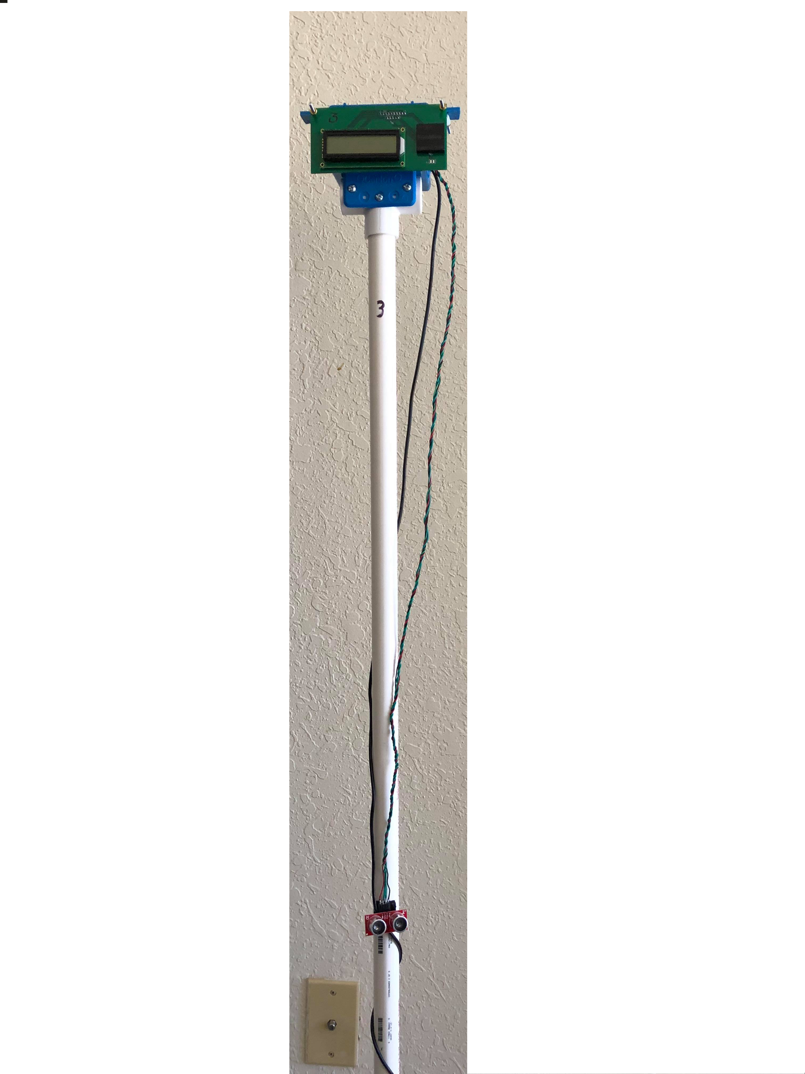
The Solution
Internet connected parking meters
Each meter detects and displays spot availability
Spot availability displayed on mobile app
Mobile app allows users to make reservations

Slide 5
System Overview
Hardware (meter):
Sends sensor (RFID, Ultrasonic) data to backend
Displays spot status on LCD
Backend:
Handles RFID verification and reservation logic
Sets LCD color
App:
Displays spot availability
Allows users to make reservations

Slide 6
Hardware
Presented By: Ojus Deshmukh

Slide 7
Hardware Overview
Power Supply
Components
Sensors
Controllers
Pseudocode
PCB Design

Slide 8
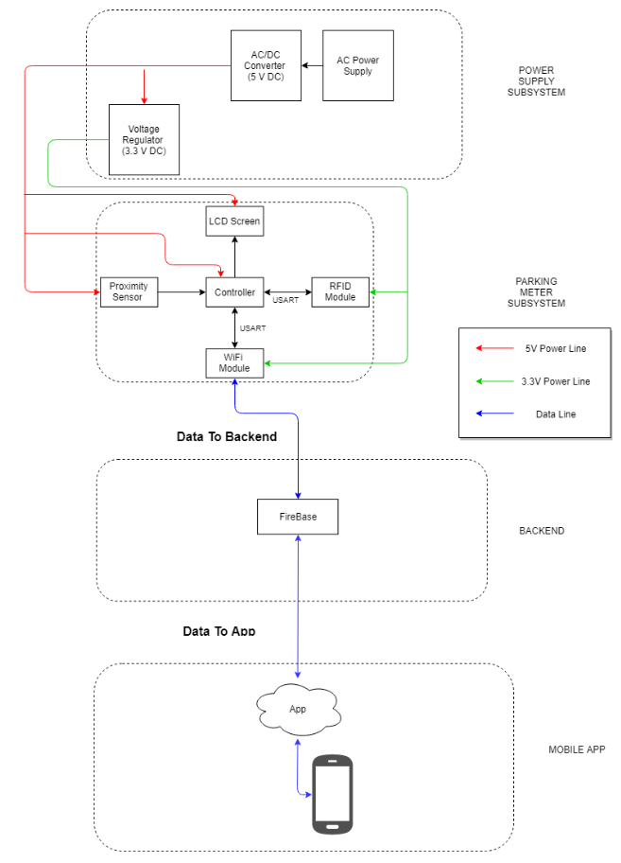

Slide 9
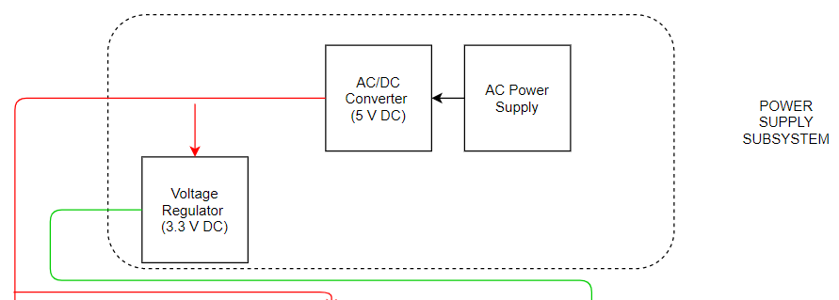
Power Supply Subsystem

Slide 10
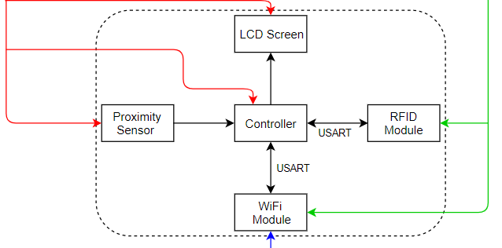
Parking Meter Subsystem

Slide 11
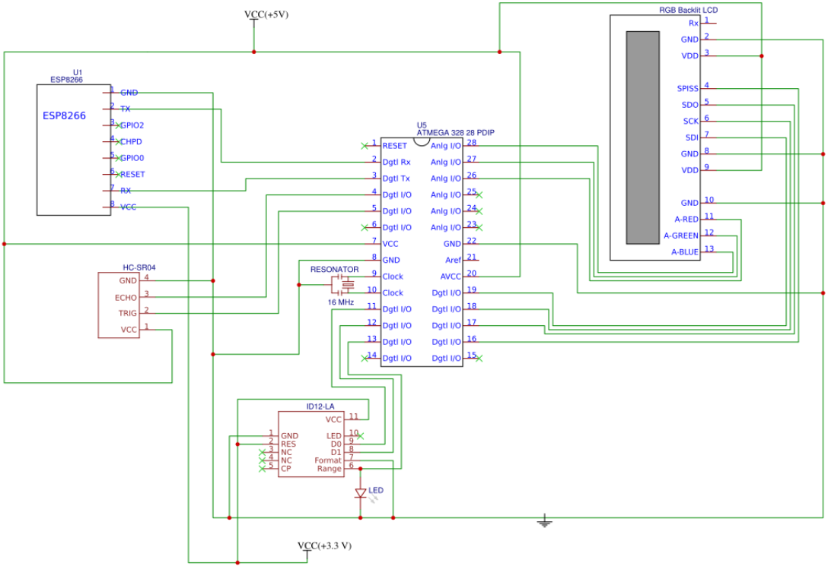
Circuit Diagram

Slide 12
Device Characteristics
Component | Voltage | Current
Microcontroller(ATMega 328-P) | 5V | 7-15 mA
Ultrasonic Sensor(HC-SR04) | 5V | 15 mA
RFID Reader(ID-12LA) | 5V | 15 mA
WiFi Module(ESP8266-01) | 3.3V(Supplied using 3.3V regulator) | 67-500 mA
LCD Screen + RGB Backlight(NHD-0216K3Z) | 5+1.9, 2.9, 2.9 V | 15 + 15, 20, 20 mA

Slide 13
ATMega 328-P Microcontroller
Previously used
Cheap
Easy to use with existing libraries

Slide 14
ID-12LA RFID Reader
Tx/Rx pins simulated using SoftwareSerial library
Built-in antenna
Labeled as 12 cm read range
Actually close to 5 cm

Slide 15
NHD-0216K3Z LCD Screen
16x2 character LCD
I2C communication using Wire I2C library
RGB backlight

Slide 16
HC-SR04 Ultrasonic Sensor
400 cm detection range
Up to 15 measurements/second
Low-cost, easy to implement

Slide 17
WiFi Module ESP8266-01
3.3 V power
ESP-Firebase library
Built-in antenna
Low cost, easy to implement

Slide 18
Ultrasonic Algorithm
Take 10 measurements over 3 seconds
Ultrasonic sensor often reports false readings
Spot is only marked open/closed if all 10 measurements agree

Slide 19
RFID Communication
When RFID tag is in range, serial communication becomes available
Parse out start-of-transmission characters and newline/carriage return to get RFID data

Slide 20
LCD Communication
Start I2C Communication
Define I2C Device Address
Send data prefix, followed by data
End I2C Communication

Slide 21
Main PCB (Design)

Slide 22
Main PCB (Board)

Slide 23
Front PCB (Design)

Slide 24
Front PCB (Board)

Slide 25
Backend
Presented By: Vivek Calambur

Slide 26
Backend Technology
FirebaseArduino library for ESP8266
Firebase RTDB as primary database
Google Cloud Functions
Python 3 with Pyrebase library

Slide 27
Backend Data Flow

Slide 28
ESP8266 Communication
ESP8266 has four main functions:
Receive sensor data
Send sensor data to Firebase
Listen for Firebase changes
Send updated LCD info

Slide 29
ESP8266 Communication (cont.)
Communication to microcontroller through serial
Connected to TX/RX pins
Used start and end characters
Communication to Firebase through library
FirebaseArduino library
Used event listeners extensively

Slide 30
Spot Assignment Algorithm
Hosted on Google Cloud Functions
Function called on reservation creation
Triggered by HTTP POST request
Ensure that reservation has available spot
Spots assigned in most efficient manner

Slide 31
Spot Assignment Algorithm (cont.)

Slide 32
Spot Assignment Algorithm (cont.)
Cases:
User has insufficient balance (FAIL)
All spots are taken during timeslot (FAIL)
Spot available for reservation (SUCCESS)
On success, push to Firebase
On failure, display error message on app

Slide 33
RFID Verification
Hosted on Google Cloud Functions
Needed for two reasons:
Enforce correct user for reservations
Payment
Function called on user parking in spot

Slide 34
RFID Verification (cont.)

Slide 35
Reservation Enforcement
Hosted on Google Cloud Functions
Necessary for two reasons:
Enforce on reservation overstay
Cleanse unused reservations
Triggered on a cron job (every minute)

Slide 36
Mobile App
Presented By: Manjesh Mogallapalli

Slide 37
Mobile App Overview
Users create account
Monitor Spot Availability
Make Reservations
View Reservations with Spot Number

Slide 38
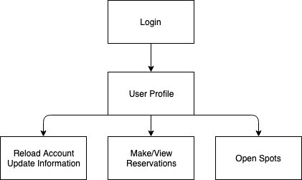
Mobile App Flowchart

Slide 39
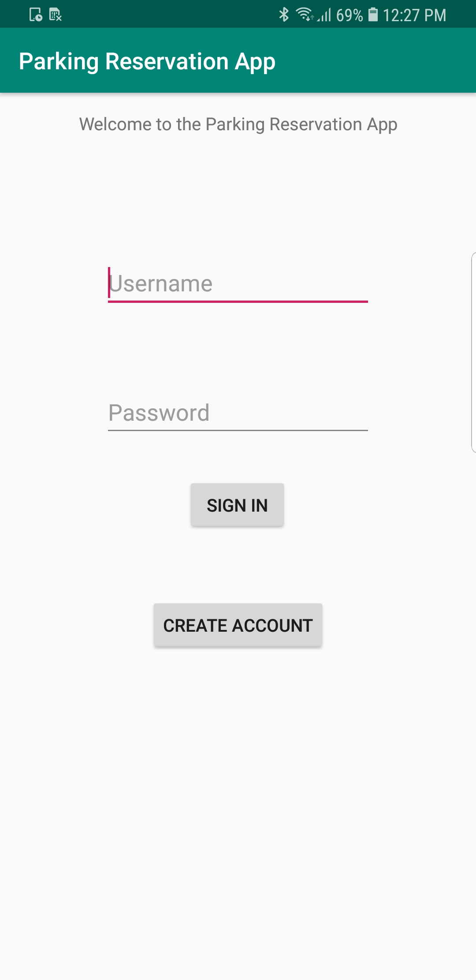
Create Account/User Profile

Slide 40
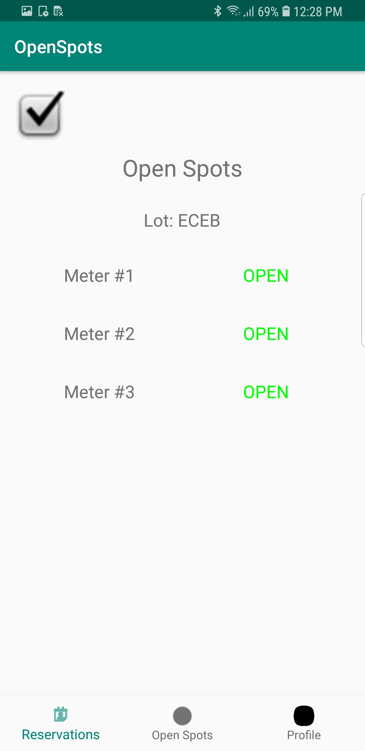
Open Spots

Slide 41
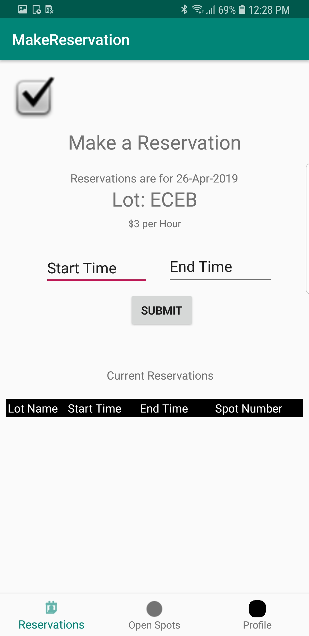
Make/View Reservations

Slide 42
Conclusion
Presented By: Manjesh Mogallapalli

Slide 43
Project Analysis
Achievements:
Users can view parking spot status in real-time
Users can make reservations
System can verify reservations via RFID
System can enforce reservations/payment
Weaknesses:
Ultrasonic reliability

Slide 44
Challenges
Ultrasonic timeout
FirebaseArduino certificate issue
PUT vs. PATCH on Firebase
Wi-Fi chip pin configuration
New to mobile dev
Minor PCB mistakes

Slide 45
Future Improvements
Explore alternatives to Ultrasonic Sensor
Refine software
Modify physical design

Slide 46
Credits
Kyle Michal
Soumithri Bala
Professor Arne Fliflet

