Slide 1
Real-Time Free Throw Feedback Device
Team Number: 22
Joseph Vande Vusse
Sanjay Kalidindi
Mathew Kizhakkadathu
TA: Hershel Rege

Slide 2
Introduction
Background - We love sports (particularly basketball)
Problem - Practicing basketball properly can be difficult without a coach, other players, or a camera
Goal - Help with individual practice
Solution - Our device, starting with a simple free throw
Notes:
J

Slide 3
Objective
Wearable
Inexpensive
Fast (“real-time”)
Notes:
M

Slide 4
High Level Requirements
Sensor circuits and microcontroller must be fastened to the user to be considered a wearable device
System must be affordable for any amateur (≤ $100)
Entire data transfer from analog sensors to computer script performing high-level functions and displaying results must occur in ≤ 5 seconds to live up to “real-time” name
Notes:
M

Slide 5
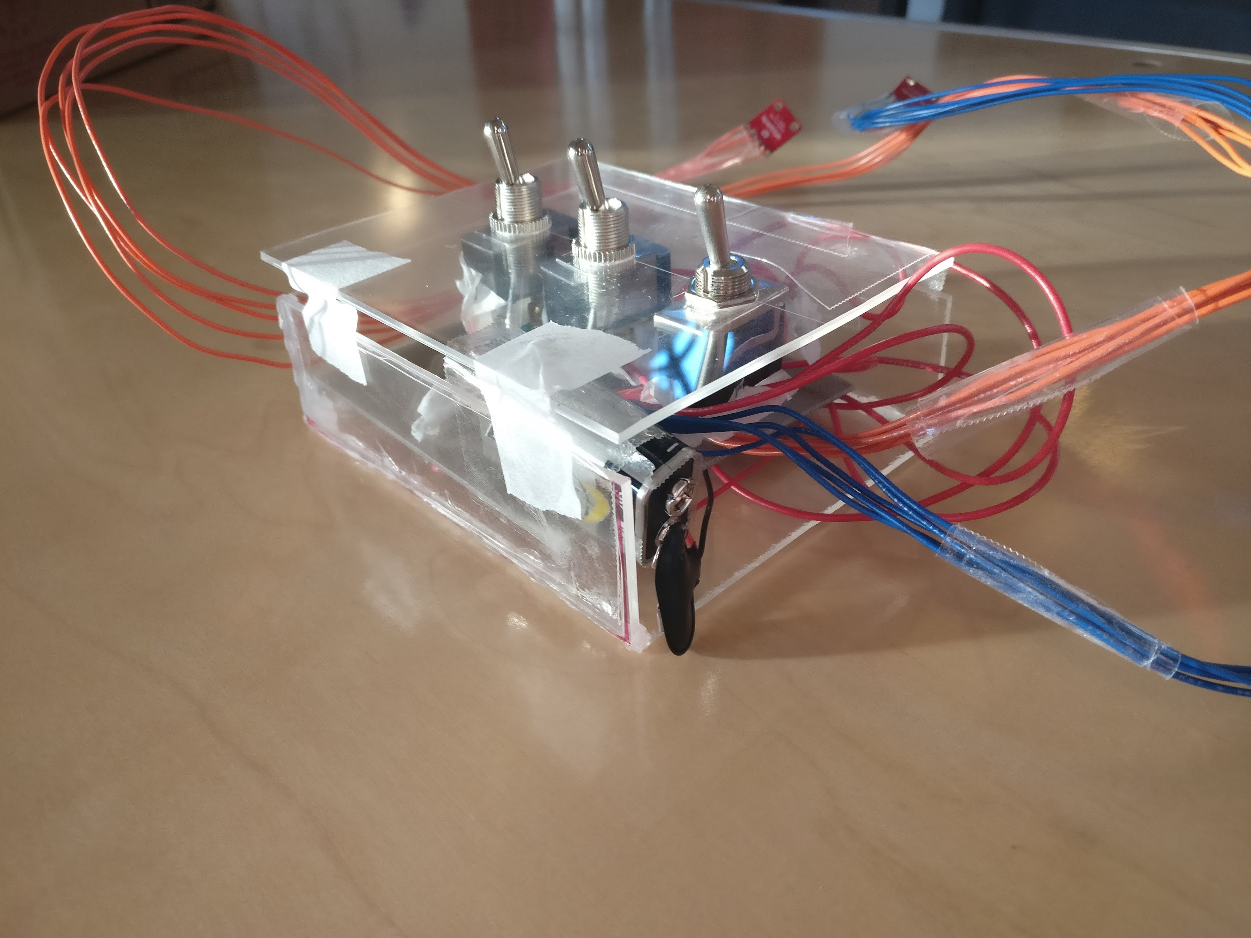
Notes:
M

Slide 6
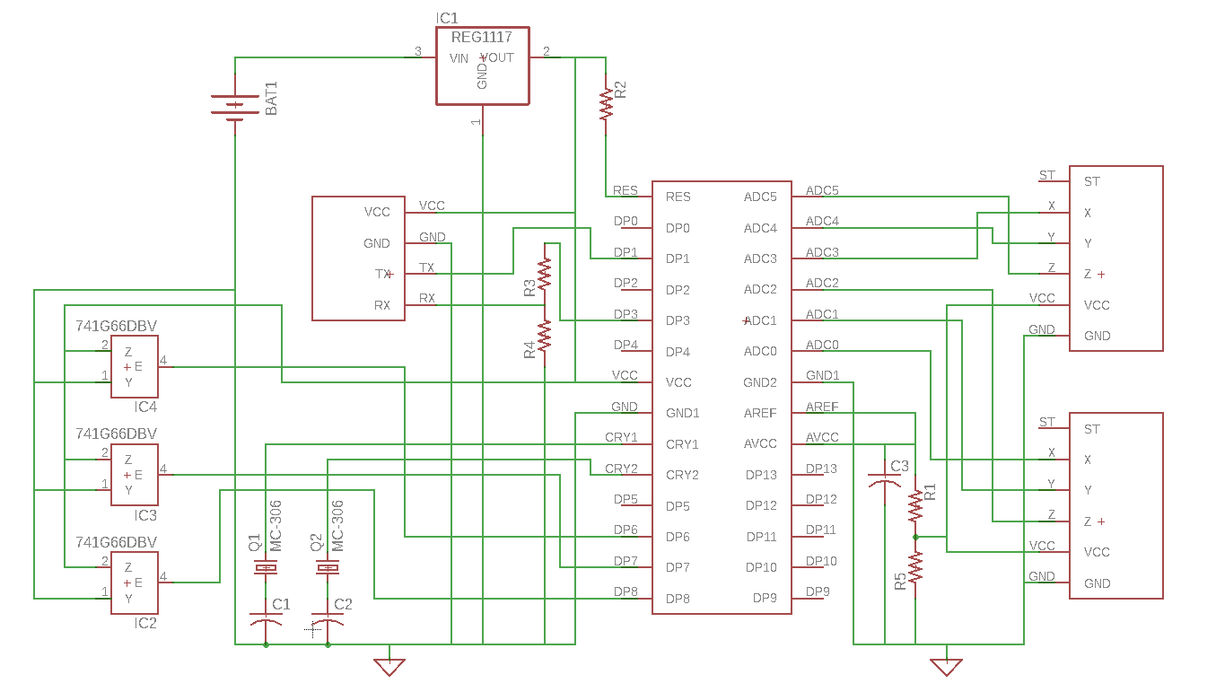
Schematic
Notes:
M

Slide 7
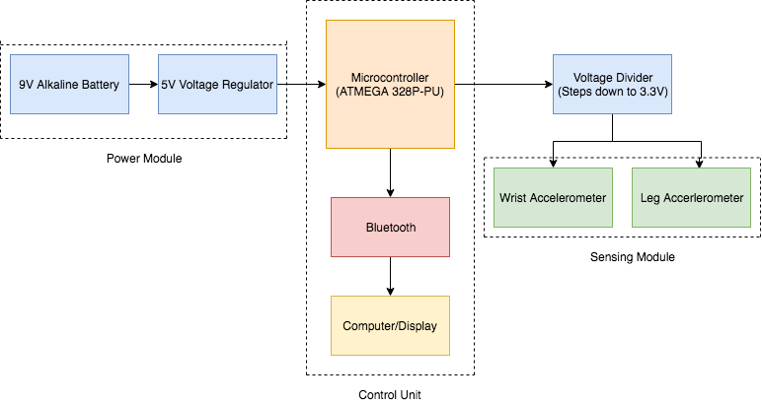
Block Diagram
Notes:
S

Slide 8
Overview
Hardware:
2 Accelerometers (Leg and Wrist)
Bluetooth Module
Power Module
Voltage Divider
Voltage Regulator
9V Alkaline Battery
Software:
Arduino IDE programming of microcontroller (ATmega328P-PU)
Support Vector Machine - Python machine learning model to analyze shot results
Notes:
M

Slide 9
Physical Design

Slide 10
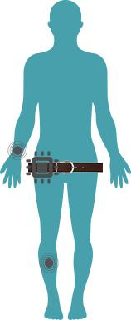
Locations on User

Slide 11
Power Module

Slide 13
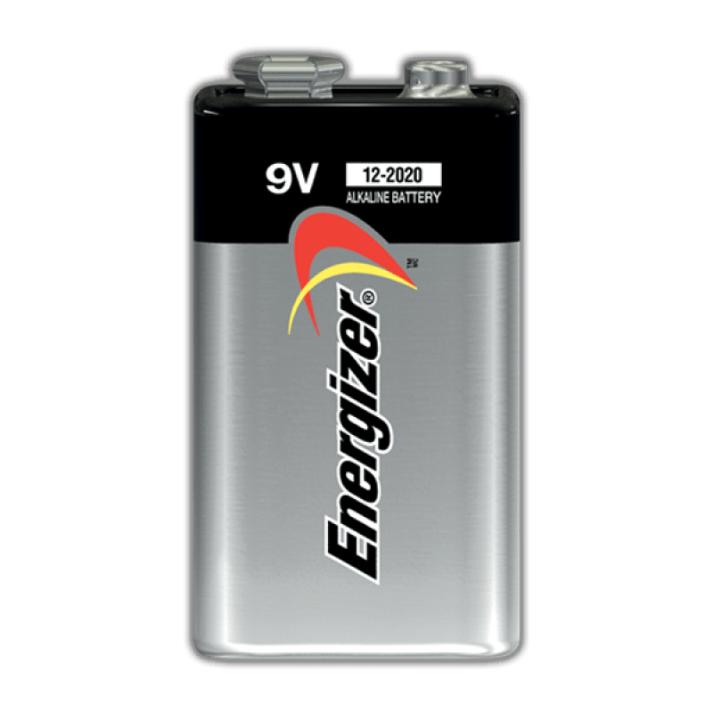
Power
9V Alkaline Battery
5V Voltage Regulator for VCC on ATmega
Voltage Divider from AVCC to step down voltage to 3.3 V

Slide 14
Issues that Arose
Trouble feeding 5V into VCC
Trouble feeding 3.3V into AVCC
VCC and AVCC are connected internally

Slide 15
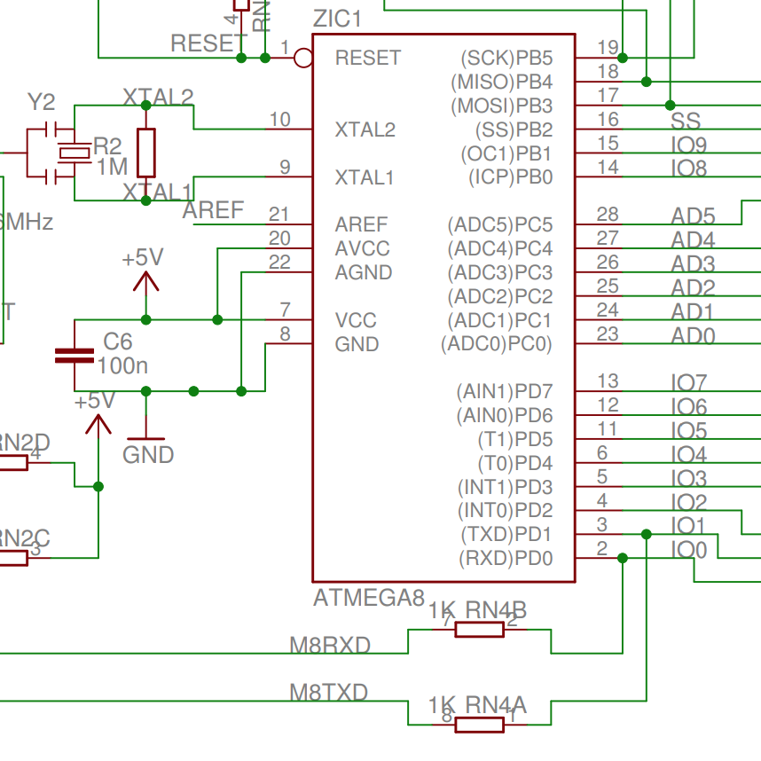

Slide 16
Requirements and Verification
Power Module
Capable of powering microcontroller
Capable of powering two accelerometers
Capable of powering bluetooth module
Successful voltage step down from ~3 V to 1.8 V

Slide 17
Sensing Module and Printed Circuit Board

Slide 19
Sensing Module
Triple axis output - Raw data for each axis
Check ADXL335 functionality - Verified voltage fluctuation with movement
We chose our accelerometer based on a range close to the actual movement of a user

Slide 20
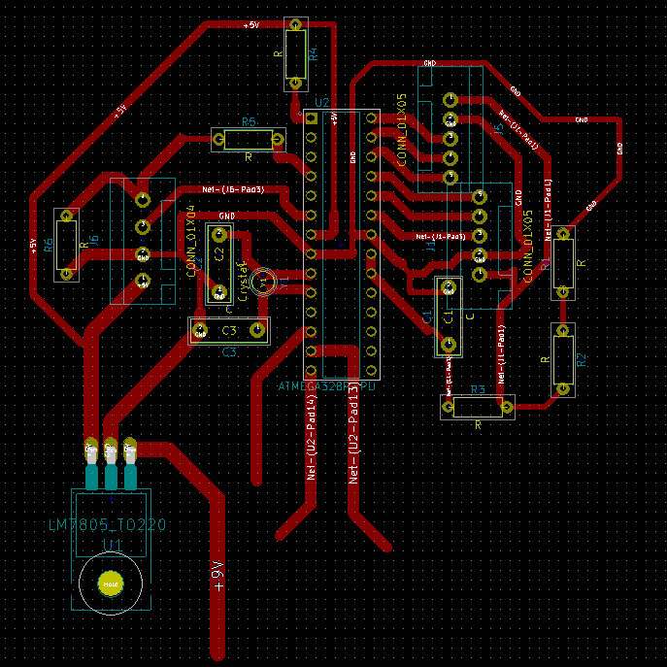
PCB Layout

Slide 21
PCB Issues
Traces were output correct voltages, but leads of components were attached
Traces were verified through functionality of prototype on breadboard

Slide 22
Control Unit and Software

Slide 24
Requirements and Verification
Microcontroller
Receive 1,500 readings in 1 second
Transmit data to Bluetooth module in 1 second
Store 24 KB of data in flash memory
Analog-to-Digital Converter
Data stream discretized and available in 1 second

Slide 25
Requirements and Verification
Bluetooth Module
Compatibility with version 2.0
Receive/transmit to receiver in 1 second
Sustain 5 ft connection range
Computer
Compatibility with version 2.0
Receive/store HC-06 values in text file
Construct SVM from training data
Receiving data → feedback takes 2 seconds

Slide 26
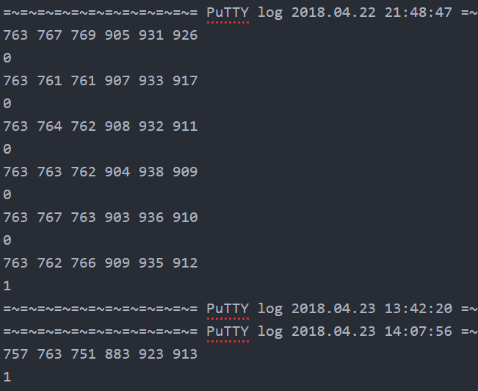
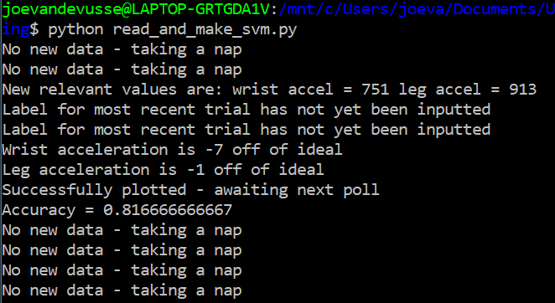
Output

Slide 27
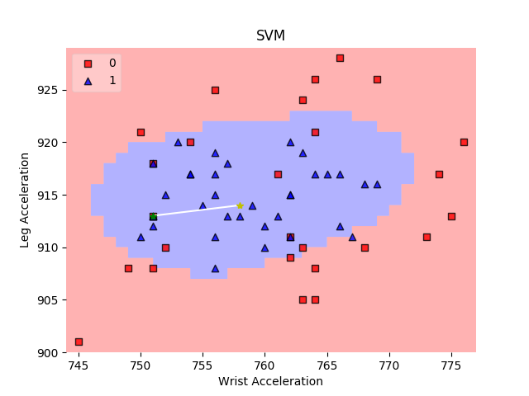
Results/Discussion
Clustering Accuracy = 81.7%

Slide 28
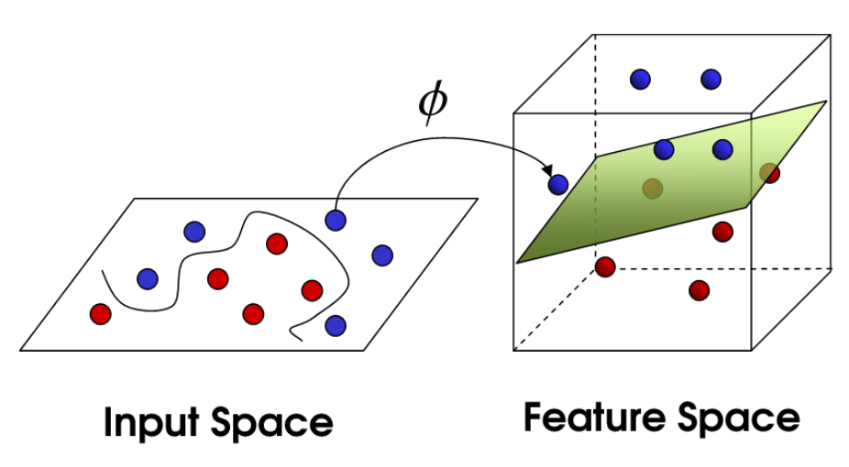
How the SVM Works

Slide 29
Video

Slide 30
What Worked
Overall, product worked as intended
Sensor data and labels properly passed along
Sensors → MCU → Bluetooth → PuTTy → Python
SVM constructed
Data clustered fairly well

Slide 31
What Didn’t
Code crashed on occasion
Sensor data was not sensitive enough
X/Y/Z values did not change enough with changes in shooting form
Data would shift after a power reset
Baselines differed cycle to cycle
Perhaps implement more features
More information, but harder to visualize

Slide 32
Conclusion

Slide 33
Future Improvements
Wireless Accelerometers - convenience
Sturdier and more comfortable enclosing for MCU
Expand to shots of varying distances
Wearable display - eliminate computer
Notes:
J

Slide 34
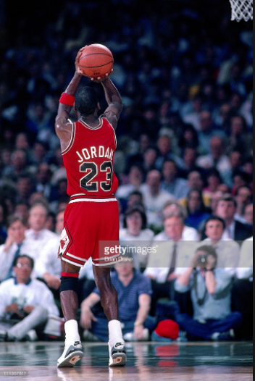
Questions?

