Slide 1
Fast Towel Disinfecting Cabinet
Team 25 -- Harsh Agrawal and Jacky Wang and Christopher Willenborg
Professor: Jing Jiang
TA: Kyle Michal

Slide 2
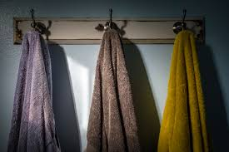
Introduction
Background
Notes:
Harsh
Background:
Due to the fast-pace lifestyle, many people wash/clean their towel around every 10-15 days. However, the recommended frequency that people should clean their towel to avoid bacteria growing into colonies is every two to three days. Currently in the market, there are no products that can both dry a towel and disinfect a towel within a short period of time.

Slide 3
Objectives
UVC light covers 85% of the towel
Humidity is below 50% upon completion
Door is closed when UVC lights are on
Notes:
Chris
The cabinet is designed such that the UVC light, in a worst case scenario, covers 85% or more of the towel surface.
The humidity in the cabinet is kept under 50% upon completion, and the completion time should be less than 7 hours.
The cabinet should be closed whenever UVC lights are on.

Slide 4
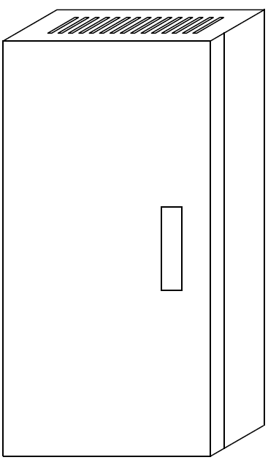
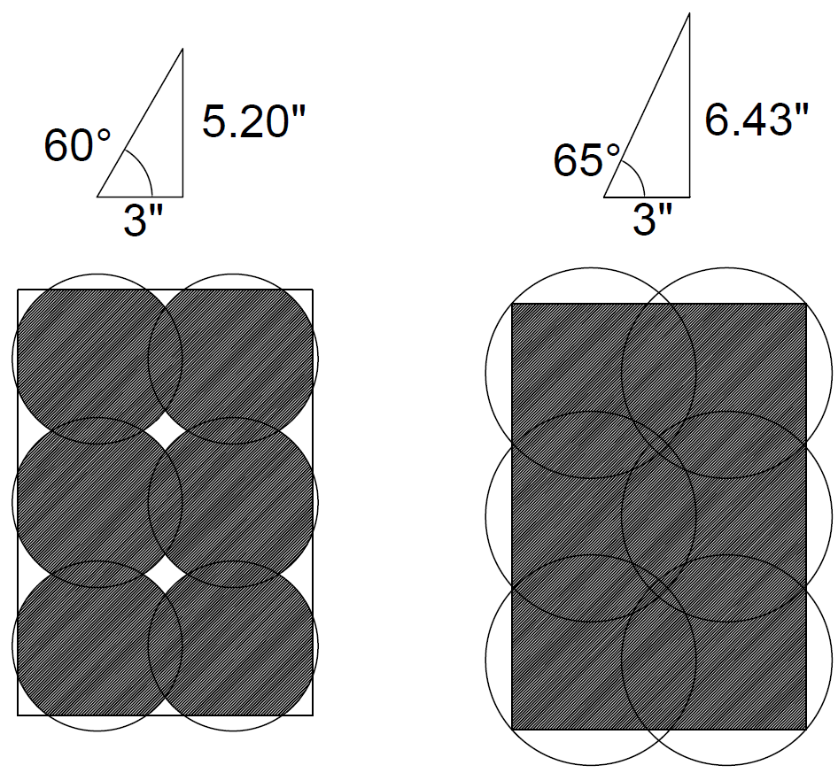
Physical Design
Opp.=Adj.*tan(θ)
Notes:
Jacky

Slide 5
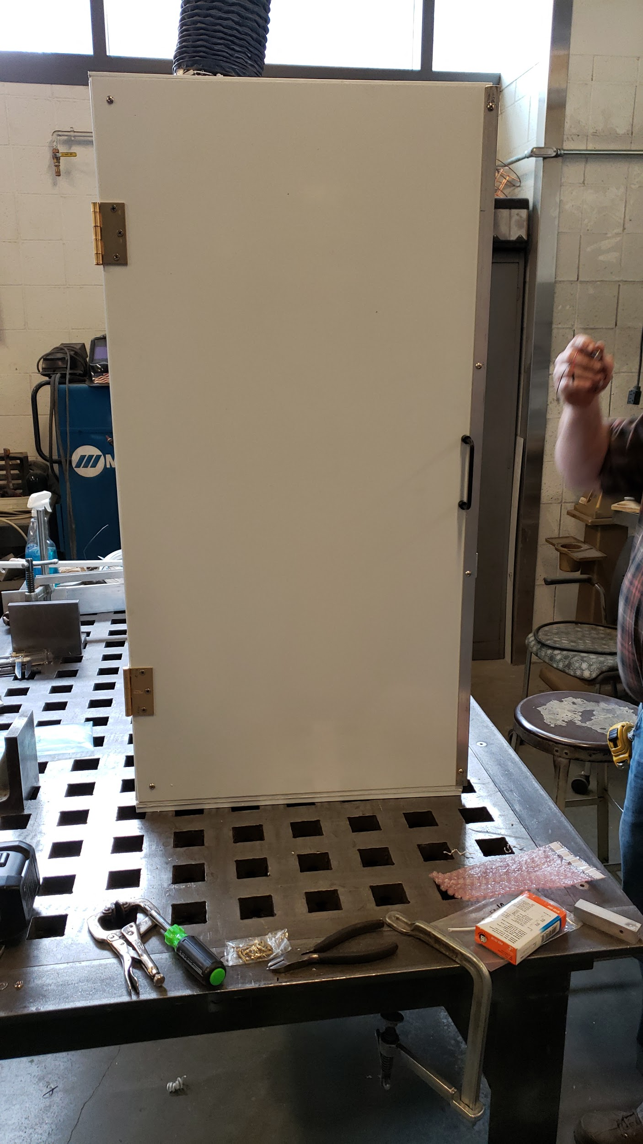
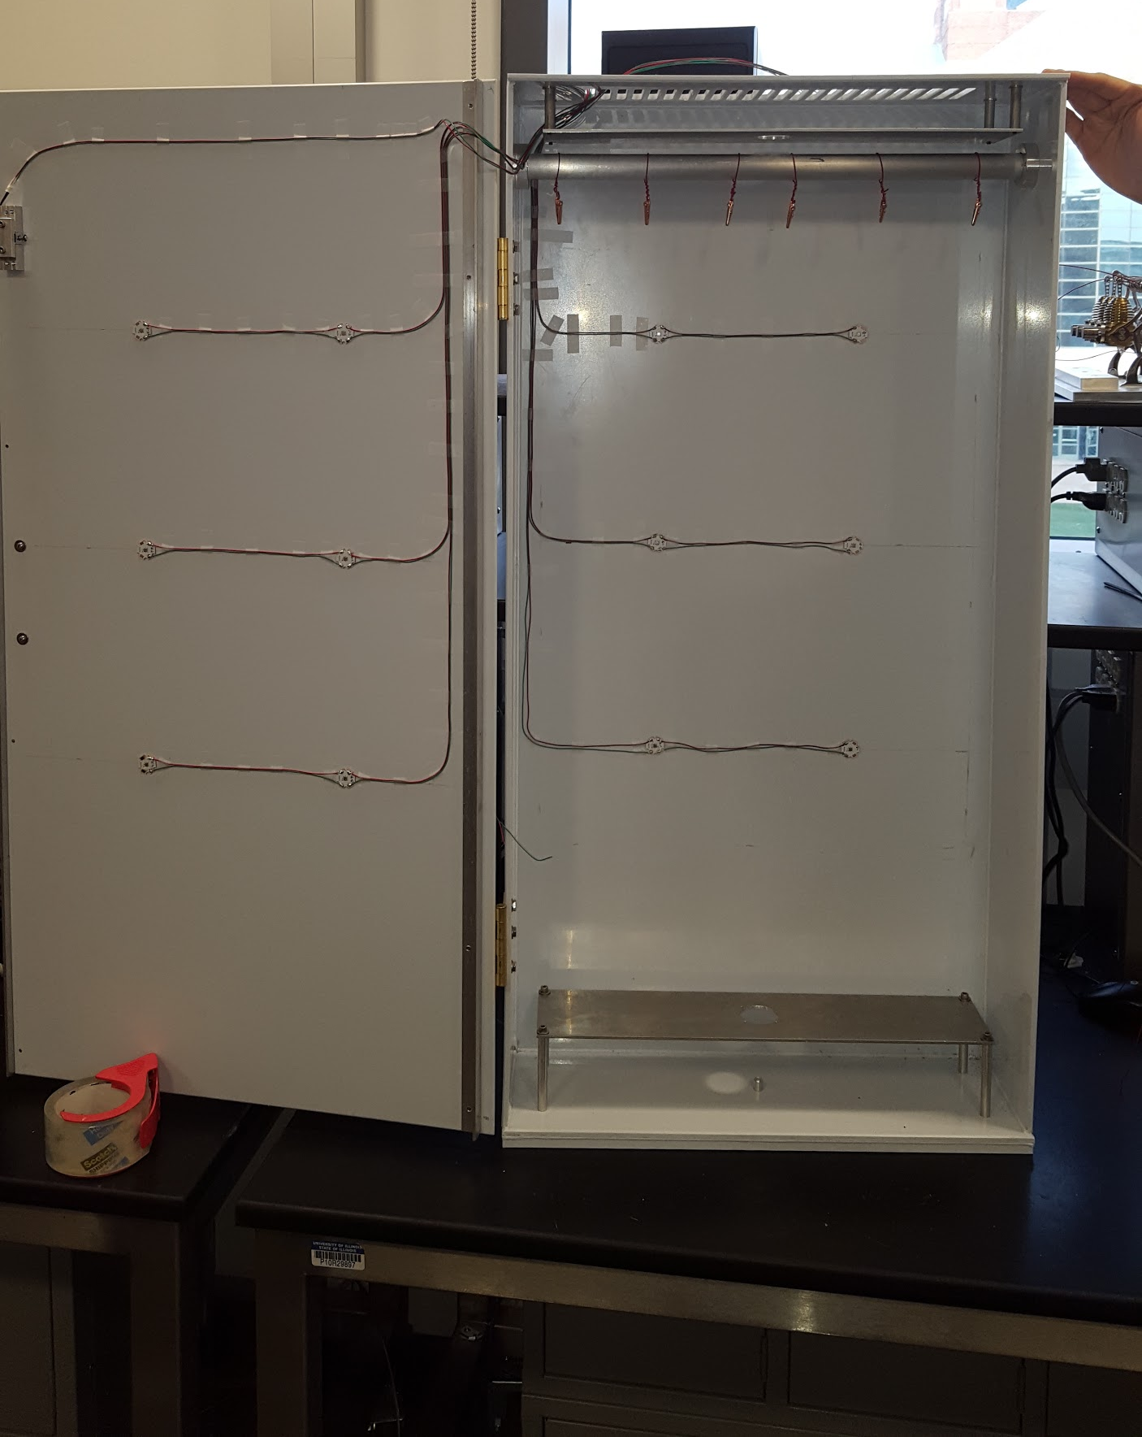
Proposed Solution
Notes:
Jacky
Objective
Our goal is to design a physical cabinet that provides an enclosed environment for disinfecting and drying a towel. To most efficiently neutralize the bacteria, we decide to use the UVC LED. After the disinfecting cycle, the cabinet is able to dry the towel and keep the humidity within the cabinet at a very low level. So it is hard for bacteria to grow back on the towel or in the cabinet

Slide 6
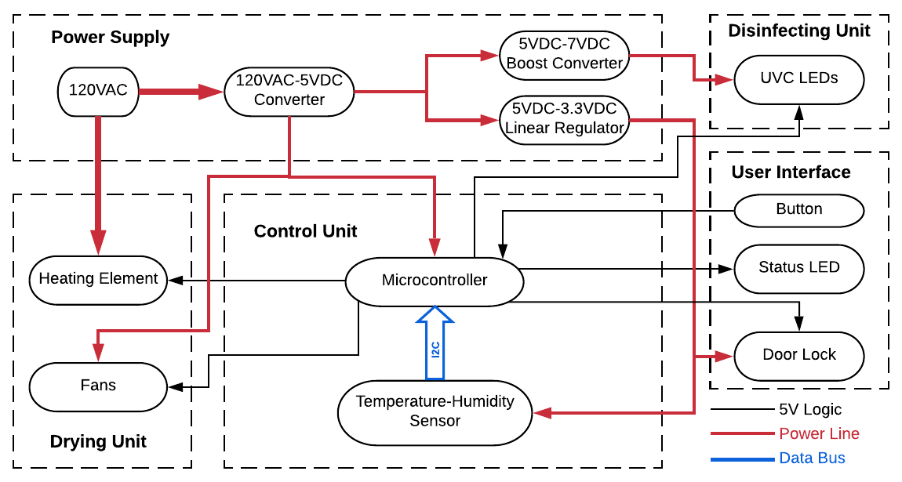
System Overview
Notes:
Harsh

Slide 7
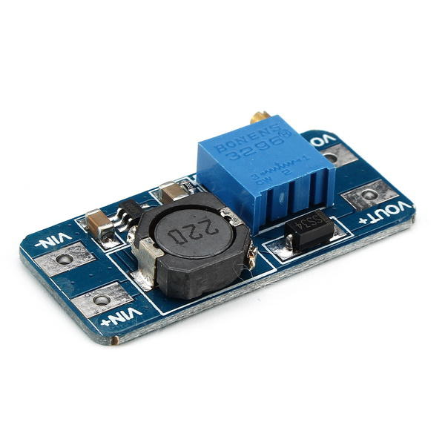
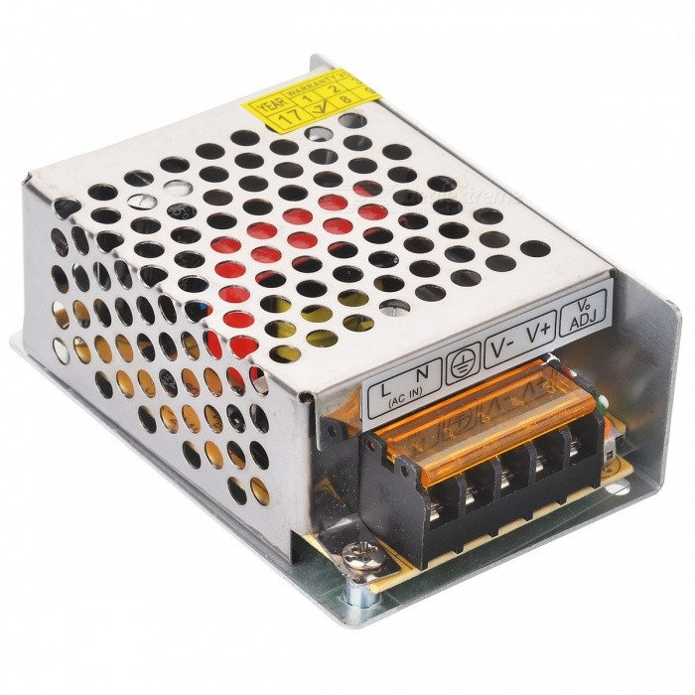
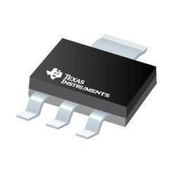
Power Supply Unit
120VAC-to-5VDC
5VDC-3.3VDC
5VDC-7VDC
Notes:
Chris
Requirements:
The AC-DC converter should take the 120VAC and step it down into 5VDC
The boost converter should take 5VDC as an input and output 7VDC.
The linear voltage regulator should take 5VDC and output 3.3VDC
Verifications or testing:
From the datasheet, the output voltage of the converter will be in a range of 5VDC ±2%
We apply 5VDC to the converter and measure the output voltage across a load. We will then compare the output with our design requirement.
From the datasheet, the linear regulator will output 3.3VDC with a tolerance of ±1%

Slide 8
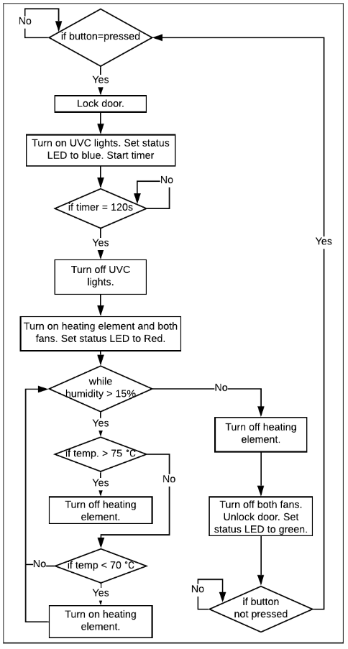
Control Unit
Notes:
Harsh

Slide 9
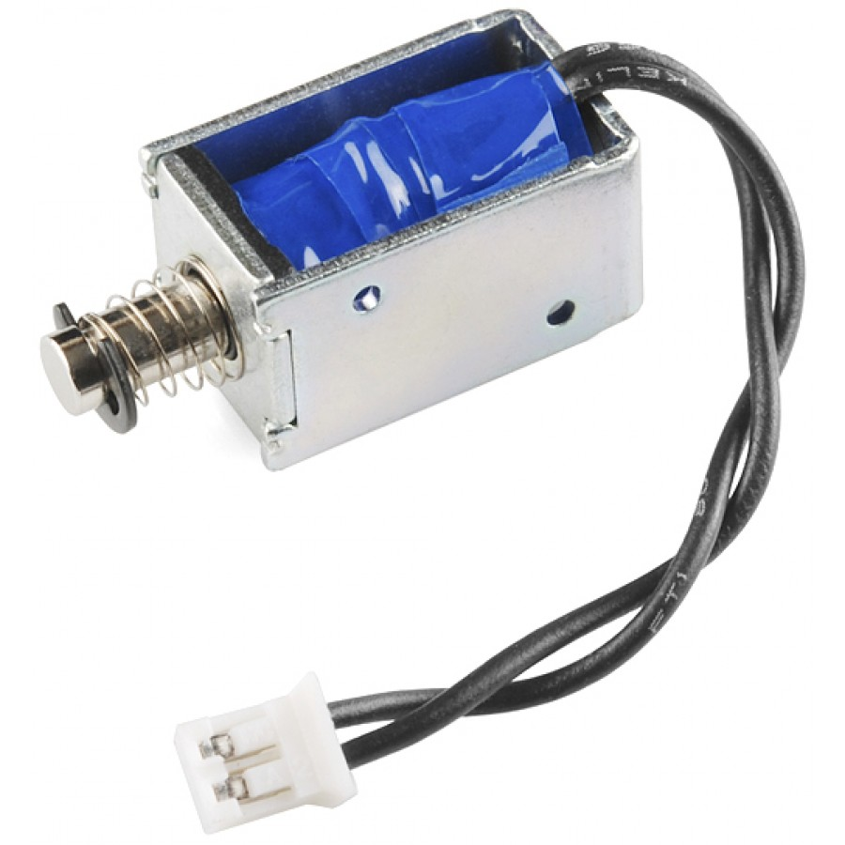
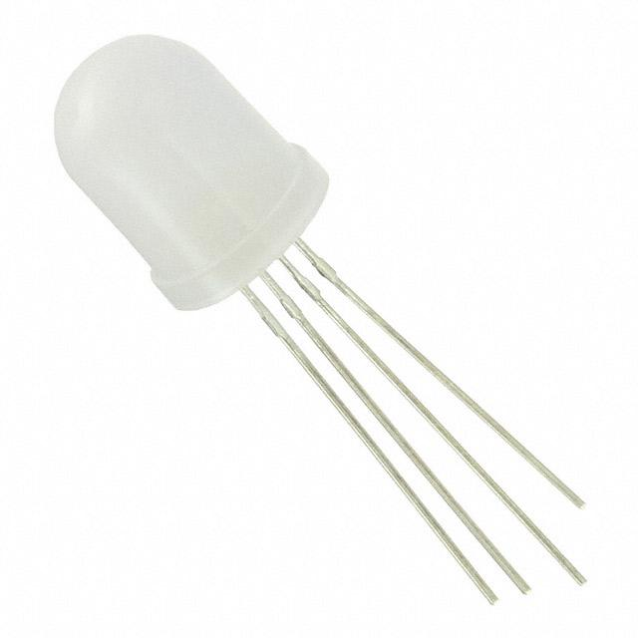
User Interface
Notes:
Requirements:
RGB LED works at 5V, drawing at most 100mA current.
The solenoid lock operates with 3.3VDC, drawing at most 1.2A current.
Verifications:
Connect common anode pin to 5V, red pin to GND via a 330Ω resistor, green and blue pins to GND via 330Ω resistors. Check if the LED lights up with red color. Repeat the process to ensure the LED can show green and blue colors as well.
Power the solenoid with 3.3VDC and check if the solenoid unlocks. The datasheet lists the resistance of the solenoid at 4.5 ohms. Thus, the datasheet would suggest the current be 0.733A.

Slide 10
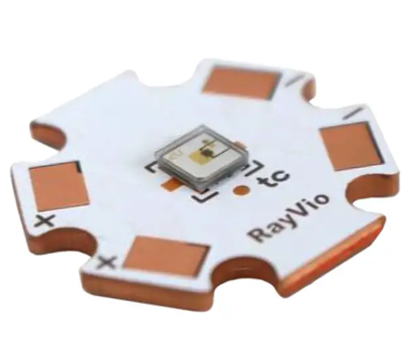
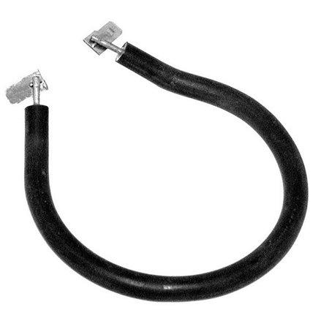
Disinfecting Unit
Drying Unit
Notes:
Jacky & Chris
LED
Requirement:
The UVC LEDs work at 7 ±1 V with less than 200mA current.
Verification:
Power the LEDs with an input voltage from 6VDC to 7.5VDC. When LEDs are powered by 7VDC, the light intensity is maximized and also the current is around 160mA
Heating elements
Requirements:
Each heating element should work at 120VAC, drawing at most 1A.
Each Fan should work at 5VDC, drawing at most 500mA.
Verifications:
Power the heating elements with 120VAC and measure the current with a multimeter.
Power the fan with a 5V power supply and check if the fan turns on.

Slide 11
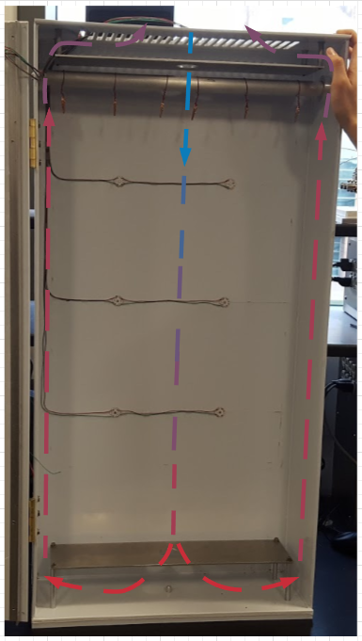
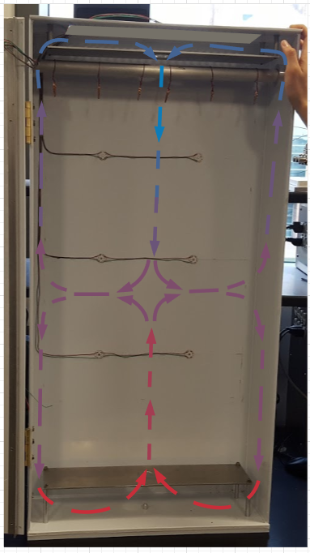
Ventilation
Notes:
Chris

Slide 12
Design changes and challenges
Physical Dimension
Original Design
(18”x36”x68”) , Volume = 44064 cubic inch
Final Design
(6”x20”x40”) , Volume = 4800 cubic inch (10.89%)
Notes:
Jacky

Slide 13
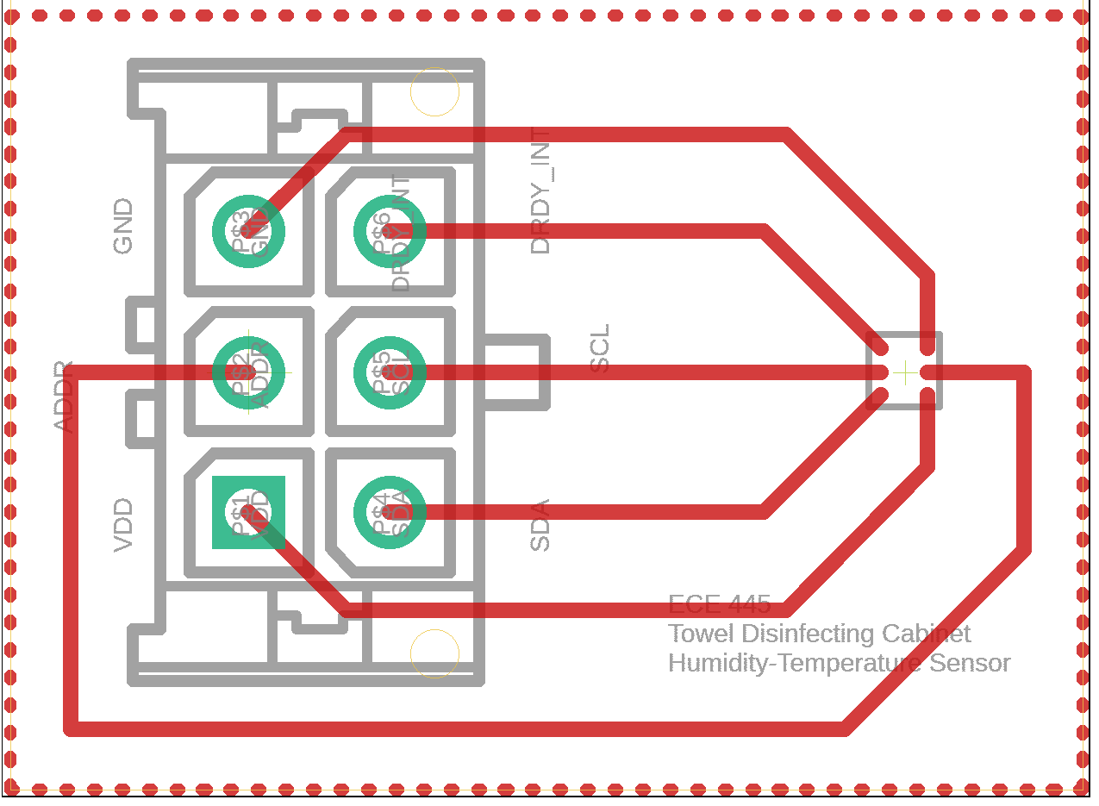
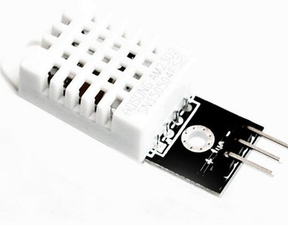
Humidity-Temperature Sensor
HDC2010 - I2C Communication DHT22
Notes:
Harsh

Slide 14
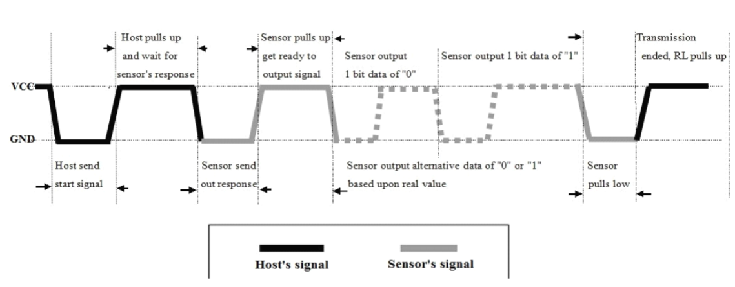
DHT22 Communication Protocol
Communicates via one digital pin
https://cdn-shop.adafruit.com/datasheets/Digital+humidity+and+temperature+sensor+AM2302.pdf
Notes:
Harsh

Slide 15
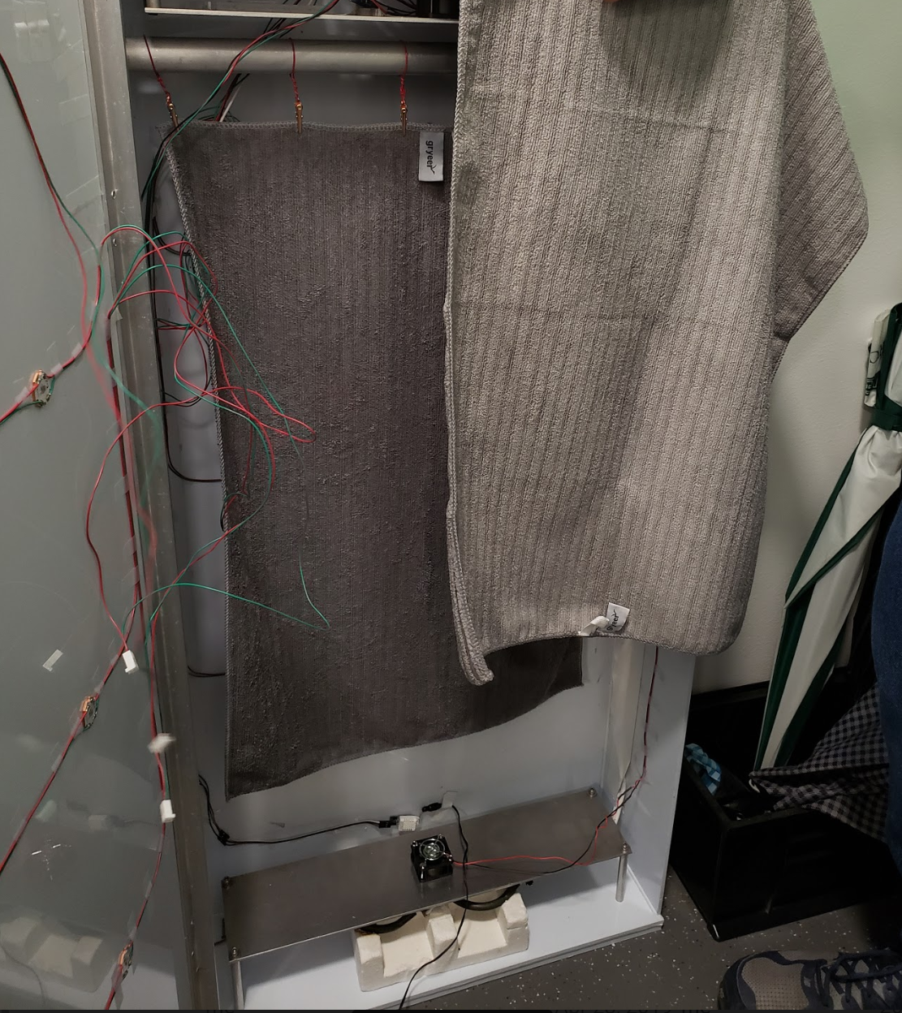
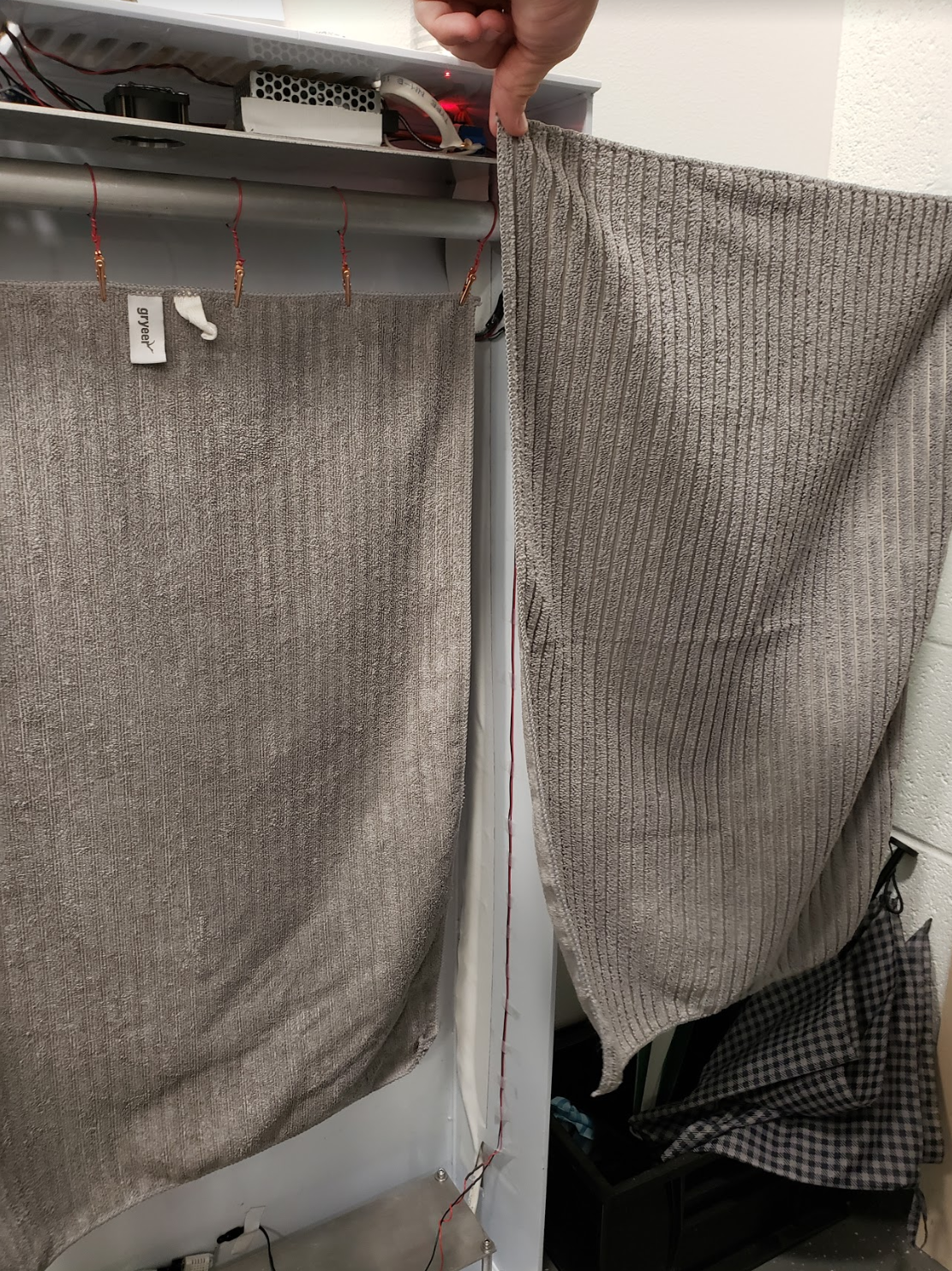
Before
After
Notes:
Jacky

Slide 16
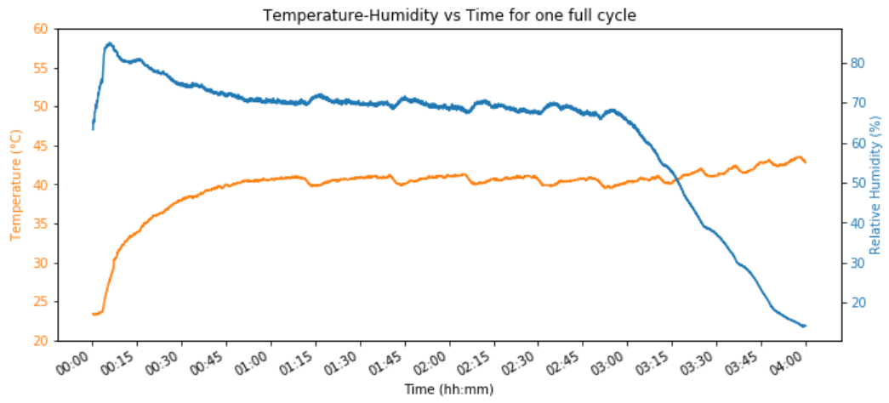
Drying Time
Notes:
Harsh
Initially, we set out to dry the towel in 7 hours. But we manage to dry a pretty wet towel right around 4 hours. To confirm the result, we run the test again. The result of the second test agrees with the result of the first one.
Water added: 10 ounces

Slide 17
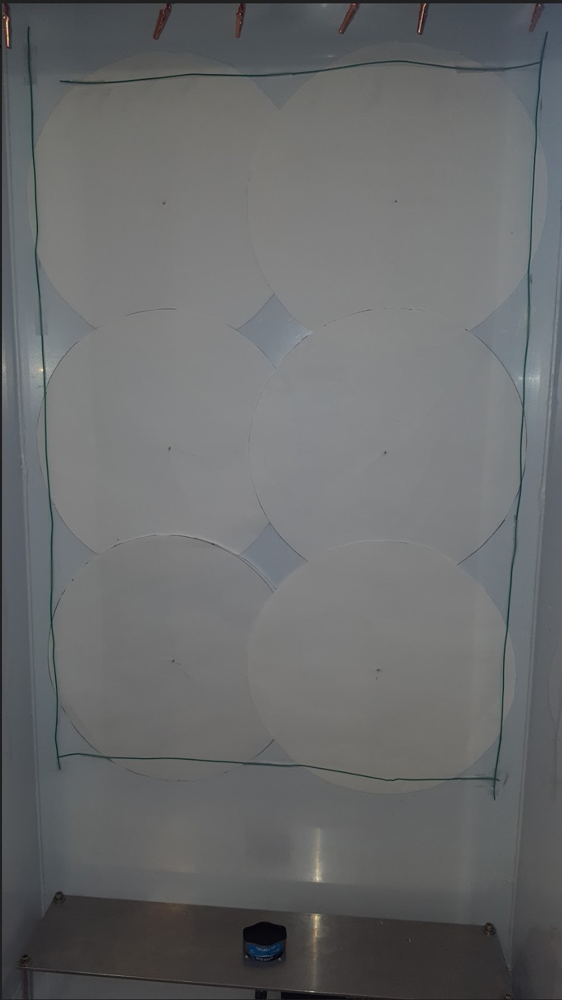
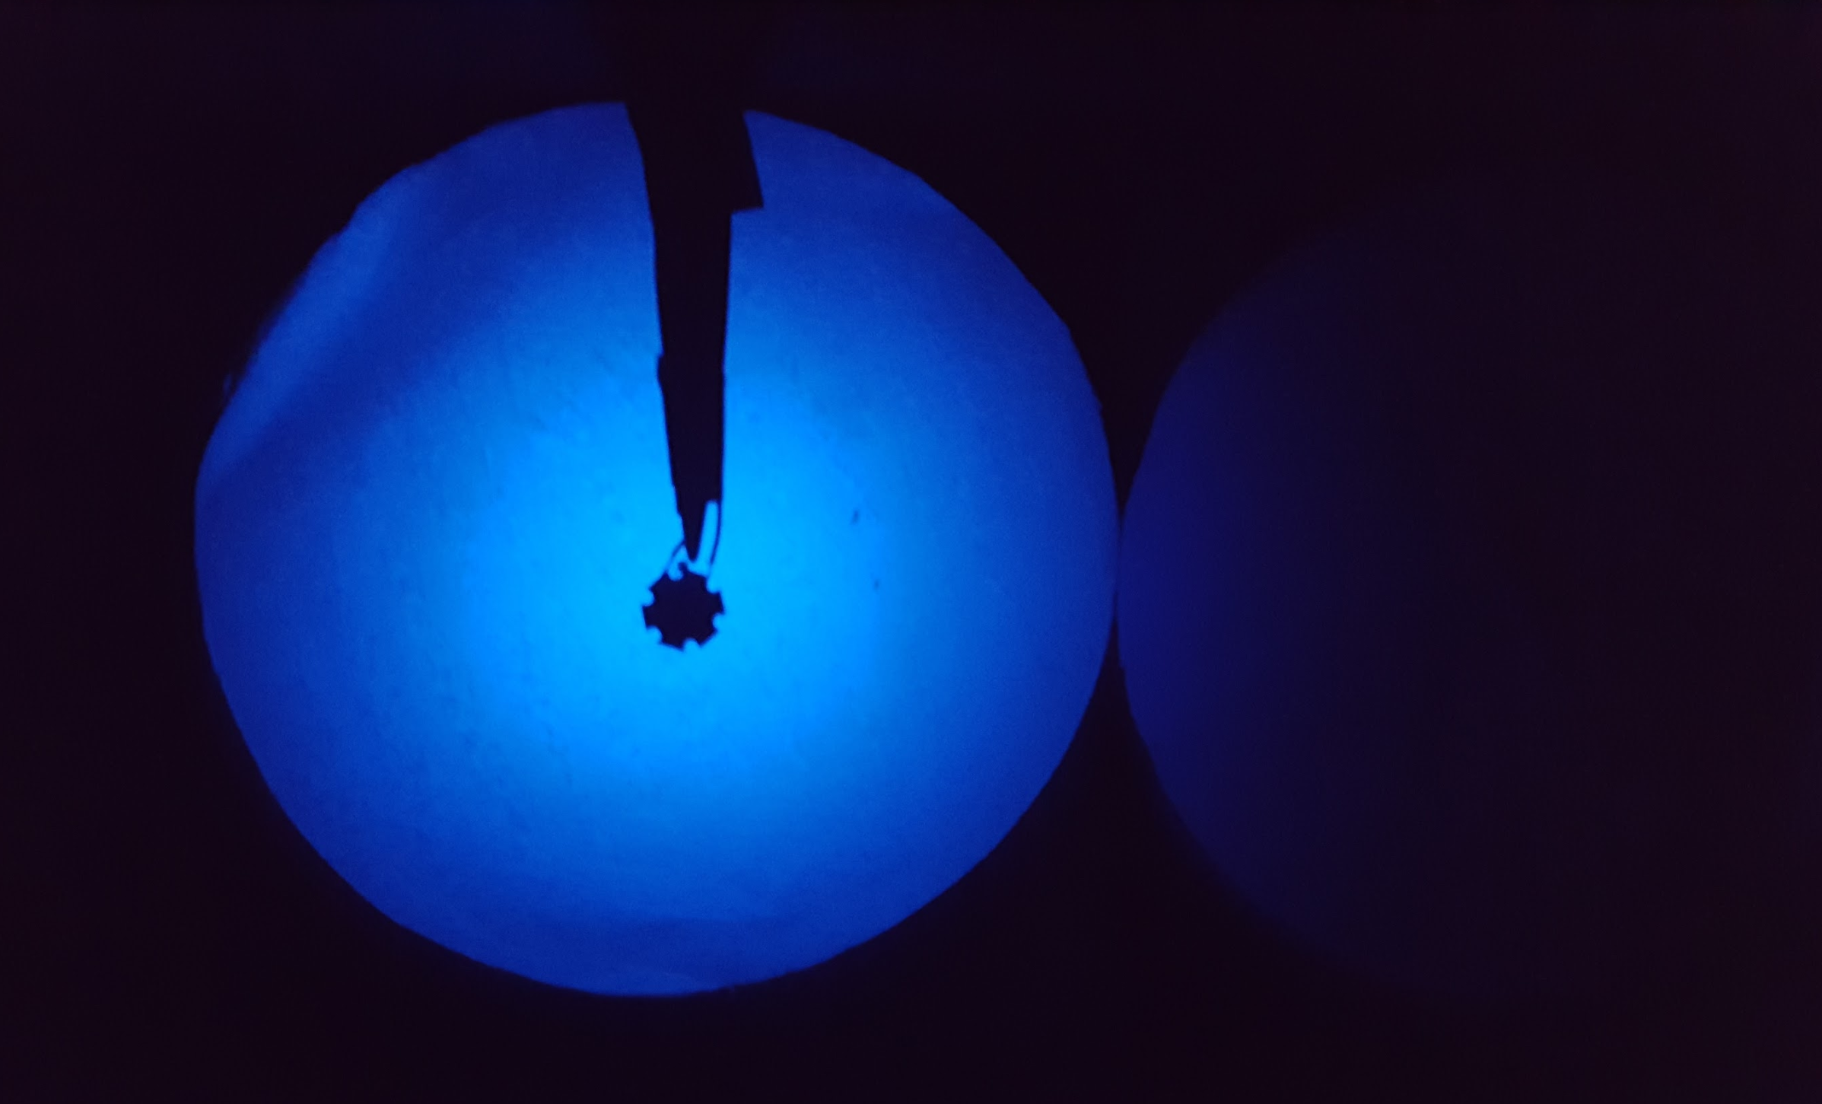
UVC Coverage
Notes:
Chris
We cut out circles to the anticipated worse case scenario coverages. We place a UVC LED 3” away from cutout. We see that the cutout is completely covered in UVC light and even part of the neighboring one as well. We place all of the cutouts in the chassis where the towel will hang. We place them on the back panel and outline the towel. We see this will be more than enough coverage for our 85% high level goal.

Slide 18
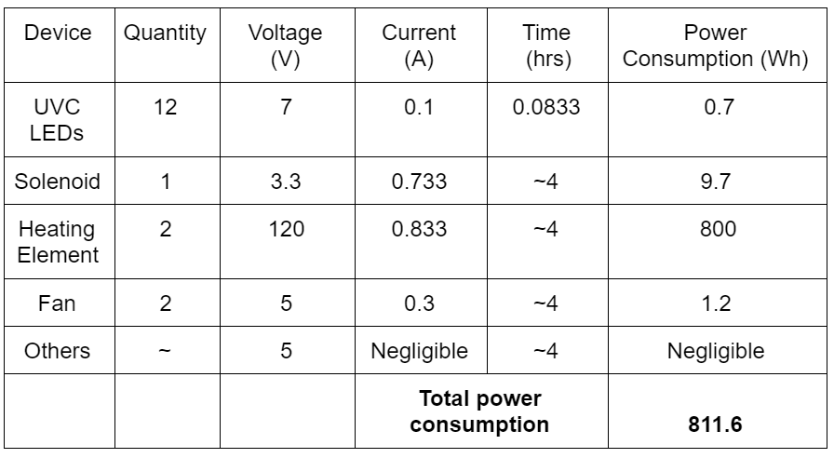
Power consumption
12 cents per kWh [2]
Cost of 1 cycle : 9.74 cents Total monthly cost : $2.92
Notes:
Chris
Saving power consumption is always a part of our design process.
We test all the components and find out the optimal operating voltage for each component.
Then we pick the converter with sufficient wattage rating to power the project.

Slide 19
Further Development
Cost of the project
Better mechanical design
Heat efficiency
Aesthetic improvement
Offer different sizes
Notes:
All
Overall, the project is very successful. We accomplish what we set out to achieve. For further improvement on the project, we can work on the following aspects of the project.
Cost of the project (E.g., Cheaper cabinet materials, cheaper UVC light source, etc)
Better mechanical design (E.g., Users do not need to manually hang the towel)
Heat efficiency (E.g., design better airflow to utilize the heat accumulated in the cabinet more efficiently)
Aesthetic improvement (E.g., cover all the wires up to have a cleaner look within the cabinet)
Offer different sizes (E.g., bath towel, hand towel, stand alone, receded into wall)

Slide 20
Reference
[1] Cdn-shop.adafruit.com. (n.d.). Digital relative humidity & temperature sensor AM2302/DHT22. [online] Available: https://cdn-shop.adafruit.com/datasheets/Digital+humidity+and+temperature+sensor+AM2302.pdf [Accessed 28 Apr. 2019].
[2] J. Jiang, “The Price Of Electricity In Your State,” NPR, 28-Oct-2011. [Online]. Available: https://www.npr.org/sections/money/2011/10/27/141766341/the-price-of-electricity-in-your-state. [Accessed: 22-Apr-2019].

