Slide 1
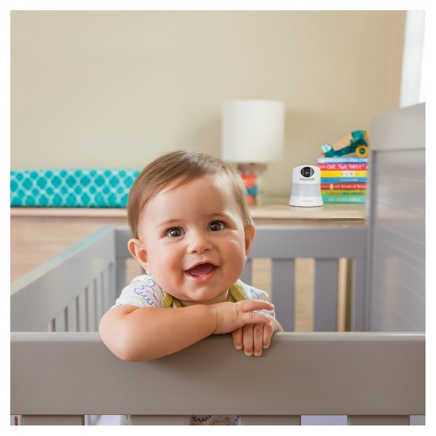
ECE 445 Final Presentation
Child Development Sensor
Team #14
Members : Xiang Wen
Yang An Tang
Eu Hong Woo
TA : Rebecca Chen
Notes:
Hello my name is Xiang and I’m part of the Child Development Sensor Team. Here are my teammates: Yang An and Eu Hong. We are all electrical engineers and our TA is Rebecca. Here is our project.

Slide 2
Project Overview
Assists research led by Prof. Nancy McElwain of the College of HDFS and co-sponsored by Prof. Harley Johnson of the MechSE department.
Problems:
Researchers must be present to obtain data.
Technology used to obtain signals are uncomfortable and unnatural.
Notes:
Assist research in the college of human development and family studies led by Professor Nancy McElwain. Researchers have found that by correlating voice and electrocardiograms, conclusions can be drawn on a child’s emotional and behavioral development. The current issue is the method of obtaining the data. Children need to spend an afternoon in the lab and wear clunky and uncomfortable equipment. It’s in an unnatural setting and researchers need to always be present.

Slide 3
Project Overview
Our project will:
Obtain ECG and voice data from toddlers and children.
Wirelessly transmit data from sensor node to main hub.
Store data locally and on the cloud.
Notes:
Obtain accurate and synchronous ECG and voice data on research subjects.
Wirelessly transmit sensor data in accessible format to a cloud server so authorized users can access it from anywhere with an internet connection.
Develop and implement sensor node (ECG sensor, voice recorder, Bluetooth module, battery source) and main hub (microcontroller, Bluetooth + WiFi module, power electronics) components that fit form factor constraints.

Slide 4
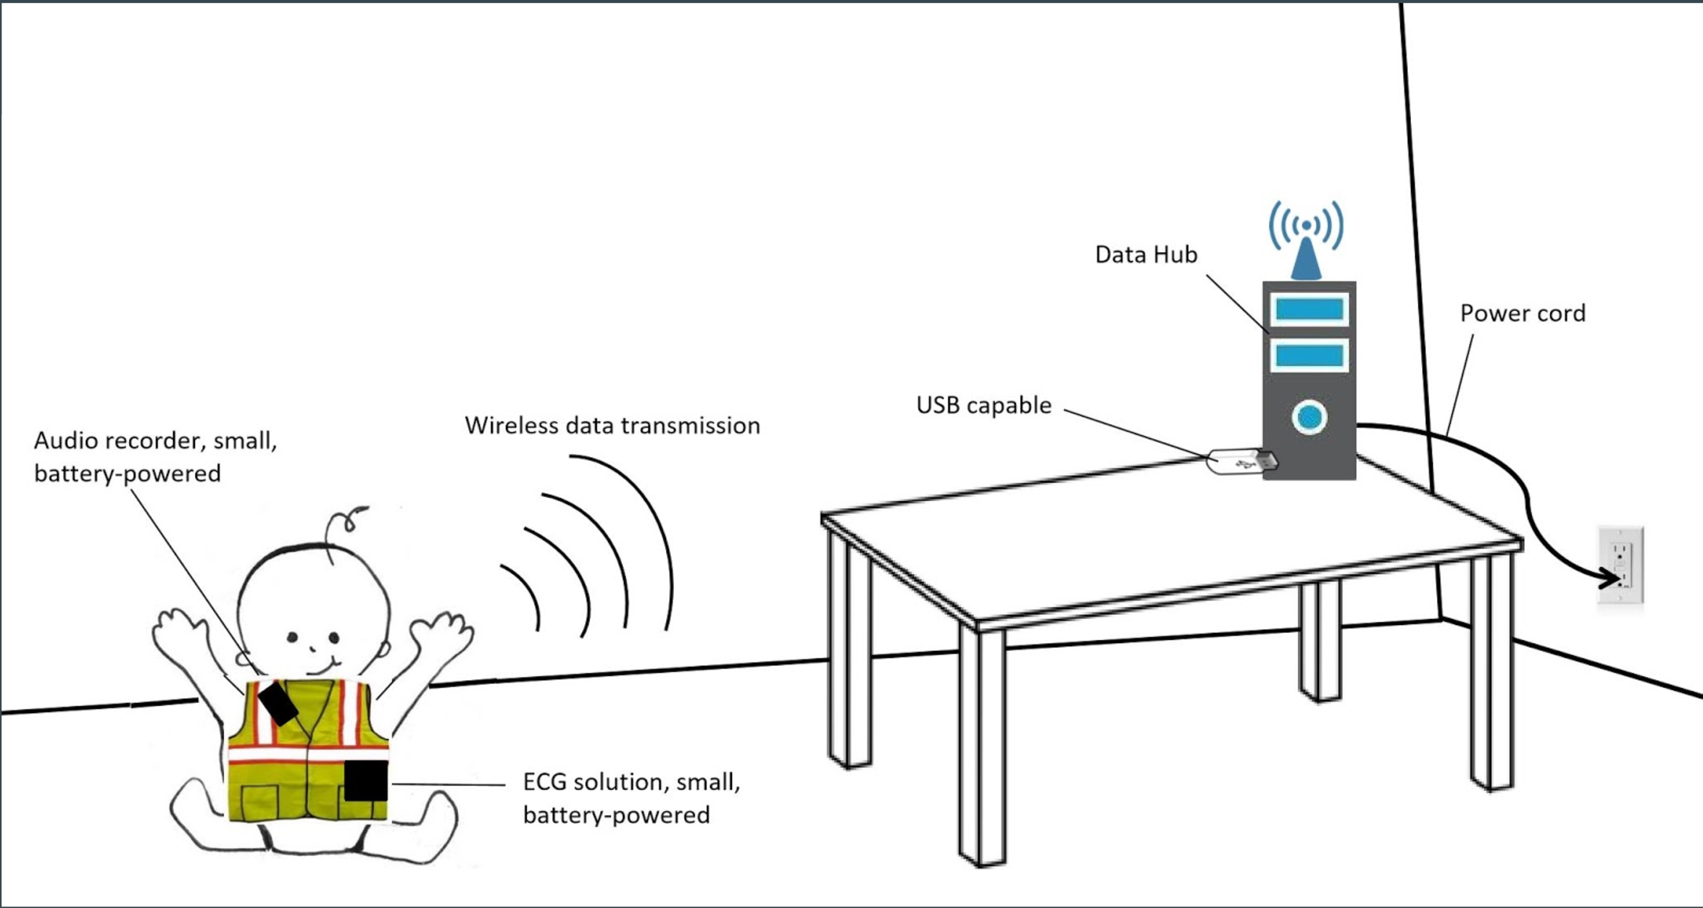
Project Overview
Sensor Node
Use Case Scenario of Child Development Sensor System
Main Hub
Notes:
Xiang

Slide 5
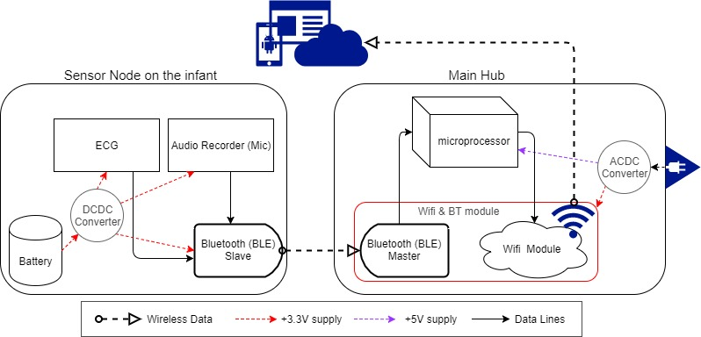
Full System Block Diagram
Notes:
Yang An

Slide 6
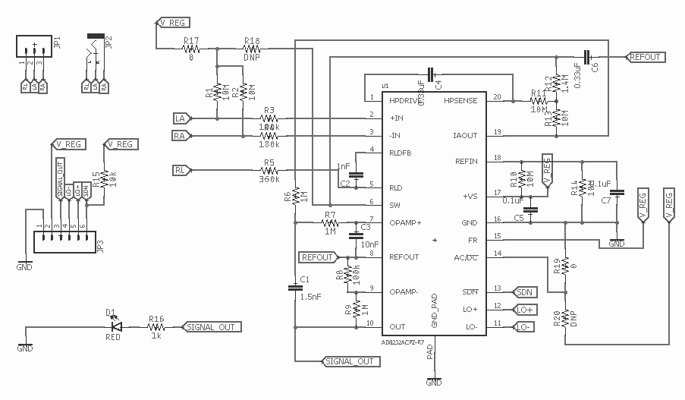
ECG Sensor - Schematic

Slide 7
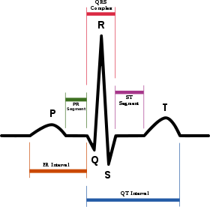
ECG (Electrocardiograph) Sensor
Requirements: ECG sensors at least 70% accurate relative to waveform from a ECG sensors currently used by the research team.
Or qualitatively, out of the 5 main dips and peaks from an ECG waveform, the R peaks needs to be distinguishable.
Notes:
Yang An

Slide 8
ECG Sensor - Results
Sampling rate: 55 Hz, Sampling Depth: 12-bits
The mean absolute percentage error of the RR-I's must be computed, and verified to be lesser than 30%.
Our results show < 1% error.
Obtained ECG
Notes:
EuHong

Slide 9
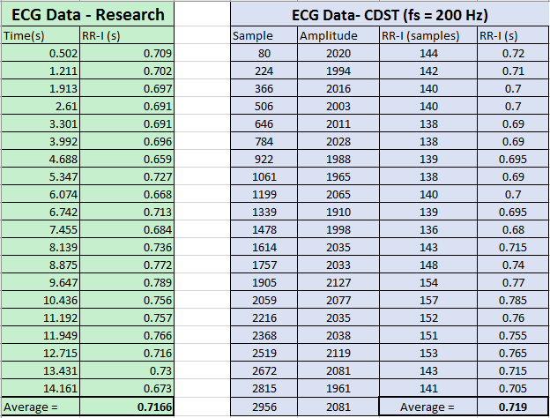
ECG Sensor - R peak interval
New setup show very similar intervals!
83.449 BPM
Current research group interval in seconds.
83.729 BPM

Slide 10
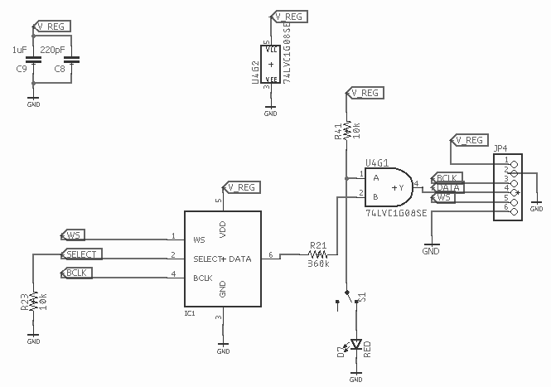
Audio Recorder - Schematic
Notes:
So this is our circuit schematic for the MIC block. We added our own small switch circuit which allows users to turn off the mic recording.

Slide 11
Audio Recorder
Initial Requirements
Audible speech (SNR ~ 6-10 dB)
A hardware mute switch is present for privacy concerns.
Sampling rate: 3 kHz, Configuration: 16-bit mono
MEMs microphone is used which outputs digital I2S signal.
Low sampling rate used due to Bluetooth limitations.
Notes:
Digital over analog to prevent noise from unreliable analog connections.
Low sampling rate is used due to limitations with how fast BLE can transmit.
Signal to noise ratio of about 50 dB-A ('A' means weighted at 1kHz signal).

Slide 12
Audio Recorder - Results
Example mic output
Example muted mic output
Notes:
DEMO THE MICROPHONE OUTPUT
THEN DEMO THE MUTED MICROPHONE OUTPUT

Slide 13
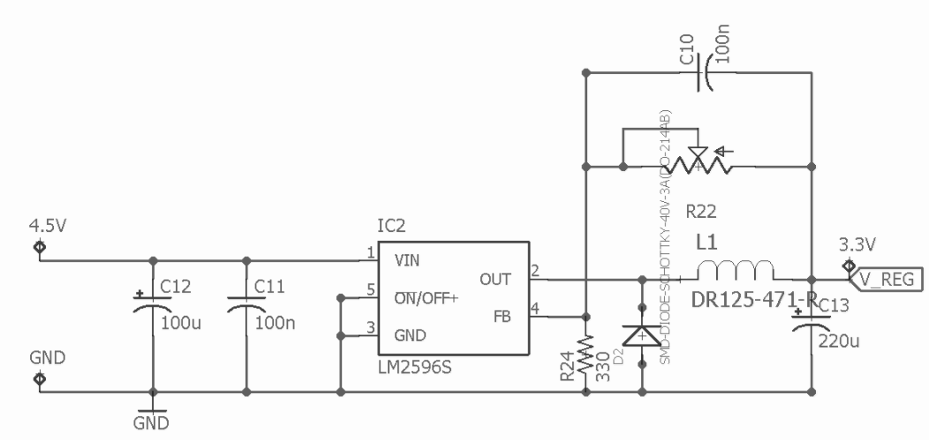
Power Electronics - Sensor Node
DC-DC Buck converter topology using LM2596 chip
Converts 4.5 V from 3 AAA batteries to 3.3 V
Adjustable output voltage useful for quick design changes
Notes:
LM2596 offers wide input range and outputs loads of up to 3 A. Not ideal because low efficiency at low loads but good for debugging and multipurposing.

Slide 14
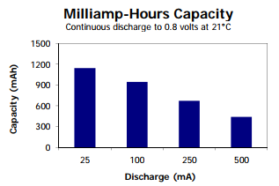
Power Electronics - Sensor Node
Passive components selected based on design requirement of 3.3 V with +/- 0.3 V ripple
Operation time of device must be at least 3-4 hours, length of one research study.
Notes:
Switching converters not perfect, will always have ripple. Choose components to reduce ripple within range. Operation time data was collected and fitted. Using the fit, an estimated operation time using 4 AAA batteries was generated. Good for a bit more than 4 hours.

Slide 15
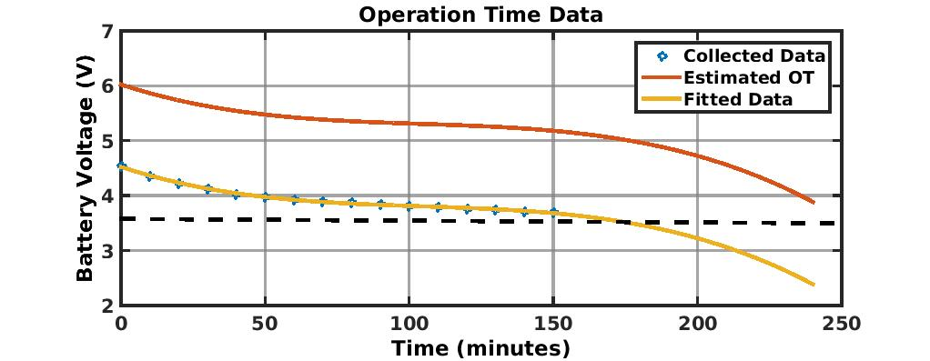
Power Electronics - Sensor Node
Notes:
Switching converters not perfect, will always have ripple. Choose components to reduce ripple within range. Operation time data was collected and fitted. Using the fit, an estimated operation time using 4 AAA batteries was generated. Good for a bit more than 4 hours.

Slide 16
MCU (Micro-Controller Unit)
To process and re-package data on main hub before uploading to the cloud.
Runs a C program that R/W over serial communication with ESP32 (BT + WiFi module).
Being limited by Bluetooth throughput, incoming data needs to be decompressed by bit manipulation.
Notes:
How data packaging was done will be briefly mentioned in later slides.

Slide 17
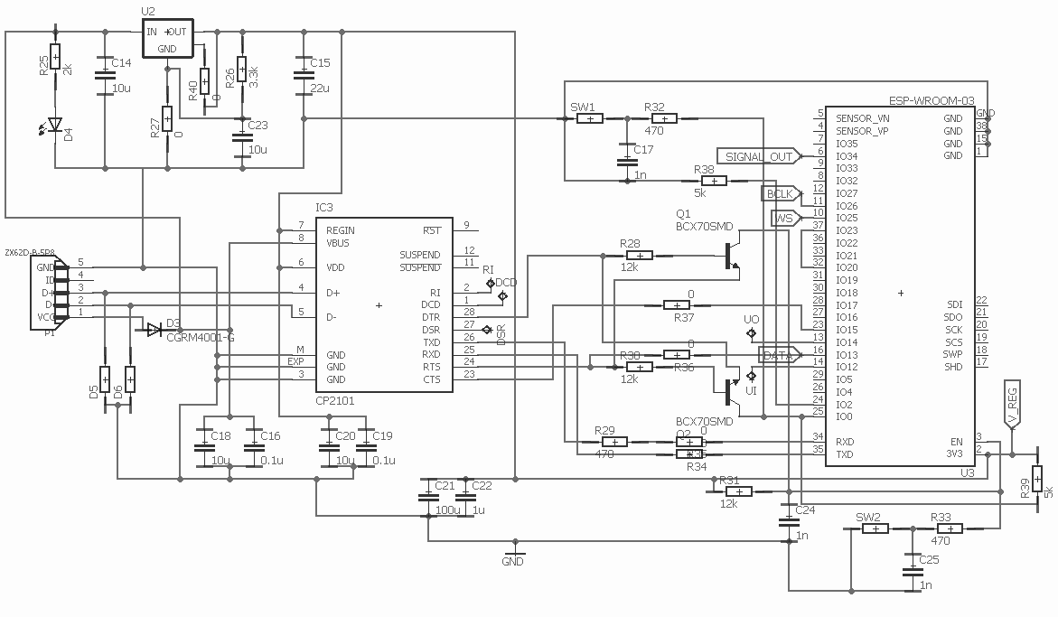
Bluetooth & WiFi - Schematic
Notes:
CP2101 USB to UART converter
ESP WROOM chip
Power regulator

Slide 18
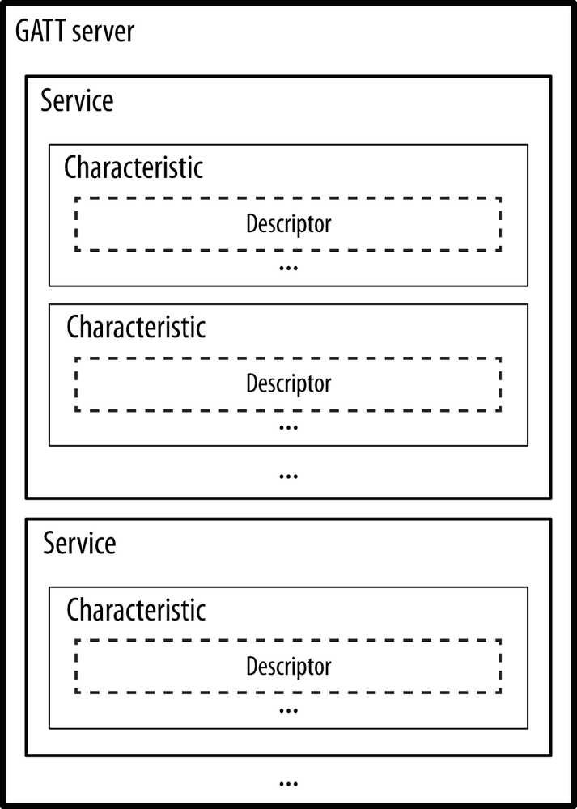
Bluetooth
BLE (Bluetooth Low Energy) used: -
Connection made by using unique UUIDs.
GATT (Generic Attribute Profile) structure contains a single Service.
Service contains two Characteristics, one for ECG data stream, other for audio data.
Notes:
GATT protocol defines how data is organized and exchanged in between different applications.
Connection made by slave scanning for advertising packets sent by the master rather than scanning for bluetooth names, in case there are multiple devices with the same name. Each BT server will have a unique ID regardless if there are two servers with the same name.
Sensor node writes to each characteristic periodically depending on the sampling frequency of each data stream.
Main hub firmware callback function that pulls and process data is triggered on each characteristic value change.

Slide 19
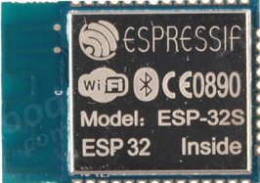
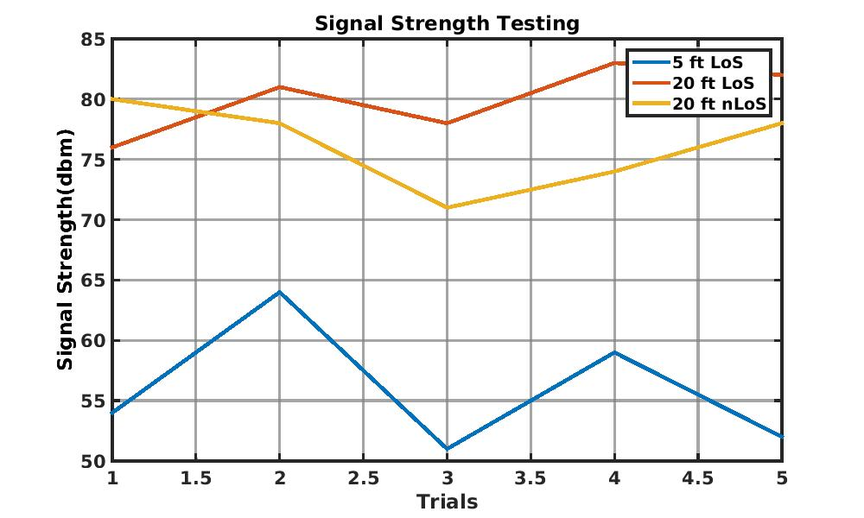
Bluetooth - Range
ESP32 Module

Slide 20
WiFi Connectivity
Enabled on the main hub’s ESP32. Disabled on sensor node’s ESP32 to save stack space and boot time.
Firmware code fully initializes WiFi, then connects to AWS (Amazon Web Services) with appropriate certificates.
A callback function written in the firmware code is triggered on each received data which pushes to AWS IoT.
Notes:
Initialization does most of the configuration declaration such as callback functions, hardware pin settings, drivers, and the TLS structure.
AWS requires a unique root CA and private key for authentication.
Once connected, using AWS APIs we are able to push every data point to AWS IoT as an archiving solution.

Slide 21
Cloud Integration - AWS
AWS IoT - built on MQTT protocol. ECG data is pushed to a specific topic.
AWS Lambda - hosts a Python script written by us that processes incoming MQTT messages containing ECG data.
AWS DynamoDB - NoSQL database that archives all processed ECG data.
Notes:
MQTT is a lightweight data streaming protocol meant for fast IoT development.
AWS Lambda is a serverless script hosting service that allows user written scripts to trigger on specific events such as new MQTT message.

Slide 22
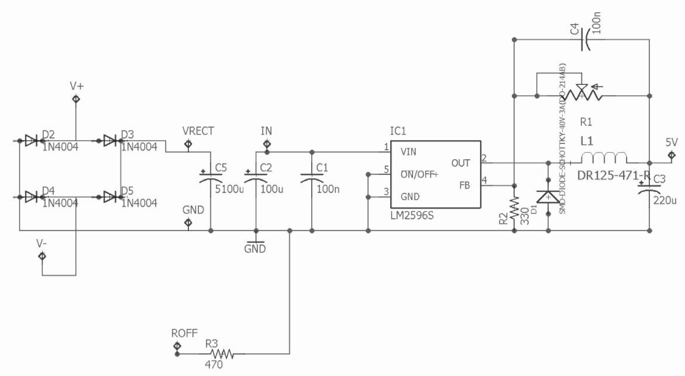
Power Electronics - Main Hub
AC-DC Full-Wave Rectifier topology fed into Buck
Converts wall outlet voltage (120 VAC, 60 Hz) to 5 V DC for the processor

Slide 23
Power Electronics - Main Hub

Slide 24
Firmware - ECG Data Packaging
An ECG data packet is 2 bytes long. The MSB (Most significant bit) of each byte differentiates the header byte. 0 being header.
The 3rd MSB determines if it is ECG or audio data. 0 being ECG, 1 being audio.
Notes:
Three reasons this is needed: 1) bluetooth, UART and AWS is not fast enough
2) bluetooth and AWS makes it easier send data type strings. So we packet it in a way that it avoids the first 20 characters on the ascii table which might cause error
3) Need to tell which is first byte and so on..

Slide 25
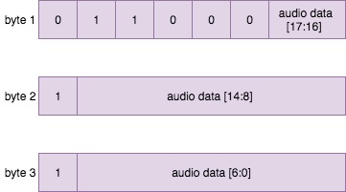
Firmware - Audio Data Packaging
Similar to ECG, the MSB is used to determine header packet or not.
3rd MSB tells whether it is audio or ECG data. In this case 1 is audio.
Other fixed bits are for alignment and to prevent landing on unwanted ASCII characters.

Slide 26
Ethics and Safety
We have to abide to the Institutional Review Board (IRB).
With the research coordinators leading the IRB review process, we have all the required approval to carry out testing.
We managed to acquire approval from the IRB to use AWS services in our project with the help of Prof. Johnson.
For safety, all electronics are housed in a casing so no exposed electronics. Electronics run on low power so minimum heat output.
Notes:
We have to protect the rights and welfare of human subjects in research.
have all the required approval to carry out testing with proper consent and in accordance to IRB protocol.
AWS has never been used in a research project before. The norm is to use box which is IRB approved.

Slide 27
Conclusion
Future Plans and Improvements:
Have ADC (Analog-Digital Converter) attached to each electrode. Travelling digital signals are less prone to noise.
Working with the MechSe team to implement capacitive electrodes instead of adhesive electrodes.
Include AI algorithms in the MCU to detect and drop noisy data.
Increase operation time and rechargeability.
Notes:
- Noise and distortion appears when there is movement. Mostly caused by movement of wires and analog signals are easily affected by it. So we need to implement adc at each electrode.
- Capacitive electrodes don’t need to be replaced every use, and it is less irritating since you don’t have anything sticking on you.
- Currently, distortions in our ecg signals are removed or fixed manually.
- Increase efficiency on power converters, use higher capacity batteries, rechargeable batteries, nickel metal hydride

Slide 28
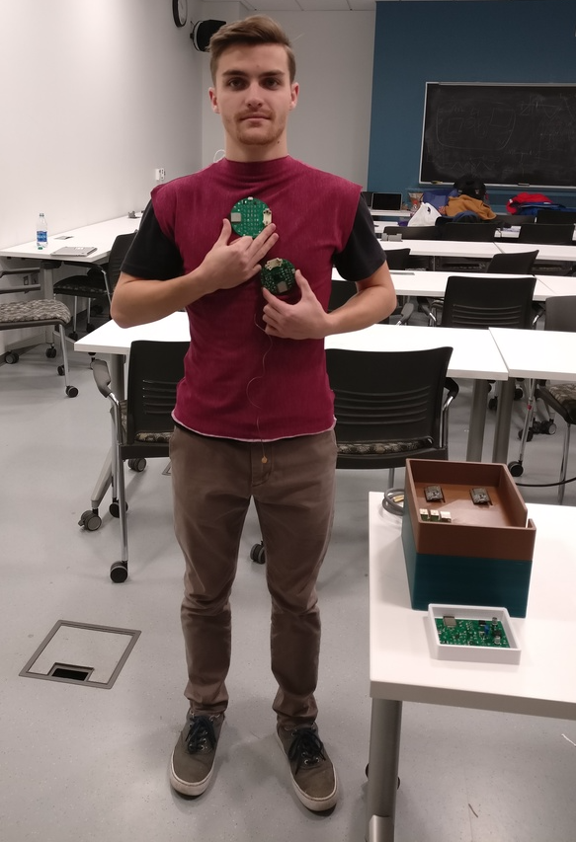
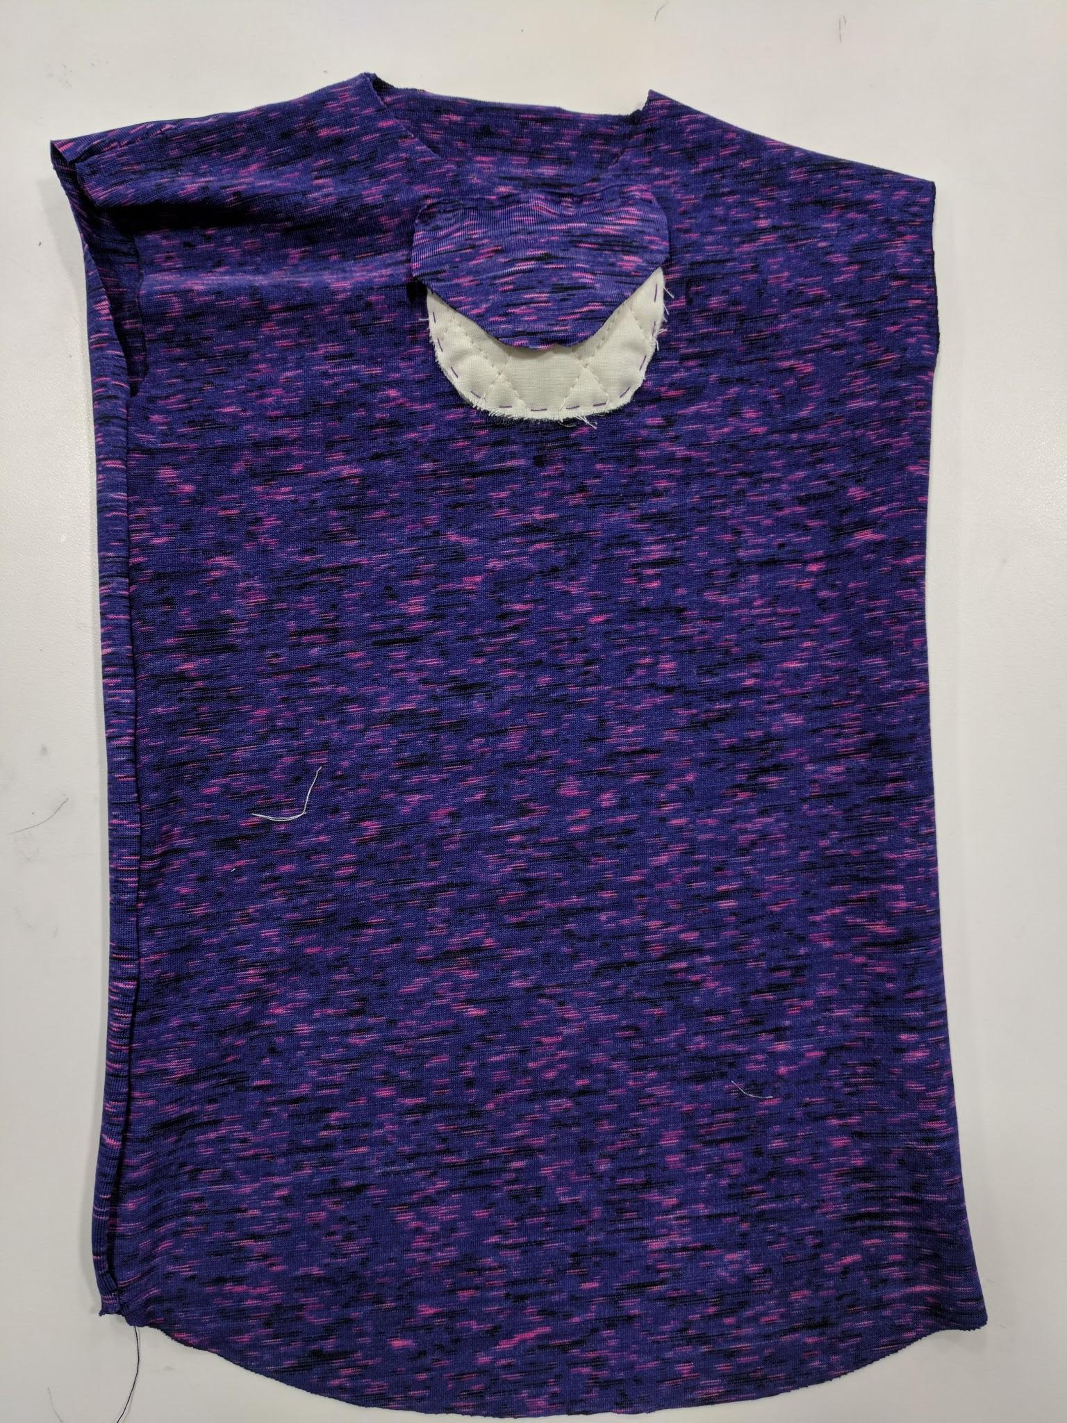
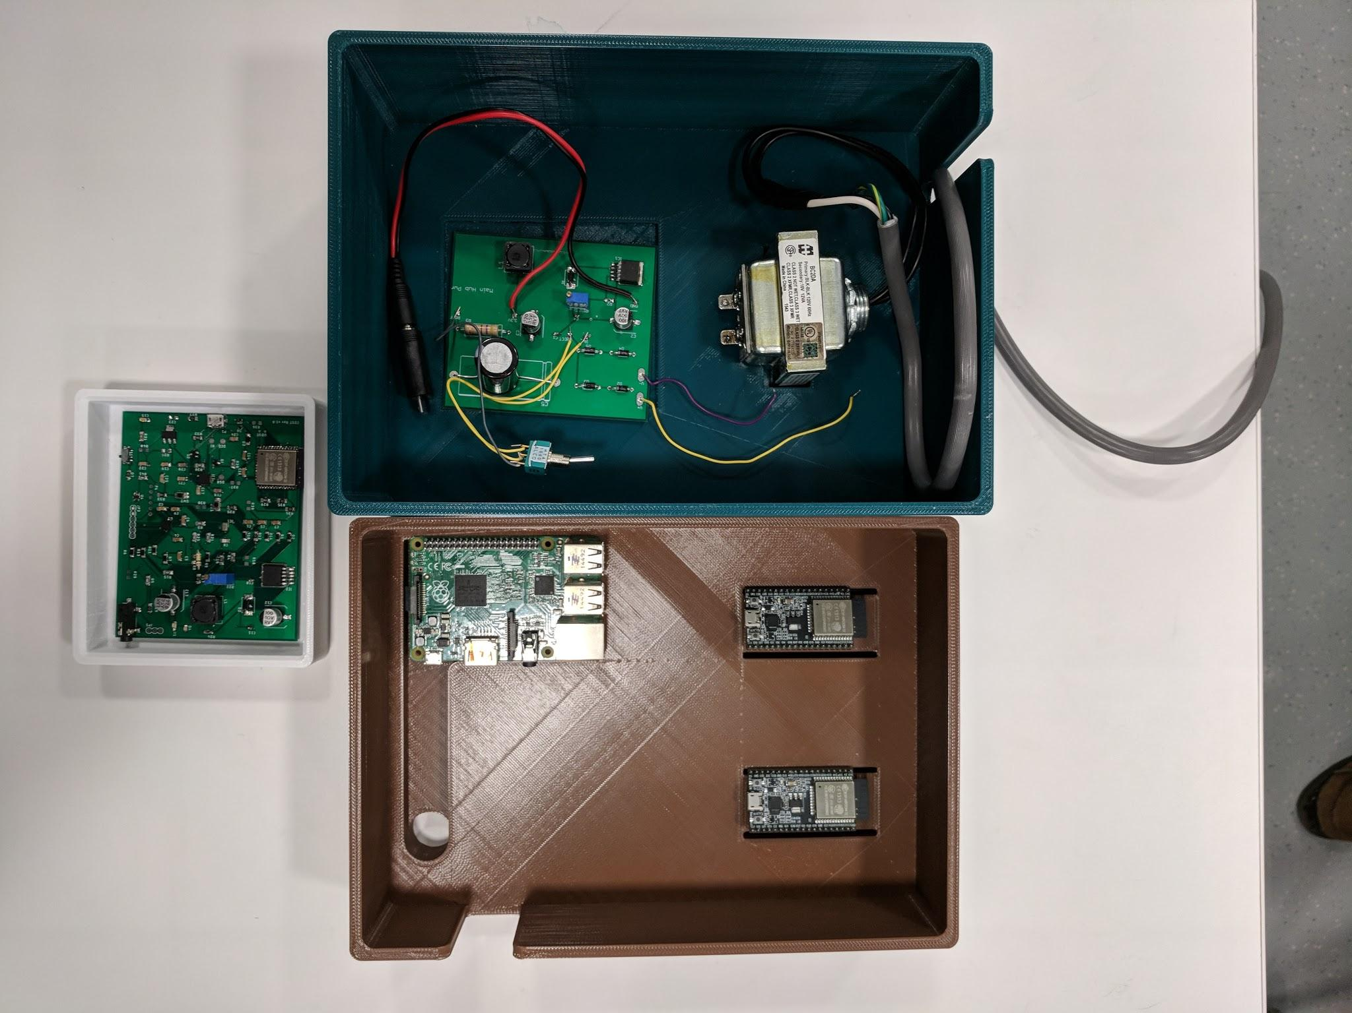
Main hub
Sensor node
Form fitting child vest
Notes:
- left: all of our electronics together. Overiew of what we’ve done.
- Vest for a young child. There is a pouch in the middle for which our sensor node will sit.
- This is a member from the mechse team. He is showing a second generation of pcb design which we helped the mechse team design. It is circular and smaller, having split for each ecg lead and microphone so that there is not many wires running through the body.

Slide 29
Thank you!
Any questions?

