Slide 1
Semiconductor Contact Probe Aligner
Zehua Chen, Stanford Zhou, Zihao Xie
TA: Rebecca Chen

Slide 2
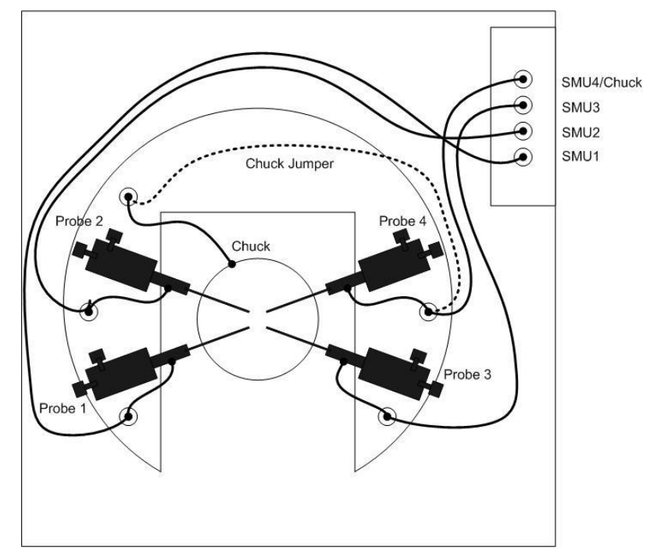
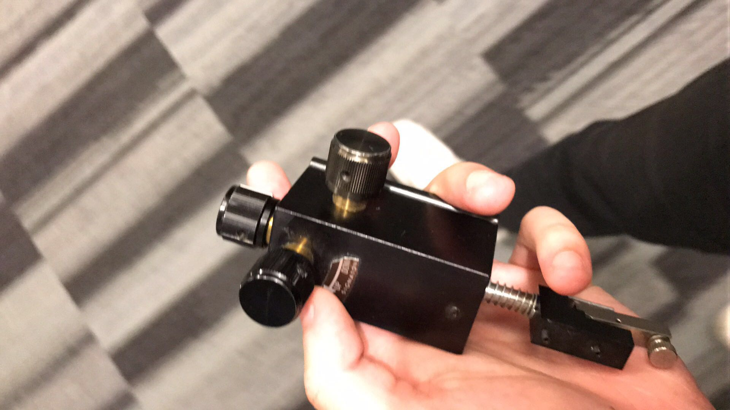
Introduction
Problems with manual probe aligner
Electronic control with motors
Precision enhancement
Protection features

Slide 3
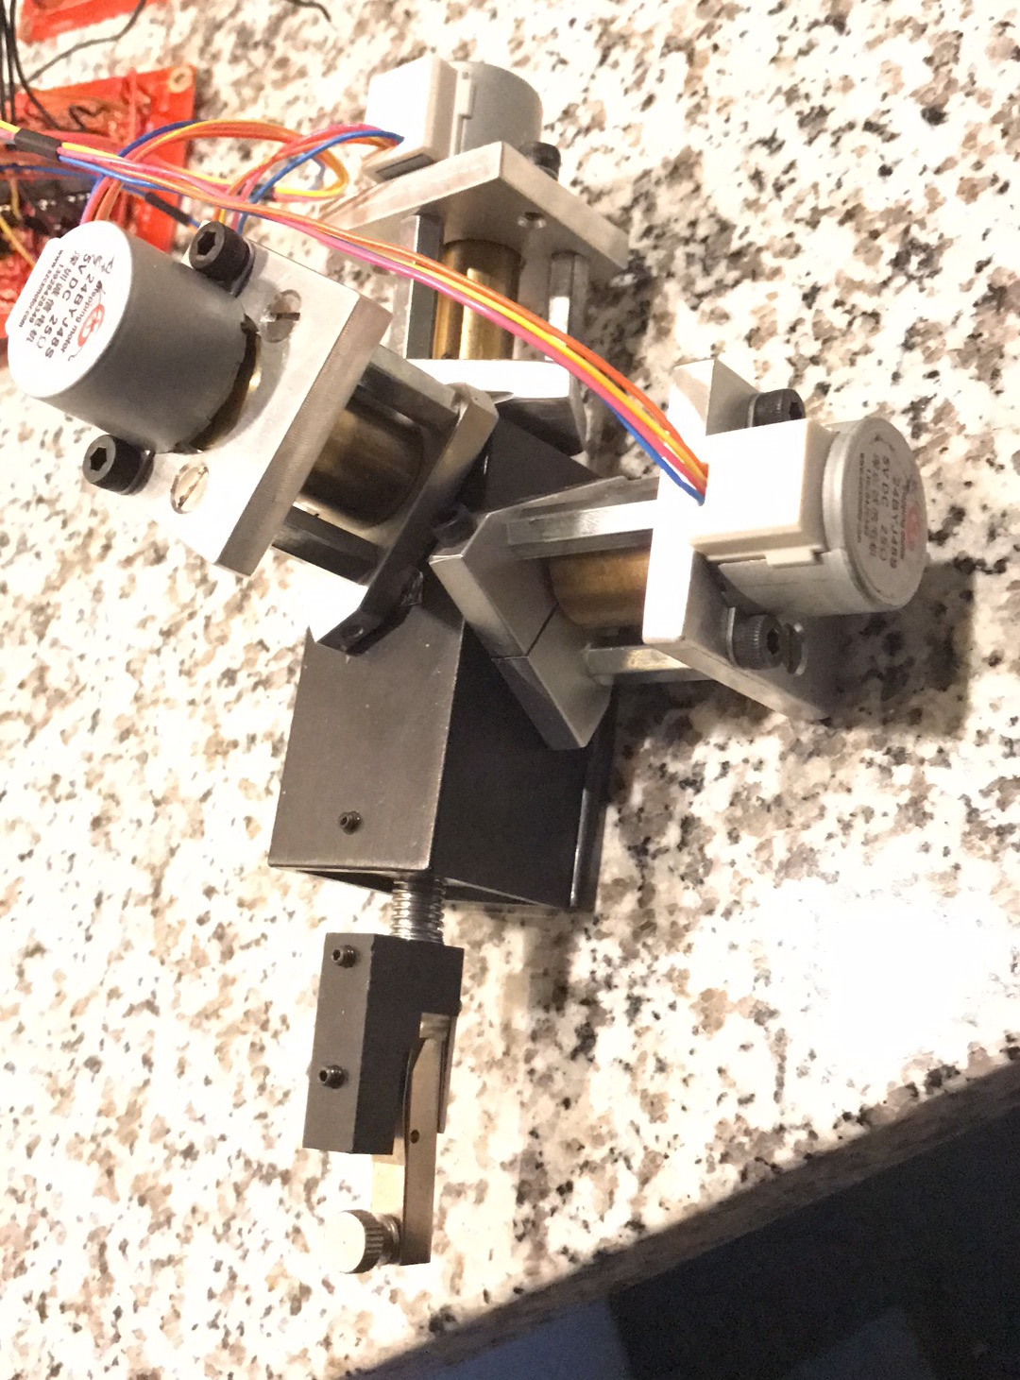
Final Design
3 stepper motors, one for each knob
Webpage based User Interface
Keyboard movement control

Slide 4
Block Diagram:

Slide 5
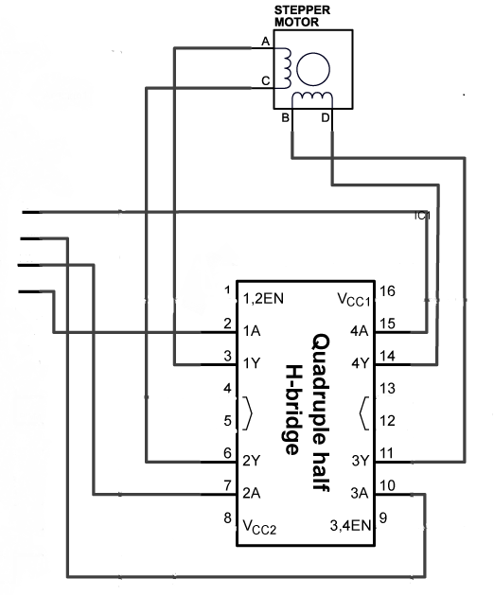
Motor Unit
6x precision compared to manual control
Motor controlled by 4 digital inputs

Slide 6
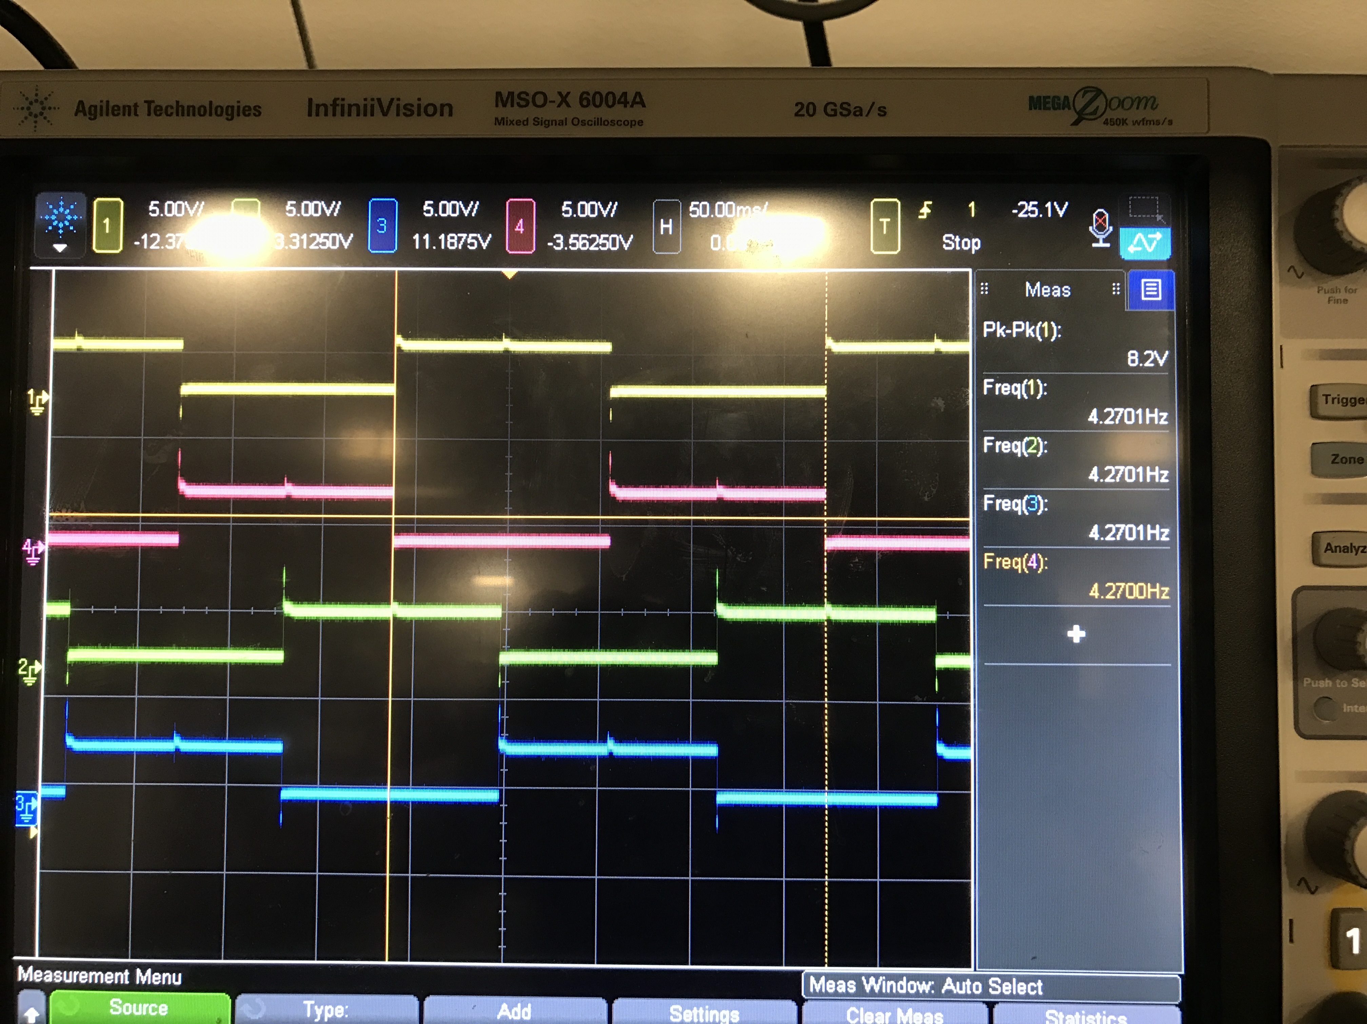
Clock-wise: Counterclockwise :

Slide 7
Generated Signal:

Slide 8
Generated Signal
First step is to generate a clock signal using 555 time delay chip.
The clock frequency should be four times larger than the desired motor driving signal.
The clock signal will be fed as the Din to the control unit.
The output from the control unit will go to the flip-flop circuit to generate the signal for the motor drive.

Slide 9
Control unit
The control unit has three components.
1. A 2-to-1 multiplexer(MUX) for speed selection.
2. A 1-to-4 de-multiplexer(MUX) for probe selection.
3. A 1-to-4 de-multiplexer(MUX) for motor selection.

Slide 10
Control unit
The selection bits for each component will be given by the Arduino board by the user interface.
1-bit for direction selection.
1-bit for speed selection.
2-bit for probe selection.
2-bit for motor selection (00 for default state).
No motor motion is allowed at default state.

Slide 12
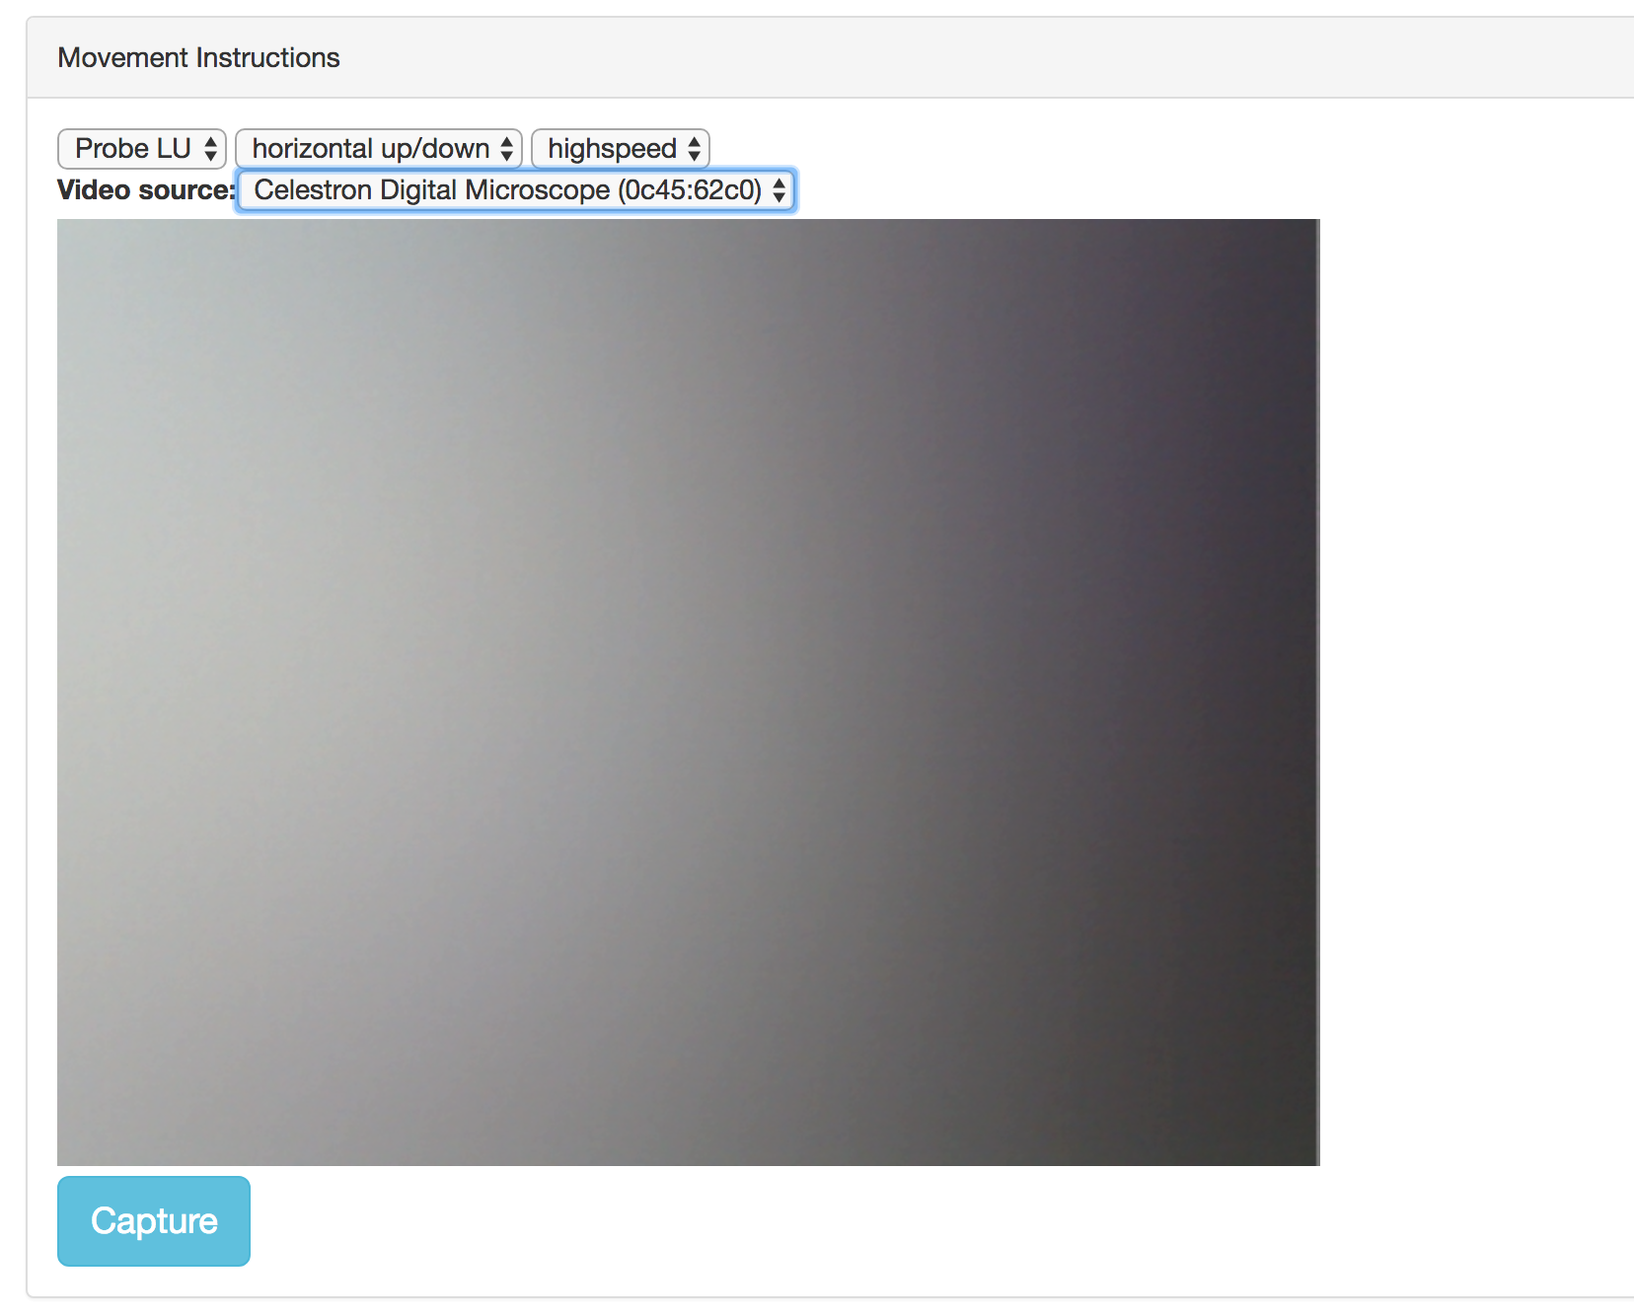
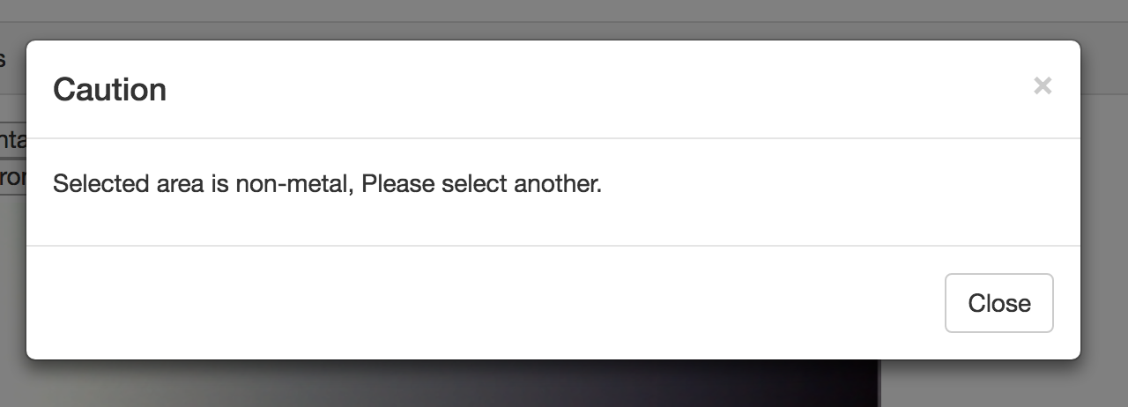
User Interface
Keyboard control
Drop down menus
The capture button
Metal detection software

Slide 13
Requirements & Verifications
Most of our features were accomplished to some level in our project.
Delay from PC to motor is bearable(around 0.5 seconds)
Project is sustainable given reliable power source

Slide 14
Issues and future improvements
Power circuit gets overheated easily.
Image processing software can be improved.
Project would be more practical with PCB control unit.

Slide 15
Thanks for watching!!

