Slide 1
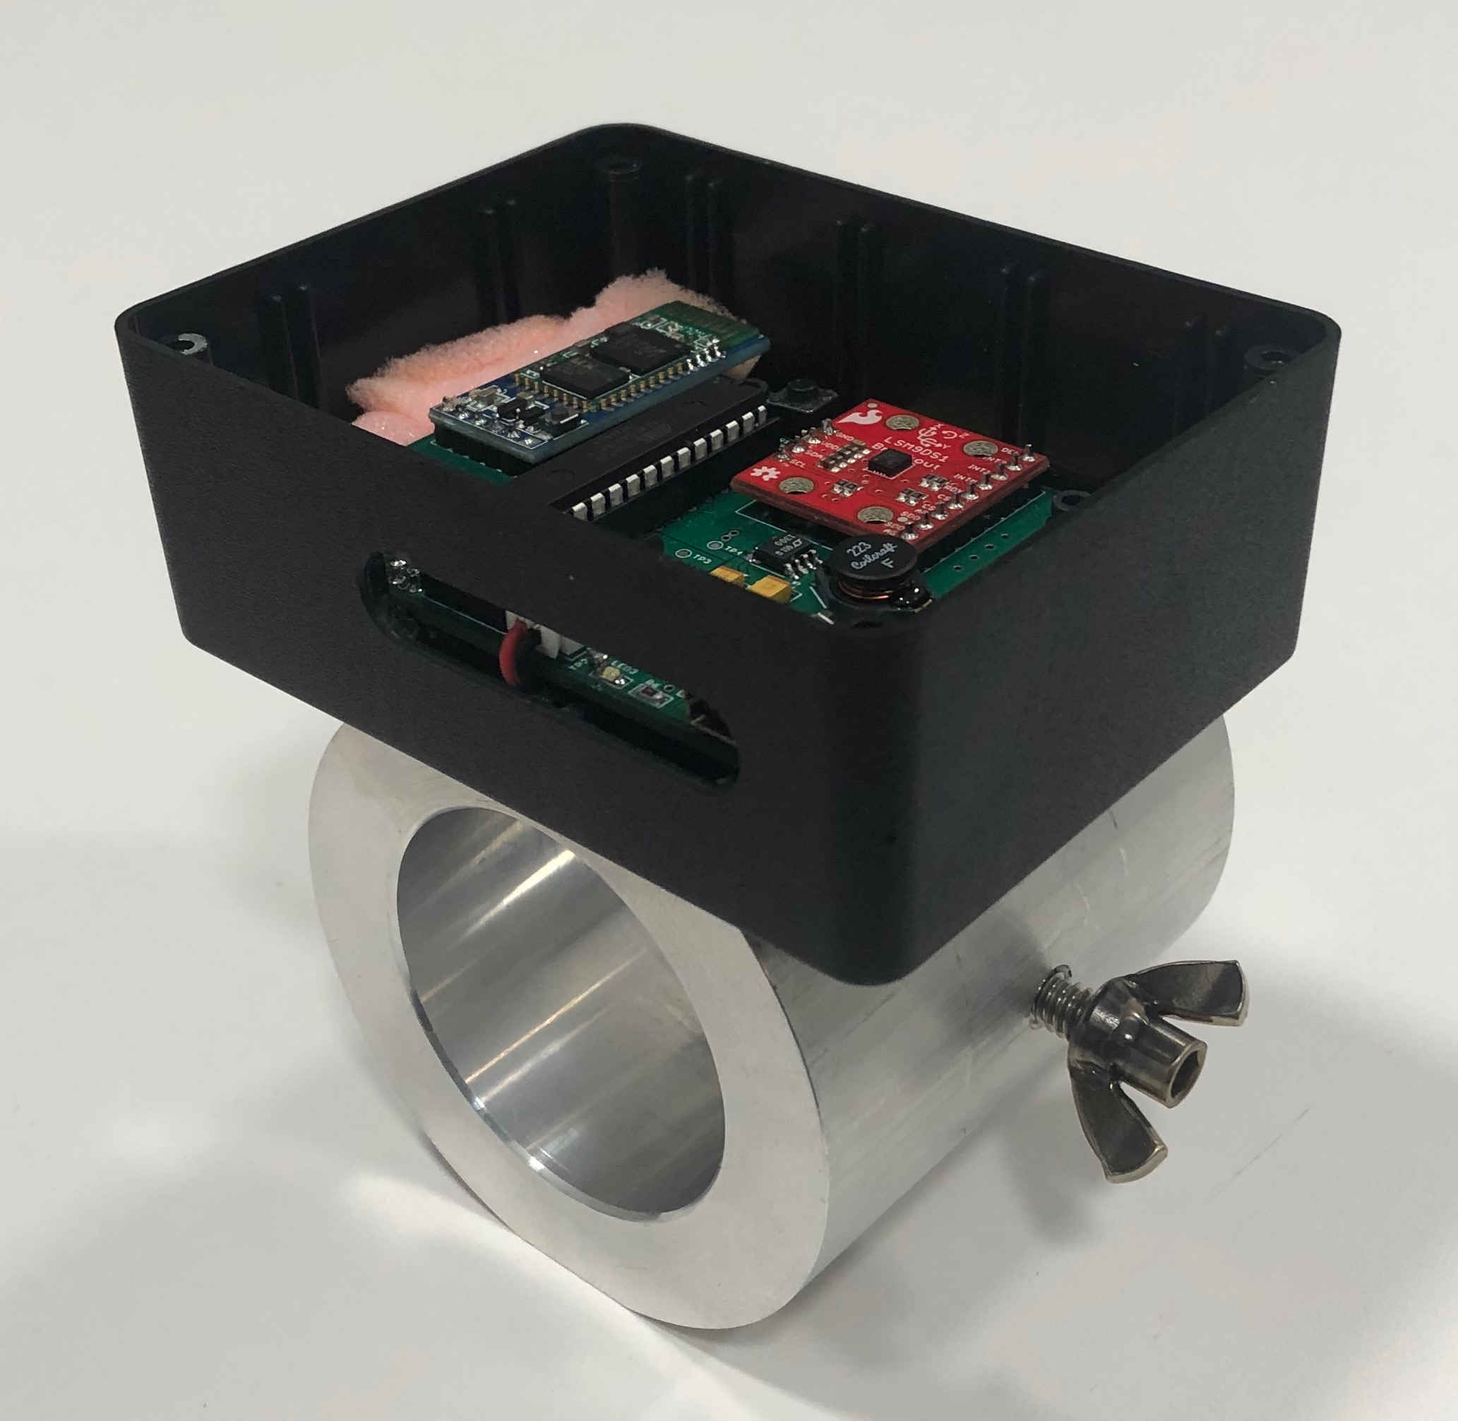
LiftSense Barbell Collars
Ethan Filzone - Chase Johnston - Rohin Kumar
Team 2

Slide 2
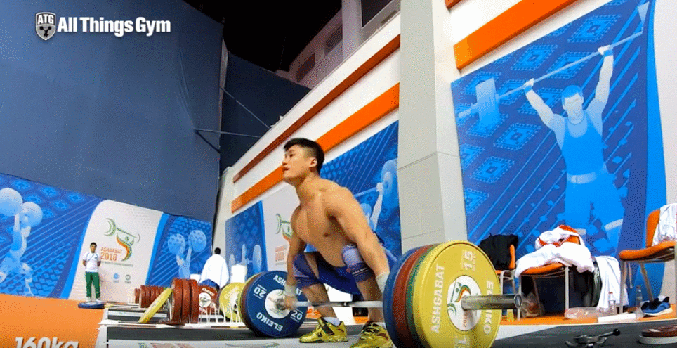
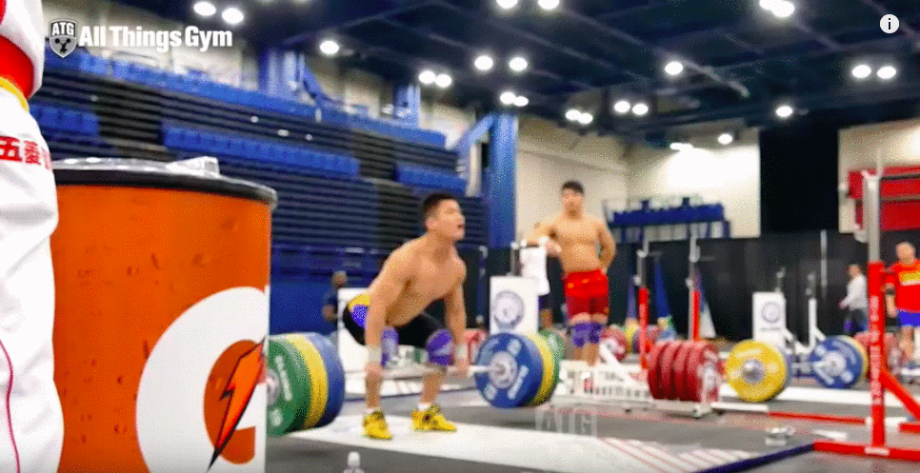
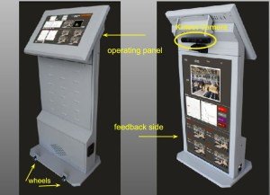
The Problem
Olympic Lifting is a highly technical sport which requires a combination of ...
Strength
Power
Speed
Coordination
Balance
Current options to become better at the Olympic Lifts …
A personal coach who has trained in these lifts for years
Chinese Weightlifting Instant Lift Assessment System (Not available to the public)

Slide 3
Our Solution
Goal: Provide recreational Olympic Lifters with the necessary feedback to become better at the Olympic Lifts
Feedback:
Velocity -> The faster the barbell moves in the vertical direction the higher the chance of a successful lift
Barbell Path -> The less deviation the barbell moves from a perfectly vertical path the higher the chance of a successful lift
Simply …
We want to move the barbell as fast as possible while ensuring optimal technique

Slide 4
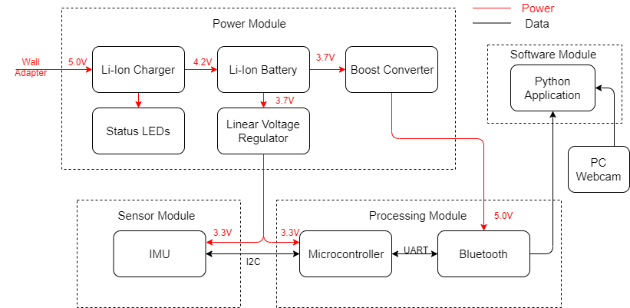
Our Solution
LiftSense Barbell Collar
Python Script

Slide 5
Mechanical Design
Lightweight
Durable Construction
Portable
Easy to Slide ‘On’ and ‘Off’ Barbell
No Interference to Lifter
No Inconvenience to Lifter
Low Cost

Slide 6
Velocity
How?
IMU
Accelerometer -> Measures linear acceleration in x, y, z direction (m/s²)
Gyroscope -> Measures angular velocity (degrees/s)
Magnetometer -> Measures magnetic field strength (uT)
Roll, Pitch, Yaw
Roll = 180 * atan2(accelY, sqrt(accelX*accelX + accelZ*accelZ))/PI
Pitch = 180 * atan2(accelX, sqrt(accelY*accelY + accelZ*accelZ))/PI
Yaw = 180 * atan2(-magY, magX)/PI
Gravity Factor
G_{z} = g*cos(roll)*cos(pitch) where g = -9.8
A’_{z} = A_{z} - G_{z}
Integration
Perform trapezoidal integration on A’_{z} with small time steps to get velocity

Slide 7
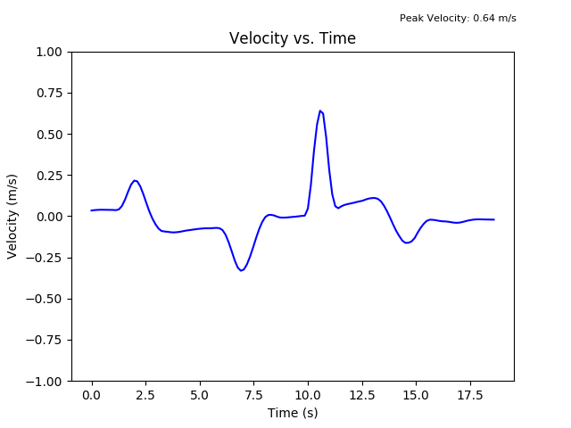
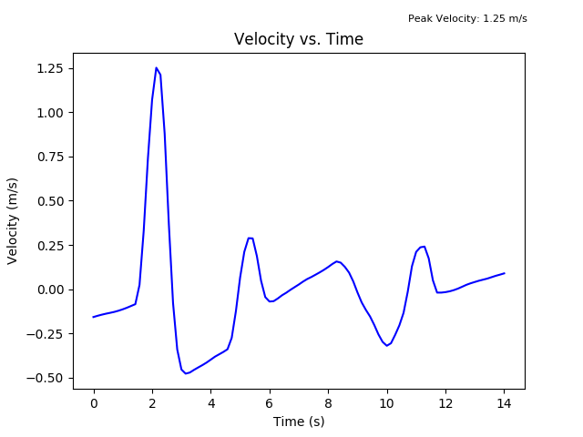
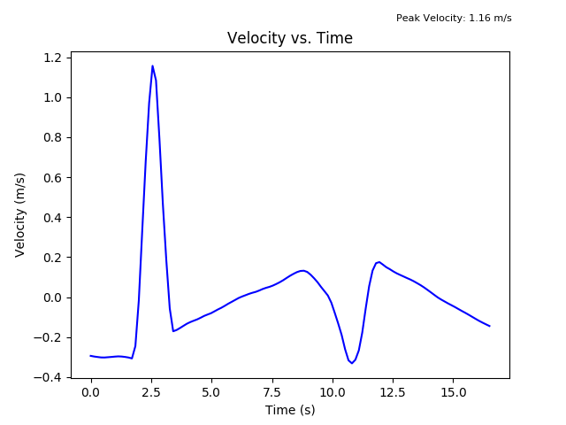
Velocity
1 Slow Deadlift + 1 Fast Deadlift
1 Clean & Jerk
1 Snatch

Slide 8
Barbell Path
How?
Computer Vision
Determine which color we want to track (green, yellow, blue, red)
Convert to the HSV (Hue, Saturation, Value) color space
Perform localization of object and filtering
Compute outline/contours of object
Determine centroid of object
Draw line connecting previous centroid position to new centroid position
Display Frame
Why This Algorithm?
Pros: Tracking color in a frame is much faster than tracking an object. This allows us to track the lift in real time
Cons: Wearing a red t-shirt while tracking a red bumper plate will likely be problematic

Slide 9
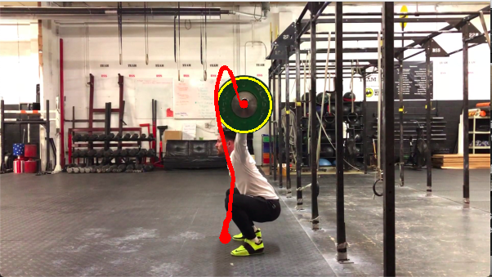
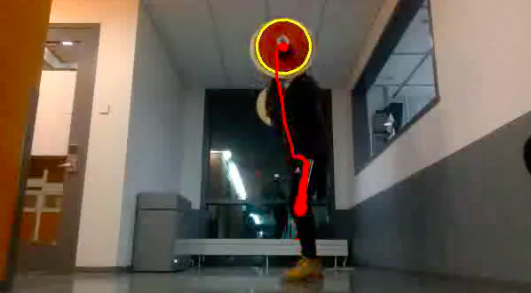
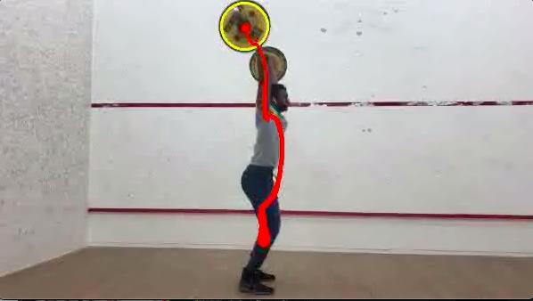
Barbell Path
1 Snatch
1 Hang Power Clean
1 Clean & Jerk

Slide 10
The Upshot
Was I pulling the barbell fast?
Was I using the proper technique?

Slide 11
Summary of Features
For Any Olympic Lift …
Velocity vs. Time
Peak Velocity
Barbell Path
Can be used even if you forgot your LiftSense Barbell Collars at home!
Just record a video your phone and pass it into the python script
Seamless Mechanical Design
Fully Integrated Python Script
Easily Connects to PC via Bluetooth
Rechargeable device via micro - USB and Wall Adapter

Slide 12
Future Work
Improve removal of drift and noise via advanced filtering techniques
Kalman Filter / Sensor Fusion
Phone application for enhanced and easier user interaction and experience
Android / iPhone Application
Object tracking versus color tracking for computer vision?
Neural Networks

