Slide 1
Self-Adjusting Jacket
ECE 445 SP2017
TA : Kexin Hui
Team #76
Haoyu Wu
Michael Hou
Chuan xie

Slide 2
During certain times of the year, the outdoor temperature varies a lot throughout
the day.

Slide 3
Introduction
The goal of the project is to make a jacket that can sense the temperature of current environment and adjust the “thickness” of itself automatically.
To adjust the thickness of jacket, we will use the insulating property of air.

Slide 4
High Level Requirements
Battery Life
4 AA batteries can sustain and provide the electricity of the whole system for at least two hours.
Temperature Range
The system will automatically adjust the thickness of the jacket when a temperature change greater than 1 degree occurs
Thermal Insulation
When the air pockets are filled with air at an appropriate level, the user will feel warm in an environment lower than 10 celsius.

Slide 5
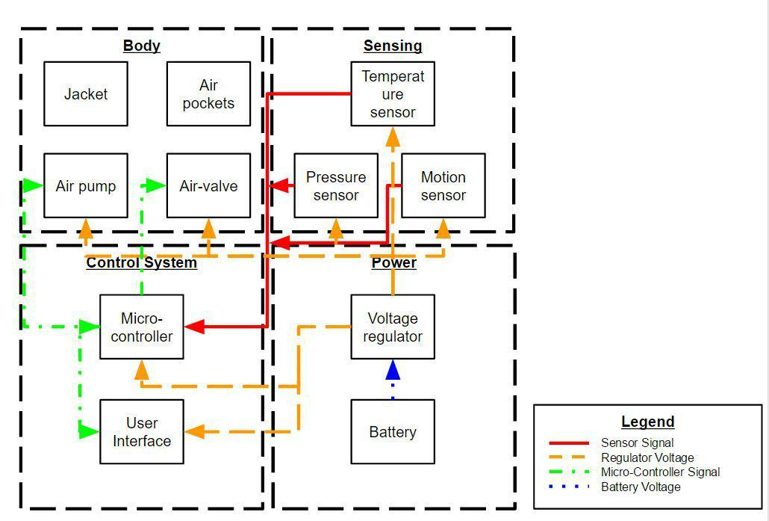
Block
Diagram

Slide 6
Main Body
Consists of the air bags, an air valve, and an air pump.
All components as air-tight as possible.
Serves as the insulating thermal layer.

Slide 7
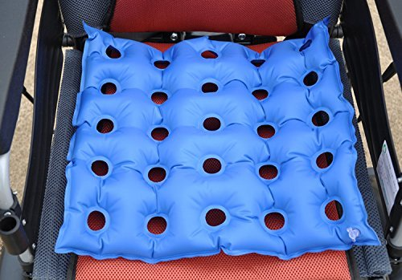
Air Bags
Flexible, foldable, and
light weight
Min. height = 1.95cm
R-value = 0.87

Slide 8
Insulating property of Air
Gasses like air do not transfer heat very well because the molecules are so far apart from each other.
R-value of Air = 0.87 at 1.95cm
Recommend R value for skiing is around 1.7

Slide 9
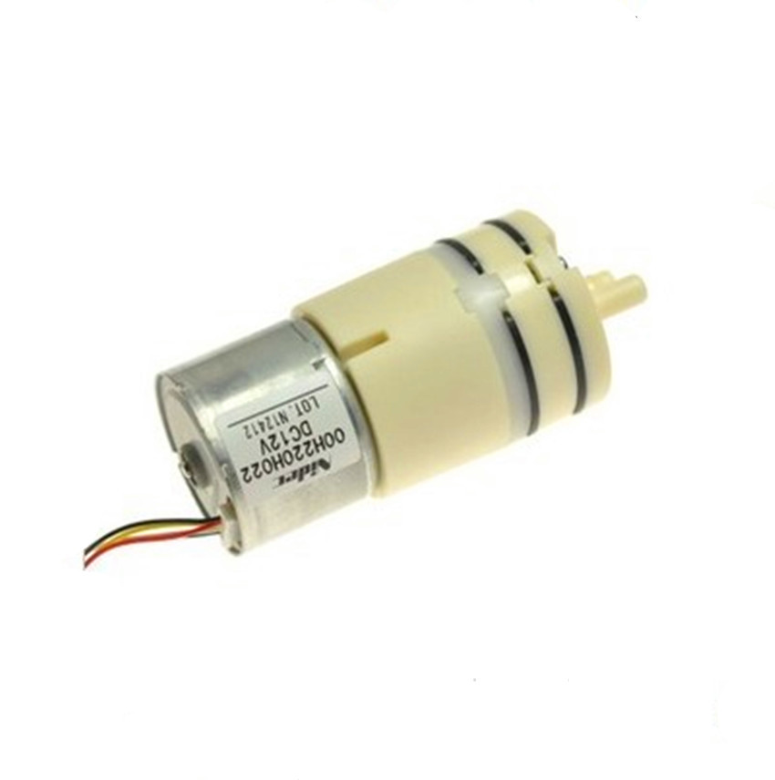
Air Pump
SIZE VS POWER
Max Voltage is 6V
Pump the air bag to
Desired height of around 2cm in
150 seconds

Slide 10
Sensing Unit
Temperature Sensor
Temperature Sensor senses the current environment temperature
Motion Sensor
Motion sensor measures whether the jacket is currently being worn
Pressure Sensor
Measures the air pressure inside the air pockets

Slide 11
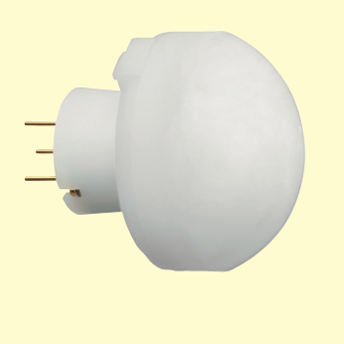
Motion Sensor
Infrared Motion sensor
Max distance - 3M
Detect Condition:
The temperature difference between the target and the surroundings must be higher than 4 degree
Movement Speed: 1.0m/s
Target Concept: Human Body with approx size of 700x250 mm

Slide 12
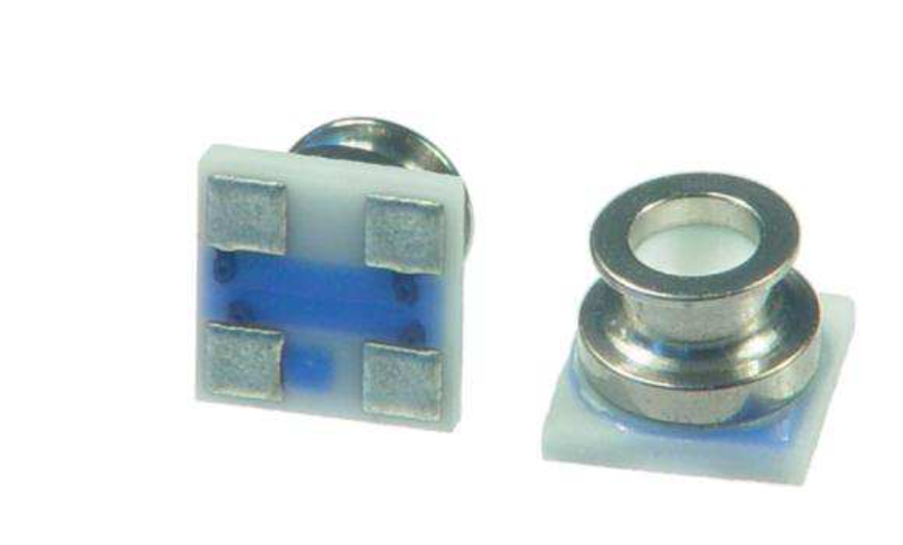
Pressure/Temperature Sensor
High Unit Cost $16
Small size - 3.3 x 3.3 x 2.75 mm
1.8 x 0.8 mm O-ring
( Fit our tubes)

Slide 13
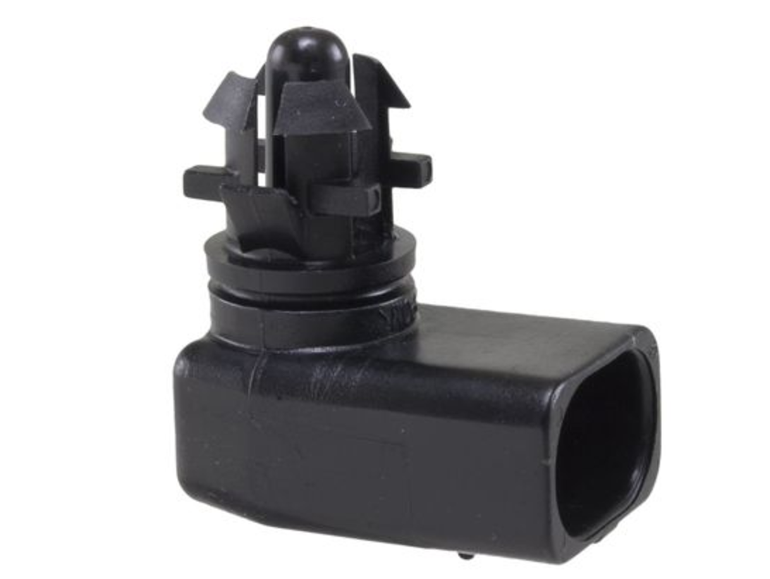
Temperature Sensor
Resistance Temperature Detector
Temperature Increases, Resistance Increases

Slide 14
Control System
Interpret the input from sensors
Receives data from user interface
Control the air valve and air pump

Slide 15
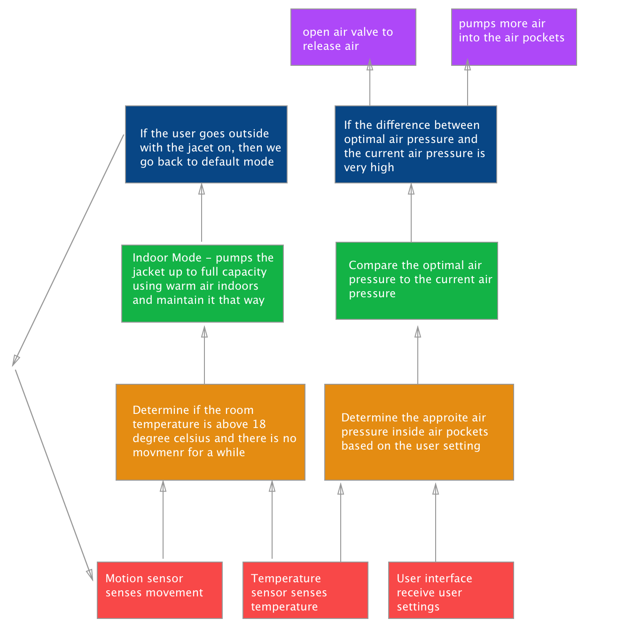
Control Logic
3 Inputs
Motion sensor
Temperature sensor
User interface
2 Outputs
Air pump
Air valve
Story for illustration purposes only

Slide 16
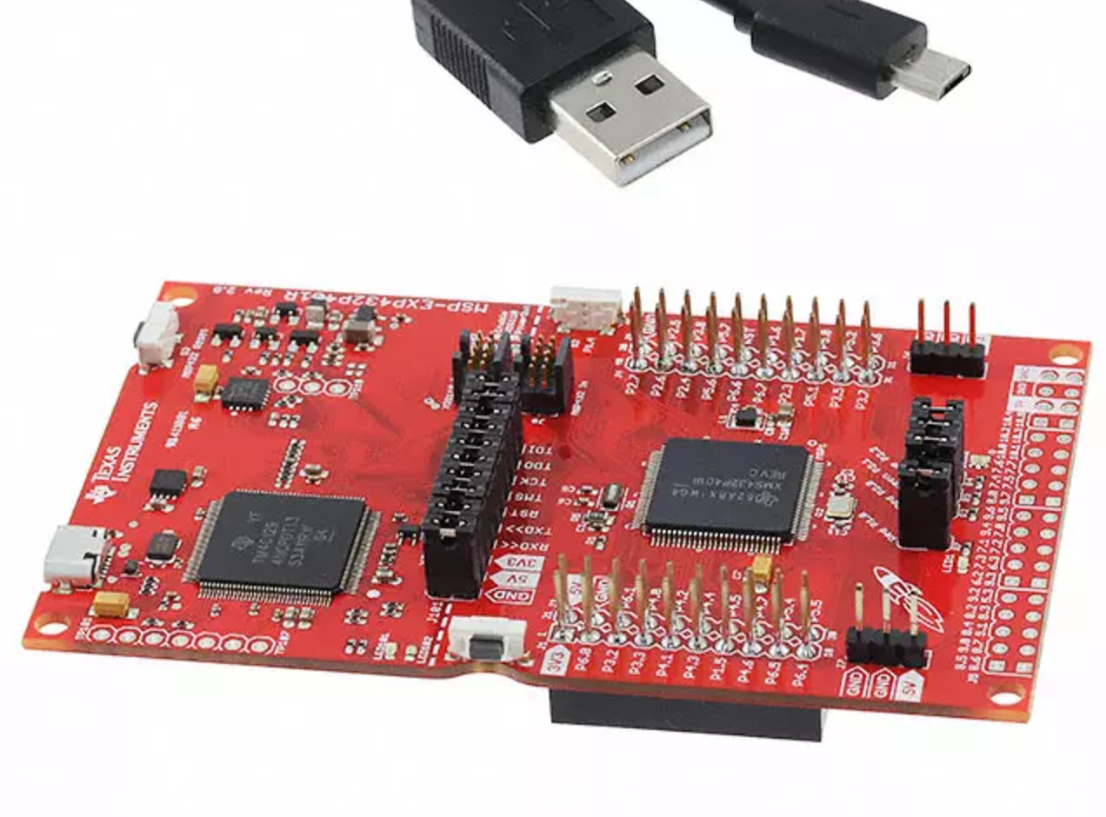
Microcontroller
AnalogRead
Map 0-3v into integer values between 0-1023.
0.0029 v per unit
DigitalWrite
Output voltage 3.3v

Slide 17
Interpret Analog Readings
Room temperature average - 23 °C
Temperature reading starting point - 676
Reading begin to drop as we touch the temperature sensor (very slowly)
37 °C - 480

Slide 18
Temperature Sensor Readings
Time ( seconds) | Value | Temperature ( °C )
0 | 676 | 23.2
45 | 636 | 25.8
90 | 593 | 28.6
135 | 551 | 31.4
180 | 513 | 34.2
225 | 480 | 37

Slide 19
Damaged Pressure Sensor
Use clock cycle instead
Delay(500) each cycle - 0.5 seconds
150s - a counter to 300

Slide 20
Power Unit
4 AA batteries provides 6V voltage
Use voltage regulator to get 3.3v to feed the sensors
Support the whole system for at least 2 hours

Slide 21
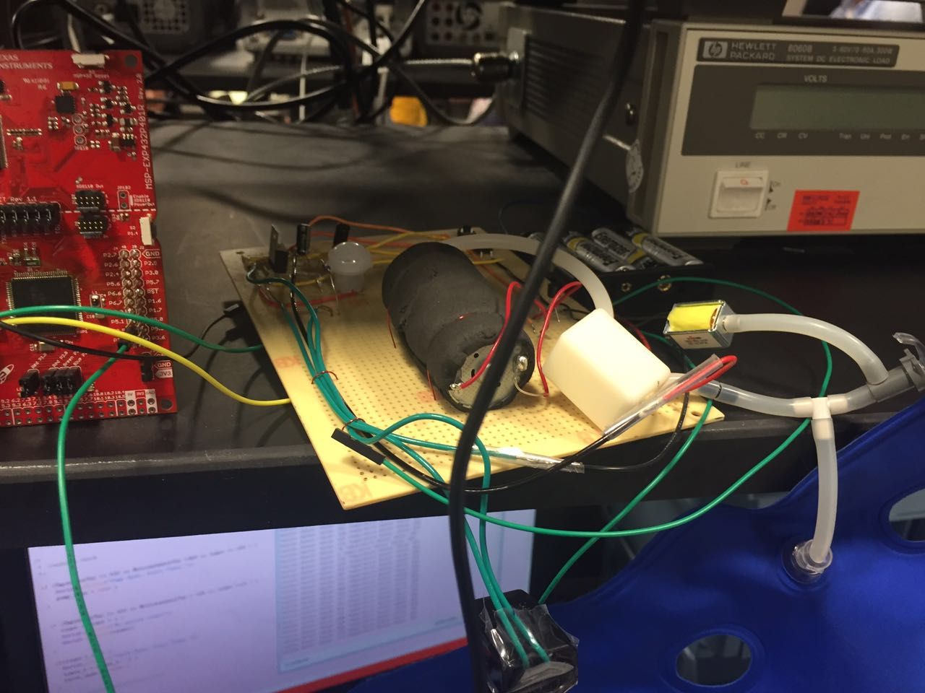
Circuit Components
Temperature Sensor
Motion Sensor
Motor
Valve
Microcontroller
Airbag
Voltage Regulator

Slide 22
Future Work
Redesign air bags to wrap around a jacket
Wifi Capability
Using rechargeable batteries
Small LED panel indicating the temperature and the percent of air which is filled in the air bags

Slide 23
End of Presentation.
Thank you for watching and
listening.
Team # 76

