Slide 1
Modular Analog Synthesizer
Group 29
Robert Olsen & Joshua Stockton

Slide 2
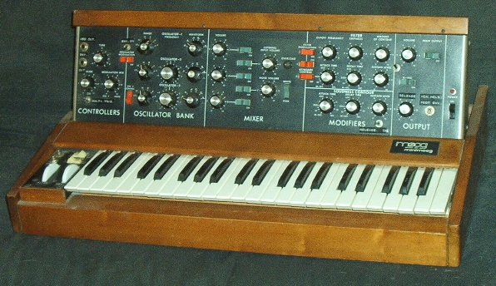
Introduction
Musical synthesizers have been around since the 1920’s
Typically consist of Voltage Controlled Oscillator (VCO), Voltage Controlled Amplifier (VCA), and Voltage Controlled Filters (VCF)
Not necessary to have a piano-style user input, but commonly seen
Moog Minimoog (released 1970)

Slide 3
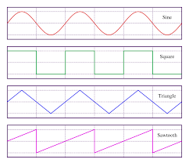
Objective
Music education lacks timbre
Timbre is quality of a sound (smoothness or roughness)
Simple, easy method for all ages to access concept of timbre

Slide 4
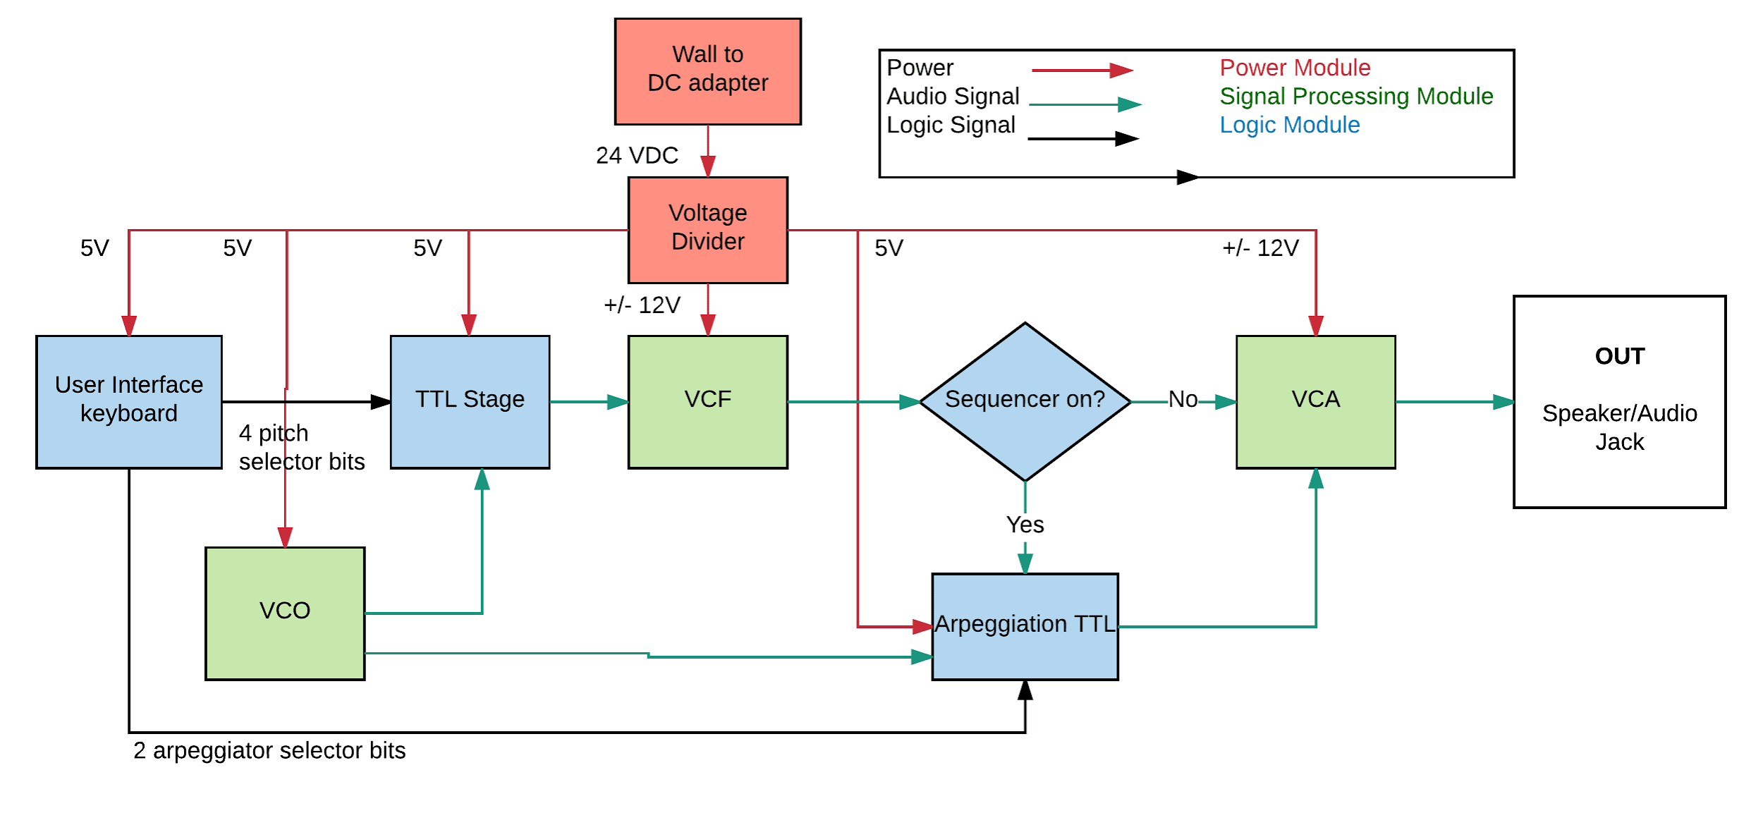
Block Diagram

Slide 5
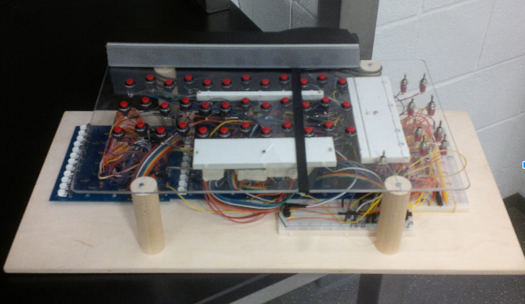
The Synthesizer
Amplified Speaker
3 Rows of Keys
Arpeggiator Control
Octave Select
Tempo Control

Slide 6
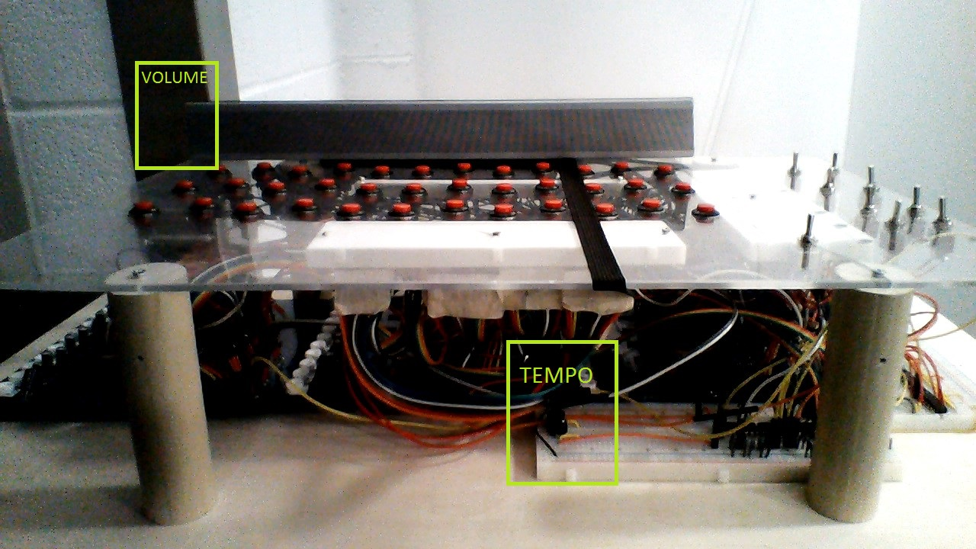
User Inputs

Slide 7
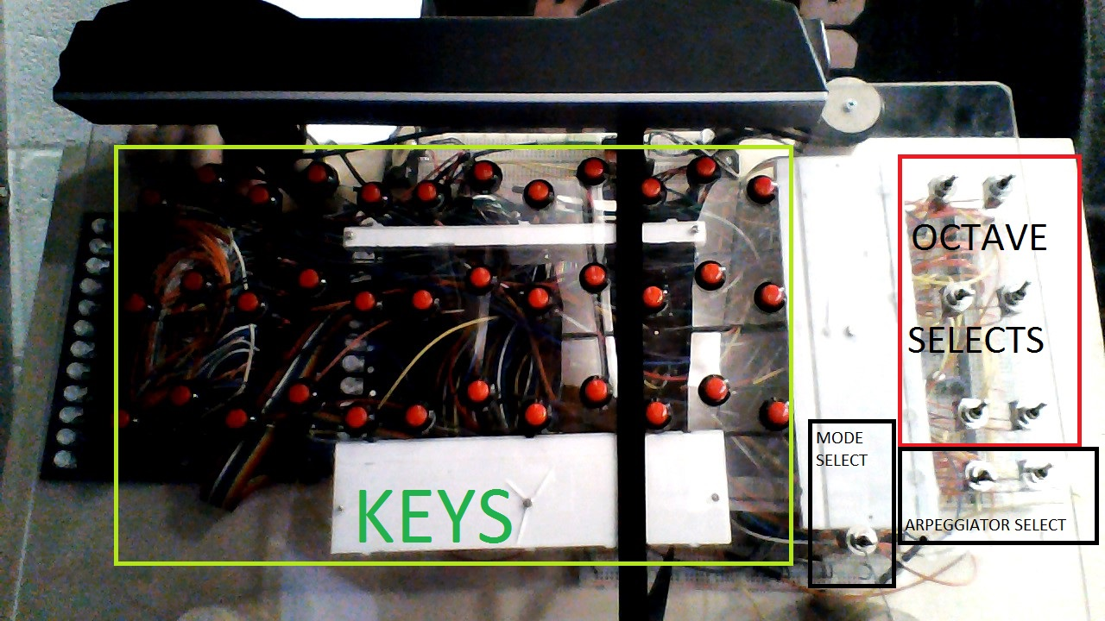
User Inputs

Slide 8
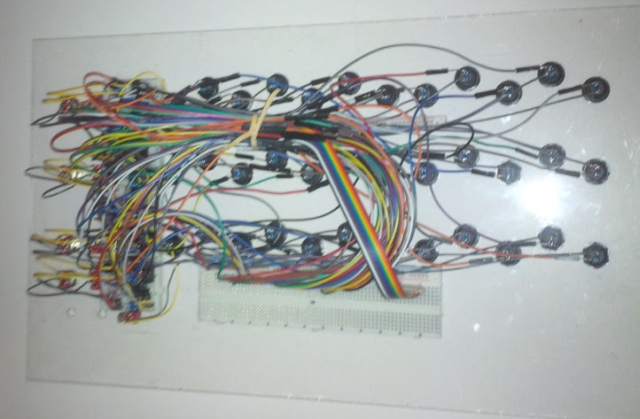
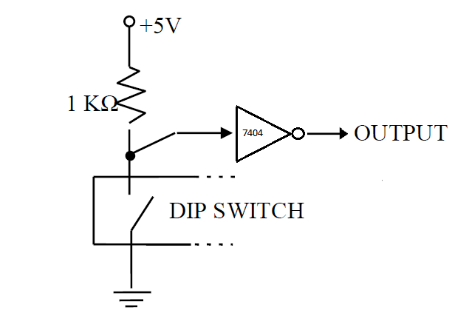
Keyboard Module
Texas Instruments
SN7404 : Inverter

Slide 9
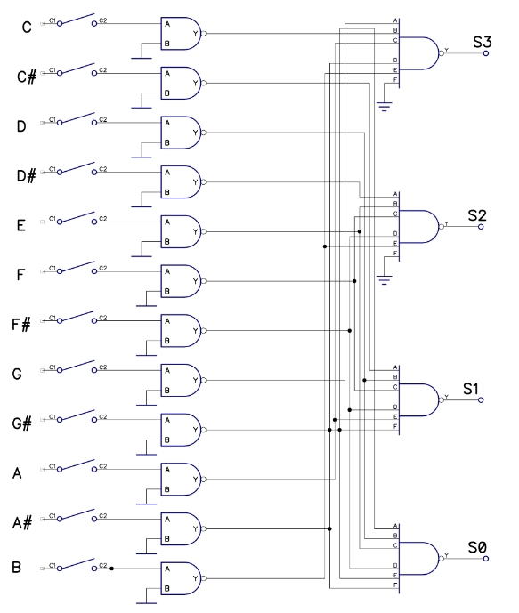
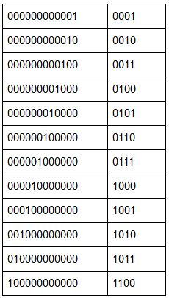
Keyboard Logic
One-Hot Encoding ⇒ S₃- S₀
Texas Instruments
SN7400
SN7430

Slide 10
Keyboard Logic
R&V

Slide 11
System Logic
11-bit Word
S₃ - S₀ : Note Select
Oct₁ - Oct₀ : Octave Select
Wav₁ - Wav₀ : Wave Select
Arp₁ - Arp₀ : Arpeggiator Rhythm Select

Slide 12
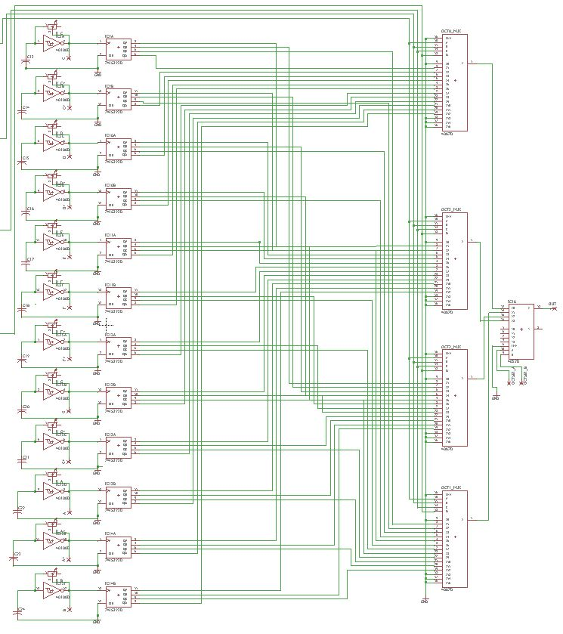
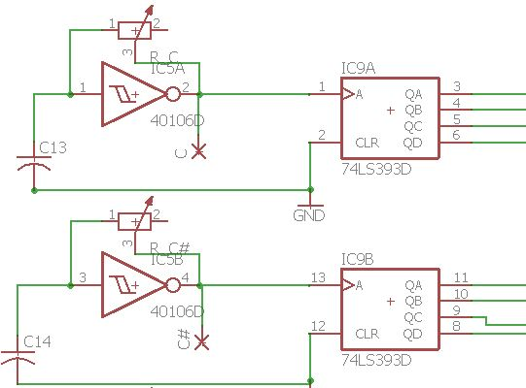
Square Wave Generator
Texas Instruments
CD40106 : Schmitt Trigger
74HC393 : Binary Divider
CD4067, CD4052 : Muxs

Slide 13
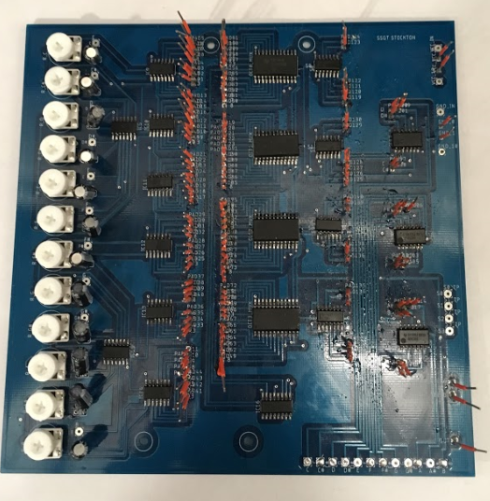
Square Wave Generator
Modular
One per Wave
Houses Keyboard Logic
Texas Instruments SN7400 & SN7430
Converts One-Hot Encoding to Binary Number
Accepts One-Hot Encoding from Keyboard Module
12 Variable Resistors
Adjustable Frequency
C
C#
D
D#
E
F
F#
G
G#
A
A#
B
Keyboard In

Slide 14
Square Wave Generator
R&V
Buttons Play the Correct Notes
Demonstrate 4 Octaves

Slide 15
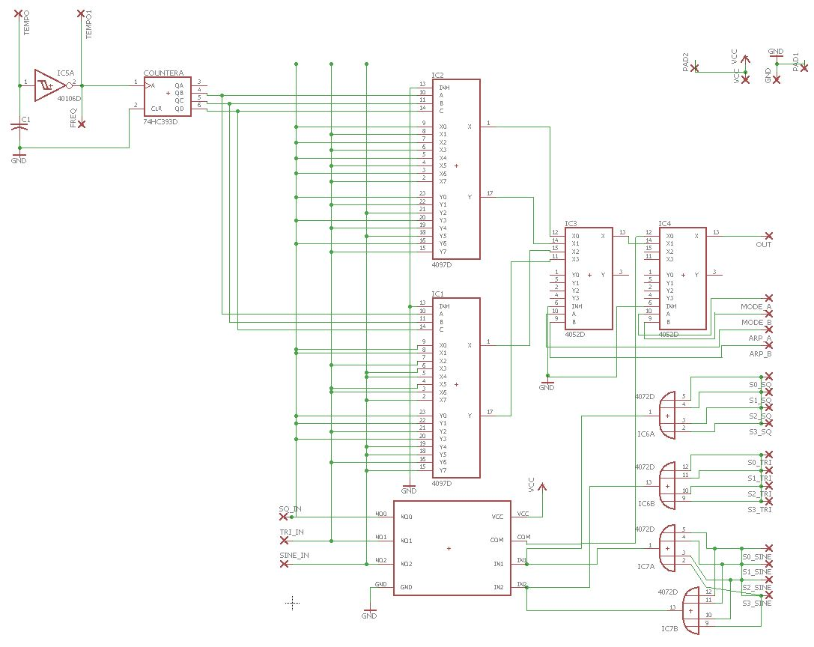
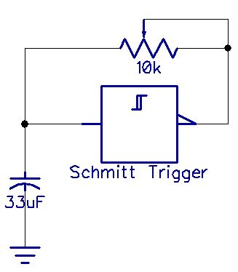
Arpeggiation Logic
Texas Instruments
CD40106 : Schmitt Trigger
74HC393 : Binary Counter
CD4097, CD4052 : Muxs
TS5A3357 : Analog Switch
CD4072 : OR Gate
Tempo Control

Slide 16
Arpeggiation Module
R&V
Change Rhythms
Adjust Tempo

Slide 17
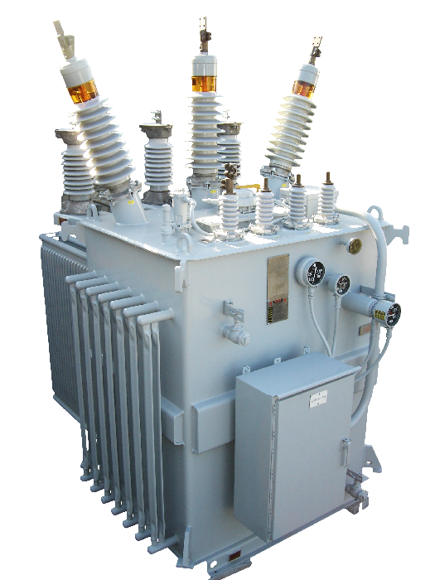
Power
24 VDC wall adapter
Need +/-12 V and 5 V to power components
Tolerance set was +/- 5%
0.25 V for 5
0.6 V for 12 V

Slide 18
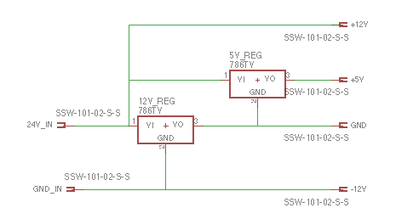
Voltage Divider

Slide 19
Voltage Divider Video

Slide 20
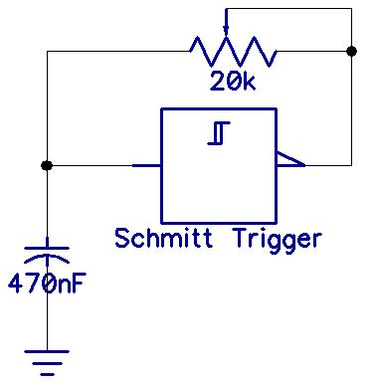
Voltage Controlled Oscillator
Schmitt triggers utilized to provide separate oscillators for each pitch within the 5th octave
Produces nearly perfect square wave and is easily tunable and versatile thanks to the variable resistors used
Frequency approximated with

Slide 21
Video of Waveform

Slide 22
Design Requirements and Verification
Note | C5 | C#5 | D5 | D#5 | E5 | F5 | F#5 | G5 | G#5 | A5 | A#5 | B5
Desired Frequency (Hz) | 523 | 554 | 587 | 622 | 659 | 698 | 740 | 784 | 830 | 880 | 932 | 987
Measured Frequency (Hz) | 517- 531 | 540- 560 | 561-598 | 605- 635 | 642-660 | 676-710 | 710- 750 | 773-805 | 802- 843 | 853- 890 | 935- 961 | 960- 1021
Error (absolute value) | 1.14-1.5% | 1.08- 2.5% | 1.8- 4.4% | 2.09- 2.7% | 0.1- 2.5% | 1.7- 3.1% | 1.35- 1.6% | 1.4- 2.6% | 1.5- 3.3% | 1.4- 3.06% | 0.3- 3.1% | 2.7- 3.4%

Slide 23
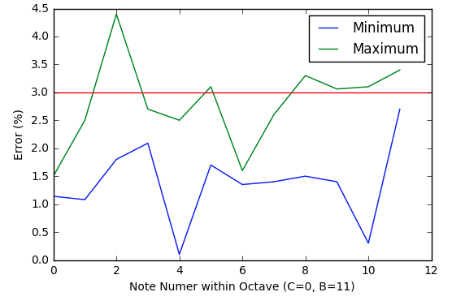
Graph of Error

Slide 24
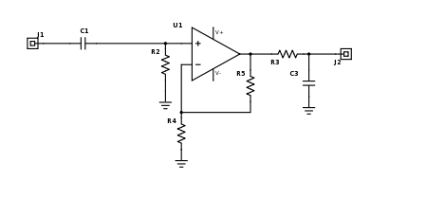
VCF

Slide 25
Video

Slide 26
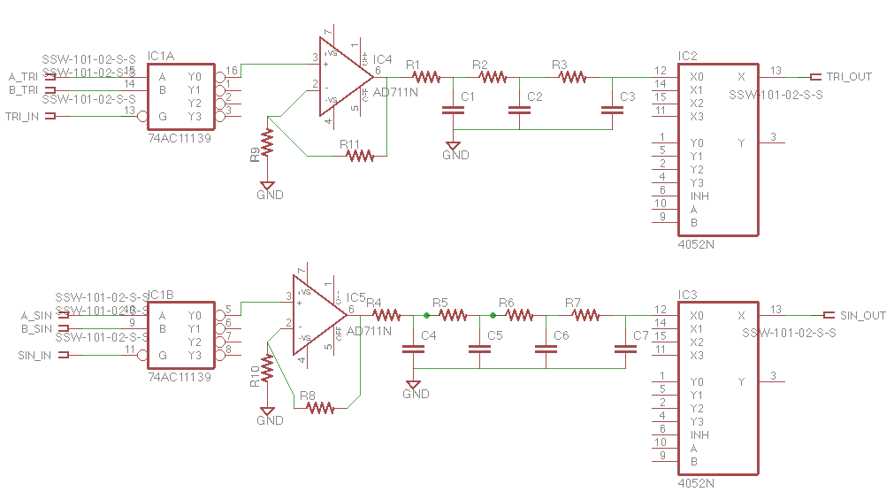
Waveshapers

Slide 27
Waveshaper Video

Slide 28
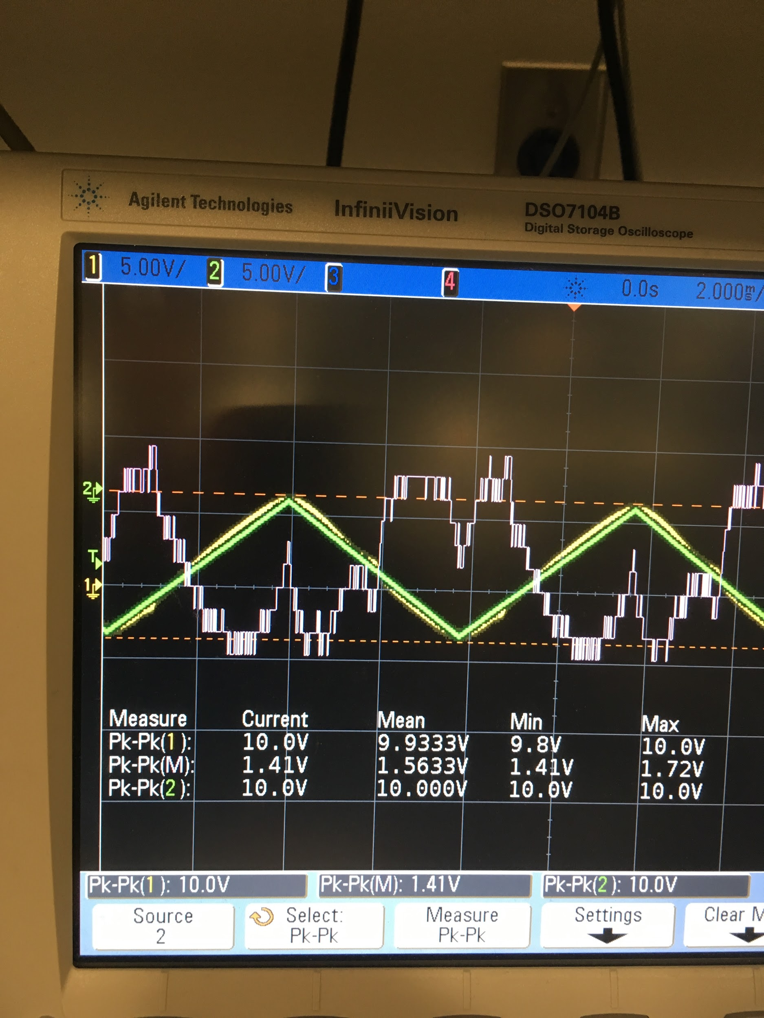
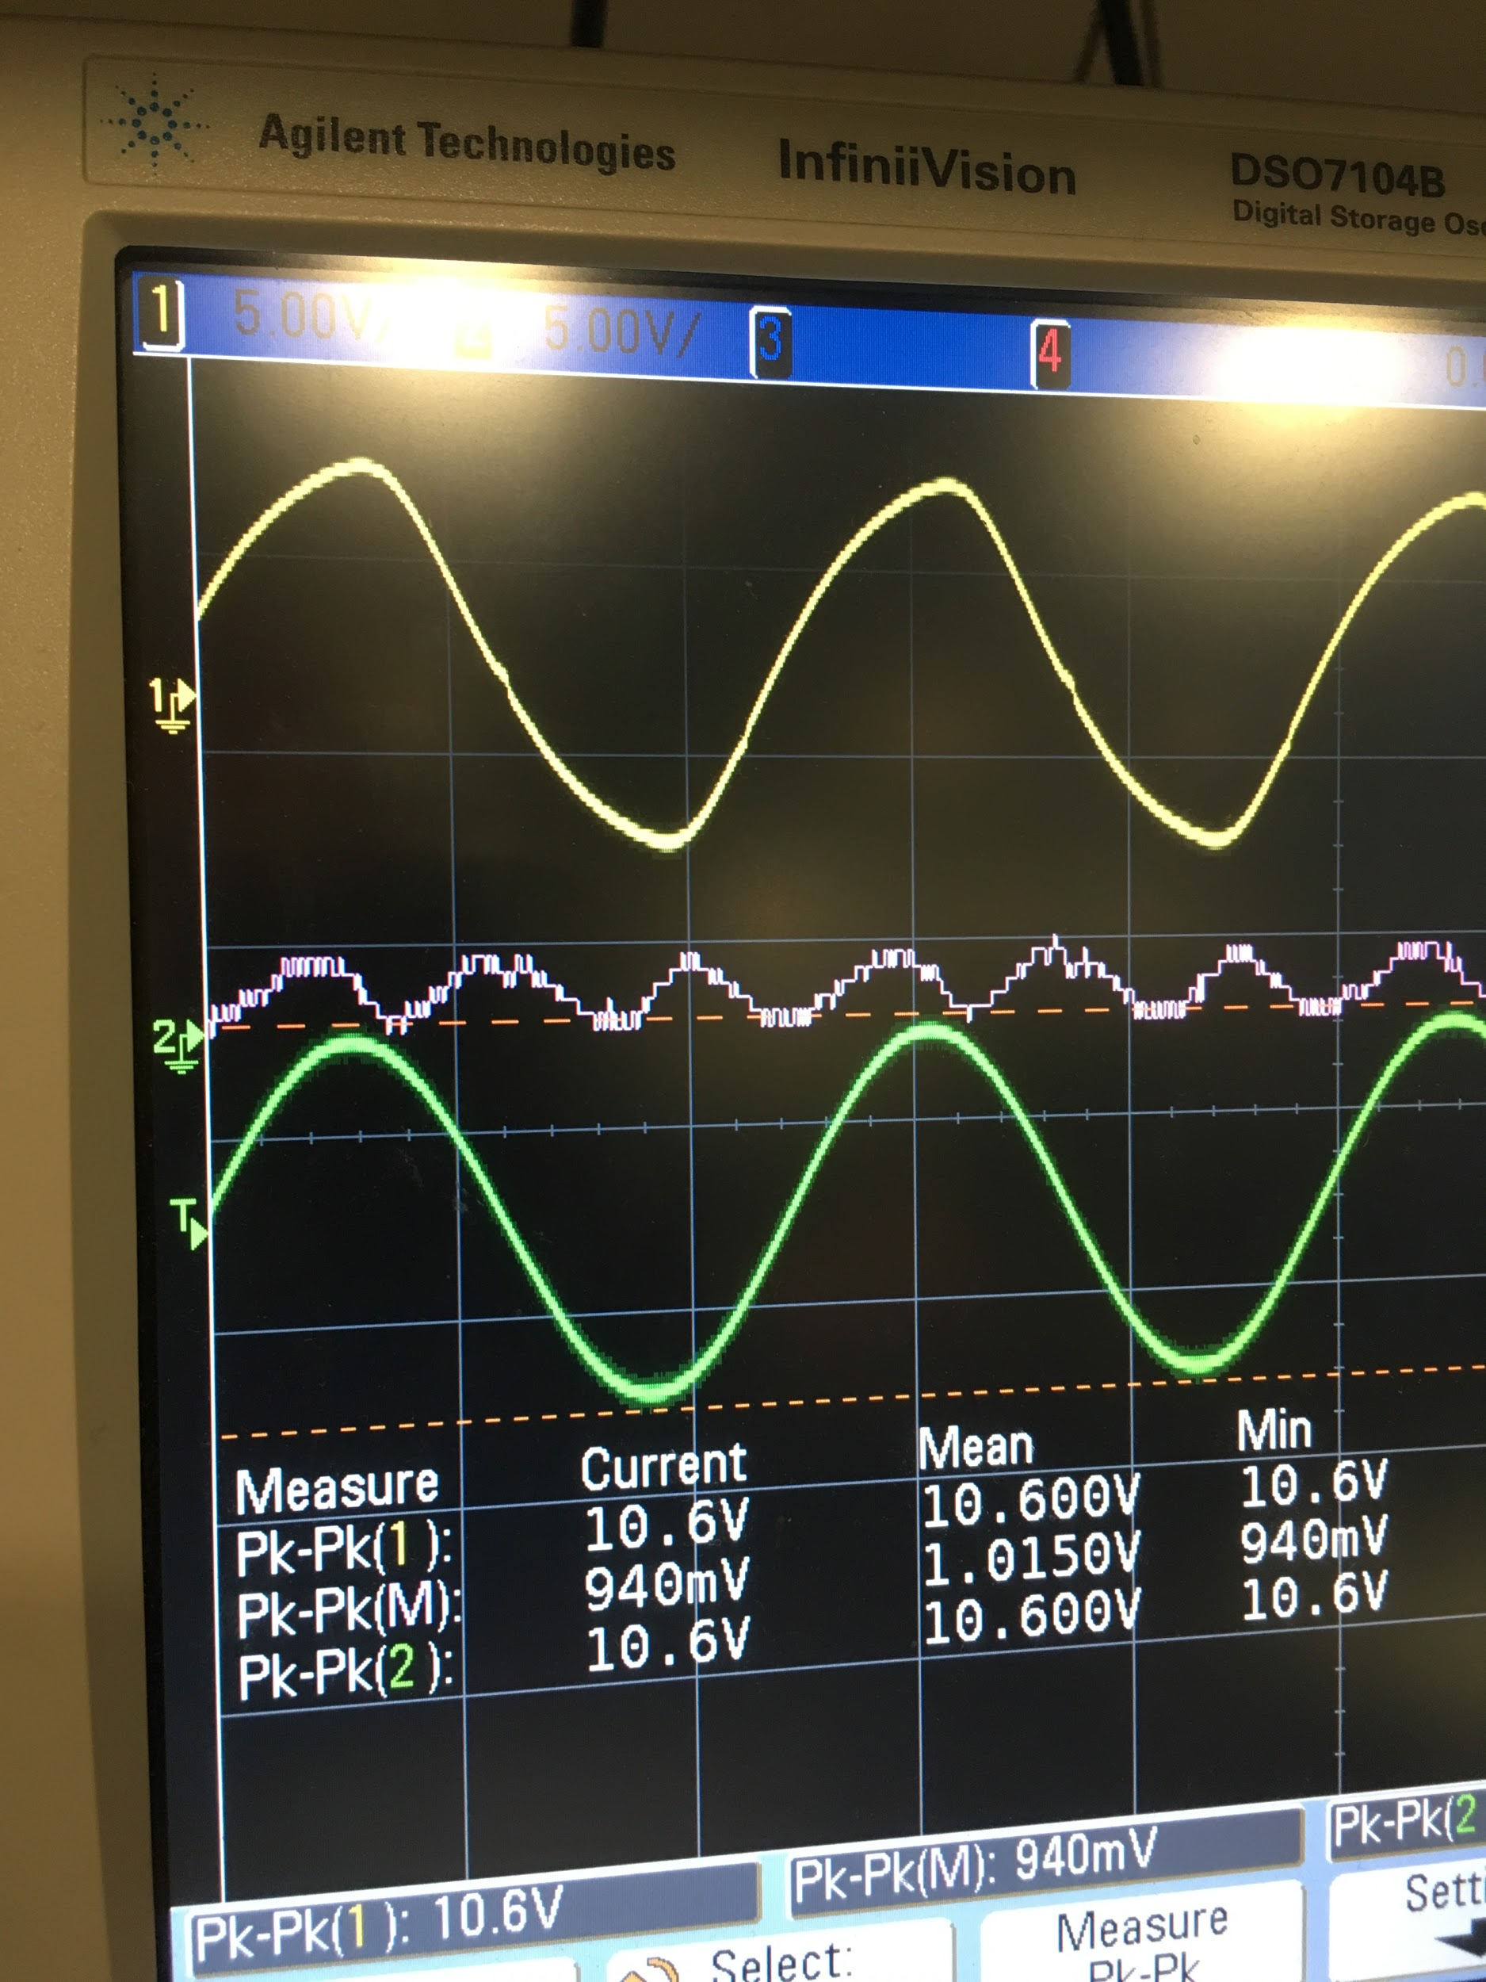
R&V
Triangle Error: 14.1% Sine Error: 9.4% Goal: 10% error

Slide 29
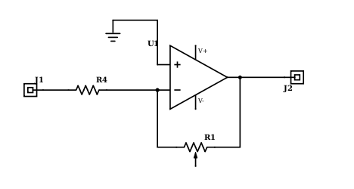
VCA

Slide 30
R&V
Goal: 1 VPP - 20 VPP

Slide 31
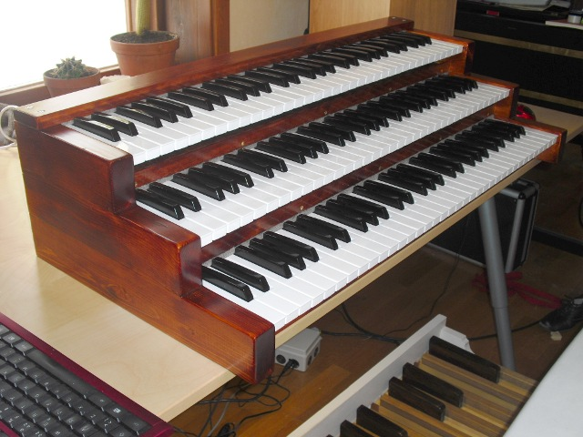
Conclusion
This product offers a fun and interactive way to learn about timbre.
Problem: difficult to tune precisely, attenuation led to distortion
Solutions: different potentiometers, DC offset early
In the future, a great thing to do would be to integrate a better and more user-friendly user interface
slimmer box, piano-style keys, etc.

