Slide 1
Smart Hybrid Drone Battery
ECE 445: Senior Design
Namin Shah, Nicolas Nkiere, Raj Lulla
TA: Uma Lath | Team #15
5/2/2022

Slide 2
Battery Life: A Mission Critical Problem
Energy density is the biggest limiting factor for us.
We’d pay 25%
more for 25% more battery life.
Achievable flight time is an absolutely key factor for any kind of UAS.
-Travis Roberts, Support Manager
-Chris Beckman, Director of Operations
-Omar Eleryan,
CEO
The biggest problem with drones is their endurance.
-Lucian Banitz,
Senior Staff Engineer
Battery life is a critical factor.
-Rick Reeser, Technical Lead, Airborne Systems
ECE 445
GRAINGER ENGINEERING

Slide 3
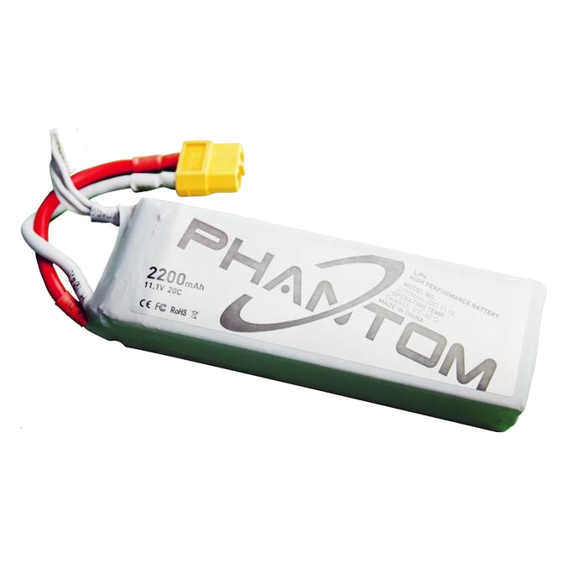
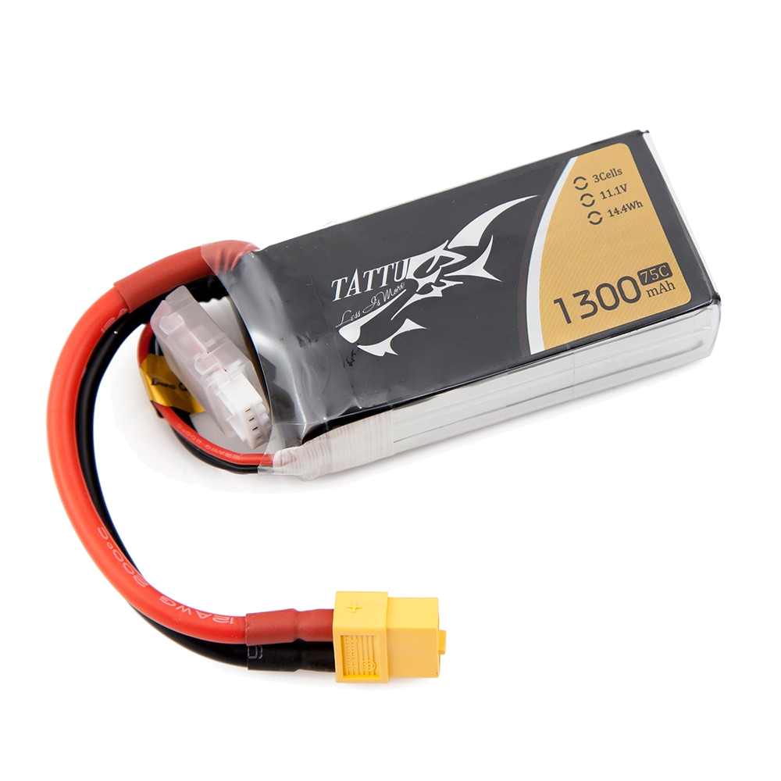
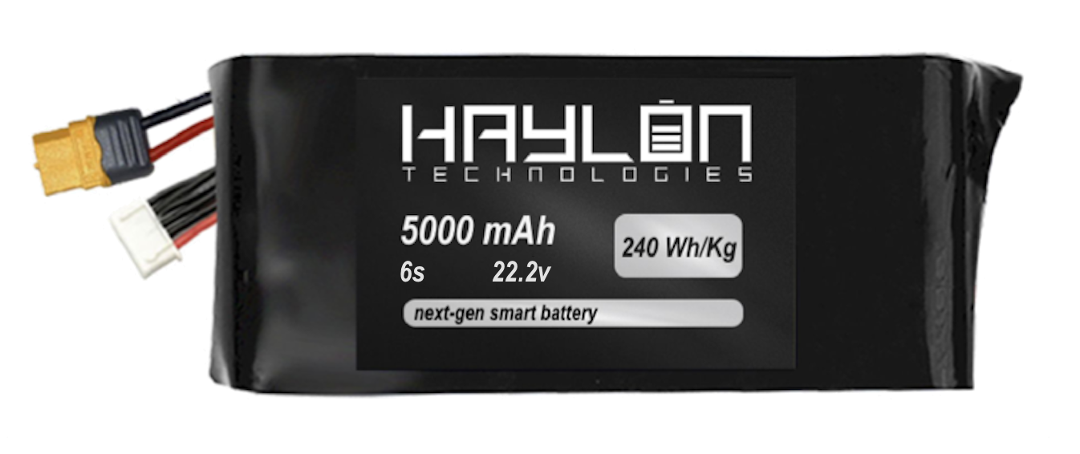
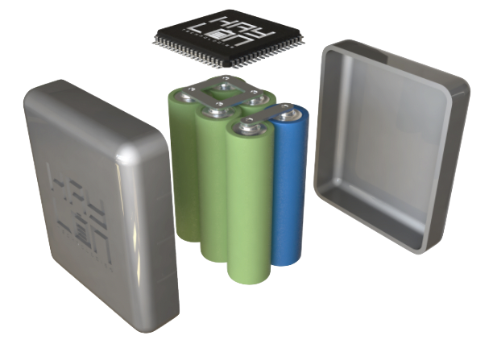
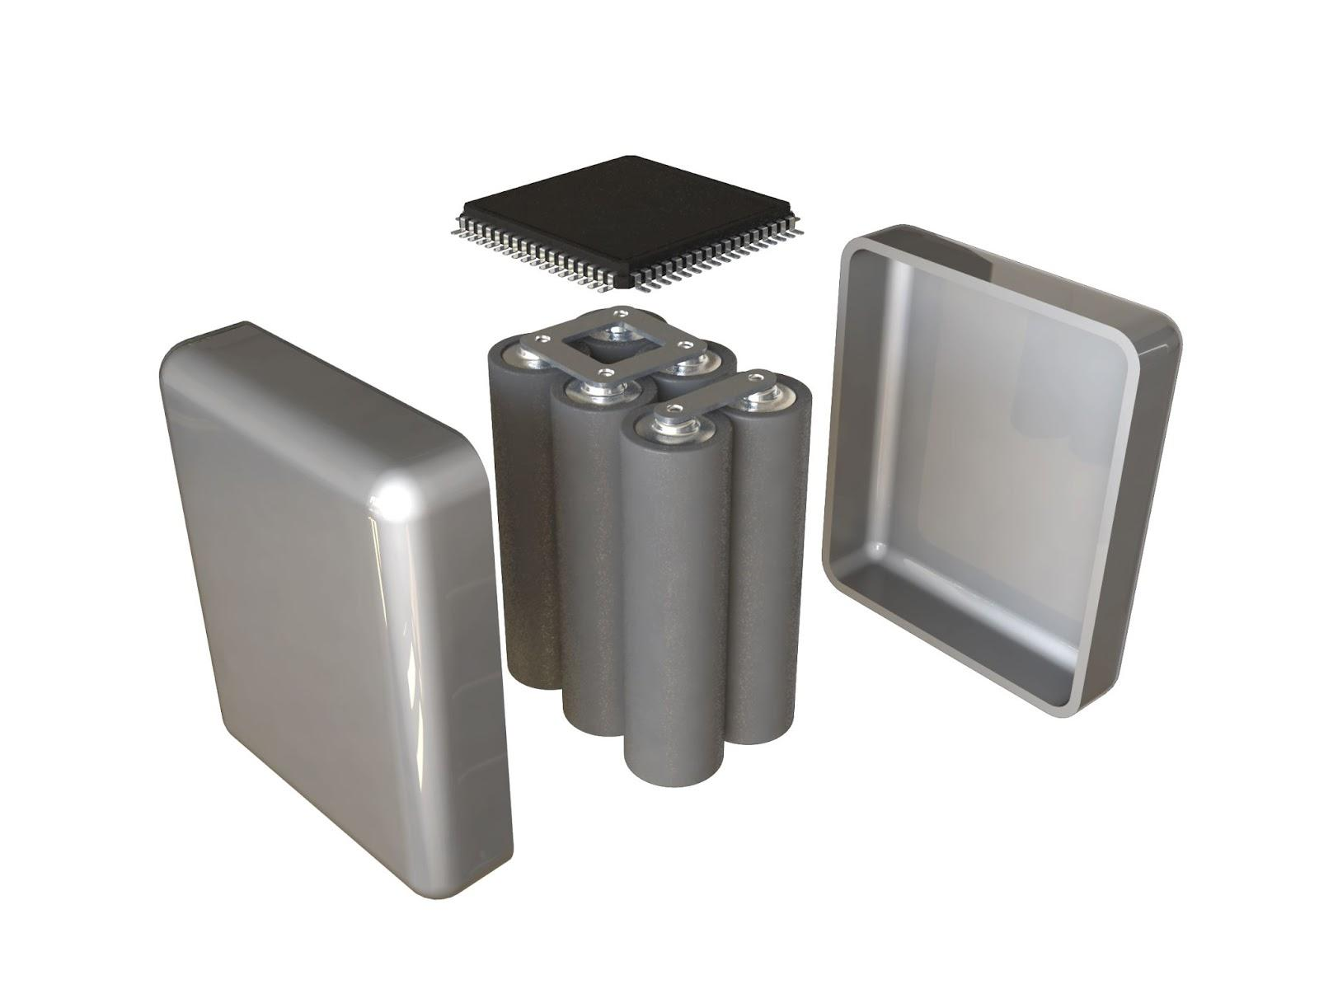
Our Solution
DUMB
SMART
ASIC intelligently selects best cell for each task
ASIC uses same cell type for each task
“Jack-of-all-trades” cell
“High capacity” cell
for hovering
“High stability” cell
for takeoff/acceleration
ECE 445
GRAINGER ENGINEERING

Slide 4
High Level Requirements
Successful high side switching circuits that allow the microcontroller to alternate between energy buffers that supply to the load at will. This switching should occur seamlessly, within a few clock cycles
A successful version of the switching algorithm that visually improves the shape of the discharge curve of our Li-NCA cell, when compared to the discharge curve from typical use
Our battery provides 11.1 volts, maintains a 20A max output, similar to a standard drone battery, and holds 50% more energy than a standard drone battery at the same weight
ECE 445
GRAINGER ENGINEERING

Slide 5
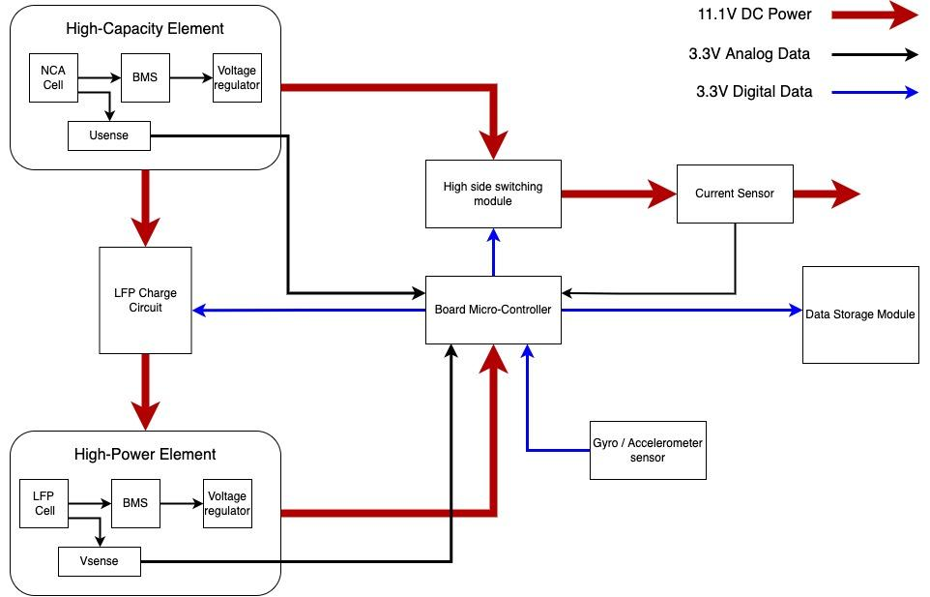
Block Diagram
ECE 445
GRAINGER ENGINEERING

Slide 6
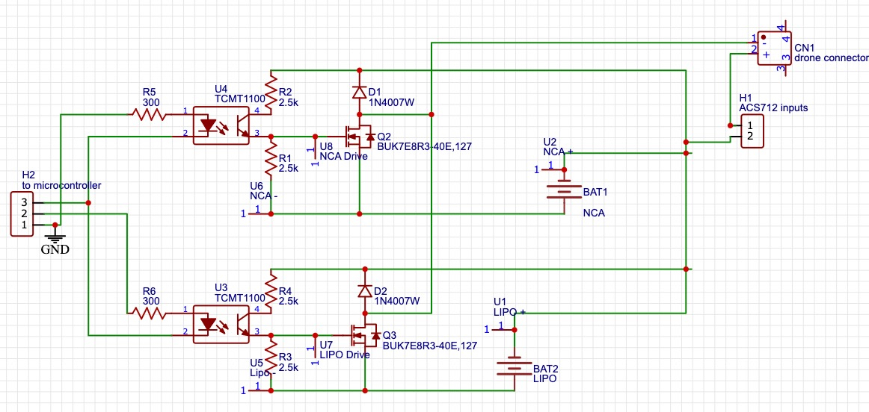
Circuit Schematic
ECE 445
GRAINGER ENGINEERING

Slide 7
R&V Requirements
The switching module should be able to deliver up to 15 ± 1A through the high power cell.
Battery Voltage | Output Current
12.2V | 16.68A
Throttle was moved until current on multimeter exceeded 15 Amps
Battery Voltage | Output Current
10.8V | 6.03A
The switching module should be able to deliver up to 6A through the high energy cell.
Throttle was moved until current on multimeter exceeded 6 Amps
Power Supply Output
11V Output
1.1001 Amps
P = 12.1011W
Multimeter Readings (10Ω)
V = 10.998V
I = 1.10 Amps
P = 12.0978W
The on state resistance should be less than 20 mOhms for both switches.
12.1011W - 12.0978W = 3.3mW < 5 mW
ECE 445
GRAINGER ENGINEERING

Slide 8
Data Collection
Implemented hardware and code for MPU6050 unit
Curr | X Accel | Y Accel | Z Accel | X Rot | Y Rot | Z Rot | Temp
-0.22 | 0.3 | 0.9 | 8.76 | -0.03 | -0.03 | -0.03 | 29.11
-0.15 | 0.33 | 0.9 | 8.76 | -0.03 | -0.04 | -0.03 | 29.12
-0.15 | 0.31 | 0.92 | 8.73 | -0.03 | -0.04 | -0.03 | 29.13
-0.15 | 0.31 | 0.91 | 8.79 | -0.03 | -0.05 | -0.03 | 29.14
0.07 | 0.31 | 0.9 | 8.77 | -0.03 | -0.04 | -0.03 | 29.14
-0.15 | 0.31 | 0.9 | 8.77 | -0.02 | -0.04 | -0.03 | 29.14
-0.3 | 0.32 | 0.92 | 8.76 | -0.02 | -0.04 | -0.03 | 29.12
-0.22 | 0.31 | 0.9 | 8.79 | -0.02 | -0.05 | -0.03 | 29.14
-0.3 | 0.28 | 0.9 | 8.75 | -0.03 | -0.04 | -0.03 | 29.13
0 | 0.31 | 0.93 | 8.75 | -0.03 | -0.04 | -0.03 | 29.14
Implemented hardware and code for SD card reader
Programmed microcontroller to collect data from sensors and systematically record on SD card
ECE 445
GRAINGER ENGINEERING

Slide 9
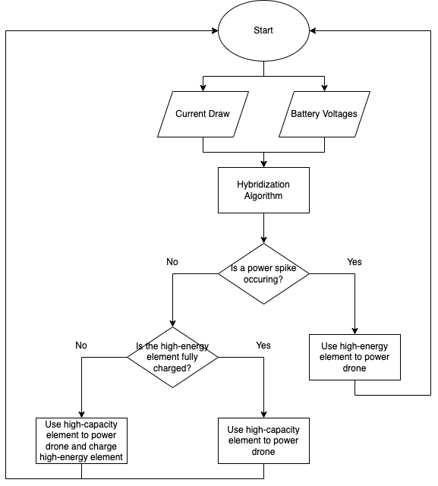
Switching Algorithm
Flight data such as acceleration, voltage, speed, current draw are collected throughout flight operations
Particular attention is given to high current spikes happening
Switch to high power battery when there is a high probability of current spike happening in within the next clock cycles
ECE 445
GRAINGER ENGINEERING

Slide 10
Issues We Faced
Charge circuit didn’t work
Using Bluetooth instead of SD card - Bluetooth range
Unable to fly plane and collect real data
ECE 445
GRAINGER ENGINEERING

Slide 11
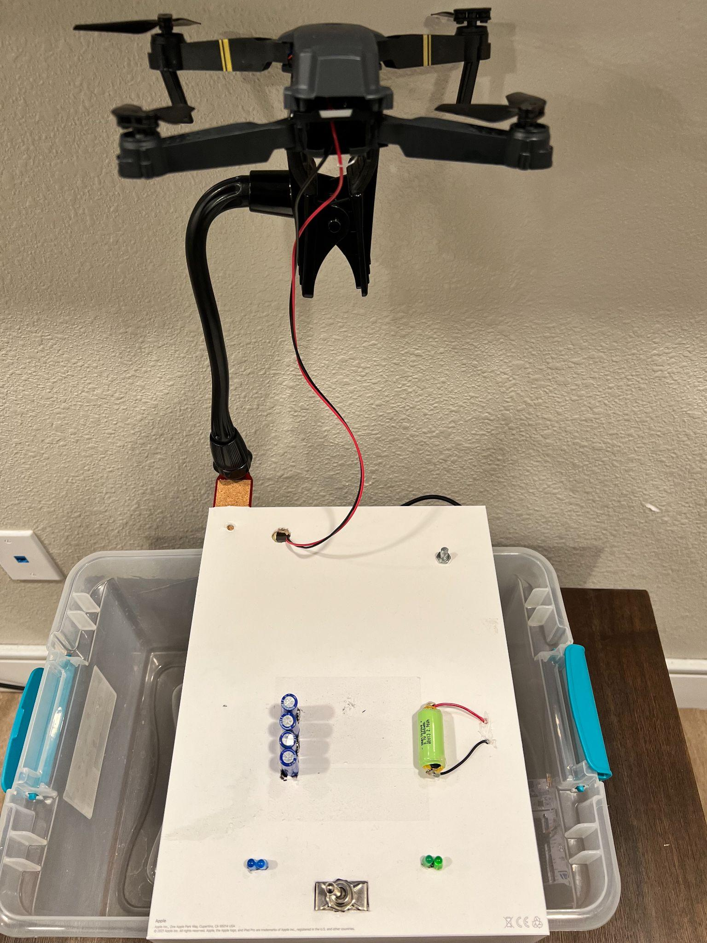
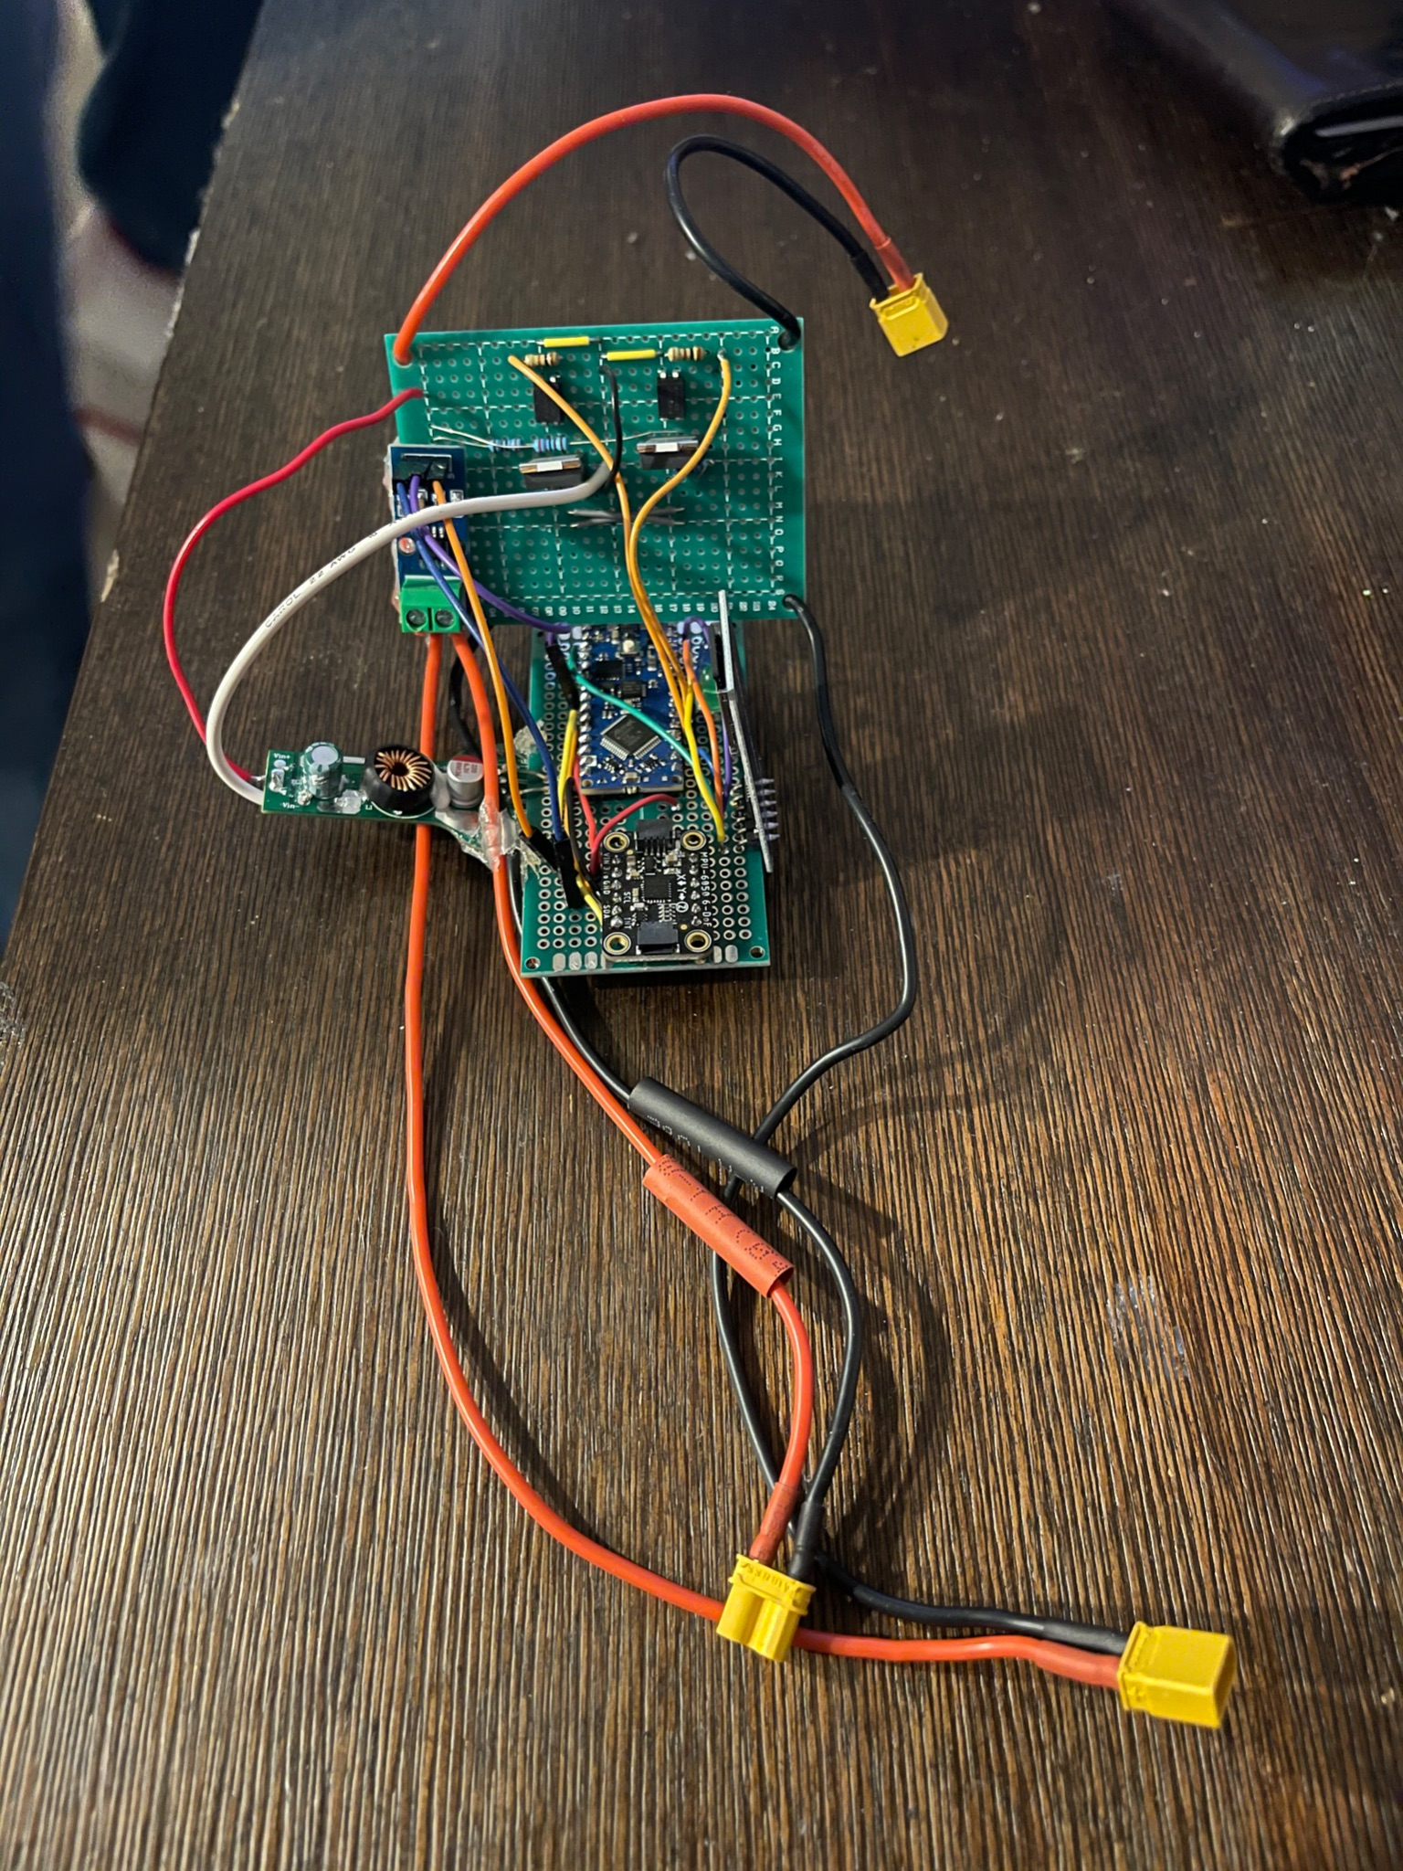
Project Evolution
ECE 445
GRAINGER ENGINEERING

Slide 12
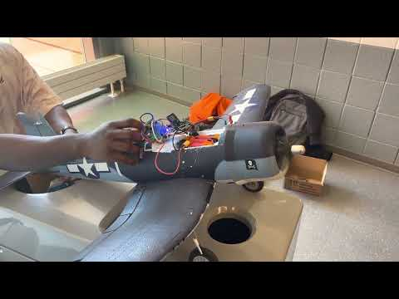
Project Video
ECE 445
GRAINGER ENGINEERING

Slide 13
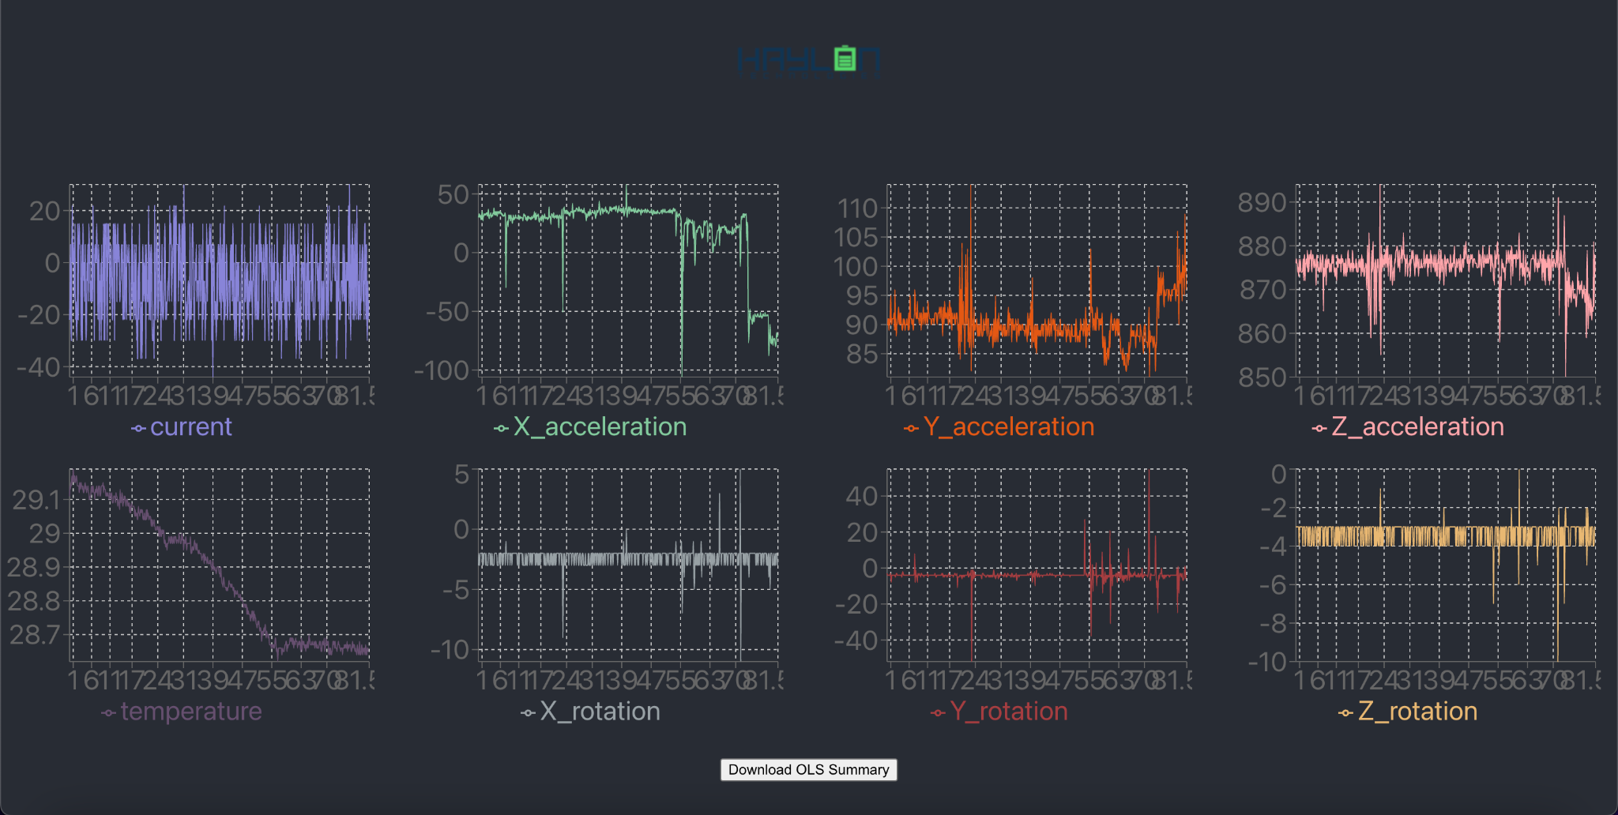
Analysis Platform
ECE 445
GRAINGER ENGINEERING

Slide 14
Our Results
Venom Drone Battery
HAYLON Smart Drone Battery
3x Li-NCA
3450 mAh
144 g
+
1x LFP
380 mAh
32g
=
3830 mAh
176 g
2200 mAh
175 g
ECE 445
GRAINGER ENGINEERING

Slide 15
Market Size
SOM: Drone batteries
$2 Billion & 19% CAGR
SAM: Drone, scooter & power tool batteries
$8 Billion & 10% CAGR
TAM: All rechargeable batteries & BMS
$100 Billion & 7% CAGR
ECE 445
GRAINGER ENGINEERING

Slide 16
Traction and Future Plans
ECE 445
GRAINGER ENGINEERING

